Slide 1
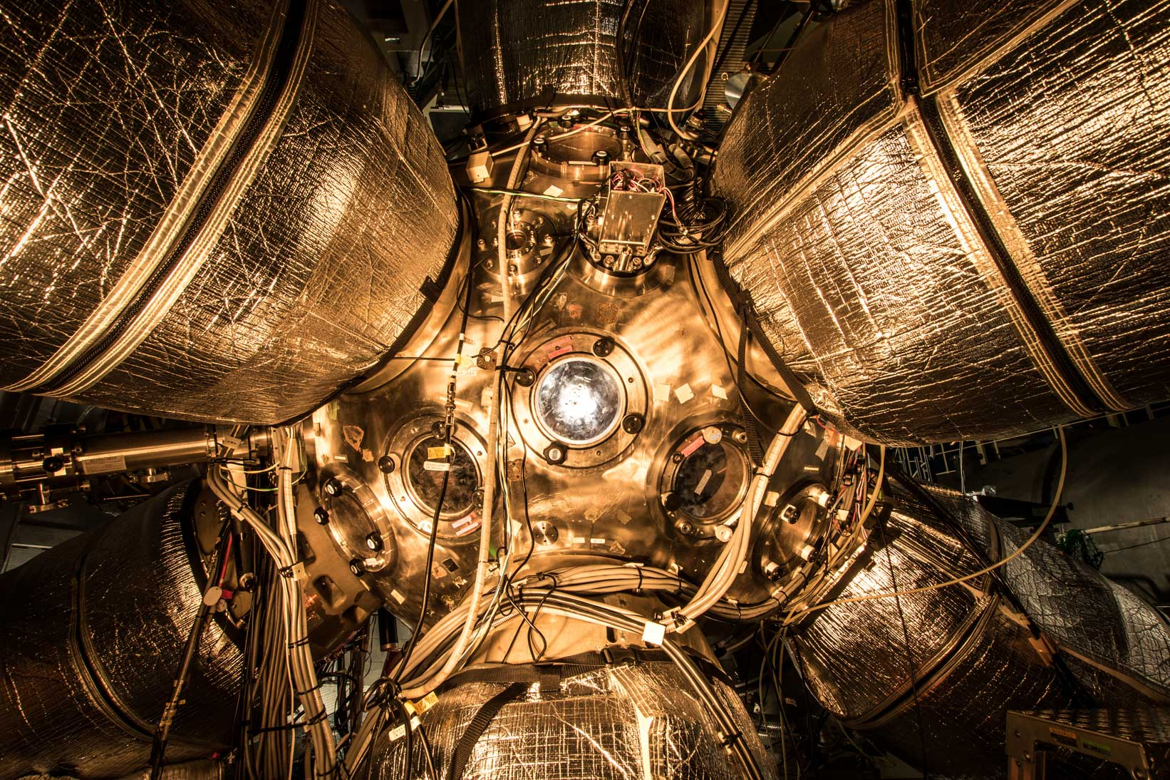

The FIREX program at the Institute of Laser Engineering and future upgrades
Alessio Morace.
Institute of Laser Engineering, Osaka University.
PALS laboratory, FZU, IPP, Czech Academy of Sciences

Slide 2

Outline of the talk
NIF ignition and introduction to ILE’s FIREX
Brief summary of FIREX-I results, Fast electron and Ion Fast Ignition
Necessity for change in approach: Increase intensity for PW pulse.
FIREX-NEO and upgrades
Summary of the TALK

Slide 3
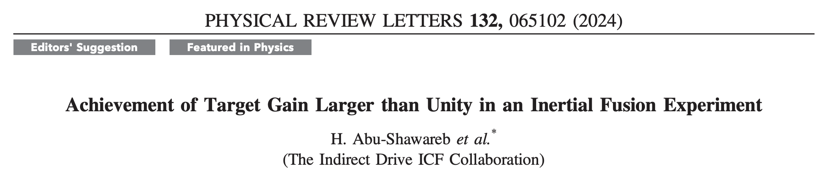
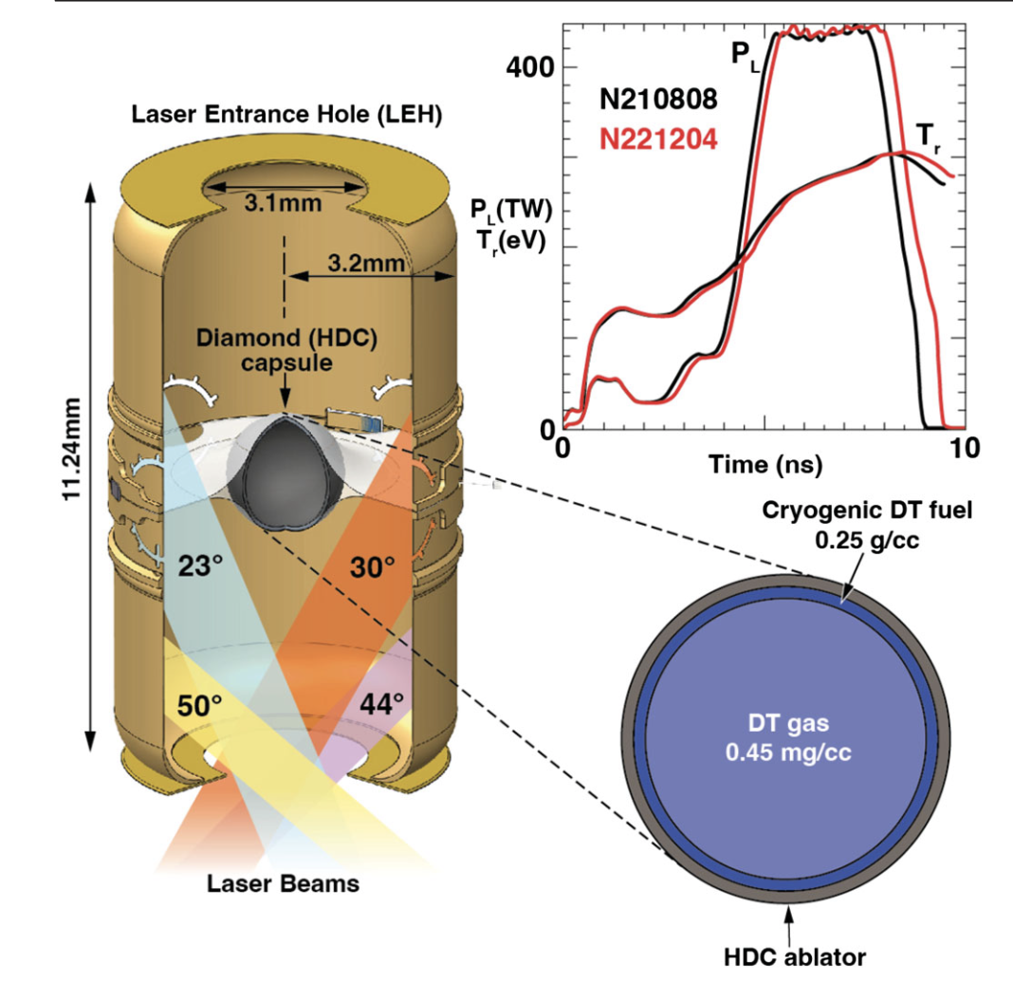
NIF Ignition was achieved by indirect drive
In the indirect approach the laser energy is converted into a thermal bath of soft x-rays with quasi-plankian distribution at 300 eV.
The soft x-rays ablate the outer surface of the capusule and drive the compression.
Heating of the DT gas is obtained by PdV work.
At peak density the temperature of the DT gas reaches 4.5-6 keV.
With ignition and burn into the “cold” fuel DT temperature goes well above 10 keV.
Notes:
Mention CHS in icf description for slide 7

Slide 4
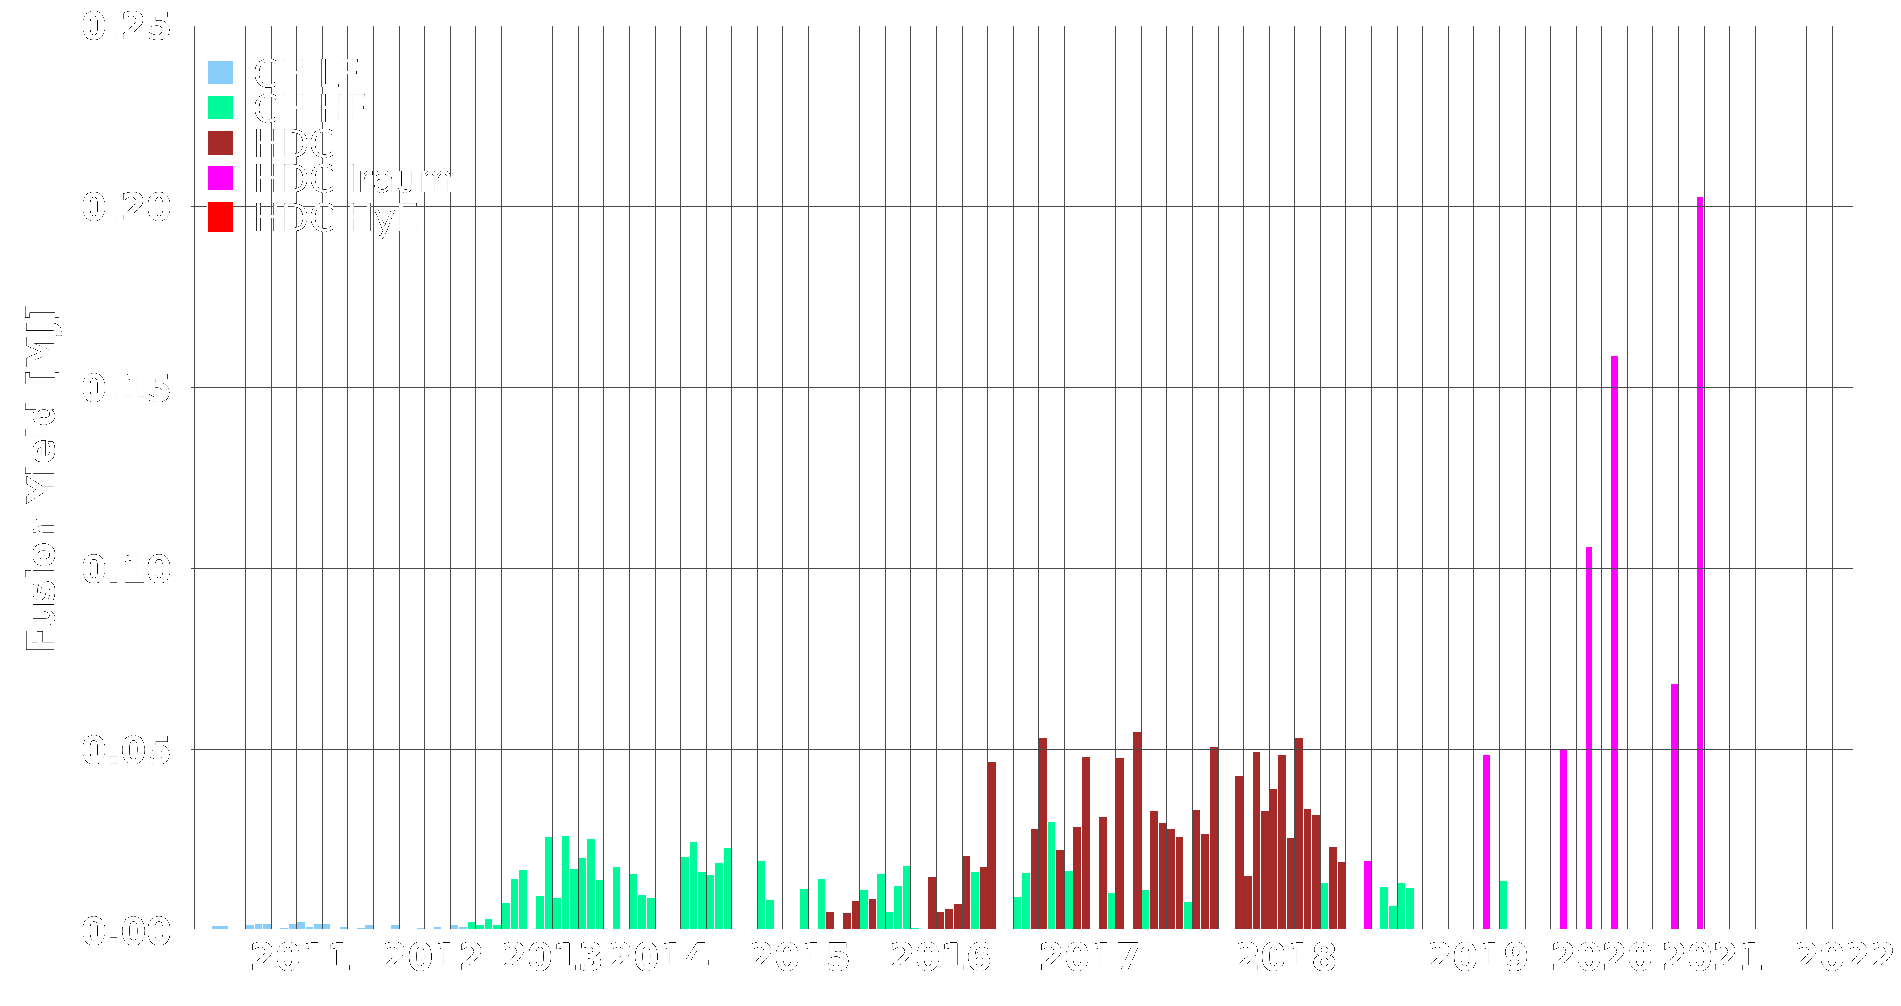
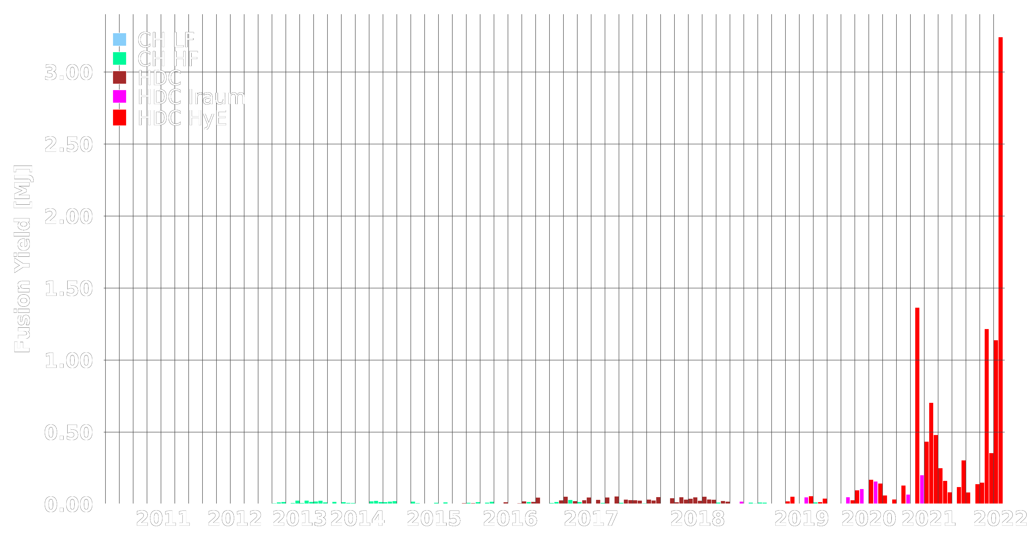
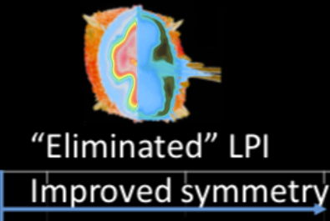
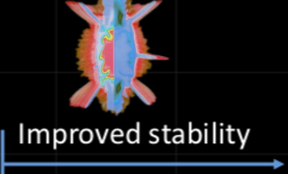
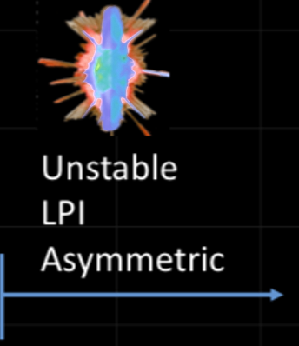
By 2021, experiments had produced ~70% of the input energy – we were close!
Recent experiments have produced ~150% of the input energy – IGNITION!!
Increased Coupling (HybridE / I-Raum)
IGNITION
“Burning Plasma”
Regime
Higher velocity & lower coast-time
Higher velocity
Notes:
AND SO WITH THESE ENCOURAGING, RECENT RESULTS, I'M GOING TO TURN THE PRESENTATION OVER TO MY COLLEAGUE DEREK MARISCAL TO TALK TO YOU ABOU THE SIMULATION, AND IN PARTICULAR THE MACHINE LEARNING, THAT HELP GUIDE THE DESIGN AND OPTIMIZATION OF THE NUCLEAR FUSION RESEEARCH ON THE NIF

Slide 5
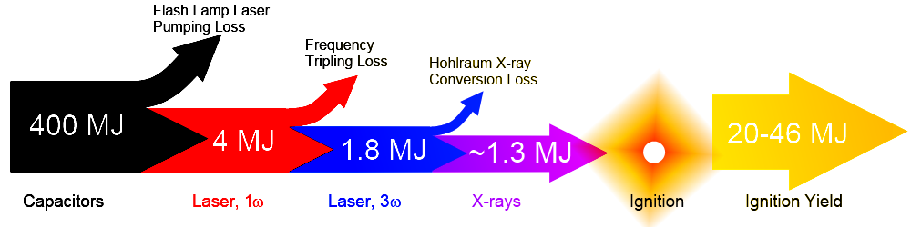
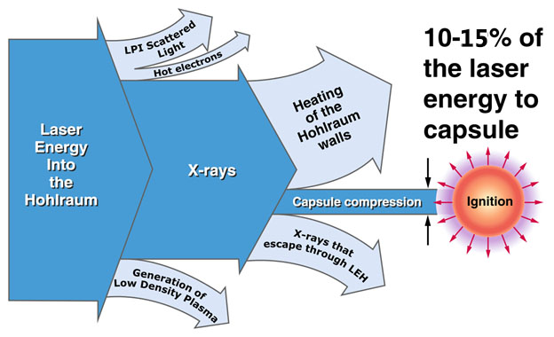
NIF Ignition was achieved by indirect drive
Improve the laser technology:
NIF is Flash lamp pumped laser. Over 90% of the energy is lost during the pump process. Diode pumped laser would drastically improve the efficiency ~ 10x.
Now on NIF about 1/2 of the laser energy produced goes into the holhraum.
The indirect-drive CHS approach is also intrinsically inefficient as the vast majority of the laser energy goes into heating the holhraum itself, and part of if escapes through the entrances in the form of x-rays.
Notes:
Rename the title

Slide 6
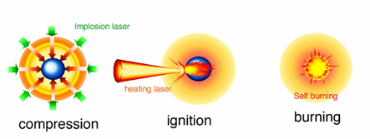
Alternative ICF approaches: Fast Ignition
The difficulty and extreme sensitivity to symmetry and instabilities in CHS igntion led to the conception of alternative approaches, the most popular of which is Fast Ignition.
In fast ignition the stages of compression and heating are separated, with the heating produced by a ultra-high intensity laser pulse, which will produce energetic particle beams (electrons or protons/ions) that will deliver their energy in the compressed core. Creating a lateral hot spot triggering ignition and burn.

Slide 7
PdV work by implosion produces the spark in the central ignition scheme.
External energy injection produces the spark in the fast ignition scheme.
Compression
Self-
Ignition
Burn
Diesel engine
Compression
Ignition
Burn
Central
Ignition
Scheme
Gasoline engine
External
Ignition
Spark Plug
Fast
Ignition
Scheme
Ignite with spark plug
→ Downsizing

Slide 8
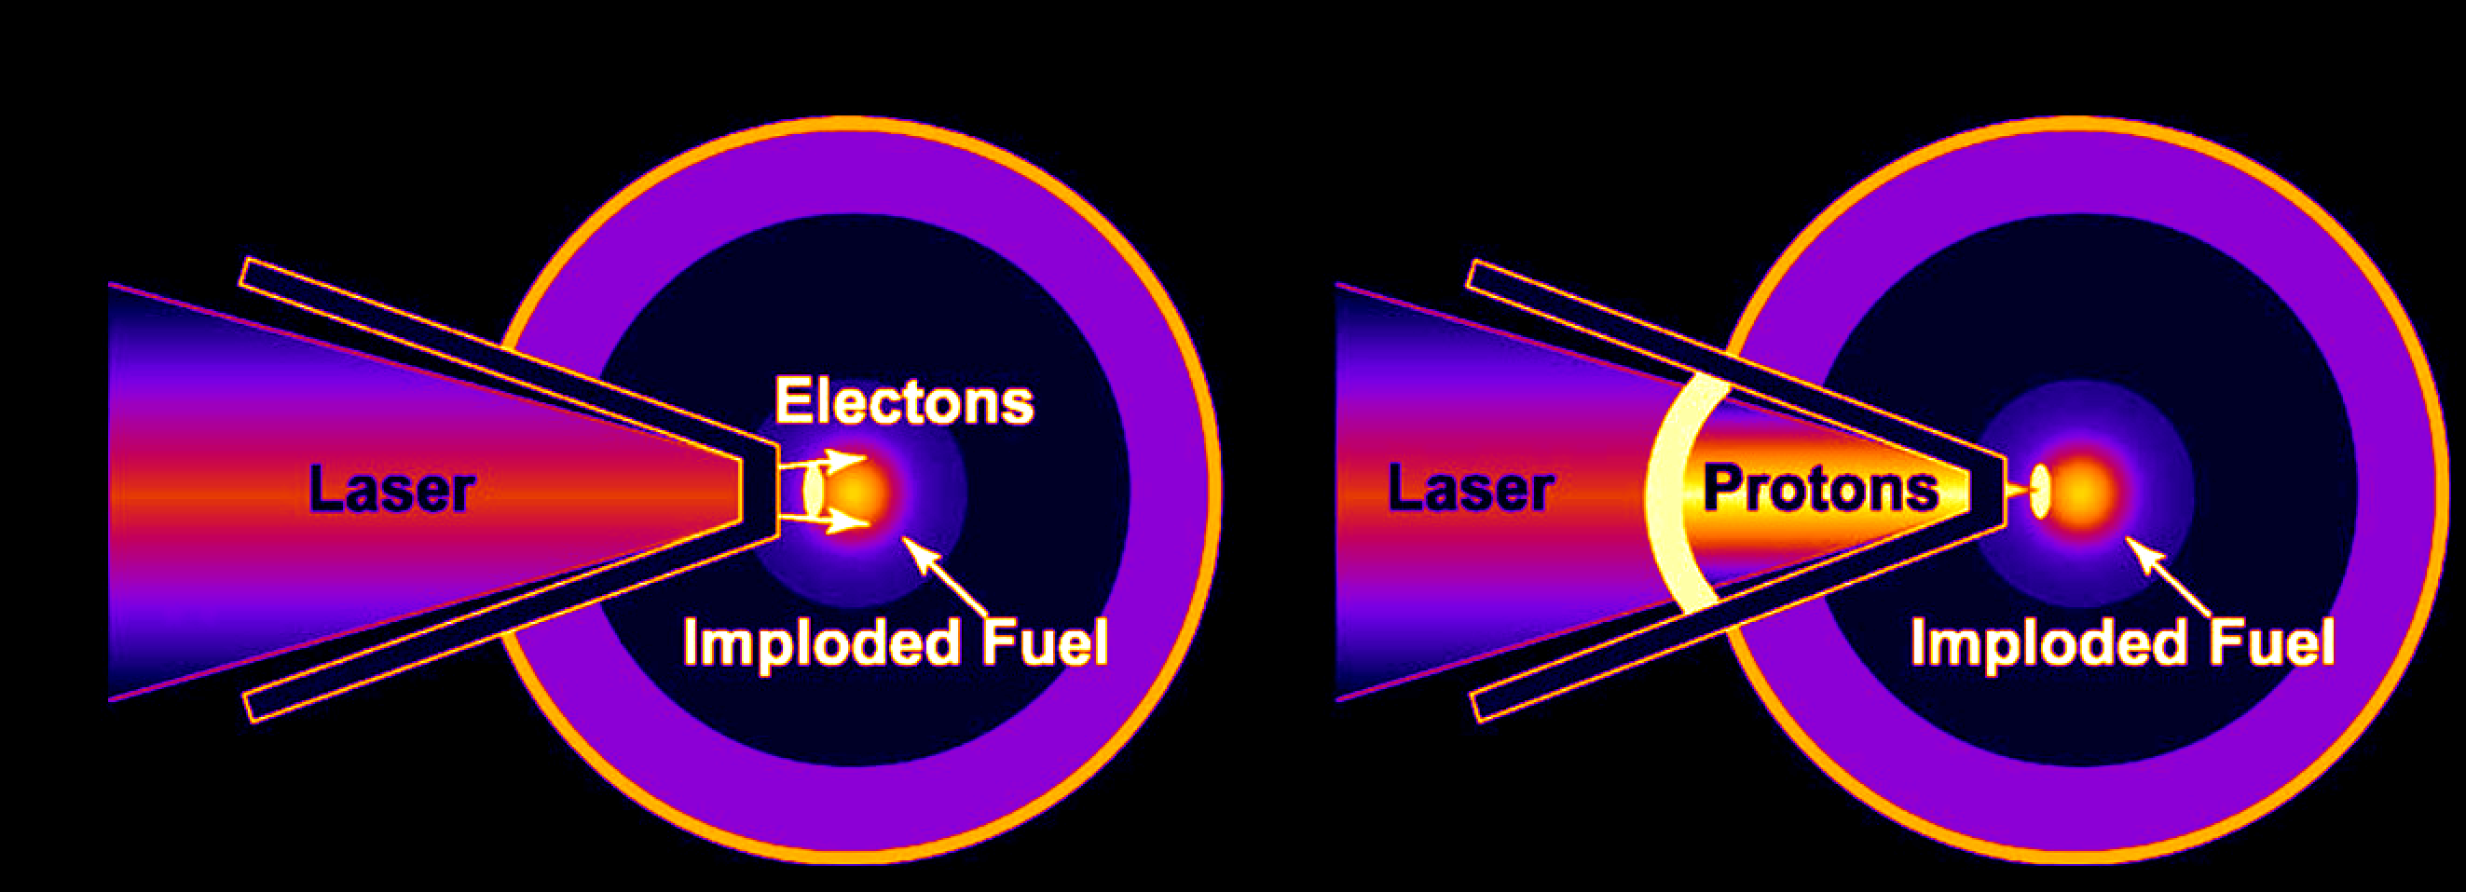
The FIREX project at ILE, The University of Osaka
The FIREX-I project aimed at demonstrating the heating up to 5 keV of a compressed plasma with ρR ~0.1g/cm². Two main approaches adopted were Fast Electron and Ion Fast Ignition
Utilizes the fast electron beam generated by the UHI laser to directly heat up the compressed core.
Utilizes the protons/ions, generated as secondary source from a thin foil, to heat up the compressed core.

Slide 9
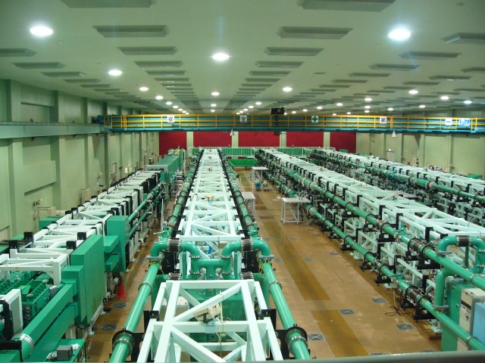
GXII-LFEX system
LFEX beamline
4 beamlets
10 kJ , 2.5 kJ/beamlet
1.5 kJ for 1.5 ps operation
GXII beamlines
12 beams
3.5 kJ at 2ω
1.2-10 ns

Slide 10
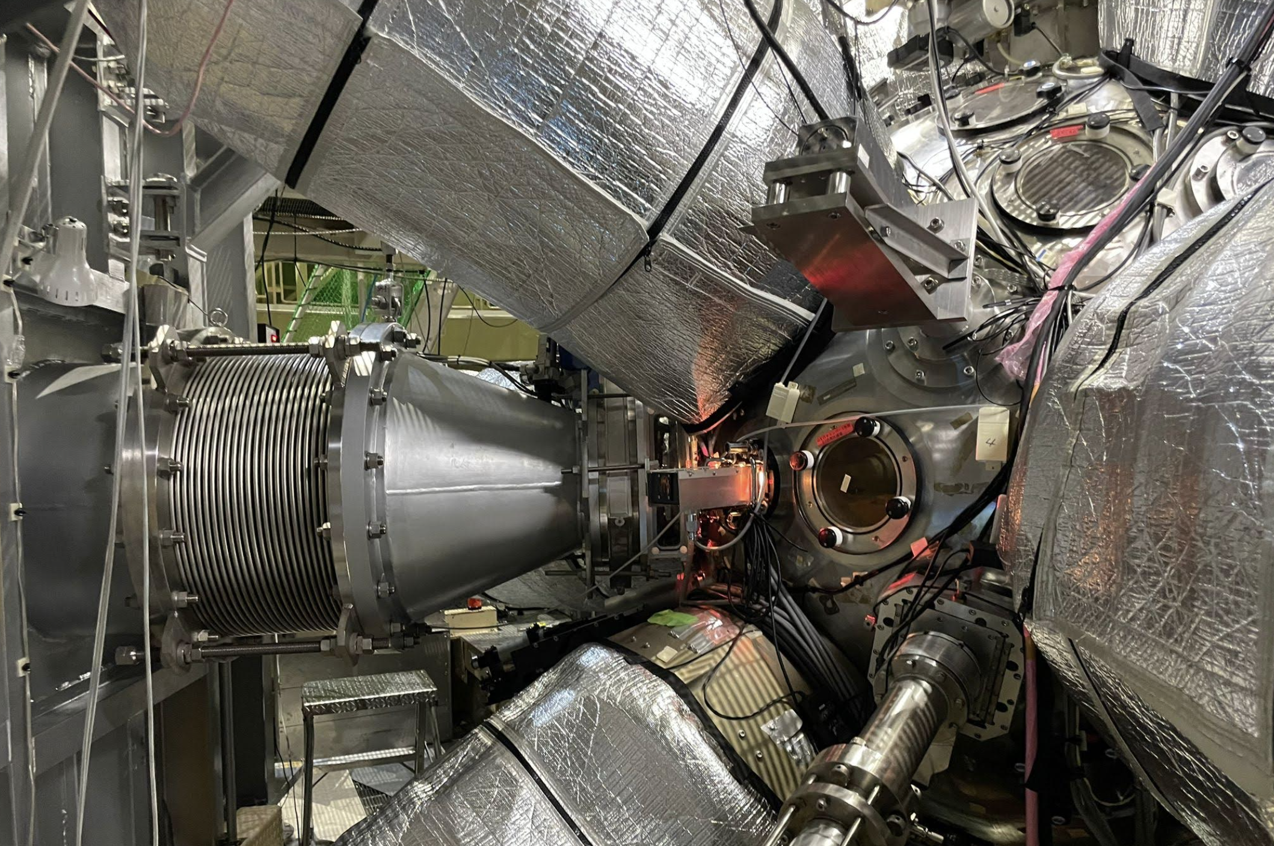
GXII-LFEX system
This is the T1 chamber at ILE.
It receives LFEX laser and the GXII beams in spherical symmetry (4 kJ at 2w)
It allows for scaled down FI experiments

Slide 11
GXII-LFEX system
This is the T1 chamber at ILE.
It receives LFEX laser and the GXII beams in spherical symmetry (3.5 kJ at 2w)
It allows for scaled down FI experiments
LFEX

Slide 12
GXII-LFEX system
This is the T1 chamber at ILE.
It receives LFEX laser and the GXII beams in spherical symmetry (4 kJ at 2w)
It allows for scaled down FI experiments
GXII
LFEX
GXII
GXII

Slide 13
Outline of the talk
NIF ignition and introduction to ILE’s FIREX
Brief summary of FIREX-I results, Fast electron and Ion Fast Ignition
Necessity for change in approach: Increase intensity for PW pulse.
FIREX-NEO and upgrades
Summary of the TALK

Slide 14

Fast Electron Fast Ignition (S. Fujioka group)
Three major mechanisms of isochoric heating with REB*
*REB: Relativistic Electron Beam
Drag
Heating
Resistive
Heating
Drag heating:
Energy transfer from relativistic electrons to bulk electrons via binary collisions.
Resistive heating:
Ohmic heating via a return current that is driven by the forward REB for sustaining the current neutrality.
Diffusive heating:
Heat transport from a heated plasma to a cold plasma via nonlocal-diffusive fashion.
Bulk electron
Fast electron
Diffusive
Heating
Drag
Heating
Diffusive
Heating
Resistive
Heating

Slide 15
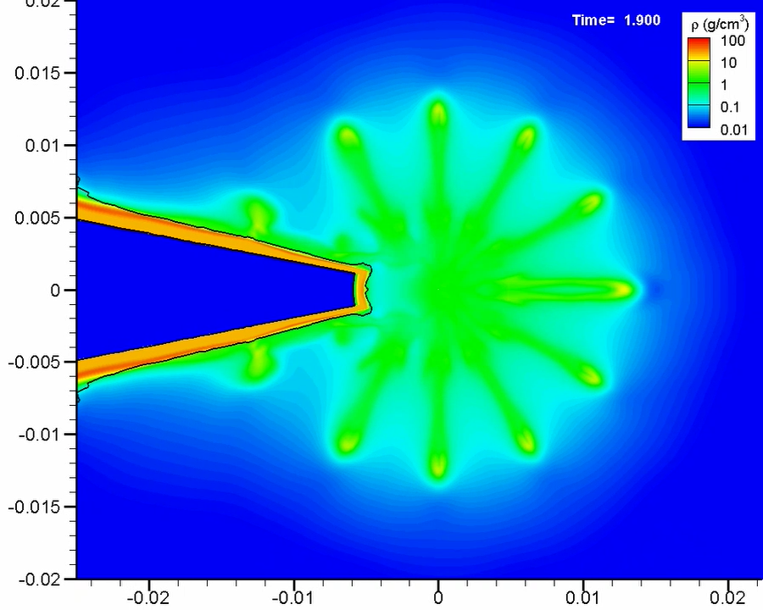
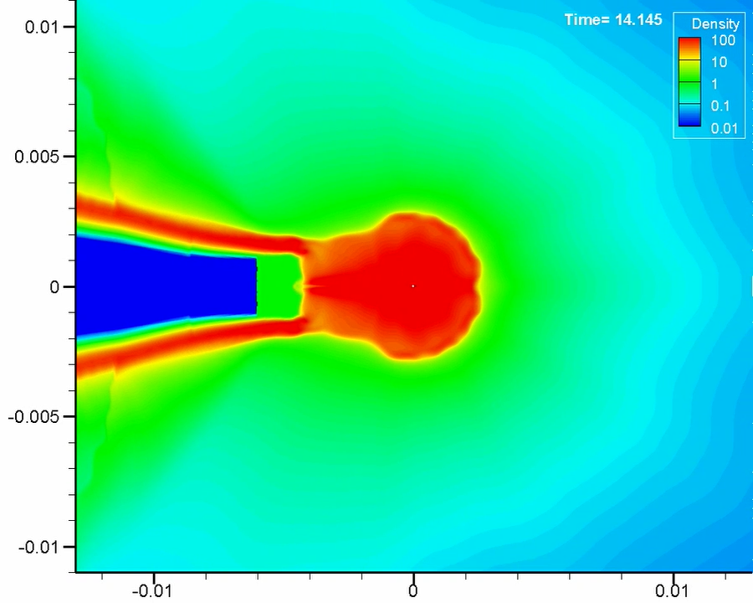
Solid ball fuel has been chosen over shell (S. Fujioka group)
Ragarding the compressed fuel, solid ball have been selected, being hydrodynamically stable and mass producible
Conventional thin shell fuel
Advanced solid ball fuel

Slide 16
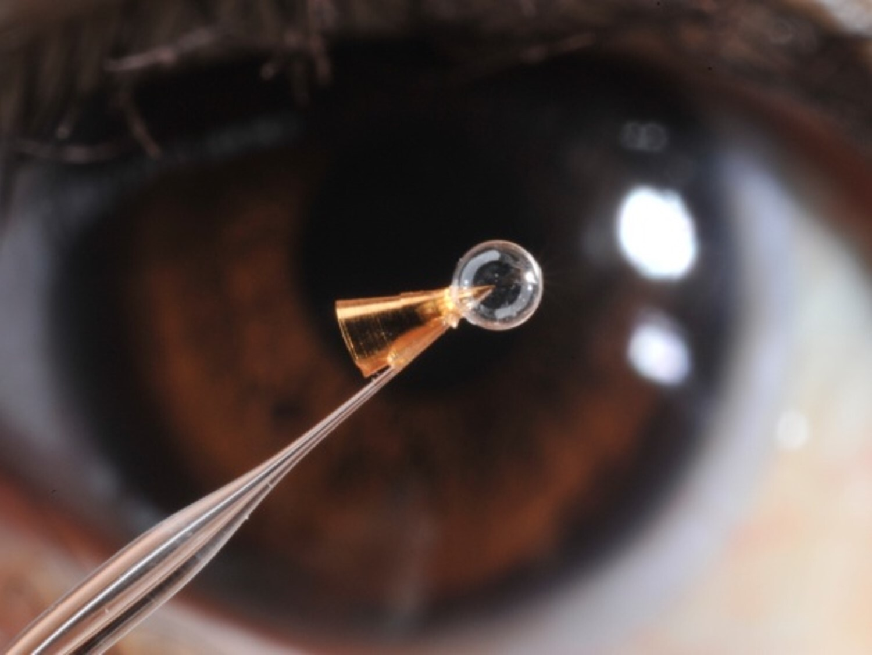
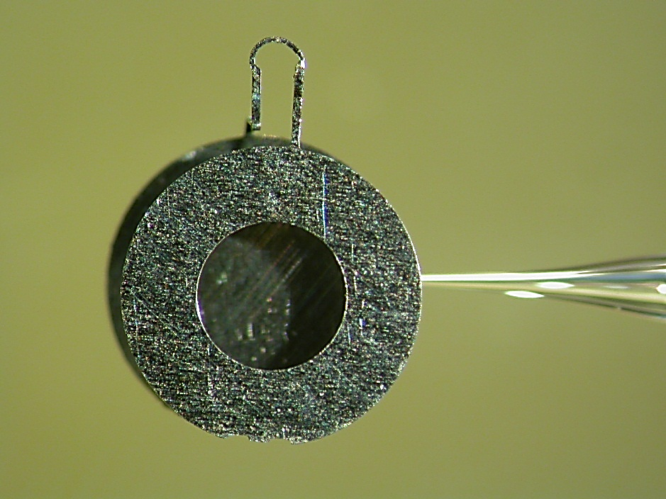
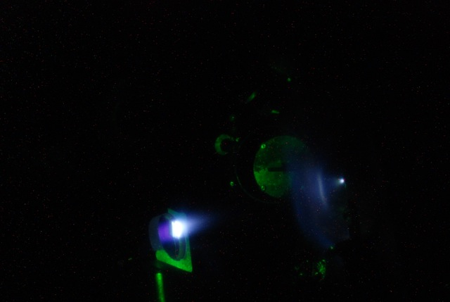
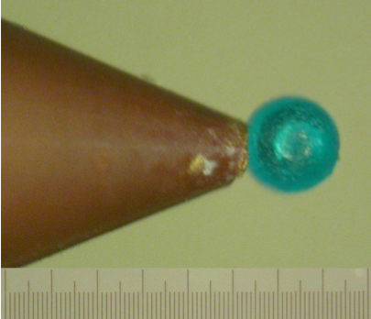
Fast Electron Fast Ignition, ILE approach
Guiding cone
for laser-absorption
R. Kodama+, Nature 2004.
Capacitor-coil
for REB collimation
S. Fujioka+, Sci. Rep. 2013.
Current ~ several MA
B ~ kT
GEKKO-XII
1mm
Plasma mirror
for cooling REB
Y. Arikawa+, Appl. Opt. 2016.
A. Morace+. Nuclear Fusion 2017
Solid ball
for stable fuel compression
S. Fujioka+, Phys. Rev. E, 2015.

Slide 17
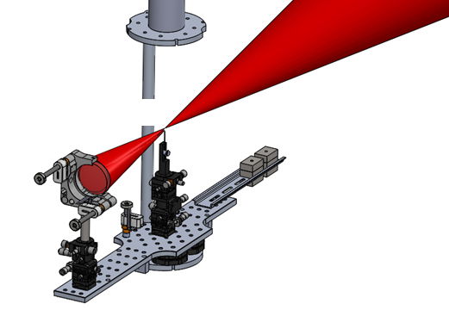
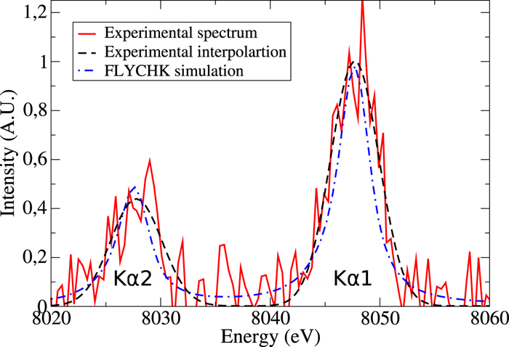
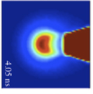

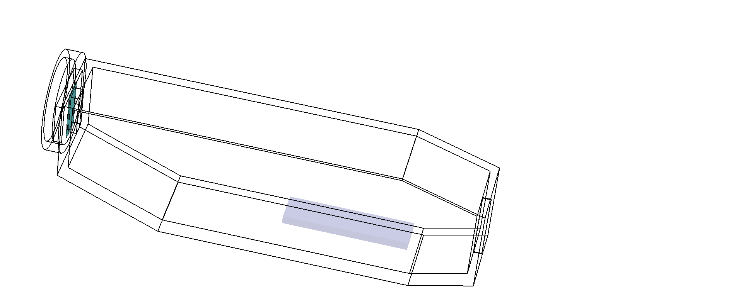
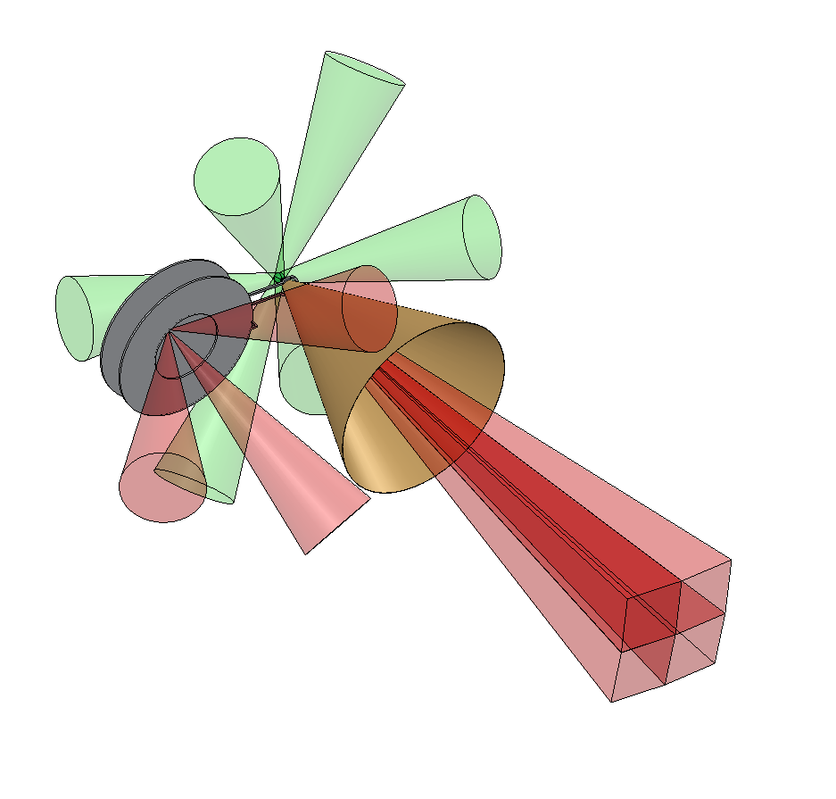
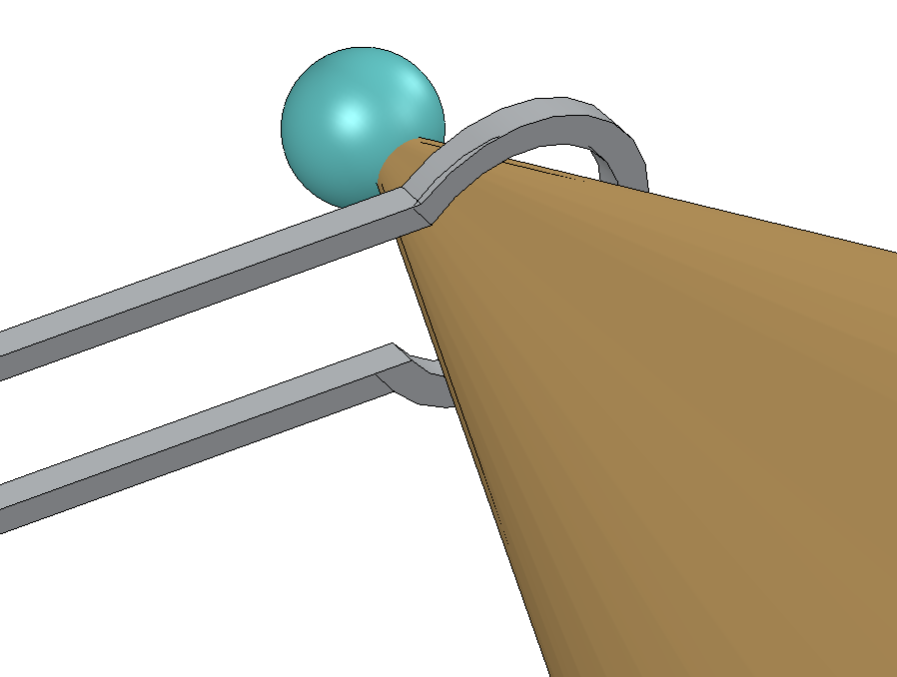
Fast Electron Fast Ignition, ILE approach
Experimental set-up
Cu-Kα spectroscopy
Cu-Kα imaging
LFEX
Spherical crystal
Interaction point
GEKKO-XII (2ω)
for implosion
Plasma mirror
Flat crystal
Cu-doped CH solid ball
(250 μmφ)
GEKKO-XII (1ω)
for B-field
Current
Gold cone
(45 deg. full angle)

Slide 18
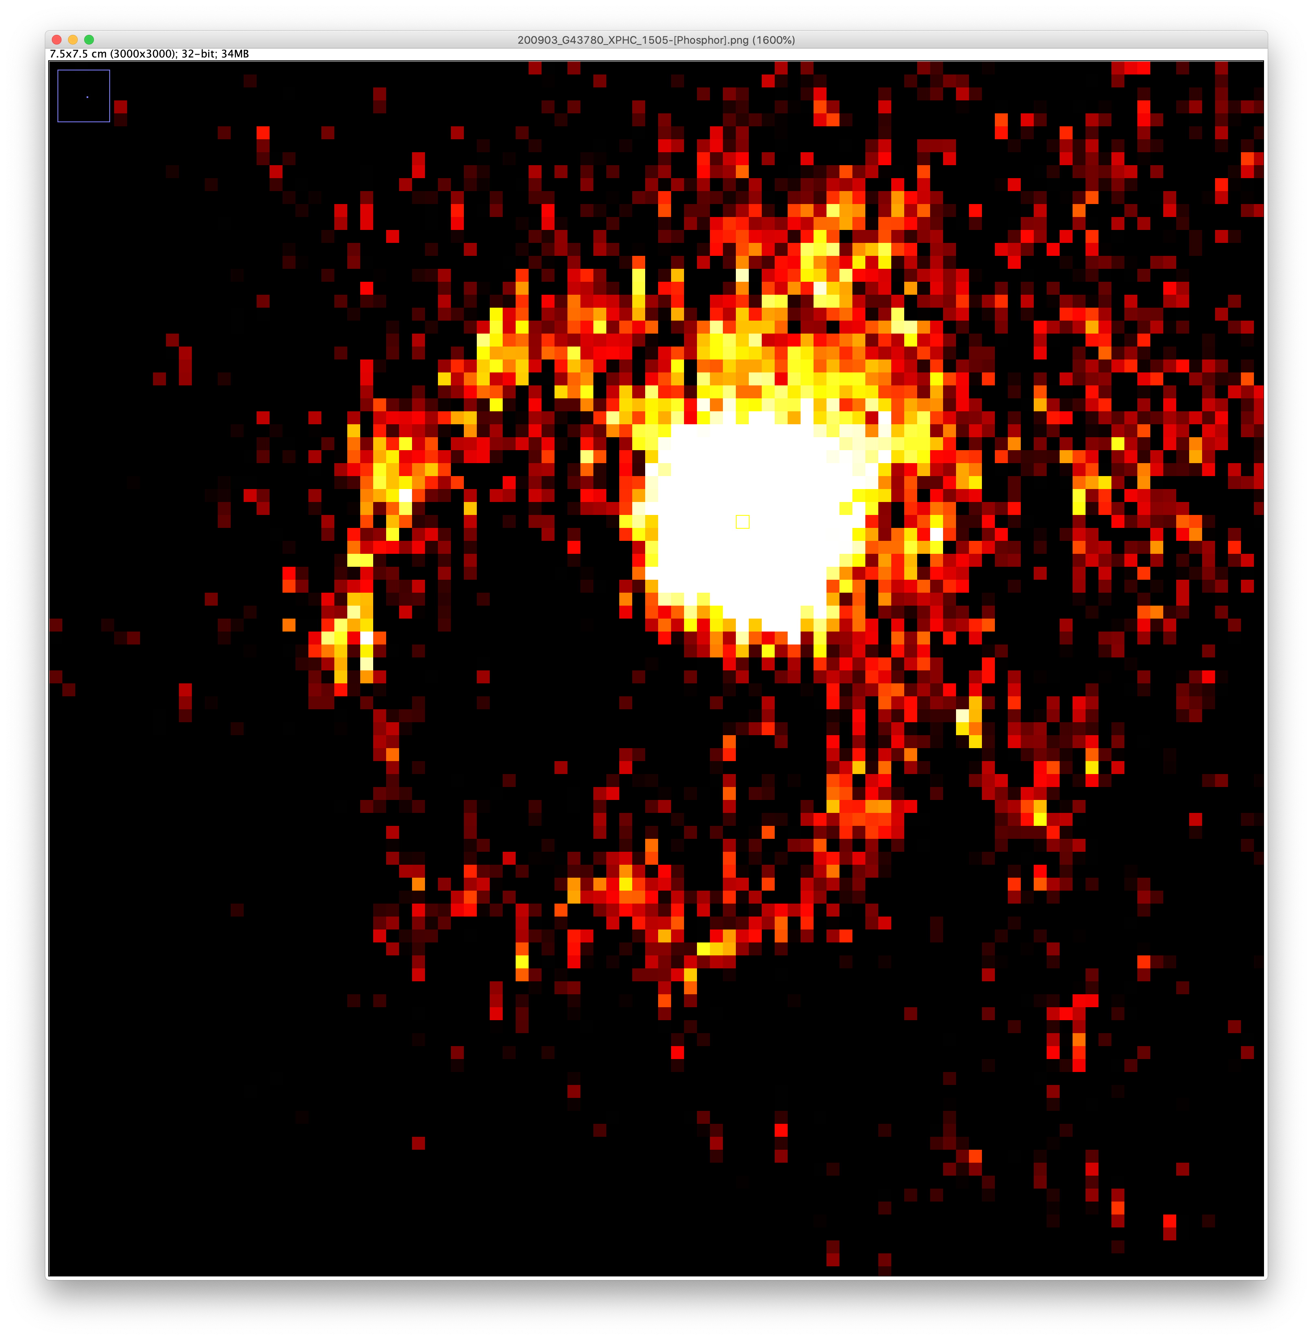
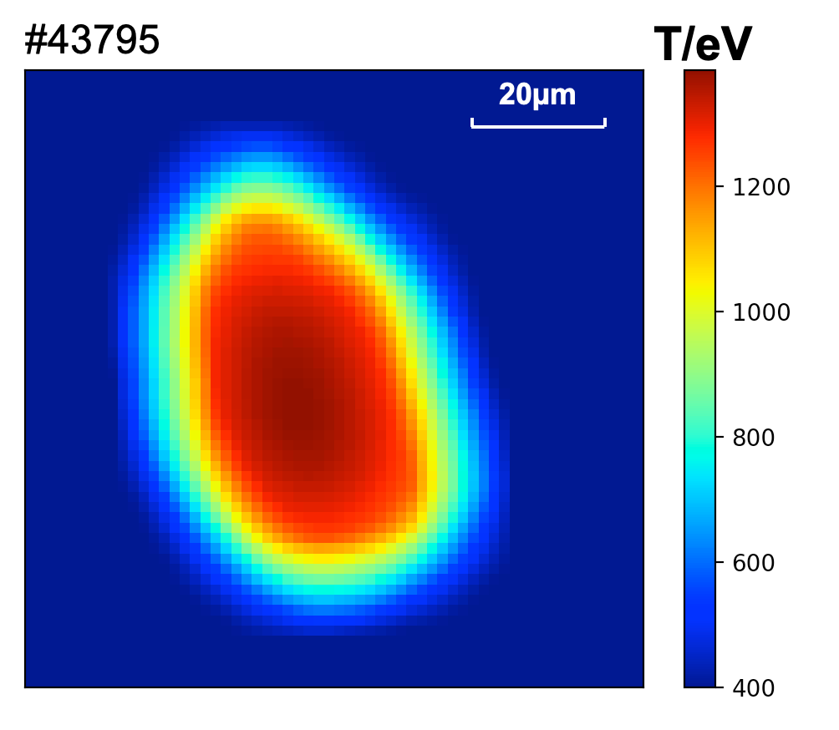
Significant heating > 1 keV was measured in the compressed Cu-oleate plasma
Drag Heating Efficiency
X-ray image
Heated area
Cu-doped CH solid ball
(250 μmφ)
Gold cone
(45 deg. full angle)
Current
Temperature
#43780

Slide 19

”Classic” proton fast ignition concept at ILE
The concept is similar to Fast Electron Fast Ignition. However the current density is lower, but the coupling efficiency is higher. The key parameters to be investigated and enhanced are:
Conversion efficiency
Focusing
Heating efficiency (coupling)
2D PIC simulation
2D Hydrodynamic simulation
Courtesy Prof. Fujioka

Slide 20
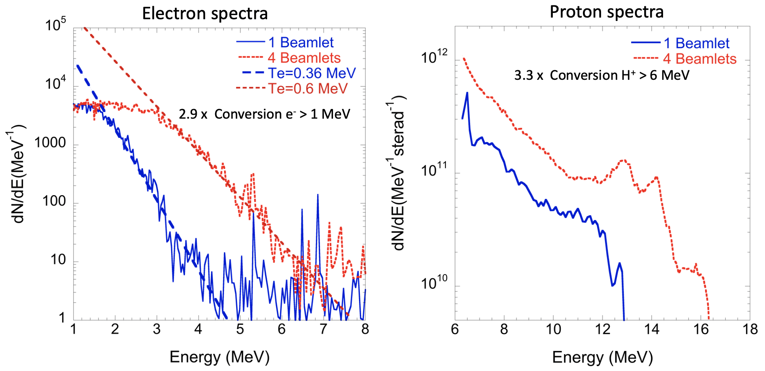
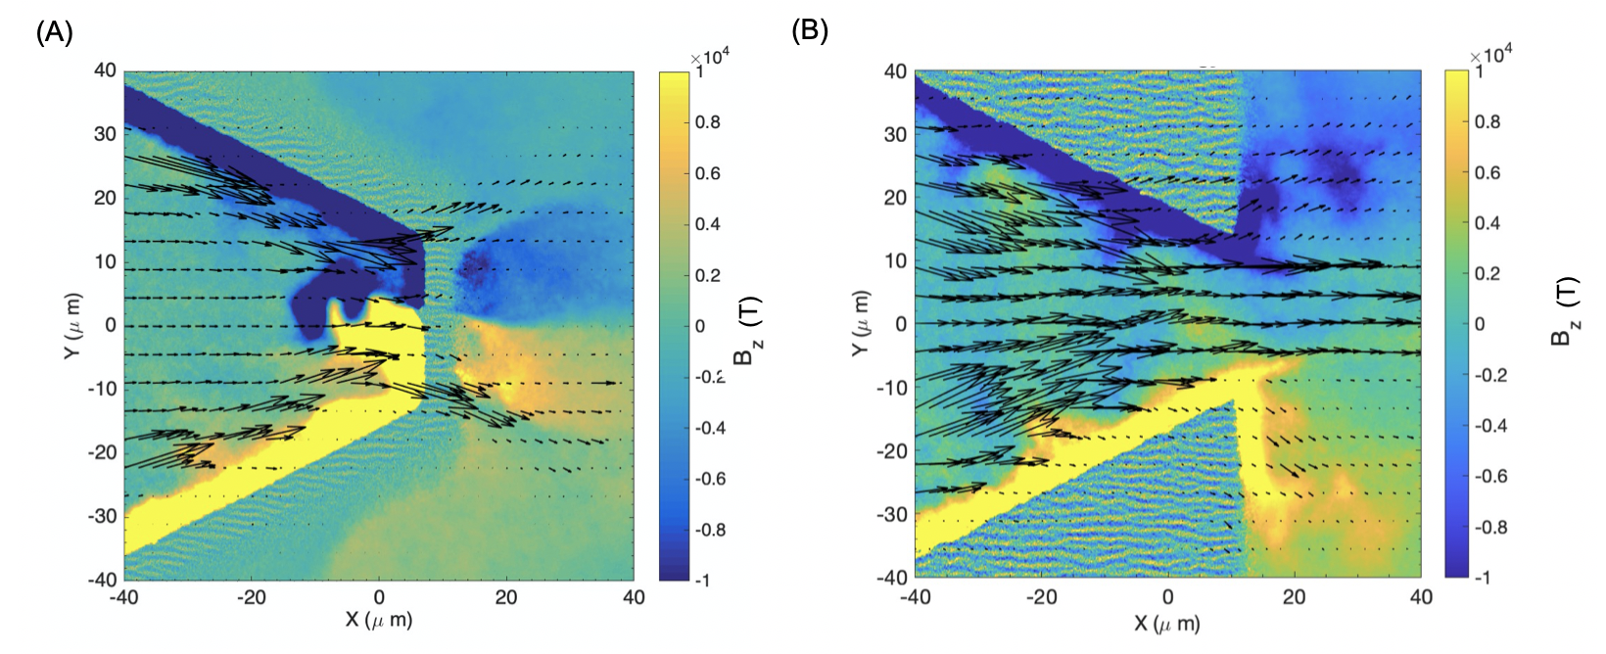
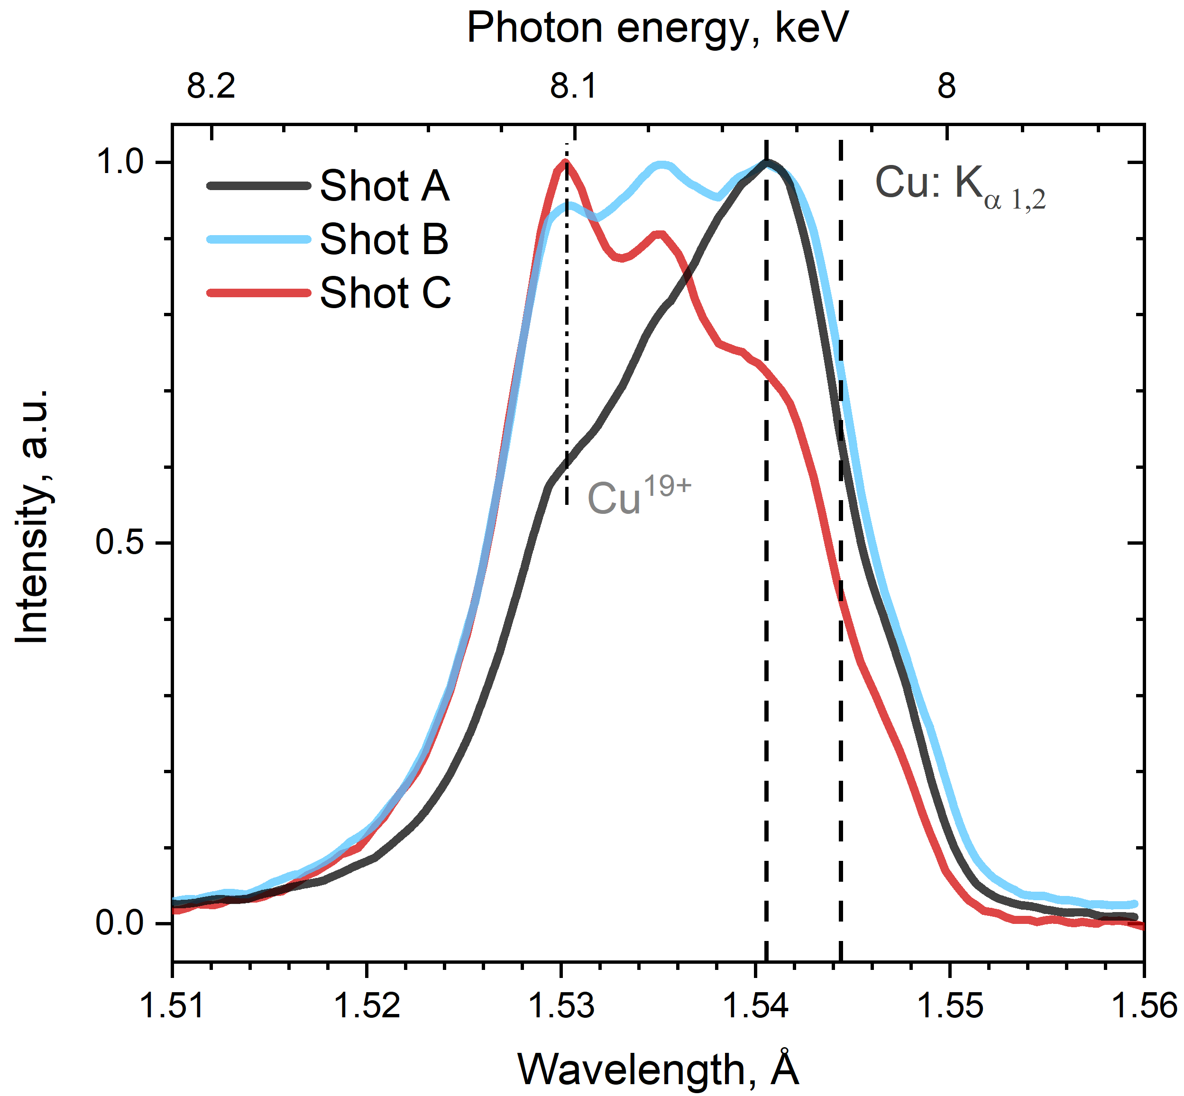
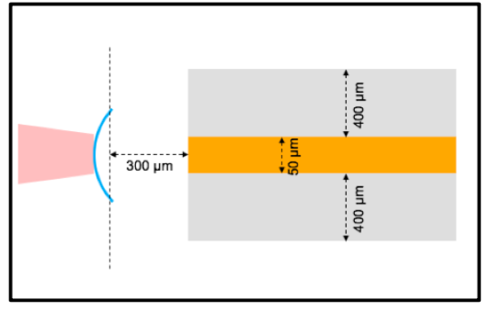
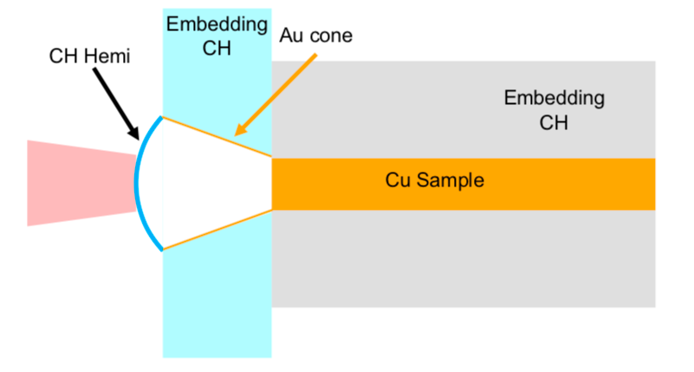
FIREX -1 activity on Proton Fast Ignition.
Investigated the LPI for multiple beamlet kJ-class laser and demonstrated that temporally and spatially overlapped beamlets lead to more than 200% increment in conversion efficiency via interference.
A. Morace et al. Nature Communications 10, 2995 (2019)
Studied the proton beam dynamics in focusing plasma devices and demonstrated that the dynamics is dominated by super-strong B-fields.
A. Morace et al. Scientific Reports 12, 6876 (2022)
200 eV
Investigated the ion induced heating in mid-Z material through x-ray spectroscopy .
Martynenko, Morace et al. PPCF 65 (2023)
225 eV
205 eV

Slide 21
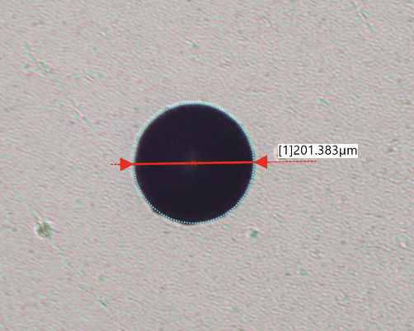
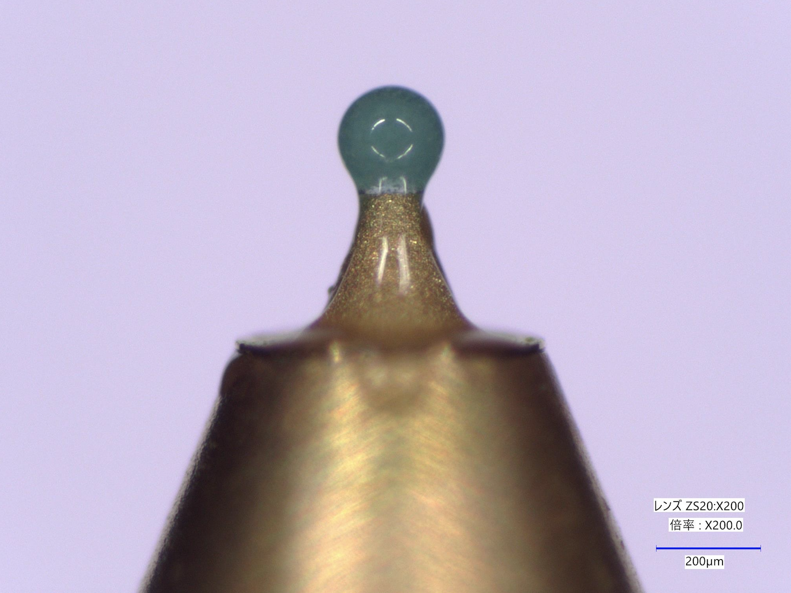
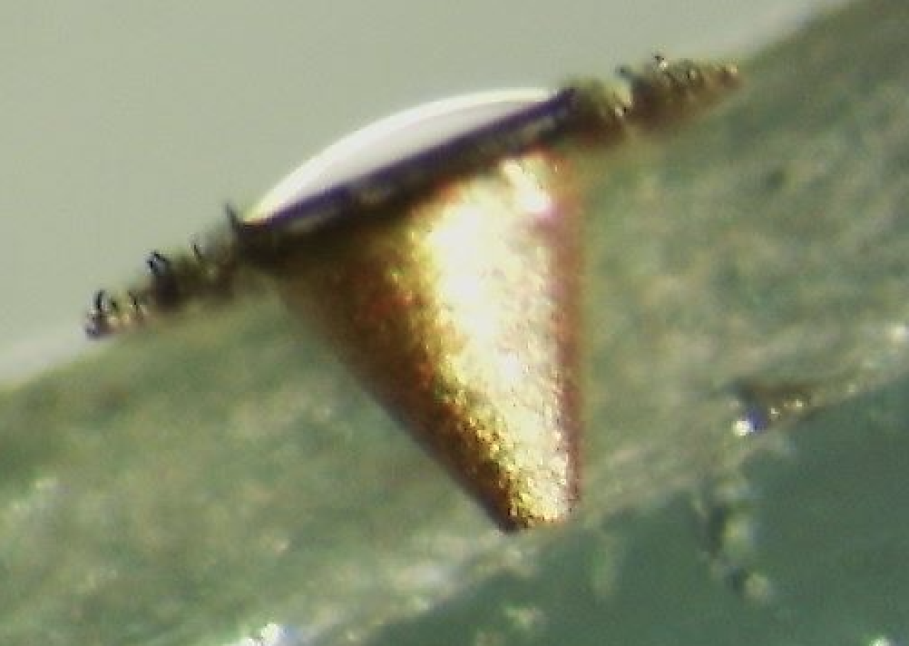
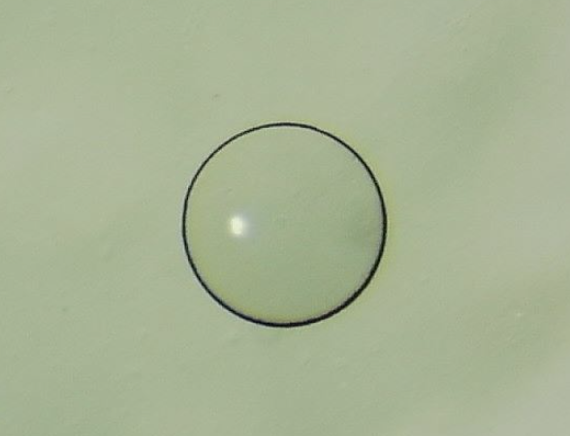
Towards a fully integrated PFI experiment in early 2026
In this experiment we use cone targets attached to a cu-oleate ball 200 um in diameter + 30 um PVVA coating
Oleate ball
PFI cone
Hemi-shell
PFI cone
300 um
300 um
hemishell
Despite this, it appears clear that the PFI approch alone may be insufficient the heat up the plasma to ignition temperature

Slide 22
Rationale for looking to new approaches to FI
These “classic” approaches to Ignition have some severe limitations.
In particular for Fast electron FI we have:
Complexity of the setup, unrealistic in high-repetition rate scenario.
Limitation of the heating provided by hot electrons
For Ion/proton FI:
Integrated experiments absent, the two attempted so far failed miserably.
Severe limitations in conversion efficiency, especially in presence of large imposion plasmas and cone structure.
Limited contribution provided by the protons, while Carbon stopping occurs at too low densities, not suitable for a lateral hot spot generation.
We searched for different mechanisms

Slide 23
Outline of the talk
NIF ignition and introduction to ILE’s FIREX
Brief summary of FIREX-I results, Fast electron and Ion Fast Ignition
NEW FI approach: Direct heating of a compressed, solid DT ball .
GXII and LFEX upgrades
Summary of the TALK

Slide 24

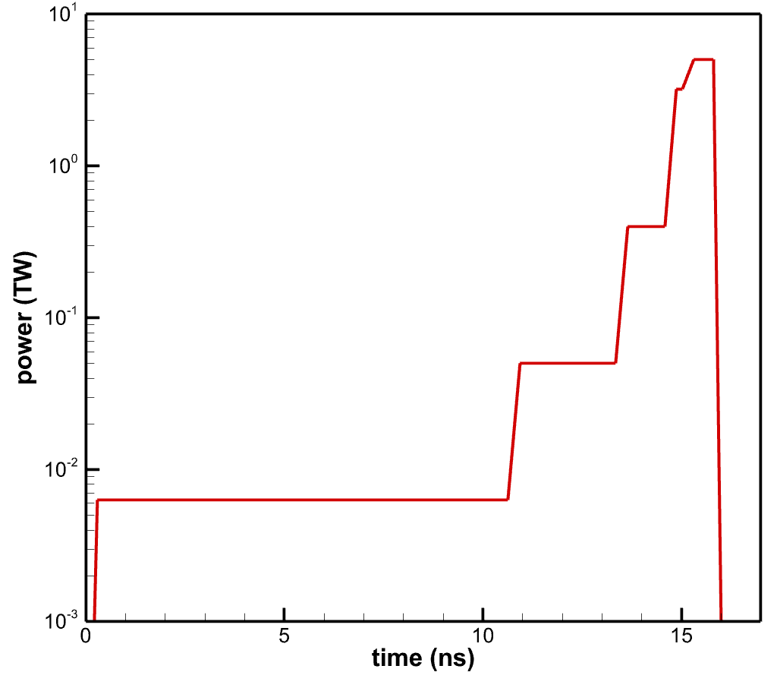
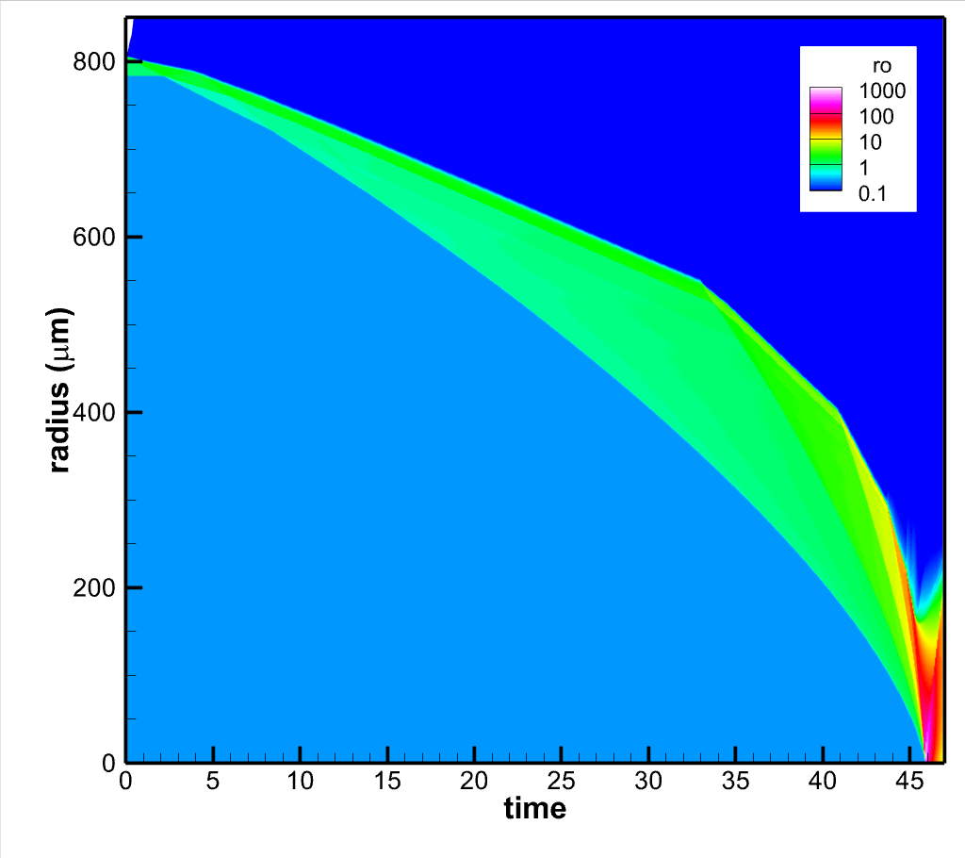
Direct heating of a compressed, solid DT ball (Y. Sentoku)
A new Fast Ignition approach is proposed, involving implosion and direct heating of a solid DT ball by an extreme intensity, PetaWatt, picosecond laser.
Al 0.1µm
DT 250um liquid
(current: CD 100um)
E=6kJ, λ=351nm,
1D-hydro simulation
ρ=100g/cm³
ρR=0.219 g/cm²
The maximum achievable density is proportional to the foot/spike ratio
High dynamic range pulse tayloring is required.
6kJ of GXII energy at 3ω can compress a 250 um radius solid DT ball to 0.22g/cm² with foot/spike ratio > 1000
Spike pulse
1
2
3
4
Foot pulse
5

Slide 25
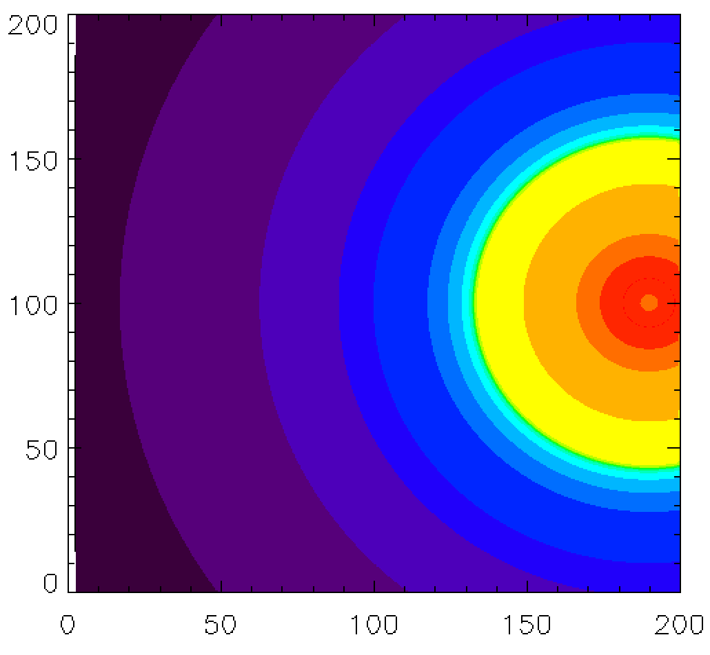
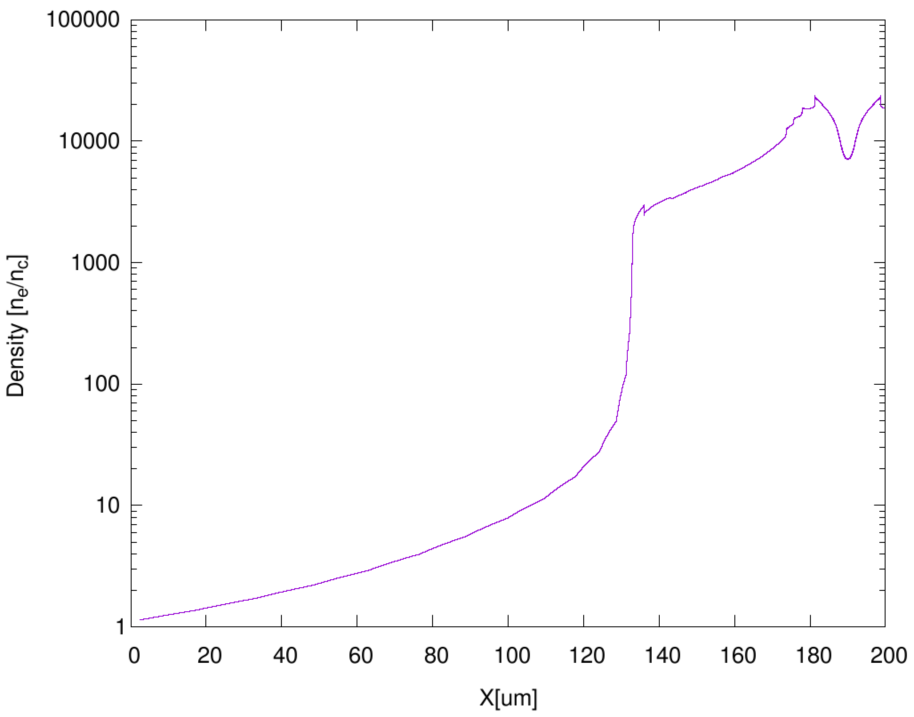
Plasma profile inserted in the PICLS simulation (Y. Sentoku, N. Iwata, H. Nagatomo)
Implosion of a sold ball by 6kJ/3ω
1D-hydro simulation density profile
2D-PICLS simulation
n_{c}
Corona plasma:
not so collisional
Core plasma:
highly collisional
100n_{c}
10000n_{c}
Laser plasma interaction
Heat transport
Full PIC:
kinetic physics
Reduced PIC:
collisional
energy
transport

Slide 26
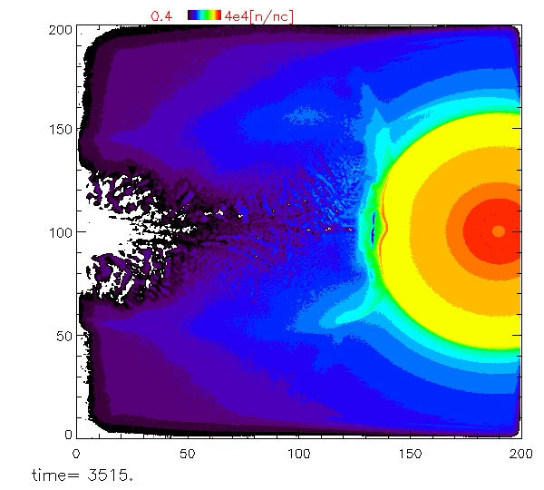
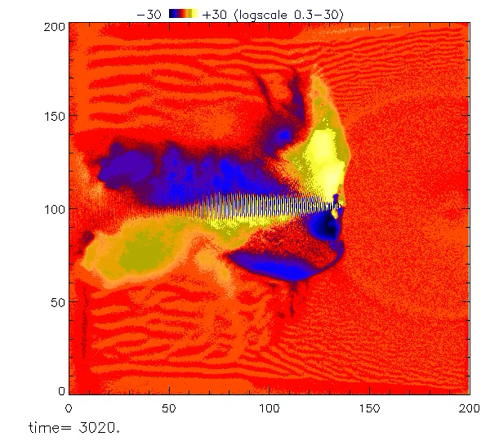
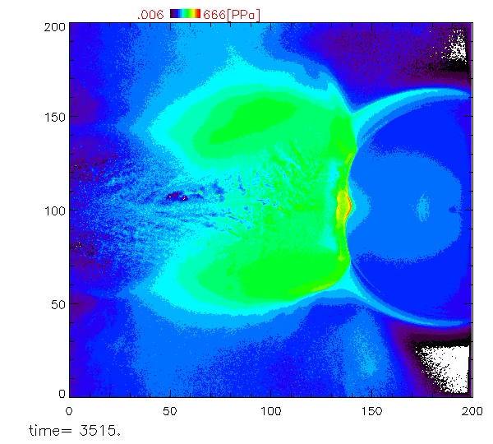


Direct heating of a compressed, solid DT ball (Y. Sentoku, N. Iwata )
Collisional 2D PIC simulation by PICLS
Heating laser: 1 PW, Energy 2.3 kJ, pulse width 2.4 ps, spot diameter 10 um (→ I = 1.23 x 10²¹ W/cm², a₀ = 30)
Target: DT solid ball imploded by a 6 kJ laser. Initial density profile calculated by a radiation hydro simulation ILESTA-1D.
8000x8000 grids, 5 particles per cell for each ion species, Bremsstrahlung radiation colling included.
Electron density
Magnetic field B_{z}
D+ energy density
100
100
[GG]
3
0.4
n_{e} / n_{c}
40000
y [μm]
100 g/cc
y [μm]
-3
0
y [μm]
0
0
100
200
0
100
200
-100
0
100
200
x [μm]
x [μm]
x [μm]

Slide 27
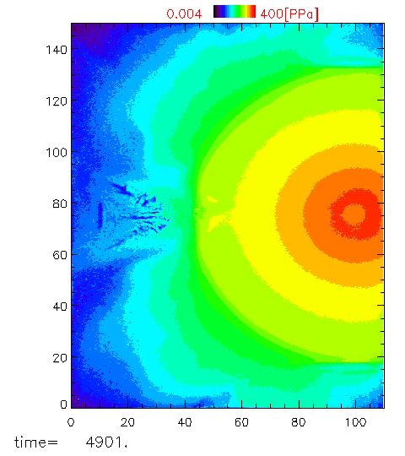
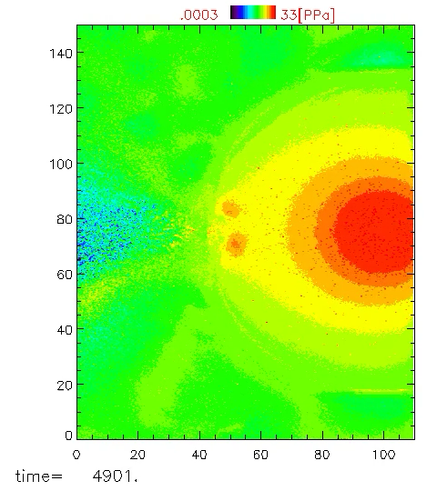
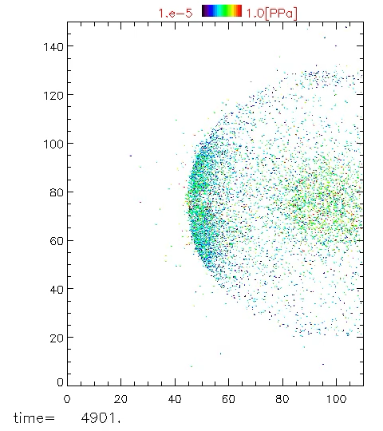
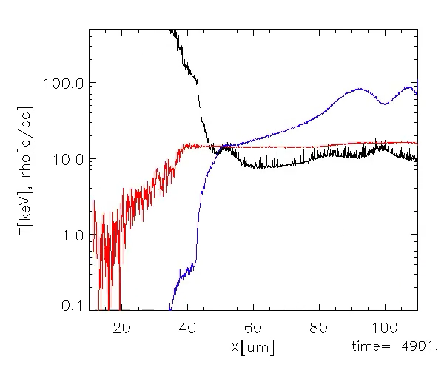
The heatwave propagates and heats the compressed core (Y. Sentoku, N. Iwata)
The dominant component that determines core heating is the propagation of the heatwave from the LPI region
Electron pressure
D+ pressure
alpha yield
Electron heat wave ~ 0.06c
Density ρ
Te
Average ion energy

Slide 28
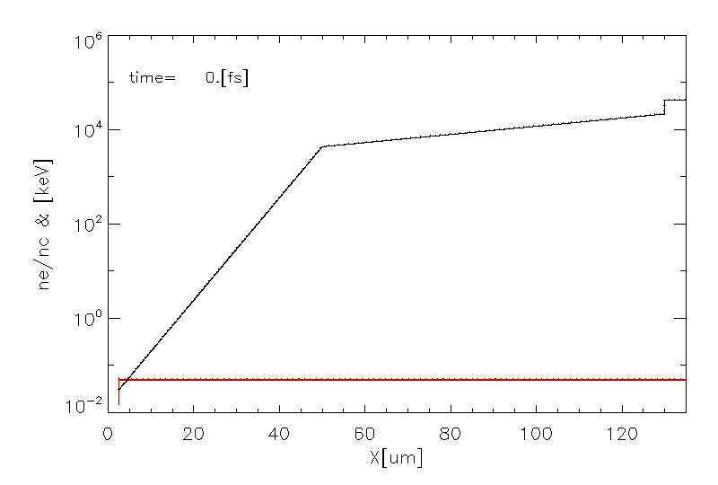
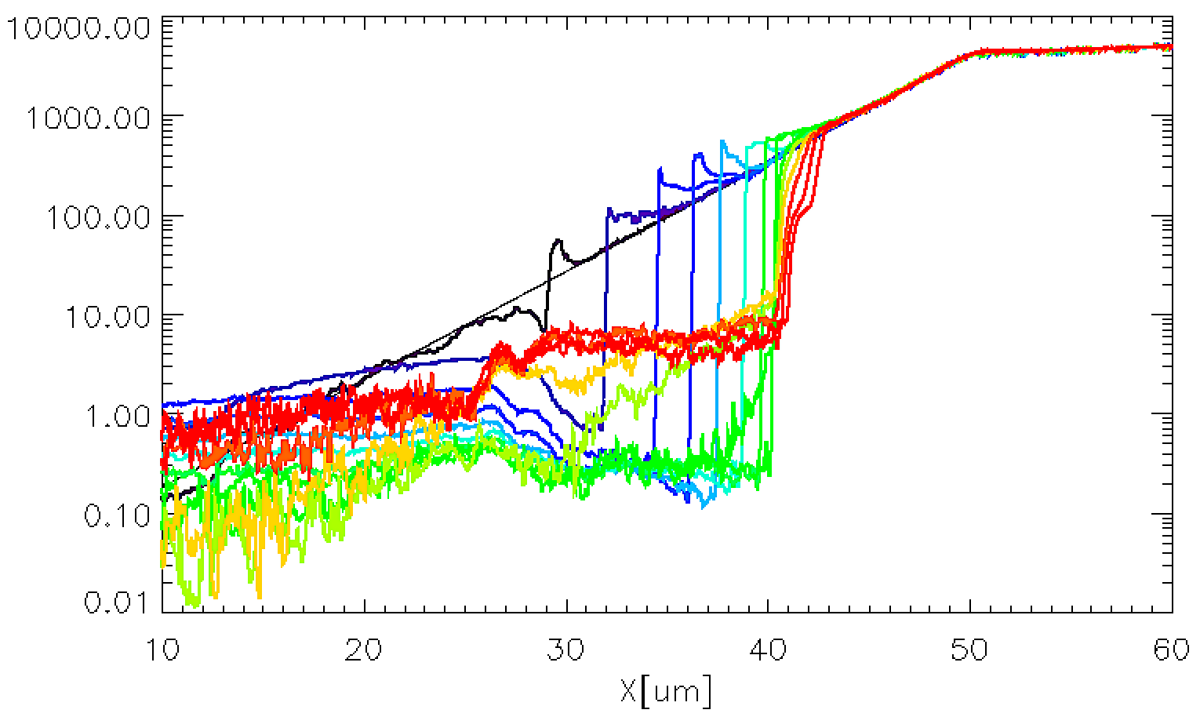



Quasi-2D collisional PIC simulation of plasma interface evolution (Y. Sentoku, N. Iwata)
Over 2 ps we observe hole-boring and density profile steepening till it reaches the limit (plasma pressure counteracts the radiation pressure )
Temporal evolution of plasma density
Initial plasma profile
Electron energy spectrum observed in x > 40 mm
10⁶
10⁴
Laser
a₀ = 30,
1 PW
1 ps
2 ps
10⁵
Fully resolve up to 10⁴ n_{c}
10³
0.5 ps
2 ps
10⁴
250 fs
10³
10²
3.5 ps
10²
n_{e} / n_{c}
250 fs
DT plasma
10
dN/d(log E) (= E dN/dE)
10
1
Maxwellian fitting
T_{p} = 15 MeV
1
0.1
0.1
0
40
80
120
x [μm]
0.01
10⁻²
10⁻¹
10⁰
10¹
10²
0
20
30
40
x [μm]
Electron energy [MeV]
Laser light pushes the plasma surface up to the limit density at t ~ 2 ps.
After reaching to the limit density, copious electrons with energies lower than the ponderomotive energy appear.

Slide 29

Fusion yield keeps rising exponentially even after LFEX pulse terminates (Y. Sentoku, N. Iwata)
It appears that we can approach fusion gain of 1 with 2.5 kJ LFEX energy, with intensity > 1x10²¹W/cm² and a 6 kJ, 3ω compression laser
LFEX injection
Energy (normalized by LFEX)
Fusion energy output
Simulation time limit
Time (ps)

Slide 30
Outline of the talk
NIF ignition and introduction to ILE’s FIREX
Brief summary of FIREX-I results, Fast electron and Ion Fast Ignition
NEW FI approach: Direct heating of a compressed, solid DT ball .
GXII and LFEX upgrades
Summary of the TALK

Slide 31








Upgrades for GXII and LFEX have been funded
Increase shot rate
Laser energy improvement
Tritium target capability
Precision target positioner
Operation system
Precision pulse shaping,
smoothed beam profile
Pulse post compressor
Oscillator, pre-amplifier
Interaction chamber
Laser diagnostics
Controlling system
Capacitor bank, pulse power switch
Optics damage repairing
Flash lamps

Slide 32
New oscillators with SSD beam smoothing for GXII (Y. Arikawa and GXII team)
It will allow for foot/spike ratio of 5000 with 3 direction SSD beam profile smoothing
Foot pulse oscillator
Spike pulse oscillator
CW seed laser
Arbitral Wave form Oscillator
(MODBOX)
SSD-1D
Fiber laser system
Arbitral Wave form Oscillator
(MODBOX)
Fiber Spectrum modulator
Fiber Spectrum modulator
14.25GHz
3rd harmonics
90%R
Regen Amp
Amp
10%T
SSD-3D
Free space system
8.4 GHz
200
5000
4.9GHz
I
I
1
G1
G2
G3
t
1
t

Slide 33




3 directional SSD beam smoothing
Focus beam pattern with random phase plate
SSD-3D + phase plate
Gekko 12 beams
match to the hexagonal focal pattern
Hexagonal shape
1st direction
2nd direction
3rd direction
Smoothing by spectrum
dispersion SSD
N. Miyanaga, G.Miyaji, 2002

Slide 34





LFEX upgrades
Capacitor bank: Automated gas gap switch system
At OPCPA-AMP: precision excitation laser system improving energy control, uniform intensity distribution, and pulse contrast.
Main AMP : Repolish damaged optics, enabling x3 energy ( 4 kJ @ compressor)
Compressor: Precision on-shot beam monitor,
At target chamber: post compressor
Precision Monitors
Current Near field
pattern monitor
Focusing
Current focal spot
improved focal spot
Project leader: S. Fujioka

Slide 35


Post-compressor for extreme intensity LFEX (A. Morace, Y. Arikawa)
In order to achieve extreme intensities on LFEX, it is required to increase the energy of LFEX to ~ 4kJ, pre-compress the LFEX pulse from 2 ns to 100 ps with the LFEX compressor, and finally compress from 100 ps to 1 ps with a post compressor installed directly in the target chamber.
Compressor : 2 ns to 1.5 ps, 1kJ in 4 beams focused by a single parabola
Post-compressor concept
Compressor
Target
Chamber
1 ps LFEX
OAP
100 ps LFEX @ 4 kJ

Slide 36
Post compressor concept
G1
The post-compressor is a partially sacrificial system composed by only 4 optics.
We work at damage threshold on the M1, concave parabola, I ~ 6 x10¹¹ W/cm²
We are above damage threshold on the gratings G1 and G2 which will be replaced after every shot
We will work on the final OAP as plasma mirror with intensity ~ 6x 10¹³ W/cm²
Expected intensity on target ~ 1-5x10²¹ W/cm²
40.5 cm
M2
12 cm
TCC
M1
40 cm
G2

Slide 37

A second design being considered allows for co-axial focusing
Reflection from M1 at 90 deg from LFEX, compressor dimensioning remains the same.
M2 will be a f/1 parabola
G2
M2
M1
G1

Slide 38






Japan–US Collaborative Technical Discussion with Lawrence Livermore National Laboratory
LLNL visit (February 2025)
Discussion with LLNL laser group, Optics group,
Pulse power groups,
Plasma-electrode
pockels cell (PEPC)
Coating on KDP crystals
Precision fiber oscillator
Pulse power switches
Thanks to the great helps by LLNL,
our development are progressed!

Slide 39



ILE’s strategy: We are refurbishing GEKKO-XII & LFEX lasers. Our facility will demonstrate the heatwave fast ignition with gain ~ 1
Current
2026年
2029年
I. Demonstrate heatwave heating
& hole boring over critical
density
Proof of Principle： NIF
High-efficiency demonstration
FIREX
PRL2020
Refinement
III. Integrated Experiment
solid ball implosion + LFEX heating
core density >100g/cc
Demonstration of efficient heating
Ion temperature ~ 10keV + neutron diagnostics
GEKKO-XII
6kJ/3ω
pulse shaping
II. Achieve high-density implosion
for solid ball explosion
core density 10g/cc → >100g/cc
PW Laser
3kJ/3ps
LFEX（4 beam）
3kJ/1.5-6ps
deformable
Design a compact laser fusion with about 100kJ laser energy and with gain > 100.
GEKKO-XII
6kJ
Tailored pulses
GEKKO-XII
6kJ
Tailored pulses
Gain ~ 1
High rep laser
development
Senju-Lite (10J/100Hz)
Senju (100J/100Hz)
J-EPoCH
Advanced DT Target Development Research
Measurement and improvement of DT mixing ratio
Development of high-quality DT target

Slide 40
Summary
In summary, ILE future strategy for ICF will be focused on the direct heating of compressed, solid DT ball.
This scheme promised to reach gain of 1 using less than 10kJ total laser energy on target.
Upgrades for both GXII and LFEX system will be implemented to achieve the condtions required to access gain 1
We hope to provide you with exciting results in a few years, Thank you!

