Slide 1


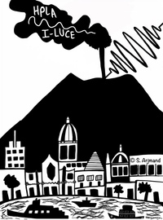
I-LUCE Facility Layout:
INFN-Laser indUCEd radiation production
Dr GA Pablo Cirrone
Istituto Nazionale di Fisica Nucleare
Laboratori Nazionali del Sud (Italy)
Carmen Altana, Sahar Arjmand, Danilo Bonanno, Antonio Caruso, Roberto Catalano, Giacomo Cuttone, Alma Kurmanova, Mariacristina Guarrera,
Demetrio Oliva, Alfio Pappalardo, Giada Petringa, Josè Suarez, Salvatore Tudisco
With the unvaluable support of the LNS Technical and Research Divisions

Slide 2

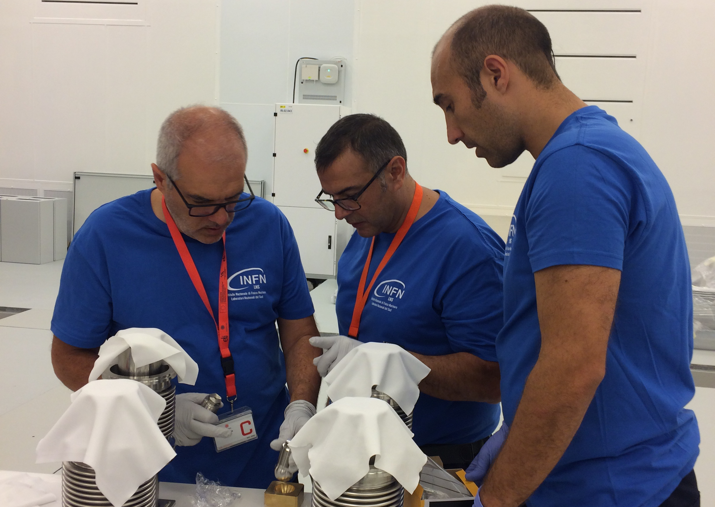




Laser and plasma route at INFN-LNS
PLANETA
ECLISSE
PLAIA
PLATONE
PLEIADI
LILIA
ELIMED
PANDORA
L3IA
DDT
FUSION
I-LUCE
2000
2009
2012
2017
2018
2023
2025
Discussion groups for an high-power laser acquisition
(L Calabretta et al)
ELIMED contract
PNNR initiatives
IMPULSE project
L Torrisi, S Gammino, G Cuttone, A Anzalone, G Lanzalone, A Bonasera, D Margarone

Slide 3
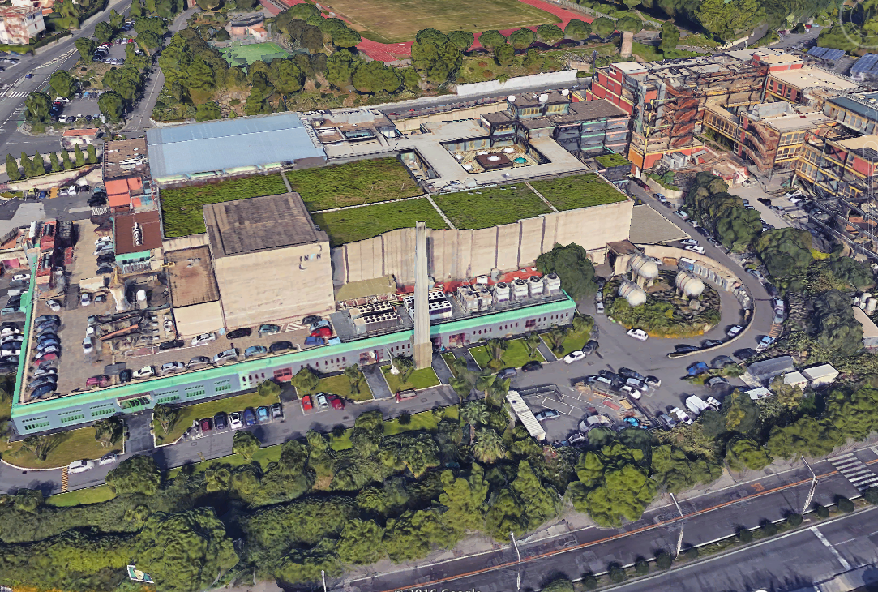


Offices
Exp beamlines
Tandem accelerator
(4 – 26 MV)
Laser bay
Cyclotron accelerator (10 – 80 AMeV)

Slide 4
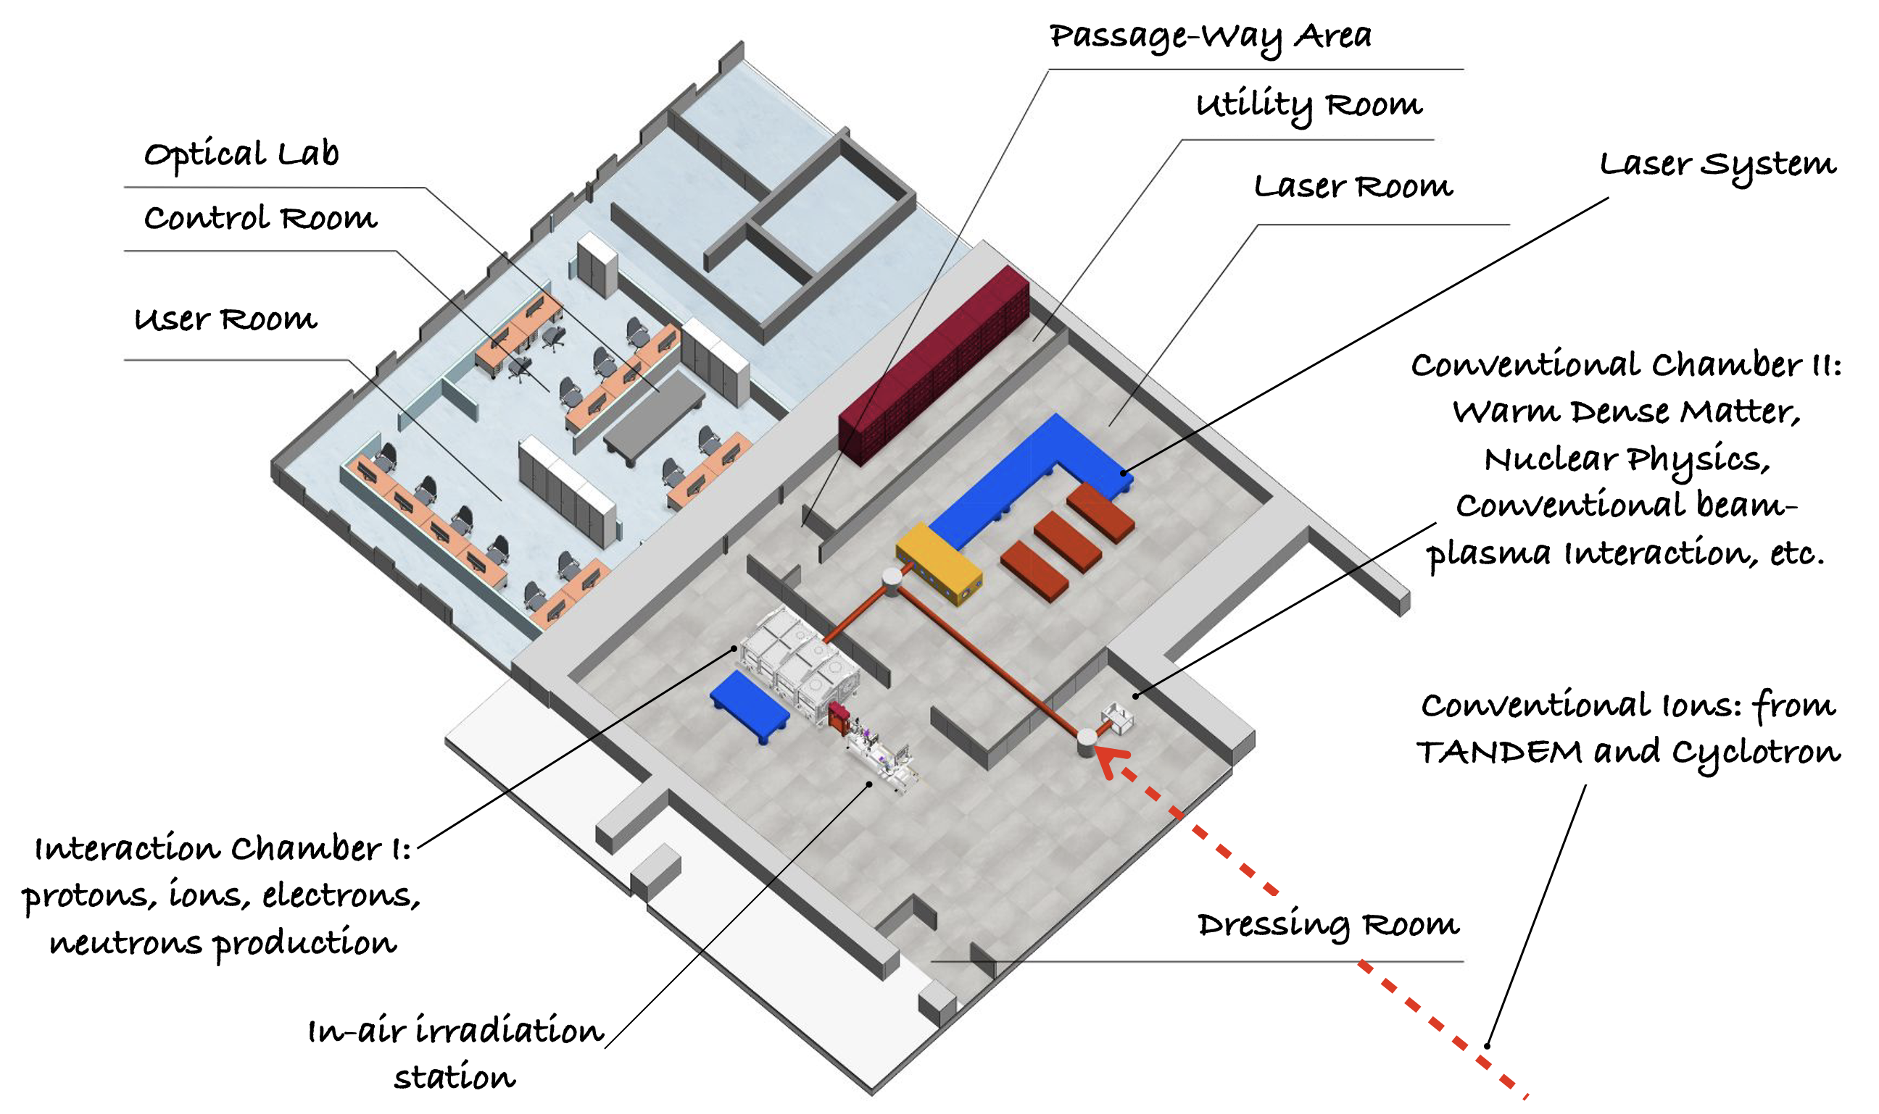

I-LUCE current status
Two laser systems (L1 and L2),
four Experimental Stations (ES),
and three laser outputs
July 2025
L1
November 2026
Coherent Astrella system (L1):
9 mJ, 35 fs, 1 kHz
THALES Quark (L2)
> 8 J, 23 fs, 2.5 – 10 Hz
> 11 J for a 500 TW upgrade
ES1
L2
ES3
ES2
ES4
ES1 and ES2:
electron accelerations
ES3: ion acceleration
ES4: ion-plasma interaction; nuclear physics studies, neutron production

Slide 5
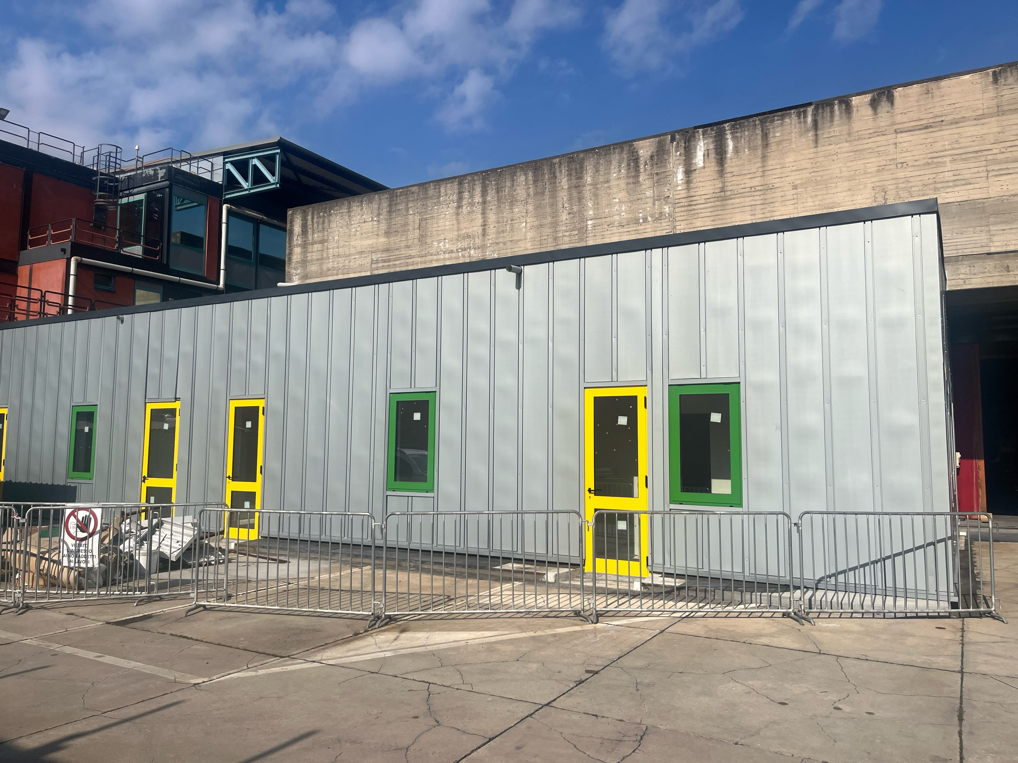
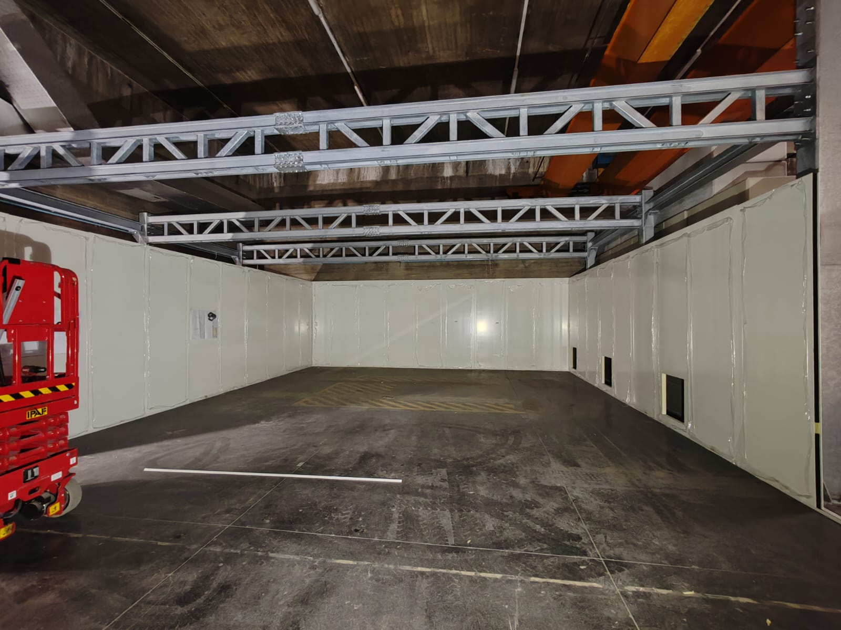
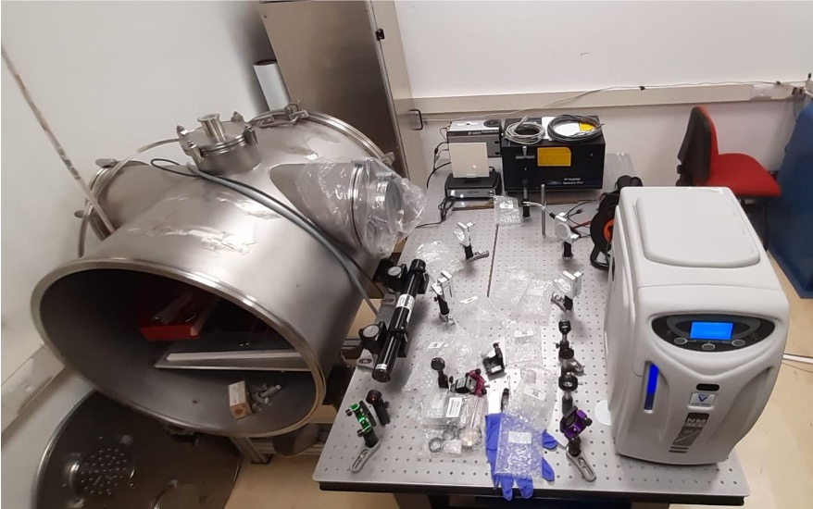
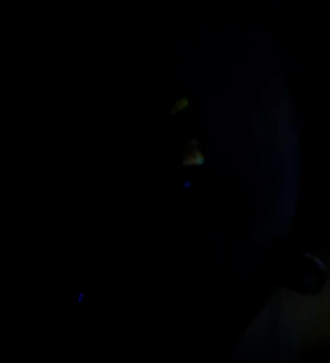
I-LUCE current status
Control and Users areas
Laser and experimental area realisation ongoing
Plasma laboratory for capillary discharge and LWFA tests

Slide 7
I-LUCE current status
High peak power laser system for I-LUCE and latest laser technology developments
Dr Simon-Boisson (THALES) today, h 17:50
Company session
Laser beam transport at I-LUCE
Dr Carmen Altana today, h 12:20
Facility session
Laser plasma electron acceleration and applications at I-LUCE
Dr Sahar Arjmand today, h 12:40
Facility session
Design and implementation of a laser-driven neutron source at INFN-LNS
Dr Simone Amaducci today, h 13:00
Facility session
Perspectives for the physics of nuclear decays in laser-generated vs ECR plasmas
Dr David Mascali, 19 November h 9:50
Nuclear physics session
Dosimetric measurements of proton beams at ELIMAIA-ELIMED facility and the new beamline @ I-LUCE
Dr Giada Petringa, 19 November h 11:40
Dosimetry and diagnostic session

Slide 8
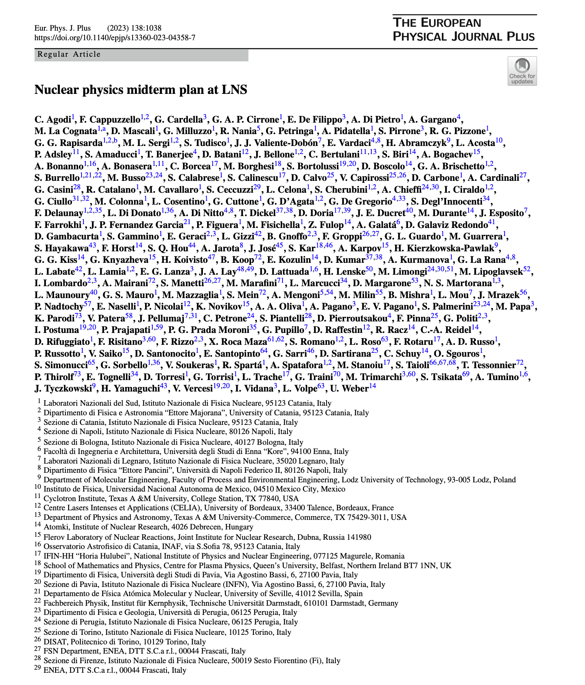
I-LUCE first phase
Available secondary sources / end-stations
Protons acceleration up to 15 MeV with solid target (up to 50 MeV)
Electrons acceleration up to 300 MeV with capillary and gas-jet system
Neutron beam
Irradiations stations for both protons and electrons for medical and multidisciplinary applications
  Radiobiology
  FLASH radiotherapy applications
  Material science
Interaction of conventional ion beams with laser-generated plasmas
C Agodi et al., Eur. Phys. J. Plus (2023) 138:1038

Slide 9
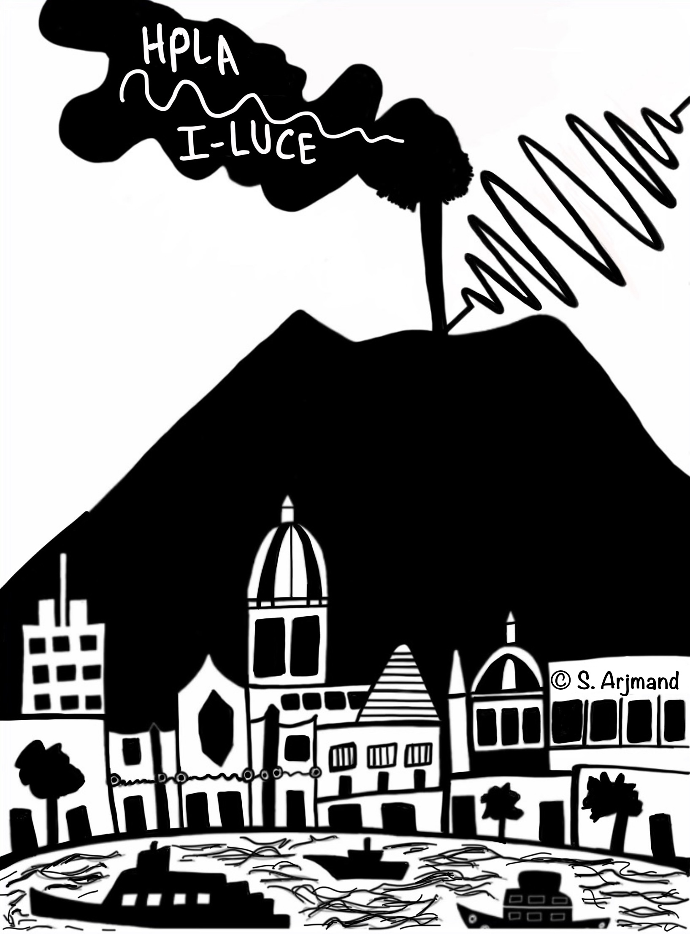
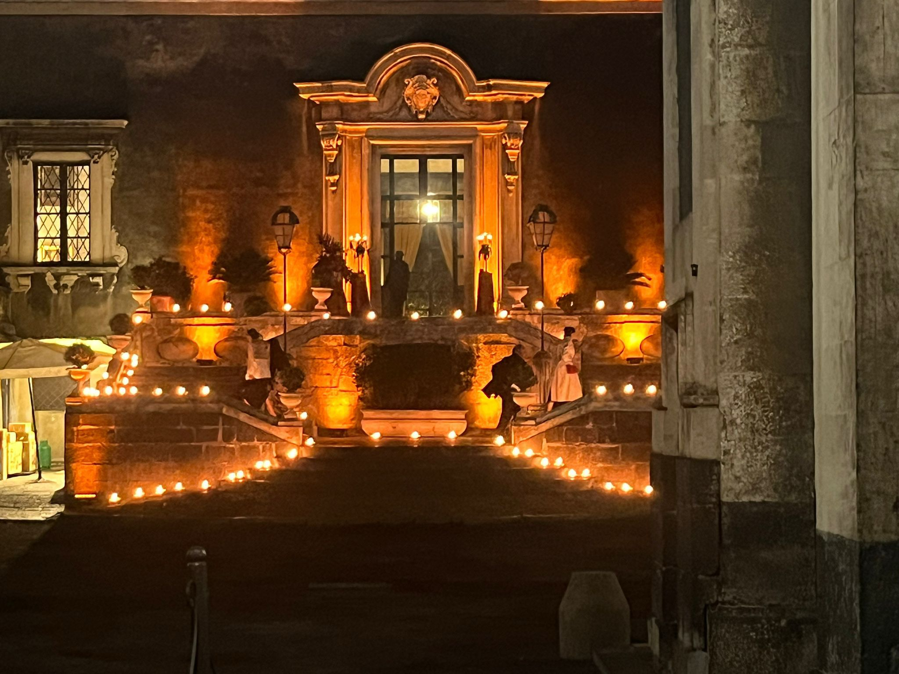
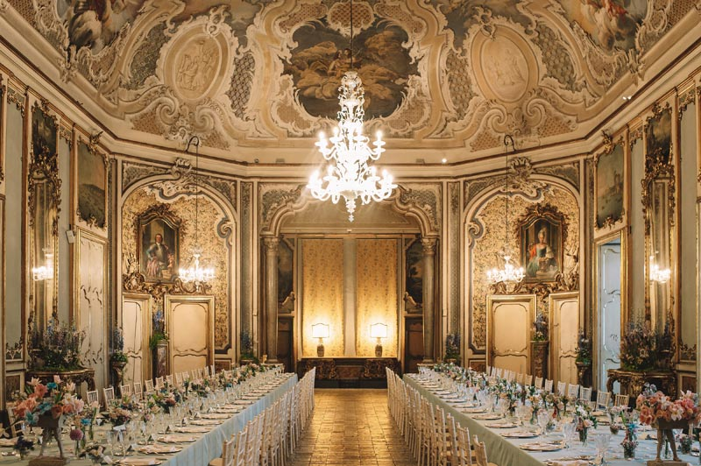
HPLA25
Scientific sessions: facility, radiation production, applications, diagnostic dosimetry and radiobiology, nuclear physics, company
Poster session with a money prize for the first and second place):
Tuesday 18th h16:40 – 17:40
Prize assigned Wednesday 19th at 13:05
Catania tour: Tuesday 18th at 17:40 a bus will wring participants to Piazza Stesicoro for a guided tour
Galà Dinner: Tuesday 18th at 20:30 participants will meet after the tour at Palazzo Biscari.
Smart casual dress code is recommended
Laboratory tour: after the lunch on the last day

Slide 10
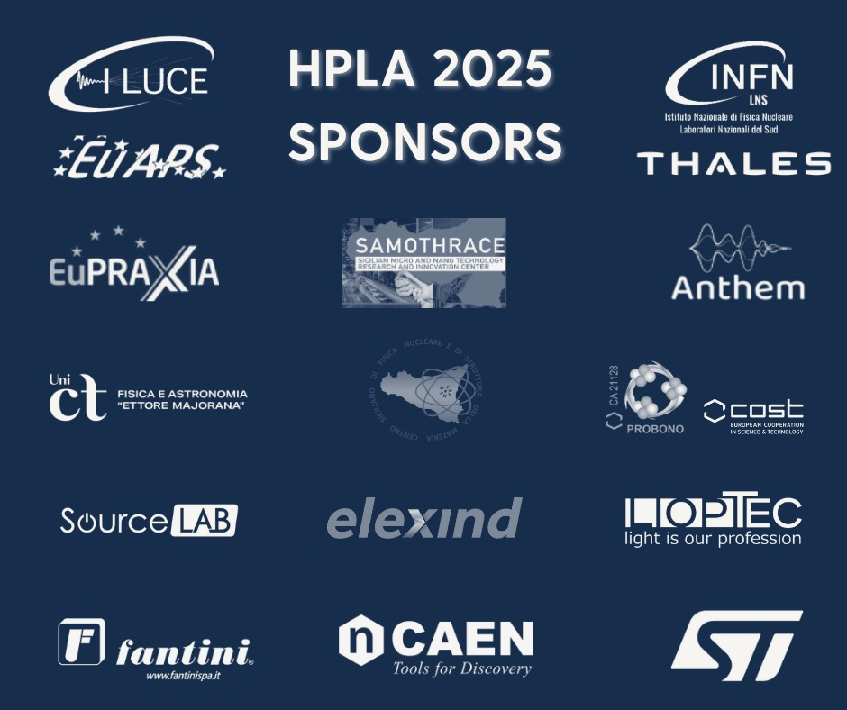

HPLA25
Conference proceedings
Following the workshop, a call for papers will be launched for European Physical Journal (EPJ) Web of Conferences (WOC): https://www.webofconferences.org/epj-web-of-conferences-forthcoming-conferences
Deadline: 31 March 2026
Details on the publication instructions will be soon available

Slide 11






Thanks and enjoy the workshop
Carmen Altana, Sahar Arjmand, Danilo Bonanno, Antonio Caruso, Roberto Catalano, Giacomo Cuttone, Alma Kurmanova, Mariacristina Guarrera, Demetrio Oliva, Alfio Pappalardo, Giada Petringa, Josè Suarez, Salvatore Tudisco
Daniele Margarone, Lorenzo Giuffrida, Marcin Rosiński, Sushil Singh, Joseph Krasa, Libor Juha and coll
Claudio Verona, Fabrizio Consoli, Massimiliano Scisciò, Salvatore Mirabella, Antonio Picciotto, Antonio Scandurra, Edmund Turcu, Aldo Bonasera and coll.
Domenico Doria et coll
Marco Borghesi and coll
Tadzio Levato

Slide 12
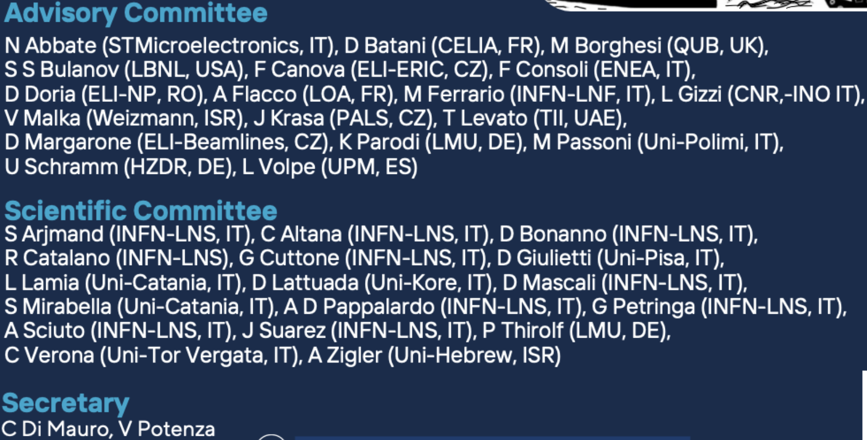
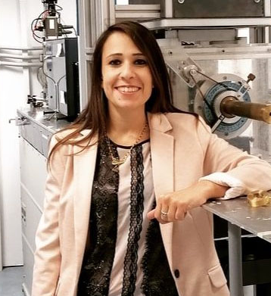
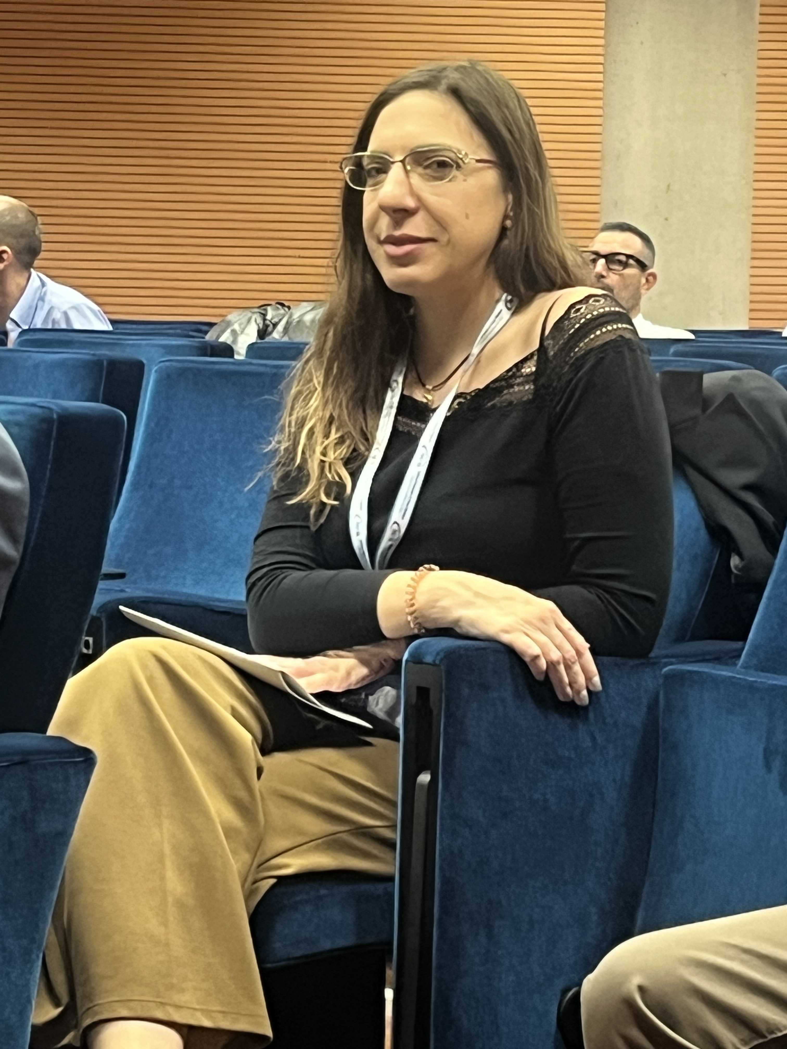
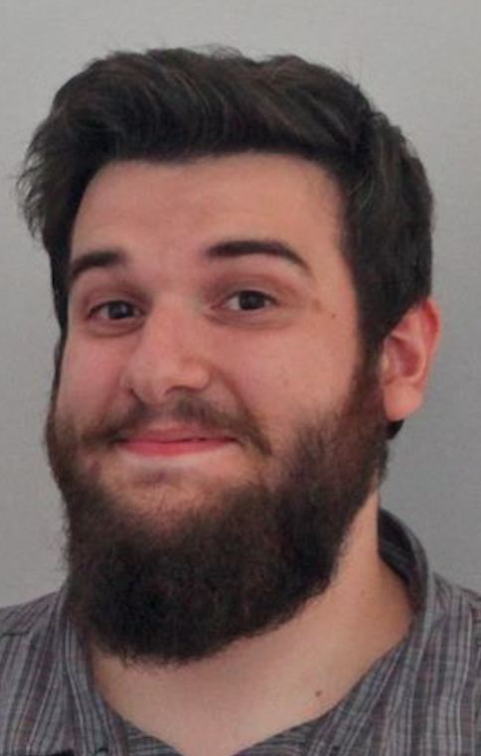
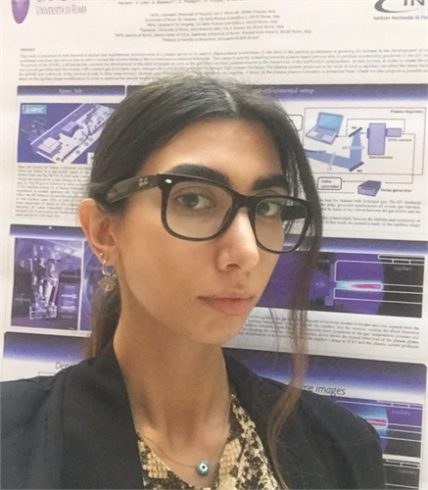
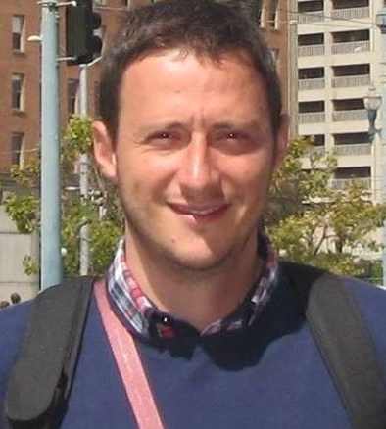
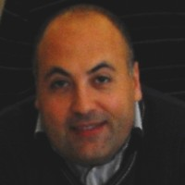
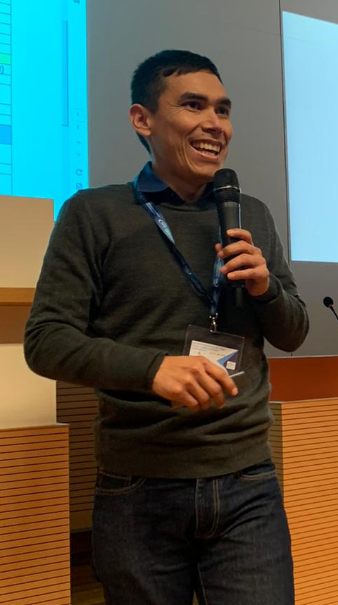
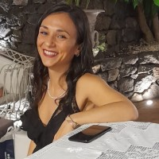
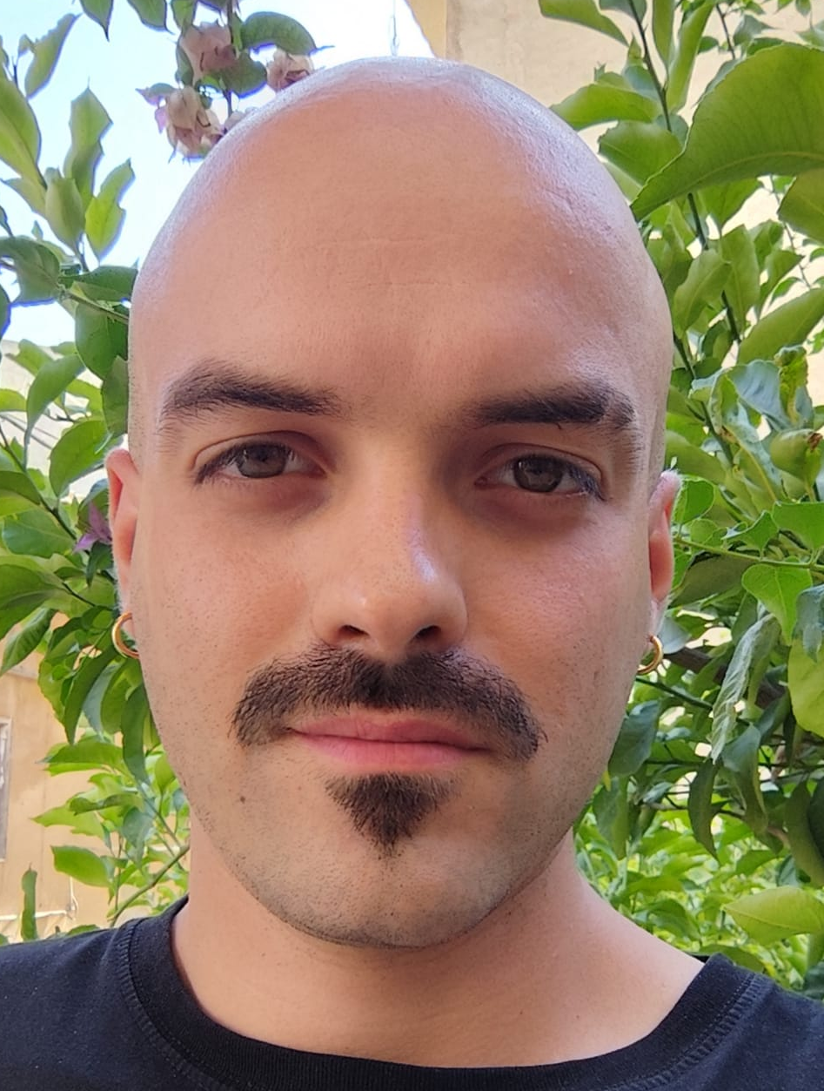

Slide 13



