Slide 1
Tests of Fundamental Physics via π⁰, η, η′
Liping Gan
University of North Carolina Wilmington
Outline
Introduction of Physics
PrimEx Primakoff Program
JLab Eta Factory (JEF)
Summary
Thanks for support by American NSF: PHY-1812396, PHY-2111181, and PHY2412800.

Slide 2
Open Questions in Modern Physics
What is the origin of QCD confinement?
How did the visible mass emerge in the early universe?
What is the cause of the matter-antimatter asymmetry in the universe?
What is the nature of dark matter?
Light pseudoscalar mesons offer a sensitive tool to explore these fundamental questions.

Slide 3
Low-Energy QCD Symmetries and Light Mesons
QCD Lagrangian in Chiral limit (m_{q}→0) is invariant under:
Chiral symmetry SU_{L}(3)xSU_{R}(3) spontaneously breaks to SU(3)
  8 Goldstone Bosons (GB)
U_{A}(1) is explicitly broken:
(Chiral anomalies)
  Non-zero mass of η₀
  Γ(π⁰→γγ), Γ(η→γγ), Γ(η′→γγ)
SU_{L}(3)xSU_{R}(3) and SU(3) are explicitly broken:
  GB are massive
  Mixing of π⁰, η, η′
  The π⁰, η, η′ system provides a rich laboratory to study the symmetry structure of confinement QCD.

Slide 4
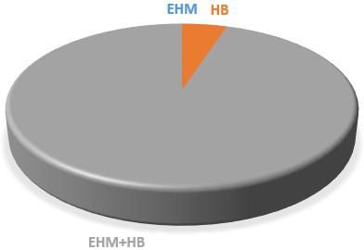
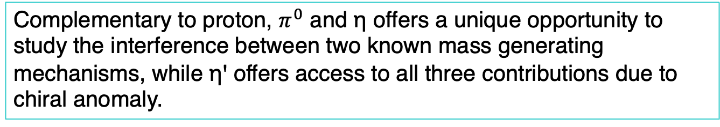

What is the origin of visible mass?
Mass-generating mechanisms:
Higgs Boson (HB), alone is responsible for <2% of the visible mass in the universe.
Emergent Hadron Mass (EHM) and its constructive interference with Higgs-Boson (EHM+HB) account for >98% of the visible mass.
Proton mass budget
$π^{0}$ mass budget
ηꞌ mass budget
https://doi.org/10.1007/s00601-024-01924-2
Complementary to proton, $π^{0}$ and η offers a unique opportunity to study the interference between two known mass generating mechanisms, while ηꞌ offers access to all three contributions due to chiral anomaly.

Slide 5
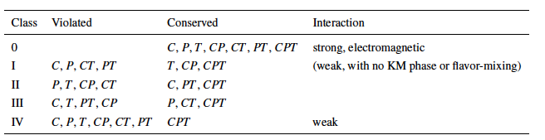
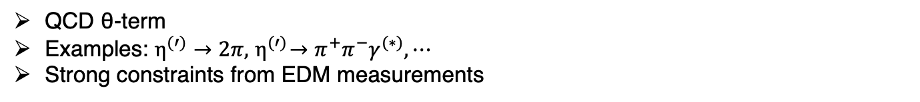
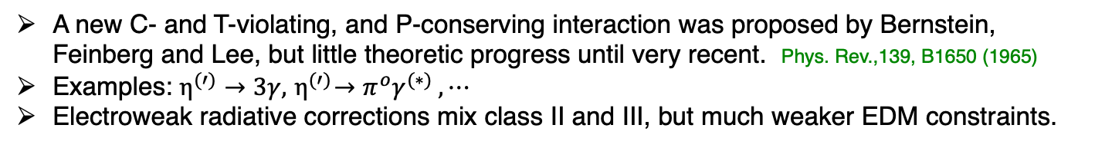
Discrete Symmetries
Class II: P-, CP-violation
QCD θ-term
Examples: $η^{(′)}→2π, { η}^{(′)}→{π^{+}π^{−}γ}^{(∗)}, ⋯$
Strong constraints from EDM measurements
Class III: C-, CP-violation
A new C- and T-violating, and P-conserving interaction was proposed by Bernstein, Feinberg and Lee, but little theoretic progress until very recent. Phys. Rev.,139, B1650 (1965)
Examples: $η^{(′)}→3γ, { η}^{(′)}→{π^{o}γ}^{(∗)} , ⋯$Lee
Electroweak radiative corrections mix class II and III, but much weaker EDM constraints.
Class III has much weaker experimental constraint, offer an opportunity for new physics search in η decays.

Slide 6
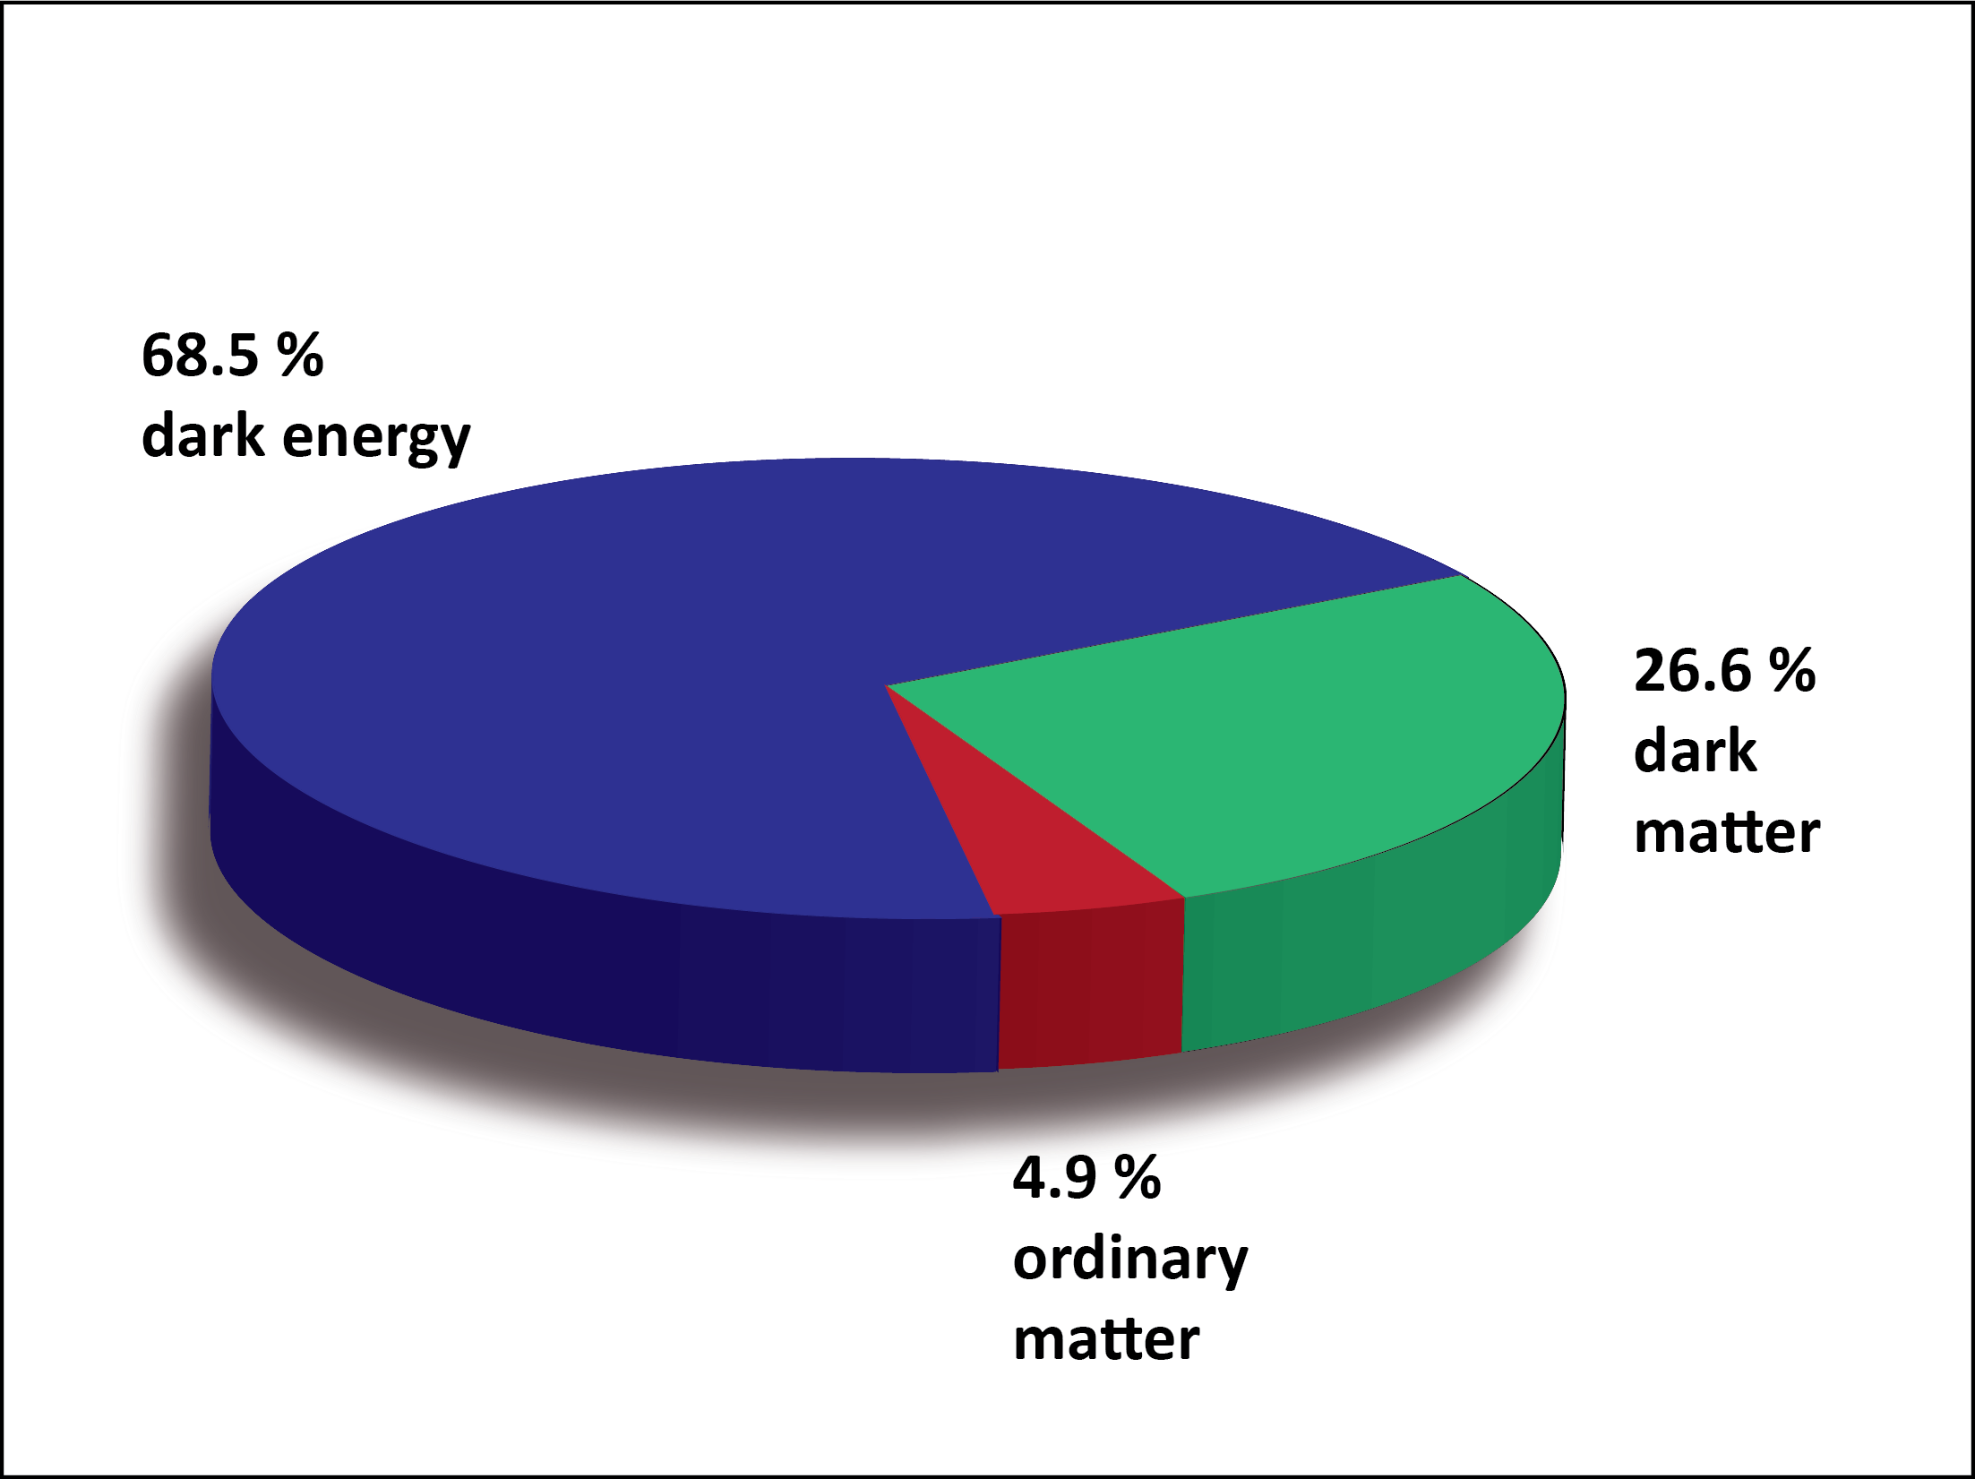
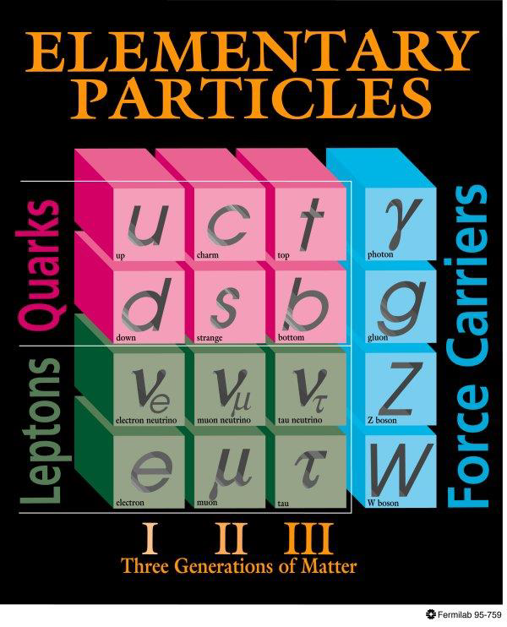
BSM Physics in Dark Sector
Dark Sector
New gauge forces, bosons and fermions beyond SM.
The stability of dark matter can be explained by the dark charge conservation.

Slide 7
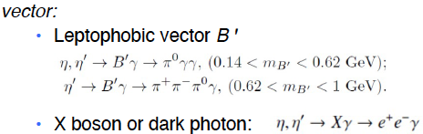


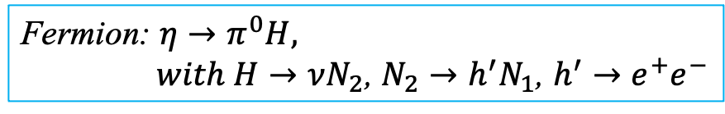
Portals Coupling SM and Dark Sector
Standard Model:
Dark Sector:
Gauge Interactions?
Dark matter?
Portals:
vector
Scalar
Fermion
ALP
Fermion: $η→π^{0}H,$
$with H→νN_{2}$, $N_{2}→h^{′}N_{1}$, $h^{′}→e^{+}e^{−}$
Phys. Rept. 945 (2022) 1-105, arXiv:2207.06905, arXiv:2203.07651

Slide 8
Landscape of BSM Physics Search
JLab
𝜋⁰, η, ηꞌ
Rept. Prog. Phys. 79, no.12, 124201
Complementary to other types of experiments, pseudoscalar mesons offer unique sensitivity for sub-GeV new physics that are flavor-conserving and light quark-coupling.

Slide 9
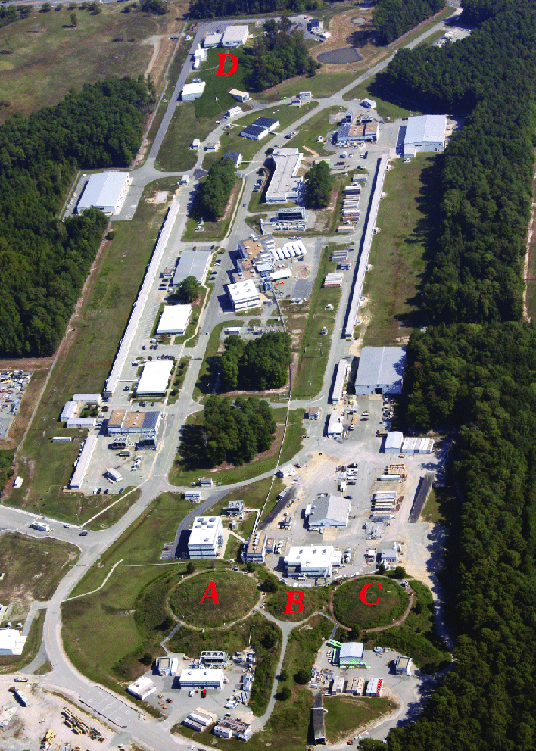
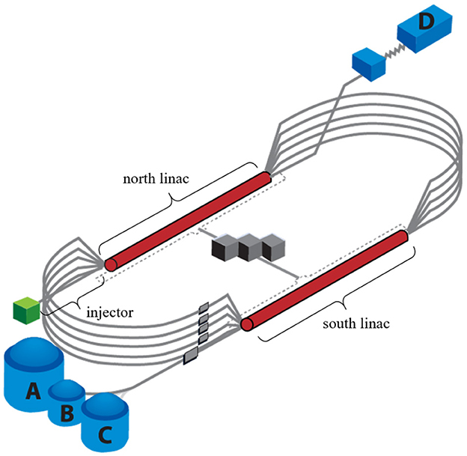
Jefferson Lab

Slide 10
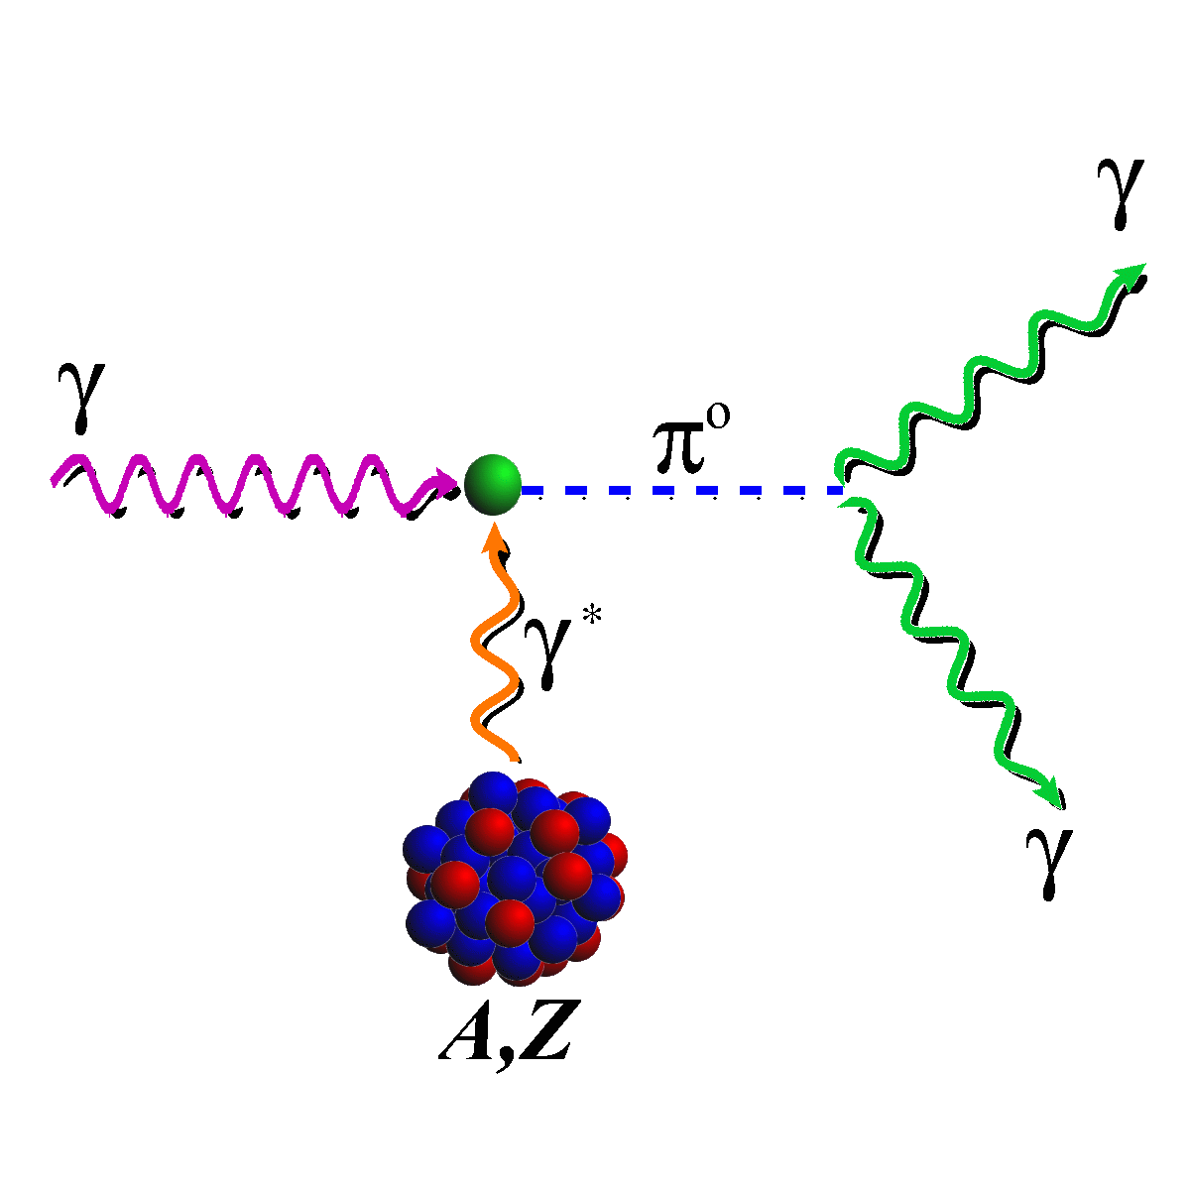
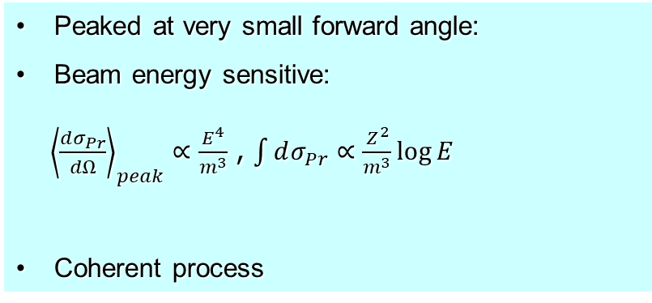
Primakoff Effect
¹²C target
ρ,ω
Primakoff
Nucl. Coherent
Nucl. Incoh.
Interference
Peaked at very small forward angle:
Beam energy sensitive:
${\left\langle \frac{dσ_{Pr}}{dΩ}\right\rangle }_{peak}∝\frac{E^{4}}{m^{3}}$ , $\int{dσ_{Pr}}∝\frac{Z^{2}}{m^{3}}\log{E}$
Coherent process
The higher beam energy is, the higher Primakoff cross section and the better separation of Primakoff from the nuclear backgrounds.
A higher beam energy is more important for more massive particle

Slide 11
PrimEx Primakoff Program at JLab 6 & 12 GeV
Precision measurements of electromagnetic properties of π⁰, η, η′ via Primakoff effect
Two-Photon Decay Widths:
  Γ(π⁰→γγ) @ 6 GeV
  Γ(η→γγ)
  Γ(η′→γγ)
Transition Form Factors
at Q² of 0.001-0.3 GeV²/c²:
F(γγ*→ π⁰), F(γγ* →η), F(γγ* →η′)
Input to Physics:
precision tests of chiral
symmetry and anomalies
light quark mass ratio
η-η′ mixing angle
input to calculate HLbL in (g-2)_{μ}
origin of the visible mass
Input to Physics:
π⁰,η and η′ electromagnetic
interaction radii
is the η′ an approximate
Goldstone boson?
input to calculate HLbL in (g-2)_{μ}
origin of the visible mass

Slide 12
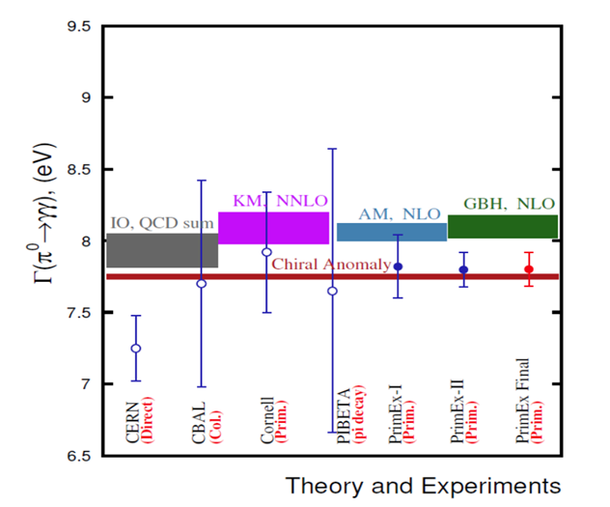
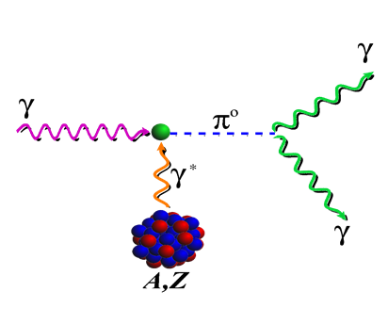
Status of Primakoff Program at JLab 6 & 12 GeV
Precision measurements of electromagnetic properties of π⁰, η, η′ via Primakoff effect
The chiral anomaly prediction is exact for massless quarks:
Γ(π⁰→γγ) is one of the few quantities in confinement region that QCD can calculate precisely at ~1% level to higher orders!
Two-Photon Decay Widths:
  Γ(π⁰→γγ) @ 6 GeV (in Hall B)
  Γ(η→γγ)
  Γ(η′→γγ)
Transition Form Factors
at Q² of 0.001-0.5 GeV²/c²:
F(γγ*→ π⁰), F(γγ* →η), F(γγ* →η′)
Science 368, 506-509 (2020)
Input to Physics:
precision tests of chiral
symmetry and anomalies
determination of light quark
mass ratio
η-η′ mixing angle
input to calculate HLbL in (g-2)_{μ}
Input to Physics:
π⁰,η and η′ electromagnetic
interaction radii
is the η′ an approximate
Goldstone boson?
input to calculate HLbL in (g-2)_{μ}
1.50% accuracy

Slide 13


Status of Primakoff Program at JLab 6 & 12 GeV (cont.)
Precision measurements of electromagnetic properties of π⁰, η, η′ via Primakoff effect
$$ηr^{2}$$
Two-Photon Decay Widths:
  Γ(π⁰→γγ) @ 6 GeV
  Γ(η→γγ)
  Γ(η′→γγ)
$$A\frac{dσ_{Pr}}{dΩ}=Γ_{γγ}\frac{8αZ^{2}}{m_{η}^{3}}\frac{β^{3}E^{4}}{Q^{4}}{\left|F_{e.m.}(Q^{2})\right|}^{2}\sin^{2}{θ_{η}}$$
Transition Form Factors
at Q² of 0.001-0.5 GeV²/c²:
F(γγ*→ π⁰), F(γγ* →η), F(γγ* →η′)
On-Going PrimEx-eta experiment (in Hall D)
A full data set was completed via three run periods in 2019, 2021 and 2022.
Data analysis is in progress.
Input to Physics:
precision tests of chiral
symmetry and anomalies
determination of light quark
mass ratio
η-η′ mixing angle
input to calculate HLbL in (g-2)_{μ}
Input to Physics:
π⁰,η and η′ electromagnetic
interaction radii
is the η′ an approximate
Goldstone boson?
input to calculate HLbL in (g-2)_{μ}

Slide 14
Physics for Γ(η→γγ) Measurement
Resolve long standing discrepancy between previous collider and Primakoff measurements:
Extract η-η′mixing angle
Improve calculation of the η-pole contribution to Hadronic Light-by-Light (HLbL) scattering in (g-2)_{μ}
Improve all partial decay widths in the η-sector

Slide 15
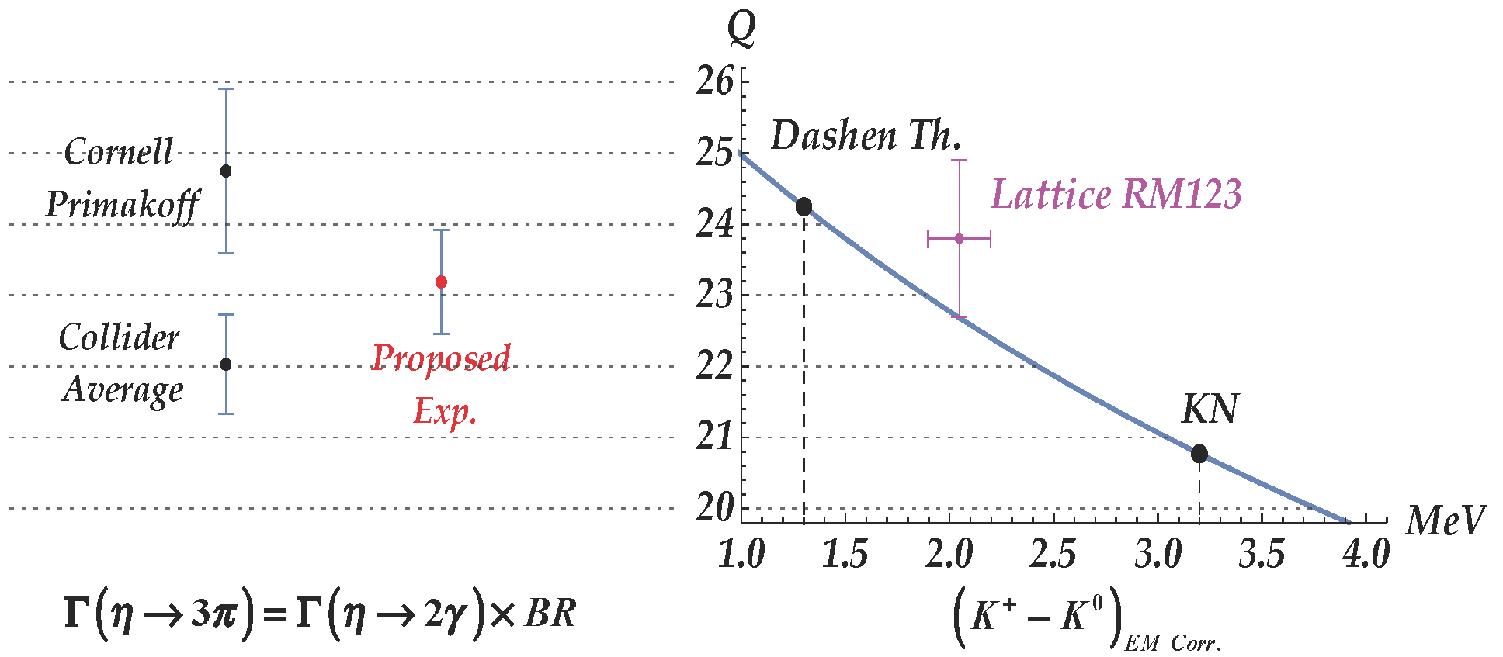
Precision Determination Light Quark Mass Ratio
  A clean probe for quark mass ratio:
    𝜂→3π decays through isospin violation:
    is small
    Amplitude:
Phys. Rept. 945 (2022) 1-105

Slide 16
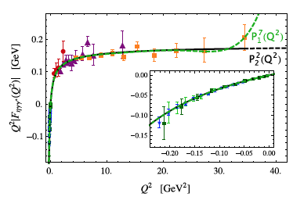
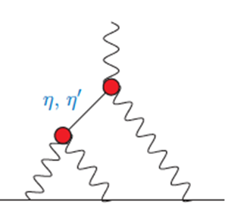
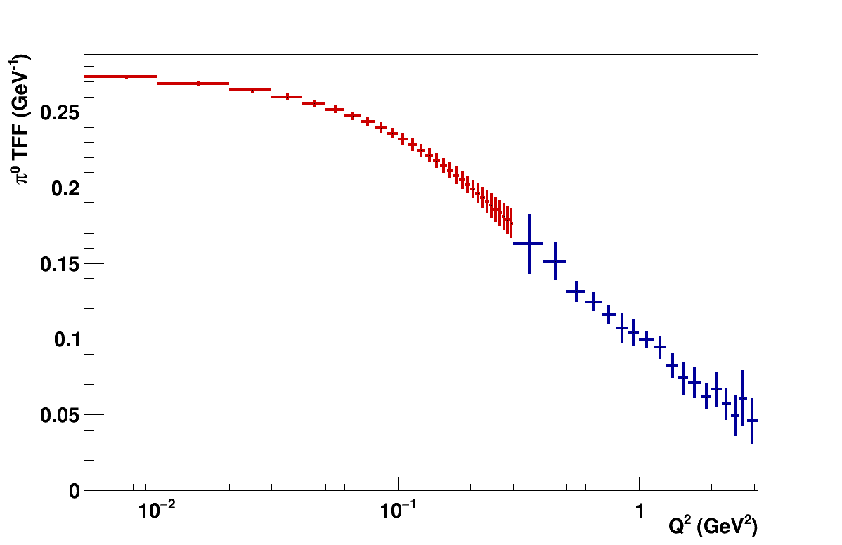
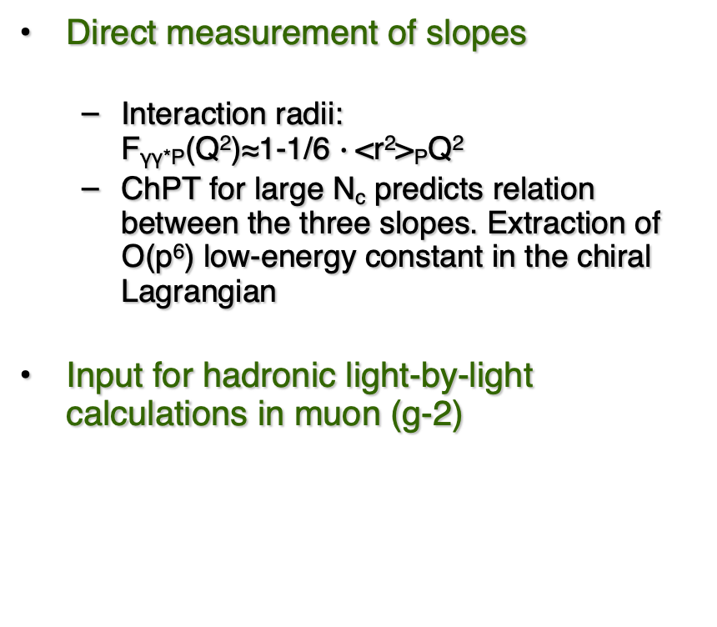
Space-Like Transition Form Factors
(Q² : 0.001-0.3 GeV²/c²)
Direct measurement of slopes
  Interaction radii:
  F_{γγ*P}(Q²)≈1-1/6 $∙$<r²>_{P}Q²
  ChPT for large N_{c} predicts relation between the three slopes. Extraction of Ο(p⁶) low-energy constant in the chiral Lagrangian
Input for hadronic light-by-light calculations in muon (g-2)
No data
$$π^{0}, η,η′$$
Projected E12-22-003 (in Hall B)
on F(γγ*→ π⁰)
Phys.Rev.D65,073034

Slide 17
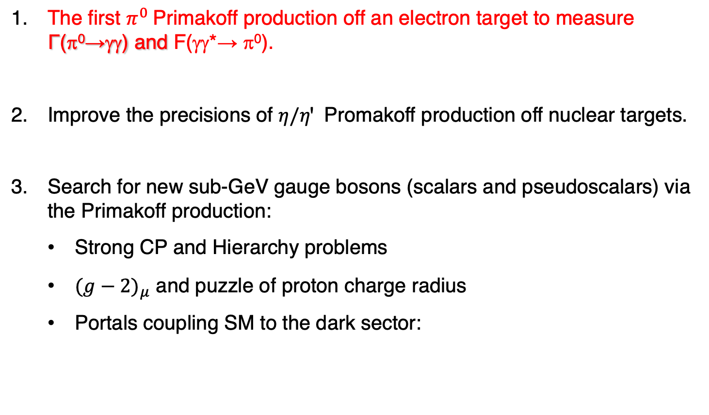
New opportunities with JLab 22 GeV Upgrade
The first $π^{0}$Primakoff production off an electron target to measure Γ(π⁰→γγ) and F(γγ*→ π⁰).
Improve the precisions of $η/ηꞌ$ Promakoff production off nuclear targets.
Search for new sub-GeV gauge bosons (scalars and pseudoscalars) via the Primakoff production:
  Strong CP and Hierarchy problems
  ${(g−2)}_{μ}$ and puzzle of proton charge radius
  Portals coupling SM to the dark sector:

Slide 18
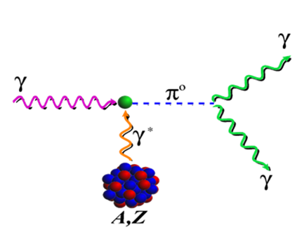
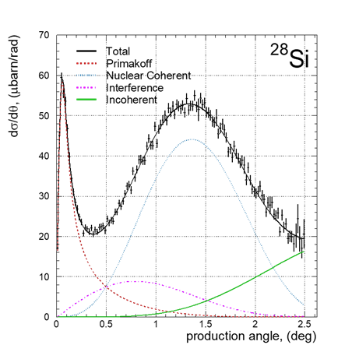
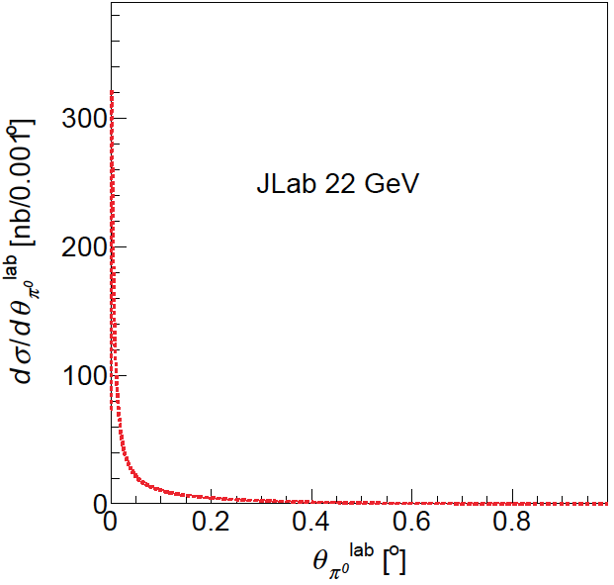

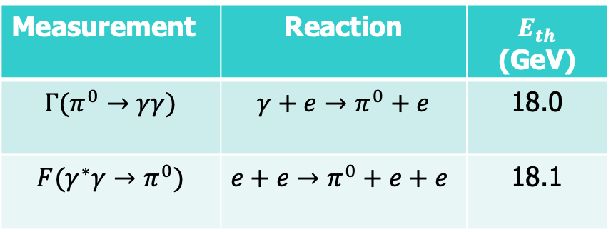



Advantages of the $π^{0}$ Primakoff Production off an Electron
Advantages of an electron target:
Eliminate all nuclear backgrounds
A point-like electron target to eliminate nuclear effects
Recoiled electron detection
PrimEx-II: ${γ+{}_{}^{28}{Si→}π}^{0}+{}_{}^{28}{Si}$
$AE_{γ}:$ 4.45-5.30 GeV
$$\frac{dσ_{Pr}}{dΩ}=Γ_{γγ}\frac{8α}{m_{π}^{3}}\frac{β^{3}E^{4}}{Q^{4}}\sin^{2}{θ_{π}}$$
$$γ+e→π^{0}+e$$
Science 368, 506-509
Measurement | Reaction | $E_{th}$ (GeV)
$$Γ(π^{0}→γγ)$$ | $${γ+e→π}^{0}+e$$ | 18.0
$$F(γ^{∗}γ→π^{0})$$ | $${e+e→π}^{0}+e+e$$ | 18.1
Main challenges for the nuclear target:
Nuclear backgrounds
Nuclear effects
No recoil detection

Slide 19
Projected $Γ\left(π^{0}→γγ\right)$ at JLab 22 GeV with an Electron Target

Slide 20
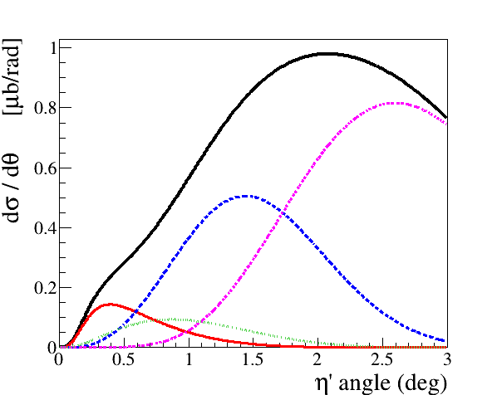
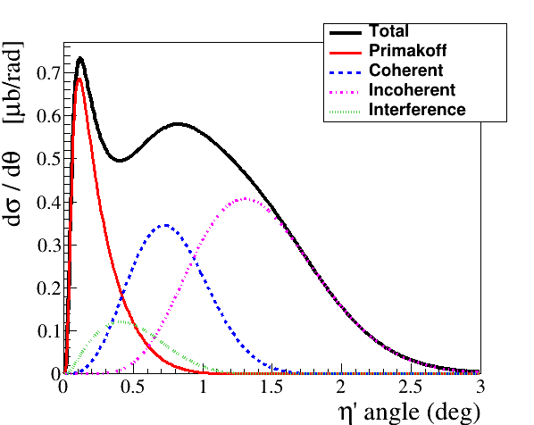

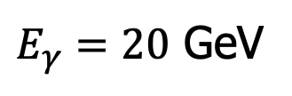
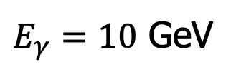
Improve Primakoff Measurements of$η/ηꞌ$ with nuclear targets
$E_{γ}=10$ GeV
$E_{γ}=20$ GeV
$$γ+{}_{}^{4}{He}→η′+{{}_{}^{4}{He}r}^{2}$$

Slide 21
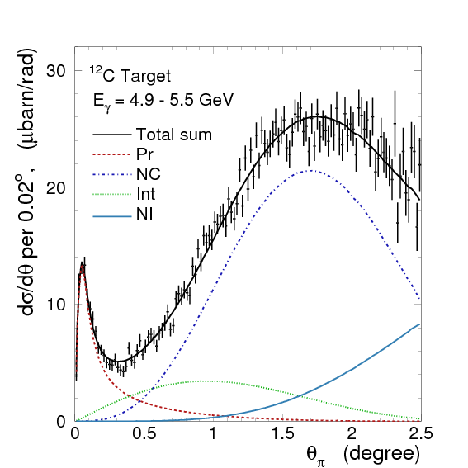
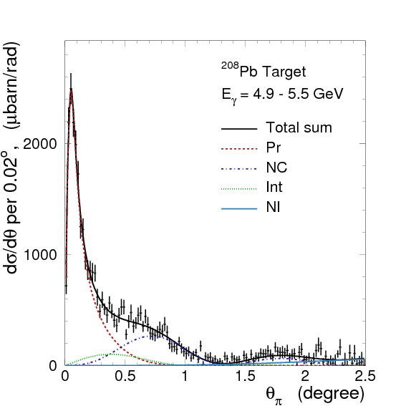

Search for sub-GeV Scalar and Pseudoscalar via Primakoff Effect
Favorable experimental condition:
A high energy beam
A high Z nuclear target
$$\frac{dσ_{Pr}}{dΩ}\sim \frac{c_{γ}^{2}αZ^{2}}{8πΛ^{2}}∙\frac{β^{3}E^{4}}{Q^{4}}∙{\left|F_{e.m.}(Q)\right|}^{2}\sin^{2}θ_{a}$$
The Primakoff signal dominates in the forward angles
¹²C
²⁰⁸Pb
PrimEx I
Minimizing the QCD backgrounds
Phys.Rev.Lett. 106 (2011) 162303

Slide 22


Projected Reach for a ALP at JLab 22 GeV
$$γ+Pb→a+Pb$$
$$a→γγ$$

Slide 23
JLab Eta Factory (JEF) Experiment at GlueX
FCAL-II
Simultaneously produce η/ηꞌ on LH₂ target with 8.4-11.7 GeV tagged photon beam via γ+p → η/ηꞌ+p
Reduce non-coplanar backgrounds by detecting recoil protons with GlueX detector
Upgraded Forward Calorimeter with High resolution, high granularity
PbWO₄ insertion (FCAL-II) to detect multi-photons from the η/ηꞌ decays
The GlueX detector will detect the charged products from the η/ηꞌ decays
23

Slide 24
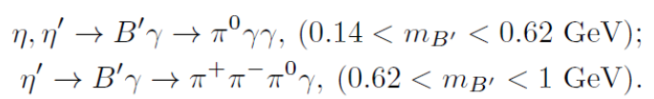

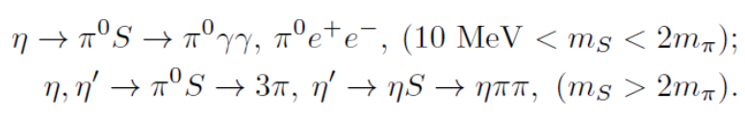






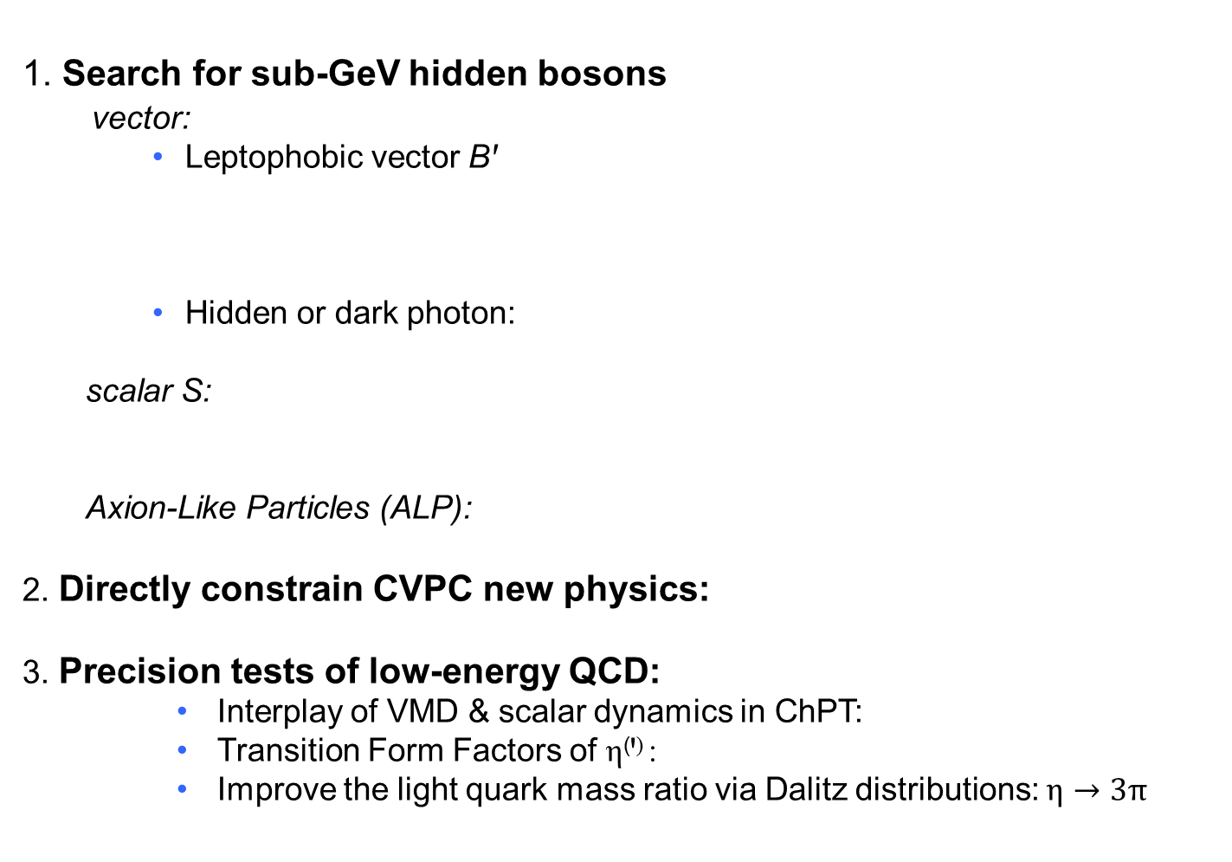
Main JEF Physics Objectives
1. Search for sub-GeV hidden bosons
vector:
    Leptophobic vector Bꞌ
    Hidden or dark photon:
scalar S:
Axion-Like Particles (ALP):
2. Directly constrain CVPC new physics:
3. Precision tests of low-energy QCD:
  Interplay of VMD & scalar dynamics in ChPT:
  Transition Form Factors of η⁽ꞌ⁾ :
  Improve the light quark mass ratio via Dalitz distributions: $η→3π$
$$η^{(′)}→3γ,{ η}^{(′)}→2π^{0}γ,{ η}^{(′)}→π^{+}π^{−}π^{0}$$
$$Aη^{(′)}→π^{0}e^{+}e^{−}$$

Slide 25
Example of a Key Channel: η→π⁰γγ
New physics:
Search for sub-GeV gauge bosons
  A leptophobic vector B’:
  η→γB’, B’ →π⁰γ
  An electrophobic scalar Φ’:
  η→π⁰Φ’, Φ’→γγ
  PRL 117,101801 (2016); PL B740,61(2015)
Dark Sector:
Gauge Interactions?
Dark matter?
PR,D89,114008
Standard Model:
Portal:
vector
Scalar
fermion
Confinement QCD:
A rare window to probe interplay of VMD & scalar resonance in ChPT

Slide 26
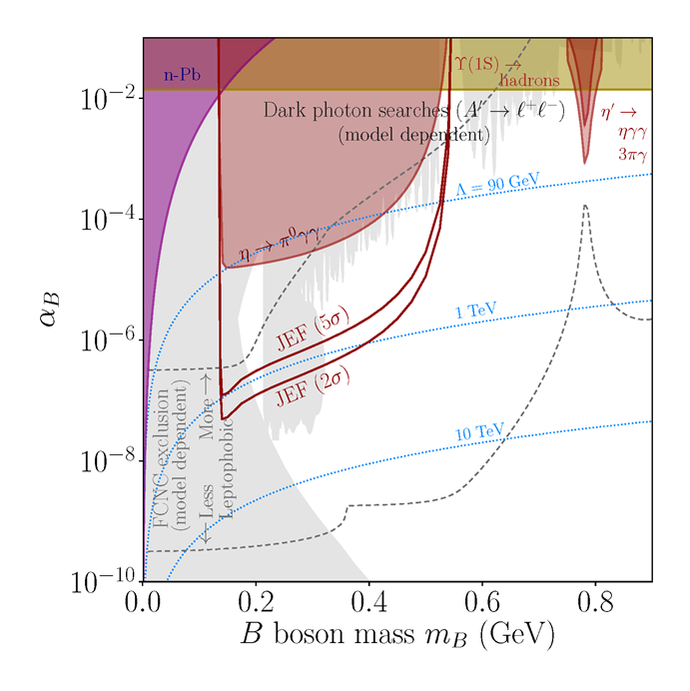
JEF Experimental Reach for B’
A search for a leptophobic dark B’ boson coupled to baryon number is complementary to ongoing searches for a dark photon
η→ B’γ →π⁰γγ
B’
γ
PL, B221, 80 (1989)
PR,D89,114008

Slide 27
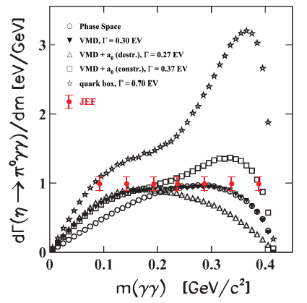
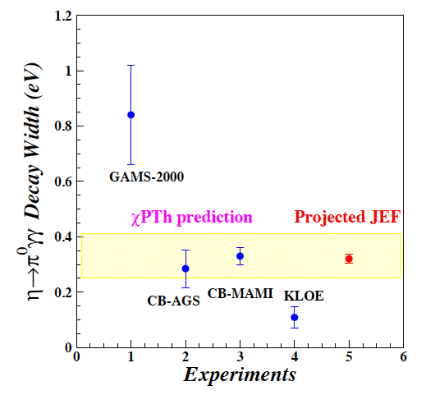
Projected JEF on SM Allowed η→π⁰γγ
J.N. Ng and D.J. Peters, Phys. Rev. D47, 4939
χPTh by Oset et al., Phys. Rev. D77, 073001
We measure both BR and Dalitz distribution
model-independent determination of two LEC’s of the O(p⁶) counter- terms
probe the role of scalar resonances to calculate other unknown O(p⁶) LEC’s
J. Bijnens, talk at AFCI workshop

Slide 28
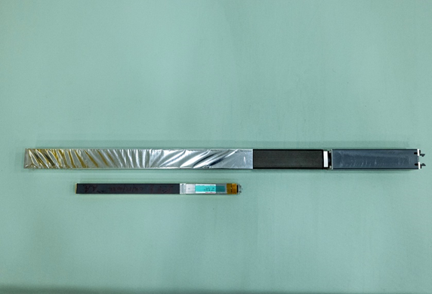
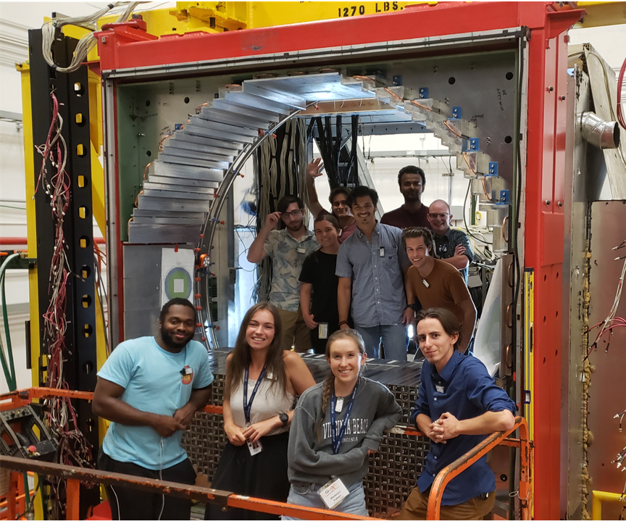
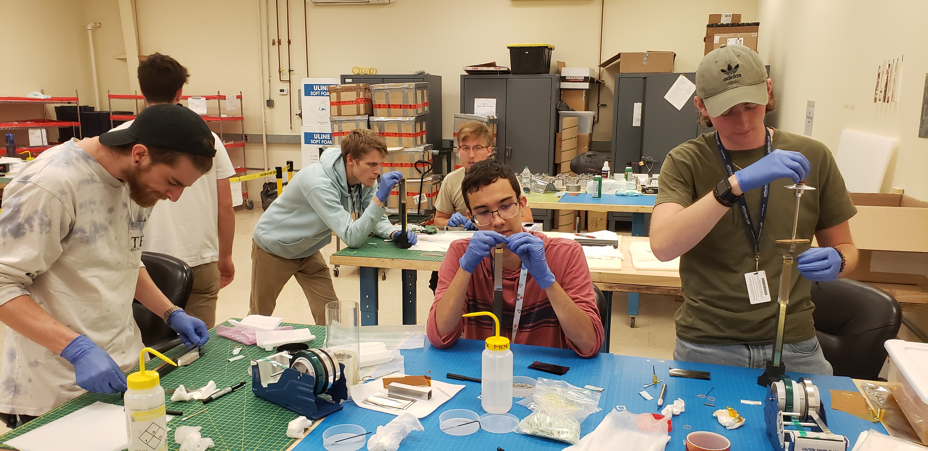
Status of the JEF Experiment
Developed an upgraded FCAL-II with a PbWO₄ insert.:
  1596 PbWO₄ modules are developed to replace ~400 Pb-glass modules.
  Installation of the upgraded FCAL-II is completed in the end of 2024.
  Over 40 undergraduate students from 11 institutes were trained by involving in this project.
Pb-glass module (4x4x45 cm³)
PbWO₄ module (2x2x20 cm³)
Undergraduate workforce
  Commissioning of FCAL-II was successfully done in April 2025 and data production for physics is currently in progress.

Slide 29
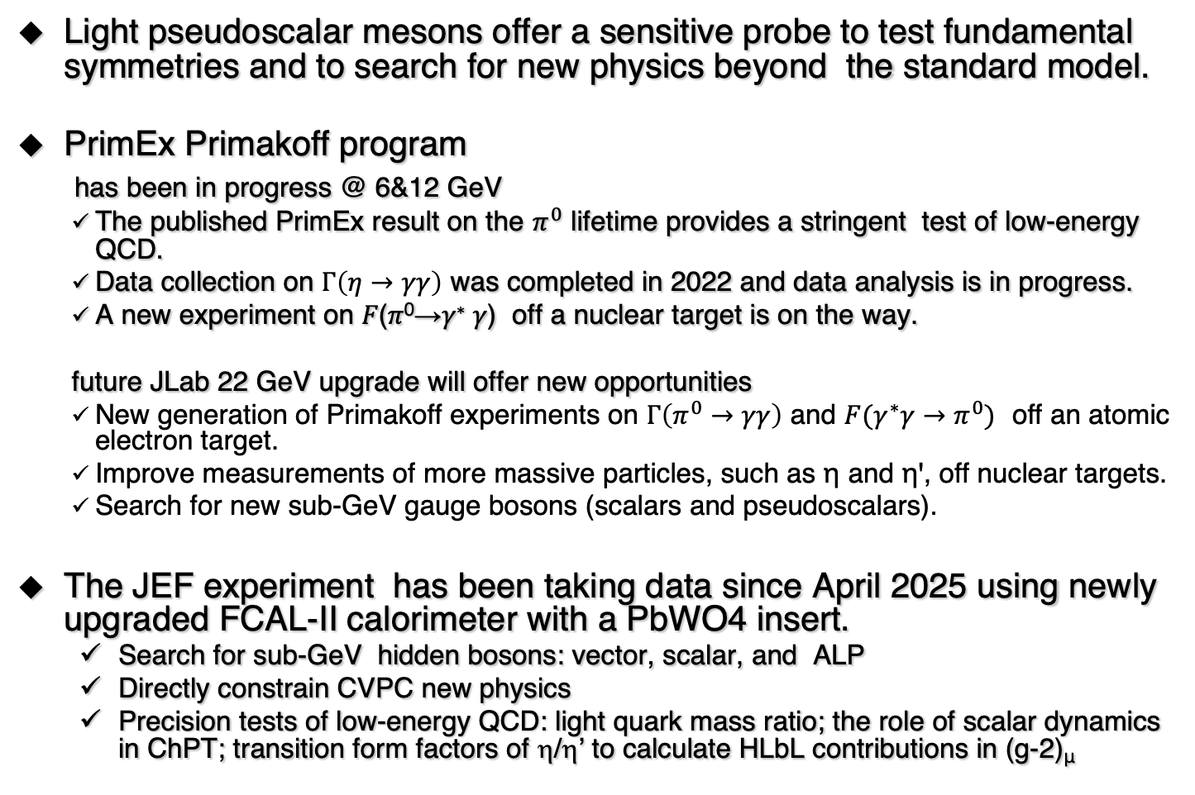
Summary
Light pseudoscalar mesons offer a sensitive probe to test fundamental symmetries and to search for new physics beyond the standard model.
PrimEx Primakoff program
has been in progress @ 6&12 GeV
  The published PrimEx result on the $π^{0}$ lifetime provides a stringent test of low-energy QCD.
  Data collection on $Γ\left(η→γγ\right)$ was completed in 2022 and data analysis is in progress.
  A new experiment on 𝐹(𝜋⁰→𝛾∗ 𝛾) off a nuclear target is on the way.
  future JLab 22 GeV upgrade will offer new opportunities
  New generation of Primakoff experiments on $Γ\left(π^{0}→γγ\right)$ and $F(γ^{∗}γ→π^{0})$ off an atomic electron target.
  Improve measurements of more massive particles, such as η and ηꞌ, off nuclear targets.
  Search for new sub-GeV gauge bosons (scalars and pseudoscalars).
The JEF experiment has been taking data since April 2025 using newly upgraded FCAL-II calorimeter with a PbWO4 insert.
  Search for sub-GeV hidden bosons: vector, scalar, and ALP
  Directly constrain CVPC new physics
  Precision tests of low-energy QCD: light quark mass ratio; the role of scalar dynamics in ChPT; transition form factors of η/η’ to calculate HLbL contributions in (g-2)_{μ}

