Slide 1
New Opportunities at Jefferson Lab
Patrizia Rossi
Lepton Interactions with Nucleons and Nuclei
Marciana Marina - Isola d'Elba (Italy), June 23-27, 2025

Slide 2
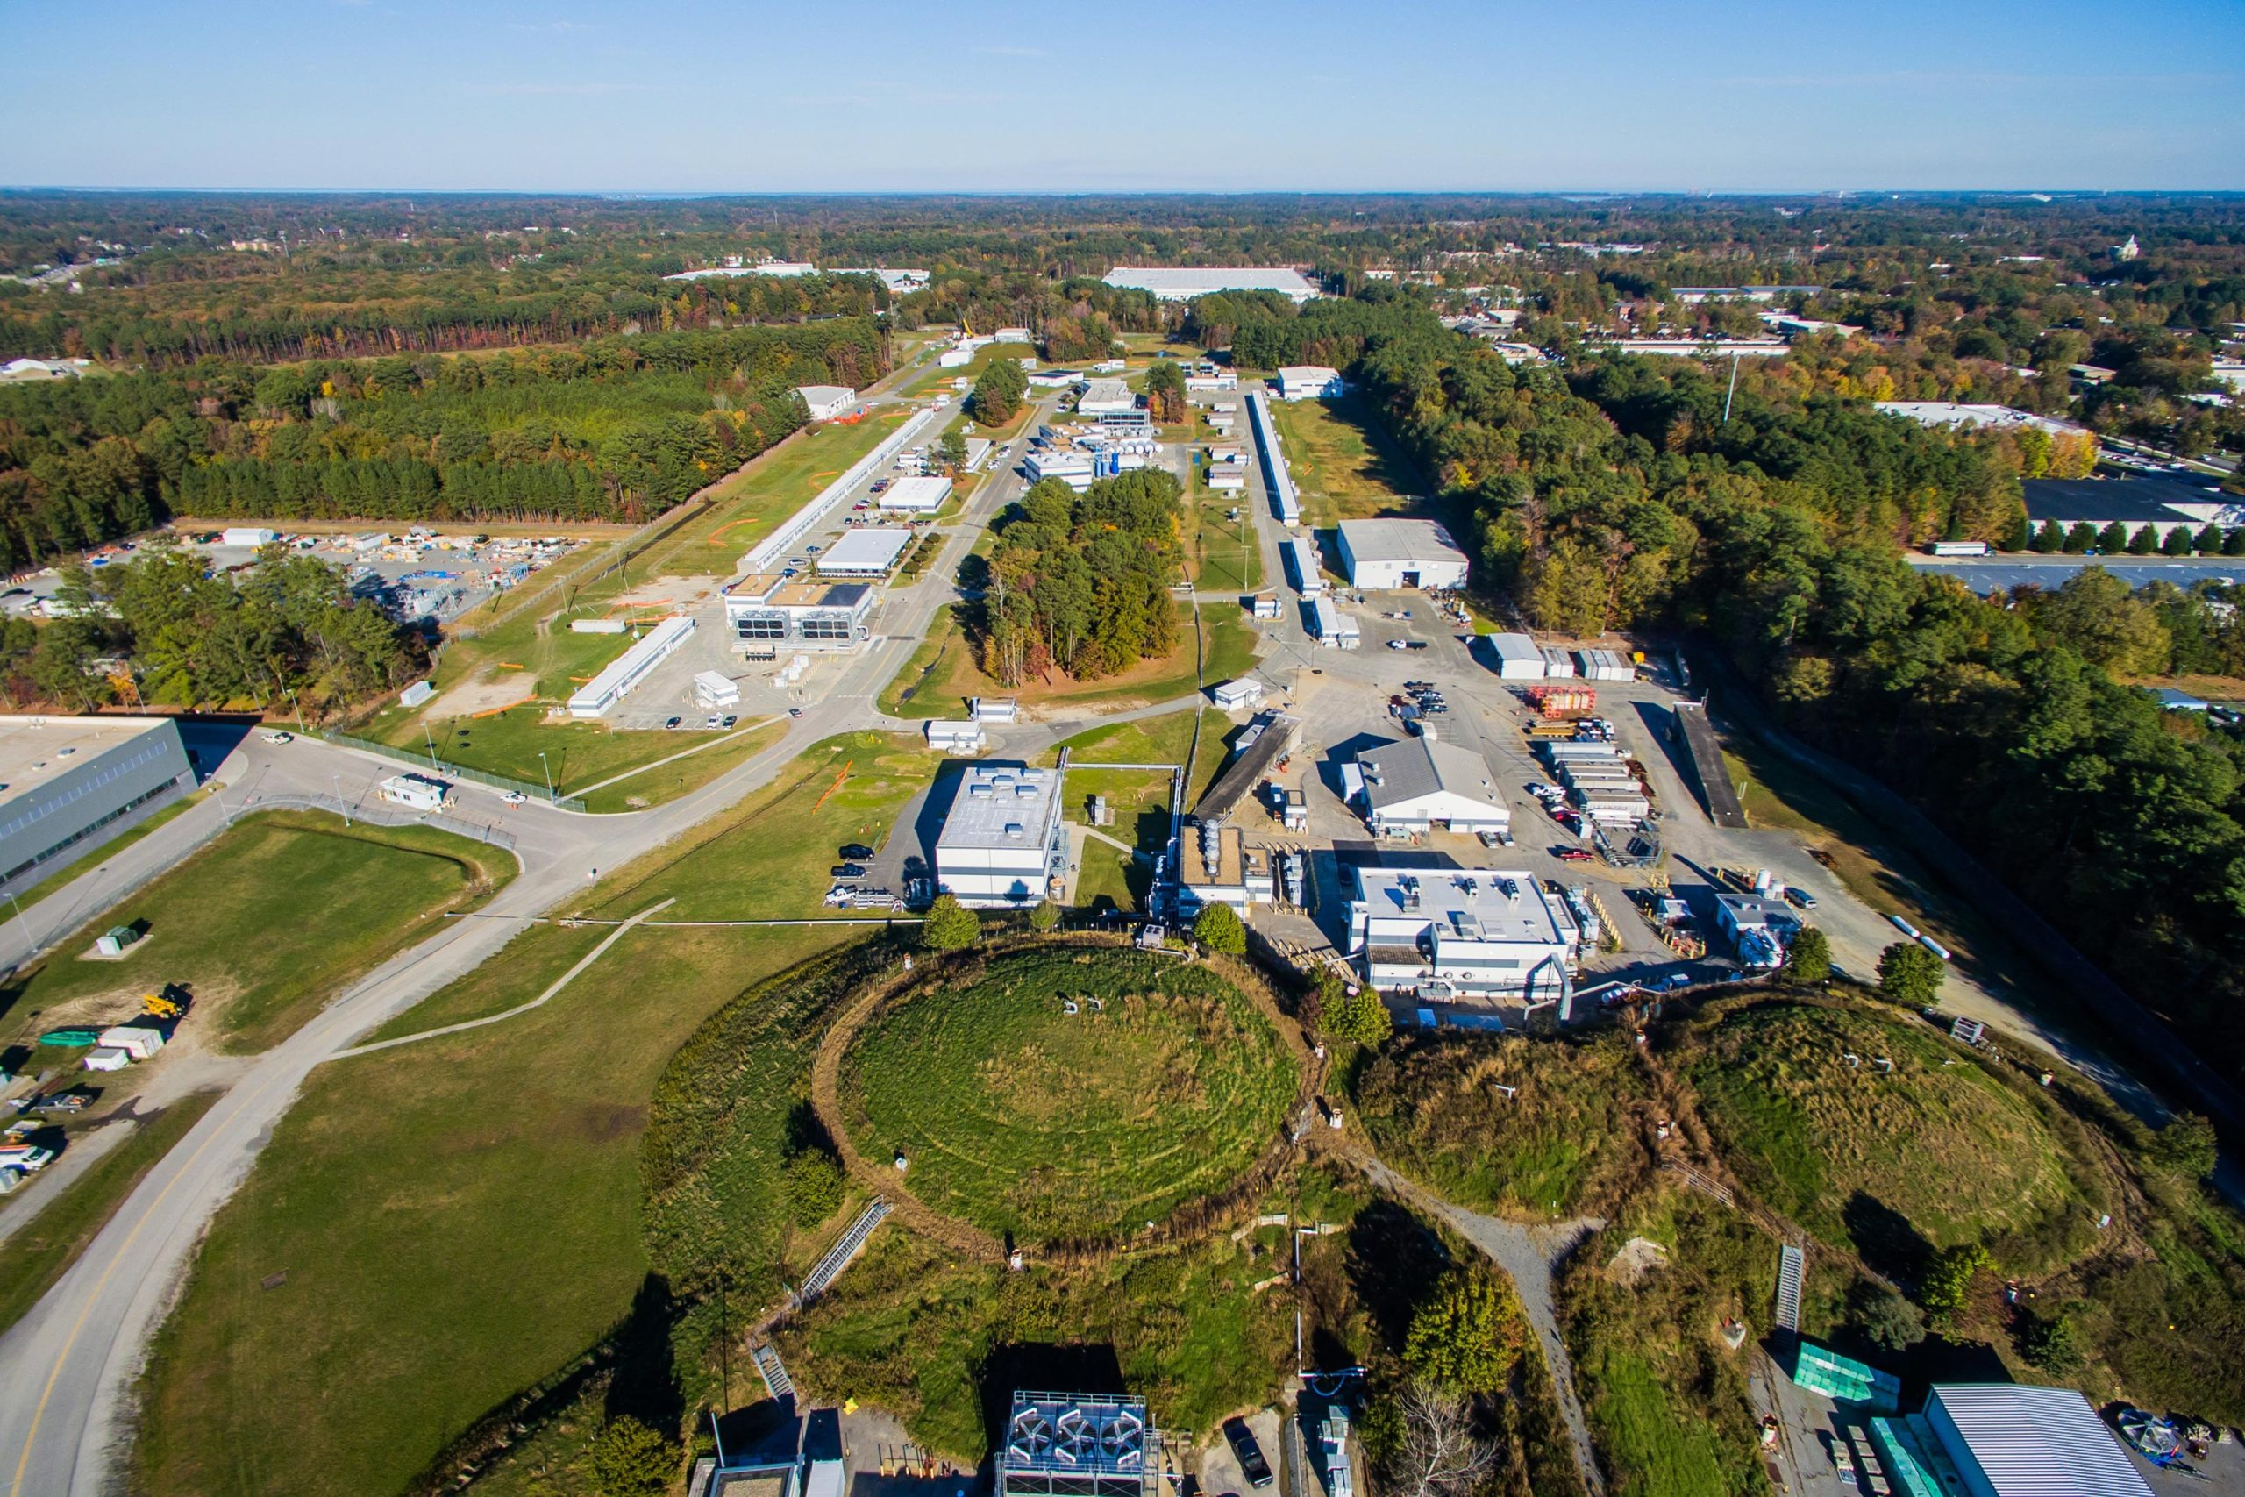
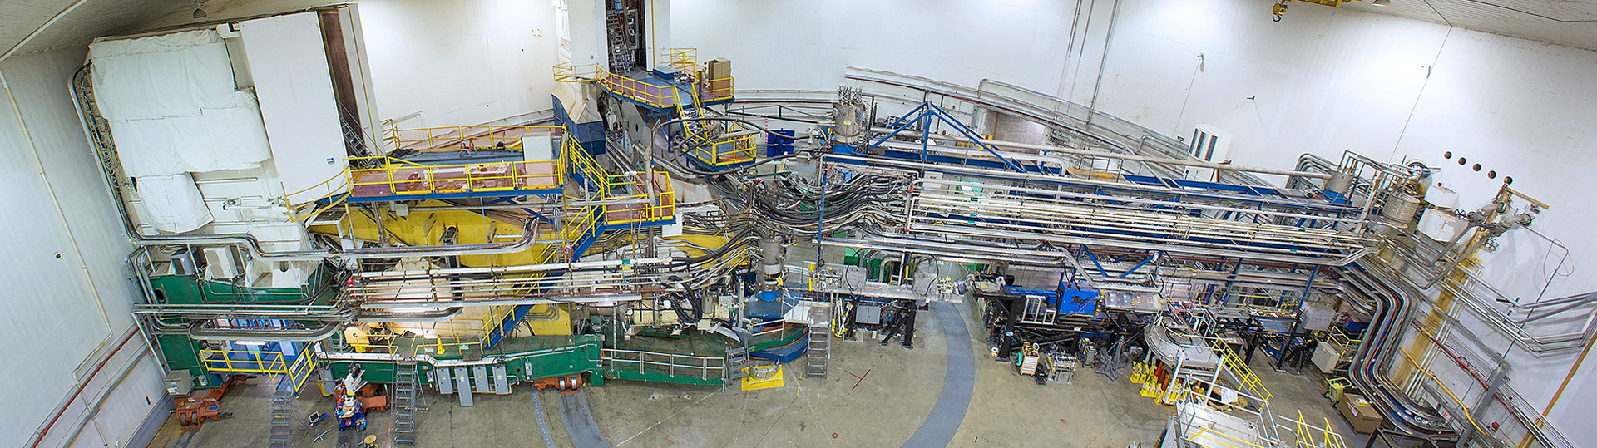
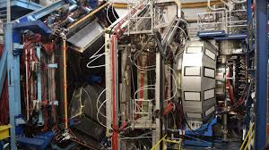
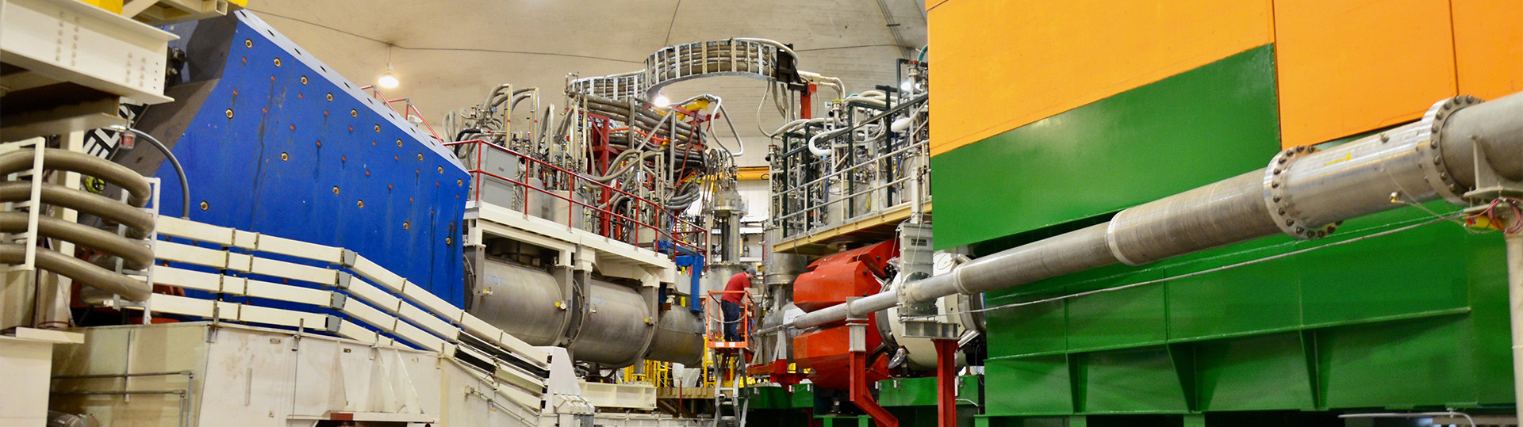
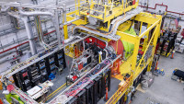
Jefferson Lab - a Cornerstone of Modern Hadron Physics Research
A Facility at the LUMINOSITY Frontier
(up to 10³⁹ cm-² s-¹ )
Explore the fundamental nature of confined states of quarks and gluons → Non-pQCD
Discover evidence for physics BSM
World-Class Electron Beam
CEBAF provides a high-quality, 12 GeV continuous electron beam with:
High Intensity
High Polarization
Unique Experimental Facilities
CEBAF supports 4 cutting-edge experimental halls with:
State-of-the-art detectors
Versatile experimental setups
Detection of multiparticle in the Final State
Hall A
Hall B
Hall C
Hall D

Slide 3
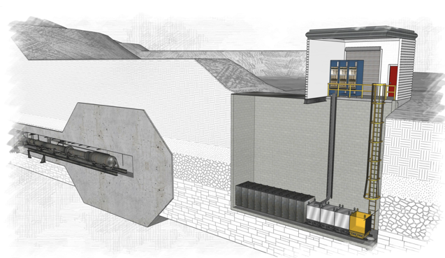
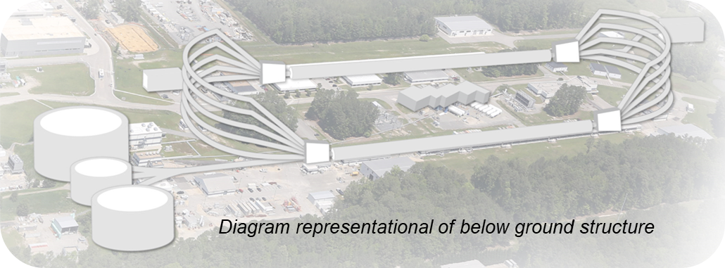
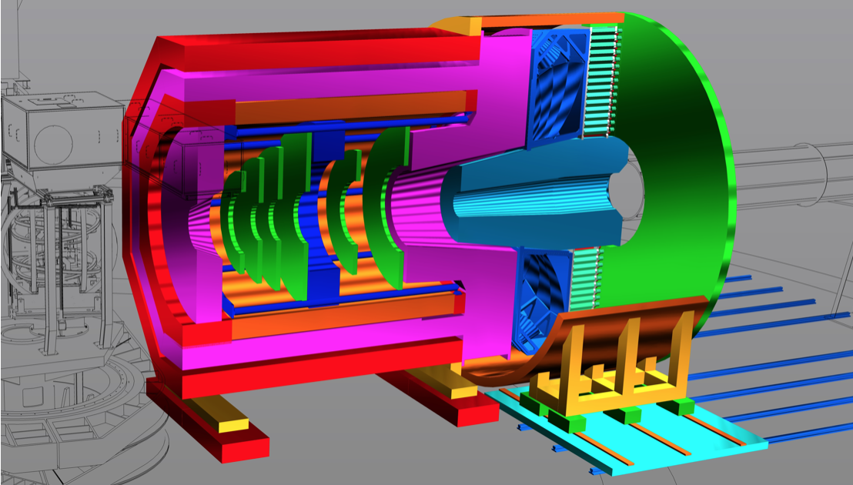
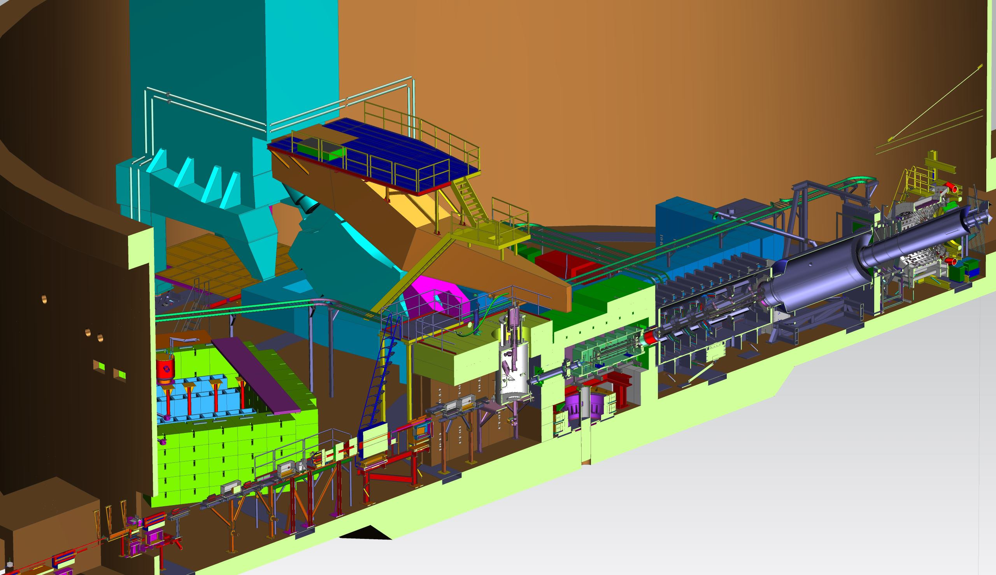
What’s next?
BDX: Beam Dump exp.
Search for light dark matter particles
Precision nucleon 3D imaging
Origin of the proton mass and gluonic force
BSM searches & nucleon structure
SoLID
High luminosity (10³⁷-10³⁹ cm⁻²s⁻¹) + large acceptance
A
B
Ultra-precise measurement of the weak charge of the electron
MOLLER
C

Slide 4
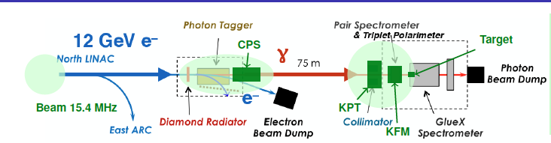
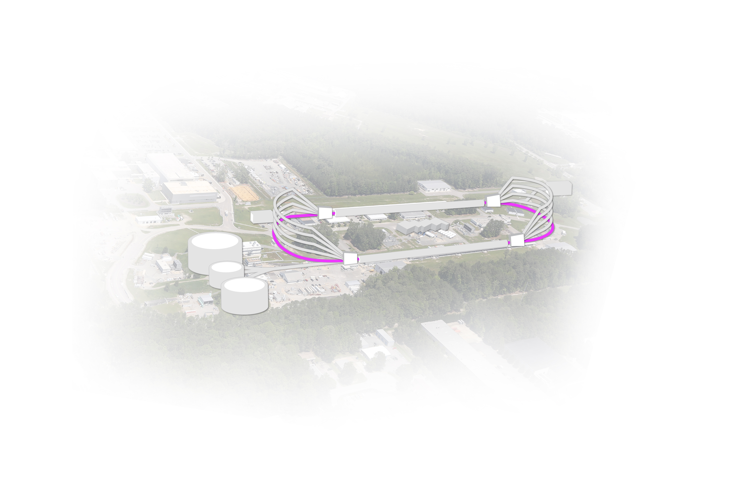

What’s next?
KLF: High Intense Kaon beam
Strangeness Spectroscopy
BDX: Beam Dump exp.
Search for light dark matter particles
Intense secondary μ and ν beams
D
SoLID
High luminosity (10³⁷-10³⁹ cm⁻²s⁻¹) + large acceptance
FFA arcs
Precision nucleon 3D imaging
Origin of the proton mass and gluonic force
BSM searches & nucleon structure
A
B
e+ @ 12 GeV
Ultra-precise measurement of the weak charge of the electron
MOLLER
e- @ 22 GeV
critical for resolving two-photon exchange issue
C
A NEW territory to explore
A BETTER insight into our current program
A BRIDGE between JLab @ 12 GeV and EIC

Slide 5
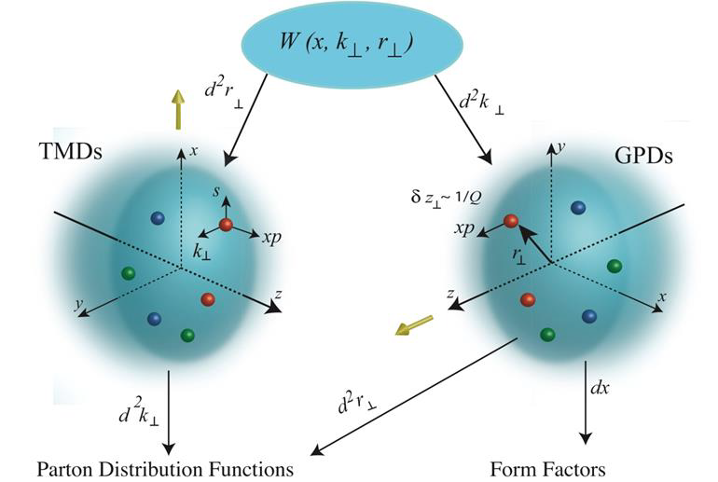
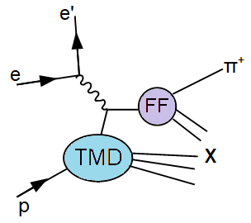
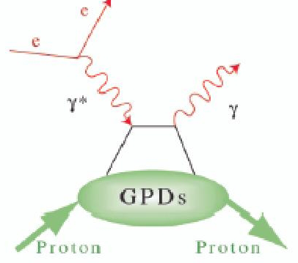
3D Imaging Unified View of Nucleon Structure
Extensive Part of the JLab program

Slide 6
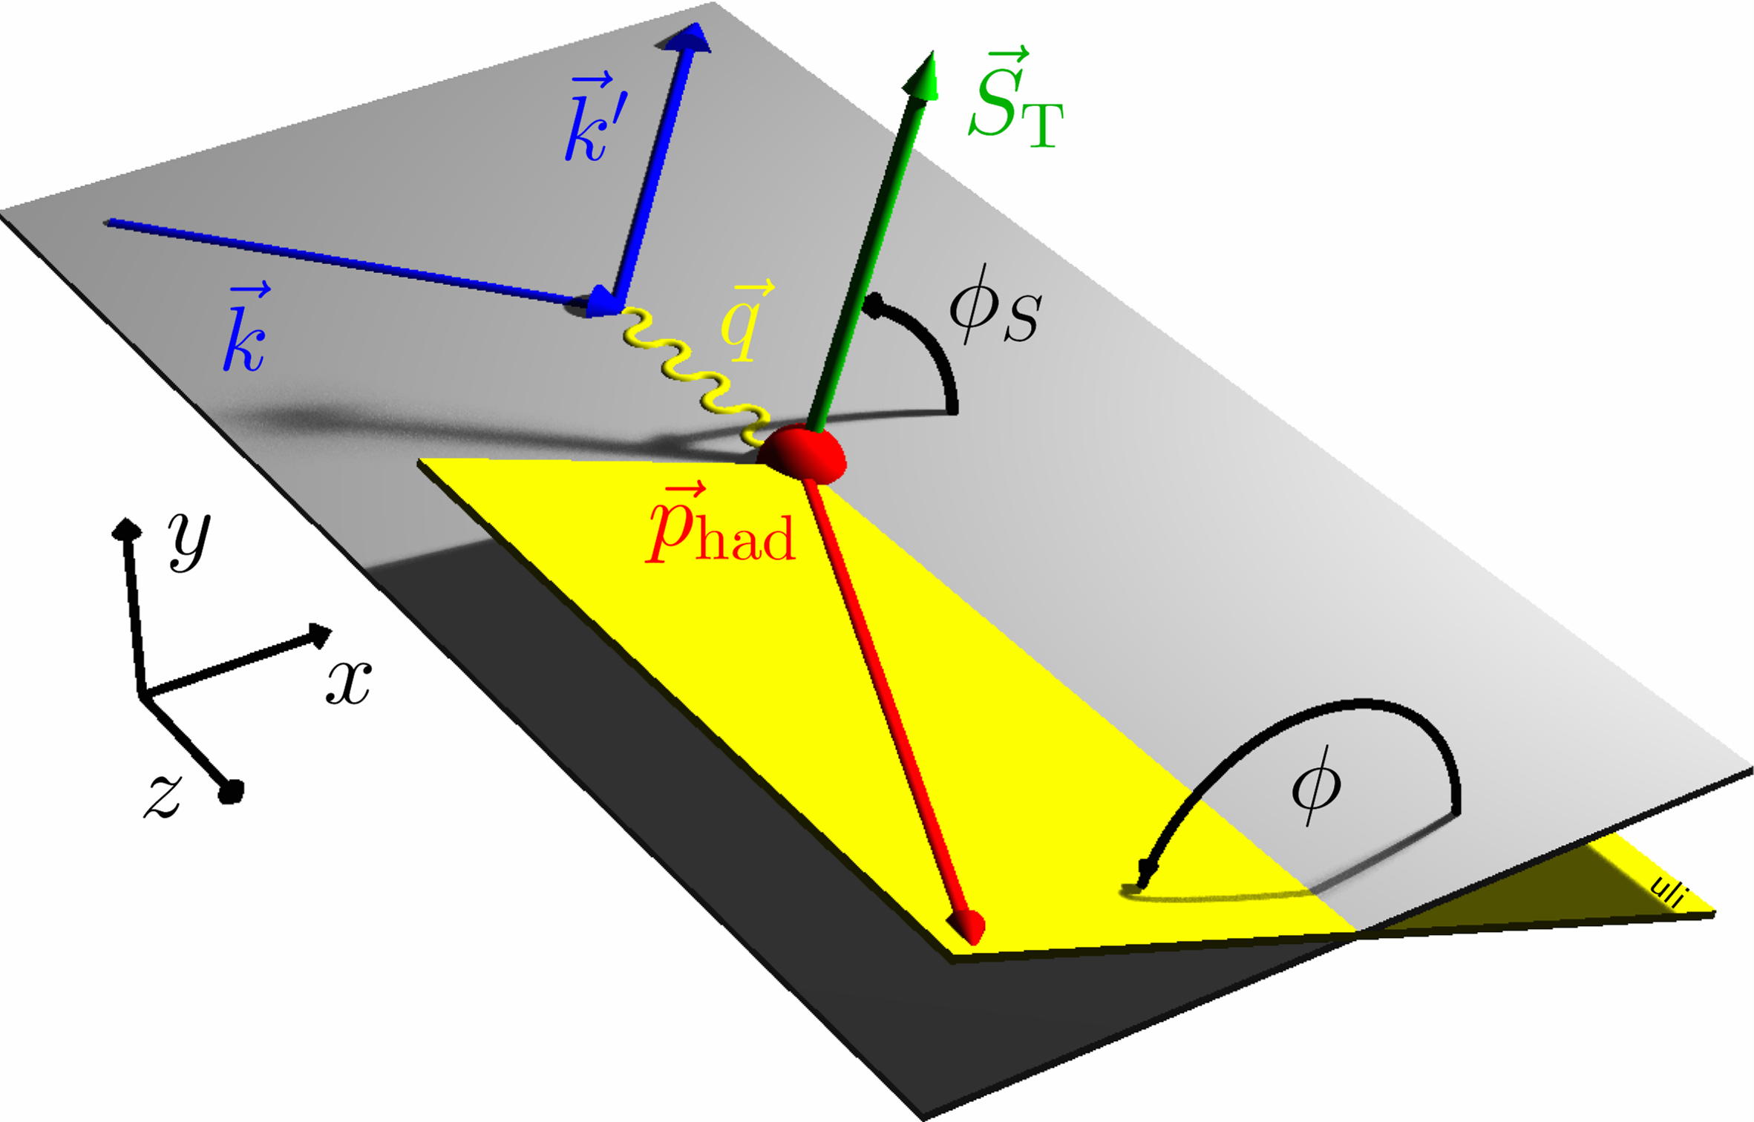
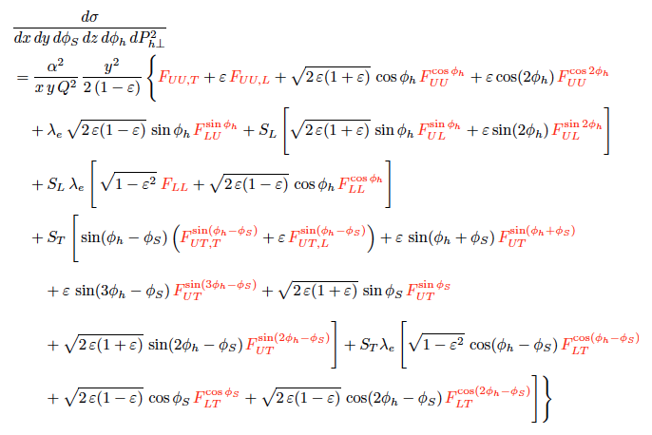
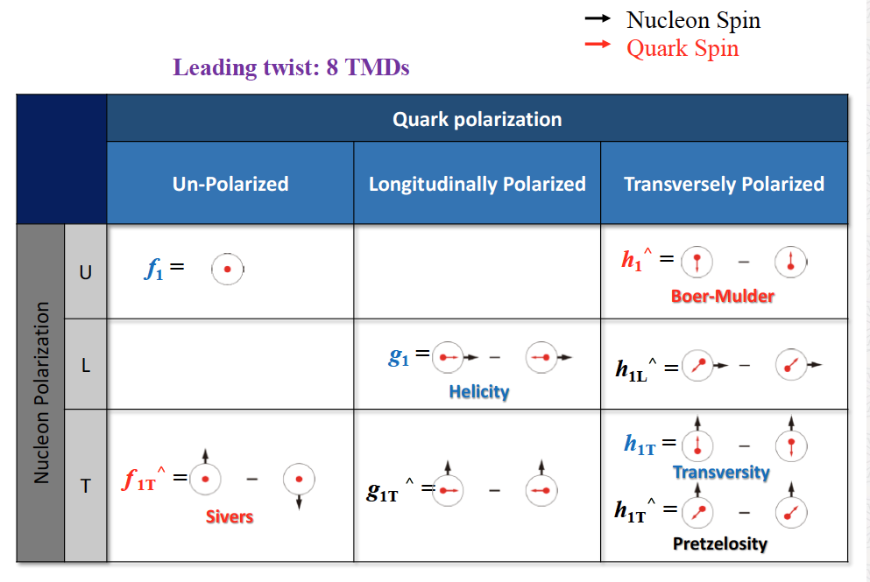
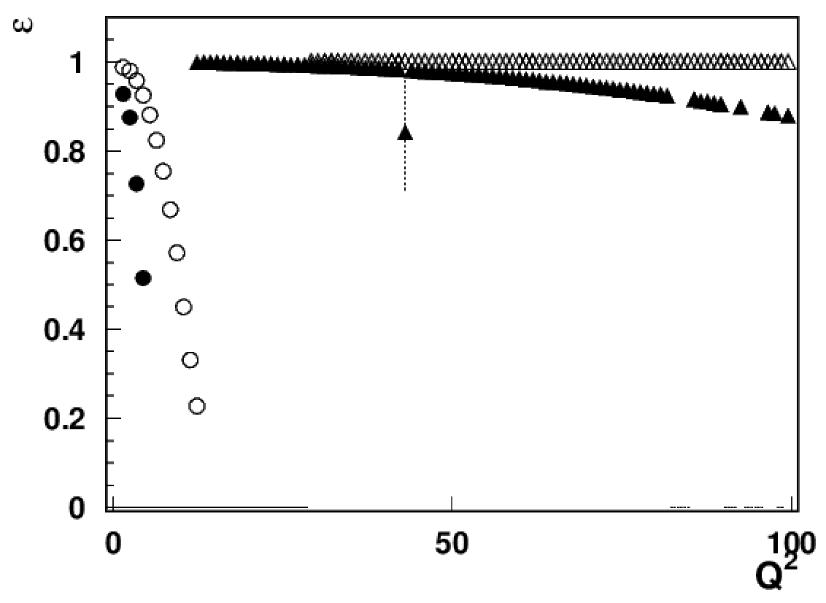
SIDIS Cross Section
Full decomposition of SFs is needed to underlying the 3D PDFs
X-section @ LO for
Combination of statistics and depolarization factors defines measurable SFs
Leading Twist
EIC18x275
EIC5x41
JLab24/HERMES
JLAB12
x=0.3
At large x fixed target experiments are sensitive to ALL Structure Functions
JLab: IDEAL PLACE TO CARRY OUT 3D STUDIES in the non-perturbative region
High Luminosity + High Polarized beam and target + High Resolutions detectors + Versatile experimental setup + Multiparticles FS detection

Slide 7
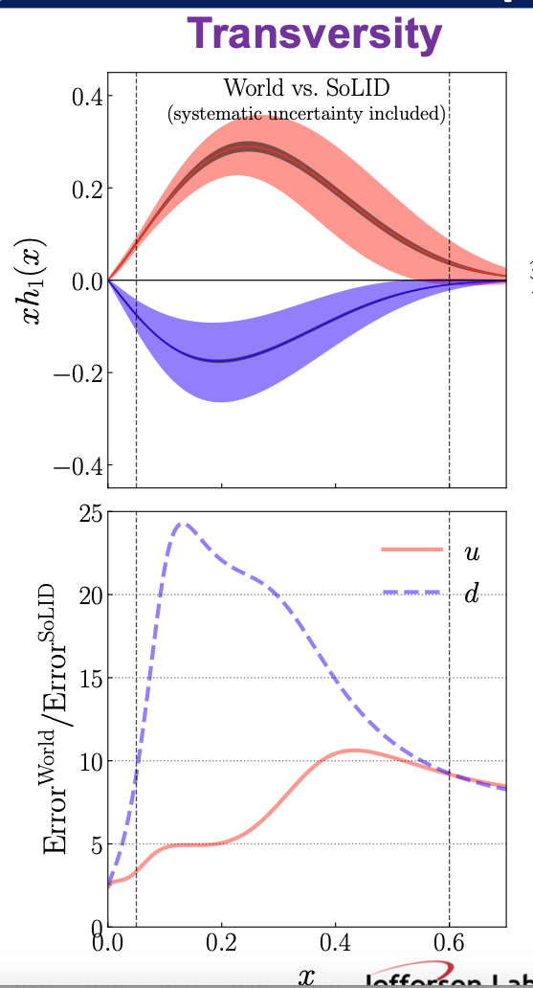
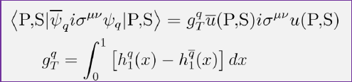
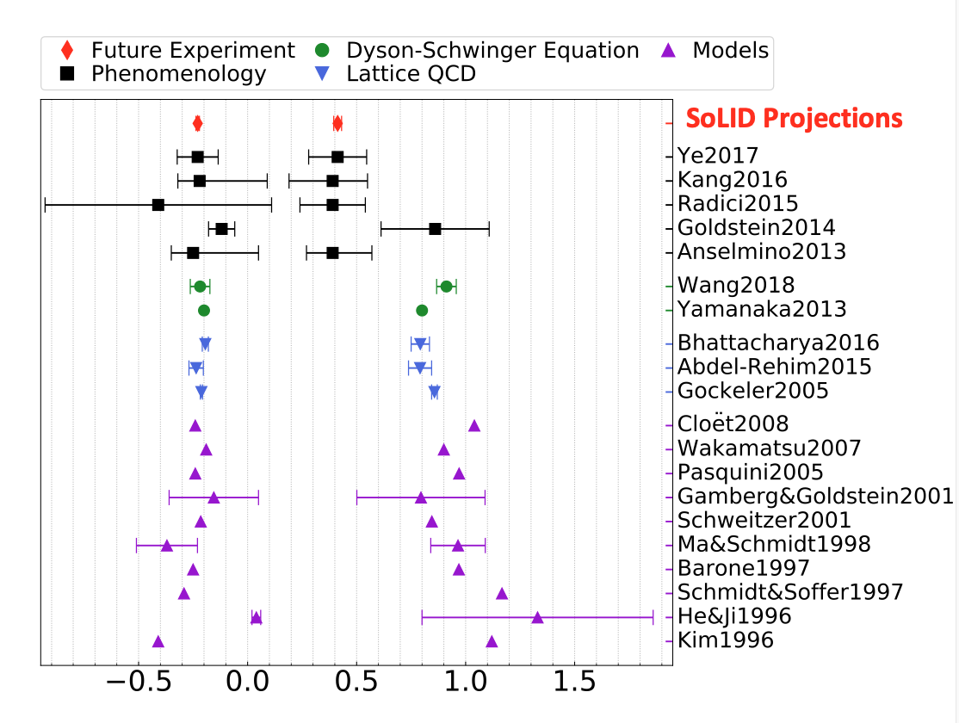
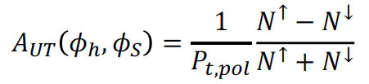

SoLID – SIDIS some Projections and Impact
SoLID
Transversity
Transversity and Tensor Charge
High luminosity (10³⁷-10³⁹ cm⁻²s⁻¹) + large acceptance
Approved program on SIDIS
Transversely polarized p and ³He (n)
Longitudinally polarized ³He (n)
A fundamental QCD quantity dominated by valence quarks
Precisely calculated on the lattice
SoLID measurements allows for high-precision test of LQCD predictions
Collins fragmentation function from e+e- collisions
7

Slide 8
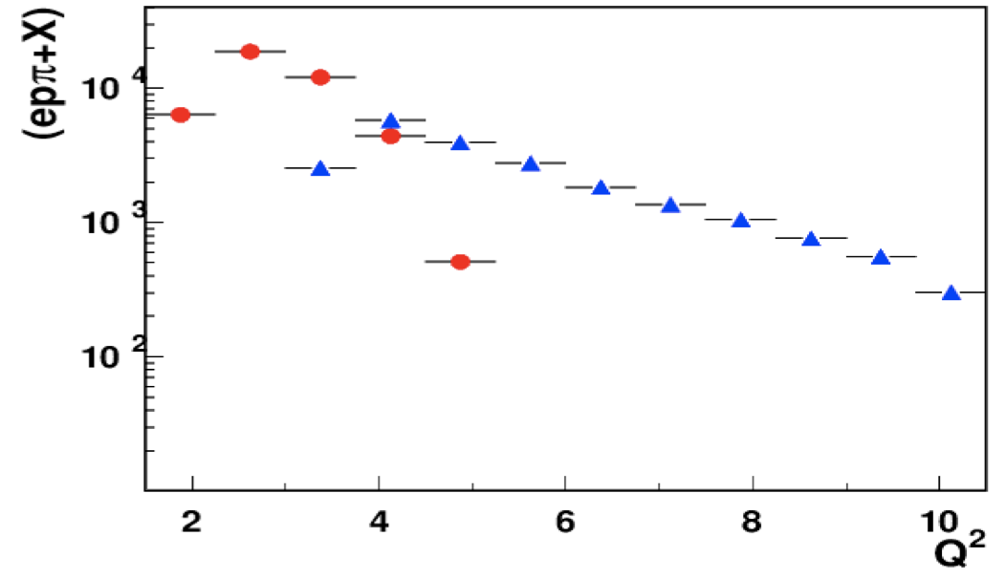
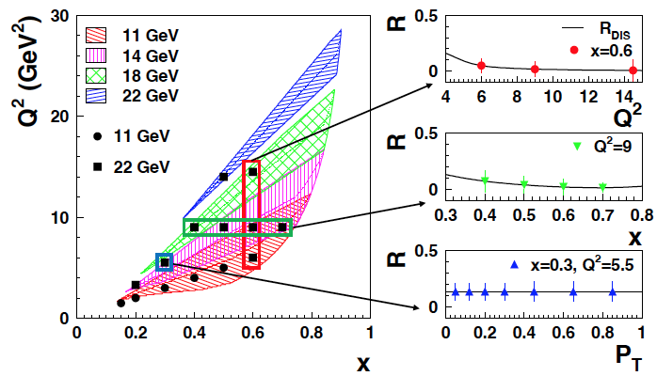
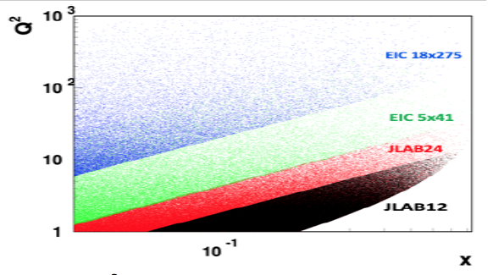
Nucleon Structure @ 22 GeV
JLab @ 22 GeV will enable several advancements, including:
Multidimensional studies of the evolution of 3D observables with the energy scale (Q²)
A unique opportunity to measure γ*_{L} and γ*_{T} contributions to observables at higher Q²
CLAS12
CLAS22
Neglecting γ_{L}* biases TMD extractions and factorization studies, limiting the accuracy of spin-dependent QCD insights
A unique opportunity to evaluate the contribution of various processes (i.e. longitudinal ρ,..) at higher Q²
All critical aspects for a deeper and better understanding of our current measurements and future measurements at EIC!

Slide 9
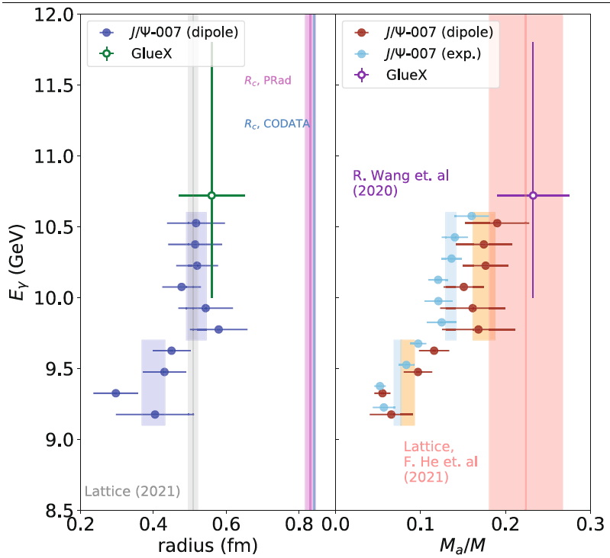
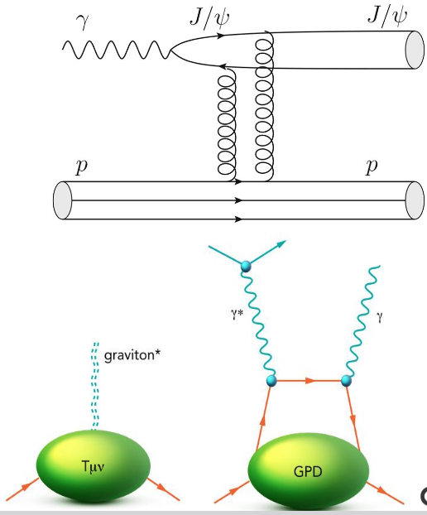

JLab delves into Proton’s Mechanical Properties
J/ψ allows to probe the gluonic GFFs.
Nature volume 615, pages 813–816 (2023)
A spin-2 particle couples to the nucleon's energy-momentum content in a way that mimics gravitational interactions.
This allows us to study nucleon’s gravitational form factors (GFFs), which reveal key mechanical properties, like how the proton’s mass, spin, pressure, and internal forces are distributed.
Pressure Distribution
Inside the Proton
The quark GFFs have been investigated in the context of DVCS
V.Burkert, L. Elouadrhiri, F.X. Girod, Nature 557 (2018) 7705, 396

Slide 10
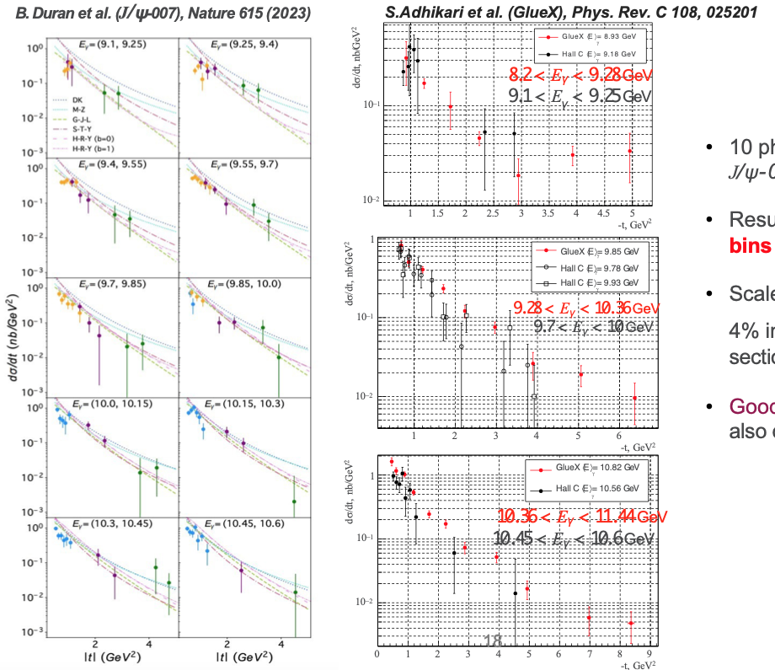
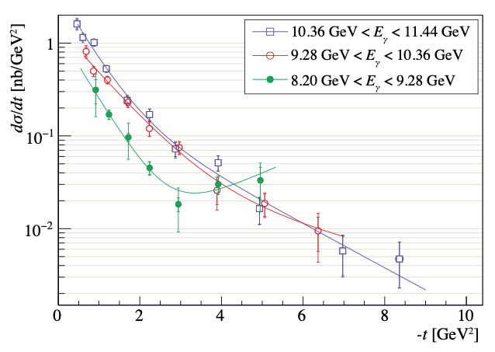
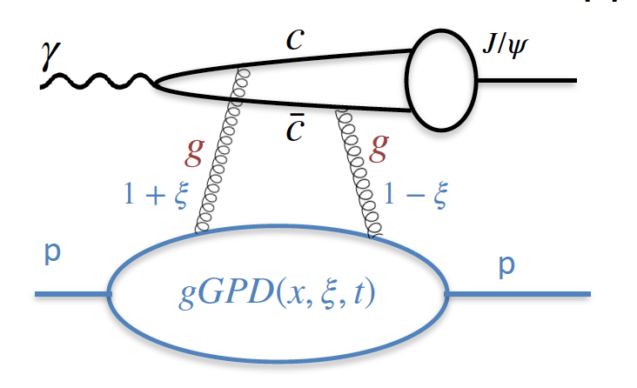
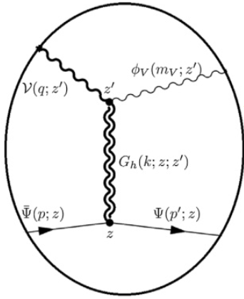
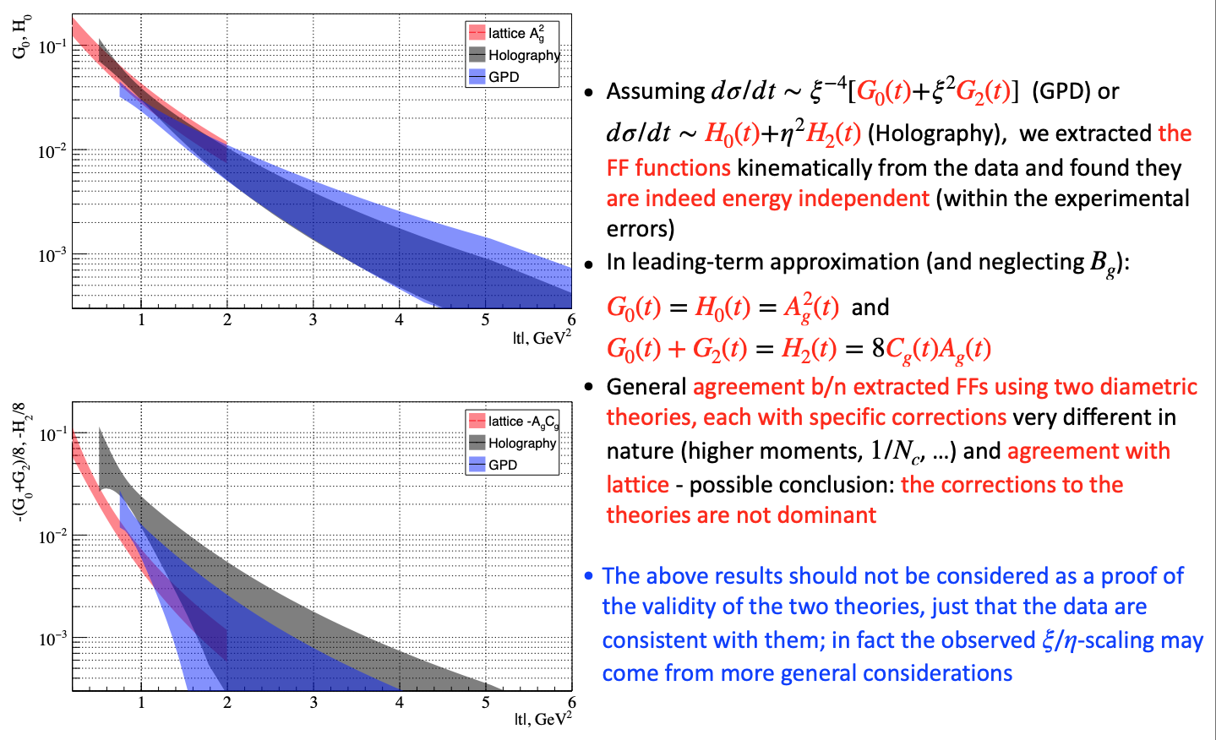
Model-dependent attempt to determine the gGFFs
Charmonium photoproduction near threshold has been used to probe the gluonic structure of the nucleon
Two theoretical approaches have been used with very different domains of validity
  GPD → requires high |t| and works for hard processes
1) (dσ/dt)_{γp→J/ψp} = F(Eγ)ξ⁻⁴[G₀(t)+ξ²G₂(t)] + . .
  Holographic → valid for soft processes -
2) (dσ/dt)_{γp→J/ψp} = N(Eγ)[H₀(t)+η²H₂(t)] + . .
Assuming 1) or 2) extracted the gGFFs kinematically from the data and found they are energy independent
Leading terms in G₀(t), G₂(t), H₀(t), H₂(t) contain gGFFs A_{g}(t), B_{g}(t), C_{g}(t)
gGFFs extracted via Rosenbluth separation technique
- In leading-term approximation (and neglecting B_{g} ):
G₀(t) = H₀(t) = A²_{g}(t)
G₀(t) + G₂(t) = H₂(t) = 8C_{g}(t)Ag(t)
General agreement in the extracted FFs using two diametric theories, and agreement with lattice
L. Pentchev, E. Chudakov arXiv:2404.18776v2

Slide 11
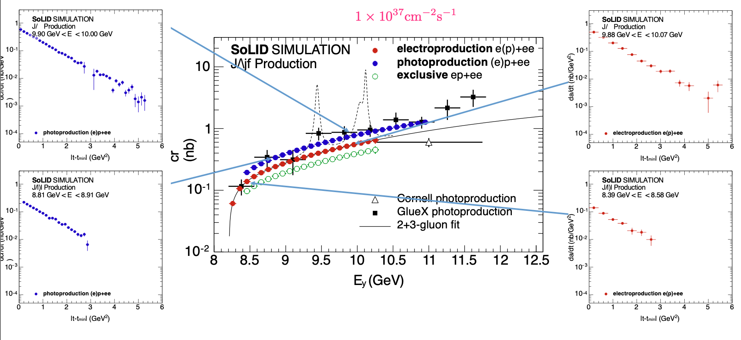
SoLID - Proton Mass,Gluonic Gravitational Form Factors
J/ψ photoproduction close to threshold used to access the gluonic content of the proton
11

Slide 12
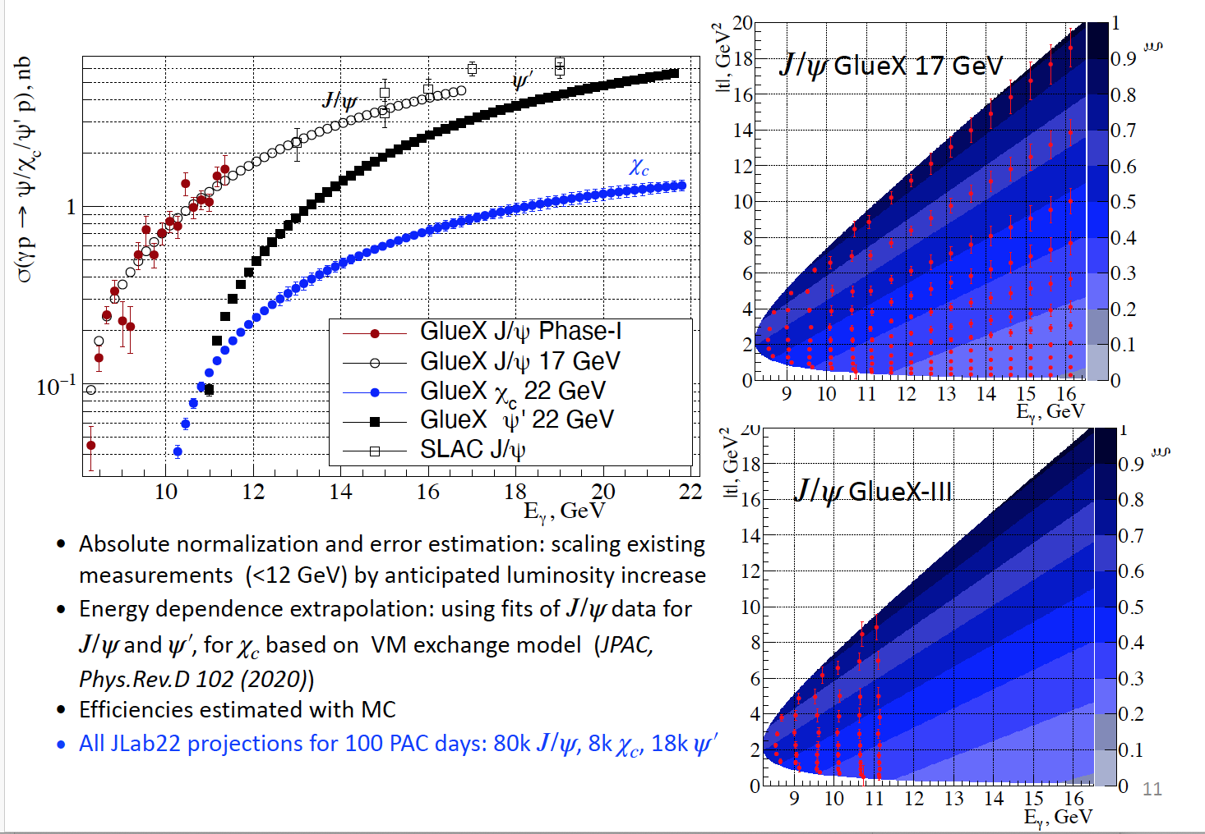
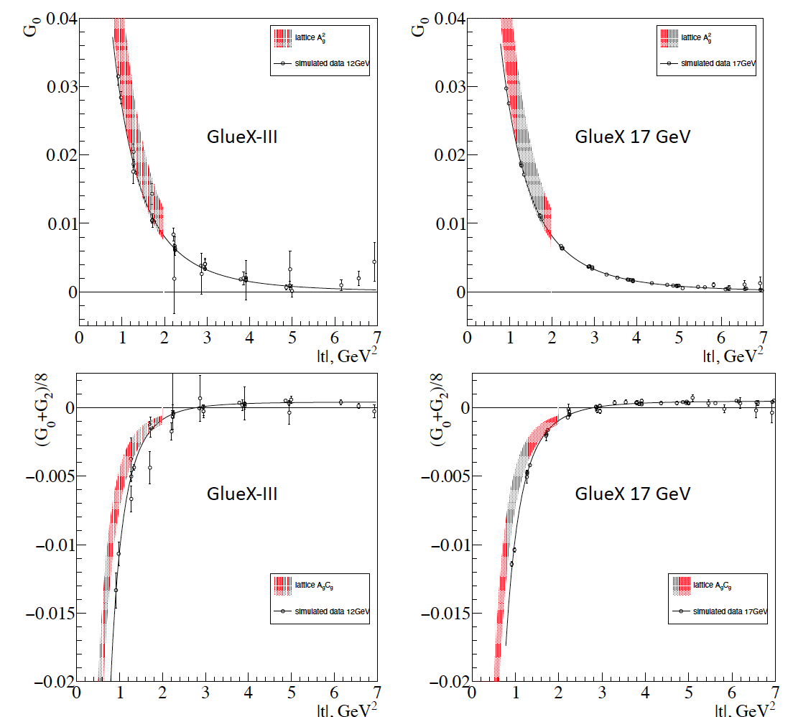
Threshold J/Ψ Photoproduction at 22 GeV
Anticipated results for the extracted gFFs
JLab22 projections for Polarization FoM
Jlab22 projections for 100 PAC days: 80k J/ψ, 8K χ_{c}, 18k ψ’
Courtesy L. Pentchev

Slide 13
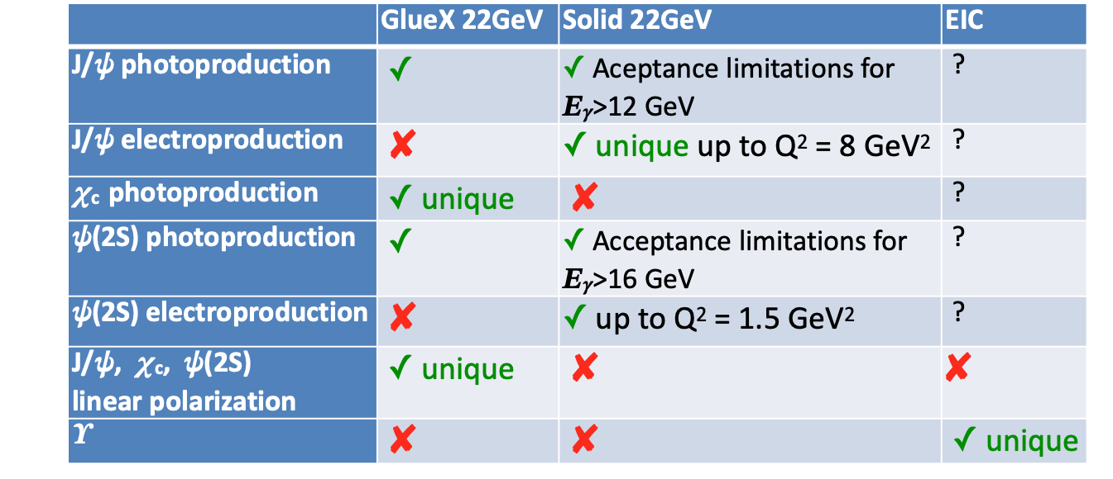
“Charmed” Studies at 22 GeV
CEBAF energy upgrade adds new dimensions:
Threshold production of higher-mass charmonium states (with different quantum numbers) ψ(2S) (SoLID, GlueX), χ_{c}(GlueX)
Threshold charmonium electroproduction at high Q² (SoLID)
Polarization measurements with high FoM (GlueX)
Studies of open-charm production, that is supposed to dominate with increasing the energy
Courtesy L. Pentchev
GlueX has linear polarization and almost full acceptance for multi-particle final states (including photons) - unique in polarization measurements and χ_{c} states.
SoLID has very high luminosity, relatively wide acceptance, capable of reaching high values in electroproduction (unique).
EIC energies much above charmonia thresholds, detection is questionable, however very suitable for studying production at threshold.

Slide 14
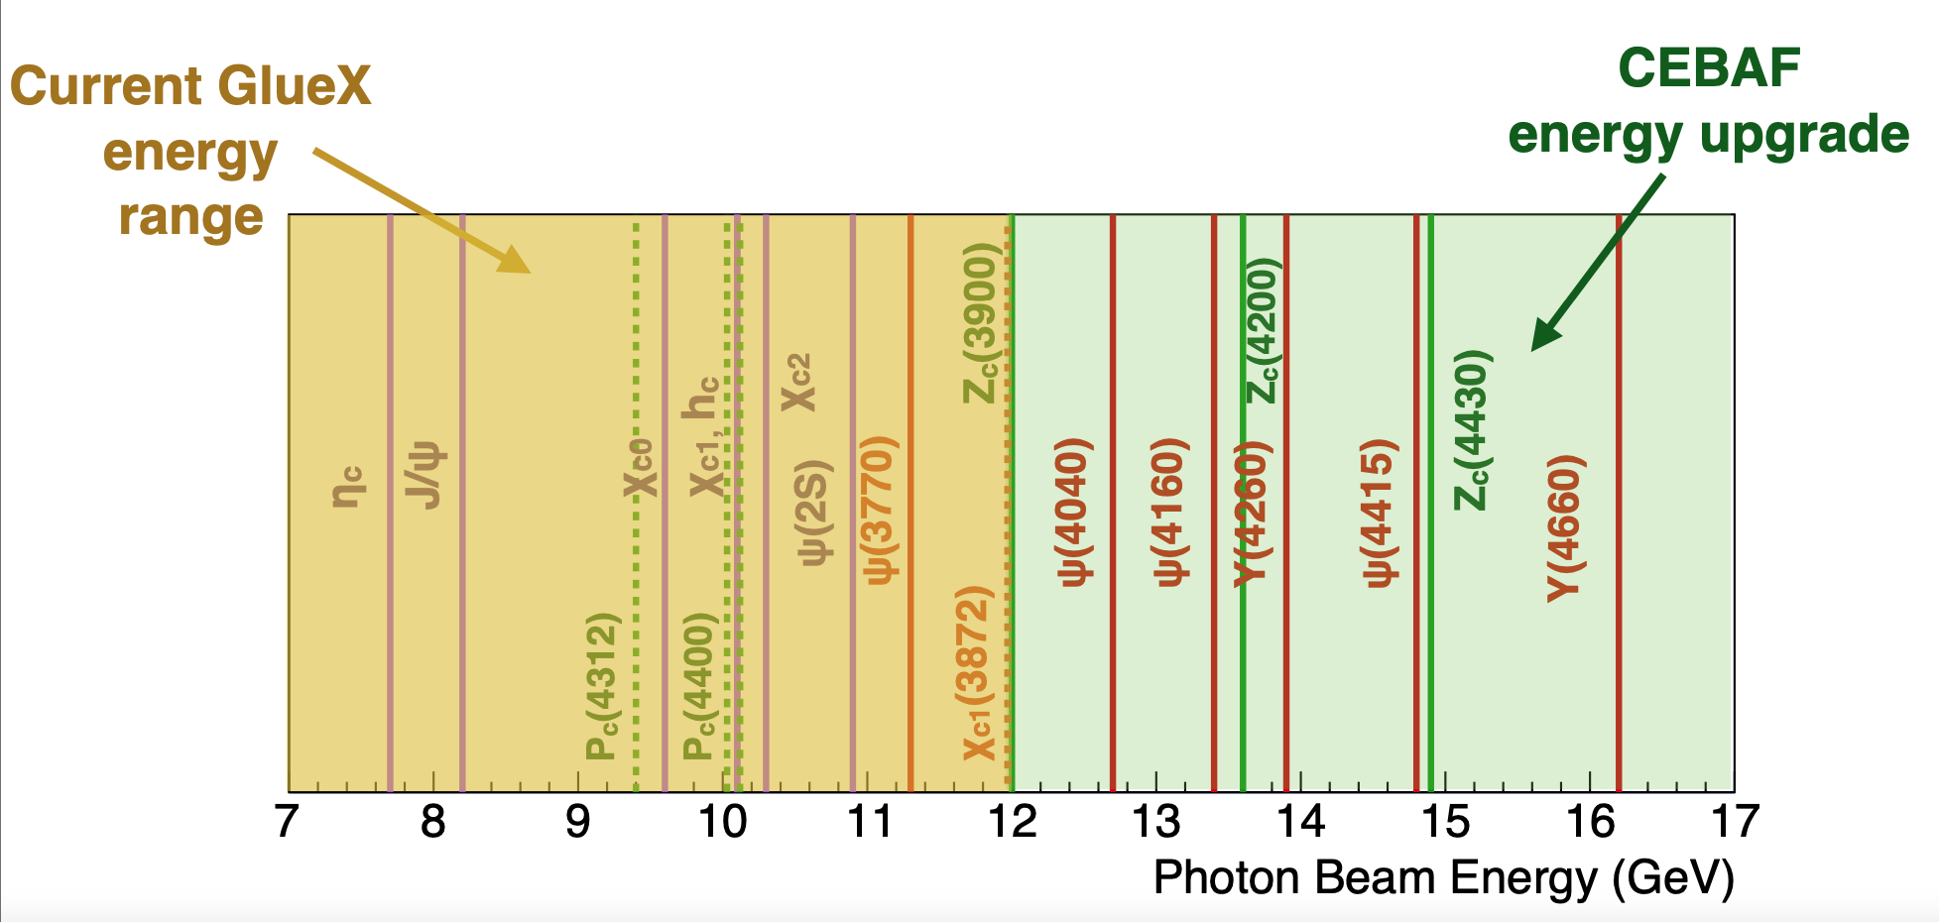
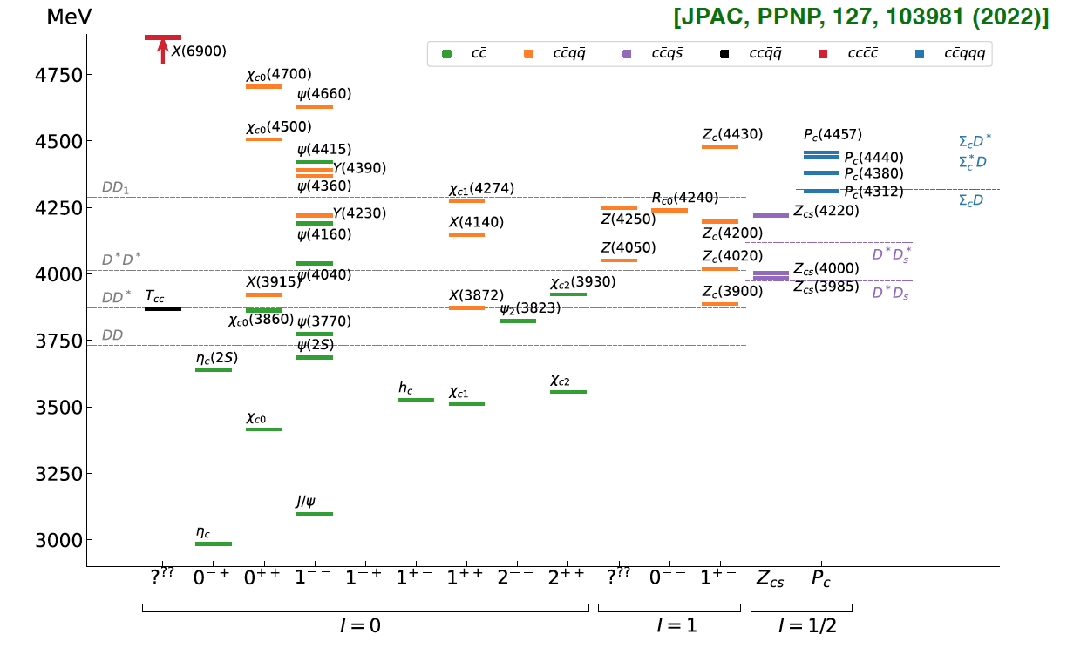
22 GeV: A New Window into the World of XYZ States
This program suits perfect the 22 GeV upgrade: Thresholds for XYZ states open just above 12 GeV
πJ/ψ
ππJ/ψ
ωJ/ψ
-
Many non-qq candidate states observed in in B decays, e⁺e- colliders
No XYZ state uncontroversially seen so far (tetraquark, molecule, virtual state, triangle singularity, ... ?)
Crucial to confirm these states in other production processes
→ never directly produced using γ/lepton beam → free from re-scattering mechanisms

Slide 15
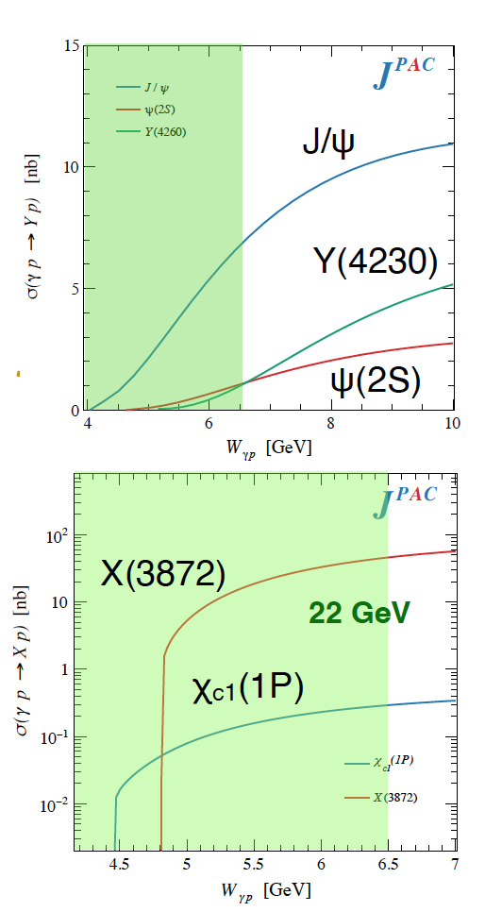
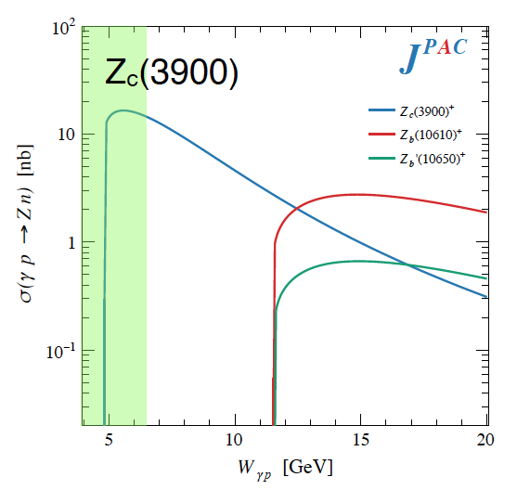
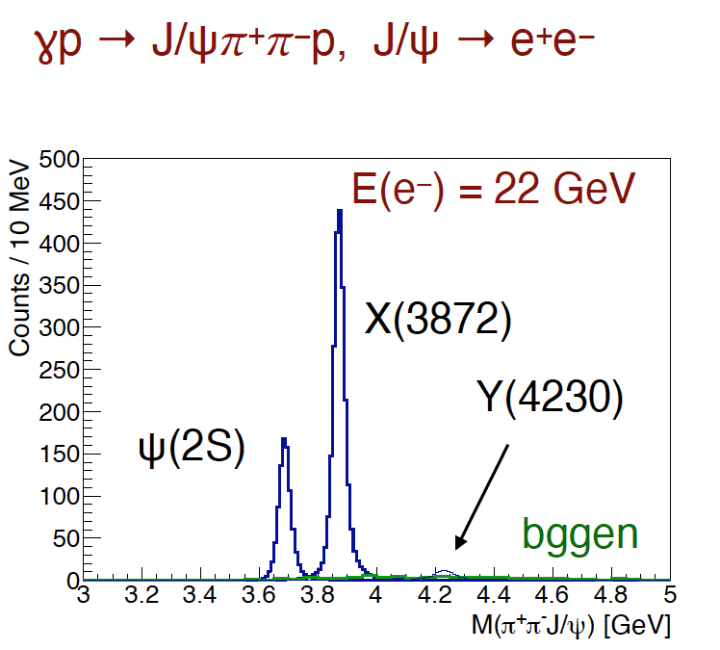
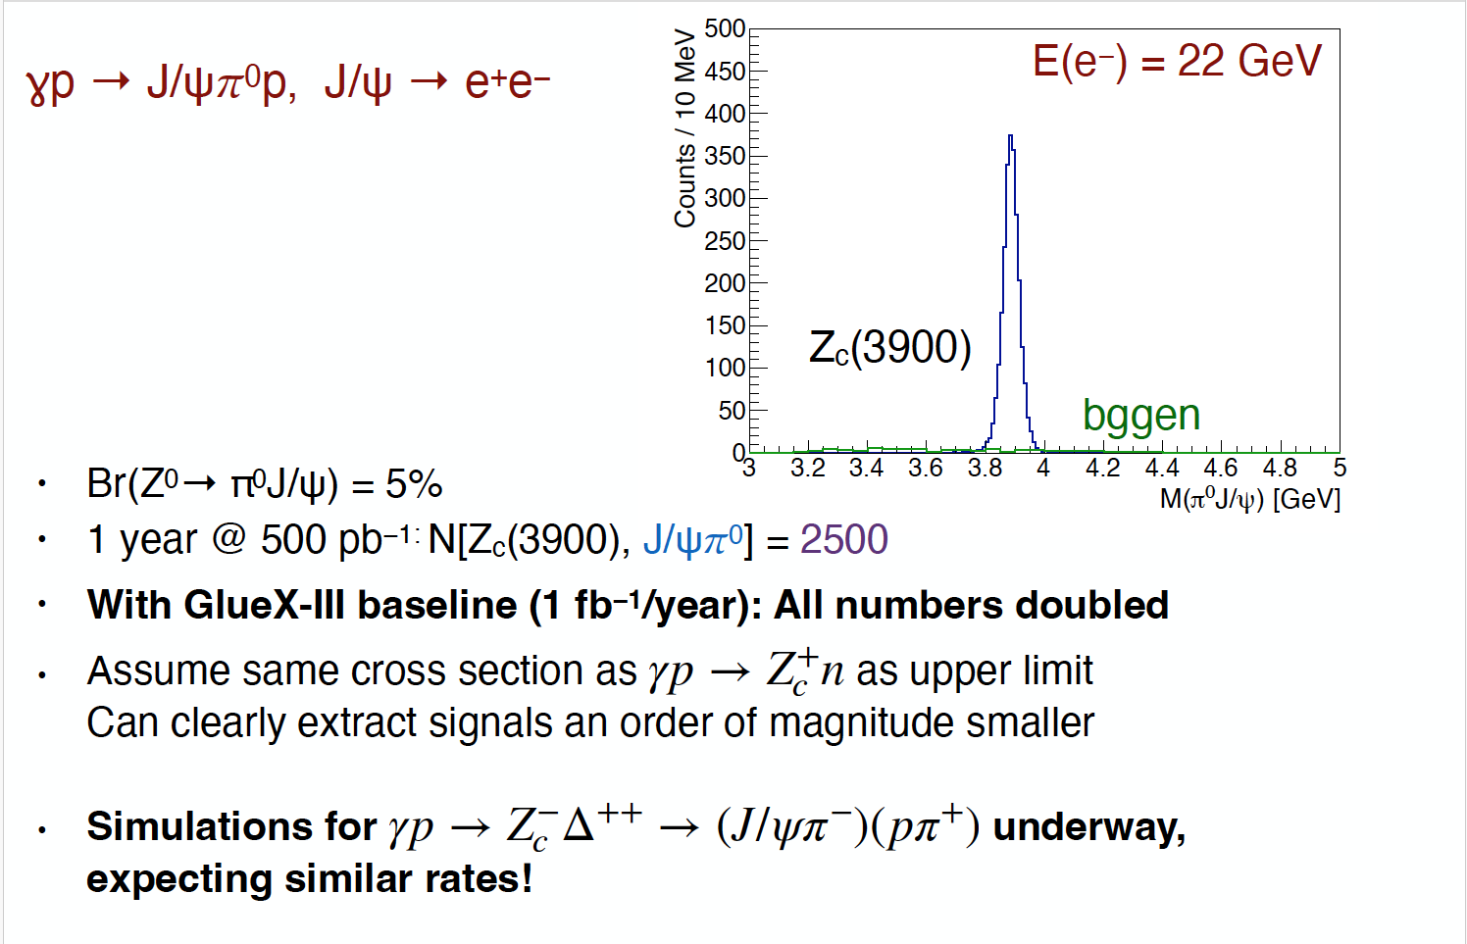
22 GeV: A New Window into the World of XYZ States
JPAC predictions using fixed-spin exchanges near threshold
(PRD 102, 114010 (2020) arXiv:2209.05882)
GlueX can test models by measuring χ_{c1}(1P), ψ(2S) production
Simulations for
γp → Z⁻_{c} Δ⁺⁺→(J/ψπ⁻)(pπ⁺)
is underway, expecting similar rates!
Next steps:
Develop reasonable non-resonant background models to include in the MC (COMPASS data can be used for guidance)
Evaluate the contribution of open charm channels
Br(X,Y→ π⁺π⁻J/ψ) = 5%
1 year@500 pb⁻1 :
N(ψ(2S)) = 900, N(X(3872)) = 2300, N(Y(4260)) = 120
Br(Z0→ π⁰J/ψ) = 5%
1 year @ 500 pb−1:
N[Zc(3900), J/ψ𝜋⁰] = 2500
With GlueX-III baseline (1 fb−1/year): All numbers doubled

Slide 16
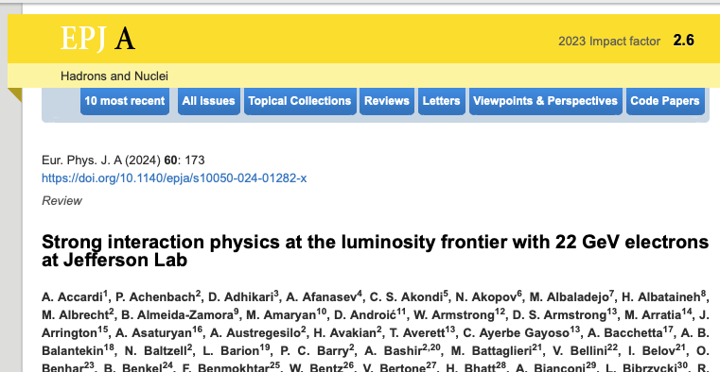
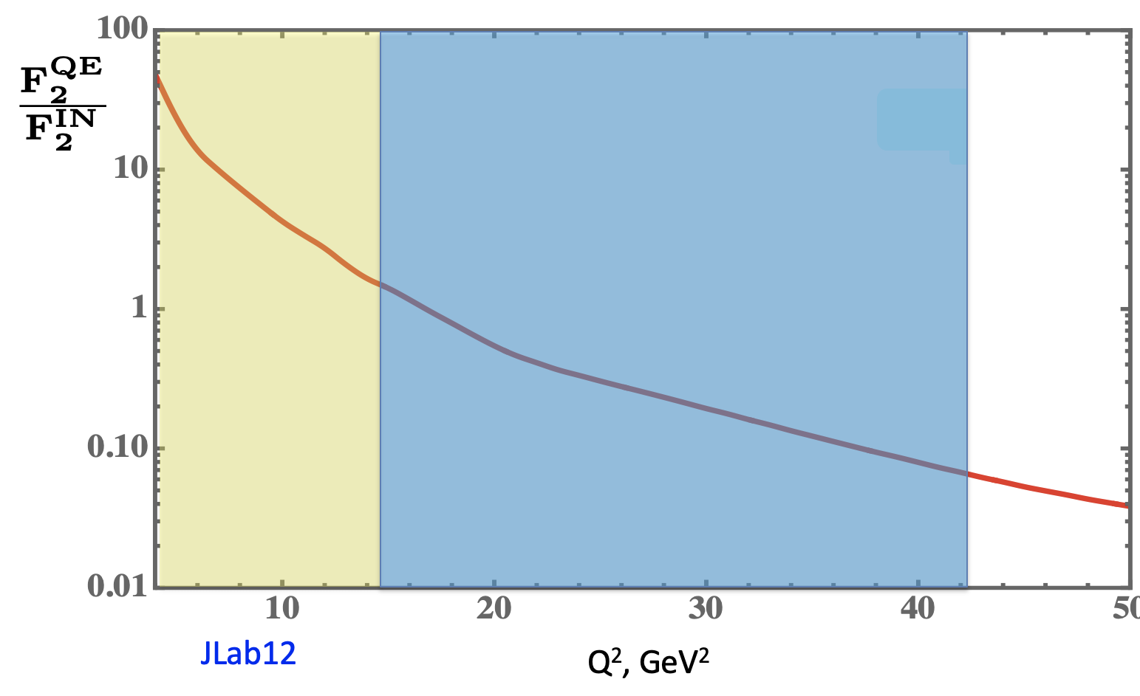
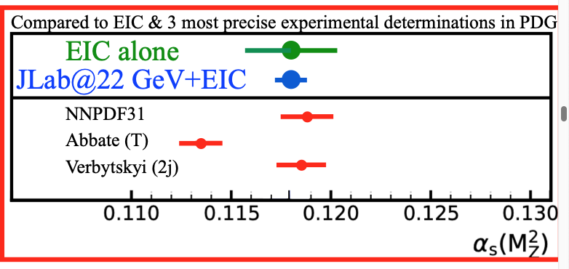
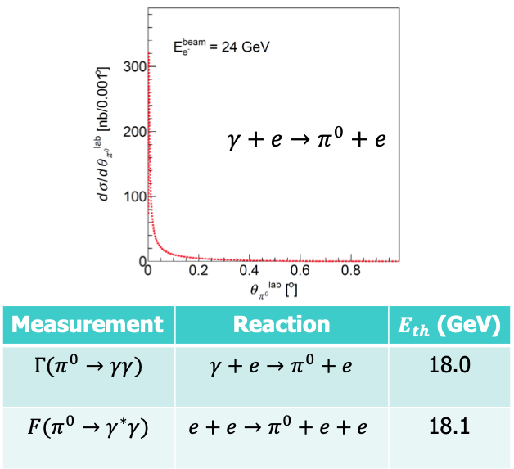
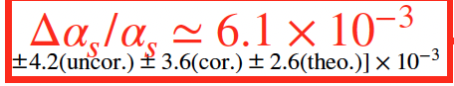
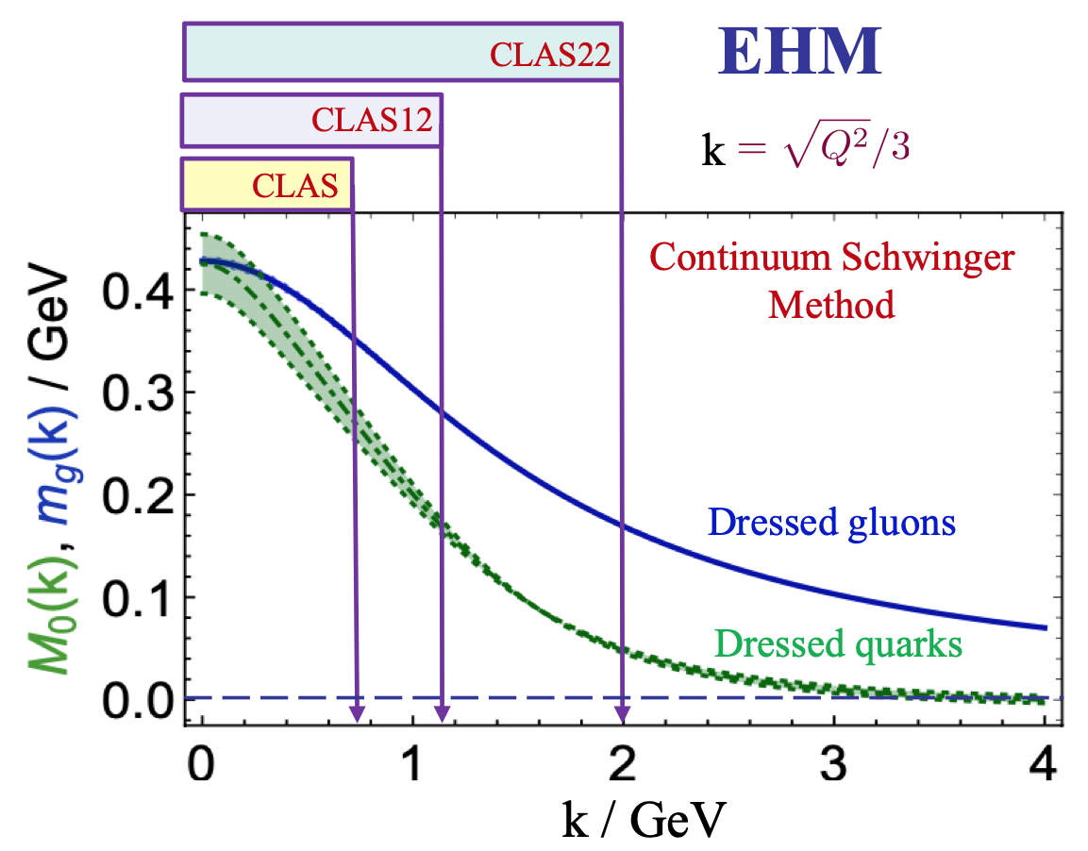
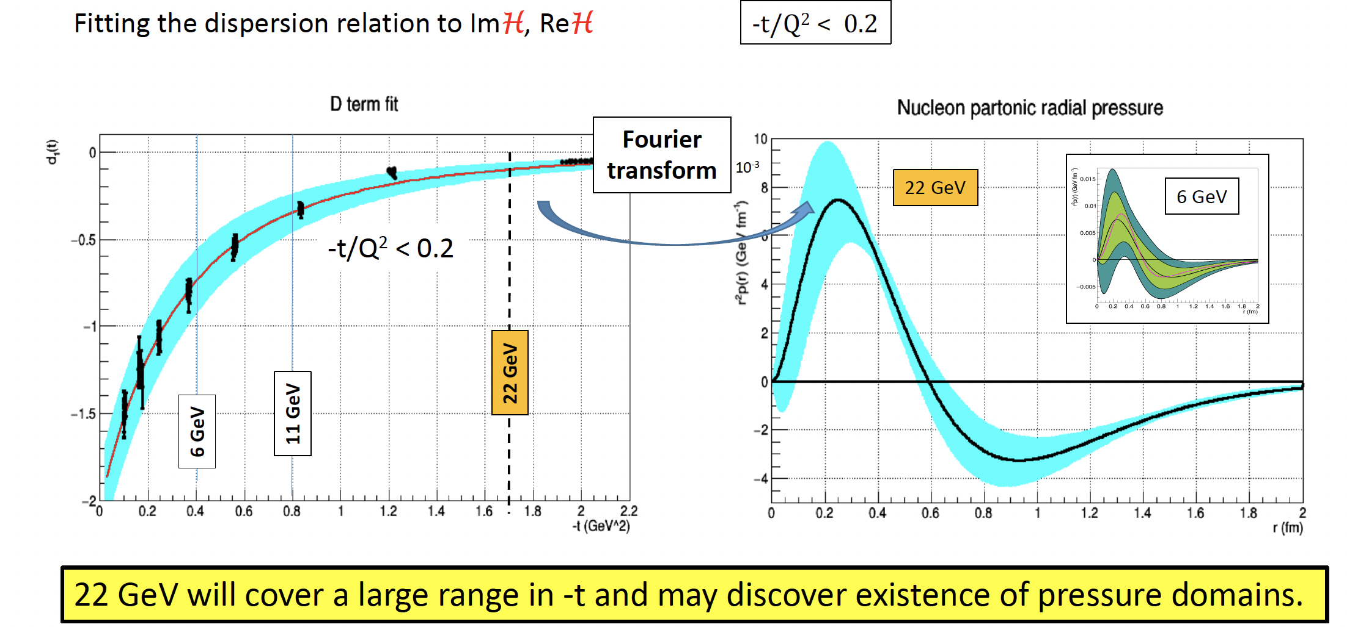
…And Many More
Super-fast Quarks in Nuclei
Nuclear core forces
~450 authors
Jlab12
Jlab22
A new document outlining the progress of the scientific case will be available soon
Primakoff on an e- target
Tests of Fund. Symm.
N* γvpN* electr. Emergence of Hadron Mass
DVCS @ 22 GeV
Mechanical Property of the proton

Slide 17
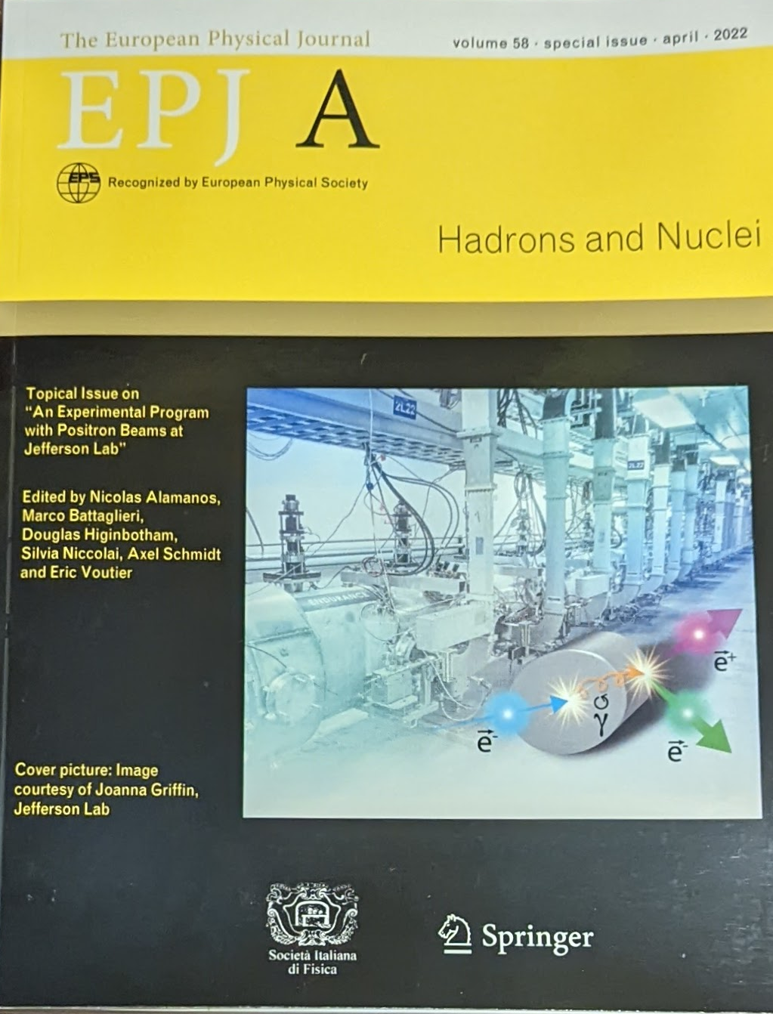




Physics Program with Ce+BAF
Beam charge asymmetries
  Two-photon exchange
  Deeply Virtual Compton Scattering
Annihilation processes
  Light dark matter searches
Charged-current processes
  Inverse beta-decay
  Access strangeness with charm-tagging
  Charged lepton flavor violation
  Axial Form Factor
Q² (GeV²)
May the 2-γ exchange be the cause of the proton FF discrepancy?
Annual in person working group meeting
Next March 24-26 at JLab
PAC approved experiments (as of Jan 2025)
Approved 6 experiments for a total of 357 total PAC days (Hall A & C)
(PAC day = two calendar day)
17
17

Slide 18







CEBAF Phased Upgrade
Phase 1:
New injector (123 MeV e⁺ & 650 MeV e⁻) in a former FEL (“LERF”)
Polarized positrons transported to CEBAF (proposed 12 GeV science program)
Phase 2:
Recirculating injector energy upgrade to 650 MeV electrons
Replace one set of arcs on each side with new FFA permanent magnet arcs to upgrade to 22 GeV – no new RF needed! No new cryomodules needed!
Accelerator R&D on-going
Installed/analyzed Dosimetry
Location to install samples
Support Degrader to quantify CEBAF acceptance
high-intensity (mA) polarized photogun
Prototype open-midplane BF magnet successfully built and evaluated for mechanical integrity
Resiliency studies of permanent magnet materials in a radiation environment at CEBAF resembling their intended operational one – ON GOING
Futures concept of Tungsten Solid Target, and GaInSn Liquid Target,
Goal: strong placement in the next Long Range Plan
  Prepare TDR for ~2028, - Earlier pTDR prepared in ~2026
18
18

Slide 19





K-Long Facility: Spectroscopy in K_{LONG} beam
K_{L} beam
Compton Photon Source (CPS): Engineering design is advanced
Be target for KL production:
Engineering design is (nearly) complete
Realization on - going
Big overhead: requires about 2 years for installation and >1 year for de-installation
Schedule under discussion
19

Slide 20





Beam Dump Experiment (BDX)
A cutting-edge experiment designed to search for light dark matter
Two step process
  An electron radiates an A’ and the A’ promptly decays to a χ (DM) pair
  II) The χ (in-)elastically scatters on a e-/nucleon in the detector producing a visible recoil (GeV)
Experimental signature in the detector:
Χ-electron → EM shower ~GeV energy
BDX-MINI: pilot experiment to prove the validity and feasibility of the BDX exp
Accumulating 10²² EOT in ~2y BDΧ sensitivity is 10-100 times better than existing limits on LDM
Two wells dug for bg muon tests
E_{beam}=2.2 GeV, no muons
Limited reach but first physics result!
Funds for the construction of the first module of the calorimeter secured.
Engineering design studies for the construction of the hall are ongoing.
M.Battaglieri et al. PRD 106, 072011
Collected 4e21 EOT (40% BDX!) in ~4 months (+ cosmics)
20

Slide 21




Secondary Beams at Jefferson Lab
High-intensity secondary beams are produced in the dump(s) fully parasitically with high-intensity 10 GeV (22 GeV) electron beam
A secondary muon beam with a bremsstrahlung-like energy spectrum extending up to 5 GeV could yield up to ∼10⁻⁶ μ/EOT, corresponding to 10⁸ μ/s for an i_{e} 50 µA
https://doi.org/10.3390/instruments8010001 (2024)
A secondary neutrino beam with a typical decay-at-rest (DAR) energy spectrum could provide up to ∼7×10⁻⁵ ν/EOT when integrated over a 1 m² detector located 10 m above the beam dump; Considering a delivered charge of 10²² EOT per year, the annual neutrino flux would be in the range of 10¹⁸ ν
Off-axis
On-axis
(2024)
21

Slide 22
Conclusions and Outlook
Jefferson Lab offers an exceptional environment for exploring QCD in the non-perturbative regime, combining high luminosity with state-of-the-art experimental facilities.
Strategic upgrades, like the 22 GeV energy enhancement will allow to cross key energy thresholds, to expand the phase space for a better understanding of our current program, and to open a new window between Jefferson Lab at 12 GeV and the EIC.
The development of positron beams is essential to isolating and quantifying two-photon exchange effects, while also enabling symmetry tests and rare process searches that deepen our exploration of the Standard Model and beyond.
Innovative experiments such as SOLID, BDX, and studies at the K-Long Facility will deepen our understanding of nucleon structure, dark sectors, and the role of strangeness in QCD.
Together, these opportunities signal a dynamic future, one that bridges precision measurements with bold exploration, and keeps Jefferson Lab at the forefront of discovery.

Slide 24

Notional CEBAF and EIC Efforts on One Chart
24
24

