Slide 1
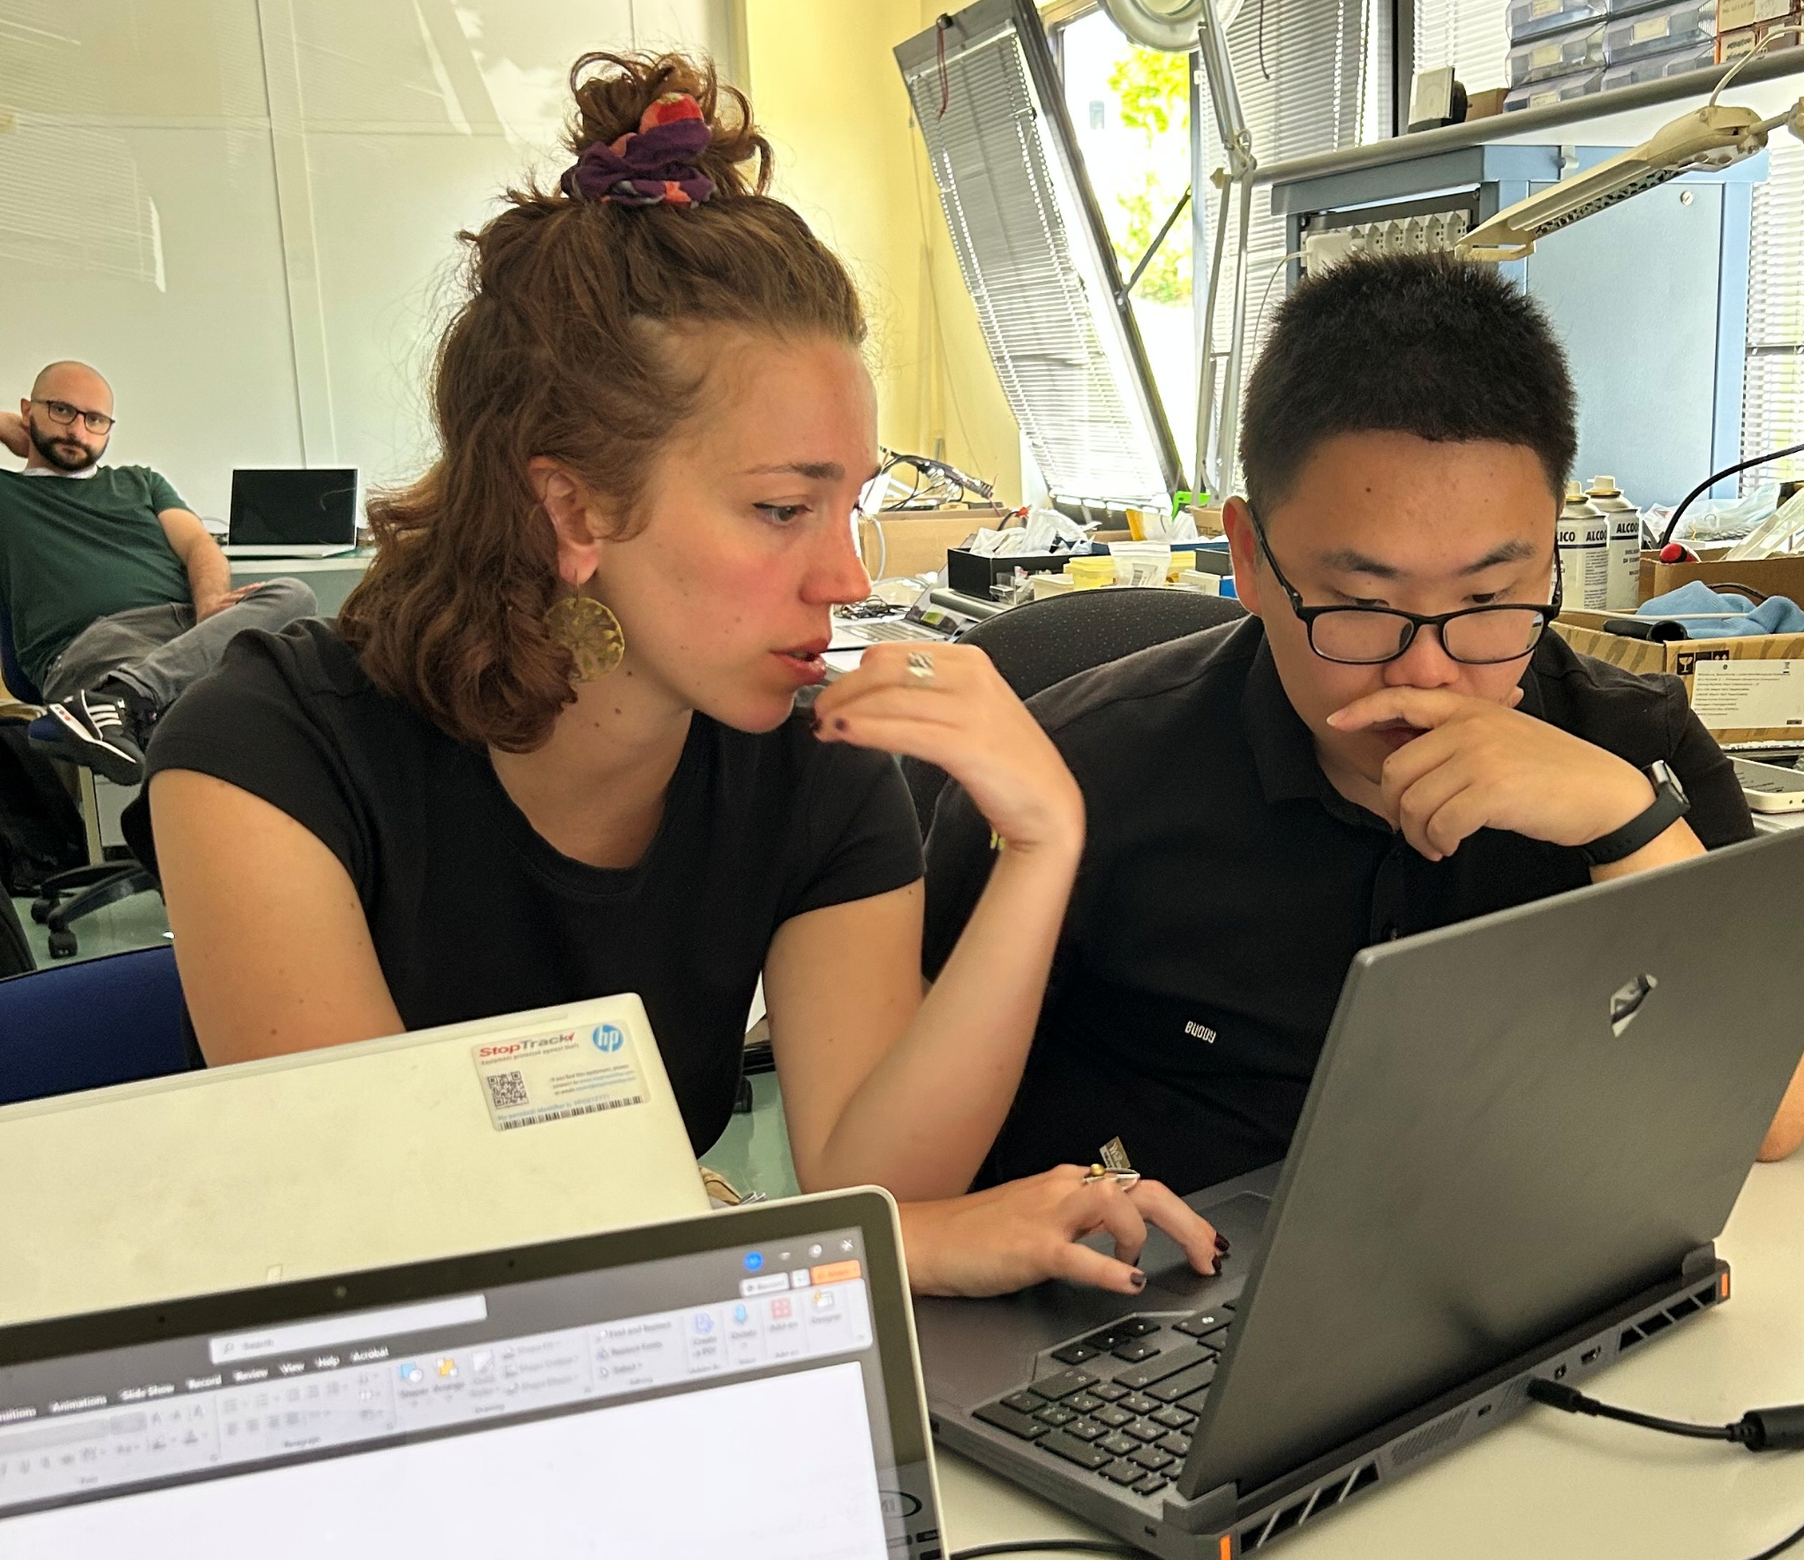
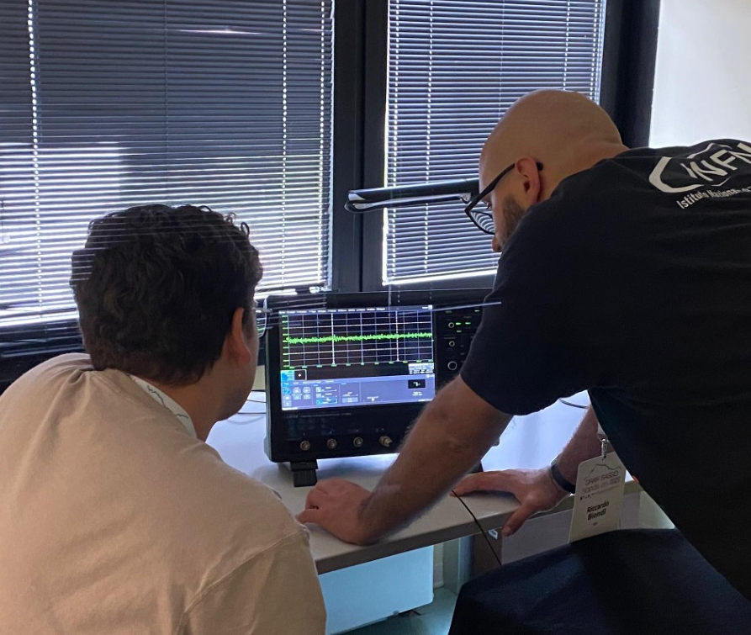
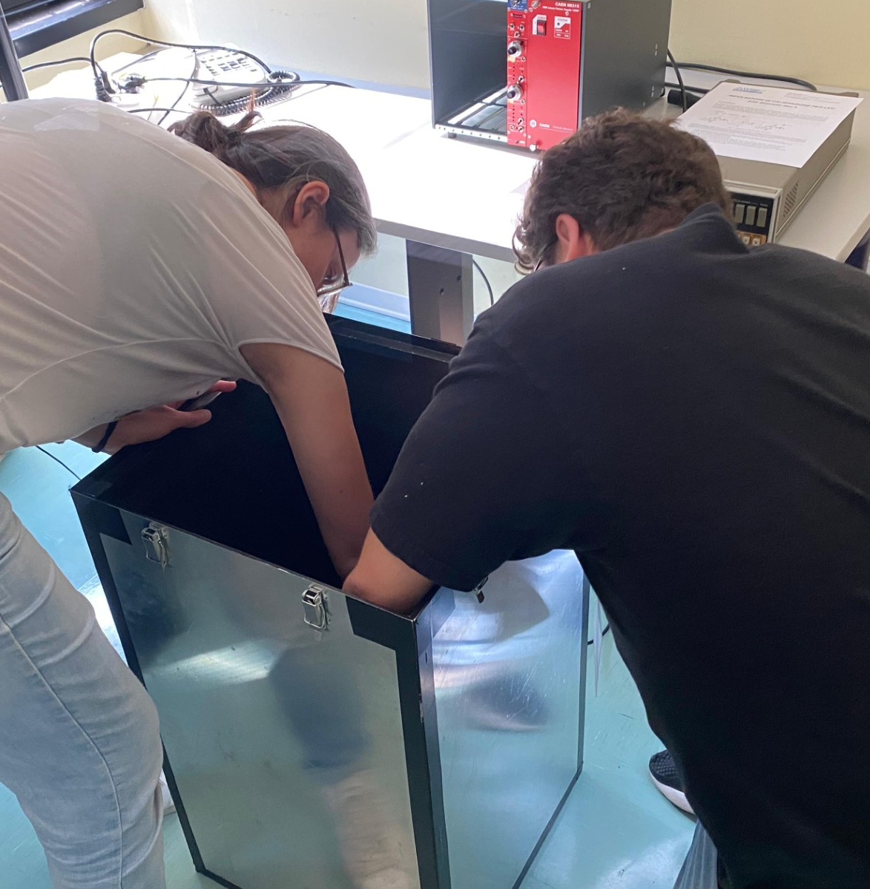
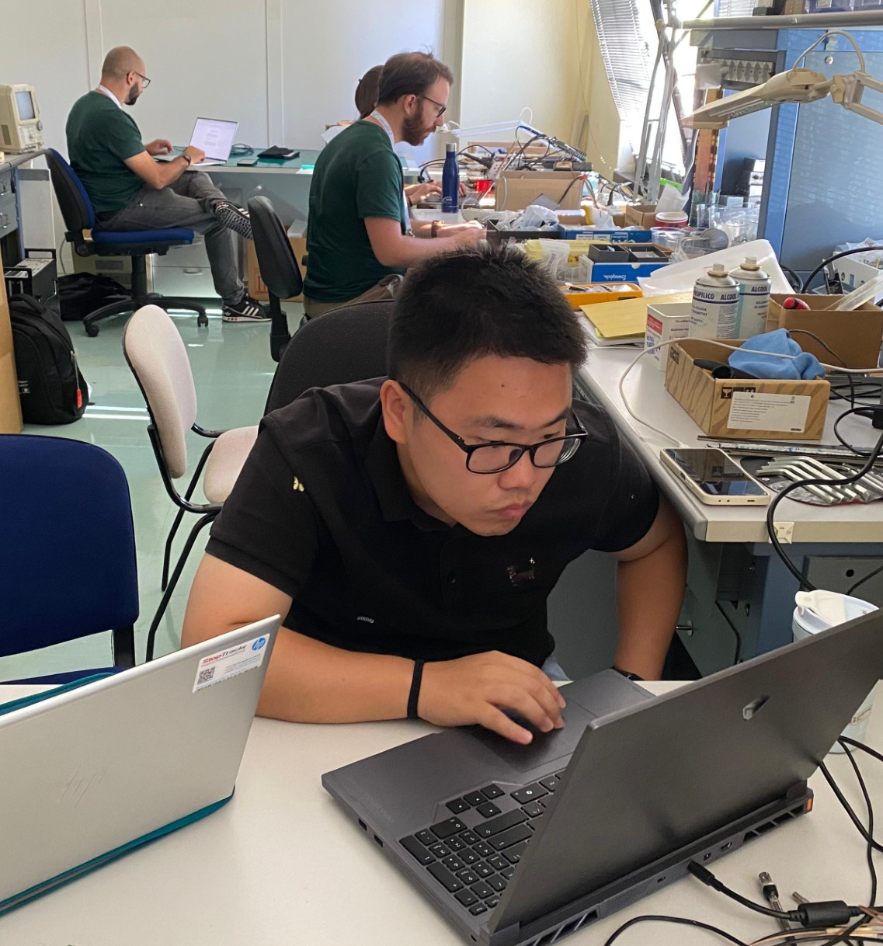
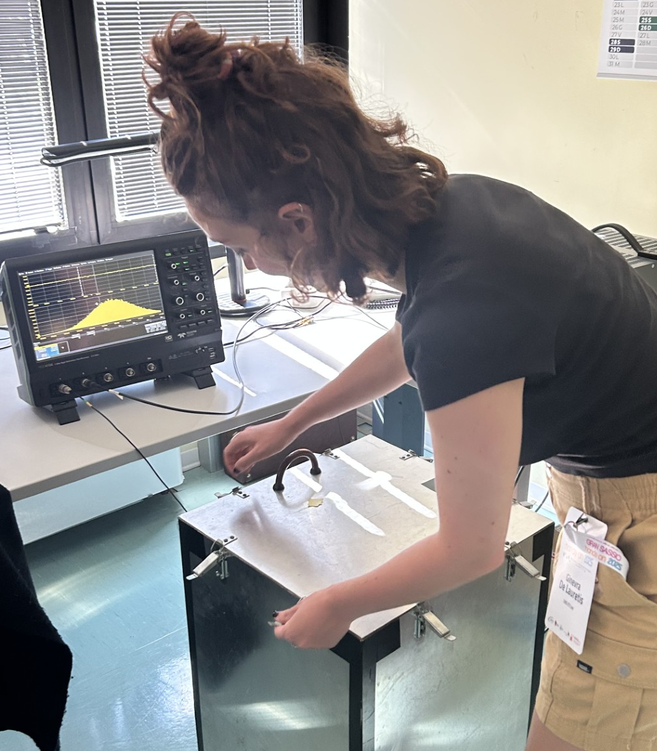



LAr Purity Monitoring
Keyu Shang, Ginevra De Lauretis, Michael Lewis
Tutors: Valentina Biancacci (GSSI), Riccardo Biondi (GSSI), Natalia Di Marco (GSSI)
Gosia Haranczyk (LNGS), Michele Morella (LNGS)

Slide 2
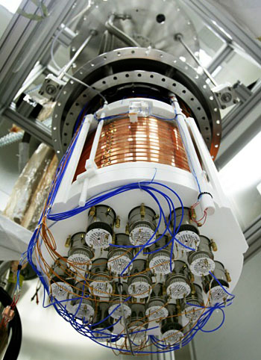
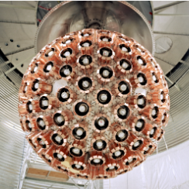
Introduction – LAr Detectors
Liquid Argon (LAr) detectors are used widely in particle, astro-particle, and applied physics applications:
Dark Matter (Darkside, Deap)
Neutrino Physics (ICARUS, DUNE, LEGEND)
PET Scanners
LAr is highly sought after due to its appropriate properties:
Noble gas is inert and scalable
Cheaper than other gases (Xenon)
High light output with singlet + triplet decay
Long electron lifetimes

Slide 3
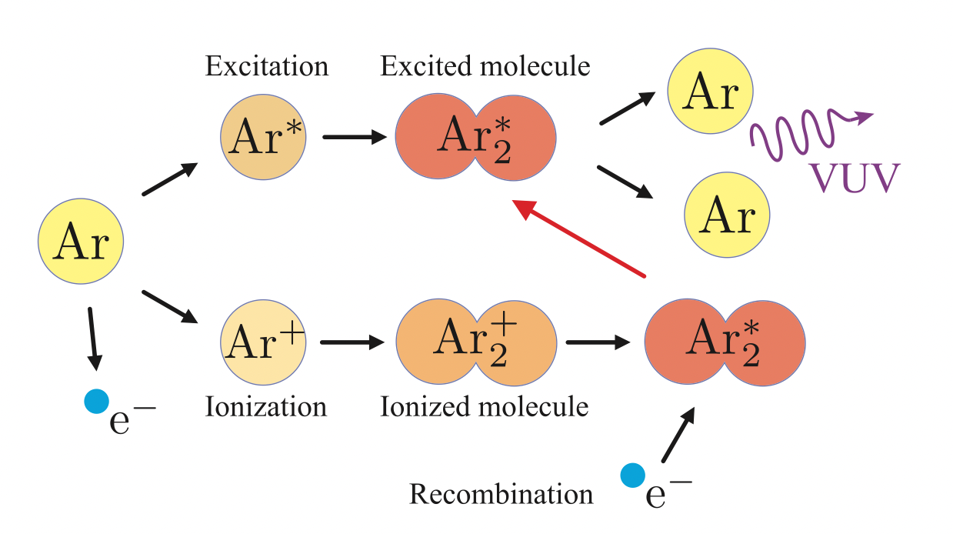
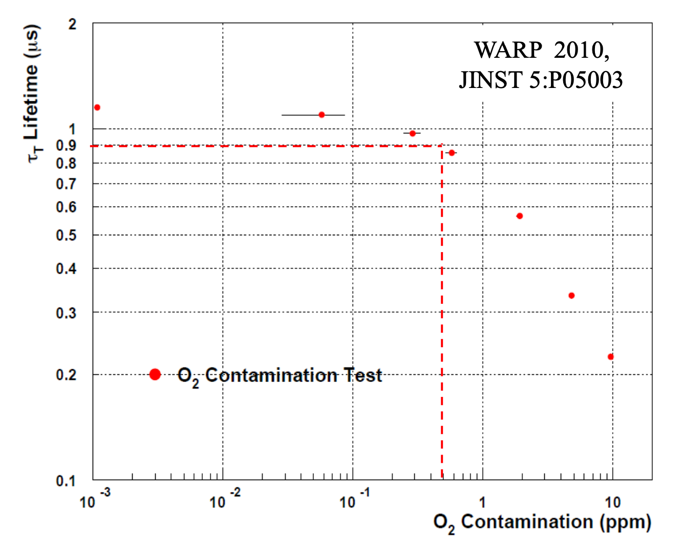
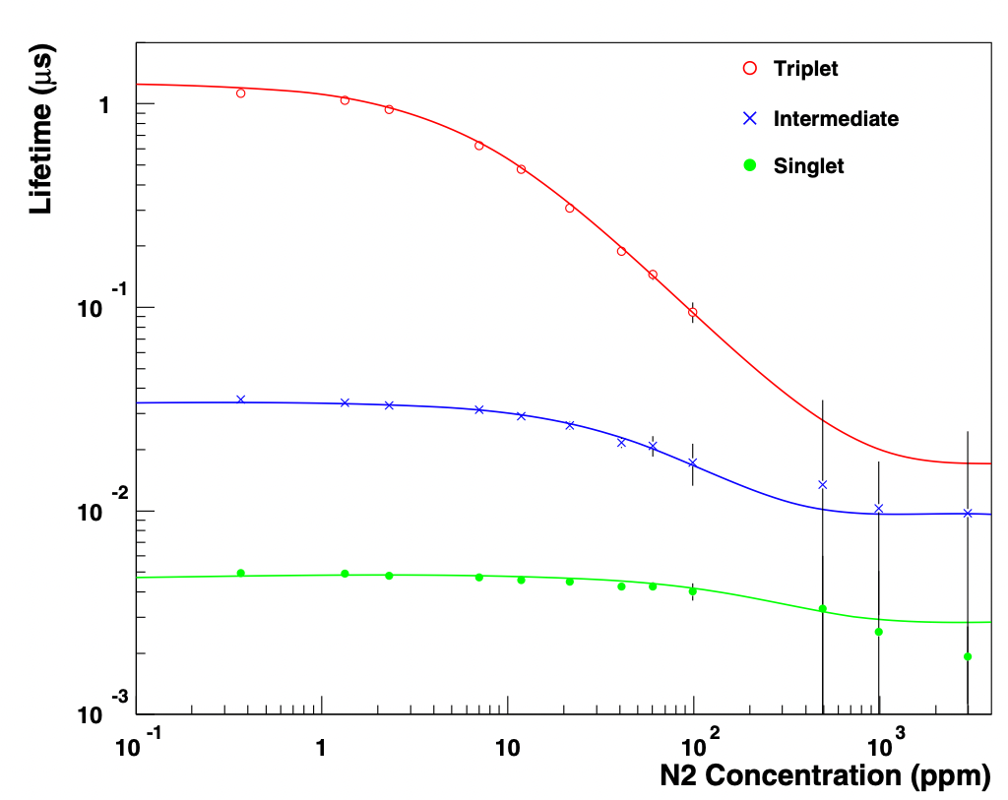
Introduction – LAr Purity and Scintillation
LAr scintillation properties include:
High light yield (40 photons per keV)
Emission wavelength: 128 nm (VUV)
Excimer lifetimes:
    Singlet → τ_{s} = ~5 ns
    Triplet → τ_{t} = 1.6 μs
Impurities (O₂ + N₂) can affect decay times:
Quenching mostly the triplet lifetime

Slide 4
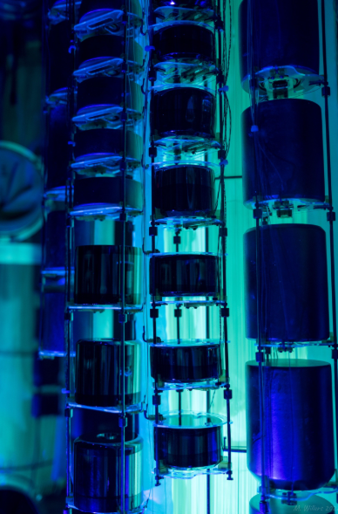
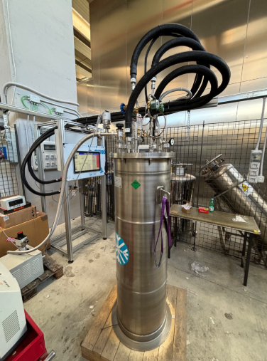
Our Goals – LEGENDArYno for Future LAr Detector
The current search for 0νββ from ⁷⁶Ge isotopes using HPGe:
Currently running LEGEND-200
The future project is LEGEND-1000
Goals:
To test and characterize light detectors for future upgrade to LEGEND experiment, LEGEND-1000.
Must determine the optical properties of the LAr in LEGEND-1000.
The activity:
Characterize and understand common properties of the light detectors and estimate LAr purity from real data.
HPGe Detectors under UV
LEGEND-1000 Prototype

Slide 5
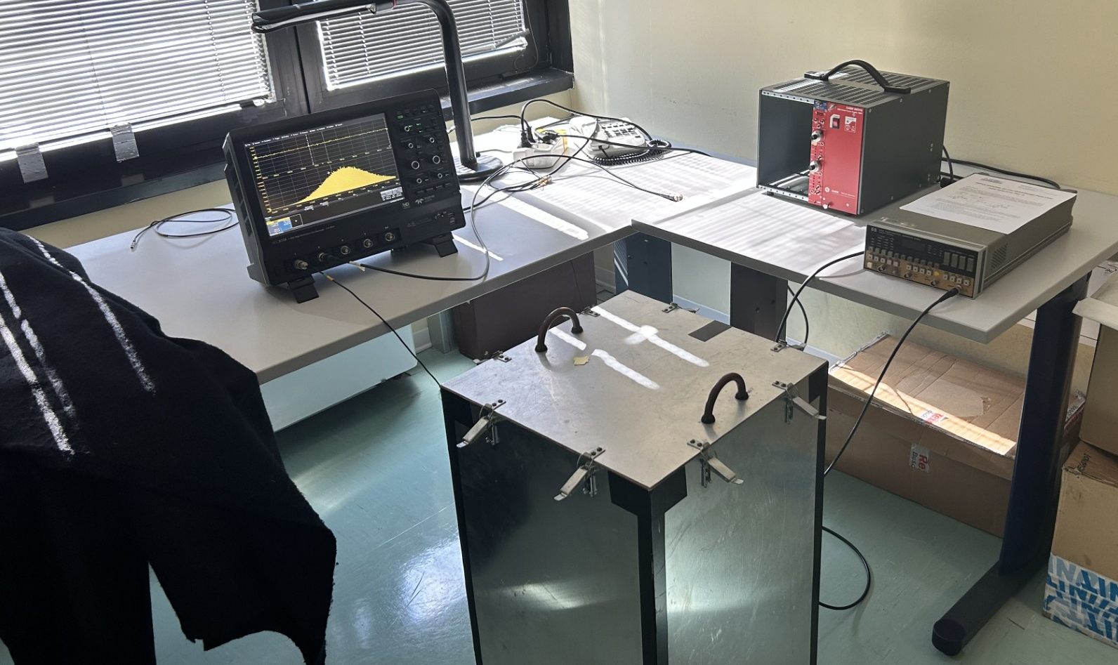
Experimental Setup - Electronics
Oscilloscope
High-Voltage
Controller
LED Pulse Generator
Cover for
Dark Box
Dark Box

Slide 6
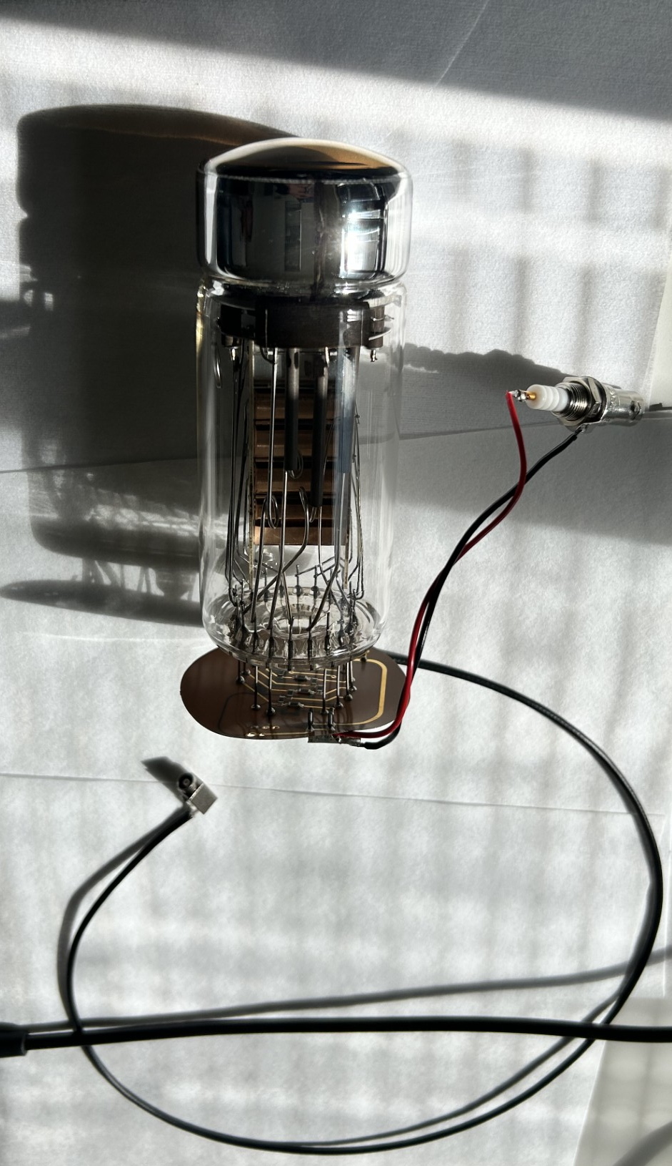
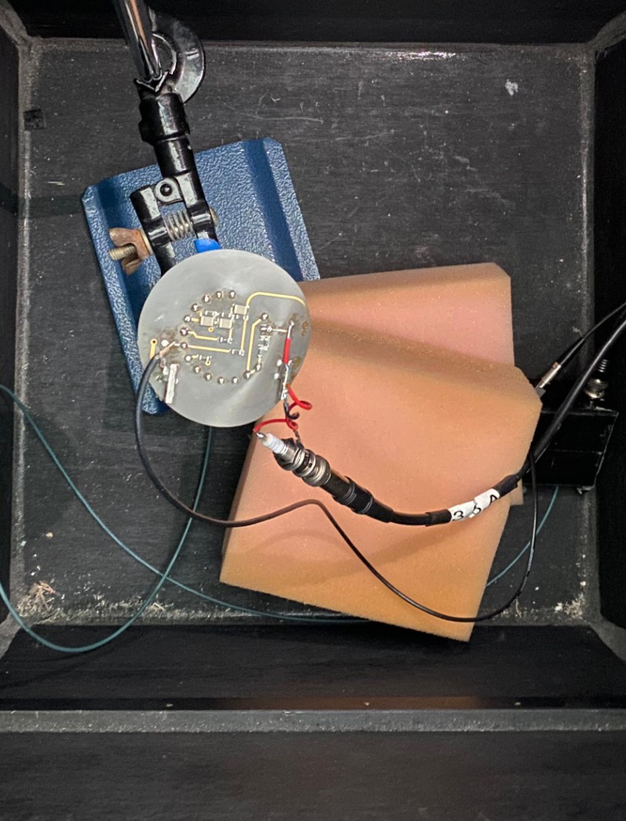
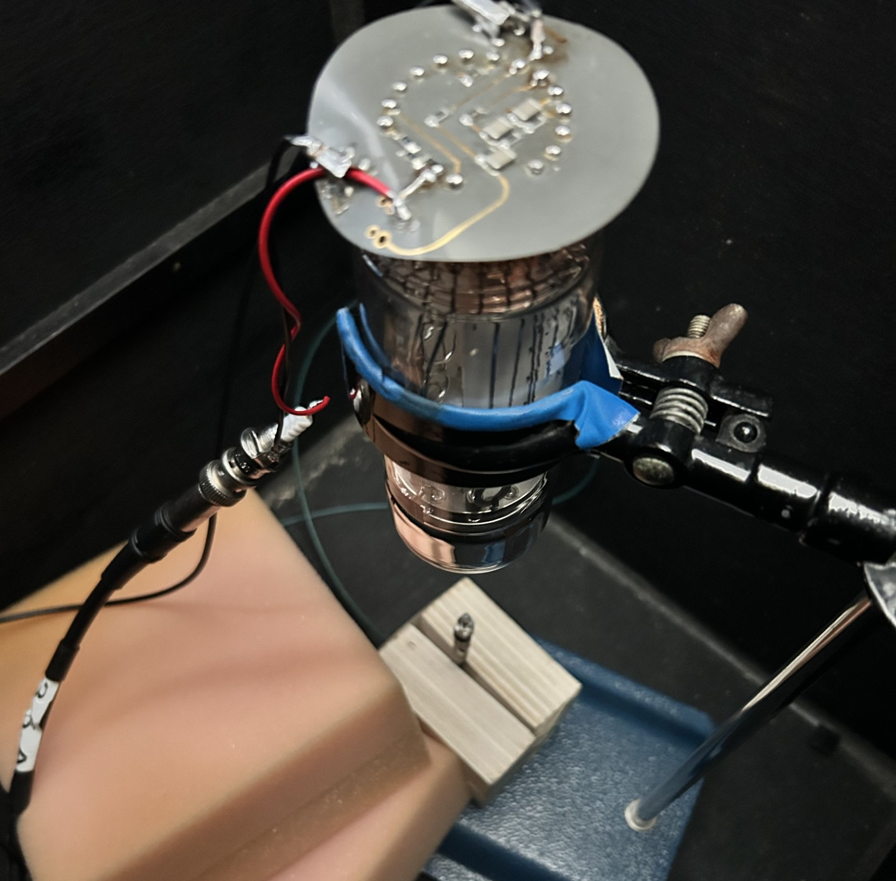
Experimental Setup - PMT
PMT Window
Top view of PMT in dark box
Side view of PMT in dark box
H-V connection
PMT
Dynodes
D = 10cm
Signal Output
Blue LED

Slide 7
Results – PMT Characterization with no LED
To understand the characteristics of the PMT under high voltage (HV), we can evaluate the single photoelectron peak to understand:
Gain
Dark count rate (DCR)
Baseline RMS
Mean +/- standard of area
From this, we can choose the optimal HV for PMT operation
LED source was used to imitate the light flashes from LAr and see how the signal is affected
Three different PMTs were characterized under only HV:
PMT-Michael (2-inch)
PMT-Keyu (2-inch)
PMT-Ginevra (3-inch)

Slide 8
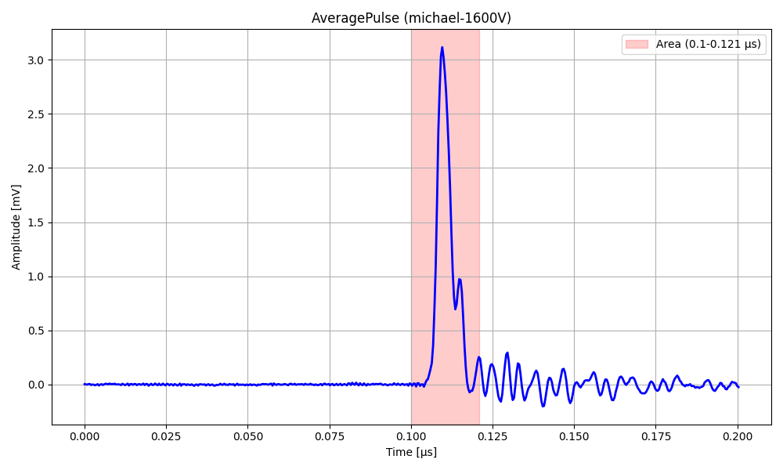
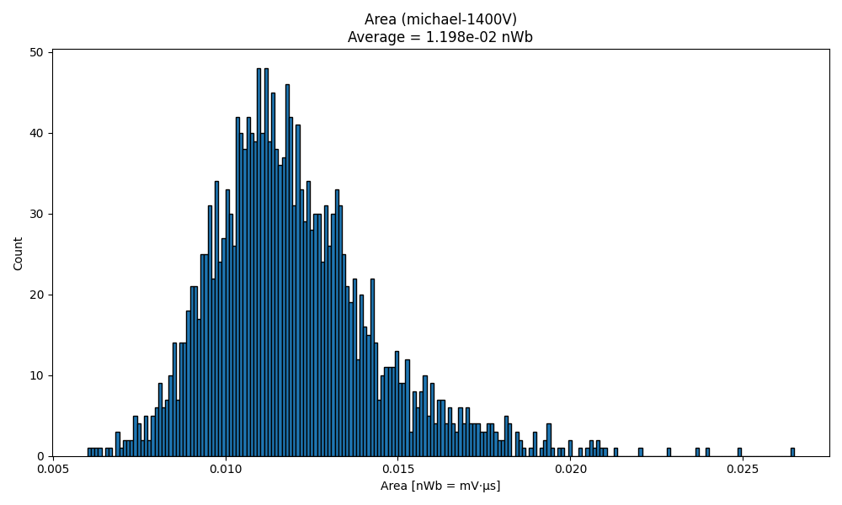
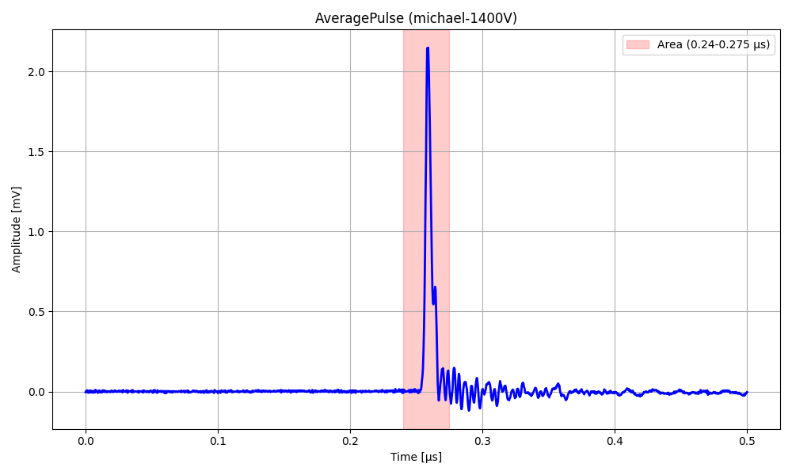
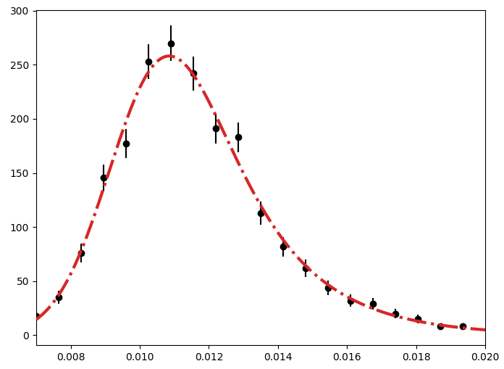
Results – PMT-Michael with no LED (1400V)

Slide 9
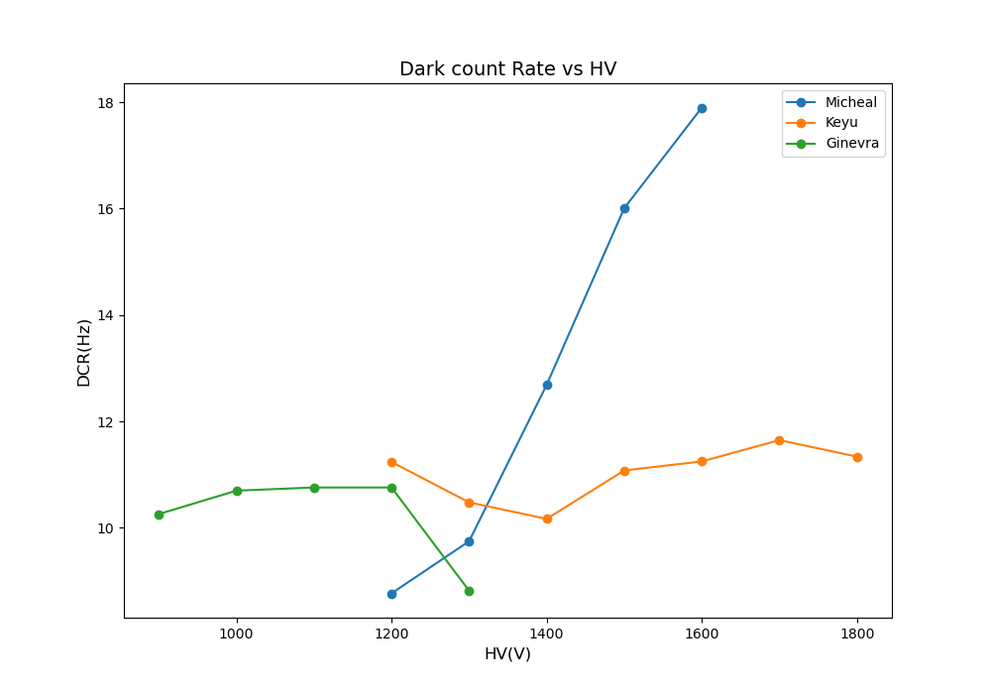
Results – DCR vs. HV

Slide 10
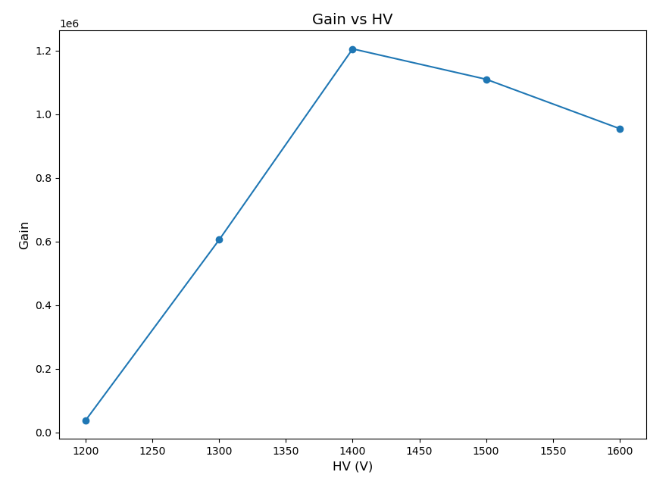
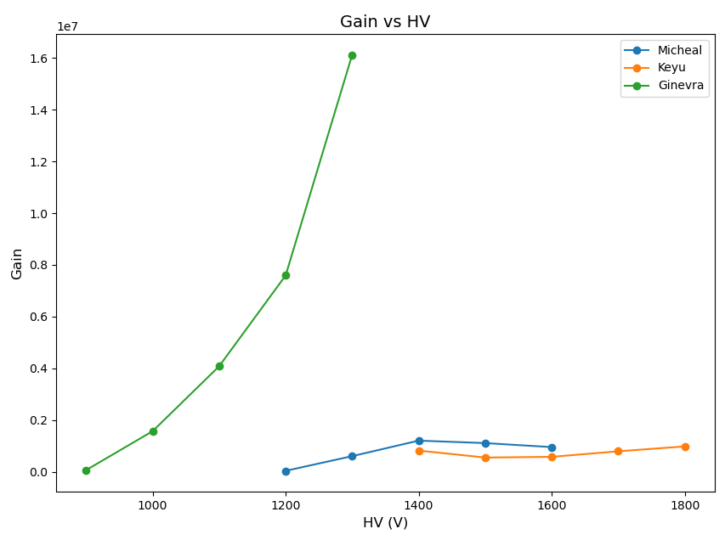
Results – Gain vs. HV
We test the response from the LED using PMT-Michael at HV = 1400V

Slide 11
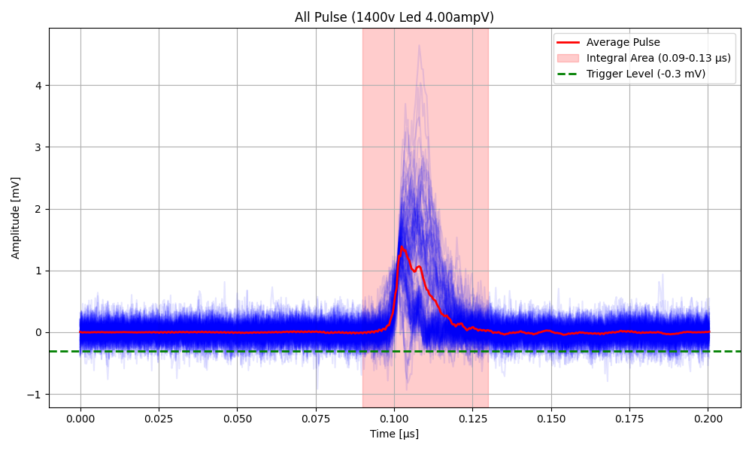
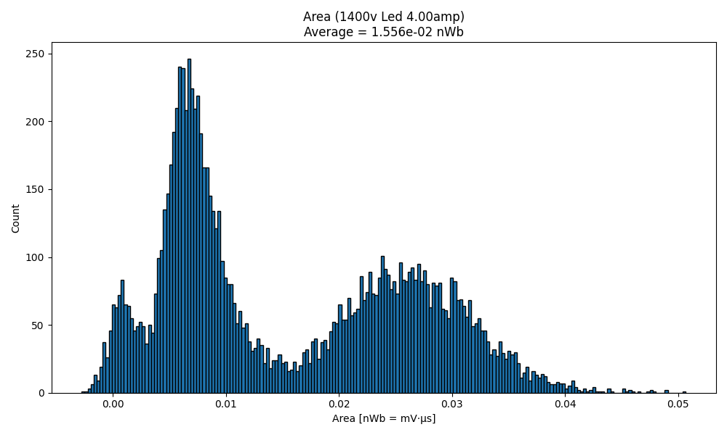
Results – PMT-Michael with LED
Triggered on PMT signal and with coincidence

Slide 12
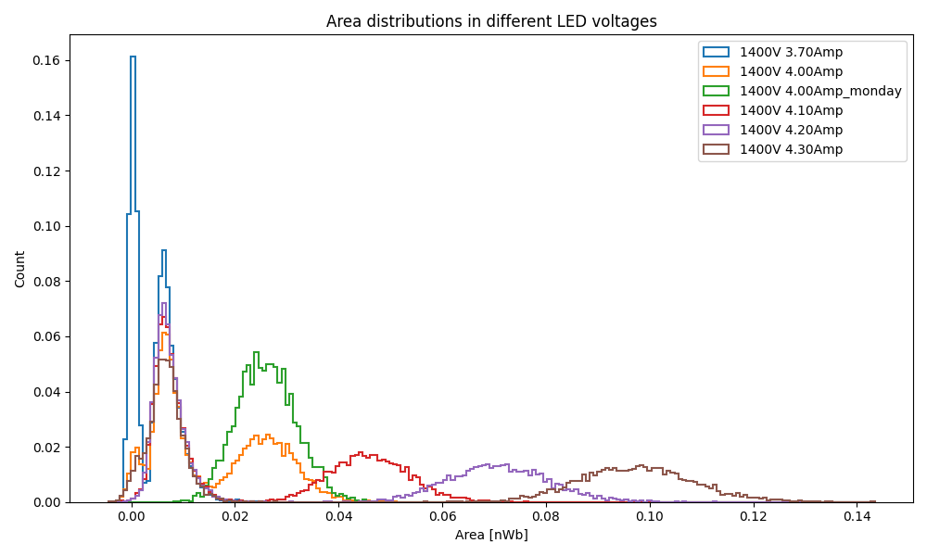
Results – PMT-Michael with LED
Noise+DCR peaks, mixed with SPE peak
Coincidence peak
Multi-Photon peaks

Slide 13
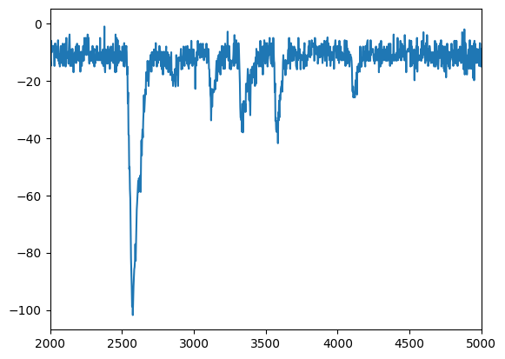
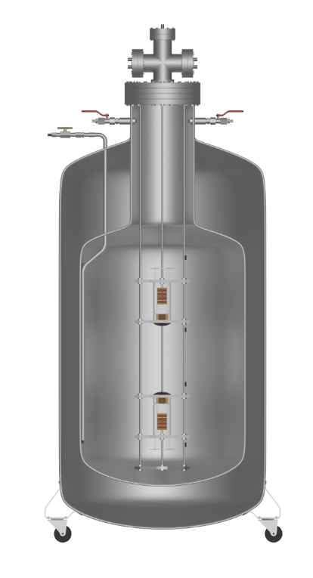
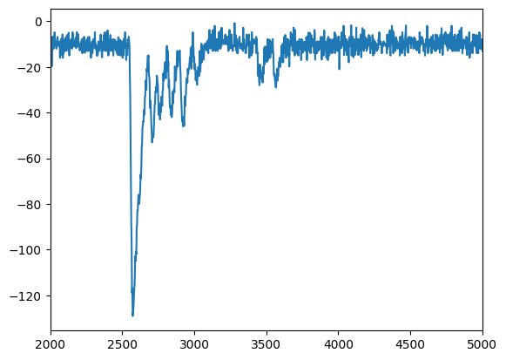
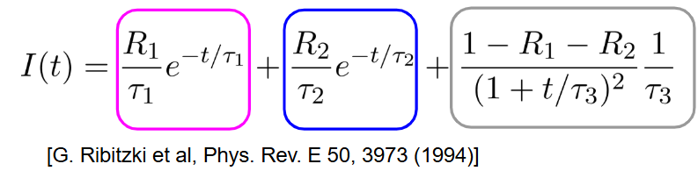
Results – Estimating purity from real LAr data
The Lar data was taken from the setup on the right:
60L metal sealed dewar, CF – 160 top flange
Scintillation from LAr viewed from two 2-inch TPB-coated PMTS
PMT readout with linear amplifiers
HV power supply
Temperature sensors to monitor the LAr
Single Waveform from the light pulse in LAr
longer lifetime pulse
Multiple components from singlet, triplet, and intermediate effects:
We are interested in the long triplet lifetimes.
Shorter lifetime pulse

Slide 14
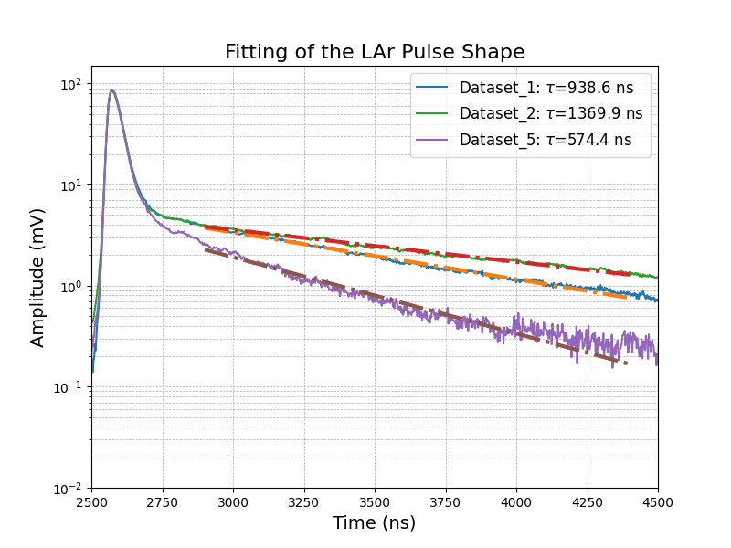
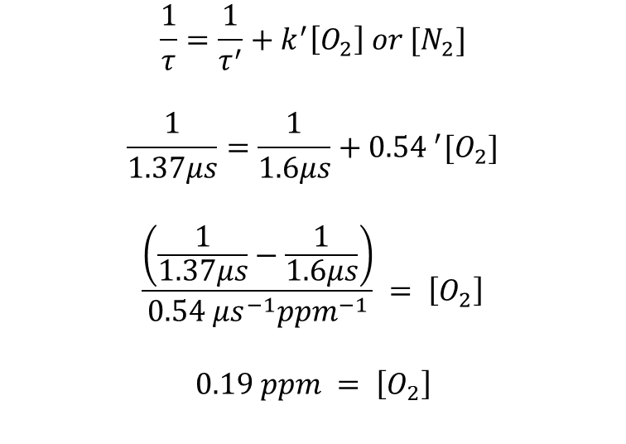
Results – Estimating purity from real LAr data
$$\frac{1}{τ}=\frac{1}{τ^{′}}+k^{′}\left[O_{2}\right] or [N_{2}]$$
$$\frac{1}{1.37μs}=\frac{1}{1.6μs}+{0.54 }^{′}[O_{2}]$$
$$\frac{\left(\frac{1}{1.37μs}−\frac{1}{1.6μs}\right)}{0.54 {μs}^{−1}{ppm}^{−1}} = \left[O_{2}\right]$$
$$0.19 ppm = \left[O_{2}\right]$$
Lifetime (τ) μs | [O₂] ppm | [N₂] ppm
1.37 | 0.19 | 0.95
0.94 | 0.81 | 3.98
0.57 | 2.09 | 10.3

Slide 15
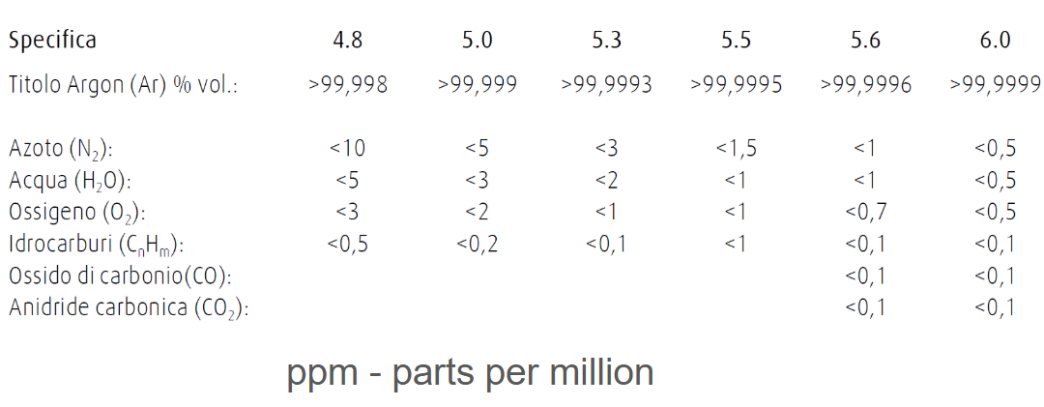
Results – Estimating purity from real LAr data
From our calculated concentration of O₂ and N_{2,} we can estimate the level of purity of Argon received from the supplier:
E.g., for τ = 0.94 μs, the concentrations correspond to an Argon rating of 5.0 (>99.999%)
This method is appropriate to measure the purity in LAr detectors (LEGENDArYno)
Lifetime (τ) μs | [O₂] ppm | [N₂] ppm
1.37 | 0.19 | 0.95
0.94 | 0.81 | 3.98
0.57 | 2.09 | 10.3

Slide 16
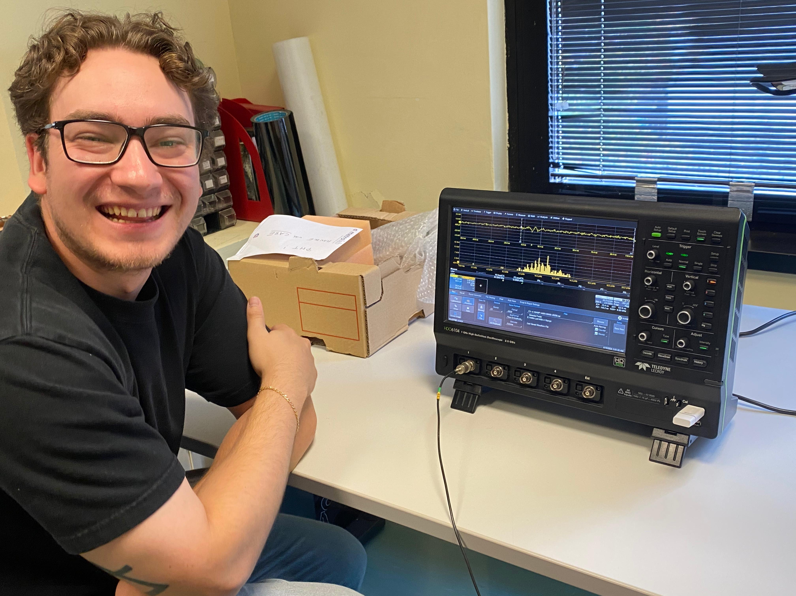
Thanks for Listening!!!!

