Slide 1
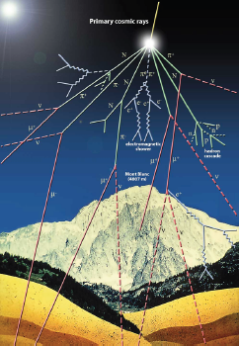
Gran Sasso Hands-on 2023 - PhD autumn school on experimental astroparticle physics
Hands-on activity: LUNA experiment
05.10.2023
Calibration of LUNA MV accelerator
Testing Ta₂O₅ targets and resonance strength determination at the LUNA-400 Accelerator
Anup Yadav (HZDR) & Verena Aures (TUM)

Slide 2
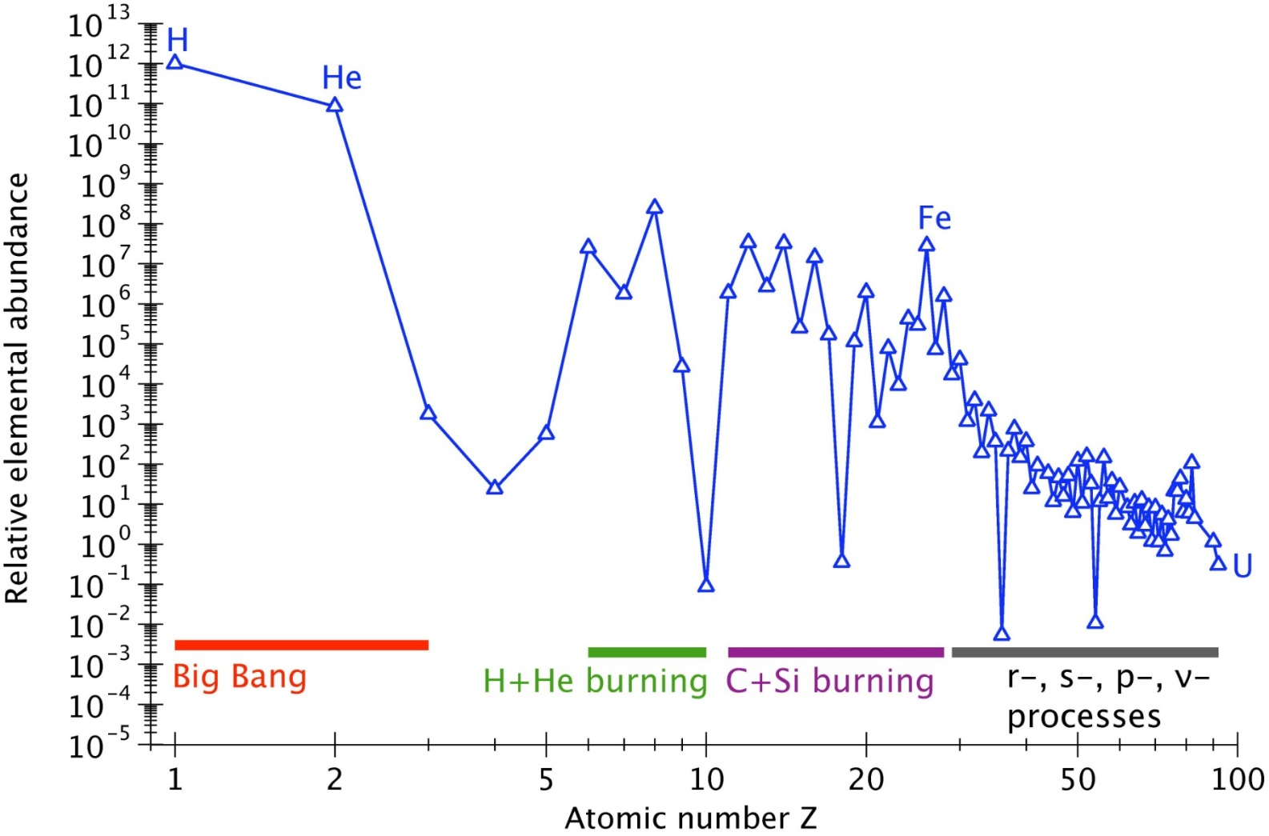
Stellar nucleosynthesis
Scientific motivation
The ³He(α,γ)⁷Be reaction affects both, the stellar hydrogen burning as well as the Big Bang Nucleosynthesis (BBN).
In the latter it influences the production of ⁷Li and
in the former the neutrino flux in the p-p II and
p-p III chain in the sun.
A recent theory study by Zhang et al. [2] proposes a correlation between the S-factor S(0) at low energies and the angular distribution of the emitted γ-rays. Measurements of this angular distribution at higher energies therefore gives the possibility to get a better estimation for a low energy data point and additionaly improves the extrapolation of the data and all analysis based on it.
BBN produced light elements, mainly H and ⁴He. Other elements are synthetized inside stars with an associated energy production.
LUNA - Direct corss section measurements @ Gamow window
The plot below shows the existing data, the solar fusion II fit and
highlights the relevant energy ranges for the sun and the BBN.
Charged-particle induced reactions

Slide 3
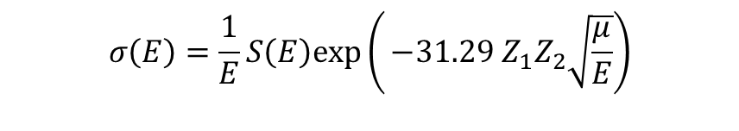
Cross section values at stellar energies
Scientific motivation
The ³He(α,γ)⁷Be reaction affects both, the stellar hydrogen burning as well as the Big Bang Nucleosynthesis (BBN).
In the latter it influences the production of ⁷Li and
in the former the neutrino flux in the p-p II and
p-p III chain in the sun.
A recent theory study by Zhang et al. [2] proposes a correlation between the S-factor S(0) at low energies and the angular distribution of the emitted γ-rays. Measurements of this angular distribution at higher energies therefore gives the possibility to get a better estimation for a low energy data point and additionaly improves the extrapolation of the data and all analysis based on it.
Example: our Sun:
kT = 1 keV
E_{C} ≈ 0.5-2 MeV
E₀ ≈ 5-30 keV
for reactions of H burning
kT but also E₀ << E_{C} !!
$$σ\left(E\right)=\frac{1}{E}S\left(E\right)exp\left(⁡−31.29 Z_{1}Z_{2}\sqrt{\frac{μ}{E}}\right)$$
Exponential decrease of the cross section with decreasing energy→Cross sections in the range of pb-fb at stellar energies
The plot below shows the existing data, the solar fusion II fit and
highlights the relevant energy ranges for the sun and the BBN.

Slide 4
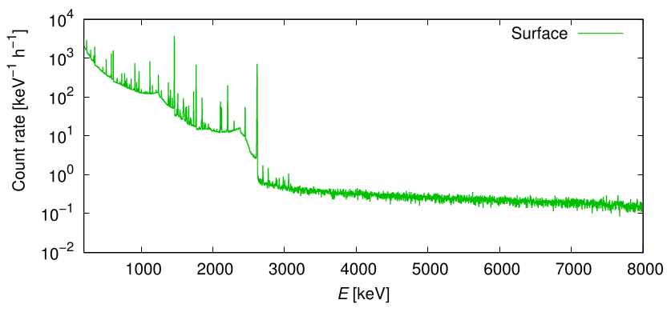
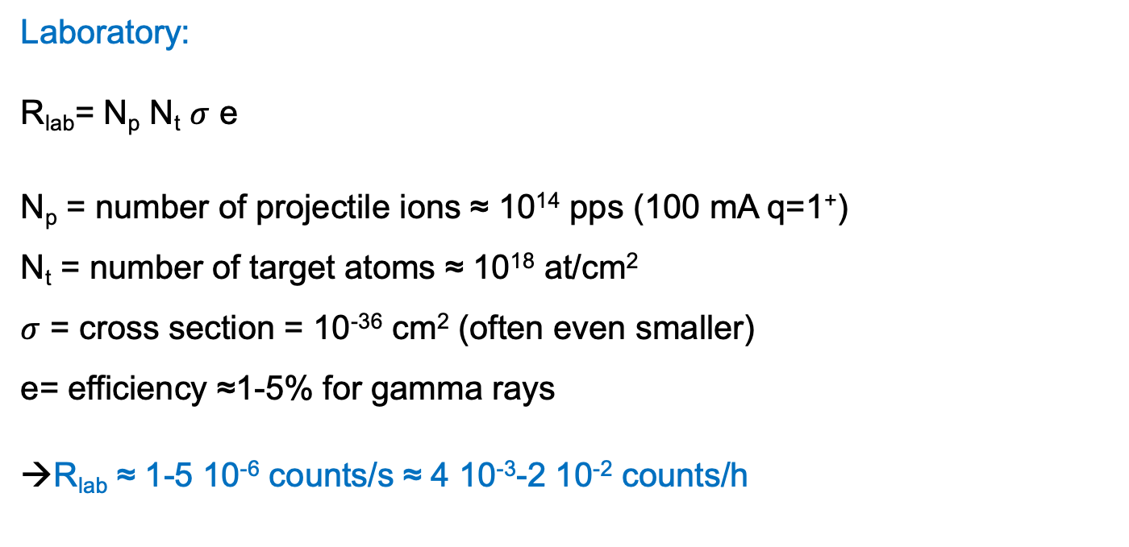
Reaction rate at stellar energies
Scientific motivation
The ³He(α,γ)⁷Be reaction affects both, the stellar hydrogen burning as well as the Big Bang Nucleosynthesis (BBN).
In the latter it influences the production of ⁷Li and
in the former the neutrino flux in the p-p II and
p-p III chain in the sun.
A recent theory study by Zhang et al. [2] proposes a correlation between the S-factor S(0) at low energies and the angular distribution of the emitted γ-rays. Measurements of this angular distribution at higher energies therefore gives the possibility to get a better estimation for a low energy data point and additionaly improves the extrapolation of the data and all analysis based on it.
Laboratory:
R_{lab}= N_{p} N_{t} $σ$ e
N_{p} = number of projectile ions ≈ 10¹⁴ pps (100 mA q=1⁺)
N_{t} = number of target atoms ≈ 10¹⁸ at/cm²
$σ$ = cross section = 10⁻³⁶ cm² (often even smaller)
e= efficiency ≈1-5% for gamma rays
→R_{lab} ≈ 1-5 10⁻⁶ counts/s ≈ 4 10⁻³-2 10⁻² counts/h
The plot below shows the existing data, the solar fusion II fit and
highlights the relevant energy ranges for the sun and the BBN.

Slide 5

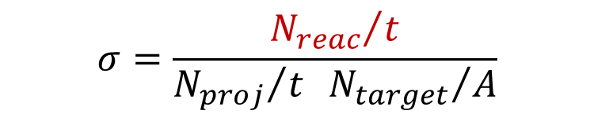
Measuring Fusion Reactions in Laboratory
Scientific motivation
The ³He(α,γ)⁷Be reaction affects both, the stellar hydrogen burning as well as the Big Bang Nucleosynthesis (BBN).
In the latter it influences the production of ⁷Li and
in the former the neutrino flux in the p-p II and
p-p III chain in the sun.
A recent theory study by Zhang et al. [2] proposes a correlation between the S-factor S(0) at low energies and the angular distribution of the emitted γ-rays. Measurements of this angular distribution at higher energies therefore gives the possibility to get a better estimation for a low energy data point and additionaly improves the extrapolation of the data and all analysis based on it.
Solid or gas
REACTION PRODUCTS
TARGET
ACCELERATOR
γ, p, n, α, ...
$$σ=\frac{{N_{reac}}/t}{{N_{proj}}/t{{ N}_{target}}/A}$$
DETECTOR
(to be chosen considering the particular case)
The plot below shows the existing data, the solar fusion II fit and
highlights the relevant energy ranges for the sun and the BBN.

Slide 6
What can we do?
Improve signal
  Increase beam intensity, increase target enrichment, …
Reduce background
  Active / passive shielding, background rejection via PSA, …
Novel detection techniques
  Improve efficiency as much as possible
Measure at higher energies and extrapolate
Scientific motivation
The ³He(α,γ)⁷Be reaction affects both, the stellar hydrogen burning as well as the Big Bang Nucleosynthesis (BBN).
In the latter it influences the production of ⁷Li and
in the former the neutrino flux in the p-p II and
p-p III chain in the sun.
A recent theory study by Zhang et al. [2] proposes a correlation between the S-factor S(0) at low energies and the angular distribution of the emitted γ-rays. Measurements of this angular distribution at higher energies therefore gives the possibility to get a better estimation for a low energy data point and additionaly improves the extrapolation of the data and all analysis based on it.
The plot below shows the existing data, the solar fusion II fit and
highlights the relevant energy ranges for the sun and the BBN.

Slide 7
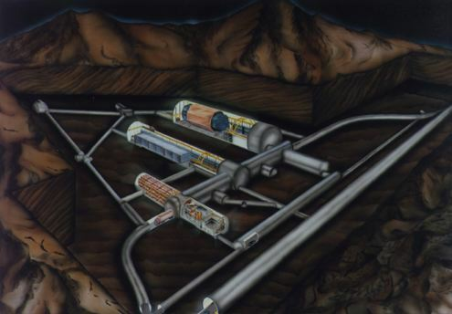
Laboratory for Underground Nuclear Astrophysics (LUNA)
Scientific motivation
The ³He(α,γ)⁷Be reaction affects both, the stellar hydrogen burning as well as the Big Bang Nucleosynthesis (BBN).
In the latter it influences the production of ⁷Li and
in the former the neutrino flux in the p-p II and
p-p III chain in the sun.
A recent theory study by Zhang et al. [2] proposes a correlation between the S-factor S(0) at low energies and the angular distribution of the emitted γ-rays. Measurements of this angular distribution at higher energies therefore gives the possibility to get a better estimation for a low energy data point and additionaly improves the extrapolation of the data and all analysis based on it.
Laboratory for Underground NuclearAstrophysics
LNGS (1400 m rock shielding ≡ 4000 m w.e.)
LUNA MV
(2022→...)
LUNA 1
(1992-2001)
50 kV
LUNA 2
(2000→…)
400 kV
Radiation | LNGS/surface
Muons Neutrons | 10⁻⁶ 10⁻³
The plot below shows the existing data, the solar fusion II fit and
highlights the relevant energy ranges for the sun and the BBN.

Slide 8
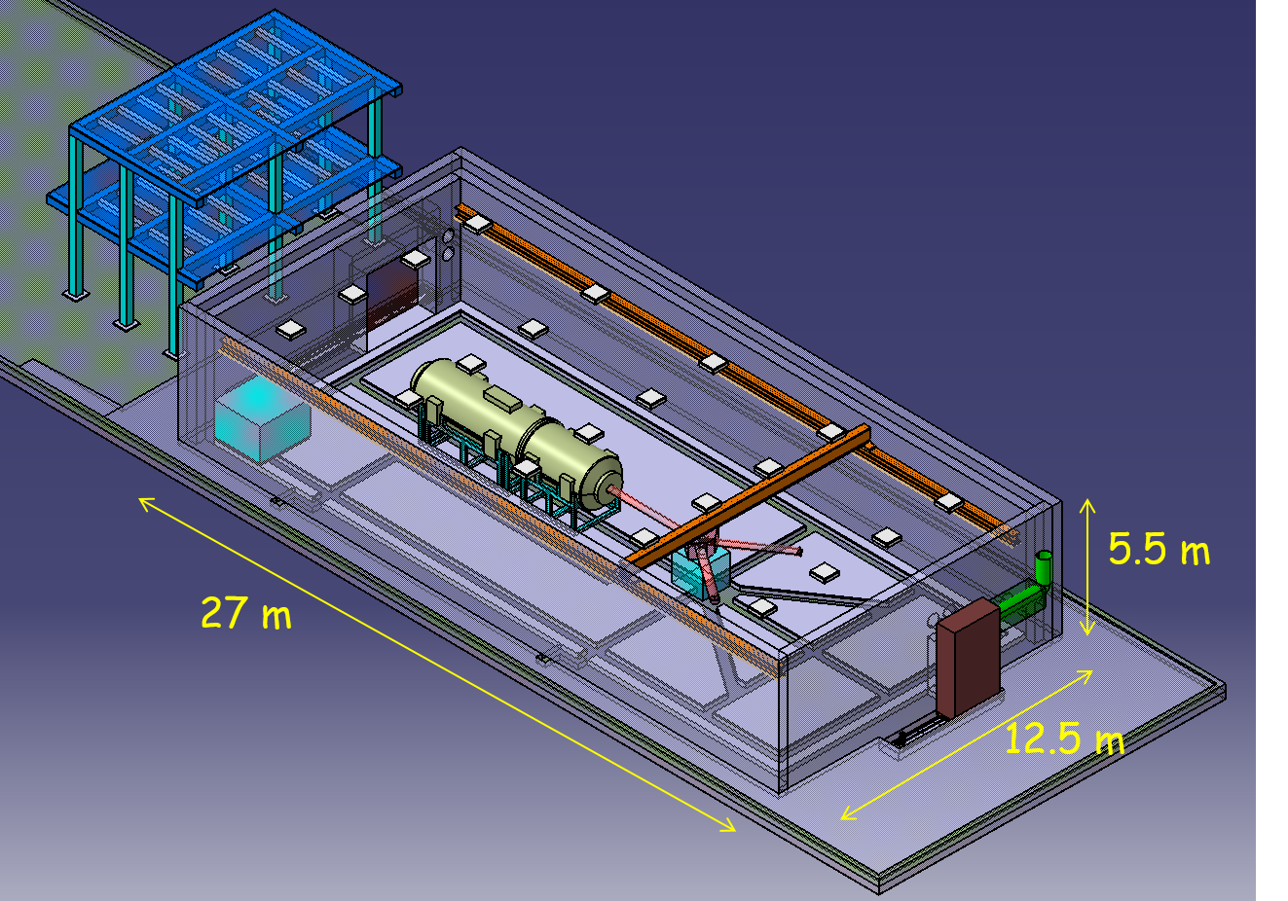
Week 1: The future LUNA MV accelerator
Inline Cockcroft Walton accelerator
Terminal voltage : 0.2 – 3.5 MV
Beam energy reproducibility: 0.01% TV or 50V
Beam energy stability: 0.001% TV / h
Beam current stability: < 5% / h
Scientific motivation
The ³He(α,γ)⁷Be reaction affects both, the stellar hydrogen burning as well as the Big Bang Nucleosynthesis (BBN).
In the latter it influences the production of ⁷Li and
in the former the neutrino flux in the p-p II and
p-p III chain in the sun.
A recent theory study by Zhang et al. [2] proposes a correlation between the S-factor S(0) at low energies and the angular distribution of the emitted γ-rays. Measurements of this angular distribution at higher energies therefore gives the possibility to get a better estimation for a low energy data point and additionaly improves the extrapolation of the data and all analysis based on it.
H⁺ beam: 500 - 1000 eµA
He⁺ beam: 300 - 500 eµA
C⁺ beam: 100 - 150 eµA
C⁺⁺ beam: 100 eµA
80 cm-thick concrete shielding around accelerator room. This will reduce the neutron flux just outside the shielding to a value about one order of magnitude lower than the neutron flux at LNGS
The plot below shows the existing data, the solar fusion II fit and
highlights the relevant energy ranges for the sun and the BBN.

Slide 9
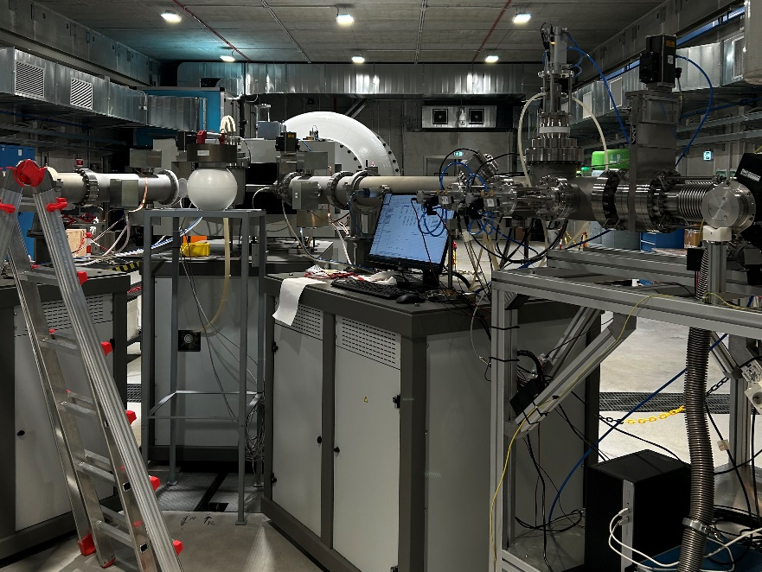
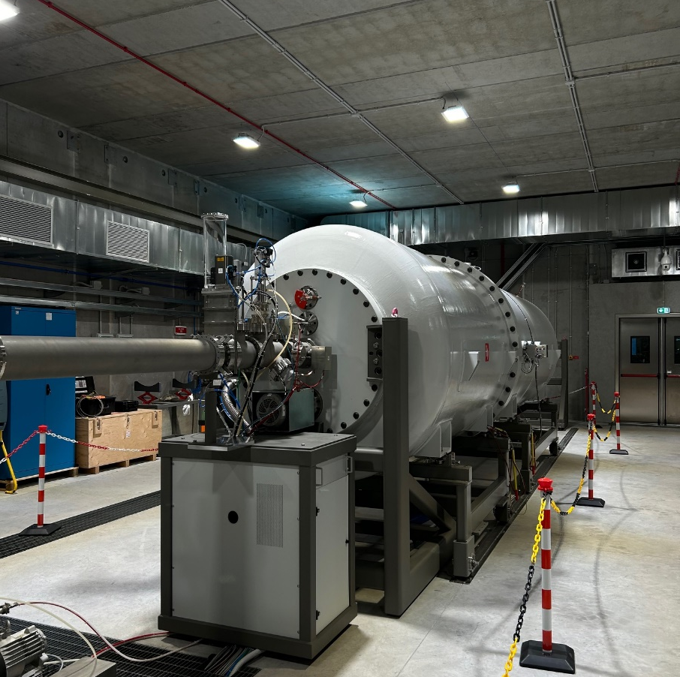
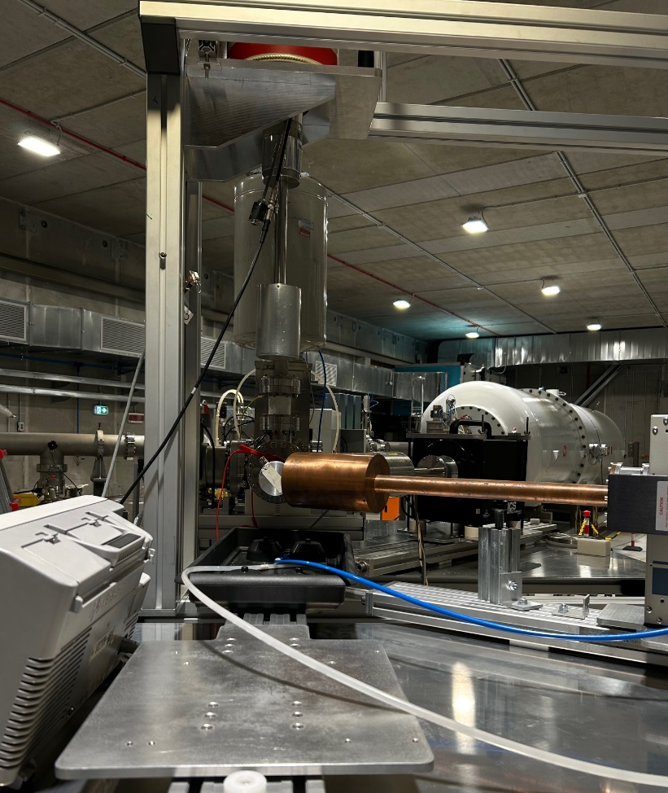
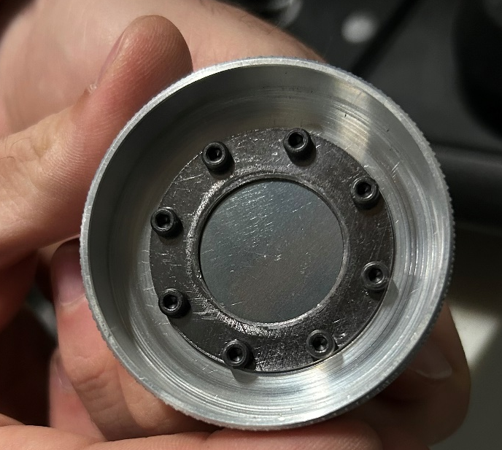
Experimental setup : LUNA-MV
²⁷Al target
HPGe detector

Slide 10
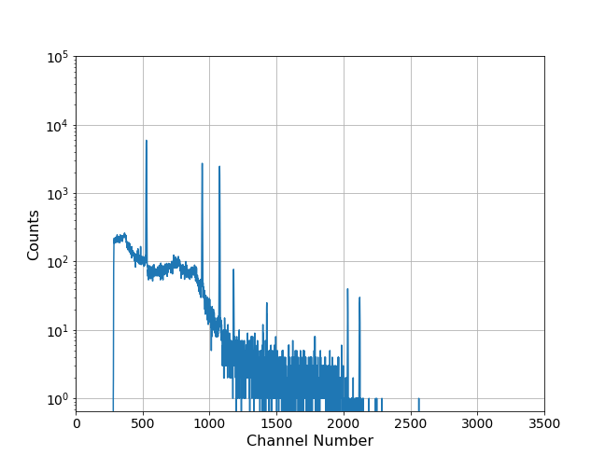
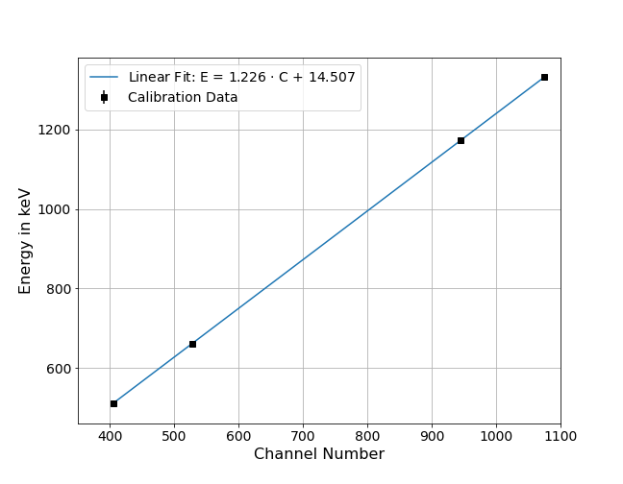
Calibration of the HPGe Detectors

Slide 11
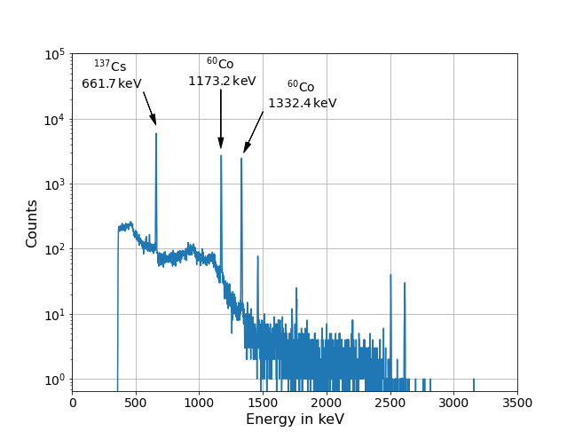
Calibration of the HPGe Detectors

Slide 12
Resonance scan of ²⁷Al(p, γ)²⁸Si reaction
Resonance scan of a well-known reaction for the accelerator energy calibration
In addition, study of beam stability for a long period

Slide 13
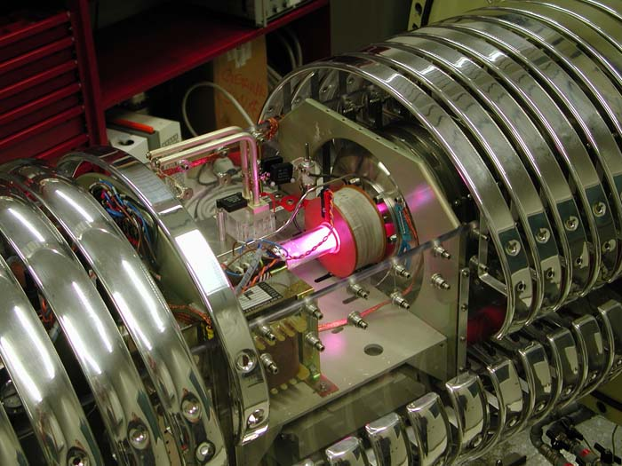
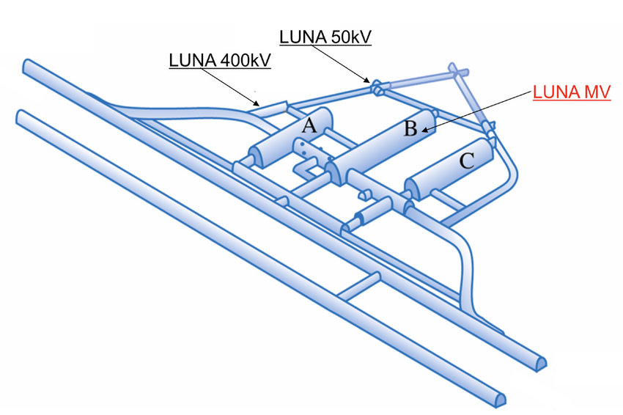
LUNA 400 KV – Week 2
E _{beam} ≈ 50 – 400 keV
I _{max} ≈ 500 μA protons I _{max} ≈ 250 μA alphas
Energy spread ≈ 70 eV Long term stability ≈ 5eV/h

Slide 14
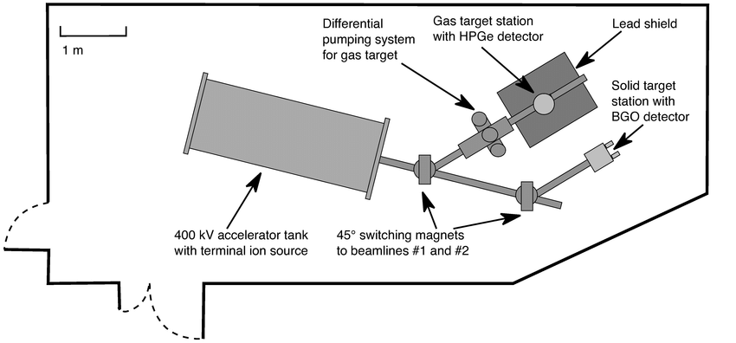
Target Production and Analysis (LUNA 400 kV)
Scientific motivation
The ³He(α,γ)⁷Be reaction affects both, the stellar hydrogen burning as well as the Big Bang Nucleosynthesis (BBN).
In the latter it influences the production of ⁷Li and
in the former the neutrino flux in the p-p II and
p-p III chain in the sun.
A recent theory study by Zhang et al. [2] proposes a correlation between the S-factor S(0) at low energies and the angular distribution of the emitted γ-rays. Measurements of this angular distribution at higher energies therefore gives the possibility to get a better estimation for a low energy data point and additionaly improves the extrapolation of the data and all analysis based on it.
LUNA-400:
Study of resonances and cross sections in gas and solid targets below 400 keV
What we did:
Solid target production (via anodic oxidation)
Analysis of data from similar targets using BGO detectors
Characterization of the extended gas target
The plot below shows the existing data, the solar fusion II fit and
highlights the relevant energy ranges for the sun and the BBN.

Slide 15
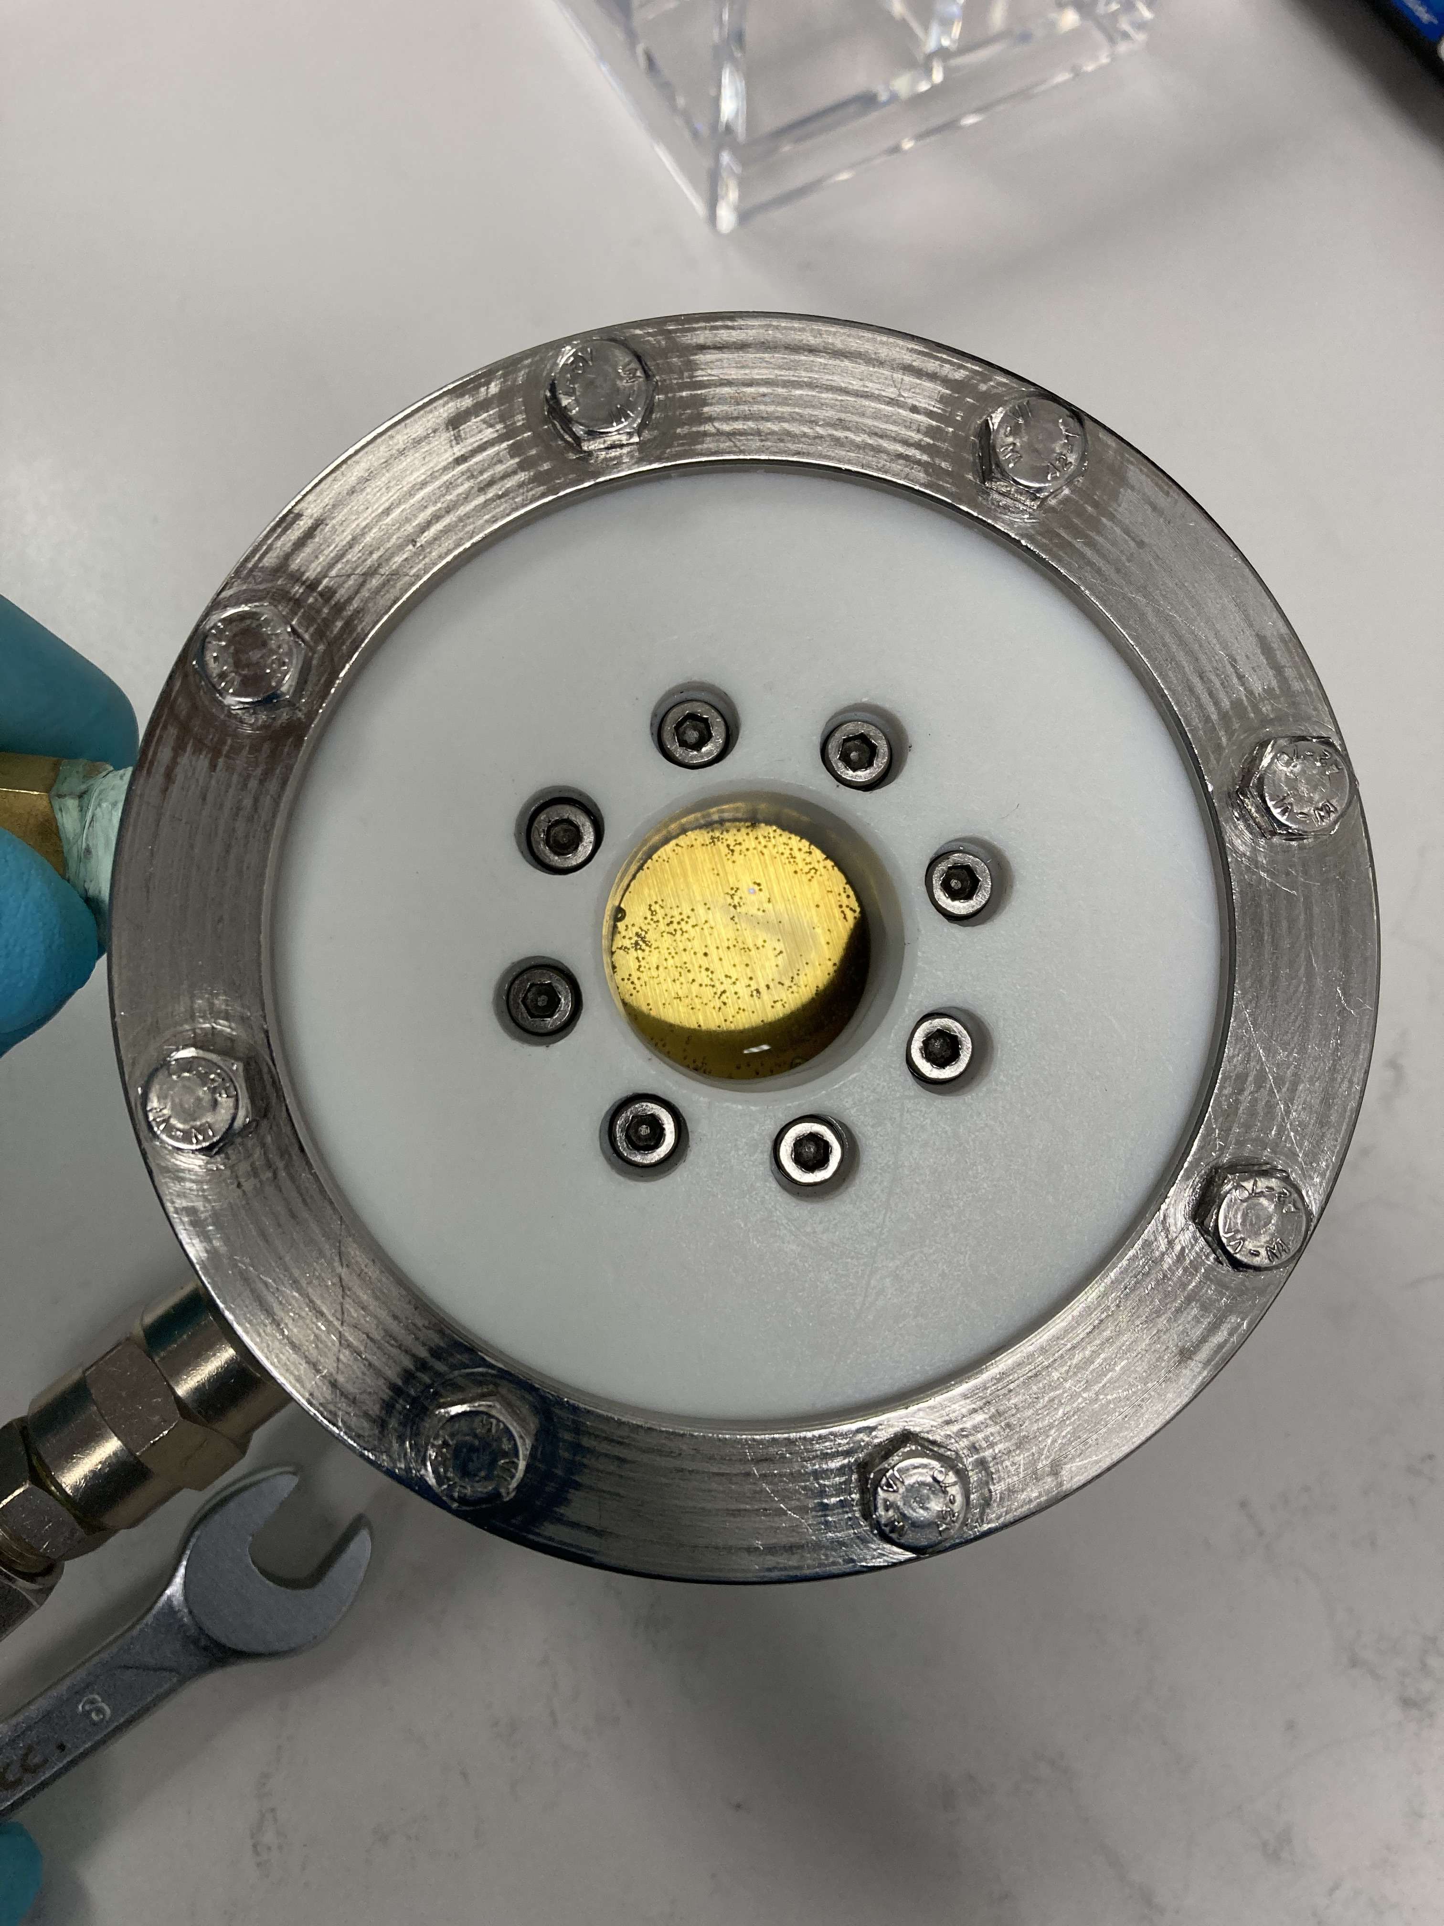
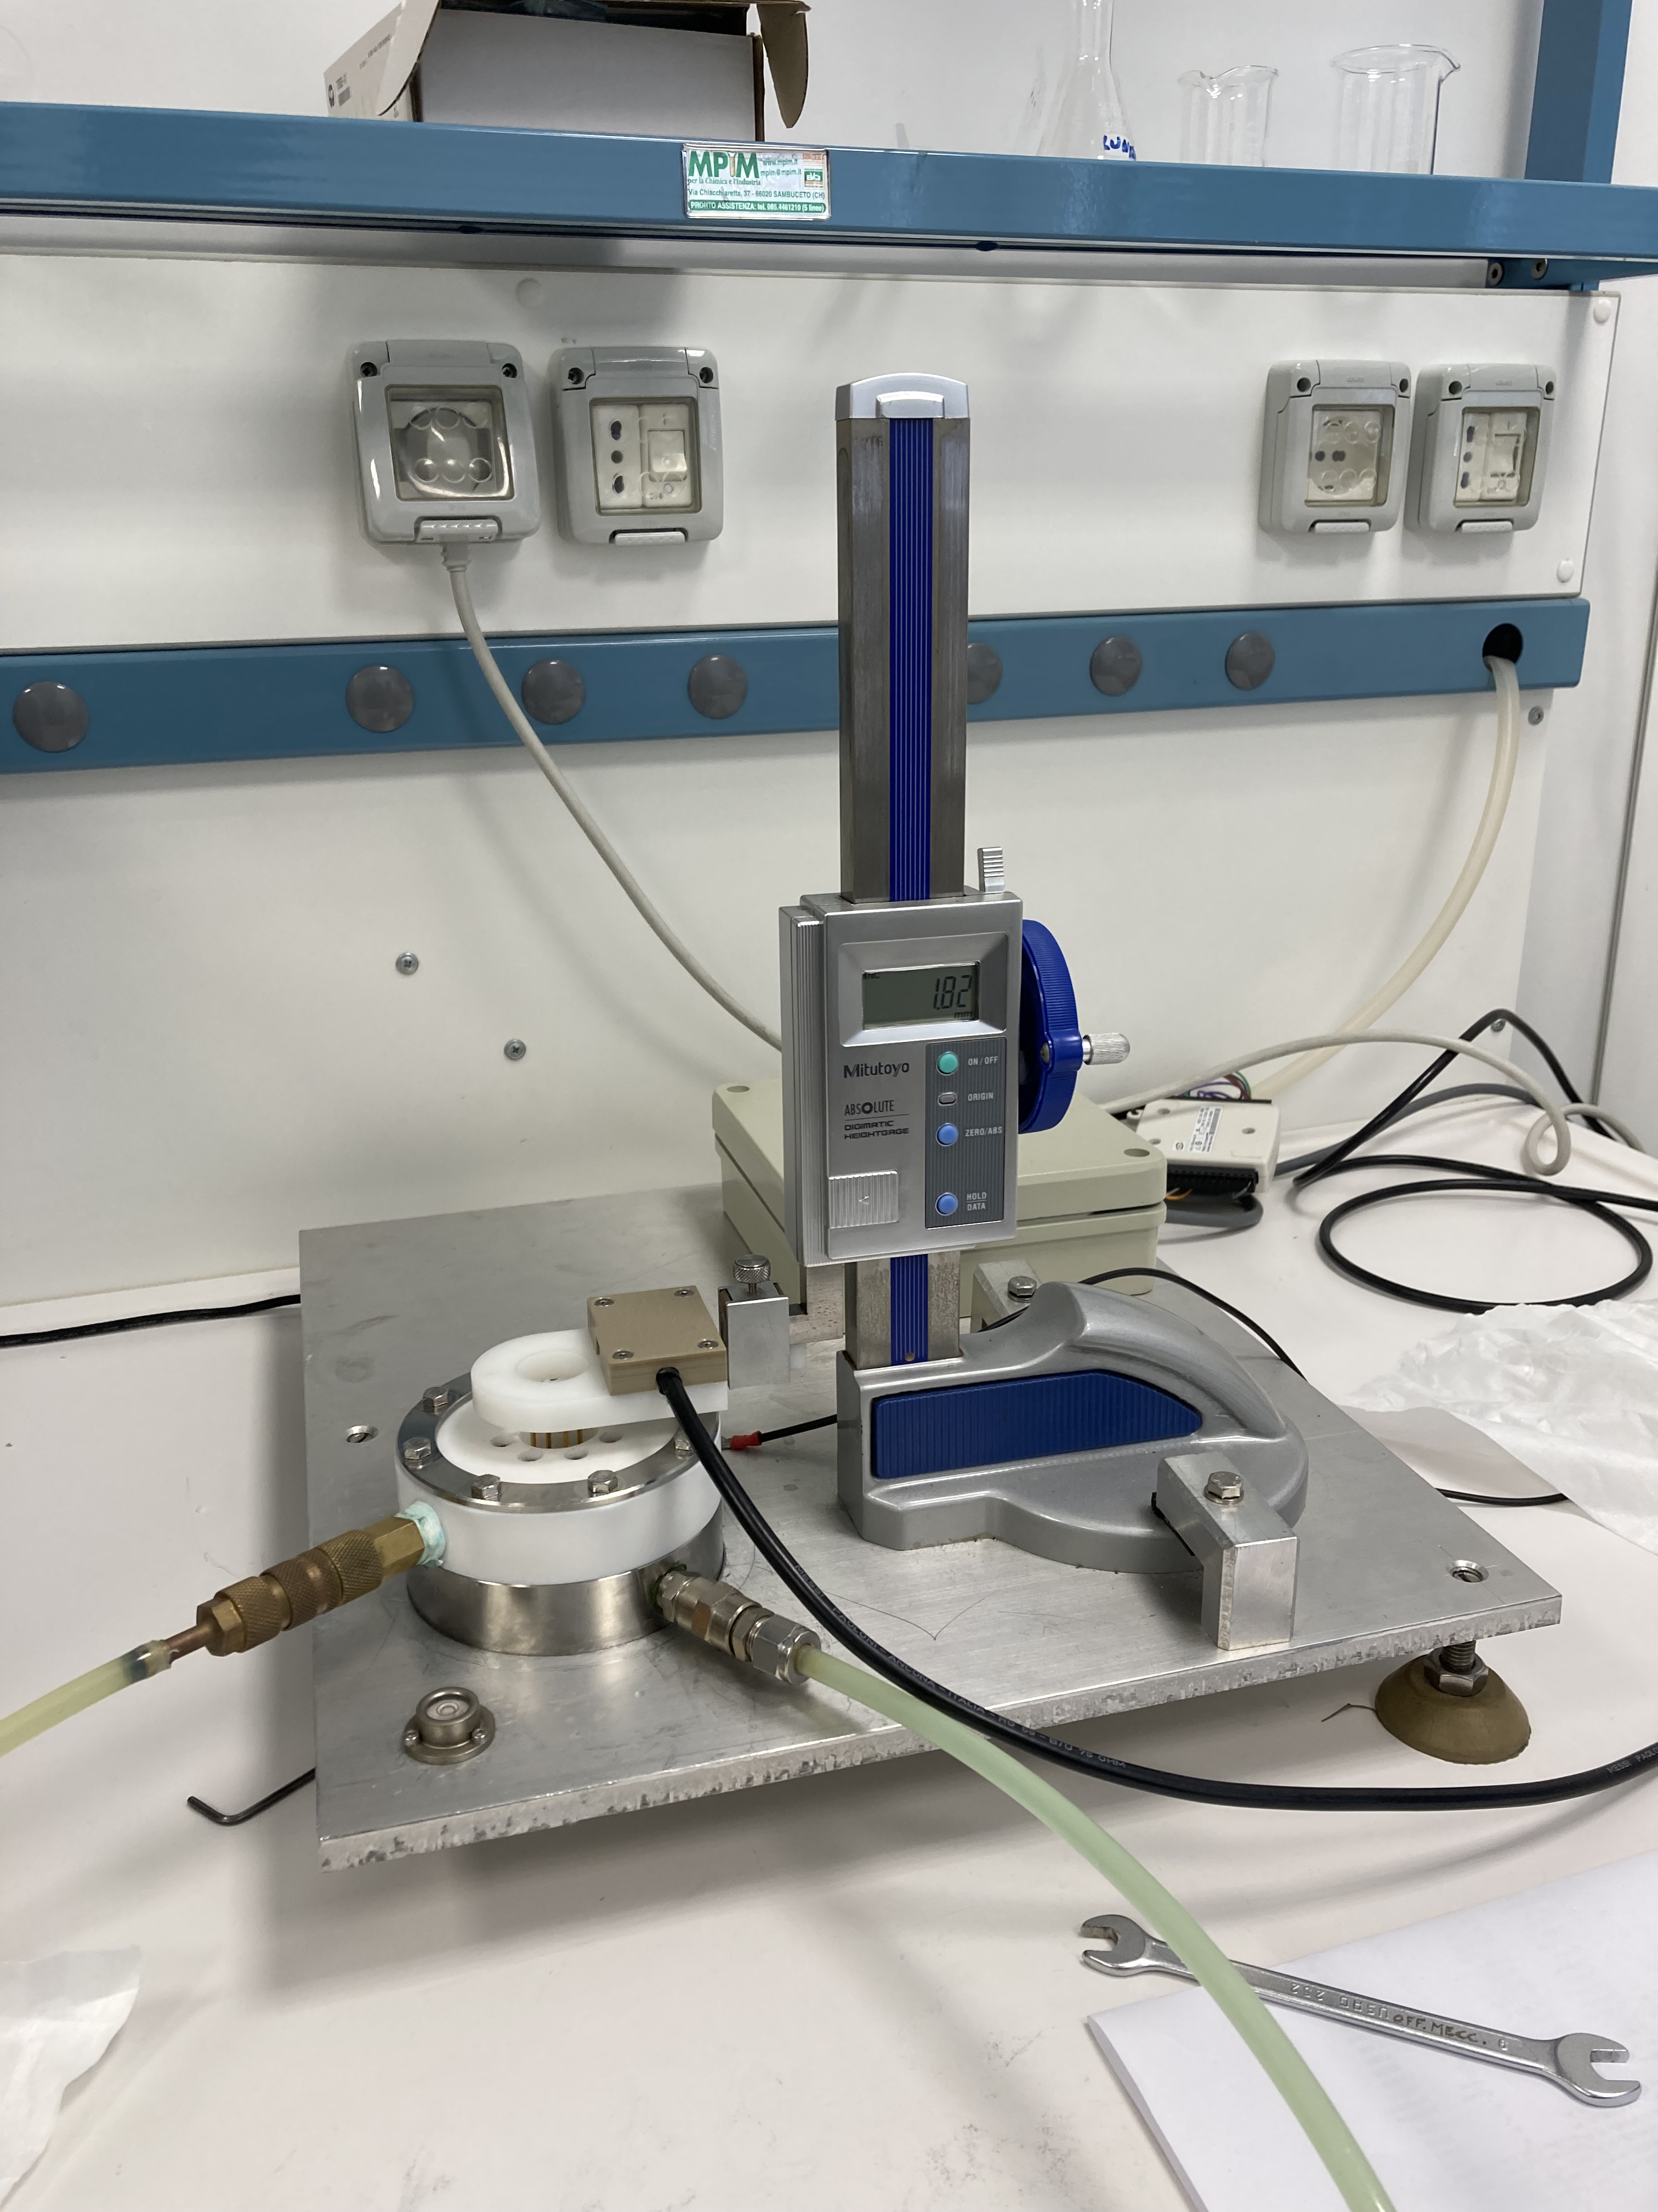
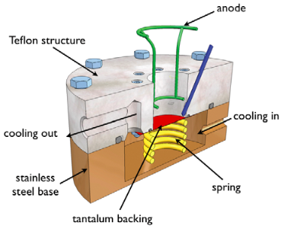
Production of Ta₂O₅ Targets
Scientific motivation
The ³He(α,γ)⁷Be reaction affects both, the stellar hydrogen burning as well as the Big Bang Nucleosynthesis (BBN).
In the latter it influences the production of ⁷Li and
in the former the neutrino flux in the p-p II and
p-p III chain in the sun.
A recent theory study by Zhang et al. [2] proposes a correlation between the S-factor S(0) at low energies and the angular distribution of the emitted γ-rays. Measurements of this angular distribution at higher energies therefore gives the possibility to get a better estimation for a low energy data point and additionaly improves the extrapolation of the data and all analysis based on it.
Solid target production via anodic oxidation on tantalum backings (Ta₂O₅)
Homogeneous targets
Well known relation between voltage and target thickness:
d = 1.9225 x (V + 1.4) nm
The plot below shows the existing data, the solar fusion II fit and
highlights the relevant energy ranges for the sun and the BBN.

Slide 16
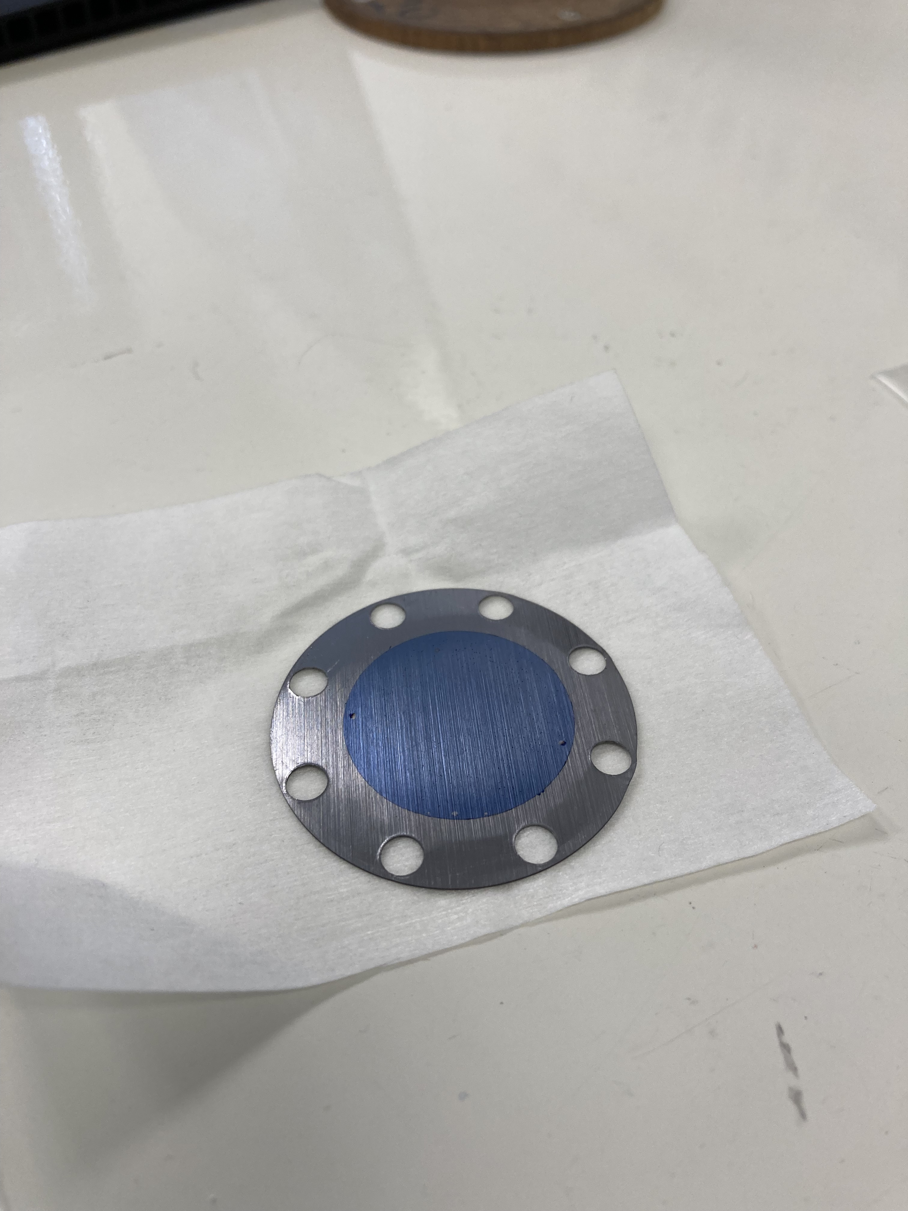
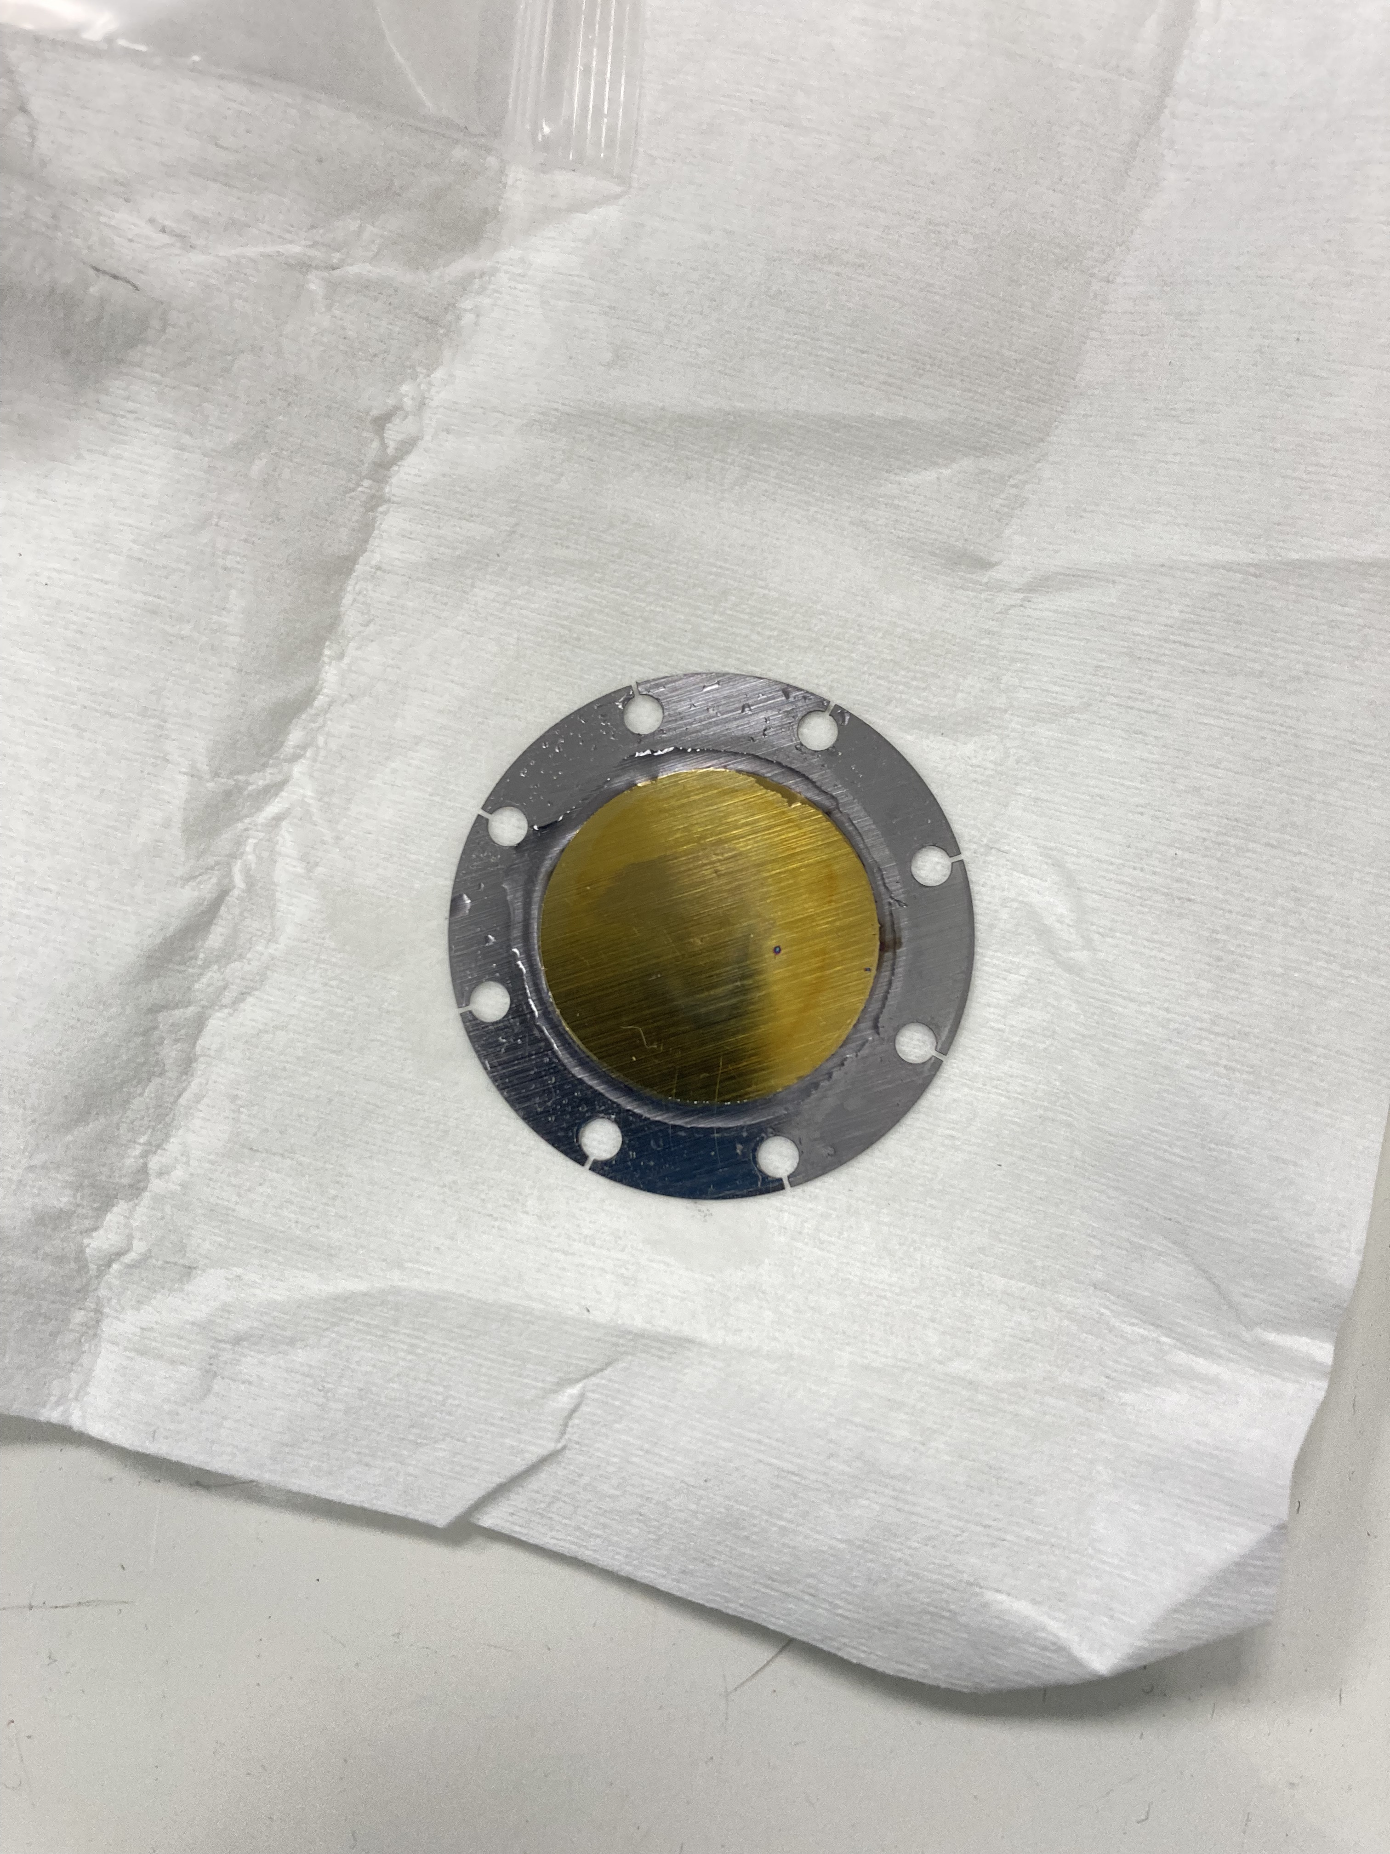
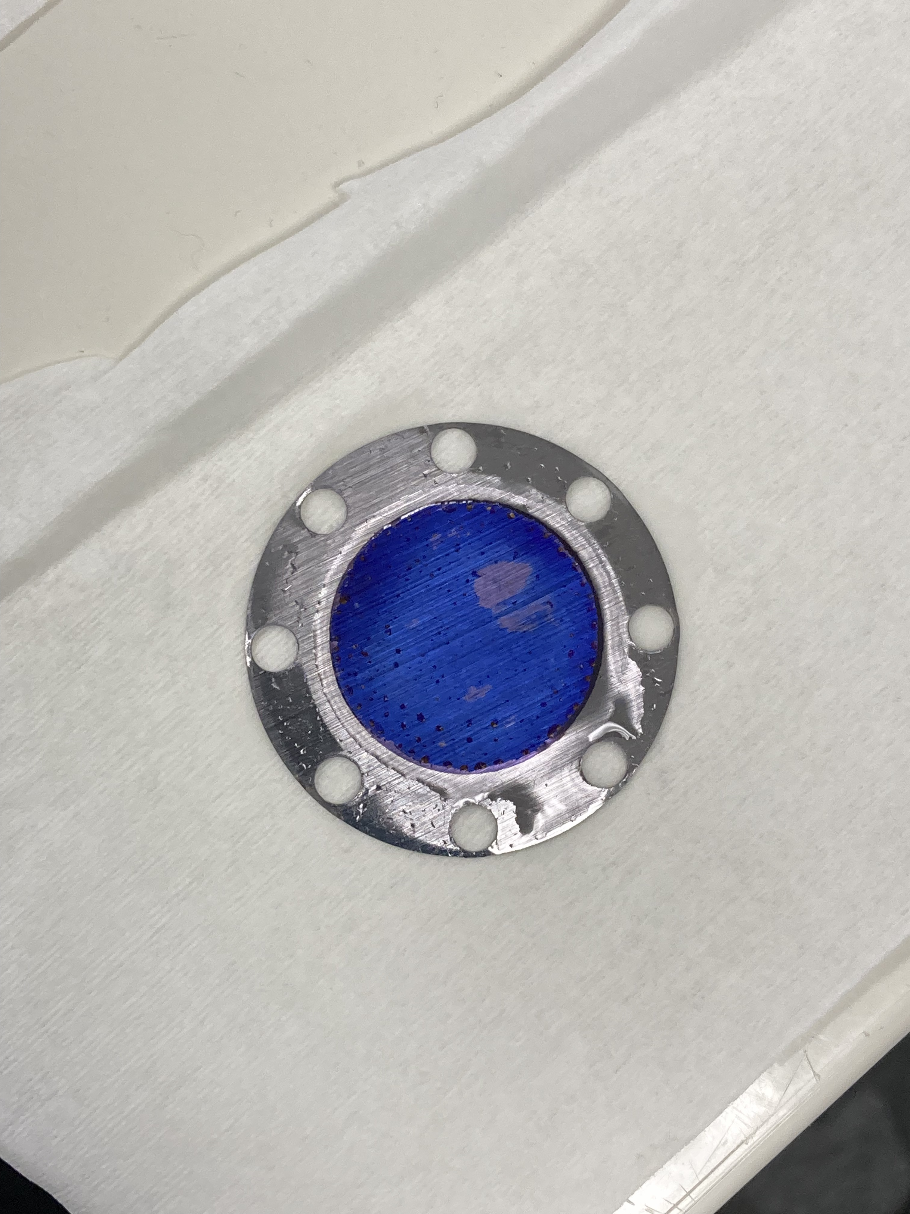
Production of Ta₂O₅ Targets
Scientific motivation
The ³He(α,γ)⁷Be reaction affects both, the stellar hydrogen burning as well as the Big Bang Nucleosynthesis (BBN).
In the latter it influences the production of ⁷Li and
in the former the neutrino flux in the p-p II and
p-p III chain in the sun.
A recent theory study by Zhang et al. [2] proposes a correlation between the S-factor S(0) at low energies and the angular distribution of the emitted γ-rays. Measurements of this angular distribution at higher energies therefore gives the possibility to get a better estimation for a low energy data point and additionaly improves the extrapolation of the data and all analysis based on it.
Different thicknesses appear in different colors:
¹⁸O (99 %) @ 48 V (but power supply failure)
¹⁸O (99 %) @ 78 V
2 ml UPW + 0.1 ml ¹⁸O (89 %) @ 30 V
The plot below shows the existing data, the solar fusion II fit and
highlights the relevant energy ranges for the sun and the BBN.

Slide 17
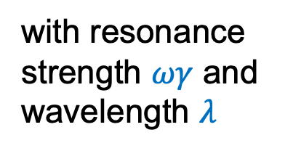
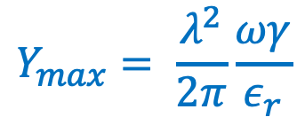

Characterization of Solid Targets: Aims and Techniques
Scientific motivation
The ³He(α,γ)⁷Be reaction affects both, the stellar hydrogen burning as well as the Big Bang Nucleosynthesis (BBN).
In the latter it influences the production of ⁷Li and
in the former the neutrino flux in the p-p II and
p-p III chain in the sun.
A recent theory study by Zhang et al. [2] proposes a correlation between the S-factor S(0) at low energies and the angular distribution of the emitted γ-rays. Measurements of this angular distribution at higher energies therefore gives the possibility to get a better estimation for a low energy data point and additionaly improves the extrapolation of the data and all analysis based on it.
Target thickness
  Use thickness from formula in nm to obtain ΔE with SRIM
  Compare theoretical result with measurement data (fit)
Stopping power $ε_{r}$
  Obtain maximal yield Y_{max} via data fitting
  Get stopping power from relation
with resonance strength $ωγ$ and wavelength $λ$
$$Y_{max}= \frac{λ^{2}}{2π}\frac{ωγ}{ε_{r}}$$
Composition
The plot below shows the existing data, the solar fusion II fit and
highlights the relevant energy ranges for the sun and the BBN.
Nuclear Resonant Reaction Analysis (NRRA)

Slide 18
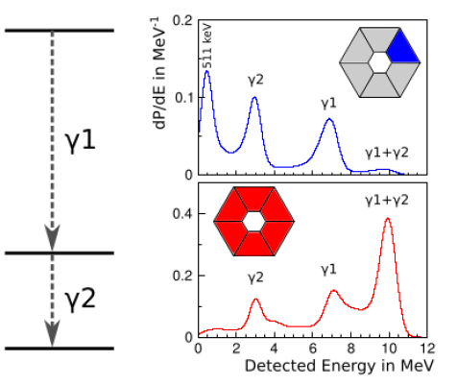
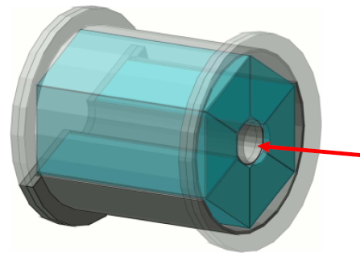
Characterization of Targets with NRRA (BGO Detectors)
Scientific motivation
The ³He(α,γ)⁷Be reaction affects both, the stellar hydrogen burning as well as the Big Bang Nucleosynthesis (BBN).
In the latter it influences the production of ⁷Li and
in the former the neutrino flux in the p-p II and
p-p III chain in the sun.
A recent theory study by Zhang et al. [2] proposes a correlation between the S-factor S(0) at low energies and the angular distribution of the emitted γ-rays. Measurements of this angular distribution at higher energies therefore gives the possibility to get a better estimation for a low energy data point and additionaly improves the extrapolation of the data and all analysis based on it.
BGO scintillator crystal detector
Worse energy resolution than HPGe but high efficiency
Detector covers entire solid angle and detects sum of photon energies
Peak of 151 keV resonance of ¹⁸O(p, γ)¹⁹F reaction at 8137.7 keV
The plot below shows the existing data, the solar fusion II fit and
highlights the relevant energy ranges for the sun and the BBN.

Slide 19
Characterization of the Ta₂O₅ Targets with NRRA
Scientific motivation
The ³He(α,γ)⁷Be reaction affects both, the stellar hydrogen burning as well as the Big Bang Nucleosynthesis (BBN).
In the latter it influences the production of ⁷Li and
in the former the neutrino flux in the p-p II and
p-p III chain in the sun.
A recent theory study by Zhang et al. [2] proposes a correlation between the S-factor S(0) at low energies and the angular distribution of the emitted γ-rays. Measurements of this angular distribution at higher energies therefore gives the possibility to get a better estimation for a low energy data point and additionaly improves the extrapolation of the data and all analysis based on it.
Scan of sample (several proton energies)
Spreaded peak around 8137.7 keV
Determine area of peak with subtracted background
Do this for every measurement point (proton energy)
Calculate yield = counts/charge
The plot below shows the existing data, the solar fusion II fit and
highlights the relevant energy ranges for the sun and the BBN.

Slide 20
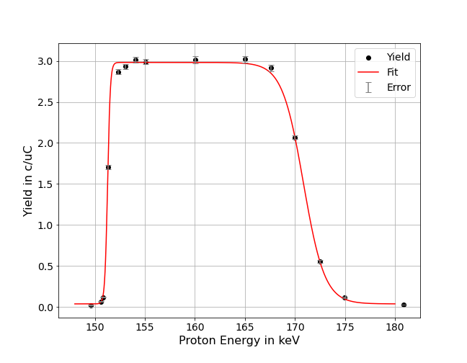
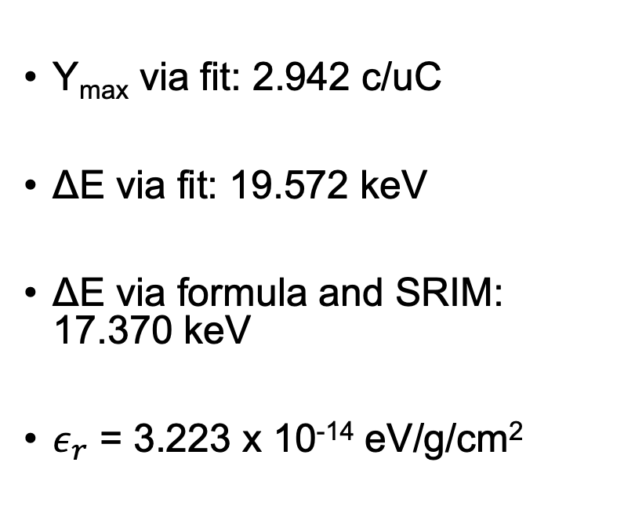
Characterization of the Ta₂O₅ Target (78 V)
Scientific motivation
The ³He(α,γ)⁷Be reaction affects both, the stellar hydrogen burning as well as the Big Bang Nucleosynthesis (BBN).
In the latter it influences the production of ⁷Li and
in the former the neutrino flux in the p-p II and
p-p III chain in the sun.
A recent theory study by Zhang et al. [2] proposes a correlation between the S-factor S(0) at low energies and the angular distribution of the emitted γ-rays. Measurements of this angular distribution at higher energies therefore gives the possibility to get a better estimation for a low energy data point and additionaly improves the extrapolation of the data and all analysis based on it.
Y_{max} via fit: 2.942 c/uC
ΔE via fit: 19.572 keV
ΔE via formula and SRIM: 17.370 keV
$ε_{r}$ = 3.223 x 10⁻¹⁴ eV/g/cm²
99 % of Oxygen-18
The plot below shows the existing data, the solar fusion II fit and
highlights the relevant energy ranges for the sun and the BBN.

Slide 21
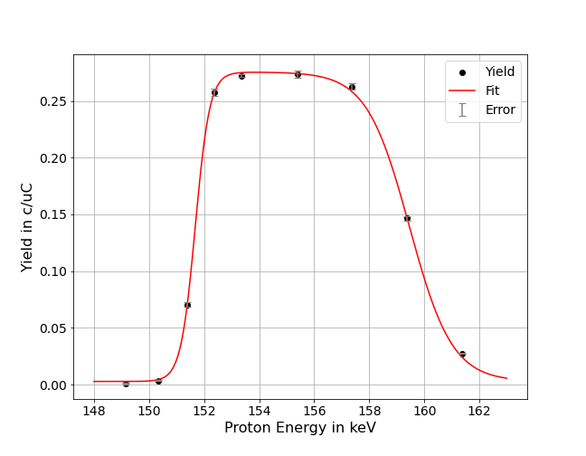
Characterization of the Ta₂O₅ Target (30 V)
Scientific motivation
The ³He(α,γ)⁷Be reaction affects both, the stellar hydrogen burning as well as the Big Bang Nucleosynthesis (BBN).
In the latter it influences the production of ⁷Li and
in the former the neutrino flux in the p-p II and
p-p III chain in the sun.
A recent theory study by Zhang et al. [2] proposes a correlation between the S-factor S(0) at low energies and the angular distribution of the emitted γ-rays. Measurements of this angular distribution at higher energies therefore gives the possibility to get a better estimation for a low energy data point and additionaly improves the extrapolation of the data and all analysis based on it.
Y_{max} via fit: 0.273 c/uC
ΔE via fit: 7.776 keV
Ratio of Y_{max}: 0.09
9 % of Oxygen-18
The plot below shows the existing data, the solar fusion II fit and
highlights the relevant energy ranges for the sun and the BBN.

Slide 22
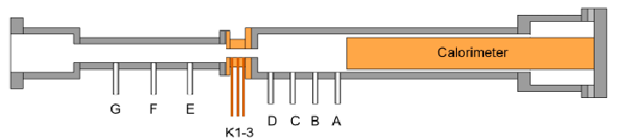
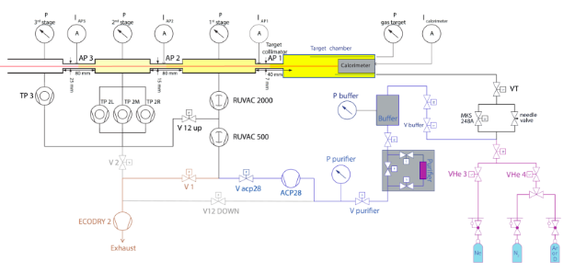
Characterization of Gas Target Density
Scientific motivation
The ³He(α,γ)⁷Be reaction affects both, the stellar hydrogen burning as well as the Big Bang Nucleosynthesis (BBN).
In the latter it influences the production of ⁷Li and
in the former the neutrino flux in the p-p II and
p-p III chain in the sun.
A recent theory study by Zhang et al. [2] proposes a correlation between the S-factor S(0) at low energies and the angular distribution of the emitted γ-rays. Measurements of this angular distribution at higher energies therefore gives the possibility to get a better estimation for a low energy data point and additionaly improves the extrapolation of the data and all analysis based on it.
Monitor gas target density
Measure pressure and temperatures at different positions
Obtain density via ideal gas law
Include results in data analysis
The plot below shows the existing data, the solar fusion II fit and
highlights the relevant energy ranges for the sun and the BBN.

Slide 23
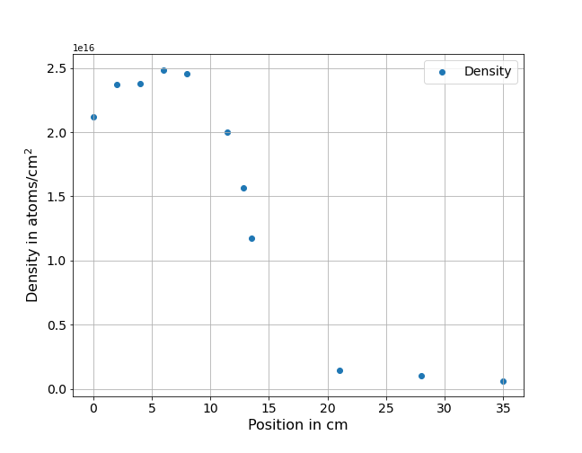
Characterization of Gas Target Density
Scientific motivation
The ³He(α,γ)⁷Be reaction affects both, the stellar hydrogen burning as well as the Big Bang Nucleosynthesis (BBN).
In the latter it influences the production of ⁷Li and
in the former the neutrino flux in the p-p II and
p-p III chain in the sun.
A recent theory study by Zhang et al. [2] proposes a correlation between the S-factor S(0) at low energies and the angular distribution of the emitted γ-rays. Measurements of this angular distribution at higher energies therefore gives the possibility to get a better estimation for a low energy data point and additionaly improves the extrapolation of the data and all analysis based on it.
Target Chamber
Calorimeter
Calorimeter heats up gas (lower density)
Constant high density in target chamber
Density drops with increasing distance from target chamber (collimator and pumps)
Collimator
The plot below shows the existing data, the solar fusion II fit and
highlights the relevant energy ranges for the sun and the BBN.

Slide 24
Summary
Scientific motivation
The ³He(α,γ)⁷Be reaction affects both, the stellar hydrogen burning as well as the Big Bang Nucleosynthesis (BBN).
In the latter it influences the production of ⁷Li and
in the former the neutrino flux in the p-p II and
p-p III chain in the sun.
A recent theory study by Zhang et al. [2] proposes a correlation between the S-factor S(0) at low energies and the angular distribution of the emitted γ-rays. Measurements of this angular distribution at higher energies therefore gives the possibility to get a better estimation for a low energy data point and additionaly improves the extrapolation of the data and all analysis based on it.
First week – Energy calibration of HPGe detectors and the LUNA MV accelerator
Second week – Target production and characterization of solid target using the LUNA 400 kV accelerator
Determination of extended gas target density profile
Thanks to our supervisors Denise and Federico!
The plot below shows the existing data, the solar fusion II fit and
highlights the relevant energy ranges for the sun and the BBN.

