Slide 1



Ptolemy
Direct measurement cosmic neutrino background
Students: Andrea Paccagnella (University of Florence)
Riccardo Elleboro (University of L’Aquila)
Tobias Schulz (University of Karlsruhe)
Supervisor: Marcello Messina (LNGS)
Federico Virzi (University of L’aquila)

Slide 2

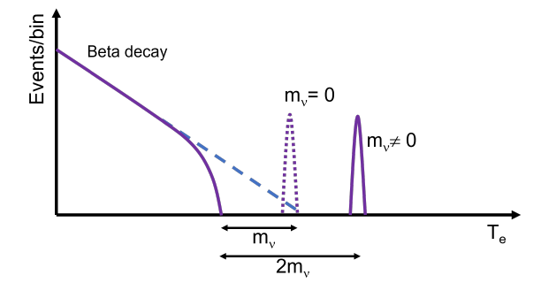
Topic of Experiment
The aim of this experiment is to measure the primordial neutrino.
This is done through the interaction of this with the atom of Tritium.
If we were to consider the neutrino without mass, the endpoint of the tritium decay would be the one dotted, while if we were to consider the neutrino with mass, the endpoint would be shown by the solid line.
To distinguish these two configurations, a precision of less than 50meV (< m_{ν}) is needed.

Slide 3
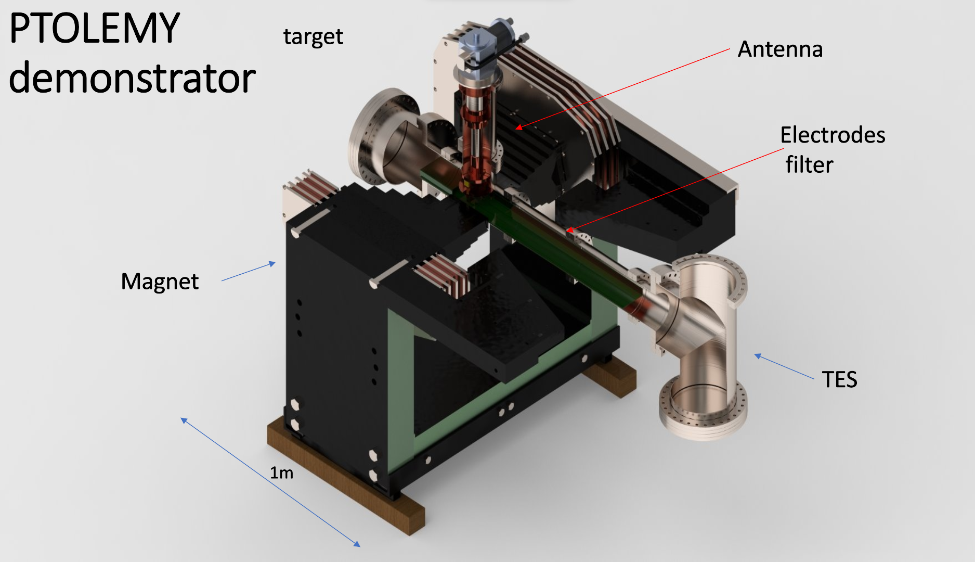
PTOLEMY demonstrator experimental setup
Notes:
calorimiter

Slide 4
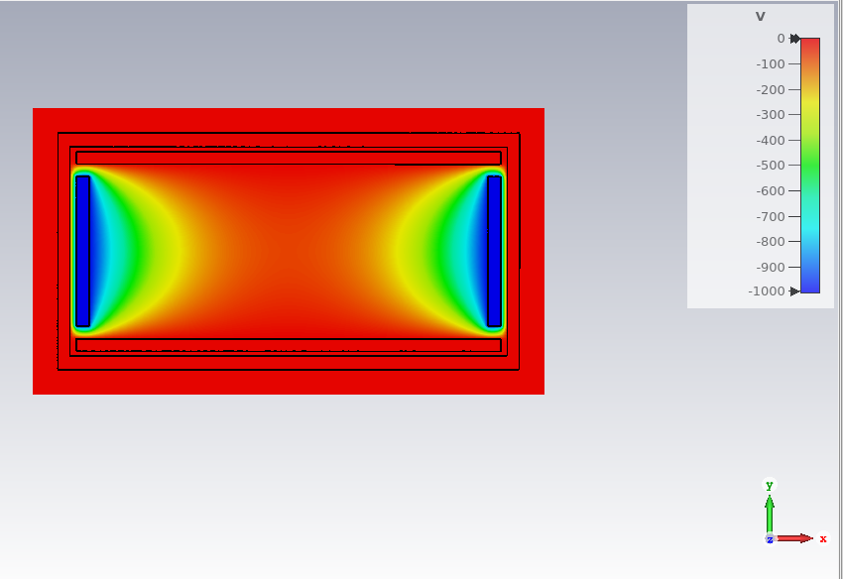
Setup Antenna
The antenna is made up of a copper coating, inside we find 4 electrodes, the two lateral ones placed at a potential of -1KV.
Its scope is to provide a radio frequency signal from which the kinematic variables of the electrons can then be extracted (K and K_{L}).
The antenna must be able to provide a precision equal to approximately K ~ 10 eV.
This is currently a research and development prototype. Its purpose is to learn to read radio frequencies.
B_{x} = 1 T

Slide 5
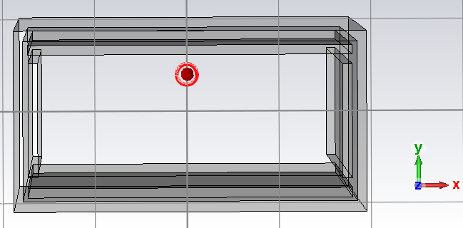
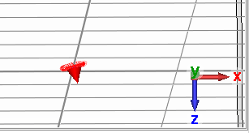
Simulation of the electron trajectory
The goal of this simulation was to measure the motion of the electron inside the antenna.
To do this we simulated a magnetic field along the x direction and we simulated the starting position of the electron with different angles (with respect to the magnetic field) and at different heights.
We focused on the measurement of the bounce period and the radio frequency measurement of the electron.
The bounce period is the time it takes for the electron to move from one electrode to another. This is correlated with the K_{L} value (T_{b} ∝ K_{L}).
y = 1 mm
𝛉 = 13°

Slide 6
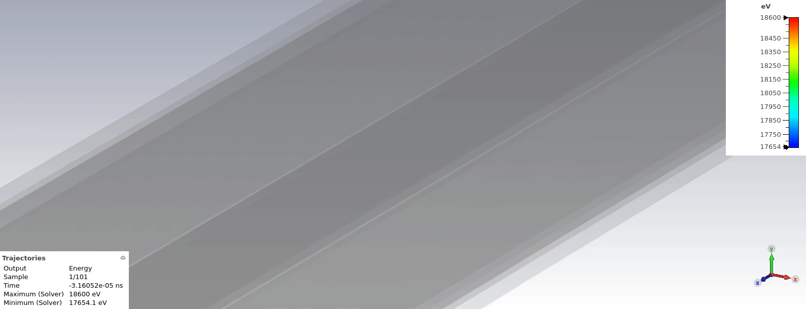
Simulation of the electron trajectory

Slide 7
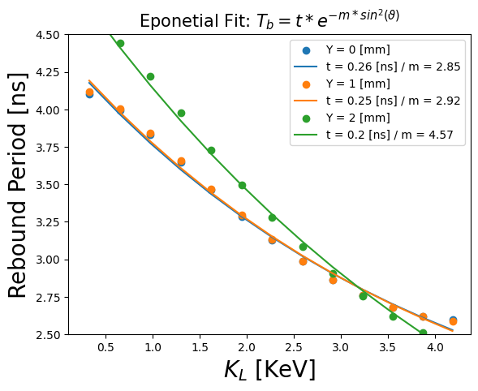
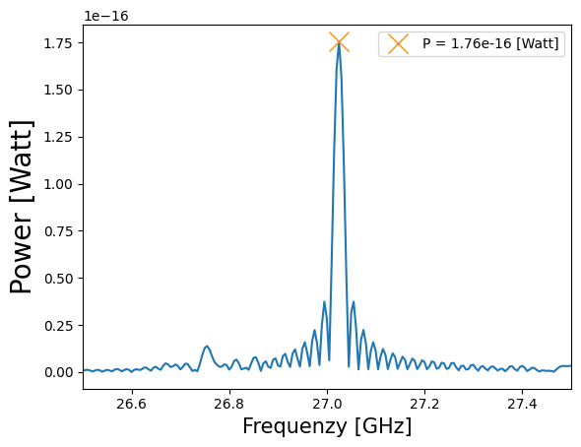
Result of Simulation
K_{L} is related to the initial position of the electron (K_{L} = K sin²(θ)
From the Larmor Frequency of the electron emitted by the interaction between the neutrino and the Tritium atom, the kinetic energy can be extracted K (f∝K).

Slide 8
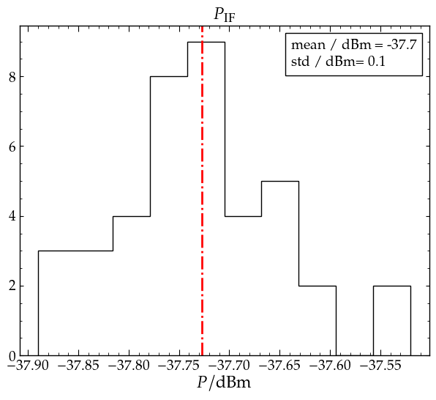
Signal detection
Problem:
RF signal from electron @ 27 GHz with signal power of 1 fW (= -120 dBm)
→ Amplification of signal and change to intermediate frequency needed
Our goals:
Create a calibration signal (@ 26 GHz and signal power of 1 fW)
Measure gain and noise of used electric components
Check stability of the setup

Slide 9
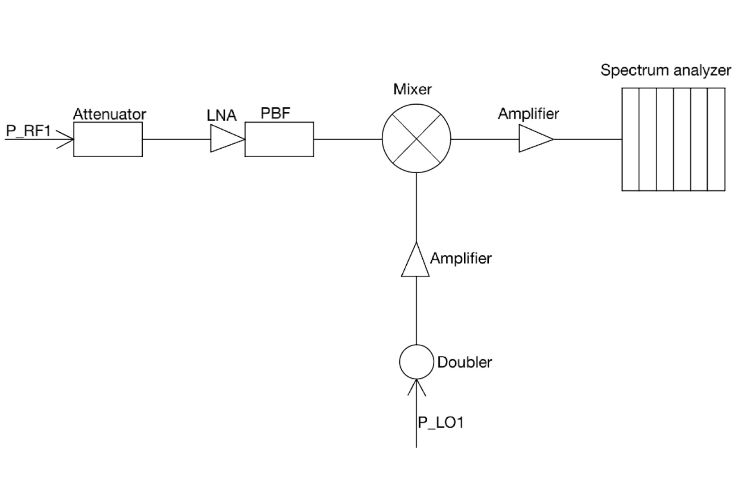
Schematic setup for signal analysis
P_RF1 is a signal at 26 GHz
P_RF1 and attenuator simulate the signal from the decay electron
P_LO1 is a reference signal at 13 GHz
the doubler is used to obtain a signal of 26 GHz
LNA is a low noise amplifier
the mixer is used to combine signals P_RF1 and P_LO1 and studying a signal at lower frequency than the previous ones

Slide 10
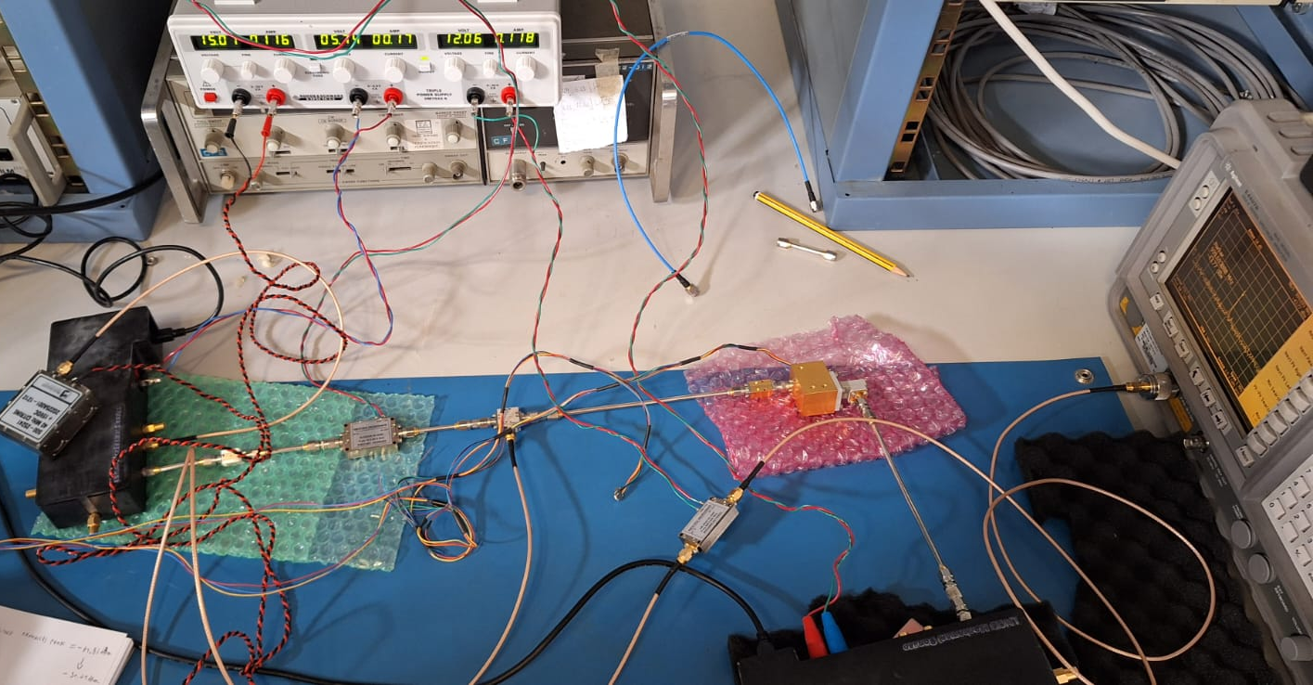
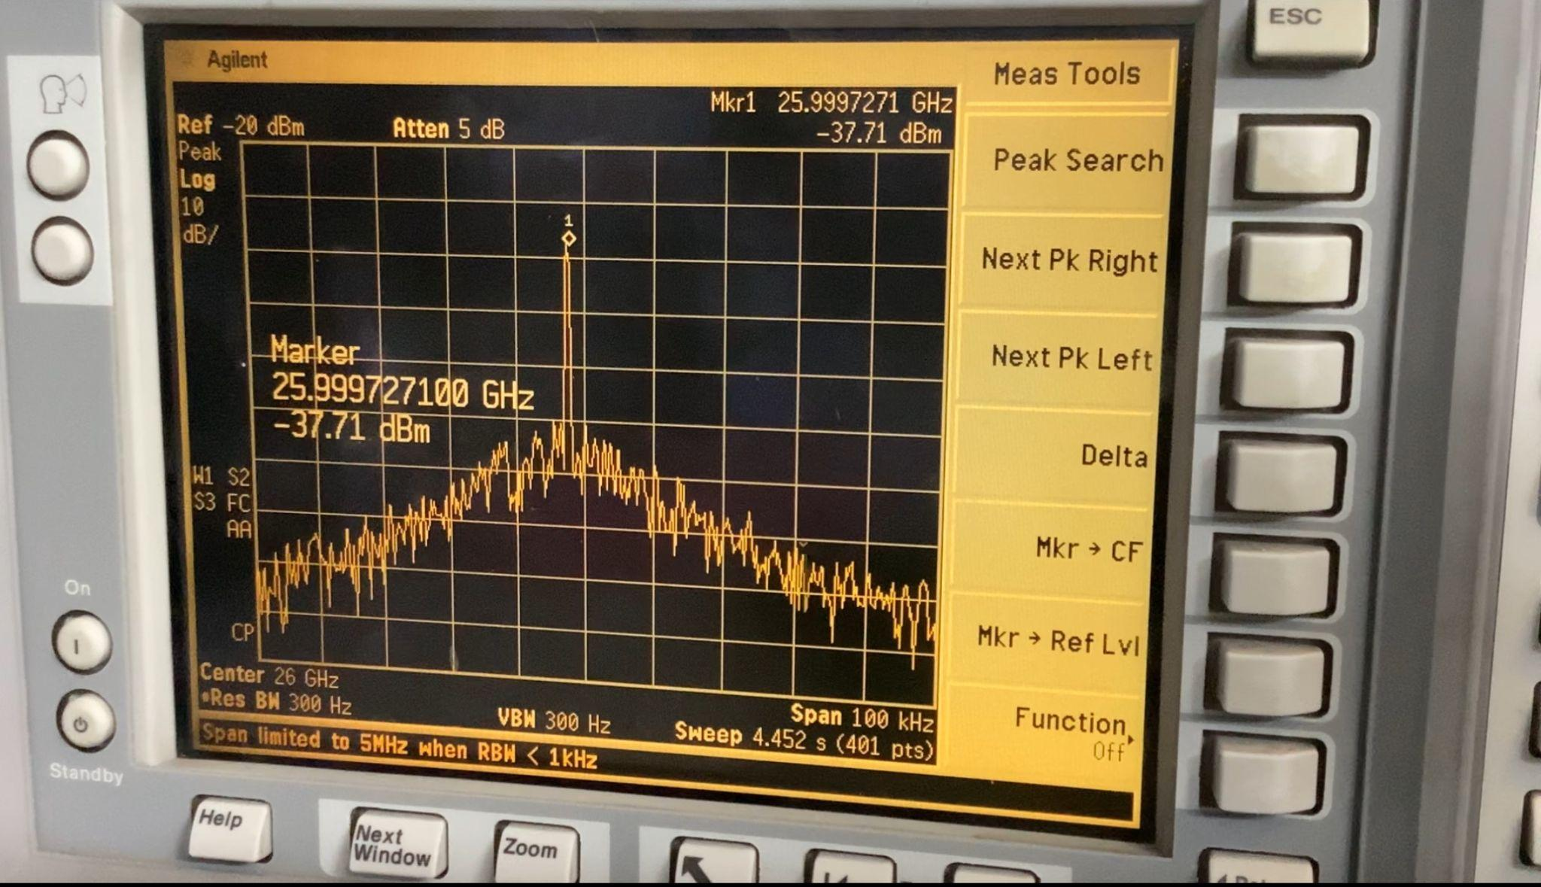
Experimental setup for signal analysis
example of picture of the signal that we see at the spectrum analyzer

Slide 11
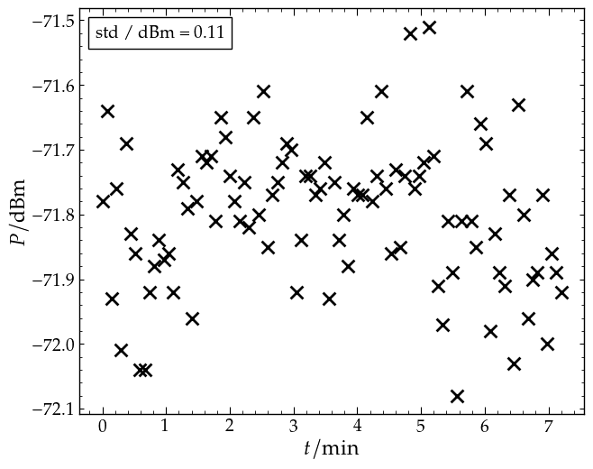
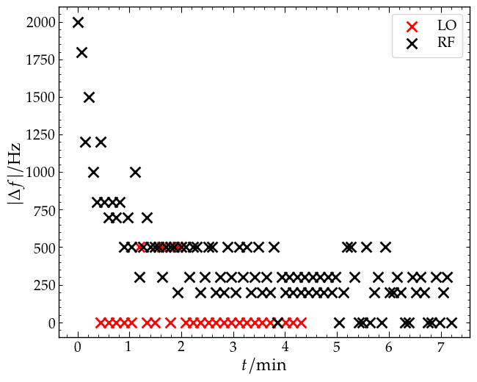
Stability measurements
Stability of signal power and frequency needed for measurements
Frequency from LO is needed to be very stable

Slide 12
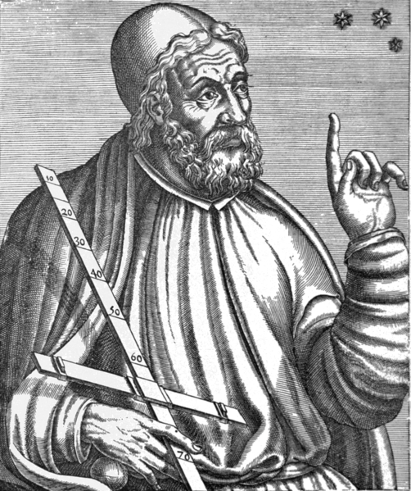
We consider it a good principle to explain the phenomena by the simplest hypothesis possible.
Claudius Ptolemaeus, “Almagest”

Slide 13
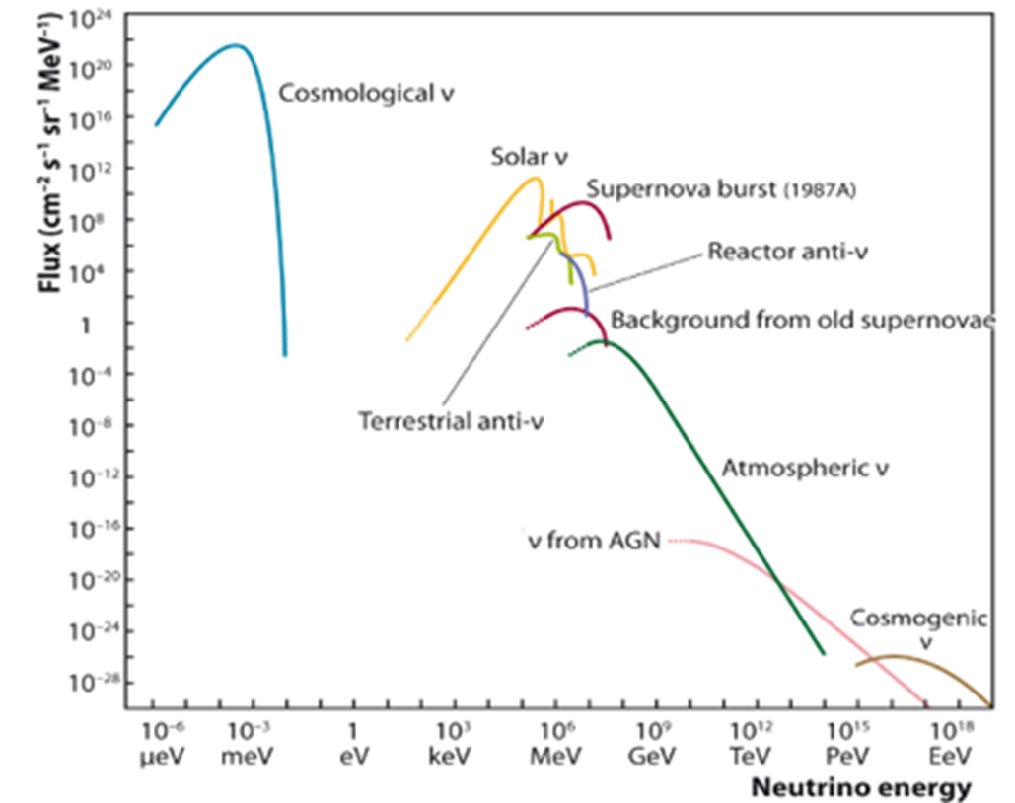
Backup

Slide 14






Backup
Cyclotron frequency:
Conversion dBm -> W:
Frequency of cyclotron radiation:
Total noise floor:
Emitted power from electron:
Friis Formular:

