Slide 1
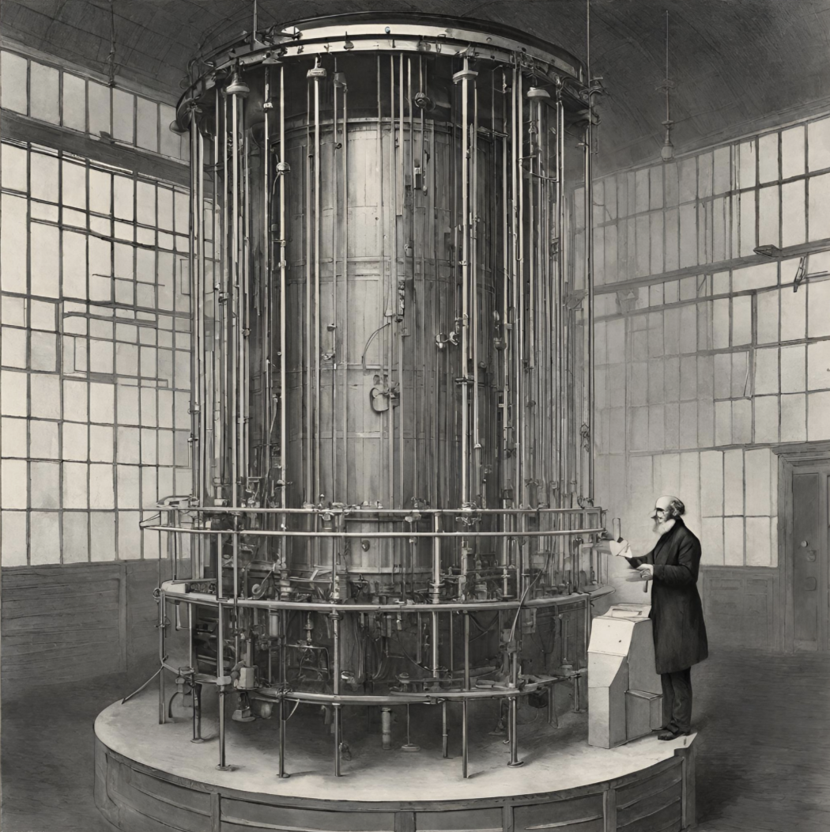
Characterization of photo-sensors for DARWIN experiment.
Daniel Salazar Gallegos
Guadalupe Duran
Iftikhar Ahmad
AI generated image

Slide 2
Contents
Introduction to Dark matter
DARWIN experiment
DARWIN hands-on
Experimental setup
SiPMs
PMT
ABALONE
Results
Conclusion
2

Slide 3
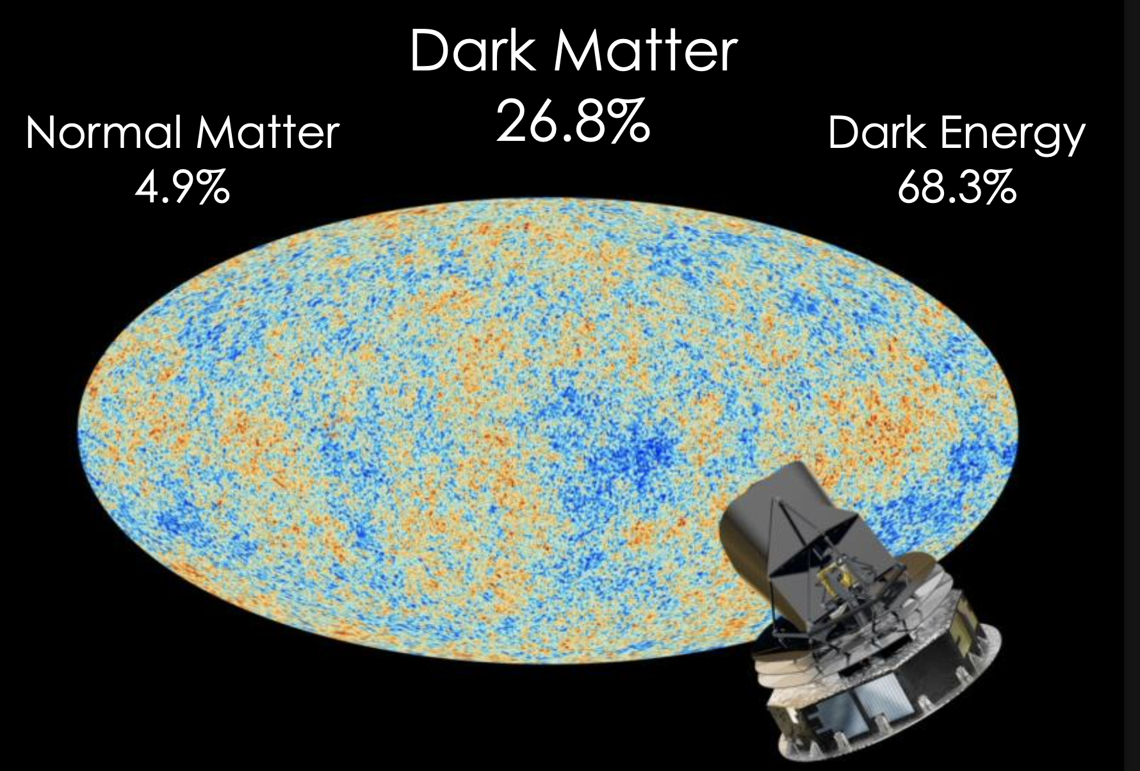
Evidence for Dark matter
Cosmic Microwave Background (CMB)

Slide 4
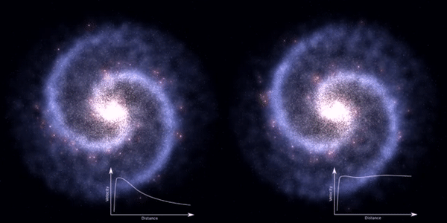
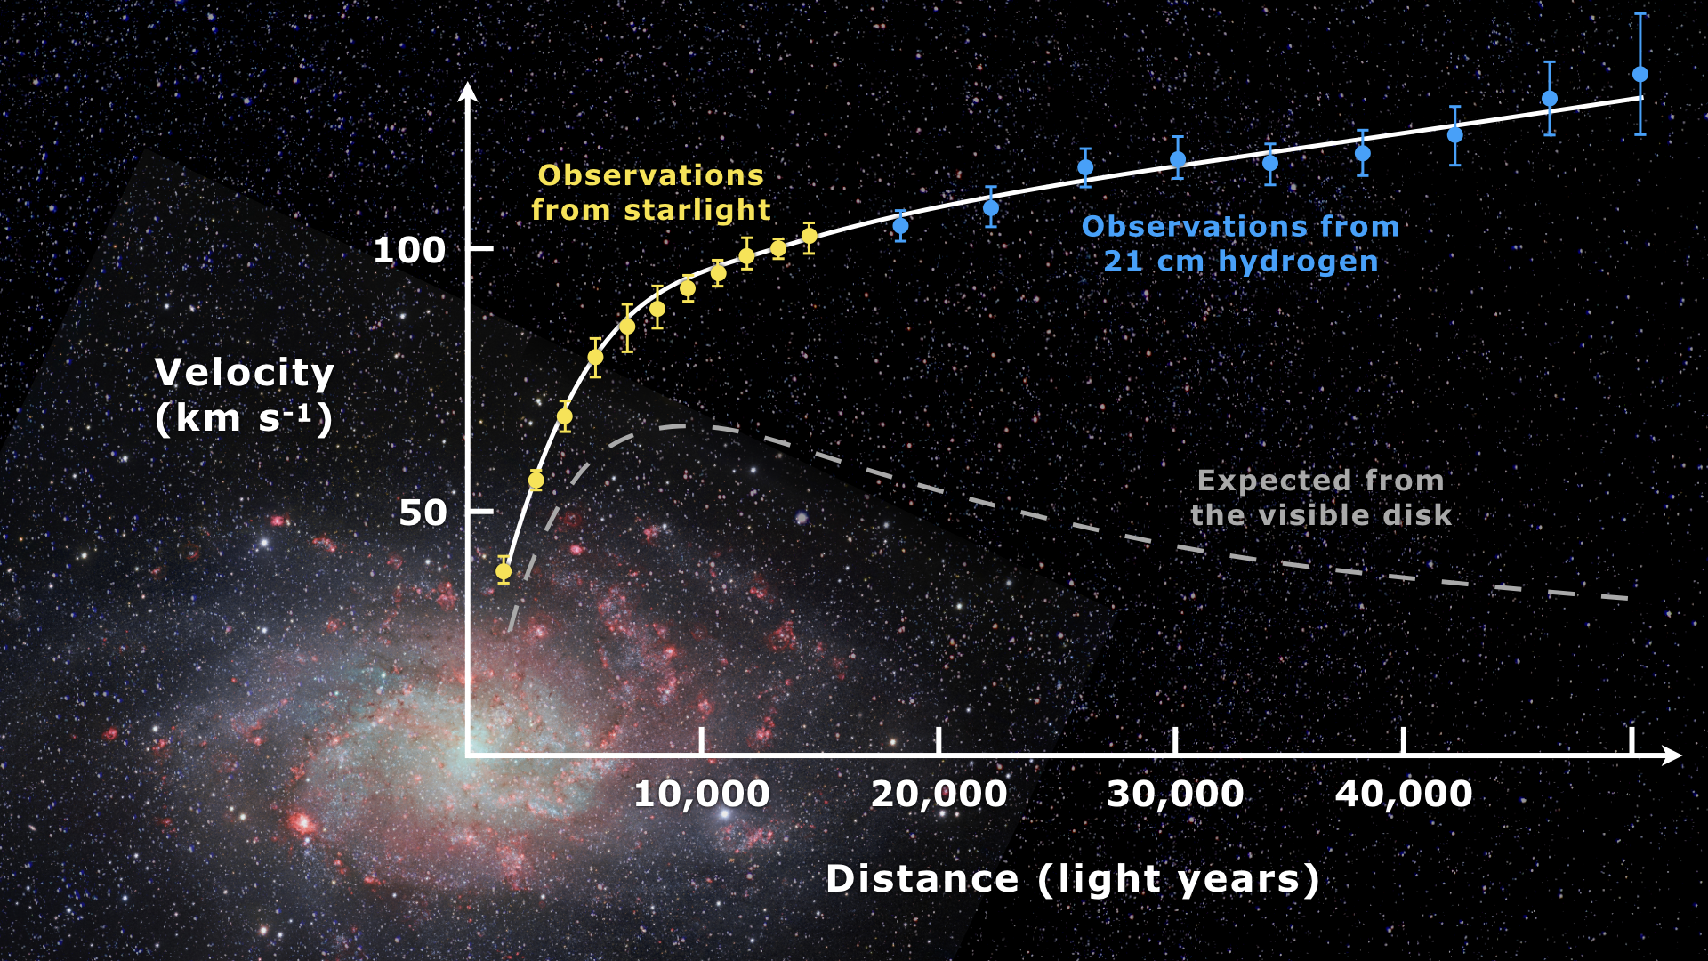
Evidence for Dark matter
Speed of Stars in a galaxy
Cosmic Microwave Background (CMB)
Rotation curve

Slide 5
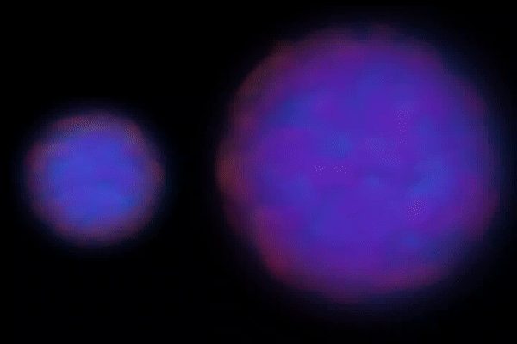
Evidence for Dark matter
Speed of Stars in a galaxy
Cosmic Microwave Background (CMB)
Rotation curve
Bullet Cluster Animation

Slide 6
Evidence for Dark matter
Speed of Stars in a galaxy
Cosmic Microwave Background (CMB)
Rotation curve
Properties of Dark Matter
Dark
Interacts via gravity
Weakly interacting
Cold
Stable
Candidates Dark Matter
MACHOs
Neutrinos
Axions
WIMPs
Bullet Cluster Animation
3

Slide 7
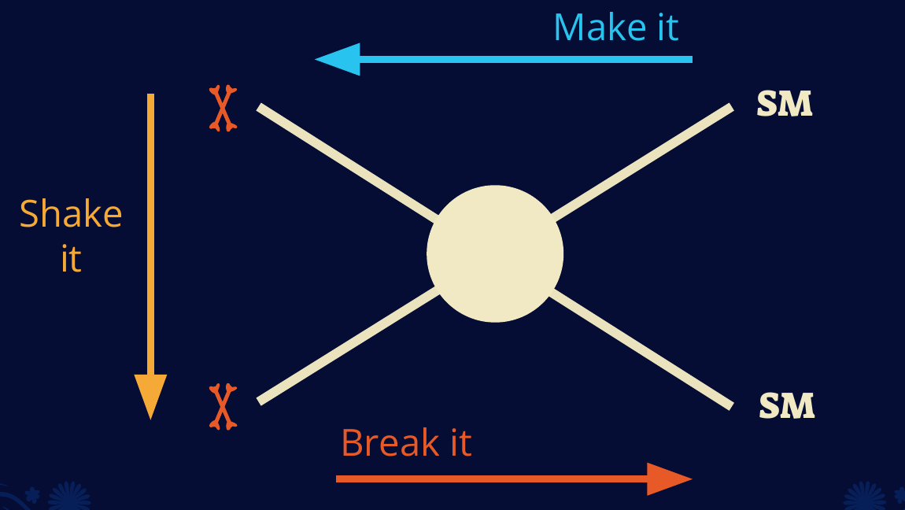
How to detect dark matter
4

Slide 8
Dark matter Detection

Slide 9
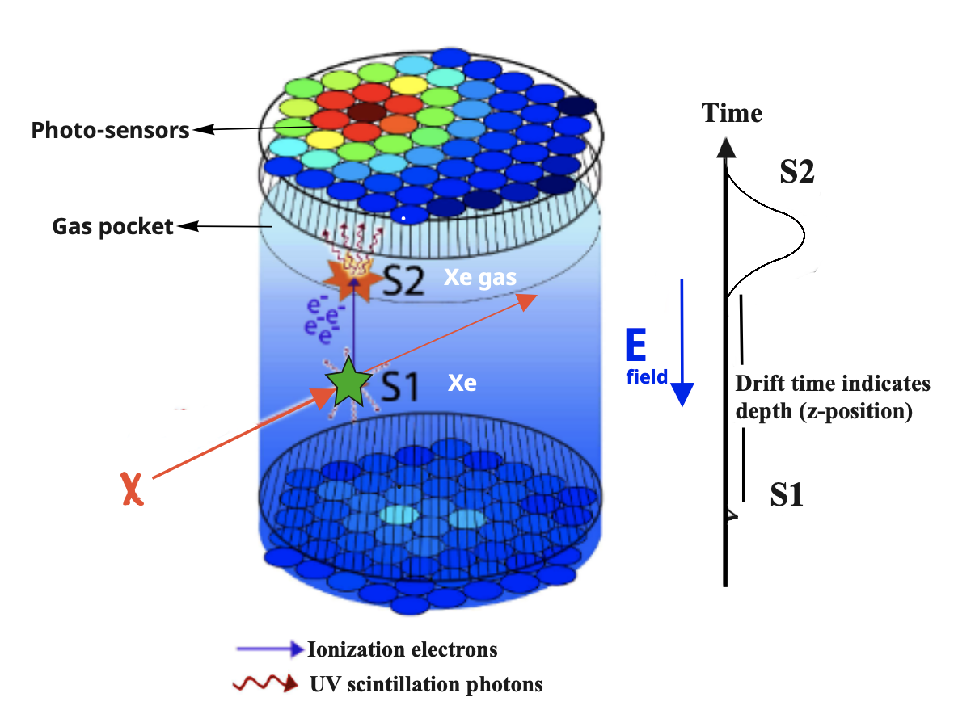
Dark matter with dual phase TPC
Time Projection Chamber (TPC)
5

Slide 10
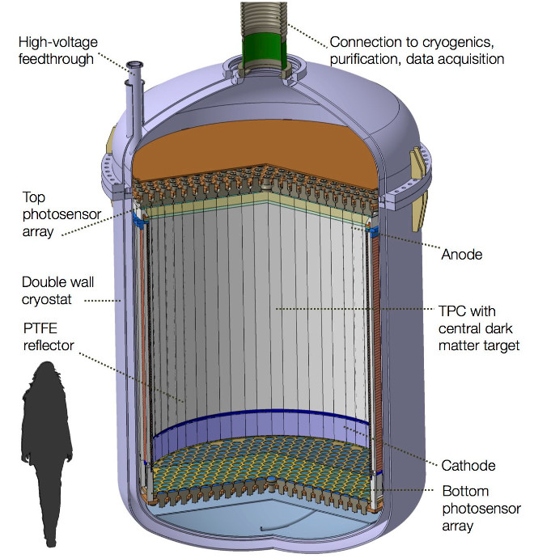
DARWIN experiment
An exposure around 200 t.y and very low background conditions are required to reach the design sensitivity.
The DARWIN baseline design foresees simultaneous charge and light readout in a dual-phase TPC using xenon target.
2.6 m
The detector consists of:
Dual-phase TPC (50 ton of LXe)
Two photon/charge sensor arrays (top and bottom)
Low-background double-wall cryostat
Outer shield filled with water (12m diameter)
6

Slide 11
DARWIN experiment Goals
DARWIN will be the “ultimate” low background astroparticle physics observatory capable of covering a diverse science program:
Search for WIMPs (Weakly interacting massive particles).
Neutrinoless double-beta decay of ¹³⁶Xe.
Detection of solar pp neutrinos via electron scattering.
Observation of supernova and solar neutrinos via CEvNS.
7

Slide 12
DARWIN Hands-on
Novel photosensors are being considered for applications in low-background and astroparticle physics.
Two promising options under evaluation are:
Silicon Photomultiplier (SiPM)
ABALONE
These technologies are being explored as alternatives to the traditional PhotoMultiplier Tube (PMT).
Our objective is to conduct a comprehensive characterization of these three technologies within a dark box.
8

Slide 13
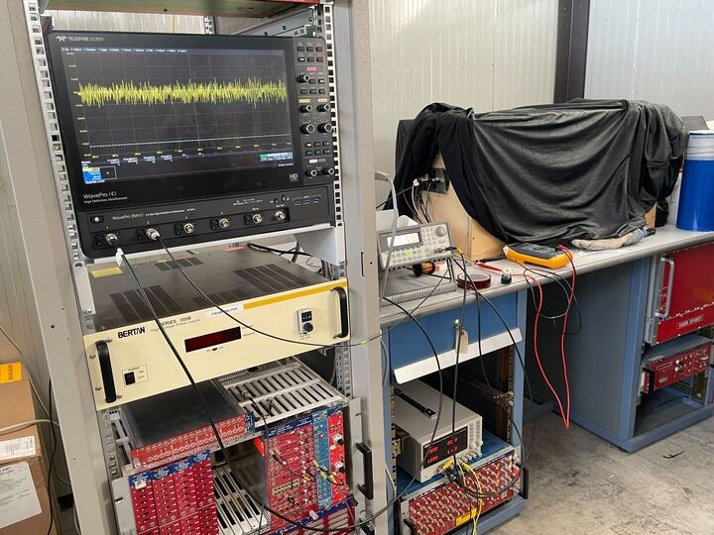
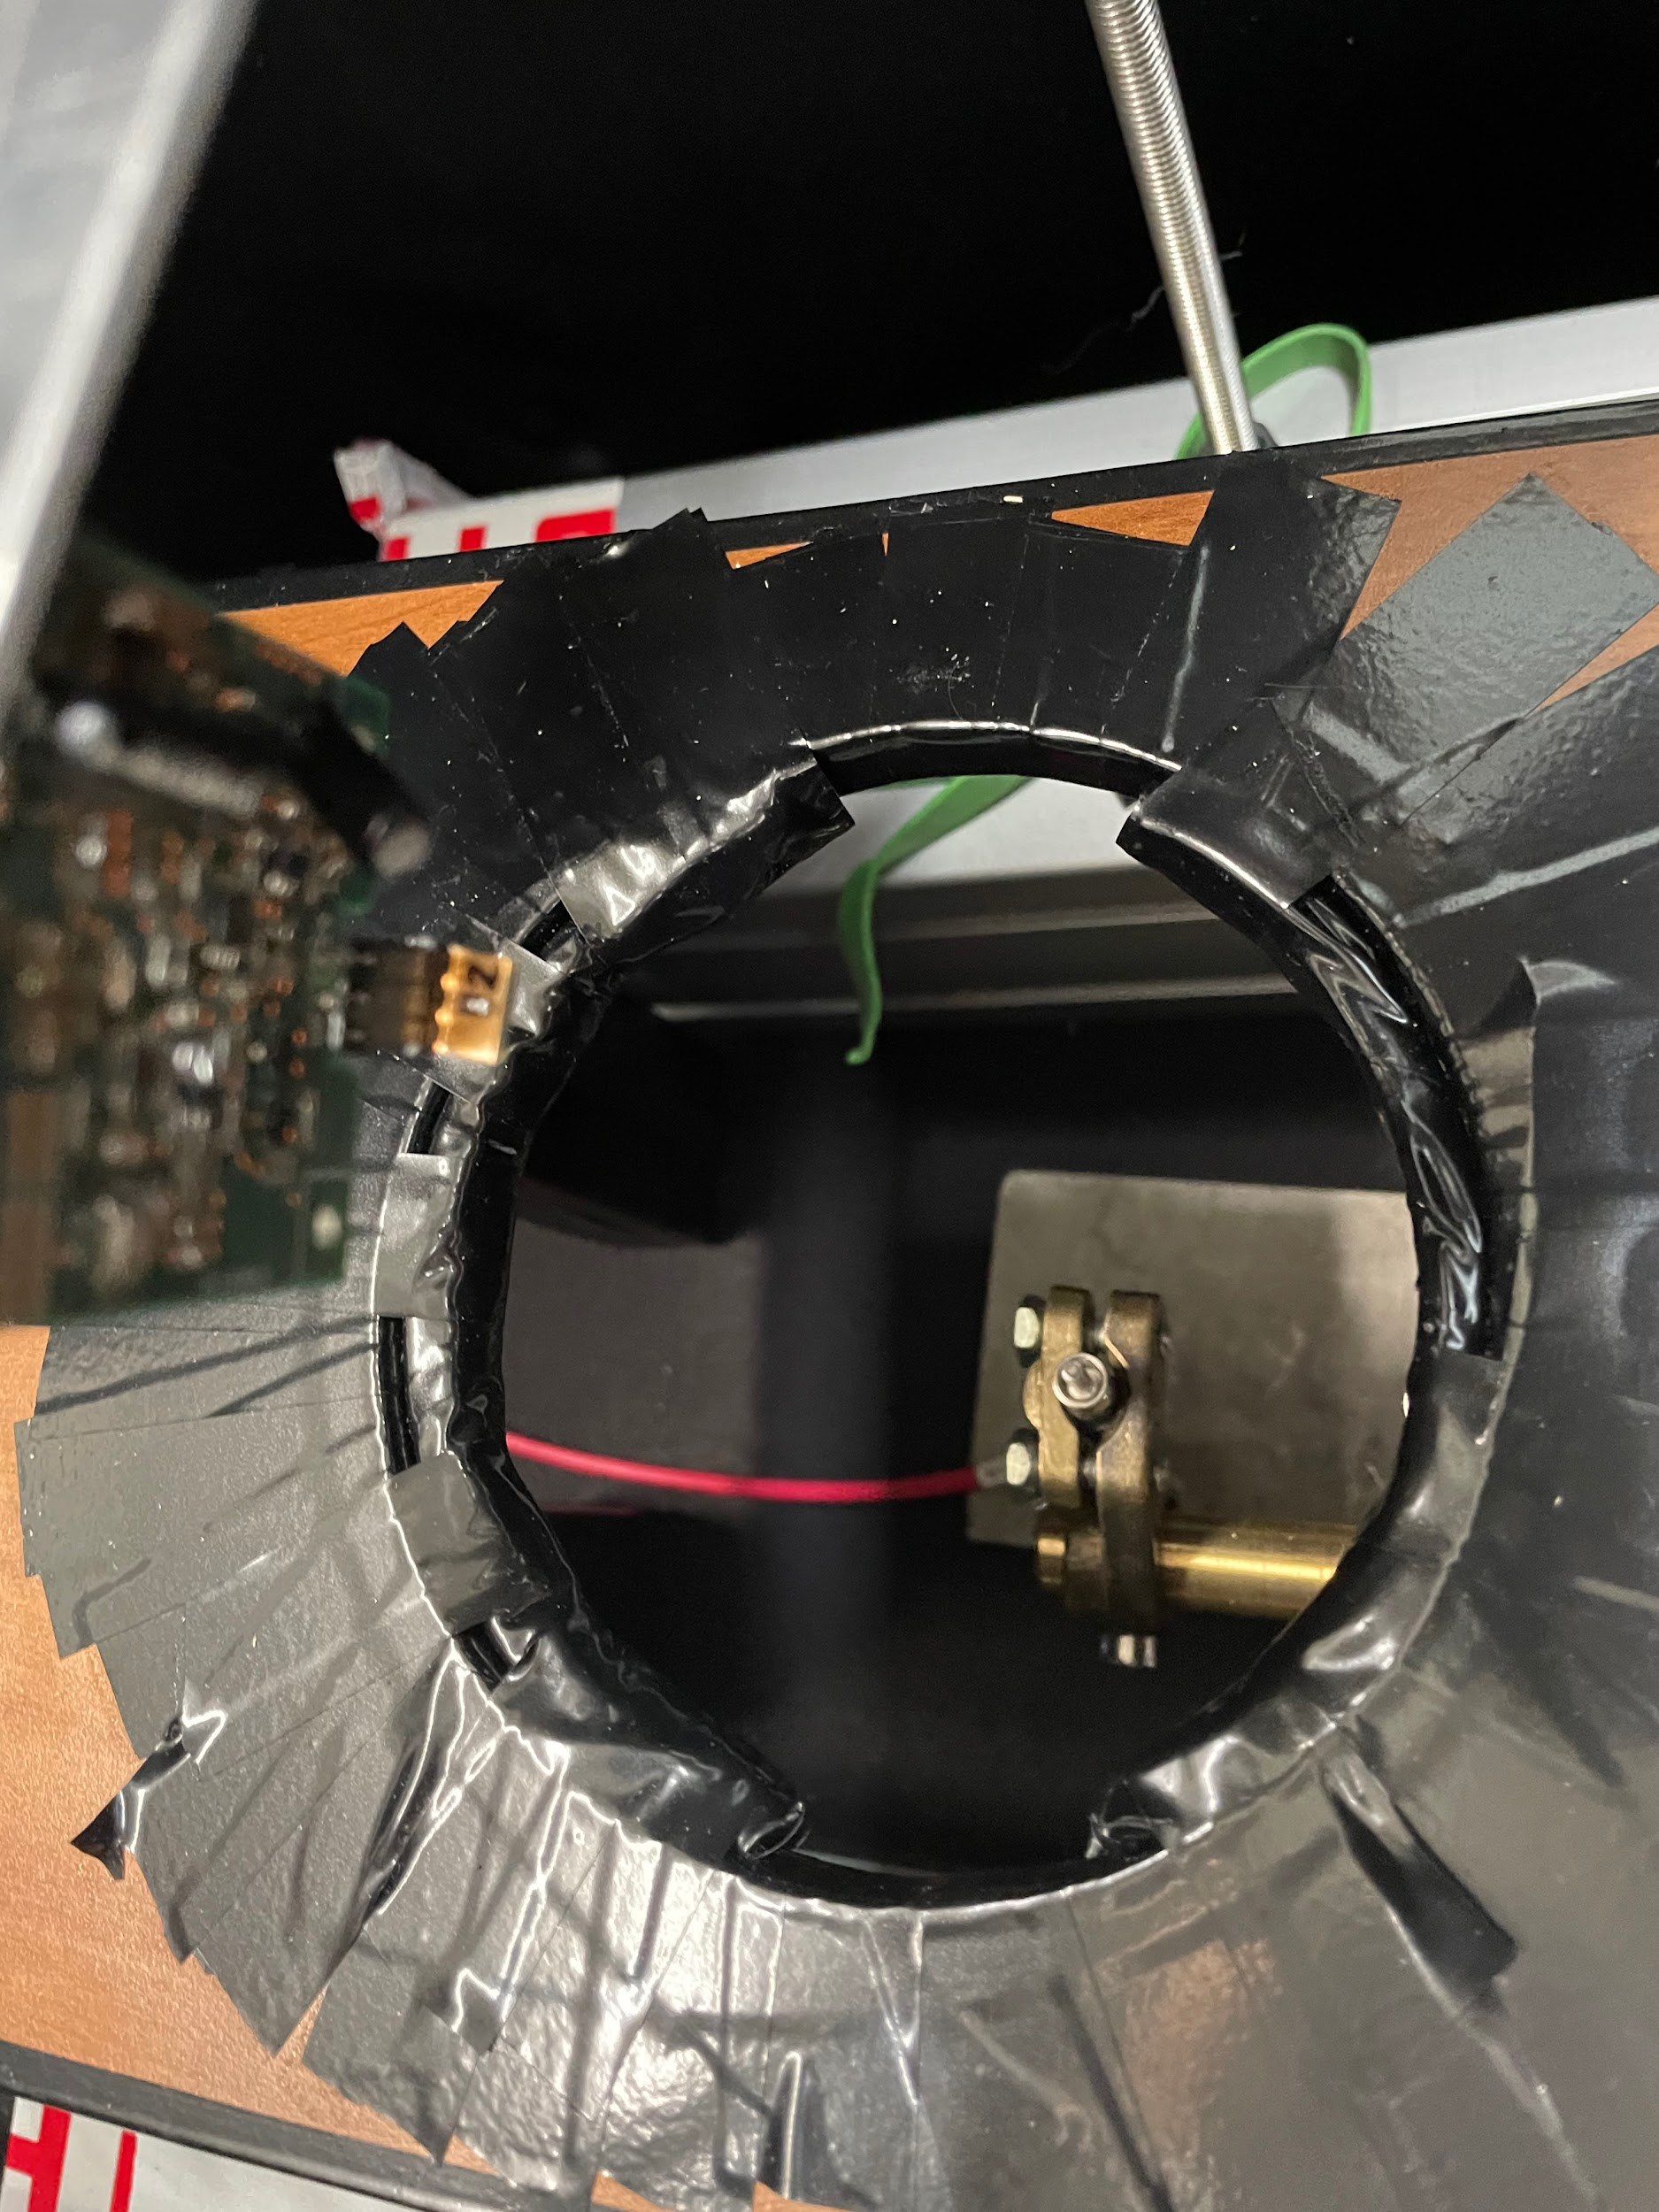
Experimental Setup
Oscilloscope Counter + NIM modules
Fiber to flash light from LED
9

Slide 14
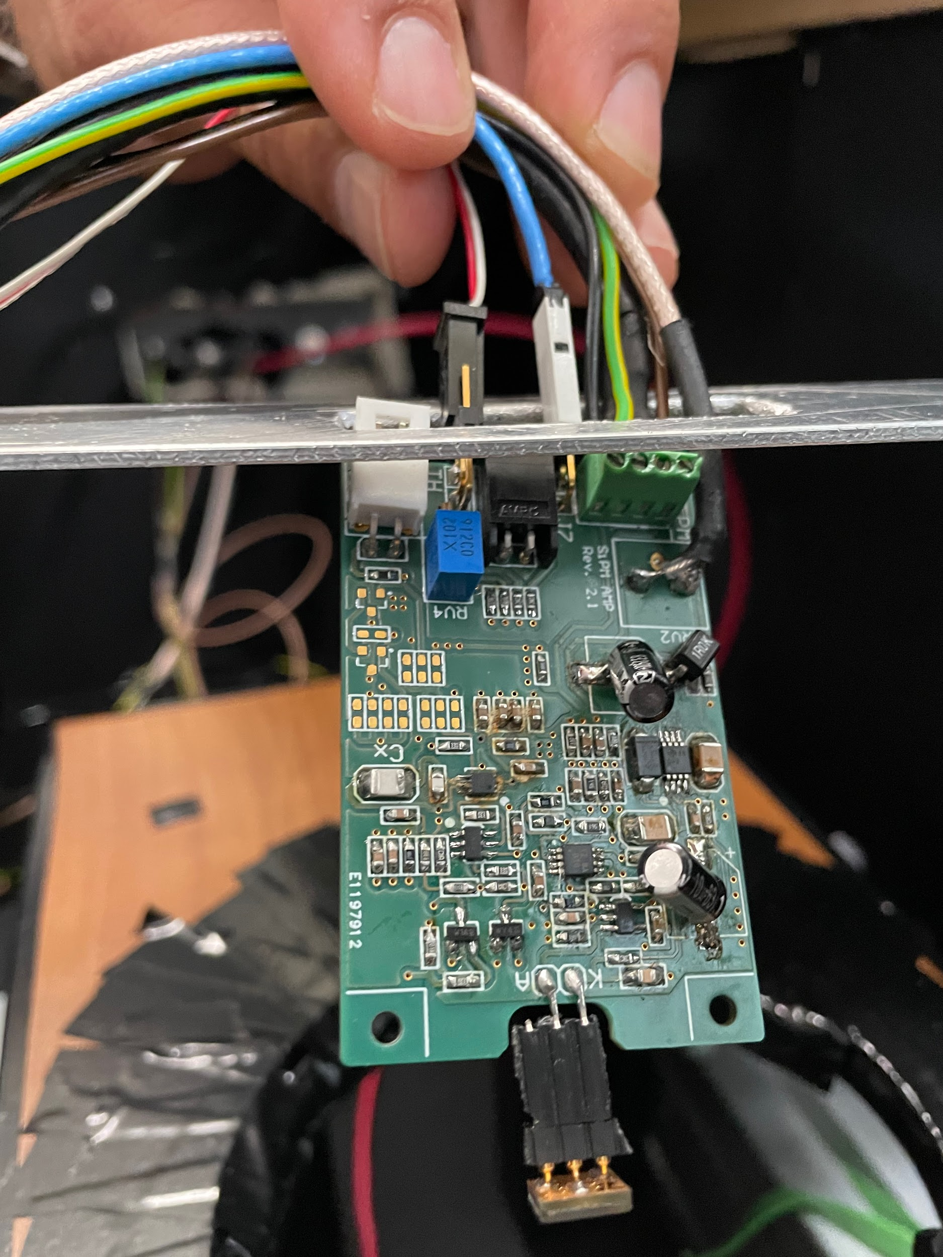
SiPM module
Solid state sensor
High gain (10⁶)
Low bias voltage (~30 V)
Single photon sensitivity
High dark rate (at room temperature)
The LED was flashed at a low level (just above the dark rate)
10

Slide 15
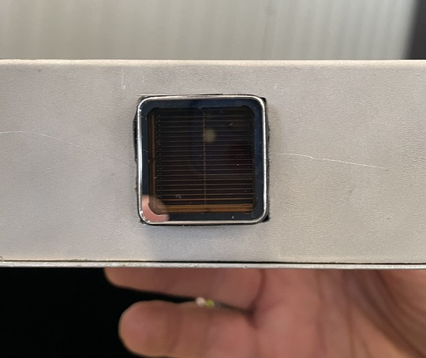
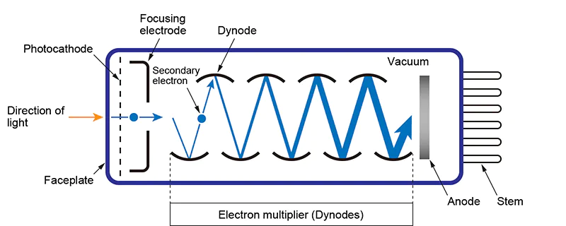
Photomultiplier tubes
Consists of a photocathode, multiple dynodes, and an anode.
Uses the principle of photoelectric effect.
Electrons are accelerated and multiplied through a series of dynodes.
Produces a significant electron multiplication, resulting in signal amplification.
Provides high gain, allowing for detection of single photons.
Flashed the LED at the Single PE level (for approximately every 10 triggers received, 1 pulse from the PMT was observed).
11

Slide 16
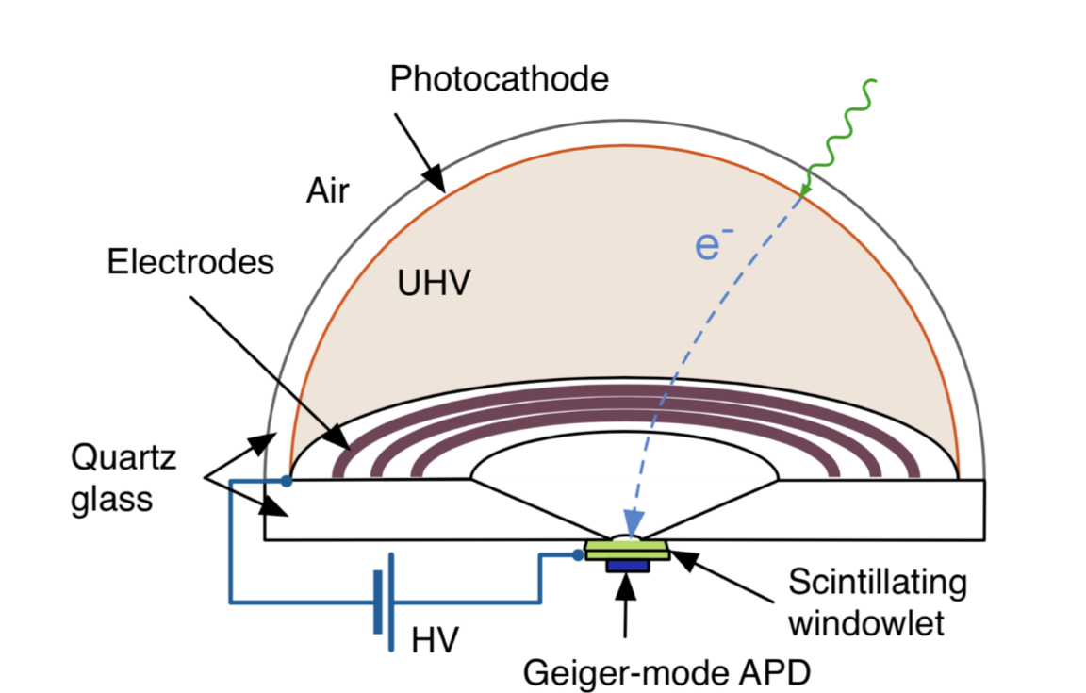
The ABALONE Photosensor
Light Intensifier
PEs accelerated into scintillating windowlet
then detected by SiPM
Capabilities:
Sensitivity to Visible and UV Light
Exceptional Radio-Purity (in final design)
Outstanding Detection Performance
Intrinsic Gain
Afterpulsing Rate
Timing Resolution
Single-Photon Sensitivity
Applications:
Particle Physics Experiments like Darwin
Medical Imaging
Requires:
High Operating voltages (10-25kV)
12

Slide 17
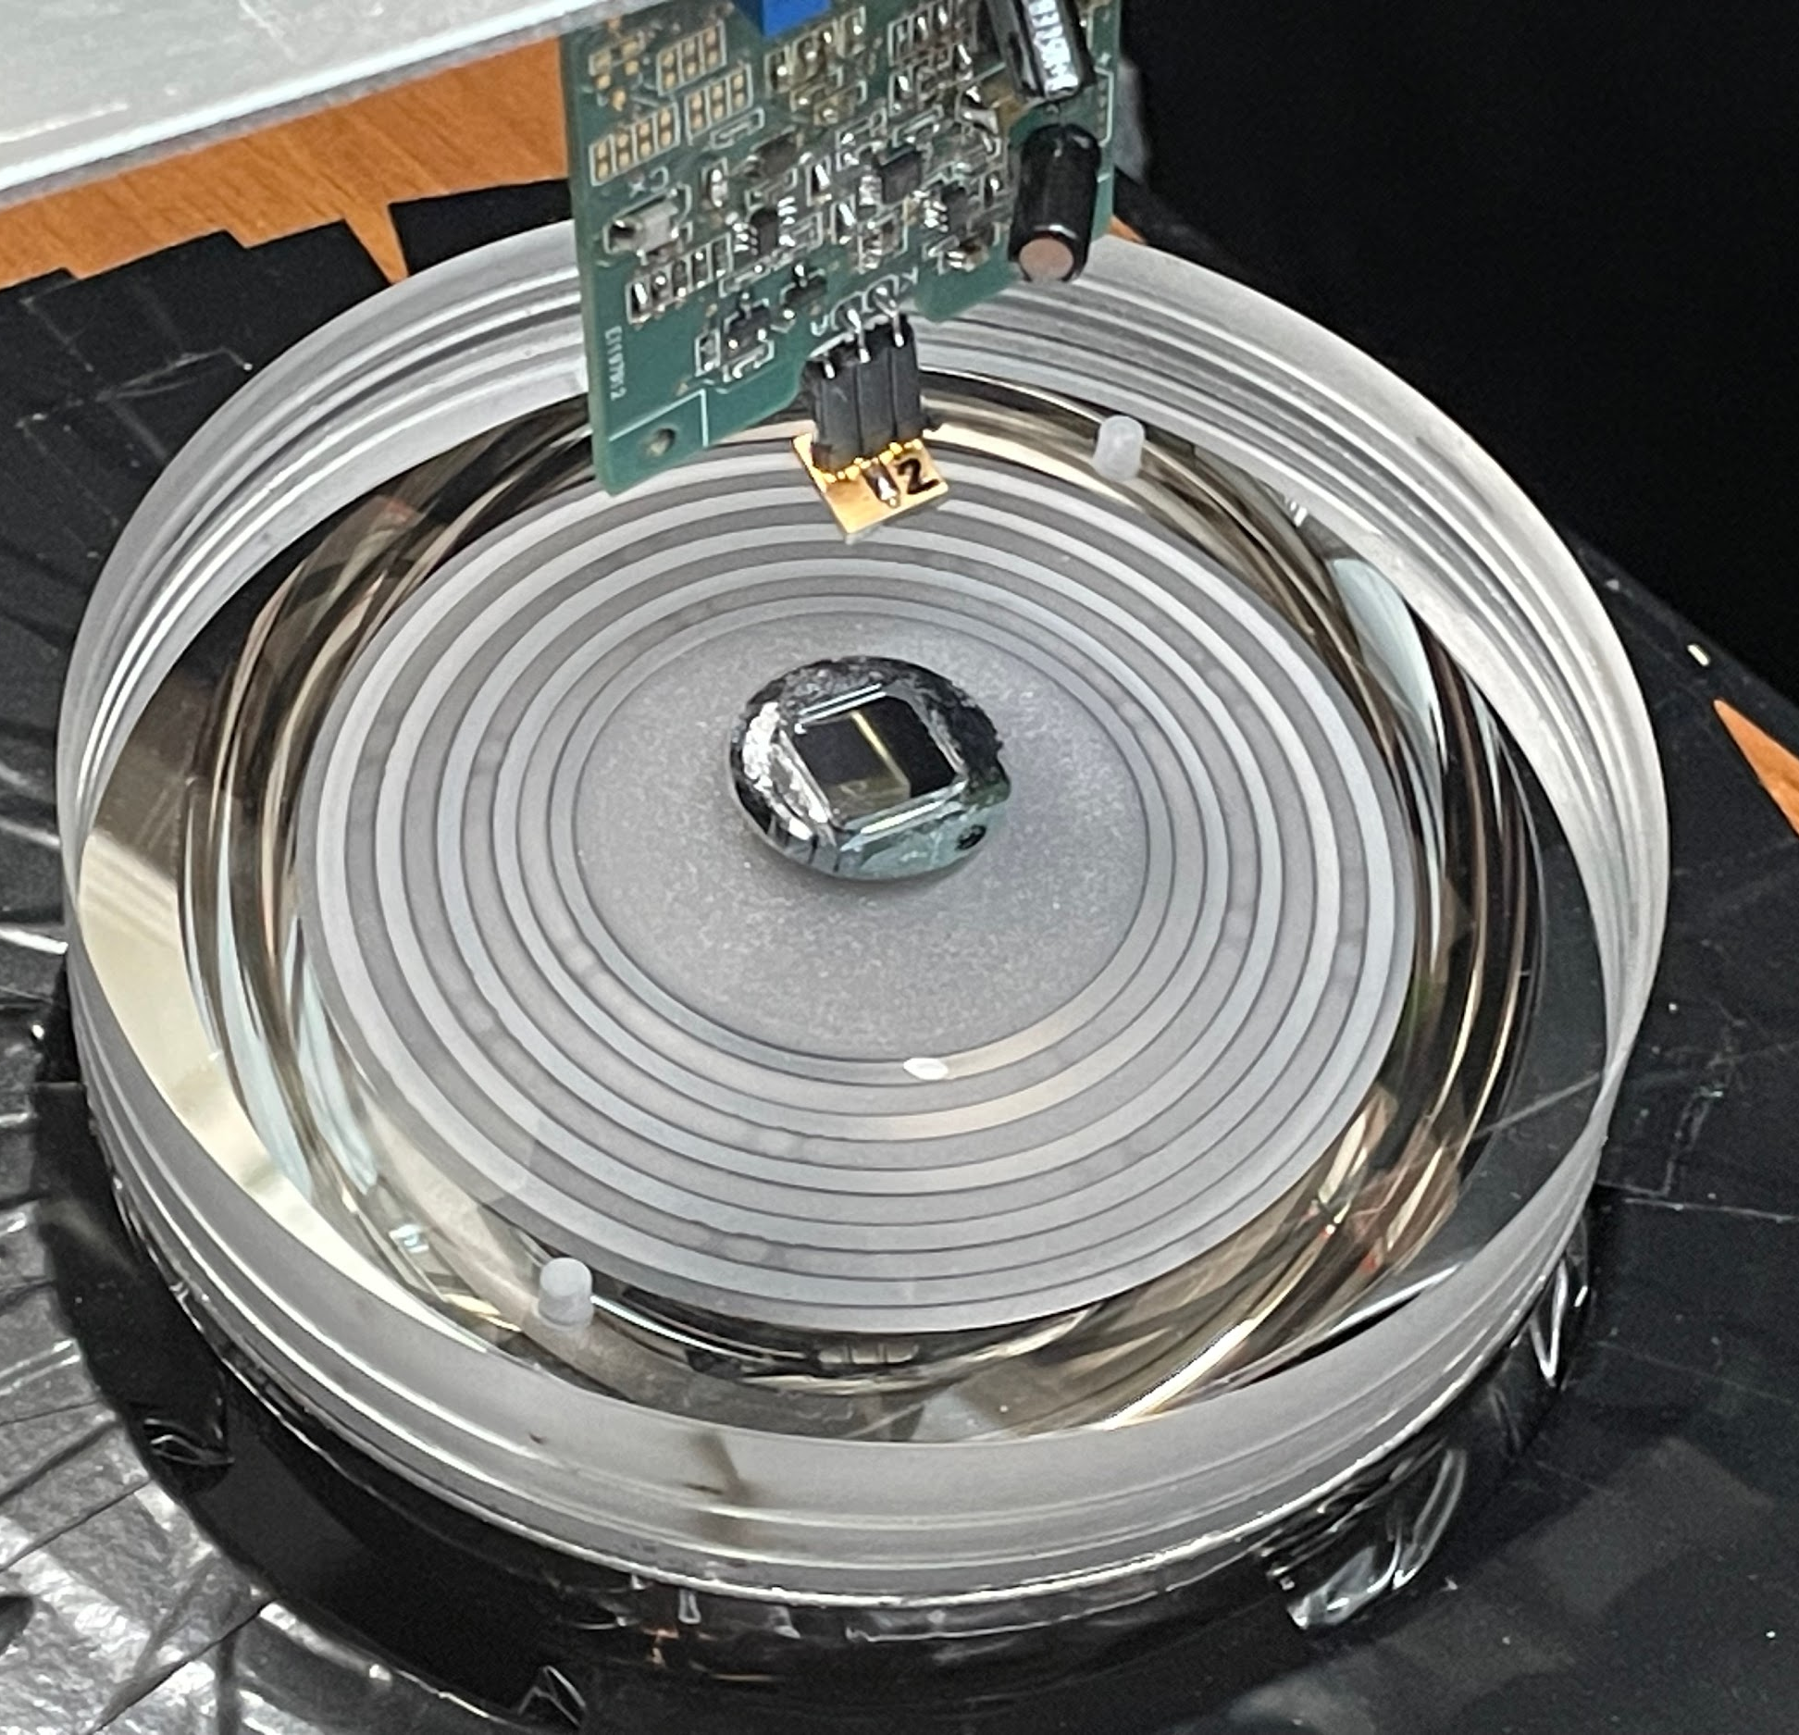
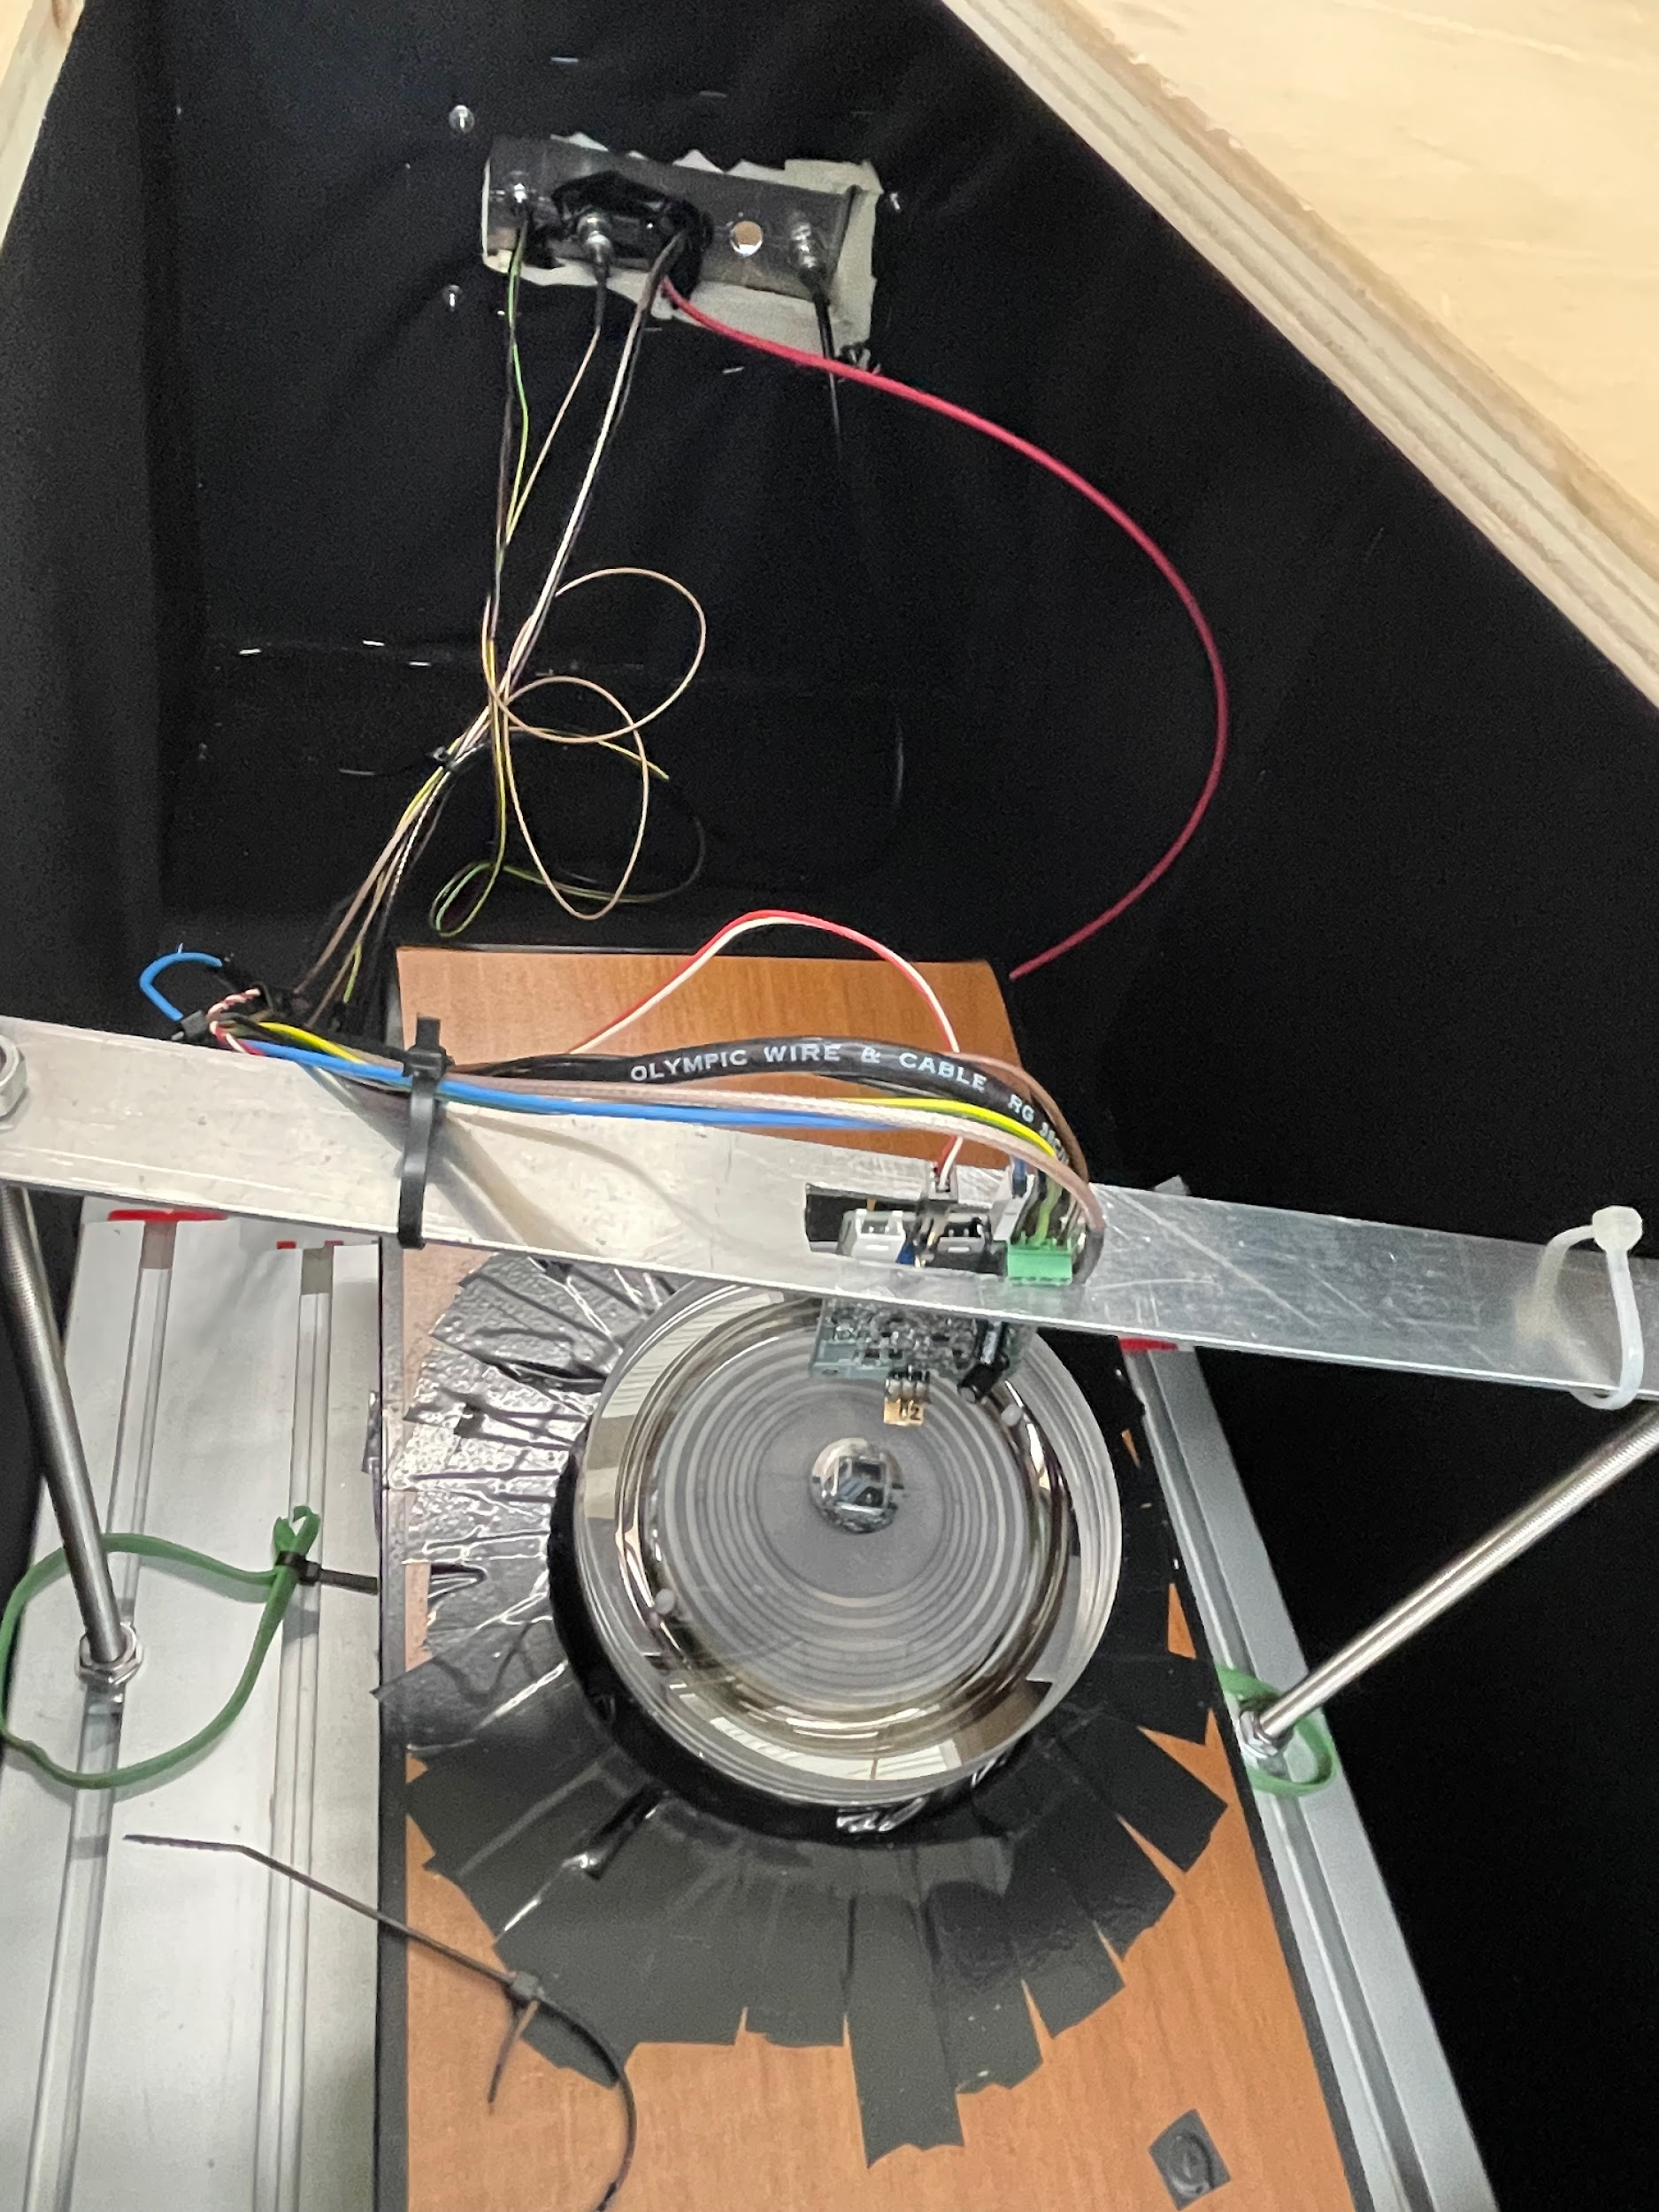
Setup
The SiPM is optically coupled to the ABALONE using an optical grease, and the unit is located above an LED
13

Slide 18
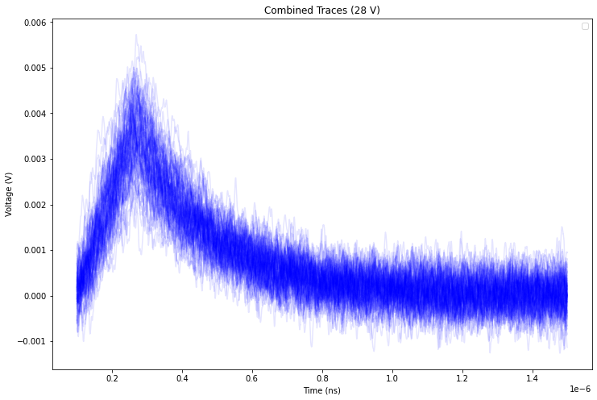
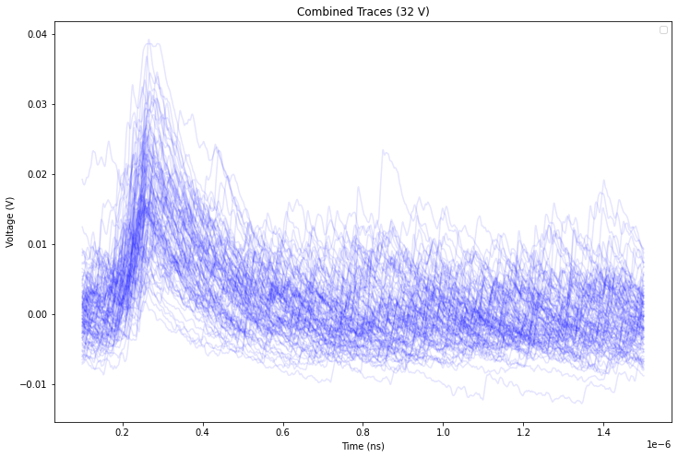
SiPMs readout
14

Slide 19
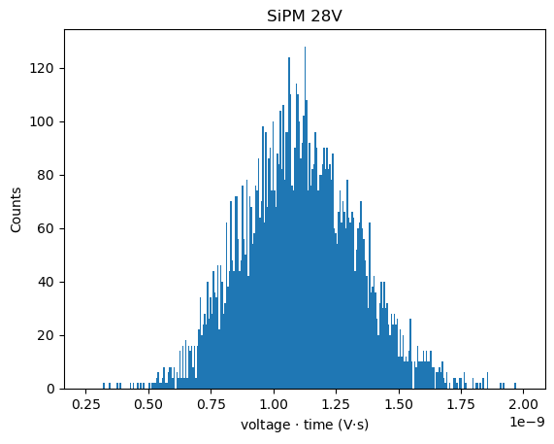
SiPM Pulse Integration
Pulses were integrated, however unable to distinguish distinct peaks of multiple photo-electrons.
About 10K samples were taken at voltages between 28V-32V
15

Slide 20
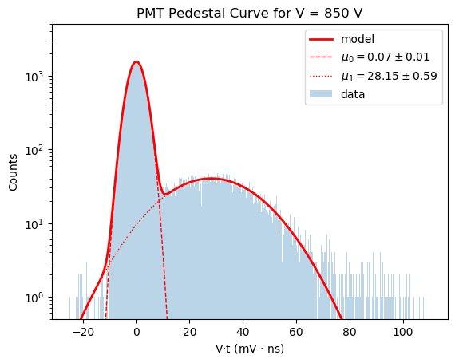
PMT Gain
Integrate Voltage after trigger to get total charge from photo-electrons.
About 50k samples were taken at bias voltages [750:950:50]
Integrals are then histogrammed and the median value of bumps are taken as PE peaks.
850 V (shown right) gain on 1 PE: 3.5E6 (e⁻)
16

Slide 21
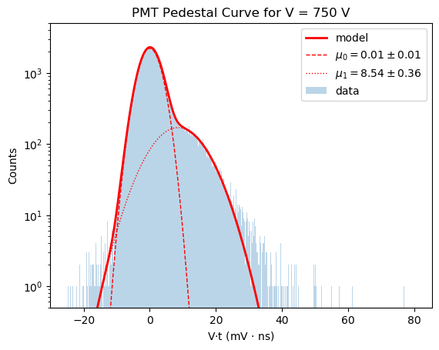
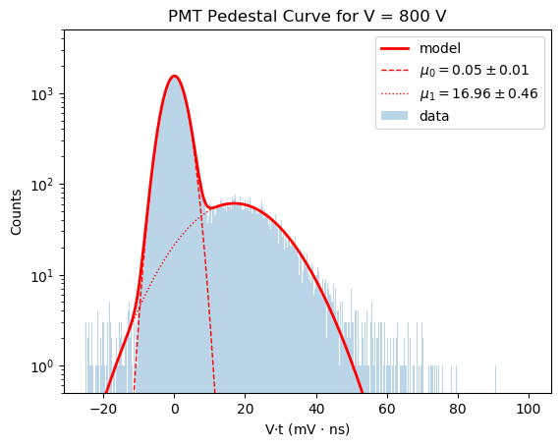
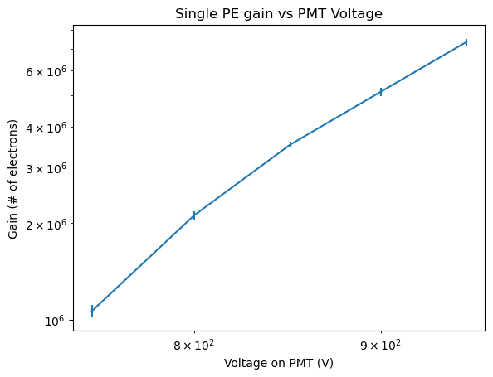
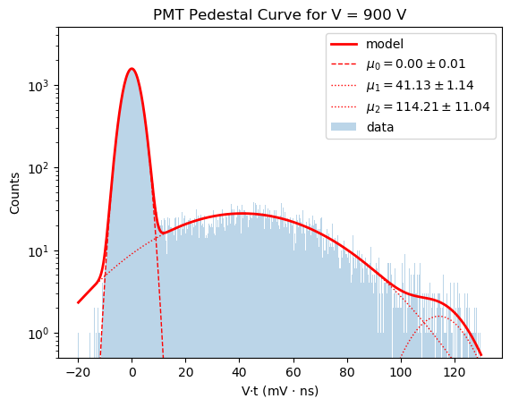
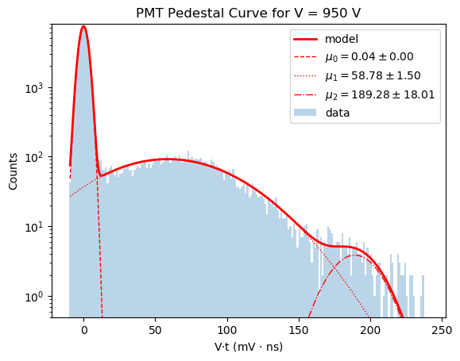
PMT Gain
17

Slide 22
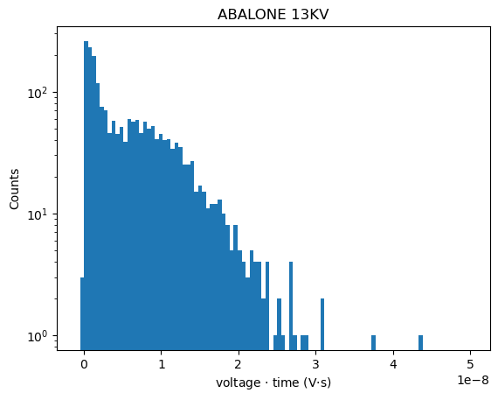
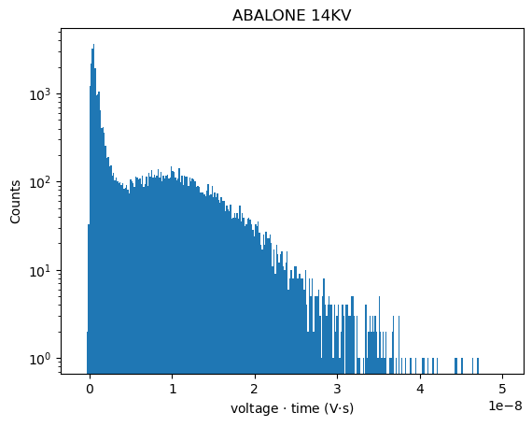
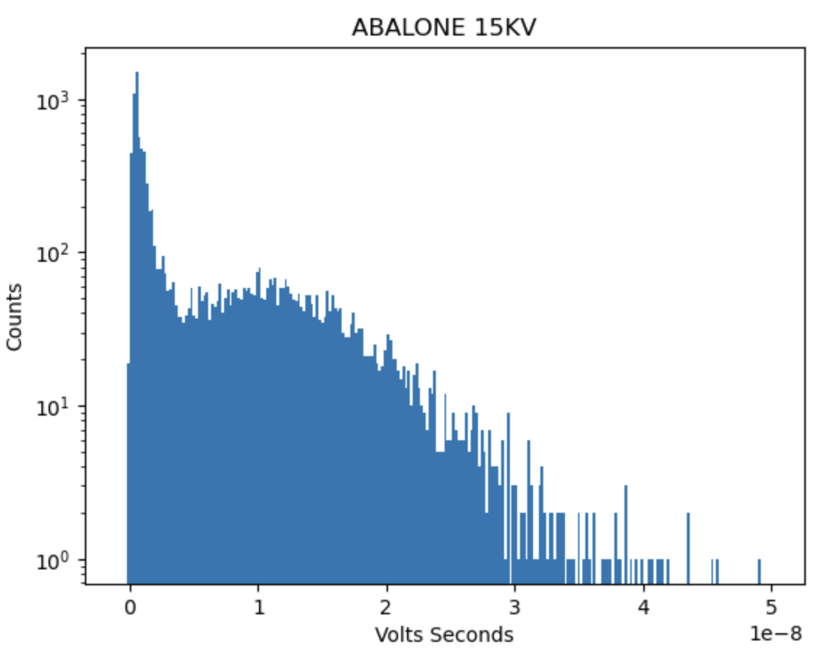
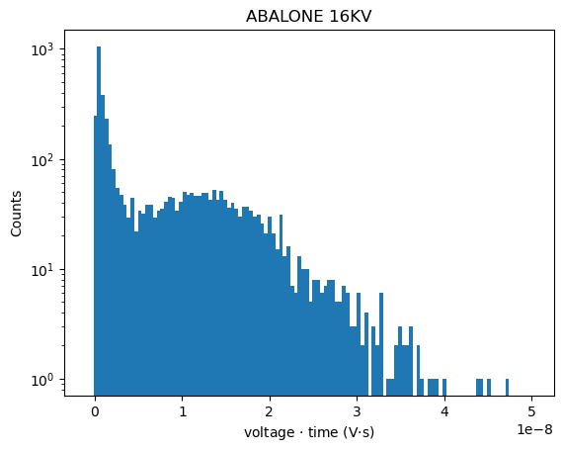
The ABALONE Photo-sensor readout with Peak Finding
Data was taken at voltages between 11KV and 18KV
Low statistics at lower voltages due to issues with data transfer
Used a pulse finding algorithm to find pulses, then integrated and plotted histogram
Note: pulses amplified by factor of 3
18

Slide 23
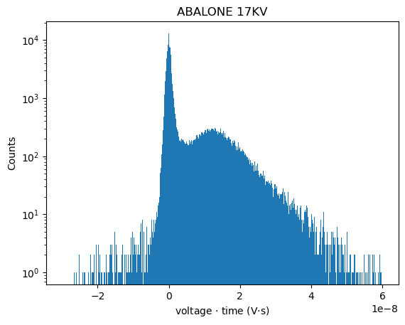
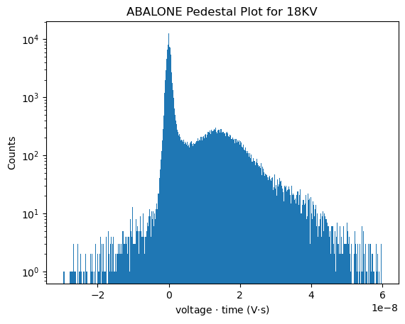
The ABALONE Photo-sensor Pedestal Plot
19

Slide 24
Conclusion
Different tests were performed using SiPMs, PMTs and ABALONE photosensor.
SiPM data was taken at room temp
The SiPMs waveforms were full of dark noise
Dark noise made it challenging to consistently integrate after trigger (see slide 15).
Measured gain of a single Photoelectron for the PMT.
Added ABALONE in front of SiPM and observed integrated charge
SiPM begins to look like PMT.
Did not get around to calculating gain
20

Slide 25
Thanks for listening!
Any Questions?
Stay tuned
WINE so serious?
20

Slide 26
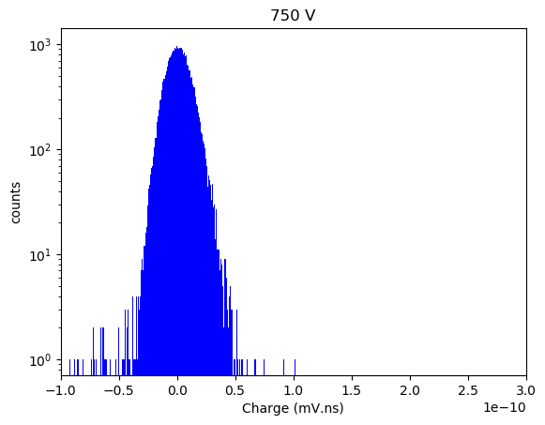
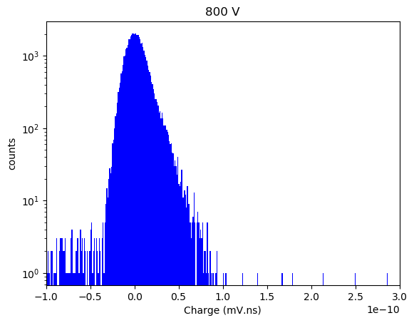
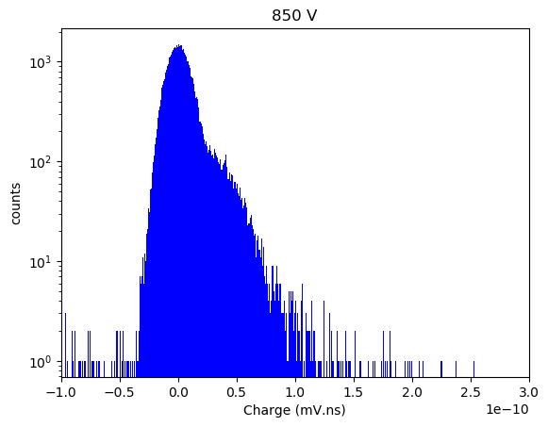
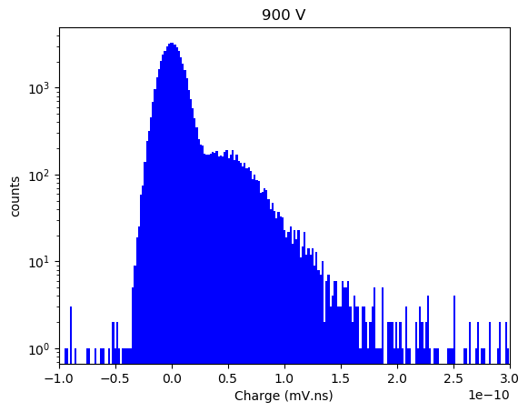
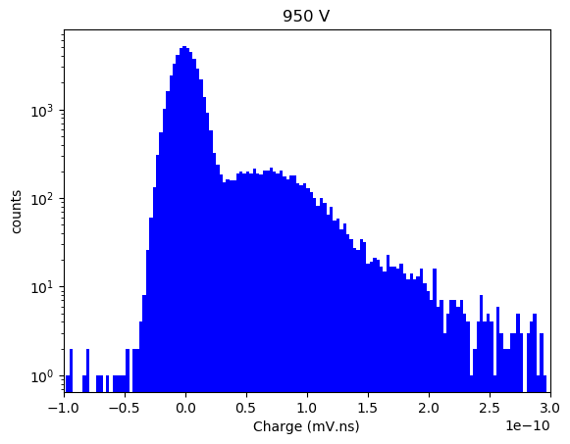
PMT (750-950 V)
14

