Slide 1
ITk Assembly Tools
PRR - 21 Jan 2025

Slide 2
Domande per Tim:
I have to cover all the assembly procedure?
Also the tools such HR insertion tool (Lecce), Cable Insertion tool (Stephen), piping insertion tool(Milano)?
Or only the Assembly tools under the responsability of Frascati?
How me and Matthew will share the time?

Slide 3
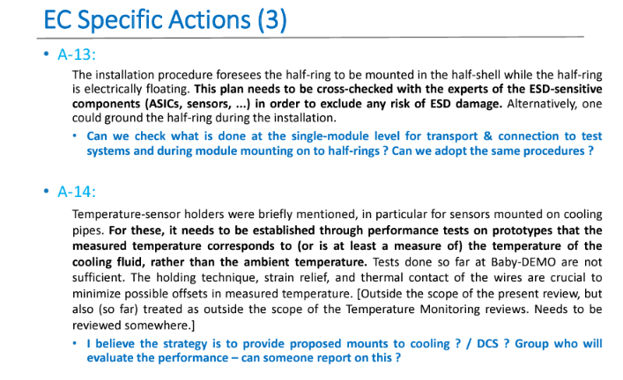
FDR Action and Recommendations
Non vedo la parte relativa ai tool.. comunque so che è richiesta una valutazione quantitativa del posizionamento dei rotating cradle e della sua ripetibilità

Slide 4
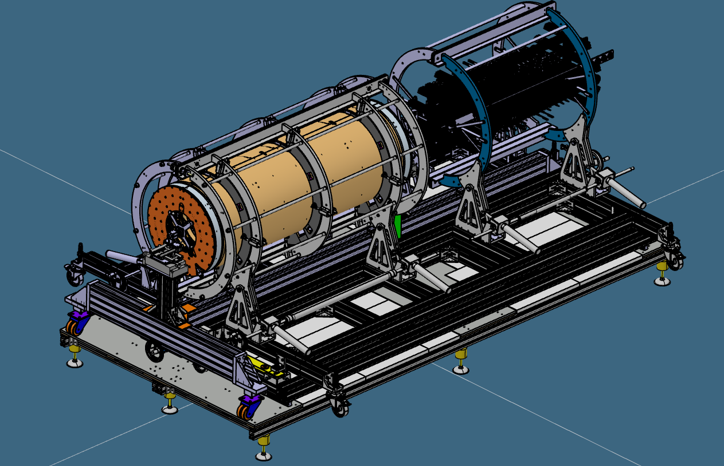
ITk Assembly Tool
y
x
z
3D Model Last Version : https://cernbox.cern.ch/s/u2VtePbdqXNoQl8

Slide 5
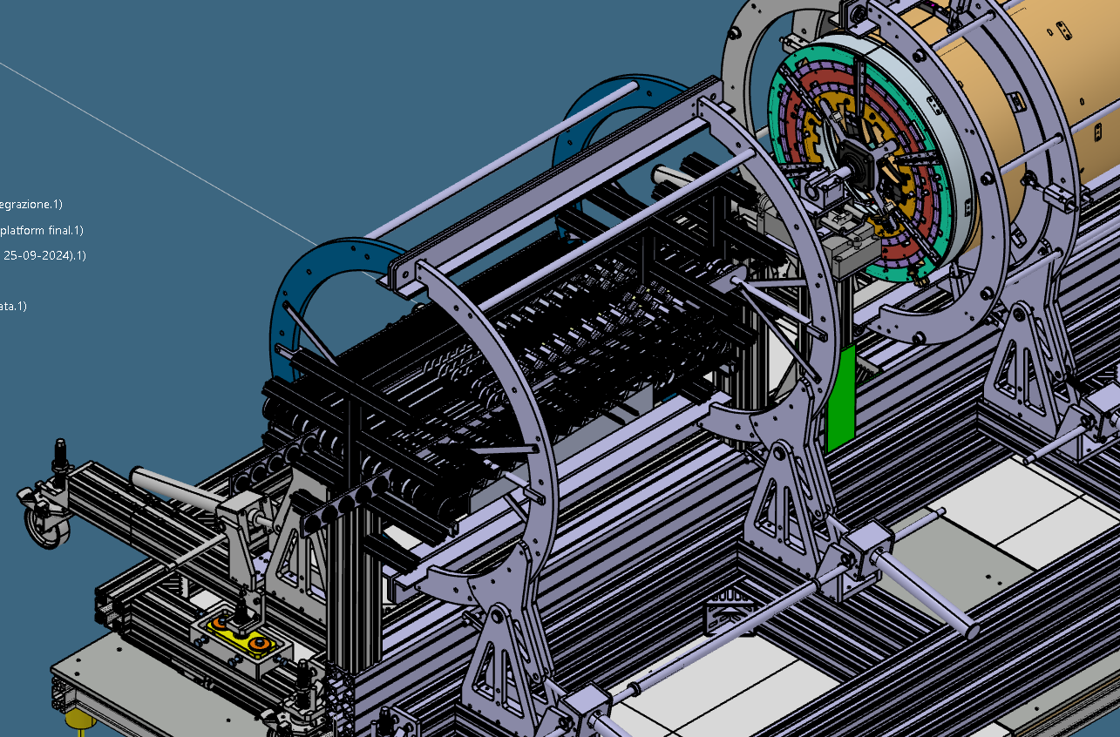
Sistemazione/Organizzazione modello su 3DE

Slide 6
ITk Assembly Procedure

Slide 7
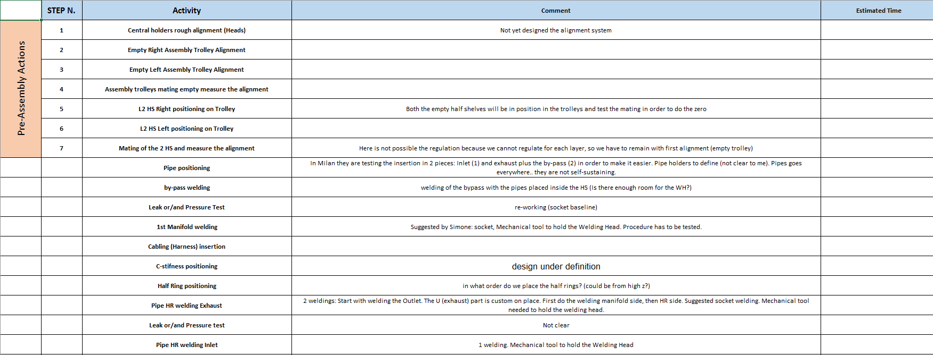
This is a first attempt in preparing the step by step assembly procedure, to be discussed with Liverpool.

Slide 8
Appunti allineamento
Mettere nottolini sui radial support per farli lavorare meglio → chi può farlo? Si può stampare, e verificare i radial di L4 che abbiamo se hanno gli inserti
Procedura di allineamento:
Allineamento di L2
Allineamento di L3 e L4 (saranno quelli che si allineeranno ad es. per L3?) oppure si allineeranno le teste a cercare il centro di L3?
2 problemi per allineare i cradle:
1. le ruote sono difficoltose da manovrare, bisognerebbe agire su tutte e 4
2. il punto fisso (che ad oggi fisso non è) fa basculare la struttura, quindi dovrebbe esserci almeno un altro punto su un piano.
Oppure avere un sistema analogo a Liverpool con sistema di allineamento solidale al terreno
Sistema per la verifica dell'allineamento:
definire un sistema di reference
misura per allineare:
le due teste tra loro
un cradle con le teste
I due cradle
Campagna di metrologia → richiesta fatta a Paris (20250108)
misurare i due cradle singolarmente-> formano un cilindro?
misurare i due cradle accoppiati-> formano un cilindro?

Slide 9
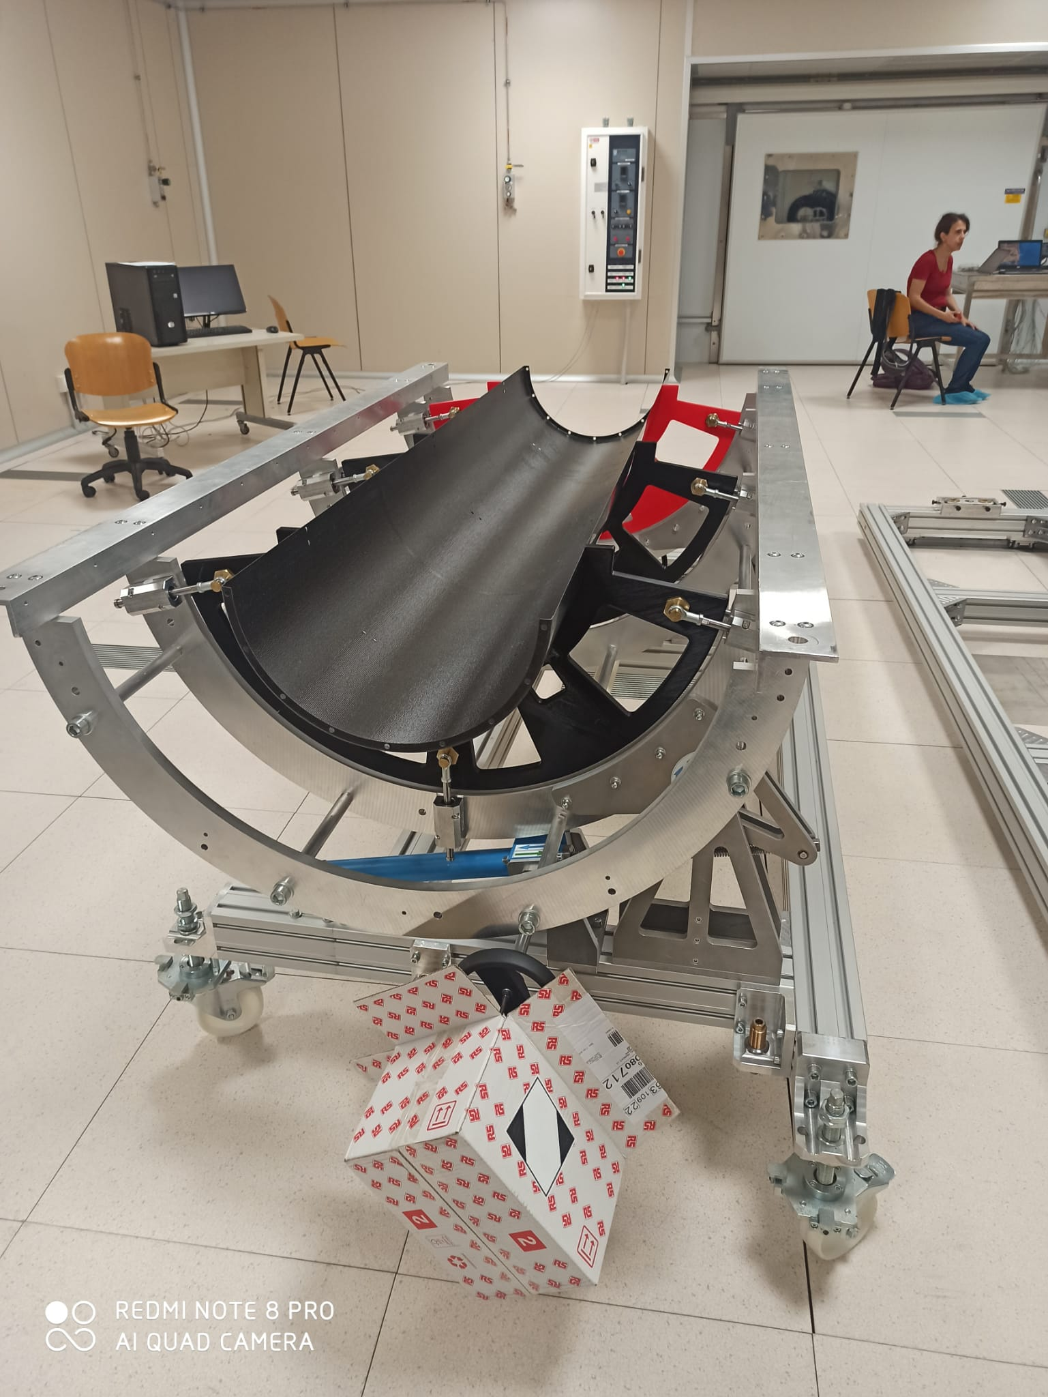

Slide 10
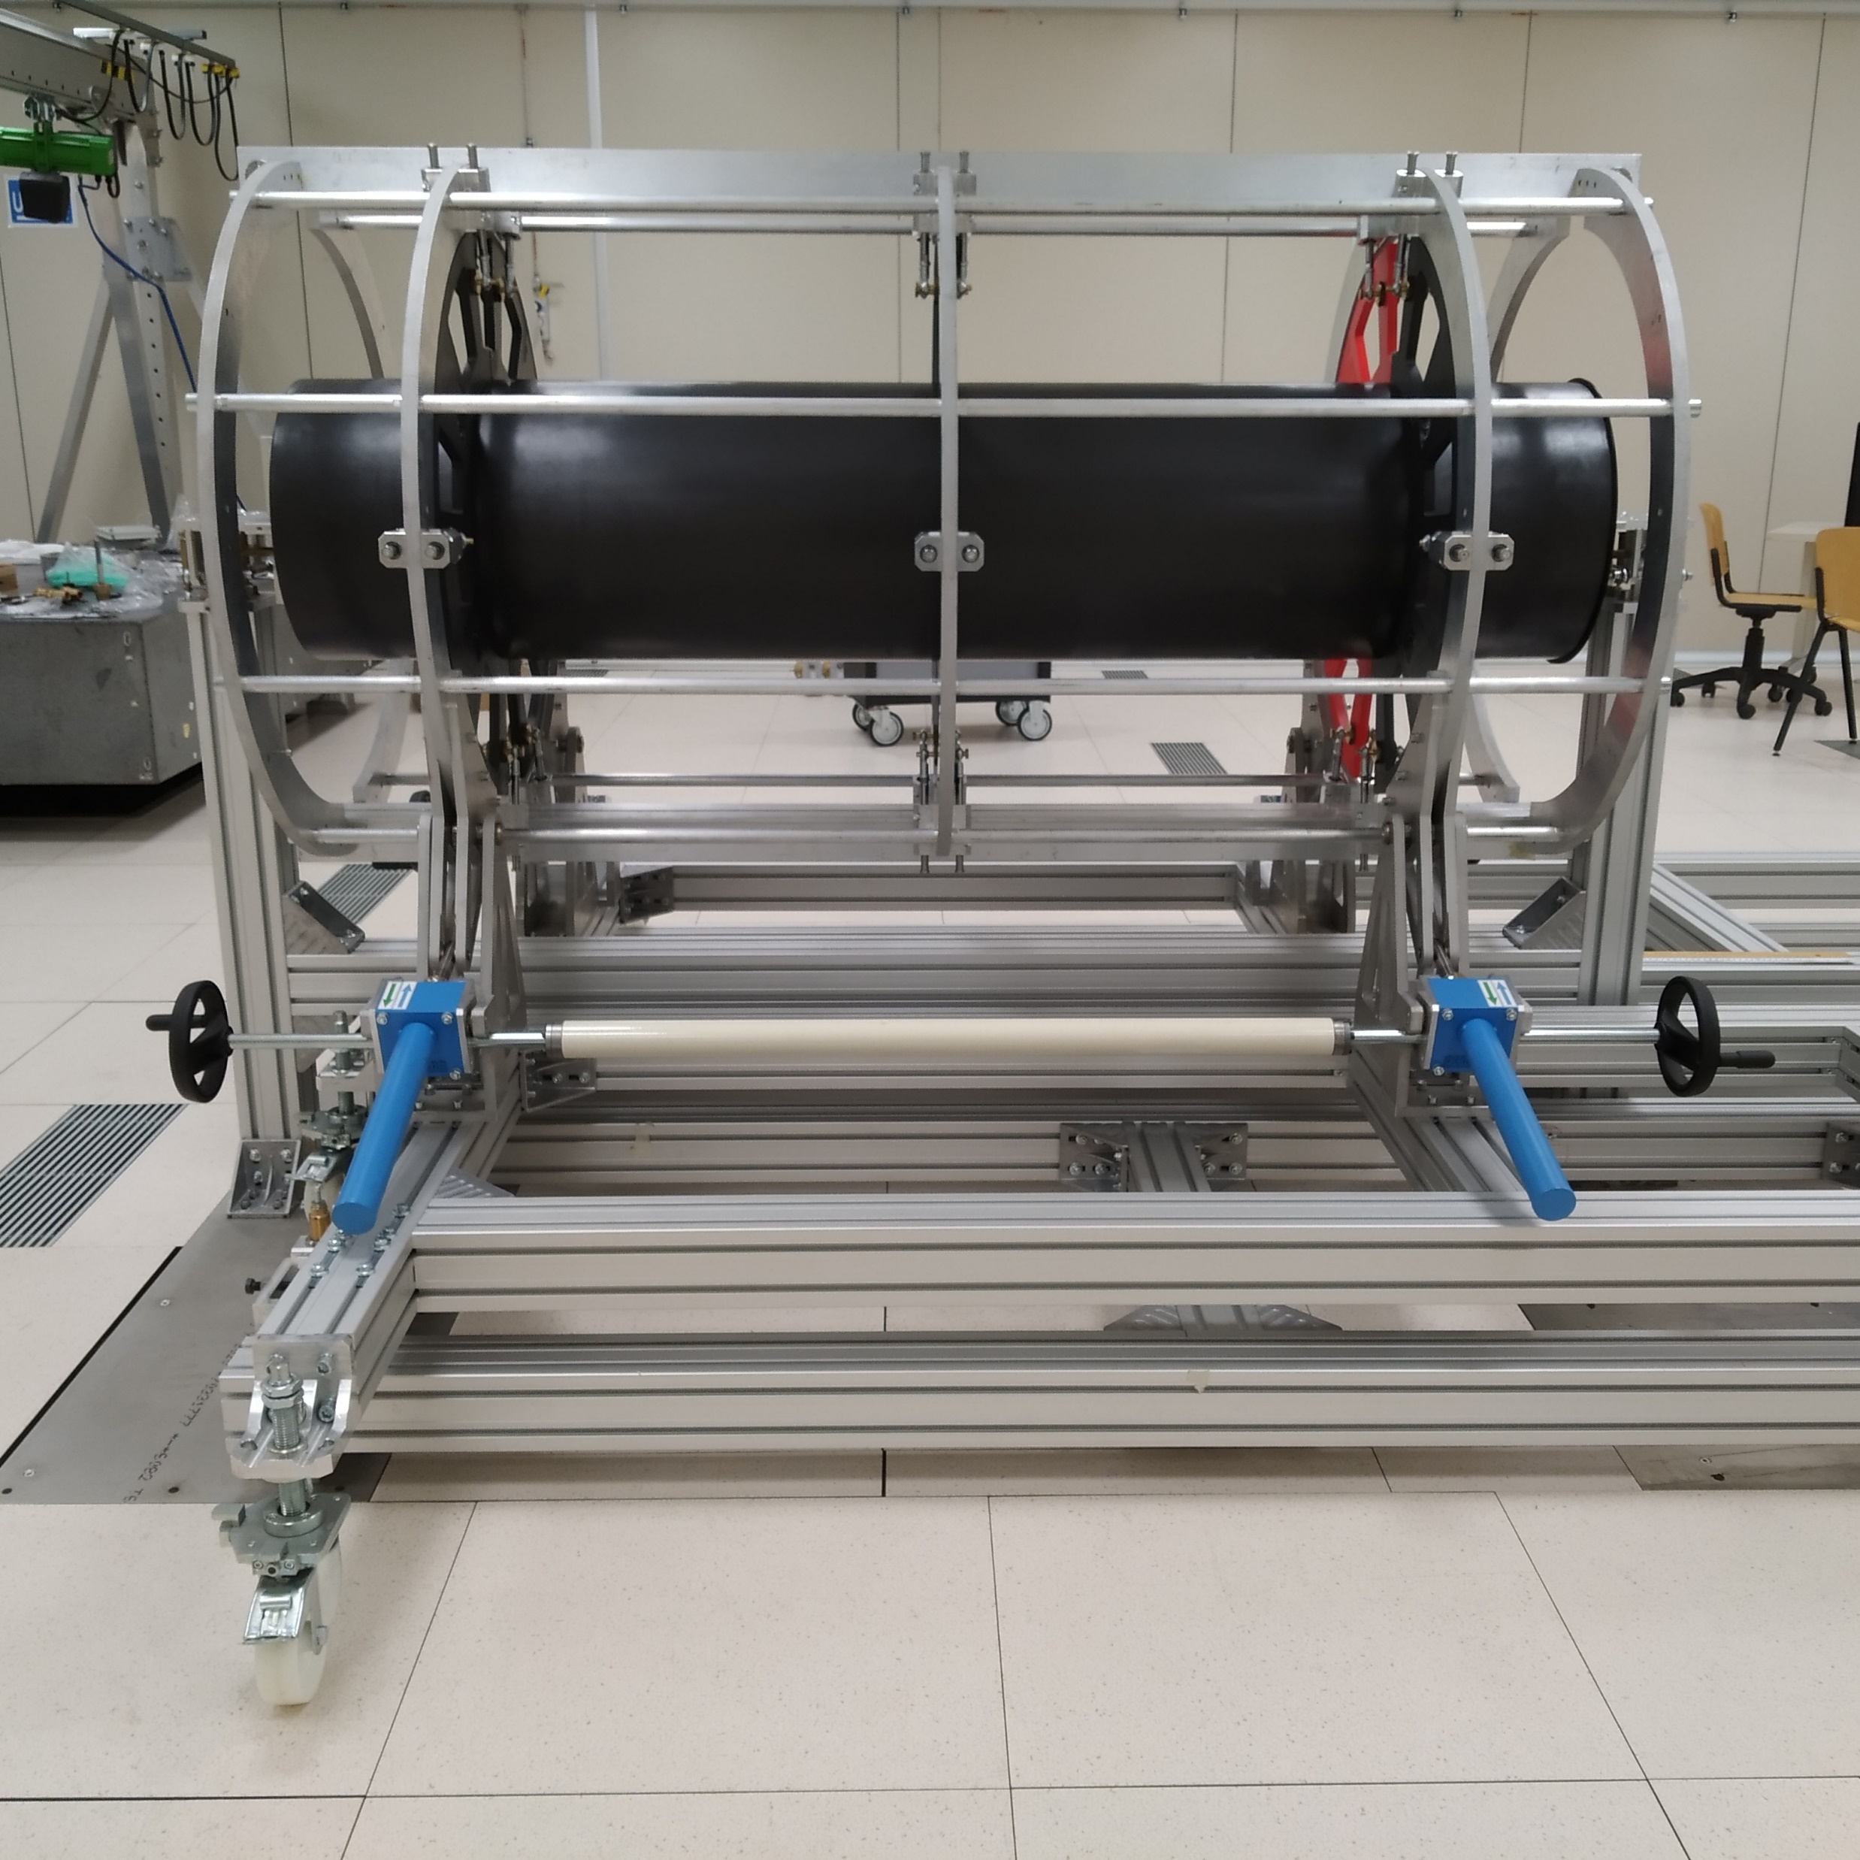
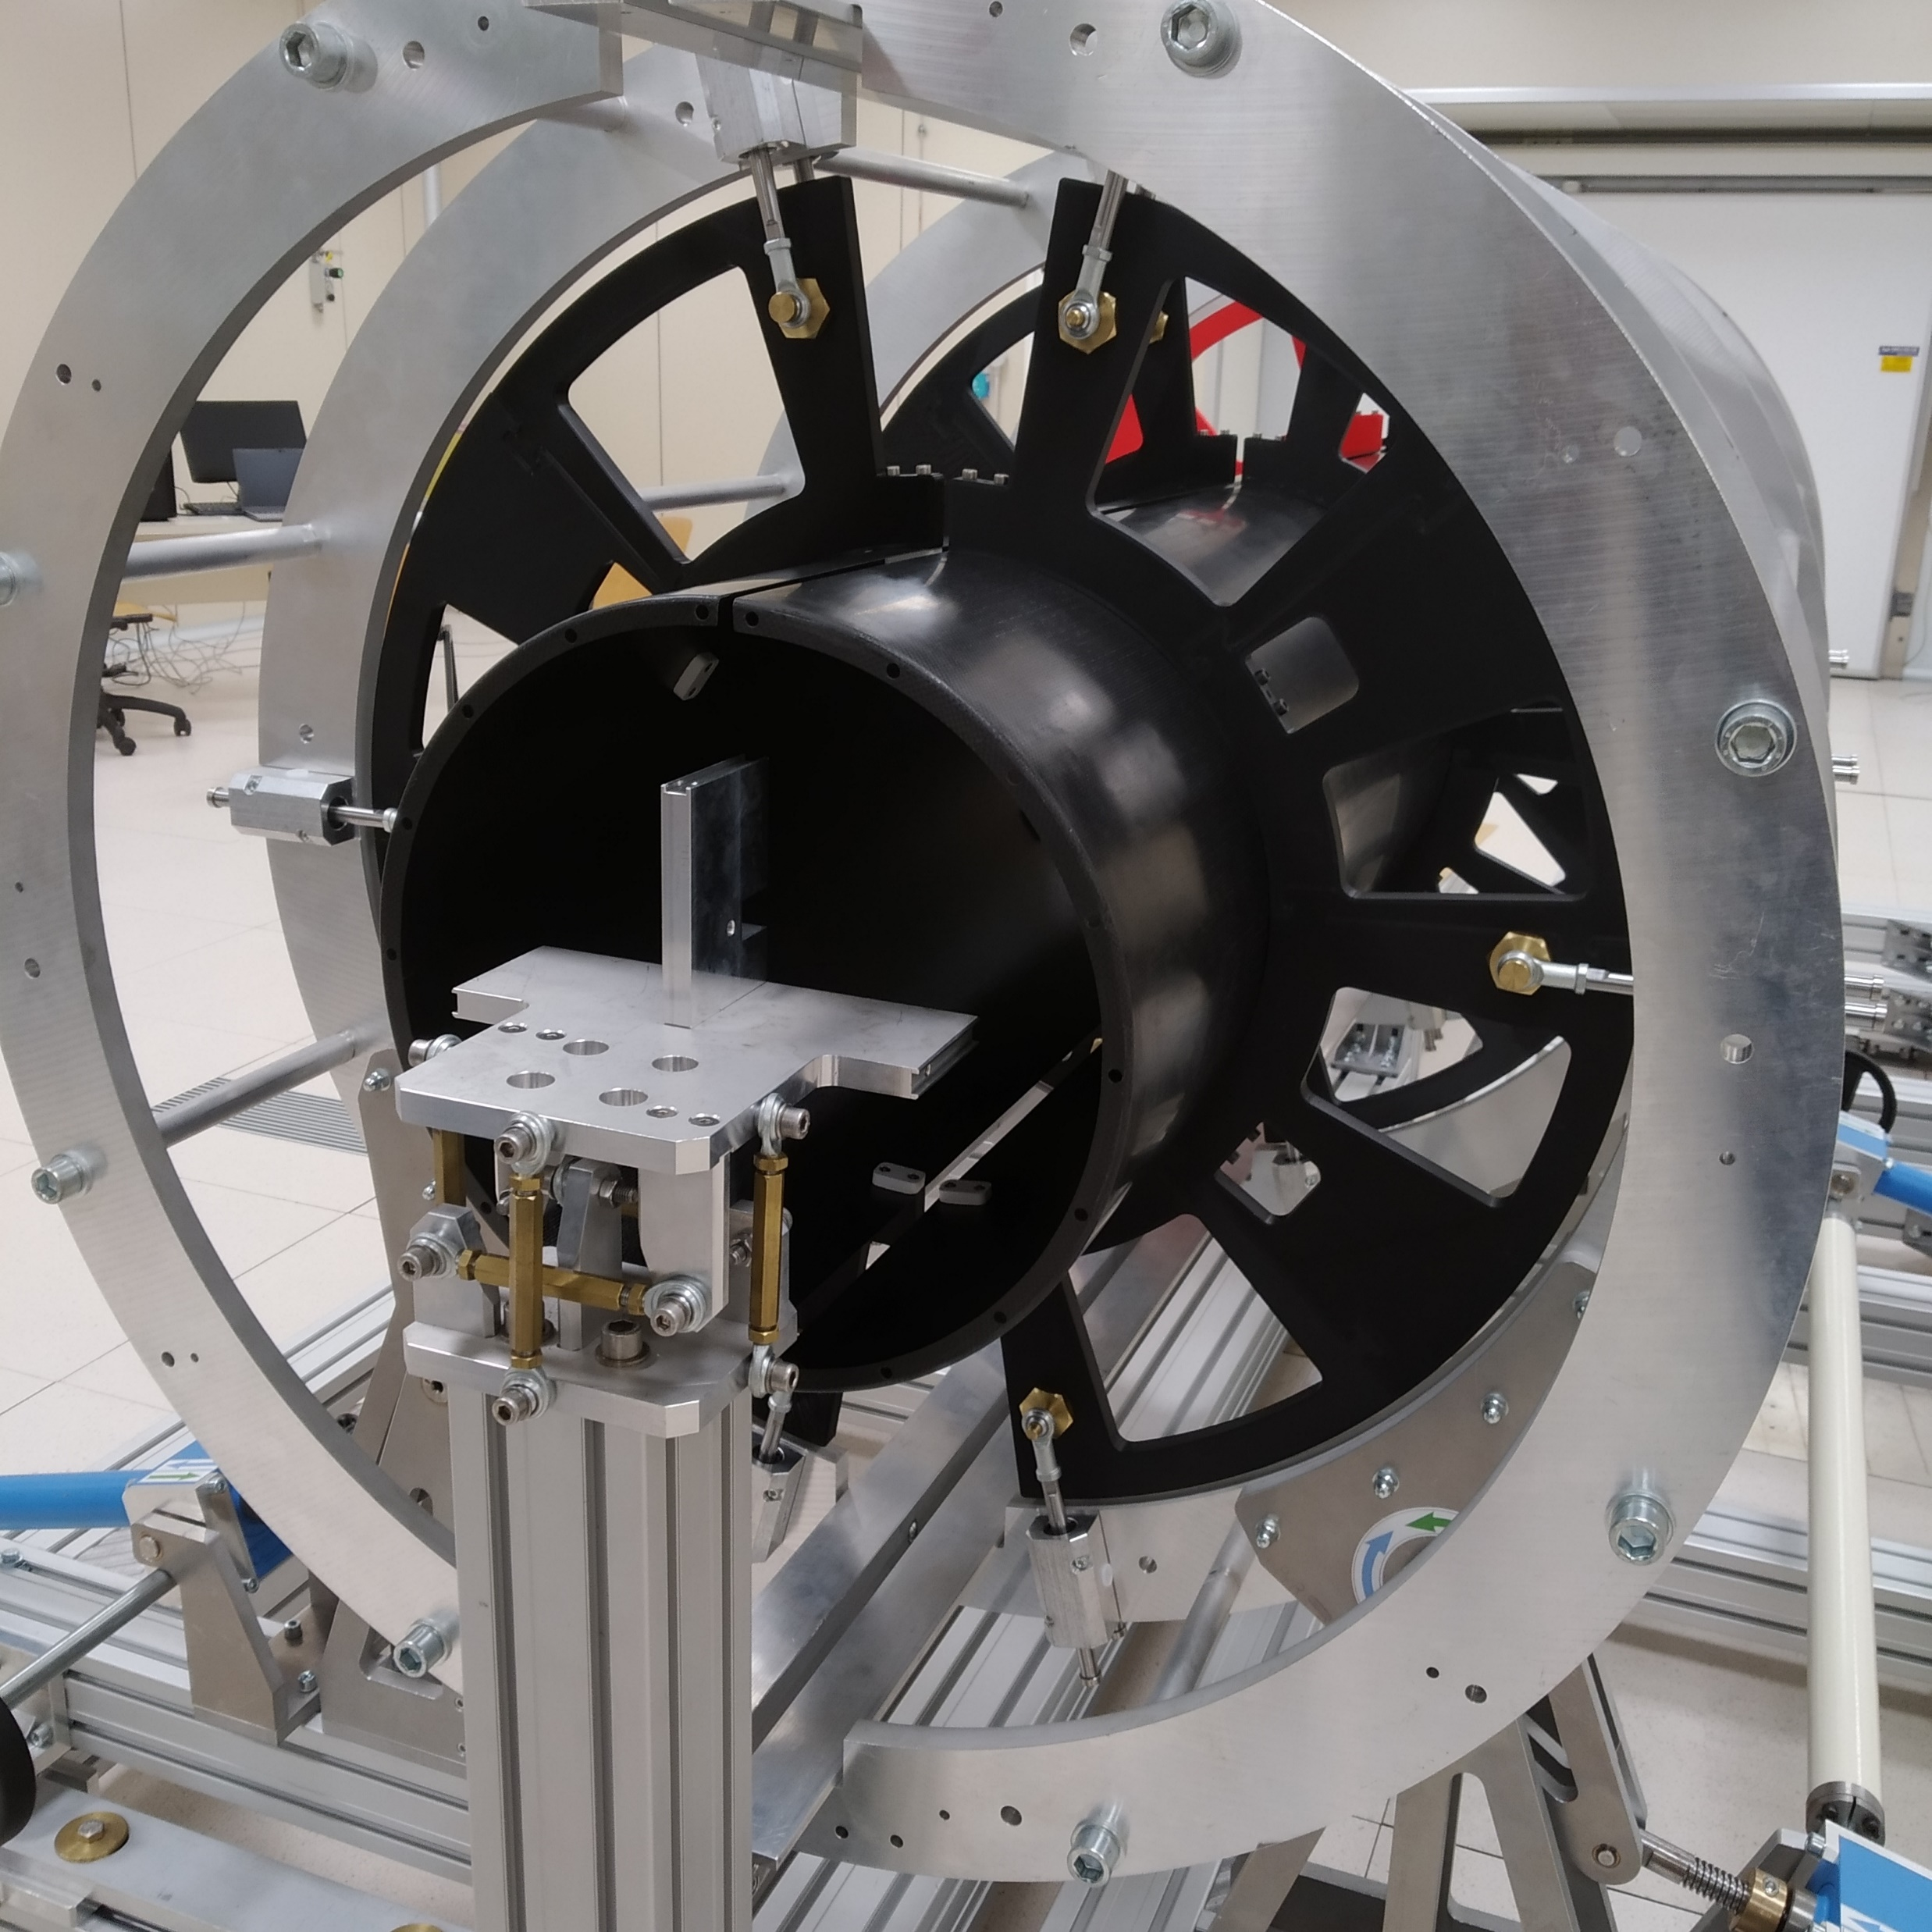
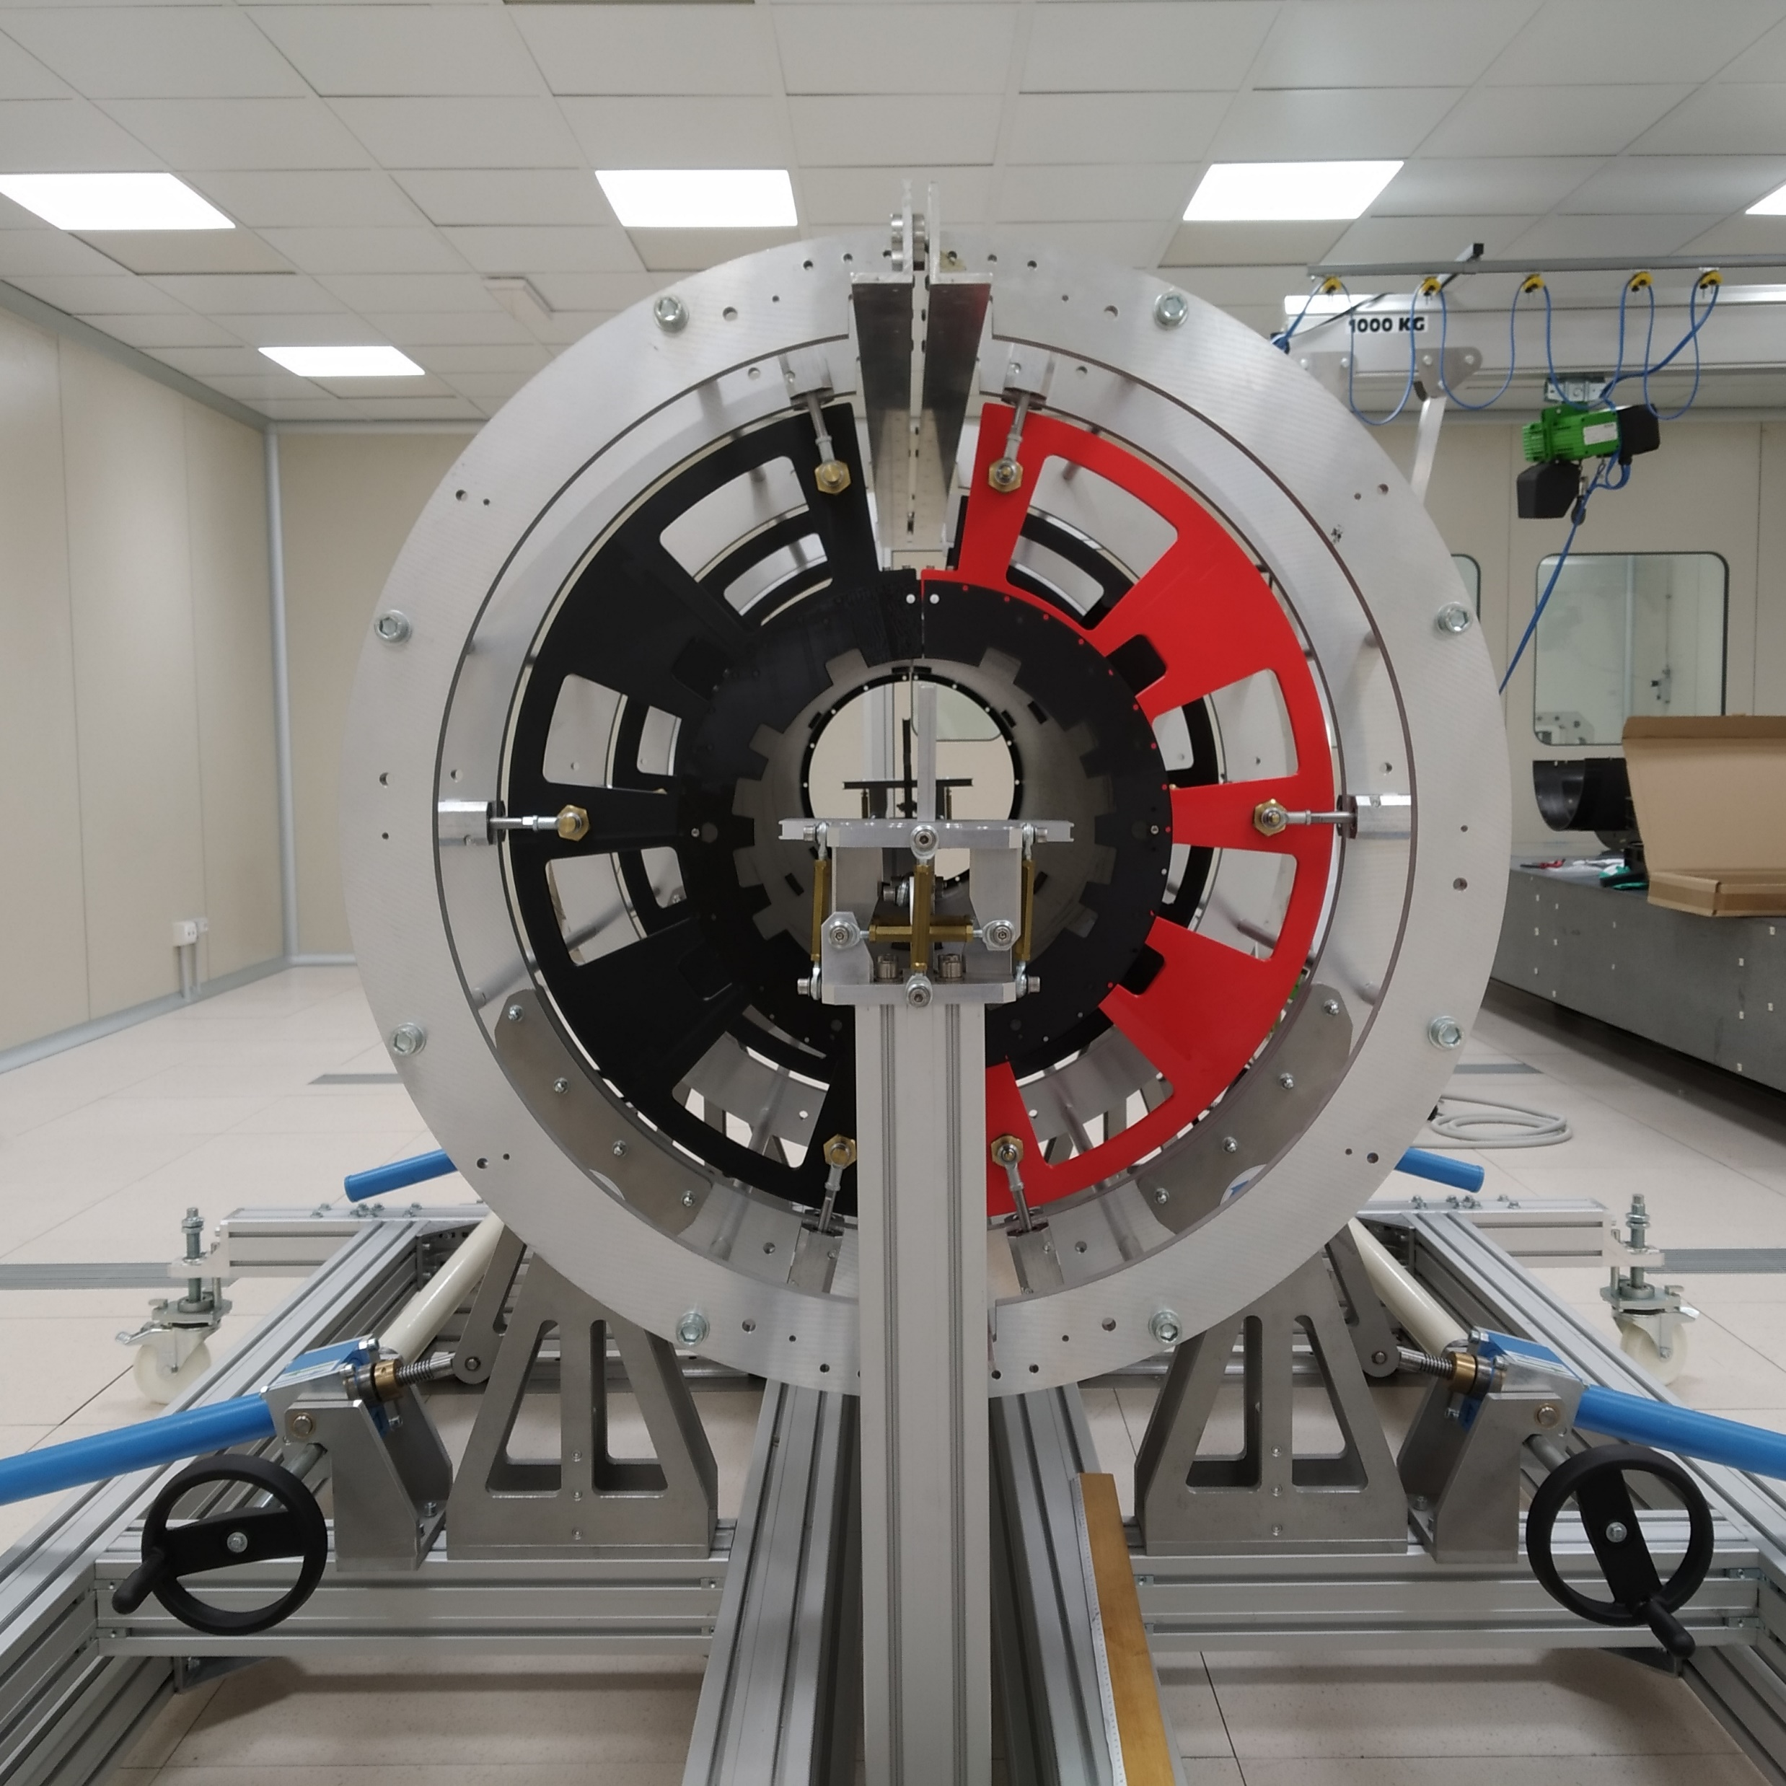

Slide 11
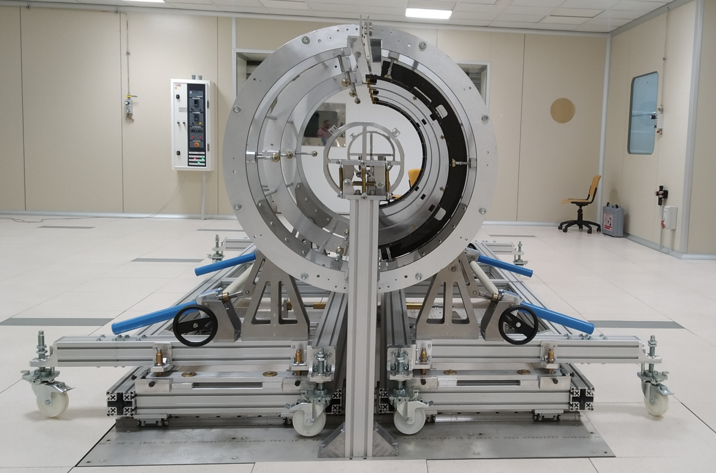
A system in order to align all the parts has to be developed yet:
The front flange could be our reference.
The system should align the "back head" respect the front one;
The rotating cradles respect the front head (reference);

Slide 12
Check the repeatability of the rotating cradle for the mating of the L3 and L4, scheduled this week
We have some ideas to modify also the Linear Frame in order to have it simpler

Slide 13
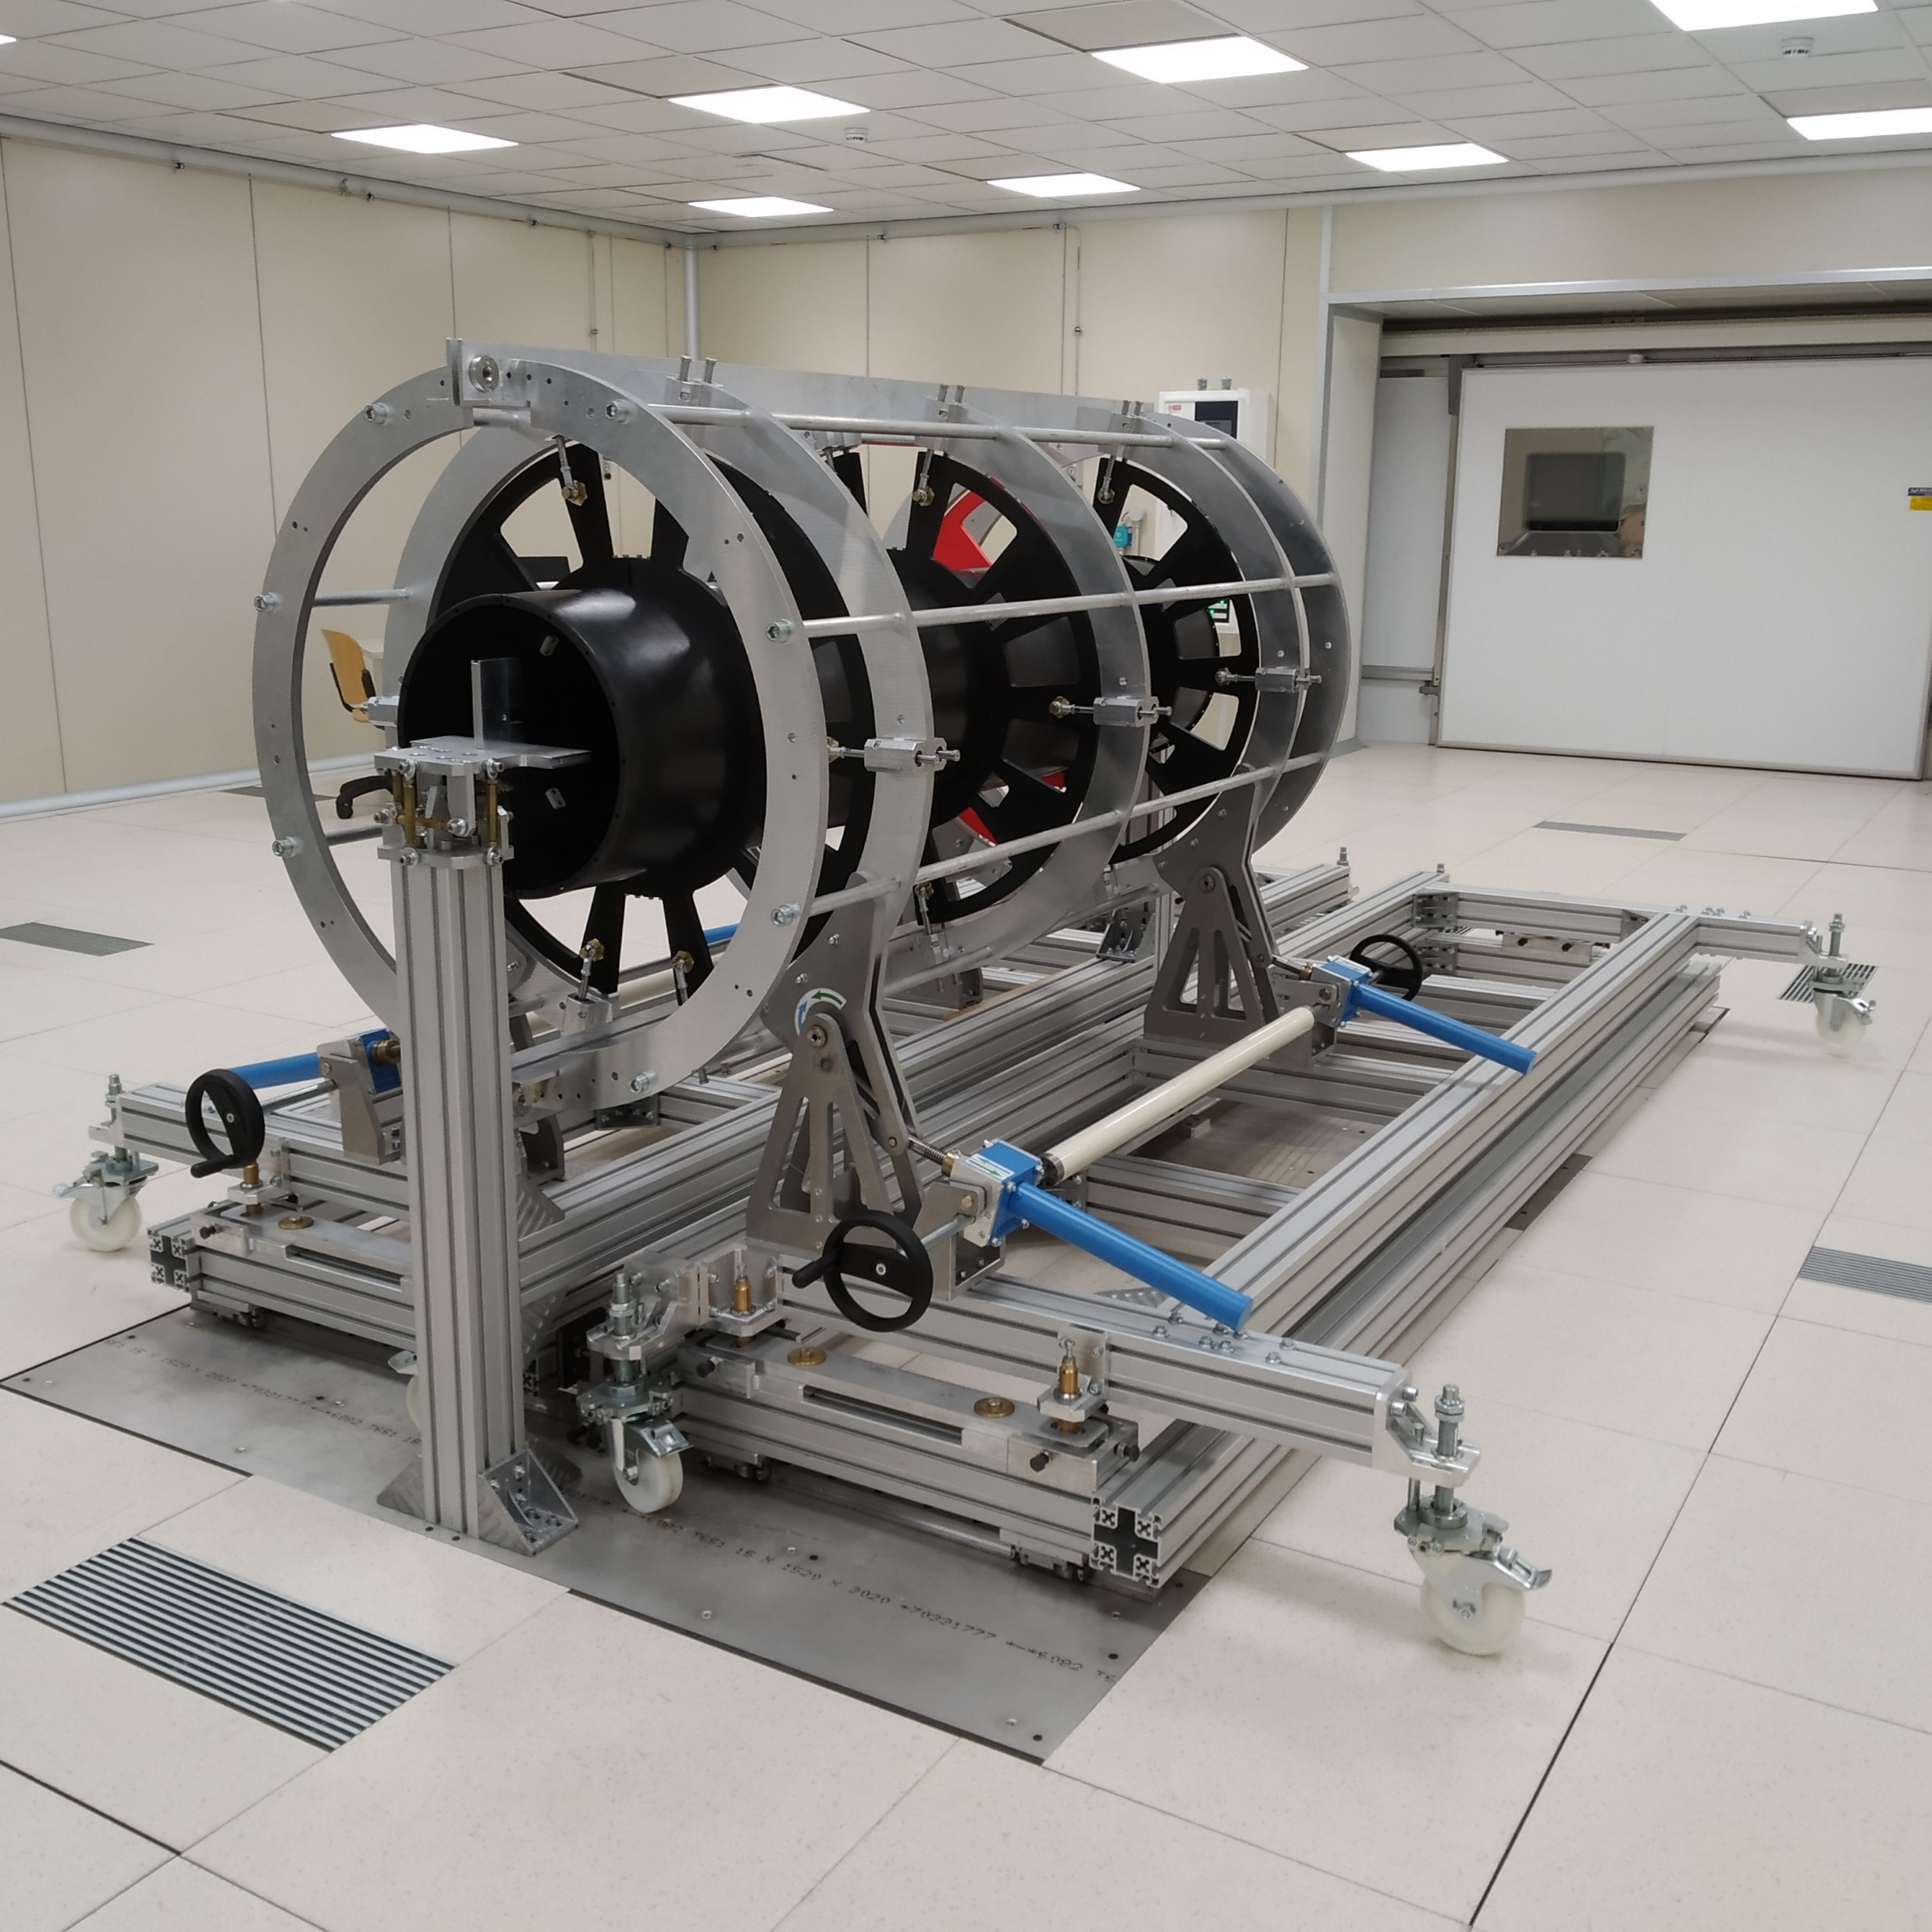
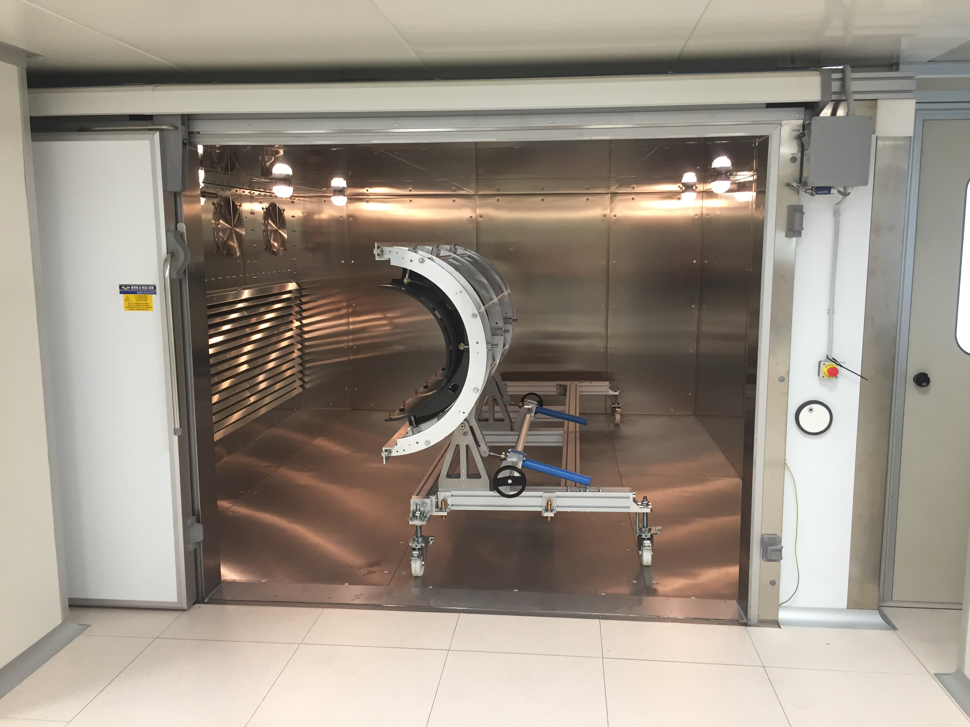
Da verificare le caratteristiche di carico della piastra, del pavimento flottante e della camera climatica

Slide 14
DETECTOR SUPPORT "HEADS"

Slide 15
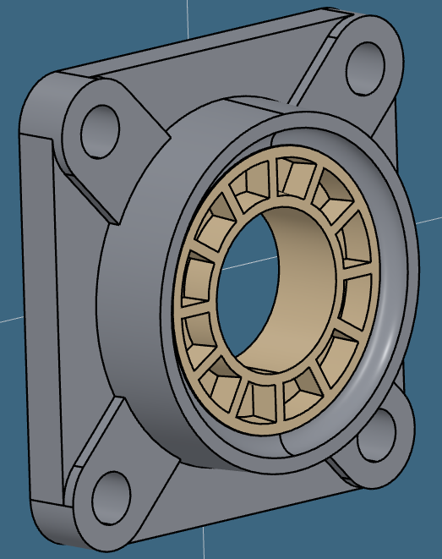
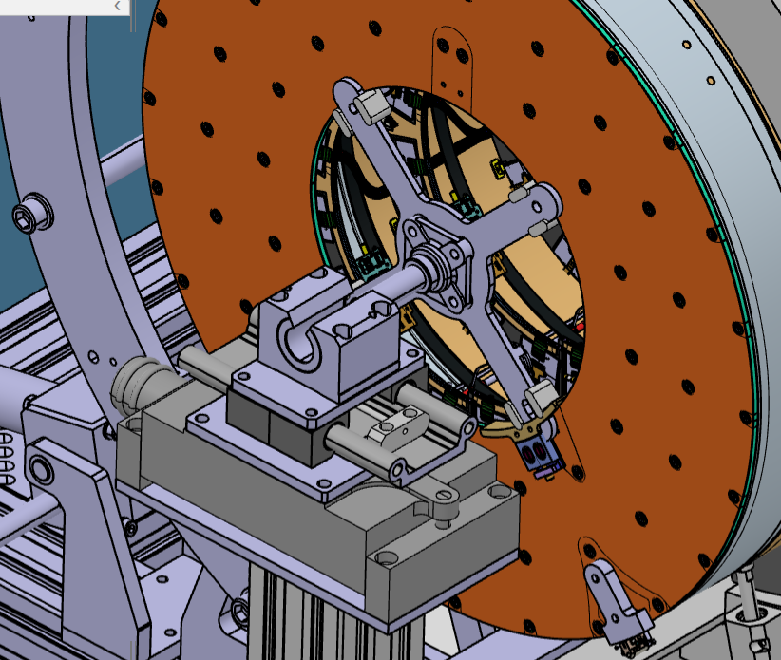
Linear slider "z"
Spherical Joint. Too small, we are thinking to use a bigger diameter
Linear Guide "y"
Linear Guide "x"
4 arms cross plate
y
x
z
by Filippo Rosatelli and Bruno Ponzio

Slide 16
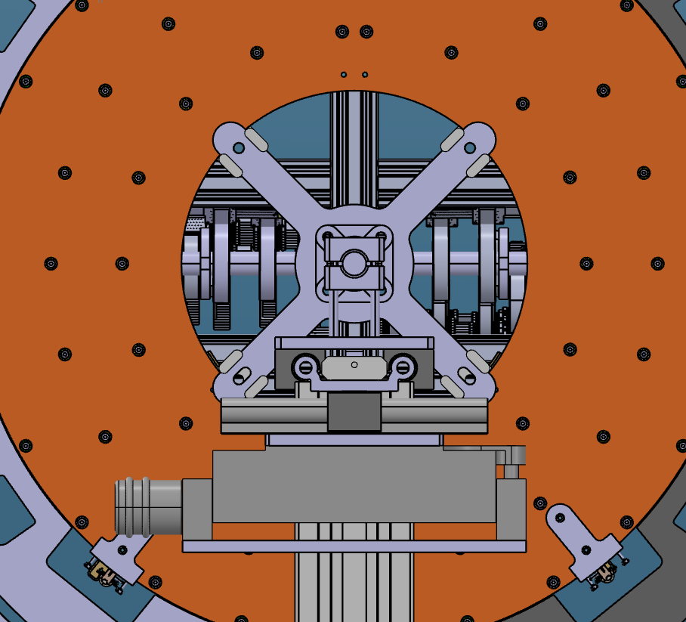
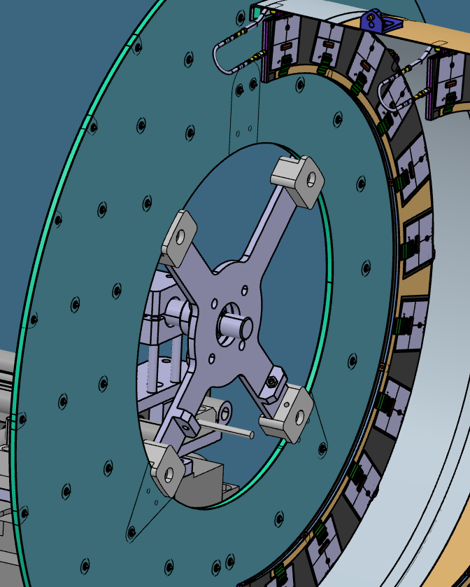
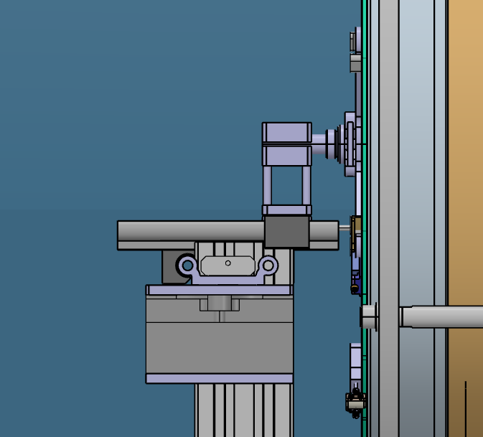
Some reinforcement is needed? Mauro Monti performed the FEA analysys. I can't find the talk.
In the bottom part there are already for the IST support.
4 clamping points
The material of the cross could be Aluminum or CF.
These 2 clamps will be provided with screws and springs. To finalize the design.

Slide 17
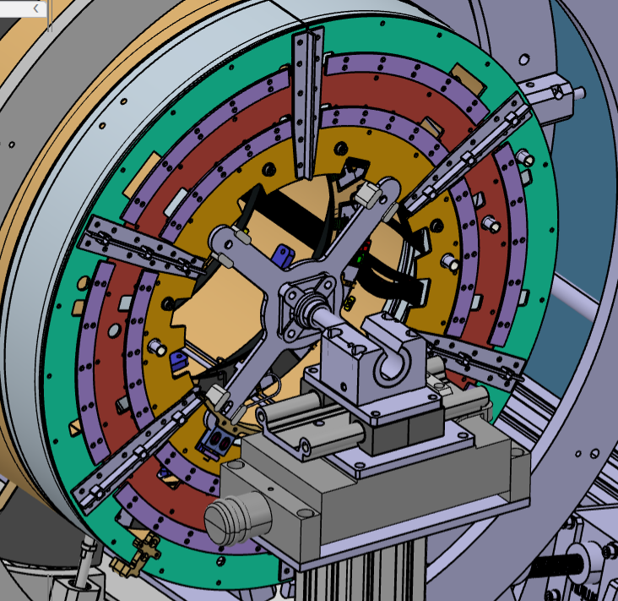
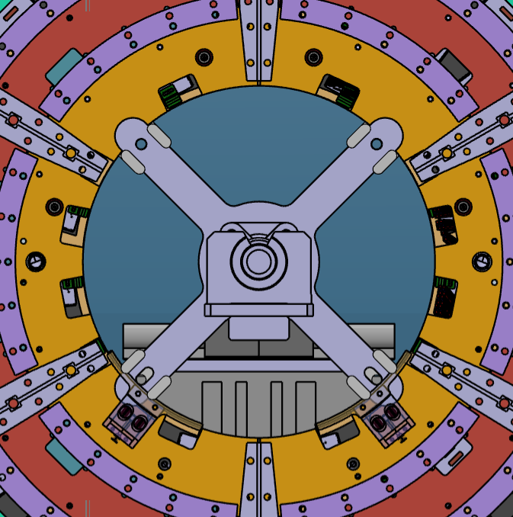
On the back flange the clamps seems to be ok. The 3D model of the heads is available in the cern box, so there are some contraints for the position of the cable aperture in the back flange.

Slide 18
Conclusions
The design is quite advanced and it is converging to a final solution
Filippo requires to work on that full time
Next steps
Finalize the design:
increase the diameter of the rod;
define the material and design for the "cross";
details for the clamping system (with screws and springs);
Add the Alignment system
Purchase the parts
Perform some test to check all the functionalities

Slide 19
T-Trolley

Slide 20
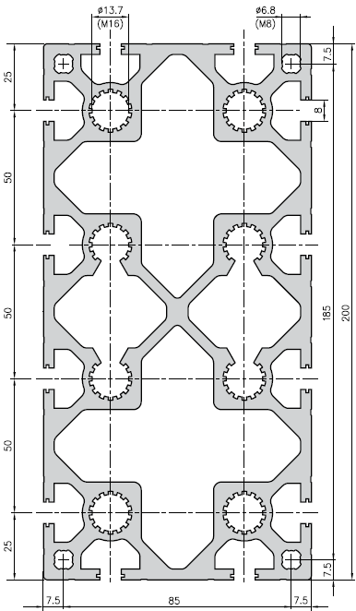
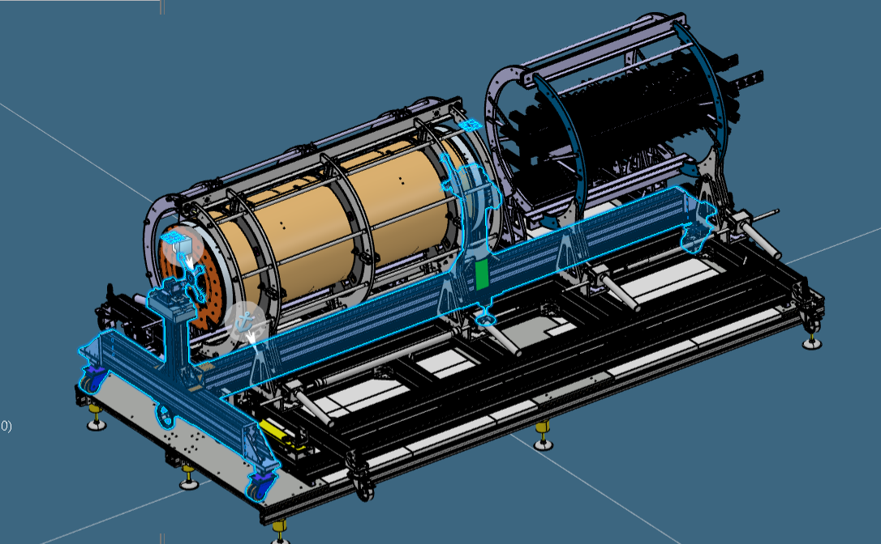
T-trolley
Shipped at LNF
by Marco Battisti and Bruno Ponzio
section of the beam

Slide 21
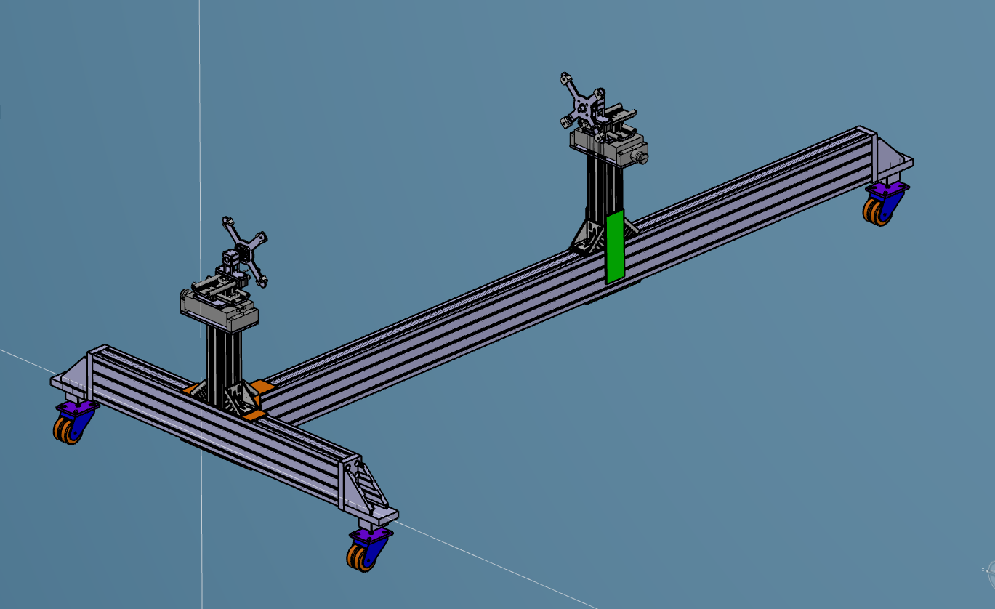
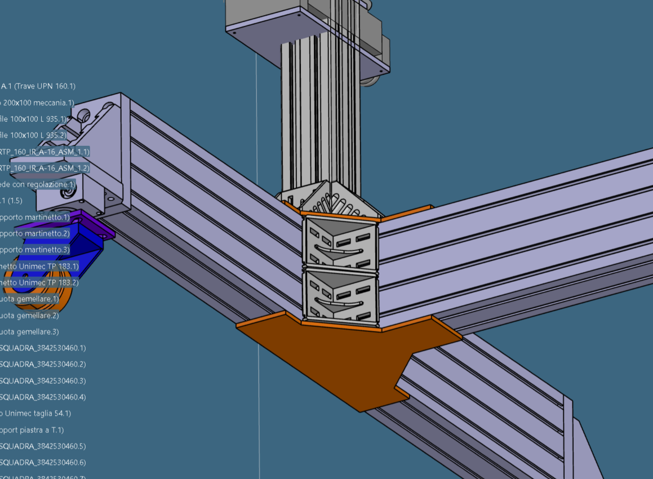
Reinforcments for the beam connections. Room problems for using the nominal ones. To be garanteed the perpendicularity between the 2 beams.
Missing the alignment system supporting the T-trolley during the mating of the layers. To be defined.

Slide 22
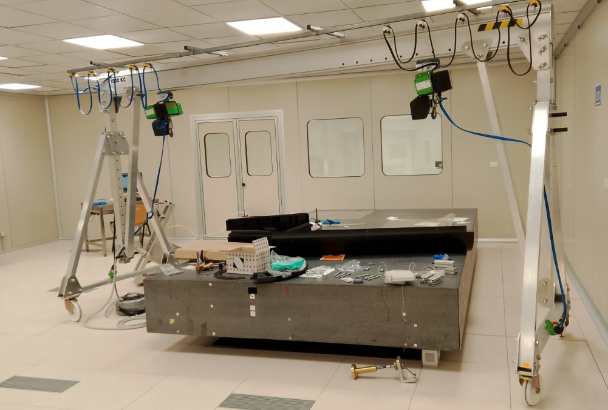
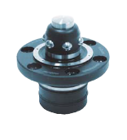
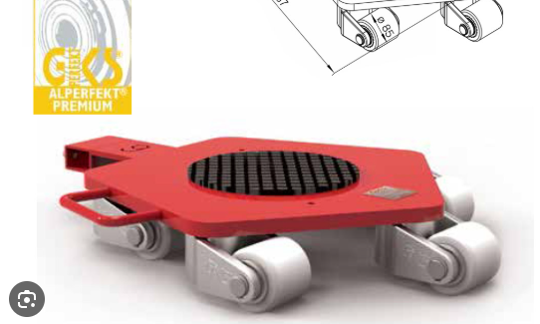
Lifting system and wheels
Upper view of the system
Centering system
Wheels
Wheels
Detector
Pillars
Service
Pillars
No room for automatic system

Slide 23
Conclusions
we had some delay due to Marco activities on other tasks
the design of the beam is frozen
the beam is puchased
Next steps
design the alignment system
finalize the lifting system and wheels insertion
Production of the system
Test to check all the system (mechanical test, Climatic chamber test...)

Slide 24
ITk SHIPPING/TEST BOX

Slide 25
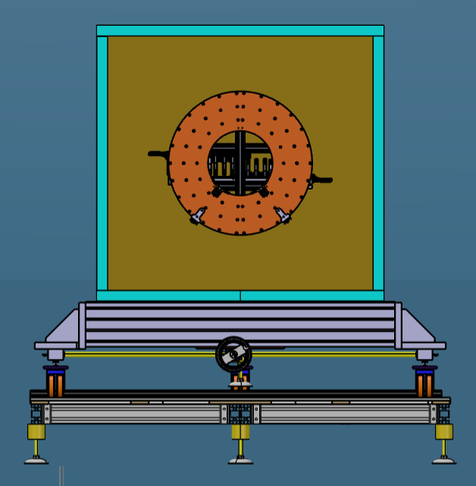
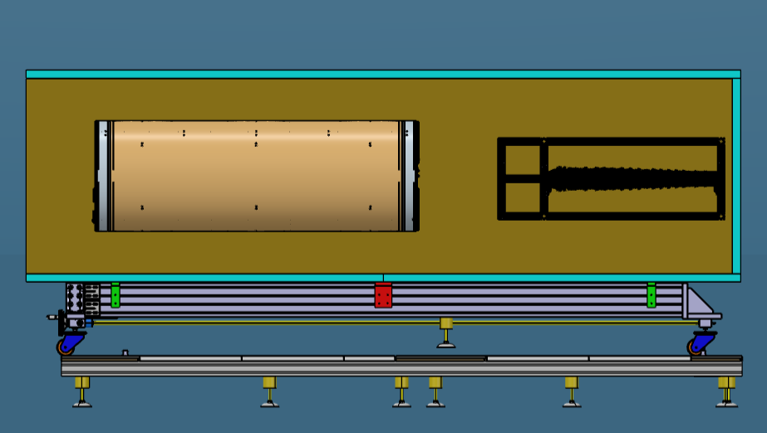
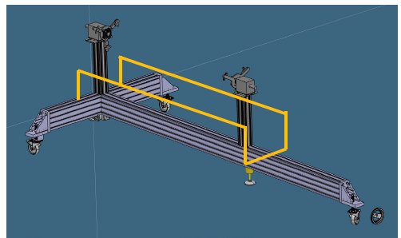
Solution with a smaller box
by Antonio Croce
Optoboxes
Switch load system
4200 mm
Rail support
Dumped Platform
1660mm

Slide 26
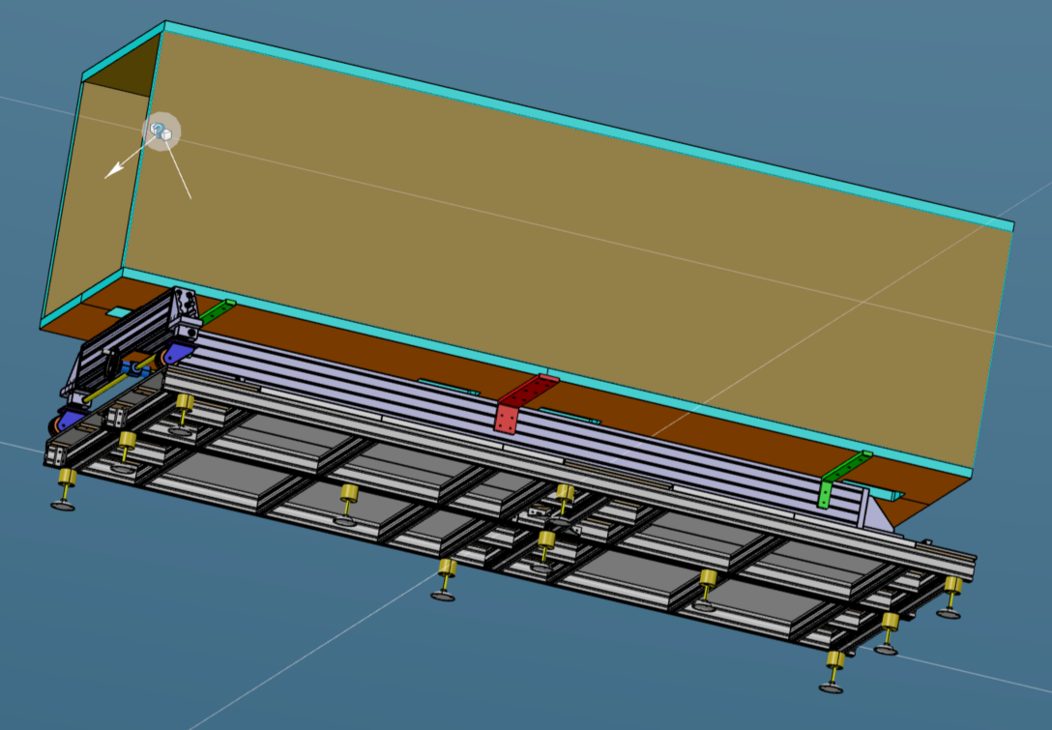
Connections to the T-trolley

Slide 27
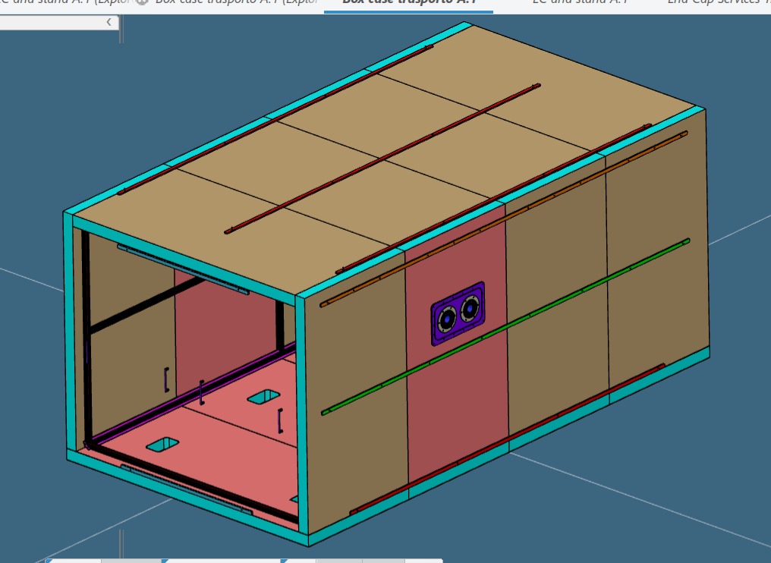
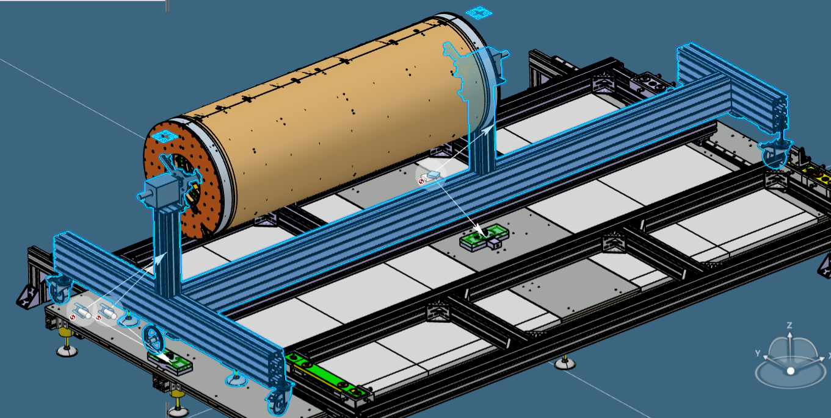
Shipping trolley and shipping/test box
Solution with a box including the T-trolley
rail
rail support
Shipping/test box is under definition
Not clear how to go in the box
The idea is to use the T-trolley for the shipping and a system supporting the rails is under study.

Slide 28
SR1 TEST AND INTEGRATION

Slide 30
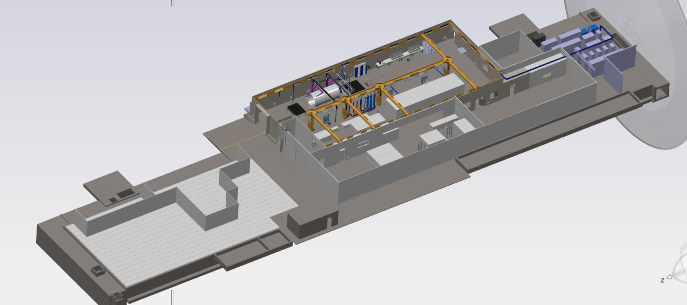
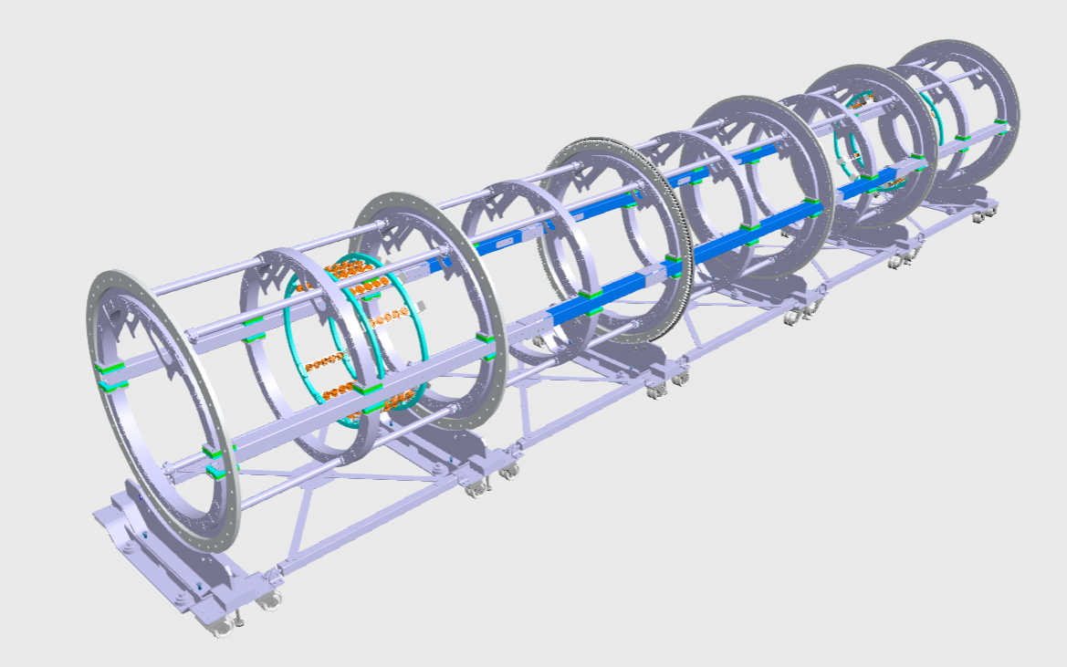

Slide 31
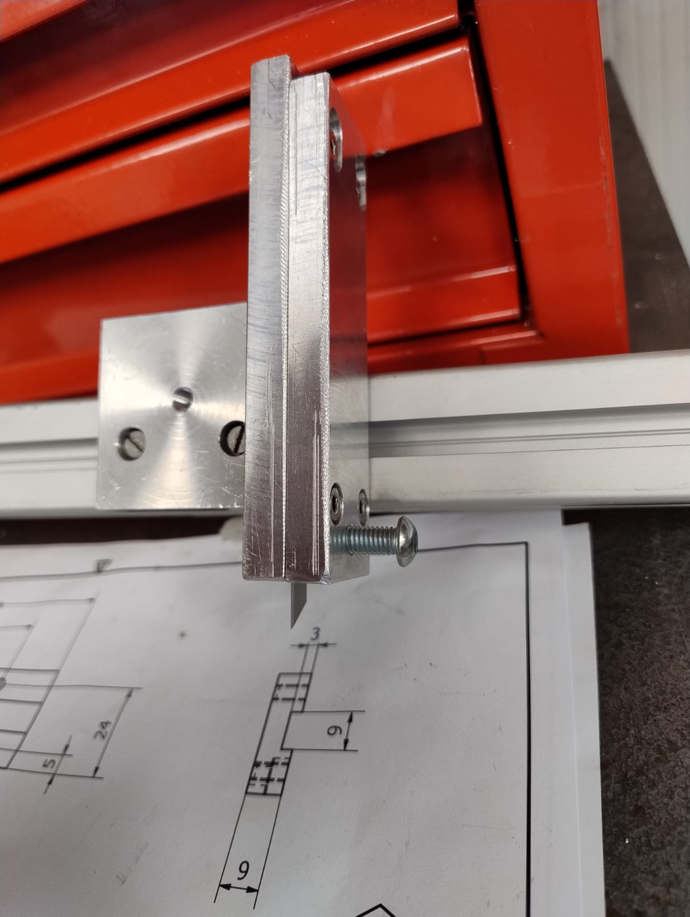
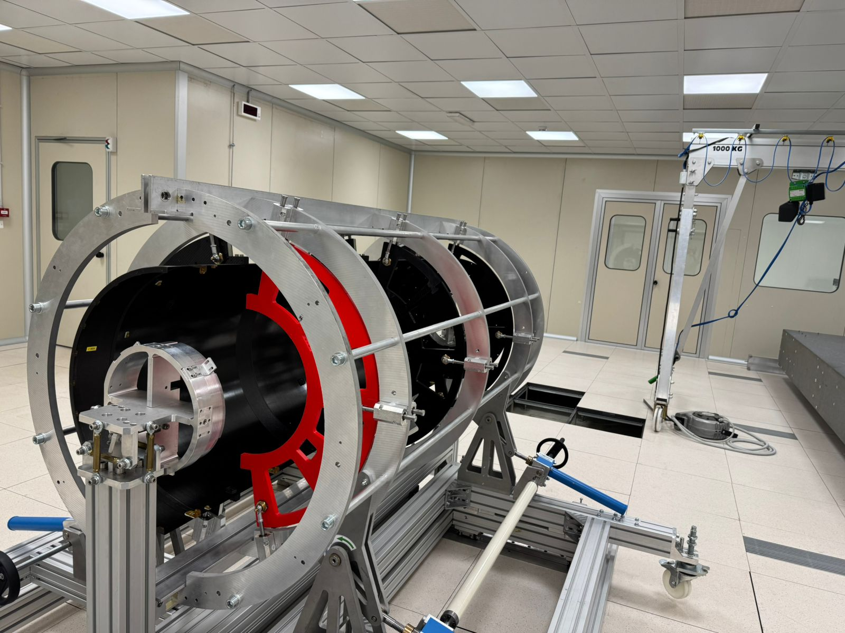
Prototypes
The idea is to have the whole detector in a prototype/mockup version in in order to test the mating (empty), then the insertion of the piping, the insertion of the cables and the Half Rings, and then the mating with the populated HS and the PP1 manifold (see tomorrow talk) for each layers. Some HRs could have the piping to perform some welding test.
What we have so far:
Half Shell: we have one Half L4 (from Liverpool) and 2 L2 (from Aviacompositi).
Lugs: all printed in ULTEM (by Naples)
In production the tool for the positioning the lugs of the HS (by Giuseppe Pileggi LNF)
Radial Support: we have the 3 for L4 HS (final) and the 6 for the full L2 (printed)
Lz flange: already printed (ABS)
Hz flange: Printed for L2 (ABS)

Slide 32
Half rings: we have the skins in CF for 2 HRs per type. The cutting tool for Rohacell is ready.
Lugs: all printed in ULTEM (by Naples)
In production the tool for the positioning the lugs in the HRs (by Giuseppe Pleggi and Lorenzo Roscilli)
Abbiamo l'aiuto di un tecnico per l'incollaggio degli HR

