Slide 1
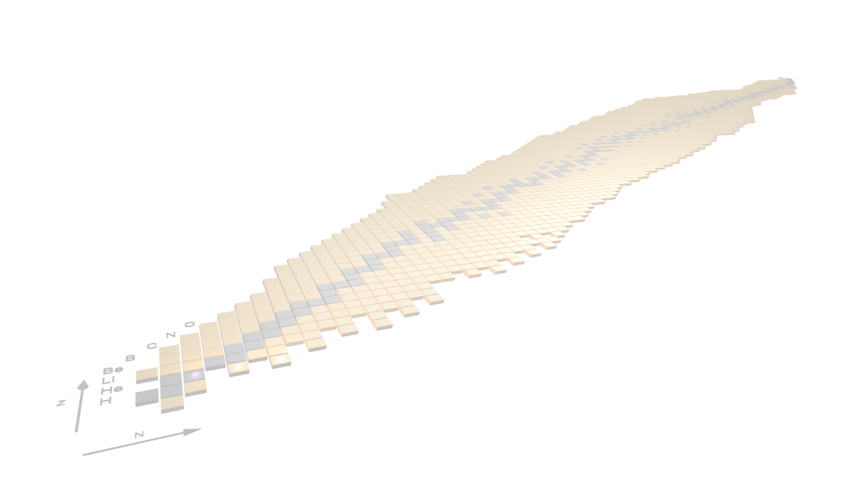


Nuclear structure studies via direct transfer reactions
(GASPEC)
F. Galtarossa (INFN Padova)
for the GAMMA group
franco.galtarossa@pd.infn.it
NUSDAF Collaboration Meeting, Catania, 21-24 October 2025

Slide 2
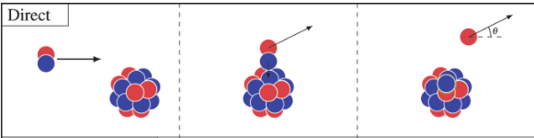
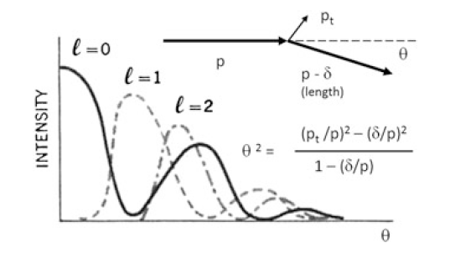
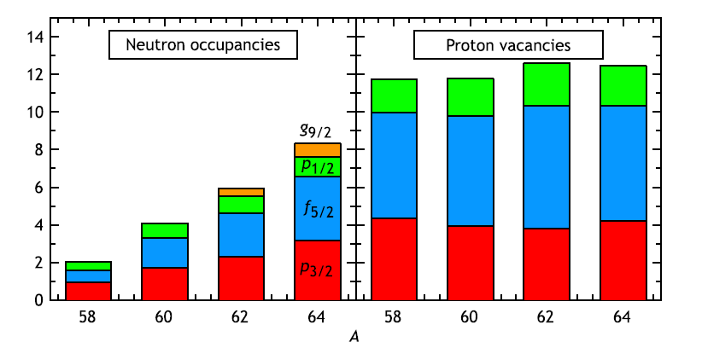
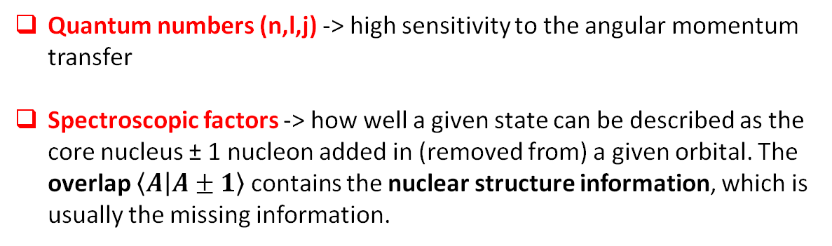

Direct transfer reactions
Direct transfer reactions are reactions where one or two nucleons are exchanged between projectile and target in a peripheral collision -> «Reactions that go directly from initial to final states without the formation of an intermediate compound system». (G. R. Satchler, Direct Nuclear Reactions, 1983)
Quantum numbers (n,l,j) -> high sensitivity to the angular momentum transfer
Spectroscopic factors -> how well a given state can be described as the core nucleus ± 1 nucleon added in (removed from) a given orbital. The overlap $\left\langle A | A±1\right\rangle$ contains the nuclear structure information, which is usually the missing information.
Experimentally:
$${\left(\frac{dσ}{dΩ}\right)}_{EXP}=C^{2}S{\left(\frac{dσ}{dΩ}\right)}_{DWBA}$$
J. P. Schiffer et al., Phys. Rev. Lett. 108 (2012) 022501
F. Galtarossa
NUSDAF meeting, 22-24 October 2025
2

Slide 3
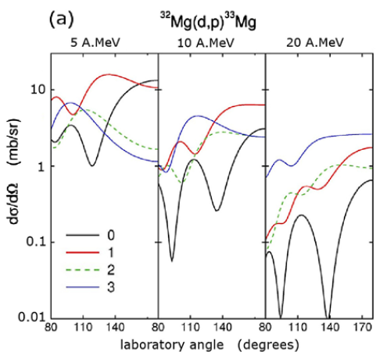
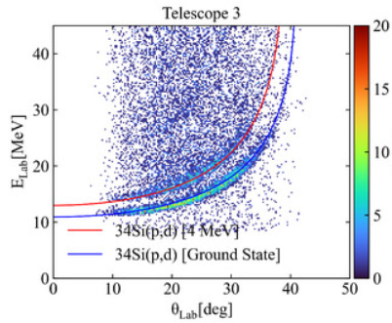
Schematic experimental view of direct transfer reactions in inverse kinematics
Stripping reactions
Pick-up reactions
(d,p), (t,p), (³He,d), (³He,n), (α,³He)
Typical beam energies: 5-10 MeV/u
Maximum of the cross section: backward laboratory angles
Possible experimental difficulties: low energy of light particles
(p,d), (p,t), (d,³He), (³He,α)
Typical beam energies: 30-50 MeV/u
Maximum of the cross section: forward laboratory angles
Possible experimental difficulties: background in particle spectra from competent reaction channels
F. Galtarossa
NUSDAF meeting, 22-24 October 2025
3

Slide 4
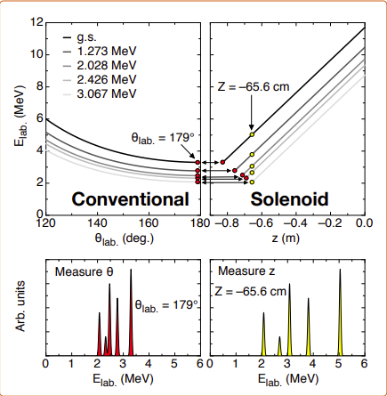
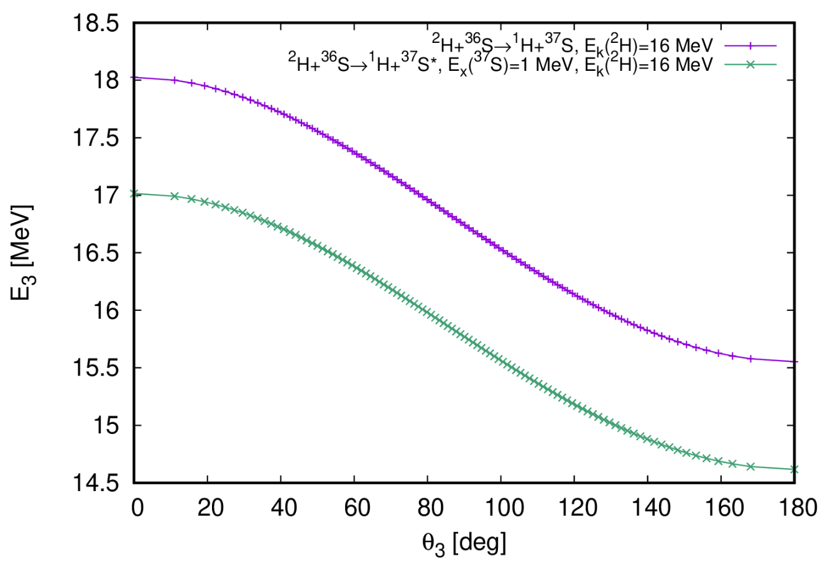
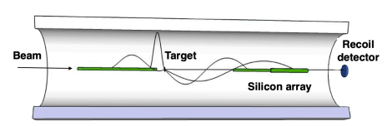
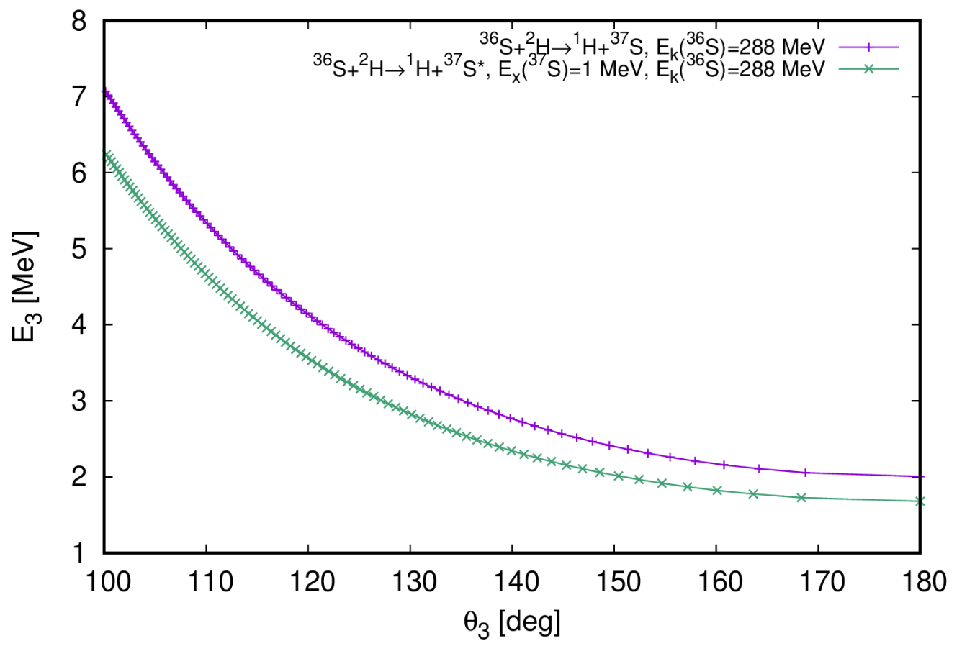
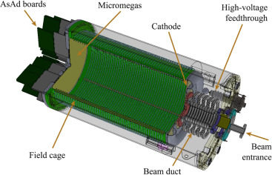


Experiments with RIBs: dealing with kinematic compression and low luminosity
SOLENOIDS
(limited to ≥ 10⁴ pps)
$$\frac{{dE}^{∗}}{{dE}_{k}}=1$$
DIRECT
1 MeV
HIGHLY-SEGMENTED SILICON ARRAYS
Taken from SOLARIS White Paper
TIME PROJECTION CHAMBERS
$$\frac{{dE}^{∗}}{{dE}_{k}}>1$$
INVERSE
300 keV
Well-adapted to be coupled to γ-ray arrays
Suitable for very low intensities (< 10⁴ pps)
F. Galtarossa
NUSDAF meeting, 22-24 October 2025
4

Slide 5
Possibilities at FRIB along N = 28

Slide 6
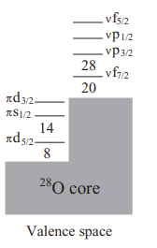
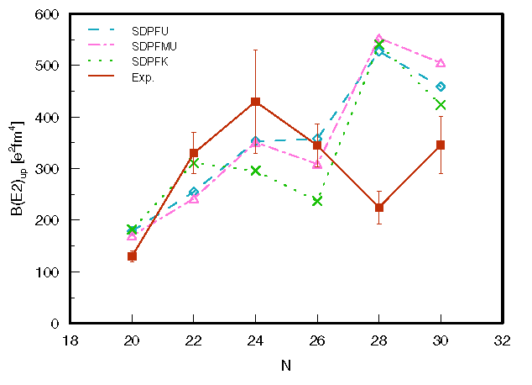
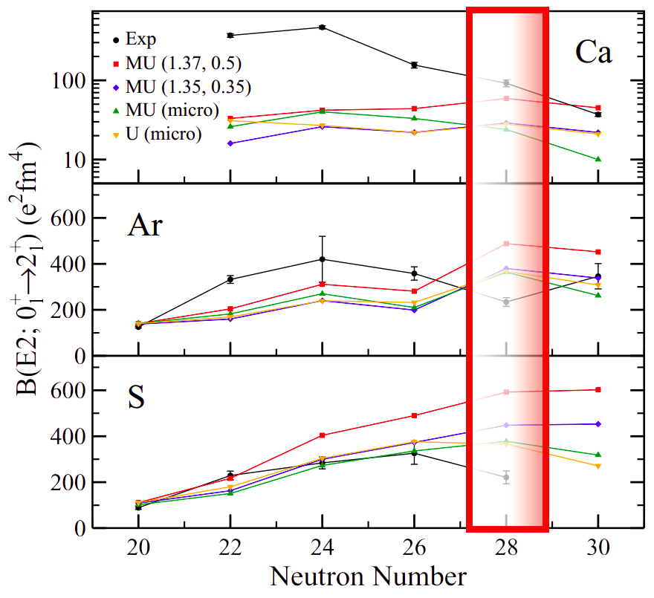
Do we understand the physics at N = 28?
Similar discrepancy in ⁴⁴S, located −2p with respect to ⁴⁶Ar
Intermediate-energy Coulomb excitation measurements in agreement with the SDPF-U results up to ⁴²S
Effect of polarization charges on B(E2) calculations is found not sufficient to justify the discrepancy in ⁴⁶Ar and ⁴⁴S
Large discrepancy in B(E2)
Large discrepancy with the measured B(E2) value at N=28:
problem with the proton E2 contribution ?
A. Gade et al., PRC 68, 014302 (2003)
S. Calinescu et al., PRC 93, 044333 (2016)
B. Longfellow et al., PRC 103, 054309 (2021)
F. Galtarossa
NUSDAF meeting, 22-24 October 2025
6

Slide 7
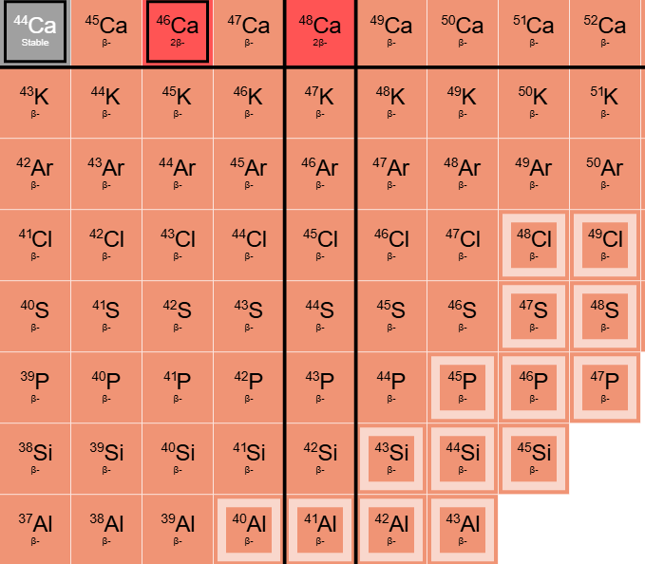
How is the N = 28 shell closure developed?
Contrasting conclusions on the development of collectivity along N = 28.
N=28 is a non-HO magic number: spin-orbit or extruder-intruder ?
E. Caurier, G. Martínez-Pinedo, F. Nowacki, A. Poves, and A. P. Zuker
Rev. Mod. Phys. 77, 427 – Published 16 June 2005
Is really 3-body force the origin of the f_{7/2} «self» binding ?
A. P. Zuker, Phys. Rev. Lett. 90, 042502 (2003)
Or maybe is the unbinding of the p_{3/2}p_{1/2} shells (halo-like) to create the N=28 magic number ?
J. Bonnard and A. P. Zuker 2018 J. Phys.: Conf. Ser. 1023 012016
Z = 18 subshell closure in ⁴⁶Ar?
Are ⁴⁴S and ⁴²Si spherical or deformed?
More «microscopic» information on both neutron and proton components of the wavefunction can be achieved with direct transfer reactions starting from (or reaching) N = 28 n-rich nuclei.
J. Fridmann et al., Nature 435 (2005)
A. Gade et al., Phys. Rev. Lett. 122, 222501 (2019) B. Longfellow et al., Phys. Rev. C 103, 054309 (2021) L. Riley et al., Phys. Rev. C 112, 014331 (2025)
F. Galtarossa
NUSDAF meeting, 22-24 October 2025
7

Slide 8
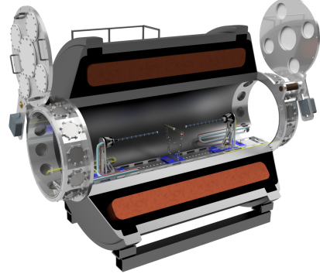
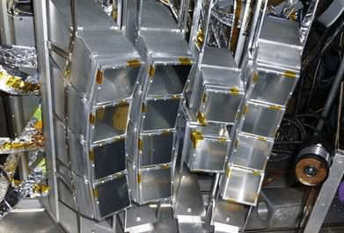
Possible studies: proton and neutron removal and adding reactions
Neutron and proton adding reactions
REACTIONS
BEAM
SET-UP
⁴⁴S(d,p) and ⁴⁴S(³He,d)
⁴⁴S at 10 MeV/u
I ~ 10³ pps now (10⁴ pps at full power?)
Possible use of ³He cryo target?
AT-TPC (SOLARIS when full power)
⁴⁵Cl
⁴⁴S
⁴⁵S
Neutron and proton removal reactions
REACTIONS
BEAM
SET-UP
⁴⁴S(p,d) and ⁴⁴S(d,³He)
HIRA Si detector array
⁴³S
⁴⁴S
⁴⁴S at 40 MeV/u
I ~ 5·10⁵ pps now
⁴³P
F. Galtarossa
NUSDAF meeting, 22-24 October 2025
8

Slide 9
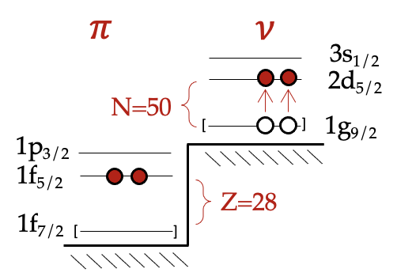
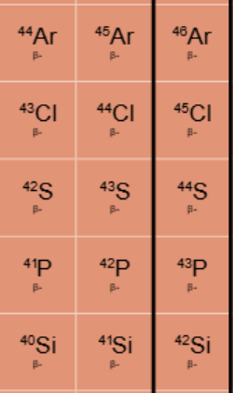
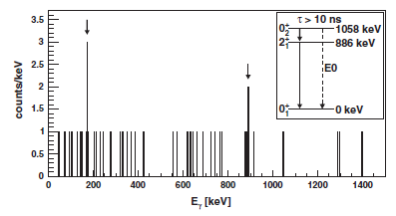
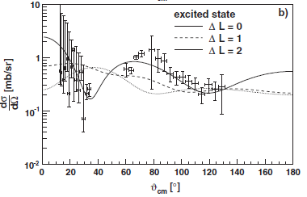
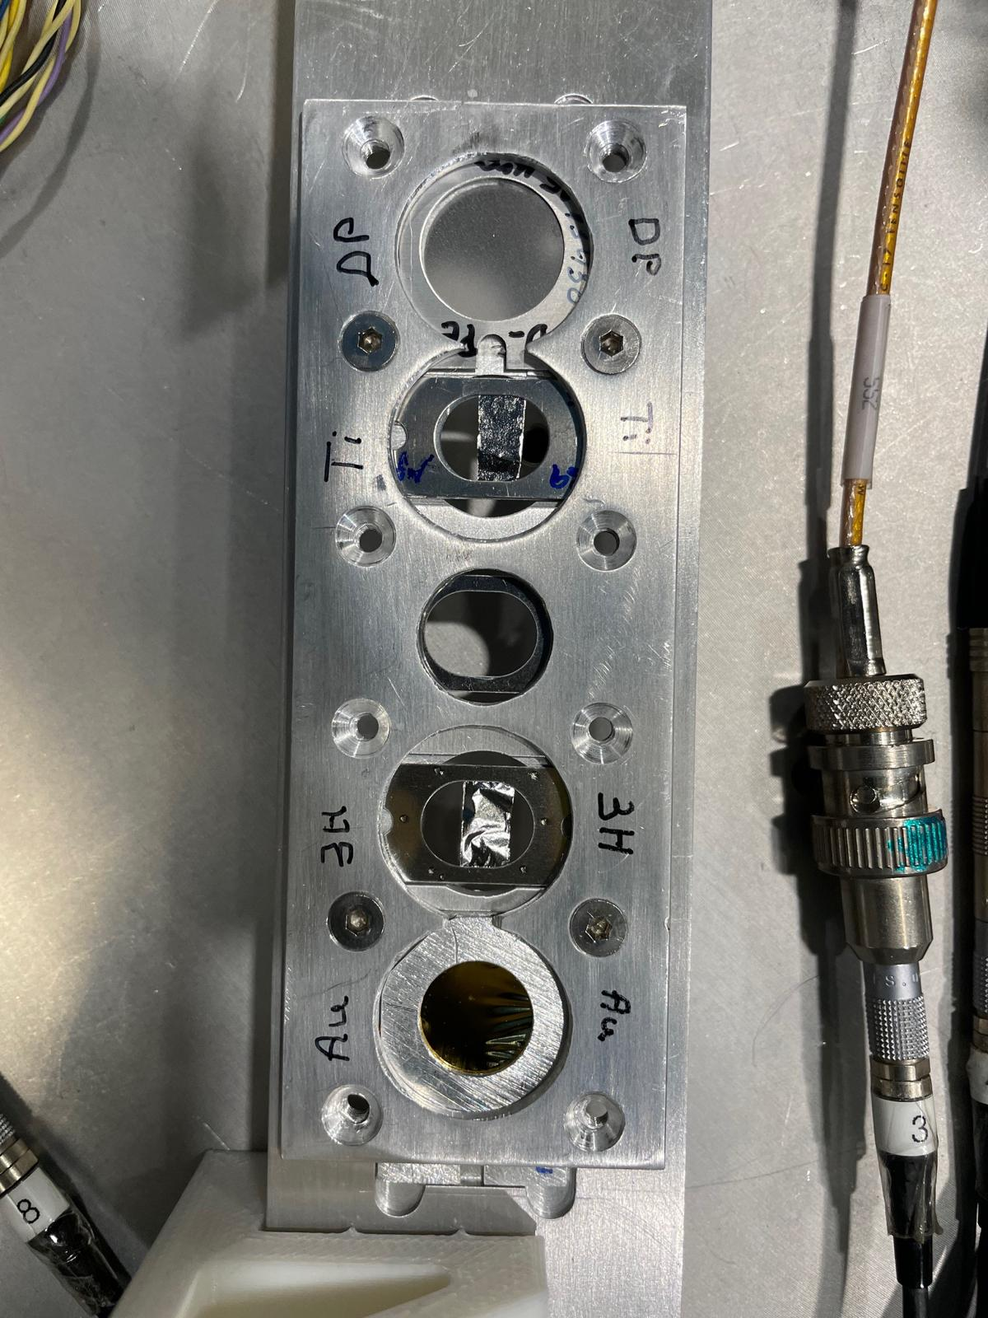
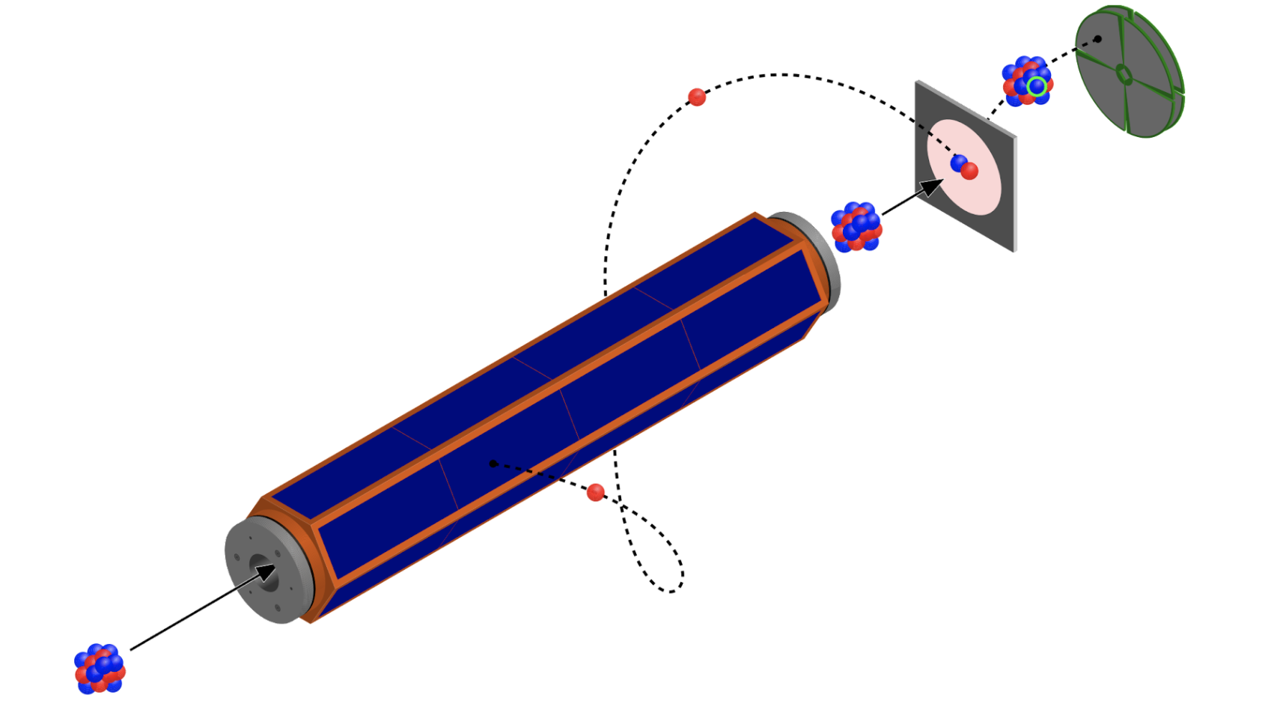

Identifying neutron-intruder structures via (t,p) reactions
$$An example:78Zn\left(t,p\right)80Zn proposed at ISOLDE$$
Start from a nucleus two-neutrons away from shell closure
Add two neutrons in a direct reaction, very selective for low-spin (0⁺, 2⁺) states
The magnitude of the cross section can be related to the structure of the populated states.
S. Bottoni and FG, proposal approved
N = 28
$$ν\left(2p−2h\right)$$
across N=50
N = 50
³⁰Mg(t,p)³²Mg at ISOLDE
ground state
of ⁷⁸Zn
⁷⁸Zn(t,p)
Insights into deformed structures of ⁷⁸Ni
N = 20
Typical ³H densities: 10¹⁸ at/cm²;
Typical cross sections: ~ 0.5 mb/sr
Typical beam intensities needed: ≥ 10⁵ pps
(⁴²S now has 5·10⁴ pps)
Beam time of about 1 week to have 200-300 counts in the peak
Fancy (and risky) options:
³H cryogenic target (2 orders of magnitude higher density)
³H active target
K. Wimmer et al., PRL 105, 252501 (2010)
F. Galtarossa
NUSDAF meeting, 22-24 October 2025
9

Slide 10
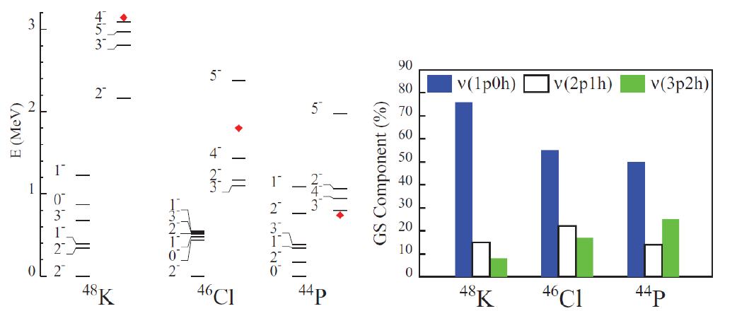
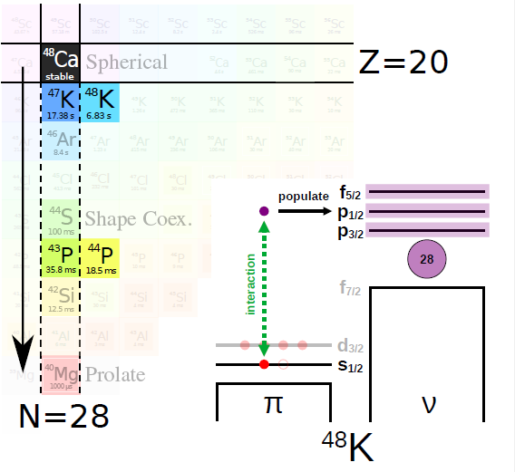
Neutron-proton interaction in odd-odd N = 29 nuclei
L. Gaudefroy, Phys. Rev. C 81, 064329 (2010)
Pure s_{1/2} proton in the gs of ⁴⁷K [Papuga et al., Phys. Rev. C 90, 034321 (2014)]
⁴⁷K(d,p) highly selective towards states in ⁴⁸K determined by π(1s_{1/2}) ⊗ ν(fp) interactions
⁴⁵Cl and ⁴³P should also have a 1/2⁺ ground state (although with a probably less “pure” configuration than ⁴⁷K) and can be tackled at FRIB.
Courtesy of C. Paxman
F. Galtarossa
NUSDAF meeting, 22-24 October 2025
10

Slide 11
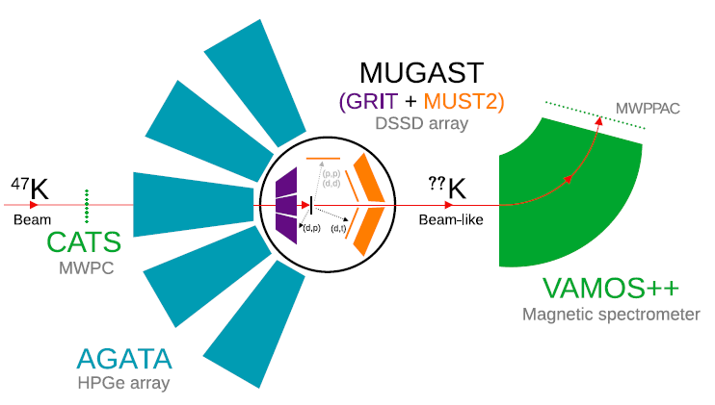
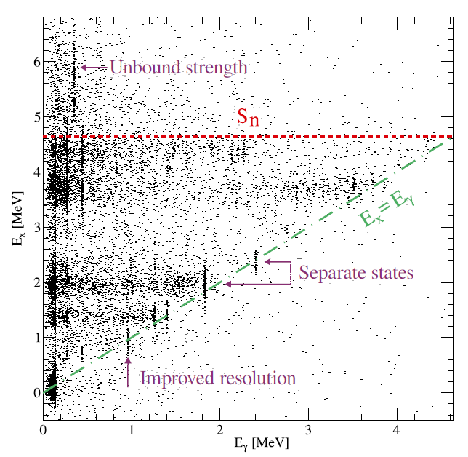
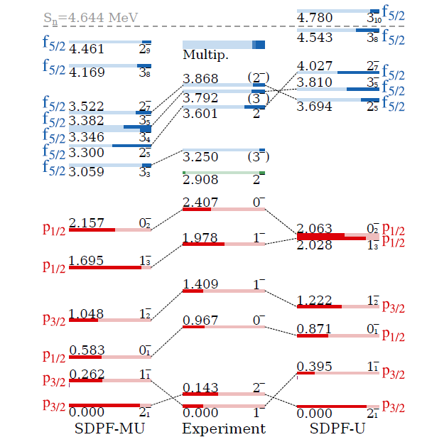
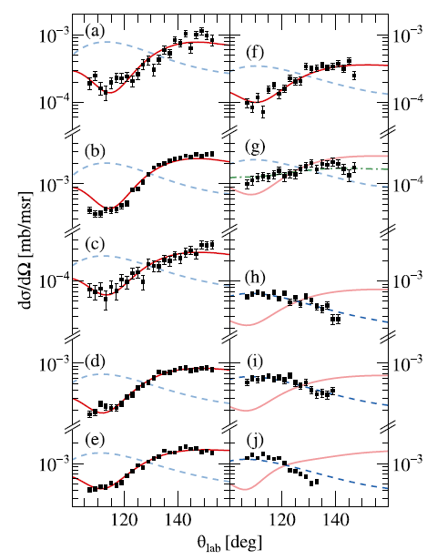
Neutron-proton interaction in odd-odd N = 29 nuclei
High-precision measurement in GANIL with AGATA-MUGAST-VAMOS: ⁴⁷K(d,p)⁴⁸K at 7.7 MeV/u and ~ 5·10⁵ pps
L = 1 and L = 3 transfers clearly distinguished by the characteristic angular distributions
Powerful γ-particle correlation to identify the populated excited states
C. Paxman et al., Phys. Rev. Lett. 134, 162504 (2025)
Here coupling to γ-ray arrays like GRETA would be very important due to the large level density of odd-odd nuclei!
Sistematically overpredicted SF -> poor understanding of the proton component?
F. Galtarossa
NUSDAF meeting, 22-24 October 2025
11

Slide 12
Possibilities at FRIB for neutron-deficient Ca isotopes

Slide 13
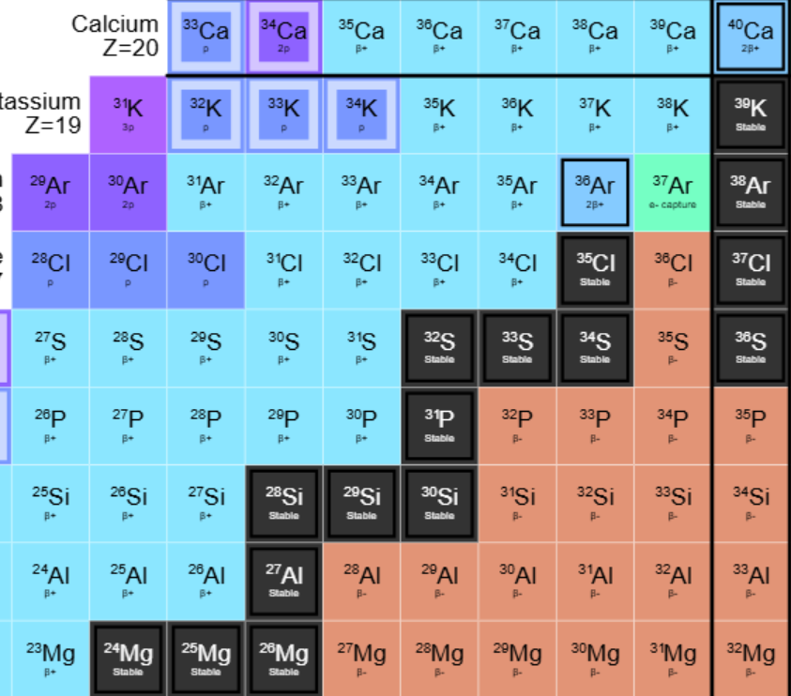
The neutron-deficient Ca isotopes
T = 1
Colossal mirror energy differences
Shell evolution along Z = 20
Proton IoI mirroring the one at N = 20?
Astrophysical scenarios
T = 2
T = 4
F. Galtarossa
NUSDAF meeting, 22-24 October 2025
13

Slide 14
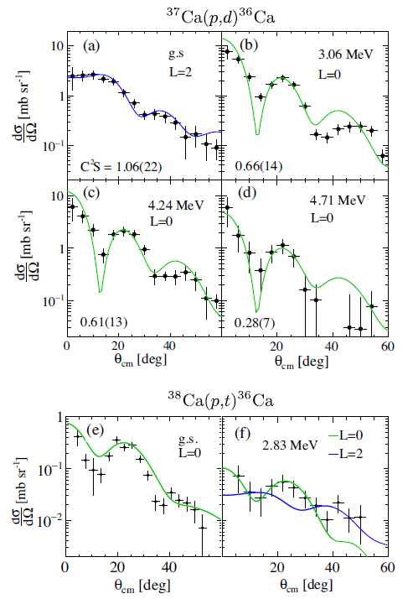
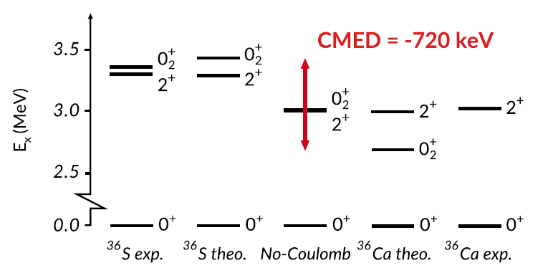
CMED in A=36 nuclei: nuclear structure effects magnified by the Coulomb force
pf empty
pf empty
pf empty
(pf)²
viceversa in ³⁶Ca for isospin simmetry
1d_{3/2}
sd
full
1d_{3/2}
2s_{1/2}
2s_{1/2}
(sd)¹⁰
0₁⁺
π
ν
π
ν
2₁⁺
2₁⁺ in ³⁶S
0₂⁺ in ³⁶S
The 2₁⁺ state in ³⁶Ca should be of neutron nature -> small B(E2)
2₂⁺
J. J. Valiente-Dobón et al., Phys. Rev. C 98, 011302(R) (2018)
1₁⁺
The 2₁⁺ and 0₂⁺ in ³⁶S are pushed away by the larger Coulomb repulsion experienced by the proton in the d_{3/2}
The 0₂⁺ in ³⁶Ca is more bound because protons in the pf shell feel smaller Coulomb repulsion than in the sd shell
CMED of 720 keV!
Confirmed in Coulomb excitation?
0₁⁺
0₂⁺
Colossal MED confirmed by identifying the 0₂⁺ state via (p,t) reaction
0₂⁺
L. Lalanne et al., Phys. Rev. Lett. 129, 122501 (2022)
F. Galtarossa
NUSDAF meeting, 22-24 October 2025
14

Slide 15
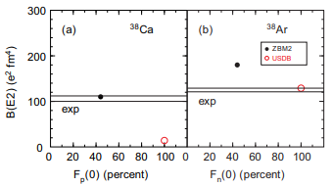
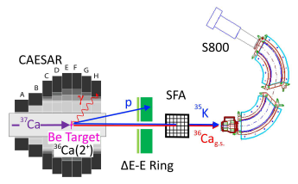
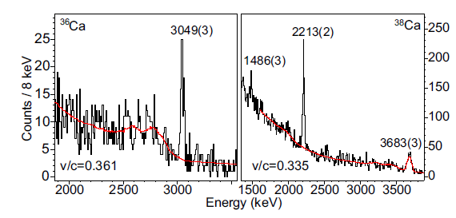
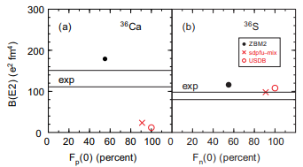
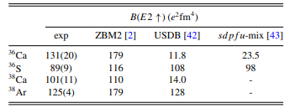
Coulomb excitation of ^{36,38}Ca at MSU
A = 38
E_{beam} = 70-80 MeV/u
A = 36
Coulex of ^{36,38}Ca evidenced a large B(E2) to the first 2⁺ state -> large proton contribution?
Sdpf-u-mix seems unable to catch the collectivity in proton-rich ^{36,38}Ca isotopes: proton core breaking components play a major role
F. Galtarossa
NUSDAF meeting, 22-24 October 2025
15

Slide 16
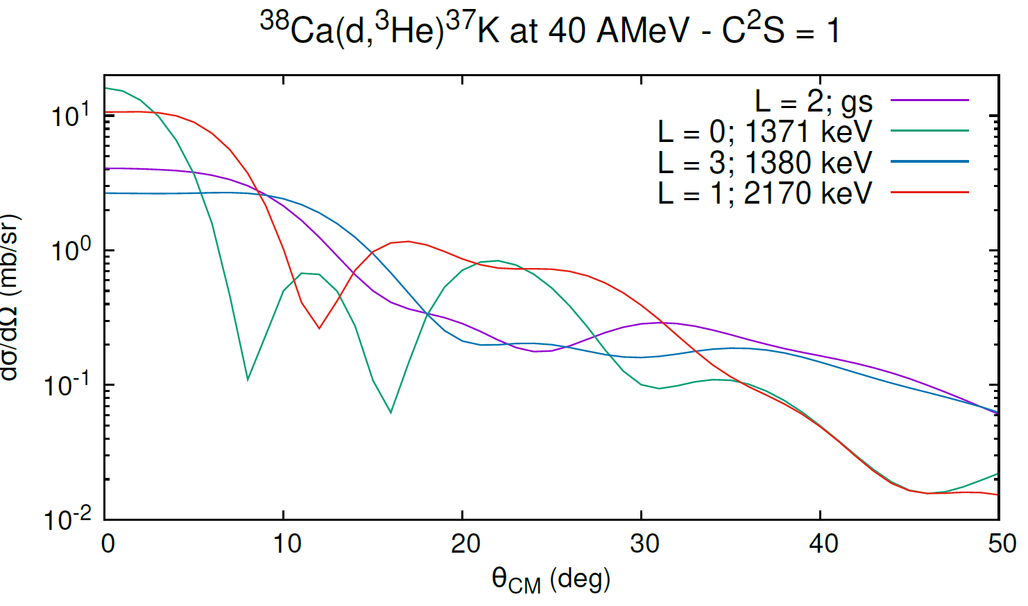
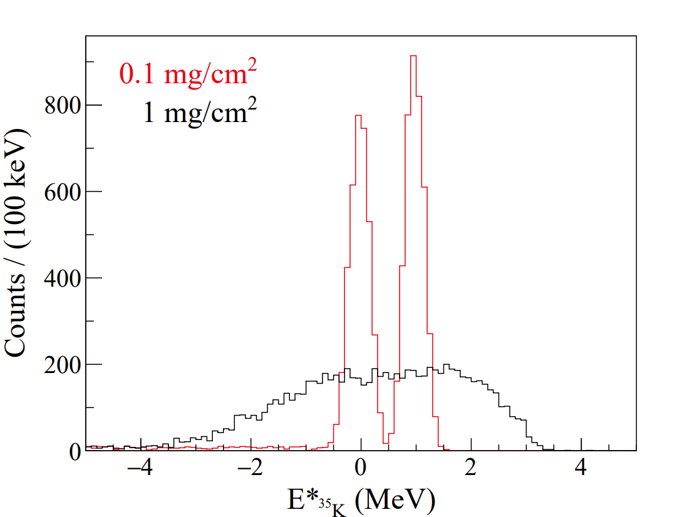
Possible studies: pick-up reaction (d,³He)
Determine the occupancy of negative-parity orbitals above Z=20 via ^{36,38}Ca(d,³He) reactions
pf empty
C²S/(2j+1) of 3/2⁺ and 1/2⁺ in ^{35,37}K significantly < 1
C²S/(2j+1) of 7/2⁻ and 3/2⁻ in ^{35,37}K significantly > 0
C²S/(2j+1) of 3/2⁺ and 1/2⁺ in ^{35,37}K ~ 1
C²S/(2j+1) of 7/2⁻ and 3/2⁻ in ^{35,37}K ~ 0
(pf)^{x}
sd
full
1d_{3/2}
2s_{1/2}
(sd)^{12-x}
No π core breaking
Large π core breaking
Good momentum matching -> clear signature of the different L transfers
Optimal beam energies: 30-50 AMeV
Set-up: HIRA silicon array for light charged particles + S800 for heavy residues (good to control transfer to proton unbound states)
Requires large beam intensities to cope with thin CD₂ targets to preserve Ex resolution
Alternative: use of an active target
F. Galtarossa
NUSDAF meeting, 22-24 October 2025
16

Slide 17
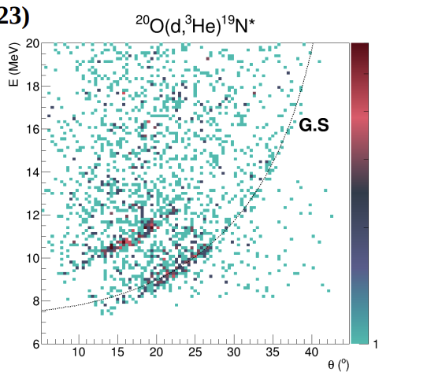
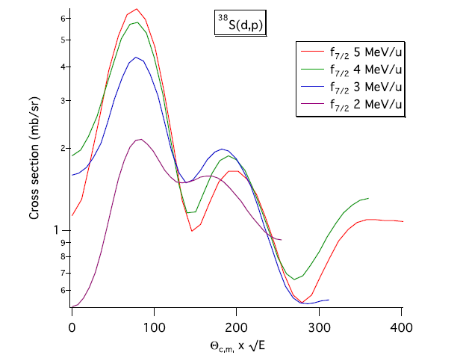
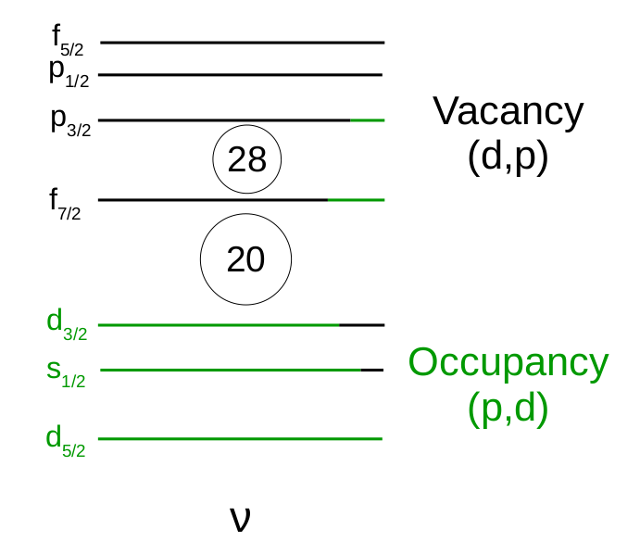
Possible studies: pick-up (³He,d) and stripping (³He,d) reactions with AT-TPC
Large target thickness ~ 10 mg/cm² equivalent
~100% efficiency
Measure simultaneously transfer and proton decay for very proton-rich nuclei
Suitable for low-intensity beams (10³-10⁴ pps)
Use of active targets for the study of transfer reactions is now quite well established (possible also for low-energy beams!)
Lois Fuentes, PhD thesis (2023)
Other interesting opportunities:
³⁶Ca(p,t)³⁴Ca -> observe the 0₂⁺ in ³⁴Ca: is the CMED still present?
³⁶Ca(p,d) and (d,p) -> map the neutron Fermi surface: is N = 16 a strong shell closure? (L. Lalanne et al., PRL 2023)
D. Bazin et al., Progr. Part. Nucl. Phys. 114 (2020) 103790
F. Galtarossa
NUSDAF meeting, 22-24 October 2025
17

Slide 18
Measurement of the E0 transition strength 0₂⁺ -> 0₁⁺ in ³⁶Ca
Courtesy J. J. Valiente-Dobón
2₁⁺
3.06
pf empty
0₂⁺
2.83
ρ(E0) ≈ mixing · <r²>
Insight on the wavefunction of the state and mixing between configurations
E0
1d_{3/2}
2s_{1/2}
0_{gs}⁺
0
π
ν
³⁶Ca
0₂⁺ in ³⁶Ca
Populate the 0₂⁺ via ³⁴Ar(³He,n)³⁶Ca 5 MeV/u
Large ³⁴Ar beam intensity available (2·10⁵ pps from FRIB website)
Measure the 0⁺→ 0⁺ transition internal pair production e⁺e⁻ The e+e- pair production branch in the 0+ → 0+ transition is 50 more intense than the EC branch.
Cryogenic or solid ³He target
Exp. set-up: GRETA, neutron detector at about 90 deg, e⁺e⁻ spectrometer
F. Galtarossa
NUSDAF meeting, 22-24 October 2025
18

Slide 19
Conclusions
Wealth of possibilities at FRIB for the nuclear structure studies via direct transfer reactions with reaccelerated and «fast» beams
Possible physics cases along N = 28 (neutron-rich) and Z = 20 (neutron-deficient) but many others can be defined.
(Very) preliminary contacts with FRIB physicists and detector responsibles to discuss feasibility and sinergies with locals
No specific detector development foreseen at the moment
F. Galtarossa
NUSDAF meeting, 22-24 October 2025
19

Slide 20
Backup slides

Slide 21
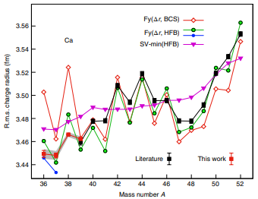
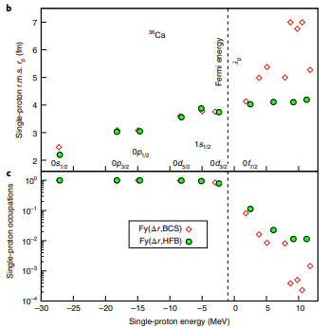
DFT with Realistic EDF predicts occupation close to 1 for bound orbitals below Z=20 in 36Ca and less than 10% above the Fermi energy (so from f_{7/2} up).
Miller et al., Nature Physics 2019

Slide 22
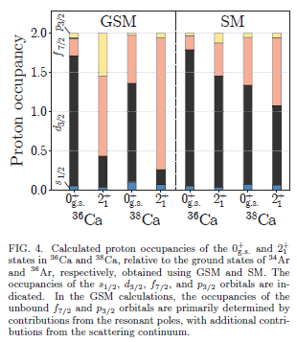
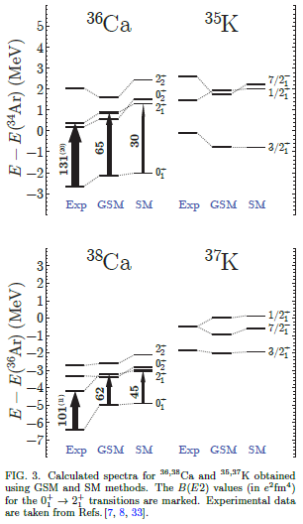
Gamow SM predictions

Slide 23
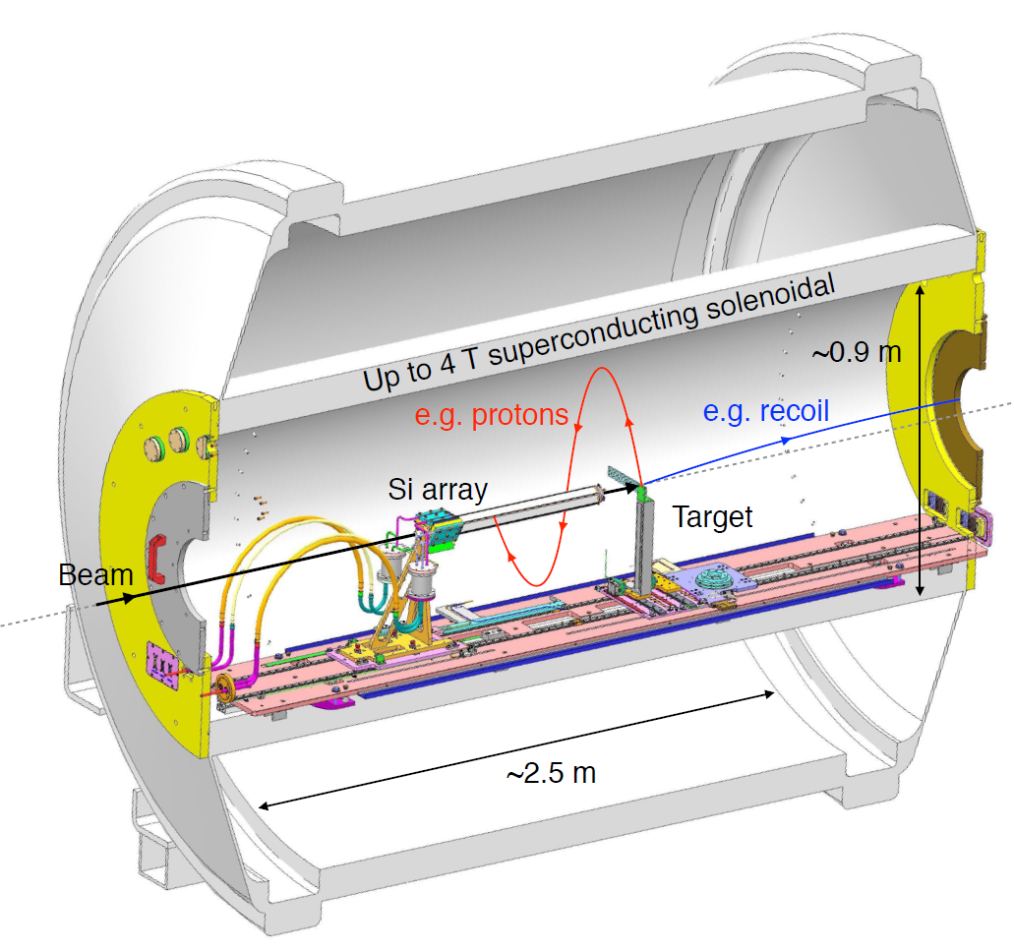
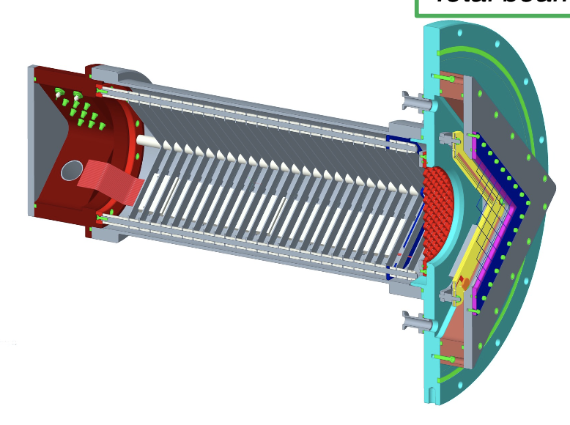
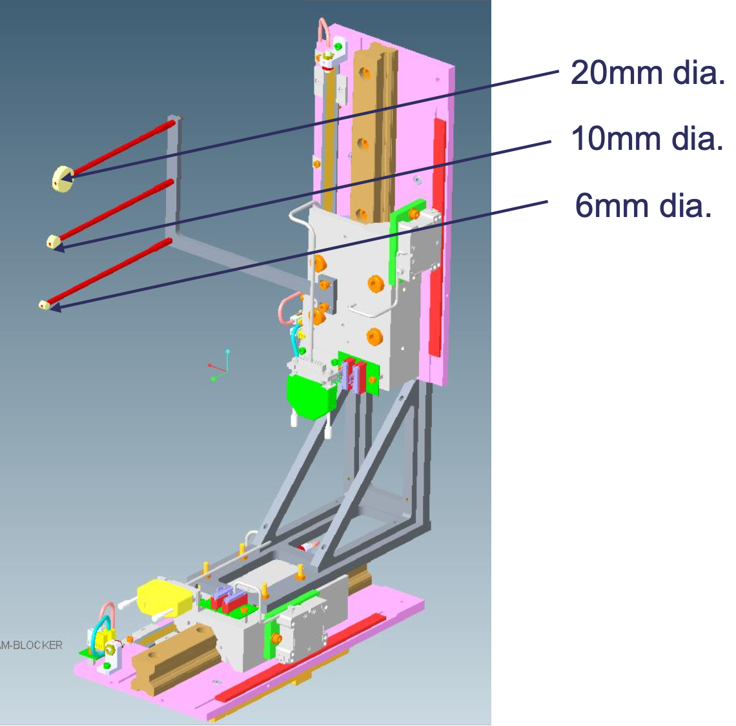





Experimental details: ⁷⁸Zn(t,p)
$$Beam$$
$$Setup$$
⁷⁸Zn @ 6 MeVA
^{ISOLDE SOLENOID}
^{SPECTROMETER}
^{(ISS)}
Already used at ISOLDE
IS491: I_{beam} = 7.8(7)⋅10⁵ pps
From TAC: I_{beam} = 2.4⋅10⁵ pps
R. Orlandi et al., PLB 740, 298 (2015)
2.5 T
$TAC$comments
Si array at backward angles
~70 % purity (Sr and Ba contaminants)
Recoil detection system
$$Target$$
$$Recoil detection$$
0.5 mg/cm² of Ti foil
Fusion on Ti
Fast-counting IC
~ 0.6 ³H/Ti loading ratio (~ 20 μg/cm²)
Already used at ISOLDE (see next)
Experiments with ³H accepted at ISS
Target available in 2024
Beam
blocker
Safety document being prepared
Bottoni&Galtarossa

Slide 24


Problem with the predicted proton wavefunction?
A. Gade et al., PRC 68, 014302 (2003)
S. Calinescu et al., PRC 93, 044333 (2016)
L. A. Riley et al., PRC 72, 024311 (2005)
Similar discrepancy in ⁴⁴S, located −2p with respect to ⁴⁶Ar
Intermediate-energy Coulomb excitation measurements in agreement with the SDPF-U results up to ⁴²S
Effect of polarization charges on B(E 2) calculations is found not sufficient to justify the discrepancy in ⁴⁶Ar and ⁴⁴S
M_{n}²
Exp
SDPFU
EXP
Exp
M_{p}²
SDPFU
EXP
Need to probe the proton wave function predicted by SDPF:
Example: πs_{1/2} almost full or empty in ⁴⁶Ar to decrease B(E2) to exp. value
Smaller effect from N=28 quenching:with νp_{3/2} almost full, B(E2)_{up} in ⁴⁶Ar still ~ 350 e²fm⁴
B. Longfellow et al., PRC 103, 054309 (2021)

Slide 25


Moving along neutron-rich N = 28 isotones
J. Fridmann et al., Nature 435 (2005)
Neutron observables understood
Persistency of the Z = 14 closure from ³⁴Si (N = 20) to ⁴²Si (N = 28).
No strong deformation in ⁴²Si.
Excellent theory for neutron-space related quantities:
confirming N=28 shell closure in ⁴⁶Ar
SDPF interaction describes valance-core neutrons interaction very well
Z. Meisel et al. PRL 114, 022501 (2015)

Slide 26

Investigating the ⁴⁶Ar proton wave function with the ⁴⁶Ar(³He,d)⁴⁷K direct reaction Backup Slides
The onset of deformation in ⁴⁴S
▶ Mean field potential energy surfaces computed in the Hartree–Fock–Bogolyubov framework as a function of the deformation parameter [Rodr´ıguez-Guzm´an et al., PRC 65, 024304 (2002)]
▶ The evolution along the N = 28 shell closure indicates a quick onset of deformation along the neutron rich side.
The Physics Case
The Experiment
Theoretical considerations
Conclusions
Backup Slides

