Slide 1
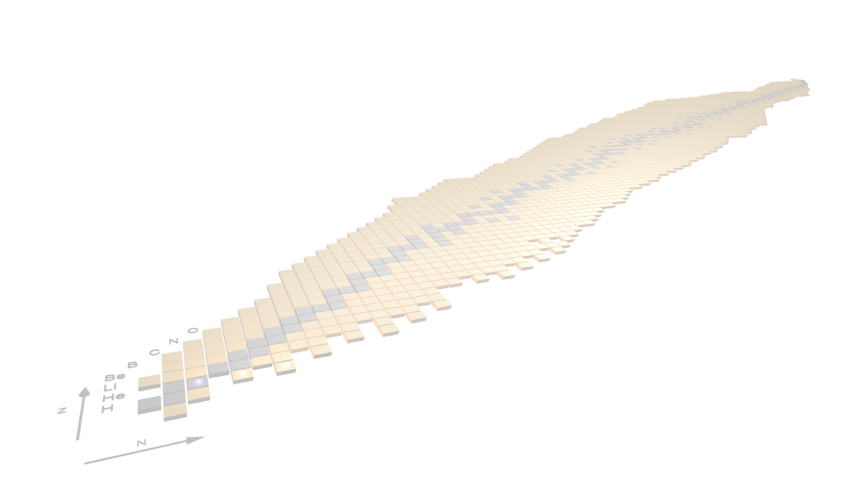



Gamma-ray and particle spectroscopy activities at FRIB (GASPEC)
Andrea Gottardo (LNL-INFN), for the GAMMA collaboration
NUSDAF Collaboration Meeting, Catania, 21-24 October 2025

Slide 2
Outline
NUSDAF
GAMMA group: physics motivation
GAMMA group: experience and know-how
(AGATA campaigns)
GASPEC: N=Z, direct reactions, Coulomb excitations
Scope of the talk:
Provide an overview of the GAMMA group activities related to what can be proposed for FRIB
Possible ideas for activities at FRIB

Slide 3




GAMMA: Nuclear structure with γ−ray spectroscopy
GAMMA group
FTE: 52.63
People: 75+4 technicians
5 Sections: FI,LNL,MI,PD,PG
In 2024:
76 publications
151 Talks
25 thesis
+ 6 from ext. fundings
National coordinators:
Benzoni, Gottardo
Local: Galtarossa, Giaz, Goasduff, Rocchini, Simonucci
Notes:
GB: 18/09/2025: cotrollato FTE e aggiornato per situazione attuale del database ==> controllare AFFINI
Togliamo citazione a PRISMA?

Slide 4
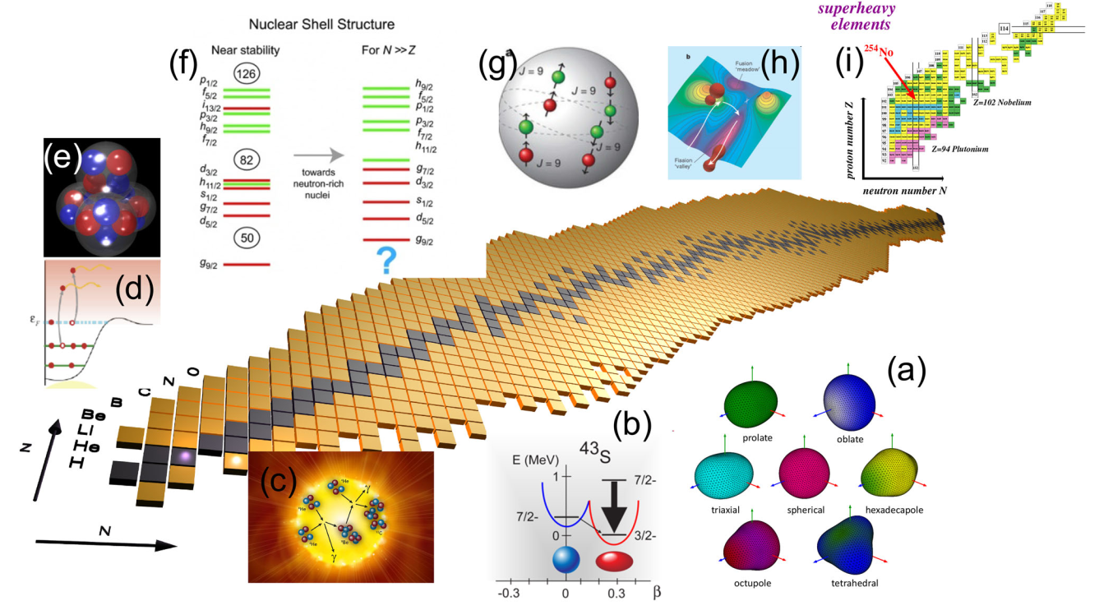
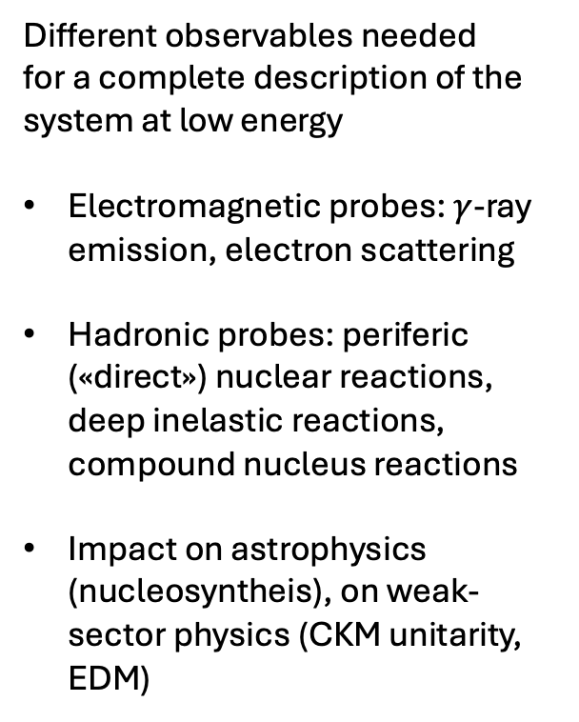
Our playground: the nucleus, a mischievous object
Different observables needed
for a complete description of the system at low energy
Electromagnetic probes: $γ$-ray emission, electron scattering
Hadronic probes: periferic («direct») nuclear reactions, deep inelastic reactions, compound nucleus reactions
Impact on astrophysics (nucleosyntheis), on weak-sector physics (CKM unitarity, EDM)

Slide 5
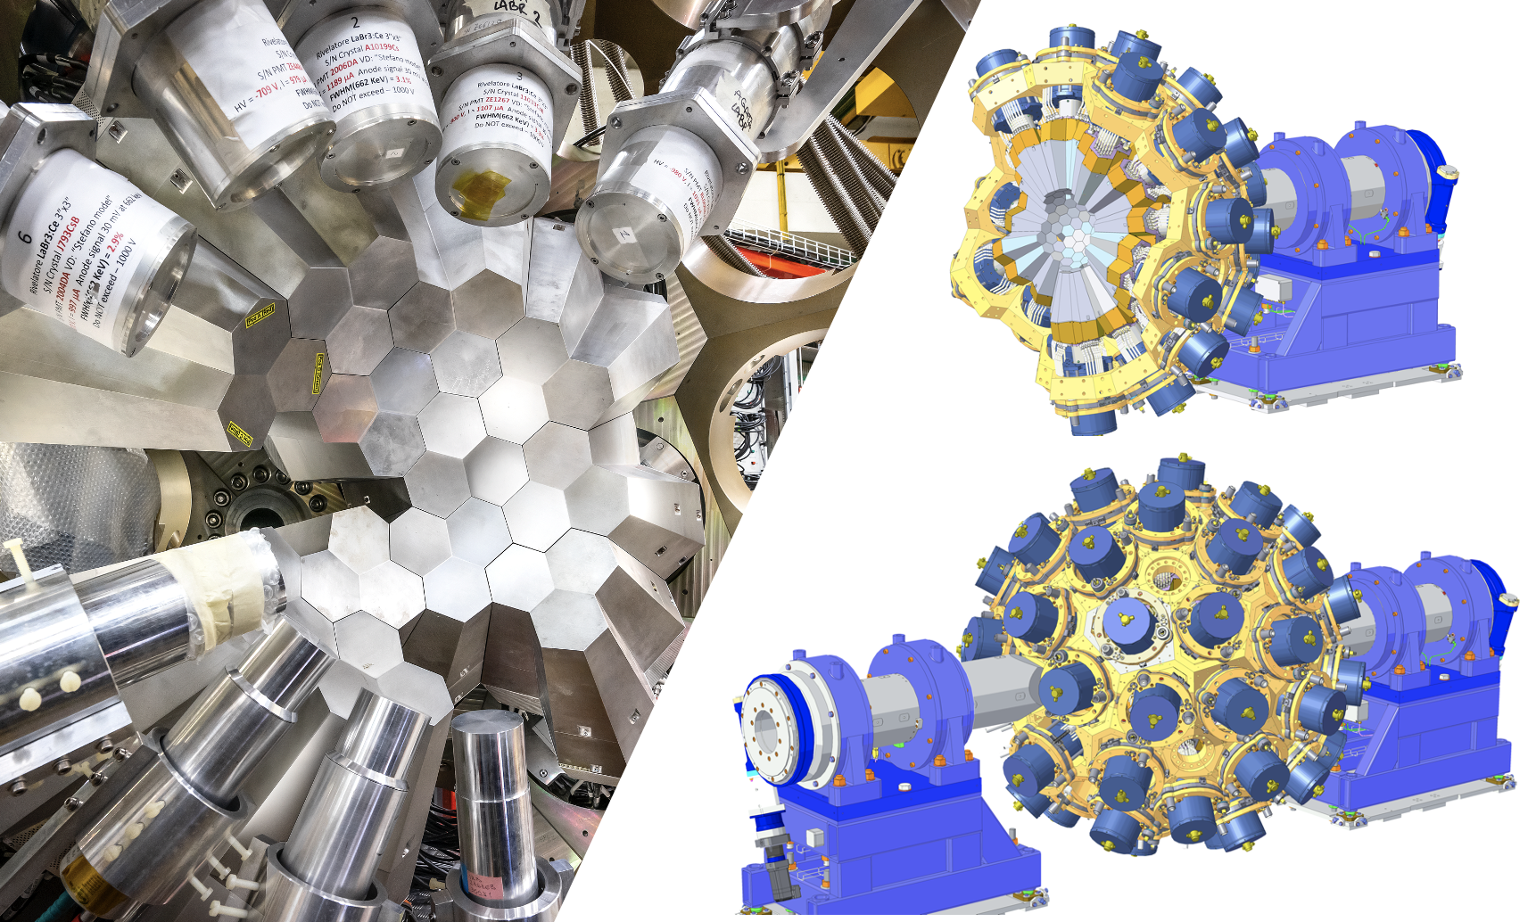
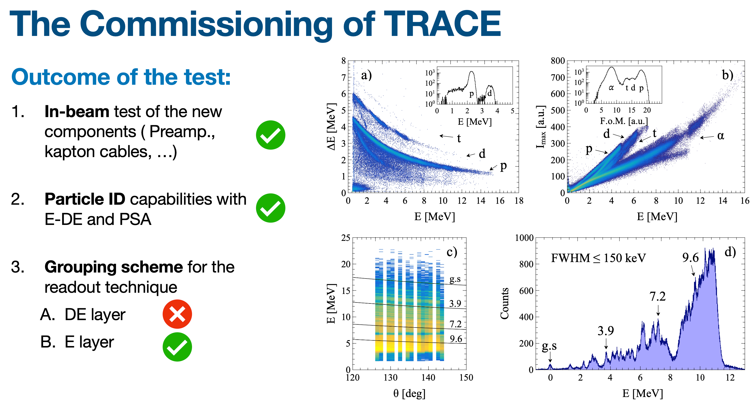
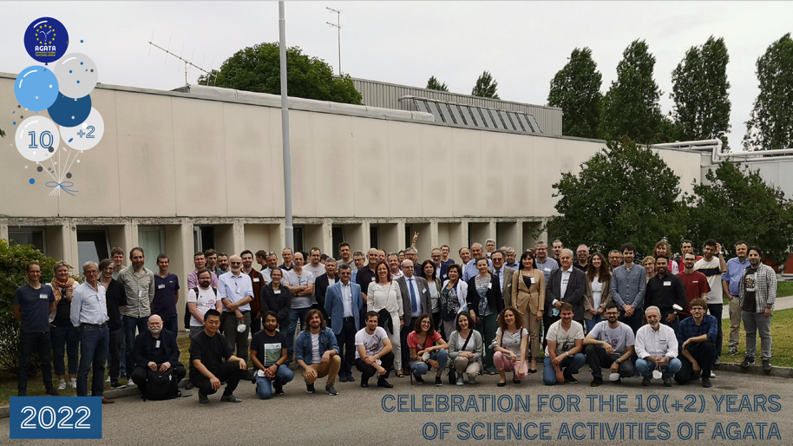
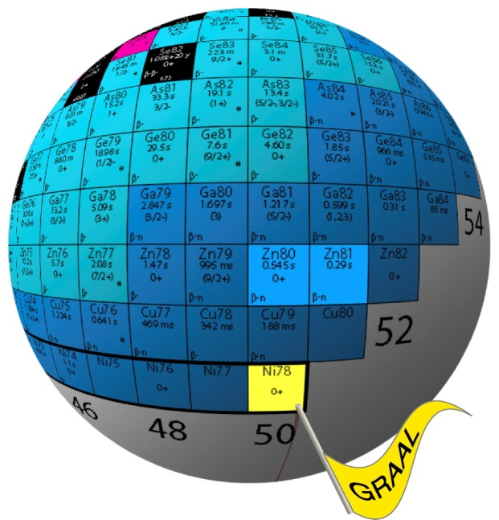

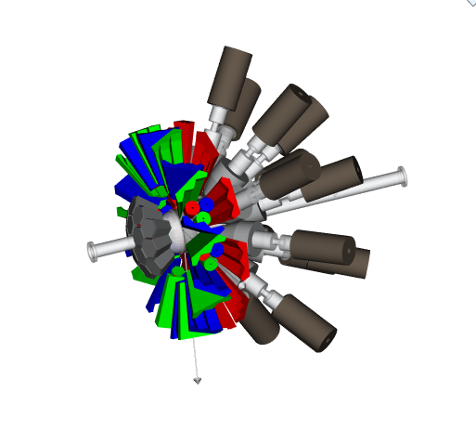
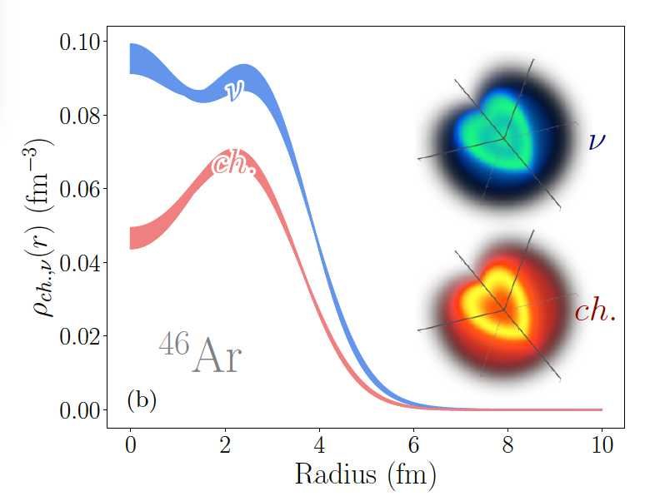
Main lines of the GAMMA collaboration
Development and operativity of large arrays:
AGATA
PARIS
GRIT
Technological development for detectors
Electronics
DAQ
Next generation training
Measurements campaigns in national and international laboratories
Synergies with other research lines and theoretical groups
New resident arrays for INFN national laboratories

Slide 6

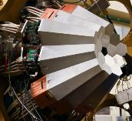
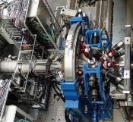
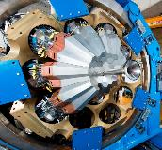
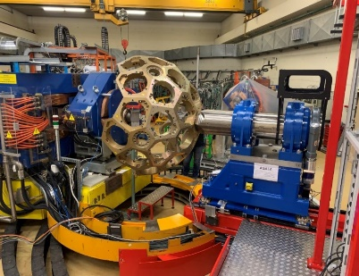
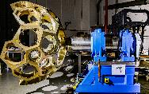
AGATA development and campaigns
Experience in operating 𝛾-ray tracking arrays
Collaboration AGATA-GRETA on tracking algorithms
Development of physics cases adapted to 𝛾-ray tracking arrays with both stable and radioactive beams
2010-2012
Legnaro, Italy
Intense stable beams
15 detectors
AGATA Demonstrator + PRISMA at LNL
2012-2014
GSI, Germany
Fast fragmentation beams
25 detectors
AGATA at GSI
2014- 2021
GANIL, France
ISOL and stable beams
approaching 1π (45)
AGATA at GANIL
2021-- 2028
LNL, Italy
Stable beams
SPES radioactive beams
AGATA at LNL
2.0
2028- 2030 (?)
GANIL, France
ISOL SPIRAL 1 Beams
AGATA at GANIL
>2030
LNL, SPES, Italy
FAIR, Germany
ISOLDE, CERN
GANIL, France
JYFIL, Finland
RIB at low and high energies

Slide 7
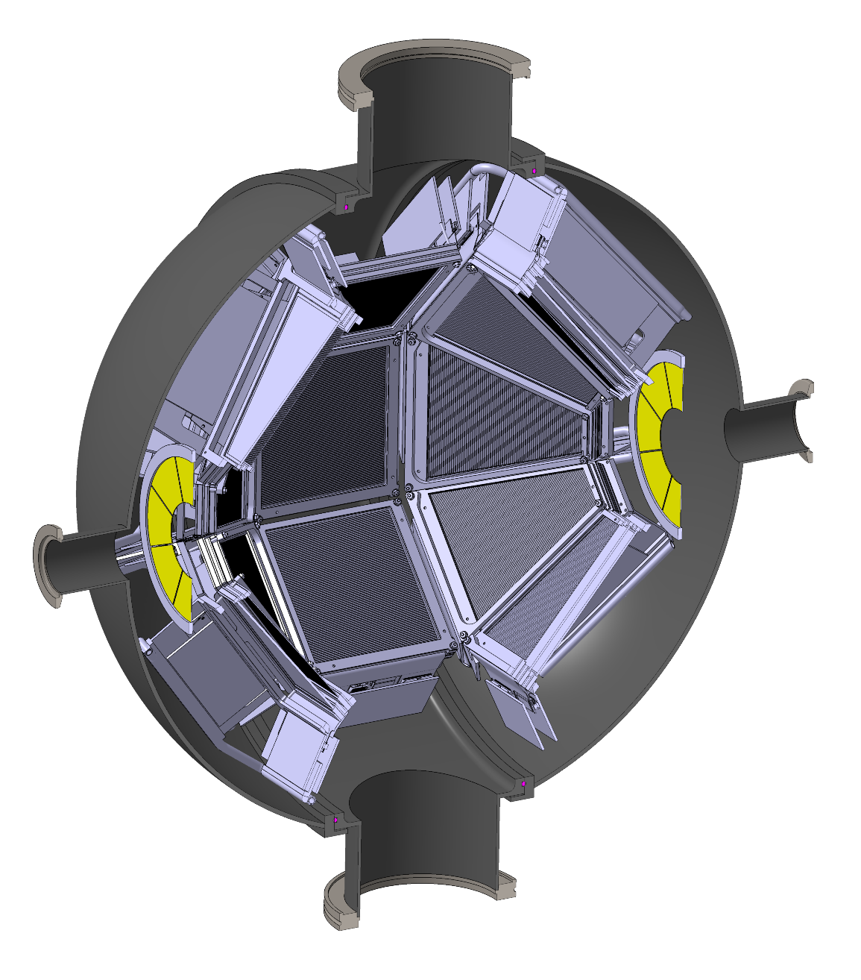
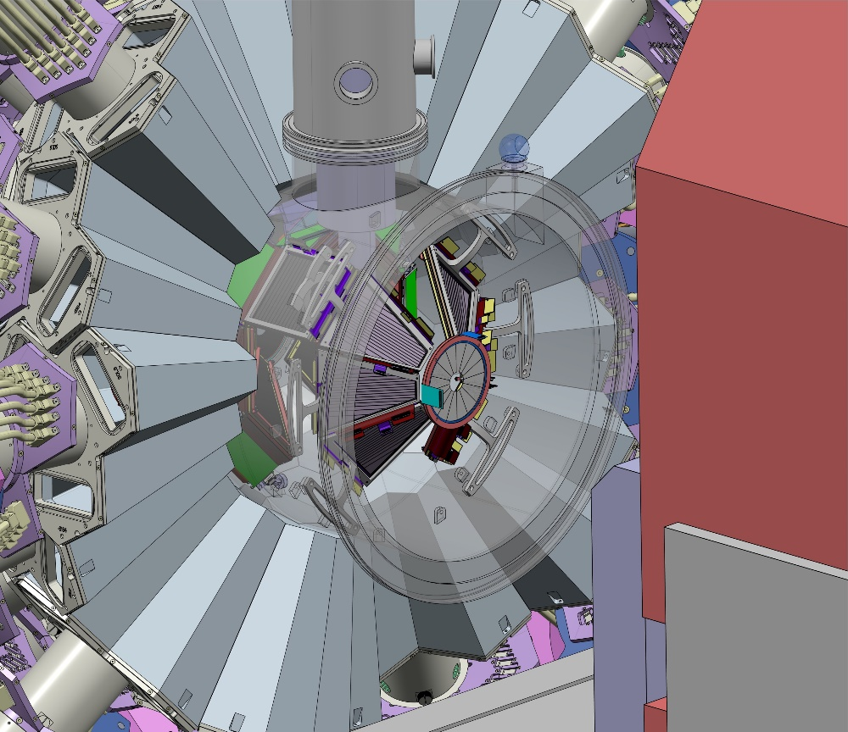


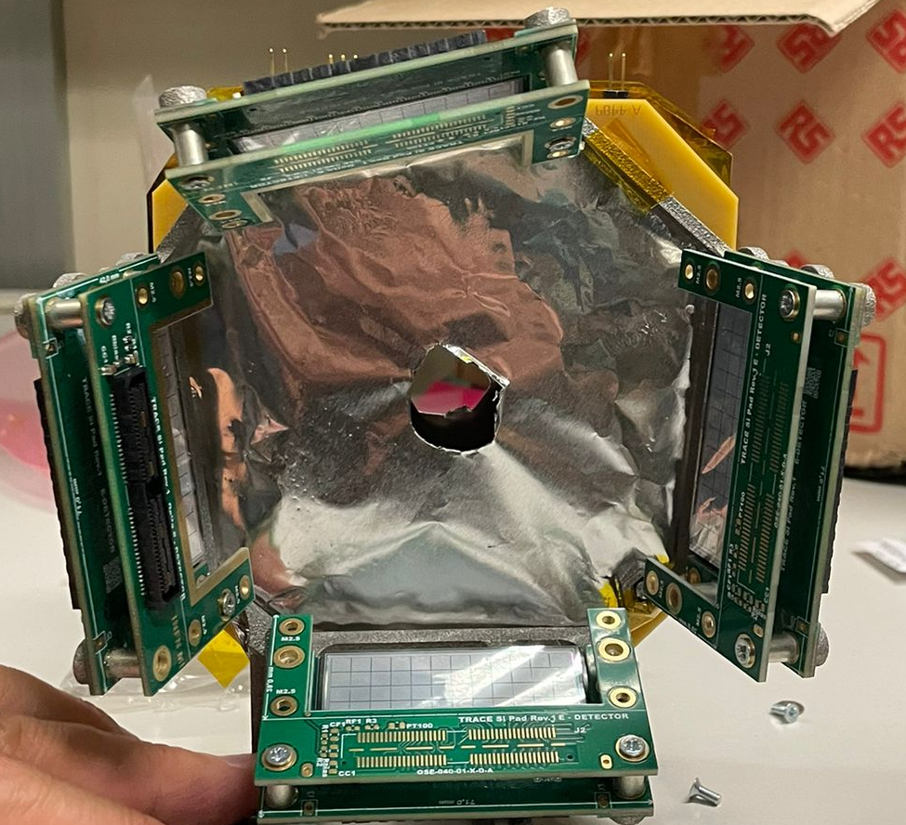
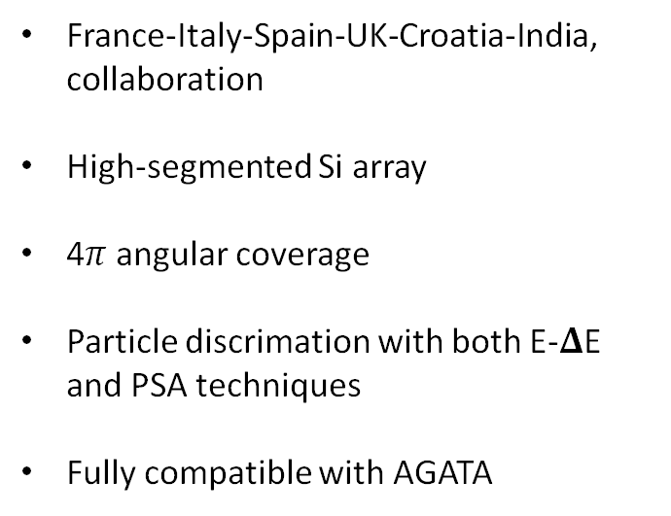
Development and operation of segmented Si arrays
GRIT at the center of AGATA with the CTADIR target
France-Italy-Spain-UK-Croatia-India, collaboration
High-segmented Si array
4$π$ angular coverage
Particle discrimation with both E-𝚫E and PSA techniques
Fully compatible with AGATA
G. Corbari
Several experimental campaigns already performed with prototypes
TRACE detector developed locally in Italy within GAMMA collab.

Slide 8
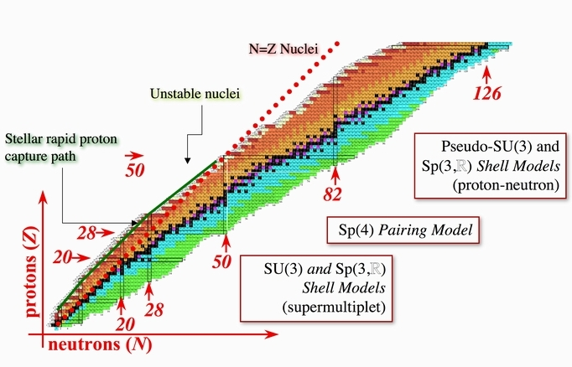
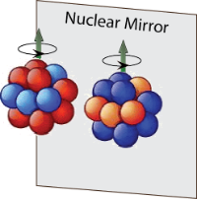
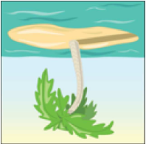
GASPEC: N=Z nuclei

Slide 9
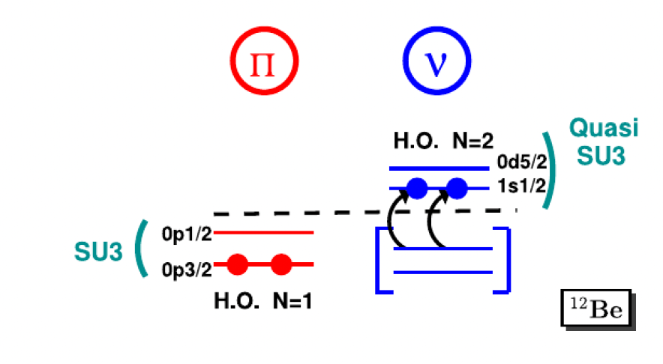
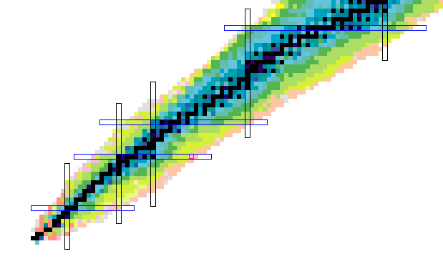
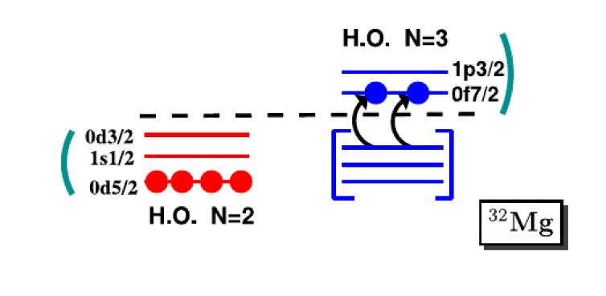
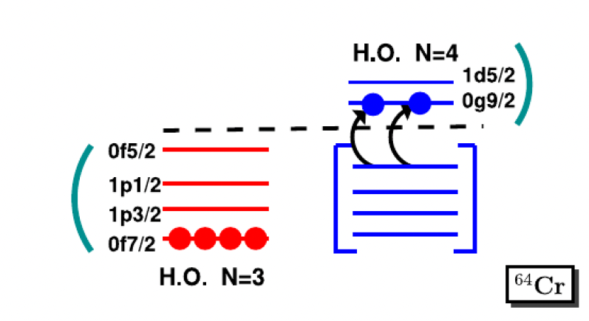
A recent example: islands of inversion at N=Z at NSCL
Z=50
N=Z
Z=40
⁸⁰Zr
Z=28
⁶⁴Cr
Z=20
N=50
³²Mg
⁴²Si
N=40
N=28
¹²Be
N=20
N=8

Slide 10
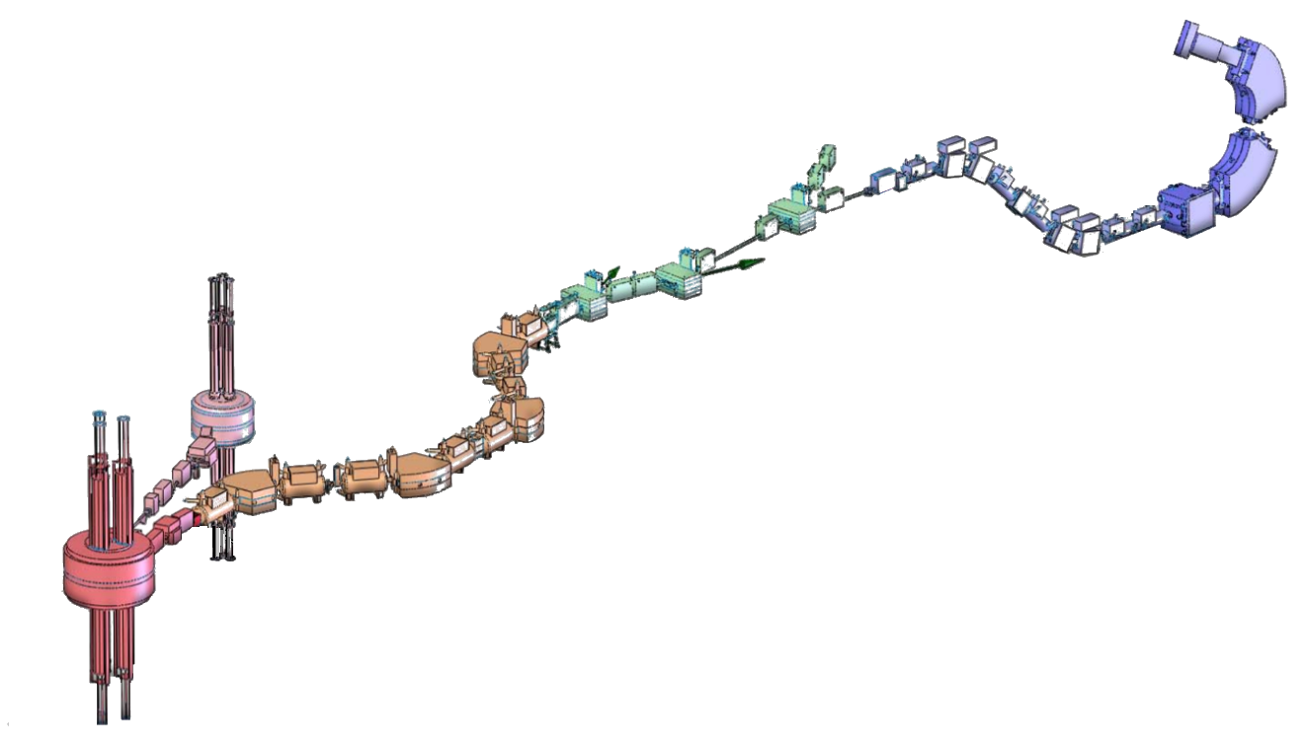
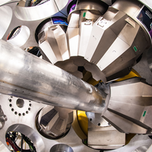
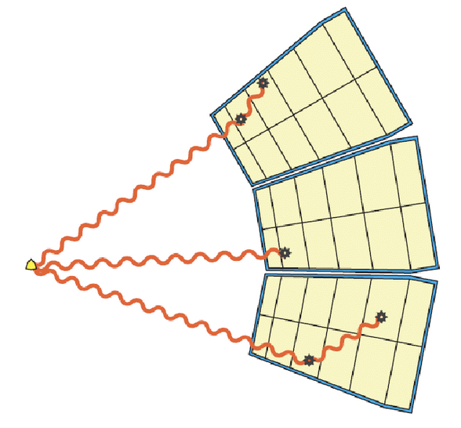
A recent example of collaboration:
⁸⁴Mo (Z=42) experiment at NSCL
Lifetime measurement for the low-lying states in ⁸⁴Mo and its vicinity
GRETINA HPGe array
Focal Plane
⁸⁴Mo, 45 MeV/u
(+ other nuclides)
NSCL
Analysis
Line
A1900
Separator
S800
Transfer Line
GRETINA
K500
⁹Be Secondary
target
F. Recchia
K1200
⁸⁶Mo, 110 MeV/u
(+ ⁸⁵Nb, ⁸⁴Zr, …)
⁹Be Production Target
⁹²Mo Primary Beam, 140 MeV/u

Slide 11
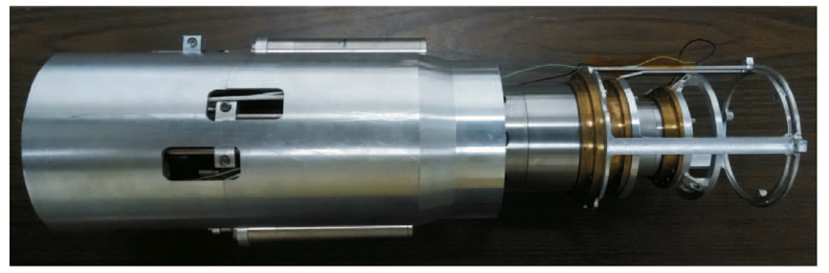
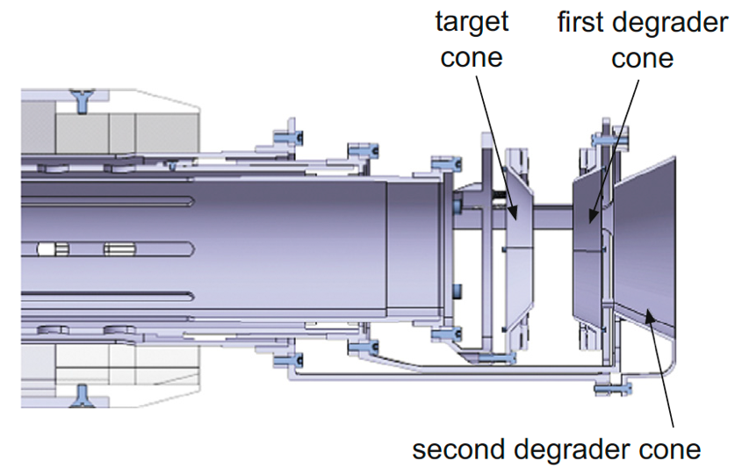


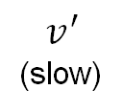
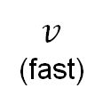
The experiment at NSCL
GRETINA was coupled to the plunger TRIple PLunger for EXotic beams (TRIPLEX)
With a secondary target, the TRIPLEX plunger
Detector
$$γ$$
$$γ^{′}$$
fast
slow
Counts
beam
$v$
(fast)
$$v^{′}$$
(slow)
Reaction
target
degrader
Energy
H. Iwasaki et al., Nuclear Inst. and Methods in Physics Research A 806, 123 (2016)
F. Recchia

Slide 12
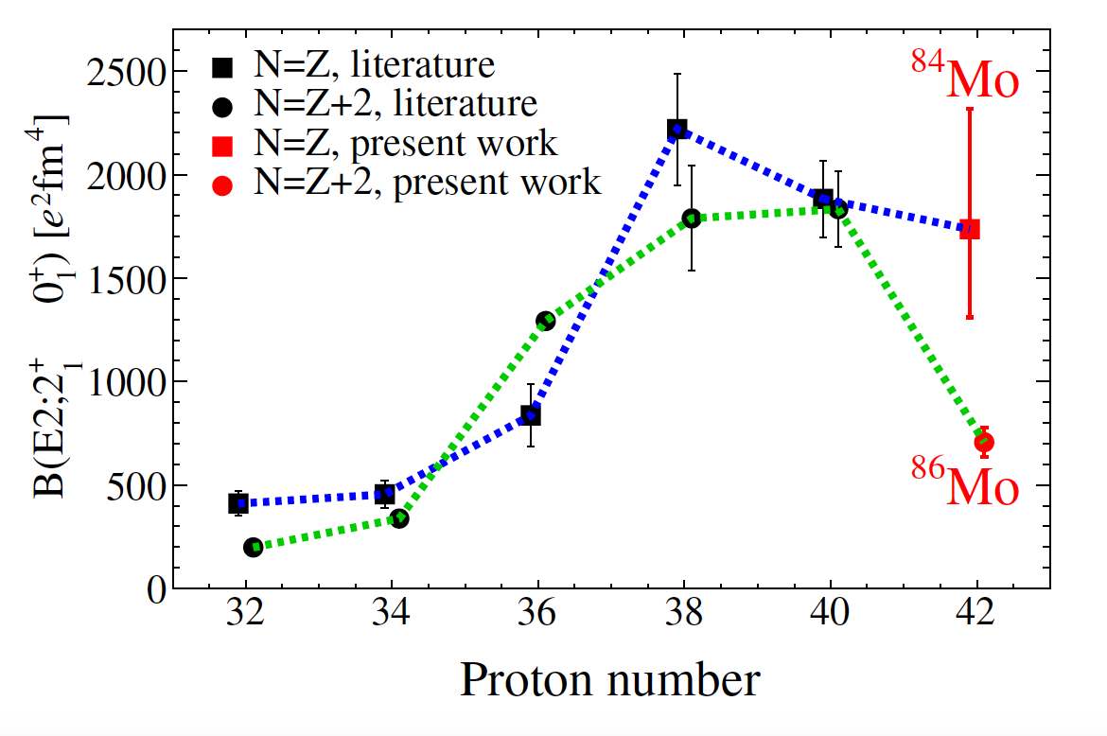

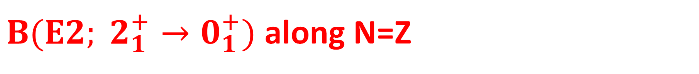

$B(E2; 2_{1}^{+}→0_{1}^{+})$ along N=Z
$τ\left(2_{1}^{+}\right)={27.1}_{−6.8}^{+8.8}$ ps
⁸⁴Mo
⁸⁰Zr
$$β_{Dopp}=0.327$$
⁸⁶Mo
First 2⁺ state in ⁸⁴Mo understandable in terms of prolate deformation
Inclusion of d_{5/2} (above N=Z=50) is needed – lifetime shorter than expected - quadrupole correlations
J. Ha post-doc work
F. Recchia

Slide 13
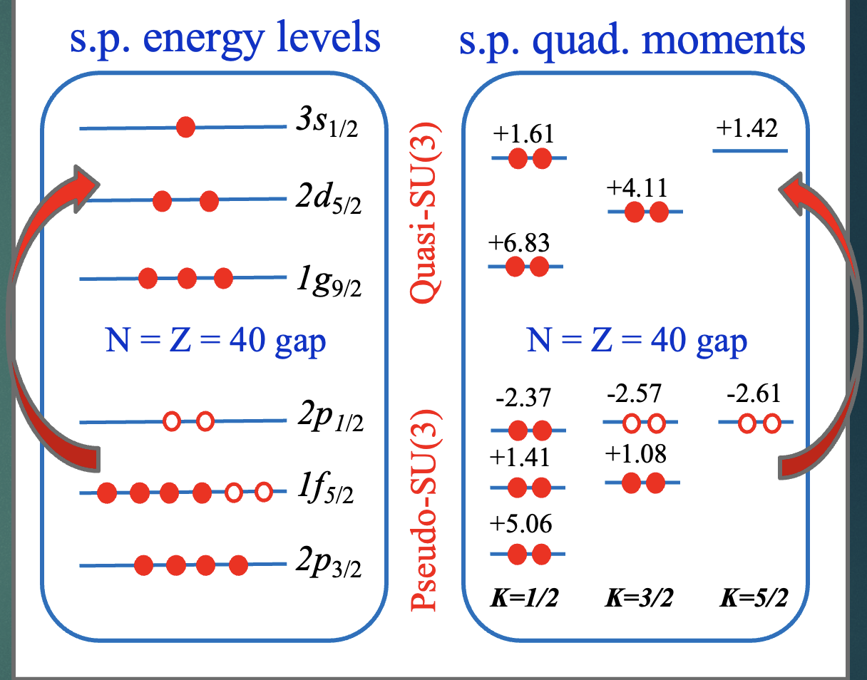
The isospin-symmetric island of Inversion
Along the N=Z line, proton and neutron particle-hole excitations contribute coherently, thus enhancing the quadrupole correlations and giving rise to the Isospin-symmetric Island of Inversion at N=Z=40
Quasi-SU3
⁸⁴Mo
⁸⁶Mo
8p-8h
mixing of
np-nh
⁸⁴Mo: same configuration for protons and neutrons.
Quadrupole correlations favor np-nh excitations.
F. Recchia
Accepted in Nat. Comm.

Slide 14
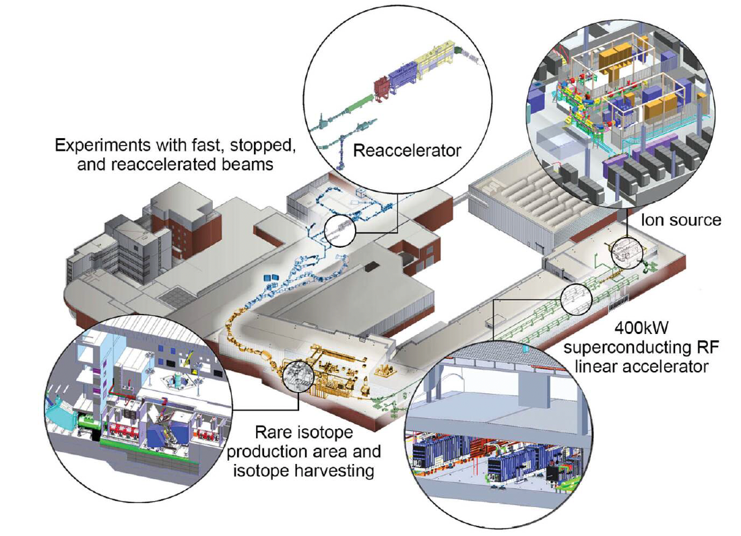
Opportunities for N=Z beams at FRIB
N=Z region in the g_{9/2} shell (⁸⁰Zr-¹⁰⁰Sn):
fast beams 10³-10⁻¹ pps: (p,2p), n-knockout, rel. Coulex, decay spectroscopy
reaccelerated beams 10²-10⁻³ pps: safe Coulex, (p,p’)
High-spin ISB behavior in mirror nuclei A=44, 46 (N=20)

Slide 15
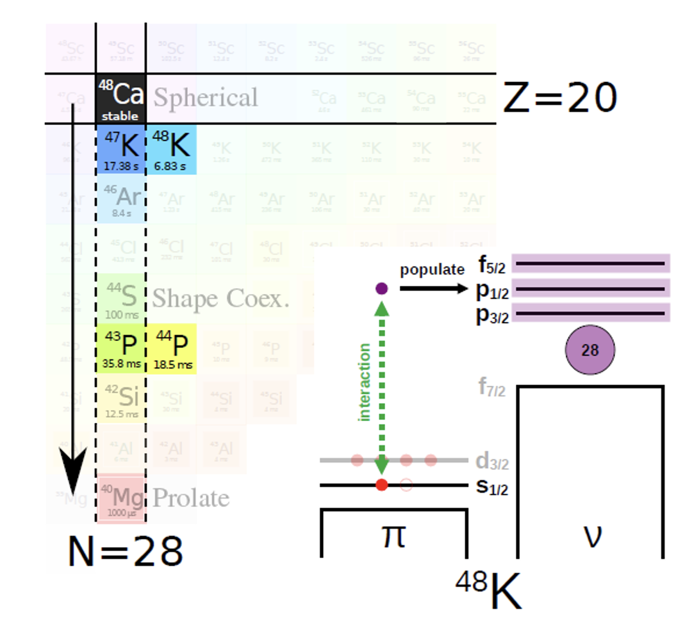
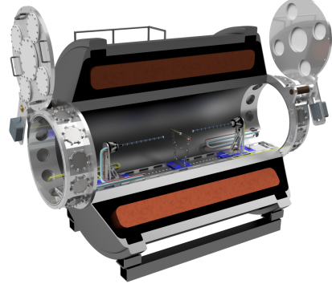
GASPEC : Direct reactions combined with 𝛾-ray spectroscopy

Slide 16
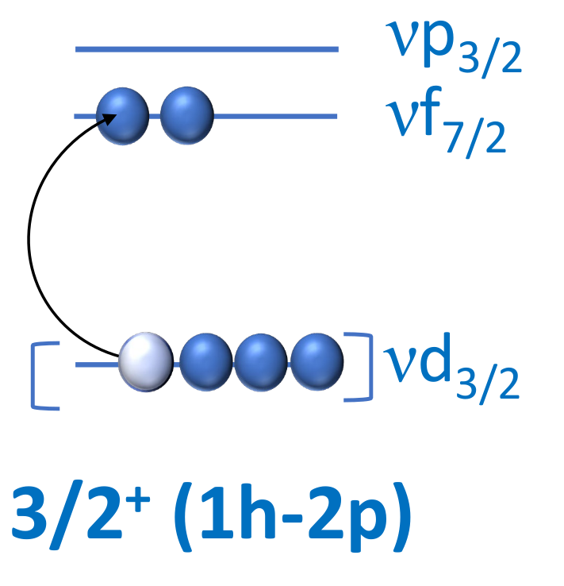
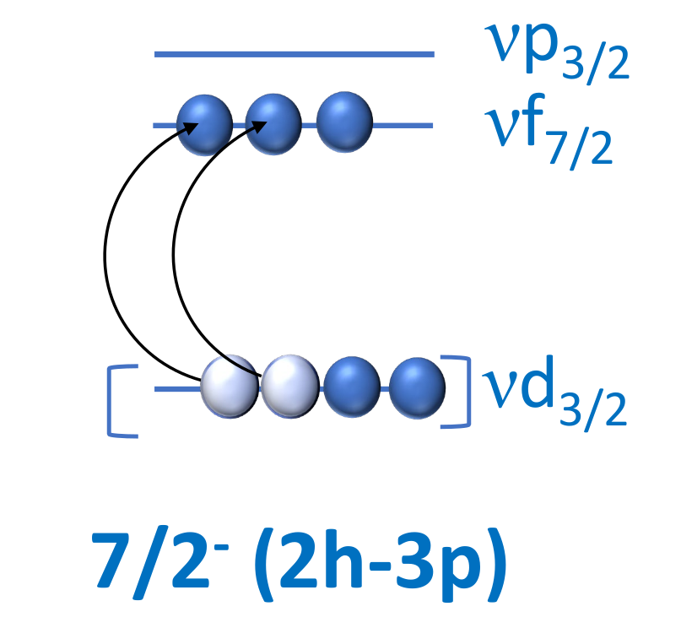

Intruder states and collectivity
in N = 21 ³⁹Ar and ³⁷S
- Onset of collectivity and intruder states is more and more important moving towards the island of inversion
- Although in ³⁸Ar transition probability are well known, the data for ³⁷S, closer to the IOI is absent
7/2⁻
0.06
2481
0.006
2023
0.07
3/2⁺
1518
0.03
3/2⁻
0.50
1267
1397
0.44
646
0.63
0.69
Z=50
7/2⁻
0
0
³⁹Ar
³⁷S
Z=40
₁₈
₁₆
Z=28
Z=20
N=40
E. Caurier, F. Nowacki, and A. Poves, Phys. Rev. C 90 (2014) 014302
N=28
E. K. Warburton, Phys. Rev. C 35 (1987) 2278; Phys. Rev. C 37 (1988) 754
R. Chapman et al., Phys. Rev. C 93 (2016) 044318
N=20
L. Zago PhD thesis
N=8

Slide 17
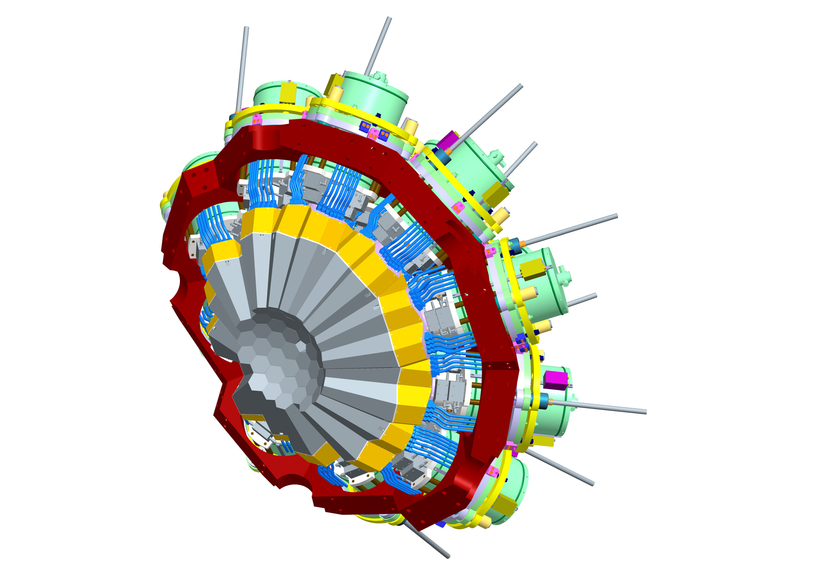
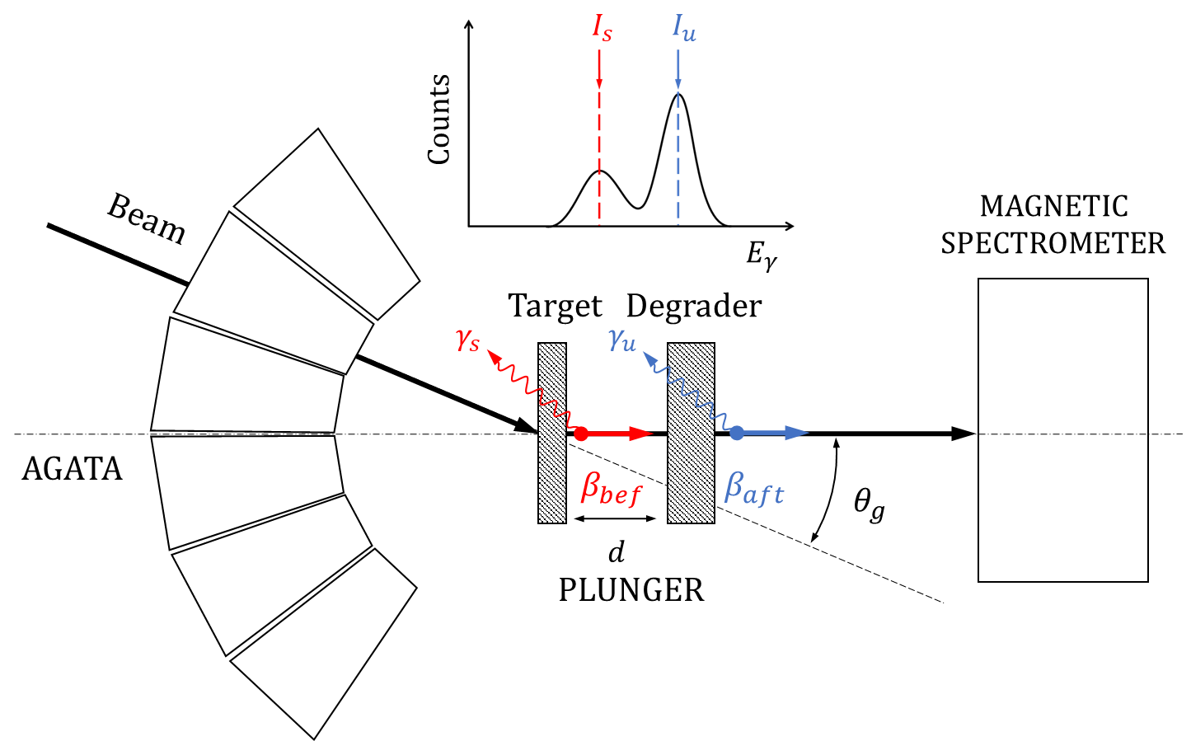
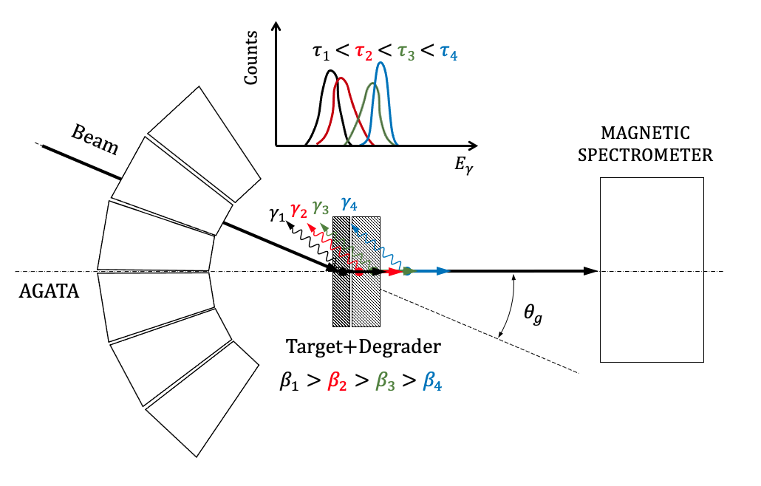
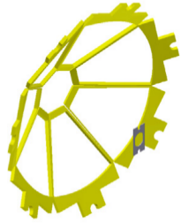

The experiment at LNL
3/2⁺ level expected to be in the range 10-100 ps -> RDDS
³⁶S(d,p)³⁷S at 4.6 MeV/u
7/2₂⁻ level expected to be in the range 50-500 fs -> DSAM
³⁶S beam
168 MeV
RDDS
DSAM
p
SPIDER
Combination of the two techniques in a single experiment
AGATA
CD₂
Au backing
p
³⁷S
Ta
stopper
High selectivity to a given set of excited states
High control on Ex -> control on feeding transitions
CD₂

Slide 18
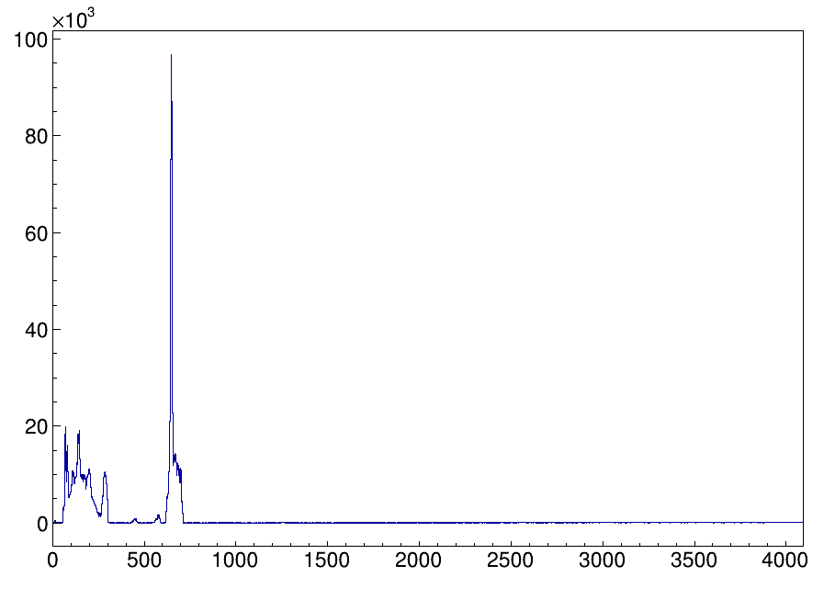
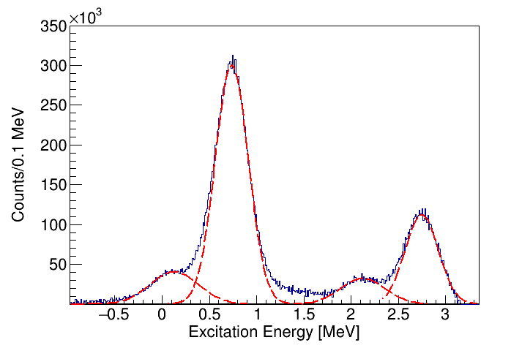
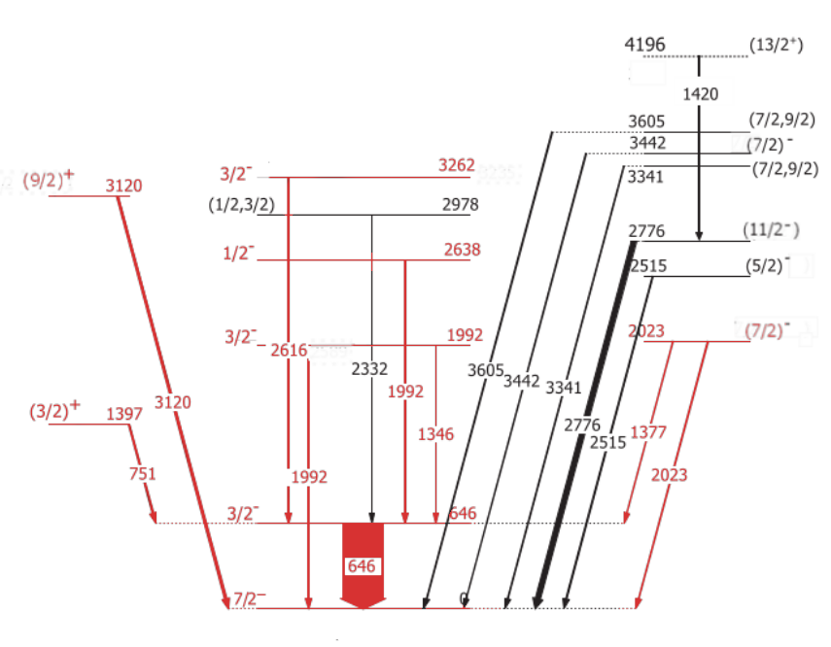
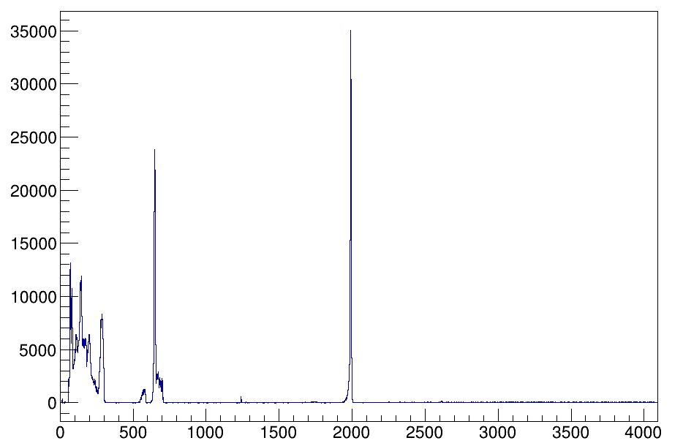
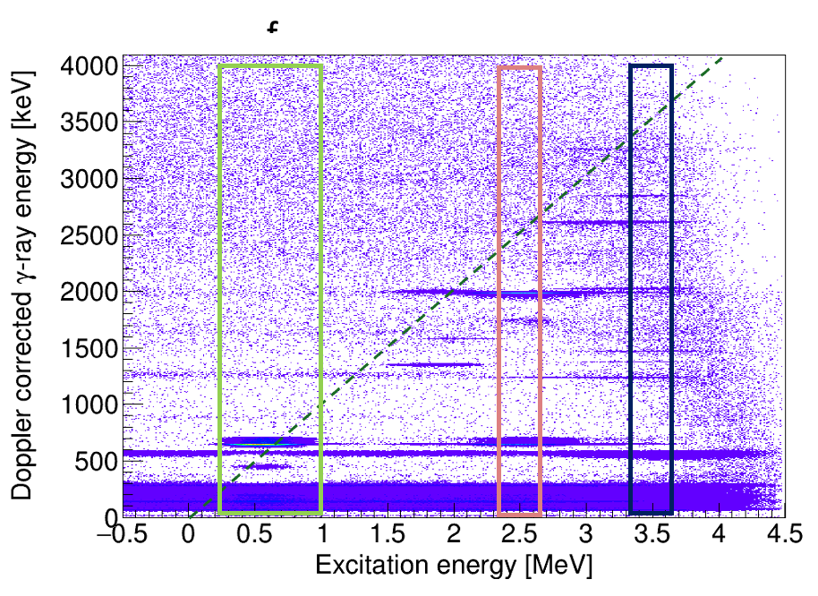
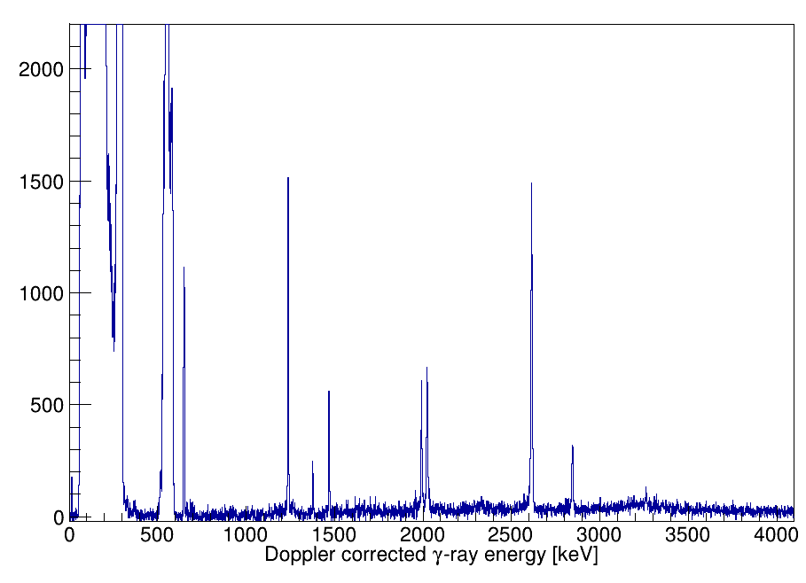
Particle - 𝛾 ray coincidences in ³⁷S
3262
3/2⁻
p_{3/2}
2638
300 keV
2616
1992
p_{1/2}
646
1/2⁻
646
0
420 keV
3/2⁻
(7/2)⁻
7/2⁻
States of interest clearly observed
Feeder control
Adapted from Grocutt et al., PRC 106, 024314 (2022)
All spectroscopic results agree with previously published measurements

Slide 19









Lifetime results in ³⁷S
0.7 mm
Non DC
3/2⁺
1397
DC
751
3/2⁻
646
7/2⁻
646
0
B(E1) = 1.12*10⁻⁵ e²fm² = 1.56*10⁻⁵ W. u.
1.5 mm
Non DC
DC
3/2⁻ s.p. state
3.3 MeV
5 mm
Non DC
T_{1/2} < 5 fs
1/2⁺ 2p1h state
2.2 MeV
DC
T_{1/2} = 60(20) fs
To be submitted for publication

Slide 20





Lifetime measurement in ²⁰O using ¹⁹O(d,pγ) and DSAM
Three-body forces
E. Clement (GANIL) and A. Goasduff (INFN-LNL)
PhD Thesis I. Zanon (INFN-Ferrara, LNL)
AGATA+VAMOS@GANIL
(PRC Rapid 2020)
Excitation Energy Spectrum
In MUGAST
𝜏(2⁺₂) = 63⁺²⁸₋₁₆ fs
γ-ray Spectrum
in AGATA
Published in Phys. Rev. Lett.

Slide 21





The strange case of N=28
Excellent SM theory for neutron-space related quantities:
confirming N=28 shell closure in ⁴⁶Ar
SDPF interaction describes valance-core neutrons interaction very well
Z. Meisel et al. PRL 114, 022501 (2015)
A. Gade et al., PRC 68, 014302 (2003)
L. A. Riley et al., PRC 72, 024311 (2005)
S. Calinescu et al., PRC 93, 044333 (2016)
Large discrepancy with the measured B(E2) value at N=28: problem with the proton E2 contribution ?
Z=50
Z=40
Direct proton-adding reaction to probe the ⁴⁶Ar ground state wave function
Z=28
Z=20
N=40
N=28
N=20
N=8

Slide 22







Proton bubble at N=28 ?
⁴⁶Ar(³He,dγ) ⁴⁷K
proton transfer
to probe π matrix element
Measurement of πs_{1/2} depletion in ⁴⁶Ar
indication of possible change
in the πs1/2-πd3/2 proton orbitals
Theory ab initio C. Barbieri (Milano)
PhD Thesis D. Brugnara (Padova) 2022
Premio VILLI 2022
AGATA-⁴⁷K in VAMOS-d in MUGAST triple coincidence
deuteron angular distribution in MUGAST
C²S[L]/C²S[L = 0] 3/2⁺ state 7/2⁻ state
2 2
SDPF-U
Experiment
0.63 2.6
Amplitude
0.08
$${0.10}_{−0.10}^{+0.11}$$
$${1.10}_{−0.15}^{+0.18}$$
0.06
ν
𝜋s_{1/2} empty, 𝜋d_{3/2} full !
The proton WF of the g.s. of ⁴⁶Ar is not correctly described
0.04
0.02
46_{Ar}
π
0.00
0
4 6
Radius (fm)
8
10
Submitted for publication

Slide 23





CTADIR – cryogenic targets for direct reactions
Cryogenic ^{3,4}He target at 9-10 K
Target density 10²⁰⁻²¹ at/cm²
Cooled with cryocooler
Fully compatible with AGATA-GRIT
Al body to be transparent to 𝛾 rays
Commissioning with proton beam
M. Sedlák, at al. Nucl. Instr. and Meth. A, 1080, 2025,170626,

Slide 24
Perspectives with FRIB beams
A rich and diversified intrumentation is already present at FRIB
We can contribute with «specific» detectors/devices in selected cases
We can propose physics cases in specific regions of the nuclide charts
- lifetimes of excited states after fast/reacc.
proton/neutron knockouts/trasnfers
- use of cryogenics targets for particle and 𝛾-
ray spectroscopy (DSAM possibilities to be
investigated )
- nuclear structure in odd-odd or odd-even
nuclei using 𝛾-ray spectroscopy for cross
section to individual levels
See F. Galtarossa’s talk for possible cases at FRIB

Slide 25


GASPEC : Coulomb excitations

Slide 26





Coulomb excitation with segmented 𝛾-ray arrays
Example: ⁷⁹Zn at ISOLDE
⁷⁹Zn gs, intruder 1/2⁺ isomer, states both in the exotic beam
Coulex at 4 MeV/u on ²⁰⁸Pb, ¹⁹⁶Pt targets
Particle spectra (forward)
Measurement of the B(E2)
on the gs and intruder 1/2⁺ isomer
(GOSIA code analysis)
Comparison with LSSM describing
intruder structures in ⁷⁸Ni
F. Angelini PhD thesis

Slide 27
Coulomb excitation at FRIB
See M. Rocchini’s talk for possible cases at FRIB
Different RIBs production method ⟹ Differents species available
Availability of reaccelerated beams: proper beam energy for Coulex
What setup for Coulex ?
Level of purity of the beams?
Complementary data from 𝛽-delayed 𝛾-ray and conversion electron spectroscopy

Slide 28





























The young strength of GAMMA: PhD, Postdocs
9 nationalities !
And… new ones !

Slide 29
THANK YOU FOR YOUR ATTENTION !

