Slide 1
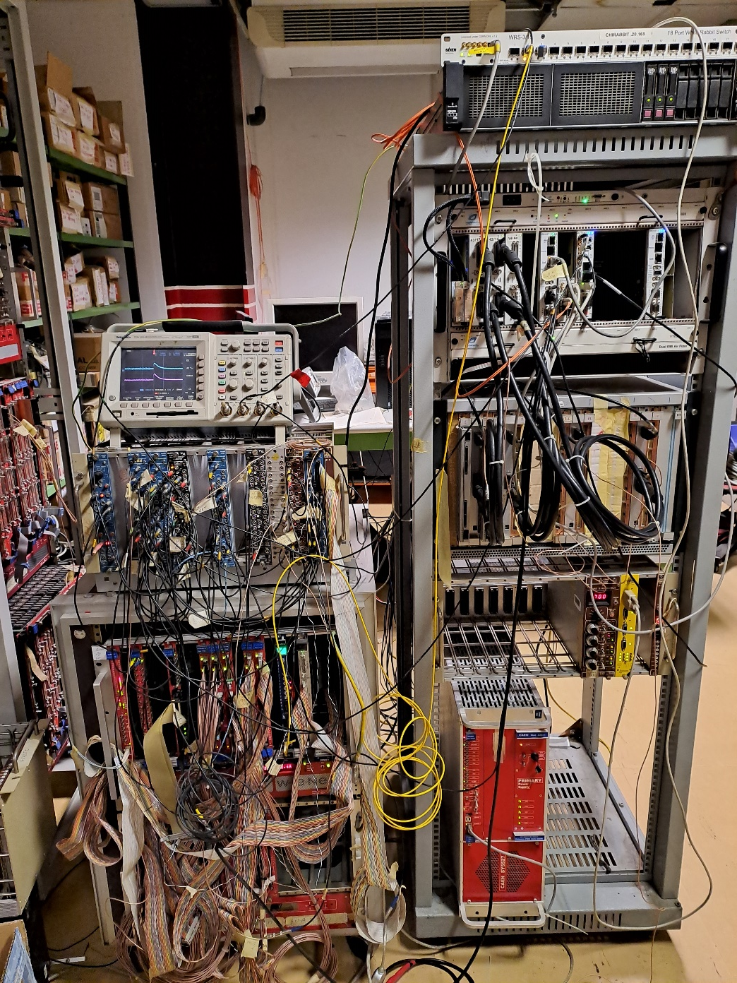
CHIMERA, FARCOS, NARCOS DAQ : DAQ coupling at LNS and GSI E. De Filippo - INFN-CT
VME
WHITE RABBIT Switch
CAEN V2718 + CAEN V977 IO/Reg.
DAQ Server with Caen A3818/A4818 PCI card
LNS test point for DAQ
Vetar2: 125 MHz 64 bit White Rabbit (WR) VME timing receiver/sender
µTCA
V1495 with FPGA compatible with GANIL CENTRUM and GET. It receives 100 MHz 48 bits TS from GET.
GET
CAEN codifiers, scalers, etc
VME
Vetar2
µTCA main modules
MCH network switch
COBO(s) DAQ
Mutant Trigger
Beast Synchro
V1495
Power
Supply
V2718
bridge

Slide 2
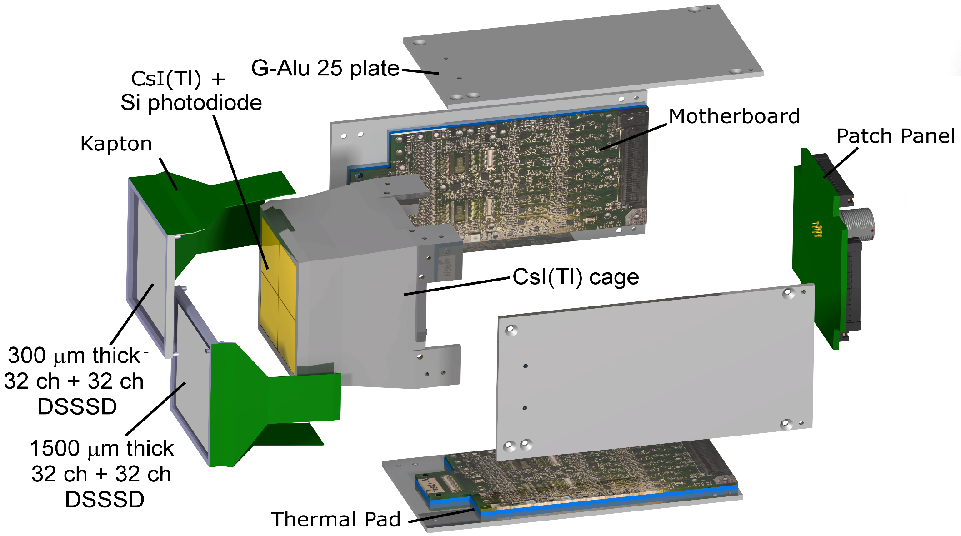
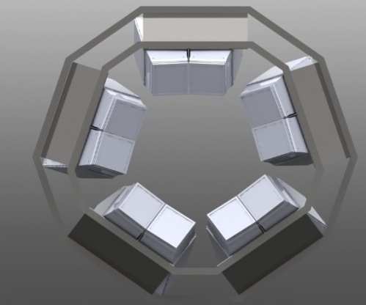
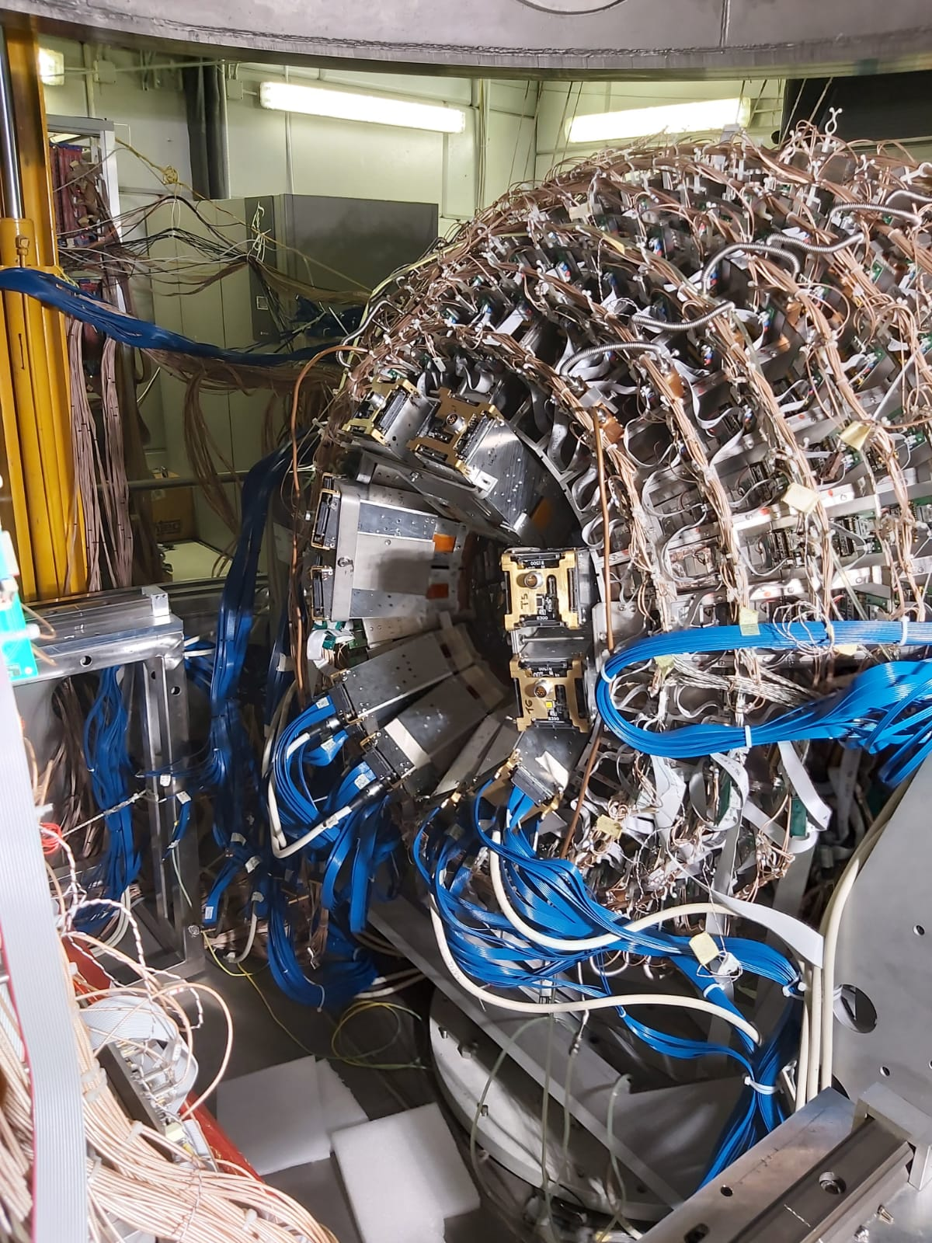
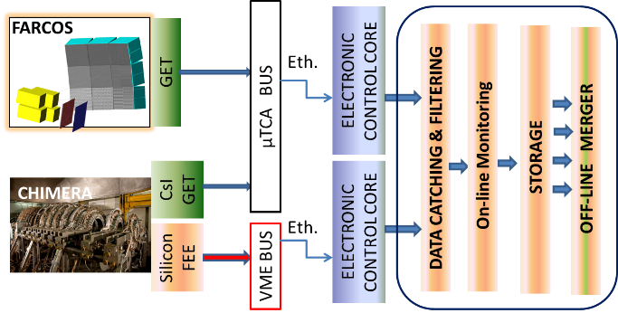
The CHIFAR experiment: exploring dynamics in the low energy regime at 20 MeV/A
CHIMERA + 10 FARCOS telescopes arranged in a Ring-like structure between 16 and 30 deg. polar angle
Using a combination of neutron poor and neutron rich beams and targets:
Beams: ¹²⁴Sn, ¹¹²Sn, ¹²⁴Xe Targets: ⁶⁴Ni, ⁶⁴Zn, ⁵⁸Ni
GET digital DAQ for FARCOS and «CHIMERA CsI» and the front-end electronics for FARCOS based on custom designed ASICs

Slide 3
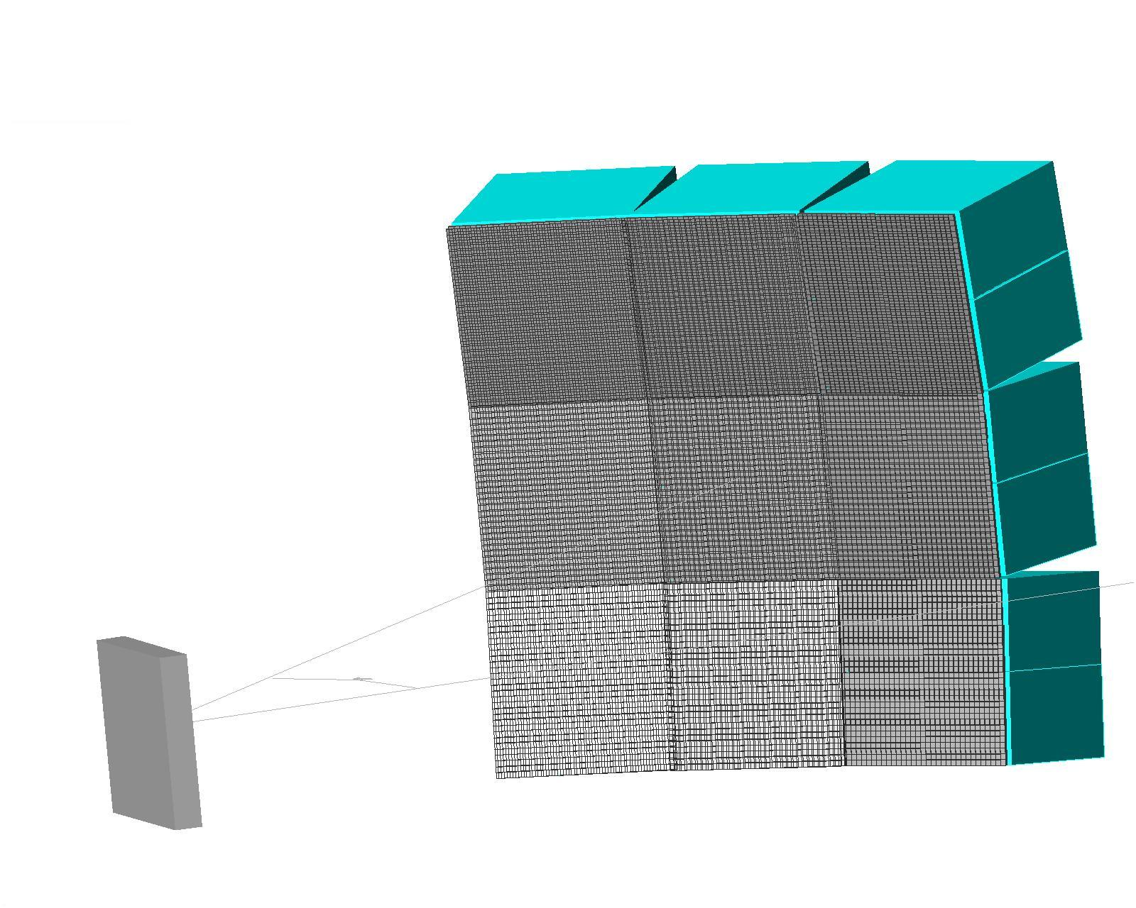
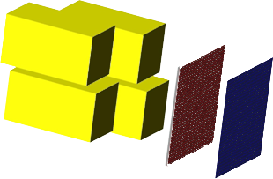
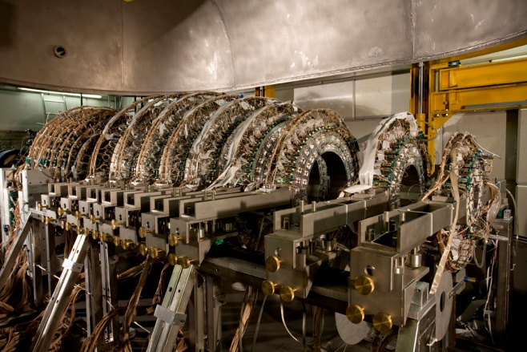
GET + CHIMERA DAQ COUPLING (a brief overview)
Acquisition node servers
FARCOS
Eth.
GET
ELECTRONIC CONTROL CORE
µTCA BUS
DATA CATCHING & FILTERING
OFF-LINE MERGER
STORAGE
CsI GET
CHIMERA
ELECTRONIC CONTROL CORE
Eth.
Silicon FEE
VME BUS
We use «NARVAL» as supervisor for both CHIMERA and GET data acquisitions (Ubuntu, CentOS)
developed at IPN-Orsay by X. Grave (maintained at GANIL, no source code available)
based on the concept of generic Actors
written in OO language ADA (core) with C++ interface
Data flow: TCP/IP
Run Control Core and GUI interface based on Java (GANIL)
VME DAQ, VME-GET Coupling, Data Analysis software for CoBo(s) and VME and general MERGER developed and mainteined at INFN Catania

Slide 4
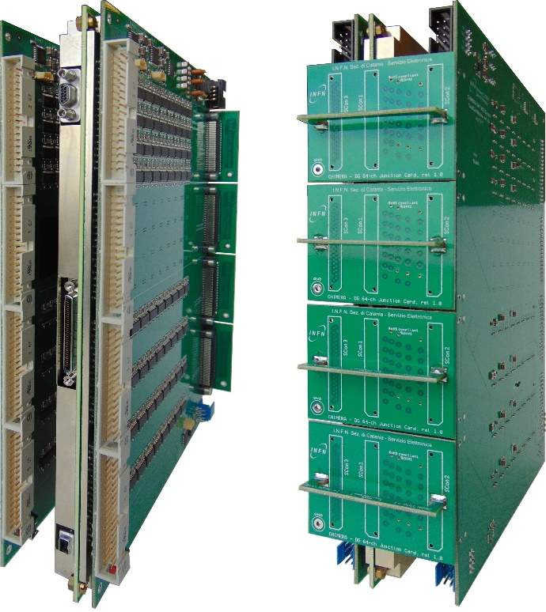
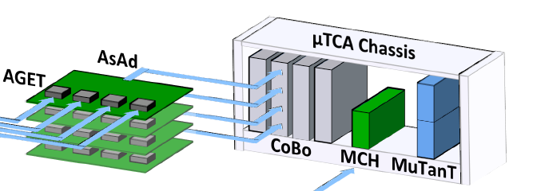
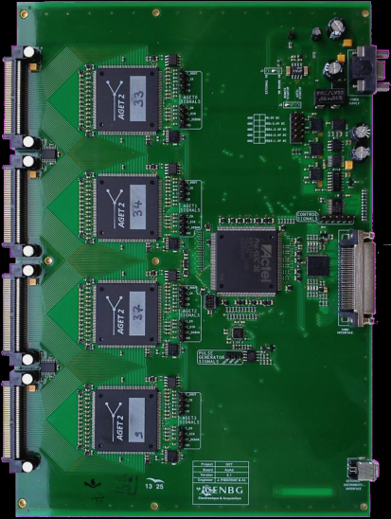

CHIMERA CSI / FARCOS to GET
CPA to Dual-Gain modules
Chimera CsI:
8 ASAD → (~2k signals)
Currently adding the whole CsI forward part (ring 4-9) to GET
Farcos (20 modules):
15 ASAD → (~4k signals)
8 CoBo (max)
1 µTCA crate
1 Mutant (three levels trigger)
1 Beast (syncro from Mutant to VME)
Computer farm + Storage (disk server) + 10Gb data / 1Gb switch slow control
Network to server(s)
AsAD board
CoBo(s) read and reduce data from the the AsAd front-end up to 4 AsAd(s), 1024 channels
A Farcos telescope
FPGA
AGET
VHDCI cable to CoBo
Signal Inputs (4x64)
ADC

Slide 5
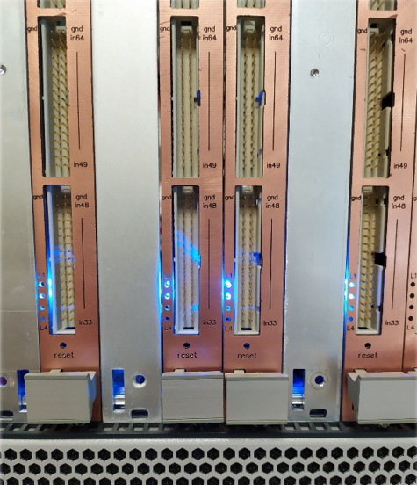
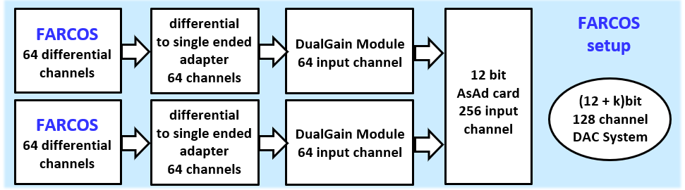
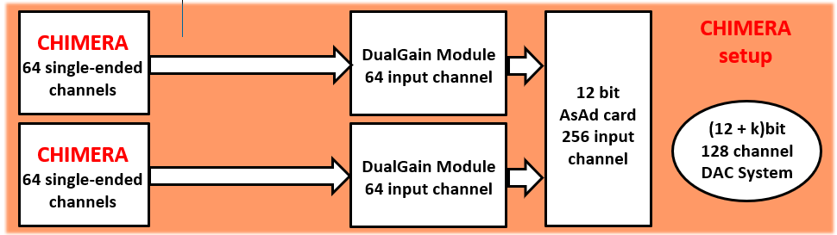
DUAL GAIN
G. Saccà et al. IWM-EC 2024 ,
Il Nuovo Cimento C48, 74 (2025)

Slide 6
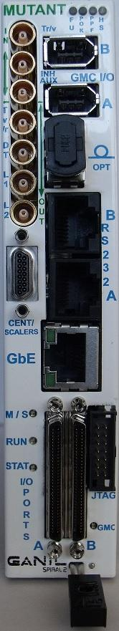
TRIGGERING WITH CHIMERA-DAQ and Mutant
MuTanT (The Multiplicity Trigger and Time) provides a 3 level trigger system: L0 (external trigger), L1 (multiplicity trigger) and L2 (user defined trigger) and clock alignment with the CoBos.
MAIN TRIGGER FOR CHIMERA/FARCOS slave
Chimera coupling with VME DAQ is done by using a Common Trigger synchro: Event Counter (EC) and/or Timestamp (TS)
Accepted Trigger to L0
VME
Mutant
Accepted Trigger to L0
Dead time
VME
L1
Mutant
Busy
L0 mode: Chimera silicon detectors triggering
Internal Multiplicity threshold
Busy
Gates generations for analog VME
L0L1 mode or L1 mode: GET master
MuTanT
Gates generations for analog VME
L1 timing >1 µs to take decision
TRIGGER FARCOS master
common trigger + shared dead-time + event-number + Timestamp

Slide 7
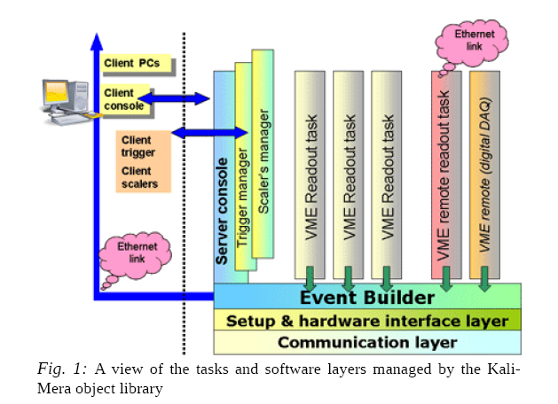
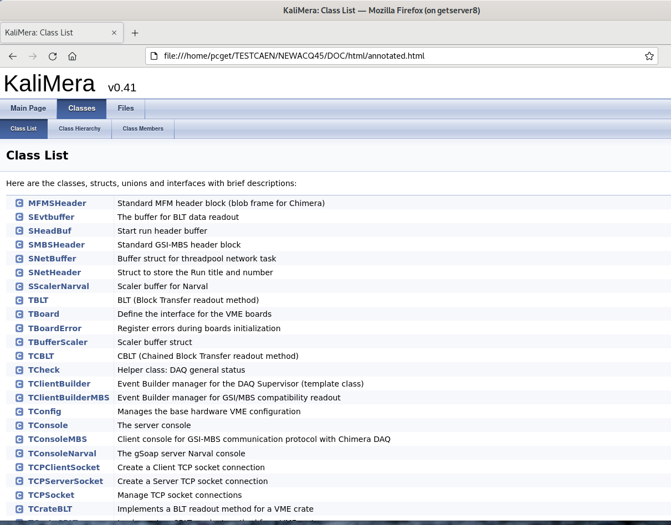
GET + CHIMERA DAQ COUPLING (readout software)
The KaliMera C++ readout library
Current version: 0.50 (2025)
Based on the library for CHIMERA VME readout first defined in 2009 up to now. It has “survived” to the MBS coupling, GET coupling and to the R3B DAQ coupling

Slide 8
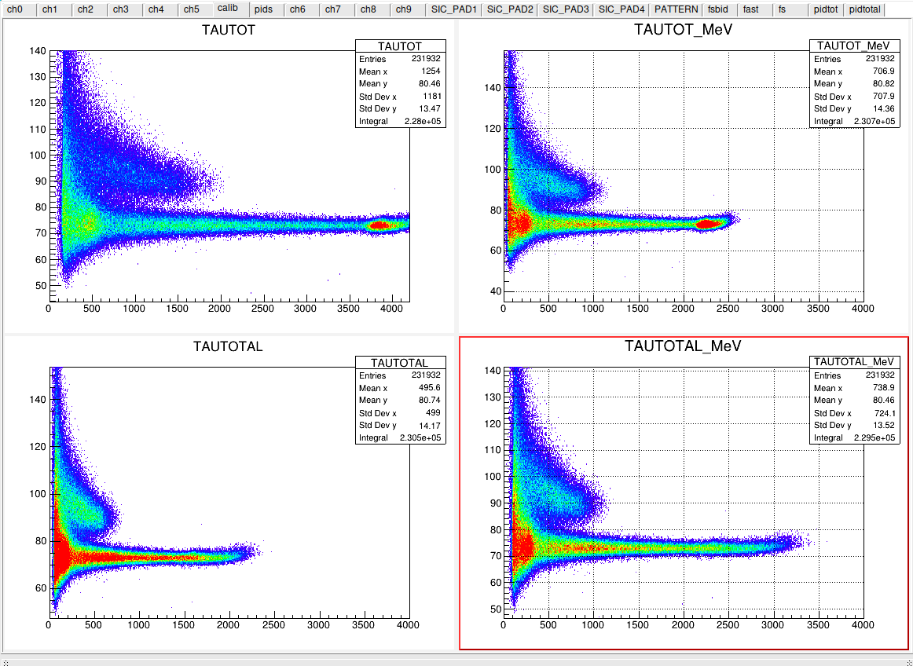
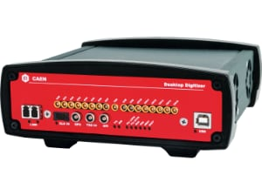

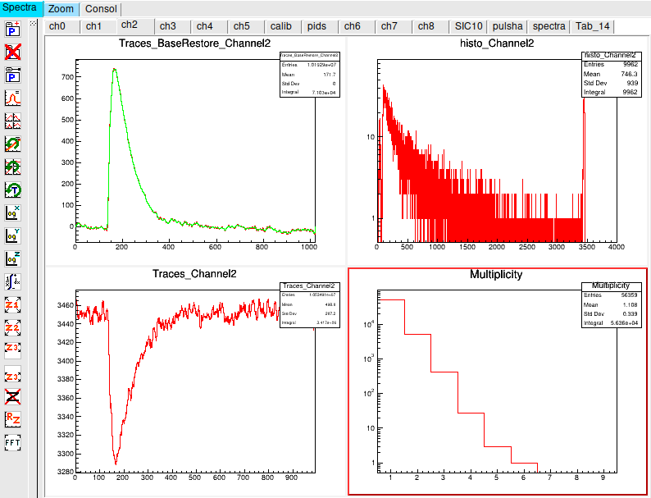
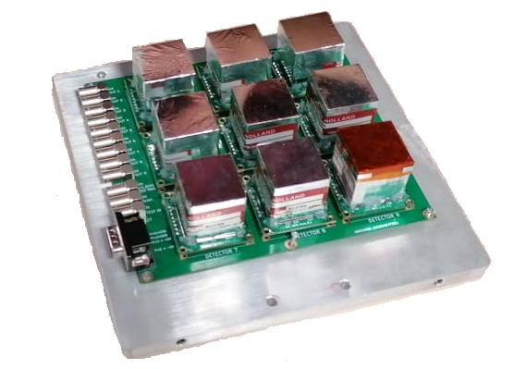
Desktop and VME digitizers for NARCOS
In common with Chimera/GET tools/libraries
Standalone Readout task for Caen digitizers (gen1)
CrossTest experiment CN@LNL
Eth.
TCP
or
UDP
Data analysis client and unpackers
GetMFMlib
Eth.
MFM header+ data
DT5742
VX2730
1 GHz, 16 ch, 12bit
Waveforms Storage
We are working on gen2 VME 32 channels 500 MHz, 14 bit digitizer:
To do :
standalone daq
Registering it in the VME KaliMera library
AmBe test (2025) LNS
NARCOS

Slide 9
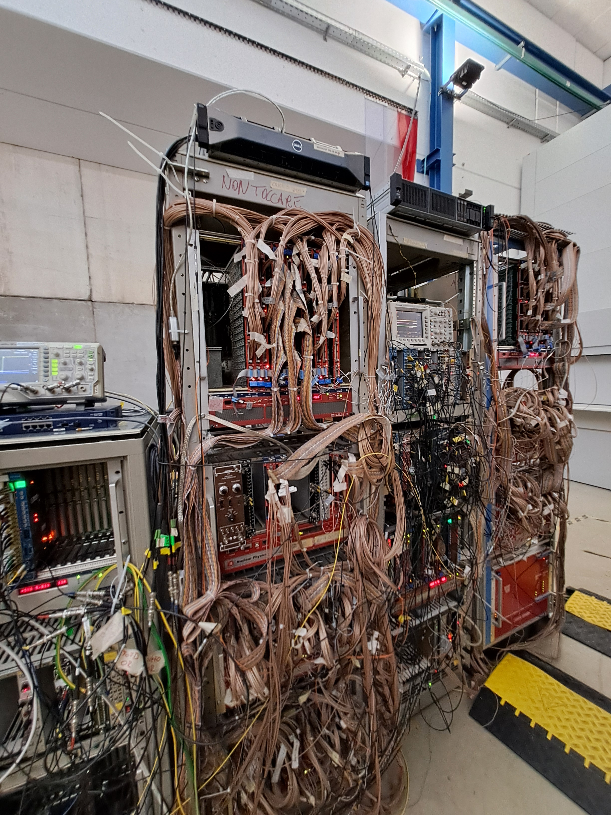
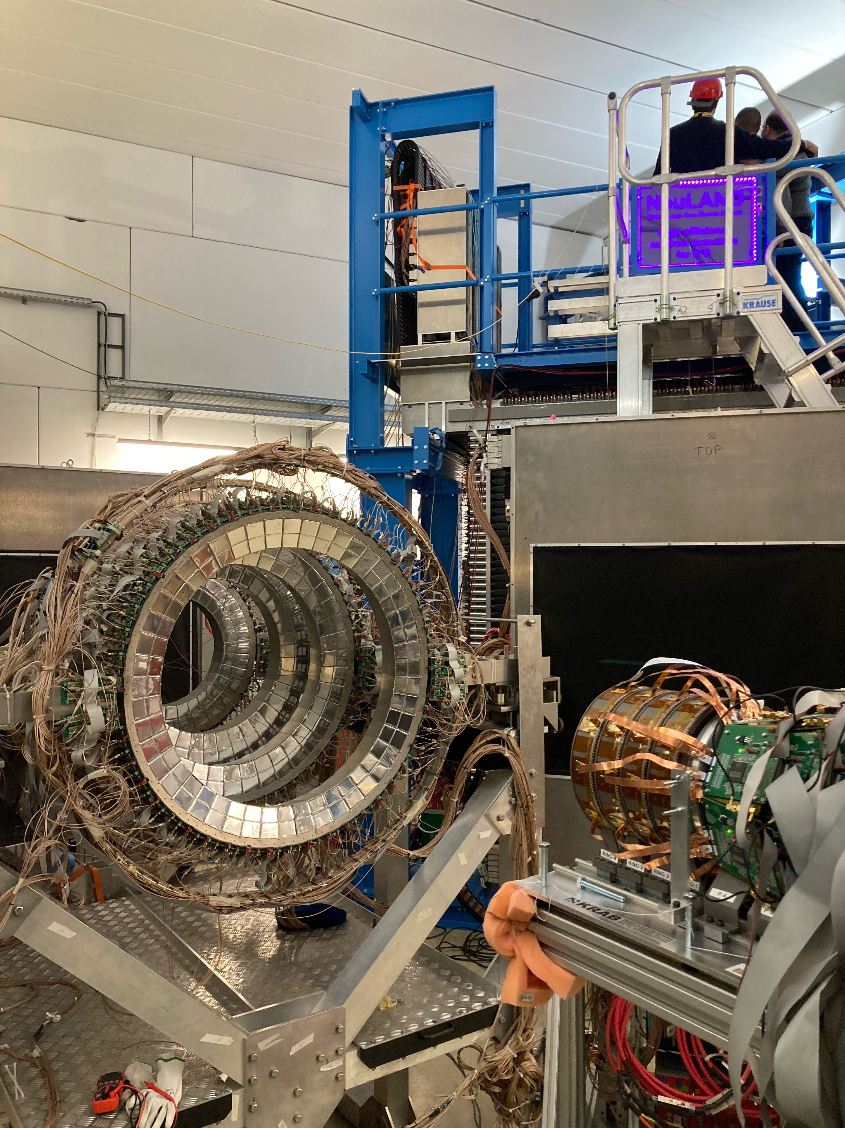
Chimera DAQ at S122 (ASYEOS-II) GSI/FAIR coupled to R3B DAQ (analog VME only)
CAVE C GSI
NEULAND
CAVE C GSI
R3B main DAQ rack
CHIMERA
KRAB

Slide 10

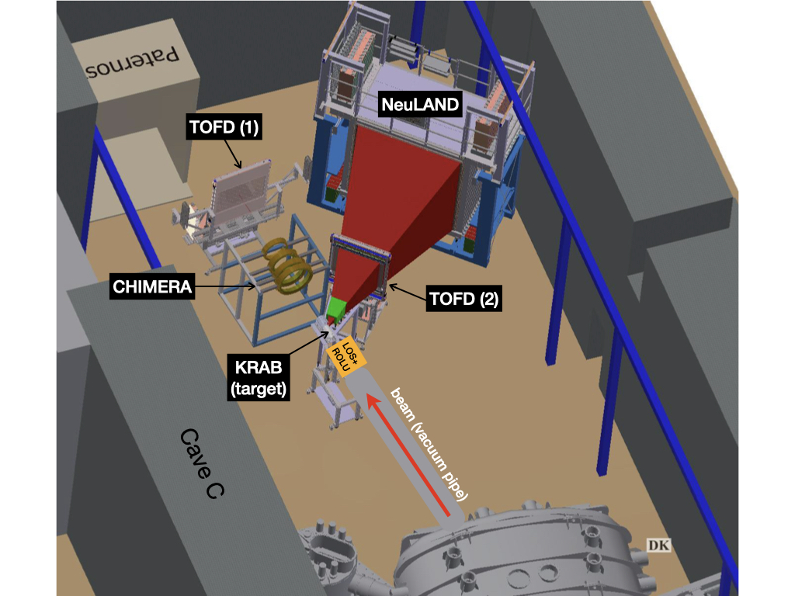
S122: ASY-EOS II data taking in cave C
Titre

Slide 11
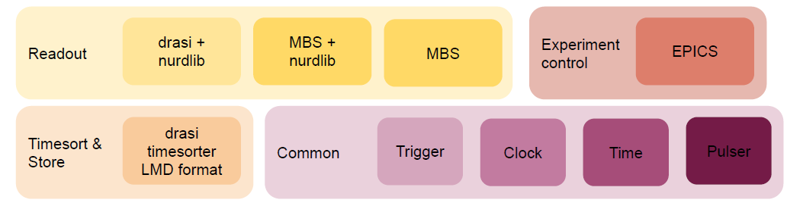
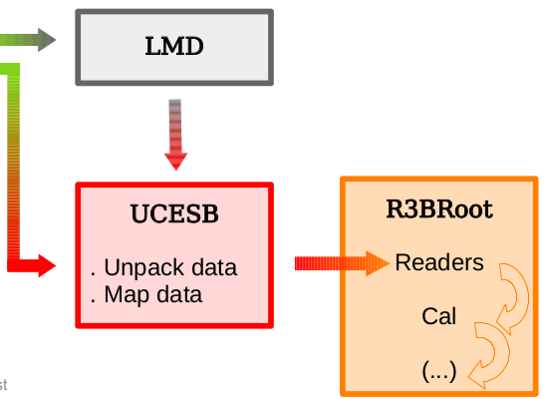
DAQ for AsyEos-II S122: software readout + data unpacking
In R3B DAQ chimera is a data-client sending LMD data blocks to the main time-sorter server
CHIMERA (drasi)
KRAB
We gave dead-time signal to the main DAQ, and we received a common trigger from the DAQ (VULOM)
DAQ:
LMD + chimera event white-rabbit WR timestamp)
Kalimera C++ library (v45-> v. 050)
VME readout
TimeStamp (TS) is derived from the WR source (10 ns accuracy). Time-order (TO) orders data based on TS
DRASI
https://fy.chalmers.se/~f96hajo/drasi/doc/
https://github.com/R3BRootGroup/R3BRoot

Slide 12
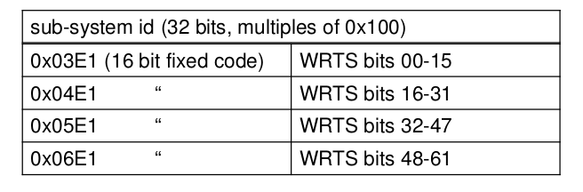
DAQ for AsyEos R3B : VETAR2 inside the kaliMera C++ library and DAQ readout scheme
Vetar2: 125 MHz 64 bit White Rabbit VME timing receiver
INIT AND START
White Rabbit TS Data Format
DRASI READER
pop
void Read_event()
Shared queue
FIFO
R3B DAQ data flow
push
INIT hardware and DAQ
To UCESB/MainDAQ
(TCP/pipe)
Optical fiber to WR switch
Readout loop
BUFFER:
Timestamp +
MFM header +
Chimera DATA
LMD header
OK-event
Accepted trigger
Readout thread
KaliMera library

Slide 13
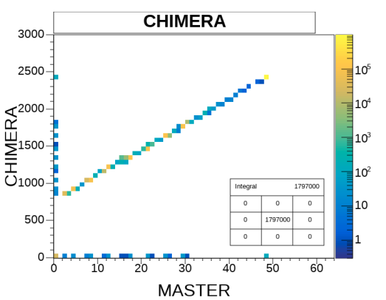
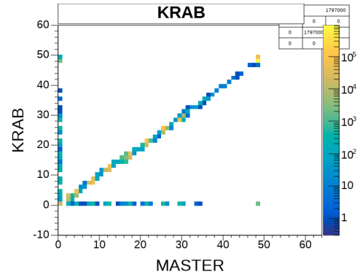
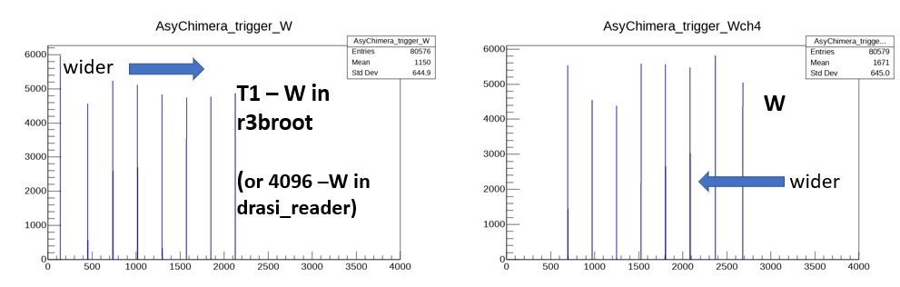
Variable width trigger for Sync-check in CHIMERA-R³B (s122)
T1
T3
event
SYNCHRO on-line check
T1 = main R3B trigger

Slide 14
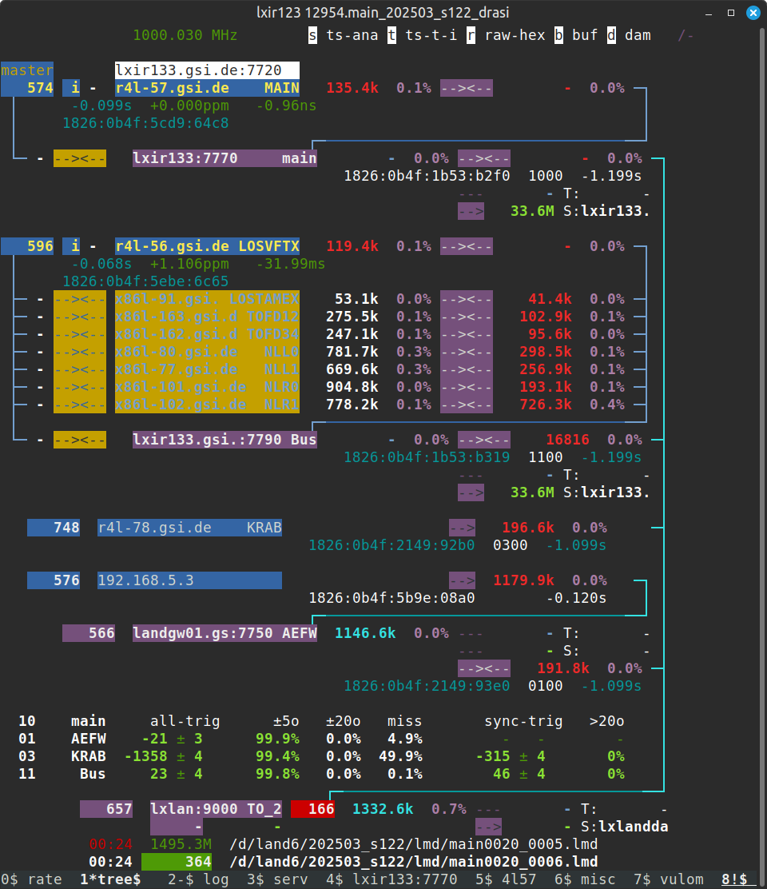
Data flow and ordering (s122)
The R3B DAQ TREE describes and checks the data flow
Time-orderer TO orders each data stream based on the timestamp associated with it
Timestamp is taken fron WR source
The EventBuilder sends the data to TO
The data from TO are “stitched” i.e. put together within a time window (<4 μs). Stitched data are the raw data on which we can perform off-line data analysis
CHIMERA

Slide 15
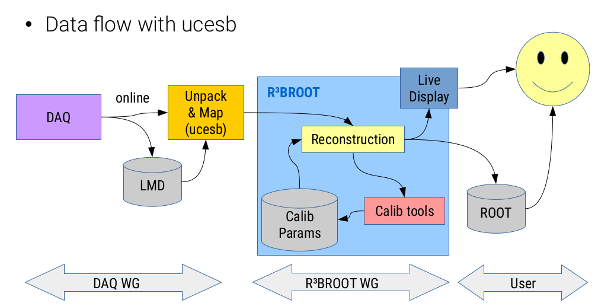
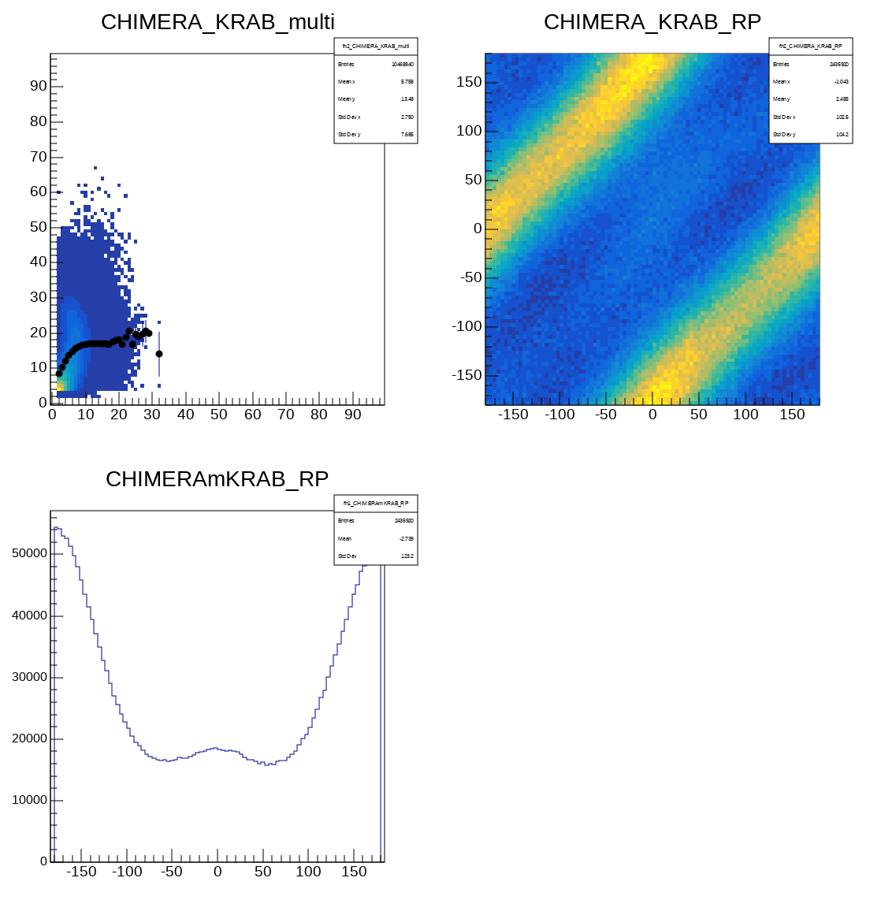
Unpacking data with UCESB at R3B DAQ
R3B flow for data unpacking and data analysis
run192 Au 600 AMeV + Au 2% KRAB_multi>=4
mult_{KRAB}
RP_{KRAB} (deg)
mult_{CHI}
RP_{CHI} (deg)
Yield (arb. units)
RP_{CHI} -RP_{KRAB} (deg)
UCESB stands for Unpack and Check Every Single Bit, It can read several forms of raw data formats, in particular LMD, from file or network. It writes files, both raw data in LMD or unpacked and mapped into Root, and can start a server with protocols to distribute data over network. UCESB is a program that generates unpackers to parse the acquired data.

Slide 16
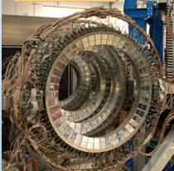
For discussion: (SYMEOS + SYSTERSE)
NARCOS: Readout with custom boards for SiPM. DAQ development with CAEN digitizers. Expected resolvable problems for coupling NARCOS prototype at FRIB. . . .
FARCOS: GET electronics, Narval supervisor, custom TimeStamp, synchronization problems with foreign DAQ. But at MSU should be past experience with GET for SπRIT TPC . . . . .
CHIMERA rings ? . . . Problems with FEE and analog electronics (too old QDCs/TDCs). New FEE, DAQ, Triggering, etc ? . . . . .

Slide 19
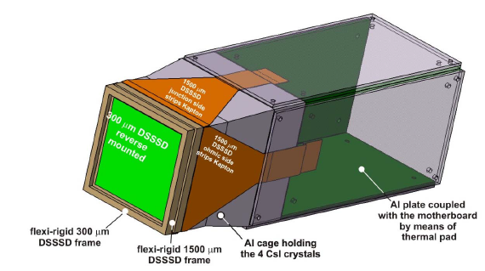
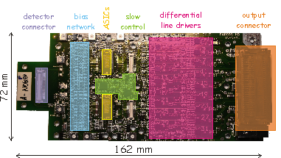
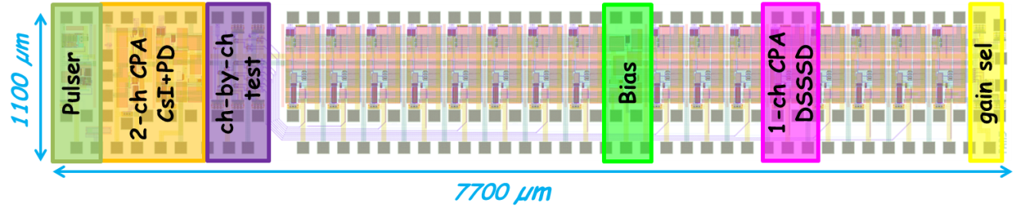
Selectable-Gain CMOS Charge Preamplifier for
Pulse Shape Analysis in Double Sided Silicon Microstrip Detectors for FARCOS
single design for both thicknesses and of both polarities
strip capacitance about 65 pF (300 µm) and 35 pF (1500 µm)
strip leakage current ~5 nA (300 µm) and ~25 nA (1500 µm)
target dynamic ranges: 90 MeV,
200, 350, 500 and 2000 MeV.
static power consumption ~10 mW/channel
Digitally Selectable gain
A Kapton cable connects each face of each DSSSC to a custom PCB motherboard housing the front-end ASIC (2x(16+1) channels.
G | FSR (MeV) | Sensitivity (mV/MeV) | Sensitivity (mV/pC) | Feedback cap. (pF)
0 | 90 | 11.11 | 250 | 4
1 | 200 | 4.44 | 100 | 10
2 | 350 | 2.78 | 62.50 | 16
3 | 500 | 2.02 | 45.45 | 22
4 | 2000 | 0.49 | 11.11 | 90
16-ch ASIC layout
0.35 μm C35B4C3 AMS tech
16-ch CPA for DSSSD
2-ch CPA for CsI(Tl) + PD readout
on-chip pulser
channel-by-channel test signal injection
temperature monitor
A. Castoldi, C. Guazzoni, T. Parsani: Politecnico di Milano and INFN sezione di Milano

Slide 20
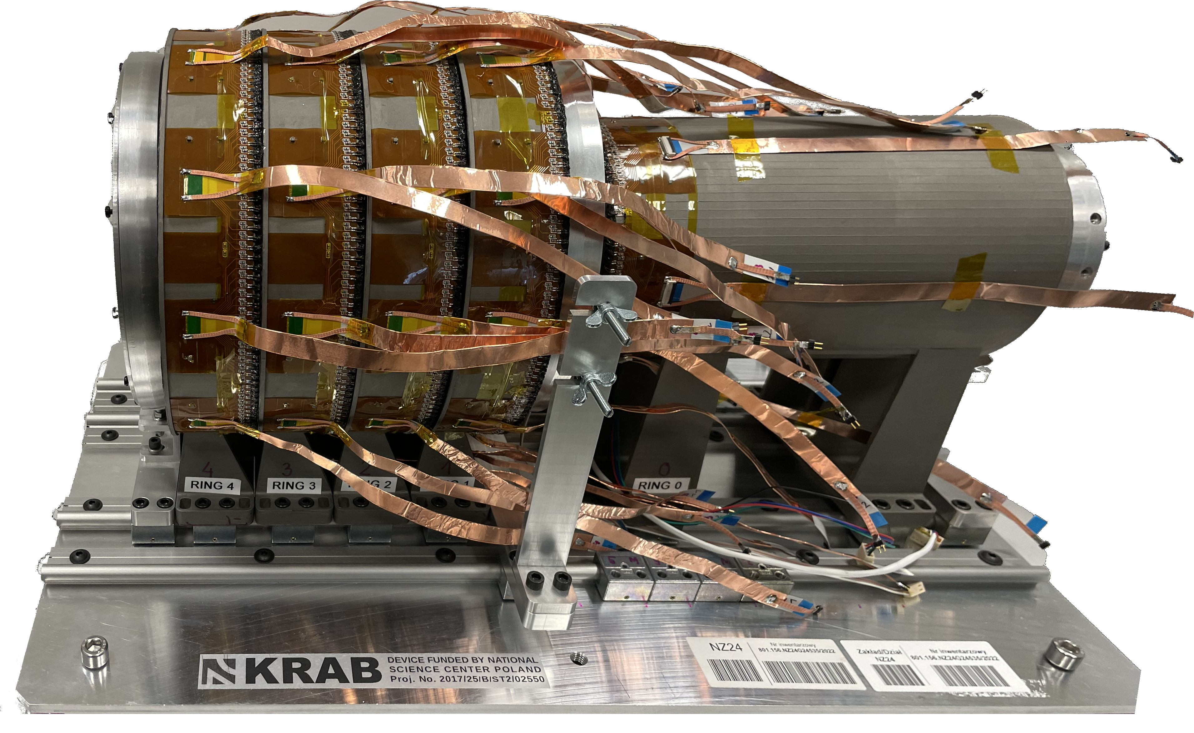
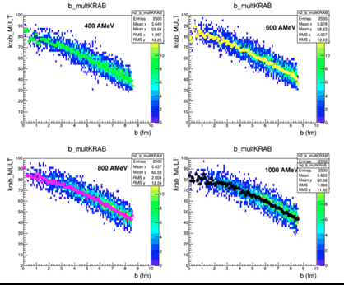
KRAB: multiplicity trigger, reaction plane and centrality detector for the ASYEOS II experiment at GSI/FAIR
Main characteristics:
5 rings of 4x4 mm² segments of fast scintillating fibers (BCF-10)
read out by 3×3 mm² SiPMs (SensL MicroFJ-30035)
high resolution 3D printed mechanical structure
ASICs used for signal processing (32 ch CITIROC 1A)
assure compactness of the electronics and wiring
compact A7585D SiPM power modules
broad coverage from 30º to 165º
high geometrical efficiency ~87% (within covered angles)
~5% multihit probability (for 1 AGeV Au+Au reaction)
it will be sufficiently large for radioactive beams
and sufficiently small and lightweight not to disturb neutrons
max radius - 12 cm
length ~43 cm (size of a ~24” monitor)
4×160 segments in forward rings
96 segments in backward ring, 736 channels
He sleeve to suppress the δ-electron background
design
UrQMD simulations

Slide 21
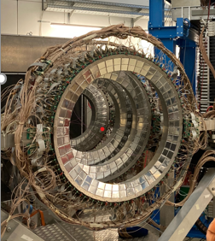
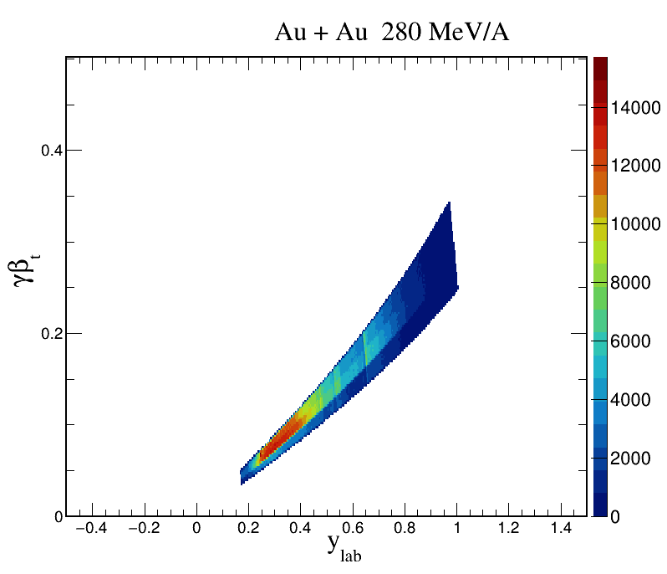
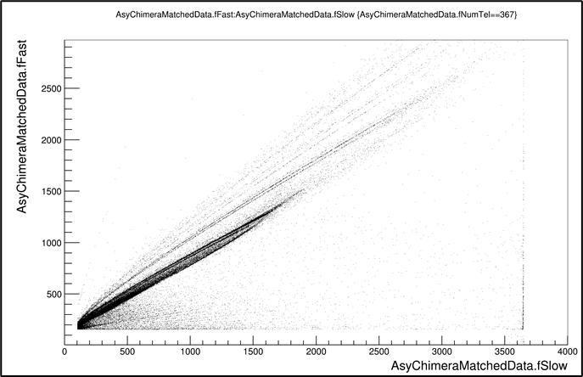
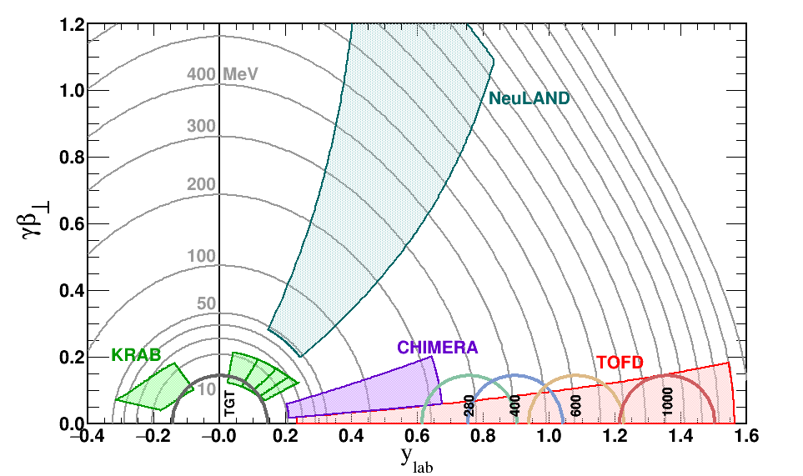
CHIMERA final goal: reaction plane determination
320 CsI(Tl) 12 cm thick, assembled in 8 rings,
covering polar angles between 4.6 and 16 deg
B
⁹Be
⁸Li
⁷Be
⁷Li
⁶Li
⁴He
³He
He (p.t.)
H
Ring 6 (all) and Ring 5 (partial) preliminary data analysis (particle identification and calibration procedures). Work in progress . . .

