Slide 1
What to expect with HIC and E_{sym} research above 100 AMeV
P.Russotto¹ et al.
on behalf of CHIRONE, R3B and ASY-EOS II Collaborations
¹INFN-LNS, Catania, Italy

Slide 2
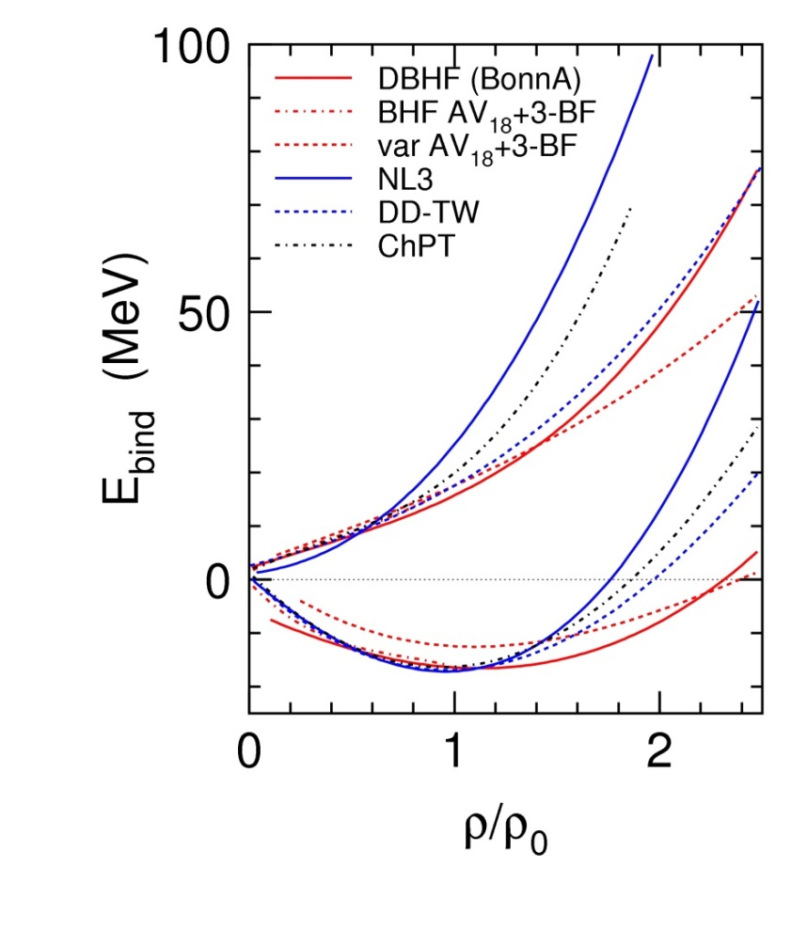
Nuclear matter EOS and symmetry energy
Neutron matter
δ=1
Fuchs and Wolter, EPJA 30 (2006)
Symmetric matter
δ=0

Slide 3
Nuclear matter EOS and symmetry energy
Quite well known
Neutron matter
δ=1
Fuchs and Wolter, EPJA 30 (2006)
Symmetric matter
δ=0

Slide 4
Nuclear matter EOS and symmetry energy
Quite well known
Symmetry energy
Neutron matter
δ=1
Fuchs and Wolter, EPJA 30 (2006)
Symmetric matter
δ=0
The symmetry energy is the difference between the energy of the symmetric matter (δ=0) and neutron matter (δ=1) and describes how the energy of asymmetric nuclear (N≠Z) depends on the saturation density

Slide 5
Nuclear matter EOS and symmetry energy
Quite well known
Not well known
Symmetry energy
Neutron matter
δ=1
Fuchs and Wolter, EPJA 30 (2006)
Symmetric matter
δ=0
The symmetry energy is the difference between the energy of the symmetric matter (δ=0) and neutron matter (δ=1) and describes how the energy of asymmetric nuclear (N≠Z) depends on the saturation density

Slide 6
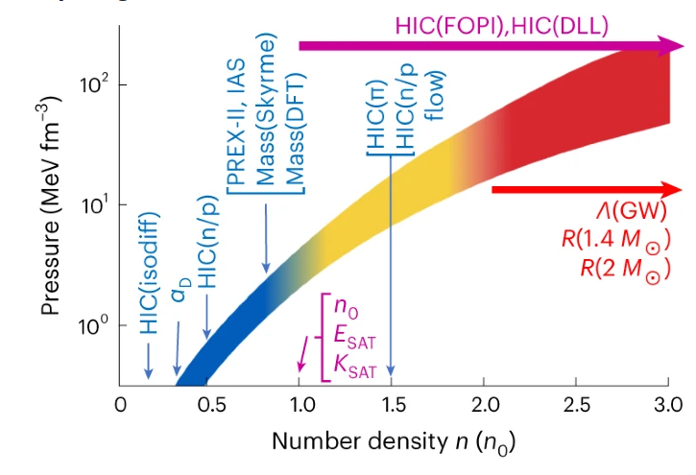
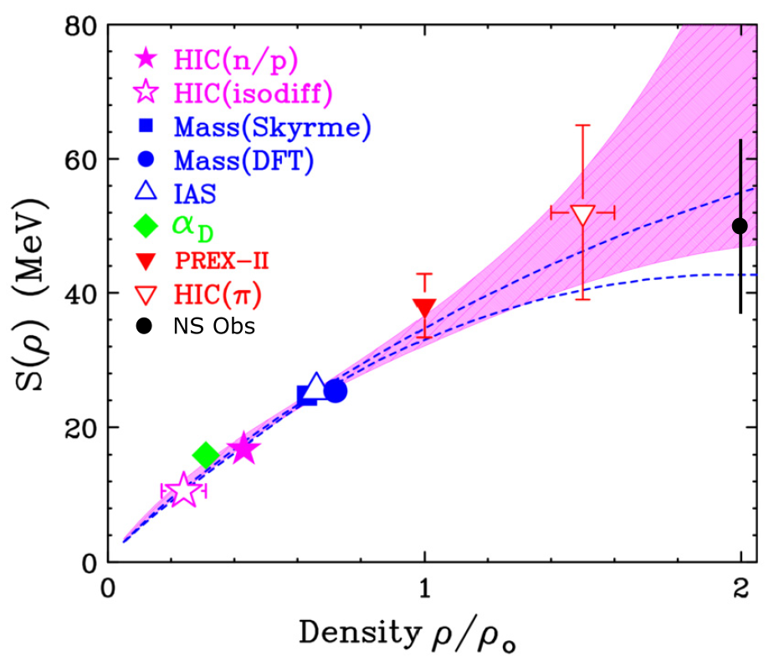
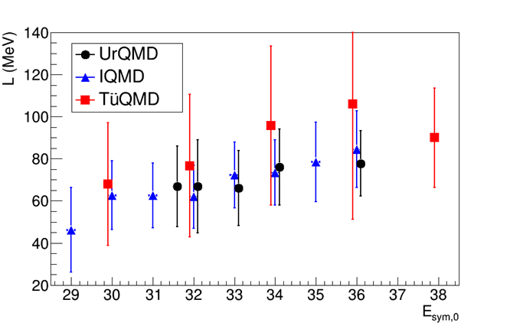



How to investigate symmetry energy: a multi-messenger probem
Chun Yuen Tsang et al., Nature Astronomy 8 328 (2024)
J.M. Lattimer, A.W. Steiner EPJA 50 (2014) 40
theory support needed!
W. Lynch and M.B. Tsang, PLB 830, 137098 (2022)

Slide 7
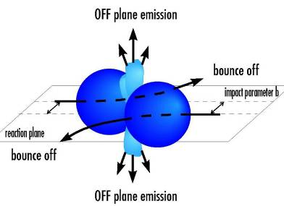
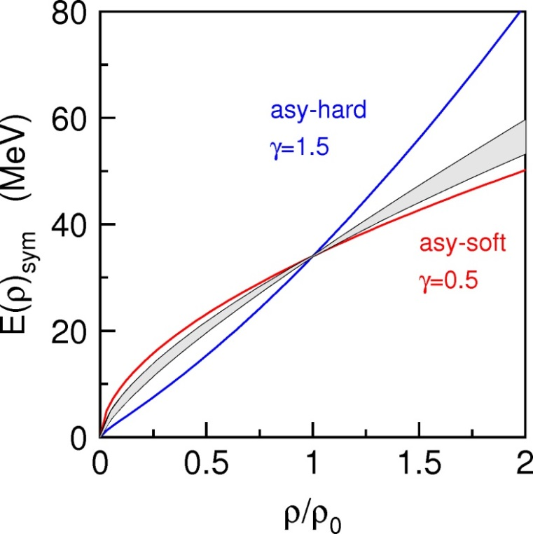
n/p flows: symmetry energy at high-densities
Parametrization for SE used in UrQMD* model:
E_{sym} = E_{sym}^{pot}+E_{sym}^{kin} = 22MeV·(ρ/ρ₀)^{γ}+12MeV·(ρ/ρ₀)^{2/3}
P.Russotto et al., PLB 697 (2011)
Needs:
centrality
reaction plane
on-target event selection
n and p (LCP) momentum
n background
Notes:
OK

Slide 8
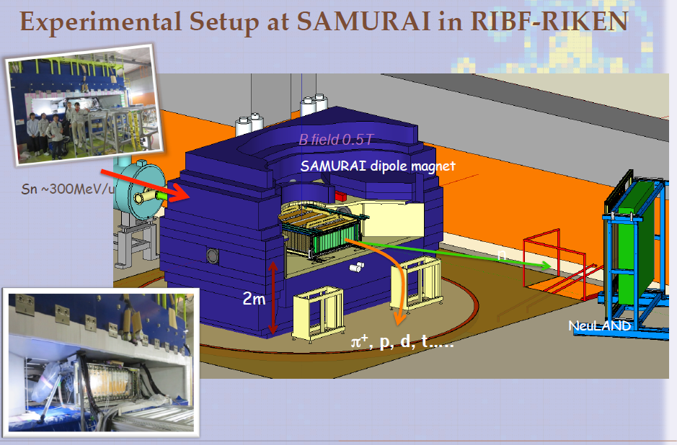
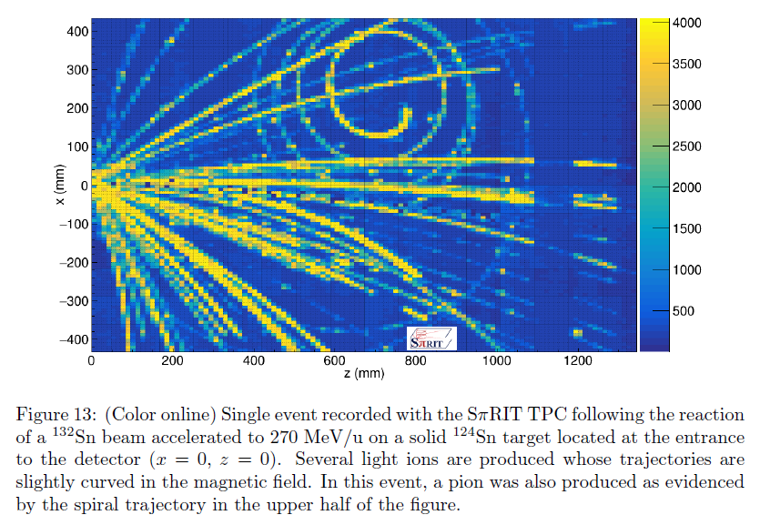
Do not forget pions, not treated here

Slide 9
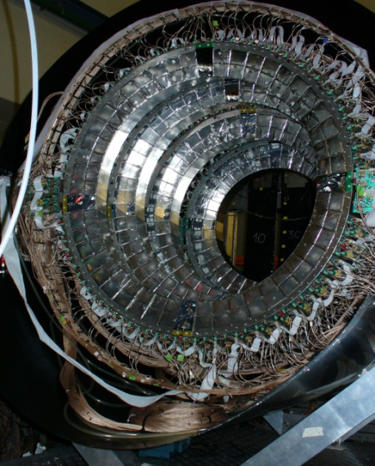
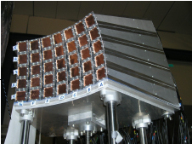
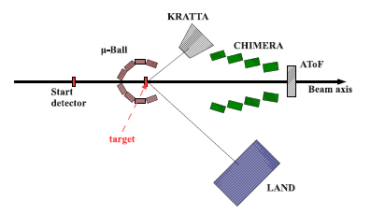
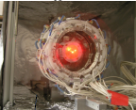
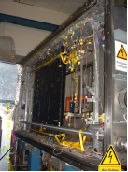
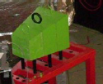
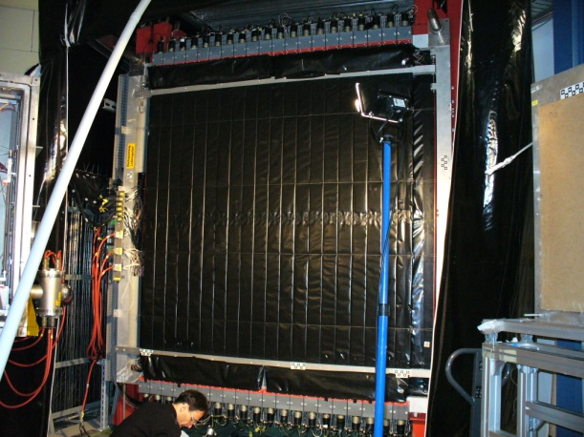
ASY- EOS I (S394) @ GSI (May 2011)
KraTTA: 35 (5x7) triple telescopes (Si-CsI-CsI) placed at 21°<Θ<60° with digital readout . Light particles and IMFs emitted at midrapidity
Au+Au @ 400 AMeV
CHIMERA: 8 (2x4) rings, high granularity CsI(Tl), 352 detectors 7°<θ<20° + 16x2 pads silicon detectors. Light charged particle identification by PSD. Multiplicity, Z, A, Energy: impact parameter and reaction plane determination
Vacuum
TOFWALL: 96 plastic bars; ToF, ΔE, X-Y position. Trigger, impact parameter and reaction plane determination
µBall: 4 rings 50 CsI(Tl), Θ>60°. Discriminate target vs. reactions with air. Multiplicity and reaction plane measurements.
LAND: Large Area Neutron Detector . Plastic scintillators sandwiched with Fe 2x2x1 m³ plus plastic veto wall. New Taquila front-end electronics. Neutrons and LCP discrimination. Flow measurements
Shadow bar: evaluation of background neutrons in LAND
Notes:
OK

Slide 10
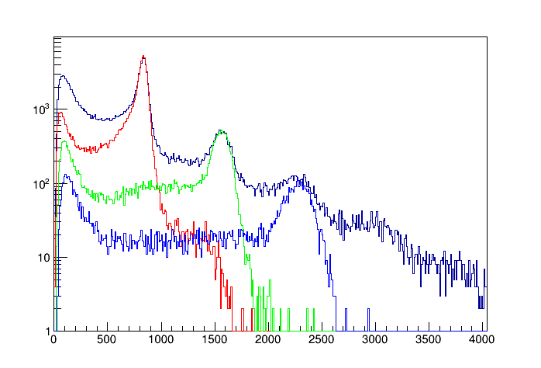
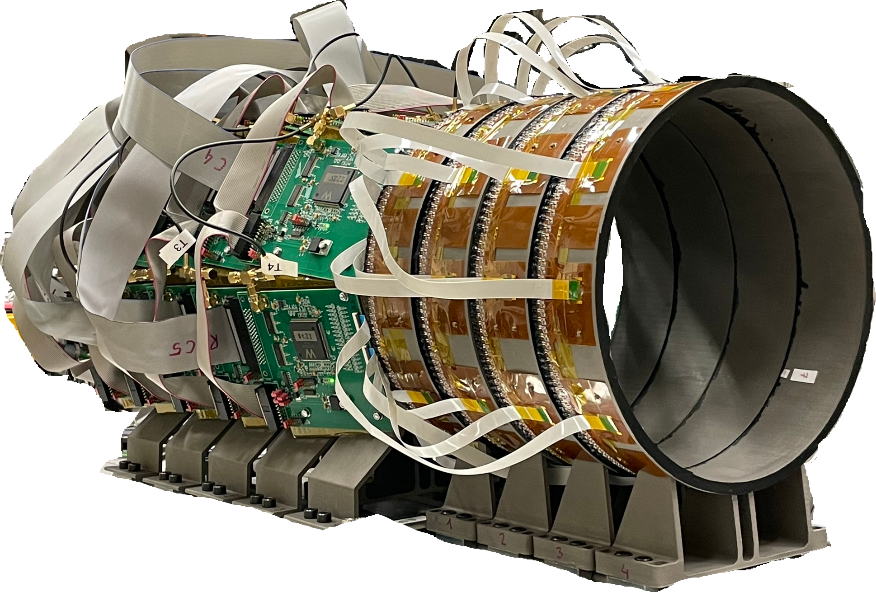
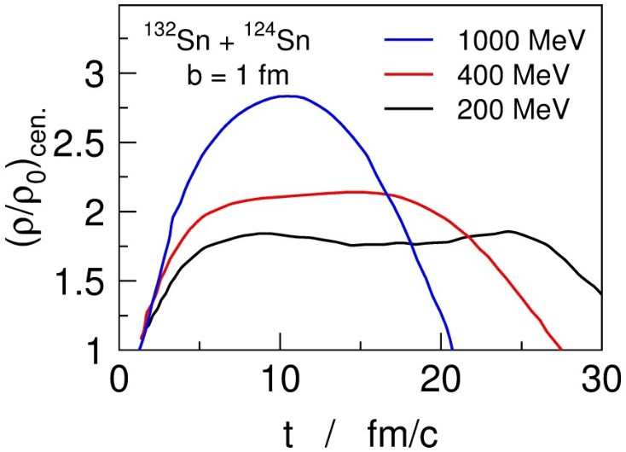
S122 (ASY-EOS II) : advancing E_{sym} studies (also) towards high densities
improved resolution
KRAB: new detector for trigger, reaction plane determination and on-beam centrality selection
Mass (arb.units.)
NeuLAND: capability to resolve p,d,t
and higher densities
Li, Bao-An, NPA 708, 365 (2002)
P. Russotto et al., PRC 94, 034608 (2016)
Au+Au 400 MeV/u
Energy [AMeV] | Justification
280 | highest sensitivity on K_{sym}
400 | reference to ASY-EOS I, n/p tests higher densities than before
600 | highest sensitivity on L, high-density tested
1000 | Maximum energy (≈ density) where models agree on v2 sensitivity
Higher incident energies →
higher densities reached (probed?)
n/p observable → higher densities probed
Notes:
OK

Slide 11
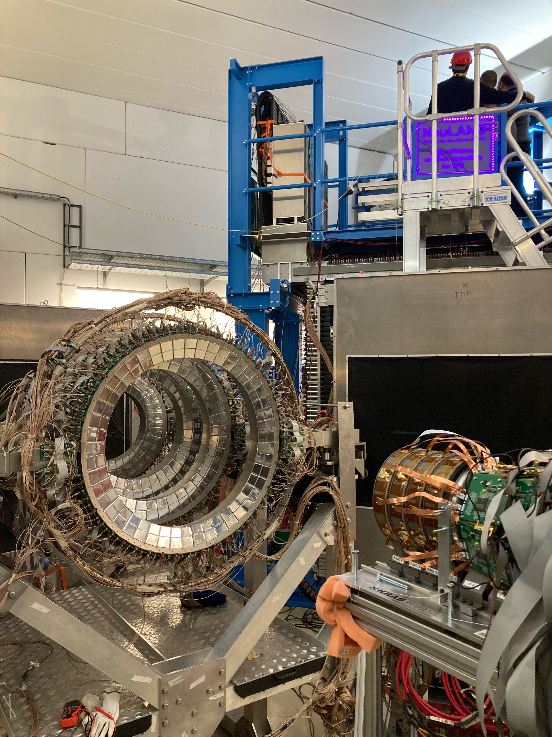
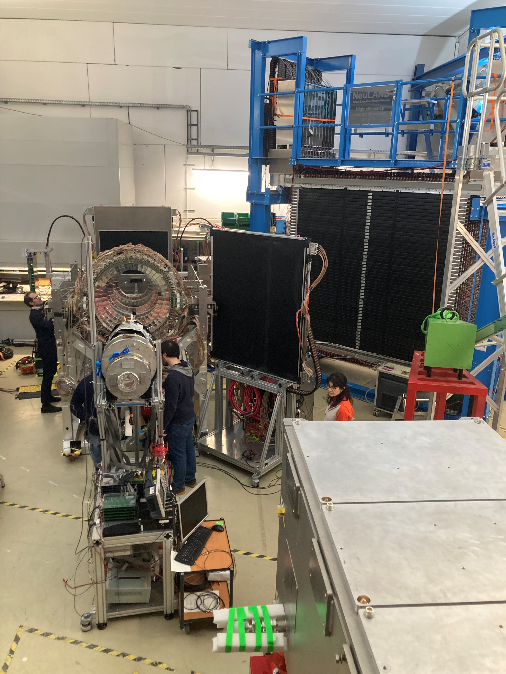
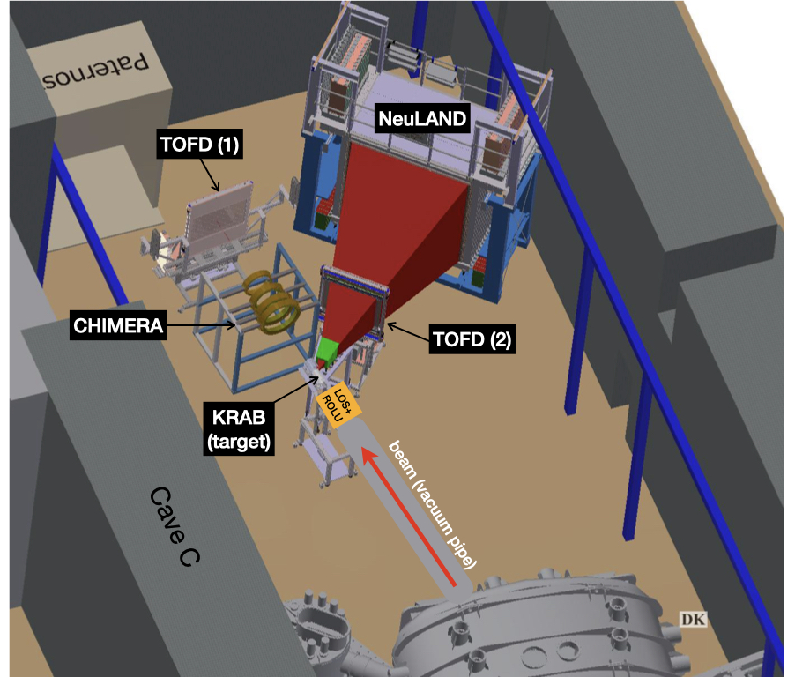
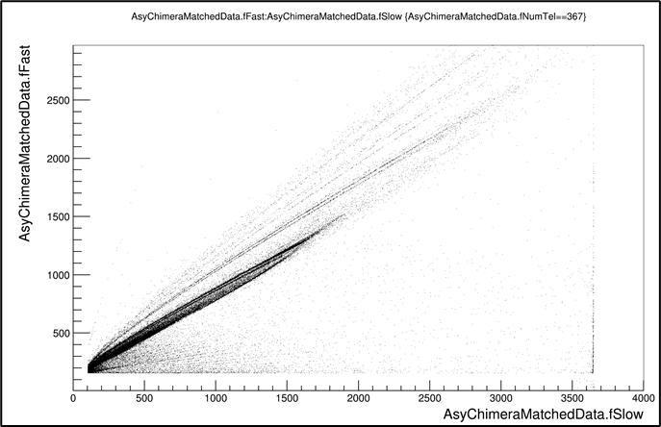
S122 (ASY-EOS II) - Symmetry energy at high densities from n/p flow excitation functions
Mar 2025
Au+Au
B
⁹Be
⁸Li
⁷Be
⁷Li
⁶Li
⁴He
³He
320 CsI(Tl) 12 cm thick, assembled in 8 rings, covering polar angles between 4.6 and 16 deg
He (p.t.)
H

Slide 12
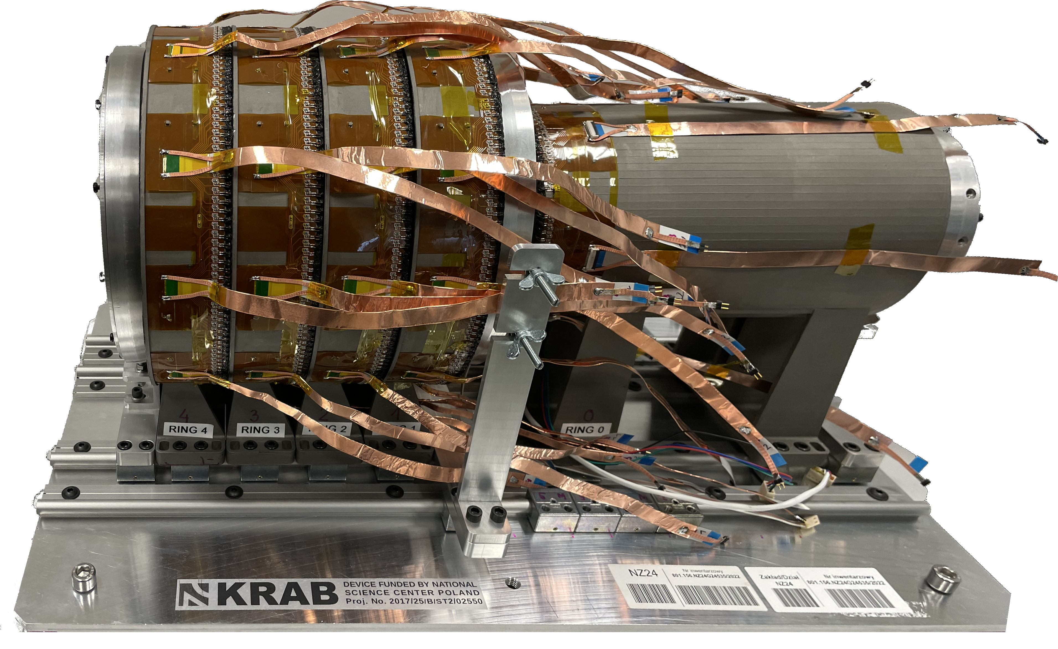
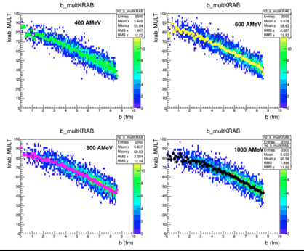
KRAB: multiplicity trigger, reaction plane and centrality detector
ASY-EOS II
Main characteristics:
5 rings of 4×4 mm² segments of fast scintillating fibers (BCF-10)
read out by 3×3 mm² SiPMs (SensL MicroFJ-30035)
high resolution 3D printed mechanical structure
ASICs used for signal processing (32 ch CITIROC 1A)
assure compactness of the electronics and wiring
compact A7585D SiPM power modules
broad coverage from 30º to 165º
high geometrical efficiency ~87% (within covered angles)
~5% multihit probability (for 1 AGeV Au+Au reaction)
it will be sufficiently large for radioactive beams
and sufficiently small and lightweight not to disturb neutrons
max radius - 12 cm
length ~43 cm (size of a ~24” monitor)
4×160 segments in forward rings
96 segments in backward ring, 736 channels
He sleeve to suppress the δ-electron background
UrQMD simulations

Slide 13
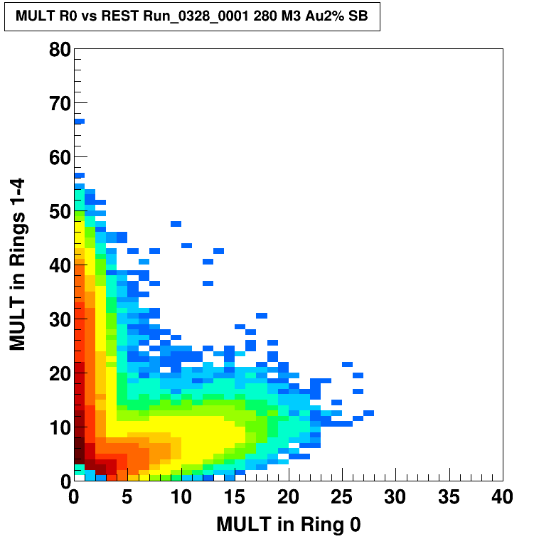
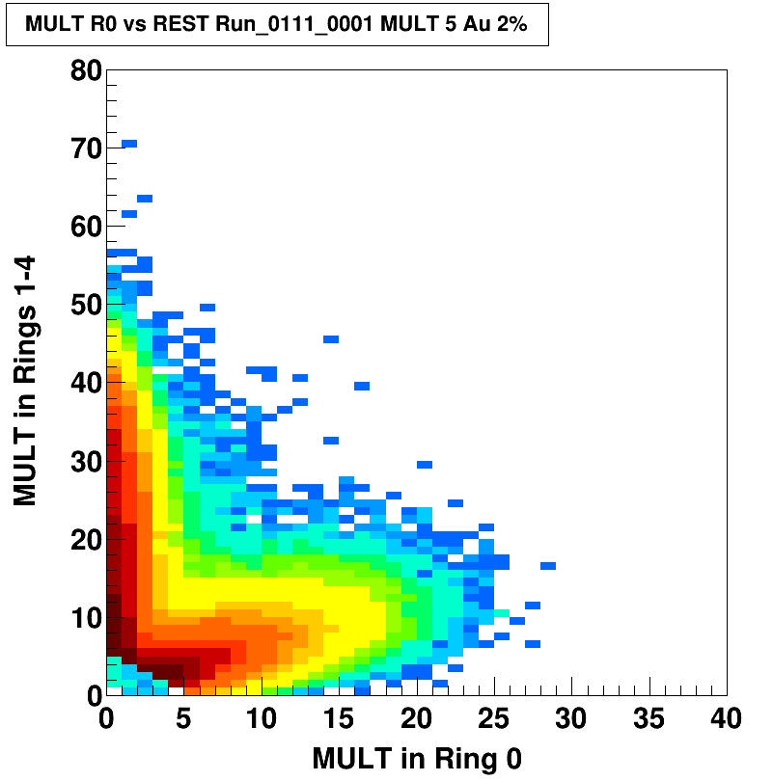
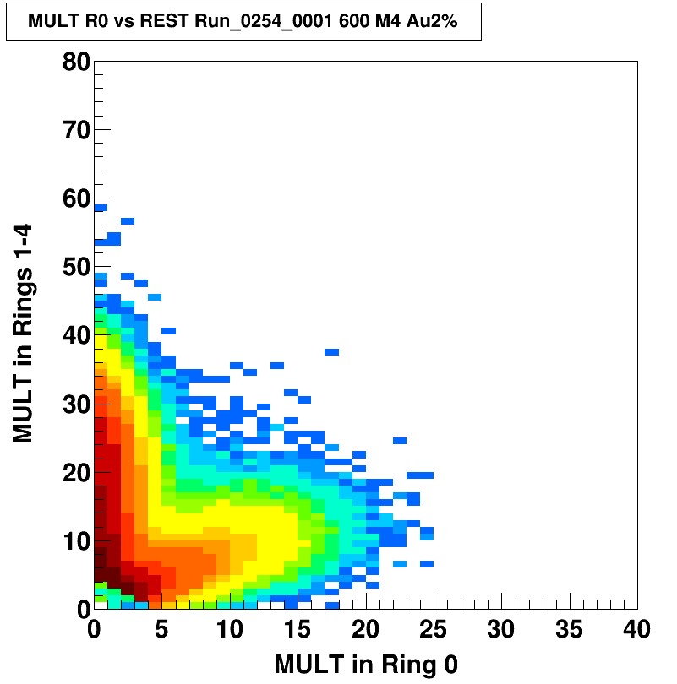
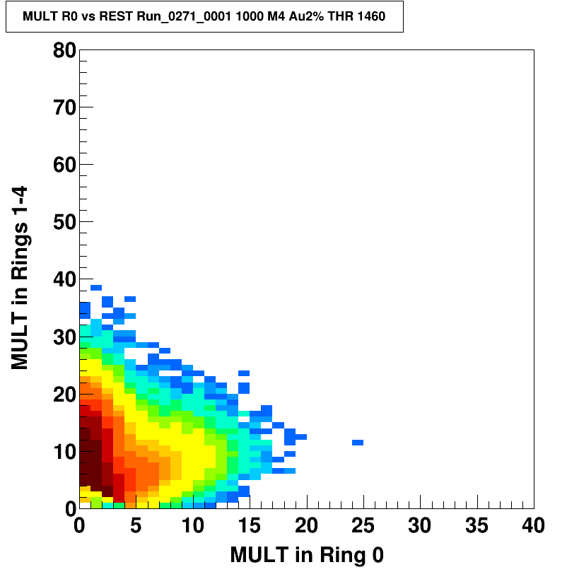
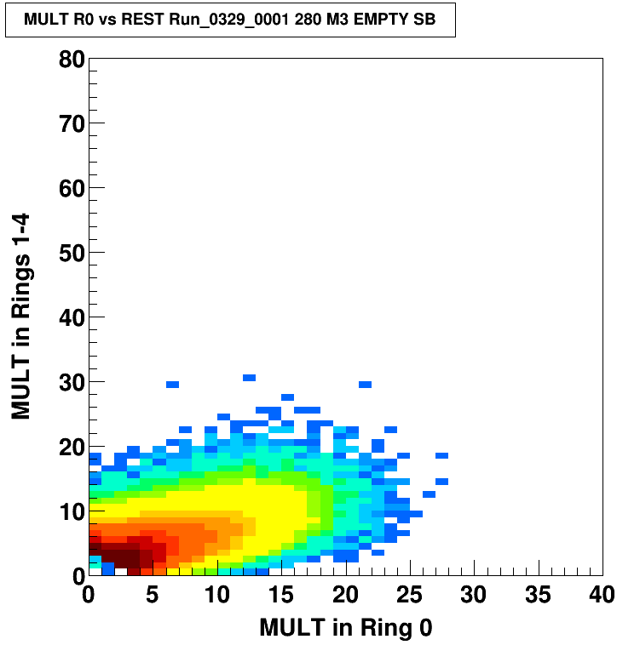
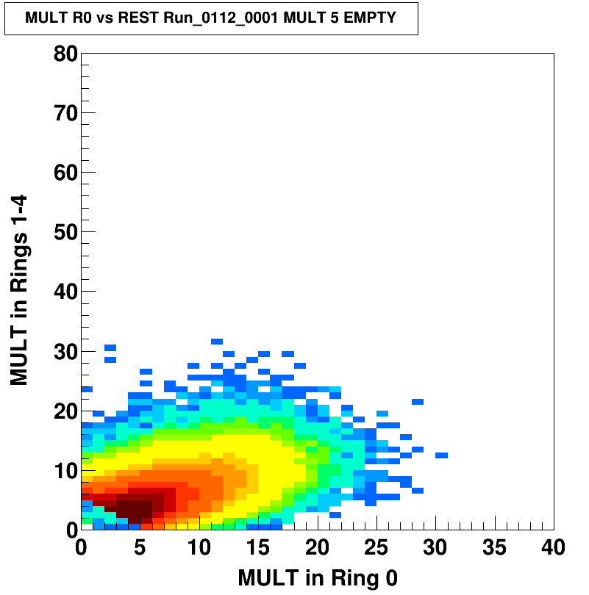
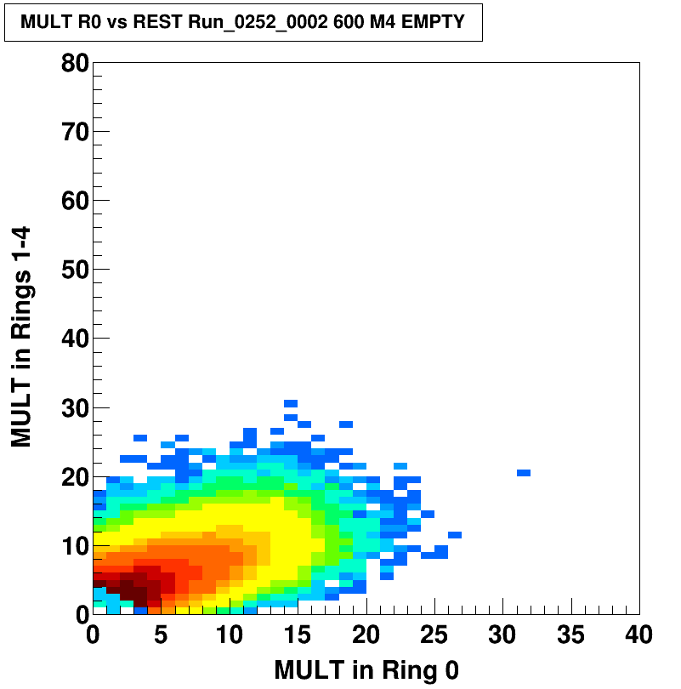
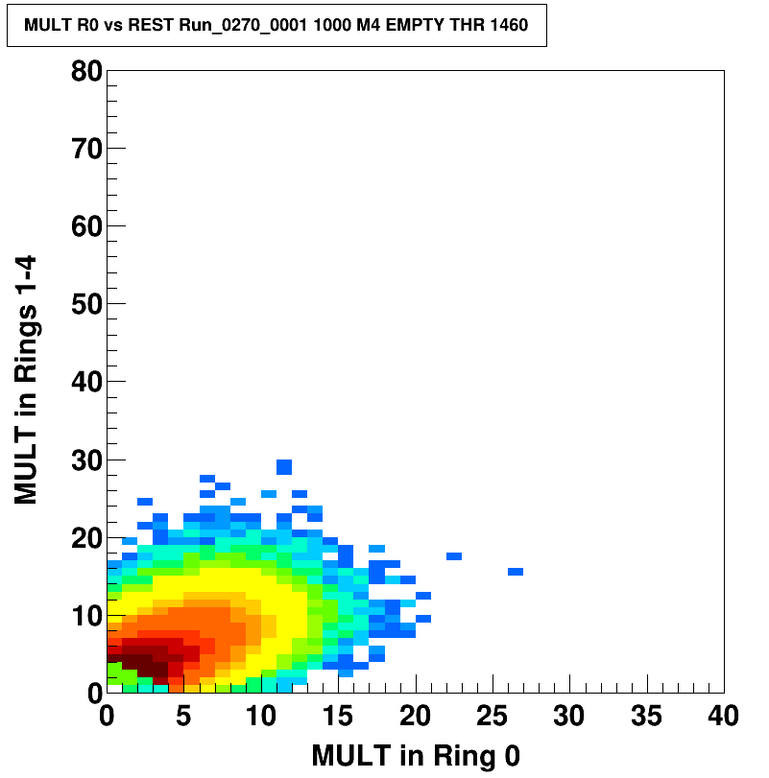
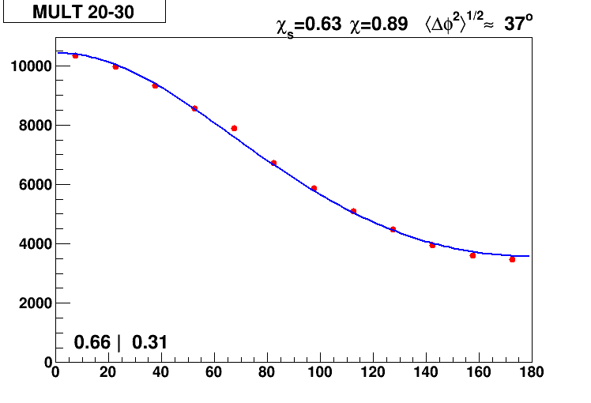
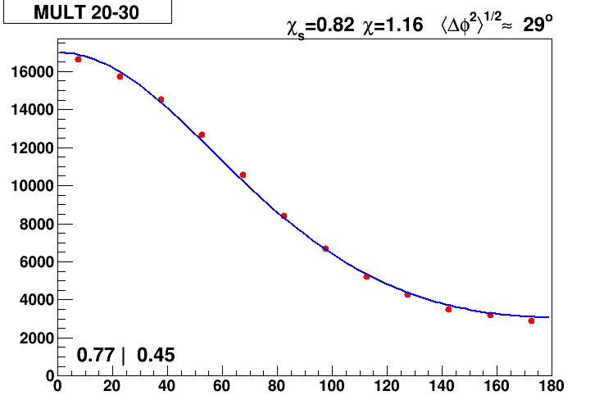
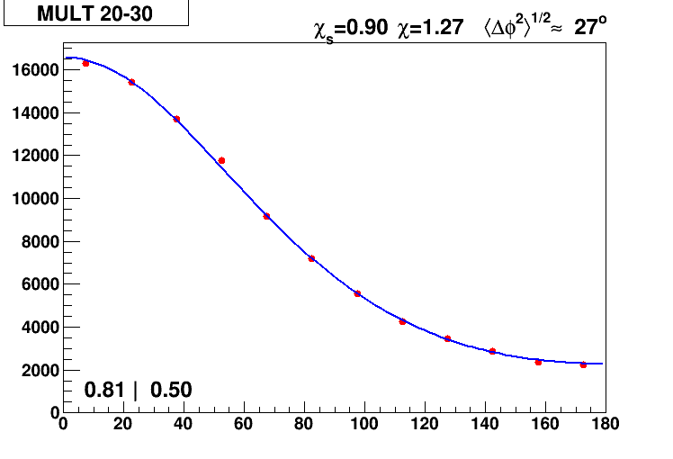
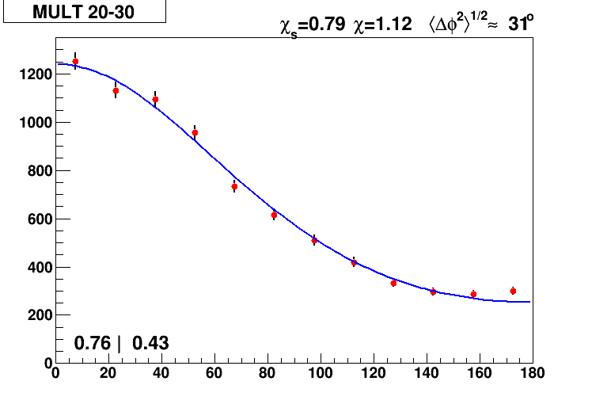
Multiplicities in forward KRAB rings vs backward ring: how to discriminate the off-target events
280
400
Au 2%
600
1000
ASY-EOS II
EMPTY
reaction plane dispersion for mid-central collisions sub-events split between rings 0+1 and 2+3

Slide 14
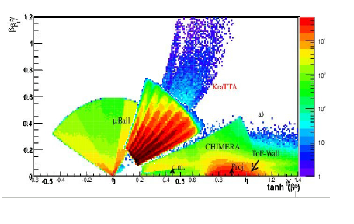
Au+Au @ 400 A.MeV: Some kinematics
ASY-EOS I
ASY-EOS I
Microball: Uniform distribution with E_{Kin}<100 Mev
KRATTA:
J. Lukasik et al., NIM 709 (2013) 120128
P. Russotto et al., EPJA 50, 38 (2014).
P. Russotto et al., PRC 94, 034608 (2016)
Notes:
OK

Slide 15
Event characterization
ASY-EOS I
P. Russotto et al., PRC 94, 034608 (2016)
Notes:
OK

Slide 16
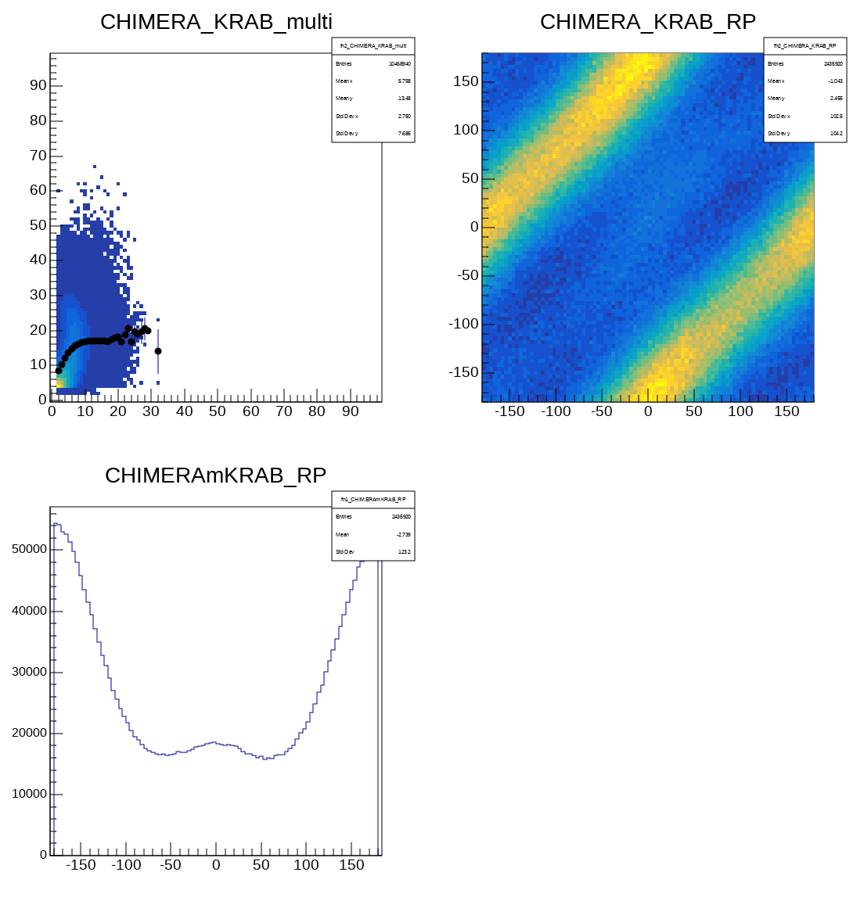
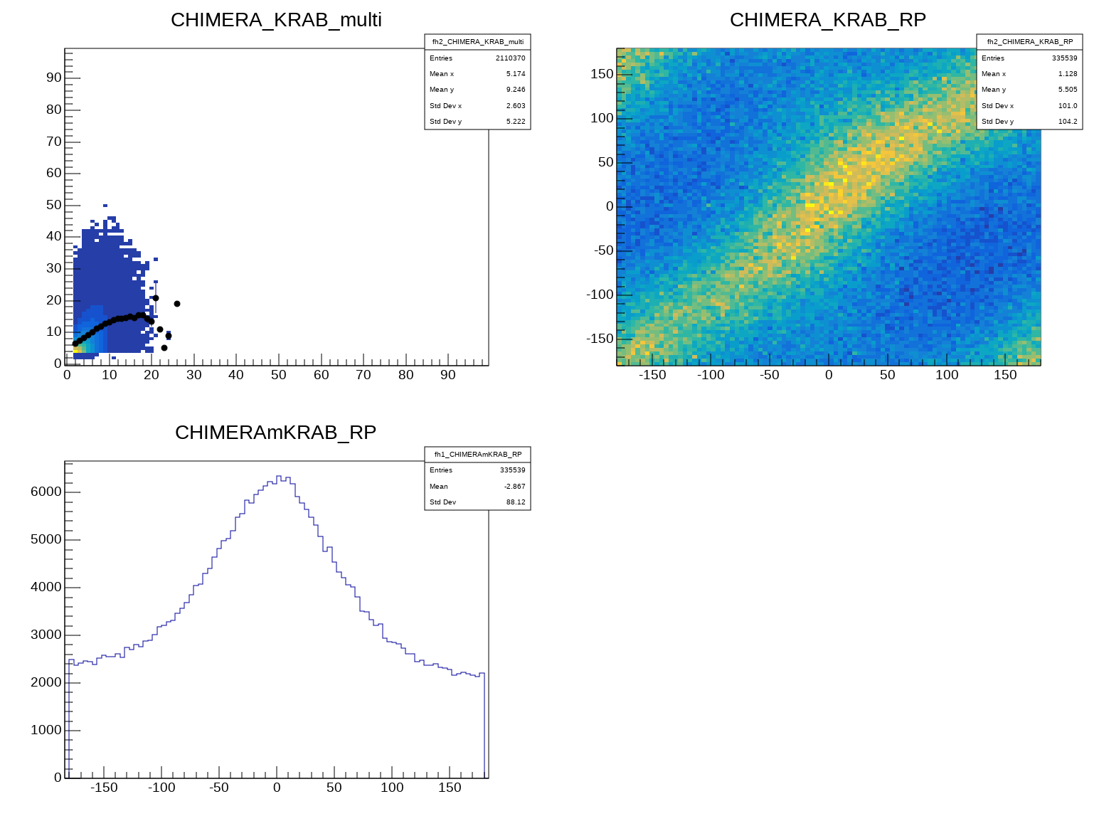
Off target (partial) rejection
target
CHIMERA
on air
from proj
∆Φ≈0°
CHIMERA
ASY-EOS II
KRAB
KRAB
∆Φ≈180°
R192 Au 600 AMeV + Au 2% KRAB_multi>=4
R199 Au 600 AMeV + BLANK target KRAB_multi>=4
mult_{KRAB}
mult_{KRAB}
RP_{KRAB} (deg)
RP_{KRAB} (deg)
mult_{CHI}
RP_{CHI} (deg)
mult_{CHI}
RP_{CHI} (deg)
Yield (arb. units)
Yield (arb. units)
RP_{CHI} -RP_{KRAB} (deg)
RP_{CHI} -RP_{KRAB} (deg)

Slide 17
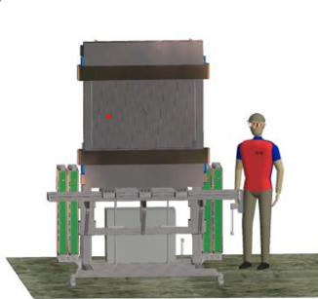
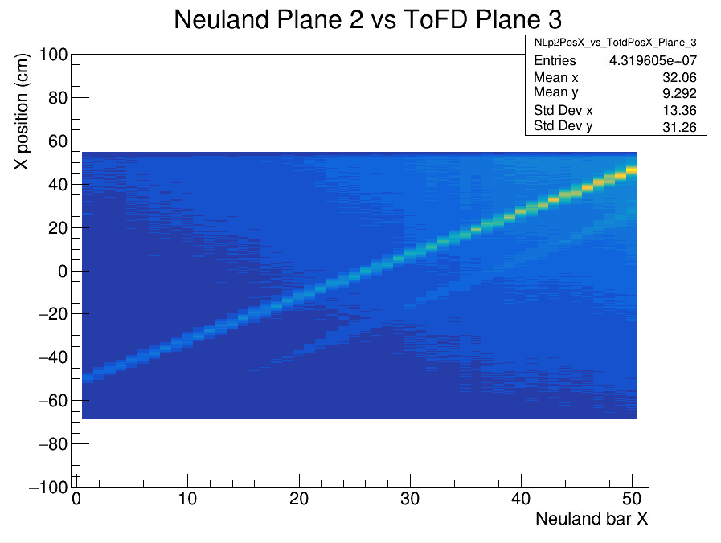
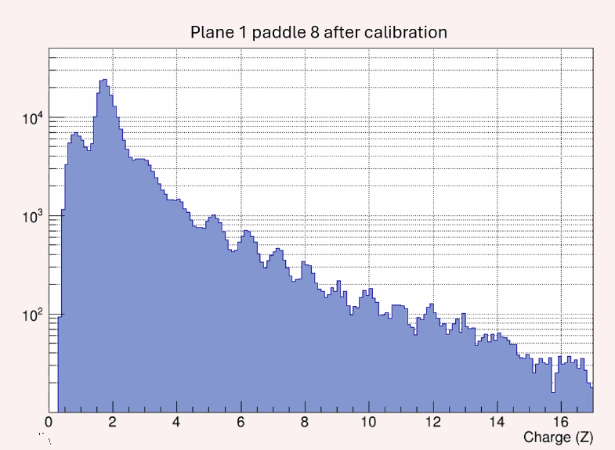
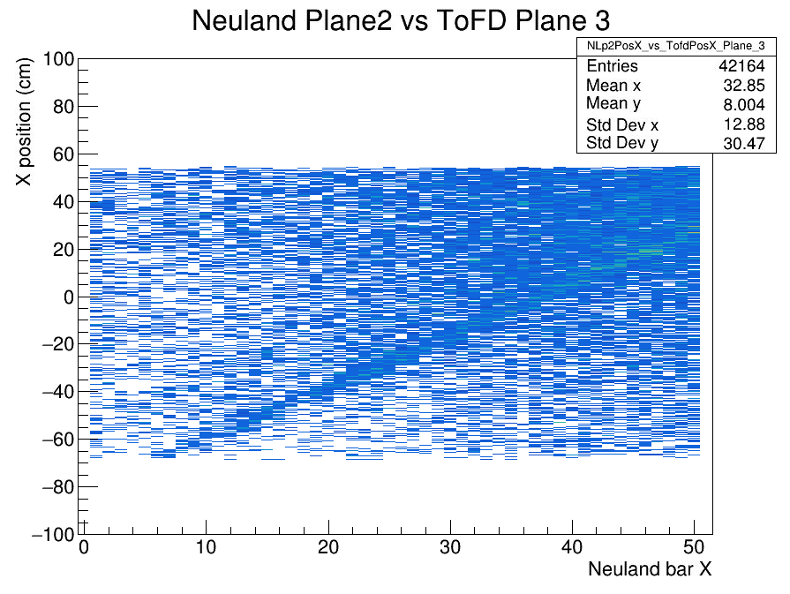
0 deg detctor and NeuLAND veto
X position correlation
TofD: 2 double planes (≈ 1200×100 mm² ) with vertical scintillator bars (27×1000×5 mm³) read out by PMTs on both far ends.
ASY-EOS II
Au target 400 MeV/A
TofD
Protons and other light ions from the reaction target
Charge distribution
Empty target (400 MeV/A)
Protons and other light coming (mainly) from the exit window of the vacuum pipe
TofD
E. Gambera, I. Gasparic, F. Risitano data analysis
.
Empty target run ,on the right, does not show this correlation line.
ToFD planes 3-4 (veto) vs NeuLAND

Slide 18
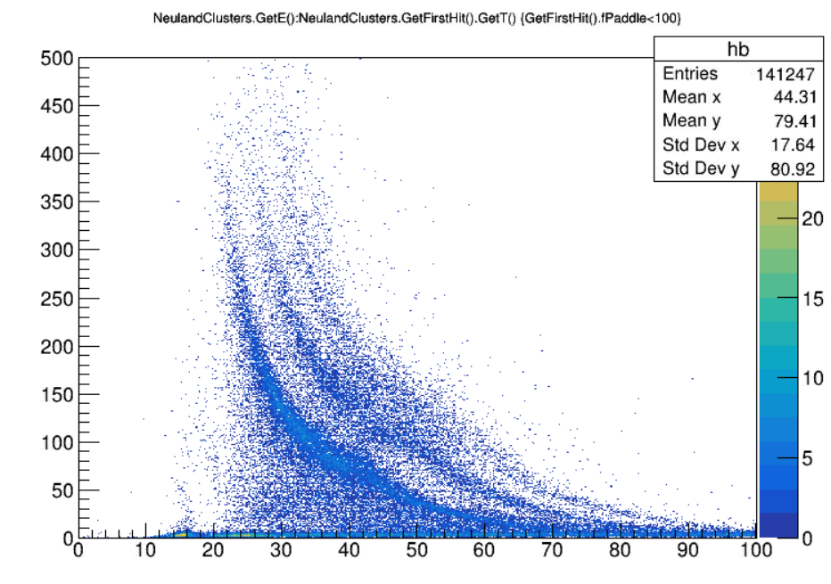
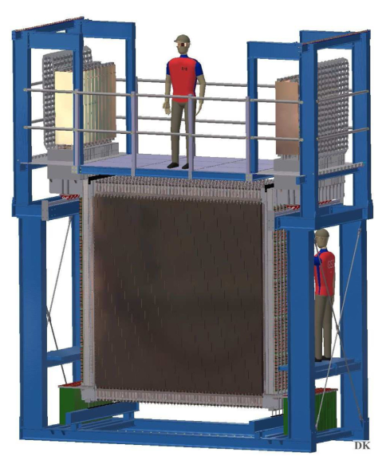
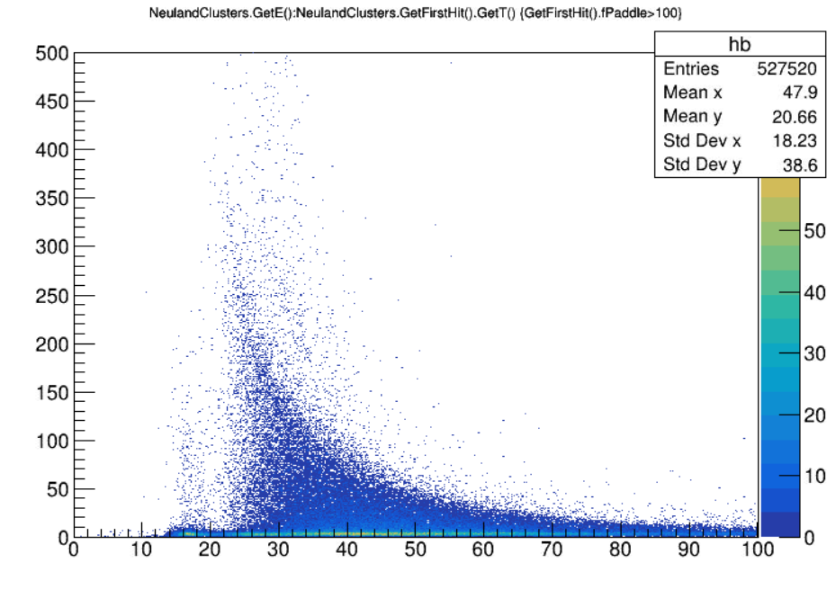
NeuLAND-key detector: n/p flows
ASY-EOS II
Hit clusterizations and raw Isotopic identification in Au+Au (280 MeV/A) obtained by using the Neuland first plane as «veto» detector: Charged particles (p,d,t) are mainly selected.
prelyminary
Energy (arb. un.)
ToF (first hit) (ns)
prelyminary
Raw neutron identification
obtained by the complementary condition (no first plane) fired.
Energy (arb. un.)
E. Gambera, I. Gasparic data analysis
ToF (first hit) (ns)

Slide 19
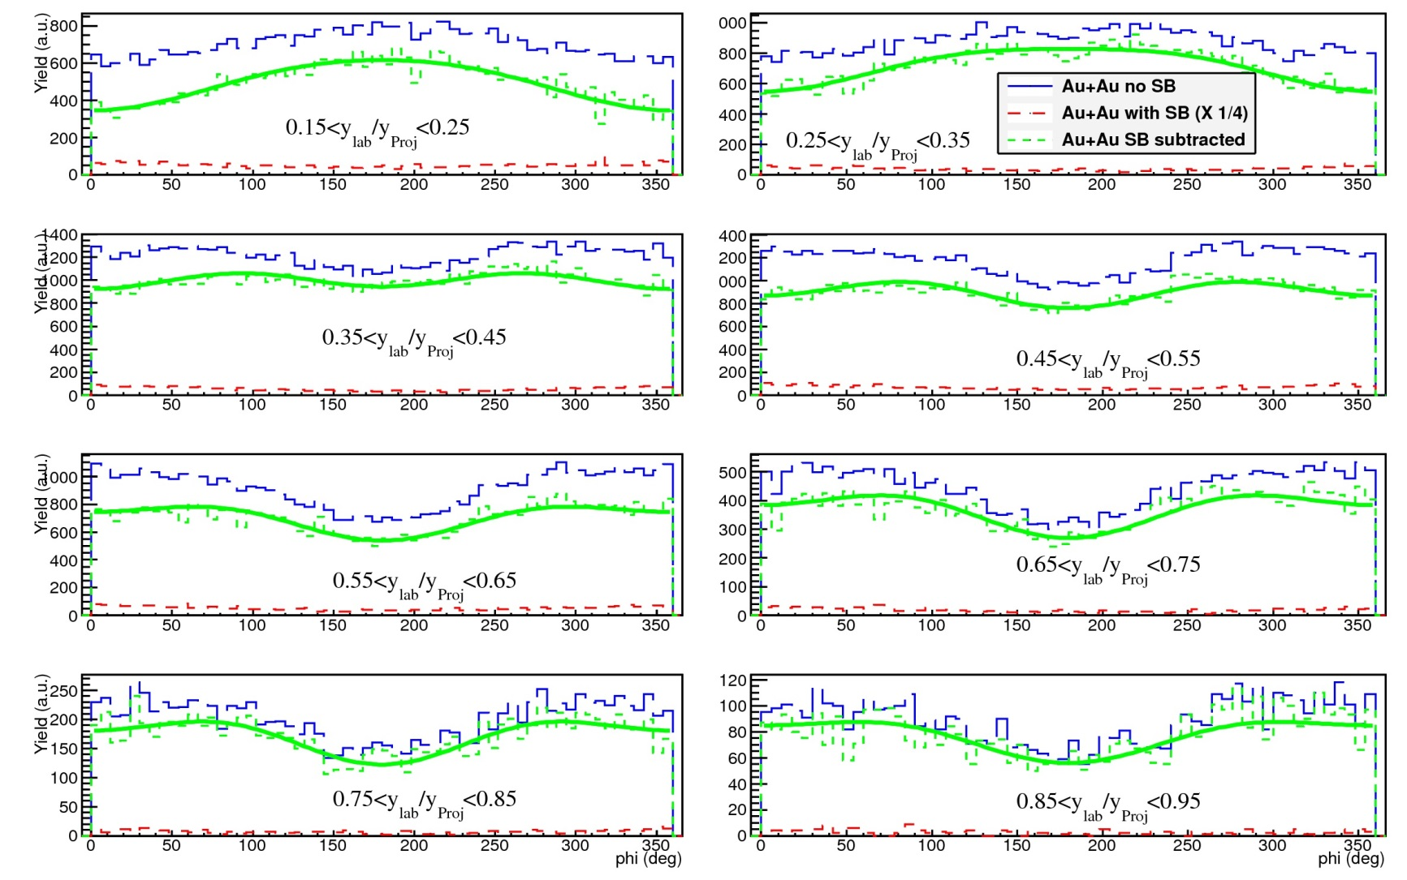
ASY-EOS I: background subtraction
ASY-EOS I
Notes:
OK
Mostrata: very old
Ris: /nuclei/isospin4_dsk/isospin/TMP_PAOLO/macros/ANALISI/MAY2013/AUG2013/NOV13/ROOTOUTPUT2/FE70dev487lite_t00706_b1_MBg1/flow200last

Slide 20
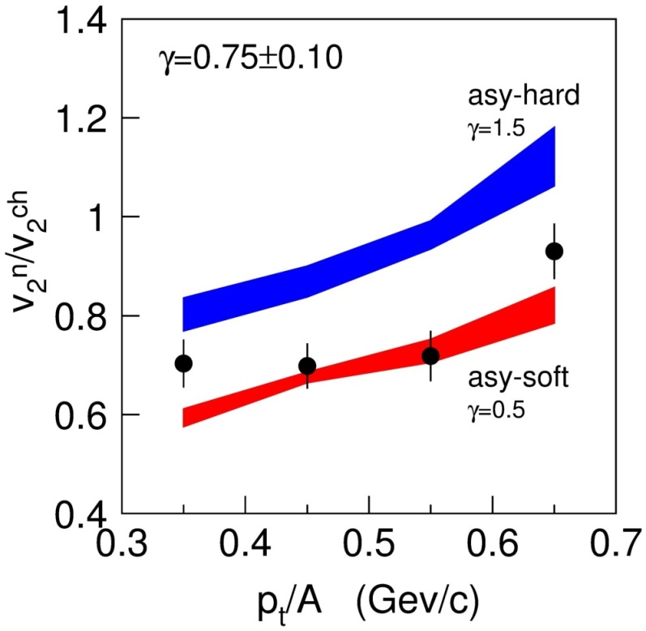
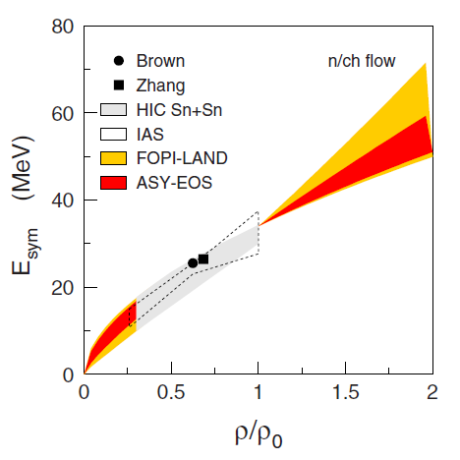
ASY-EOS I results
ASY-EOS I
L = 72 ± 13 MeV
E_{sym}(ρ₀) = 34 MeV
density to be probed in the ASY-EOS II exp, most relevant for neutron star physics
density probed by the ASY-EOS I exp
L=72±13 MeV
P. Russotto et al., PRC 94, 034608 (2016)
Notes:
OK

Slide 21
@FRIB
What could be done:
n-poor/rich Sn/Ni RIBs on n-poor/rich Sn/Ni enriched targets
from 150 to 350 AMeV and a bit beyond (FRIB-400 )
10^5 pps with 1-2% prob. int. target is enough above 200 AMeV
at lower energy, decrease target thickness but increase beam intensities (10^6 pps is OK)
keep under control beam divergency (1-2° can be tolerated, but has to be stable), how to track the beam?
observable: n, p, LCP yield, energy distribution, flow and relative ratios (n/p, t/³He, ⁷Li/⁷Be)
stopping and transparency can be investigated
use of double ratios and isospin tracer technique (measuring also mixed systems n-rich ←→ npoor) to minimize the uncertainties in model parameters
Needs:
Centrality: Z_{max}, Z_{bound}, CP multiplicity, E_{trans}¹², E_{rat} ….
reaction plane: forward detector, preferably with 2π (cylindrical) symmetry and high granularity
on-target event selection and trigger: backward detector, preferably with 2π (cylindrical) symmetry and high granularity
n and p (LCP) yield and spectra: neutron (with veto) and LCP detector, or n and LCP detectors
n background: shadow bar measurement
additional LCP detectors with high resolution at mid-rapidity and backward region

Slide 22
(minimal) conclusions
Is this feasible?
Is this sufficient?
Discussion (here) and devoted WG (after)!

Slide 25
@FRIB
What could be done:
n-poor/rich Sn/Ni RIBs on n-poor/rich Sn/Ni enriched targets
from 150 to 350 AMeV and a bit beyond (FRIB-400 )
observable: n, p, LCP yield, energy distribution, flow and relative ratios (n/p, t/³He, ⁷Li/⁷Be)
Possibility to get double yield ratios and imbalance ratios measuring also mixed systems (n-rich<- -> npoor)
10^5 pps with 1-2% prob. int. target is enough above 250 AMeV
At lower energy, decrease target but increase beam intensities (10^6 pps is OK)
Keep under control beam divergency (1-2° can be tolerated, but has to be stable)
Use of double n/p differential observable and/or imbalance ratio to minimize model parameters
Needs:
Centrality: charge of the projectile spectator (Z_{max}), Z_{bound}, CP multiplicity, E_{trans}¹²,…..
reaction plane: forward detector, preferably with 2π (cylindrical) symmetry and high granularity
on-target event selection: backward detector, preferably with 2π (cylindrical) symmetry and high granularity
n background: shadow bar measurement
n and p (ch) momentum: neutron (with veto) and CP detector, or detectors
Additional CP detectors with high resolution at mid-rapidity and backward region
Additional:
Additional CP detectors with high resolution at mid-rapidity and backward region
Measure n/p (ratio) yield and energy spectra. And also,

Slide 26
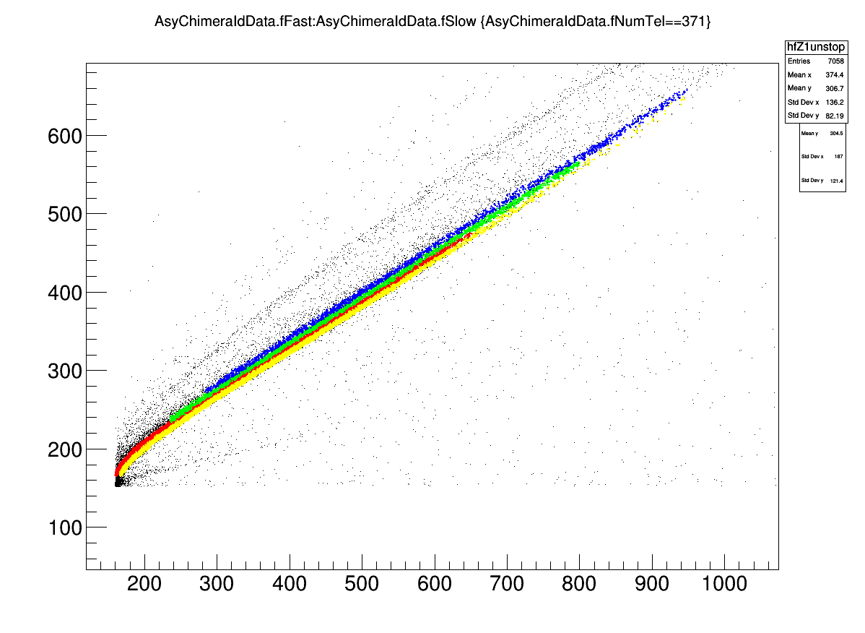

CHIMERA@GSI
320 CsI(Tl) 12 cm thick, assembled in 8 rings, covering polar angles between 4.6 and 16 deg
B
p,d,t,H(p.t.)
⁹Be
⁸Li
⁷Be
⁷Li
⁶Li
⁴He
³He
He (p.t.)
H
³He,⁴He,He(p.t.)

Slide 27
ASY-EOS I: background rejection
CHIMERA
M(Y_{cm}>0.1) ≥ 4
for Y_{cm}>0.1
for Y_{cm}<0.1
μBall
M ≥ 2
GOOD
ad. from P. Danielewicz et al., PLB 1985
Notes:
OK

Slide 28
Nucear matter EOS and symmetry energy
Quite well known
Not well known
Symmetry energy
Neutron matter
δ=1
Fuchs and Wolter, EPJA 30 (2006)
Symmetric matter
δ=0
The symmetry energy is the difference between the energy of the symmetric matter (δ=0) and neutron matter (δ=1) and describes how the energy of asymmetric nuclear (N≠Z) depends on the saturation density

Slide 31

Transport 2017 MSU
Mizuki Nishimura
132Sn + 124Sn 108Sn + 112Sn 124Sn + 112Sn 112Sn + 124Sn ~300 MeV/u

Slide 32


ASY-EOS S394 experiment @ GSI Darmstadt (May 2011)
Au+Au, ⁹⁶Zr+⁹⁶Zr , ⁹⁶Ru+⁹⁶Ru @ 400 AMev
µBall: 4 rings 50 CsI(Tl), Θ>60°. Discriminate target vs. reactions with air. Multiplicity and reaction plane measurements.
KraTTA: 35 (5x7) triple telescopes (Si-CsI-CsI) placed at 21°<Θ<60° with digital readout . Light particles and IMFs emitted at midrapidity
TOFWALL: 96 plastic bars; ToF, ΔE, X-Y position. Trigger, impact parameter and reaction plane determination
Vacuum
Krakow array
Beam Line
Chimera
Shadow bar: evaluation of background neutrons in LAND
Target
TOFWALL
µBall
Shadow bars
Start detector
LAND: Large Area Neutron Detector . Plastic scintillators sandwiched with Fe 2x2x1 m³ plus plastic veto wall. New Taquila front-end electronics. Neutrons and Hydrogen detection. Flow measurements
LAND+VETO
CHIMERA: 8 (2x4) rings, high granularity CsI(Tl), 352 detectors 7°<θ<20° + 16x2 pads silicon detectors. Light charged particle identification by PSD. Multiplicity, Z, A, Energy: impact parameter and reaction plane determination

Slide 33
Au+Au @ 400 A.MeV: Some kinematics
KRATTA:
J. Lukasik et al., Nucl. Instr. Meth. 709 (2013) 120128
* Uniform distribution with EKin<100 Mev
P. Russotto et al., EPJA 50, 38 (2014).
P. Russotto et al., PRC 94, 034608 (2016).
Notes:
KraTTA confirms fopi

Slide 34


Charged Particles:
(Au+Au)-(Au+EF)
Neutrons:
(Au+Au)-(Au+Au with SB)+
-(Au+EF)+(Au+EF with SB)
Adapted from “roadmap” paper, C. Horowitz et al, J. Phys. G: Nucl. Part. Phys. 41 (2014) 093001
Results…
Au+Au @ 400 AMeV b<7.5 fm
Short range correlations may influence results
FOPI-LAND DATA : P.Russotto et al., Phys. Lett. B 697 (2011)
γ = 0.9 ± 0.4 ; L=83±26
HIC: (mainly Isospin diffusion for Sn+Sn) M.B. Tsang et al., PRC 86, 015803 (2012)
neutron skin thickness, binding energies,….: Brown, PRL 111, 232502 (2013); Zhang & Chen, Phys. Lett. B 726 (2013), Danielewicz & Lee, NPA922 (2014).
stiffer
ASY-EOS DATA: P. Russotto et al., PRC 94, 034608 (2016)
γ = 0.72± 0.19 ; L=72±13
Gao-Chan Yong, Phys. Rev. C 93, 044610 (2016)
F. Zhang, Gao-Chan Yong, EPJA 52, 350 (2016)

Slide 35


Aladin ToF-Wall
96 plastic bars 2.5X 100 cm
2 walls (front and rear) θ < 7°
Z, velocity & X-Y position.
Impact parameter and
reaction plane determination
Notes:
35

Slide 36

Time, charge and space resolution
FWHM = 2.35 σ
A. Schüttauf

Slide 37

96 plastic bars 2.5X 100 cm
2 walls (front and rear) θ < 7°
Z, velocity & X-Y position.
Impact parameter and
reaction plane determination
Aladin ToF-Wall (GSI)
Notes:
37

Slide 38

MicroBall (USA)
µBall:
4 rings, 50 CsI(Tl)
~ 1 cm thick
60°<θ<147°.
Discriminate target vs. air interactions (backward angles). Multiplicity measurements.
Notes:
38

Slide 39

CHIMERA
352 CsI 12 cm thick
+ 32 Si (telescopes)
8 Rings covering 7°<θ<20°
Light ions
Z, Ekin & θ-φ.
Impact parameter and
reaction plane determination
CsI
12 cm
Si
300 μm
Notes:
39

Slide 40



Identification in CHIMERA...
¹⁹⁷Au+¹⁹⁷Au @ 400 AMeV
CsI(Tl)
p
d
t
Z=1 punching through

Slide 41




Large Area Neutron Detector :LAND (GSI)
33.1<ϑ_{lab}<58 deg
Neutrons and Hydrogen detection. Flow measurements
Th.Blaich et al.,NIM A314 (1992)
Notes:
41

Slide 42
Large Area Neutron Detector (LAND)
Th.Blaich et al.,NIM A314 (1992)
Neutrons efficiency>80% (for E>400MeV)
No ^{1,2,3}H isotopic discriminations
Adapted from P.Pawloski,IWM2007
Notes:
42

Slide 43
Large Area Neutron Detector (LAND)
neutron and proton detection
Th.Blaich et al.,NIM A314 136-154 (1992)
P. Pawloski et al., “Study of neutron emission using Land detector“, Procs of IWM2007

Slide 44

Large Area Neutron Detector (LAND)
Adapted from P.Pawloski,IWM2007
Notes:
44

Slide 46


ASY-EOS (I)
ASY-EOS exp. @ GSI (2011) Au+Au @ 400 AMeV
P. Russotto et al., PRC 94, 034608 (2016)
Main observable neutron-charged particles elliptic flow ratio: robust and effective in exploring high density behaviour of E_{sym}
L=72±13 MeV
■ exp
example of comparison:
Zhang and Li, EPJA 55:39 (2019)
E_{sym}=47±10 MeV from NS radii, max mass, tidal pol.

Slide 47
ASY-EOS (I)
ASY-EOS exp. @ GSI (2011) Au+Au @ 400 AMeV
P. Russotto et al., PRC 94, 034608 (2016)
Main observable neutron-charged particles elliptic flow ratio: robust and effective in exploring high density behaviour of E_{sym}
L=72±13 MeV
■ exp
example of comparison:
Zhang and Li, EPJA 55:39 (2019)
E_{sym}=47±10 MeV from NS radii, max mass, tidal pol.

Slide 49
Nucear matter EOS and symmetry energy
Quite well known
Not well known
Symmetry energy
Neutron matter
δ=1
Fuchs and Wolter, EPJA 30 (2006)
Symmetric matter
δ=0
The symmetry energy is the difference between the energy of the symmetric matter (δ=0) and neutron matter (δ=1) and describes how the energy of asymmetric nuclear (N≠Z) increases going away from saturation density

Slide 50


How to investigate symmetry energy: a multi-messenger probem
GW170817 from BNS merger (LIGO)
PRL 120, 172702 (2018)
Chun Yuen Tsang et al., Nature Astronomy 8 328 (2024)

Slide 51
n/p flows: symmetry energy at high-densities
Elliptic flow from ASYEOS-I experiment
L = 72 ± 13 MeV
E_{sym}(ρ₀) = 34 MeV
Parametrization for SE used in UrQMD* model:
E_{sym} = E_{sym}^{pot}+E_{sym}^{kin} = 22MeV·(ρ/ρ₀)^{γ}+12MeV·(ρ/ρ₀)^{2/3}
P. Russotto et al., PRC 94, 034608 (2016)

Slide 52





Symmetry energy investigations: still hot topic…especially at high-densities
Courtesy J. Lukasik, NUSYM2024, Caen
W. Lynch and M.B. Tsang,
PLB 830, 137098 (2022)
$$L=3ρ_{0}{\left(\frac{dE_{Sym}(ρ)}{ρ}\right)}_{ρ=ρ_{0}}$$
Low density
High density

Slide 53

Combining HIC and astrophysical results to constrain neutron matter EOS
S. Huth et al., Constraining Neutron-Star Matter with Microscopic and Macroscopic Collisions, Nature 606, 276–280 (2022)
« HIC » = FOPI+ASY-EOS+AGS - « Astro » = GW, NICER (pulsar X-ray hot spots)
HIC data favors larger pressures at 1-1.5 ρ₀, where sensitivity is highest
similar observations with NICER data
EOS at higher densities (>2ρ₀) mostly determined by astrophysical observations
Conclusion:
advancing HIC experiments to higher densities
ASY-EOS II
ASY-EOS I
P. Russotto et al.,
PRC 94, 034608 (2016)

Slide 54

S122 (ASY-EOS II) - Symmetry energy at high densities from n/p flow excitation functions
Energy [AMeV] | Justification
280 | highest sensitivity on K_{sym}
400 | reference to ASY-EOS I, n/p tests higher densities than before
600 | highest sensitivity on L, high-density tested
1000 | Maximum energy (≈ density) where models agree on v2 sensitivity

Slide 55




CHIMERA@GSI

Slide 56
S122 (ASY-EOS II) - Symmetry energy at high densities from n/p flow excitation functions
To the experiment participated a large collaboration from :
R³B – GSI (Germany)
CHIMERA (Italy)
IFJ-PAN Krakow (Poland)
INDRA-FAZIA (France-Italy)
MSU-FRIB (USA)
Texas A&M (USA)
GANIL (France)
RIKEN (Japan)
CHIMERA
ToFD (dp1)
LOS & ROLU
KRAB
Beam pipe
target
ToFD (dp2)
Shadow Bars
NeuLAND
Spokepersons S122:
P. Russotto (INFN-LNS, Italy)
J. Łukasik (IFJ-PAN Krakow, Poland)
A. Le Fèvre (GSI Darmstad, Germany

Slide 57



S122 (ASY-EOS II) : advancing Symmetry Energy studies towards high densities
Au+Au @ 400 AMeV
In Heaven
density to be probed in the ASY-EOS II exp, most relevant for neutron star physics
Li, Bao-An, NPA 708, 365 (2002)
Au+Au 400 MeV/A
n/p
n/ch
density probed by the ASY-EOS I exp
Higher incident energies → higher densities probed
n/p observable Z=1 isotopic resolution) → greater sensitivity to higher densities
P. Russotto et al., PRC 94, 034608 (2016)
p
d
t
New KRAB detector
Multiplicity trigger, reaction plane and centrality detector
R3B NeuLAND: resolving p,d,t

Slide 60

Y-position correlation

Slide 61




EOS for nuclear matter
The nuclear EOS describes the relation between energy, pressure, density, temperature and isospin asymmetry. It is an essential ingredient in nuclear physics and astrophysics.
Nuclear matter phase diagram (schematic)
Question: how E/A depends on the density ρ and isospin asymmetry δ=$\frac{ρ_{n}−ρ_{p}}{ρ_{n}+ρ_{p}}$
SIS
E/A(ρ, δ)=????
Liquid gas coexistence
N/Z

Slide 62
EOS of asymmetric nuclear matter: symmetry energy
-16 MeV

Slide 63

n/p flows: symmetry energy at high-densities
Parametrization for SE used in UrQMD* model:
E_{sym} = E_{sym}^{pot}+E_{sym}^{kin} = 22MeV·(ρ/ρ₀)^{γ}+12MeV·(ρ/ρ₀)^{2/3}
UrQMD*: Qingfeng Li
Data. W. Reisdorf et al.

Slide 64


Slide 65
Main observable neutron-charged particles elliptic flow ratio: robust and effective in exploring high density behaviour of E_{sym}
■ exp

