Slide 1


Modeling double charge-exchange reactions
(RIBDCE – Many-body systems)
J.I.Bellone^{2,1}, M.Colonna¹, D.Gambacurta¹, H.Lenske³
¹INFN - Laboratori Nazionali del Sud (Catania, Italy)
² Università degli Studi di Catania (Italy)
³Institut für Theoretische Physik, Justus-Liebig-Universität
Giessen, Germany
NUSDAF 2025 – 1st Collaboration Meeting on NUclear Structure,
Dynamics and Astrophysics at FRIB
22-24 October 2025 Catania (Italy)

Slide 2
Outline:
Introduction on charge-exchange (CE) transitions: strong and weak processes
Modeling Heavy Ion Double CE reactions (two-step process):
formalism, connection to nuclear structure elements (2BTD)
DCE reaction cross section
Summary and perspectives

Slide 3
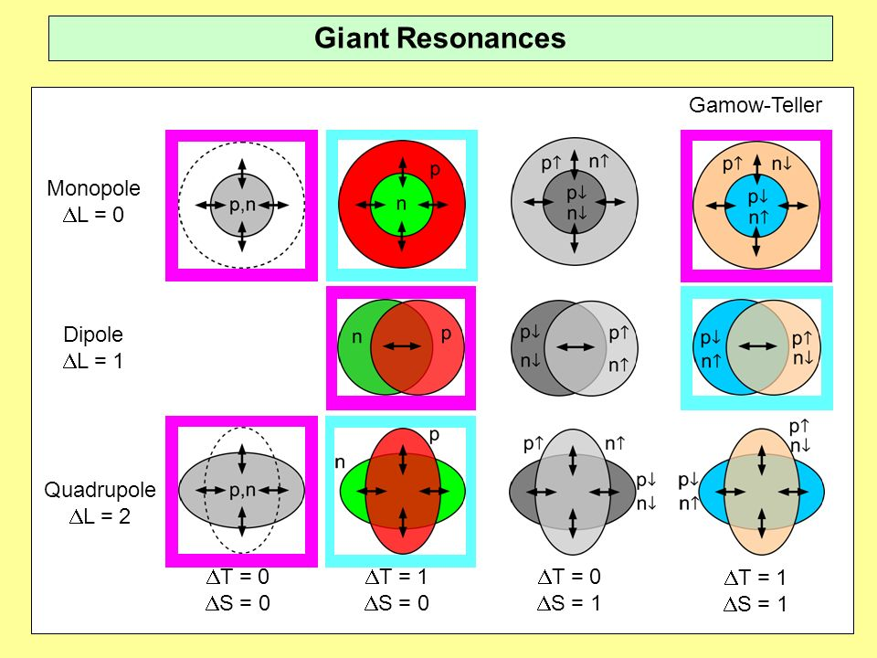

Charge exchange nuclear reactions
offer the possibility to explore nuclear transitions in the spin-isospin channel
(ex: Fermi (S=0, T=1) and Gamow-Teller excitations (S=1, T=1)
Ex: neutron drip-line nuclei ⁶He(p,n)⁶Li
Double charge exchange reactions
Ex: ⁴He(⁸He,αα)4n tetraneutron
- RCNP / RIKEN ex: the search of the double GT resonance
- NUMEN@INFN-LNS: probe DCE Nuclear Matrix Elements
Ex: ¹¹⁶Cd (²⁰Ne, ²⁰O) ¹¹⁶Sn, ¹³⁰Te (²⁰Ne, ²⁰O) ¹³⁰Xe, ⁷⁶Ge (²⁰Ne, ²⁰O) ⁷⁶Se @ 15 MeV/A
→ heavy ions
F. Cappuzzello, H. Lenske et al., Prog.Part.Nucl.Phys. 128 (2023) 103999
→ Analogies with β decays
New process:
2nd order + correlations
- beyond standard model
0νββ
1

Slide 4

Sequential Double Charge Exchange process (Double SCE)
sequence of two uncorrelated SCE reactions
(β)
(γ)
(α)
J.I. Bellone, S. Burrello, M.C., J.A. Lay, H. Lenske, PLB 807 (2020) 135528
2

Slide 5


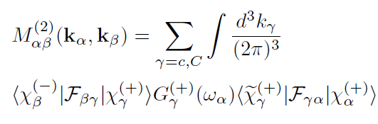


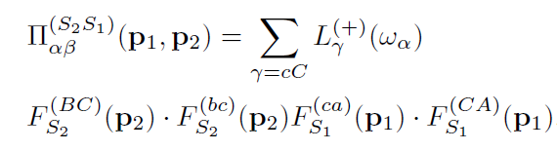
DSCE reaction cross section at a glance
Lenske, Bellone, Colonna, Gambacurta,
Universe 7(4):98 (2021)
Bellone, PLB (2020)
DSCE
cross section
DSCE transition matrix element
CE transition form factor
polarization
spin-spin tensor
distorted waves
V_{ST}
central
T = 1
T = 1, S = 1
tensor
T = 1, S = 0
-> CE transition density
3

Slide 6





DSCE polarization tensor
s-channel DCE NME
t-channel
2nd step
1st step
s-channel
target
projectile
-> CE transition density
~
QRPA calculations
with Skyrme interactions
-> CE transition operator
4

Slide 7
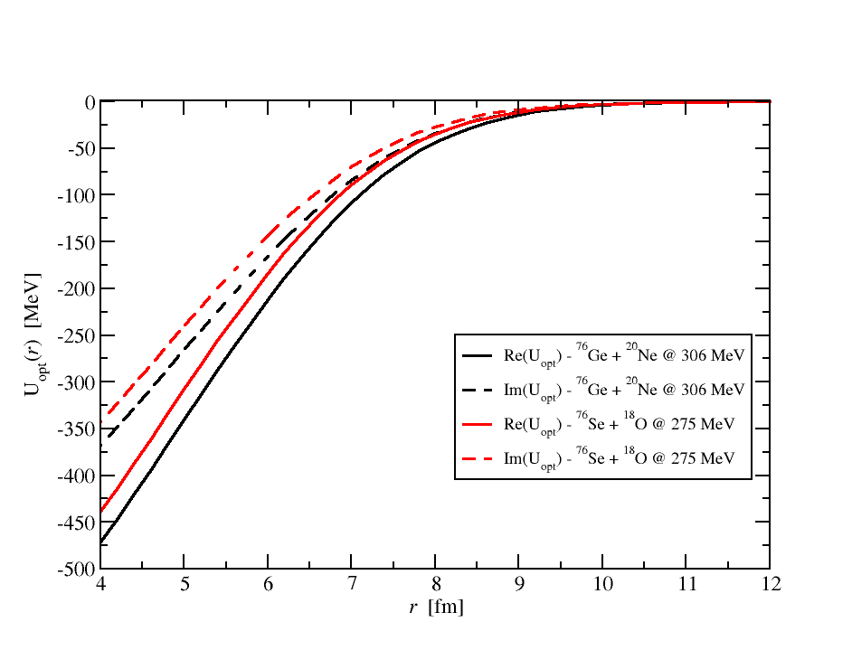
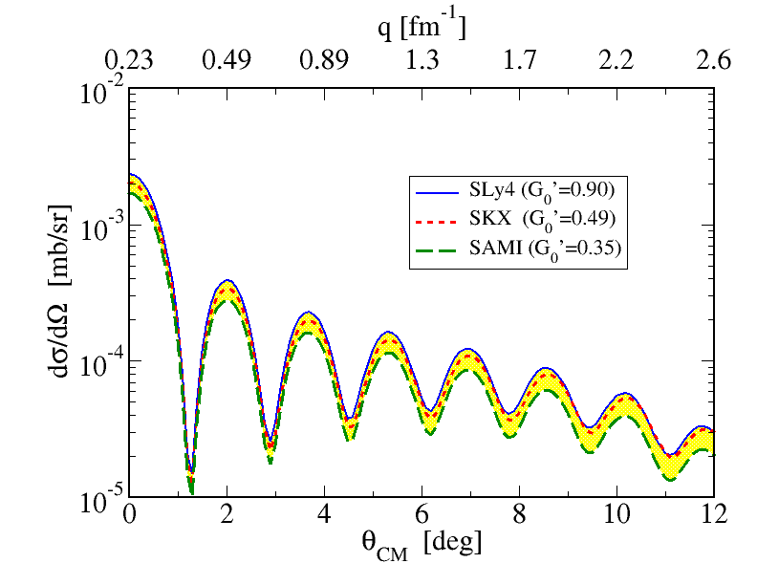
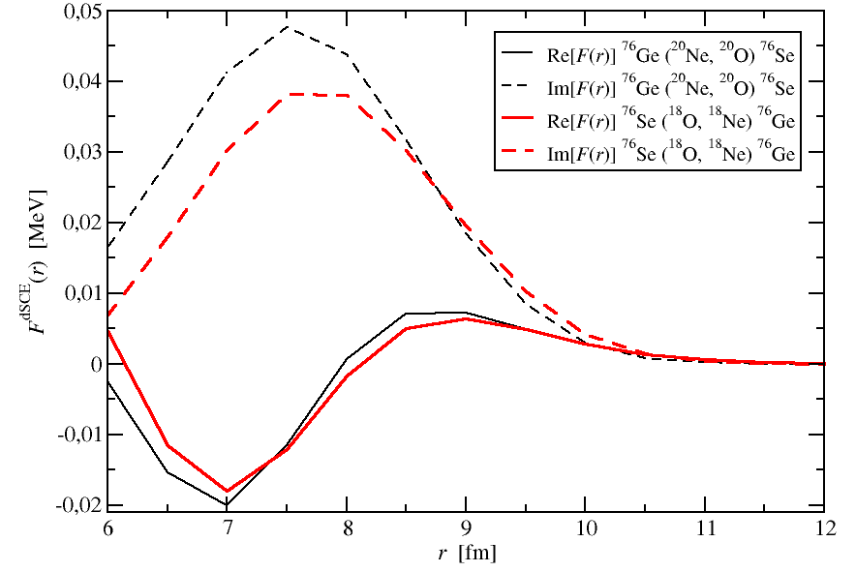
DSCE Cross Section - ⁷⁶Se(¹⁸O,¹⁸Ne_{g.s.})⁷⁶Ge_{g.s.} @15 AMeV
Optical potential
insert dSCE-PLB optical potentials used
Sao-Paulo potential (SPP)
La Fauci et al,
PRC 104, 054610 (2021)
Form factors
Sensitivity to the employed effective interaction
(and Landau-Migdal parameter G₀’)
M. Bender et al., Phys. Rev. C 65, 054322 (2002)
QRPA calculations
Sly4 Skyrme interaction
cC states: E_{max} = 50 MeV, J_{max} = 7 ћ
Bellone, Colonna, Gambacurta, Lenske
PRC 111, L061602 (2025)
5

Slide 8

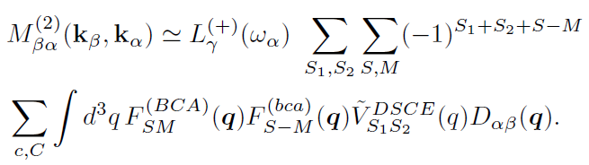

DSCE Cross Section: s-channel formalism
s-channel DCE NME
DSCE polarization tensor
Average 2b
transition density
[q = (p₁+p₂)]
DCE NN interaction
“Average approximation”→ “one-step”
reaction formalism !
Bellone, Colonna, Gambacurta, Lenske
PRC 111, L061602 (2025)
6

Slide 9
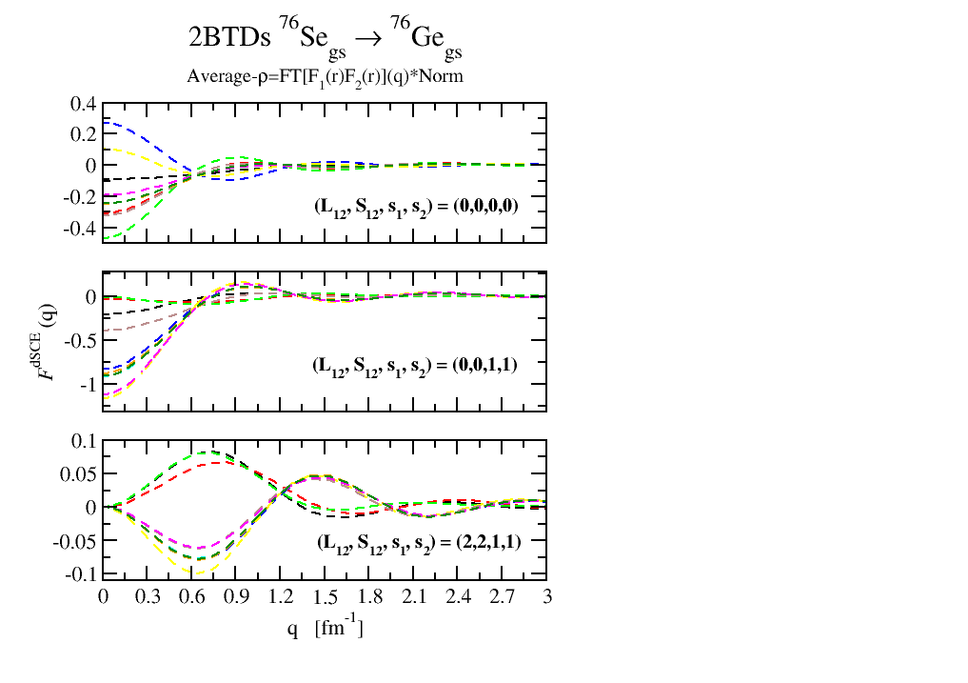
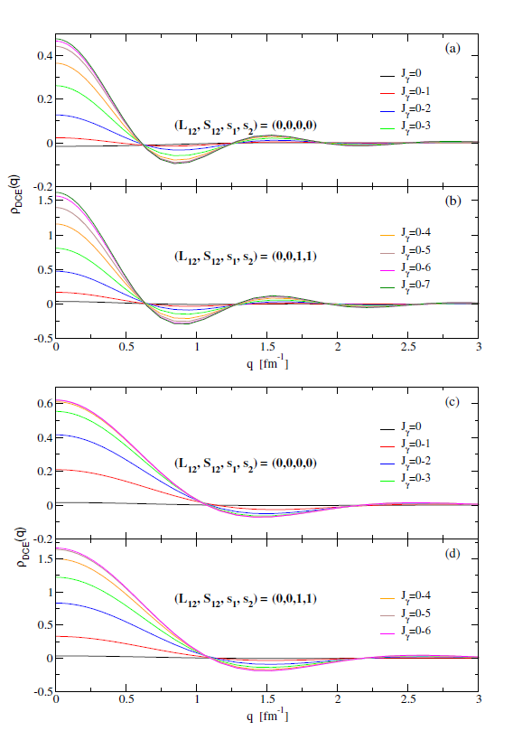
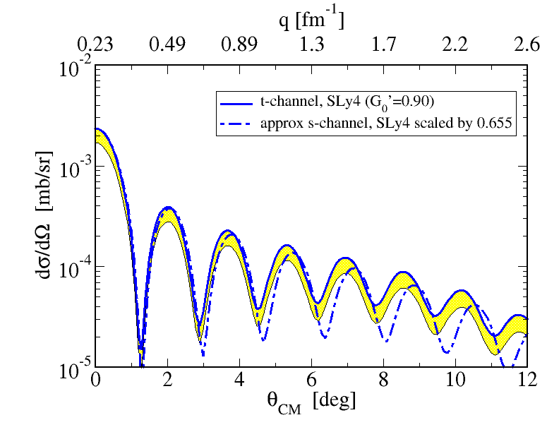
2BTDs and comparison with approx. s-channel results.
⁷⁶Se(¹⁸O,¹⁸Ne_{g.s.})⁷⁶Ge_{g.s.}
QRPA calculations
Sly4 Skyrme interaction
2BTDs ¹⁸O → ¹⁸Ne_{g.s.}
2B transition densities
in approx. s-channel
representation
E_{max} = 50 MeV
DSCE cross section
7

Slide 10
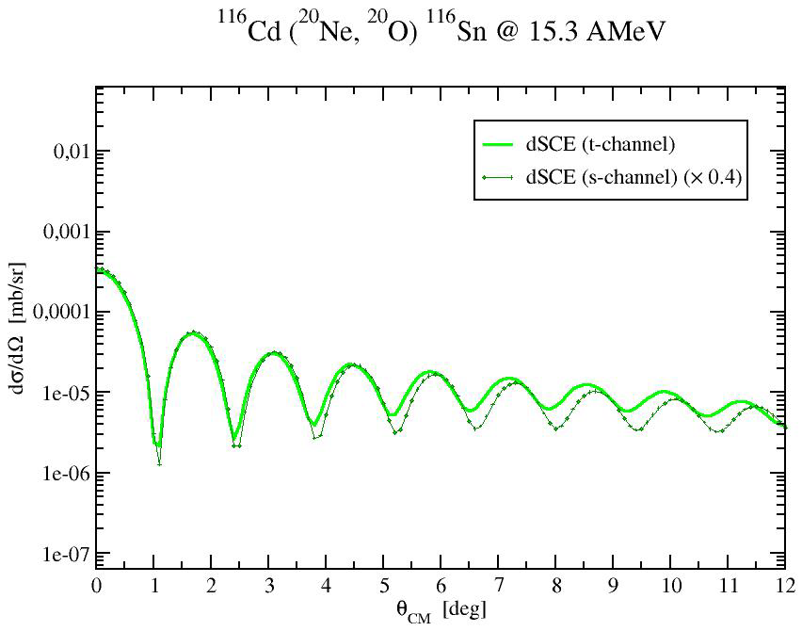
Comparison with approx. s-channel results.
⁷⁶Se(¹⁸O,¹⁸Ne_{g.s.})⁷⁶Ge_{g.s.}
preliminary
Preliminary results for a heavier target
DSCE cross section
7’

Slide 11
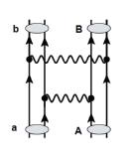
Summary and Perspectives :
DCE reactions as a two-step process
cross-section calculations
possibility to probe nuclear structure ingredients (2BTDs)
Perspectives:
Check several structure models (QRPA, Shell Model, IBM,…)
for DCE NMEs → extension to exotic nuclei
→ Investigate analogies with double-beta decay
-> data driven constraints on 0νββ NMEs
Majorana-like (pionic) DCE mechanism
Impact of short-range correlations on the DCE reaction
mechanism
CE mode
T_{π,N} matrix
Target
Projectile
Lenske, Bellone, Colonna, Gambacurta,
Universe 10(5), 202 (2024).
8

Slide 12
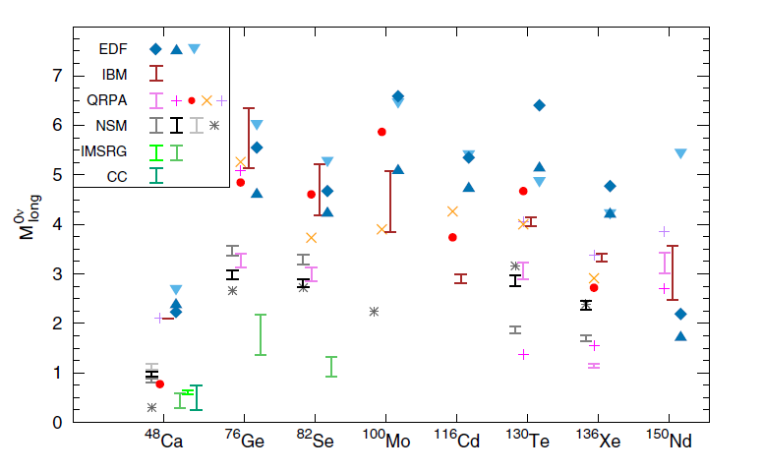
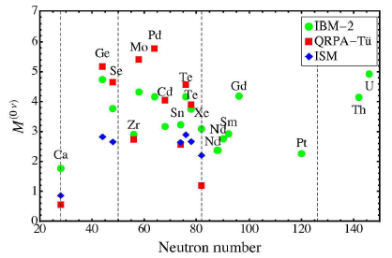

Nuclear charge-exchange (CE) transitions:
- Collective nuclear excitations induced by strong interaction
(Isobaric Analog Resonance, Gamow-Teller Resonance)
Isospin and spin-isospin terms in the effective nucleon-nucleon interaction in the medium.
- Spontaneous processes induced by weak interactions (β and double-β decays )
Astrophysical processes, neutrinoless double-β decay (0νββ)
nuclear structure inputs (Nuclear Matrix Elements)
L=0
L=1
L=2
NME
M.Agostini et al.,
Rev. Mod. Phys. 95, 025002 (2023)
Double-β decay
Conventional
2nd order process
- within standard model
New process:
2nd order + correlations
- beyond standard model
1

Slide 13
Nuclear interaction vs Weak interaction vertices: analogies
3

Slide 14
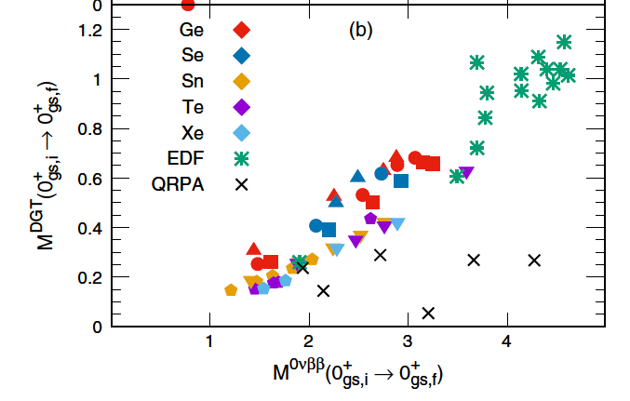
Structure model calculations for CE transitions
4
Gamow-Teller (GT)
R_{GT}- (MeV⁻¹)
RPA
Double GT
5
10
15
20
E (MeV)
S.Shen et al. , PRC 99, 034322 (2019)
M_{0νββ} vs M_{DGT}
Shell Model
DGT: Kauppinen,Suhonen,
PRC 106, 064315 (2022)
N.Shimizu et al. , PRL 120, 142502 (2018)
L.Coraggio et al. , PRC 95, 064324 (2017)
→ R-EDF
YK Wang et al. , PLB 855, 138796 (2024)

Slide 15


Cross section factorization at small momentum transfer: heavy ions
Reaction amplitude
Trend of distortion factor for heavy ions
(SCE - Black Disk Approximation)
T_{lab} = 270 MeV
A_{T} = 40
f_{BD}
Low momentum transfer $qαβ$
A_{P} = 12
18
28
f_{BD}
$dσαβ{(qαβ)=|ρ}_{Targ}^{2BTD}|2{\left(qαβ\right) |ρ}_{Proj}^{2BTD}|2{\left(qαβ\right) | V}_{}^{DSCE}|2$($qαβ$) f _{BD}
A
T_{lab}
DCE NMEs
distortion factor
(for light projectiles)
f_{BD} ~ exp(-A^{1/3})
Lenske, Bellone,Colonna,Lay, PRC 98, 044620 (2018)
Bellone et al., J.Phys. 1056, 012004(2018)
8

Slide 16
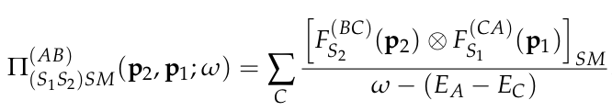
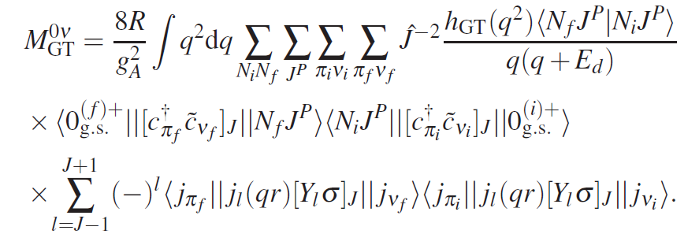
Analogies between DSCE and 2νββ-0νββ NMEs
(p₂,p₁)
DSCE NME
s-channel DCE NME
-> CE transition operator
0νββ NME
J. Barea, J. Kotila, F. Iachello, Phys. Rev. C 91 034304 (2015)
W.-L. Lv, Y.-F. Niu et al. , arXiv:2302:04423
8

Slide 17
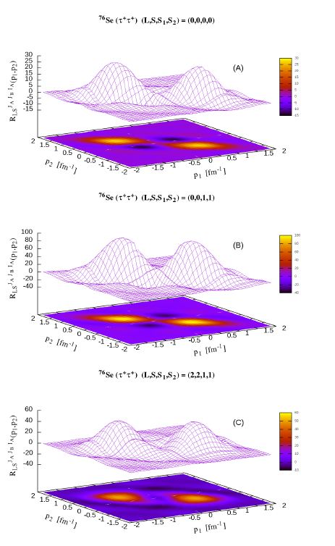
⁷⁶Se(¹⁸O,¹⁸Ne_{g.s.})⁷⁶Ge_{g.s.} – DCE NMEs (2BTD)
approximation
Fermi
2BTD ¹⁸O → ¹⁸Ne_{g.s.}
Gamow-Teller
Tensor
E_{max} = 50 MeV
QRPA calculations
Sly4 Skyrme interaction
Two-body transition densities in
approx. s-channel representation
Bellone, Colonna, Gambacurta, Lenske
to appear in PRC (Letters) arXiv:2505.24753
9

