Slide 1

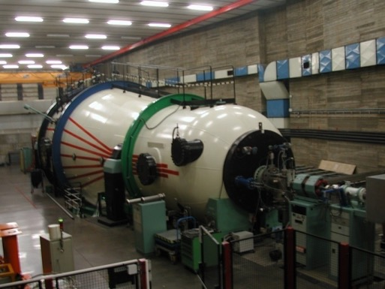
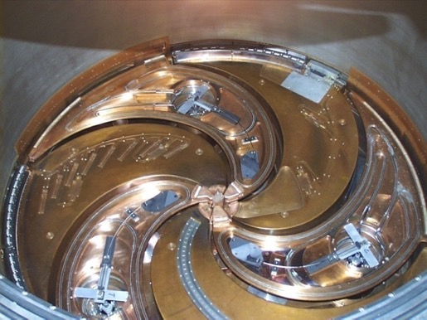
Research Opportunities at LNS
Research Activities at Laboratori Nazionali del Sud (LNS):
Nuclear Physics
Nuclear Astrophysics
AstroParticle Physics
Accelerator Physics
Applications BioMedical Sciences
Applications to Environmental Sciences
Energy Sciences and Engineering
Cultural Heritage
Ion sources for Applied Physics
The 15 MV tandem accelerator
The K800 superconductive cyclotron

Slide 2
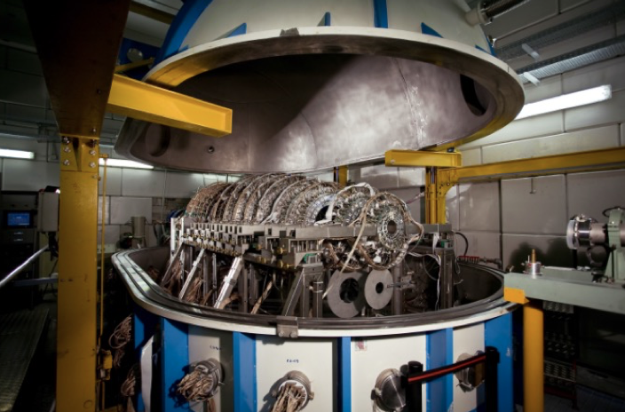
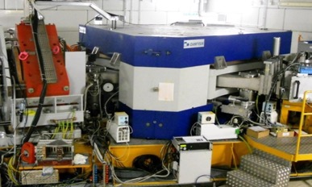
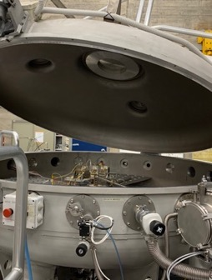
LNS Opportunities in Nuclear Physics and Astrophysics
NUMEN Project:
Determination of nuclear matrix elements (NME) for double beta decay using double
charge exchange reactions (e.g. ⁷⁶Ge).
Upgrade of the MAGNEX spectrometer and beam intensity increase.
Nuclear Astrophysics (ASFIN) project:
Measurements with Tandem beams and long-lived
radioactive species (¹⁰Be, ²⁶Al, ⁴⁴Ti).
Exotic beams to study nuclear reactions in extreme astrophysical
phenomena.
Alpha-alpha scattering
New beams, new research :
Probing the Equation of State (EoS) of nuclear matter and Exotic clustering phenomena. Access to new observables for the determination of EoS of neutron-rich nuclear matter. Use of CHIMERA multidetector and other detection systems available in the new experimental hall.
Theoretical research on the neutron stars physics and on GW.
Multidisciplinary beamline(s):
New opportunities of sample irradiation in extreme conditions.
Measurements with high dose-rate and simulations of laser accelerated beams.
CHIMERA
Study of nuclear matter under extreme conditions
MAGNEX
Study of charge-exchange reactions
Nuclear astrophysics
Nuclear reactions at low energies

Slide 3
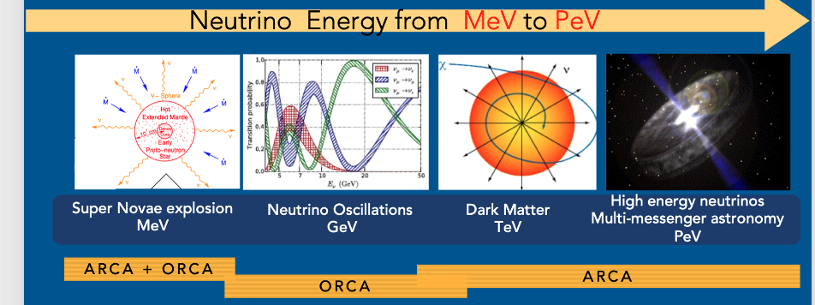
LNS Opportunities in AstroParticle Physics
KM3NeT: A next-generation neutrino telescope research infrastructure, opening a new window on the Universe and contributing to fundamental neutrino property studies.
Notably, a publication on the groundbreaking detection of a 220 PeV neutrino appeared at the beginning of this year!

Slide 4
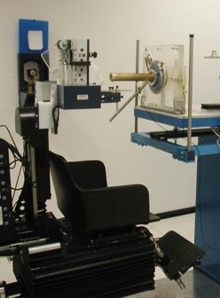
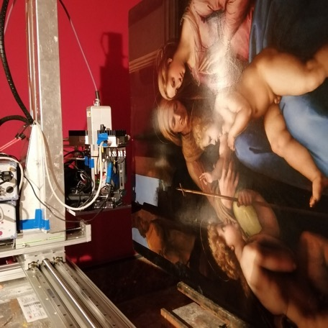
LNS Opportunities in Applied Physics
Physics applied to Medicine: Research, Clinical applications and Radiobiology
Hadron therapy: Clinical applications to the eye melanoma treatment using 62 MeV proton beams : more than 450 patients treated so far.
R&D:
Innovative detectors: Development and characterization for clinical beam dosimetry (electrons, gamma, hadrons).
Monte Carlo Simulations: Geant4 for study of biological effects and systems design.
Diagnostics and beam transport : Optimization for medical applications (conventional acceleration and laser).
New acceleration tecniques : Study and development based on laser-matter interaction
Medical physics
The CATANA irradiation hall
LANDIS
Innovation and Multidisciplinary Research
LANDIS (In Situ non destructive analysis) Laboratory :
Up to date Technologies:
Scanner for imaging XRF with multiple detection (6SDD hodoscope).
Application to the scanner LANDIS-X for cultural heritage and archeology.
LARA (Radioattività Ambientale) Laboratory:
Gamma Spectrometry:
Study of recent and historical lavas from Etna vulcano.
Analysis and modeling of magmatic channels.
Cultural Heritage

Slide 5
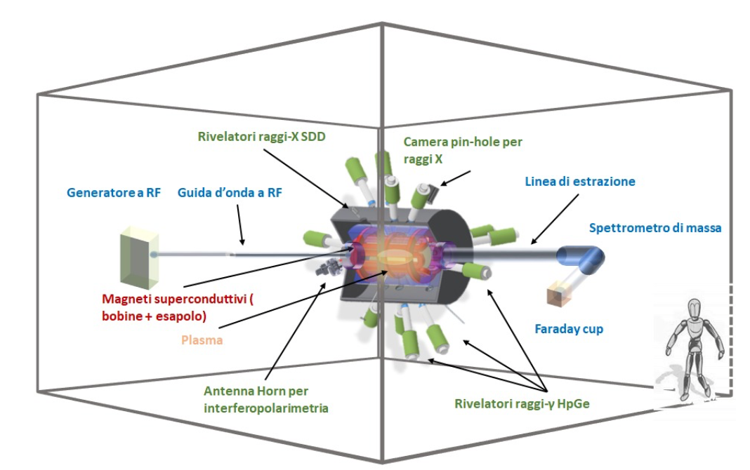
PANDORA and I-LUCE: Future Frontier research at LNS
PANDORA Project: Study of beta decay of radioisotopes in star-like plasmas and opacity measurements.
Status: magnetic Trap tender already concluded, multidiagnostics under definition (synergy with different Laboratories).
Installation of the setup end 2025, commissioning and measurements with 134Cs (priority), 176Lu and 94Nb from 2026.
I-LUCE (Laser indUced aCcEleration) Project : Production of ultra-short laser radiation and particle beams.
Power: up to 500 TW (most powerful in Italy).
Goals: Accelerations of electrons (up to 3 GeV), protons and ions (up to 60 AMeV). Production of gamma, X and neutrons. Study of phenomena in plasmas.
Configuration:
Two laser beamlines (radiation and plasmas) E1 – E2
Interaction of plasma with TANDEM/CS beams (ion-plasma study).
Bonus: LNS uniquely enables these studies of ion-plasma interactions (GSI offers comparable but distinct capabilities).

Slide 6
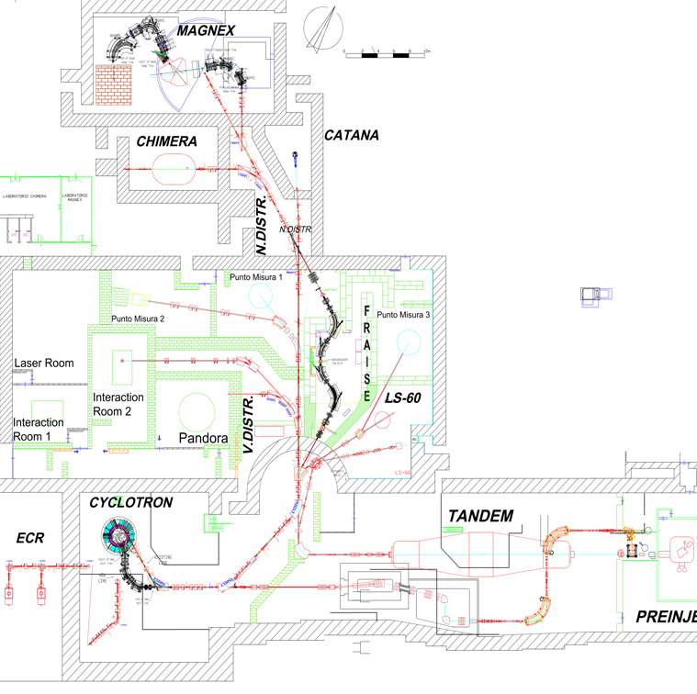
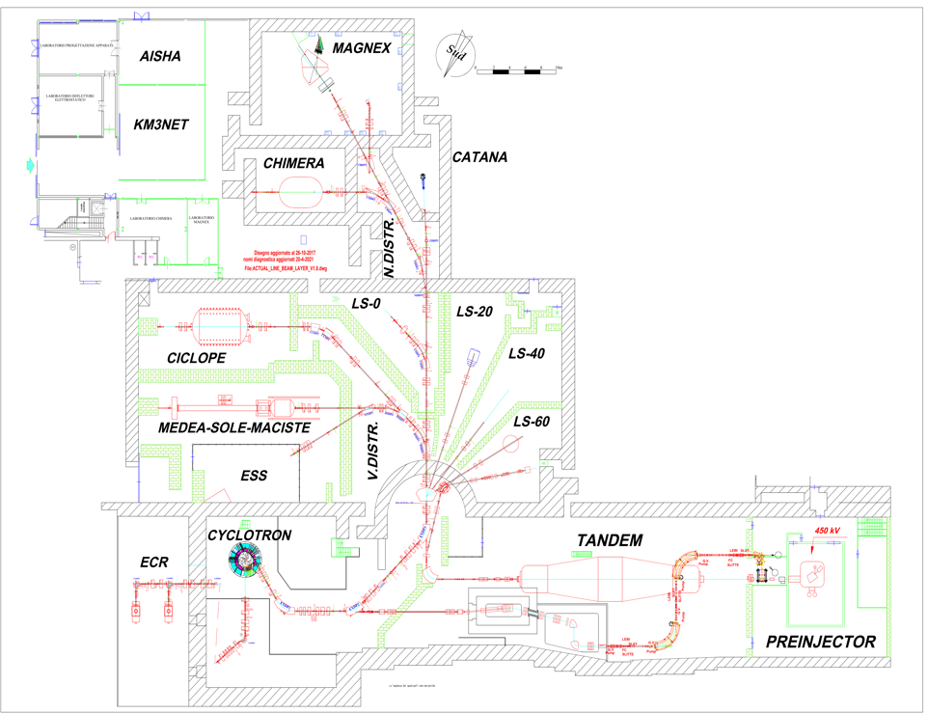
Past Future
Facilities: past and future
Multi-purpose chambers
CHIMERA
MAGNEX
PANDORA
I-LUCE
Other facilities
- in-air irradiation line
- X-ray tube
Text

Slide 7
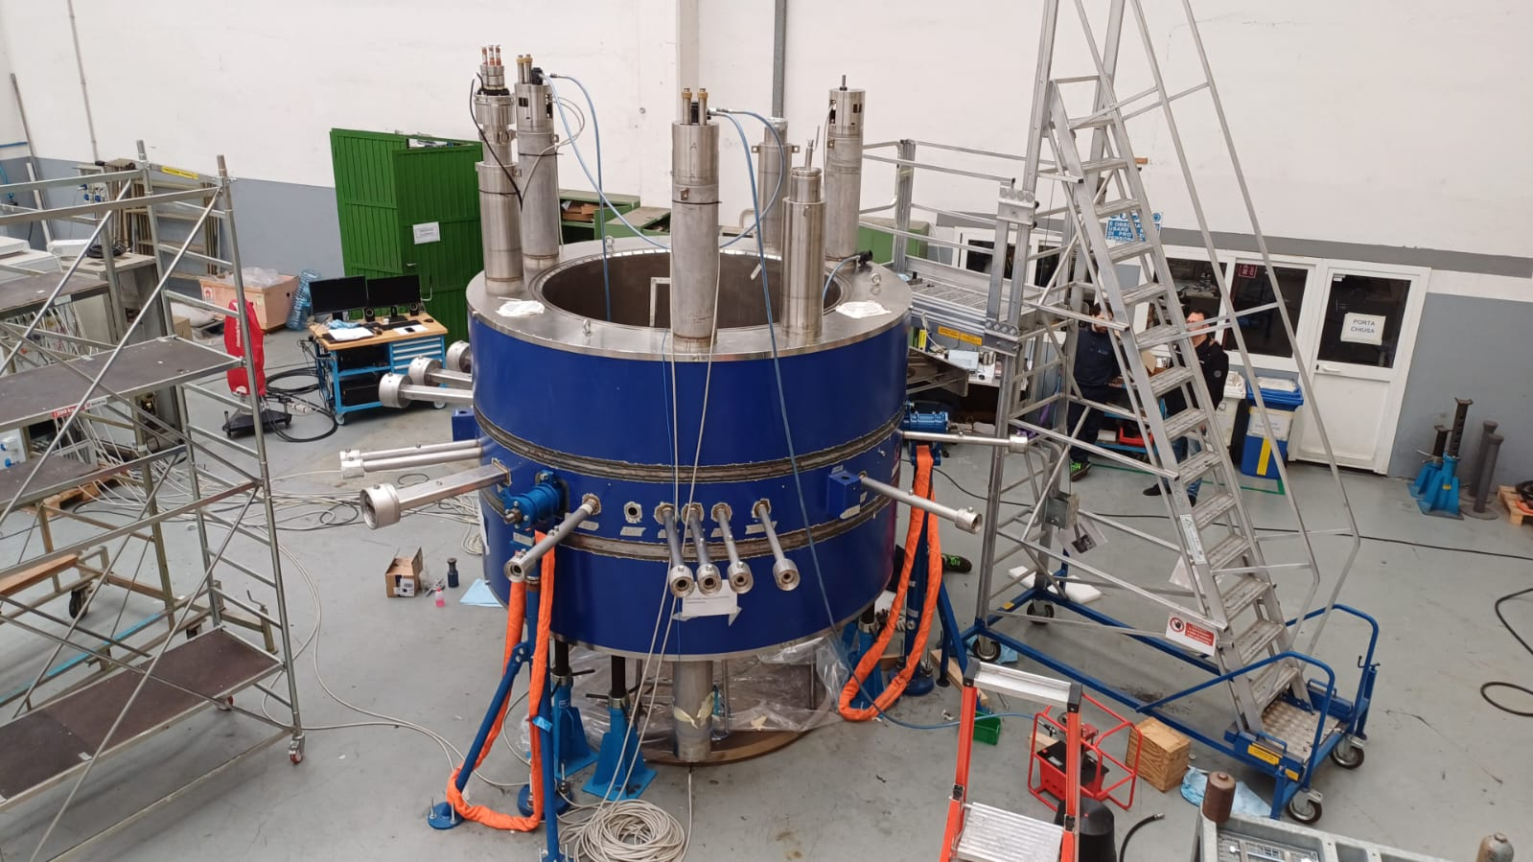
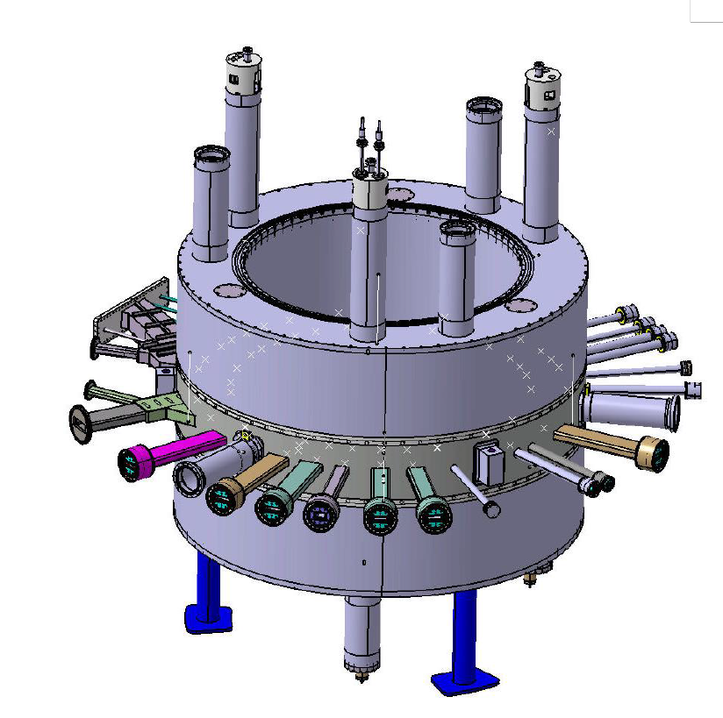
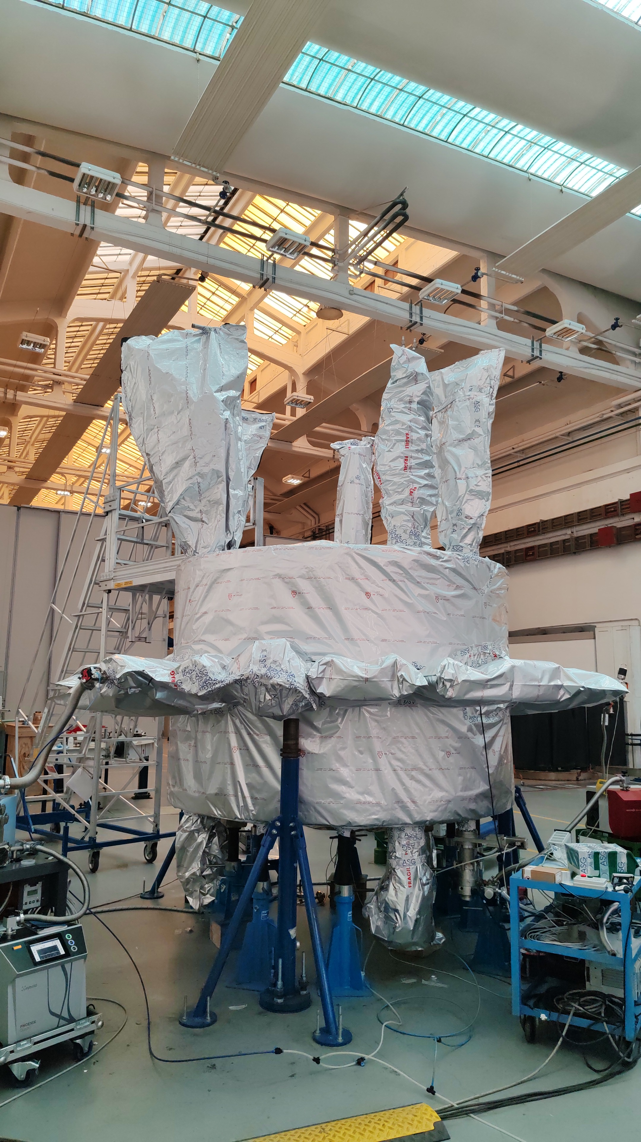
Superconducting Cyclotron
New magnetic system-recent news
Successful vacuum tests
TANDEM: improvements to ancillaries
beamline realignment

Slide 8
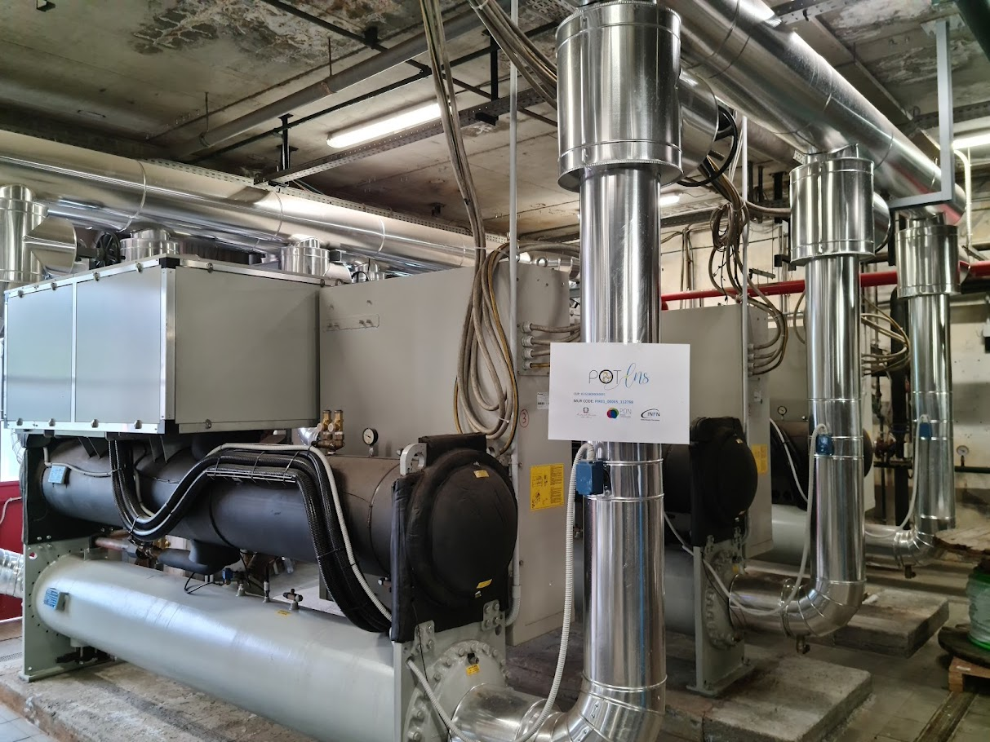
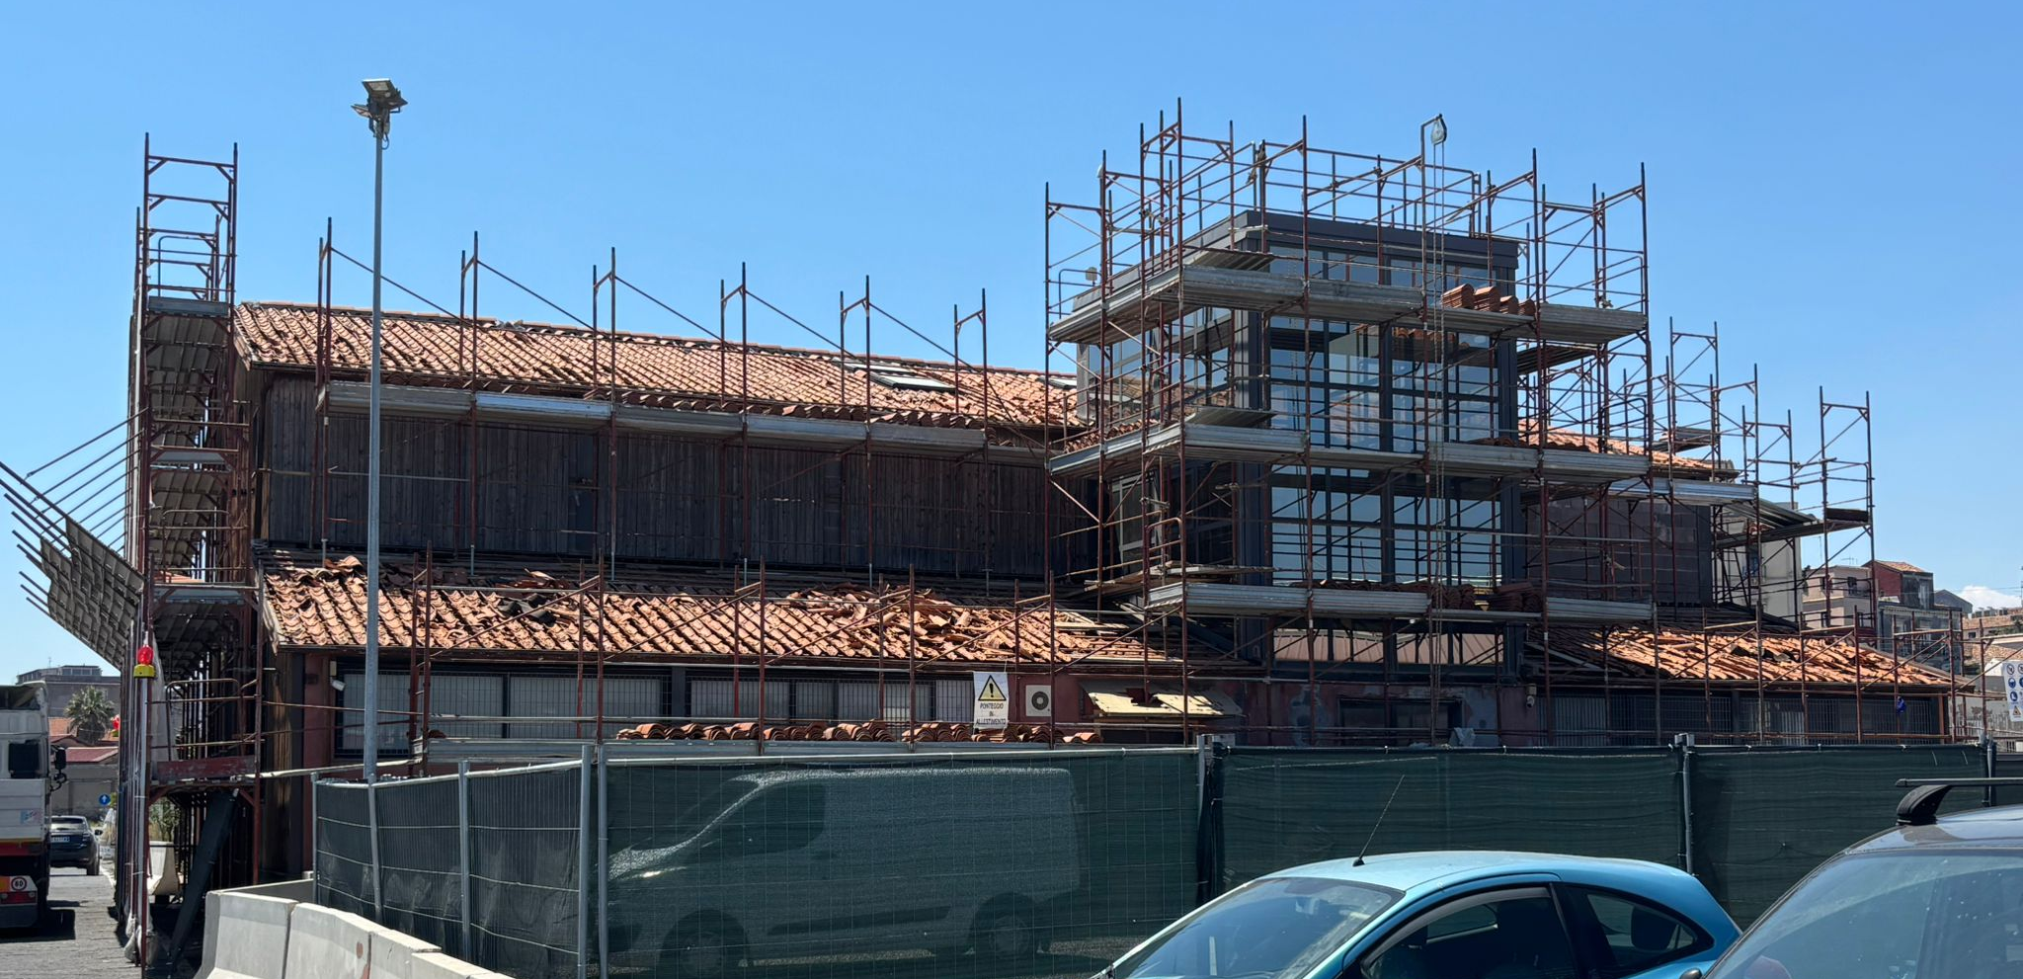
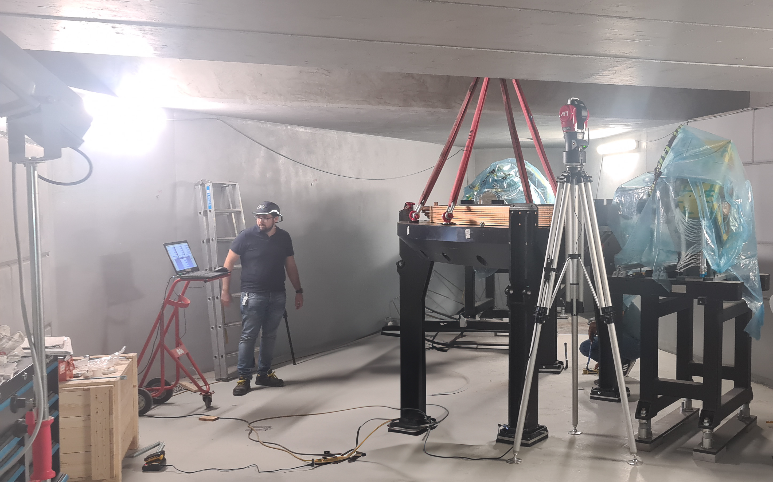
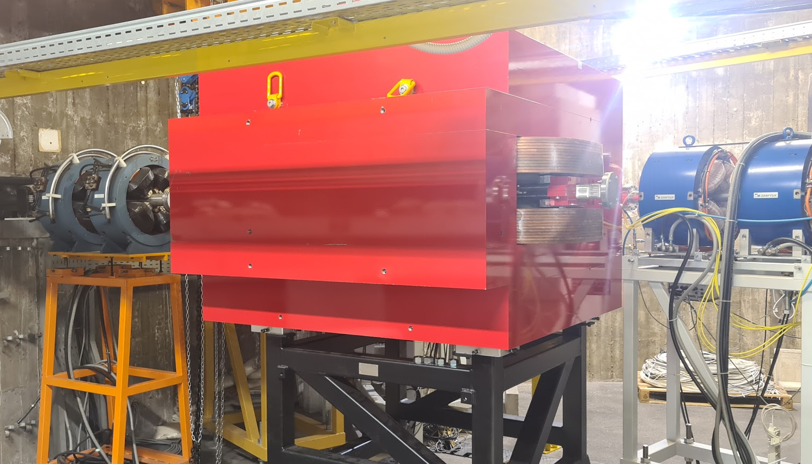
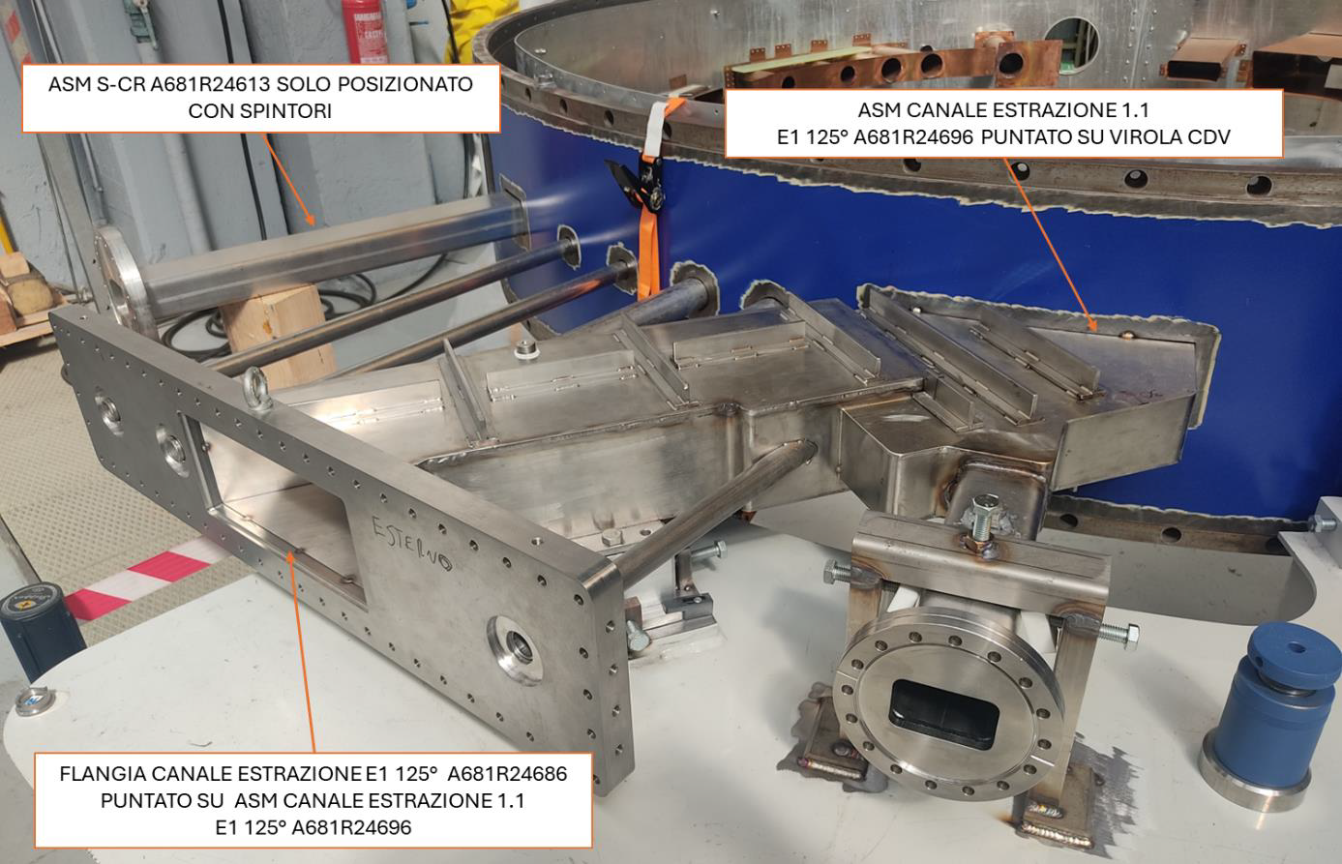
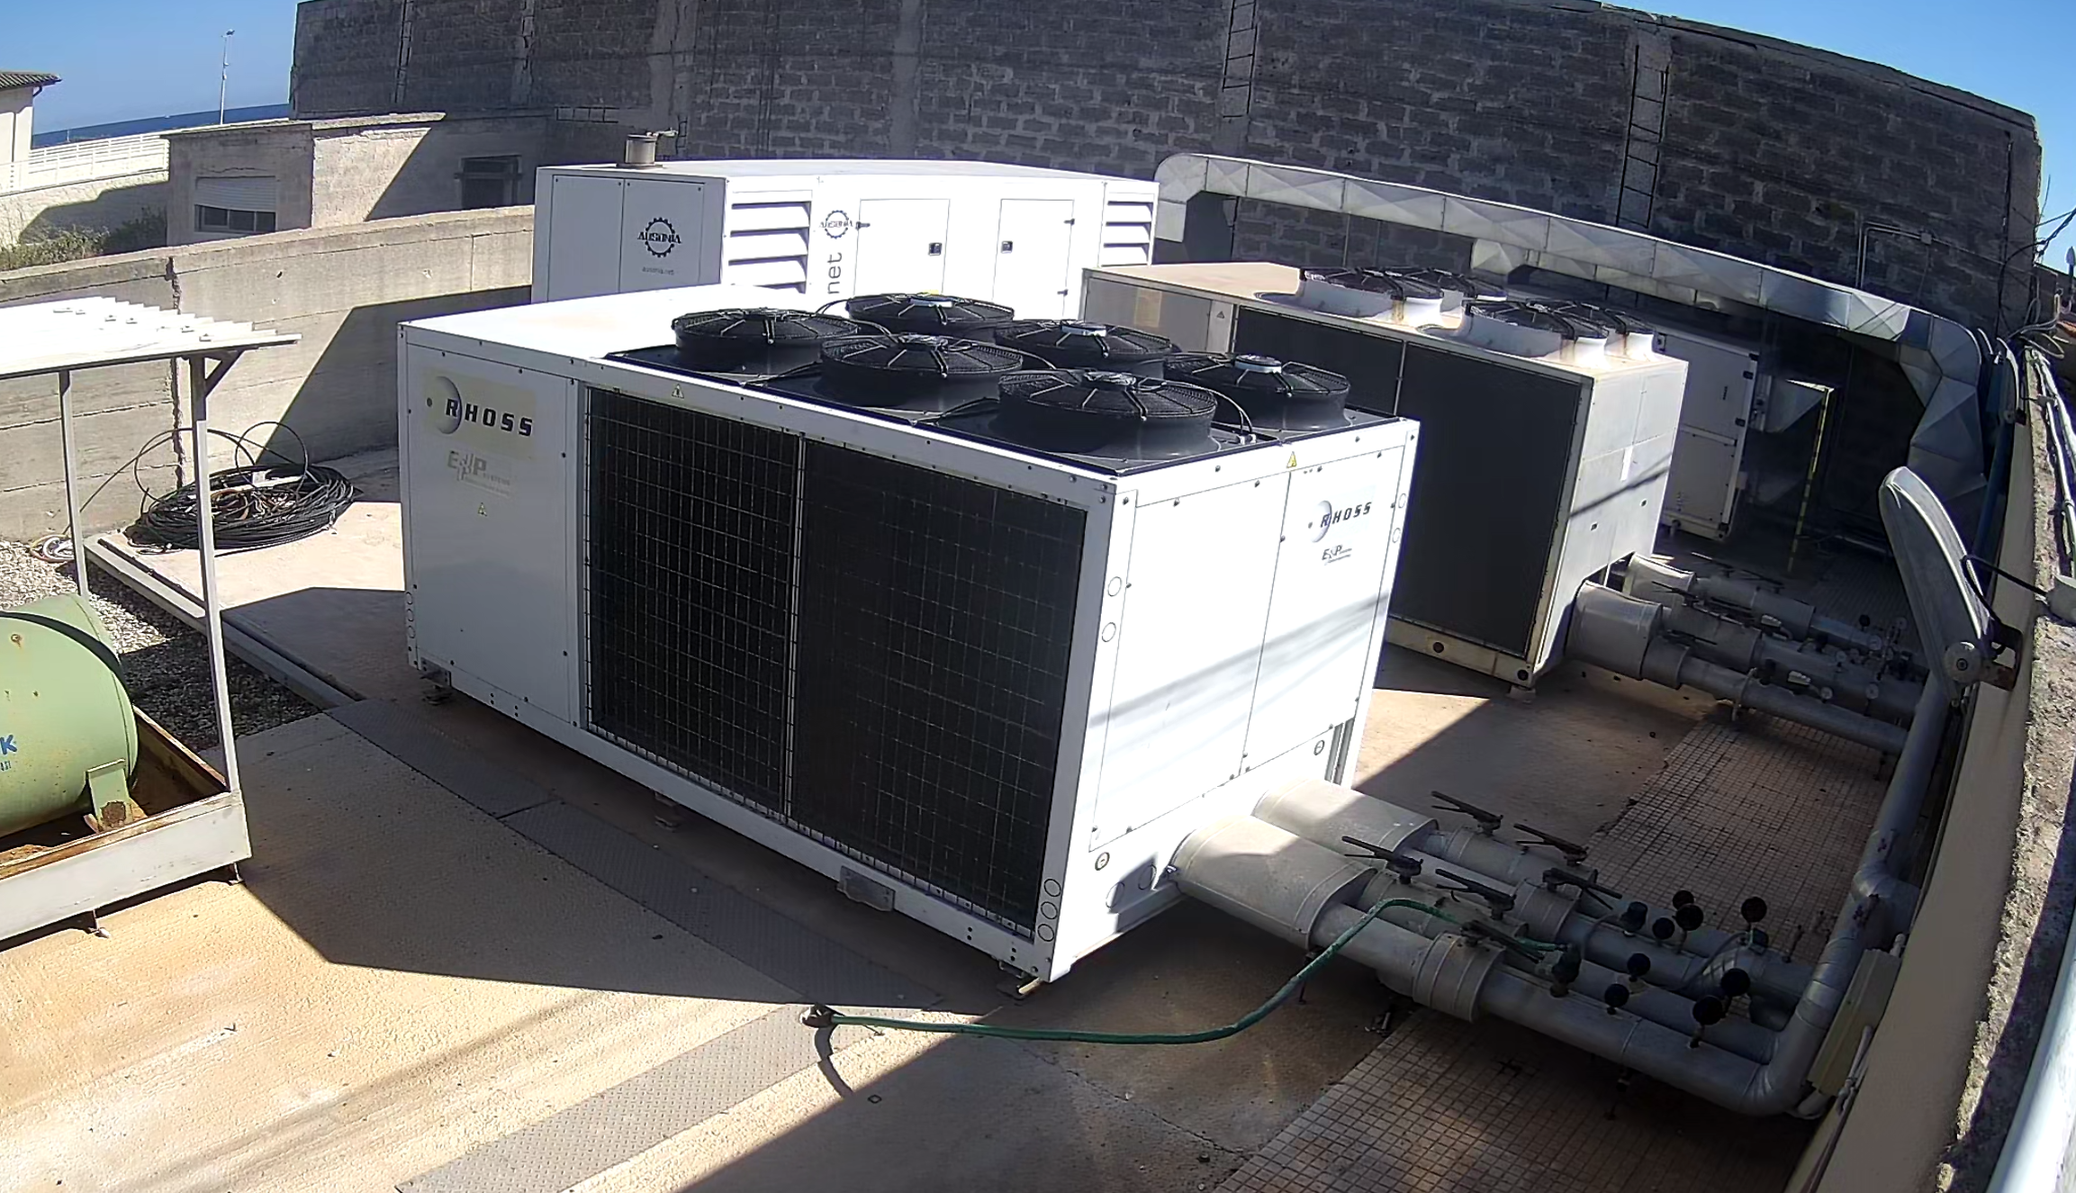

Slide 9
Improvements to technical plant: - optimization and compliance to standard - continuity of services since the accelerator commissioning - reduction of environmental footprint - maintenance according to the best practices - redundancy when possible During last 5 years, investments above 8 M€ have been used, plus the resources of POTLNS, and about 5 are scheduled.

Slide 10

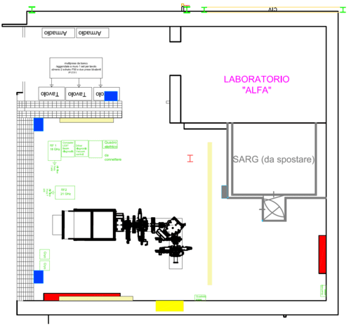

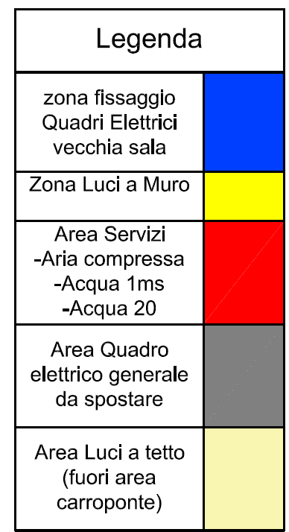
TELAMONES
(TEst LAboratory for MOdelling New Ecr ion Sources)
The new facility under completion at INFN-LNS devoted to R&D activities on
highly charged and high intensity ion sources
SARG
SARG spectrometer for nuclear astrophysics to be moved in a dedicated room.

Slide 11
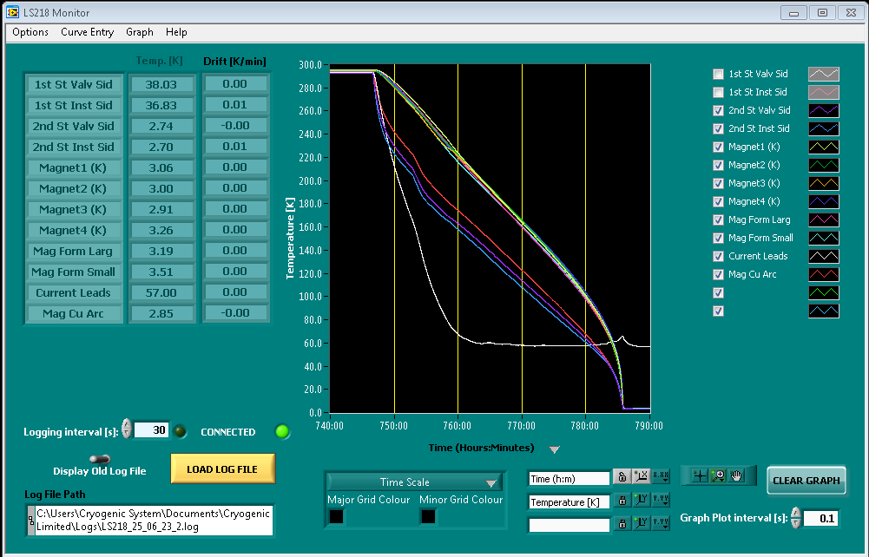
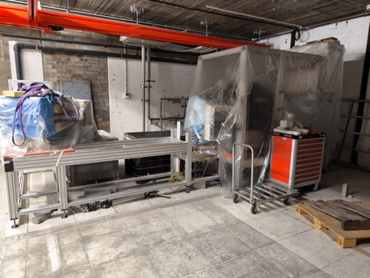
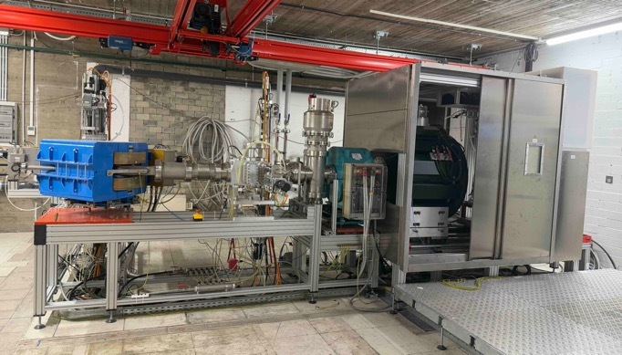
AISHa
Cryogenic system still alive agter 5 yrs in the boxes!!!
Activites before the summer stop:
Training up full to field
Magnetic measurements check
Final controls verifications

Slide 12
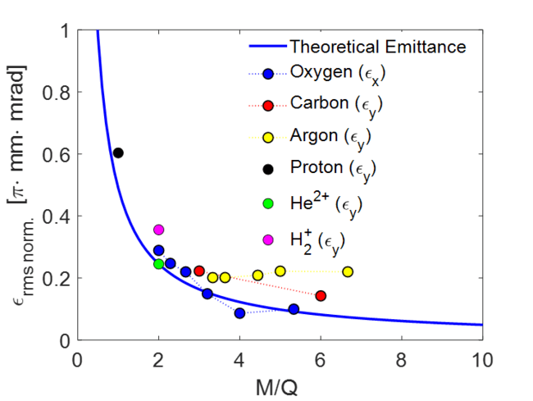
AISHa performances @INFN-LNS (2018-20) (17.3-18.4 GHz – 1.5 kW max)
He⁺
C³⁺+He⁺
Charge state | Beam intensity [e$μ$A] | $$ε_{rms.norm}$$ [$π∙mm∙mrad$]
¹⁶O⁶⁺ | 1400 | 0.2198
¹⁶O⁶⁺ | 225 | 0.115
¹⁶O⁷⁺ | 350 | 0.247
¹²C⁴⁺ | 650 | 0.272
¹²C⁴⁺ | 150 | 0.222
¹²C⁵⁺ | 165 | ---
⁴⁰Ar¹¹⁺ | 155 | 0.201
⁴⁰Ar¹²⁺ | 140 | 0.201
He²⁺ | 5400 | 0.418
He²⁺ | 700 | 0.245
He²⁺
CH⁴+He ($\sim 10:1$)
C⁶⁺+He²⁺
C⁴⁺
C⁵⁺
O² + He (4:1)
O⁶⁺
O²⁺
O⁵⁺
O⁴⁺
O³⁺
O⁷⁺

Slide 13
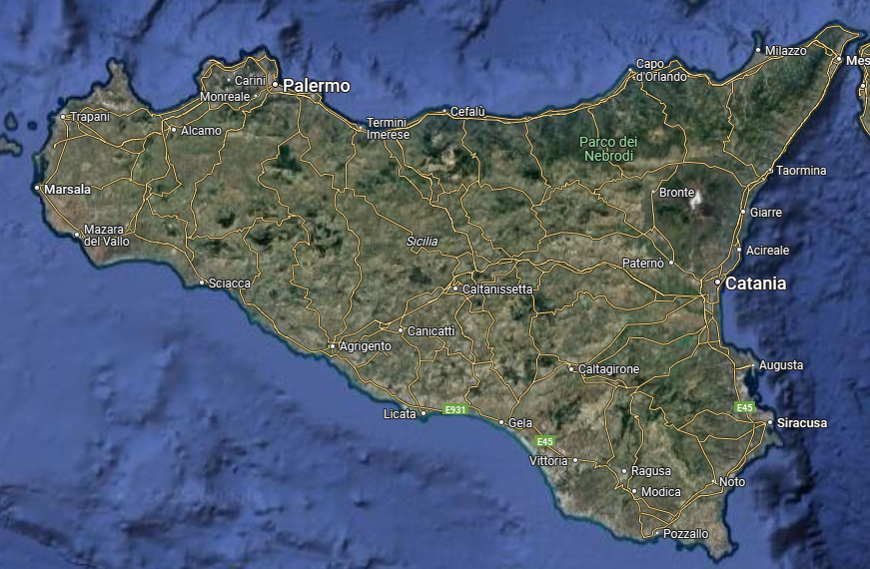
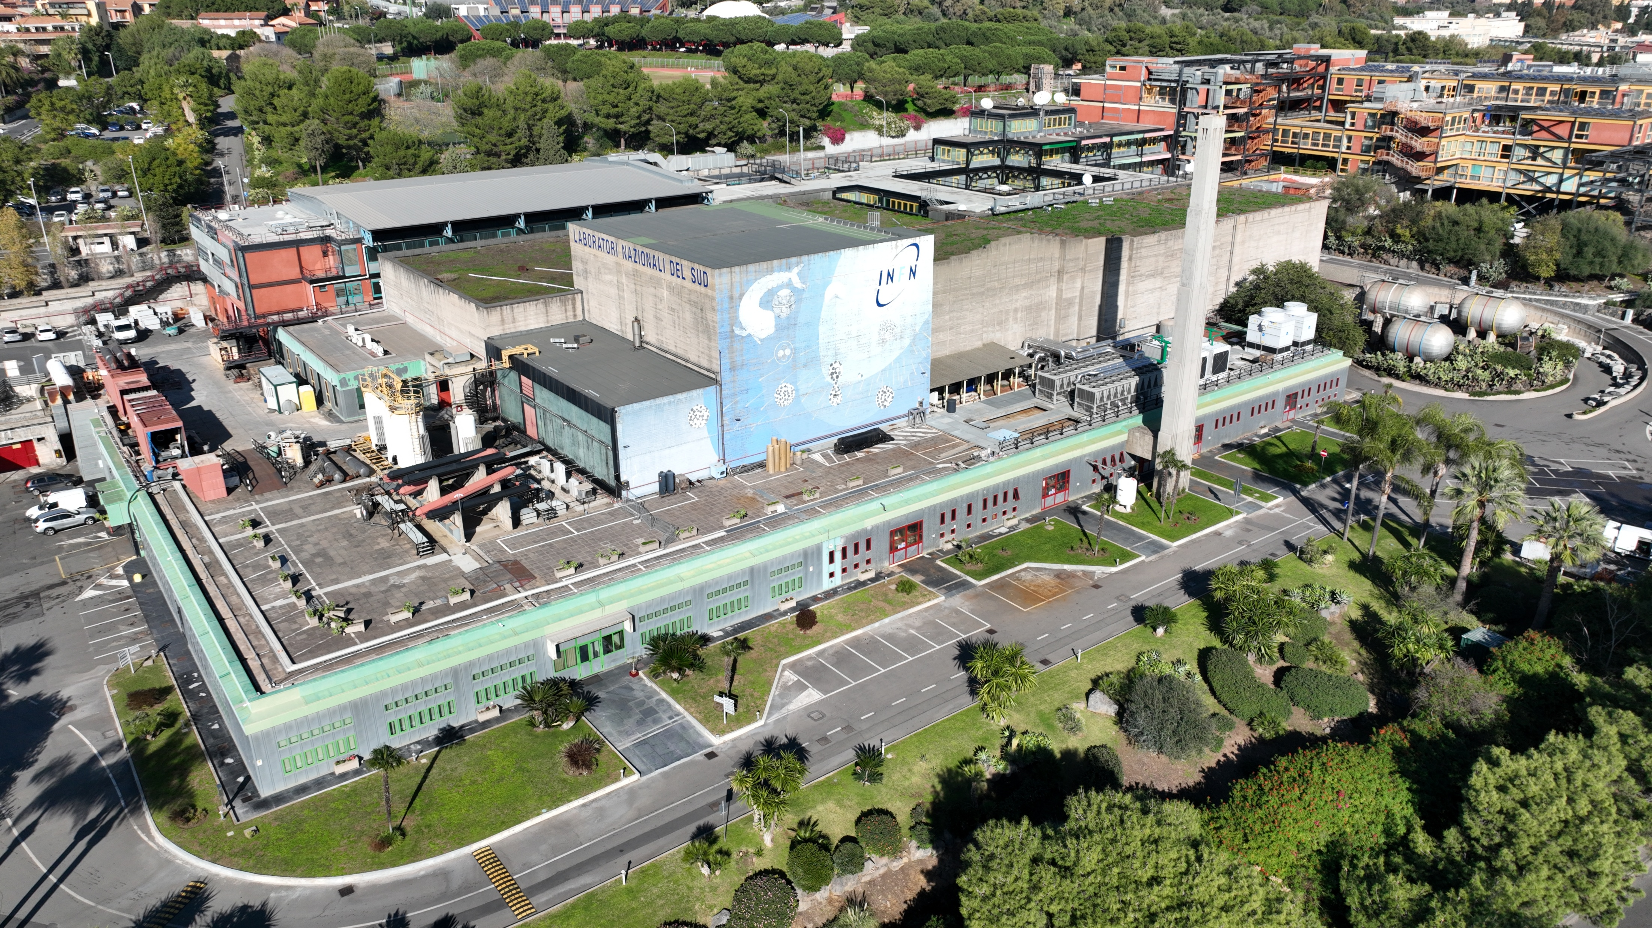
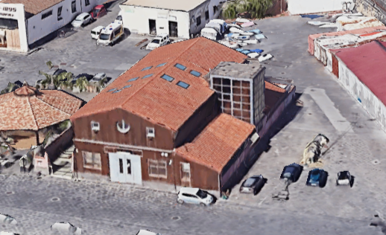
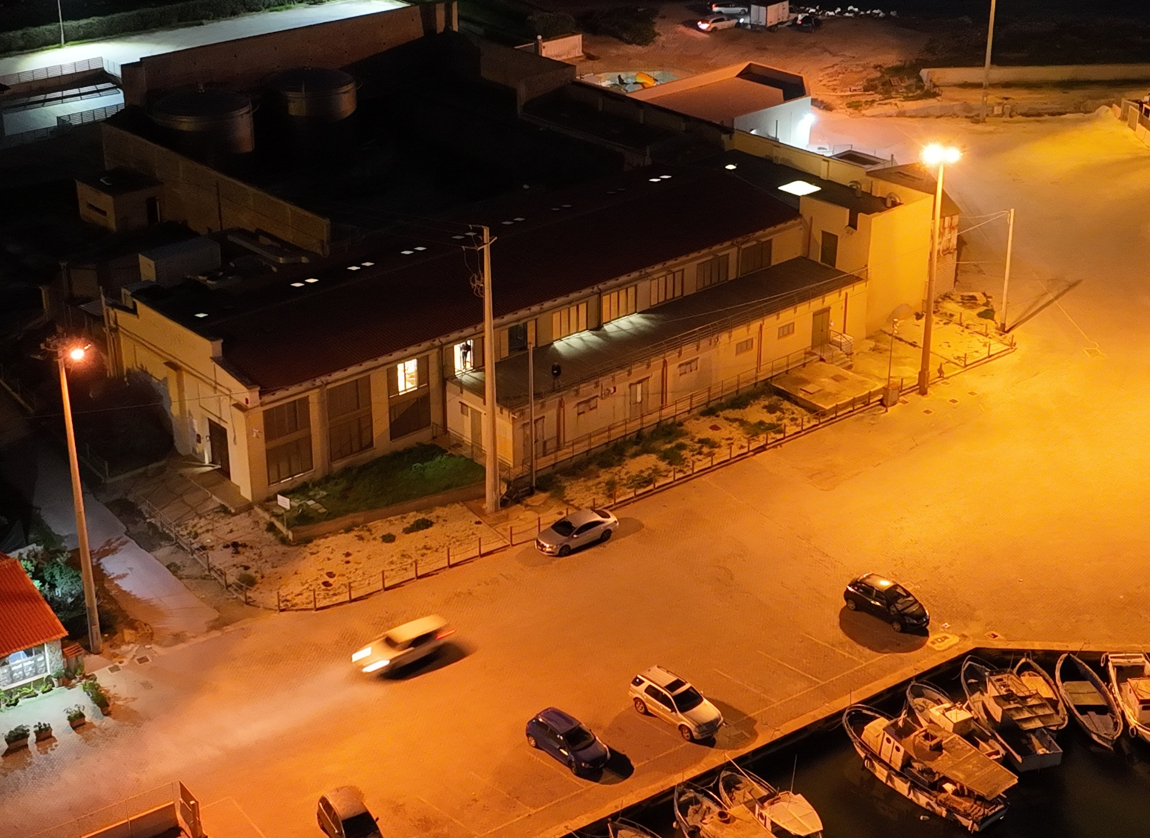

Slide 14
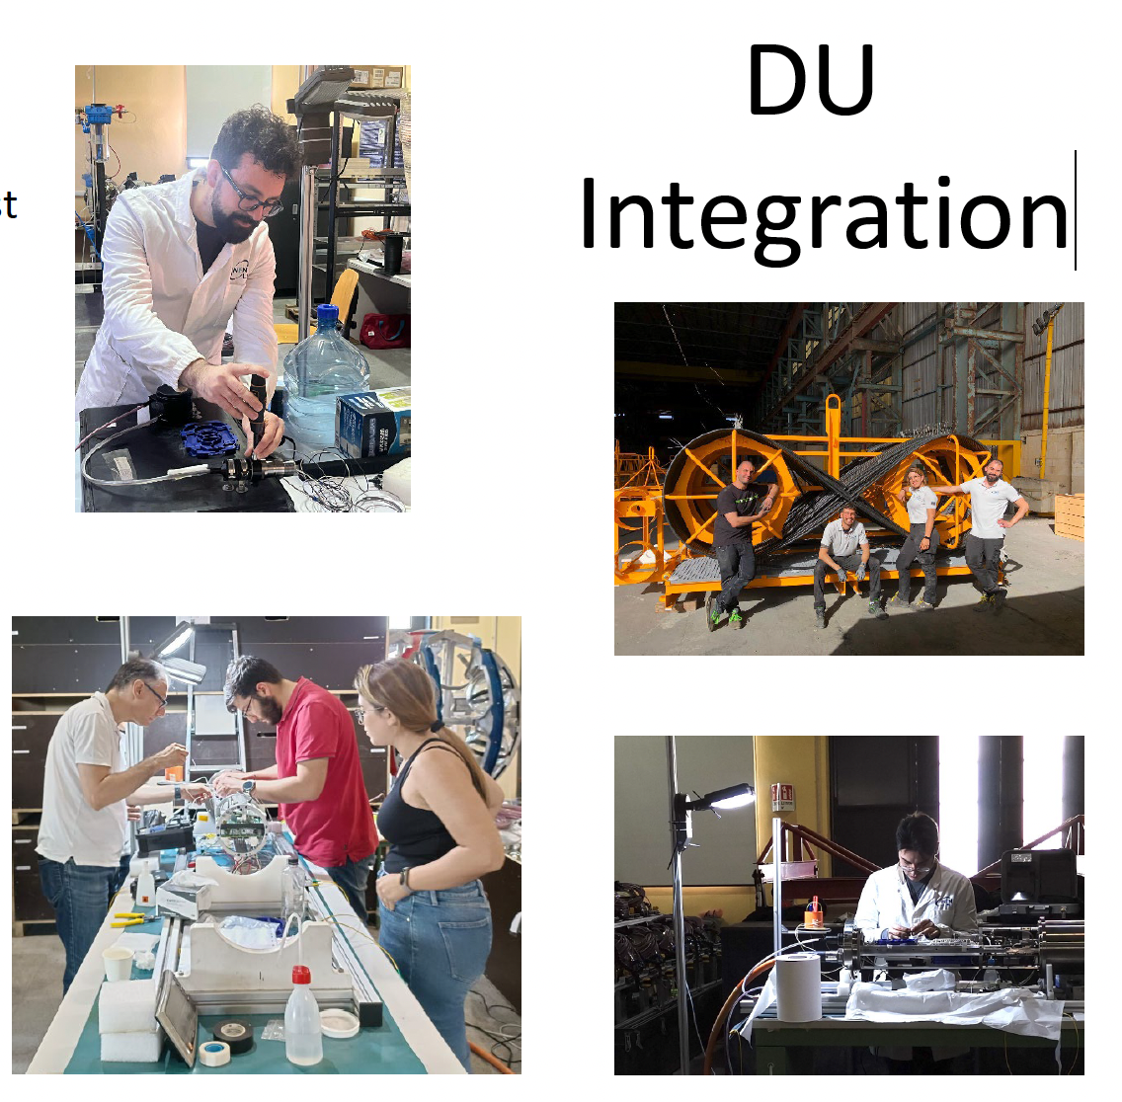
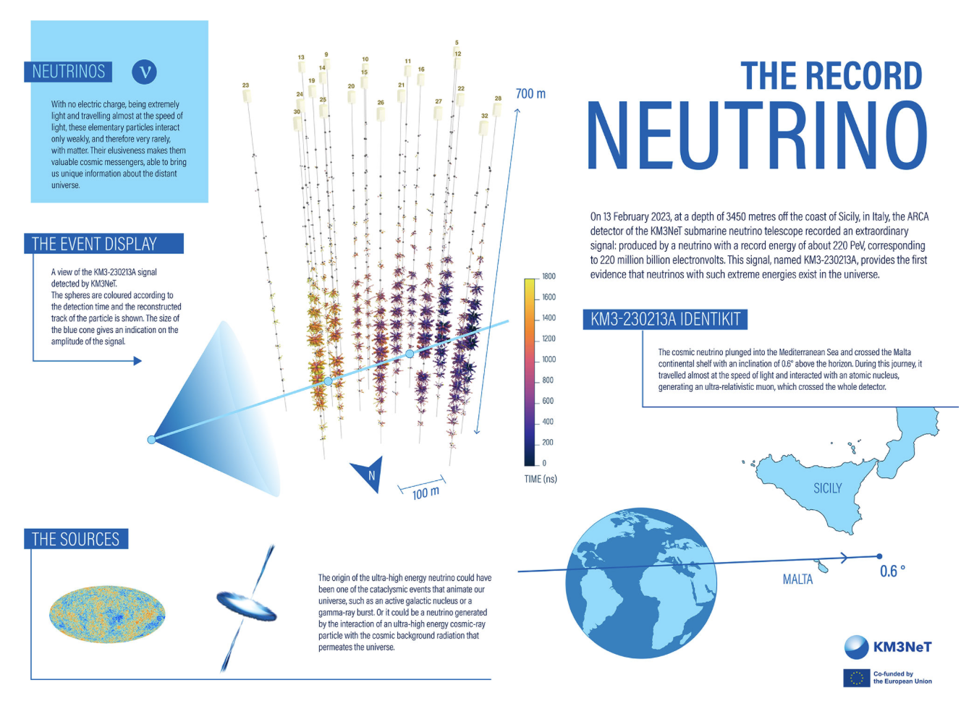
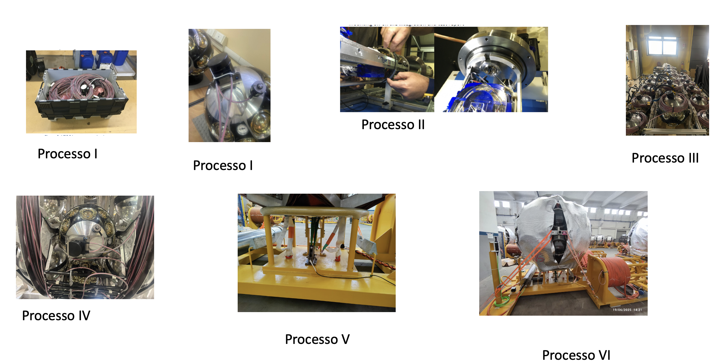
The Record Neutrino and the record supporting LNS user service
KM3NeT collaboration Nature volume 638, pages 376–382 (2025)

Slide 15



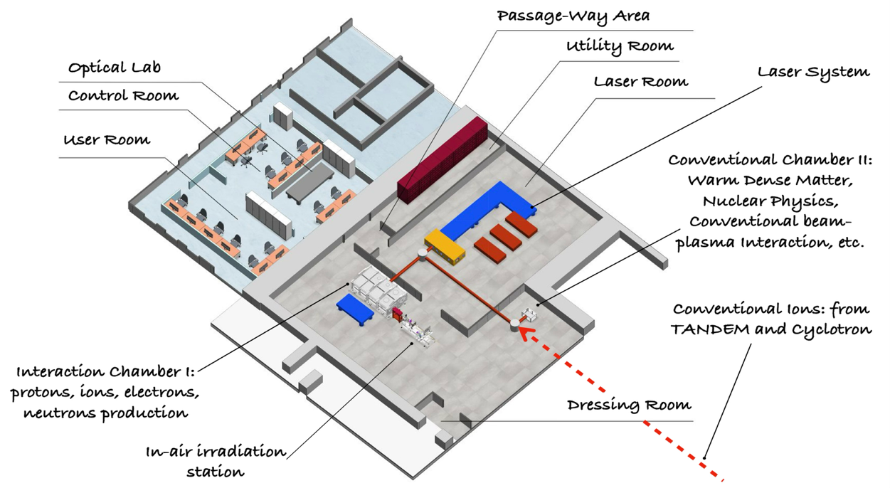

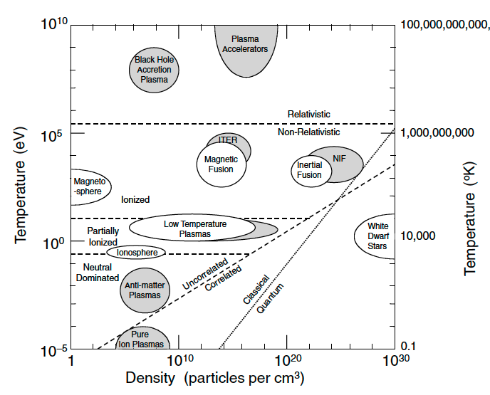
Future laser-based research infrastructure @ INFN-LNS: I-LUCE (INFN – Laser indUCEd radiation production) facility
Two laser systems (L1 and L2)
Three laser outputs
Four experimental stations (ES1, ES2, ES3 and ES4)
L1
ES1
L2
I-LUCE
ES3
ES2
ES4
WDM
Electron temperature [K] | 10¹⁰ – 10¹¹ (MeV range)
Electron density [cm-3] | 10²¹ – 10²⁴
Ion temperature [K] | 10⁷ – 10⁹
Compressed matter density [cm-3] | Up to 10²⁶
CM
15

Slide 16



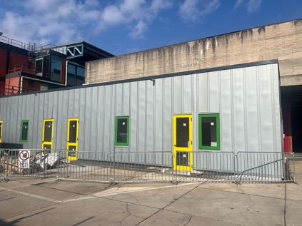
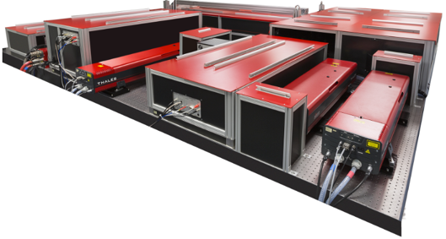
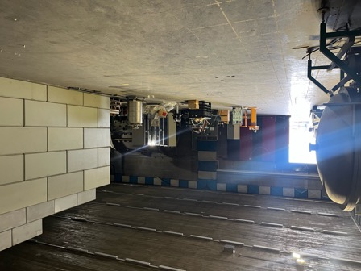
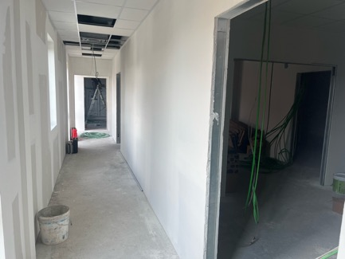

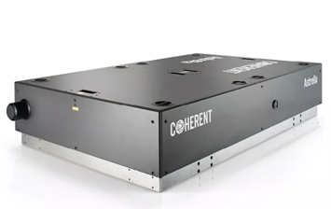
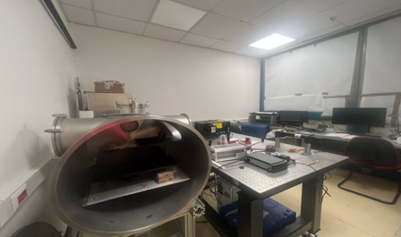
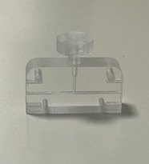
Available laser systems @ I-LUCE facility
Quark 320 system
Control and Users room
L1
Laser Power | < 260 GW
Laser wavelength | 860 nm
Laser Energy per Pulse | 5 – 9 mJ
Laser Pulse Duration | > 35 fs
Laser Intensity | ${10}^{17}$ – ${10}^{18} \frac{W}{{cm}^{2}}$
Repetition Rate | 1 kHz
Plasma Density | ${10}^{17}$–${10}^{19}$ ${cm}^{−3 }$
Experimental area
Optical laboratory
L2
Laser Power | 45 – 320 TW
Laser wavelength | 860 nm
Laser Energy per Pulse | 1.5 – 8 J
Laser Pulse Duration | 23 – 25 fs
Laser Intensity | ${10}^{18}$ – ${10}^{20} \frac{W}{{cm}^{2}}$
Repetition Rate | 2.5 – 10 Hz
Plasma Density | ${10}^{17}$ –${10}^{19}$ ${cm}^{−3}$
Strehl Ratio | >80% with Deformable Mirror
Plasma laboratory
Astrella laser system
Plasma discharge capillary
Photos of the laser system/control area building ?

