Slide 1
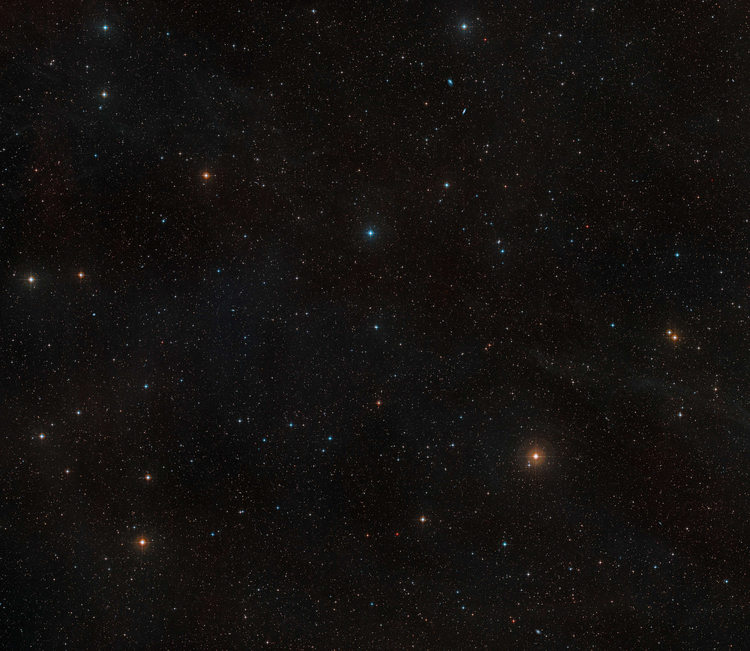
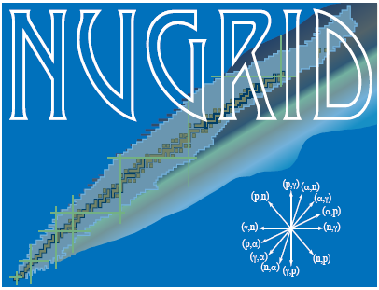




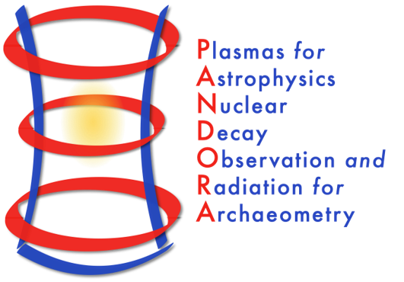
Explosive nucleosynthesis, nucleosynthesis beyond Fe
NUSDAF 2025 - 1st Collaboration Meeting on NUclear Structure, Dynamics and Astrophysics at FRIB
Catania, Oct 22, 2025
Lorenzo Roberti, INFN – Laboratori Nazionali del Sud, Catania, Italy
Main collaborations:
Pandora + AsFiN
Budapest group: M. Pignatari, M. Lugaro
Rome + Berkeley group: M. Limongi, A. Chieffi, A. Falla, L. Boccioli
NuGriD collaboration

Slide 2
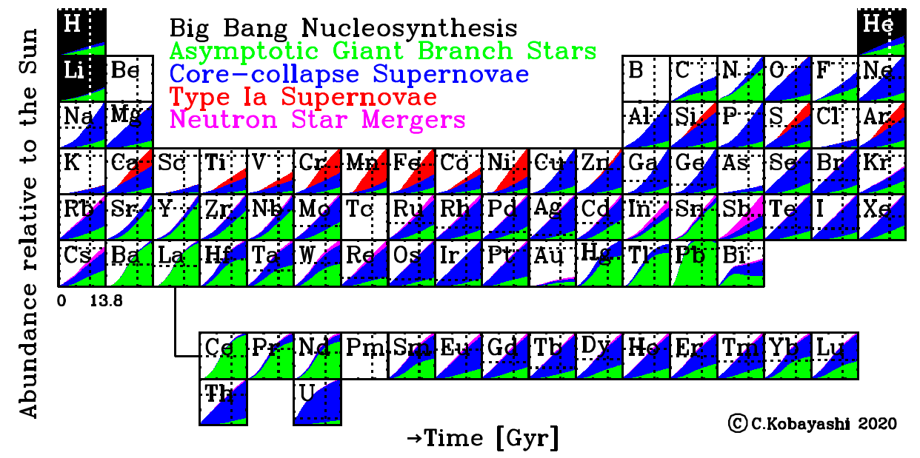
Nucleosynthesis of the elements

Slide 3
The core-collapse supernova scenario
Massive stars (M>9 M⊙) go through all the nuclear burning stages in a non degenerate environment, form a Fe core, and eventually explode as core-collapse supernova (CCSN).
The Fe core becomes unstable, collapses to nuclear density, rebounces, and through a sequence of events a shock wave is launched, driving the explosion of the star.
The propagation of the shock wave through the mantle of the star induces compression and heating → some modification of the chemical composition produced during the hydrostatic burning stages is expected → Explosive nucleosynthesis.

Slide 4
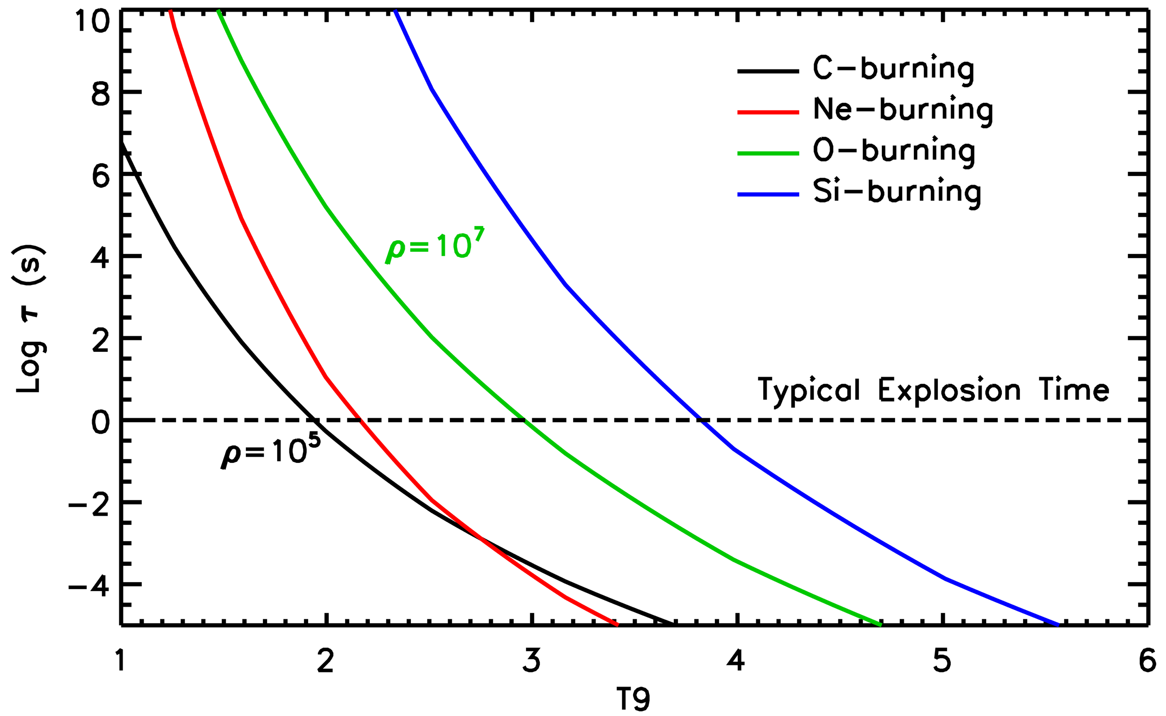

The core-collapse supernova scenario
Explosive nucleosynthesis occurs on a much shorter timescale than that of the hydrostatic nucleosynthesis.
Therefore, higher temperatures are required to exhaust a certain nuclear fuel.
For the typical explosion timescale ($\sim$1 s), the typical burning temperature for any given nuclear burning to occur is:

Slide 5

The core-collapse supernova scenario
Explosive nucleosynthesis occurs on a much shorter timescale than that of the hydrostatic nucleosynthesis.
Therefore, higher temperatures are required to exhaust a certain nuclear fuel.
For the typical explosion timescale ($\sim$1 s), the typical burning temperature for any given nuclear burning to occur is:
No major nuclear burning occurs over the typical explosion timescale at $T <1.9∙109 \text{K}$. Explosive He-H burning? n-process?

Slide 6
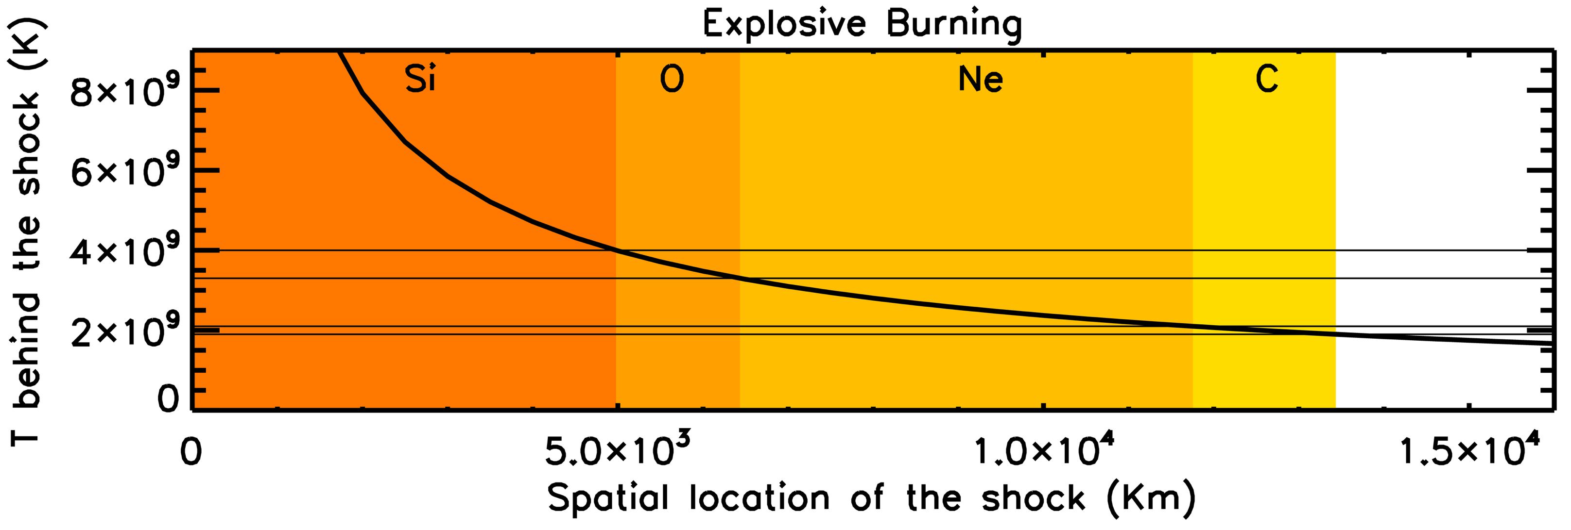



The core-collapse supernova scenario
The explosion is radiation dominated: we can identify "volumes" in the star within which the various explosive burning can occur →This is (almost) independent from the properties of the pre-supernova star!
:
$$E_{expl}≃1 foe \left(1 foe={10}^{51}erg\right)$$
$$T9≥ 4 → RxSi ≤5000 km$$
$$T9≥ 3.3 → RxO ≤6400 km$$
$$T9≥ 2.1 → RxNe≤11750 km$$
$$T9≥ 1.9 → RxC ≤13400 km$$
$$T_{shock}={\left(\frac{3E_{expl}}{4πaR_{shock}^{3}}\right)}^{1/4}$$

Slide 7
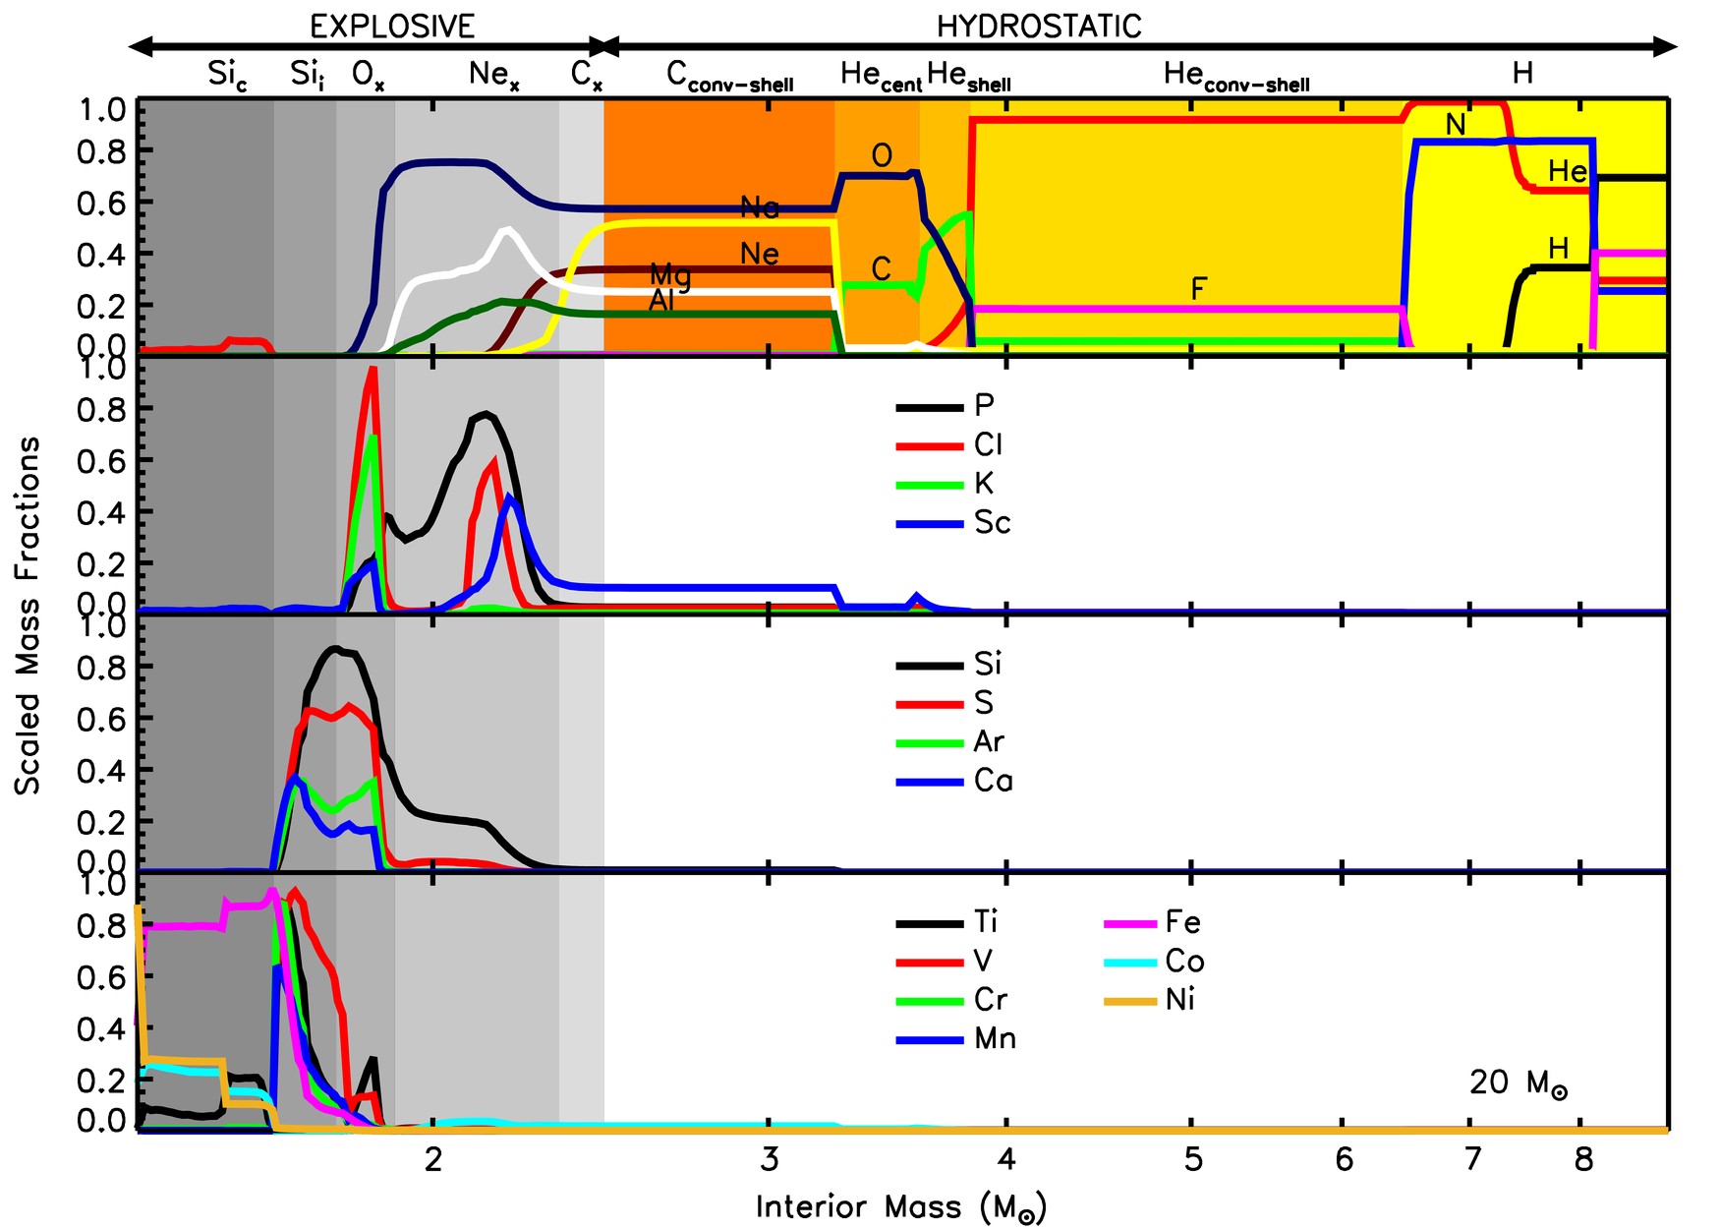
Explosive nucleosynthesis in CCSNe
Element | Production Site
N (¹⁴N) | Hydrostatic H burning
F (¹⁹F) | Hydrostatic He convective shell
C (¹²C) O (¹⁶O) | Hydrostatic core He burning (¹⁶O partially modified by Cshell and Ne_{x})
Ne (²⁰Ne) Na (²³Na) Mg (²⁴Mg) Al (²⁷Al) | Hydrostatic C convective shell Partially destroyed by C_{x} (²³Na) and Ne_{x} (²⁰Ne) Partially produced by Ne_{x} (²⁴Mg,²⁷Al)
P (³¹P) | Ne_{x}
Cl (³⁵Cl, ³⁷Cl) | Ne_{x}+O_{x}
K (³⁹K) | O_{x}
Sc (⁴⁵Sc) | Hydrostatic C convective shell Ne_{x}+O_{x}
Si (²⁸Si) S (³²S) Ar (³⁶Ar) Ca (⁴⁰Ca) | O_{x}+Si_{i}
V (⁵¹Cr) Cr (⁵²Cr,⁵²Fe) Mn (⁵⁵Mn,⁵⁵Co) | Si_{i}
Ti (⁴⁸Cr) | O_{x}+Si_{i}+Si_{c}
Fe (⁵⁶Ni) Co (⁵⁹Co,⁵⁹Ni) Ni (⁵⁸Ni,⁶⁰Ni) | Si_{c}

Slide 8
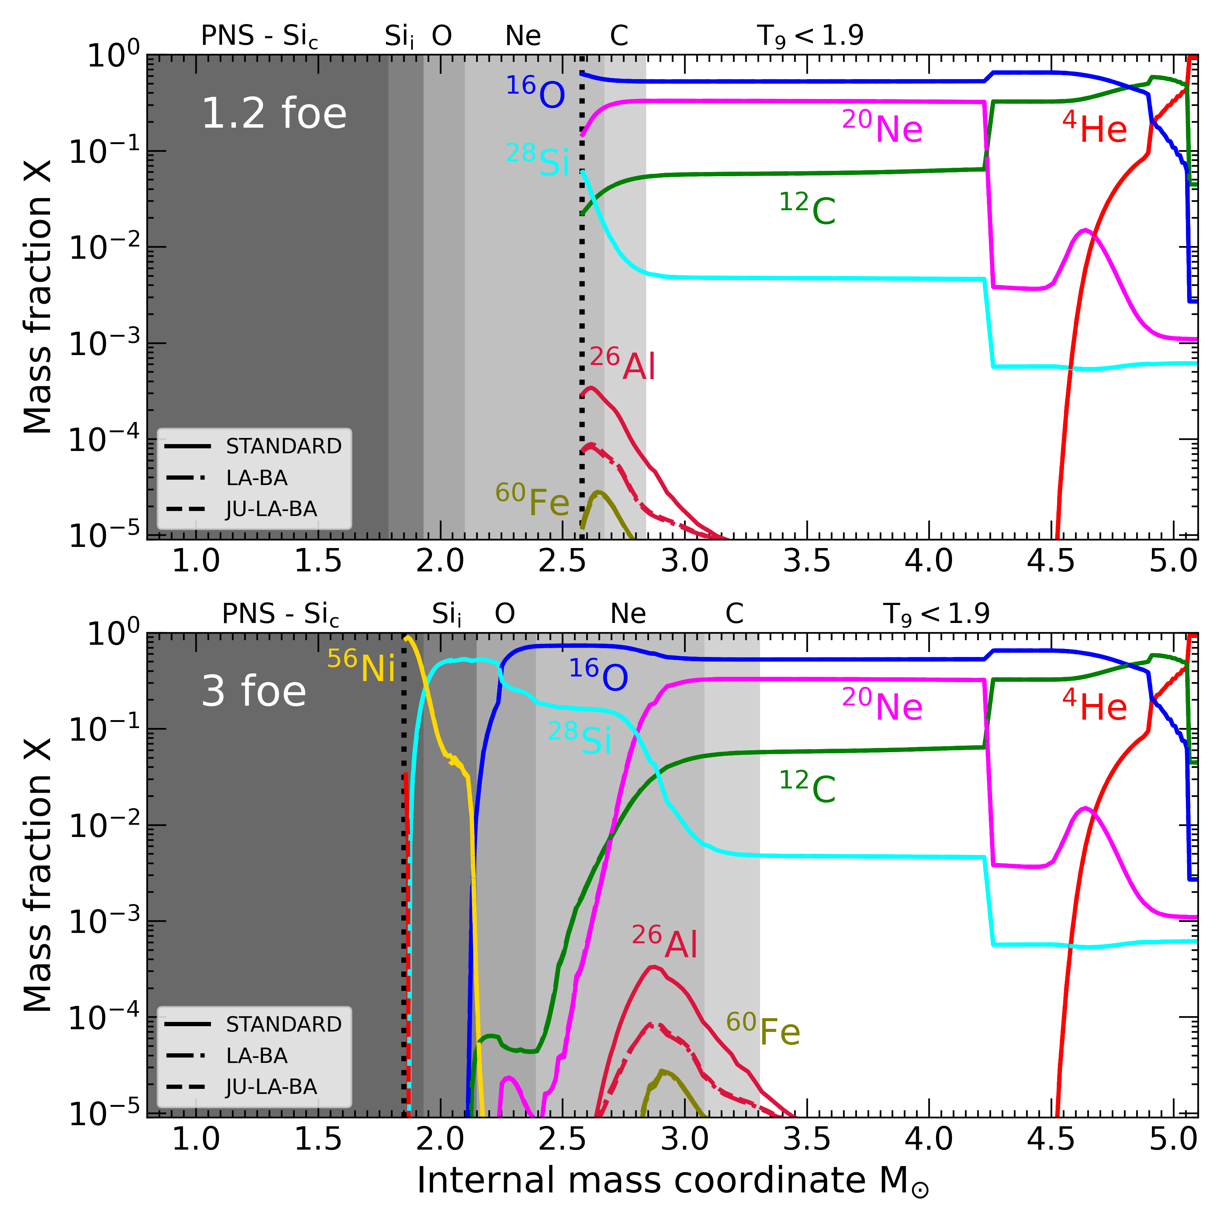
Radioactive nuclei
Production of Short-Lived Radioactive (SLR) nuclei:
²⁶Al and ⁶⁰Fe produced in Ne_{x} burning;
³⁶Cl produced via n-captures in C_{x} burning;
⁴¹Ca and ⁵³Mn produced in Si_{x} and O_{x} burning;
⁹²Nb, ^{97,98}Tc, ¹⁴⁶Sm via the 𝜸−process in Ne_{x} burning.
Battino, Roberti et al., 2024, Universe, 10, 204

Slide 9
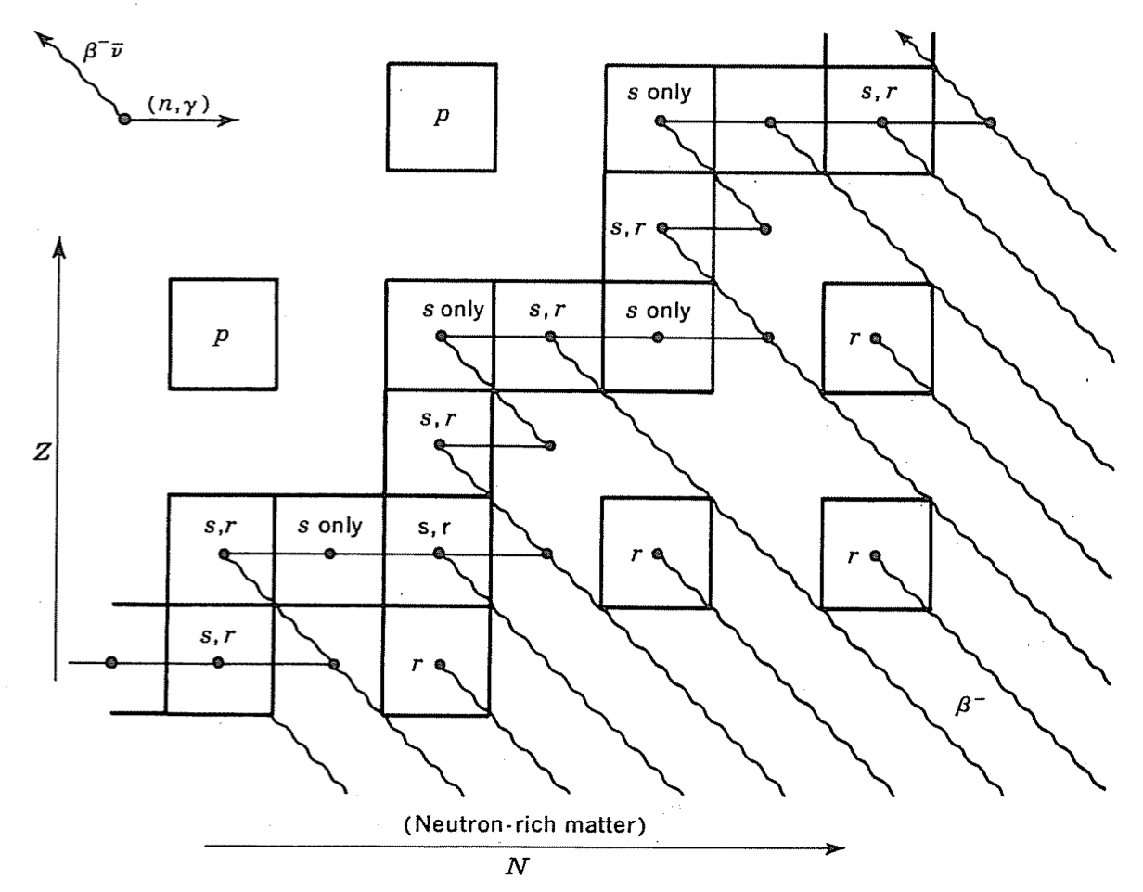


The $γ−$process nucleosynthesis
The γ-process: a sequence of photodisintegrations (γ,n), (γ,p), and (γ,$α$) in O/Ne rich layers in CCSN explosions from massive star progenitors (e.g., Woosley & Howard, 1978; Rayet et al., 1995);
Production of p-nuclei: 35 neutron-deficient isotopes of elements heavier than Fe;
Underproduction of typical γ-process yields from massive stars (factor of $\sim$2-4) compared to the solar system abundances. Larger underproduction of ^{92,94}Mo and ^{96,98}Ru yields ($\sim 1$ order of magnitude).
Clayton, D.D. (1968) Principles of Stellar Evolution and Nucleosynthesis. University of Chicago Press, Chicago.

Slide 10
The $γ−$process nucleosynthesis
Temperature: between 2 and 3.5 GK → explosive O and Ne burning;
It is a chain of photodisintegrations: the nuclear uncertainties propagate from heavier to lighter nuclei;
Difficulty to explain even the heaviest p-nuclei isotopic ratios.
Roberti et al., 2023, A&A, 677, A22

Slide 11
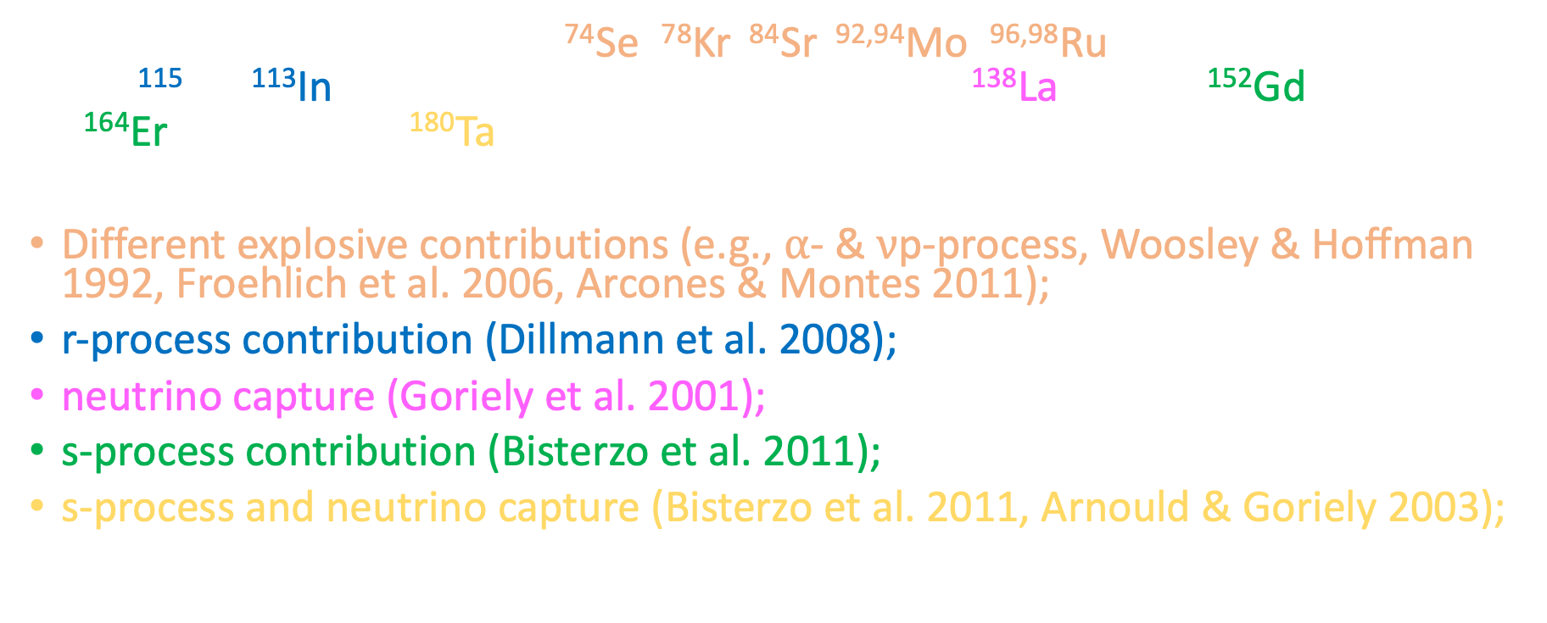
The $γ−$process nucleosynthesis
35 stable proton-rich nuclei: ⁷⁴Se, ⁷⁸Kr, ⁸⁴Sr, ^{92,94}Mo, ^{96,98}Ru, ¹⁰²Pd, ^{106,108}Cd, ^{112,114,115}Sn, ¹¹³In, ¹²⁰Te, ^{124,126}Xe, ^{130,132}Ba, ^{136,138}Ce, ¹³⁸La, ¹⁴⁴Sm, ¹⁵²Gd, ^{156,158}Dy, ^{162,164}Er, ¹⁶⁸Yb, ¹⁷⁴Hf, ¹⁸⁰Ta, ¹⁸⁰W, ¹⁸⁴Os, ¹⁹⁰Pt and ¹⁹⁶Hg.
Different explosive contributions (e.g., $α$- & $ν$p-process, Woosley & Hoffman 1992, Froehlich et al. 2006, Arcones & Montes 2011);
r-process contribution (Dillmann et al. 2008);
neutrino capture (Goriely et al. 2001);
s-process contribution (Bisterzo et al. 2011);
s-process and neutrino capture (Bisterzo et al. 2011, Arnould & Goriely 2003);
cold $γ$-process in pre-SN for A<110 (Roberti et al. 2023).

Slide 12
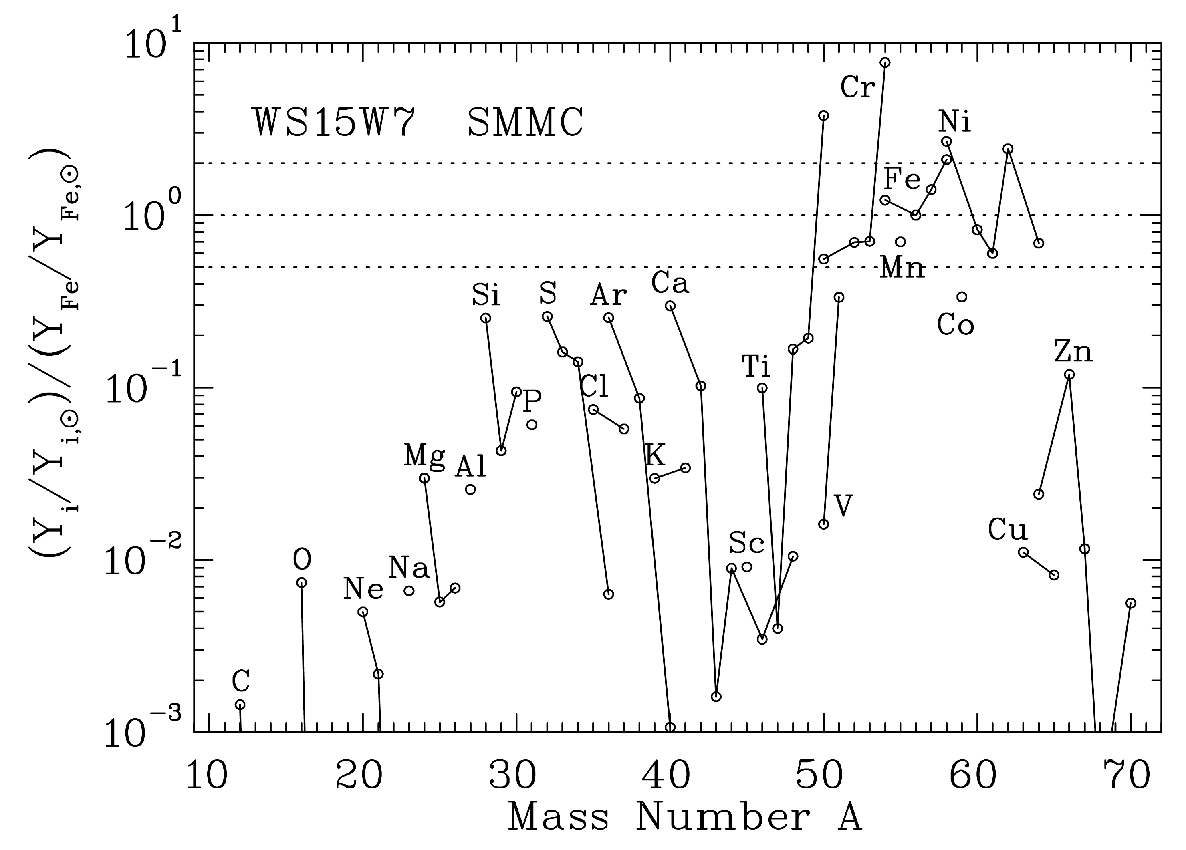
The Type IA supernova scenario
Type Ia Supernovae: explosion of an electron degenerate structure (COWD or ONeWD) due to accretion of H-/ He-/ C/O-rich matter from a companion.
Thermonuclear runaway in a degenerate environment: the incineration of the matter up to an NSE chemical composition.
Main products are Fe-peak nuclei. Possible contribution to p-nuclei from s-process seeds.
Single or Double degenerate scenarios, deflagration or detonation?
Brachwitz et al., 2000, ApJ, 536, 934

Slide 13
Other explosive scenarios
Novae: stellar explosions that occur in close binary systems. Hydrogen-rich matter is transferred via Roche lobe overflow from a low-mass main-sequence star to the surface of a compact white dwarf (CO or ONe).
X-Ray Bursts: thermonuclear explosions that take place on the surface of accreting neutron stars in binary systems.
Common envelope with NS: similar to XRB, accretion on a neutron star in a common envelope system.

Slide 14
Summary and conclusions
Explosive nucleosynthesis made a large fraction of the element of the periodic table;
Massive stars end their lives as CCSNe, ejecting newly formed elements;
The shock-driven explosive burning reshapes the chemical composition of stellar layers, producing intermediate elements, radioactive and p-nuclei;
Type Ia SNe, novae, and X-ray bursts (possibly) complement CCSNe in Galactic enrichment.

