Slide 1


Detector arrays for indirect experiments with RIBs in Nuclear Astrophysics
G.L. Guardo on behalf of the AsFiN group

Slide 2
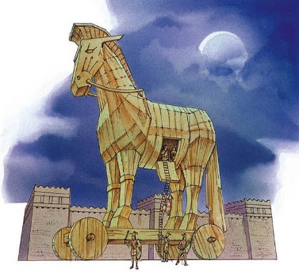
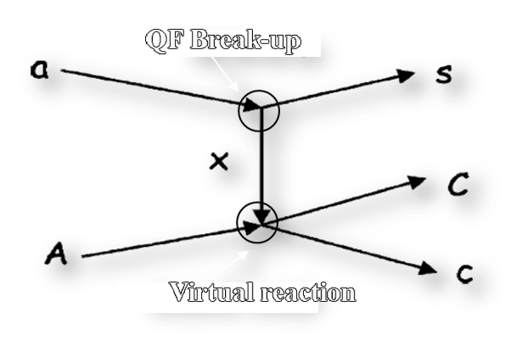
The Trojan Horse Method
The idea of the THM is to extract the cross section of an astrophysically relevant two-body reaction A+x→c+C at low energies from a suitable three-body reaction a+A→c+C+s
Quasi free kinematics is selected
only x - A interaction
s = spectator (p_{s}~0)
E_{A} > E_{Coul} →
NO coulomb suppression
NO electron screening
NO centrifugal barrier
THM Review paper→ Spitaleri C. et al., Prob. of Fund. Mod. Phys., 1991 Tumino A. et al., An. Rev. Nuc. and Part. Sci. 2021

Slide 3
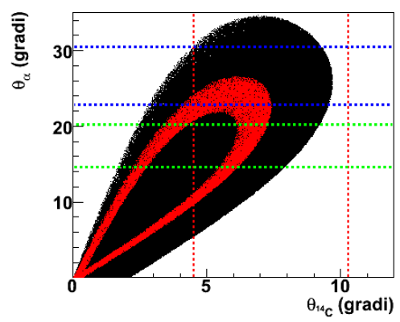
Preliminary Study
Study of the ¹⁷O(n,α)¹⁴C reaction: extension of the Trojan Horse Method to neutron induced reactions
¹⁷O+²H, E_{beam}=43.3 MeV
Deuteron as source of virtual neutrons!!
This allows then to determine the experimental apparatus:
¹⁴C detection→ 6°<θ_{C}<10°
α detection→15°<θ_{α}<20°
→23°<θ_{α}<31°
Black points: kinematic calculations
Red points: kinematic calculations + |p_{s}|<5 MeV/c

Slide 4
Experimental Setup
²H
p
The reaction ¹⁷O(n,α)¹⁴C was studied via the ²H(¹⁷O,α¹⁴C)p , V_{coul}=2.3 MeV;
The deuteron is the TH nucleus. Strong cluster n+p; B=2.2 MeV, |p_{s}|=0 MeV/c .
n
¹⁴C
¹⁷O
α
Experiments performed at ISNAP at the University of Notre Dame (USA) and LNS of Catania;
E_{beam}(¹⁷O)= 43.5 MeV;
Target thickness CD₂ ∼150 µg/cm²;
IC filled with ∼50 mbar isobutane gas;
Angular position to cover the QF angular region
Symmetric set-up in order to increase the statistic.

Slide 5
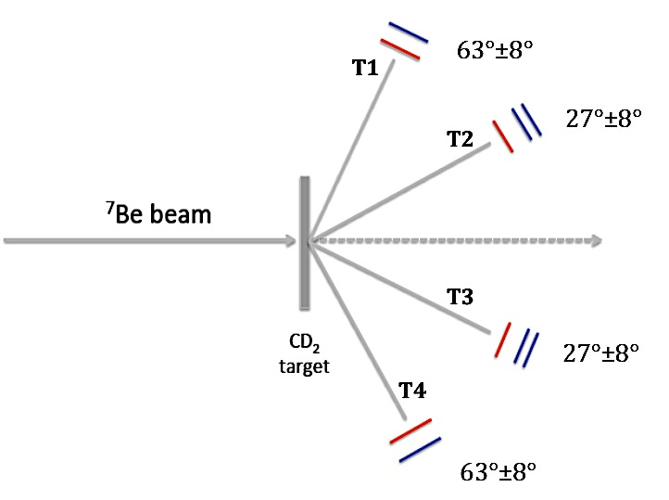
The BELICOS Experimental Setup
The ⁷Be(n,α)α reaction via THM
400 μg/cm² CD₂ target;
EXPADES detection system
Pierroutsakou, D. et al. 2016, NIMPA, 834, 46
Setup symmetrical, respect to the beam line, in the reaction plane
Trigger: coincidence between two telescopes
T2(T3)→ IC + DSSSD (300 μm) + SPad (300 μm)
T1(T4)→ IC + DSSSD (300 μm)
100 mbar isobuthane for IC
Calibration with ⁷Li beam on ¹²C, ¹⁹⁷Au and CH₂

Slide 6
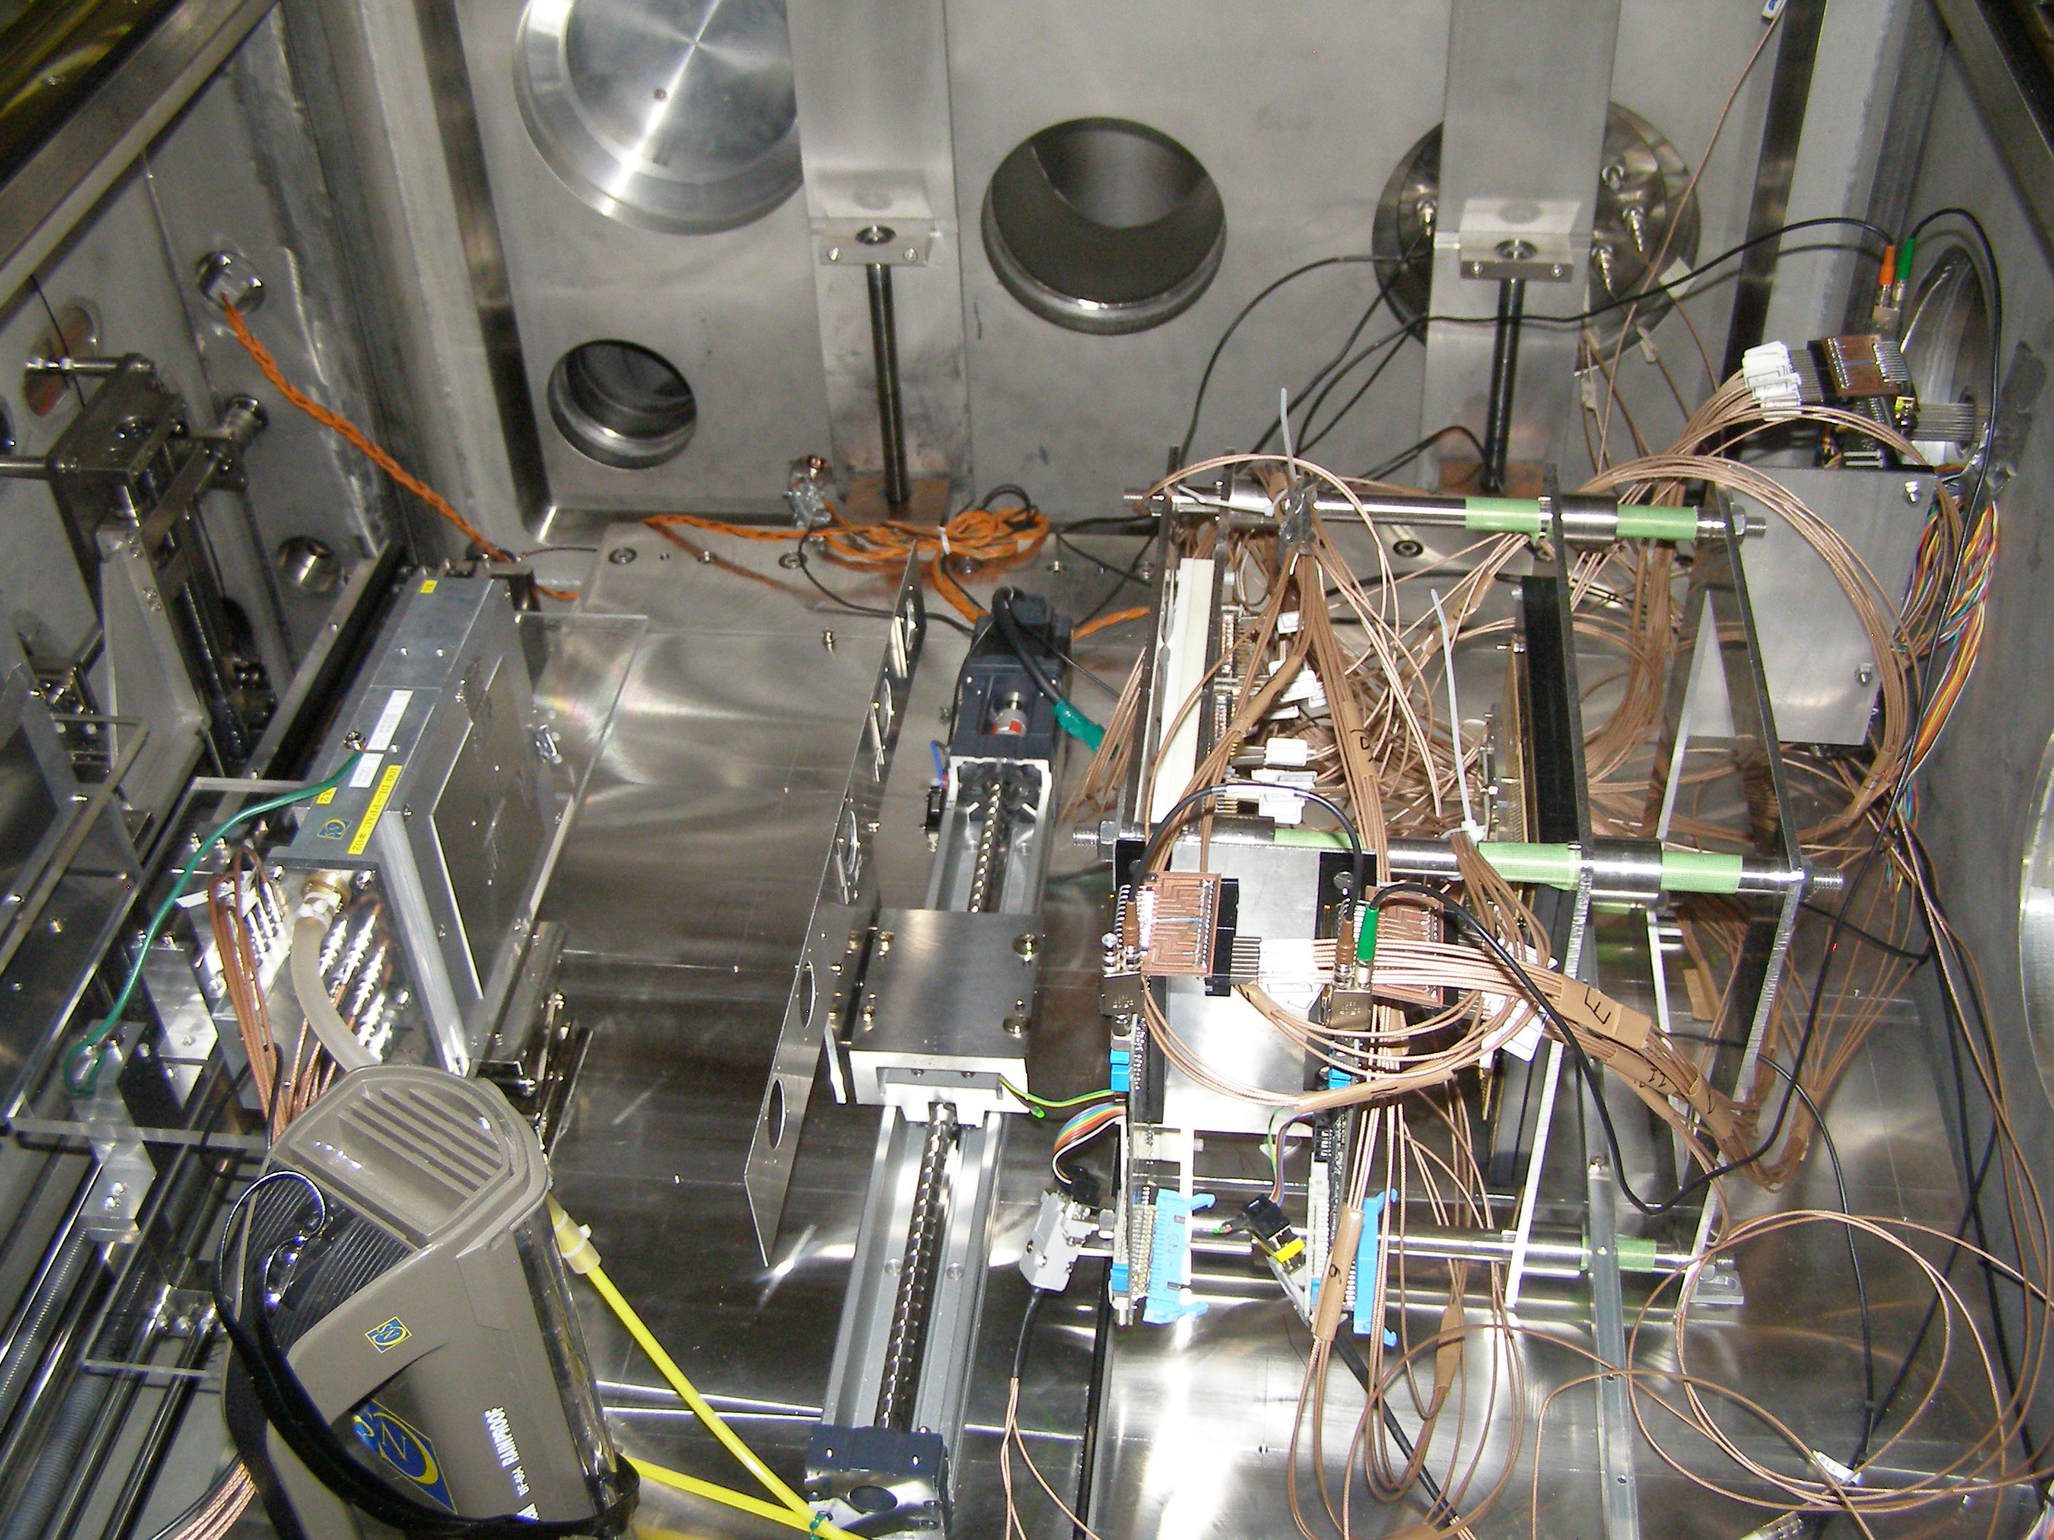
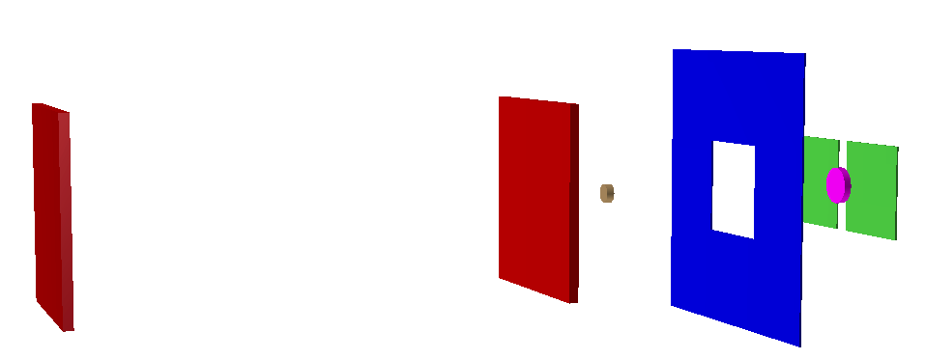
THM study of ¹⁸F(p,α)¹⁵O @ CRIB
ASTRHO
PPAC 2
PPAC2
TARGET
ASTRHO
PPAC 1
Safety
disk
DSSSD
BEAM
TARGET
DSSSD
CD₂ TARGET 150-200 μg/cm^2
ASTRHO → α
n. 8 bidimensional position-sensitive detectors (BPSD,
45 x 45 mm², 500 μm thick
DSSSD → ¹⁵O
n. 2 Double Sided Silicon Strip Detectors (16 strips x-y)
Trigger: total or, off-line multiplicity 2 fixed
 | DSSSD | ASTRHO
Angular range | 2° - 11° | 11° - 31°
Angular resolution | 0.5° (tracking+ detectors) | 0.5° (tracking+ detectors)
Energy resolution | 0.8% | 0.8%

Slide 7
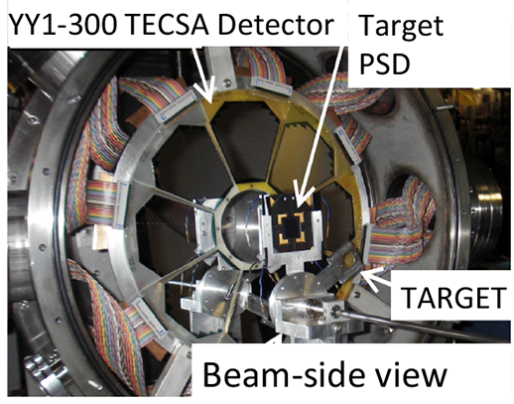
THM study of ¹⁸F(p,α)¹⁵O @ TAMU
TECSA
α
¹⁸F beam
X1 PSD
¹⁵O
CD₂ Target
CD₂ TARGET 400-800 μg/cm^2
TECSA → α
n. 8 16 arch strip YY1-300 um
B.T. Roeder et al. NIM A634, 71 (2011)
X1-PSD → ¹⁵O
n. 2 16 strips each, position sensitive
Trigger: TECSA X1-PSD coincidence
 | X1-PSD | TECSA
Angular range | 3° - 12° | 15° - 40°
Angular resolution | 0.7° | 1.1°
Energy resolution | 0.8% | 0.8%

Slide 8
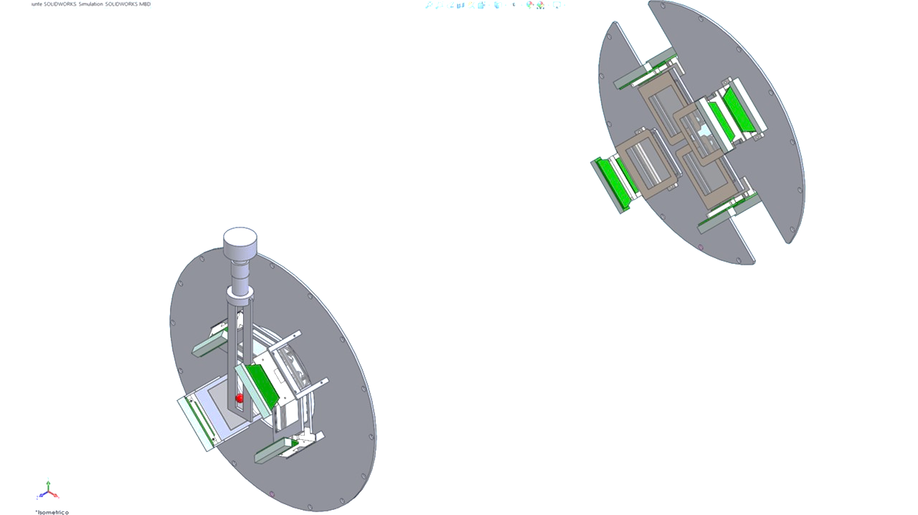
THM study of ²⁶Al(n,p)²⁶Mg @ TRIUMF
NEFASTA
B1 detectors will cover the 2°-6.1° angular range, while B2 telescopes will cover the 2.9°-7.1° interval
8 telescopes arranged into two groups:
- group A 60 mm away from the target, made up of two couples of telescopes, set in the vertical (A1) and in the horizontal (A2) planes. Each telescope will be composed of one DSSSD 1000 μm thick (32x32 strips, 51.2x51.2 mm²) and one pad detector 1500 μm thick
BEAM DIRECTION
A1 group will cover the angular ranges 9.4°-55.6°, while those in A2 will cover 32.9°-79.1°
- The second group of detectors (named B) will be placed at about 700 mm from the target position. Two couples of telescopes, set in the vertical (B1) and in the horizontal (B2) planes, each composed of a 20 μm SSSSD and a 1000 μm DSSSD
Mechanical drawings by Dr. M. Costa

Slide 9
THM study of ¹⁴O(α,p)¹⁷F @ FRIB
Requirements:
Large area coverage
Low detection threshold
No PSD or DE techniques are viable for particle ID
High energy and angular resolution for kinematical particle ID

Slide 10
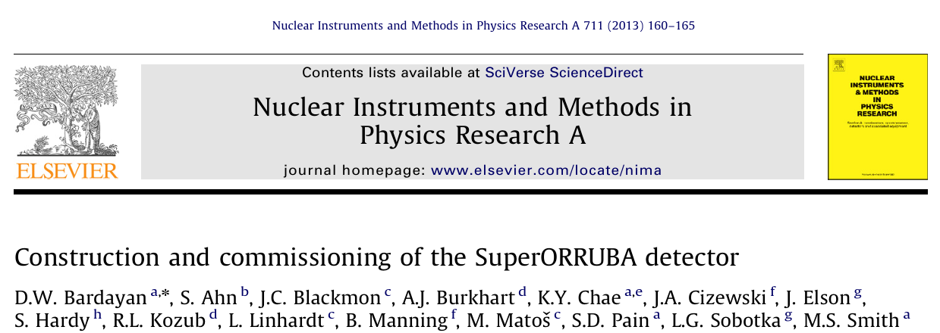
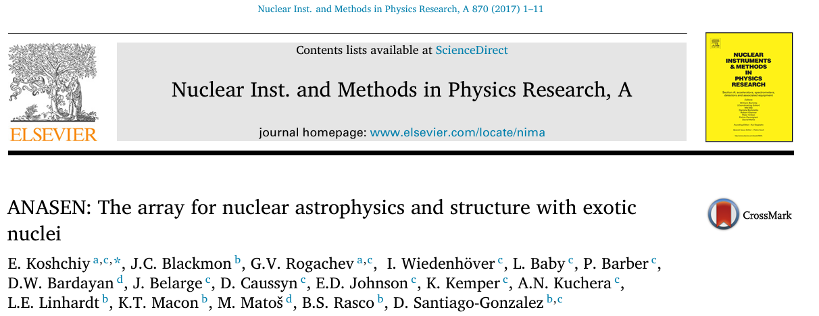
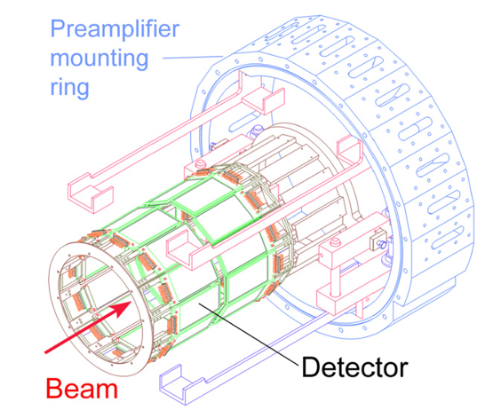
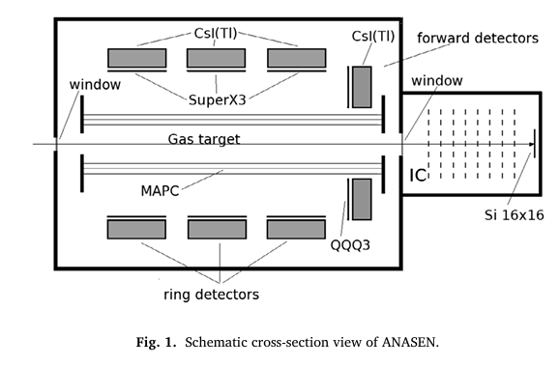
THM study of ¹⁴O(α,p)¹⁷F @ FRIB
Technical detail
SuperORRUBA consists of two rings of silicon detectors designed to operate with one ring forward of 90° in the laboratory and the second backward of 90°. The silicon detectors are based on double-sided non-resistive silicon strip technology. The detectors cover an area, 7.5 cm by 4 cm, with the front sides divided into 64 1.2 mm by 4 cm strips, and the back sides segmented into 4 7.5 cm by 1 cm strips. The 1.2-mm strips are oriented perpendicular to the beam direction, while the 1-cm strips were parallel. The angular resolution in polar angle is less than 1-deg. The azimuthal angular resolution is less important, and thus larger strip pitches are used on the backside.
Technical detail
ANASEN uses a 43-cm long position-sensitive proportional counter surrounding the beam axis to enable an active-target mode. Silicon-strip detectors surround the proportional counter in a barrel configuration with 3 rings of 12 rectangular Super X3 and annular QQQ3 detectors at forward angles form the cap of the barrel. All detectors in the array are backed by trapezoidal-shaped 2-cm thick CsI(TI) crystals.

Slide 11
Large High-resolution Array of Silicon for Astrophysics
Characteristics:
Wide angular range coverage
Low energy threshold
Compactness
High energy resolution
Angular resolution allows for PID

Slide 12
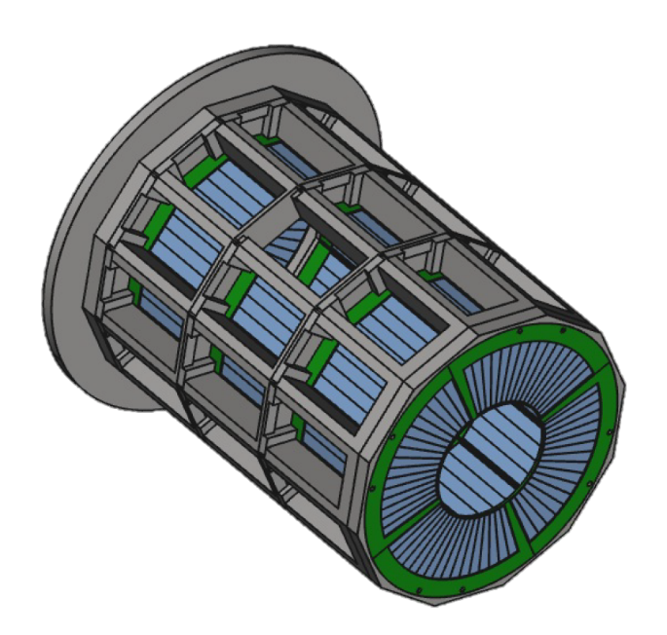

Extreme Light Infrastructure Silicon Strip Array
Characteristics:
Wide angular range coverage
Low energy threshold
Compactness
Angular resolution better than 0.5 cm
Energy resolution better than 1%
Kinematical identification of outgoing particle
Barrel configuration:
3 rings of 12 position sensitive X3 silicon-strip detectors by Micron
2 end cap detectors made up of 4 QQQ3 DSSSD by Micron
>550 channels readout with standard/digital electronics
Perfectly suited for nuclear astrophysical studies!!
G. L. Guardo et al. EPJ Web of Conf. 165, 01026 (2017)

Slide 13
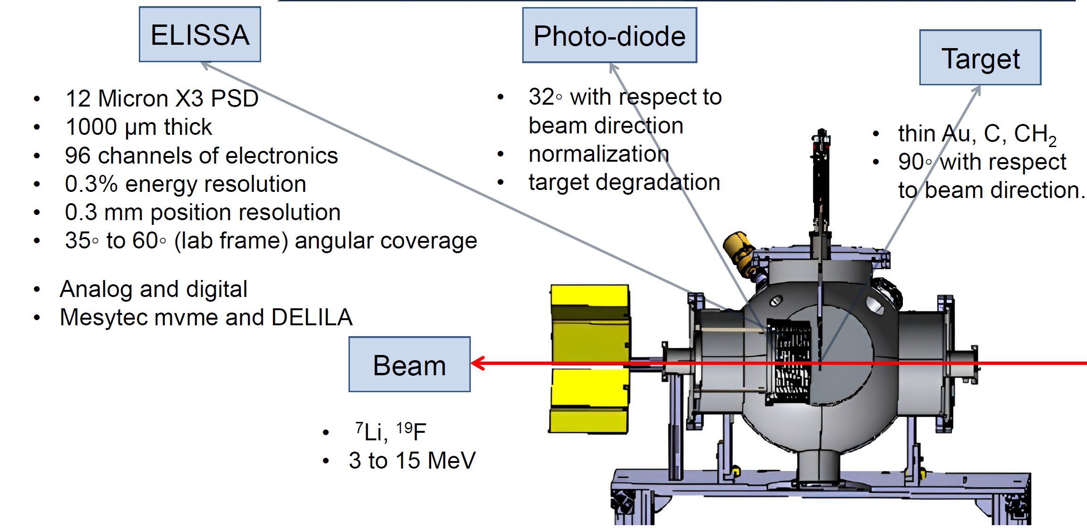
Extreme Light Infrastructure Silicon Strip Array

Slide 14
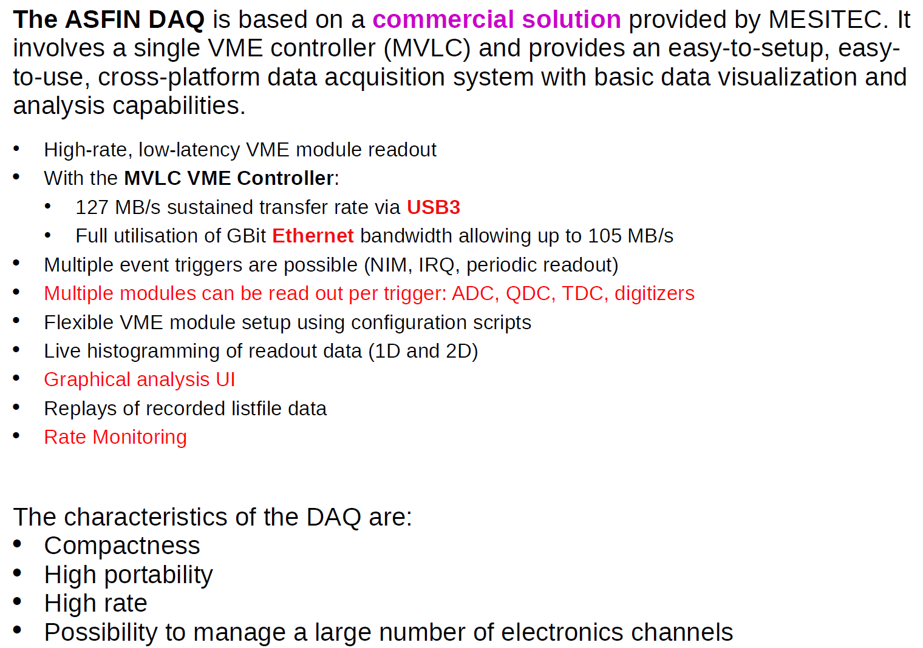
Asfin Data Acquisition

Slide 15
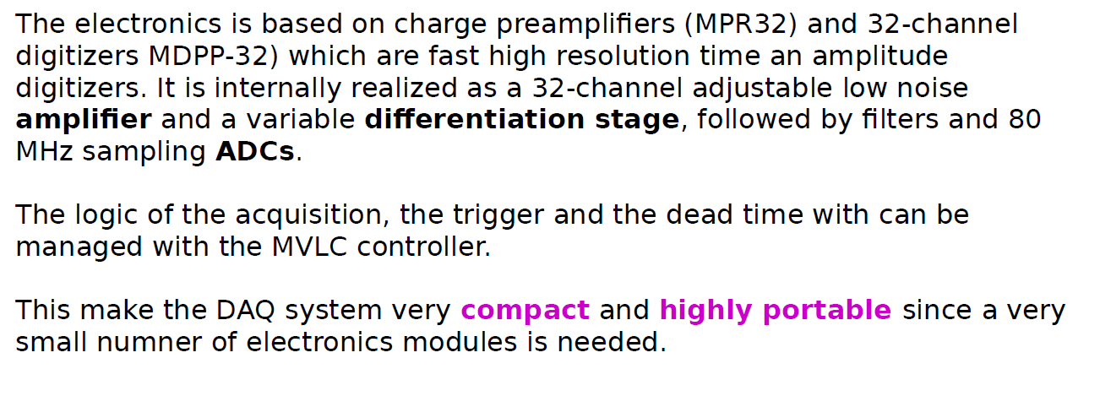
Asfin Data Acquisition

Slide 16
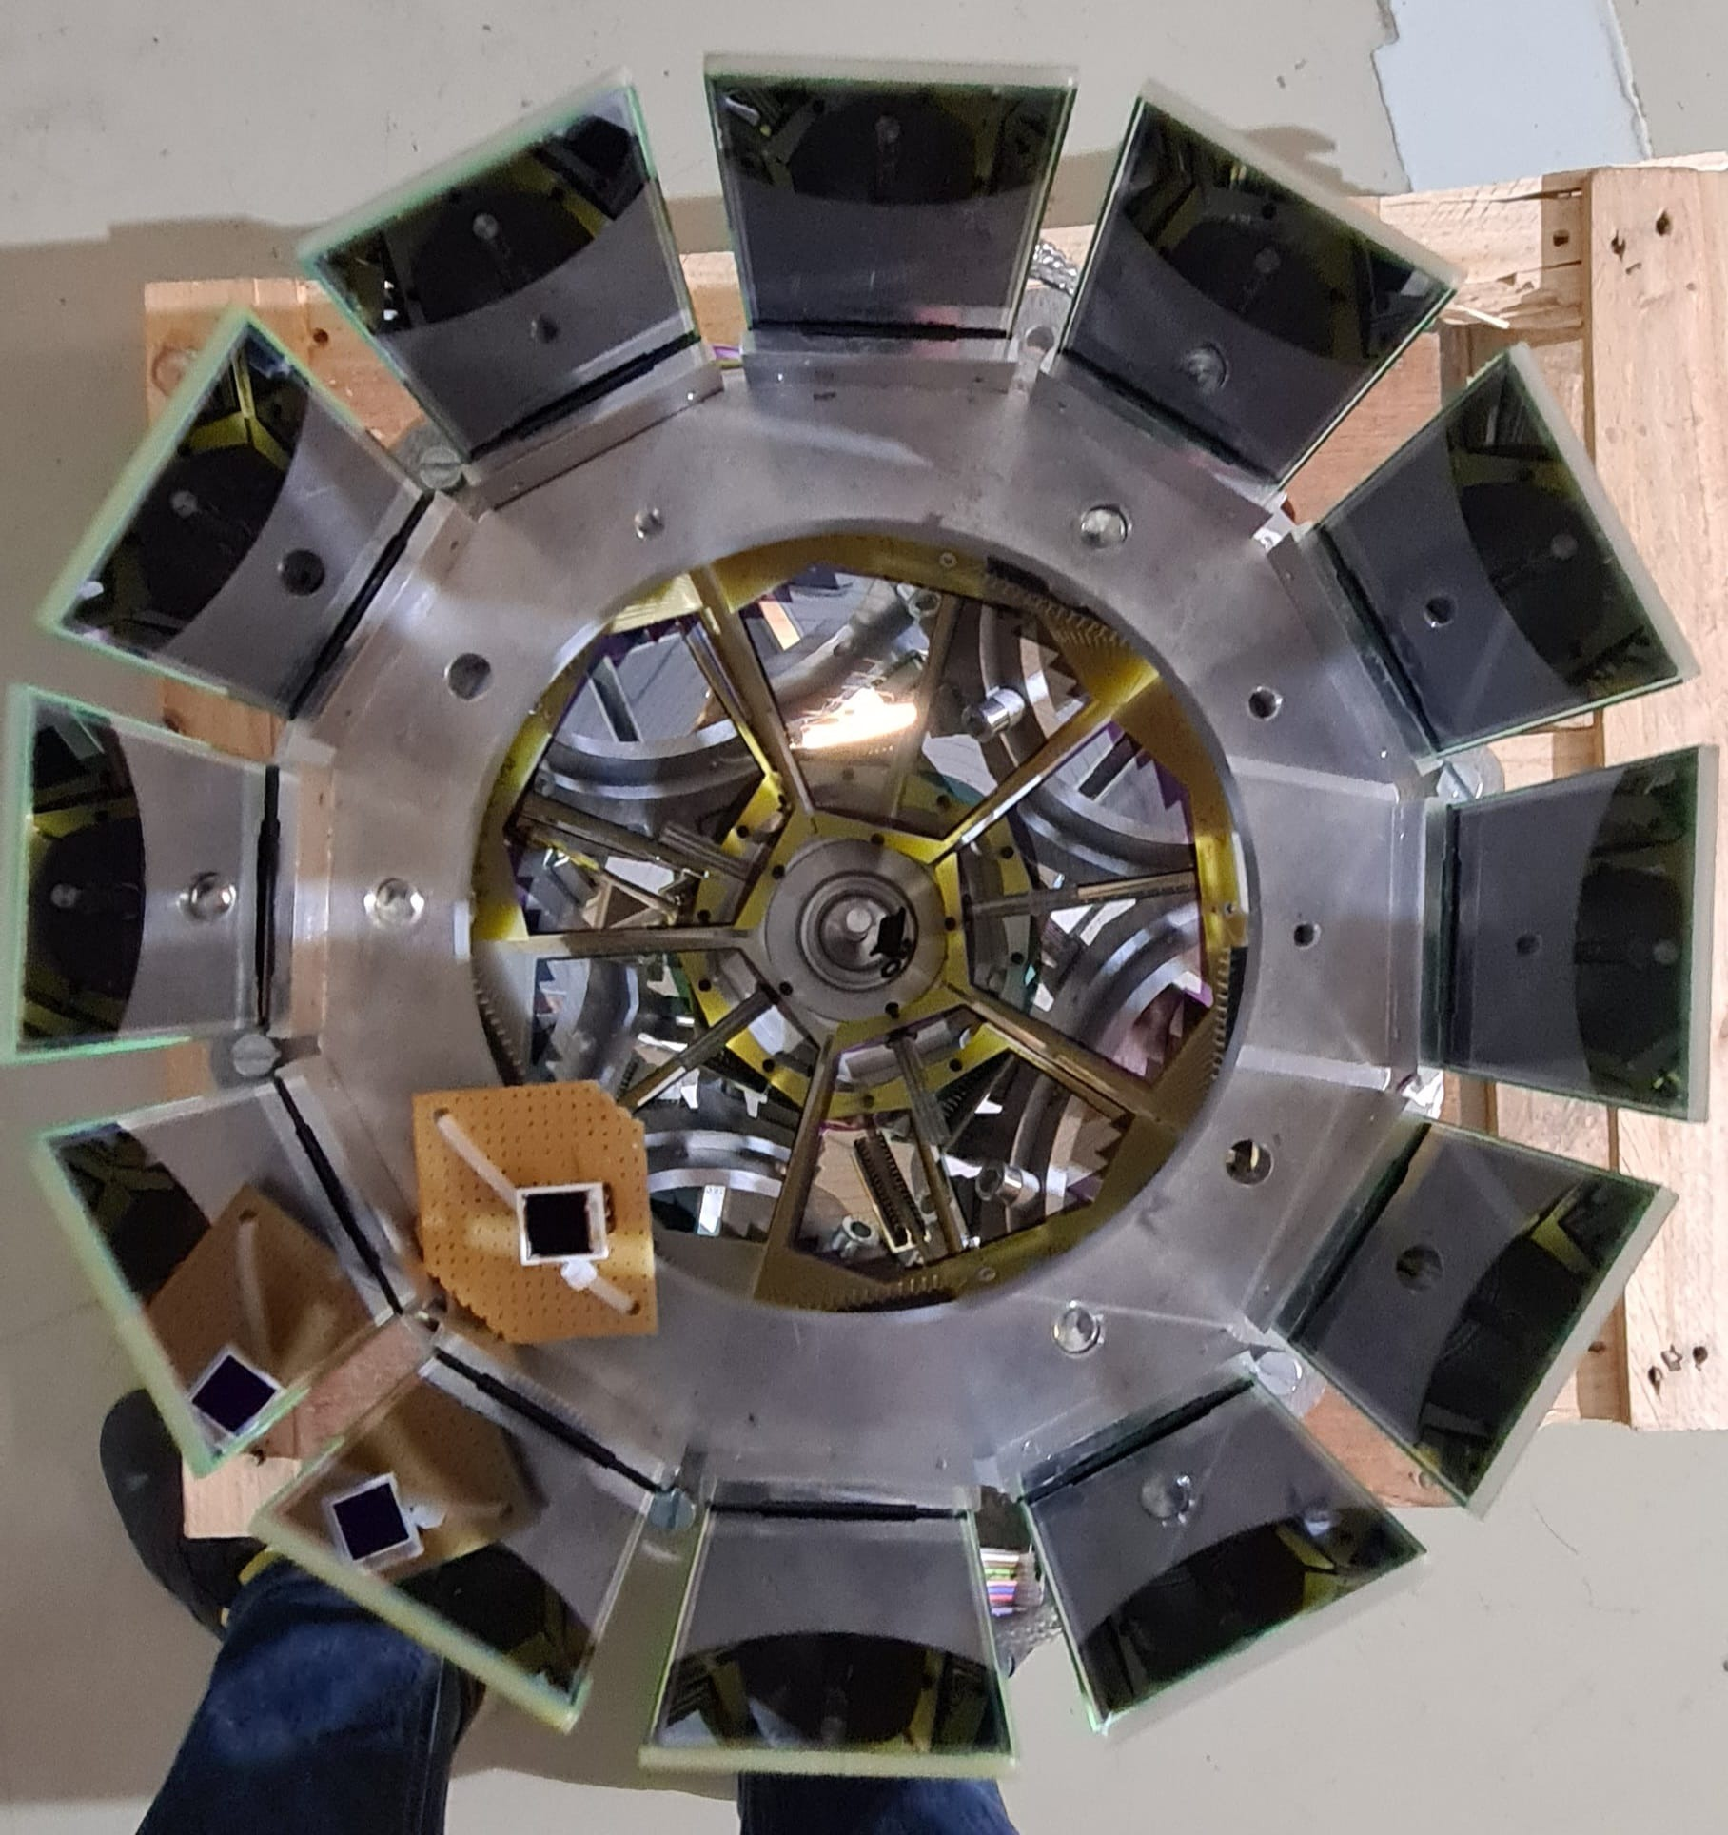
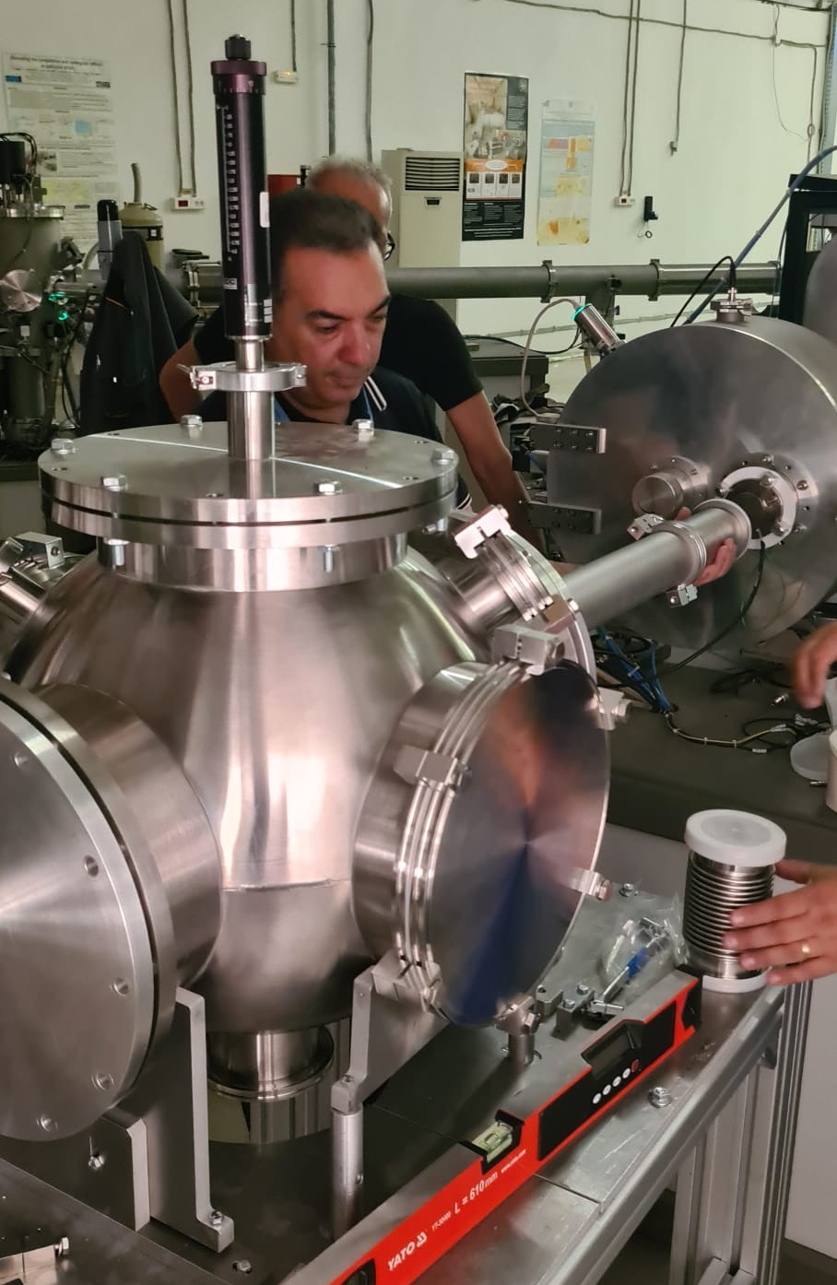
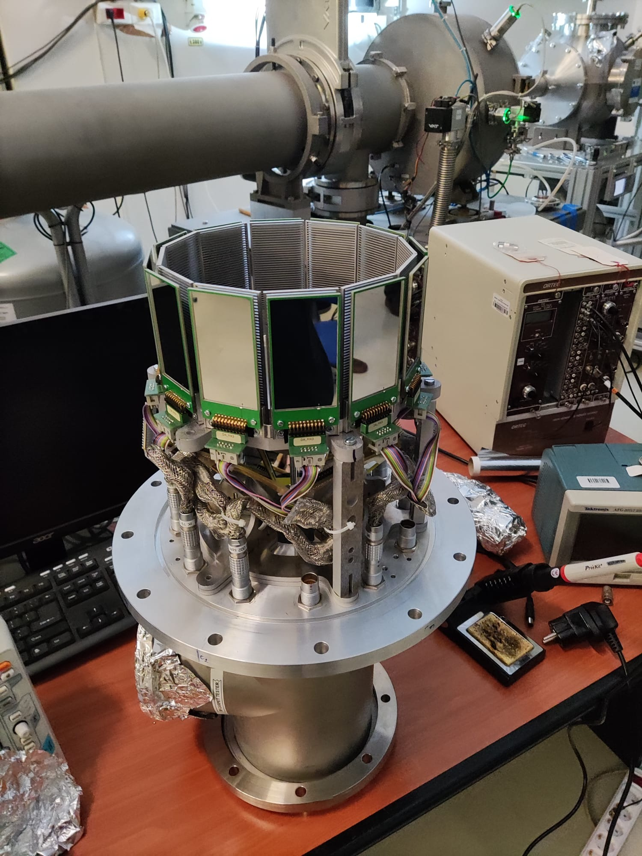
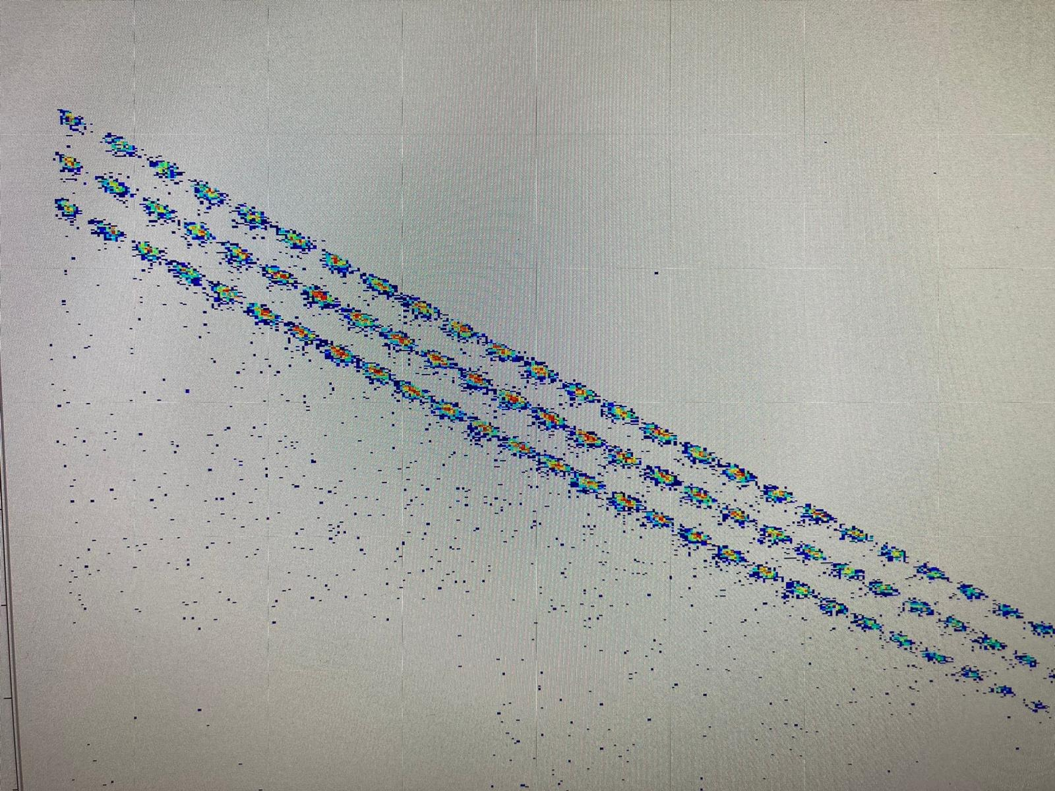
Direct Experiments with ELISSA&LHASA
The ¹⁹F(p,α) reaction

Slide 17
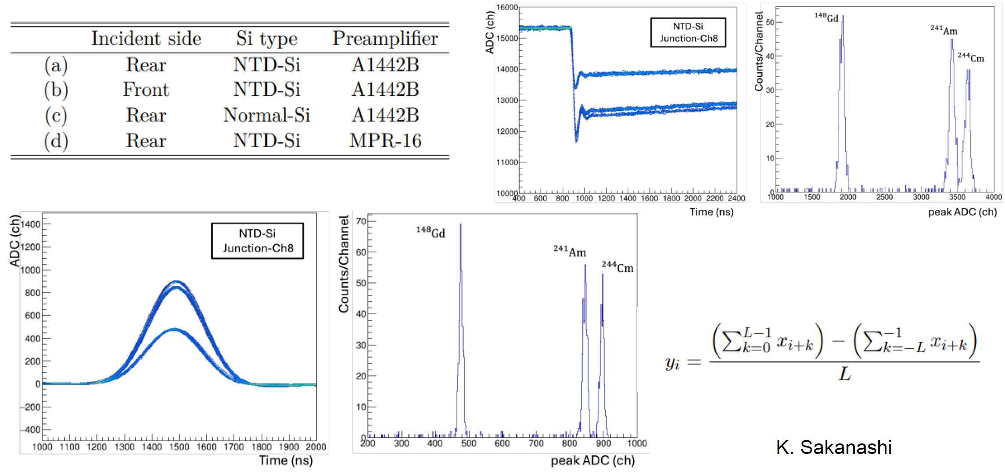
Particle Identification with Pulse Shape Analysis

Slide 18
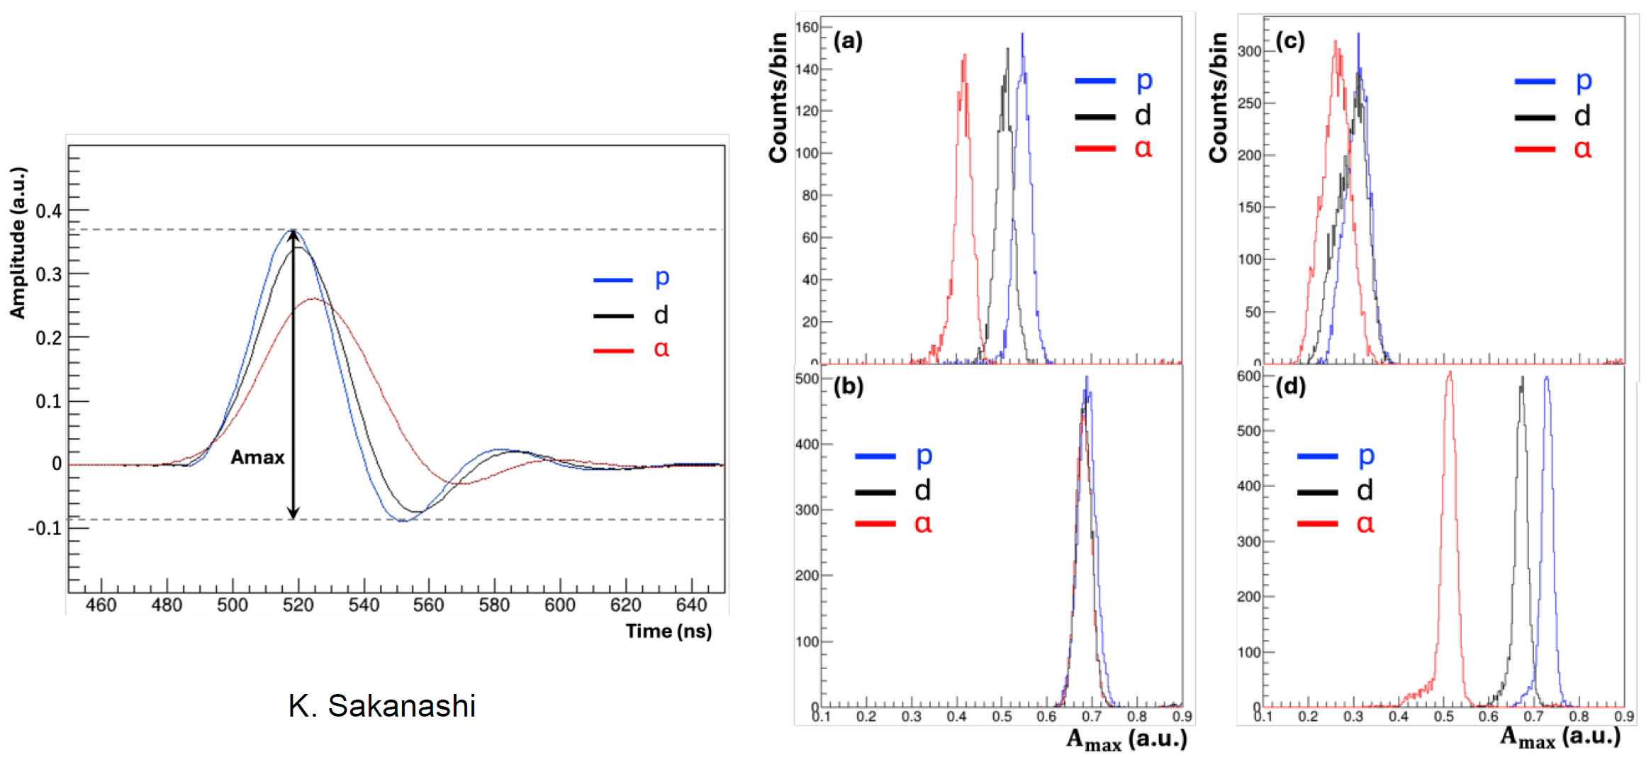
Particle Identification with Pulse Shape Analysis

Slide 19
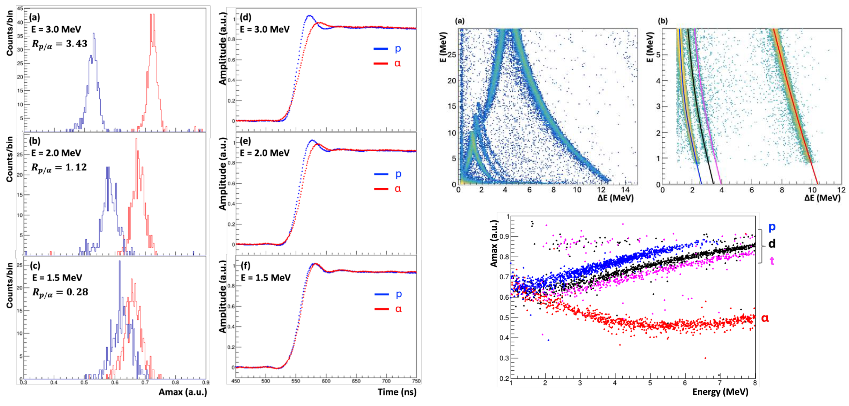
Particle Identification with Pulse Shape Analysis

Slide 20
Conclusions
The availability of radioactive ion beams at facilities like FRIB is a unique opportunity for nuclear astrophysics, as a number of reaction of primary astrophysical importance can be measured for the first time
To catch these experimental opportunities, the Asfin group is developing new arrays with peculiar characteristics: high-resolution, low-threshould, high-efficiency, compactness…
Preliminary results on methods and arrays make us confident for the new perspectives and open the way for new experimental campaigns

Slide 21

Thank you for your attention

Slide 22


Collaborations
Cyclotron Institute,Texas A&M,US: R. Tribble, V. Goldber Texas A&M Commerce US: C. Bertulani
Florida State University US: I. Wiedenhofer
Notre Dame University US: M. Wiescher, M. Couder
C.N.S. Riken, Wako, Japan: S. Kubono, H. Yamaguchi, S. Hayaka University of Taskent: B. Irgaziev, R. Yarmukhanmedov
CIAE, Beijing, China: S. Zhou, C. Li, Q. Wen
Nuclear Physics Institute, ASCR, Rez, Czech Rep.: V. Kroha, V. Burjan, J. Mrazek
Nipne IFIN Bucharest: L. Trache
ELI-NP Bucharest: C. Matei, D. Balabanski Atomki, Debrecen, Hungary: G. Kiss
CSNSM, Orsay, France : A. Coc , F. Hammache, N. De Sereville
University of Catalunya: J. Jose
Rudjer Boskovic Institute Zagreb Croatia: N. Soic, M. Milin GIST, Gwangju, South Korea: W. Bang
@Catania: A. Bonasera, S. Cherubini, G. D’Agata, A. Di Pietro, P. Figuera, S. Gammino, G.L. Guardo, M. Gulino, M. La Cognata, L. Lamia, D. Lattuada, A.A. Oliva, R.G. Pizzone, G.G. Rapisarda, S. Romano, D. Santonocito, M.L. Sergi, R. Spartà, C. Spitaleri, A. Tumino
@Napoli M. La Commara @Padova M. Mazzocco, S. Pigliapoco, A. Togni
@Perugia S. Palmerini, M. Limongi, A. Chieffi, M.C. Nucci

