Slide 1

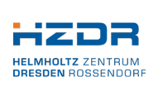

Millisecond flash lamp treatment for SRF accelerating cavities
Status of the activity at March 2024
Cristian Pira, INFN
Slawomir Prucnal, HZDR
cristian.pira@lnl.infn.it

Slide 2
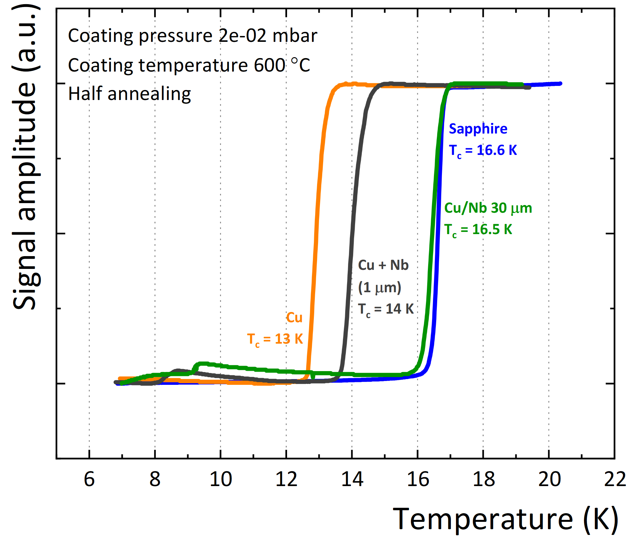
Goal
I.FAST WP9 demonstrate that Tc and performances of Nb₃Sn coating are strongly affected by substrate
The goal of Msec Flash annealing project is to develop a novel thermal process to improve performances of SC coating by suppressing (reducing) Cu substrate heating
Tc of Nb3Sn coatings depends on the thickness of Nb barrier layer

Slide 3
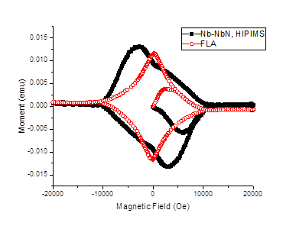
First results on planar samples
Material crystallinity improved in all thin film superconductor tested
On Nb and NbN coatings FLA produce a narrower hysteresis curve
On Nb₃Sn coatings FLA improve lattice parameter (closer to bulk values)
Nb on Cu
NbN on Cu
Nb₃Sn on Cu

Slide 4
FLA system for 6 GHz cavities
Holding system ready
Vacuum system designed and commissioned
First test planned in June 2024
Holding system for the flash lamp and cavity
3D design of the complete system

Slide 5
Schedule
MS3 – Nb₃Sn Tc improved by FLA
MS1 - Demonstrated FLA improvement (Nb on Cu)
MS4 - Demonstrated FLA uniformity (Nb on Cu 6GHz)
MS2 – FLA system for 6 GHz ready
MS5 – High Q cavity at 4.2 K
Sample test on track (MS1)
Delay of 3 months on MS2
today

Slide 6
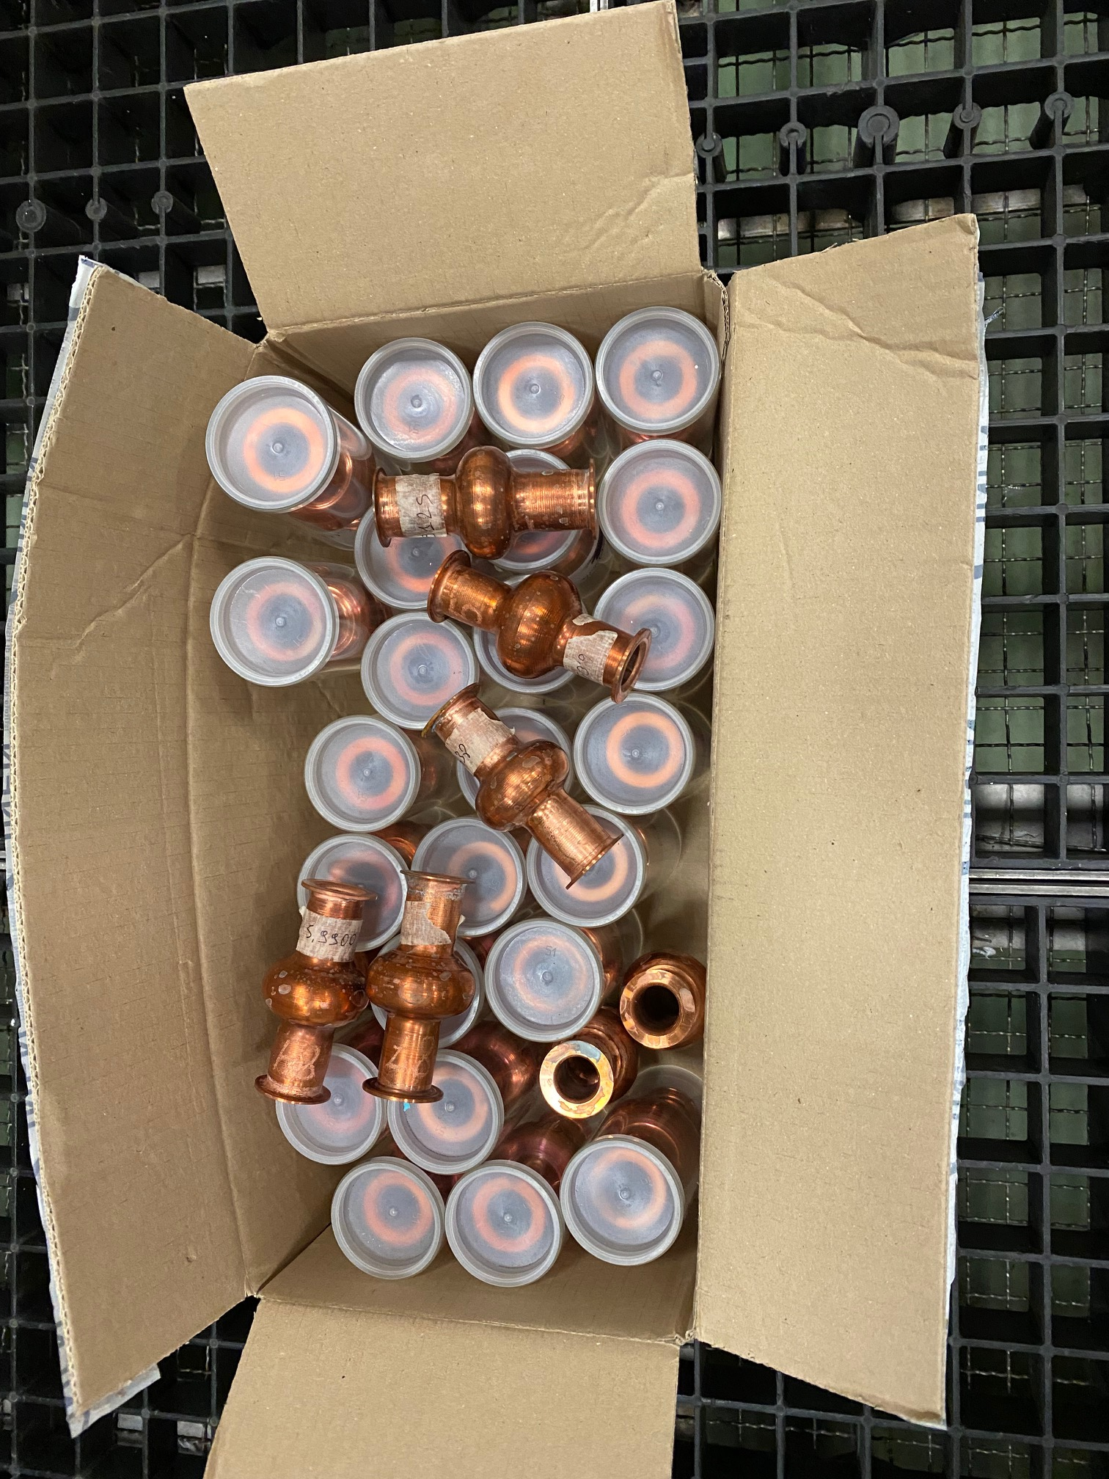
Collaboration with industrial partners
Piccoli Srl produced 2023 more than 30 seamless 6 GHz Cu cavities for WP9 and FLA project with an optimized process

Slide 7
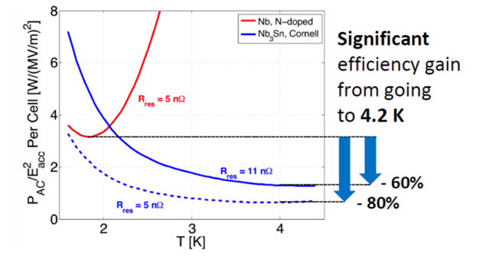
Sustainability
Our technology will significantly reduce the environmental impact and energy-costs of SRF accelerator technology:
The goal is to realize SC resonant cavities operating at higher T than bulk Nb reducing cryogenic power costs by 60%
The thermal load and hence the temperature throughout the entire substrate is much lower compared to conventional annealing: FLA consume less energy (20-30% power reduction (1), resulting in a reduction of CO₂ emissions
(1) Rovak GmbH experience on Semiconductors

