Slide 1
VBF H → cc Search: From CMS to a Future Collider with a Novel MPGD-HCAL
Ph.D School in Particle Physics – XL cycle
Università degli studi di Bari Aldo Moro
Presentation of the PhD CMS Activities
PhD STUDENT
Lisa Generoso
SUPERVISORS
Dott.ssa Rosamaria Venditti
Dott. Luigi Longo

Slide 2
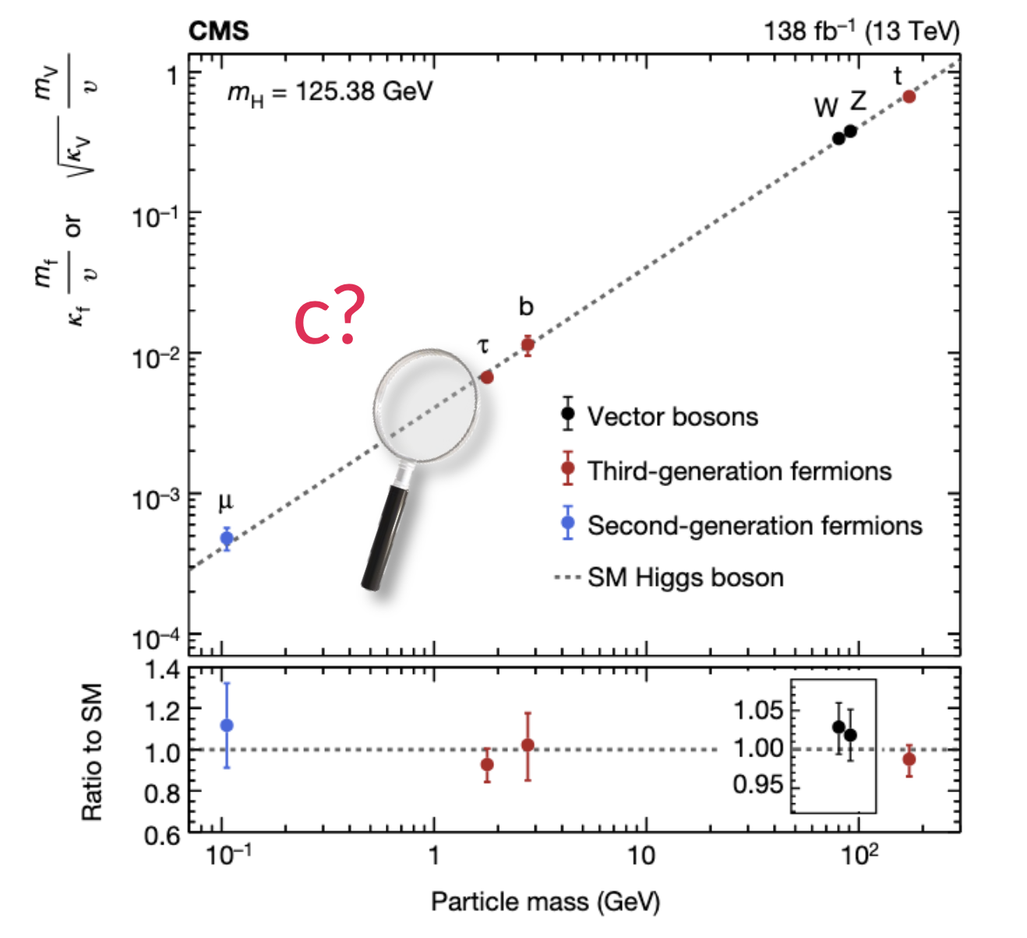
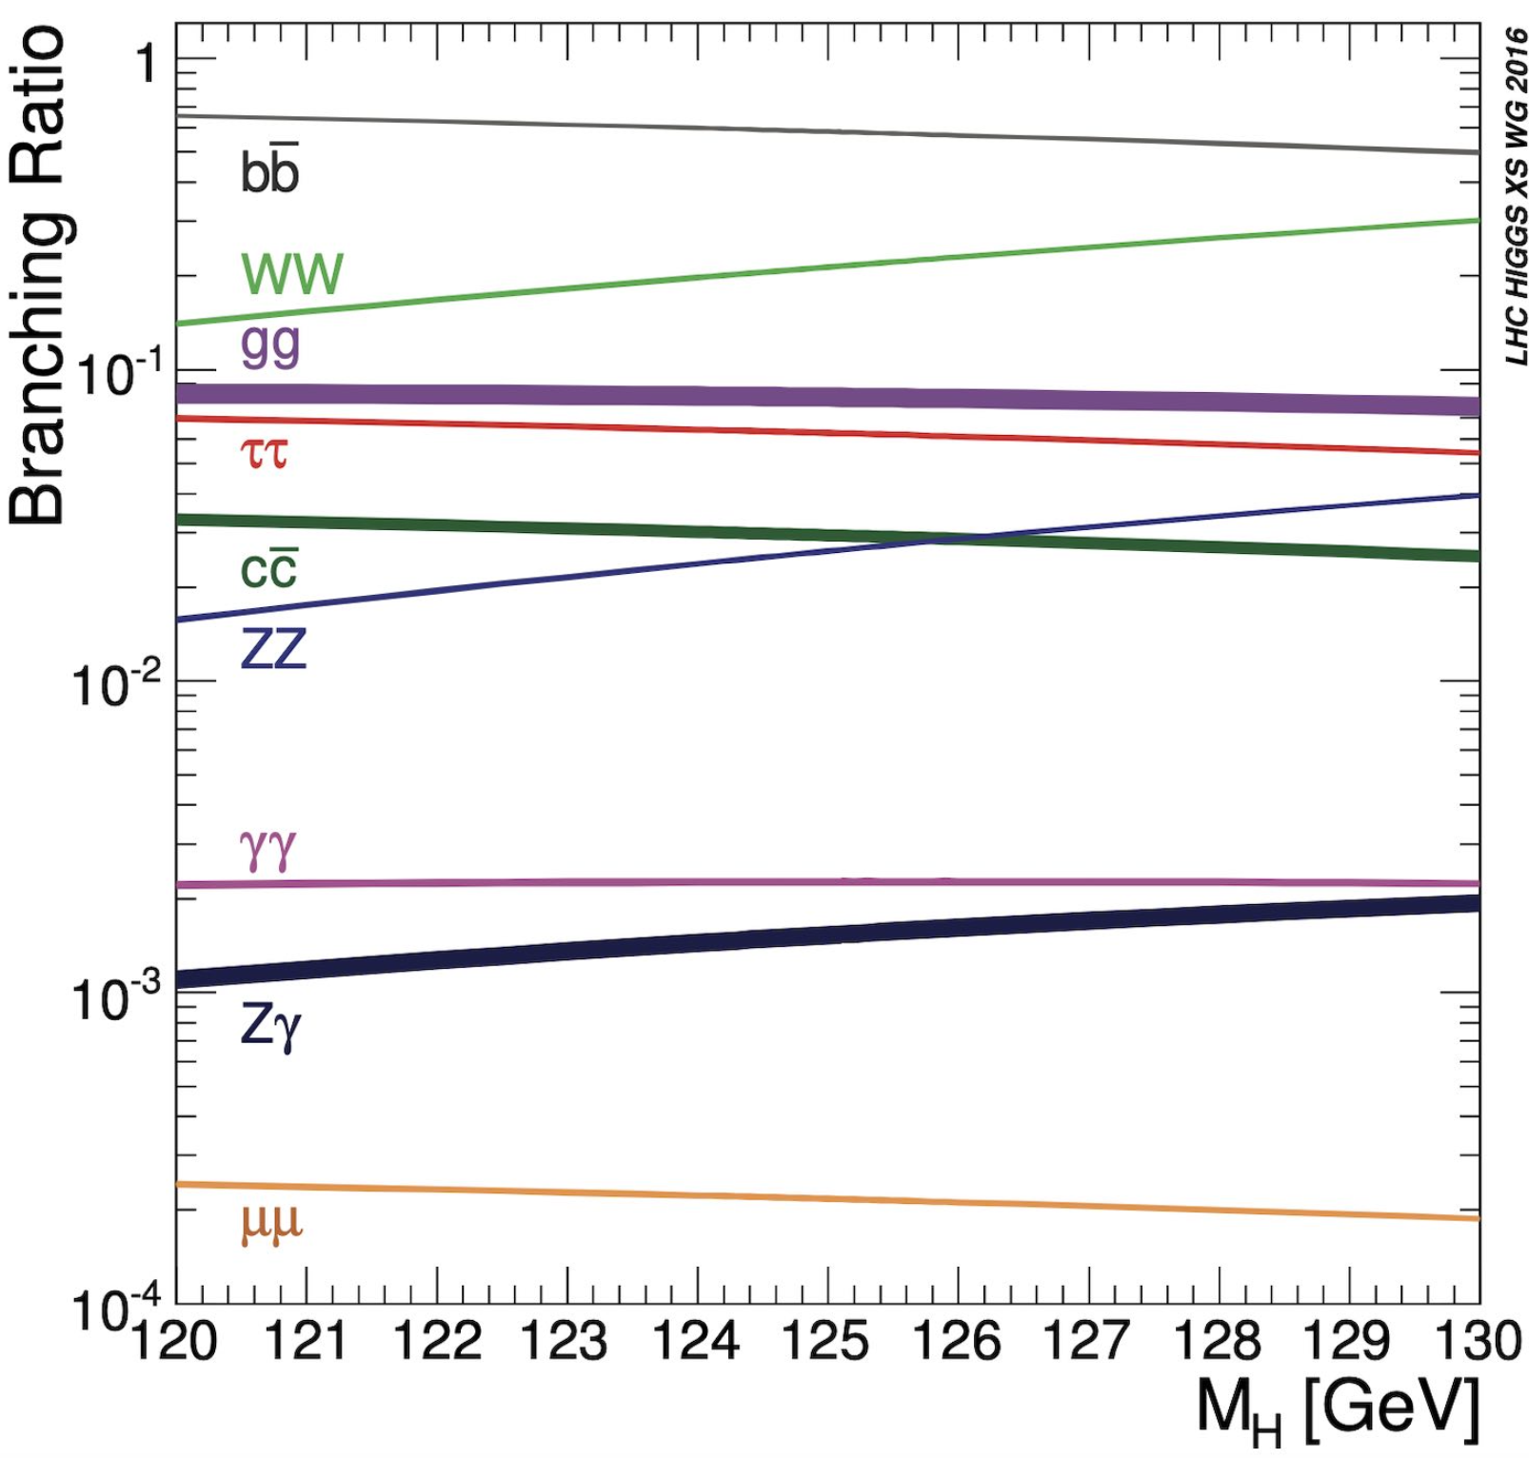
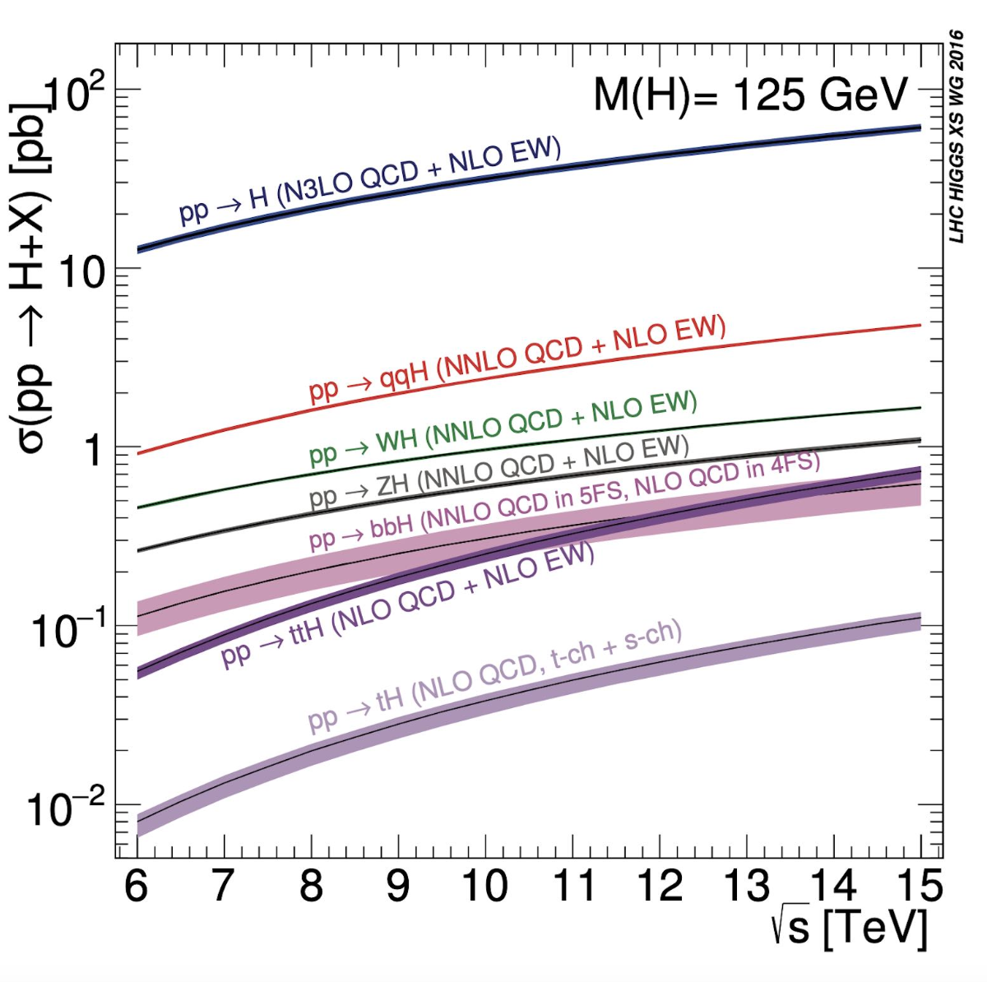
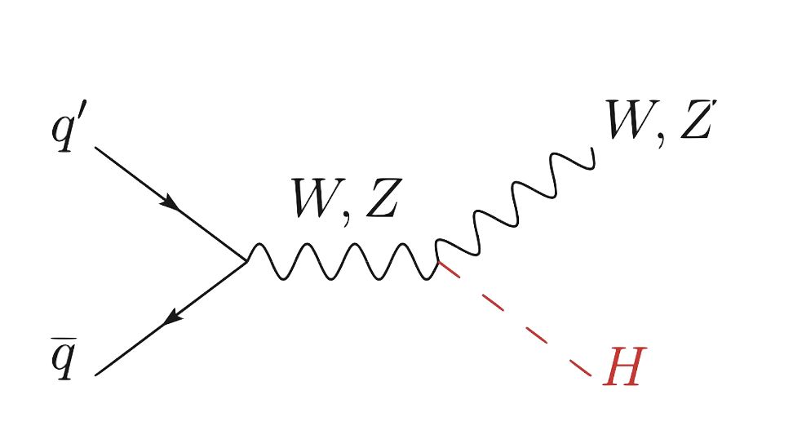
Search for H → cc at CMS
_
Yukawa couplings
To weak bosons and third-generation fermions measured with 10-20% precision → compatible with the SM
To second-generation quarks (Hcc) extremely challenging:
small branching ratio
overwhelming QCD background
difficulty of identifying charm quark jets and distinguishing them from bottom quark jets
Higgs Decay Modes
Higgs Production at LHC
B(𝐻 → 𝑐𝑐̅) ̴̴ 3%
VH mechanism investigated at CMS with Run-2 data upper limit:

Slide 3
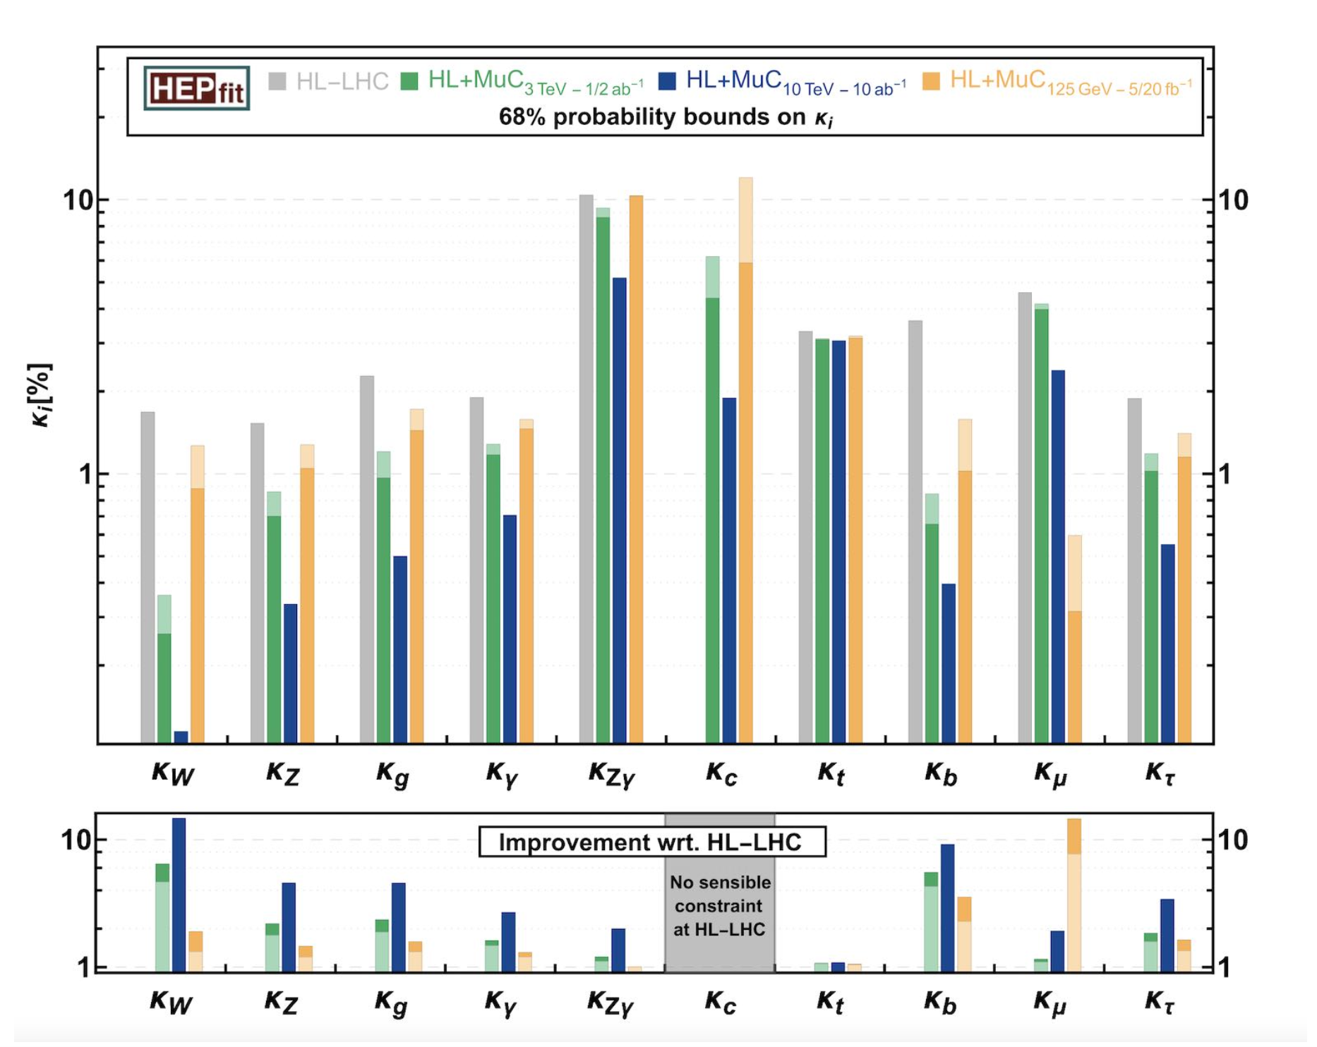
Search for H → cc at HL-LHC and Future Colliders
_
HL-LHC
PROJECTIONS
Expected H(cc) coupling via VH mode: 𝞵 (VH, H→ cc) = 1 ± 1.2
Still difficult to achieve → new analysis techniques involving multivariate analysis and jet substructure required
Expected evidence at the end of Run4 (1250 fb⁻¹)
End of HL-LHC → 5σ significance
Measurement of the coupling constant with Future Colliders
Center of Mass energy: 13.6 TeV→ 14 TeV
Up to 3000 fb⁻¹ Integrated Luminosity
→ larger dataset / most experimental uncertainties scaled down
Key: Future Colliders
Muon Collider
HL-LHC
HE-LHC
ILC
CLIC
CEPC
FCC-ee
FCC-ee/eh/hh
JHEP01(2020)139

Slide 4
Search for H → cc at HL-LHC and Future Colliders
_
HL-LHC
PROJECTIONS
Expected H(cc) coupling via VH mode: 𝞵 (VH, H→ cc) = 1 ± 1.2
Still difficult to achieve → new analysis techniques involving multivariate analysis and jet substructure required
Expected evidence at the end of Run4 (1250 fb⁻¹)
End of HL-LHC → 5σ significance
Measurement of the coupling constant with Future Colliders
Center of Mass energy: 13.6 TeV→ 14 TeV
Up to 3000 fb⁻¹ Integrated Luminosity
→ larger dataset / most experimental uncertainties scaled down
PhD Project Activities :
Analysis of VBF H(cc) with Run3 data in preparation for HL-LHC
Assess H(c) coupling precision on a realistic full simulation of the Muon Collider framework
R&D of a novel MPGD-based HCAL
Key: Future Colliders
Muon Collider
HL-LHC
HE-LHC
ILC
CLIC
CEPC
FCC-ee
FCC-ee/eh/hh
JHEP01(2020)139

Slide 5
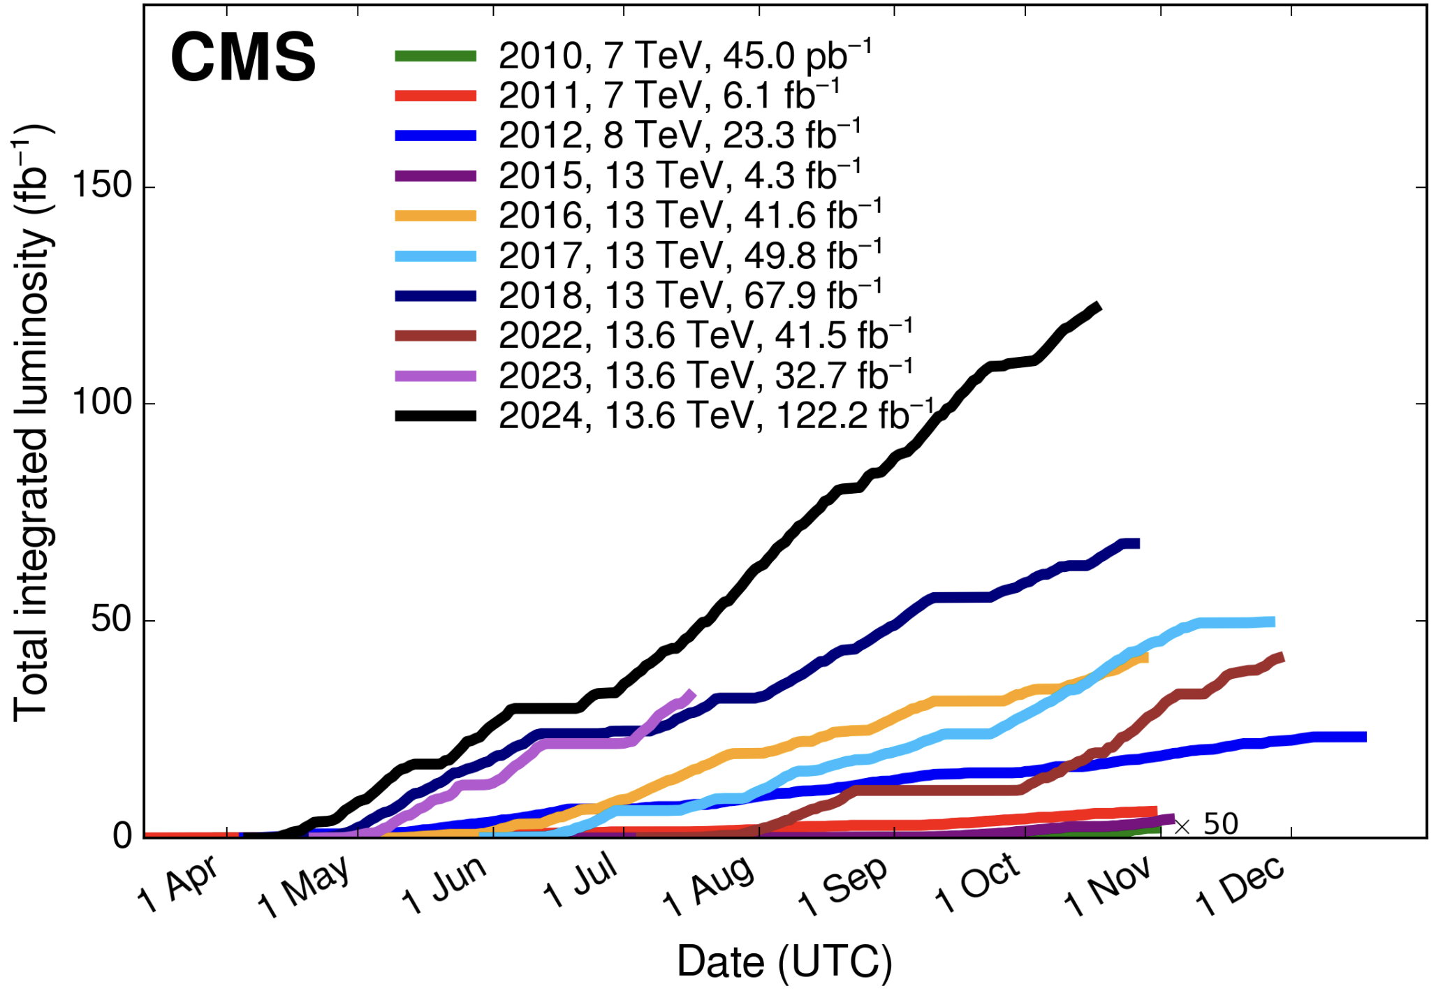
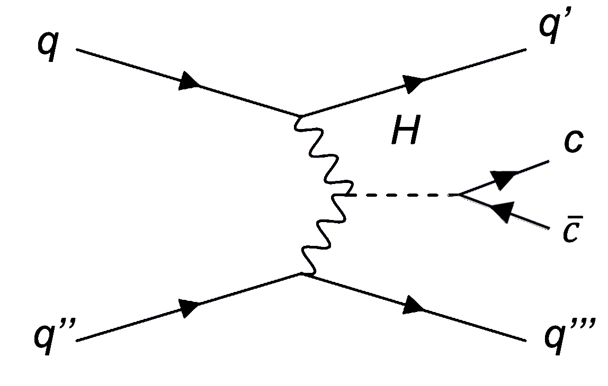
Search for VBF H → cc at CMS
_
Statistical Analysis of Full Run-3 Data at CMS
Investigate VBF production mode:
For full Run3 : expected integrated luminosity of 300 fb⁻¹
Higher cross section (~7% of the total XS)
q’ and q’’’ jets produced forward and backward, approaching the beam-pipe→ distinctive signature for the background rejection
Expected background:
QCD (dominant) ggH → cc
VBF H → bb ggH → bb
QCD Z/W → qq EWK Z/W → qq
Strategy:​
Perform the search using full Run-3 Data
Explore Neural Network approaches for signal-to-background discrimination → signal-to-background modelling
Final Goal: Estimate upper limit on the signal strength in full Run3 data

Slide 6
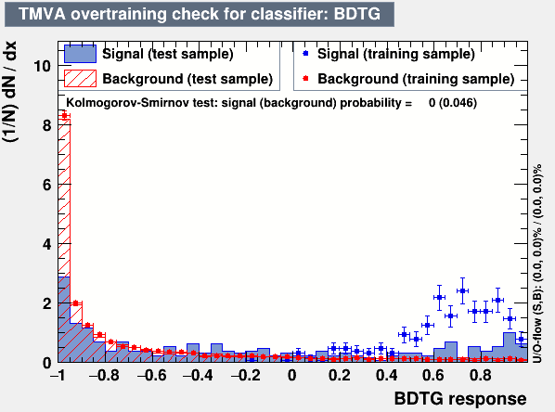
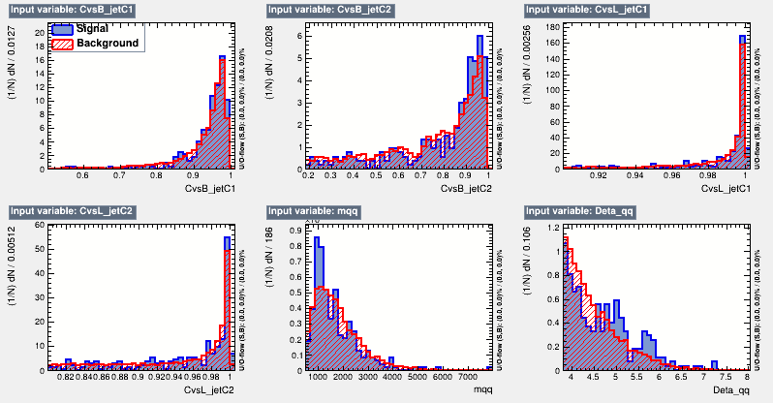
VBF Hcc: CMS Analysis of Run3
Study of the validation channel Z→ 𝒄$\overline{c}$
Dataset : 2023C
First training performed using QCD as bkg and VBF Zqq as signal
VBF Zqq signal has a too small statistics for the training → need to generate further MC
To perform a very preliminary feasibility study on the VBF Zcc signal sensitivity, we applied tight cuts on CvsL and CvsB discriminators

Slide 7
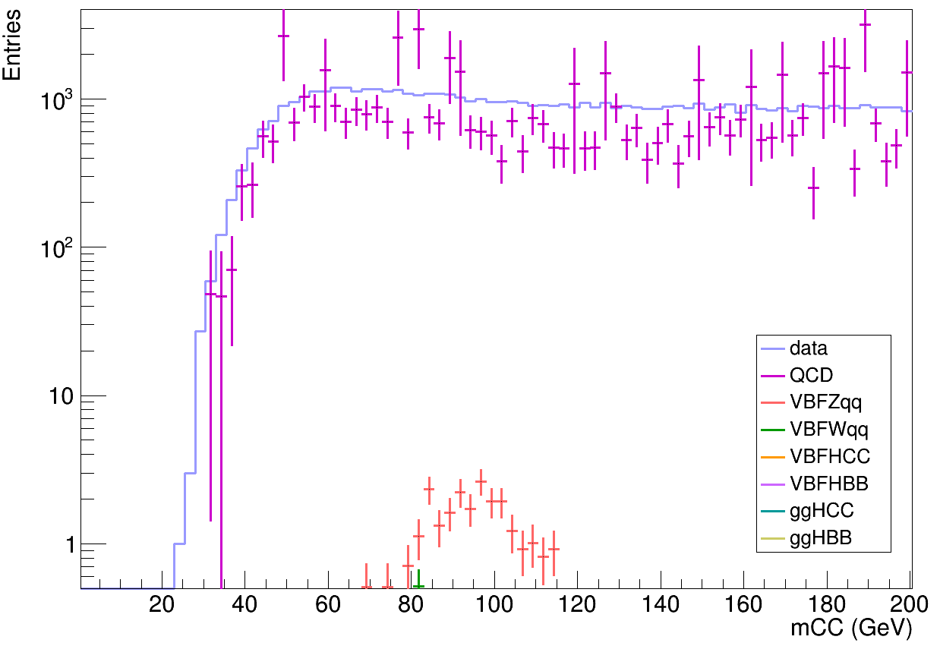
VBF Hcc: CMS Analysis of Run3
Study of the validation channel Z→ 𝒄$\overline{c}$
Cuts on discriminators :
CvsL_jet1 > 0.9
CvsL_jet2 > 0.8
CvsB_jet1 > 0.5
CvsB_jet2 > 0.8
Tight cut as if it is applied at the generator level
313 signal events : insufficient to perform a proper training
Possible approaches :
Generate further MC samples of Zcc and re-run the training
Apply weights from H→cc training on samples of Z into 4 jets
(Entries ⋅ N)/(L⋅𝜎)

Slide 8
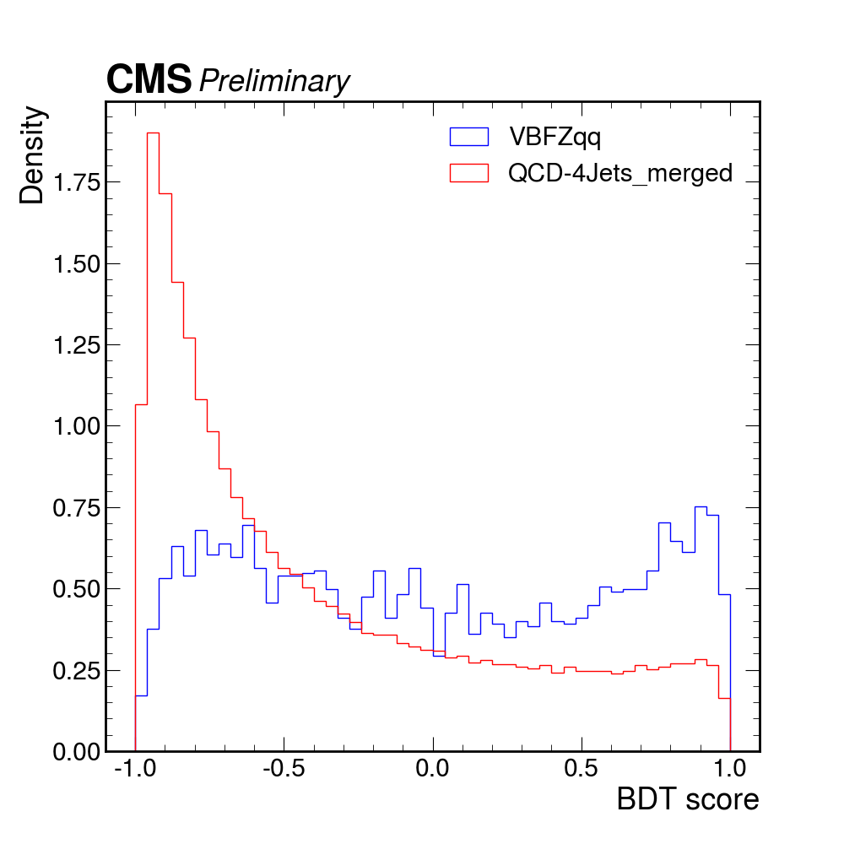
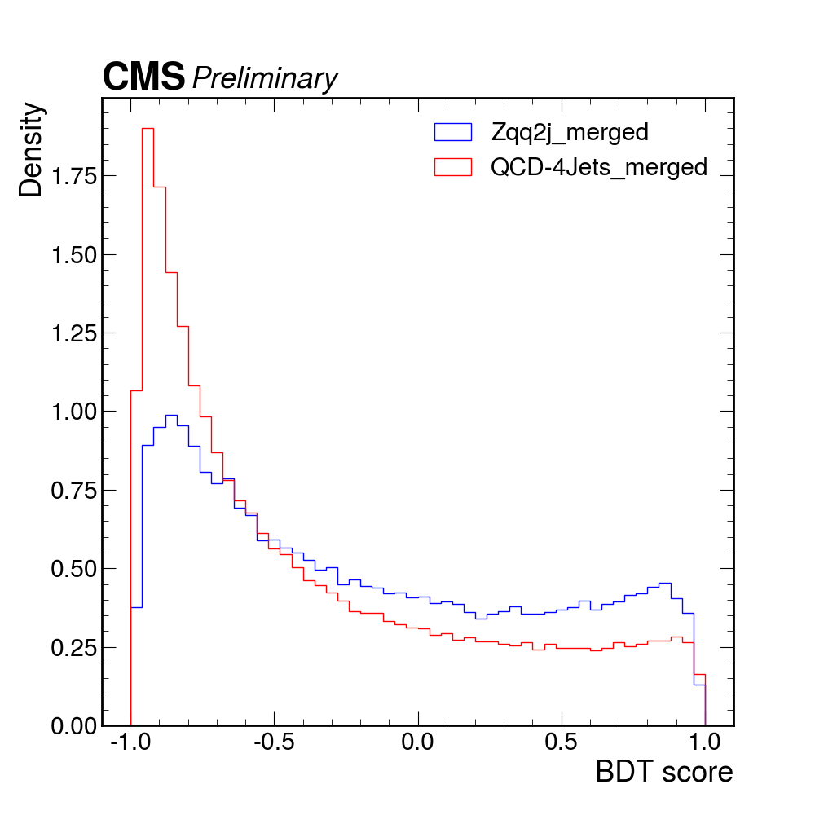
VBF Hcc: CMS Analysis of Run3
Study of the validation channel Z→ 𝒄$\overline{c}$
Apply weights from H→cc training on samples of Z into 4 jets:
VBF Zqq
DY Zqq2j
BDT score of Z :
Flat distribution for VBF production
Peaked at –1 (like bkg) for DY production
→ Cut at BTD > 0.8 to observe the Z mass peak

Slide 9
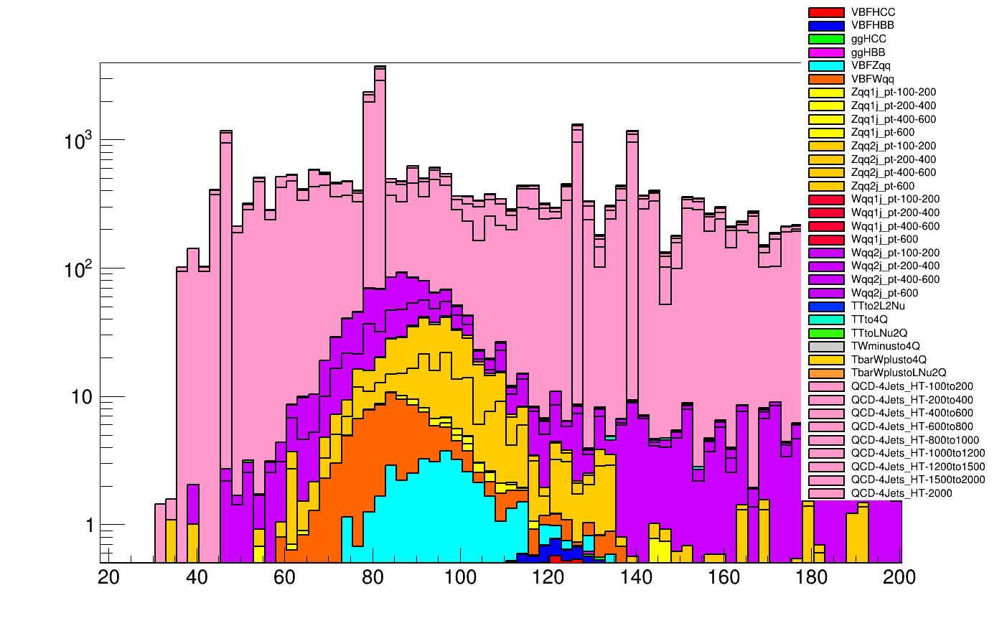
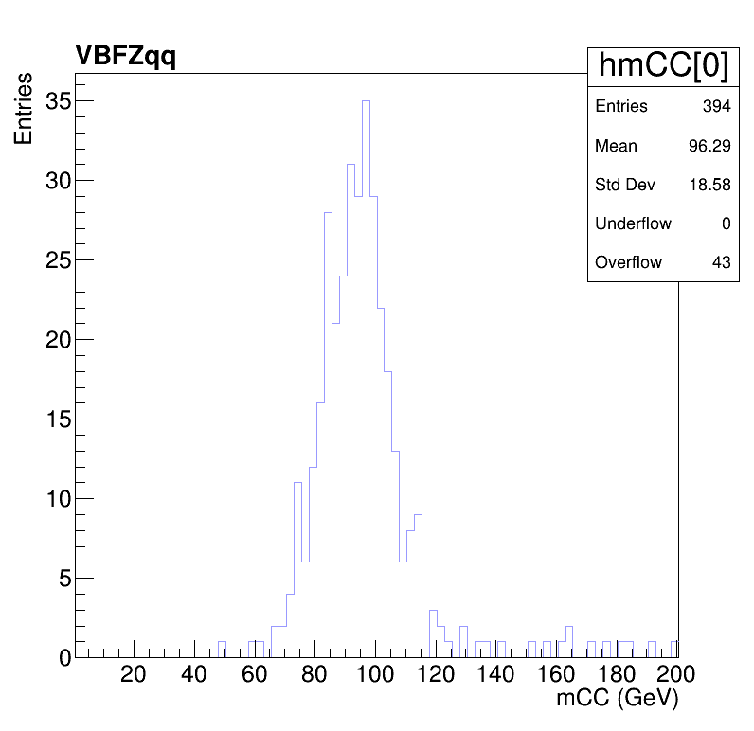
VBF Hcc: CMS Analysis of Run3
Study of the validation channel Z→ 𝒄$\overline{c}$
Cut at BTD > 0.8 for the invariant mass plot
~ 4.46 normalized signal events within the 80-120 GeV
Signal significance → 0.52
(Entries ⋅ N)/(L⋅𝜎)
Entries

Slide 10
Next Steps
CMS Analysis of Run3
Study of the validation channel Z → $c\overline{c}$
Generate further MC samples of Zqq, forcing the Z to decay into a $c\overline{c}$
Try new approaches as alternatives to the BDT, such as GNN

Slide 11
Merry Christmas
And Happy New Year

