Slide 1
CMS young meeting
20/12/2024
Nicola (PhD student) and Umesh (Post-doc)
Dose rate measurement at GIF++ (25-27 Nov 2024)

Slide 2
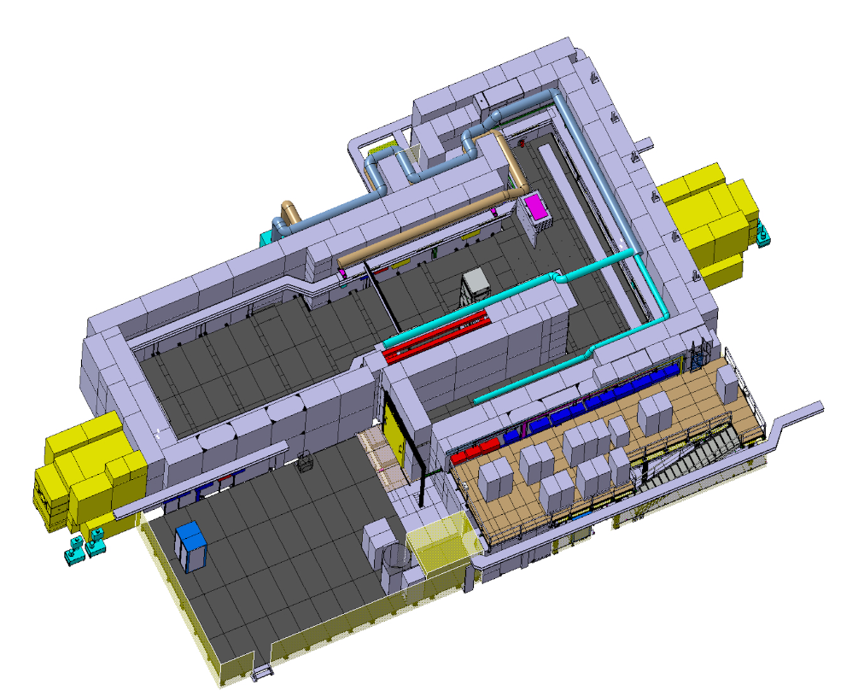
Motivation
Since 2014 the Gamma Irradiation Facility at CERN is extensively used for: Eco-gas, longevity and R&D detector studies involving several Detector technology: DT, MDT ,CSC ,RPC, iRPC, GEM…
One simulation study is available (without detectors) done on by Pfeiffer Dorothea. She developed simulation Software in GEANT4-10.0 to simulate GIF++ radiation background: “The radiation field in the Gamma Irradiation Facility GIF++ at CERN” [1]
New bunker geometry was implemented in 2018 → new simulation work is needed
[1] http://dx.doi.org/10.1016/j.nima.2017.05.045

Slide 3
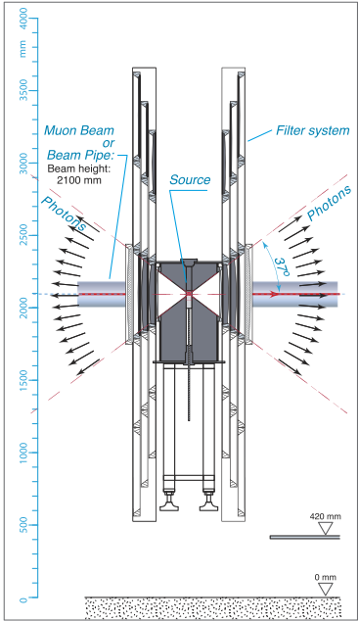
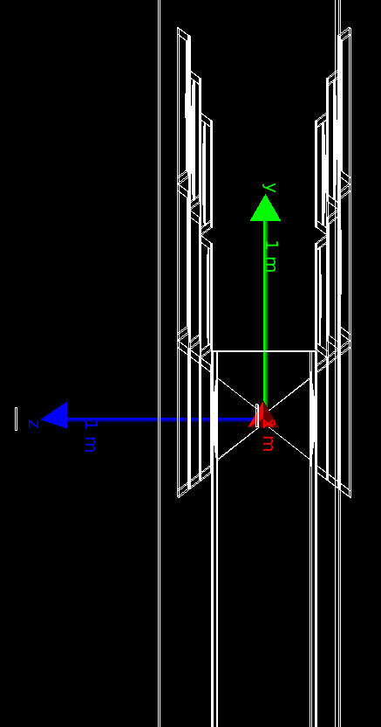
GIF++ simulation
New GDML GIF++ layout implemented for Geant4
Geometry updated to 15 m upstream
Version Geant4-11.0
Filter implementation for ABS
NO EXPERIMENTAL INSTALLATION INCLUDED IN THE SIMULATION LAYOUT

Slide 4
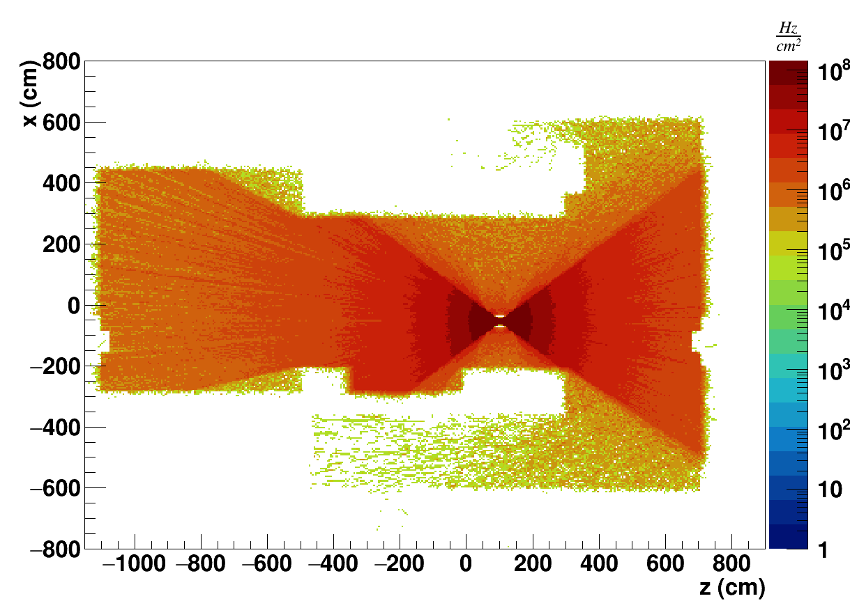
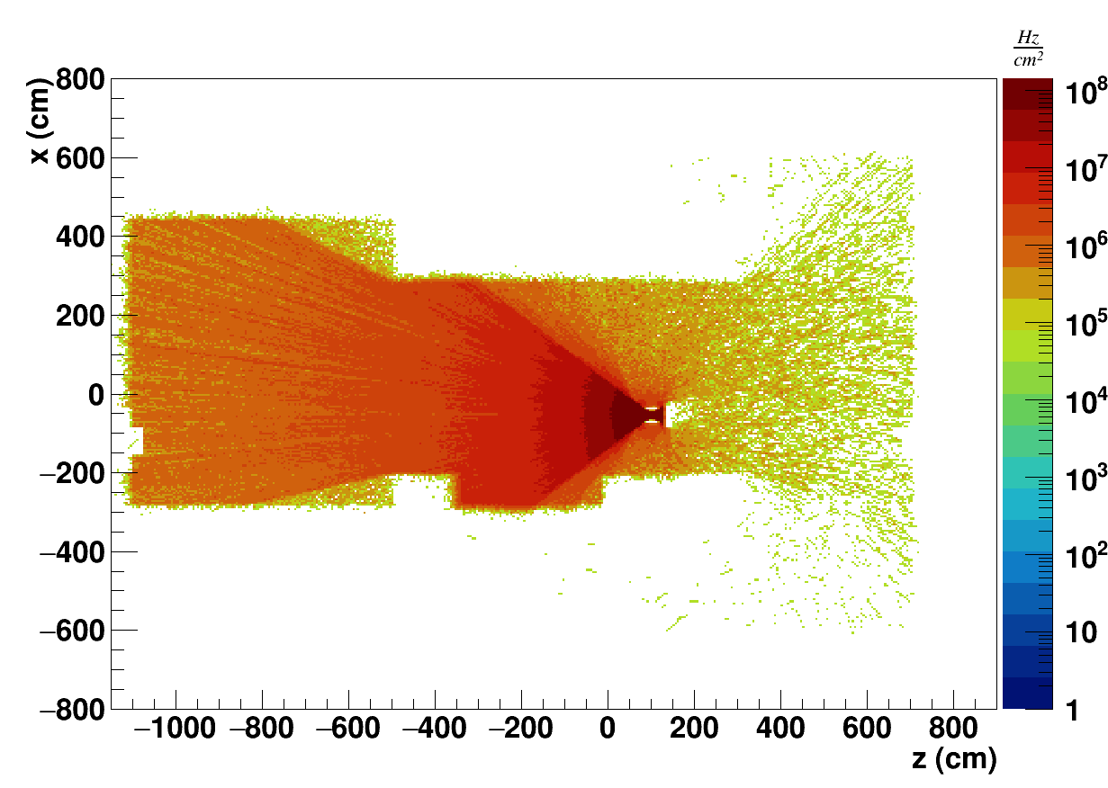
GIF++ simulation plot
Flux examples of irradiation with ABS = 1 in US region:

Slide 5
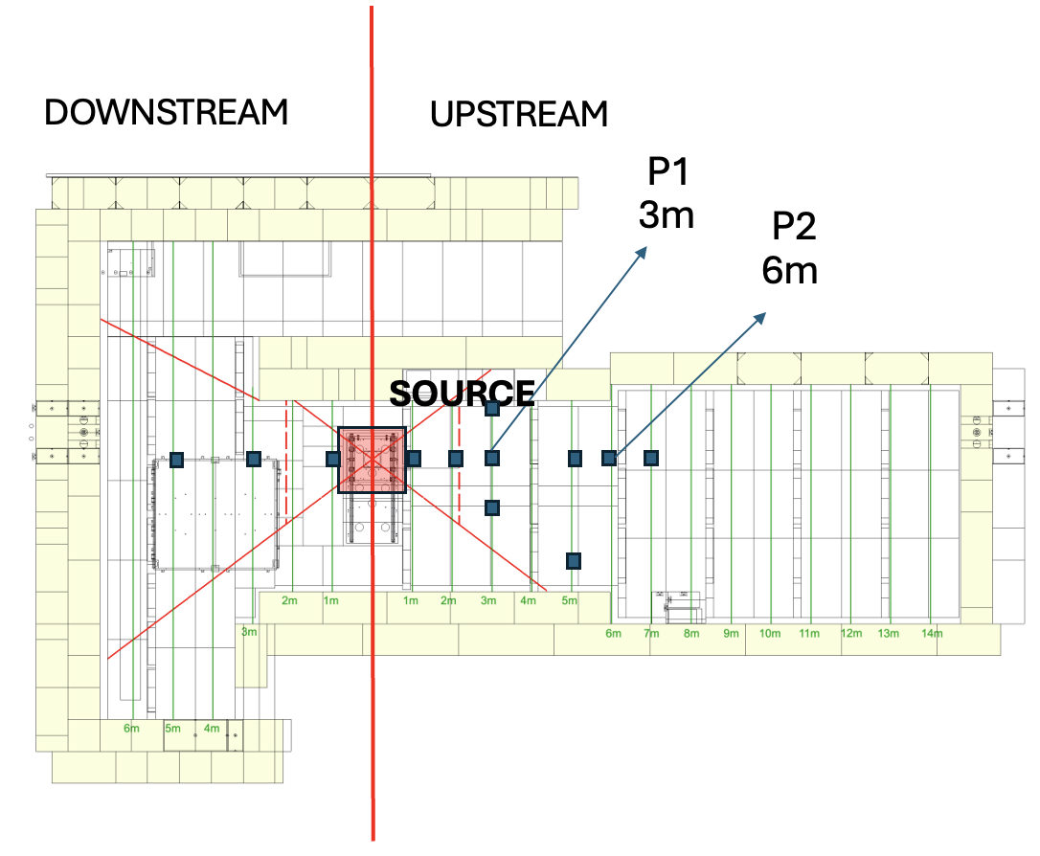
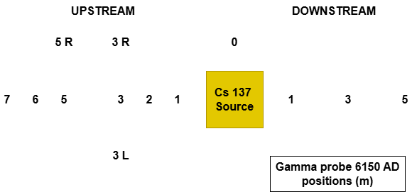
GIF++ dose campaign:
Source of ¹³⁷Cs of 662 keV photons at 11.5 TBq (January 2024)
Gamma Probes 6150AD-15 was used
ABS (effective attenuation) used: 1, 2.2, 3.3, 4.6, 6.9, 10, 22, 33, 46, 69 and 100
Conducted measurements at the distance (m) from the source indicated below with full clearance (no RPC trolleys).
At 3m and 6m, ABS 1, 2.2 and 3.3 measurements were carried out with RPC trolleys in between the source and probe.

Slide 6
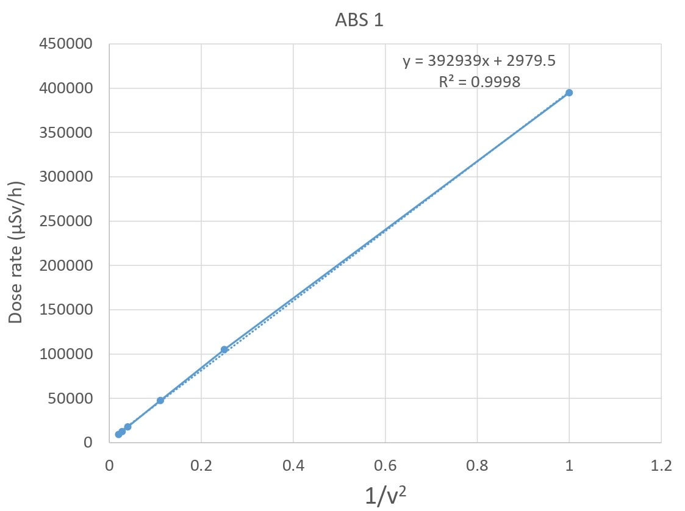
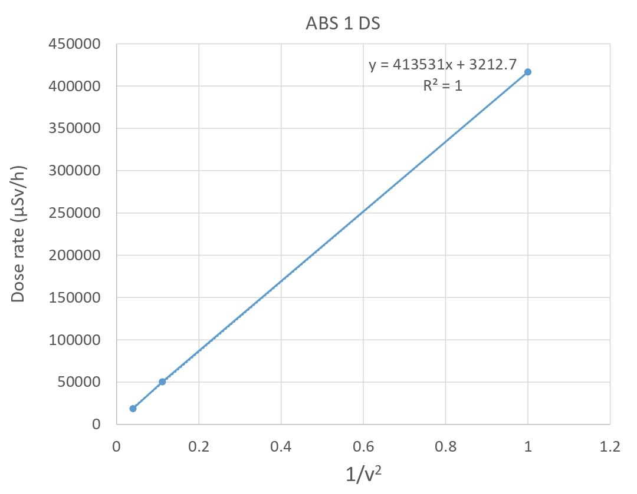
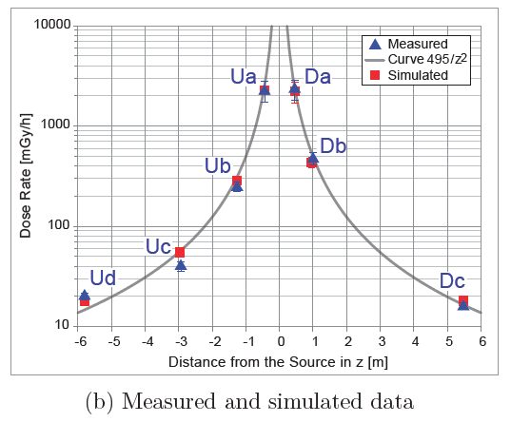
Inverse-square law
a)
b)
Figure 2: Dose rate vs 1/z² fitting for ABS 1 a). UPSTREAM b). DOWNSTREAM
Figure 1: Dose rate vs probe distance from source for ABS 1
The average slope of dose rate for ABS 1 is 403 mSv/h/m²
Figure3: Dose rate vs distance from source, GIF++ paper
Notes:
Plot from -6 until 6 meters make same plot.

Slide 7
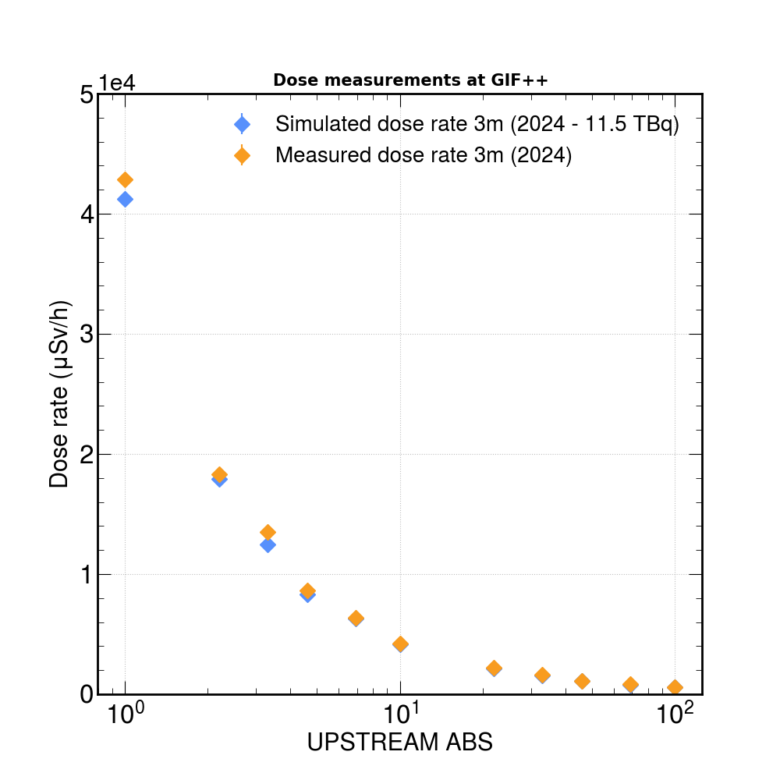
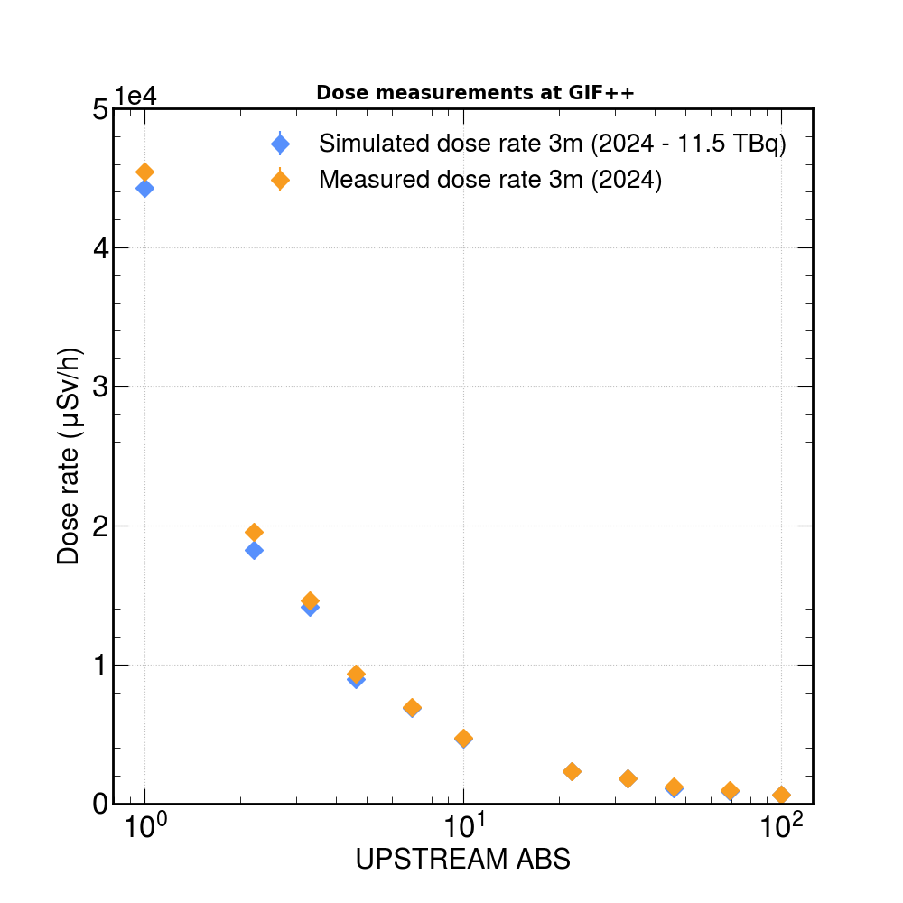
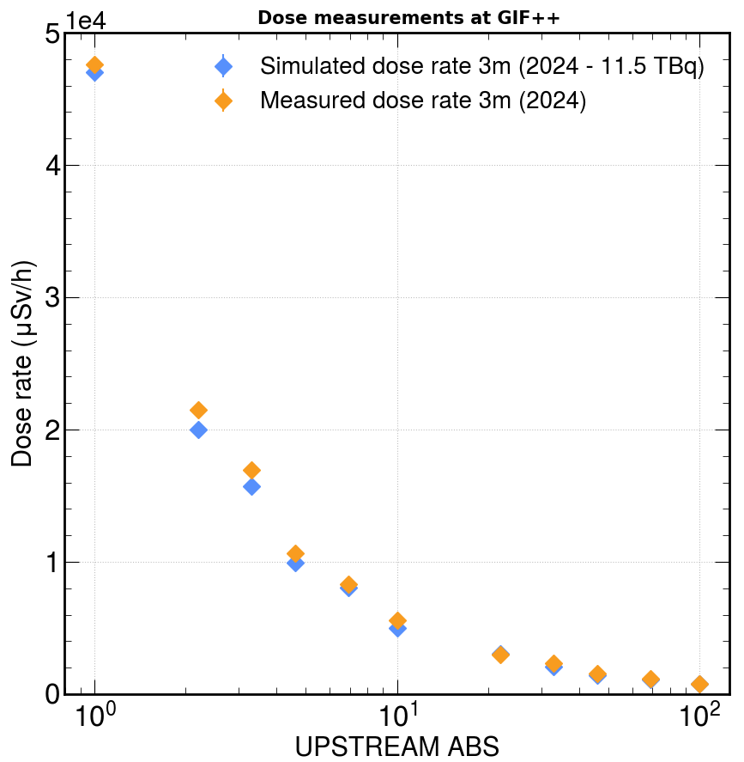
Simulation vs. measures
a)
b)
c)
Figure 4: Dose rate vs ABS in UPSTREAM, 2024 simulated vs measured dose rate for
a). 3m(x=-1.2)L b). 3m(x=0) c). 3m R(x=1.2)
Simulated the dose rate for 3m L (x= -1.2), 3m (x=0) and 3m R (x=1.2).
Simulated and measured dose rates are in good agreement for 3m (x=0).
Measured dose rates for 3m L (x= -1.2) and 3m R (x=1.2) are slightly higher than the simulated dose rate.

Slide 8
Field shape
The GIF++ irradiator and filter system is designed to produce a homogeneous radiation field of ±37º, with a sharp decrease at the edges.
The current depends only on the distance from the irradiator along the z-coordinate and is uniform in all xy planes. (GIF++ paper)
The dose rate is not uniform across the XY plane, there is a little reduction in the dose rate.
Figure 5: Dose rate vs probe distance from source

Slide 9
Conclusions
The simulation code of GIF++ have been upgraded
The 2024 dose rate measurements at GIF++ for all the ABS and positions are very well correlated with the 1/z² fit
Simulated and measured dose rates are in good agreement for 3m
A roughly estimation indicates that the irradiation field seems not planar on xy plane

Slide 10
Summary of CMS activities 2024
Test beam at GIF++ luglio (CMS-RPC and RPC EcoGas@GIF++)
Summer CMS Muon week
«Upgraded simulation of the CERN Gamma Irradiation Facility (GIF++)” - XVII international Conference RPC2024, Santiago di Compostela, 9-13 September

Slide 11
THANKS! MERRY CHRISTMAS TO EVERYBODY!!

Slide 12
Backup slides

Slide 13
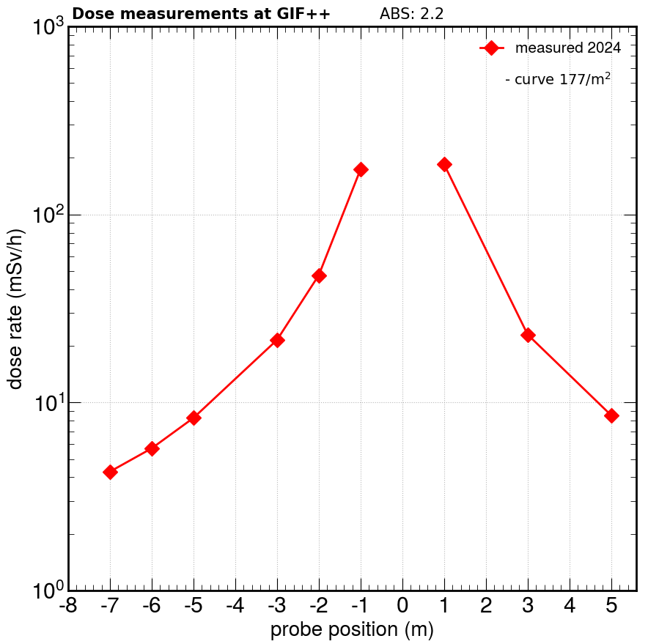
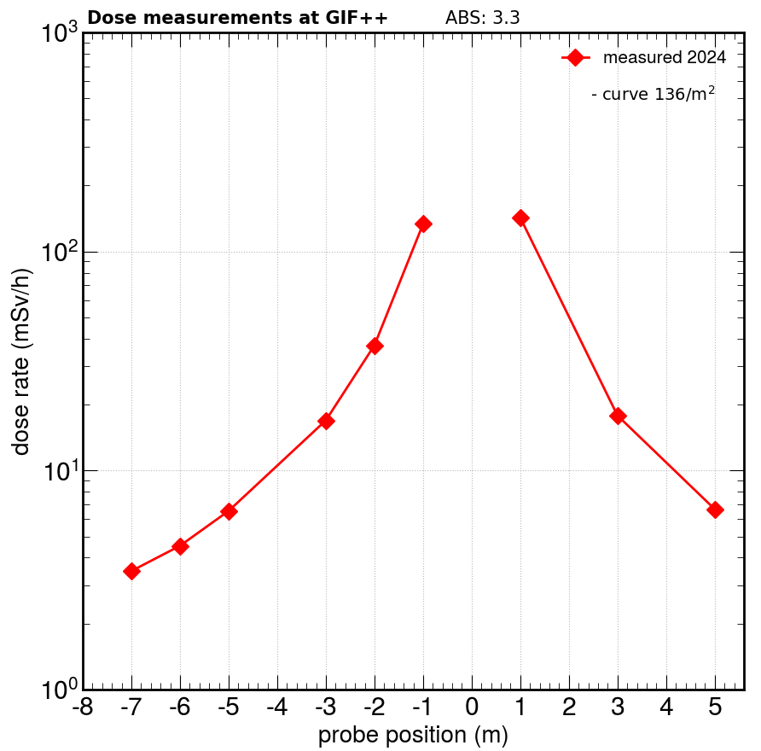
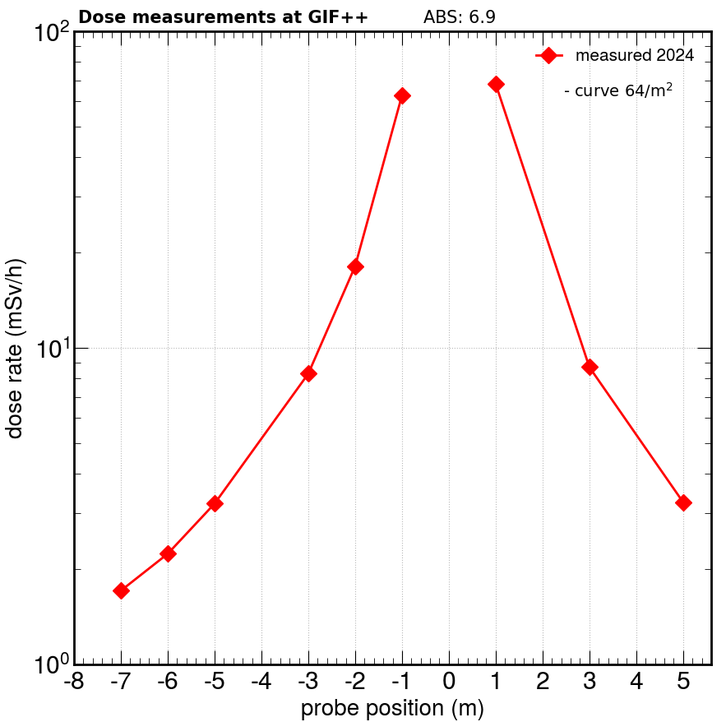
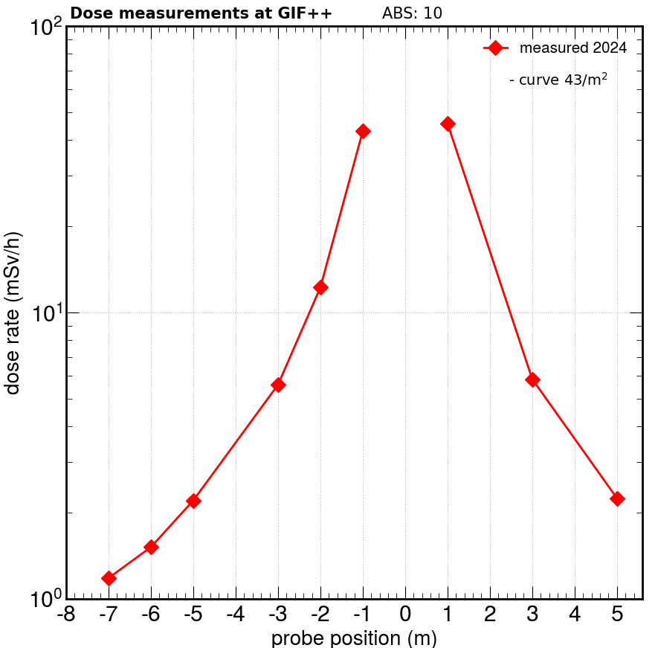
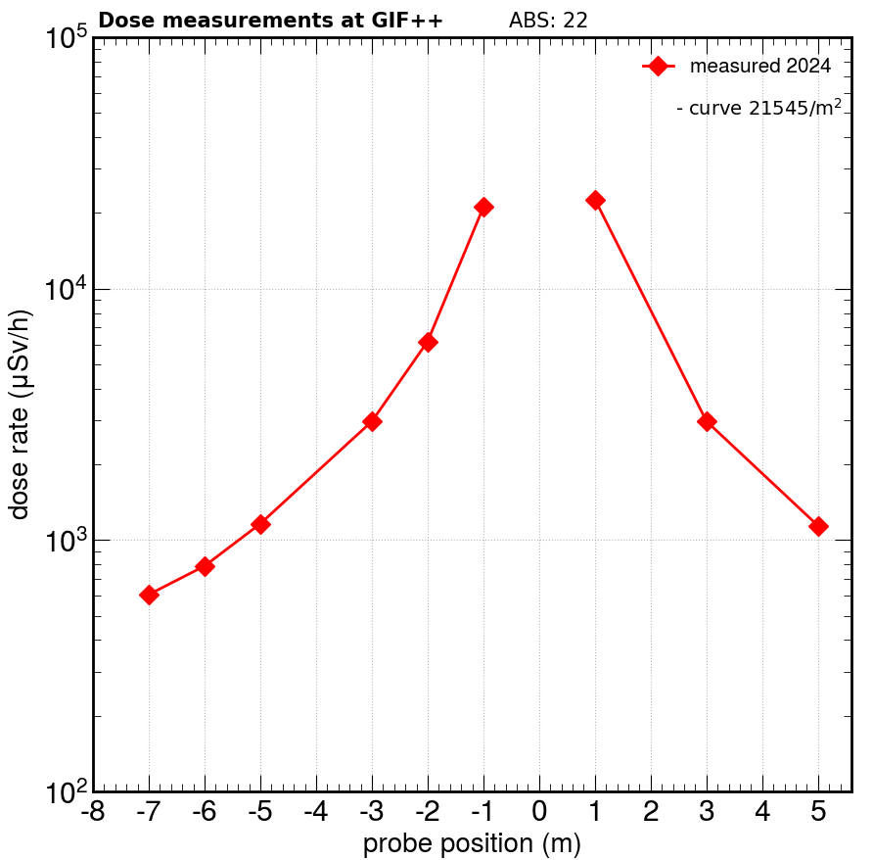
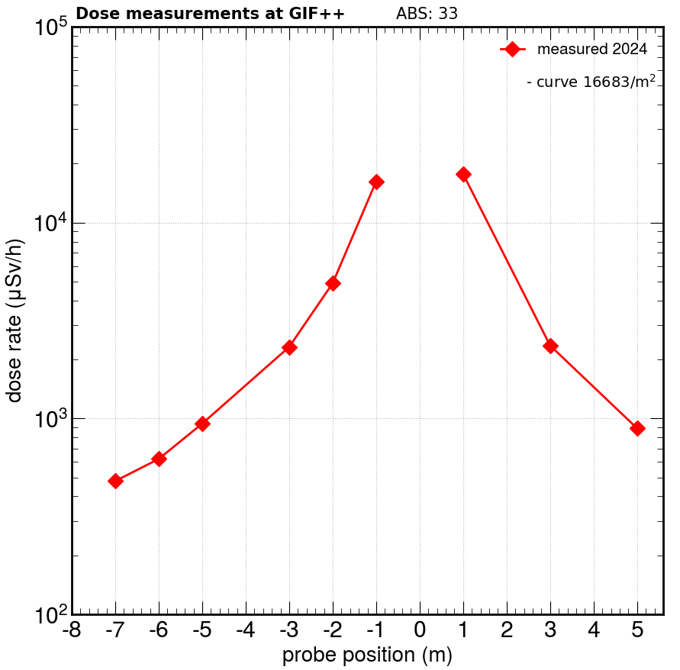
ABS 2.2
ABS 3.3
ABS 4.6
ABS 6.9
ABS 10
ABS 22
ABS 33
ABS 46

Slide 14
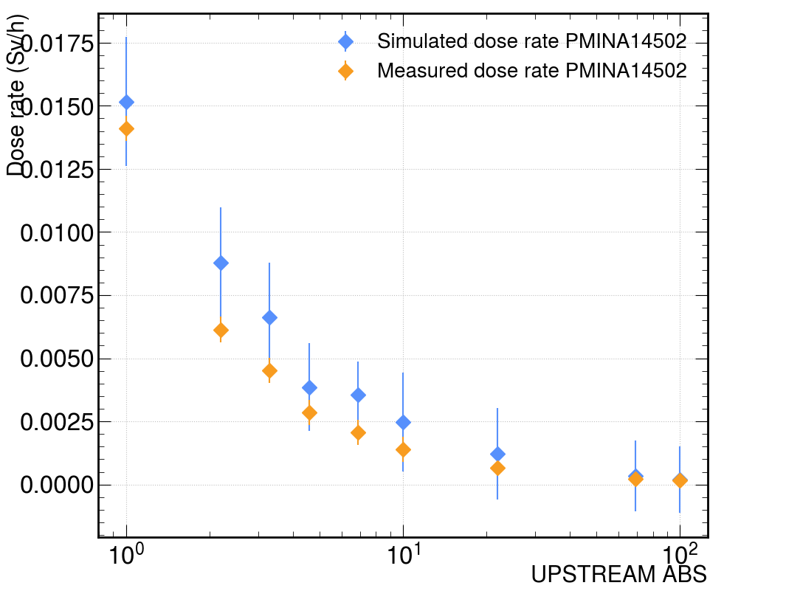
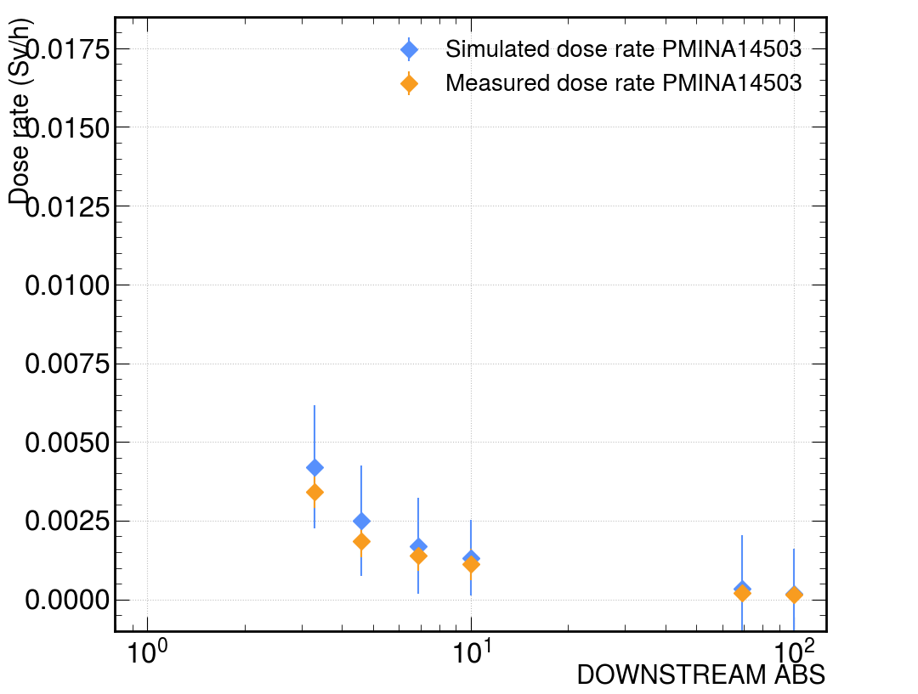
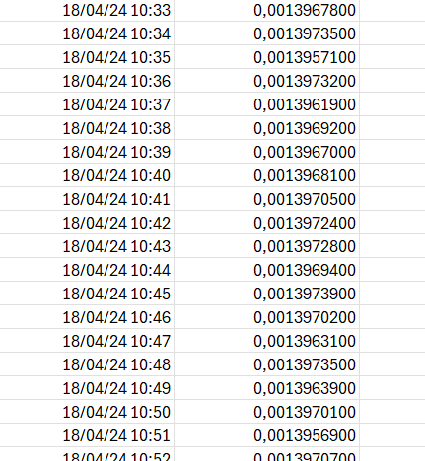
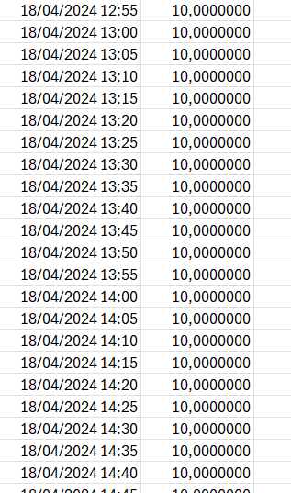
GIF++ preliminry validation with PMINA dosimeters*
Upstream and Downstream validation
Simulated and measured values (test beam campaign 2024) in agreements inside error margin
NO SHADOW from experimental set-up on the PMINA response
PMINA data available at: https://timber.cern.ch/
GIF database for ABS values, https://epdt-rd-monitoring.web.cern.ch/
UPSTREAM (DS ABS =1)
DOWNSTREAM (US ABS =1)
Data and Time Dose rate
Data and Time ABS
*Upgraded simulation of the CERN Gamma Irradiation Facility (GIF++) - XVII international Conference RPC2024, Santiago di Compostela, 9-13 September

Slide 15
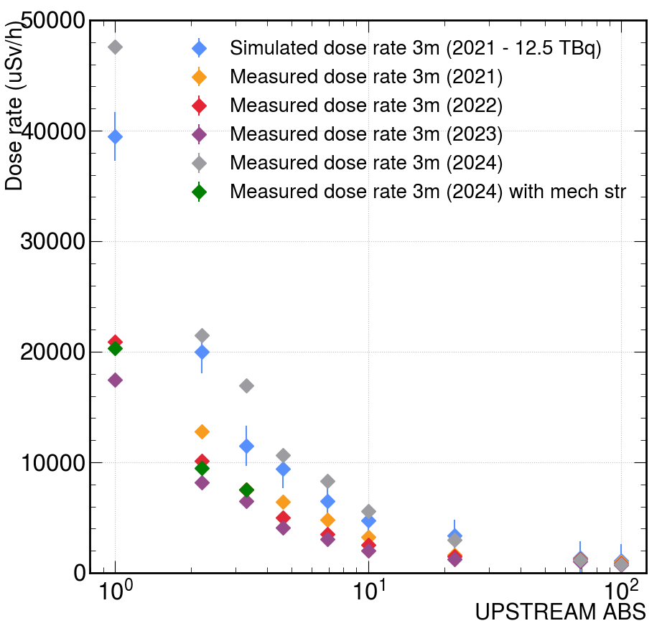
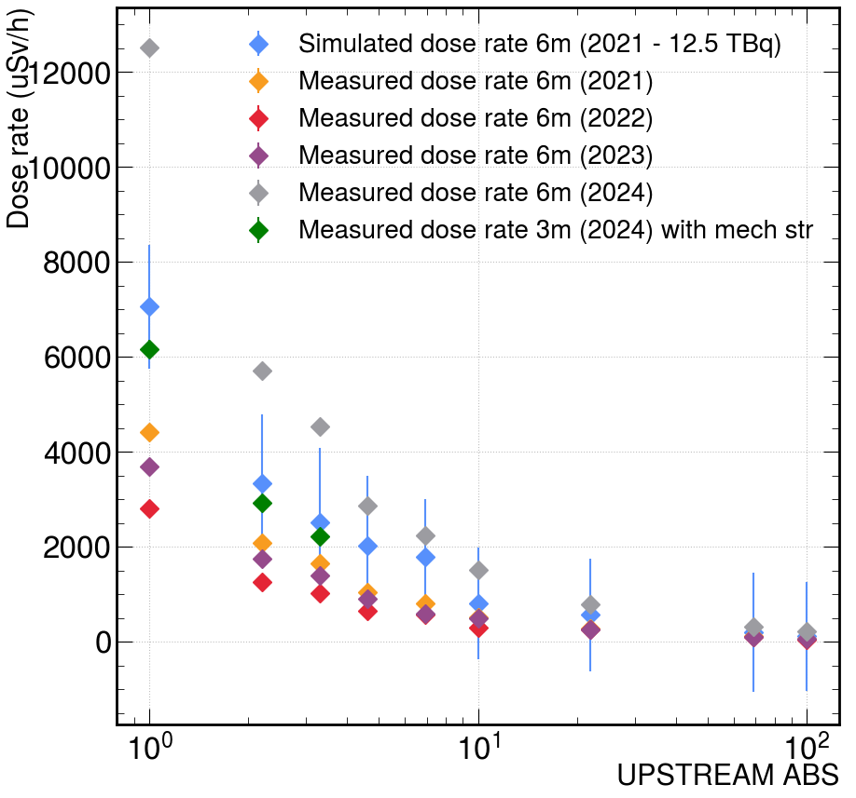
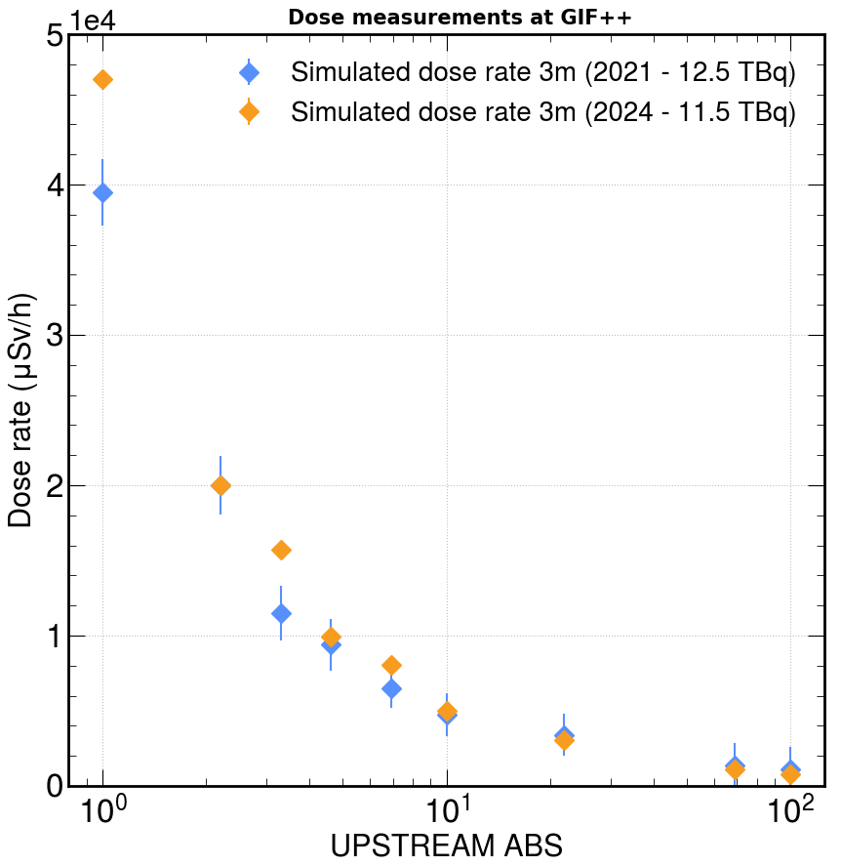
Dose rate comparison
Figure 5: Dose rate vs ABS in UPSTREAM data with trolleys a). 3m b). 6m
Figure 6: Simulated dose rate 2021 vs 2024
We measured three data points, i.e., ABS 1, 2.2, and 3.3, at distances of 3 m and 6 m with trolleys between the source and probe. With the trolleys in between, it appears that the dose rate is reduced by around half.
Possibly the measurements conducted from 2021 to 2023 are with the trolleys.
Simulated dose rate 2024 is higher than the 2021 dose rate

Slide 16
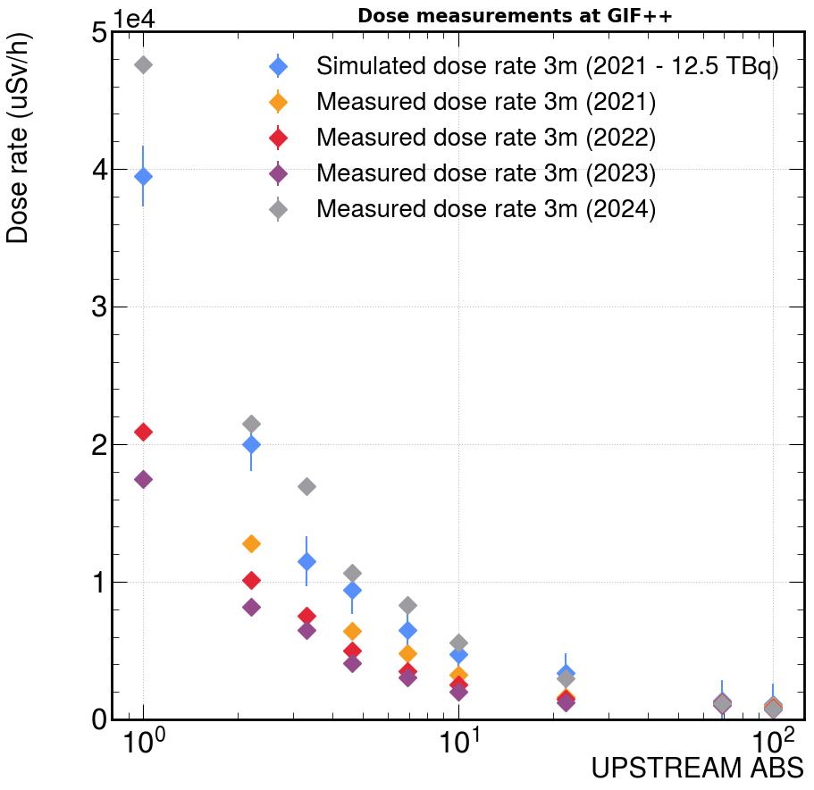
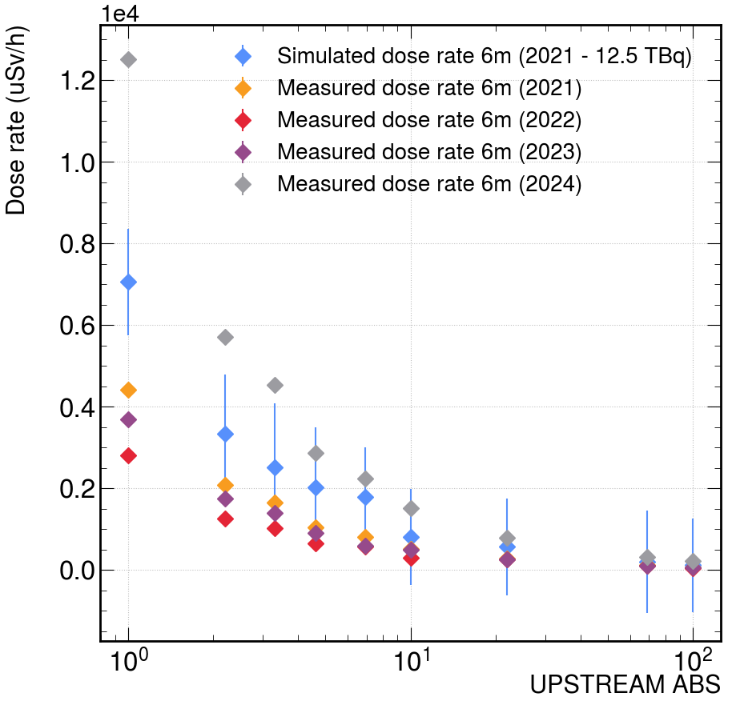
Dose rate comparison
Figure 4: Dose rate vs ABS in UPSTREAM a). 3m b). 6m
It was observed that measured dose rate at 2024 (at 11.5 TBq) is higher than the simulated dose rate
at 2021 (12.5 TBq) for all the ABS at 3m and 6m, for statistical uncertainity.

Slide 17
Raw data

Slide 18
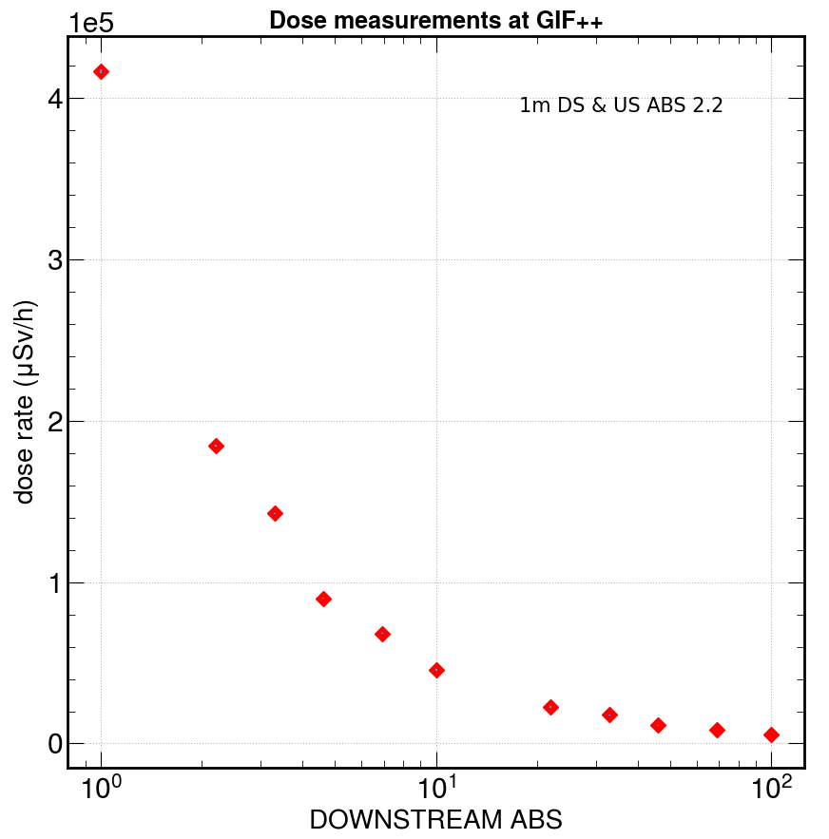
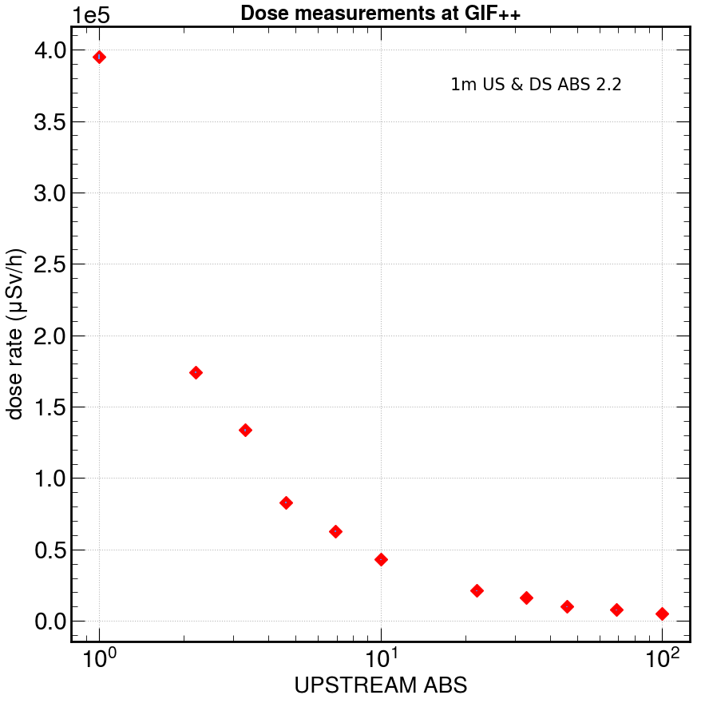
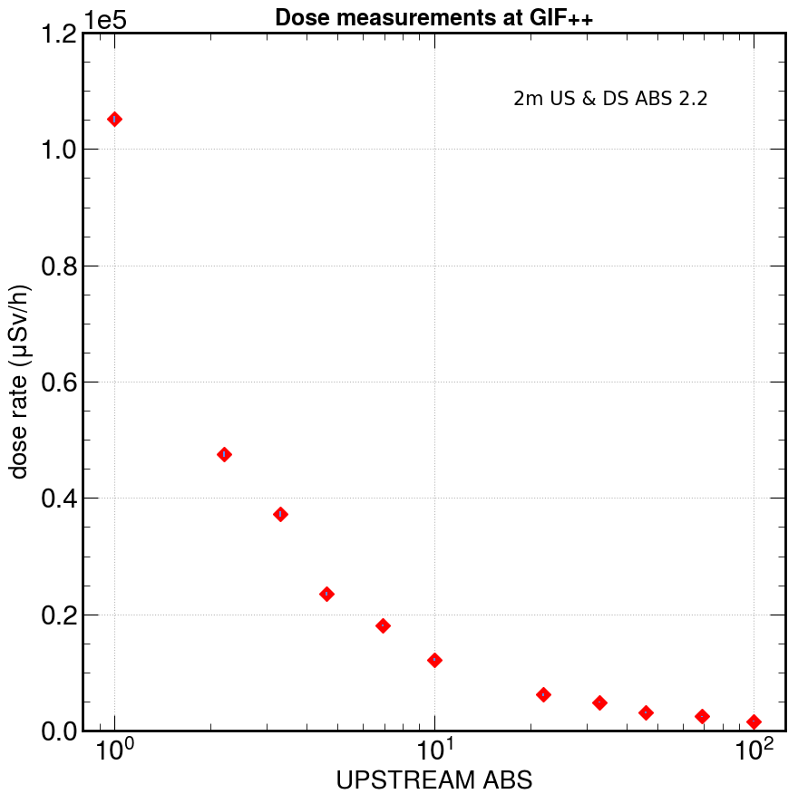
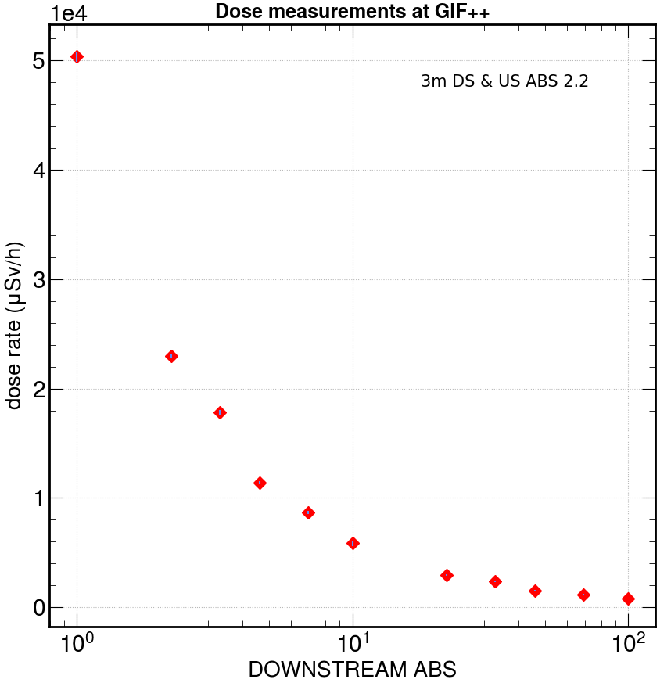
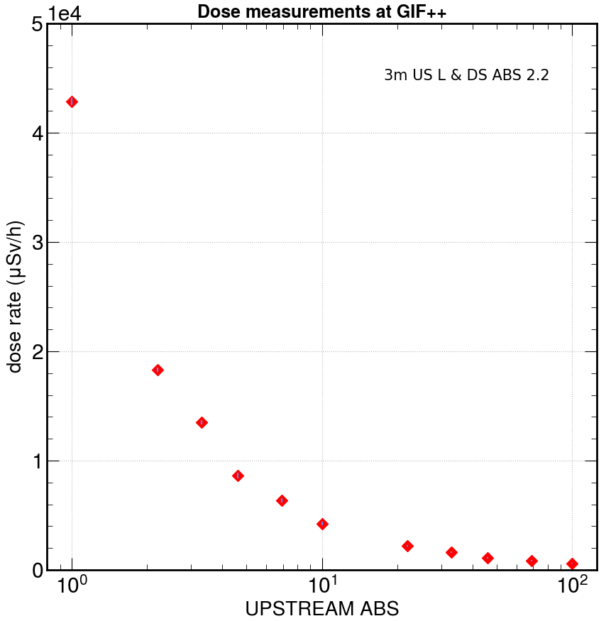
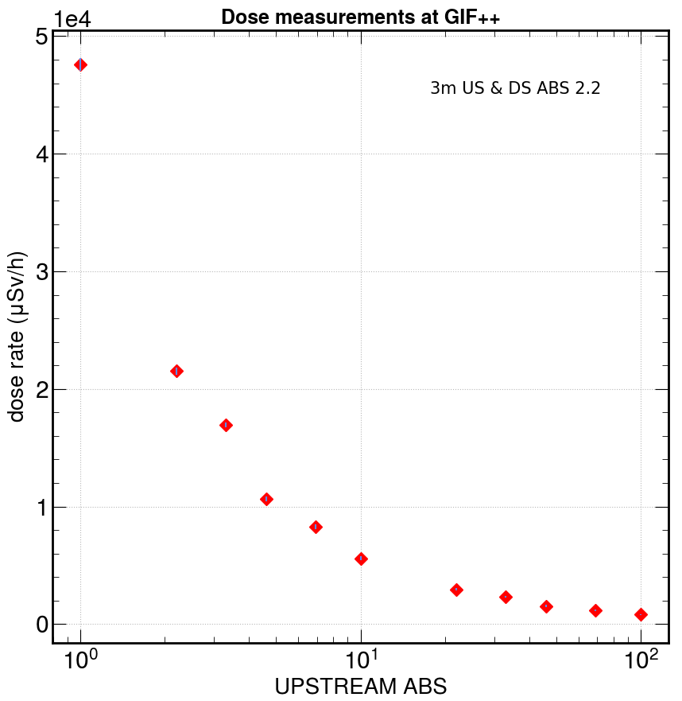
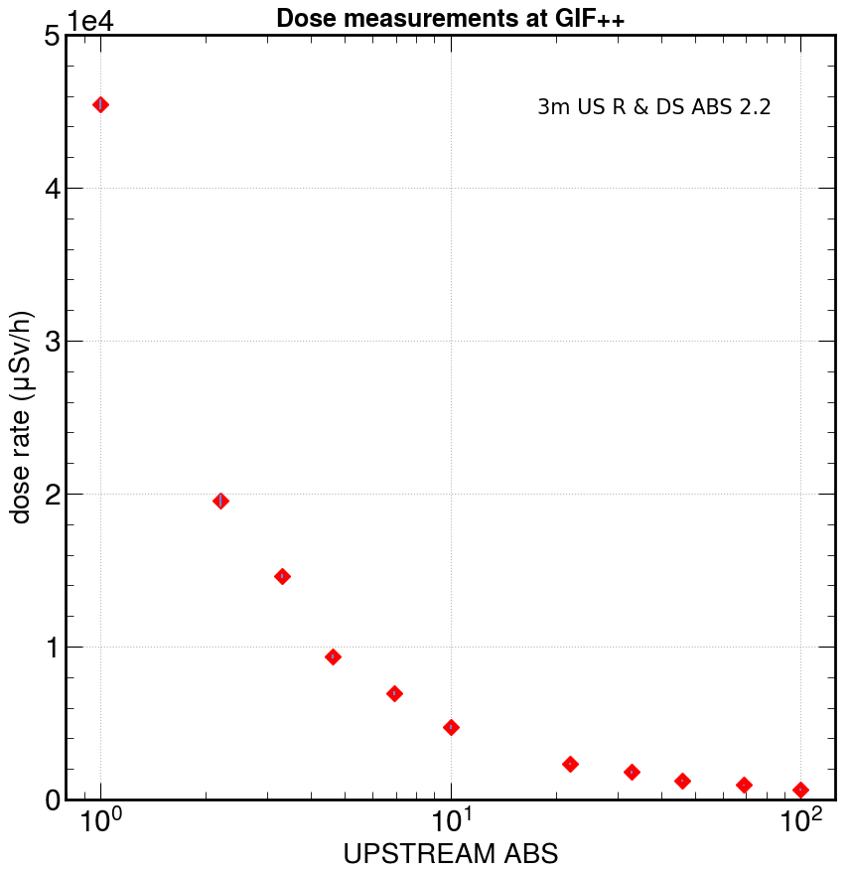
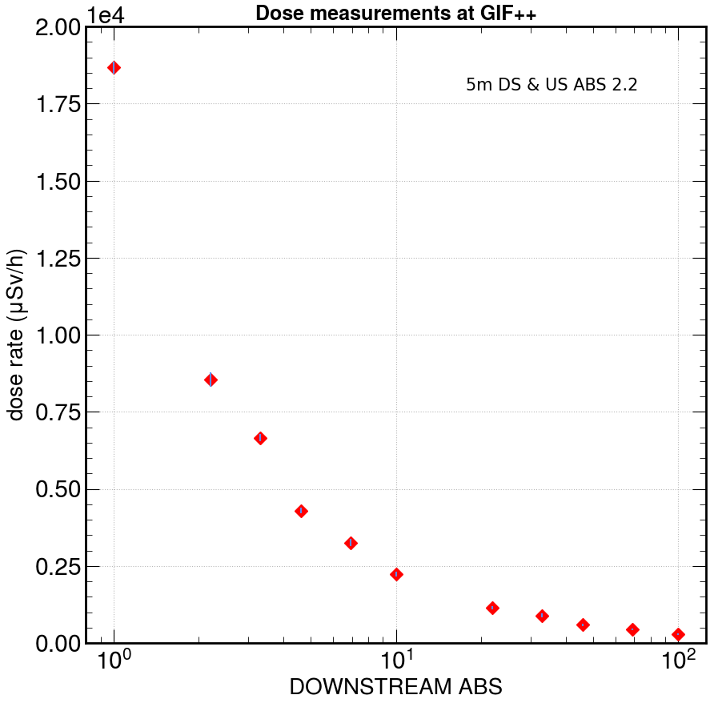
1m DS
1m US
2m US
3m DS
3m US L
3m US
3m US R
5m DS

Slide 19
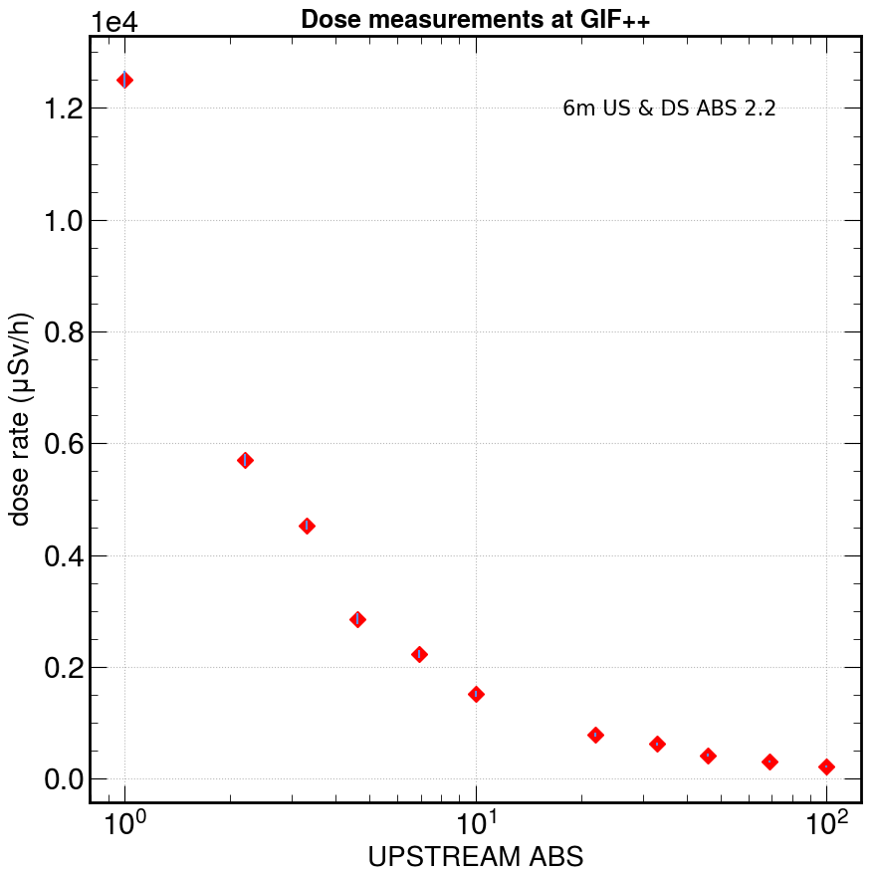
5m US
5m US R
6m US
7m US

