Slide 1
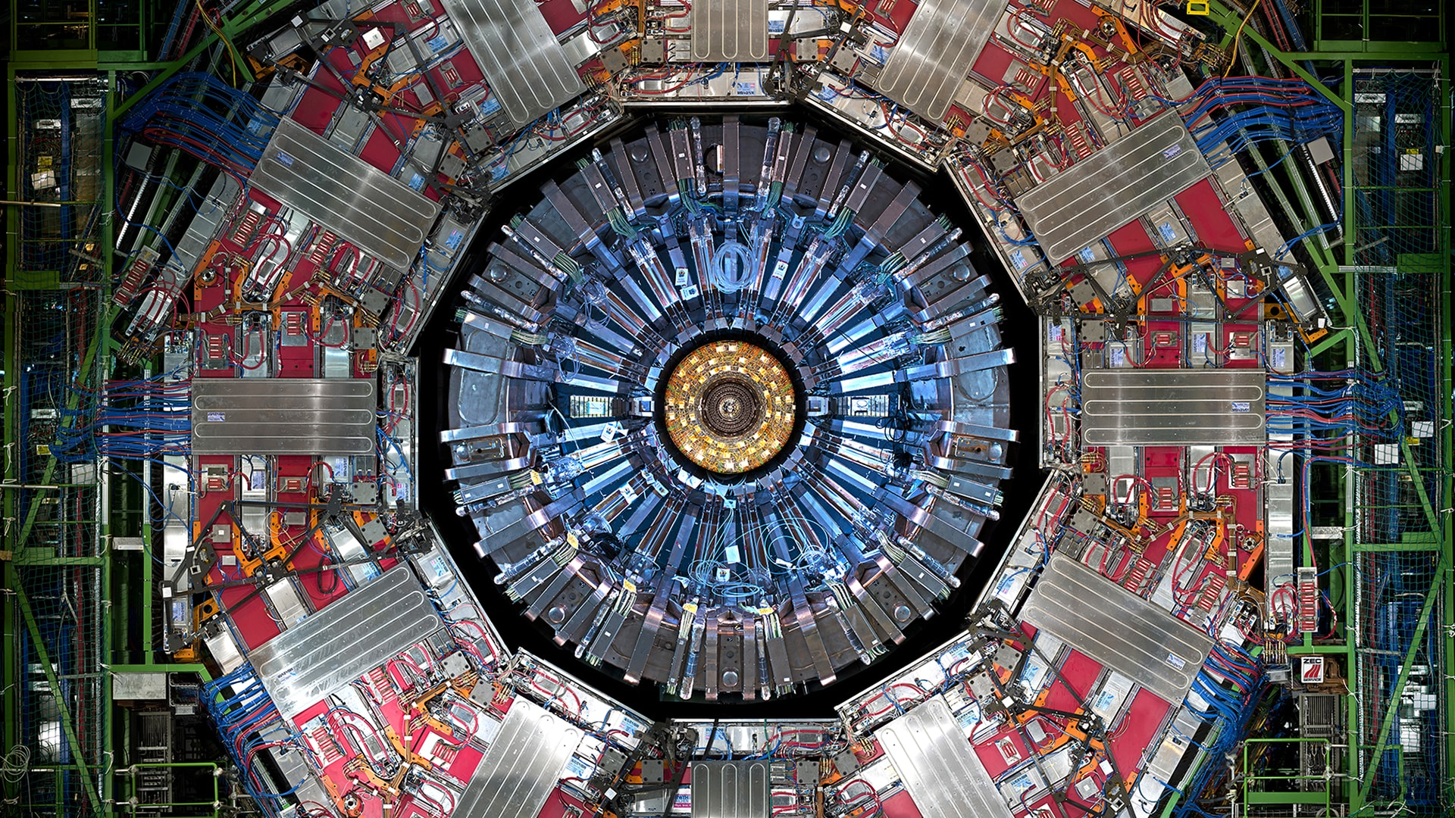
Search for the $B_{(s)}^{0}→4μ$ decay at the CMS experiment
M. Buonsante ^{[1]}, F. Simone ^{[2]} , R. Venditti ^{[1]}
^{[1]} Università & INFN Bari
^{[2]} Politecnico & INFN Bari
CMS Bari 20/12/24

Slide 2
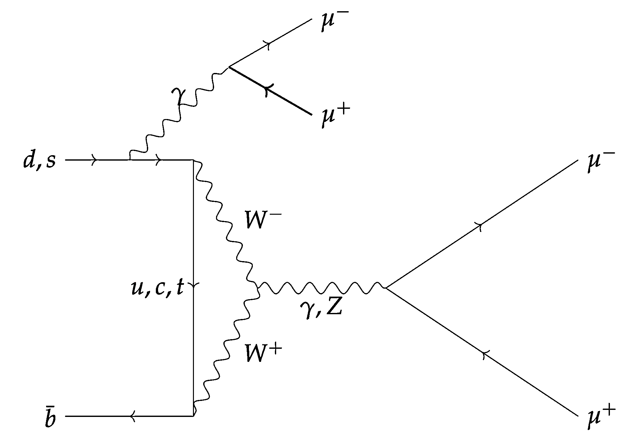
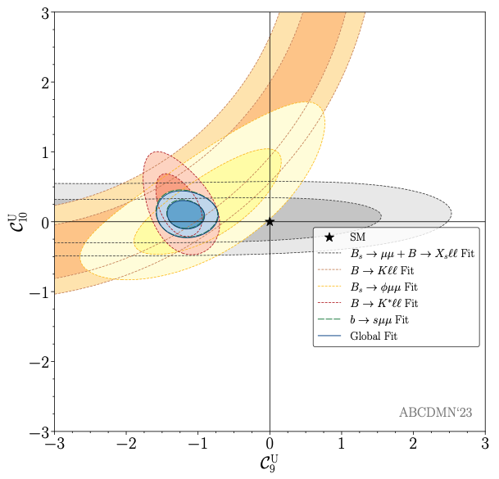
Theoretical Framework
The SM allows $B_{\left(s\right)}^{0}→4μ$ decay only via loop diagrams
FCNC transition → very small BR [JHEP 03 (2022) 109]
$BR\left(B_{s}^{0}→4μ\right)= 0.9−1.0∙{10}^{−10}$
$BR\left(B^{0}→4μ\right)= 0.4−4.0∙{10}^{−12}$
BSM physics could modify this BRs
difference in Wilson coefficients
Interest in $C_{9}(μ)$ showing some deviations from SM
}
SM Predictions
$B_{\left(s\right)}^{0}→4μ$ in the SM
$$H_{eff}\left(b→sll\right)=\frac{G_{F}α}{√2π}V_{ts}^{∗}V_{tb}\sum_{i=1}^{10}{C_{i}\left(μ\right)O_{i}\left(μ\right)+{C′}_{i}\left(μ\right){O′}_{i}\left(μ\right)}$$
Right-handed quark
not in SM!
Only $O_{7,9,10}(μ)$ and ${O′}_{7,9,10}(μ)$are relevant for our decay
[Eur. Phys. J. Spec. Top. (2023) 1-20]
2
Notes:
[JHEP09(2024)026]

Slide 3
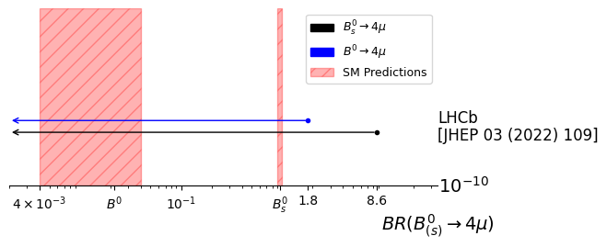
State of the art
The only result so far is from LHCb [JHEP 03 (2022) 109]
Decay | Current world best UL (95% CL)
$ℬ(B_{s}^{0}→4μ)$ | $8.6 ×{10}^{−10}$
$ℬ(B^{0}→4μ)$ | $1.8 ×{10}^{−10}$
Full Run 1+2 dataset, which corresponds to an integrated luminosity of 9 fb−1 and √s = 7, 8, 13 TeV
3

Slide 4
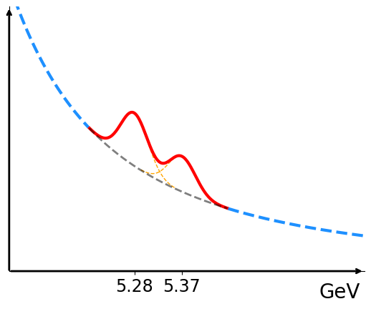
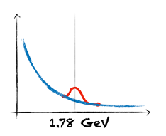
Analysis strategy
Event selection to maximize the signal significance
$B^{0}/B_{s}^{0}→4μ$signals from MC
Data in the mass sidebands as a proxy of the background
Normalization channel: $B_{s}^{0}→J/ψ\left(2μ\right)φ\left(2μ\right)$
Control channel $B_{s}^{0}→J/ψ\left(2μ\right)φ(2K)$
Boosted Decision Tree (BDT) for background suppression
Event categorization based on BDT output and mass resolution
Signal extraction from the 4μ invariant mass
4

Slide 5
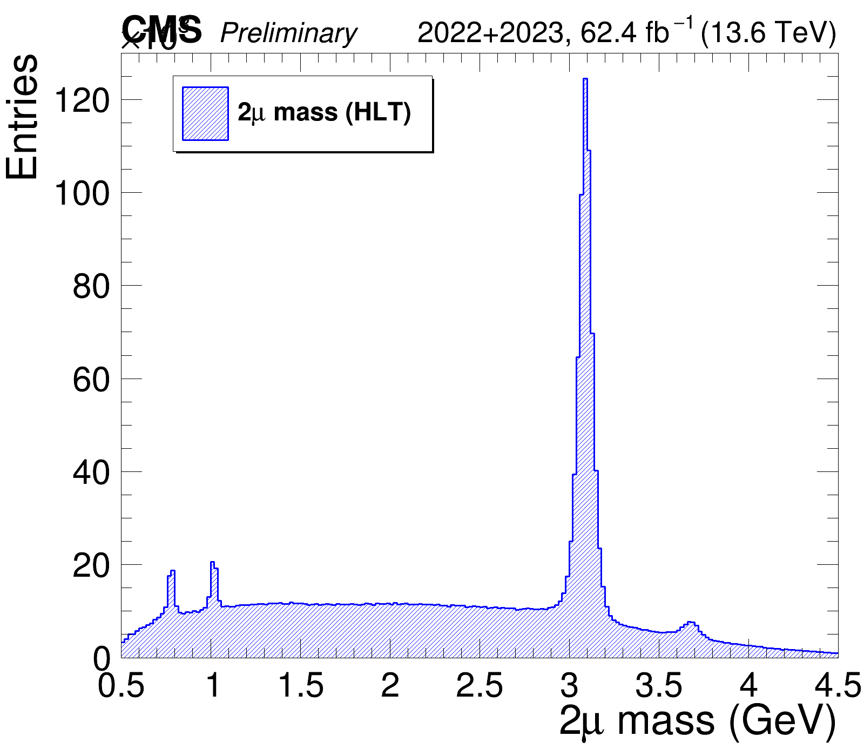
Data and Selections
NEW!
Run3 p-p collisions (2022 → 2024 data)
$${×10}^{3}$$
ParkingDoubleMuonLowMass*
Resonance vetos
HLT_DoubleMu4_3_LowMass (171.5 $fb^{−1}$)
Main Selections
Muon $p_{T}$ and η | $p_{T}>2$ GeV and $\left|η\right|<2.4$
Muon ID | Global ID & Medium ID
$4μ$ inv. Mass | [4.5, 6.5] GeV
HLT-reco matching | ∆R($μ^{reco}$, $μ^{HLT}$) < 0.1
Mass of the two muons selected by the HLT (after requiring 4 muons with mass in [4.5, 6.5])
* Promptly reconstructed thanks to the available computational resources
5
Notes:
-evidenziare che la ricerca è possibile grazie al double muon low mass trigger path -specificare che la selezione è ottimizzata per soft muons (?)

Slide 6
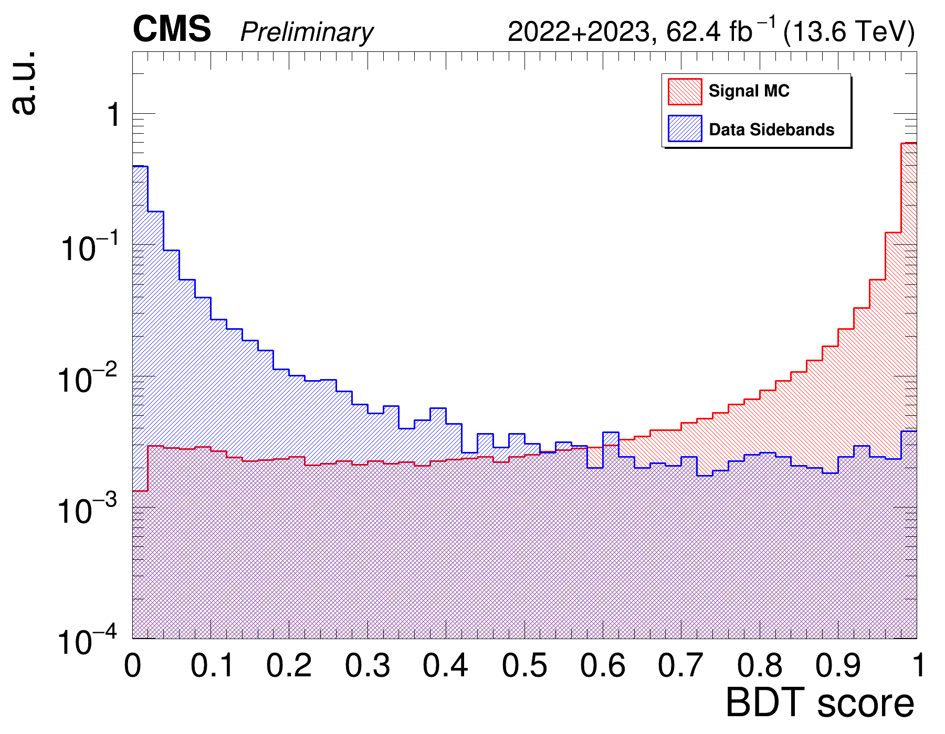
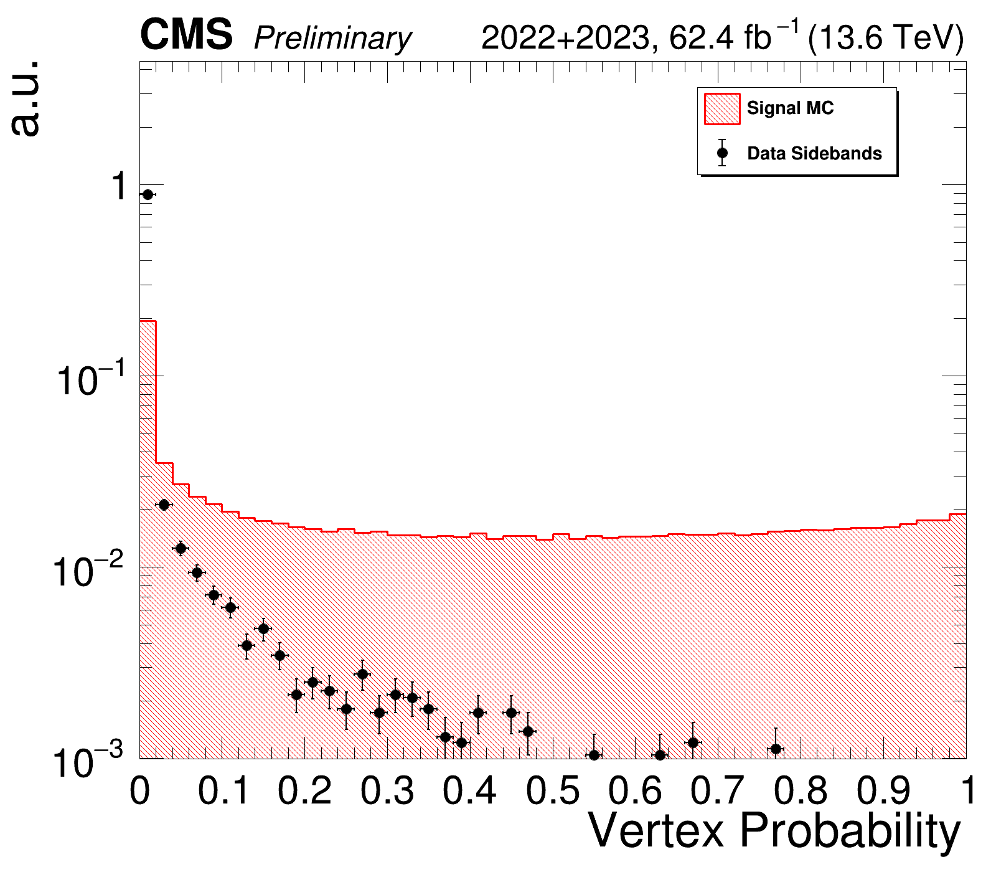
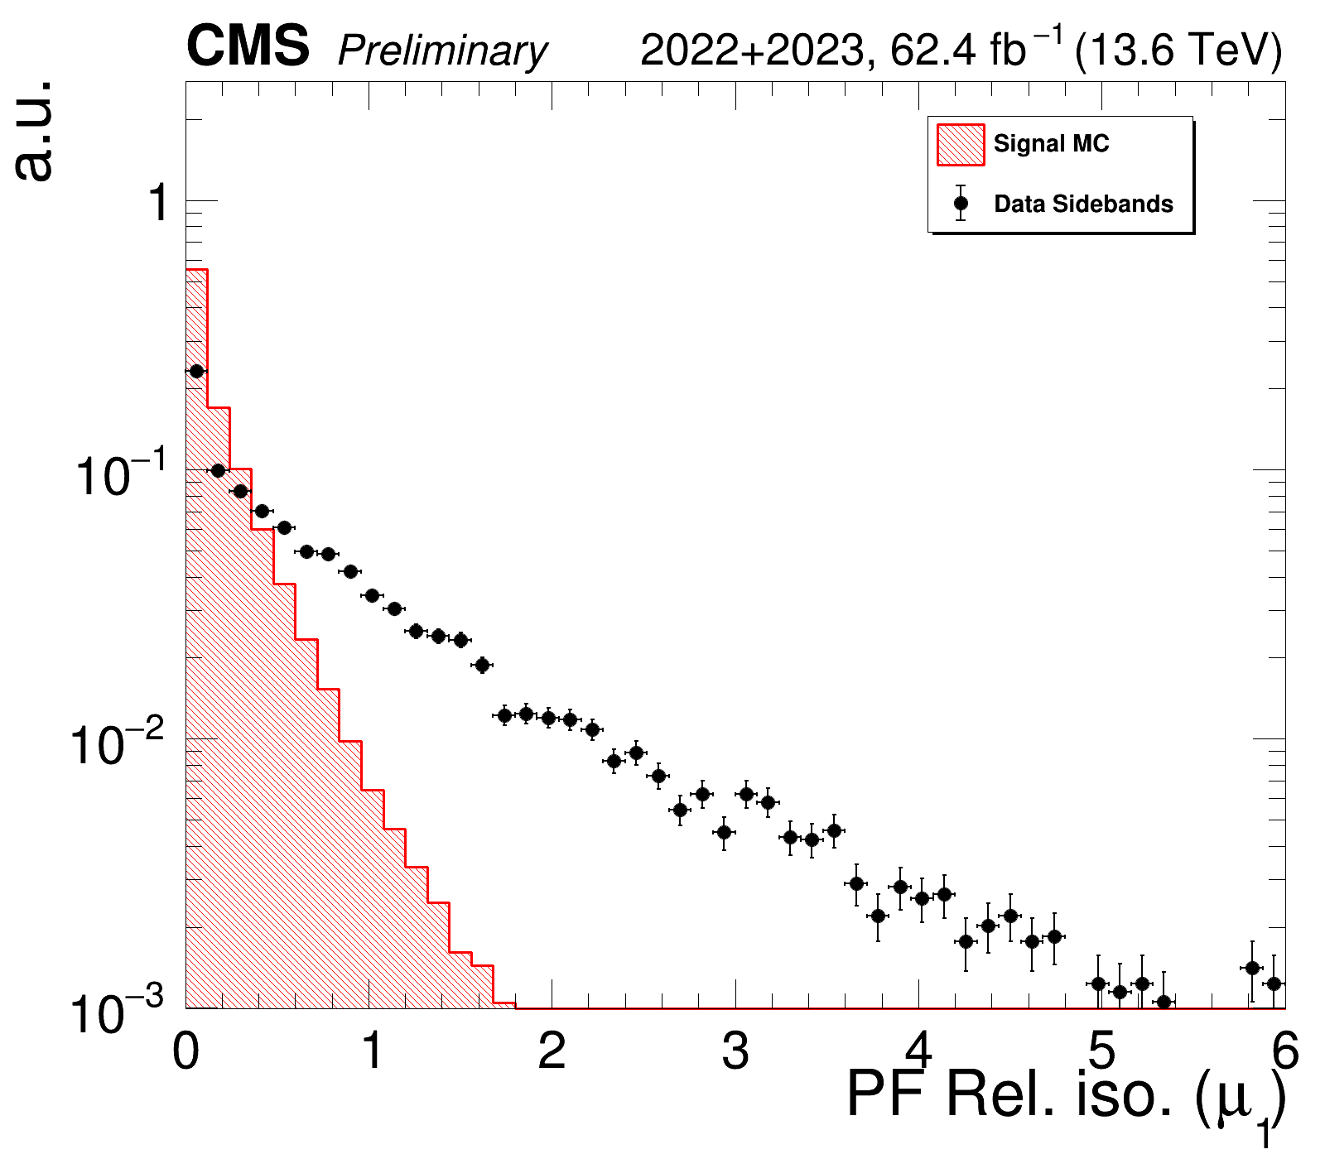
Multivariate analysis
A Boosted Decision Tree (BDT) is trained to distinguish:
Signal: MC $B^{0}/B_{s}^{0}→4μ$simulations passing the selections
Background: data events in mass sidebands
BDT, with XGBoost boosting algorithm, trained with 10-fold cross validation procedure
With 11 input variables:
B candidate $p_{T}, η$, vertex, flight direction
μ impact parameter, isolation
> 0.48
Preliminary Cut
6
Notes:
-aggiungere linea per taglio sul BDT

Slide 7
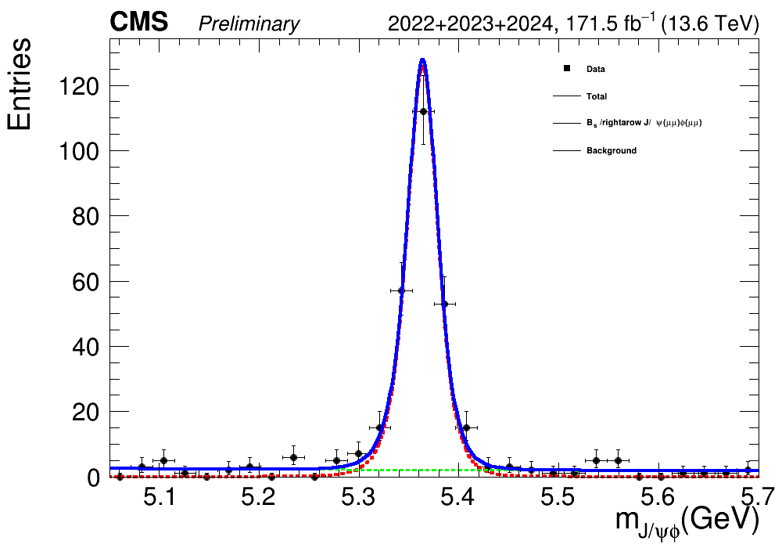
Normalization
$B_{(s)}^{0}→4μ$ BR measured relative to $B_{s}^{0}→J/ψ\left(→2μ\right)φ(→2μ)$
Same final state → systematic uncertainties cancel out
246 ± 16 Events
$N_{s}^{B_{(s)}^{0}}=\frac{ε_{signal}}{ε_{norm}}×\frac{ℬ\left(B_{\left(s\right)}^{0}→4μ\right)}{ℬ\left(B_{s}^{0}→J/ψ\left(2μ\right)φ(2μ)\right)}×N_{B_{s}^{0}→J/ψ\left(2μ\right)φ(2μ)}×\frac{f_{d}}{f_{s}}$
Fragmentation fractions (only for $B_{0}$)
$$ε=ε_{gen}×{ ε}_{sel}{× ε}_{bdt}$$
Using latest results from CMS [Phys. Rev. Lett. 131 (2023) 121901]
First observation at CMS!
7

Slide 8
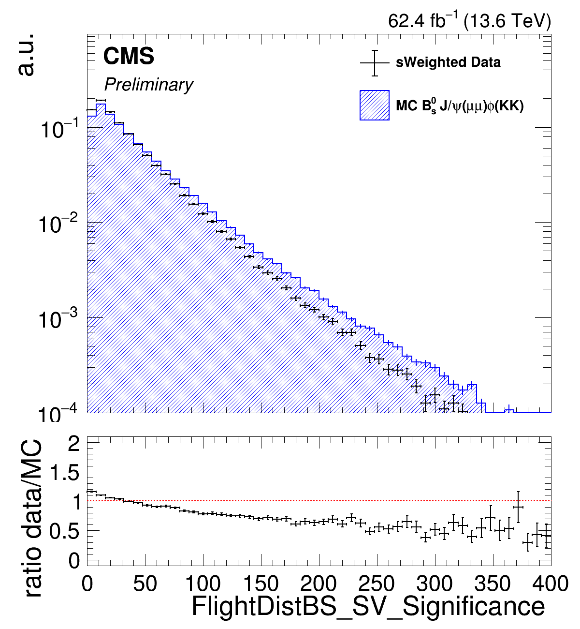
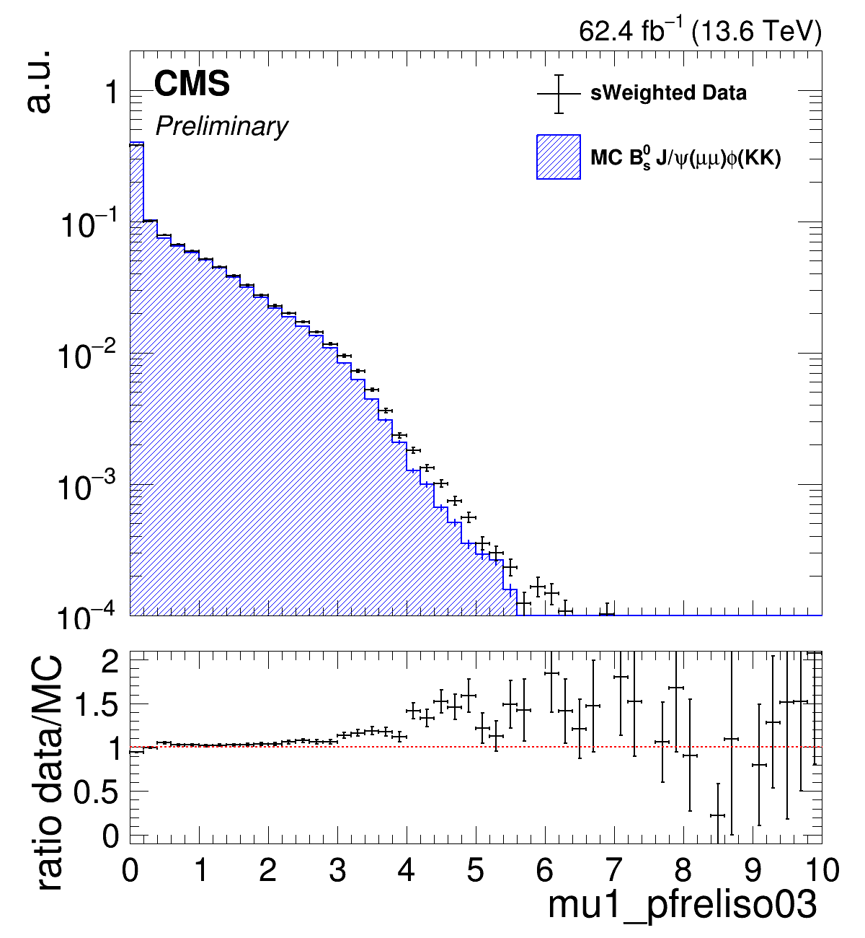
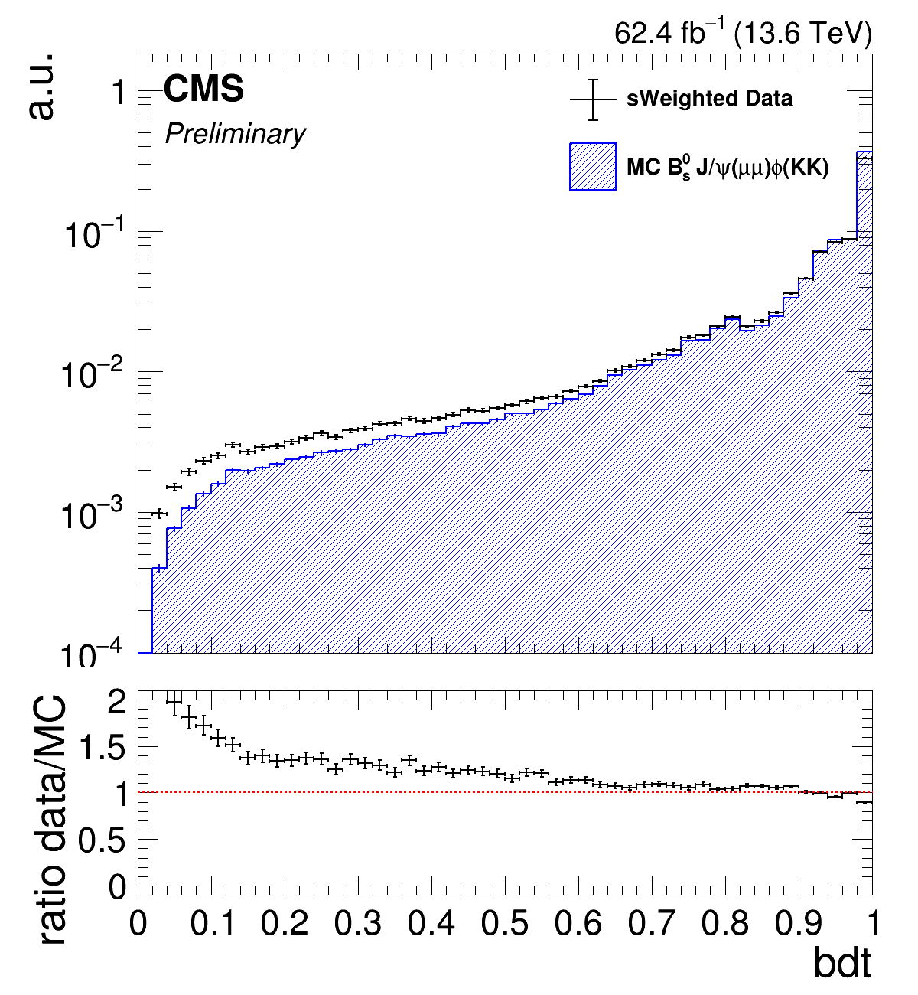
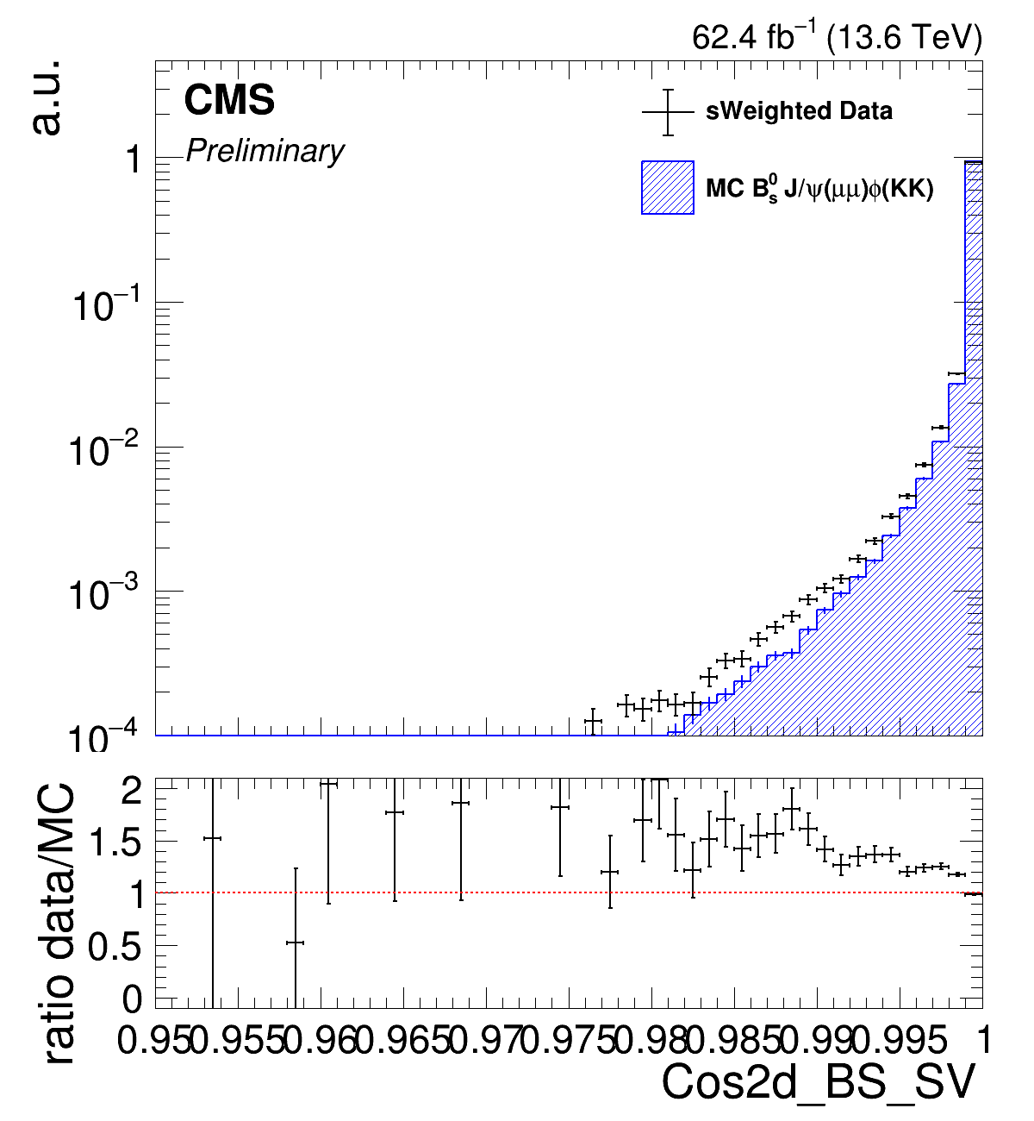
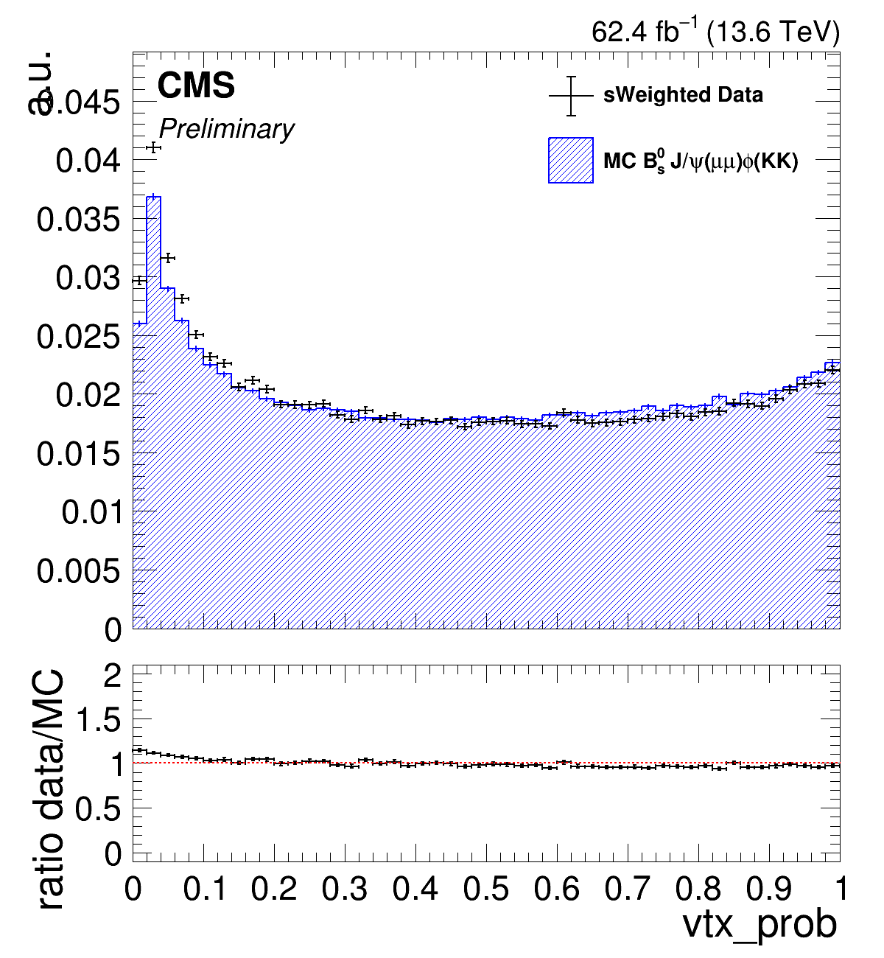
Data-MC compatibility
Data-MC compatibility verified using $B_{s}^{0}→J/ψ\left(2μ\right)φ(2K)$ channel
Large statistics
To account for this discrepancy
Sys. Unc.
+
BDT reweight
NEW!
(Ongoing)
8

Slide 9
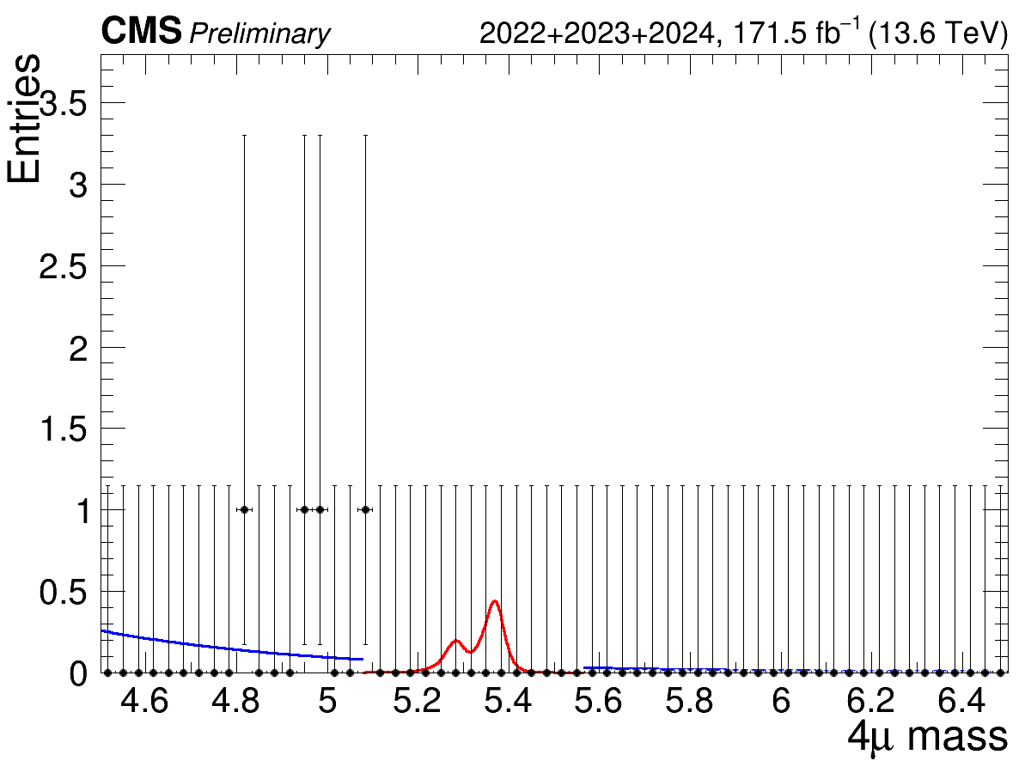
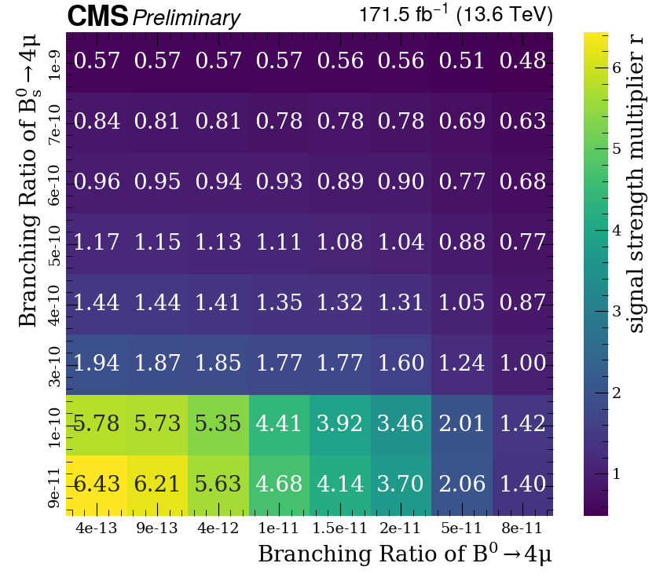
Signal extraction
Categorization based on invariant mass resolution and BDT score → ML fit of the 6 categories
Expected Upper Limits computed for the $B^{0}$ and $B_{s}^{0}$ signals independently (as done by LHCb):
$BR\left(B_{s}^{0}→4μ\right)<5.97 ×{10}^{−10}$ @ 95% C.L.
$BR\left(B^{0}→4μ\right)<1.35 ×{10}^{−10}$ @ 95% C.L.
The two signals could both contribute, difficult to resolve tough
Calculate the UL using the combined signal PDF for different combinations of BRs
NEW!
NEW!
9
Notes:
CADI Line + Moriond 2025

Slide 10
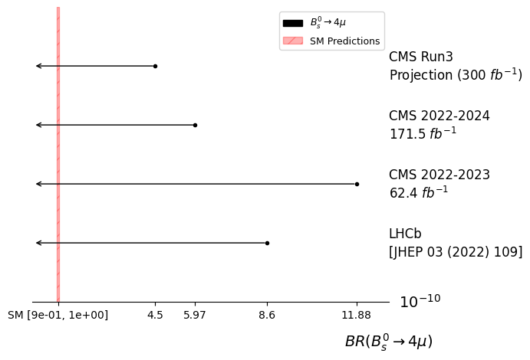
Conclusions
[BPH-24-007] Search for $B_{(s)}^{0}→4μ$ decays at CMS with 2022-2024 data
35% better than LHCb
Plan: Publish the analysis with the full data from 2022 and 2024
Testing: Inclusion of Run2 data
Timeline: Summer 2025
NEW!
Marco Buonsante - CMS Bari 20/12/2024
10

Slide 11
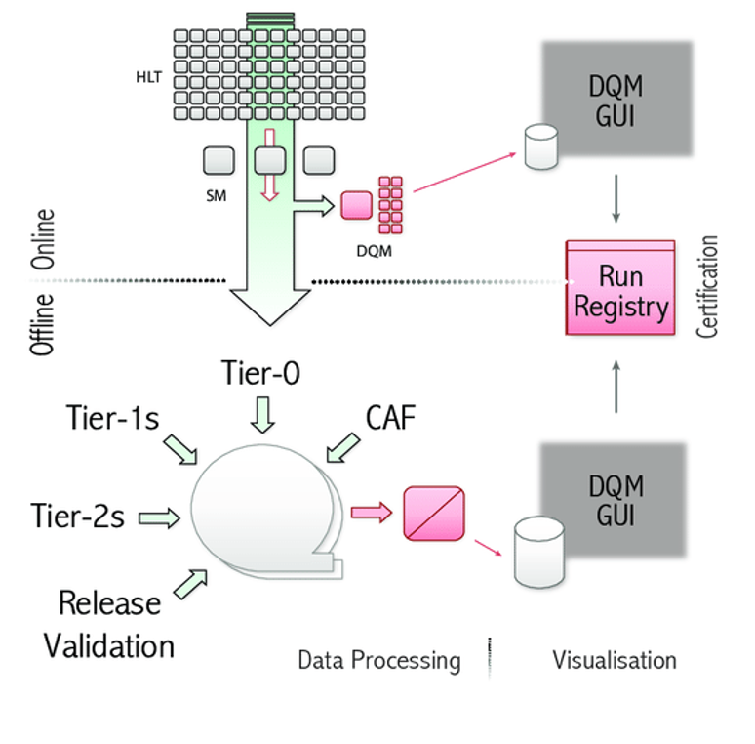
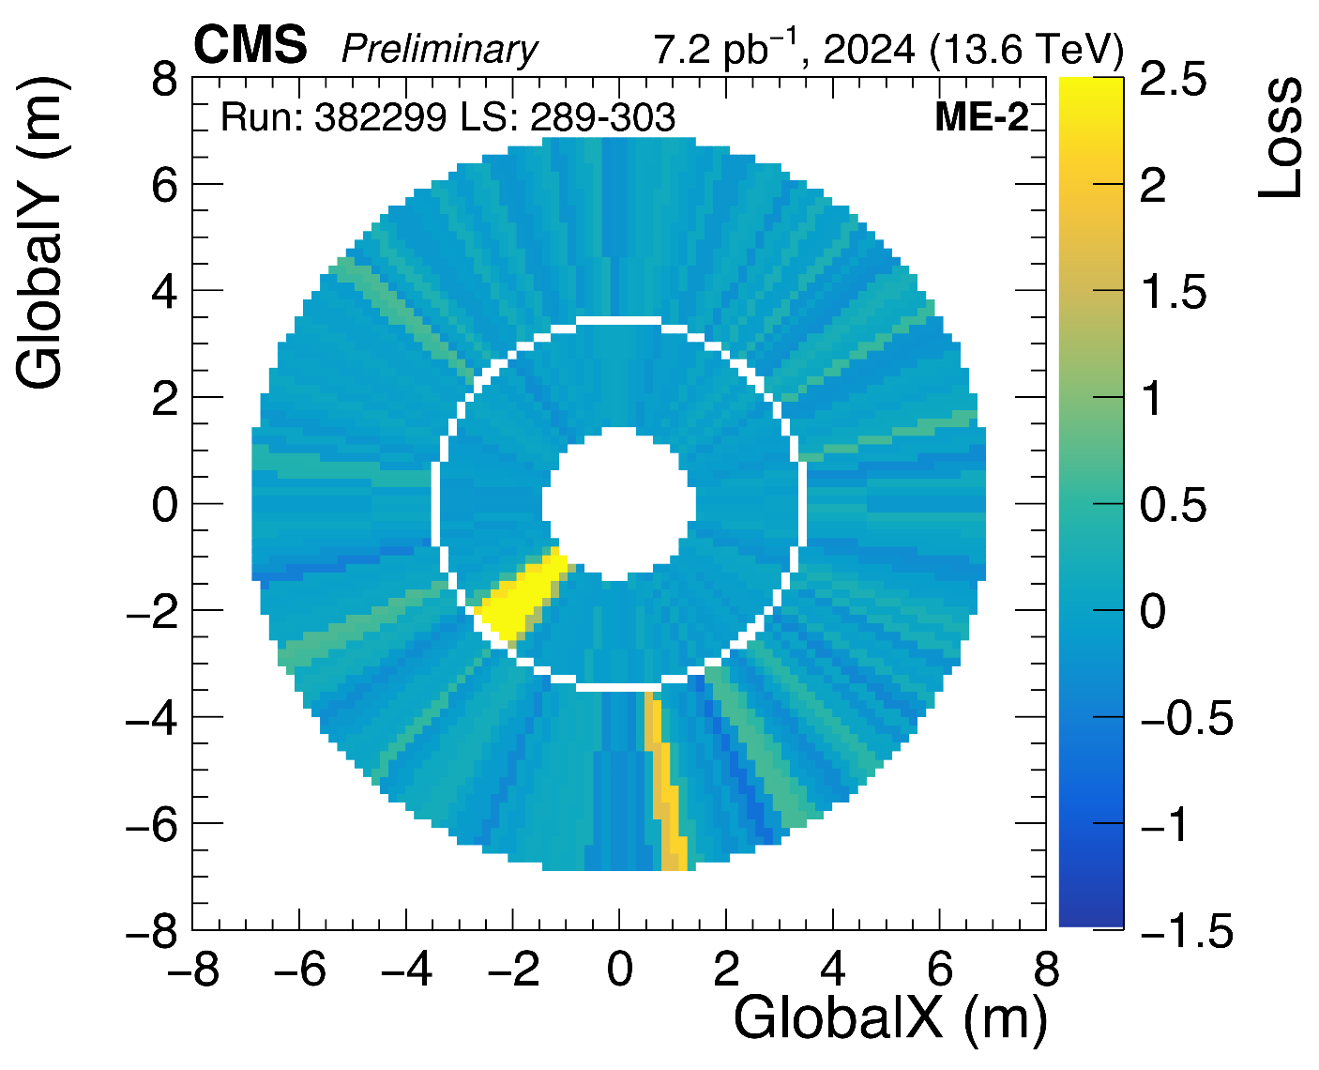
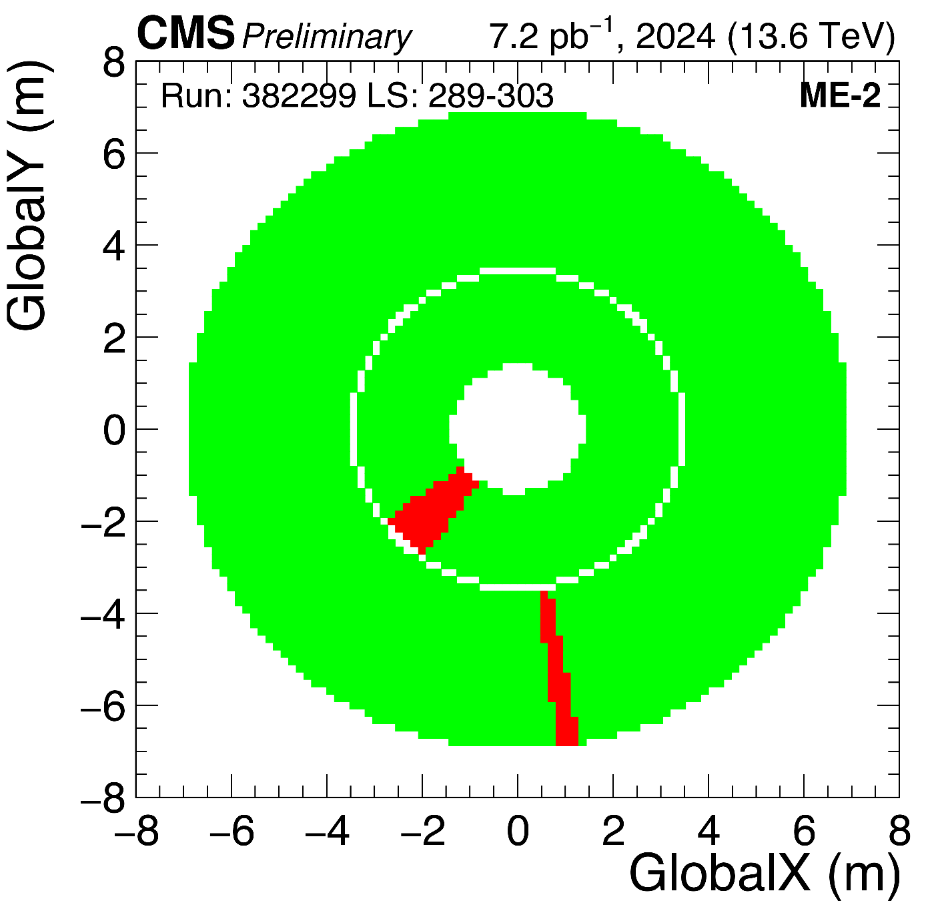
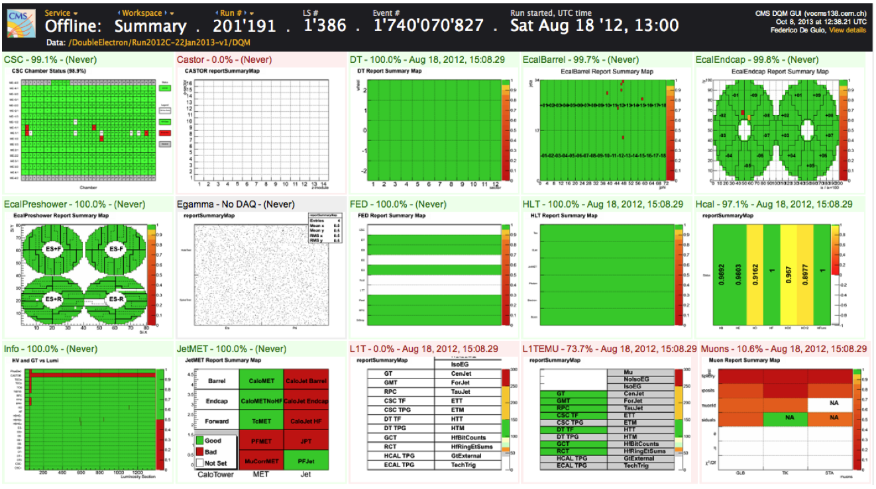
ML for the online DQM of the CMS muon system
Goal: Develop a flexible ML anomaly detection tool
Inputs: Occupancy plots from muon system sub-detectors
ResNet Autoencoder
Encoder
Decoder
Tested with Cathode Strip Chambers (CSC) occupancy plots
150k LSs (from 2024 data taking)
11

Slide 12
Thanks for your attention
12
Notes:
Sistematiche Backup

Slide 13
Backup
13

Slide 14
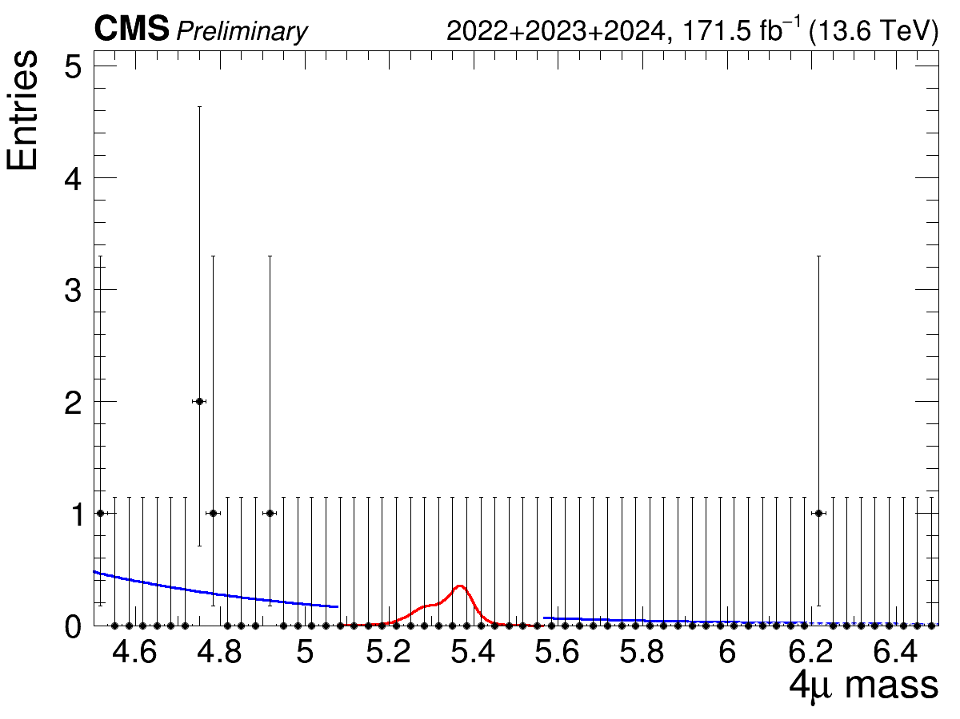
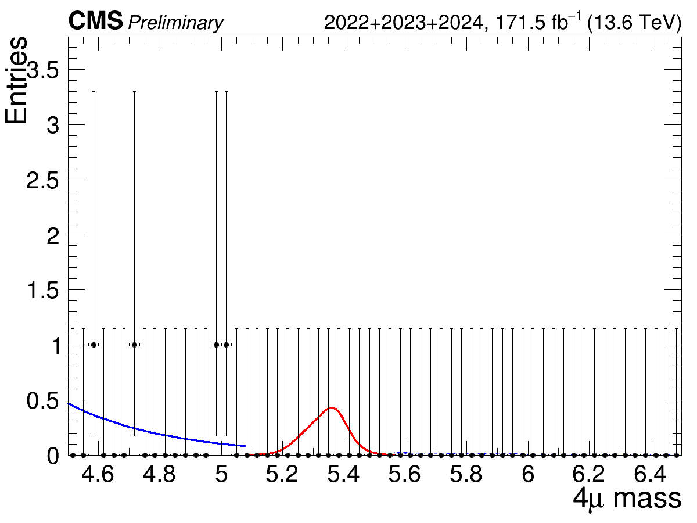
Bs BR=1e-9;
B0 BR=8e-11
B1
C1

Slide 15
Datasets
Data collected in p-p collisions in Run3 during 2022 and 2023
Dataset: ParkingDoubleMuonLowMass (integrated luminosity of 62.4 $fb^{−1}$)
Centrally produced MC samples:
Type | MC Sample | Dataset
Signal | $B^{0}→4μ$ | BdTo4Mu_FourMuonFilter_TuneCP5_13p6TeV_pythia8-evtgen
Signal | $B_{s}^{0}→4μ$ | Bs0To4Mu_FourMuonFilter_TuneCP5_13p6TeV_pythia8-evtgen
Normalization | $B_{s}^{0}→J/ψ\left(2μ\right)φ(2μ)$ | BsToJpsiPhi_JMM_PhiMM_MuFilter_SoftQCDnonD_TuneCP5_13p6TeV-pythia8-evtgen
Control | $B_{s}^{0}→J/ψ\left(2μ\right)φ(2K)$ | BsToJPsiPhi_JPsiToMuMu_PhiToKK_SoftQCDnonD_TuneCP5_13p6TeV_pythia8-evtgen
15
Notes:
- aggiungere che il dataset anche se è parking é stato ricostruito prompt

Slide 16
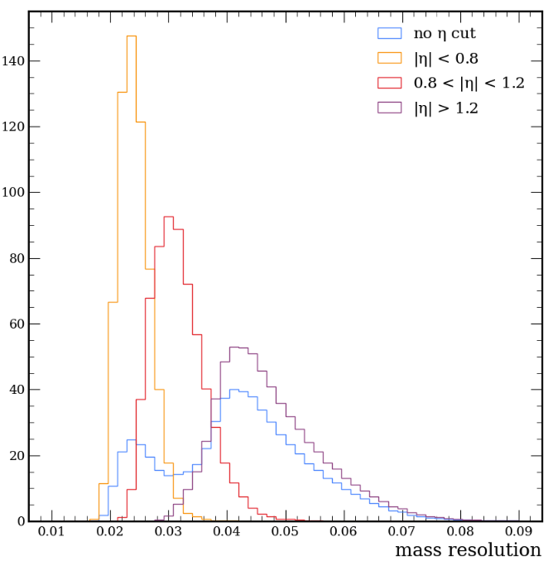
Events Categorization
Events are categorized in 3 mass-reso categories:
[0, 0.027) ,
[0.027, 0.038)
[0.038, inf)
Each category is divided into 2 based on the BDT score.
a.u.
Mass Resolution
16

Slide 17
Systematic Uncertainties
Uncertainty | Percentage
Signal normalization | 9%
Effective lifetime of$B_{s}^{0}$ | 6%
Uncertainty on b-quark fragmentation fractions | 4%
Data MC differences in BDT prediction | 10%
4 μ mass scale uncertainty | 0.01%
17

