Slide 1
C-O burning

Slide 2
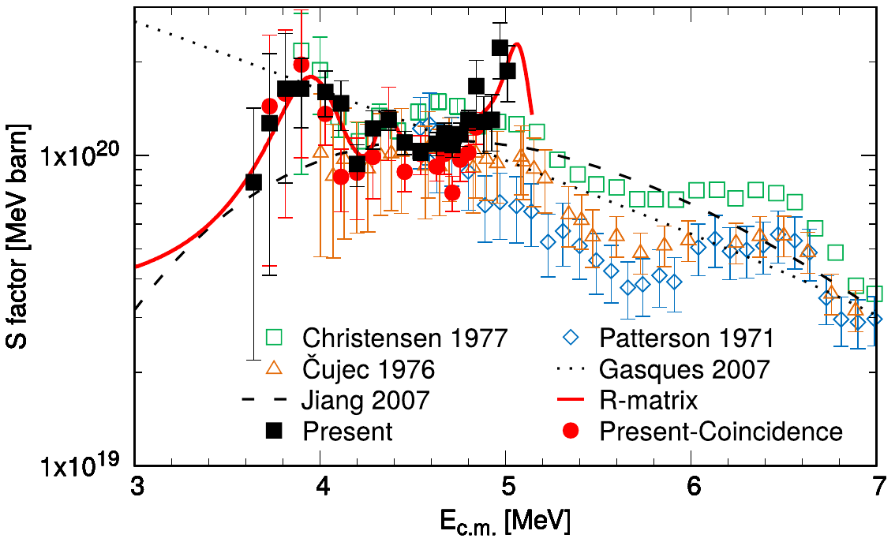
Status of the art
Numerous efforts (experimental and theoretical) to determine the reaction rate of the ¹²C+¹⁶O fusion
Uncertainties remain below 4 MeV in the E_{c.m.}→ extrapolation necessary
Around 6.5 MeV there seems to be a resonant structure → more information needed
X. Fang et al. Phys. Rev. C 96 045804 (2017)

Slide 3
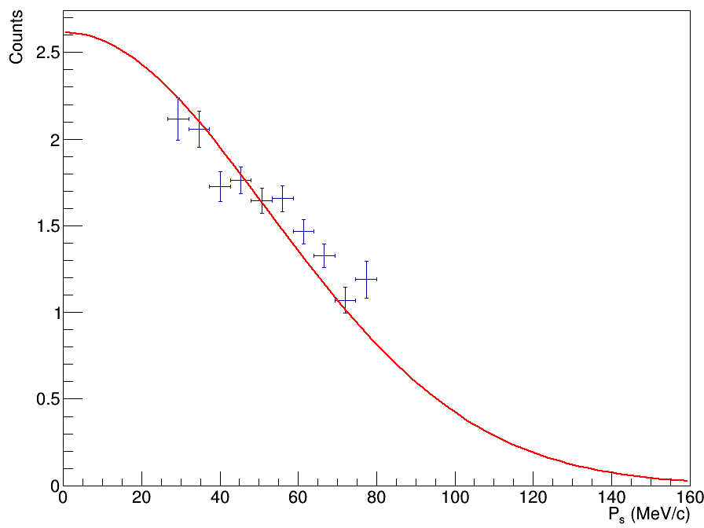
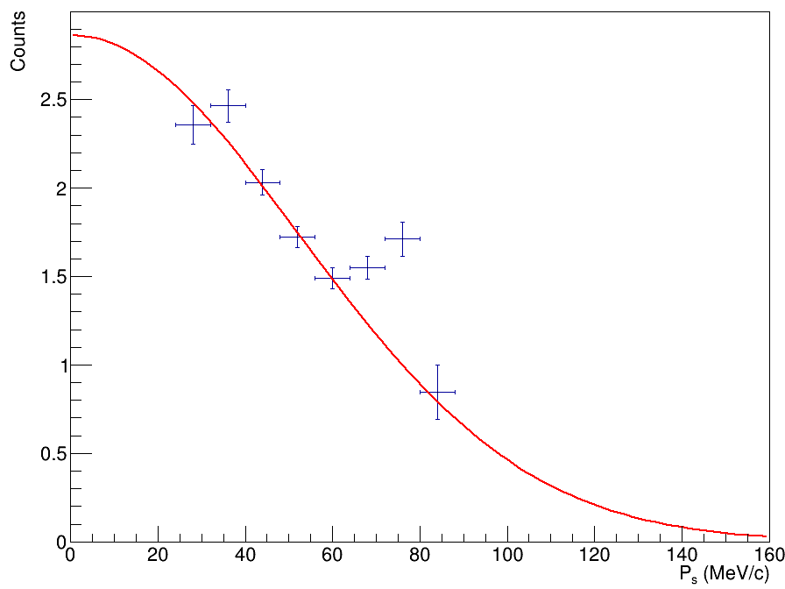
THM application
Trojan Horse reactions:
¹⁶O(¹⁴N, α²⁴Mg)²H
¹⁶O(¹⁴N, p²⁷Al)²H
TH Nucleus:
¹⁴N → ¹²C+d
K.P. Artemov et al., Phys. Lett., 149 B 325 (1984)
R.W. Zurmȕhle et al., Phys. Rev. C 49 , 2549 (1994)
Tumino, A. et al. Nature 557, 687 (2018)
α0
¹⁴N
d
¹²C
α / p
¹⁶O
²⁴Mg / ²⁷Al
α1

Slide 4
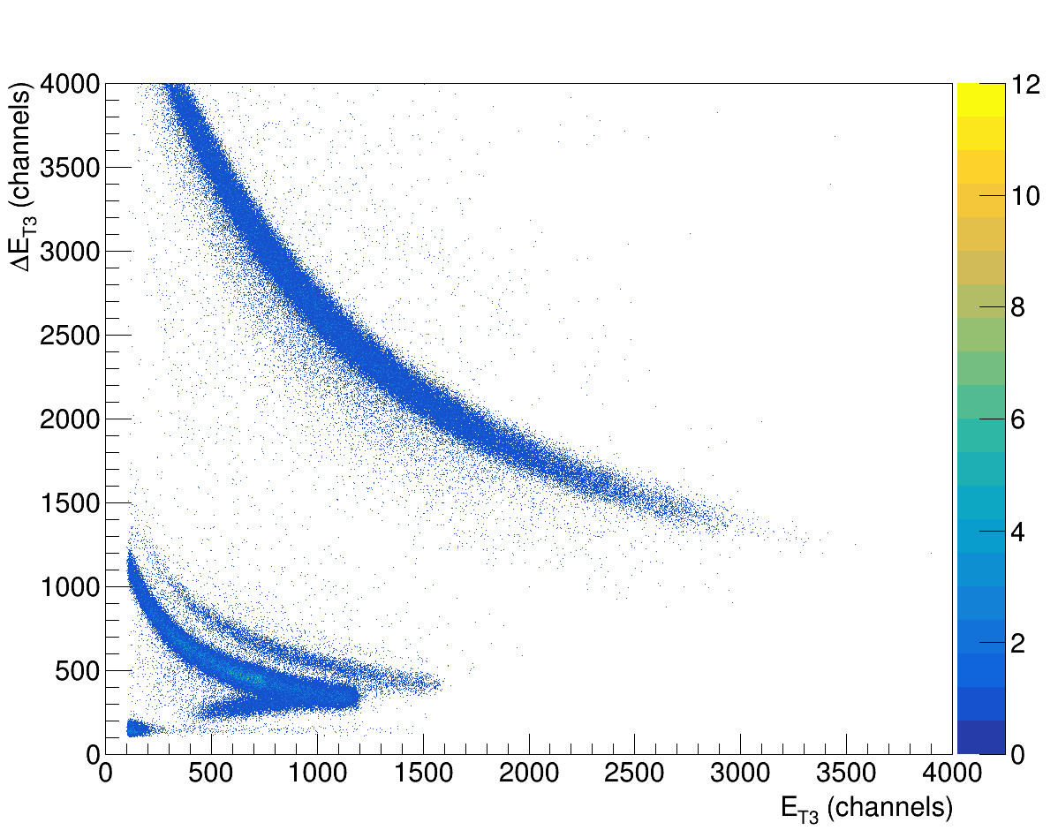
THM application

Slide 5
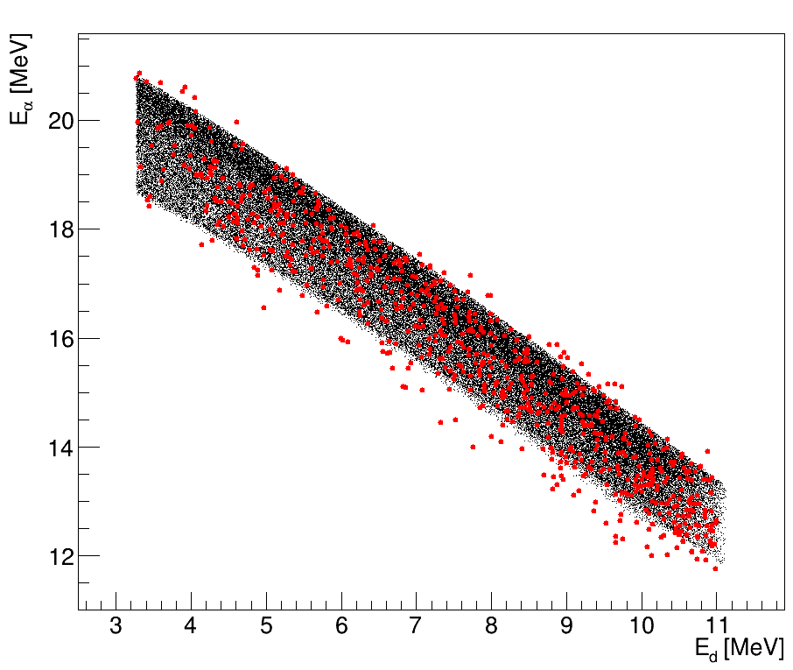
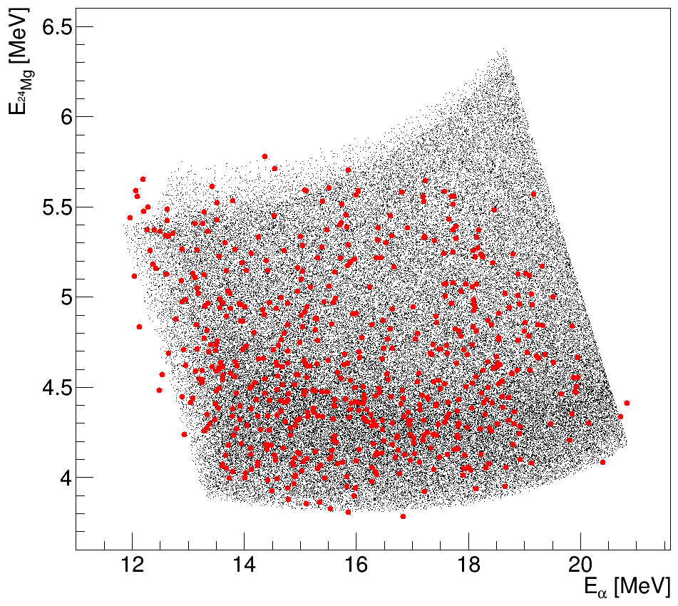
THM application
Comparison between experimental kinematic place and corresponding three-body kinematic simulation
Experimental data are in accordance with the simulations
simulation
experiment
simulation
experiment

Slide 6
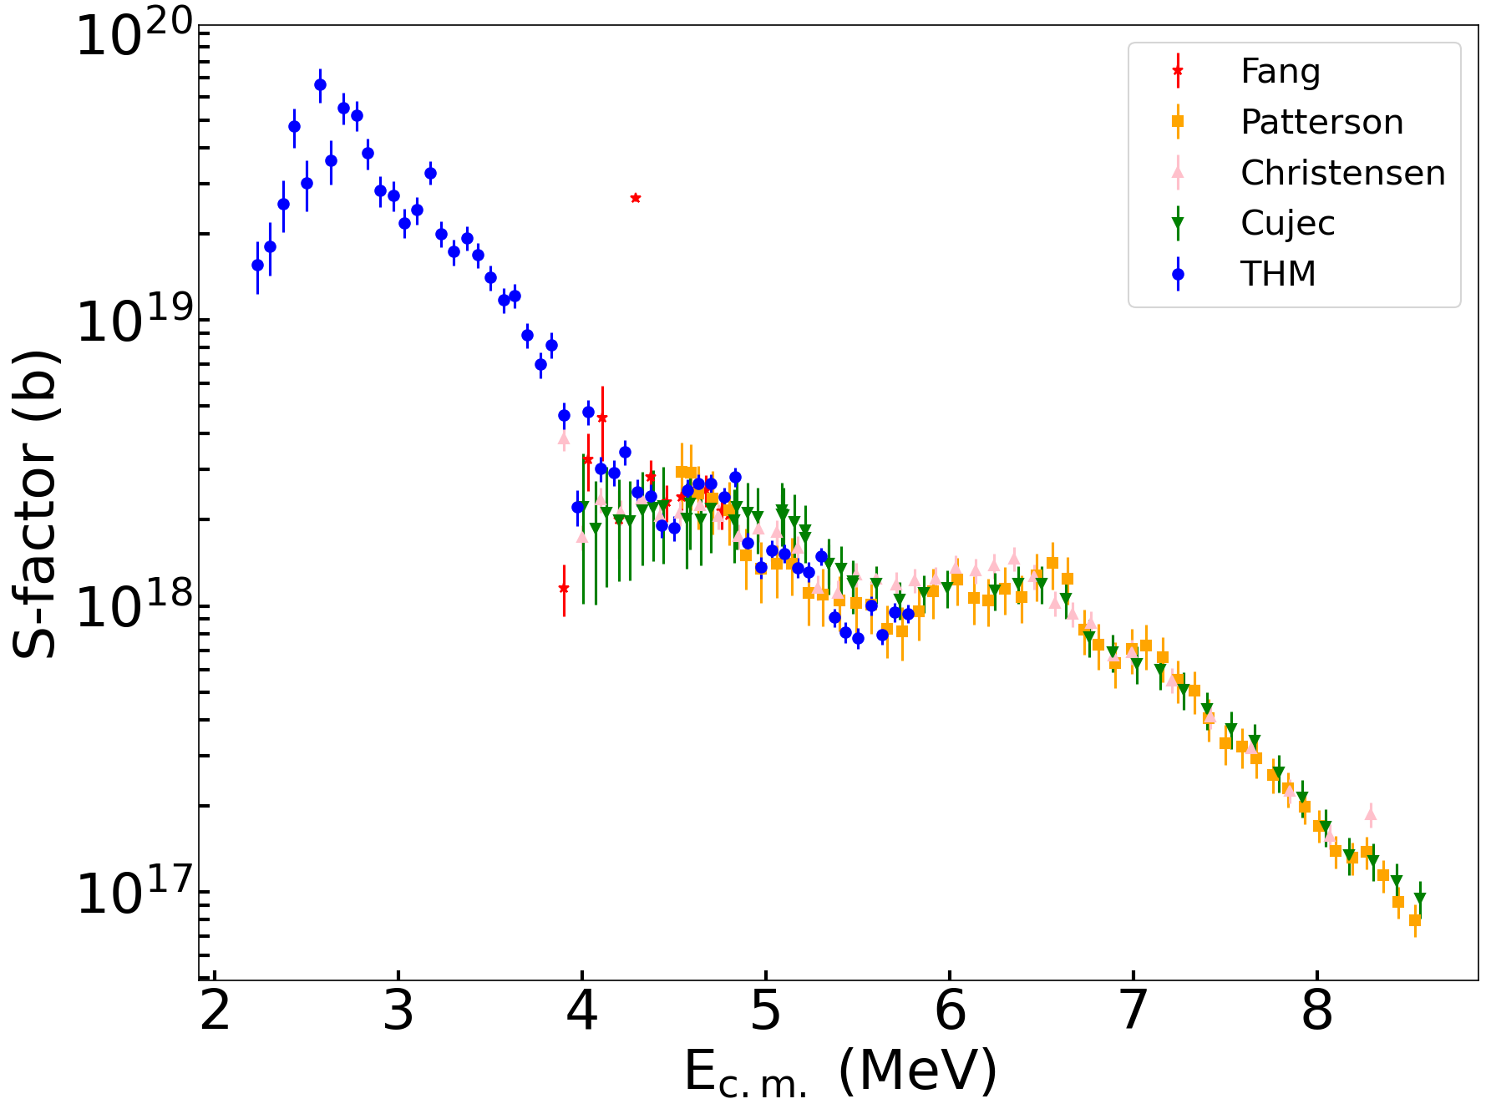
Preliminary s-factor

Slide 7
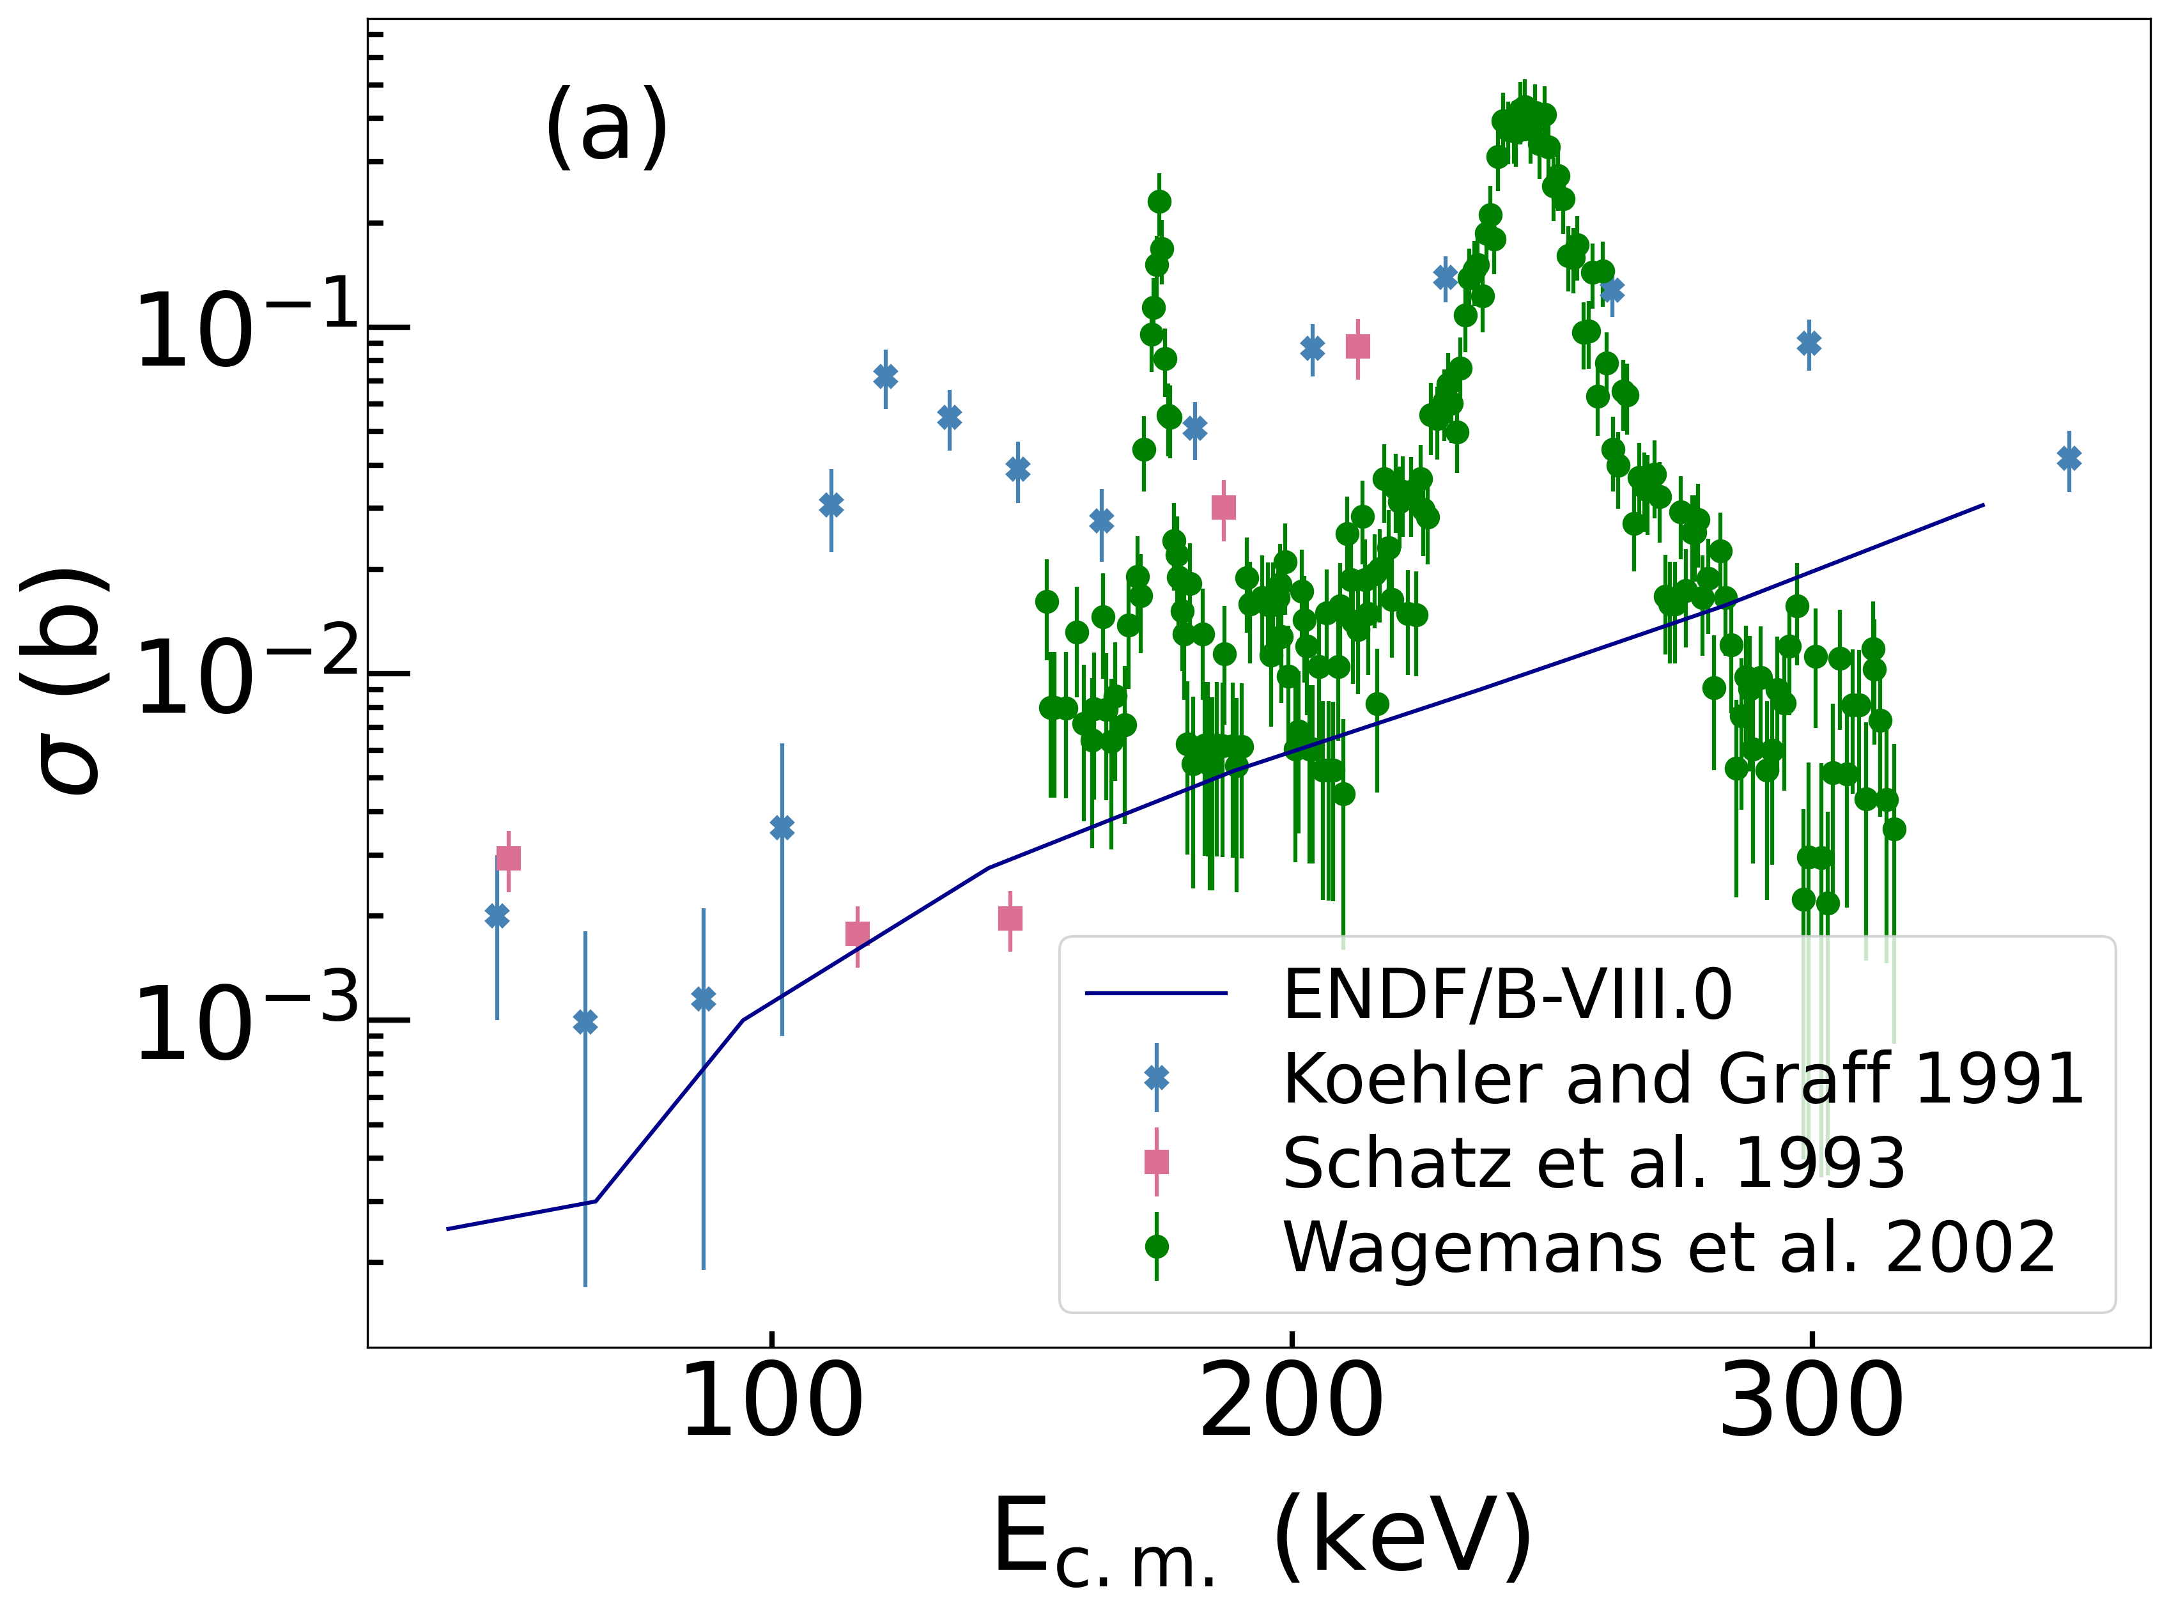
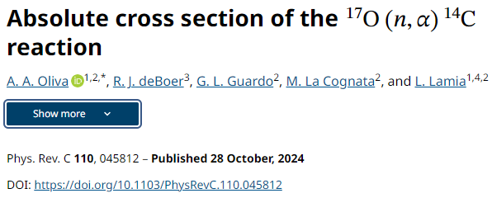
Talking about Oxygen…

Slide 8
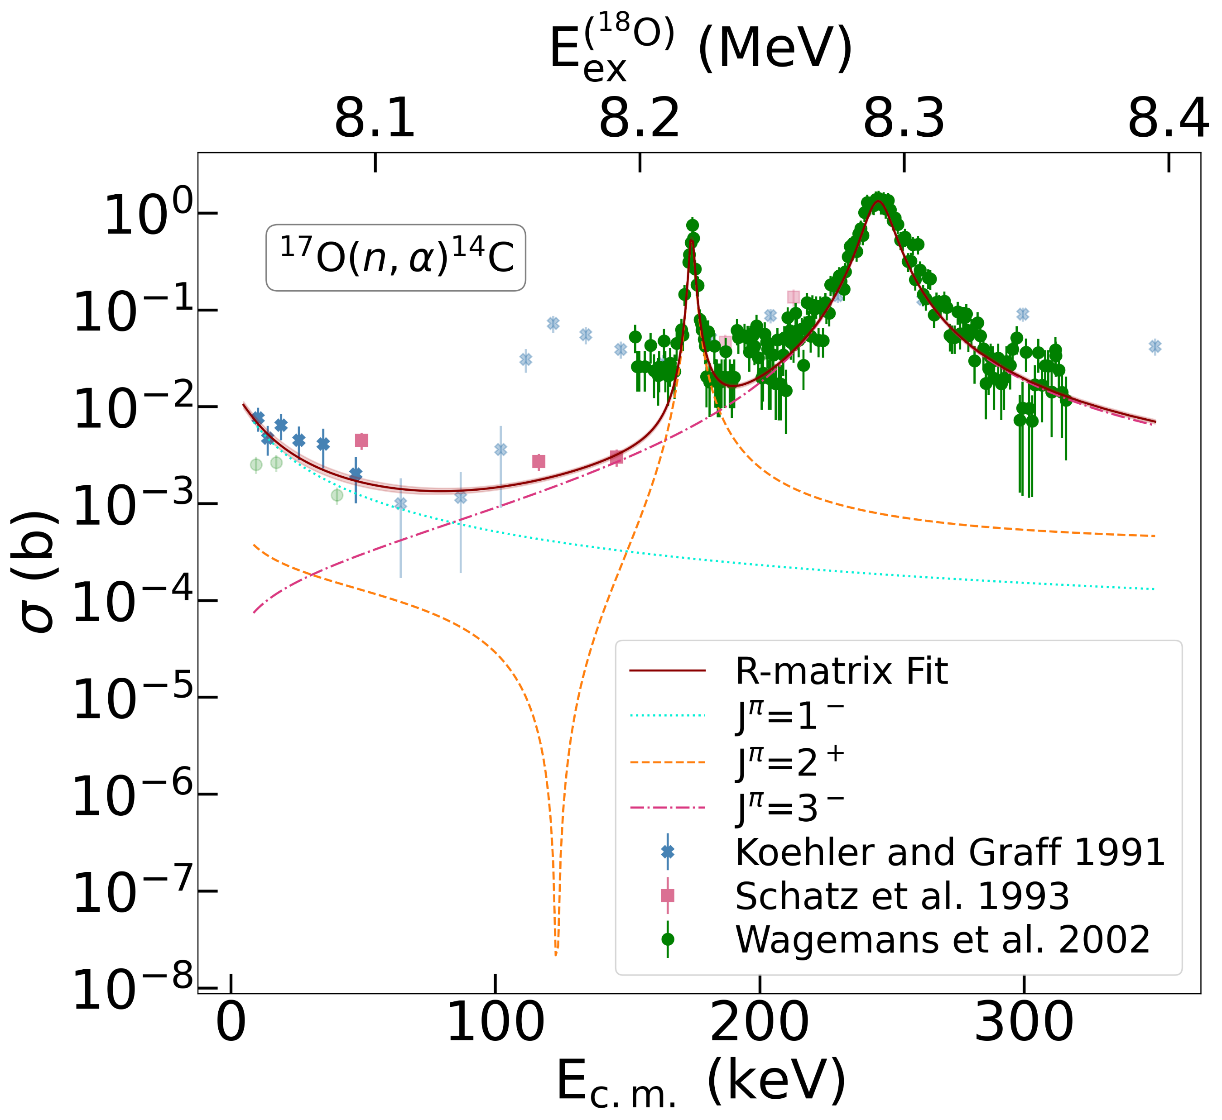
Talking about Oxygen…

Slide 9
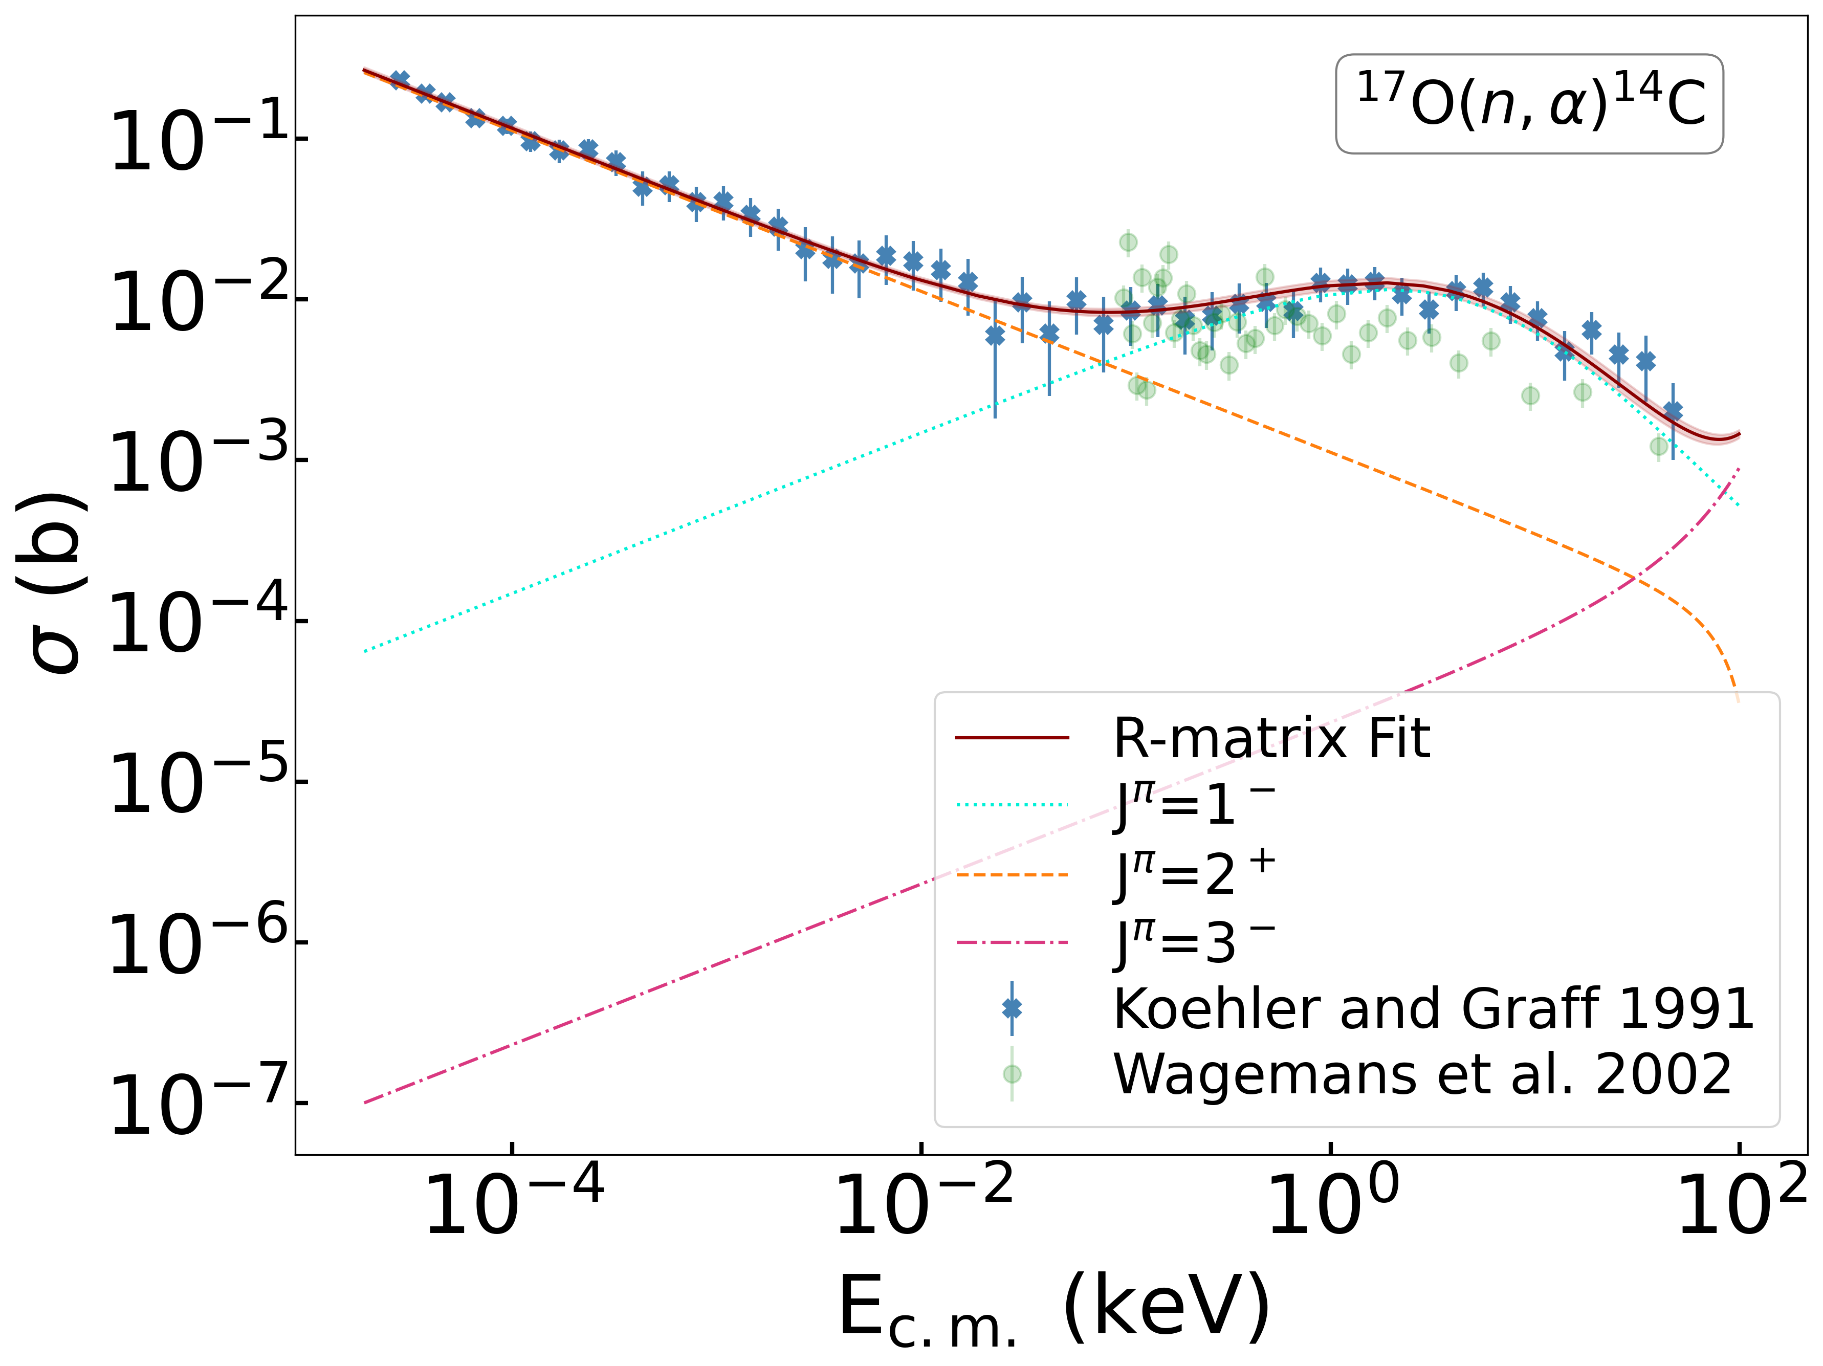
Talking about Oxygen…

Slide 10
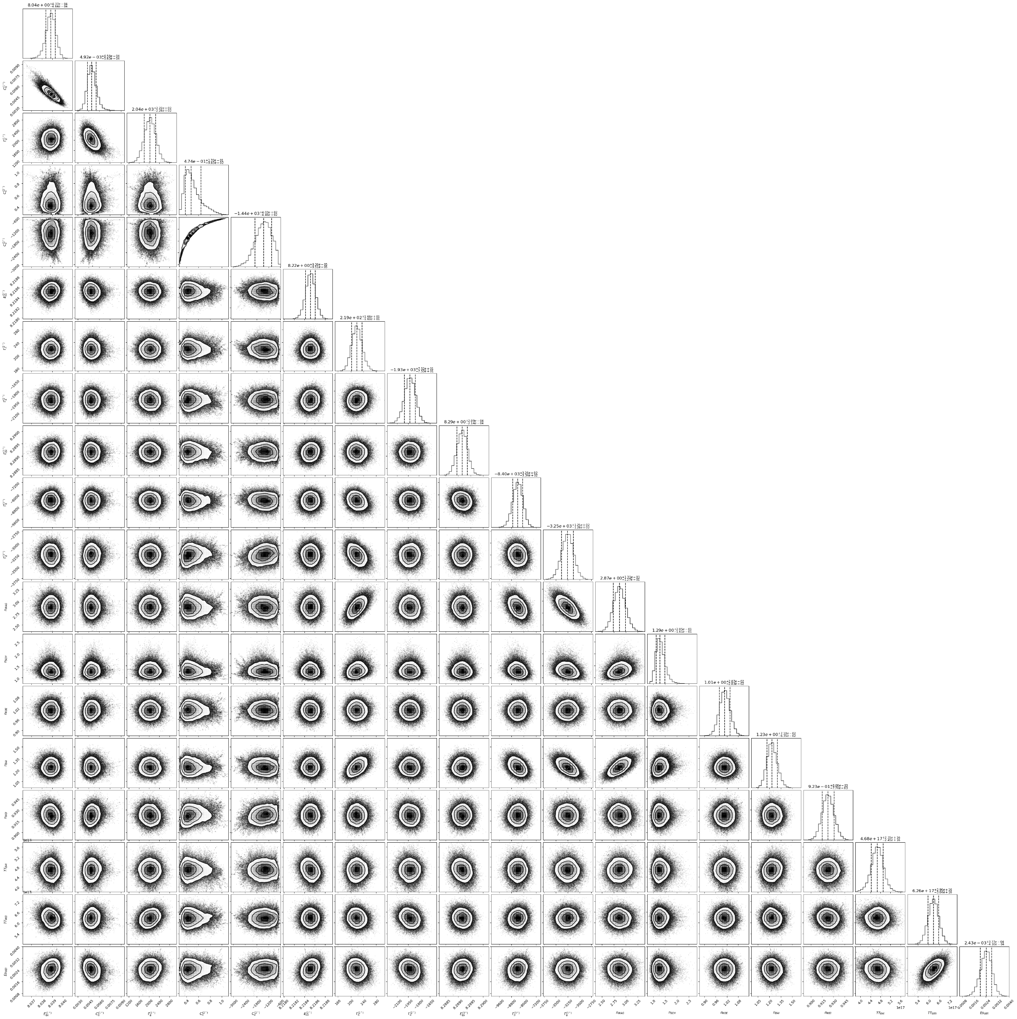
Talking about Oxygen…

Slide 11
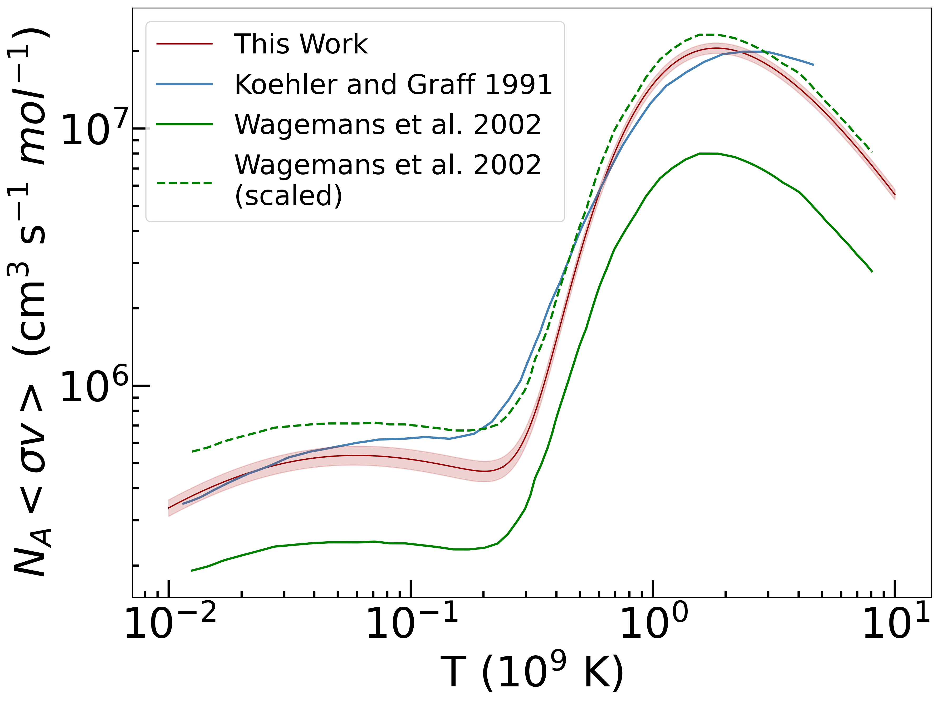
Talking about Oxygen…

Slide 12
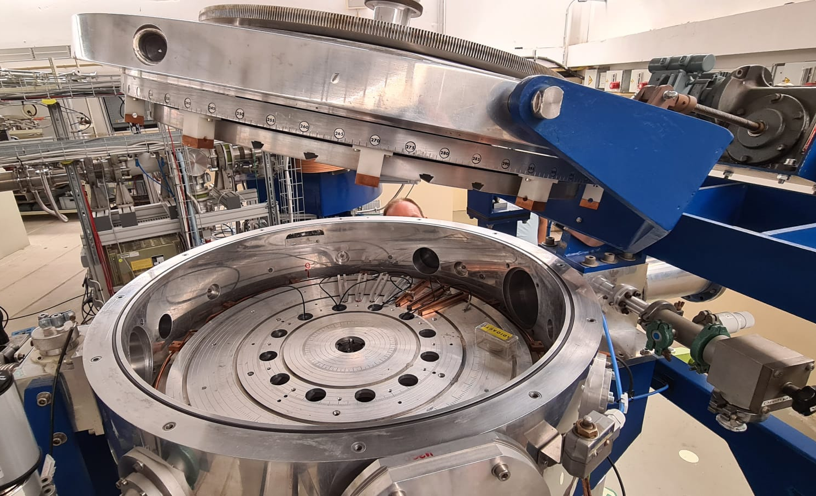
Talking about Oxygen…
Weak component s-process
¹⁷O(n,α)¹⁴C and ¹⁷O(α,n)²⁰Ne since they act as a neutron poison and a recycle channel during s-process nucleosinthesys in massive stars (M>8M_{SUN})
⁶Li
d
The goal is to measure the reaction via the THM using ⁶Li as trojan horse nucleus (α+d).
α
²⁰Ne
¹⁷O
n
The first step aims on measuring the ¹⁷O(α,α)¹⁷O scattering in order to perform a preparatory multi-level multi-channel R-matrix analysis of the reactions and identify the best set to normalize the TH data.
The experiment will be performed at University of Koln with an α beam of 4-15 MeV.

Slide 13
Some future experimental challenges by the «young people»
New experimental efforts to measure ²²Ne(α,n)²⁵Mg (Roberta) → need of new new TH nuclei (²⁶Mg, ²³Na..)
TH nuclei with high A
Reactions like ¹⁷O(α,n) or ²²Ne(α,n)²⁵Mg : to avoid n-detection → need to detect the «heavy» nucleus
TPC

Slide 14
…and some software
New DAQ acquisition system with MVME software -> thoroughly tested the acq side, needs more work on the online analysis
GROOT available on Docker Hub and as a binary build (for ubuntu 24.04 and alma9) on github
Python package to calculate the MR-matrix -> to use in conjunction with BRICK
New version of BRICK rewritten from scratch (w/ J. deBoer, D. Odell)

