Slide 1


Photodissociation experiments
G.L. Guardo
on behalf of the AsFiN group

Slide 2
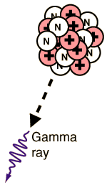
Photodissociation processes in astrophysics
In evolved stars, high photon densities are present, making it possible to dissociate stable seed nuclei the photon energies being as large as many MeV.
For the first time high intensity (3∙10⁸ γ/s) high resolution (<10⁻³) will be available, making it possible to measure photodissociation reactions of astrophysics importance (HIGS, NEW SUBARU, ELI-NP??)
Big Bang Nucleosinthesys and Li-problem
⁷Li(γ,t)⁴He
Si-burning in stars and presupernova phase
²⁴Mg(γ,α)²⁰Ne
²⁸Si(γ,p)²⁷Al
p-process (production of proton rich nuclei)
⁹⁶Ru(γ,α)⁹²Mo
⁷⁴Se(γ,p)⁷³As

Slide 3
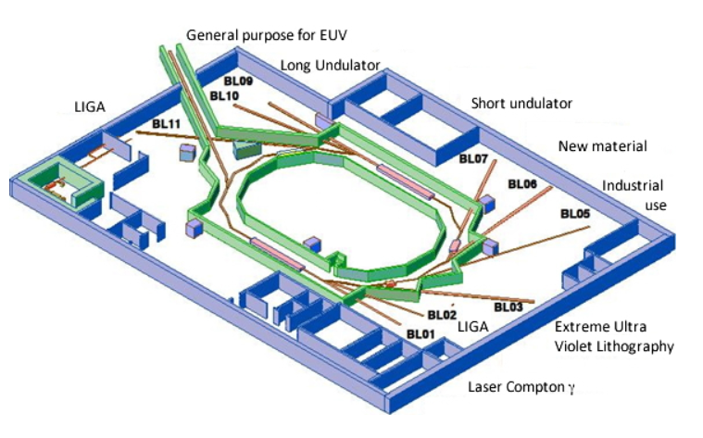
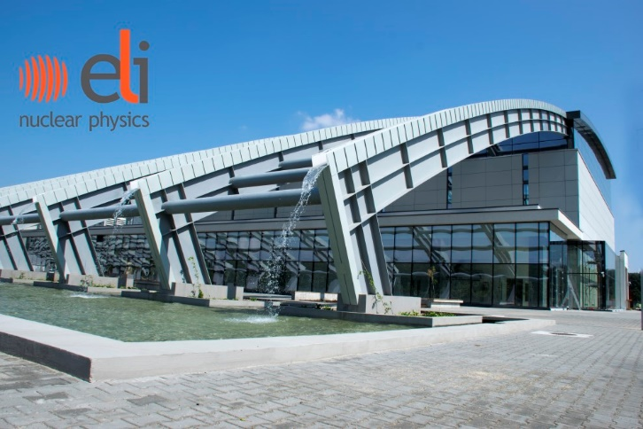
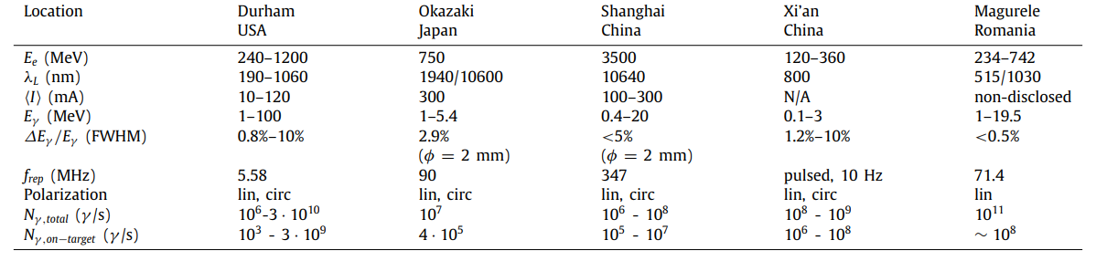
New facilities for gamma beams

Slide 4
New facilities for gamma beams

Slide 5
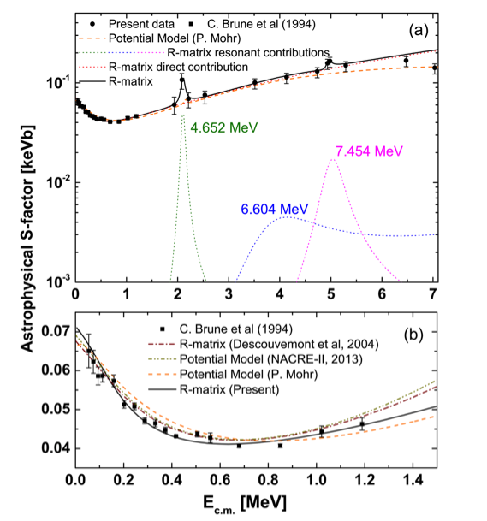
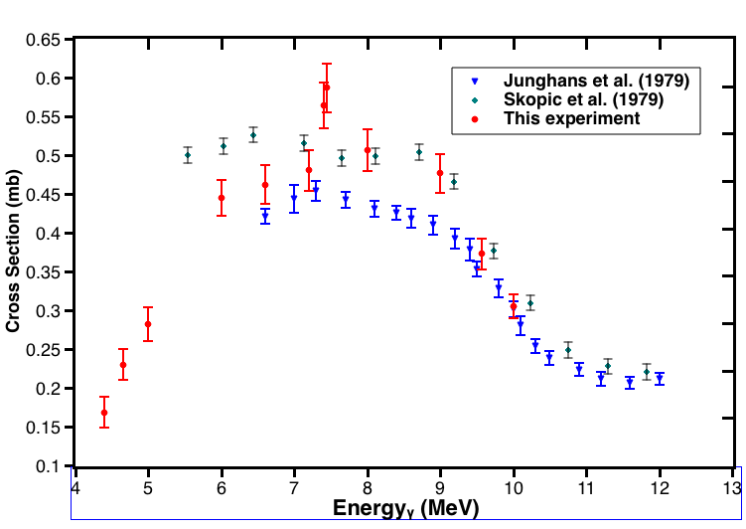
The ⁷Li(γ,t)⁴He reaction
Results

Slide 6
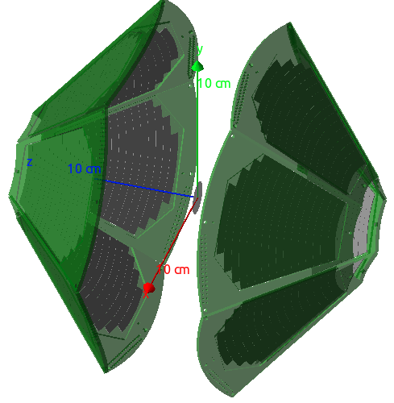
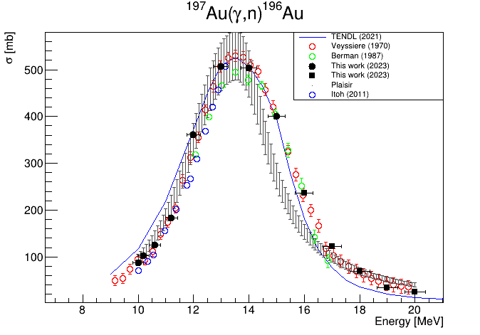
The p-process campaign
Direct measurement of photodissociation reactions of interest for p-process and BBN
Long campaign with measurements on ¹¹²Sn(γ,p), ¹¹²Sn(γ,α), ¹⁰²Pd (γ,p), ¹⁰²Pd (γ,α) and ⁷Li (γ,p)
Beam flux measurement using Activation method ➔ Restifo’s Master thesis
¹¹²Sn(γ,α)¹⁰⁸Cd
¹¹²Sn(γ,p)¹¹¹In
E_{γ} [MeV] | 10-20
Total Time | 106 h
DE-E Det | YY1
# channels | 256
Preliminary
SIDAR array consisting of 2 lamp-shade SSD (12 YY1)

Slide 7
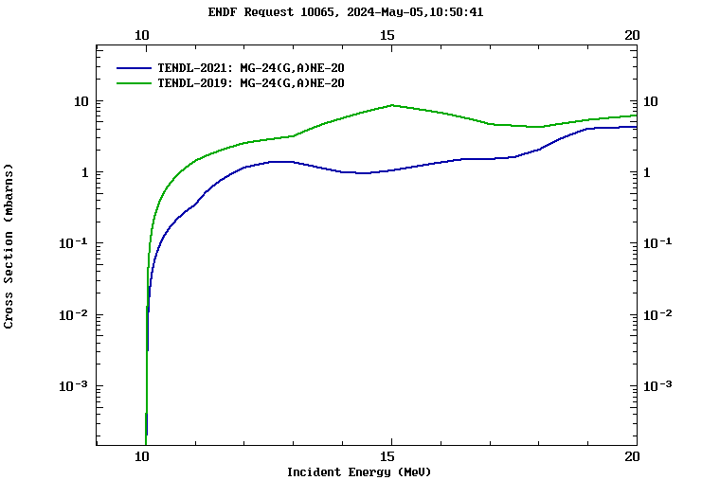
The ²⁴Mg(γ,α)²⁰Ne reaction
  In Si-burning, preceding the core-collapse supernova stage, fusion reactions such as ²⁸Si+²⁸Si or ²⁸Si+³²S are too unlikely to occur owing to the Coulomb barrier.
The nucleosynthesis is governed by the slowest reaction in the network: ²⁴Mg(γ,α)²⁰Ne
Its cross section is calculated from the inverse reaction and is affected by a factor of 2 uncertainty.
A direct ²⁴Mg photodissociation measurement using gamma beams of energies 10.4 - 12 MeV will allow us to determine a much more accurate cross section

Slide 8
The ²⁴Mg(γ,α)²⁰Ne reaction
E_{γ} = 10-13 MeV provided by HIGS facility
1.2 cm collimator defines beam spot
MgC target (200 μg/cm²)
LHASA array (lamp-shade)
12 YY1 detectors (or DSSSD)
Standard electronic read-out
Eγ (MeV) | Total rate | Event/strip | Stat.Err. | Hours
10 | 15 ev/h | 0.5 | 30% | 72
10.5 | 100 ev/h | 3 | 15% | 12
11 | 100 ev/h | 3 | 15% | 12
11.5 | 100 ev/h | 3 | 15% | 12
12 | 100 ev/h | 3 | 15% | 12
12.5 | 100 ev/h | 3 | 15% | 12
13 | 100 ev/h | 3 | 15% | 12
Campaing measurement (Fall 2025)
(1) Robin Smith et al., Sheffield Univ., UK, P-21-19, 9Be(g,aa)
(2) Kelley Chipps et al., ORNL, P-10-23, Photodisintegraiton of p-process nuclei
(3) G. L. Guardo et al., INFN, Italy, P-09-24, 24Mg(g, a) cross-section measurements

Slide 9
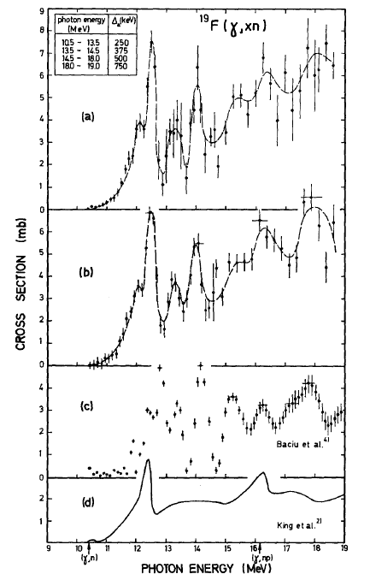
The ¹⁹F(γ,n)¹⁸F experiment
A high-precision measurement of the photo-neutron reaction cross sections for ¹⁹F which can be used to determine the ¹⁸F(n,γ)¹⁹F reaction rate. Furthermore, the ¹⁸F(p,γ)¹⁹Ne reaction is an important reaction in the CNO cycle. The properties of ¹⁸F(n,γ)¹⁹F reaction can be used to constrain the reaction properties of ¹⁸F(p,γ)¹⁹Ne due to the fact that ¹⁹F-¹⁹Ne are mirror nuclei.
Project leader: Dimiter L. Balabanski
ELI-NP Team: P-A Söderström, A. Kusoglu, D. Testov and Y. Xu
University of South China: Wen Luo and his team
Beihang University: Sun Baohua
IIT Ropar: Deepika Choudhury
NPL, UK: Giuseppe Lorusso
INFN-LNS: G.L. Guardo, D. Lattuada, G. Rapisarda, M.L. Sergi

Slide 10
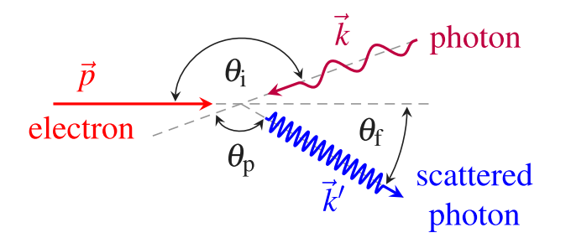

Laser Compton Backscattering
Laser photons are boosted into the MeV regime, which is the interesting range for nuclear physics experiments, when scattered off ultrarelativistic electrons with energies of several hundreds of MeV. By a proper collimation system, the scattered photons at very backward angles can be selected resulting in an almost monoenergetic photon beam, that can be tuned by varying the electron or laser photon energy.

Slide 11
EuPRAXIA Gamma Beam
Fascio di elettroni: da 500 MeV a 2 GeV, 100 pC single bunch a 400 Hz, energy spread 0.5%, emittanza rms norm. 0.5 mm.mrad,
lunghezza bunch inferiore al psec, focalizzato a sigmax=15 micron al punto di interazione con il laser
Laser: 1.2 eV Yb:Yag (lambda=1030), 0.5 Joule di energia nell’impulso a 400 Hz, M2=1.2, bandwith=0.001, sigma-t=1.5 psec,
focalizzato a W0=25 micron al punto di collisione
E-elettroni = 750 MeV, energia fotoni gamma 10. MeV
E-elettroni = 1000 MeV, energia fotoni gamma 18. MeV
E-elettroni = 2000 MeV, energia fotoni gamma 73. MeV
Numero fotoni gamma a 10 MeV al secondo compresi in una bandwidth di 0.5% = 1.7 * 10^8
Densità spettrale del fascio di fotoni gamma a 10 MeV = 3320. fotoni / (sec.eV)
Le prestazioni di ELI-NP come da TDR erano: densità spettrale a 10 MeV 5000.
Quindi siamo nel range, diciamo forse inferiori solo di un fattore 2, ma con la possibilità
di arrivare a 2 GeV quindi con energia di fotoni molto maggiore di ELI-NP, la cui energia
massima era 19.5 MeV.
Courtesy M. Ferrario & L. Serafini

Slide 12
EuPRAXIA Gamma Beam
Courtesy M. Ferrario & L. Serafini

Slide 13

Thank you for your attention

