Slide 1
«Neutronbrush®» device for Neutron Intra-Operative RadioTherapy (nIORT®):
a new RT technique, performed during surgery (to remove tumours even at an advanced stage).

Slide 2
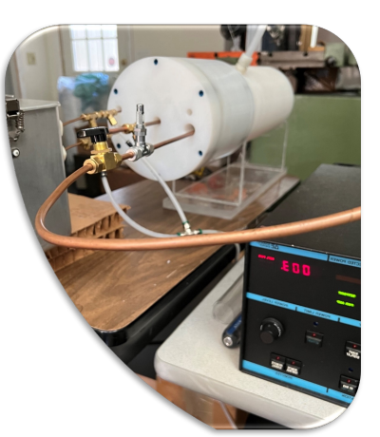
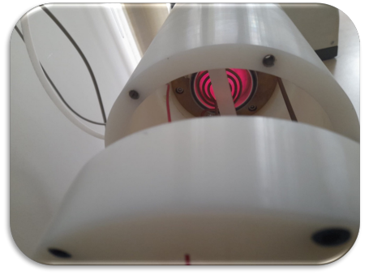
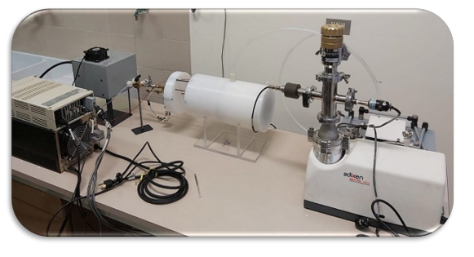
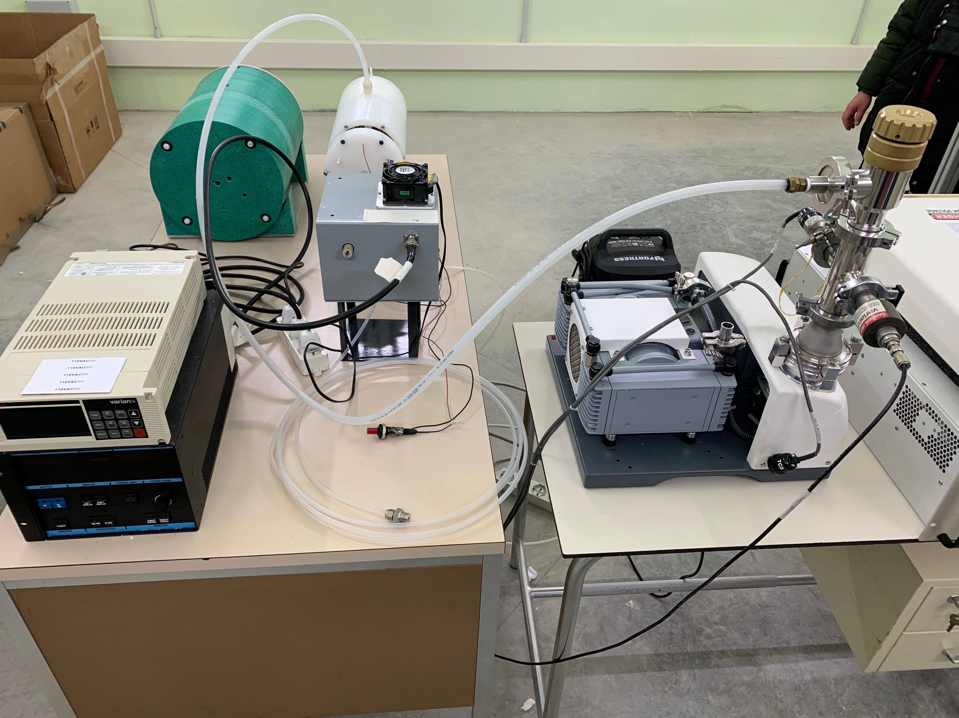
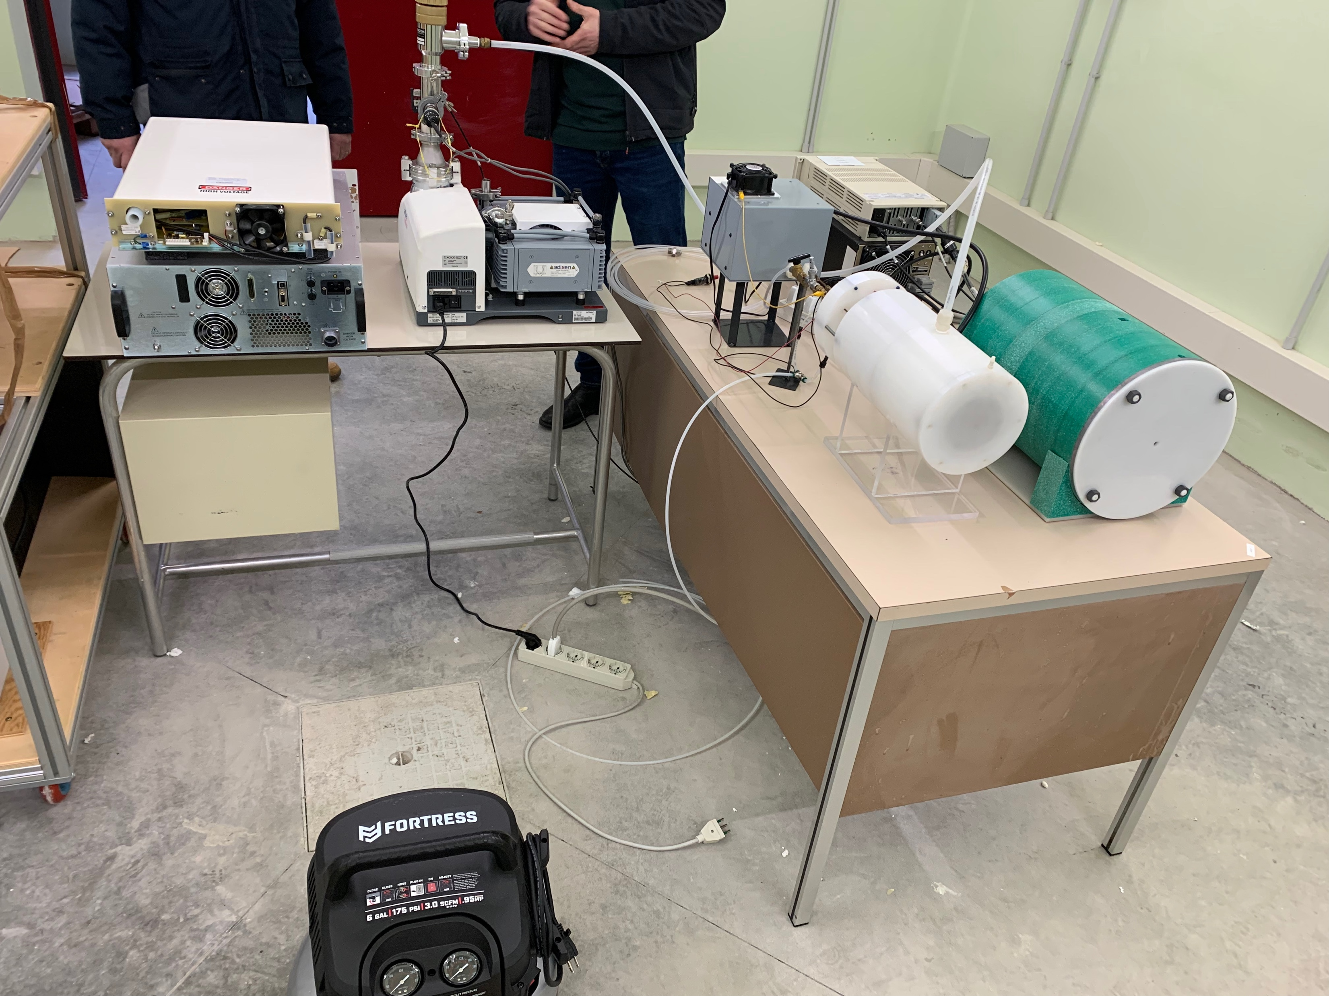
CNG for nIORT®
The “Key component” of NeutronBrush® device is a new Compact Neutron Generator (CNG). A collaboration agreement between ENEA and TheranostiCentre Srl (TC) was signed in 2019 and led to a patent and to the manufacturing of TWO LABORATORY PROTOTYPES, both built at Berkion Technology LLC (USA) and installed at ENEA Research Centre in Brasimone (BO).
The CNGs were designed for the treatment of advanced solid tumours with the neutron Intra-Operative Radiation Therapy (nIORT®). Fast neutrons (2.45 MeV energy) have a radiobiological effectiveness (RBE) ≅3-5 times higher than X-rays, γ-rays & electrons (used in current IORT techniques).

Slide 3
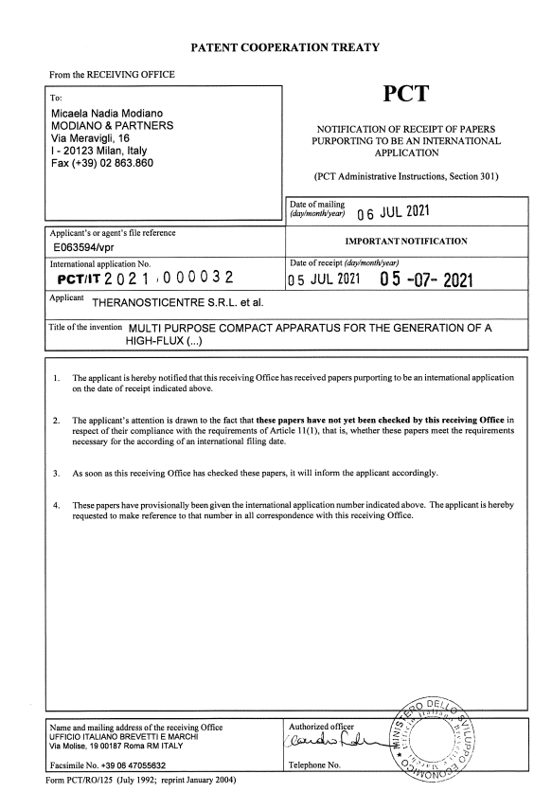
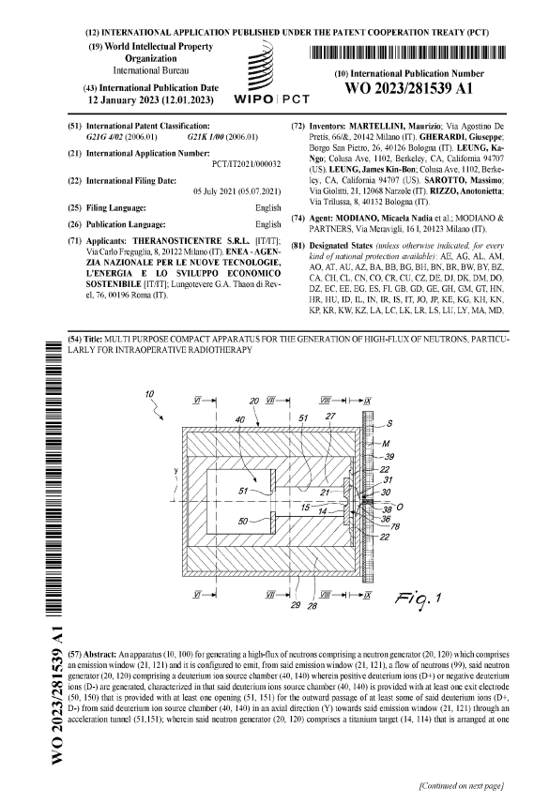
CNG patent
PCT/IT2021/000032 filed in July 2021 (WIPO/PCT Int. Public. in January 2023)
MULTI PURPOSE COMPACT APPARATUS FOR THE GENERATION OF A HIGH-FLUX OF NEUTRONS, PARTICULARLY FOR INTRAOPERATIVE RADIOTHERAPY
ABSTRACT
An apparatus (10, 100) for generating a high-flux of neutrons comprising a neutron generator (20, 120) which comprises an emission window (21, 121) and it is configured to emit, from said emission window (21, 121), a flow of neutrons (99), said neutron generator (20, 120) comprising a deuterium ion source chamber (40, 140) wherein positive deuterium ions (D+) or negative deuterium ions (D-) are generated, characterized in that said deuterium ions source chamber (40, 140) is provided with at least one exit electrode (50, 150) that is provided with at least one opening (51, 151) for the outward passage of at least some of said deuterium ions (D+, D-) from said deuterium ion source chamber (40, 140) in an axial direction (Y) towards said emission window (21, 121) through an acceleration tunnel (51,151);
wherein said neutron generator (20, 120) comprises a titanium target (14, 114) that is arranged at one end of said acceleration tunnel (51, 151), before said emission window (21, 121), and that is connected to a voltage
generator (ΔV+, ΔV-) so as to be biased, said titanium target (14, 114) being configured to be struck by the deuterium ions (D+, D-) emitted from said deuterium ion source chamber (40, 140) and consequently to emit neutrons (99) from said emission window (21, 121); and wherein said acceleration tunnel (51, 151) extends along said axial direction (Y) from said at least one exit electrode (50, 150) to said titanium target (14, 114) and is defined by a lateral wall (27, 127) made of an electrical insulating material.

Slide 4
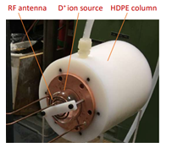
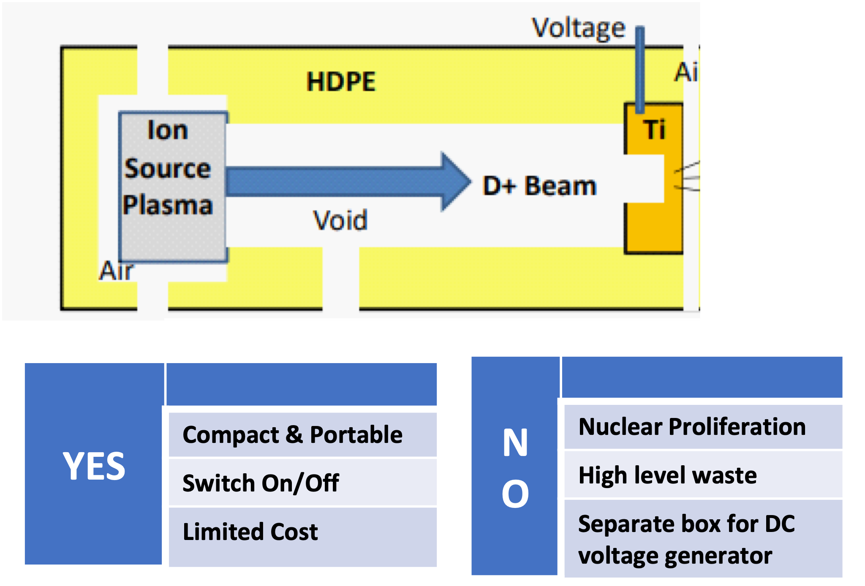
CNG design features
CNG is compact (~33cm l x 18 cm Ø) and light (<100 kg) → Remotely controllable with a robotic arm and usable in an operating room dedicated to nIORT®
CNG has 3 main components: 1) Plasma Source (D+ ions) 2) Accelerator column (High Density PE) 3) Titanium target (Ti) → Fusion DD reaction: 2.45 MeV neutrons
CNG powered by 100 kV-10 mA DC: - n yield = 3.3 10⁹ s⁻¹ - n flux ~10⁸ cm⁻² s⁻¹
10 ÷ 20 Gy (RBE) dose target (clinical end-point) in 8 ÷ 16 minutes (one-shot nIORT® treatment)

Slide 5
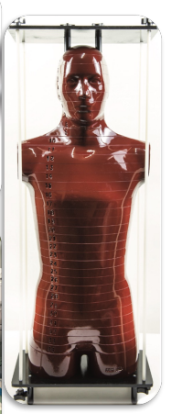
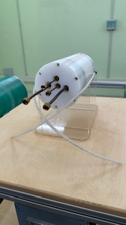
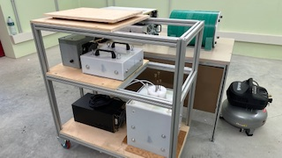
CNG prototypes
Two CNG prototypes are currently located at the ENEA Research Centre in Brasimone. Accurate Radiation Protection calculations and Monte Carlo simulations are in progress to get authorizations (Category A)
With LINCER project (2019-2022: “Laboratory for the characterization of Compact Neutron Irradiator in Emilia Romagna”), new bunker-laboratory @ ENEA equipped with instrumentation for neutron beam measurements
Example: CNG + Anthropomorphic phantom

Slide 6
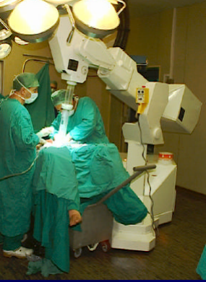
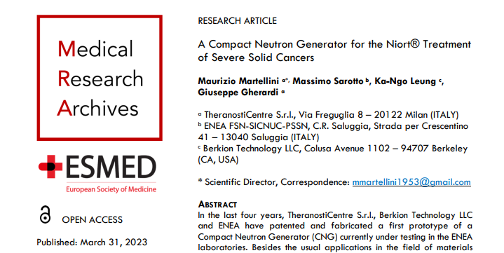
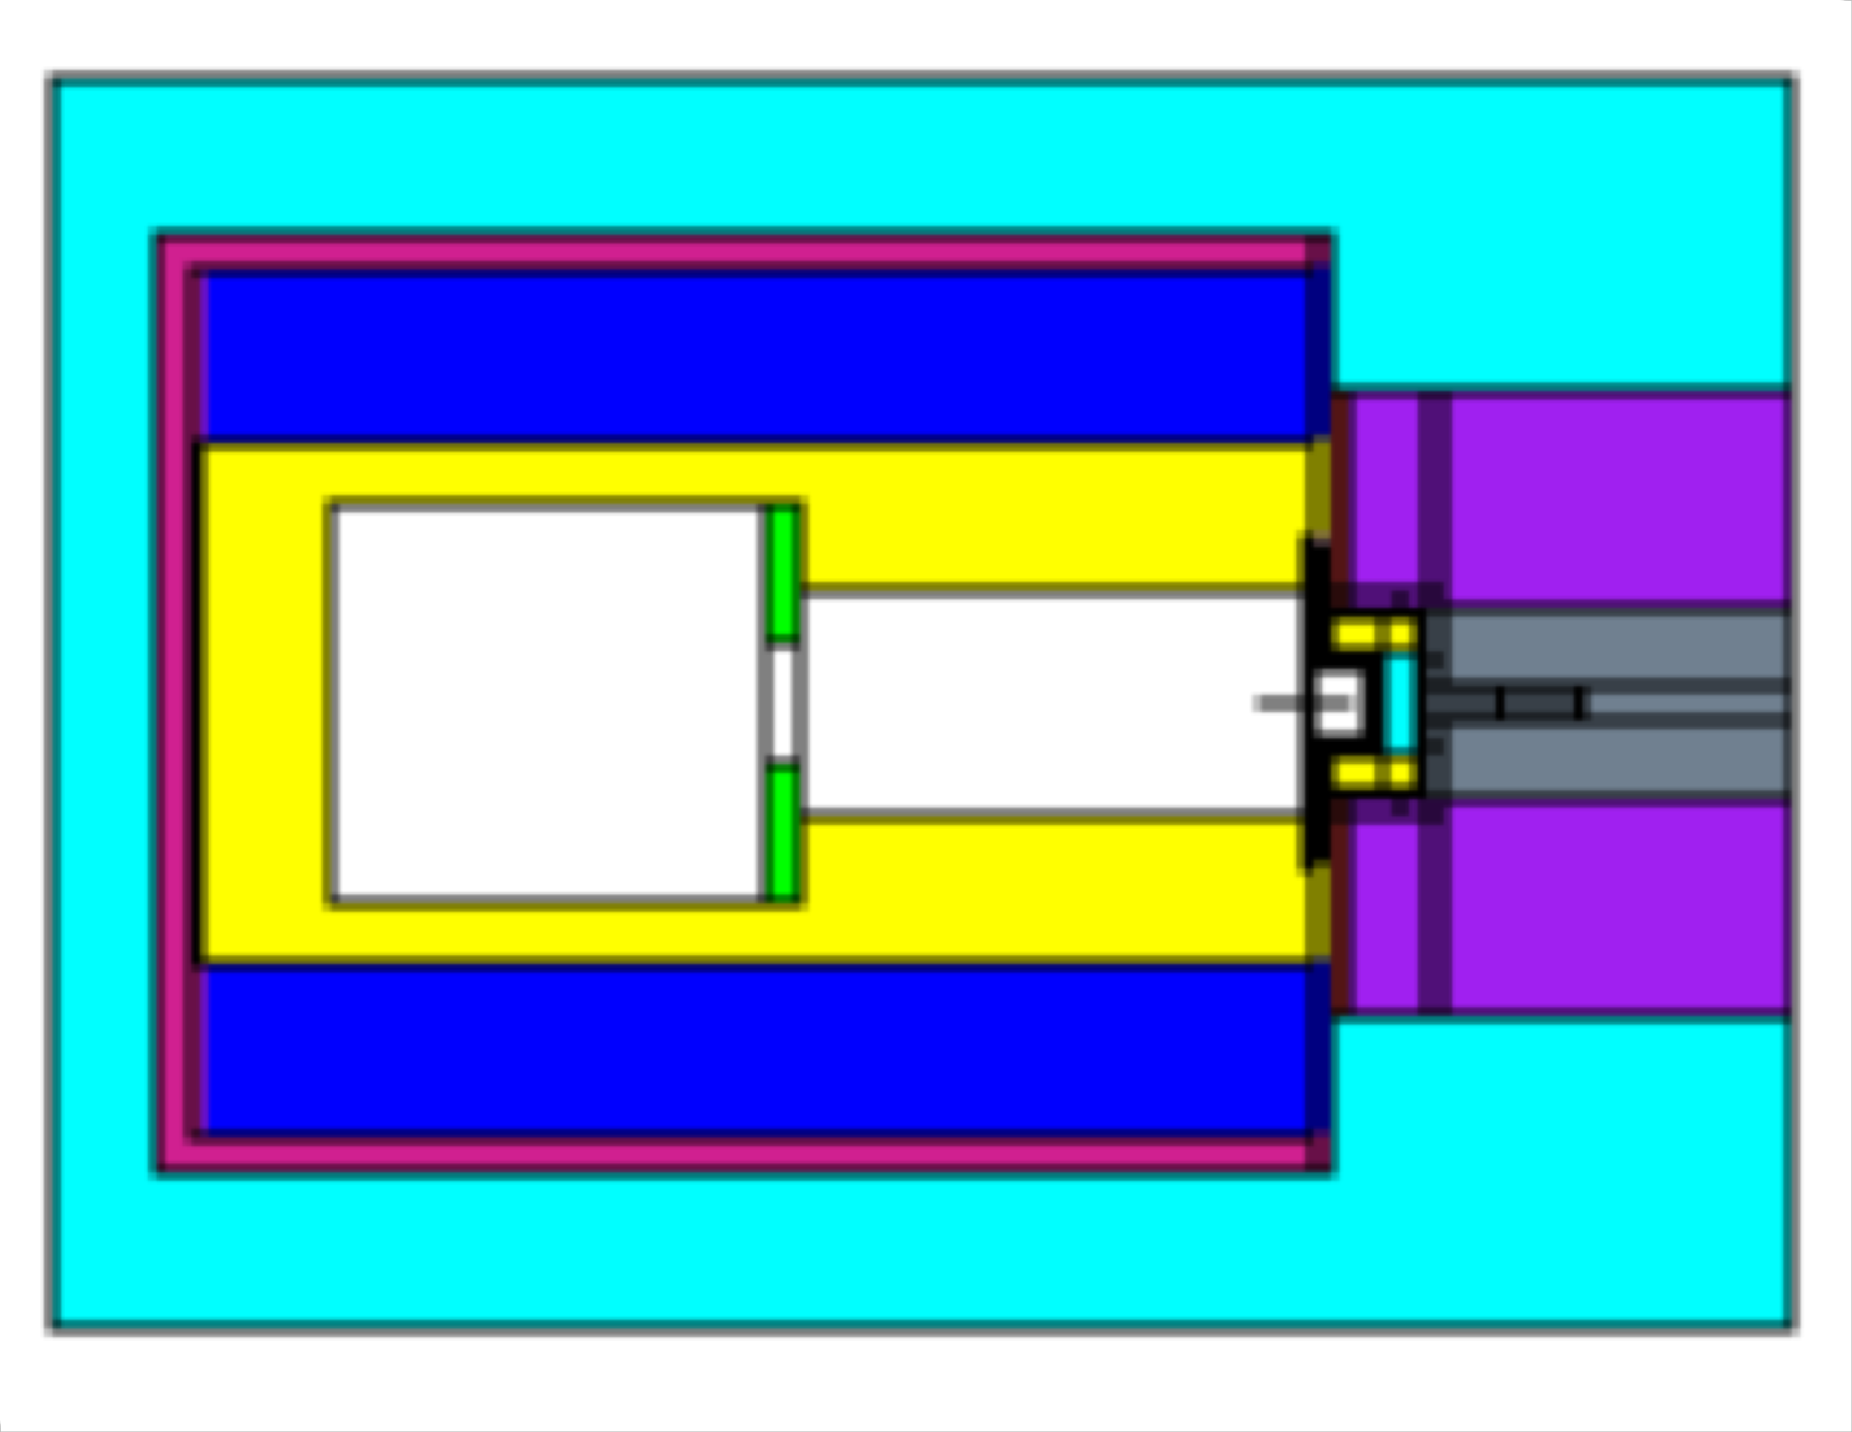
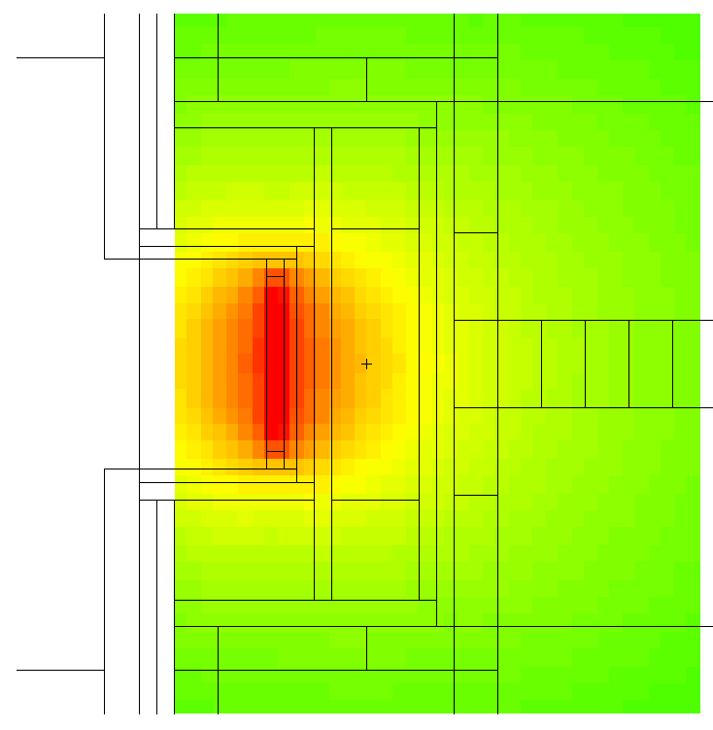
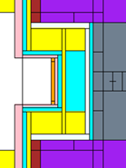
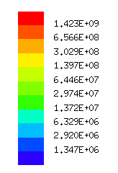
CNG with nIORT® applicator
Second CNG prototype (can be sealed): - could be used in a hospital operating room without safety concerns - will be equipped with an IORT applicator to be inserted into surgical cavity Monte Carlo analyses with MCNP code simulating potential nIORT® treatments demonstrate promising results e.g., nIORT® irradiation of breast and brain tumours (with craniotomy; GBM) with hemispherical (iso-dose) and cylindrical (front-focused dose) applicators.
Skin
HDPE
Tumor bed
Applicator
Muscle

Slide 7
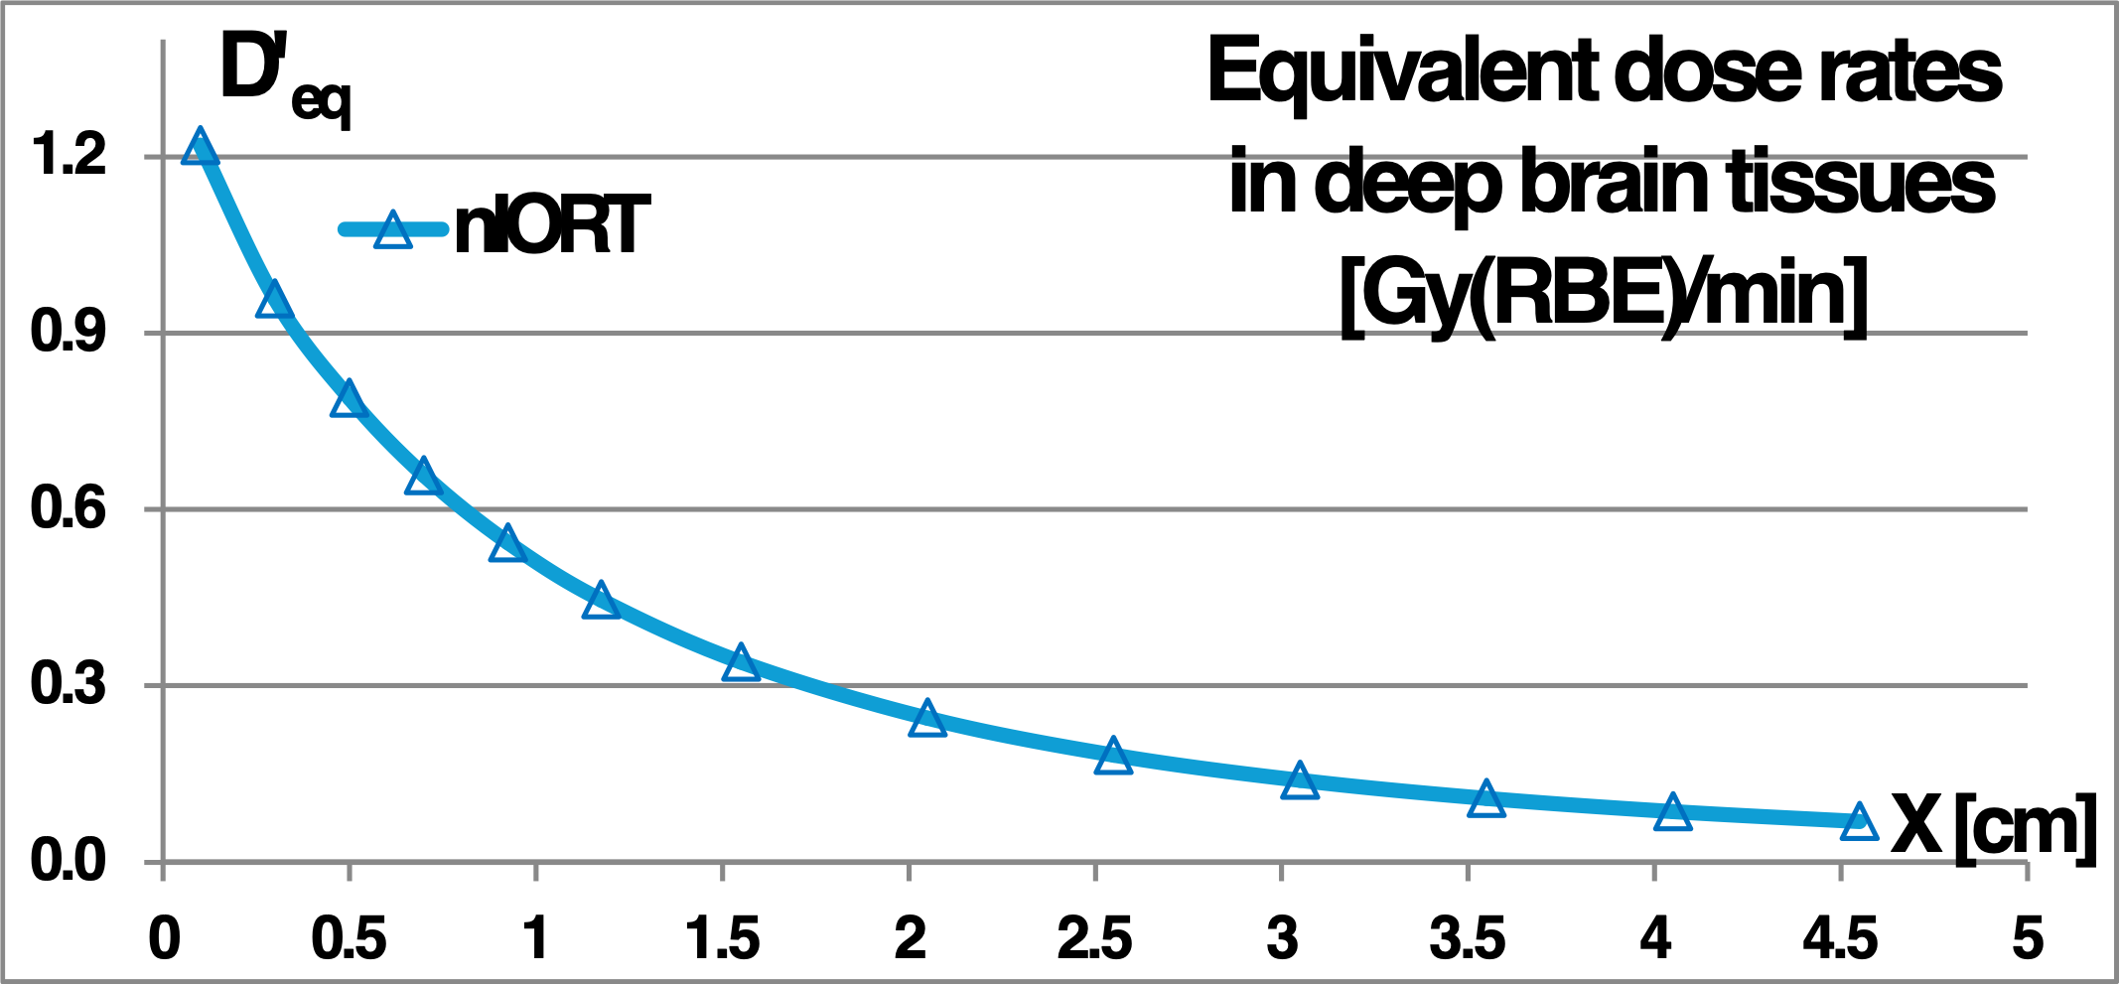
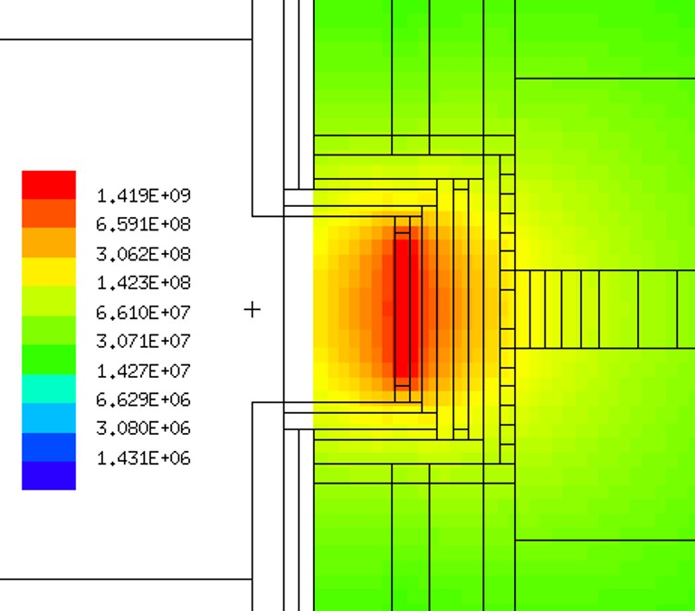
Suppl
Advantages by nIORT® 1/2
Direct irradiation of the tumor bed with 2.45 MeV monoenergetic neutrons: - high linear energy transfer (LET ~30÷50 keV/mm) - high radiobiological efficiency (RBE ~3-5 times than X & γ-rays and electrons) - reduced oxygen enhancement ratio (OER) → high efficacy in tumour cells killing through DNA double breaks (DSBs)
Dose of neutron ionizing radiation is halved at 1 cm depth in irradiated tissues: - reducing the risk of secondary radiation-induced tumours (RISMs) - sparing nearby organs at risk (OARs) from radiogenic effects
Almost isotropic spatial distribution of the radiation field (as a sort of “ionizing foam” filling the surgical cavity): - killing of potential quiescent cancer microcells not removed by surgery; - risk reduction of developing, after the “one-shot” nIORT® treatment, cancer cells at the initial site, or in the form of local-regional metastases. Thanks to high-RBE neutrons, biochemical signals emitted by primary tumour cells to surrounding microcellular environment (TME) could be interrupted by fast neutrons, → nIORT® treatment by Neutronbrush® could determine almost complete remission of solid tumour and local metastases in neighbouring TME (pre-clinical tests needed).
[cm⁻² s⁻¹]
7

Slide 8
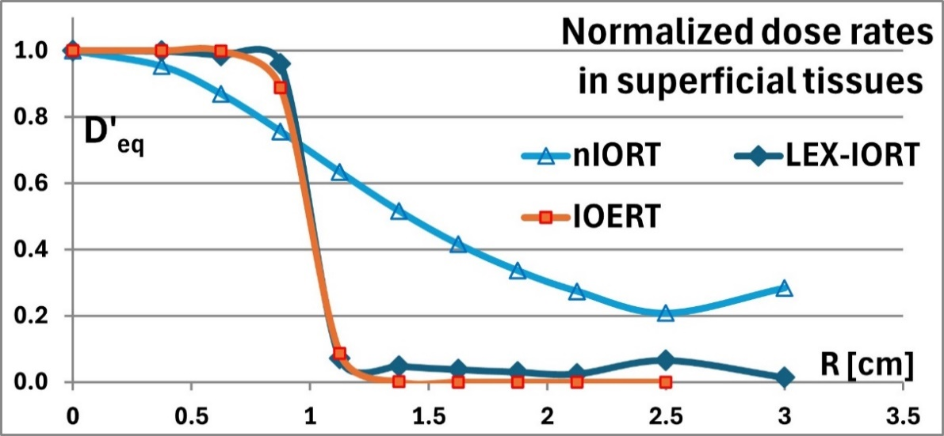
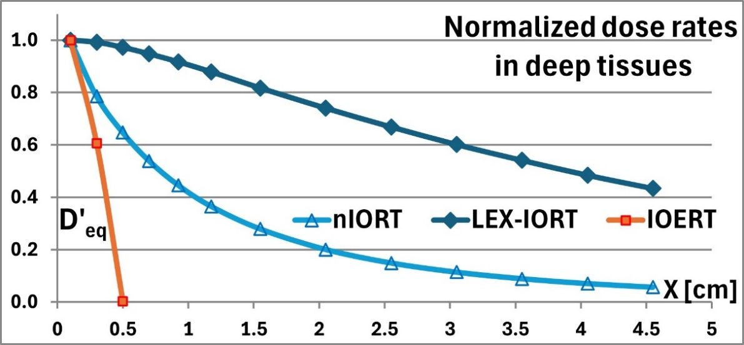
Advantages by nIORT® 2/2
4) Accurate MCNP calculations demonstrated the “complementary” features of nIORT® beam respect to standard IORT techniques e.g., focused LEX-IORT (50 keV X-rays) and IOERT (1 MeV electrons)
5) In clinical terms, nIORT® is a “neoadjuvant therapy” and could be subsequently accompanied by appropriate: - chemotherapy (aimed at removing potential distant metastases) - and/or immunotherapy (clinical evidence of synergistic effects*) → High-RBE neutrons should further enhance immune system response, stimulating both innate & adaptive immune responses in patients → More robust anti-tumour response by a multimodal approach protocol, potentially improving patient survival
* Encouraging results by early-phase clinical trials exploiting combinations of RT and immunotherapy, including vaccines, ICIs & adoptive cell therapies
8

Slide 9
Journals and Patents
Feasibility Study on the nIORT® Adjuvant Treatment of Brain and Breast Cancers by Fast Neutrons produced by a DD-fusion Compact Generator, M. Martellini, M. Sarotto, Ka-Ngo Leung, G. Gherardi, L. Falzone, American Journal of Biomedical Science & Research, [online] 22(3), May 2024, ISSN :2642-1747, DOI: 10.34297/AJBSR.2024.22.002969
Feasibility Study on the nIORT® Adjuvant Treatment of Glioblastoma Multiforme through the Irradiation Field of Fast Neutrons Produced by a Compact Generator, M. Martellini, M. Sarotto, Ka-Ngo Leung, G. Gherardi, A. Rizzo, G. Ottaviano, L. Falzone, European Society of Medicine, Journal Medical Research Archives, [online] 12(2), February 2024. https://doi.org/10.18103/mra.v12i2.5090
A Compact Neutron Generator for the Niort® Treatment of Severe Solid Cancers, M. Martellini, M. Sarotto, Ka-Ngo Leung, G. Gherardi, European Society of Medicine, Journal Medical Research Archives, [online] 11(3), April 2023. https://doi.org/10.18103/mra.v 11i3.379
Simulation of the nIORT® treatment by fast neutrons of severe brain cancers (as GBM) and comparison with standard IORT techniques adopting X-rays and electrons, M. Martellini, M. Sarotto, P. Ferrari, G. Gherardi, M. Venturi, In reviewing phase in Scivision Journal Cancer Science & Research [online]
Multi Purpose Compact Apparatus for the Generation of a high-flux of neutrons, particularly for Intraoperative Radiotherapy, M. Martellini, G. Gherardi, K. Leung, J. Leung, M. Sarotto, A. Rizzo, July 5, 2021. Under evaluation at Patent Cooperation Treaty (PCT), International patent application n. PCT/IT2021/000032. World Intellectual Property Organization: International Publication n. WO 2023/281539 A1, January 2023.
Apparatus for the intraoperative radiotherapy. Martellini M, Gherardi G. European Patent 2019; EP 3 522 177 B1.

Slide 10
State of the project
Two CNG prototypes – built by BT and purchased by TheranostiCentre Srl - are currently in a dedicated bunker at the ENEA Research Centre in Brasimone for experimental characterisation.
ENEA is partnering with TheranostiCentre Srl to perform electromechanical tests of the prototypes. Plasma Ignition tests (with Hydrogen) will begin as soon as ENEA has obtained the mandatory certifications.
In the meanwhile: - TheranostiCentre Srl has researched a possible company in the field of generators for medical devices to proceed in planning the path towards a TRL8
- some interactions with private and public companies and entities have been undertaken to obtain the necessary funds and find formula to reach the determined goal in the planned time
9

Slide 11
Mission of TC and future steps
TheranostiCentre Srl is a company that: - deals with R&D of technology related to the use of neutrons in equipment for the treatment of solid tumours - does not have as its corporate purpose to become a production or distribution unit of the Neutronbrush® device.
First phase: - Initial experimental tests will be carried out in the ENEA bunker-laboratory;
- Further tests will be carried out in vivo and on organoids with the support of technical/clinical personnel (also to analyse future steps oriented towards subsequent Neutronbrush® industrialization).
In the second phase:
- Neutronbrush® will be manufactured as a medical device suitable for use in an operating room with the support of IORT clinical personnel (in collaboration with hospitals and/or university clinics will be necessary)
In the third phase:
- TheranostiCentre Srl, the partner company and ENEA will work on the device insertion into an industrial chain, including the production of both the Neutronbrush® and the robotic arm for its movement (with related support equipment).
The fourth phase will be dedicated to analyse the reference market and the distribution of the finished product.
Certainly, in the development of the project, there will be phases of product and process patenting, certifications, etc.
10

Slide 12
Suppl
Contatti:
TheranostiCentre Srl
Via Freguglia 8
20122 Milano
Direttore Scientifico: Prof. Maurizio Martellini mmartellini1953@gmail.com
11

