Slide 1
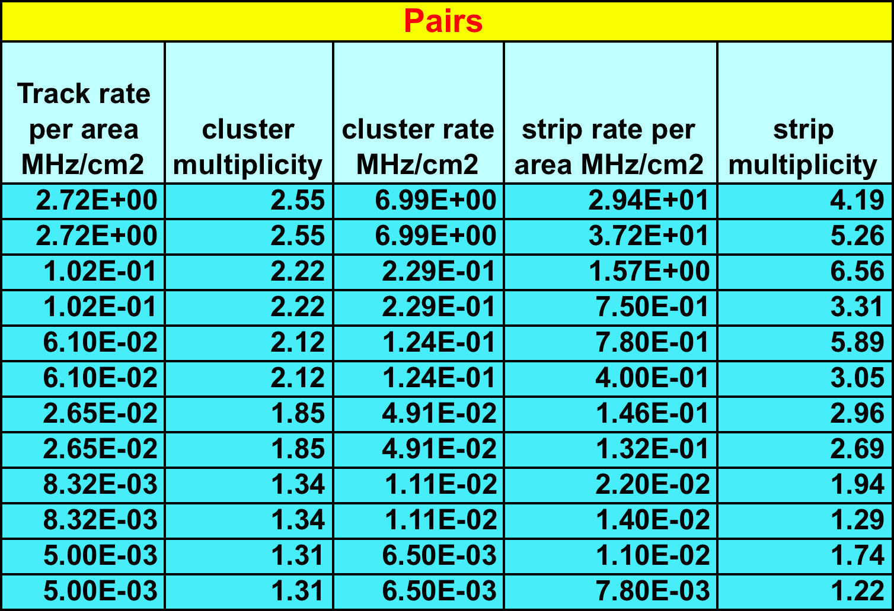
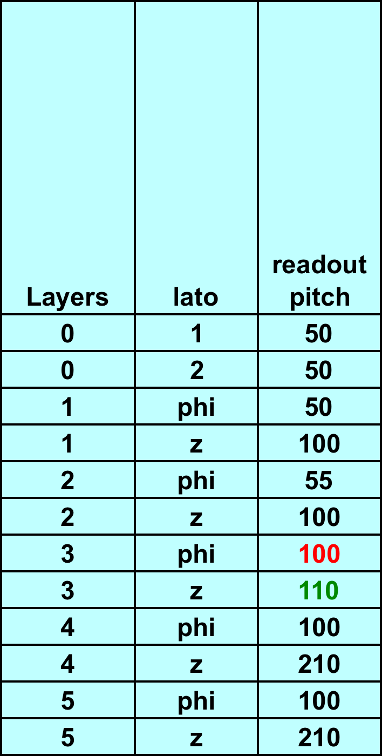
Rates March 12 (after Vienna and normalization fixed for pairs and rad bhabha)
All numbers and plots from Riccarco Cenci can be found in
http://www.pi.infn.it/~cenci/bruno/svt/plotV3/

Slide 2
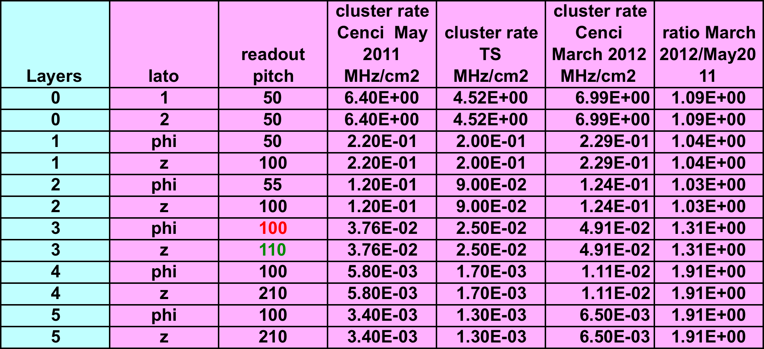
Compairison with old rates Pairs May 2011
Cluster rates:
In L0-2 within 10% from May2011 data
In L3-5 still a larger discrepancy w.r.t May2011
Strip rates discrepancy seems higher (code ??)

Slide 3
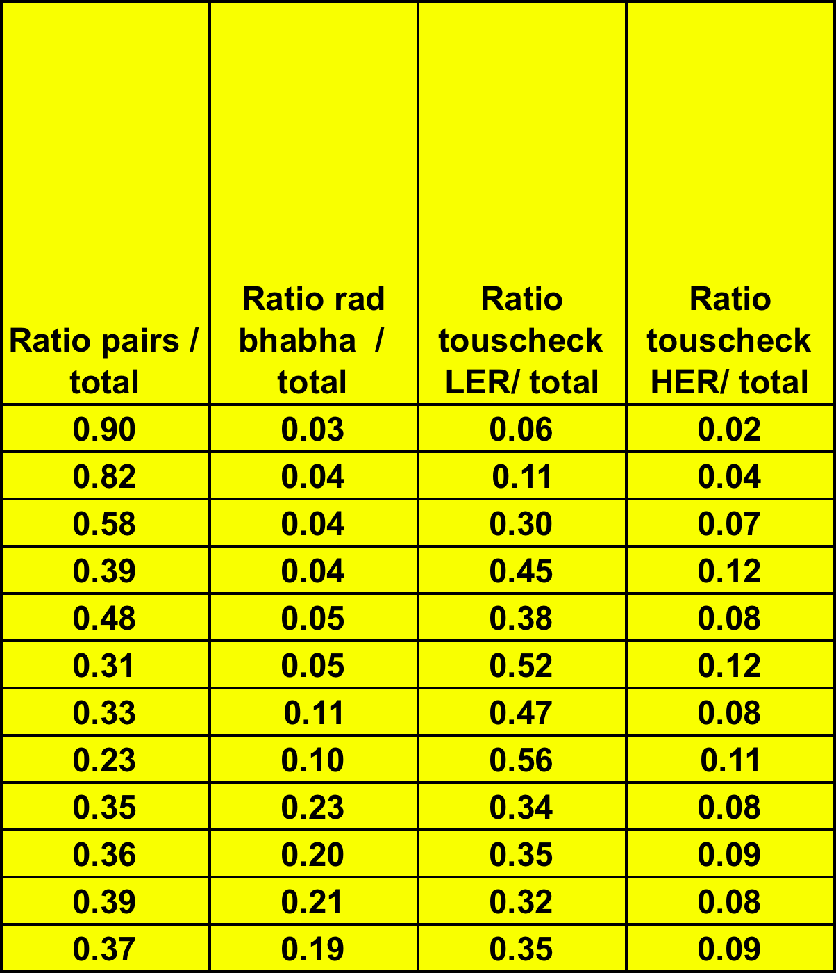
Rates March 12 (after Vienna and normalization fixed for pairs and rad bhabha)

