Slide 1
Peripheral Electronics
Some updates
Mauro Citterio
--------
INFN Milano

Slide 2
DAQ reading chain for L0-L5
Optical 1 Gbit/s
Front-end chips
Optical Link
2.5 Gbit/s to ROM
UPILEX+Cu (?)
FEB
C
Copper bus
Serdes
or FPGA
ROM
Detector
fibers
HDIs
< 1 m
Transition card
LV1
High rad area 15Mrad/year
Off detector
low rad area
Counting room
Std electronics
Work concentrated on → fanout (layer0)
→ Copper bus vs Bundle of magnet wires
→ Data transmission on Copper bus
- specifications
→ better estimate of “power lines” on Copper bus
2

Slide 3
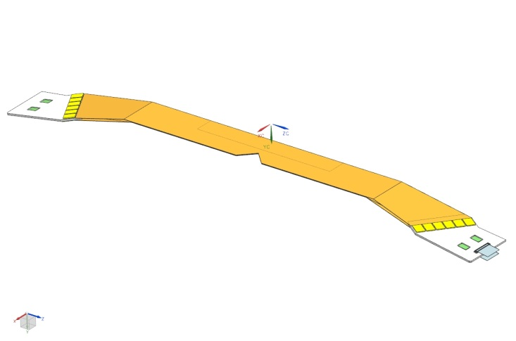
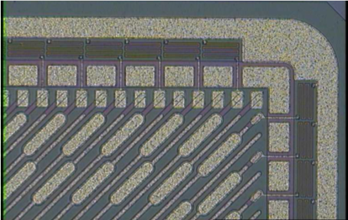
Fanout (layer 0)
→ Design progressing on Aluminum/Kapton 2 layer fanout
Fanout min. pitch is 80 um
Bonding always toward detector side (Stefano/Filippo concern resolved)
Fanout resistance first estimate ~ 0.8 ohm/cm (assuming Aluminum resistivity ~ 33 ohm x metro x 10⁻⁹)
Narrow pitch needed over a length of ~ 40 mm
Cern suggestions:
minimize the area where the pitch is 80 um
Perform a test on one layer to verify reliability/consistency of pitch
Concern about bending such a fine lines (perform resistance test before and after bending) on first sample
Spread lines before reaching bonding
Overall fanout width about 36 mm → To be verified in model

Slide 4
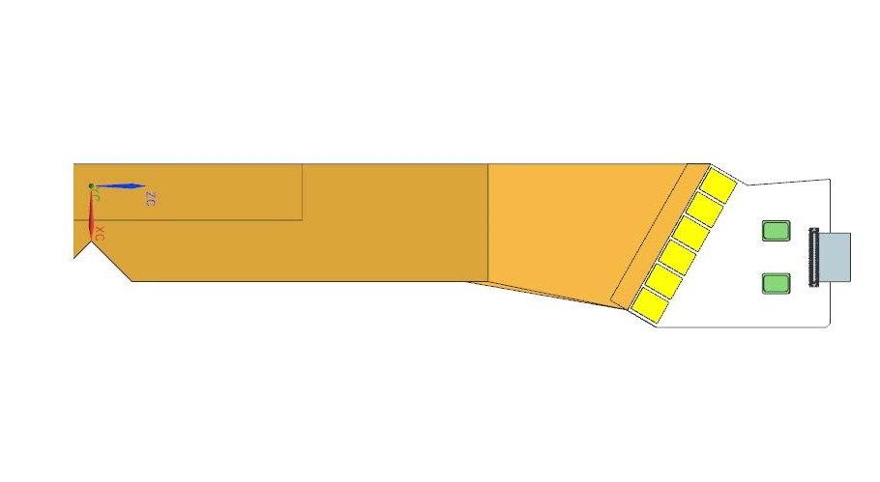
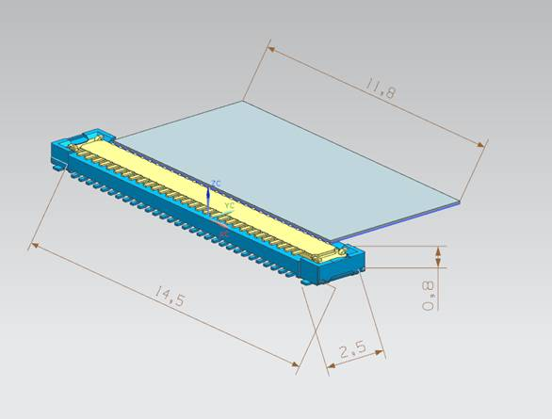
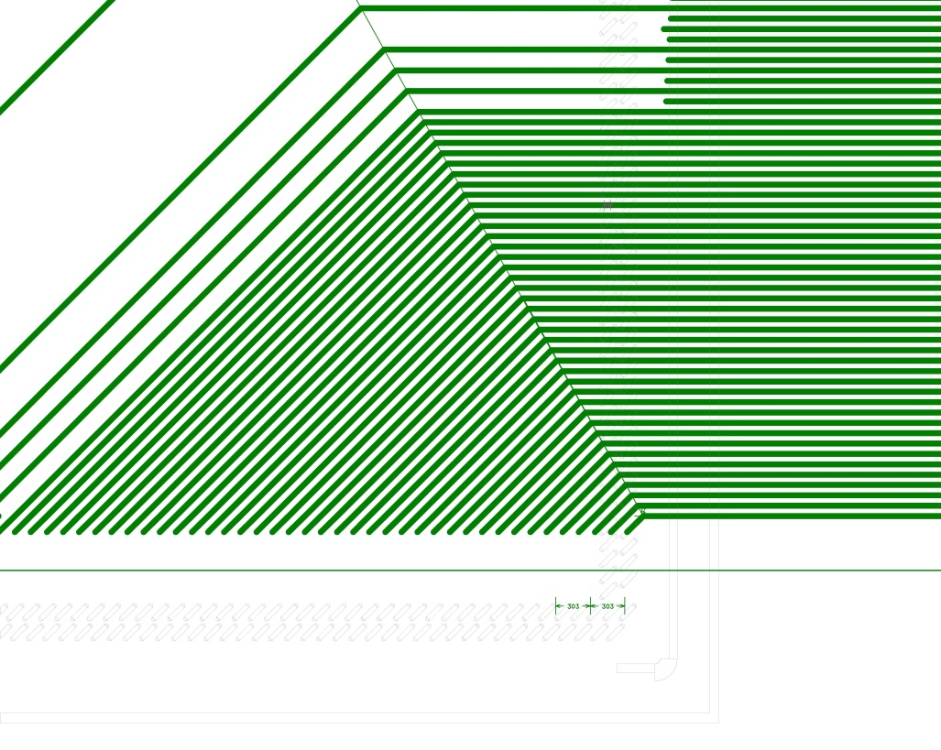
Output connector (originally 64 pins reduced to 50 pins. Should carry all copper lines (up to 11 LVDS + power LV and HV maybe).
Pins will increase in outer layers !!!
Not clear why hybrid sides are not parrallel
Larger pitch used near IC (~ 100 um)
29 mm
Simple geometry requested by CERN
Mimimum pitch ~ 80 um
Serializer
The layout of the fanout requires
~ 36 mm. It looks possible from the mechanical point of view, but we need to verify that carefully.
If not, than we need to decrease the pitch. The real minimum pitch need to tested on first CERN sample.

Slide 5
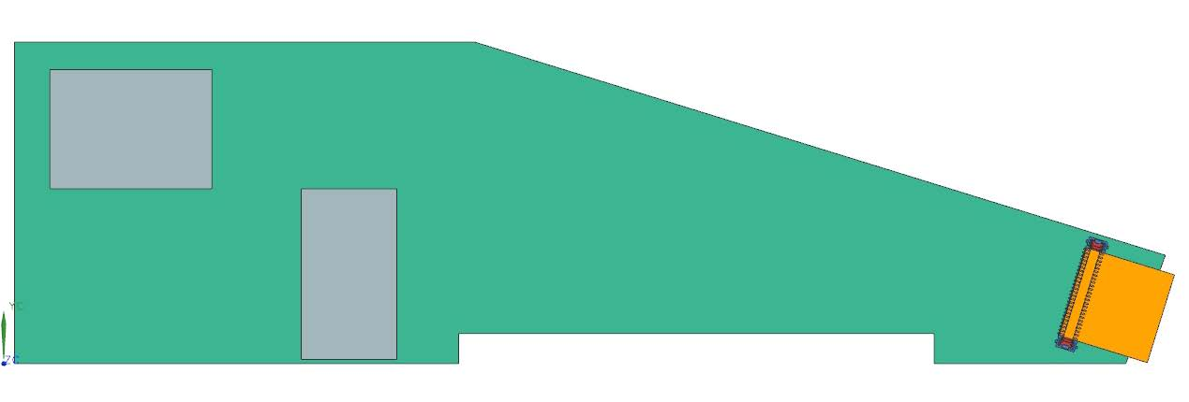
Output connector (originally 64 pins reduced to 50 pins.
To be able to fit in the transition card
Increasing pins, means increased connector size → we will need to make space not only for the connector, but also for the cable itself !!

Slide 6
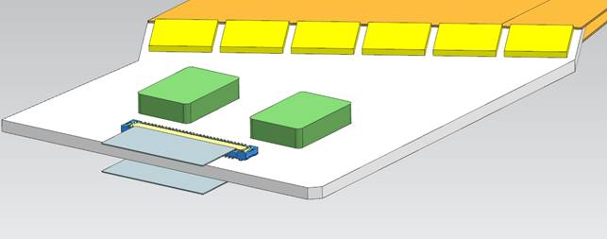
HDI
Periph.
blocks
Layer 0 HDI dimensions
We should “freeze” the dimensions
I have started to draw a real “schematic and layout”.
I am planning to have it completed by Frascati meeting
In the coming days we should agree on some “tentative” pad layout
No show-stopper up to now
Still need to understand if we need to “shielding between LVDS lines close to the connector
Clock routing not yet addressed
Number of layers seems similar to Babar HDI
Summary of LVDS lines
3 clocks (System clock, Time Stamp clock, readout clock)
1 REG In
1 REG out
1 Reset
1 Trigger
4 Data lines
Periph.
blocks
Digital backend
Analog channels
DATA
OUT
Periph.
blocks
Periph.
blocks

Slide 7
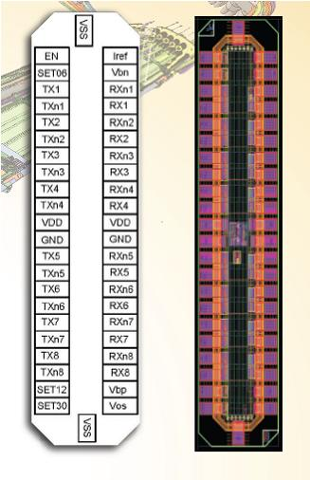
LVDS test in preparation
IC acquired from CERN (8 receivers and 8 transmitters, 6x1.5 mm)
Extract of info from CERN:
IBL loads 5.6m of twisted pair cable with this LVDS (FE-I4).
Baud rate is 160Mb/s, transmission quality is marginal. Eye-plot is small mostly due to NO pre-empjasis
nSPQ uses the same LVDS over a cable lenght (bunch of magnet wires) of 6.3m with a baud rate of 80Mb/s. Bit error rate is < 10E-14.
With only one magnet wires baud rate could increase up to 120-130Mb/s, but if a bunch is used «mutual impedance» creates a problem
We are bonding the IC to a board
We will retest performance with multiple magnet wires
we would need to interpose shields ?
In parallel we will test an LVDC driver designed by Bergamo group
I am also start designing a flat cable (6 mils data lines, 70 um thick, with shield + power lines)

