Slide 1


Welcome to Neutrino Telescopes 2025
+4 editions of NO-VE
Monument of Galileo Galilei in Prato della Valle (“the best 18 years of my life”)
Inspired by the starry sky by Giotto (don’t miss the visit to Cappella degli Scrovegni on Thursday)

Slide 2
After 37 years we abandon the venue in Venice
If we had any doubts about the appeal of Venice, we could consult Fred Reines' letter
The traditional venue in Venice by Istituto Veneto delle Scienze Lettere e Arti lost all the ancillary spaces (transferred to a luxury restaurant) and become inadequate to host this conference.
The conference is organized by INFN – Sezione di Padova and the Department of Physics and Astronomy of the Padova University
Padova hosts two Unesco Heritage Sites and a lot of attractions (you can follow the links at our conference page)
… and it is less than 30 minutes by train from Venice.
VENICE IS A GREAT PLACE FOR A CONFERENCE
F. Reines
University of California, Irvine, CA
“Oh”, said the accompanying companion to the 4th International Symposium on Neutrino Telescopes and the 400th Anniversary of Galileo. “I am so pleased to have an excuse to visit Venice, one of my favorite places on this earth. However (she continued) I must confess that I never did understand this great fuss about a particle which is reputed to do so little”. This remark set me thinking. The neutrino venture heralded by Pauli’s bold hypothesis and Fermi’s famous formulation has indeed been full of surprises some of which will be described at this Symposium.
The field has been broad and deep, encompassing astrophysical and particle consequences and ranging from the distant nebulae to the unification of the elementary
forces. The searches have led from the ocean deeps to deep inside the earth and sun. …
… http://neutrino.pd.infn.it/Reines-1992.pdf

Slide 3
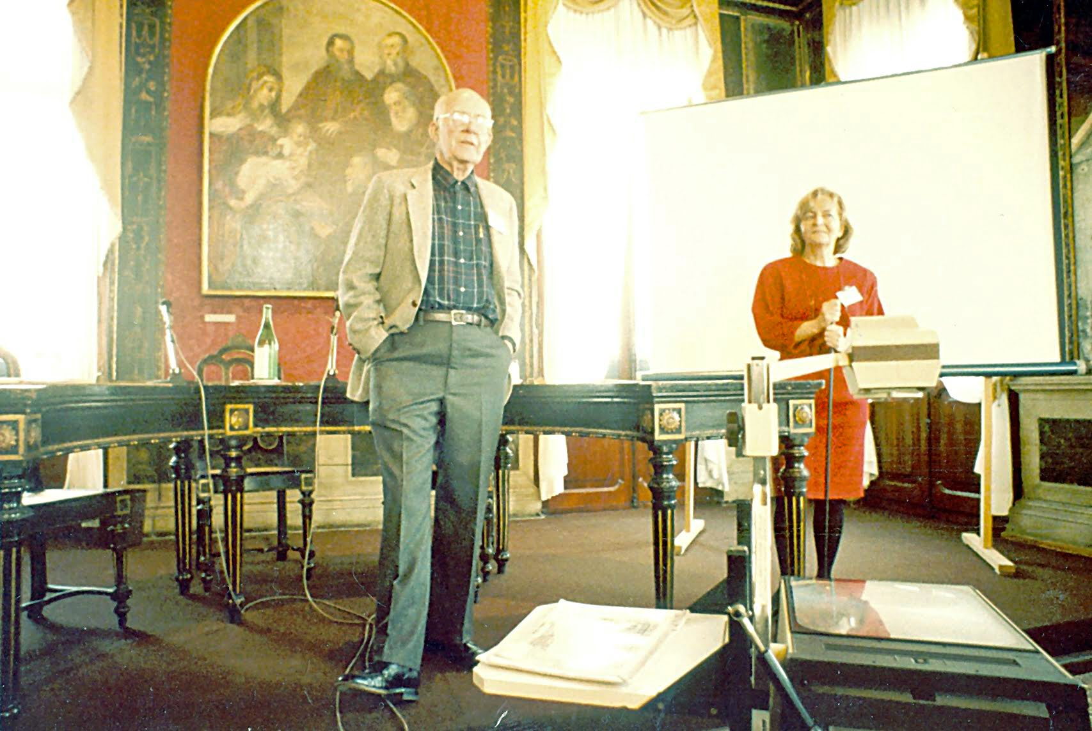
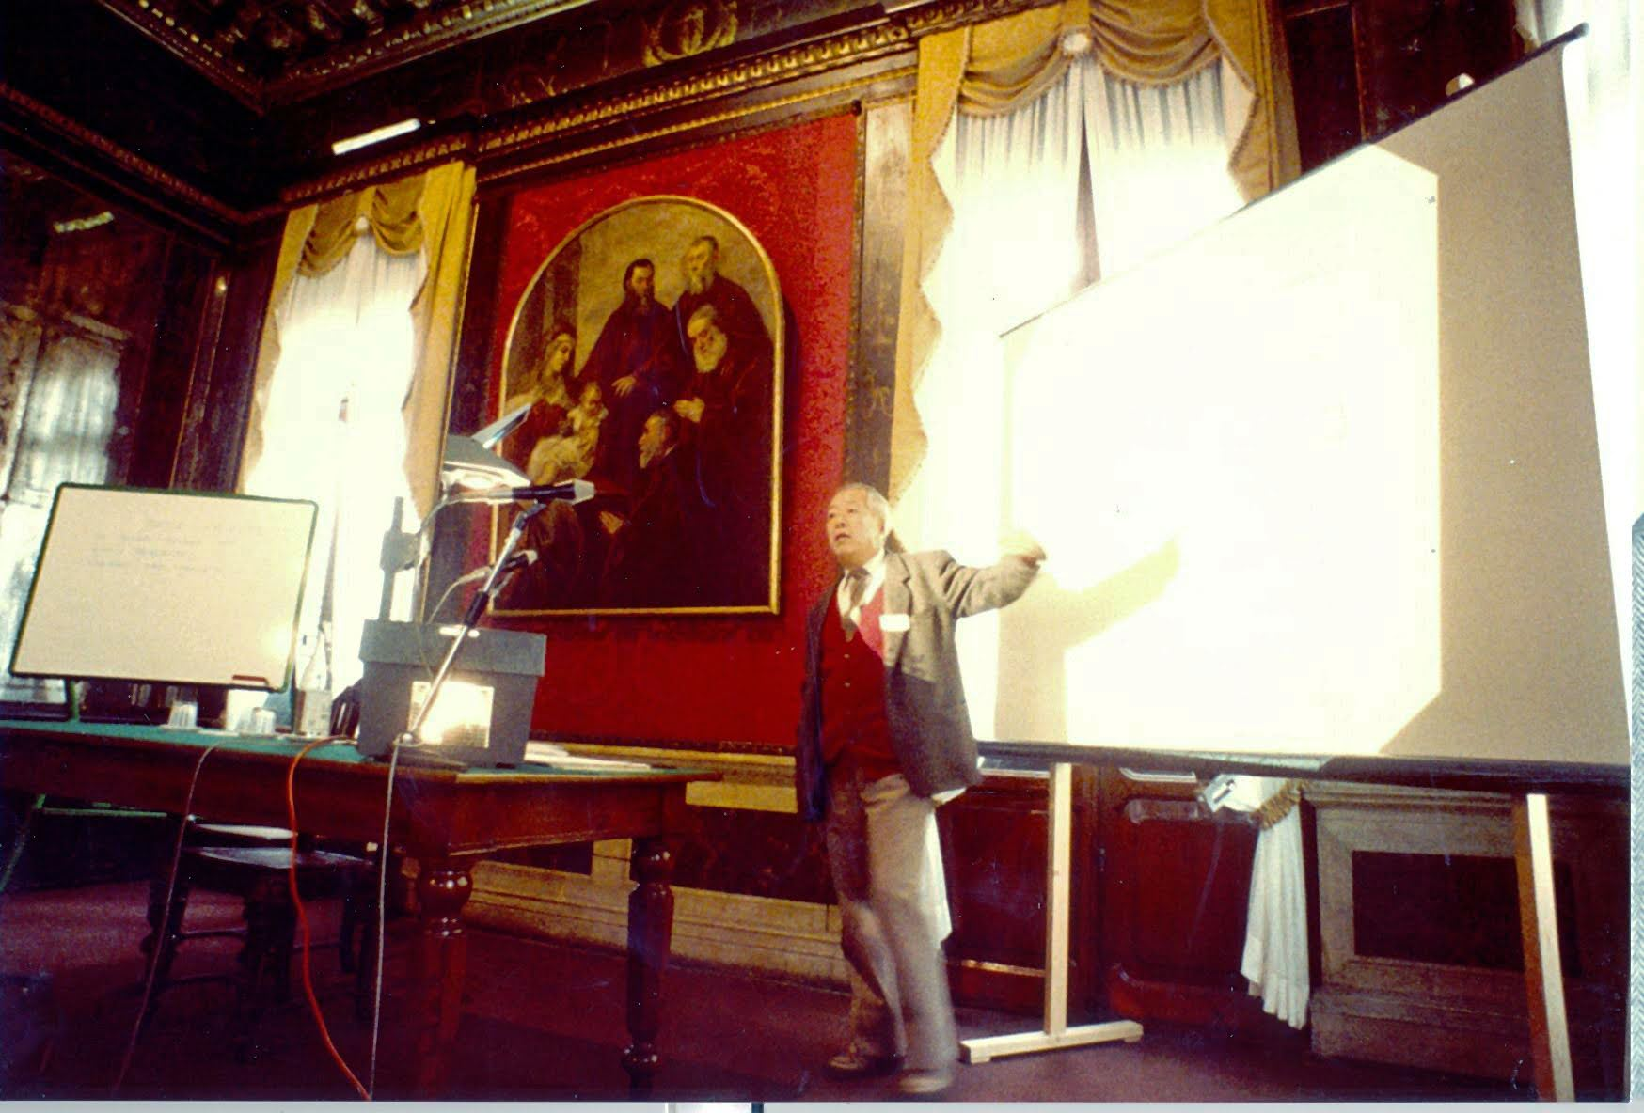
The conference initiated in 1988, by Milla Baldo Ceolin
Already in the (first) golden era of Neutrino Telescopes
Solar Neutrinos detected by Ray Davis at Homestake
The evidence of solar neutrinos with more than 3 std can be dated around 1979 (no article entitled “Discovery of ..”)
It’s also the first detection of electron neutrinos (note the inverted ordering in neutrino discoveries: electron antineutrinos followed by muon neutrinos and electron neutrinos)
Pauli-Reines: 26 years; Reines-Davis: 23 years
Confirmed by Kamiokande in 1990
Ray Davis & Milla Baldo Ceolin, 1990
Supernovae neutrinos detected in 1987
By Kamiokande II, IMB and Baksan
Kamiokande just published the anomaly of atmospheric neutrinos
Soon followed by the negative results of Nusex and Frejus
Laboratori Nazionali del Gran Sasso completed in 1987
MACRO under construction
Gallex approved, Icarus and Borex(ino) already proposed
SNO in advanced phase of approval at SnoLab
Detection of neutrinos in natural water already in place
Dumand was prototyping deep water detectors
Detection in ice already proposed. Presented by R. March.
INFN Padova – ICRR collaboration to study the possibility of neutrino water cerenkov detection in a lake (LENA)
M. Koshiba, 1988
Great fun to compare this landscape with the present golden era as will be discussed in this workshop
Super-Kamiokande proposed in 1984 and approved in 1991
Described by Koshiba-san at the conference

Slide 4
Thanks to all the people involved
International Advisory Committee Barry C. Barish - Caltech University Sandhya Choubey - KTH Stockholm Pasquale Di Bari - Univ. of Southampton Takaaki Kajita - Institute for Cosmic Ray Research (ICRR) Francis Halzen - Univ. of Wisconsin, Madison Manfred Lindner - Max-Planck-Institut für Kernphysik Heidelberg Paolo Lipari - INFN, Roma Eligio Lisi - INFN, Bari Antonio Masiero - Univ. of Padova and INFN-PD Teresa Montaruli - Univ. de Geneve Silvia Pascoli - Univ. of Bologna Serguey Petcov - SISSA and INFN-Trieste Elisa Resconi - Technical Univ. of Munich, Germany Alexei Yu. Smirnov - Max-Planck-Institute für Kernphysik, Heidelberg and ICTP, Trieste Maurizio Spurio - Univ. of Bologna and INFN-Bo Francesco Vissani - INFN-Laboratori Nazionali Gran Sasso
Local Organizing Committee Elisa Bernardini (co-chair) Carlo Broggini Gianmaria Collazuol Francesco D'Eramo Christian Farnese Marco Grassi Andrea Longhin
Mauro Mezzetto (chair) Fabio Pupilli Elisa Prandini Pina Salente Chiara Sirignano (co-chair) Luca Stanco Filippo Varanini
Participating in: T2K, SK, HK, Icarus, Dune, Juno, IceCube, NuScope, Legend, Luna, Magic, CTA, Euclid, theory
Secretariat Pina Salente, INFN-PD Laura Zanovello, INFN-PD
Technical Support Massimo Gravino, INFN-PD
Sara Magrin, Univ. of Padova
Matteo Menguzzato , Univ. of Padova Roberto Temporin, Univ. of Padova

