Slide 1

DUNE: Overview and Status
David Rivera on behalf of the DUNE Collaboration
Neutrino Telescopes 2025
October 2, 2025

Slide 2
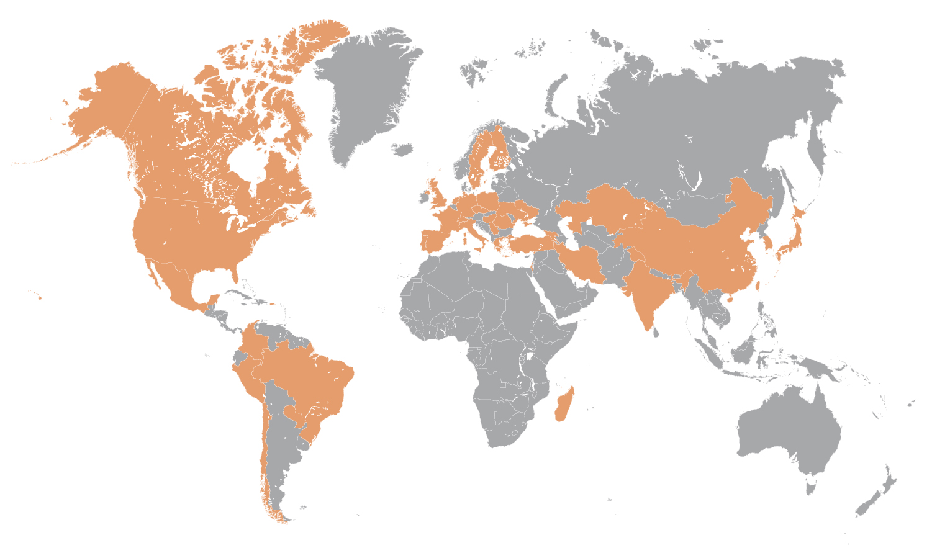
The Collaboration
Consists of:
1400+ collaborators
>200 institutions
35+ countries

Slide 3
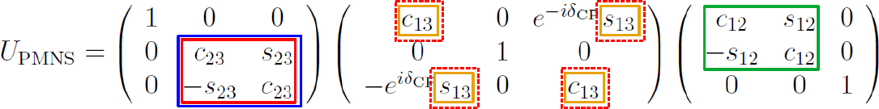
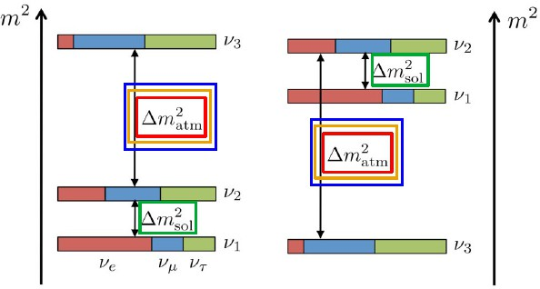
Current Landscape
Open questions in neutrino oscillation physics:
Is 𝝂_{𝟑} the heaviest (normal ordering) or the lightest (inverted ordering)? What is the sign of Δ𝑚₃₂² ?
Do 𝝂 and anti-𝝂 oscillate differently? What is the value of 𝛿_{𝐶𝑃}?
Does 𝝂_{𝟑} contain more 𝝂_{𝝉} or 𝝂_{𝝁}? What Is the 𝜃₂₃ octant?
Is the 3-flavor neutrino picture correct? Is the PMNS matrix unitary?
  New physics??
Super-K T2K, NOvA Daya Bay, Reno solar, KamLAND
Current best measurements (solid) and complementary measurements (dashed)

Slide 4
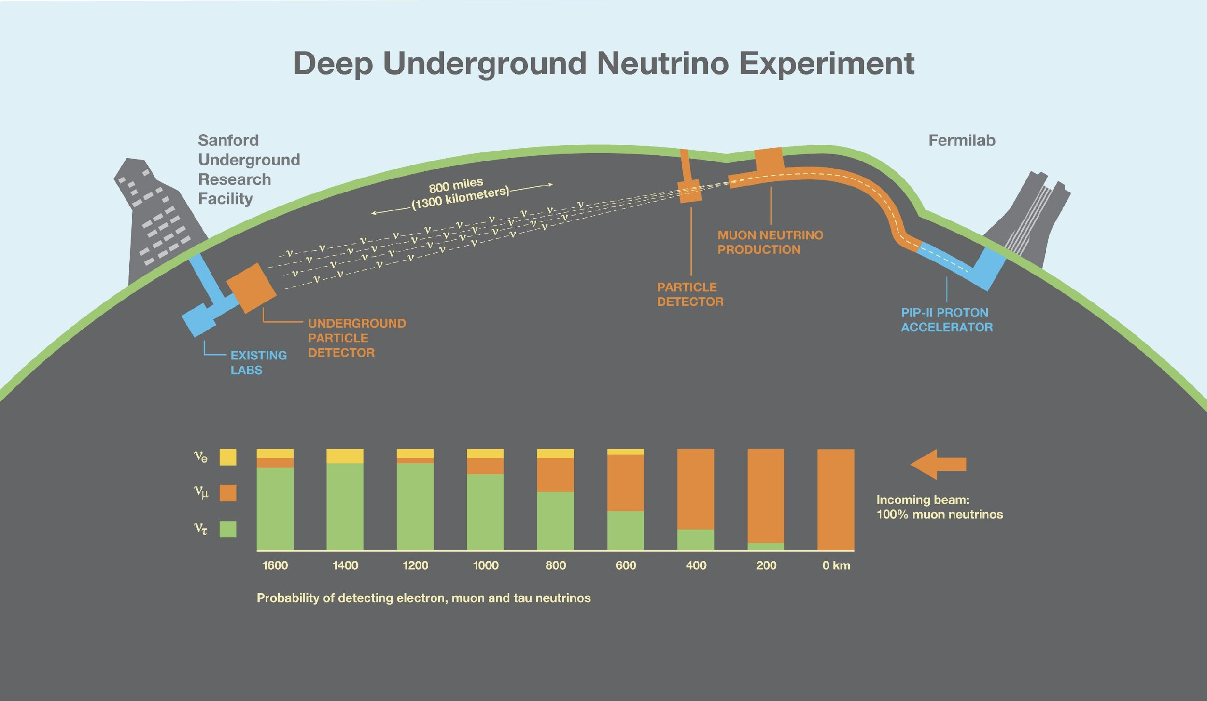

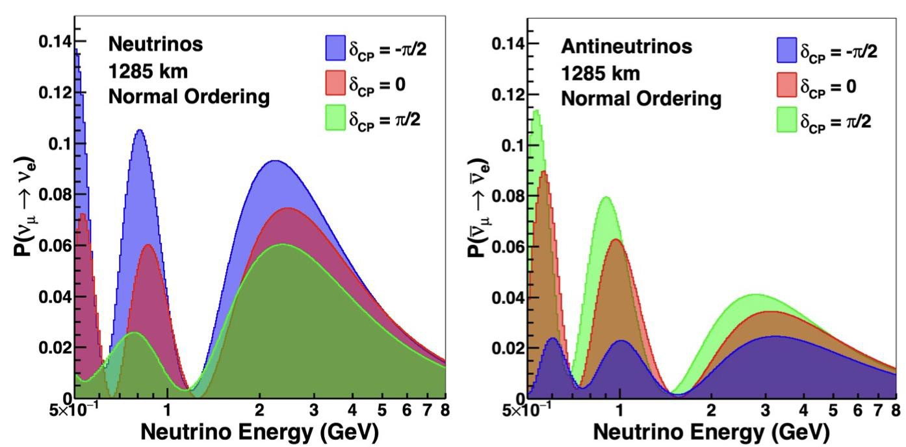
Key design choices:
Intense, wideband (anti)neutrino beam, (~100 MeV – 10 GeV)
Long-baseline: 1300 km, matter effect no longer degenerate w/ (possible) CPV
Large, multi-kiloton, sensitive Far Detector (FD), 1.5 km underground
Highly capable Near Detector (ND) to constrain systematics
Liquid Argon TPC technology: Sensitivity to multiple channels (numu disappearance, nue appearance)
Long operational program
Design Philosophy
Measure all parameters governing long-baseline neutrino oscillations at high precision and do so as a function of L/E using wideband (anti)neutrino beams.

Slide 5
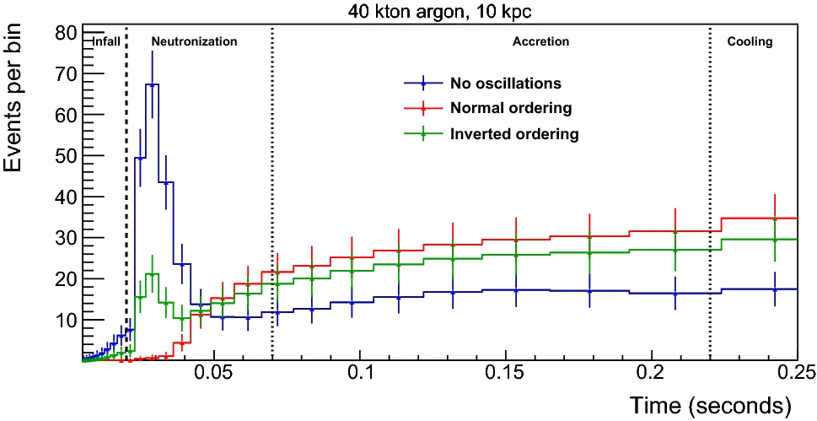
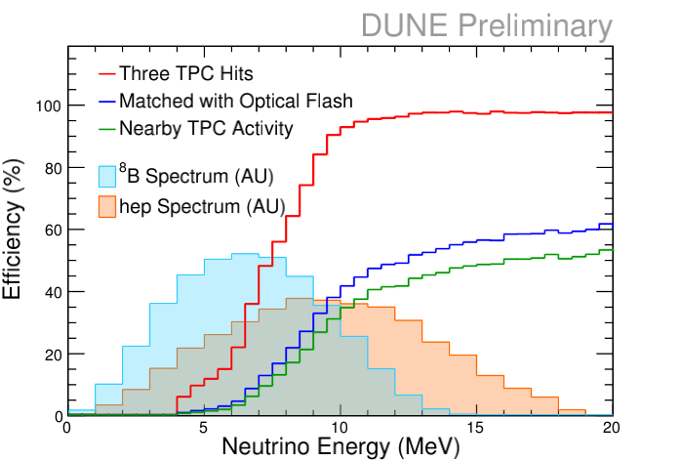
Eur. Phys. J. C 81, 423 (2021)
DUNE ν_{e}
DUNE will serve as an observatory for astrophysical sources of neutrinos from day 1:
Supernovae
Atmospheric
Solar
See D. Guffanti’s talk today

Slide 6
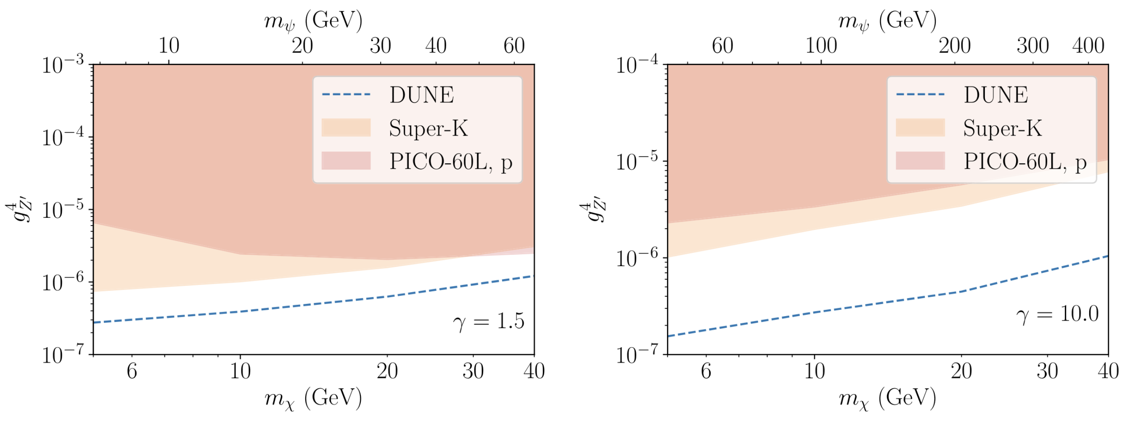


PRD 103, 095012 (2021)
Perform BSM physics searches:
Proton decay
Neutron-antineutron oscillations
Boosted Dark Matter $→$
Heavy Neutral Leptons
Plus more!

Slide 7
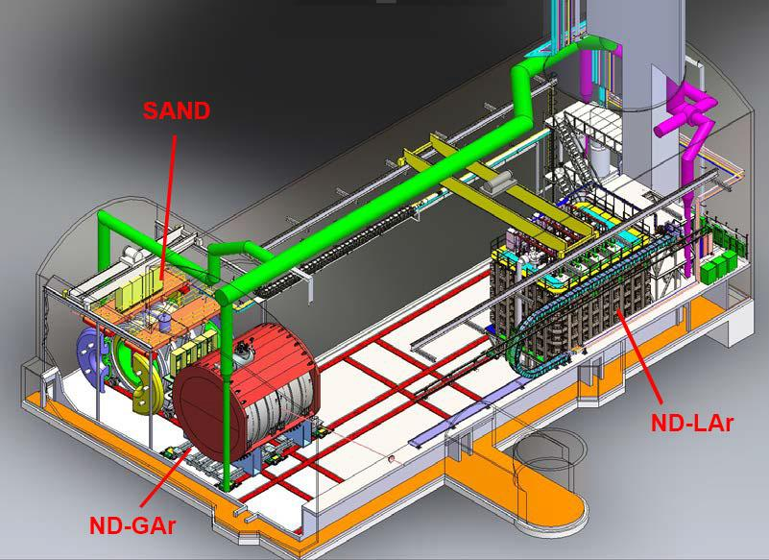
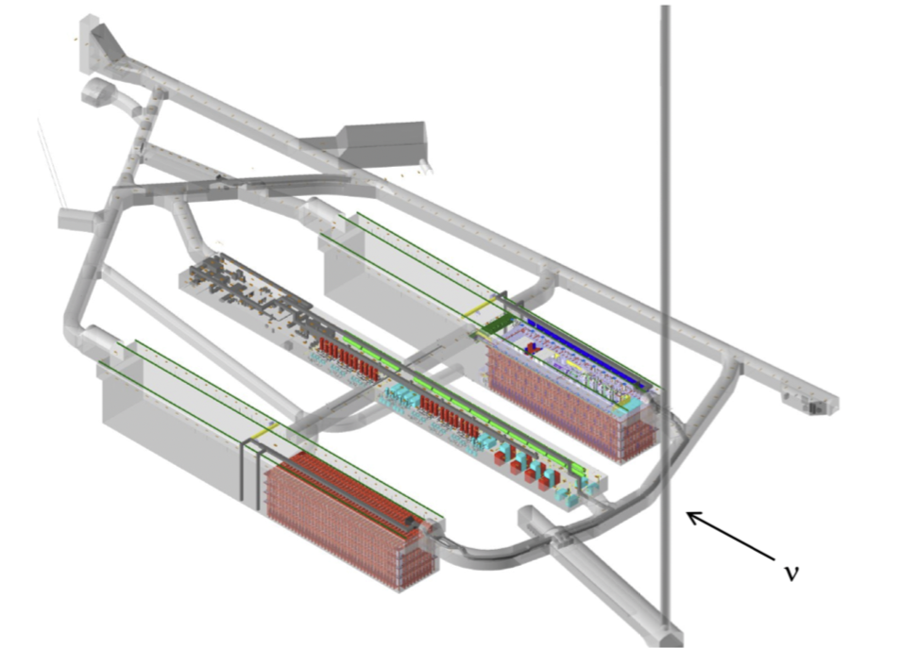
ND:
~62 m underground at the Near Detector Service Building
Nominally: one LArTPC with pixelated readout (ND-LAr), one Gaseous Argon TPC (ND-GAr), both movable under the DUNE-PRISM concept
On-axis, magnet and calorimeter for flux monitoring (SAND)
FD:
1.5 km underground at the Sanford Underground Research Facility (SURF)
Nominally: four, 17 kiloton Liquid Argon Time Projection Chambers (LArTPCs)

Slide 8
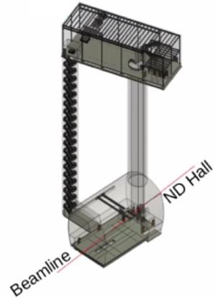
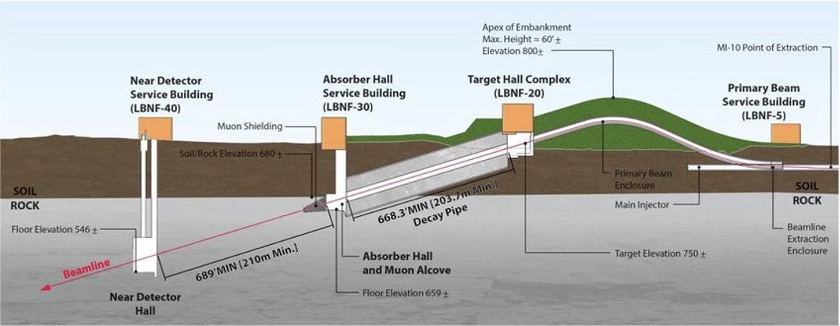

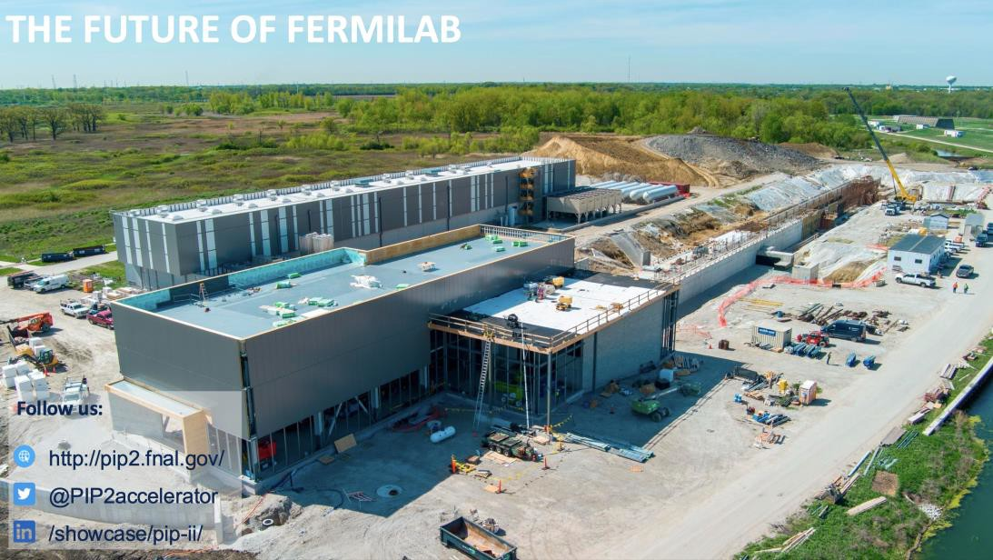
Long Baseline Neutrino Facility (LBNF)
Proton beam
  1.2 MW, upgradeable to 2.4 MW
  60-120 GeV protons from FNAL accelerator complex
  Initial upward pitch, bent down at 5.8∘ to reach Sanford
Horns/beam line designed to maximize CP violation sensitivity, long baseline optimizes MH measurement
ND flux measurement predicts flux at the FD

Slide 9
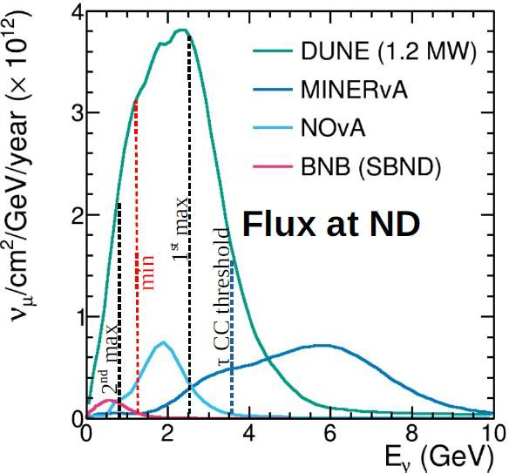
Long Baseline Neutrino Facility (LBNF)
Proton beam
  1.2 MW, upgradeable to 2.4 MW
  60-120 GeV protons from FNAL accelerator complex
  Initial upward pitch, bent down at 5.8∘ to reach Sanford
Horns/beam line designed to maximize CP violation sensitivity, long baseline optimizes MH measurement
ND flux measurement predicts flux at the FD

Slide 10
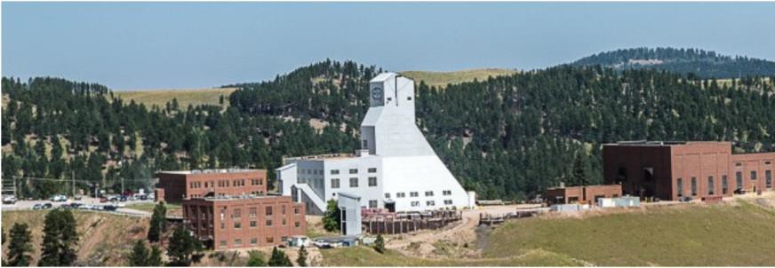
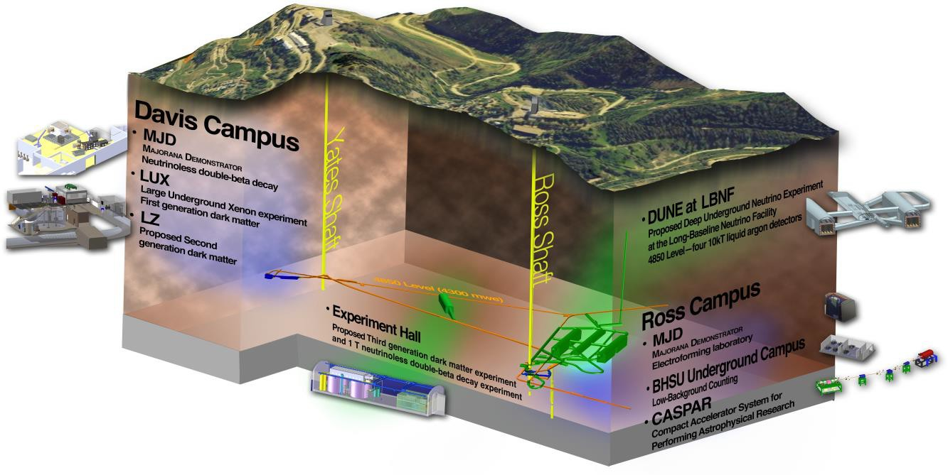
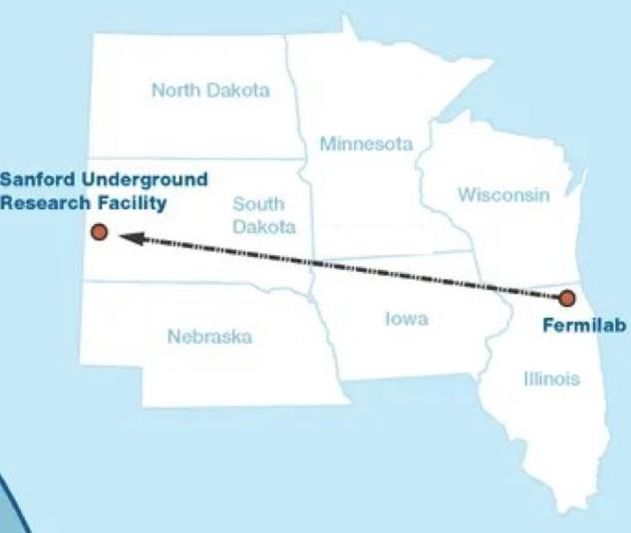


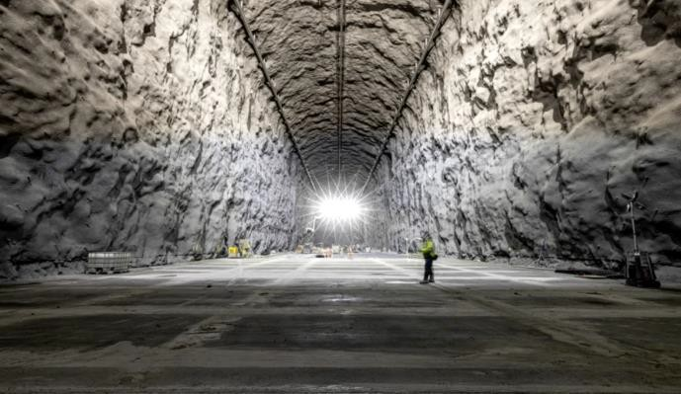

Sanford Underground Research Facility (SURF)
In the Homestake gold mine, Lead, S. Dakota
Home of Ray Davis’s solar neutrino experiment
Two caverns for all four detectors and one central utility hall for DUNE
Far site excavation completed in 2024
  Building & Site infrastructure main focus now
DUNE facility,
4850 ft (1.5km, 4300 mwe)

Slide 11
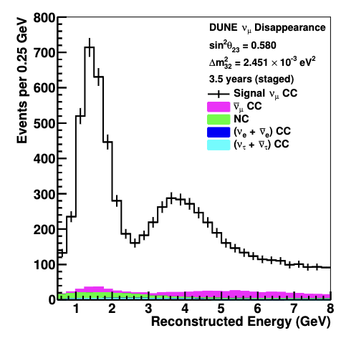
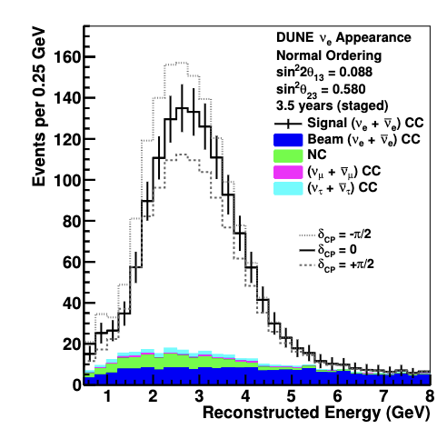
Sanford Underground Research Facility (SURF)
In the Homestake gold mine, Lead, S. Dakota
Home of Ray Davis’s solar neutrino experiment
Two caverns for all four detectors and one central utility hall for DUNE
Far site excavation completed in 2024
  Building & Site infrastructure main focus now
DUNE facility,
4850 ft (1.5km, 4300 mwe)

Slide 12
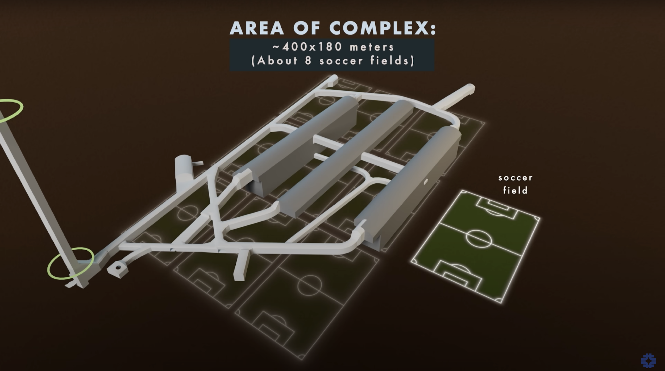
The DUNE Far Detector (FD)
Renovated
Ross Shaft
FD Module 1 (FD1)
North Cavern
FD Module 2 (FD2)
FD3
Central Utility Cavern (CUC)
FD4
South Cavern

Slide 13
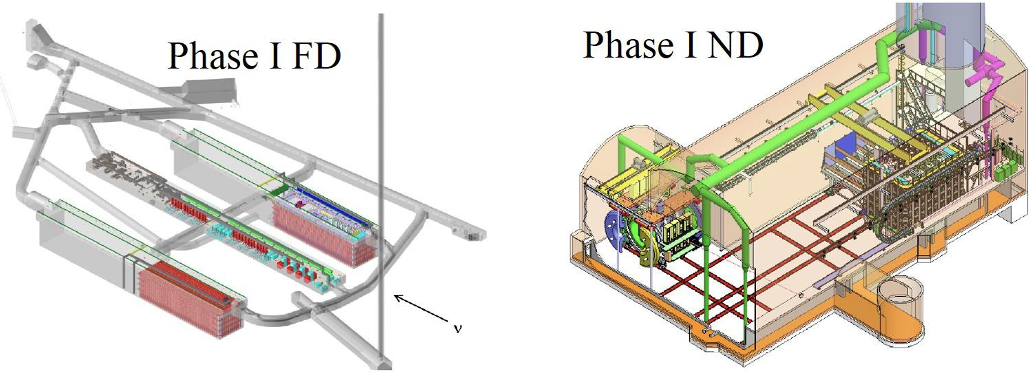
DUNE Plans and Installation
PHASE I
Ramp to 1.2 MW beam intensity
Two 17 kt (10 kt fiducial) LAr TPC FD modules – one Vertical Drift (VD) + one Horizontal Drift (HD)
Near Detector:
  ND-LAr + Temporary Muon Spectrometer (TMS)
    Movable, to enable PRISM
  On-axis monitor: SAND
2.4 MW beam intensity
Far Detector: Four 17 kt (10 kt fiducial) LAr TPC FD modules
  Module 3 – LArTPC
  Module 4 – Module of Opportunity
Near Detector:
  TMS → ND-GAr, to provide enhanced ND interaction physics capabilities

Slide 14
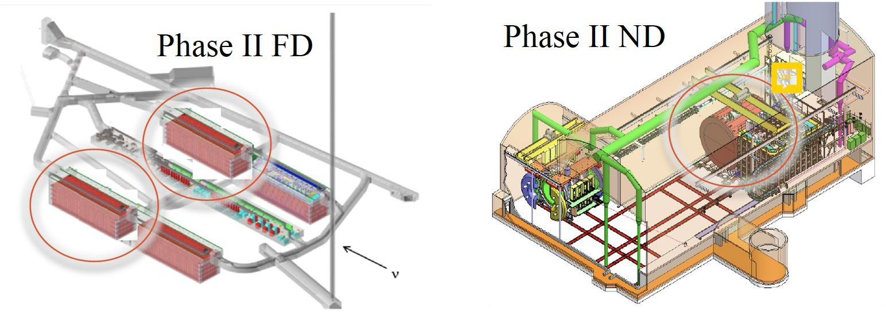
DUNE Plans and Installation
Ramp to 1.2 MW beam intensity
Two 17 kt (10 kt fiducial) LAr TPC FD modules – one Vertical Drift (VD) + one Horizontal Drift (HD)
Near Detector:
  ND-LAr + Temporary Muon Spectrometer (TMS)
    Movable, to enable PRISM
  On-axis monitor: SAND
PHASE II
2.4 MW beam intensity
Far Detector: Four 17 kt (10 kt fiducial) LAr TPC FD modules
  Module 3 – LArTPC
  Module 4 – Module of Opportunity
Near Detector:
  TMS → ND-GAr, to provide enhanced ND interaction physics capabilities

Slide 15
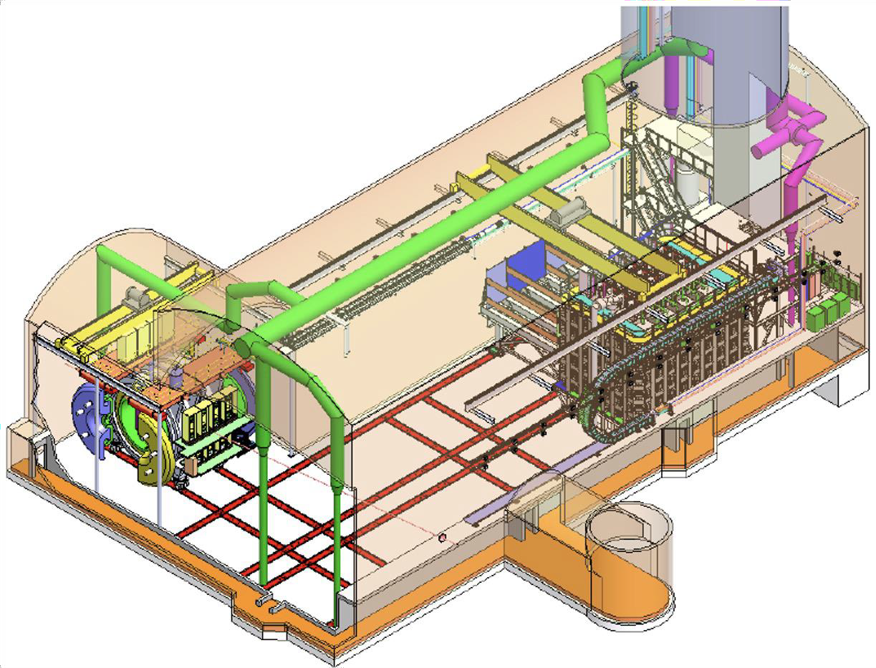
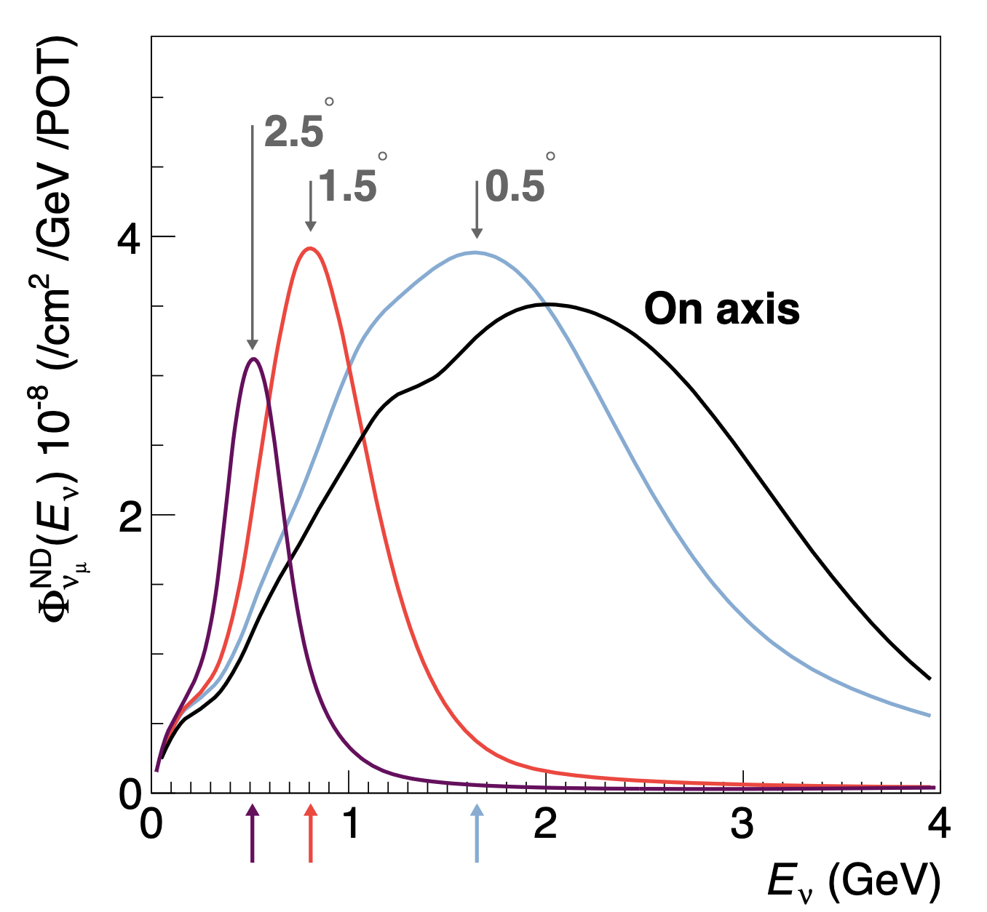
DUNE Near Detector Complex
ND-LAr and TMS move off-axis to receive different beam fluxes for disentangling flux and cross sections and constraining systematics (PRISM)
TMS
SAND
arXiv:2103.13910
ND-LAr
Hall location:
574 m from target
~60 m underground
~30 m
Beam direction
ND-LAr: LArTPC with 3-D, pixelated readout; segmented into 35 (optically isolated) modules
TMS: Muon Spectrometer (Phase I) built from steel and scintillator with magnetic field, will be upgraded to ND-Gar (Phase II)
SAND: Magnetized on-axis neutrino detector for beam monitoring
PRISM concept allows us to mimic the oscillated spectrum at FD to minimize interaction modeling uncertainties
9

Slide 16
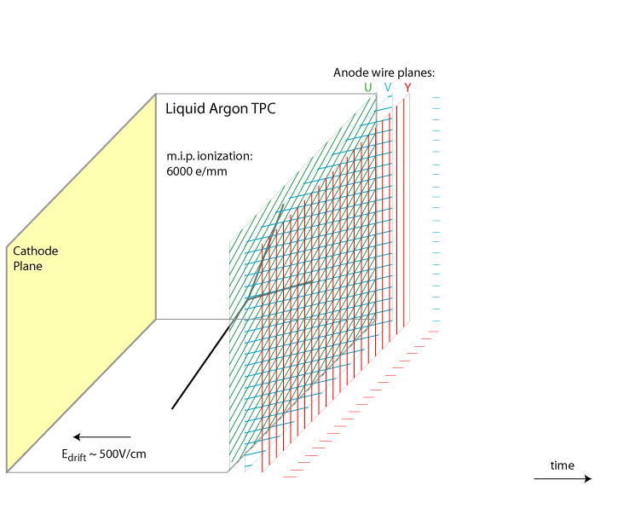
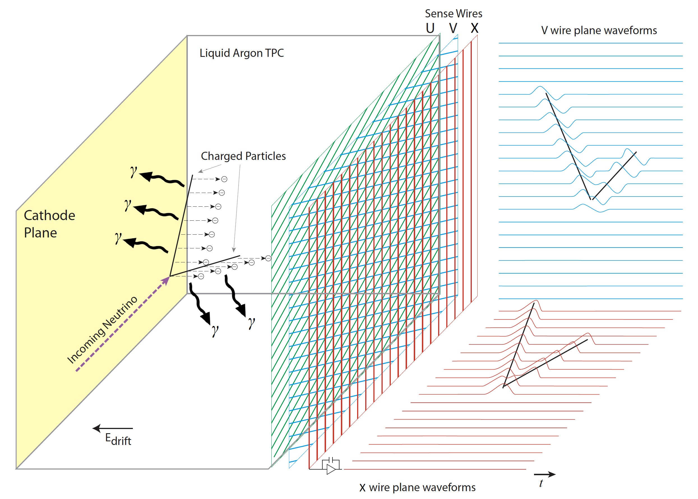
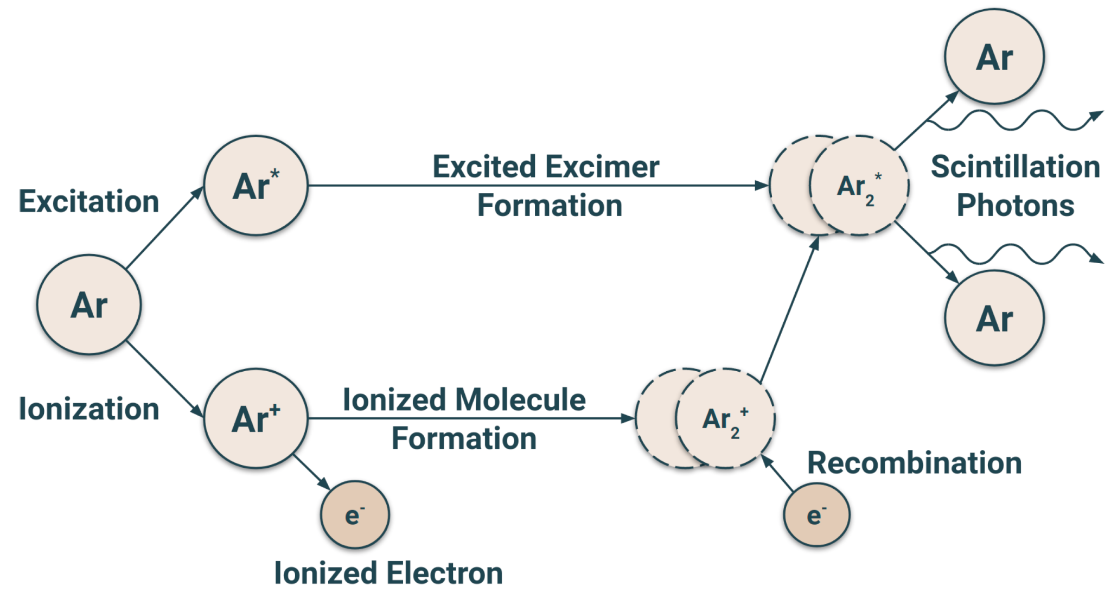
Liquid Argon (LAr) TPCs
LAr-based TPC neutrino detector pushed forth by Carlo Rubbia in 1977
  Technology demonstrated in early 1990s by the ICARUS collaboration
Basic principles:
Charged particles lose energy as they pass through LAr
The energy goes into producing electron-ion pairs and scintillation light
An electric field established within the LAr volume drifts the electrons toward the anode plane at constant speed
The TPC is instrumented with a segmented anode (wires, strips, or pixels) for charge readout and photodetectors
Time projection chamber. Animation courtesy of BNL.

Slide 17
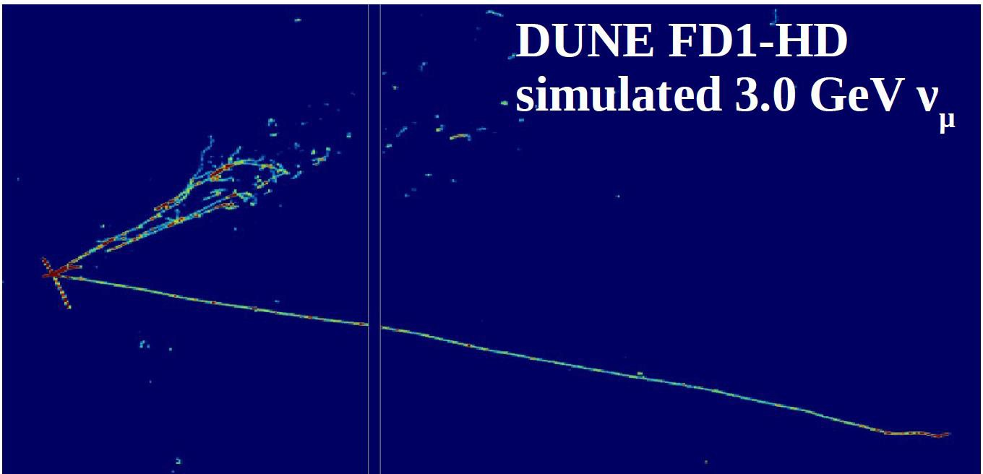
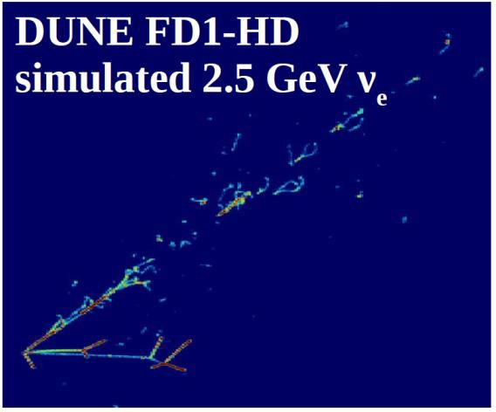
Liquid Argon (LAr) TPCs
LAr-based TPC neutrino detector pushed forth by Carlo Rubbia in 1977
  Technology demonstrated in early 1990s by the ICARUS collaboration
Basic principles:
Charged particles lose energy as they pass through LAr
The energy goes into producing electron-ion pairs and scintillation light
An electric field established within the LAr volume drifts the electrons toward the anode plane at constant speed
The TPC is instrumented with a segmented anode (wires, strips, or pixels) for charge readout and photodetectors

Slide 18
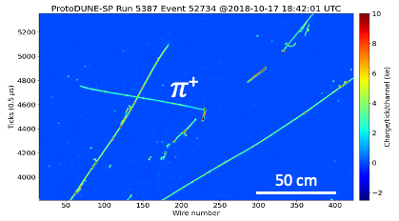
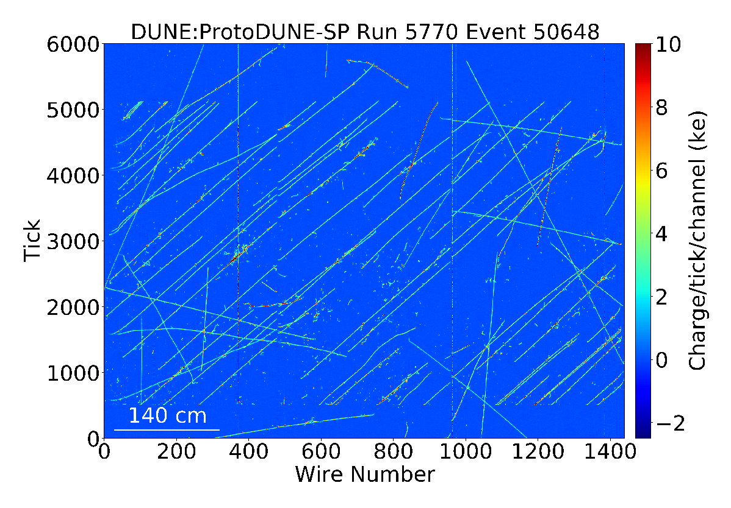
LArTPCs
Can be instrumented for millimeter position resolution
Low threshold for ionization: 23.6 eV/e-
LAr is transparent to its own scintillation light
VUV (127 nm) scintillation light is wavelength-shifted and detected via common photosensors (PMTs and SiPMs)
  24,000 photons/MeV at 500 V/cm for Minimum Ionizing Particles (MIPs)
  prompt component (6 ns) is used for t₀ determination
ProtoDUNE-SP events. 1 GeV/c pion candidate (top) and large cosmic shower event (bottom). JINST 15 P12004

Slide 19
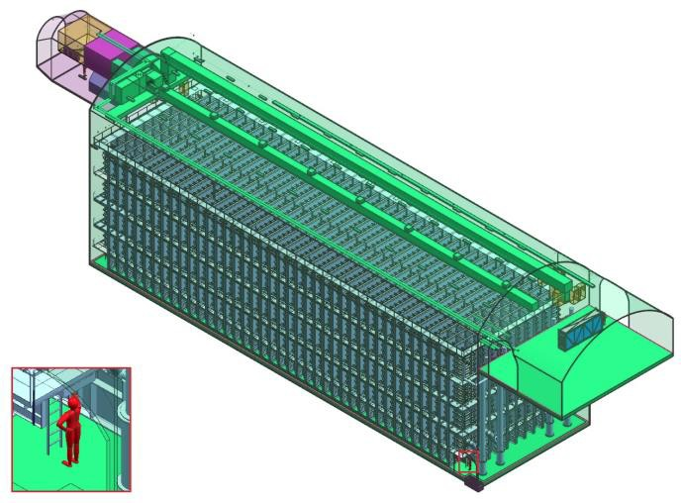
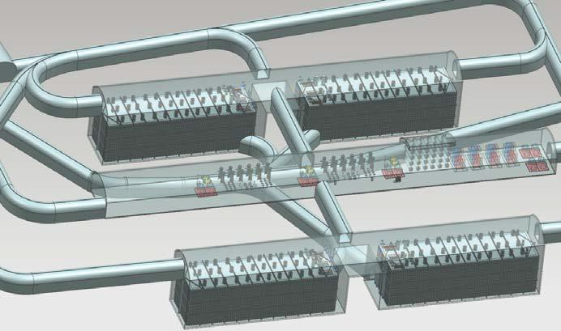
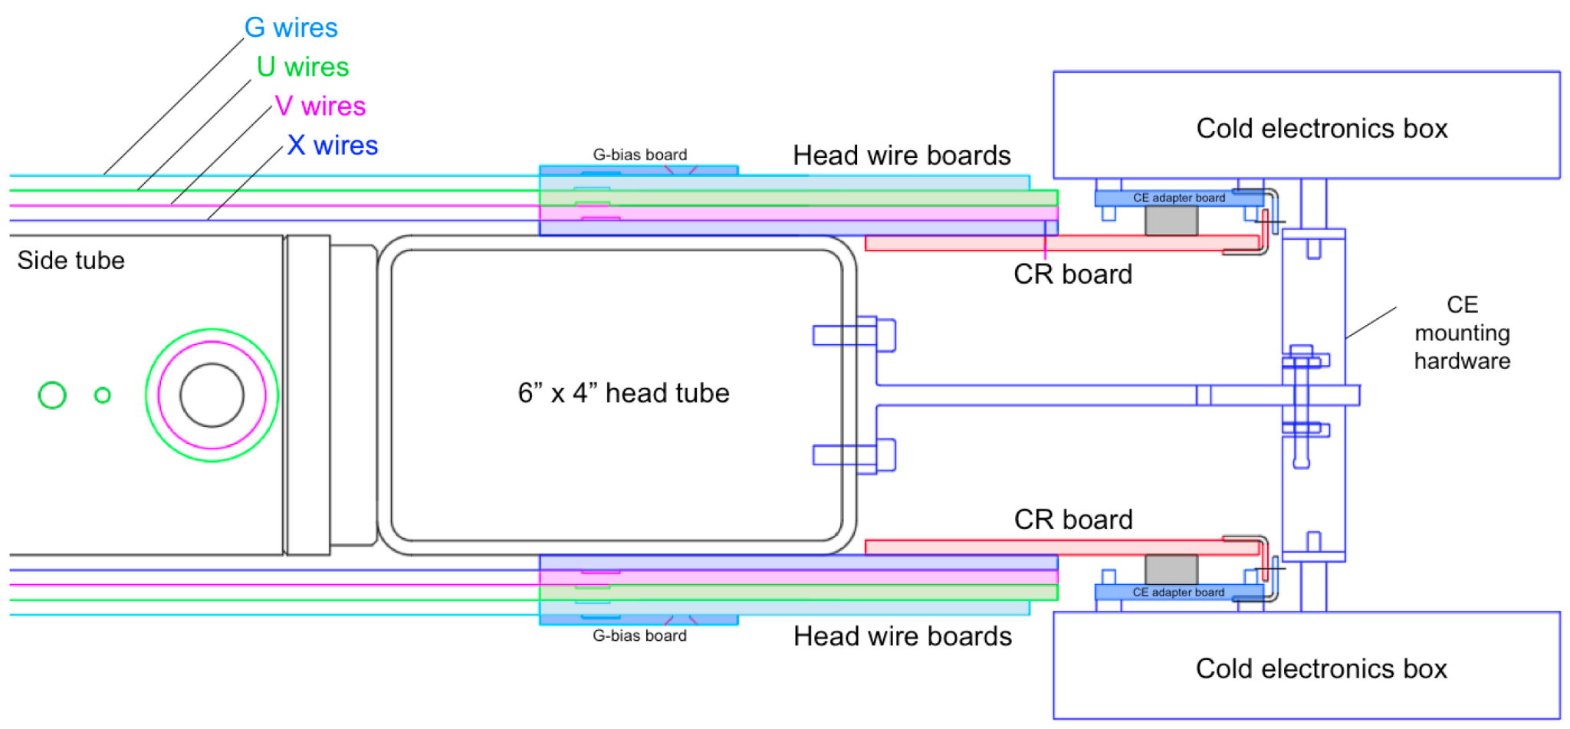
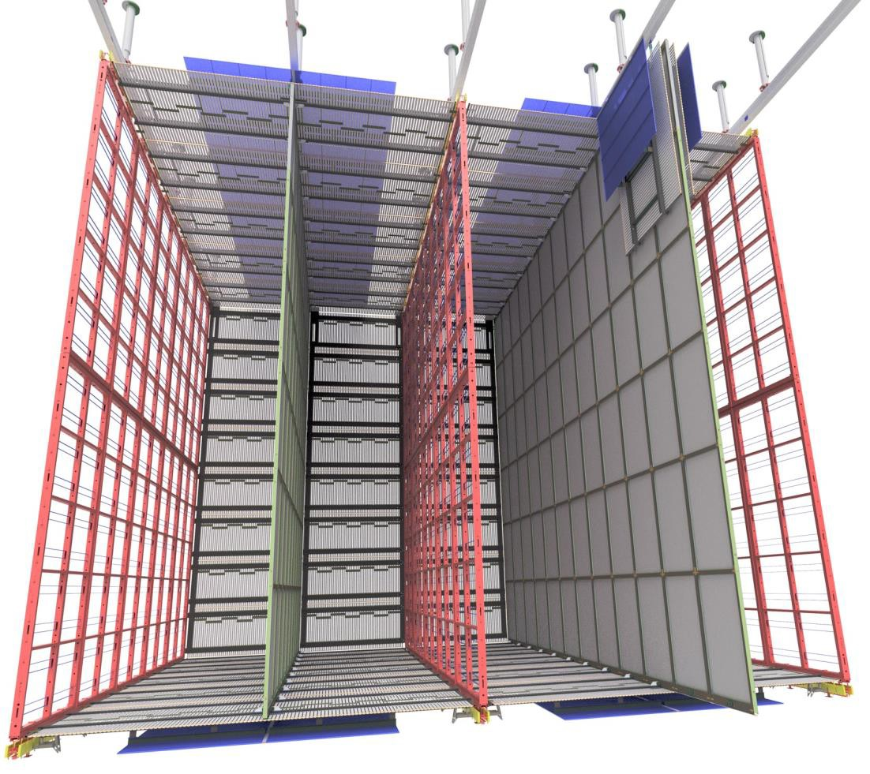
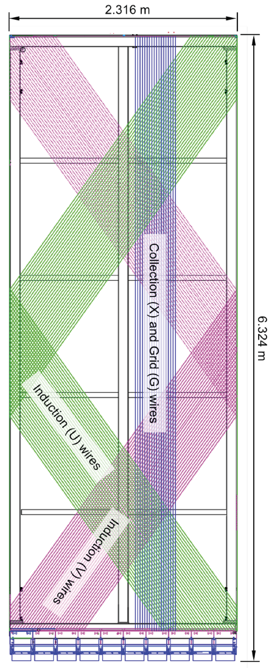
APA sideview showing the internal volume for photodetectors
Far Detector 1: Horizontal Drift
66 m
19 m
APAs
APAs
APAs
Fiducial volume: 10 kt per module
Drift distance: 3.6 m, horizontal
Drift field: 500V/cm; HV: 180kV
Anode and Cathode Plane Assemblies (APA, CPA) suspended from ceiling
Anode wire planes (2 induction, 1 collection) immersed in LAr, wire pitch: ~5 mm
Photon detectors: SiPMs based, embedded in APAs
CPA
CPA
3.6 m

Slide 20
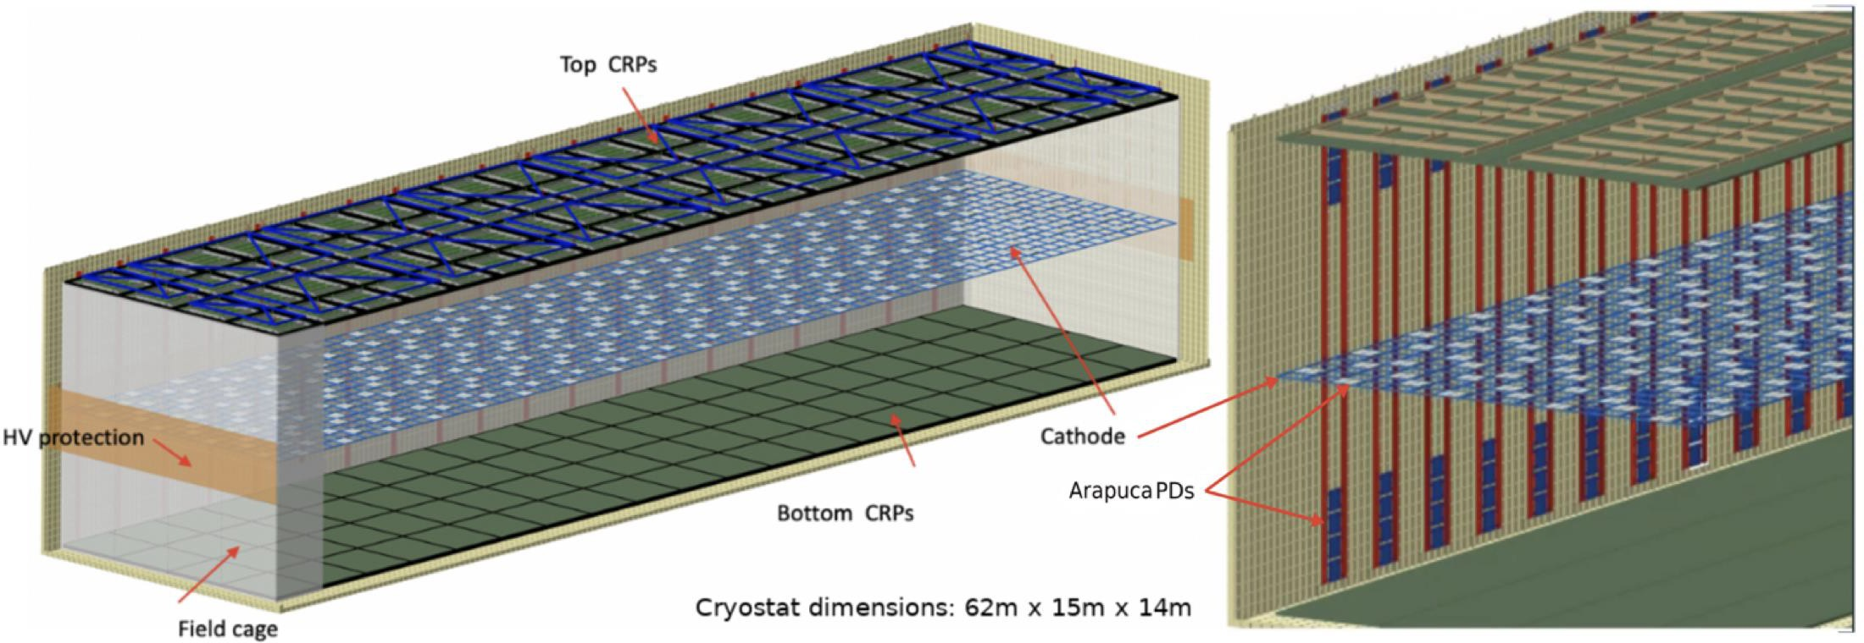
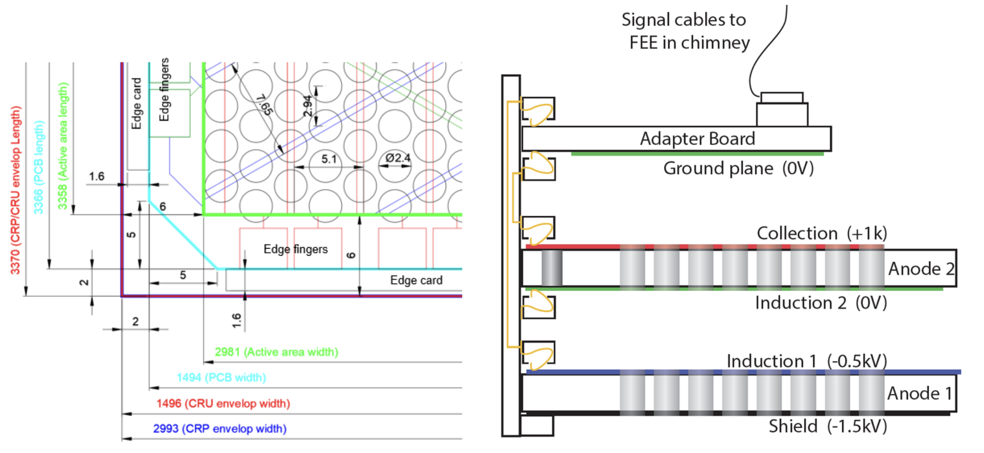
Far Detector 2 : Vertical Drift
Fiducial volume: 10 kt
Drift distance: 6.5 m, vertical
Drift field: 450 V/cm; HV: 294 kV
Anode comprised of stacked, segmented and perforated printed PCBs with etched electrodes
2 x 80 (top and bottom) Anode Charge Readout Planes (CRPs), 3.4 m x 3 m each
Cathode suspended at mid-height
Photon detectors embedded in the cathode and cryostat walls for timing and triggering
FD2: Vertical Drift (VD)
APA
6.5 m
6.5 m

Slide 21
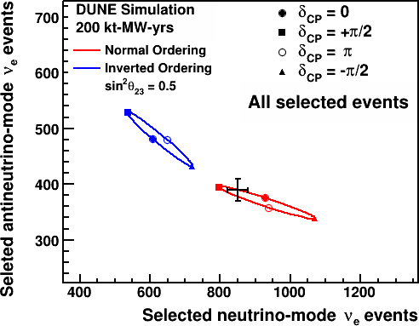
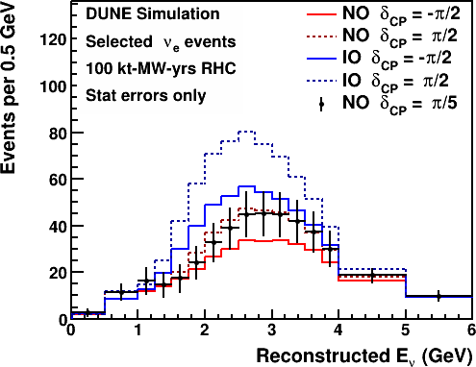
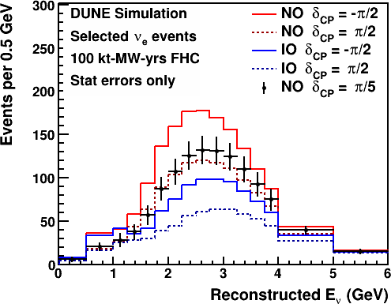
DUNE Bi-Event Plots
antineutrino mode
neutrino mode
At face value, DUNE can make Bi-Event plots like NOvA, T2K
  Discarding spectral information
No overlap → parameters are not degenerate for DUNE, by design

Slide 22
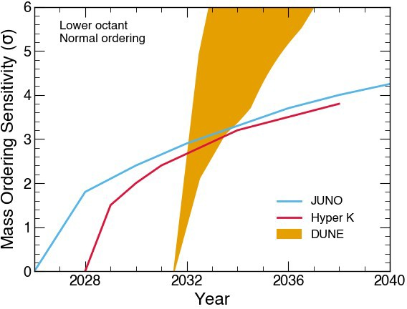
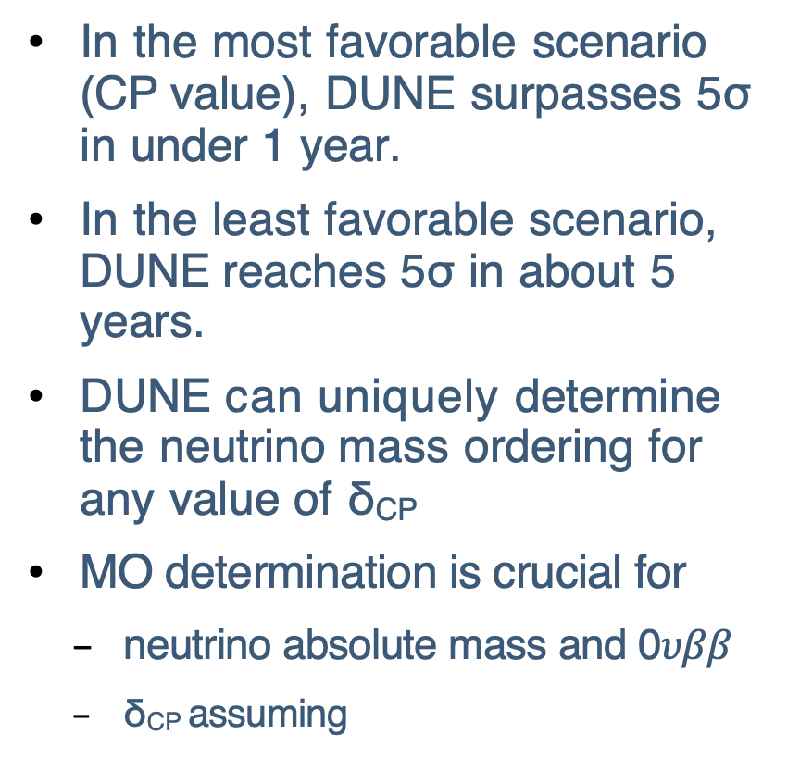
DUNE Sensitivity to Mass Ordering
In the most favorable scenario (CP value), DUNE surpasses 5σ in under 1 year.
In the least favorable scenario, DUNE reaches 5σ in about 5 years.
DUNE can uniquely determine the neutrino mass ordering for any value of δ_{CP}
MO determination is crucial for
  neutrino absolute mass and 0$υββ$
  δ_{CP} assuming
δ = +π/2
δ = -π/2

Slide 23
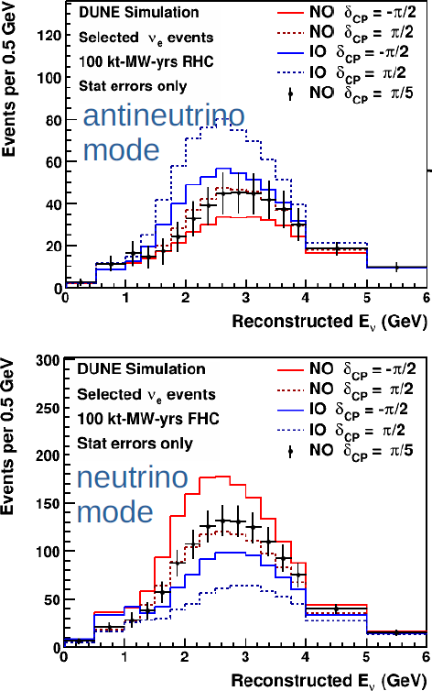
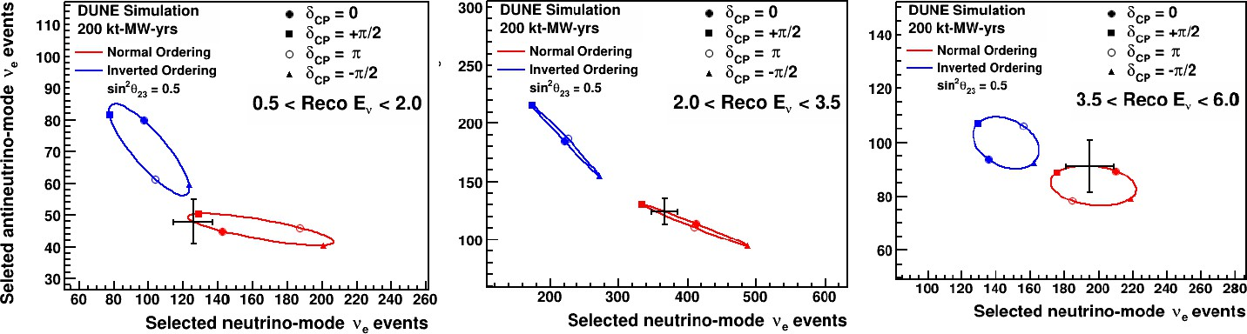
DUNE Can Do More
Plots assume DUNE Phase I
The wideband beams covering two oscillation maxima allow DUNE to make bi-event plots for multiple energy bins:
Test the energy dependence of these ellipses predicted by the 3-neutrino oscillation model
New physics would likely distort observations as a function of L/E → unique sensitivity from DUNE!

Slide 24
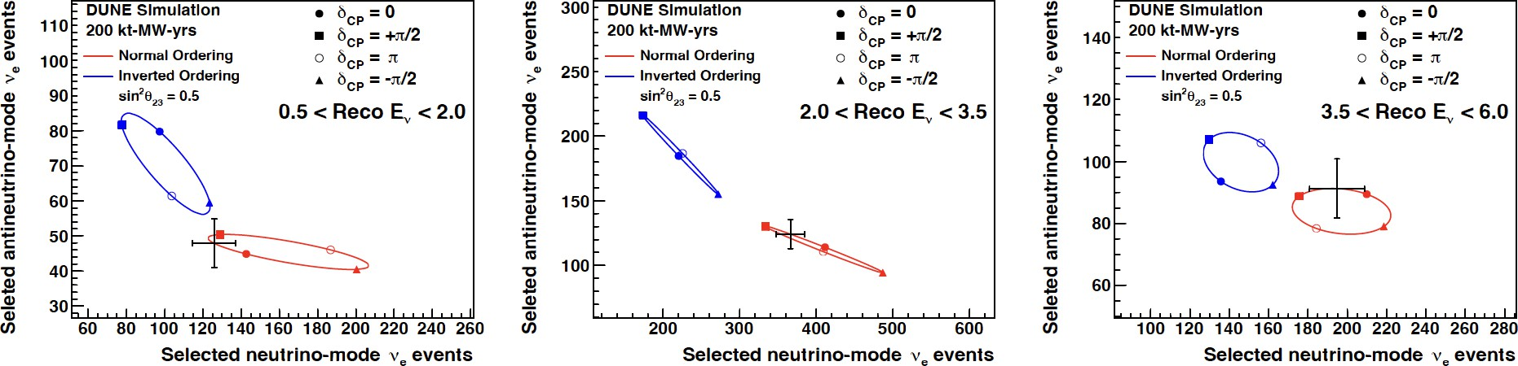
DUNE Bi-Event Plots
Plots assume DUNE Phase I
Will make unambiguous, high-precision measurements of mass ordering, δ_{CP} and θ₂₃ octant, without relying on other oscillation parameters and experiments
New physics would likely distort observations as a function of L/E → unique sensitivity from DUNE

Slide 25
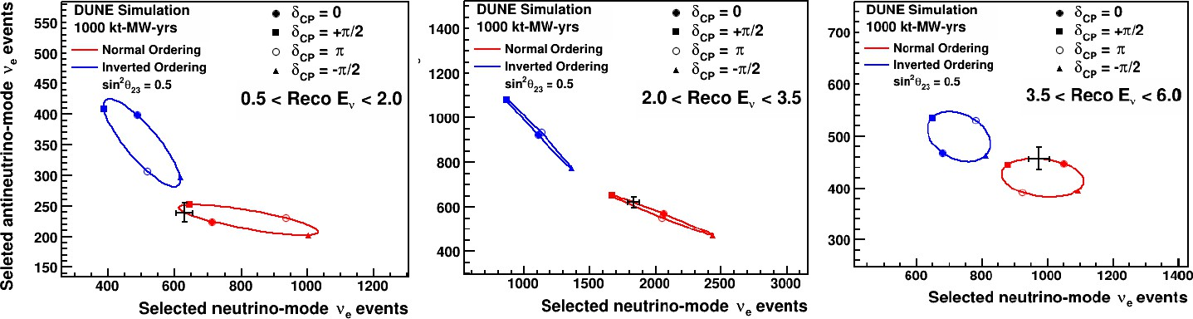
DUNE Can Do More
Plots assume DUNE Phase II
In the long term, DUNE can:
Resolve the mass ordering
Establish whether CP is violated (for a range of values)
Measure precisely the oscillation parameters, relying minimally on external constrains (i.e., input parameters from other experiments)
                Serve as an independent check, in great synergy with JUNO/Hyper-K!

Slide 26
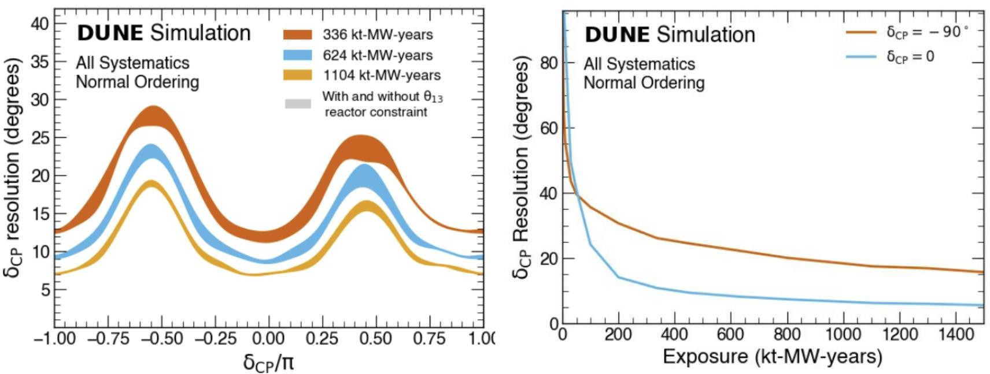
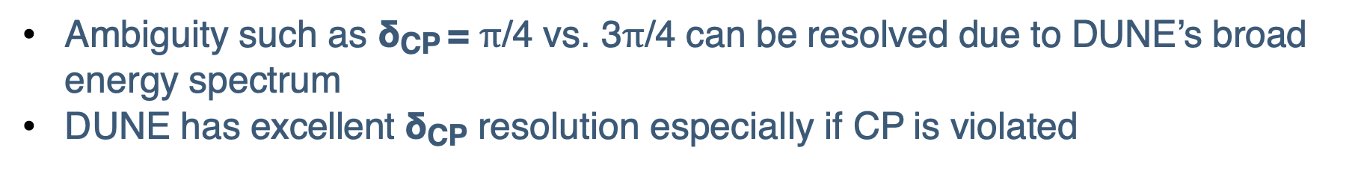
DUNE Resolution of measurement δ_{CP}
Ambiguity such as δ_{CP} = $π$/4 vs. 3$π$/4 can be resolved due to DUNE’s broad energy spectrum
DUNE has excellent δ_{CP} resolution especially if CP is violated

Slide 27

Testing the 3-Flavor Paradigm With Precision Measurements at DUNE
Measurements of θ₁₃ obtained from 𝜈_{𝑒} appearance in long-baseline experiments and anti-𝜈_{𝑒} disappearance in reactor experiments are only equivalent if unitarity is assumed
Opportunity to test the 3-flavor paradigm
DUNE measurements will rely minimally on external input parameters (model agnostic measurement)

Slide 28


ν_{τ} Appearance in DUNE beam
arXiv:2203.05591
DUNE has a substantial flux above 3.5 GeV CC threshold → possibility to measure ν_{τ} appearance
Imaging capabilities of DUNE’s LArTPCs makes it possible to reconstruct complex τ final states kinematically
ML-driven reconstruction based on hierarchical graph neutral network (GNN) being pursued
Opportunity to directly measure 3-flavor oscillations and test unitarity
Counts/year (1.2 MW beam) per module

Slide 29





Supernova Burst (SNB)
10 kpc supernova burst
Time and energy profile of SNB neutrino flux is rich in supernova astrophysics
∼ 5° pointing resolution using:
𝝂_{𝒙} + 𝒆⁻ → 𝝂_{𝒙} + 𝒆⁻
Flux includes $ν_{e}/{\overline{ν}}_{e}$ and other flavors
Argon target allows DUNE to measures 𝝂_{𝒆} (neutronization burst)
  Complementary measurements to others experiments
Sensitivity to mass ordering also via SNB detection
SNB program starts once the first FD module is turned on, earlier than beam physics
Phys Rev D 111.092006
DUNE ν_{e}

Slide 30





Atmospheric Neutrinos
Atmospherics will be DUNE’s first neutrino data
Including reconstructed hadrons substantially improves angle resolution

Slide 31

Prototypes
Two, 800-ton prototypes at CERN, ProtoDUNE Horizontal Drift (HD) and Vertical Drift (VD), are testbeds for full-scale DUNE technology.

Slide 32



ProtoDUNEs at CERN
Two generations of DUNE prototypes at CERN demonstrating FD technologies
  Run 1: ProtoDUNE Single Phase and Dual Phase
  Run 2: ProtoDUNE Horizontal Drift and Vertical Drift
LArTPCs located in charged-particle test beams
  Momentum-dependent beam composition contains 𝑒, 𝐾±, 𝜇, 𝑝, 𝜋±
Both PD HD and VD design successfully operated this year
Input to DUNE FD physics (e.g., hadron cross sections)
First physics publications, with many analyses ongoing
ProtoDUNE-VD
ProtoDUNE-HD
DUNE-HD style APA wire winding
Neutrino Platform @ CERN

Slide 33





ProtoDUNE-SP/HD Performance and Results
Electron lifetime (ms)
First measurement of kaon cross section on Ar at 5 GeV
Phys. Rev. D 110, 092011
LAr purity (electron drift lifetime) > 30ms achieved
Time Tick
ML based PID
dE/dx of test beam particles
Off-axis neutrinos in SPS beam, ProtoDUNE-HD (2024)
See Ciaran’s talk

Slide 34





ProtoDUNE-VD
Earlier this year: successful demonstration of power/signal over fiber demonstration for the photon detection system!
DUNE Work In Progress
Beam
LAr purity stable at 25 ms and
HV stable at nominal

Slide 35




ND-LAr Prototype at Fermilab
arXiv:2509.07012
2x2 prototype of ND-LAr operated in NuMI neutrino beam in summer 2024
Pixel readout LArTPC → direct 3D image
Neutrino data taken
Analysis ongoing, additional beam run planned for 2026.
  Beam-off run in 2025
LArPix

Slide 36





Far Site Status
Far site excavation complete in 2024
Building, Site and Beam Infrastructure ongoing, focus presently
FD2-VD Cryostat installation starting March 2026
FD1-HD Installation by Mid 2027
Physics by the end of 2029: Solar, atmospheric and astrophysical neutrinos
Beam physics with near detector by 2031 and Phase II to follow in ~5 years

Slide 37
Summary
DUNE will make decisive measurements for neutrino oscillations, including mass ordering and CP violation
DUNE will test the 3-flavor paradigm and search for new physics in neutrino oscillations
DUNE Near Detector has rich physic programs (cross-sections, BSM, etc.)
DUNE has unique capabilities to explore a broad range of non-beam physics (atmospherics, solar, BSM, etc)
DUNE prototype programs continue to be successful and are publishing physics ahead of DUNE
DUNE is under construction and on track to deliver science

Slide 38

Thank you!

Slide 39
BACKUP

Slide 40


Super-K established oscillation with atmospheric neutrinos
Phys. Rev. D 71 112005 (2005)
●
Super-K determined that θ₂₃ is nearly maximal, between 36°-54° at 90% C.L.
Measured Δm²_{atm} to be between 1.8-3.1 × 10⁻³ eV²
●

Slide 41


Solar experiments & KamLAND measured “solar” parameters
Phys. Rev. Lett. 100 221803 (2008)
●
SNO, Super-K (solar), and KamLAND (reactor) measured θ₁₂ to about 4%
Measured Δm²₂₁ to 2.5%
●

Slide 42


MINOS made the first ~5% measurement of Δm²
atm
Phys. Rev. Lett. 106 181801(2011)
●
Fixed baseline → excellent resolution of mass splitting
Also θ₂₃ in agreement with atmospheric data
●

Slide 43


Daya Bay measured θ₁₃
Phys. Rev. Lett. 130, 161802 (2023)
●
Daya Bay ultimate precision on θ₁₃ of 2.6% from reactor antineutrino disappearance, also measured Δm²
atm
Also RENO, DoubleCHOOZ
●

Slide 44


DUNE’s – SAND opportunities
KLOE exp.: https://www.sciencedirect.com/science/article/pii/S0168900201015029 Solid Hydrogen technique: https://arxiv.org/html/1809.08752v3
SAND’s design includes:
  Magnetic field 0.6 T
  Modular low-density target- tracking system to retain high momentum resolution for muons
  Existing ECAL with 55 ps
/ 𝑬 (𝑮𝒆𝑽) time resolution
  C, C₃H₆ and Argon target materials
SAND provides a sample of 𝝂 𝝂 - H interactions from subtraction of C from C₃H₆ $→$sample free from nuclear final state interactions (FSI) to constrain systematic uncertainties on cross-section!
DUNE preliminary
Selected CCQE on Hydrogen events in SAND assuming reverse horn current and 1 year data taking
Slide from Gianfranco Ingratta

Slide 45



SNB

Slide 46


Slide 47



Slide 48


Field Cage

Slide 49

X-ARAPUCA
Outer layers: dichroic filter coated w/ PTP on the outside
  Converts 127 nm to 350nm
WLS plate in the center converts transmitted photons into the visible (430nm)
Single-sided ARAPUCAs have reflective surface on side facing the cryostat walls
Visible photons emitted at greater than the 𝛉_{critical} reach SiPMs at plate edges
48 SiPMs on each supercell are ganged
DAPHNE readout boards in the warm digitize the signals
Exploded view of a double-sided X-ARAPUCA supercell

Slide 50

FD Module 1 - HD
17 kt Far Detector module measuring 66 m (L) x 19 m (W) x 18 m (H). Person circled in green for scale
North Cavern
17 kton of liquid Argon, total mass
500 V/cm horizontal-drift (HD) field,
3.5-meter drift length
1.6 mm/𝝻s drift velocity

Slide 51




PRISM technique: directly probing neutrino energy dependence
→
x
DUNE-PRISM
●
FD flux ≠ ND flux → uncertainties in energy dependence of cross sections, response, etc.
ND flux changes with angle due to pion decay kinematics
Take ND data in different fluxes →build linear combination to match FD oscillated spectra
Robust analysis approach with very minimal dependence on interaction modeling
●
●
●

Slide 52


FD1-HD, Closer Look
Time Projection Chamber:
25 APA pairs per Anode Plane – 150 APAs total
384,000 charge readout channels
  240,000 induction (U and V)
  144,000 collection
High granularity (4.7 mm wire pitch)
Photon detector modules
(x10 per APA)
Readout electronics
(x20 boards per APA)
Horizontal Drift 10 kt module with person for reference.
B. Abi. et al 2020 JINST 15 T08010
Light Detection:
ARAPUCA photon detector modules mounted inside APAs
Wavelength shifter + Dichroic filters + SiPM readout
10 photon detector modules per APA
  1500 modules in FD1-HD
APA sideview showing the internal volume for photodetectors
APA wire-winding structure.

Slide 53



Charge Readout
Readout electronics for FD1.
Custom, cold electronics designed to function at cryogenic temperatures
  Noise reduction
  Fewer cables and cryostat penetrations
Wire signals are amplified and shaped, digitized, and serialized in the cold
  Front-End Mother Boards (FEMBs) mount directly onto the APAs
  Continuous readout at 2 MHz
Warm Interface Boards (WIBs), receive and further package data from 4 FEMBs and forward to downstream DAQ
  Also configure and monitor FEMBs
Front-End Mother Board

Slide 54



Light Readout
ARAPUCAs: light traps coupled to SiPM readout
Dichroic filters coated with PTP on incident surface
Scintillation light is shifted to 350 nm
  Wavelength-shifted again by WLS plate into visible (430 nm)
  Internally reflected until detected by the SiPM
48 SiPMs per ARAPUCA supercell with ganged readout, 4 supercells per module
10 modules per APA
Requirement: 0.5 photoelectrons (PE) per MeV
Goal: 20 PE/MeV (avg)
Photon detection components
See H. Souza’s talk (next) for more details

Slide 55
























CRP
HV FT and Extender
Top Drift Volume
3385 mm
FIELD CAGE
NP02 at EHN1
BeamPlug
PMT Array
HV Cathode
BeamPlug
3385 mm
Bot Drift Volume
CRP
through TCO
CRP
PD C-Modules w/ PoF/SoF
PD M-Modules

Slide 56



High Voltage and Slow Controls
High voltage cathode (-180 kV) between Cathode-Anode pairs
Field cage is composed of Al profiles with resistor voltage-divider boards between them
Various detector parameters are continuously monitored
  temperatures
  pressures
  voltages
  liquid level
  purity

Slide 57

ProtoDUNE Single-Phase (SP)
Demonstrator for the full-scale, horizontal drift readout components of DUNE (e.g., APAs)
LArTPC (770 tons) in a charged-particle, test beam
Operated from August 2018 – July 2020
Beamline is instrumented with multiple position and momentum profilers + threshold Cherenkov counters
Known incident particle momentum
  300 MeV/c to 7 GeV/c
Physics goal: Measure charged-particle cross sections in energy ranges relevant for DUNE

Slide 58


ProtoDUNE-HD
ProtoDUNE-SP cryostat
4 APAs – two with readout on the bottom + long cables
Test of newest version of TPC and PDS electronics
Test of calibration systems for DUNE
  Ionization Laser System (IoLS) calibration
  Pulse Neutron Source (PNS)
  Radioactive Source Deployment System (RSDS)
  Updated purity and temperature monitoring systems
Final installations (IoLS and purity monitors) in January 2024, followed by gaseous Ar purging
Ongoing DAQ readout tests and software development for DUNE DAQ
Filling and commissioning to begin in 2024
PDHD with IoLS laser tents installed.

