Slide 1

Results from the NOvA Experiment
Martin J. Frank University of South Alabama on behalf of the NOvA Collaboration
September 30th, 2025 Padua, Italy

Slide 2
Introduction
NOνA:
NuMI: Neutrinos at the Main Injector (ν_{μ})
Off-Axis: monoenergetic beam (2 GeV)
ν_{e} Appearance
Physics Goals:
measure θ₁₃, θ₂₃, Δm²₃₂
measure δ_{CP} CP-violating phase angle
resolve mass hierarchy
resolve θ₂₃ octant

Slide 3
Introduction
NOνA:
NuMI: Neutrinos at the Main Injector (ν_{μ})
Off-Axis: monoenergetic beam (2 GeV)
ν_{e} Appearance (and ν_{μ} Disappearance)
Physics Goals:
measure θ₁₃, θ₂₃, Δm²₃₂
measure δ_{CP} CP-violating phase angle
resolve mass hierarchy
resolve θ₂₃ octant

Slide 4
Introduction
NOνA:
NuMI: Neutrinos at the Main Injector (ν_{μ})
Off-Axis: monoenergetic beam (2 GeV)
ν_{e} Appearance (and ν_{μ} Disappearance)
Physics Goals:
measure θ₁₃, θ₂₃, Δm²₃₂
measure δ_{CP} CP-violating phase angle
resolve mass hierarchy
resolve θ₂₃ octant

Slide 5
Introduction
NOνA:
NuMI: Neutrinos at the Main Injector (ν_{μ})
Off-Axis: monoenergetic beam (2 GeV)
ν_{e} Appearance (and ν_{μ} Disappearance)
Physics Goals:
measure θ₁₃, θ₂₃, Δm²₃₂
measure δ_{CP} CP-violating phase angle
resolve mass hierarchy
resolve θ₂₃ octant

Slide 6
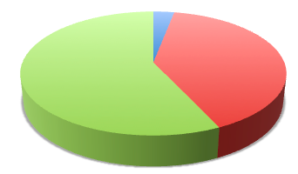
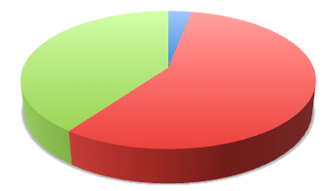


Introduction
NOνA:
NuMI: Neutrinos at the Main Injector (ν_{μ})
Off-Axis: monoenergetic beam (2 GeV)
ν_{e} Appearance (and ν_{μ} Disappearance)
Physics Goals:
measure θ₁₃, θ₂₃, Δm²₃₂
measure δ_{CP} CP-violating phase angle
resolve mass hierarchy
resolve θ₂₃ octant
𝜈₃
𝜈_{e}
?
𝜈_{e}
𝜈_{𝜏}
𝜈_{𝜇}
𝜈_{𝜏}
𝜈_{𝜇}

Slide 7
Introduction
NOνA:
NuMI: Neutrinos at the Main Injector (ν_{μ})
Off-Axis: monoenergetic beam (2 GeV)
ν_{e} Appearance (and ν_{μ} Disappearance)
Physics Goals:
measure θ₁₃, θ₂₃, Δm²₃₂
measure δ_{CP} CP-violating phase angle
resolve mass hierarchy
resolve θ₂₃ octant
Beyond Oscillation Physics
Non-Standard Interactions
Neutrino Cross Sections
Sterile Neutrinos
Dark Matter
Magnetic Monopoles
Supernova
And More!

Slide 8
Introduction
NOνA:
NuMI: Neutrinos at the Main Injector (ν_{μ})
Off-Axis: monoenergetic beam (2 GeV)
ν_{e} Appearance (and ν_{μ} Disappearance)
Physics Goals:
Search for magnetic monopoles
New results hot off the press today!
Beyond Oscillation Physics
Non-Standard Interactions
Neutrino Cross Sections
Sterile Neutrinos
Dark Matter
Magnetic Monopoles
Supernova
And More!
New

Slide 9
Neutrino Oscillation Results

Slide 10
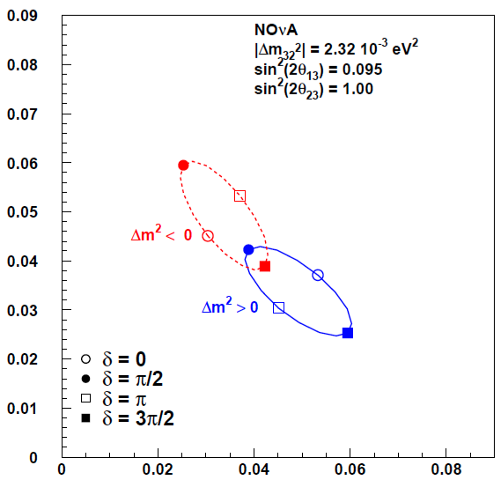
Extracting Nature’s Parameters
θ₂₃ = 45°
Using the oscillation equations, we can calculate the neutrino and anti-neutrino appearance probabilities.
normal

Slide 11
Extracting Nature’s Parameters
θ₂₃ = 45°
Using the oscillation equations, we can calculate the neutrino and anti-neutrino appearance probabilities.
normal

Slide 12
Extracting Nature’s Parameters
θ₂₃ = 45°
Using the oscillation equations, we can calculate the neutrino and anti-neutrino appearance probabilities.
normal

Slide 13
Extracting Nature’s Parameters
θ₂₃ = 45°
Using the oscillation equations, we can calculate the neutrino and anti-neutrino appearance probabilities.
normal

Slide 14
Extracting Nature’s Parameters
θ₂₃ = 45°
Using the oscillation equations, we can calculate the neutrino and anti-neutrino appearance probabilities.
normal

Slide 15
Extracting Nature’s Parameters
θ₂₃ = 45°
Using the oscillation equations, we can calculate the neutrino and anti-neutrino appearance probabilities.
inverted
normal

Slide 16
Extracting Nature’s Parameters
θ₂₃ = 45°
Using the oscillation equations, we can calculate the neutrino and anti-neutrino appearance probabilities.
Here is an example measurement NOvA might make.
inverted
normal
-σ
+σ

Slide 17
Extracting Nature’s Parameters
θ₂₃ = 45°
Using the oscillation equations, we can calculate the neutrino and anti-neutrino appearance probabilities.
Here is an example measurement NOvA might make.
inverted
+σ
normal
-σ
-σ
+σ

Slide 18

Neutrino Beam
Baseline (L = 810 km)
The neutrino beam travels from Fermilab to Ash River, MN through the earth’s crust.
Energy (E_{ν} = 2 GeV)
We can achieve a narrowly distributed neutrino energy by placing the detectors 14.6 mrad off the beam axis.
This is also the ν_{μ} → ν_{e} oscillation peak.
Protons on Target (POT)
13.6 x 10²⁰ POT: neutrino mode
12.5 x 10²⁰ POT: antineutrino mode

Slide 19
Neutrino Beam
Baseline (L = 810 km)
The neutrino beam travels from Fermilab to Ash River, MN through the earth’s crust.
Energy (E_{ν} = 2 GeV)
We can achieve a narrowly distributed neutrino energy by placing the detectors 14.6 mrad off the beam axis.
This is also the ν_{μ} → ν_{e} oscillation peak.
Protons on Target (POT)
13.6 x 10²⁰ POT: neutrino mode
12.5 x 10²⁰ POT: antineutrino mode

Slide 20
Neutrino Beam
Baseline (L = 810 km)
The neutrino beam travels from Fermilab to Ash River, MN through the earth’s crust.
Energy (E_{ν} = 2 GeV)
We can achieve a narrowly distributed neutrino energy by placing the detectors 14.6 mrad off the beam axis.
This is also the ν_{μ} → ν_{e} oscillation peak.
Protons on Target (POT)
13.6 x 10²⁰ POT: neutrino mode
12.5 x 10²⁰ POT: antineutrino mode

Slide 21
Neutrino Beam
Baseline (L = 810 km)
The neutrino beam travels from Fermilab to Ash River, MN through the earth’s crust.
Energy (E_{ν} = 2 GeV)
We can achieve a narrowly distributed neutrino energy by placing the detectors 14.6 mrad off the beam axis.
This is also the ν_{μ} → ν_{e} oscillation peak.
Protons on Target (POT)
26.6 x 10²⁰ POT: neutrino mode
12.5 x 10²⁰ POT: antineutrino mode

Slide 22
Neutrino Beam
Baseline (L = 810 km)
The neutrino beam travels from Fermilab to Ash River, MN through the earth’s crust.
Energy (E_{ν} = 2 GeV)
We can achieve a narrowly distributed neutrino energy by placing the detectors 14.6 mrad off the beam axis.
This is also the ν_{μ} → ν_{e} oscillation peak.
Protons on Target (POT)
26.6 x 10²⁰ POT: neutrino mode
12.5 x 10²⁰ POT: antineutrino mode
10 years of beam!
2014 - 2024

Slide 23
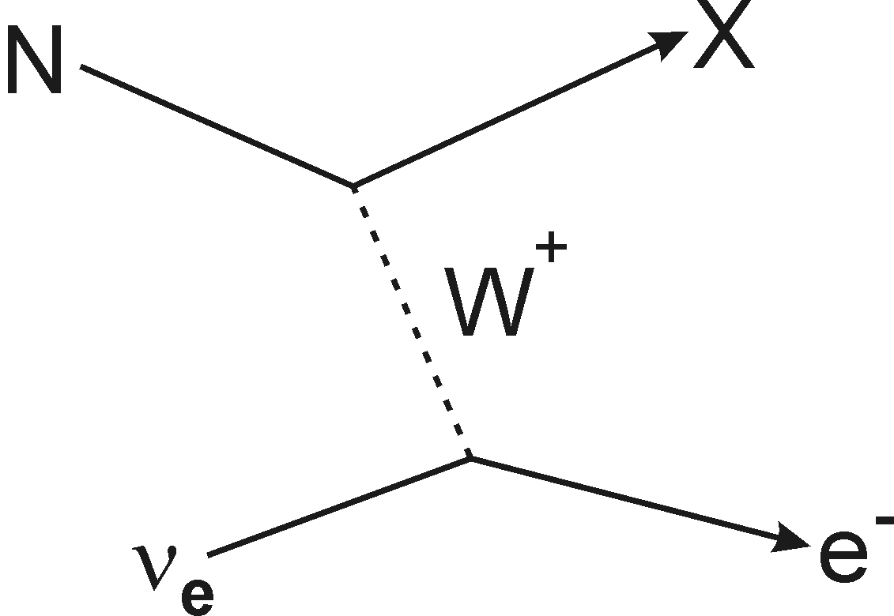
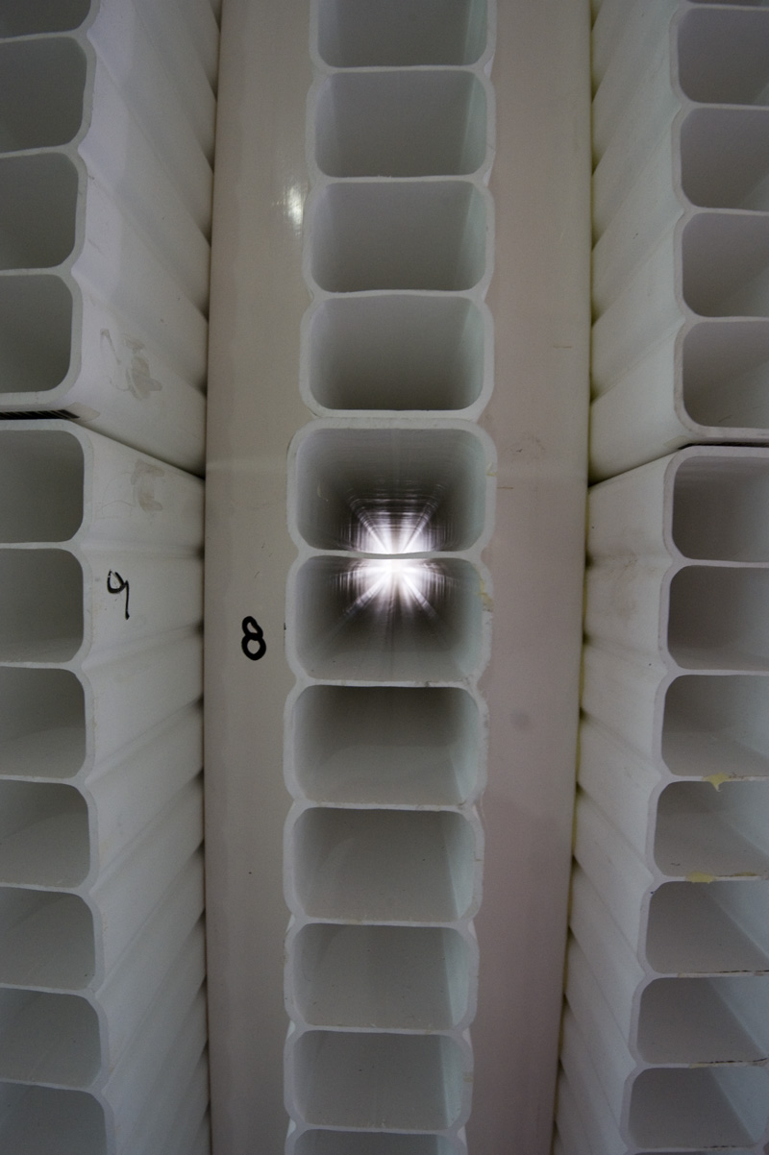
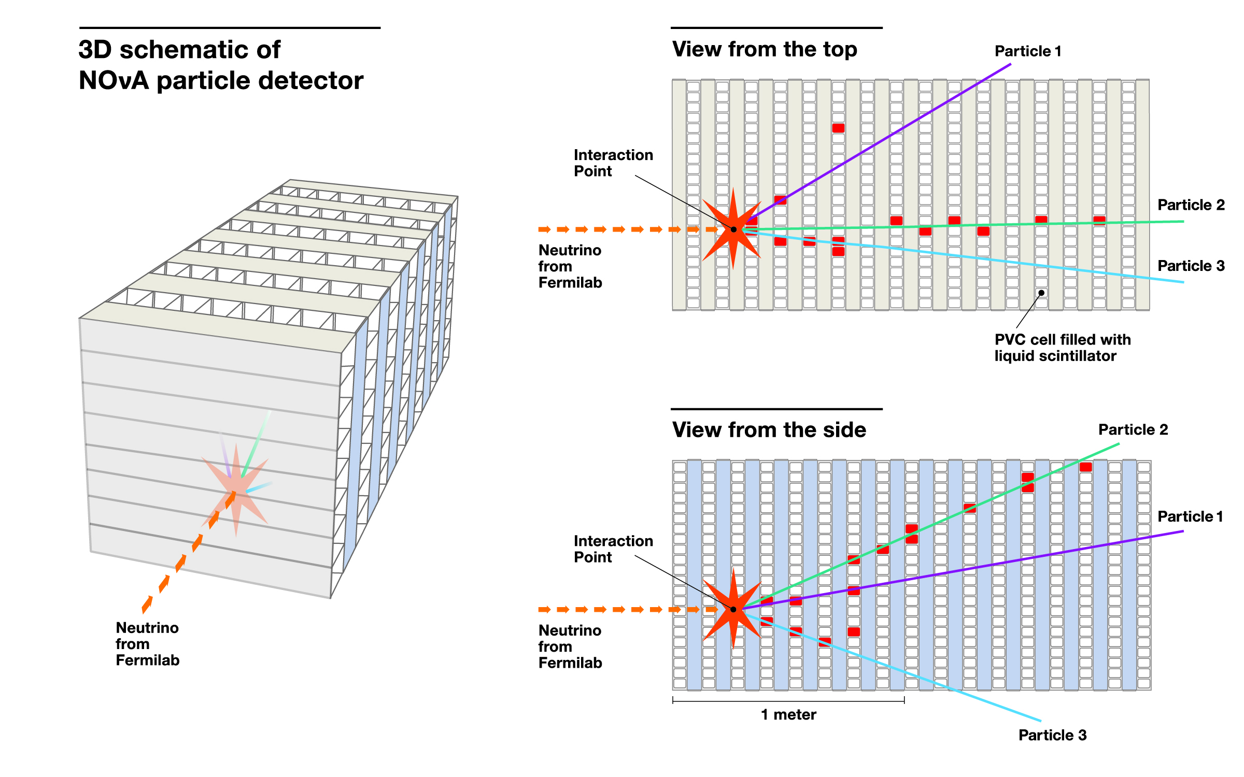
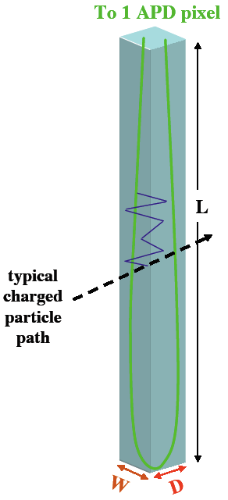
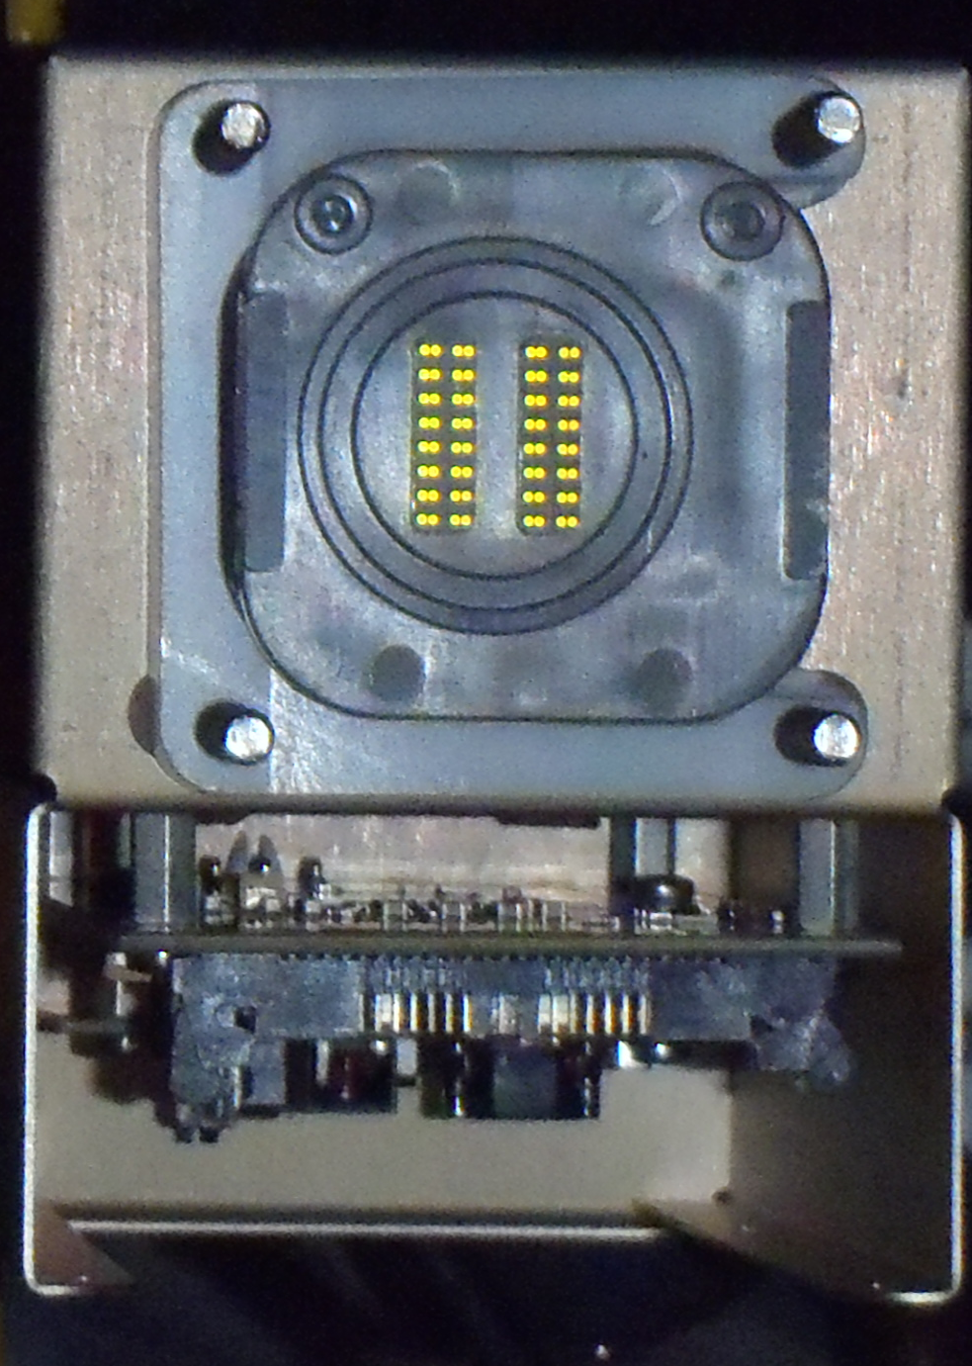
Neutrino Detection
We want to detect electron neutrinos (ν_{e}):
This requires a large detector mass and good electron identification.
NOvA is a rectangular tracking calorimeter.
low Z materials: PVC extrusions filled with liquid scintillator
radiation length ~ 40 cm, Molière radius ~ 11 cm
provides many samples per radiation length (differentiate e⁻ and π⁰)
each extrusion contains one wavelength-shifting fiber
ends of fiber read out by avalanche photo-diode (APD)
charged-current (CC) interaction
PVC extrusions
1 Channel
APD 32 Channels
Detector
y
z
x

Slide 24
Neutrino Detection
We want to detect electron neutrinos (ν_{e}):
This requires a large detector mass and good electron identification.
NOvA is a rectangular tracking calorimeter.
low Z materials: PVC extrusions filled with liquid scintillator
radiation length ~ 40 cm, Molière radius ~ 11 cm
provides many samples per radiation length (differentiate e⁻ and π⁰)
each extrusion contains one wavelength-shifting fiber
ends of fiber read out by avalanche photo-diode (APD)
charged-current (CC) interaction
PVC extrusions
1 Channel
APD 32 Channels
Detector
y
z
x

Slide 25
Neutrino Detection
We want to detect electron neutrinos (ν_{e}):
This requires a large detector mass and good electron identification.
NOvA is a rectangular tracking calorimeter.
low Z materials: PVC extrusions filled with liquid scintillator
radiation length ~ 40 cm, Molière radius ~ 11 cm
provides many samples per radiation length (differentiate e⁻ and π⁰)
each extrusion contains one wavelength-shifting fiber
ends of fiber read out by avalanche photo-diode (APD)
charged-current (CC) interaction
PVC extrusions
1 Channel
APD 32 Channels
Detector
y
z
x

Slide 26
Simulated Event Display

Slide 27
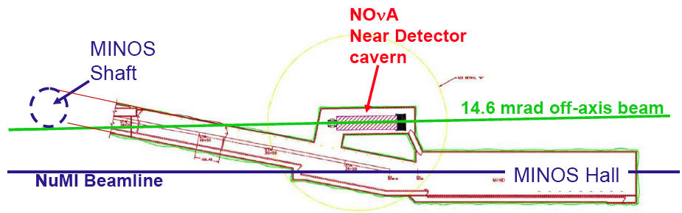
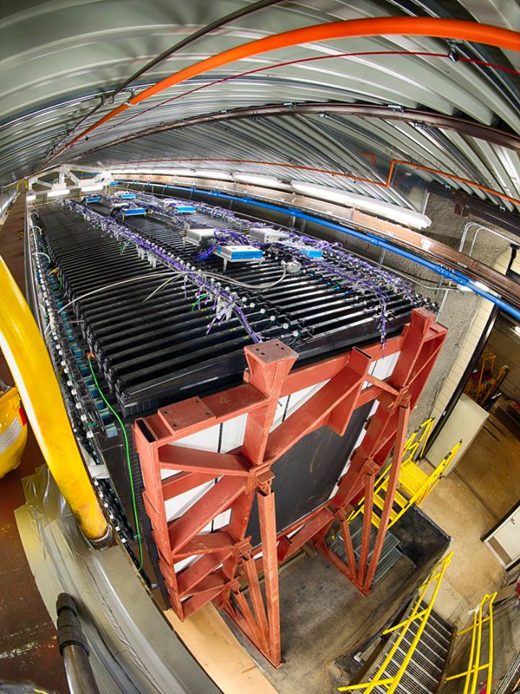
Near Detector at Fermilab
Top View
Muon Catcher
Beam
1 km downstream from NuMI target
105 m underground
300 tons
4 m × 4 m × 15 m
Instrumented with 20k channels
Several neutrino interactions per second
Few cosmic ray muons per second

Slide 28
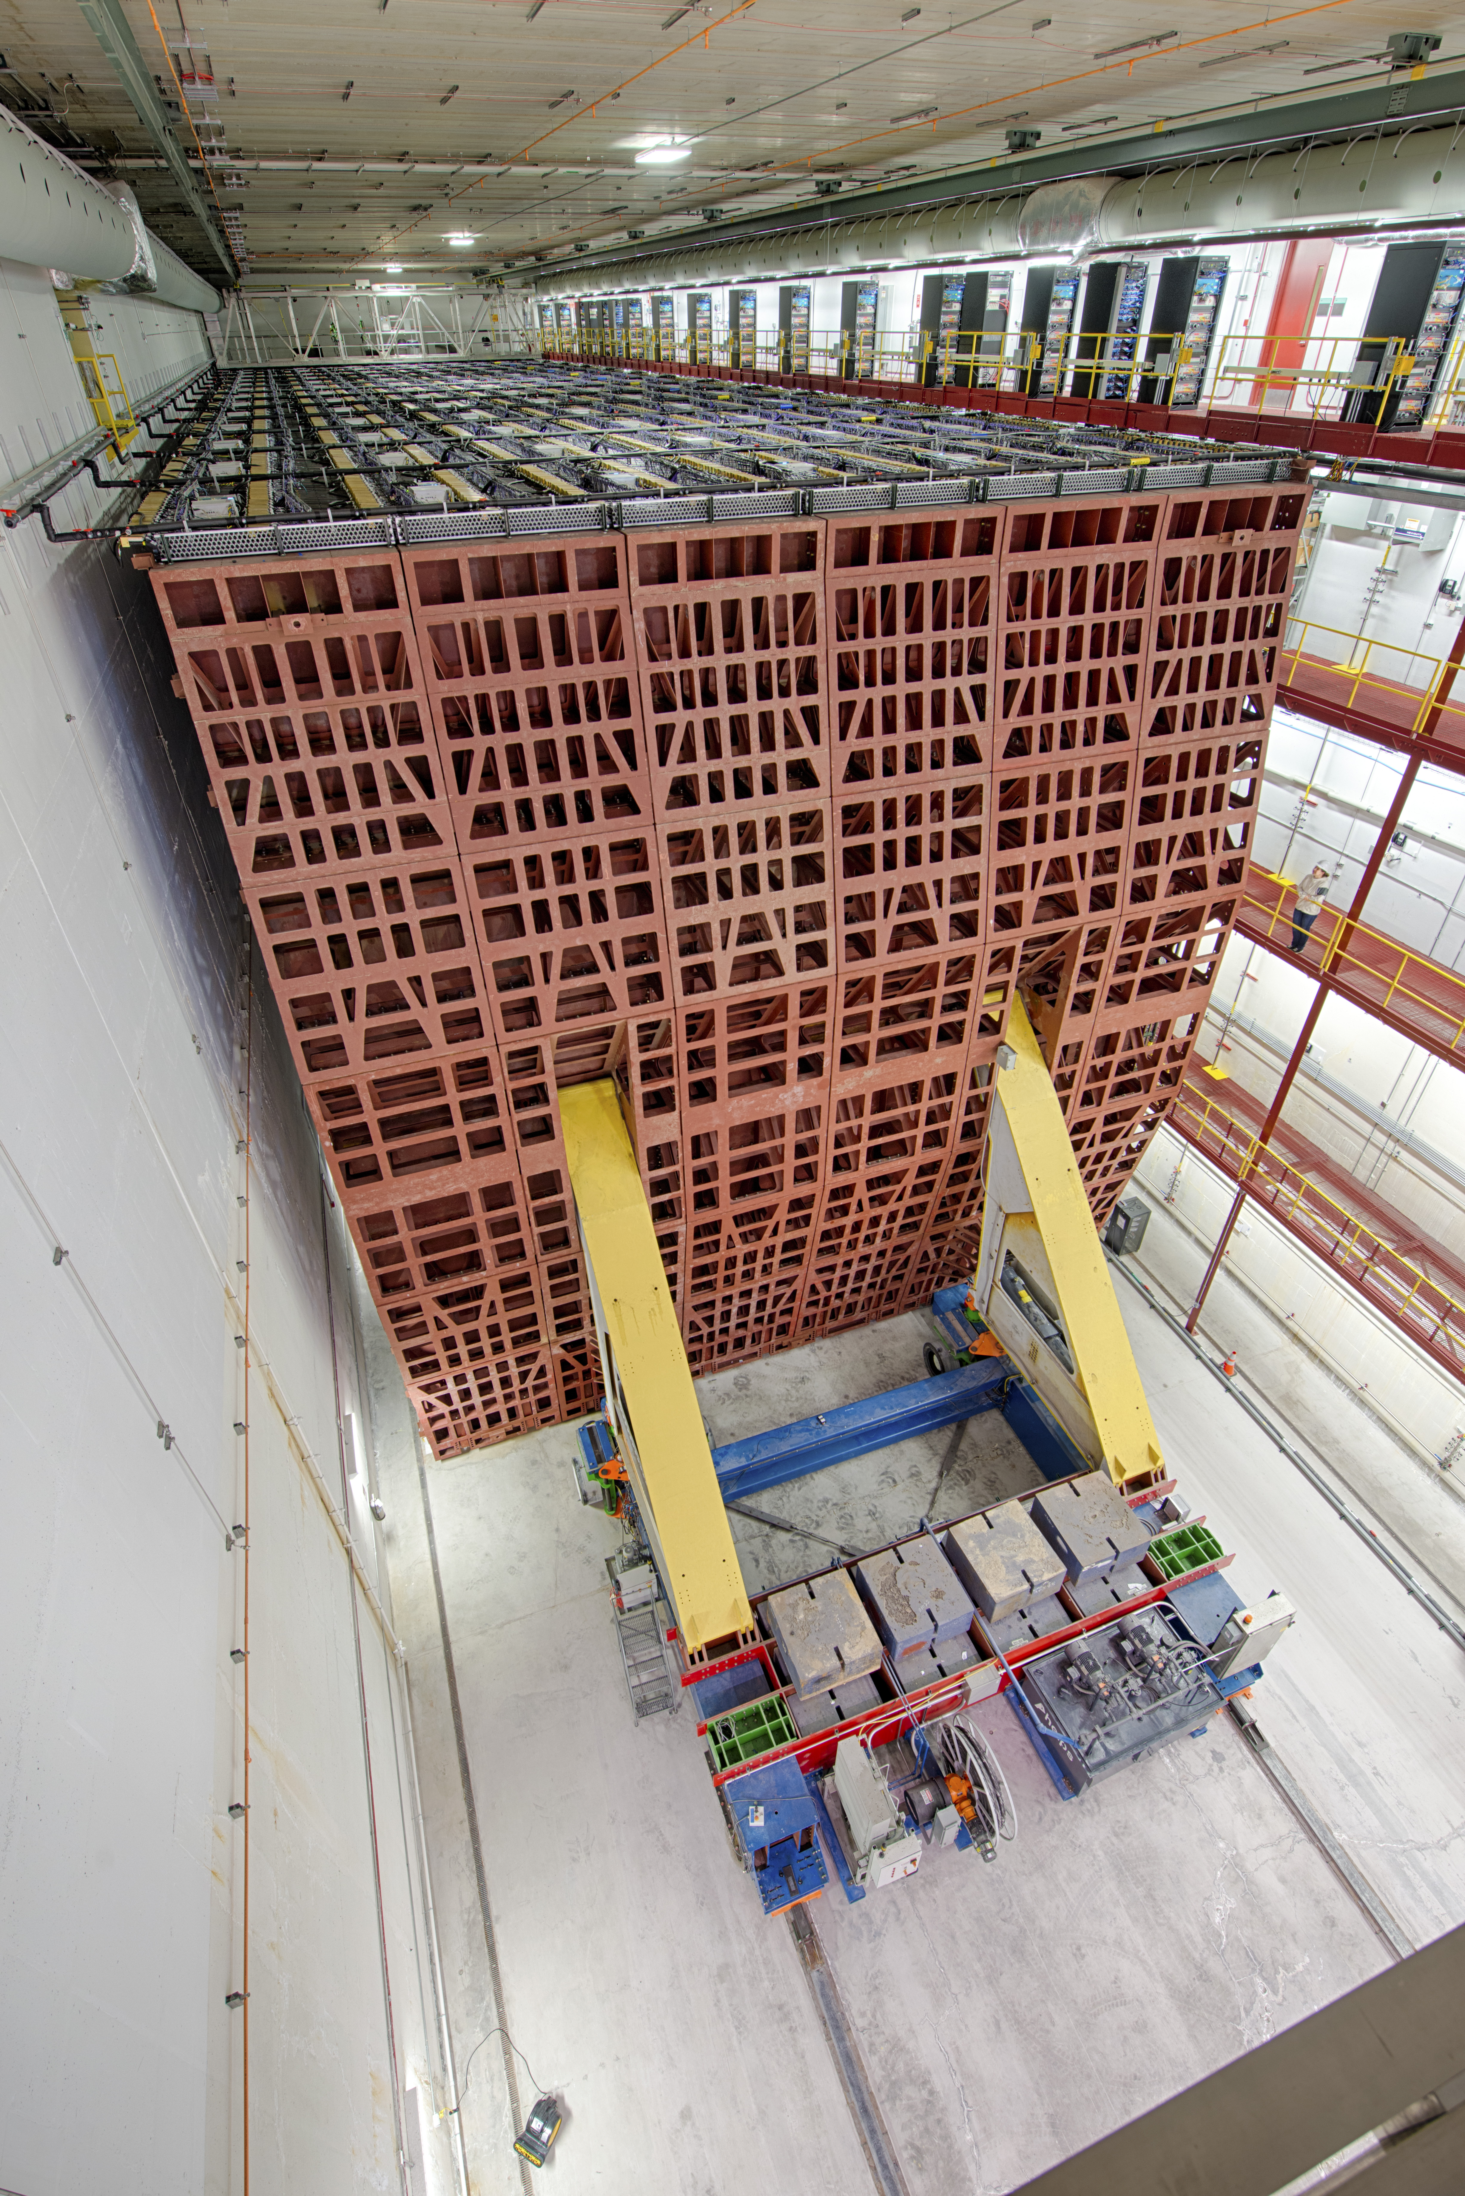
Far Detector in Ash River, MN
810 km downstream from NuMI target
On the surface
14,000 tons
15 m × 15 m × 60 m
Instrumented with 344k channels
Few neutrino interactions per year
~130,000 cosmic ray muons per second

Slide 29
Neutrino Detection
xz-view
y
z
x
yz-view

Slide 30
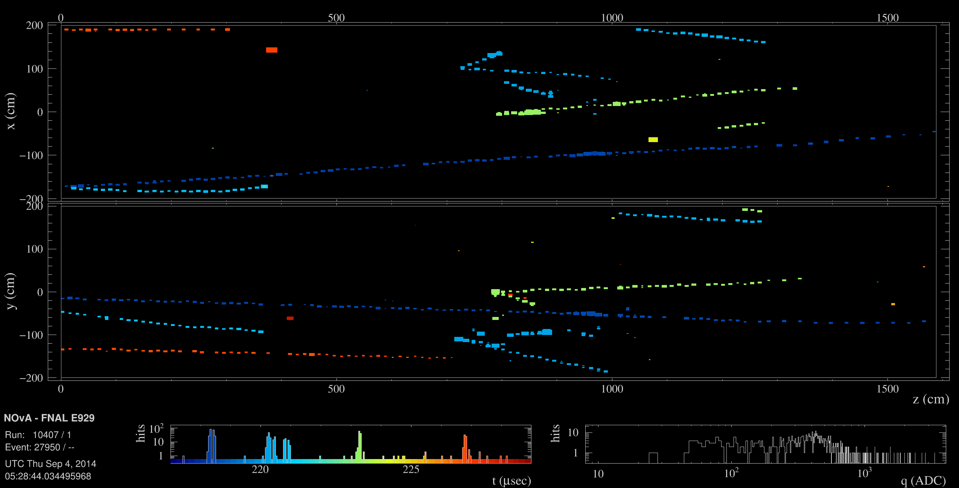
Near Detector Event Display

Slide 31
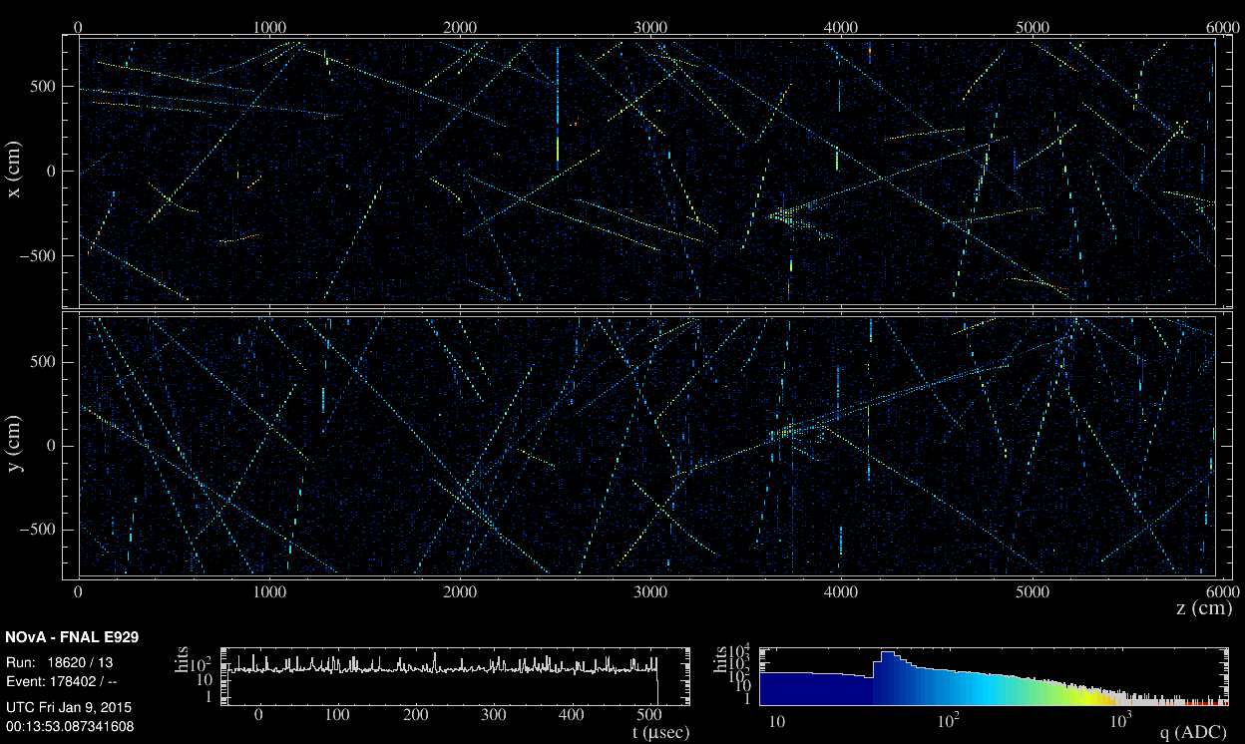
Far Detector Event Display
550 μs Exposure

Slide 32
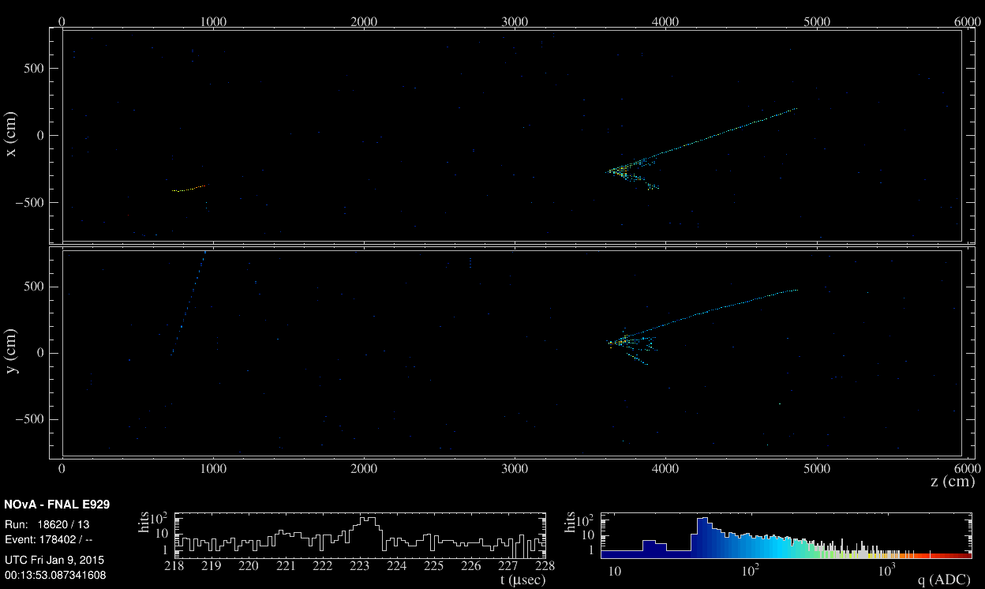
Time Zoom on NuMI Beam Pulse

Slide 33
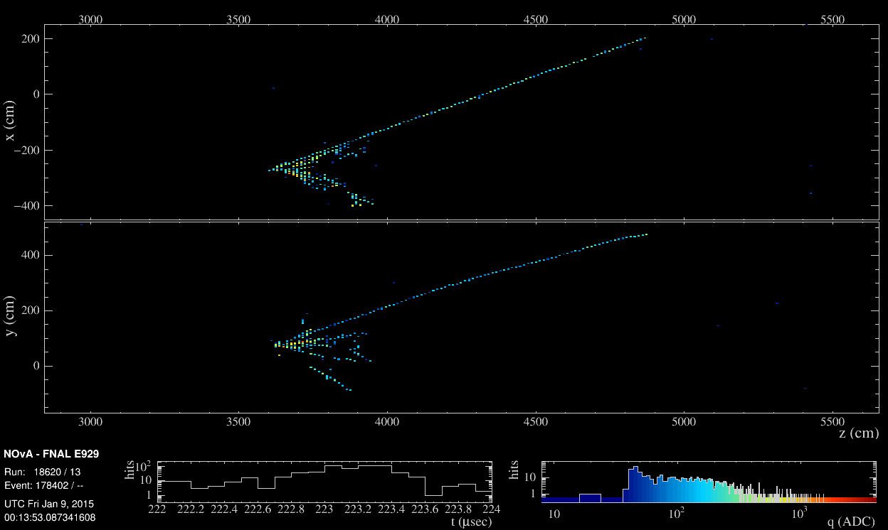
Close-Up of Neutrino Interaction

Slide 34
Far Detector Neutrino Prediction
We use a data-driven technique to extrapolate the neutrino events in the near detector to the far detector:
Estimate true energy distribution of near detector events
Multiply by expected far/near event ratio and oscillation probability
Convert far detector true energy into reconstructed energy

Slide 35
Muon Neutrino Events
Muon neutrino event counts:
384 ν_{μ} candidates (beam: 26.6 x 10²⁰ POT)
106 anti-ν_{μ} candidates (beam: 12.5 x 10²⁰ POT)
Note the dip in the energy spectra indicating the disappearance of muon neutrinos

Slide 36
Muon Neutrino Events
Muon neutrino event counts:
384 ν_{μ} candidates (beam: 26.6 x 10²⁰ POT)
106 anti-ν_{μ} candidates (beam: 12.5 x 10²⁰ POT)
Note the dip in the energy spectra indicating the disappearance of muon neutrinos

Slide 37
Muon Neutrino Events
Muon neutrino event counts:
384 ν_{μ} candidates (beam: 26.6 x 10²⁰ POT)
106 anti-ν_{μ} candidates (beam: 12.5 x 10²⁰ POT)
Note the dip in the energy spectra indicating the disappearance of muon neutrinos

Slide 38
Electron Neutrino Events
Electron neutrino event counts
181 ν_{e} candidates (beam: 26.6 x 10²⁰ POT)
32 anti-ν_{e} candidates (beam: 12.5 x 10²⁰ POT)
Samples divided into four selections:
Low-Energy, Low Particle ID (PID), High PID and Peripheral

Slide 39
Electron Neutrino Events
Electron neutrino event counts
181 ν_{e} candidates (beam: 26.6 x 10²⁰ POT)
32 anti-ν_{e} candidates (beam: 12.5 x 10²⁰ POT)
Samples divided into four selections:
Low-Energy, Low Particle ID (PID), High PID and Peripheral

Slide 40
Extract Nature’s Parameters

Slide 41
Extract Nature’s Parameters

Slide 42
Extract Nature’s Parameters

Slide 43
Extract Nature’s Parameters

Slide 44
Extract Nature’s Parameters
Mild preference for normal ordering
Mild preference for upper octant of θ₂₃

Slide 45
Extract Nature’s Parameters
Mild preference for normal ordering
Mild preference for upper octant of θ₂₃

Slide 46
Extract Nature’s Parameters
Mild preference for normal ordering
Mild preference for upper octant of θ₂₃

Slide 47
Extract Nature’s Parameters
Mild preference for normal ordering
Mild preference for upper octant of θ₂₃

Slide 48
Extract Nature’s Parameters
Mild preference for normal ordering
Mild preference for upper octant of θ₂₃

Slide 49
Extract Nature’s Parameters

Slide 50
Neutrino Oscillation Results
We measured the most precise single-experiment constraint on the atmospheric neutrino mass-splitting!

Slide 51
Magnetic Monopole Search

Slide 52
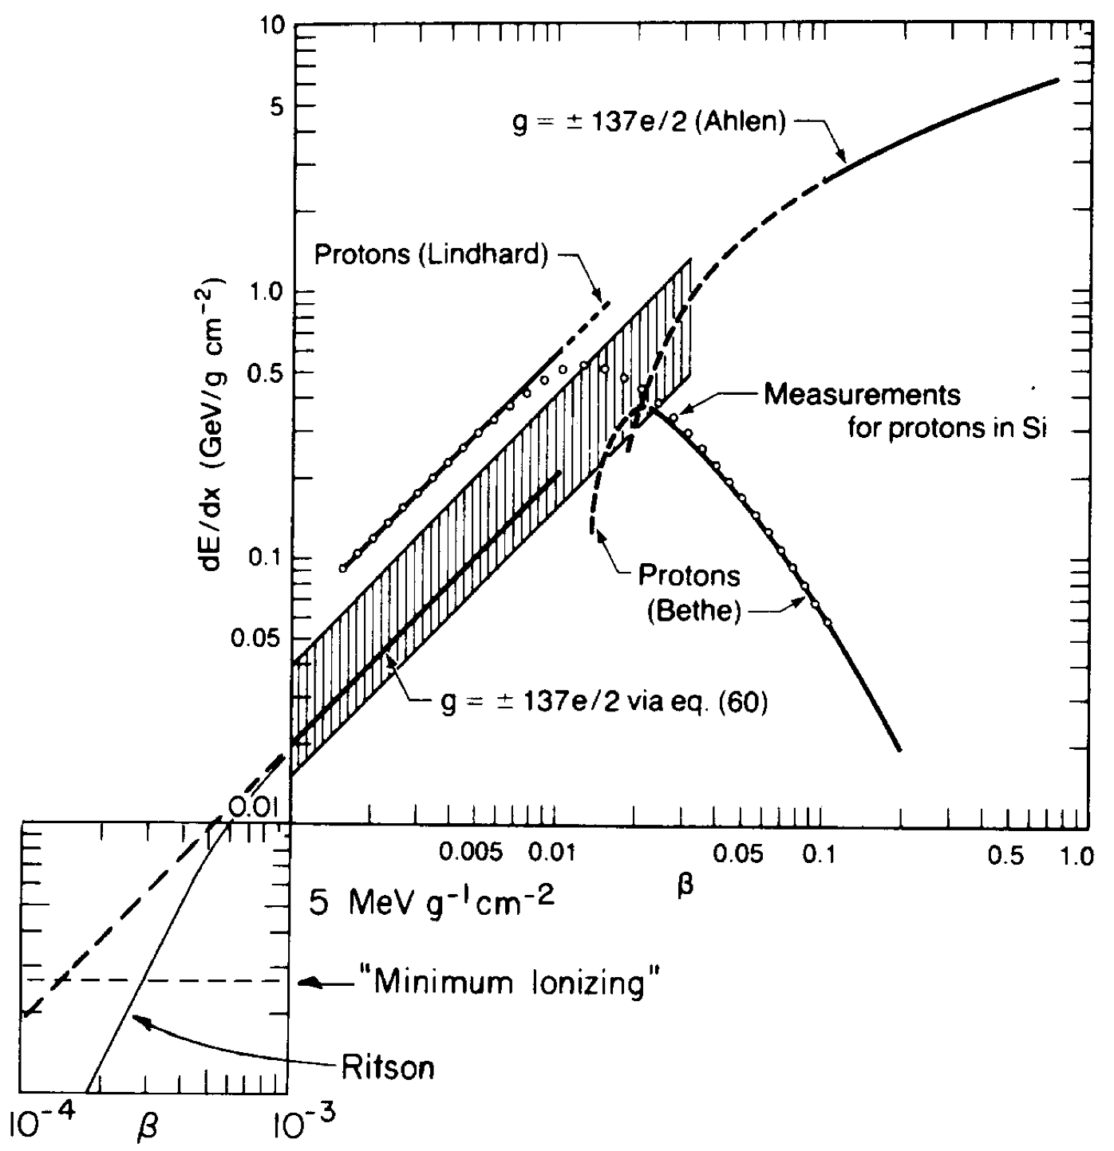
Magnetic Monopole Search
D.E. Groom, Physics Reports 140, 6, pg. 323 (1986)
“The magnetic monopole is the most venerable member of the mythological bestiary of physics.” – Don Groom
We search for magnetic monopoles.
If they exist, they will deposit energy in our detector.
NOvA has the unique potential to probe a new region of phase space:
due to our large surface area
and our location on the surface.
NOvA has dedicated triggers to write out monopole-like events.
First search published in 2021.
β = 10⁻¹
1000 ⨉ MIP
β = 10⁻²
100 ⨉ MIP
β = 10⁻³
10 ⨉ MIP

Slide 53
Magnetic Monopole Search
D.E. Groom, Physics Reports 140, 6, pg. 323 (1986)
“The magnetic monopole is the most venerable member of the mythological bestiary of physics.” – Don Groom
We search for magnetic monopoles.
If they exist, they will deposit energy in our detector.
NOvA has the unique potential to probe a new region of phase space:
due to our large surface area
and our location on the surface.
NOvA has dedicated triggers to write out monopole-like events.
First search published in 2021.
β = 10⁻¹
1000 ⨉ MIP
β = 10⁻²
100 ⨉ MIP
β = 10⁻³
10 ⨉ MIP

Slide 54
Magnetic Monopole Search
D.E. Groom, Physics Reports 140, 6, pg. 323 (1986)
“The magnetic monopole is the most venerable member of the mythological bestiary of physics.” – Don Groom
We search for magnetic monopoles.
If they exist, they will deposit energy in our detector.
NOvA has the unique potential to probe a new region of phase space:
due to our large surface area
and our location on the surface.
NOvA has dedicated triggers to write out monopole-like events.
First search published in 2021.
β = 10⁻¹
1000 ⨉ MIP
β = 10⁻²
100 ⨉ MIP
β = 10⁻³
10 ⨉ MIP

Slide 55
Magnetic Monopole Energy Deposition
β = 10⁻¹
Groom’s summary of the magnetic monopole energy deposition as calculated from EM.
Monopole interaction is similar to particle with charge Z = 69 at high β.
1000 ⨉ MIP
β = 10⁻²
100 ⨉ MIP
β = 10⁻³
10 ⨉ MIP

Slide 56
Analysis Strategy
We divide the magnetic monopole searches into two broad categories based on:
Ionization
Timing
TIMING
IONIZATION

Slide 57
Analysis Strategy
Large energy deposition is suppressed through Birks effect.
A lot of work went into verifying that these effects were properly accounted for in our simulation.
IONIZATION

Slide 58
Analysis Strategy
Large energy deposition is suppressed through Birks effect.
A lot of work went into verifying that these effects were properly accounted for in our simulation.
Fast monopoles (β ≳ 0.7) produce Cherenkov light.
IONIZATION

Slide 59
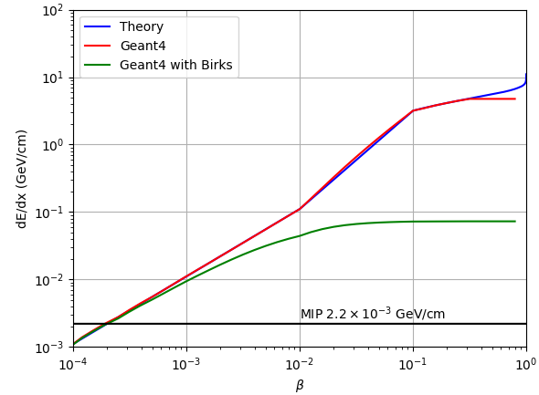
Analysis Strategy
Large energy deposition is suppressed through Birks effect.
A lot of work went into verifying that these effects were properly accounted for in our simulation.
Fast monopoles (β ≳ 0.7) produce Cherenkov light.
IONIZATION

Slide 60
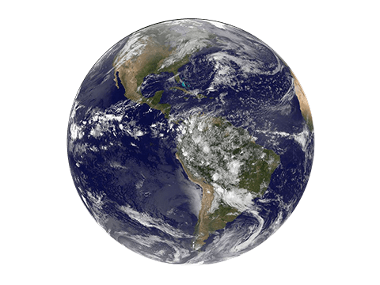
Acceptance Region
monopole
monopole

Slide 61
Data Samples
Ionization Search:
October 2015 – February 2025
2,904 days (2,713 days marked as good)
Timing Search:
February 2016 – October 2024
2,985 days (2,743 days marked as good)
Build
Data
Analyzed Data
Data
2012
2014
2016
2018
2020
2022
2024
Detector Gain Settings Changed
October 13, 2015
Now

Slide 62
Ionization Magnetic Monopole Search

Slide 63
Raw Data with Simulated Monopole
Simulated Monopole
Large Energy Deposition
50 μs Exposure

Slide 64
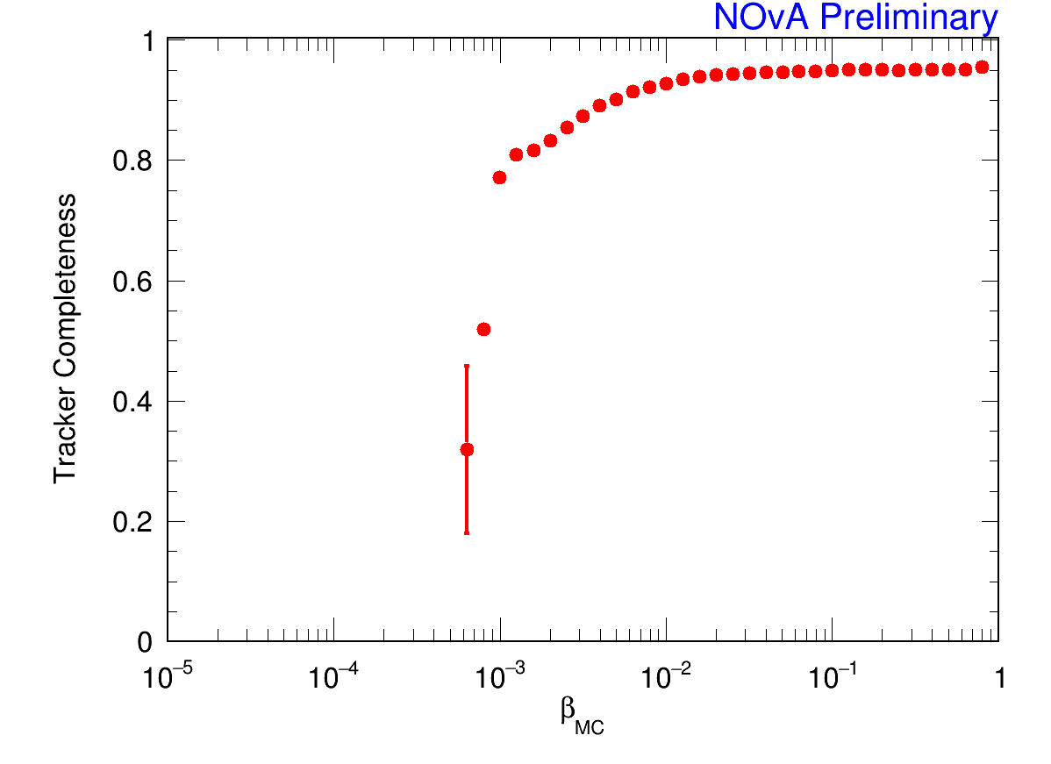
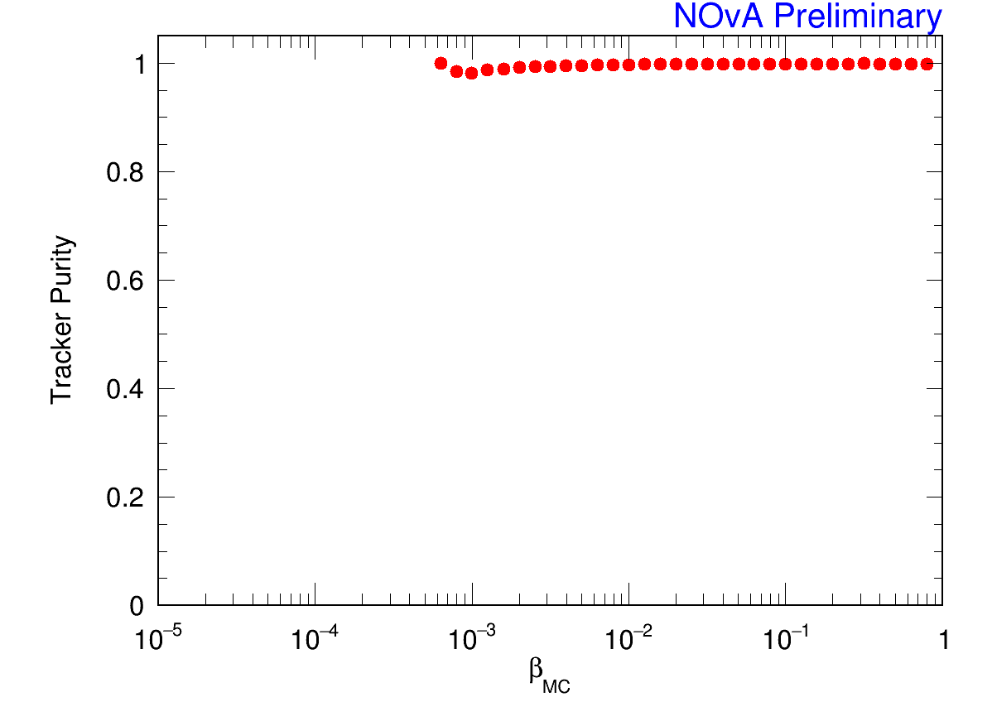
Analysis Strategy
Trigger on monopole-like patterns with high energy depositions in live data stream.
Reconstruct event kinematics offline.
~100% track purity for β > 10⁻³
~90% track completeness for β > 10⁻²

Slide 65
Offline Analysis Strategy
Data:
Triggered by ionizing monopole algorithm
MC:
Simulated monopole overlaid with cosmic data
Select events with high energy deposition
Select narrow events:
Removes energetic showering muons that tend to be wider
Energy Deposition
Monopole
Showering Muon
Track Width

Slide 66
Offline Analysis Strategy
Data:
Triggered by ionizing monopole algorithm
MC:
Simulated monopole overlaid with cosmic data
Select events with high energy deposition
Select narrow events:
Removes energetic showering muons that tend to be wider
Energy Deposition
Monopole
Showering Muon
Track Width

Slide 67
Signal Search
Track Width
Triggered Data
Energy Deposition
Simulated Monopoles

Slide 68
Signal Search
No Magnetic Monopole Event Found!
Track Width
Triggered Data
Energy Deposition
Simulated Monopoles

Slide 69
Magnetic Monopole Flux Limits

Slide 70
Timing Magnetic Monopole Search

Slide 71
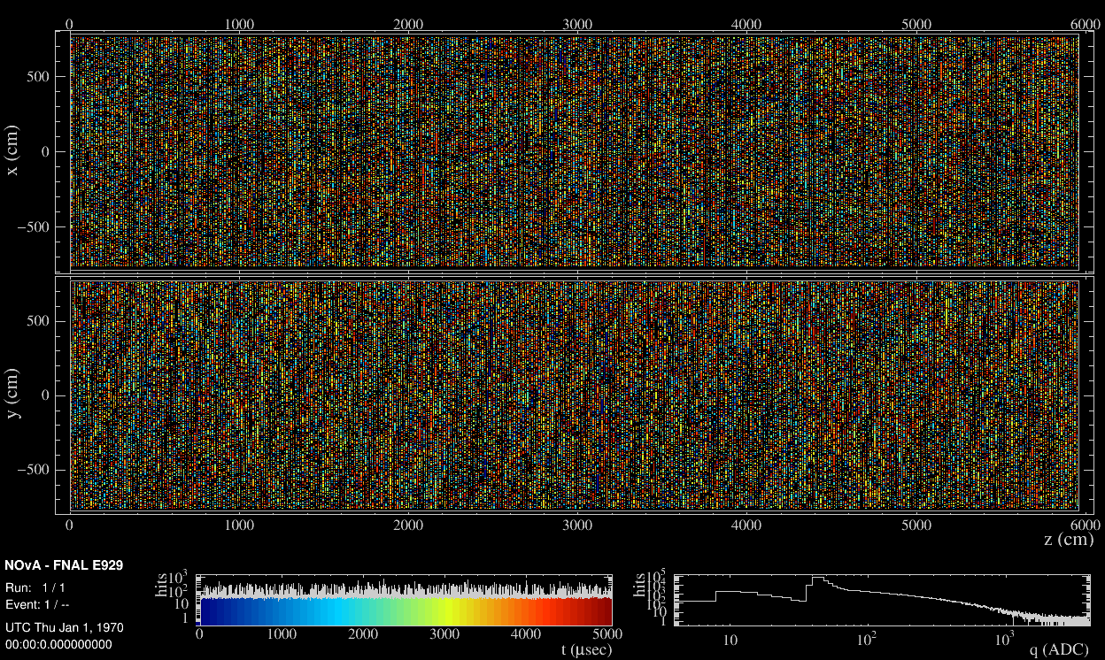
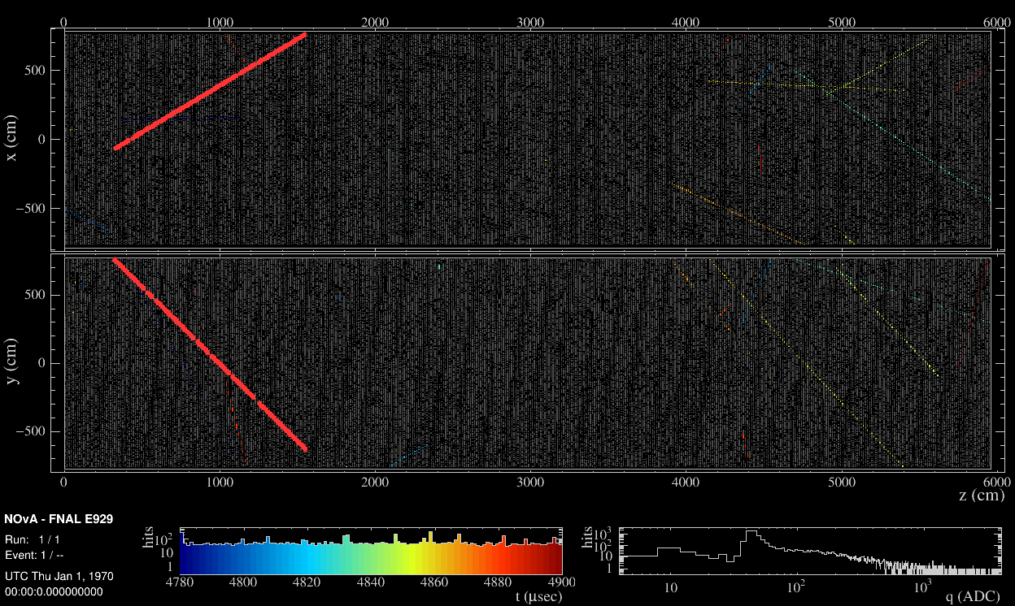
Monopole Simulation
We used simulation to determine the efficiency of selecting monopole tracks for 10⁻⁴ < β < 10⁻².
The monopoles were simulated using an isotropic flux.
Each simulated monopole was combined with 5 ms of zero bias data (i.e. data with typical running conditions).
5 ms of zero bias data

Slide 72
Monopole Simulation
We used simulation to determine the efficiency of selecting monopole tracks for 10⁻⁴ < β < 10⁻².
The monopoles were simulated using an isotropic flux.
Each simulated monopole was combined with 5 ms of zero bias data (i.e. data with typical running conditions).
5 ms of zero bias data

Slide 73
Monopole Simulation
We used simulation to determine the efficiency of selecting monopole tracks for 10⁻⁴ < β < 10⁻².
The monopoles were simulated using an isotropic flux.
Each simulated monopole was combined with 5 ms of zero bias data (i.e. data with typical running conditions).
5 ms of zero bias data
+ simulated monopole

Slide 74
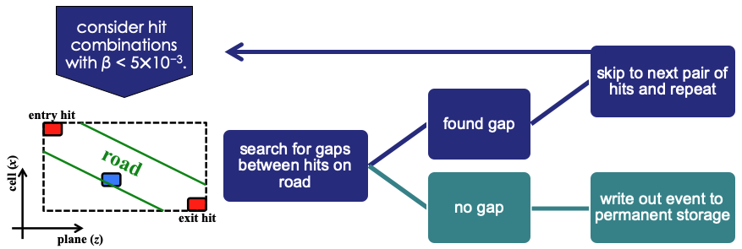
Analysis Strategy – Trigger
The NOvA detectors are equipped with a data-driven trigger (DDT) system that continuously examines the live data stream on over 100 computing nodes.
The monopole trigger algorithm examines pairs of hits on the surface of the detector for each event (5 ms).

Slide 75
Analysis Strategy – Trigger
The NOvA detectors are equipped with a data-driven trigger (DDT) system that continuously examines the live data stream on over 100 computing nodes.
The monopole trigger algorithm examines pairs of hits on the surface of the detector for each event (5 ms).

Slide 76
Analysis Strategy – Trigger
The NOvA detectors are equipped with a data-driven trigger (DDT) system that continuously examines the live data stream on over 100 computing nodes.
The monopole trigger algorithm examines pairs of hits on the surface of the detector for each event (5 ms).

Slide 77
Trigger and Reconstruction Efficiencies
Efficiency constant:
from β ~ 5x10⁻⁴
to β ~ 5x10⁻³
Some efficiency lost due to tracks parallel to the detector planes.
|θ| ~ 90°
Improvements in the trigger and offline reconstruction algorithms have increased efficiency since the 2021 result!
x
θ
z
2021

Slide 78
Trigger and Reconstruction Efficiencies
Efficiency constant:
from β ~ 5x10⁻⁴
to β ~ 5x10⁻³
Some efficiency lost due to tracks parallel to the detector planes.
|θ| ~ 90°
Improvements in the trigger and offline reconstruction algorithms have increased efficiency since the 2021 result!
x
θ
z
2021

Slide 79
Trigger and Reconstruction Efficiencies
Efficiency constant:
from β ~ 5x10⁻⁴
to β ~ 5x10⁻³
Some efficiency lost due to tracks parallel to the detector planes.
|θ| ~ 90°
Improvements in the trigger and offline reconstruction algorithms have increased efficiency since the 2021 result!
x
θ
z
2021
Now

Slide 80
Offline Reconstruction
5 ms Exposure

Slide 81
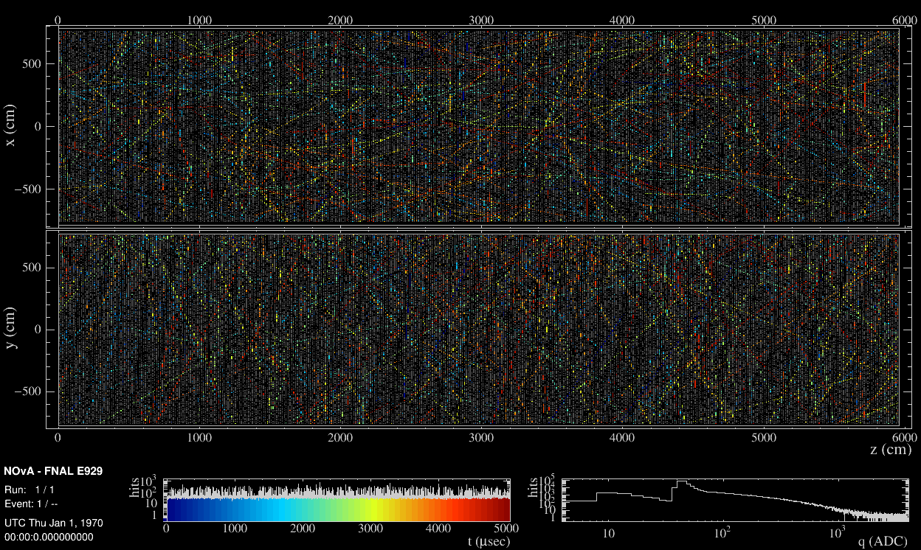
Remove Low Energy Hits
5 ms Exposure

Slide 82
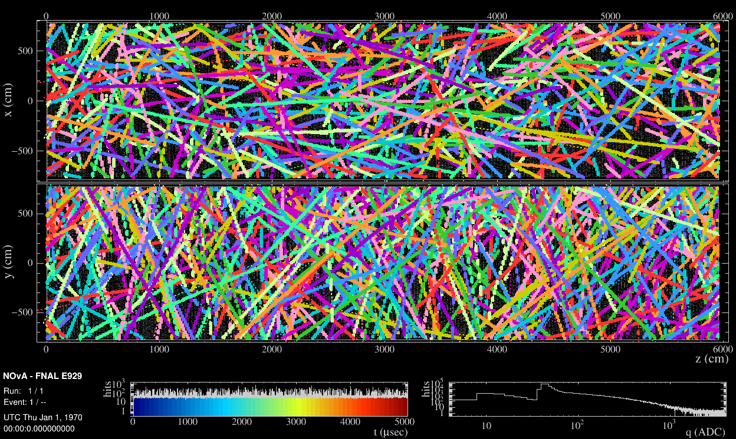
Identify Cosmic Rays
5 ms Exposure

Slide 83
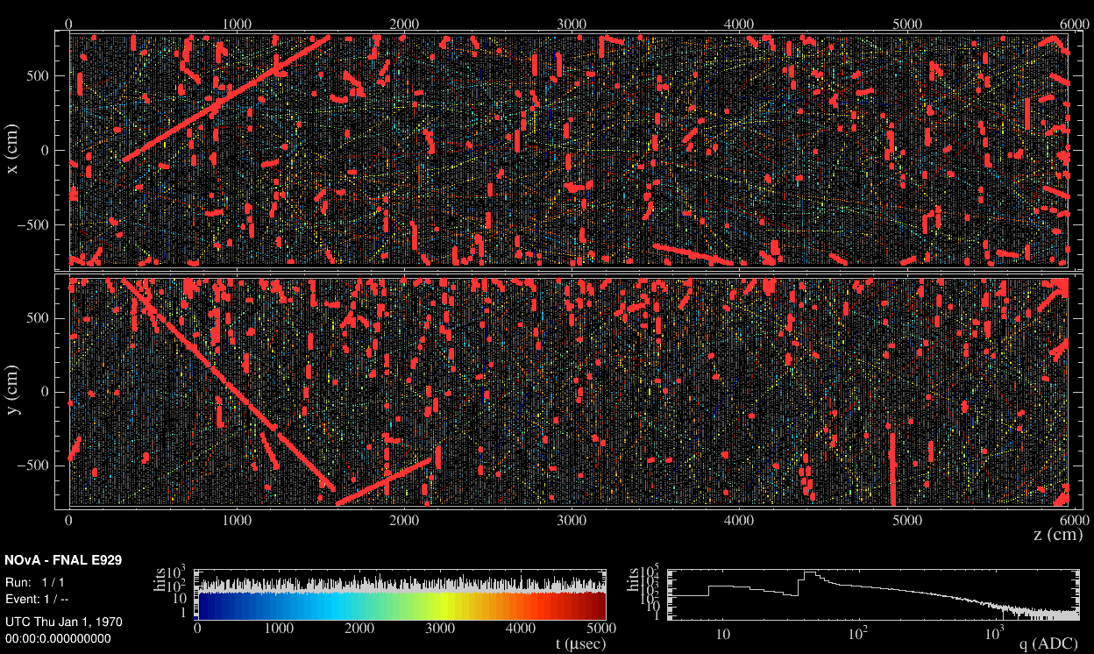
Remove Cosmic Rays
5 ms Exposure

Slide 84
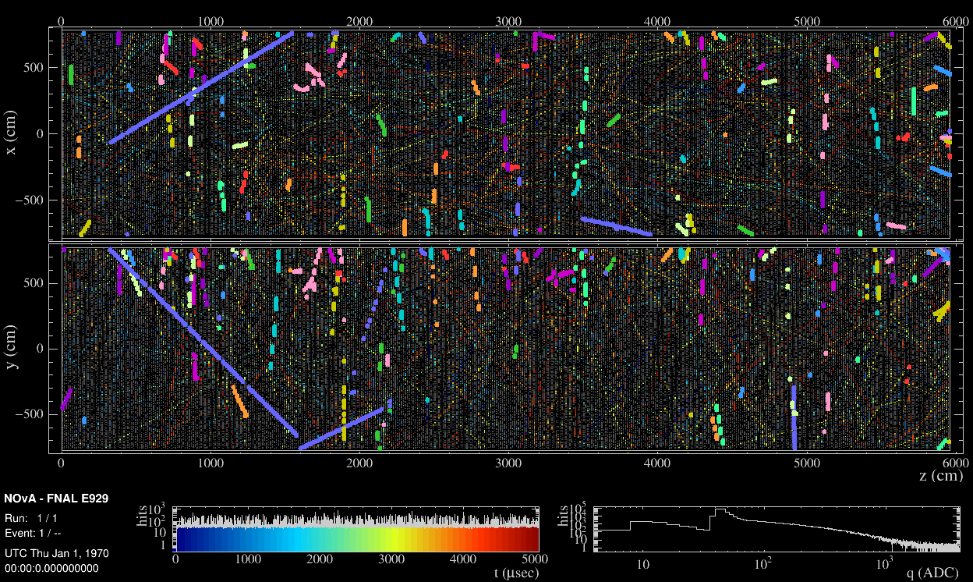
Identify Groups of Correlated Hits
5 ms Exposure

Slide 85

Time Zoom on Monopole Group of Hits
Zoom in to 4.8 ms – 4.9 ms

Slide 86
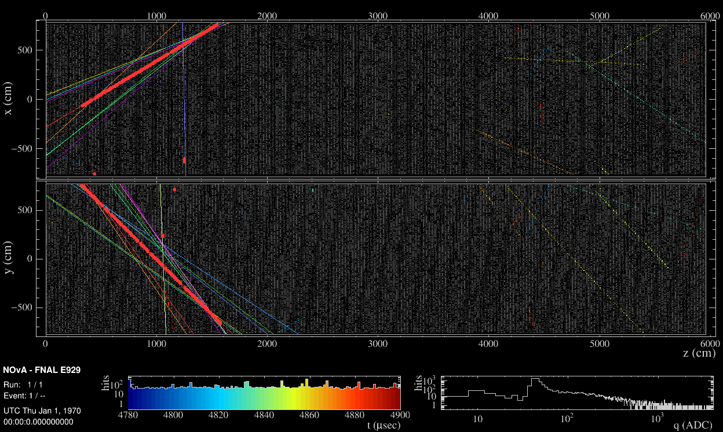
Identify Straight Line Features (Hough Tracking)
Zoom in to 4.8 ms – 4.9 ms

Slide 87
Identify Monopole Track
Zoom in to 4.8 ms – 4.9 ms

Slide 88
Analysis Strategy – Offline
We want to identify straight line tracks.
Two powerful discriminators:
Correlation coefficient: r²
Time gap fraction: f
x
r² ≈ 0
x
r² = 1
f ≈ 0
bad
t
x
good
f ≈ 1
t
Selection Cuts
r² > 0.95
bad
t

Slide 89
Analysis Strategy – Offline
We want to identify straight line tracks.
Two powerful discriminators:
Correlation coefficient: r²
Time gap fraction: f
x
r² ≈ 0
x
r² = 1
f ≈ 0
bad
t
x
good
f ≈ 1
t
Selection Cuts
r² > 0.95
f < 0.2
bad
t

Slide 90
Correlation Coefficient
Signal Region

Slide 91
Signal Search
Signal Region

Slide 92
Signal Search
No Magnetic Monopole Event Found!
Signal Region

Slide 93
Signal Search
No Magnetic Monopole Event Found!
Interesting Events
(far from signal region)
Signal Region

Slide 94
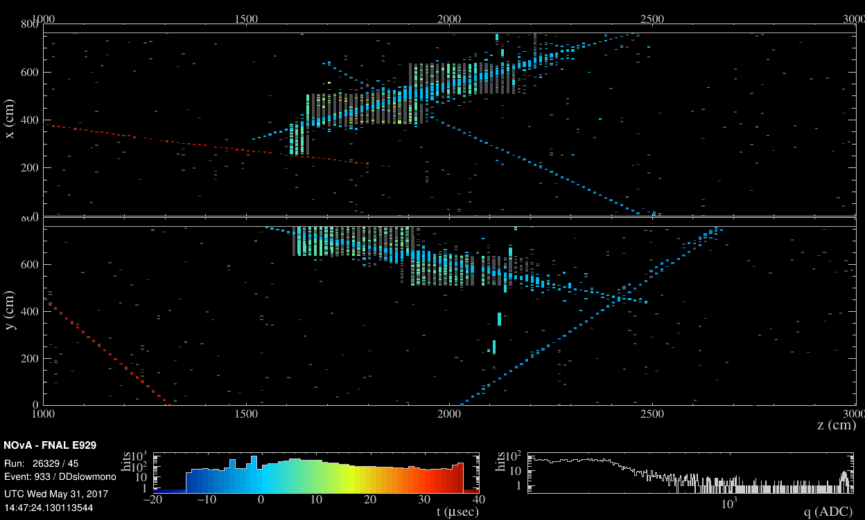
Interesting Event 1 – Timing Search
No slow activity
High energy activity
FEB flash

Slide 95
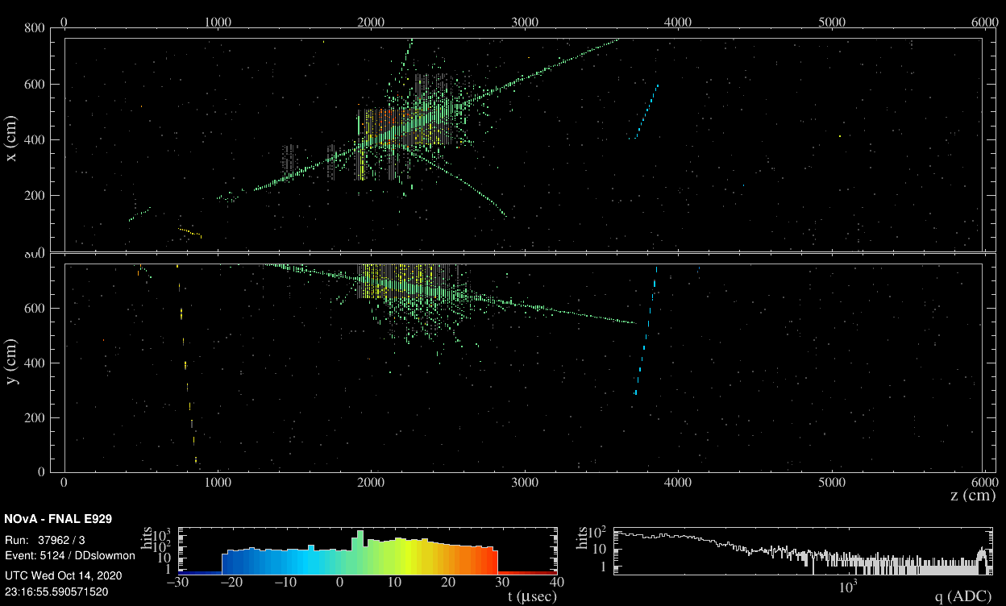
Interesting Event 2 – Timing Search
No slow activity
High energy activity
FEB flash
Beautiful event!

Slide 96
Magnetic Monopole Flux Limits

Slide 97
Magnetic Monopole Flux Limits

Slide 98
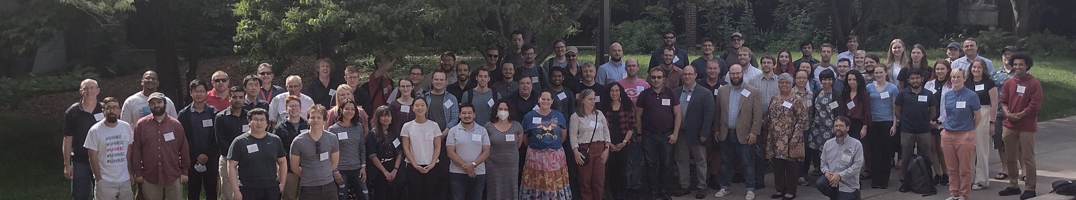






Summary
We continue to untangle the oscillation parameter phase space.
Stay tuned for our combined results with T2K (up next)!
We searched for magnetic monopoles. In the absence of any signal, we set limits as low as 2×10⁻¹⁶ cm⁻²s⁻¹sr⁻¹.
Thanks to the NOvA Collaboration!
Thanks to our funding agencies for supporting the NOvA experiment (see next slide) and my work (NSF-2412236).
>266 scientists and engineers from 51 institutions from 8 countries

Slide 99
Acknowledgements
This document was prepared by the NOvA collaboration using the resources of the Fermi National Accelerator Laboratory (Fermilab), a U.S. Department of Energy, Office of Science, HEP User Facility. Fermilab is managed by Fermi Forward Discovery Group, LLC, acting under Contract No. 89243024CSC000002. This work was supported by the U.S. Department of Energy; the U.S. National Science Foundation; the Department of Science and Technology, India; the European Research Council; the MSMT CR, GA UK, Czech Republic; the RAS, the Ministry of Science and Higher Education, and RFBR, Russia; CNPq and FAPEG, Brazil; UKRI, STFC and the Royal Society, United Kingdom; and the state and University of Minnesota. We are grateful for the contributions of the staffs of the University of Minnesota at the Ash River Laboratory, and of Fermilab. For the purpose of open access, the author has applied a Creative Commons Attribution (CC BY) license to any Author Accepted Manuscript version arising.

Slide 100
Signal Search – L > 20 m

