Slide 1
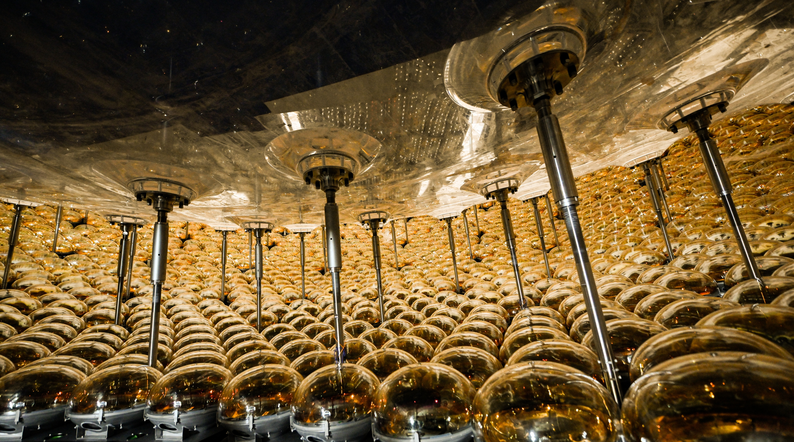

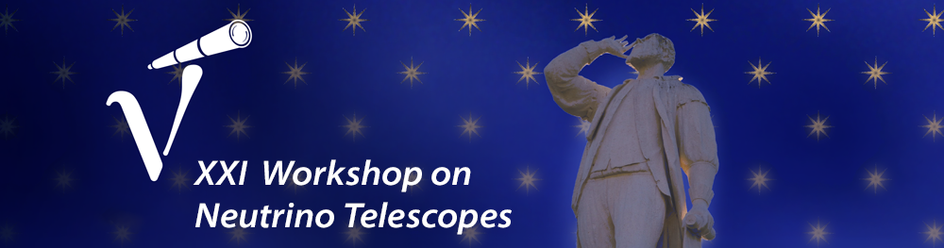
Background Components of the JUNO Liquid Scintillator
Guanda Gong
on behalf of the JUNO Collaboration
Sep 29th - Oct 3th, 2025
Padova (Italy)

Slide 2
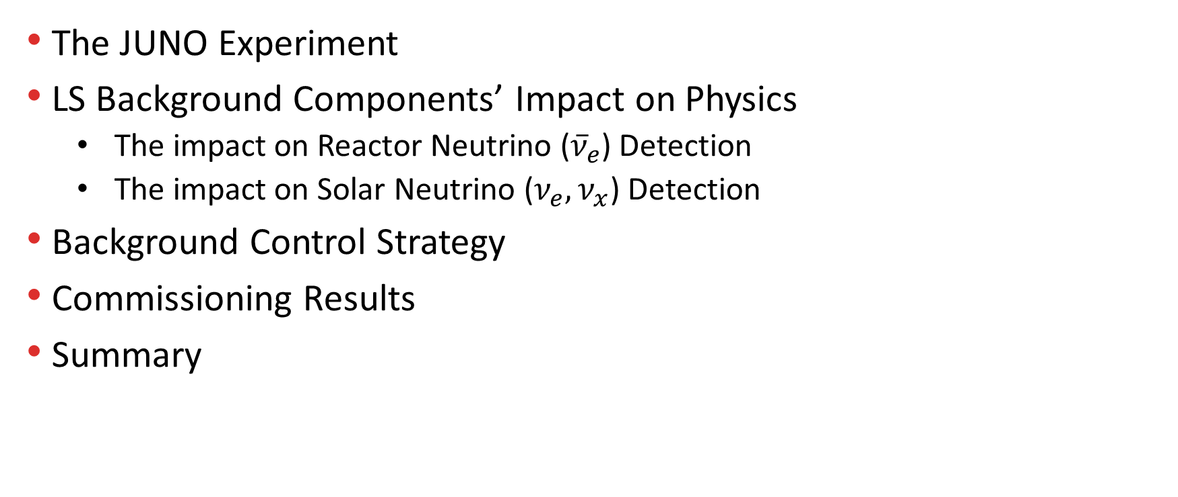
Overview
The JUNO Experiment
LS Background Components’ Impact on Physics
The impact on Reactor Neutrino (${\overline{ν}}_{e}$) Detection
The impact on Solar Neutrino ($ν_{e}, ν_{x}$) Detection
Background Control Strategy
Commissioning Results
Summary

Slide 3
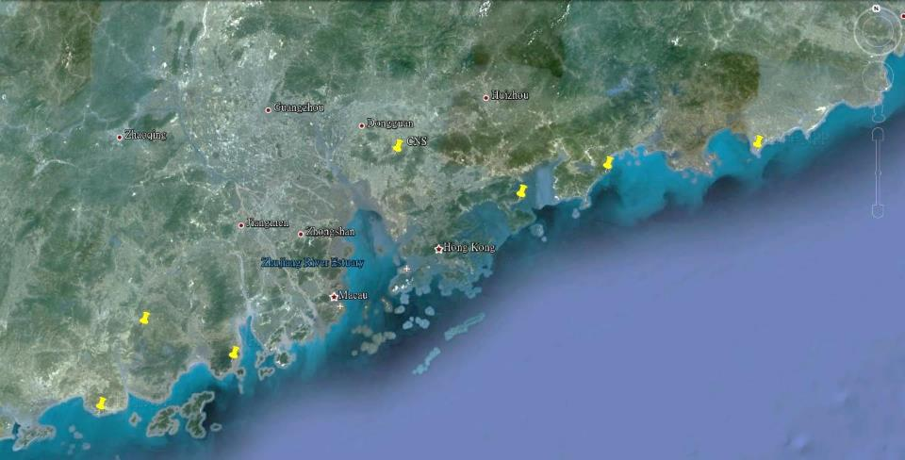
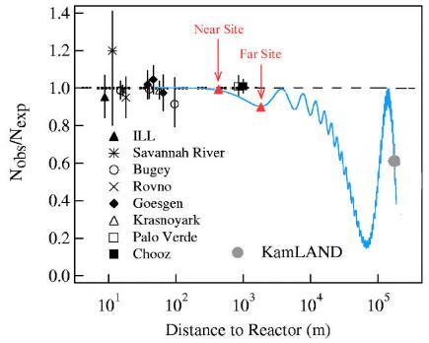

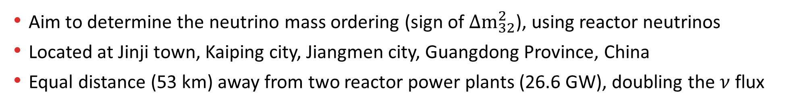
Jiangmen Underground Neutrino Observatory
Daya Bay
JUNO
Previous site candidate
Guang Zhou
2.5 h drive
Lufeng NPP
Shen Zhen
Huizhou NPP
Double Chooz
RENO
Daya Bay NPP
Zhu Hai
Hong Kong
53 km
Macau
53 km
Taishan NPP 9.2 GW
Talk by Y.F. Wang at ICFA seminar 2008, Neutel 2011;
Paper by L. Zhan, Y.F. Wang, J. Cao, L.J. Wen, PRD78:111103,2008; PRD79:073007,2009
Yangjiang NPP 17.4 GW
3
Aim to determine the neutrino mass ordering (sign of $Δm_{32}^{2}$), using reactor neutrinos
Located at Jinji town, Kaiping city, Jiangmen city, Guangdong Province, China
Equal distance (53 km) away from two reactor power plants (26.6 GW), doubling the $ν$ flux

Slide 4
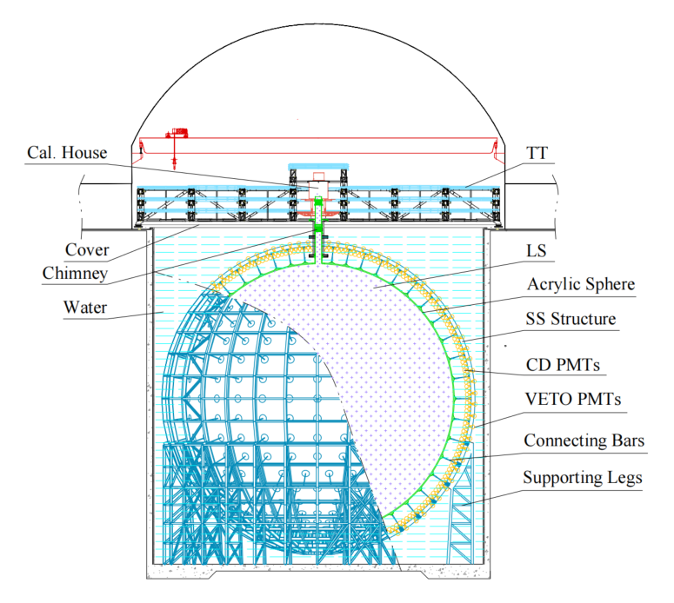
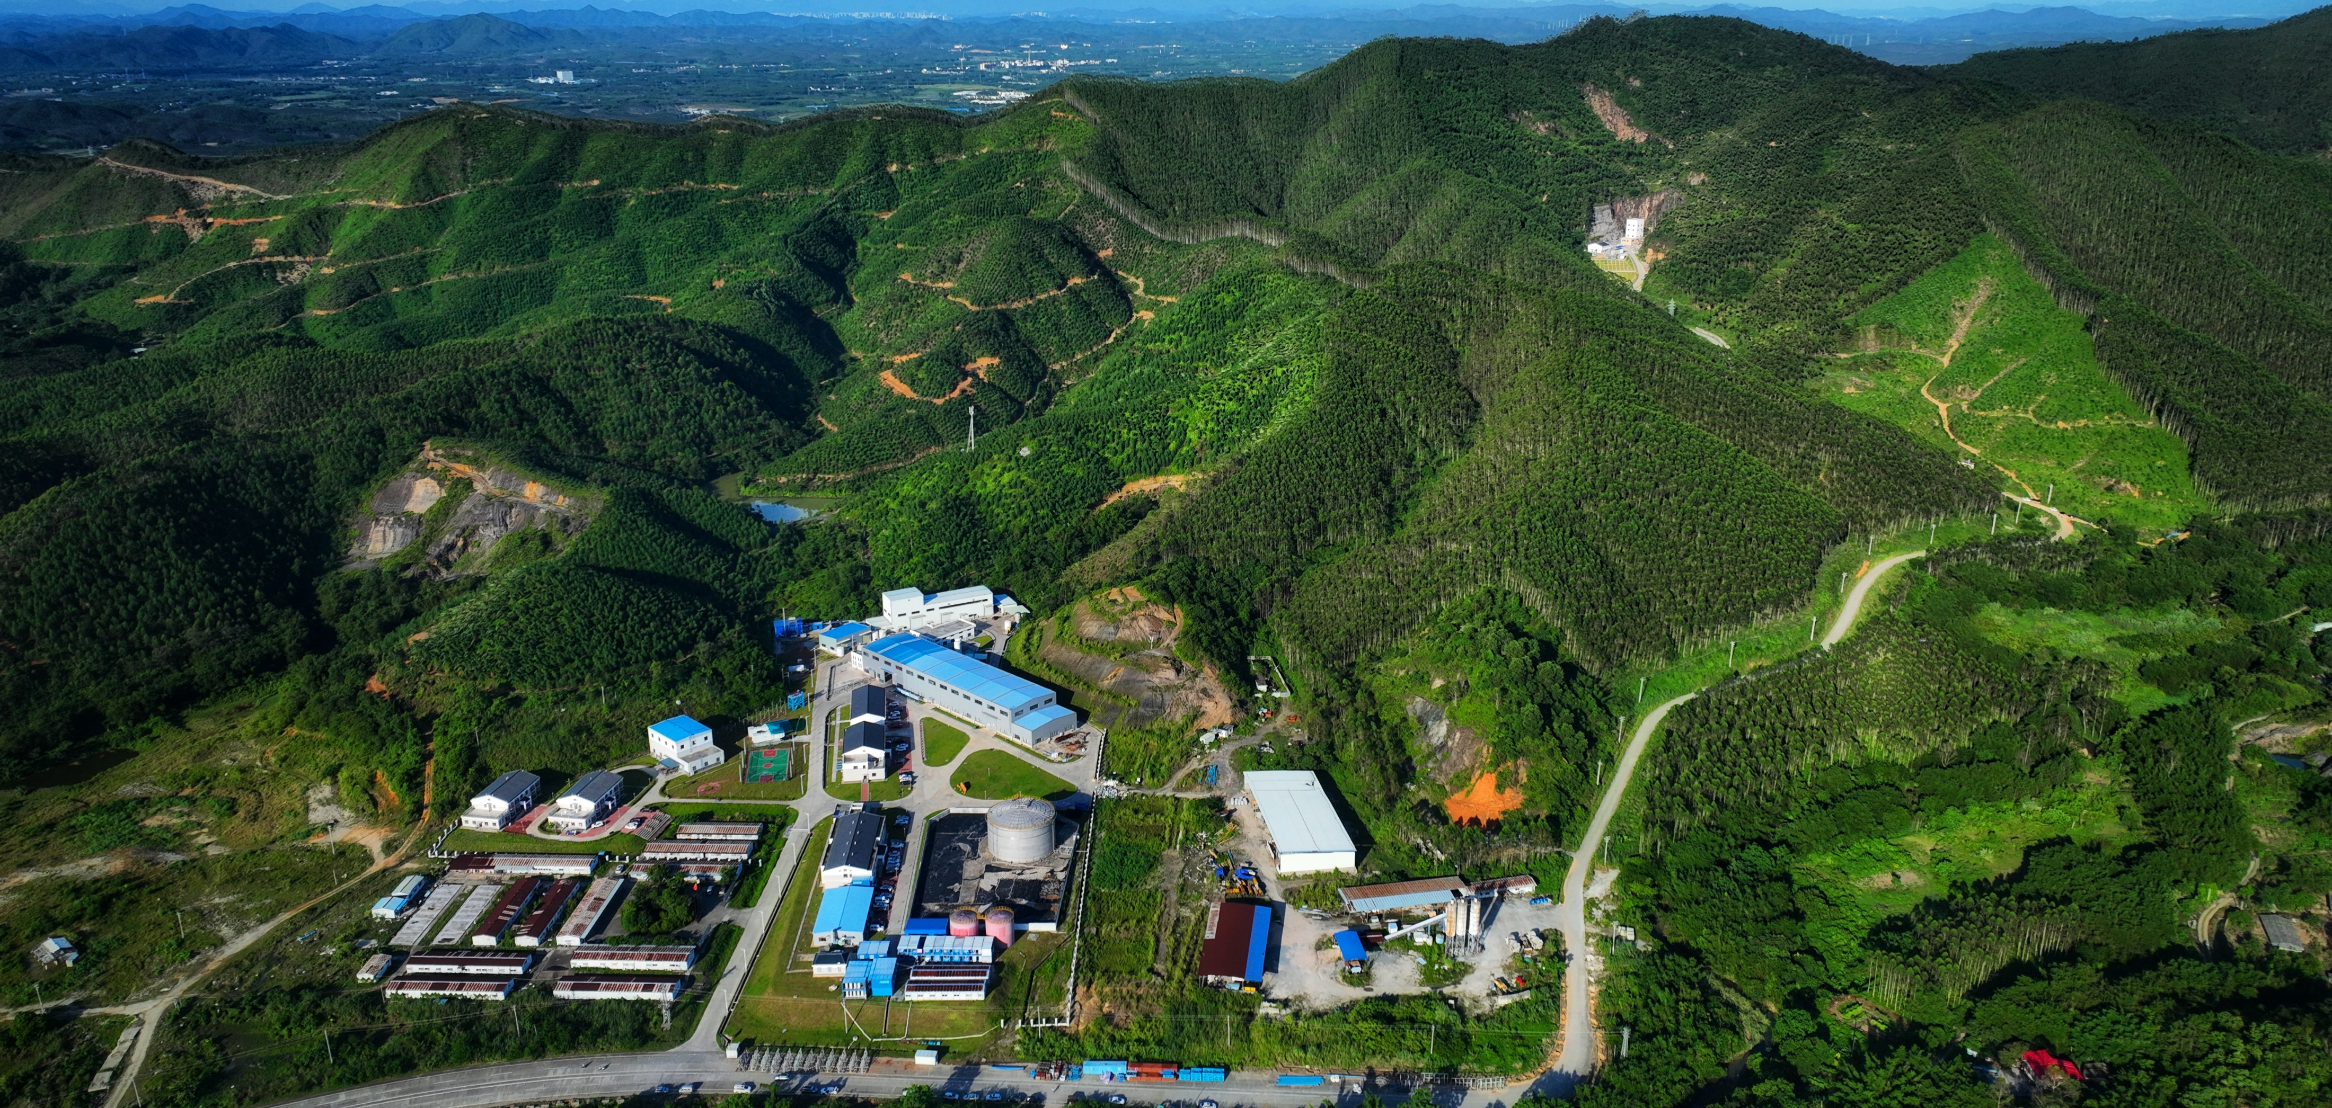
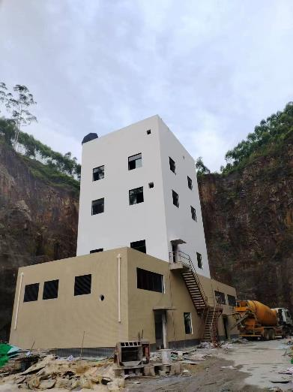
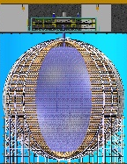
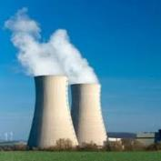
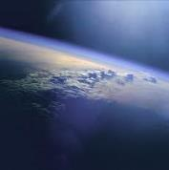
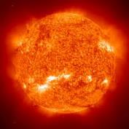
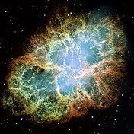
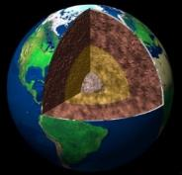
Jiangmen Underground Neutrino Observatory
20kt Liquid Scintillator
Energy resolution ~ 3%@1MeV
Civil construction finished in Dec, 2021
Detector construction finished in Dec, 2024
Overburden
~650 m (1800 m.w.e.)
Vertical tunnel: 563 m
Data Taking Started at
Aug 26, 2025
Slope tunnel：1265 m @ slope of 42%
Prog.Part.Nucl.Phys. 123 (2022) 103927
Han’s talk
Vanessa’s talk
Reactor
Atmosphere
Solar
Supernova
Earth
New physics
+
~60 IBDs per day
Several per day
Hundreds per day
~5000 IBDs for CCSN @10 kpc
Several IBDs per day
More details of the JUNO experiment status can be found in Monica’s Talk

Slide 5
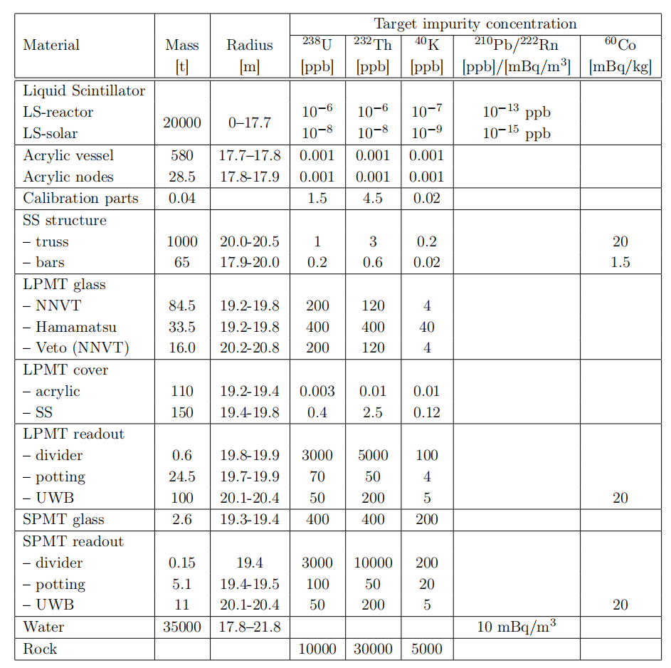
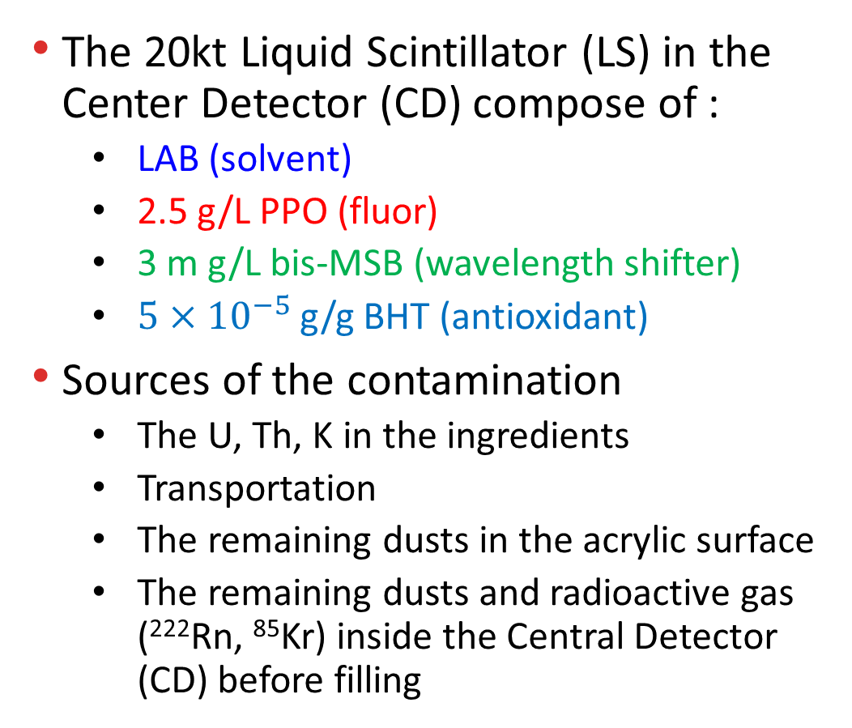
Background Components of the LS
The 20kt Liquid Scintillator (LS) in the Center Detector (CD) compose of :
LAB (solvent)
2.5 g/L PPO (fluor)
3 m g/L bis-MSB (wavelength shifter)
$5×{10}^{−5}$ g/g BHT (antioxidant)
Sources of the contamination
The U, Th, K in the ingredients
Transportation
The remaining dusts in the acrylic surface
The remaining dusts and radioactive gas (²²²Rn, ⁸⁵Kr) inside the Central Detector (CD) before filling
NIM.A 908 (2021) 164823
ppb = 10−9 g/g
JHEP 11 (2021) 102
Good physics sensitivity requires low contamination
Strict standard and strategies are proposed, balancing the physics and engineering.
Notes:
Linear Alkyl Benzene 2,5-dyphenyloxazole 1,4-bis(2-methylstyryl) benzene butylated hydroxy toluene

Slide 6
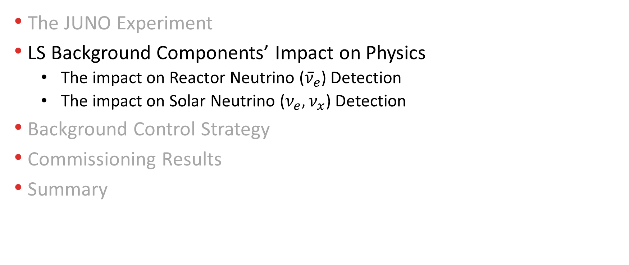
Overview
The JUNO Experiment
LS Background Components’ Impact on Physics
The impact on Reactor Neutrino (${\overline{ν}}_{e}$) Detection
The impact on Solar Neutrino ($ν_{e}, ν_{x}$) Detection
Background Control Strategy
Commissioning Results
Summary

Slide 7
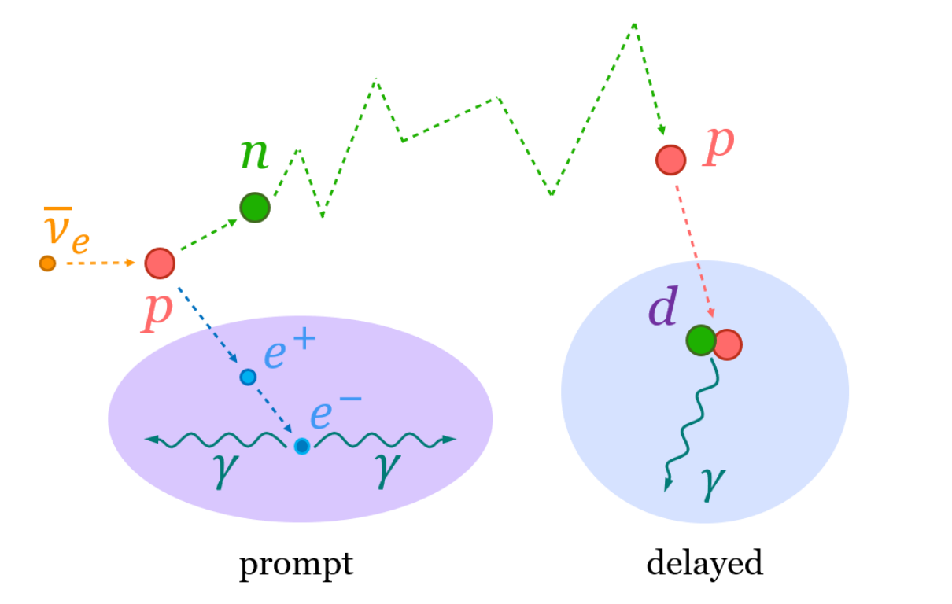
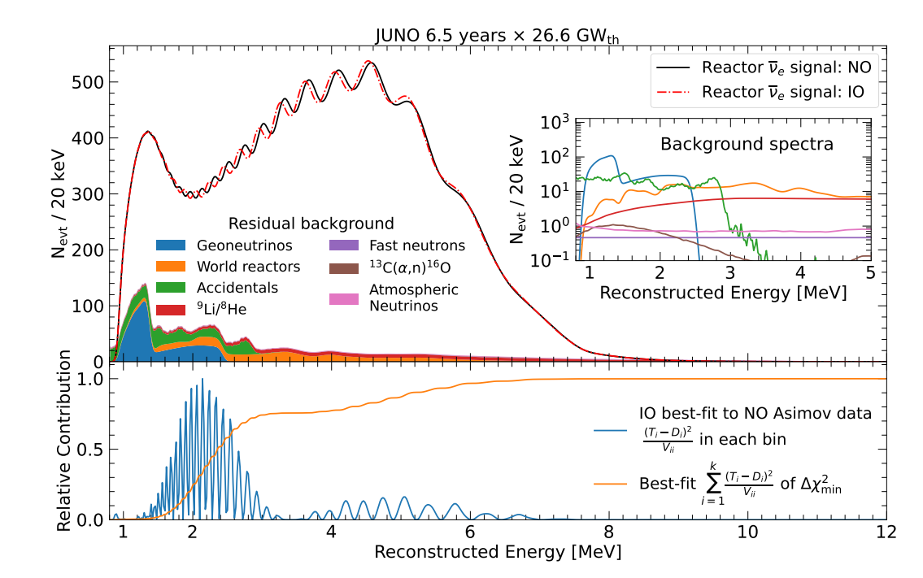
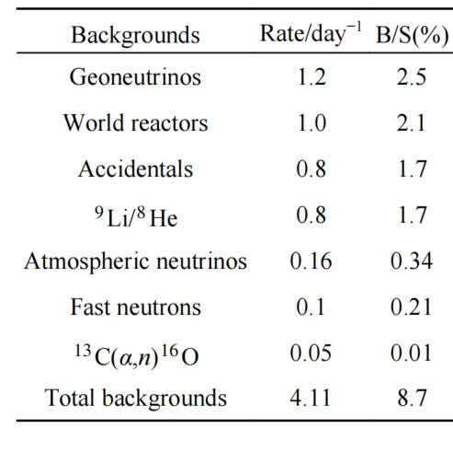

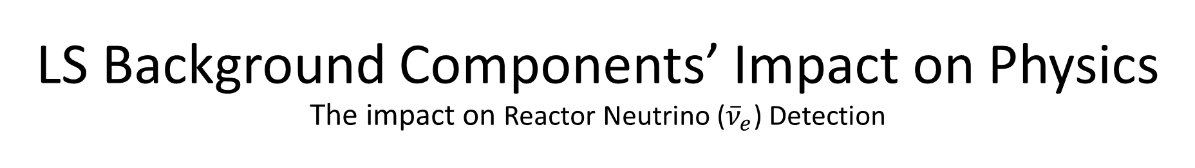



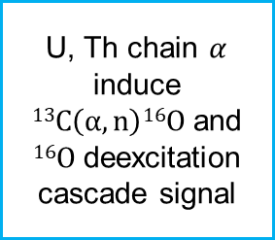




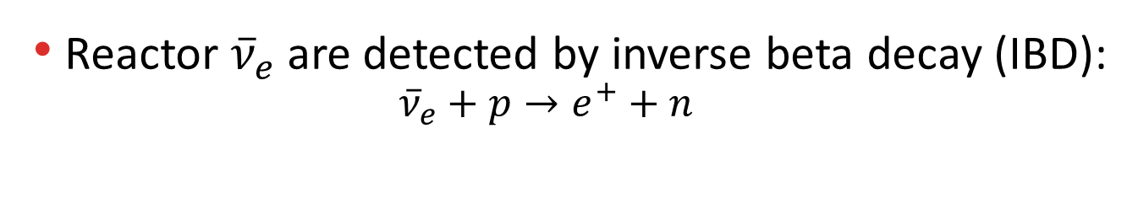
LS Background Components’ Impact on Physics The impact on Reactor Neutrino (${\overline{ν}}_{e}$) Detection
$$τ\sim 200 μs$$
Reactor ${\overline{ν}}_{e}$ are detected by inverse beta decay (IBD):
$${\overline{ν}}_{e}+p→e^{+}+n$$
More details of JUNO’s reactor neutrino measurement can be found in Han’s Talk
Signal rates after selection $\sim 47 cpd$ (counts per day)
$1$-$10 MeV$
$$2.22 MeV$$
Background rates after selection
arXiv:2503.00968
Mis-combine two uncorrelated radioactive decay / spallation neutron events
$$13C(α,n)16O$$
Accidentals
U, Th chain $α$ induce $13C\left(α,n\right)16O$ and $16O$ deexcitation cascade signal
$$0.09$$
$$0.02$$
$$4.15$$
$$0.88$$
Chin.Phys.C 49 (2025) 3, 033104
arXiv:2503.00968

Slide 8

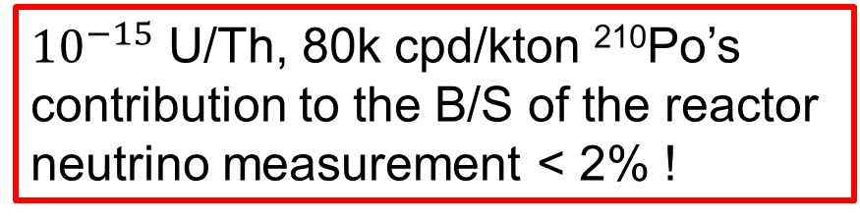
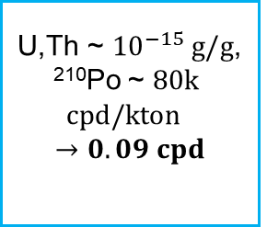
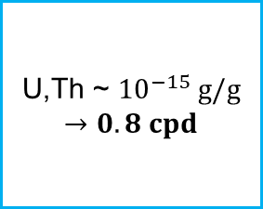
LS Background Components’ Impact on Physics The impact on Reactor Neutrino (${\overline{ν}}_{e}$) Detection
$$τ\sim 200 μs$$
Reactor ${\overline{ν}}_{e}$ are detected by inverse beta decay (IBD):
$${\overline{ν}}_{e}+p→e^{+}+n$$
More details of JUNO’s reactor neutrino measurement can be found in Han’s Talk
Signal rates after selection $\sim 47 cpd$ (counts per day)
$1$-$10 MeV$
$$2.22 MeV$$
Background rates after selection
arXiv:2503.00968
U,Th ~ ${10}^{−15} g/g$
$→$ $0.8 cpd$
$$13C(α,n)16O$$
Accidentals
U,Th ~ ${10}^{−15} g/g$, ²¹⁰Po ~ $80k$
$$cpd/kton$$
$→$ $0.09 cpd$
${10}^{−15}$ U/Th, 80k cpd/kton ²¹⁰Po’s contribution to the B/S of the reactor neutrino measurement < 2% !
$$0.09$$
$$0.02$$
$$4.15$$
$$0.88$$
arXiv:2503.00968
Chin.Phys.C 49 (2025) 3, 033104
arXiv:2503.00968

Slide 9
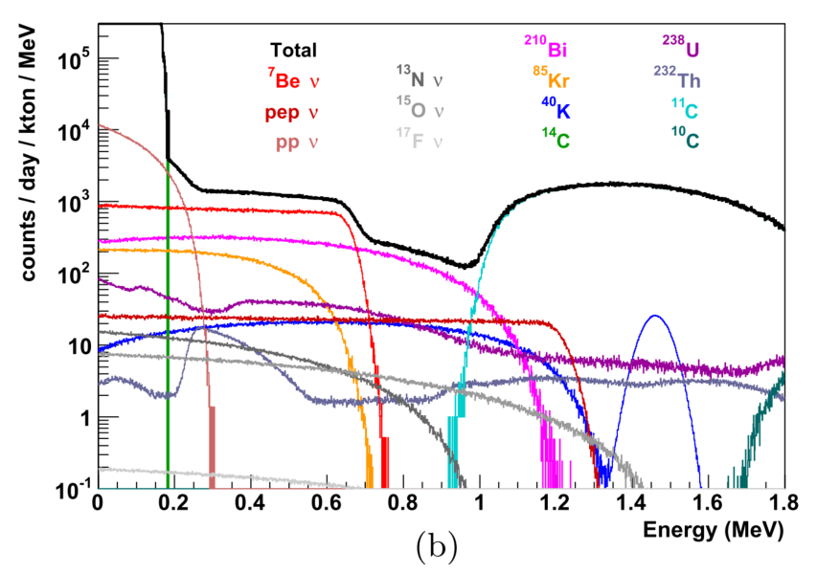
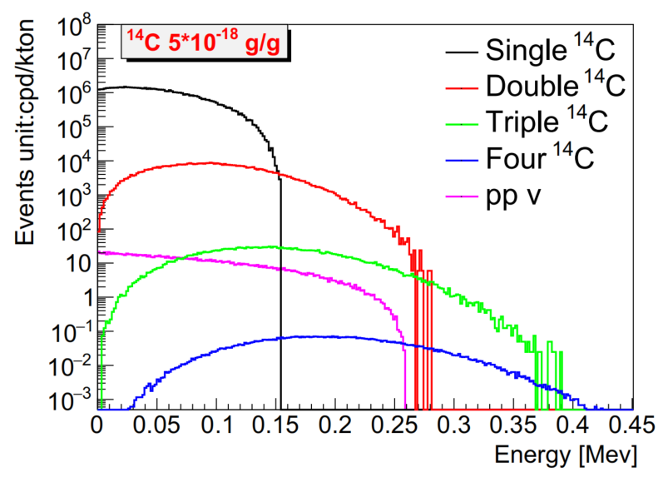
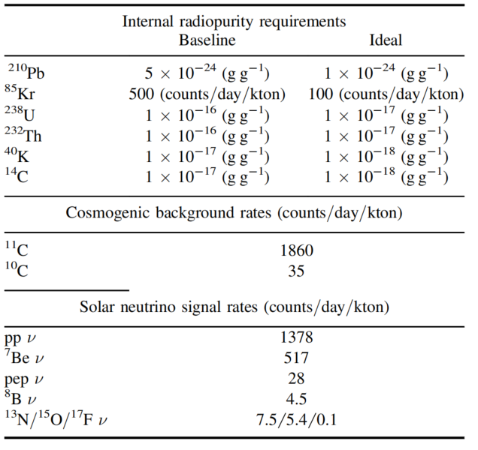
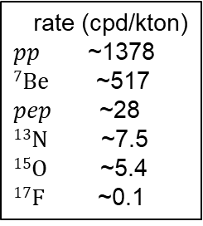
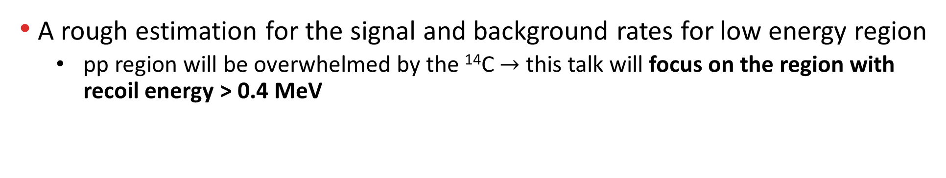
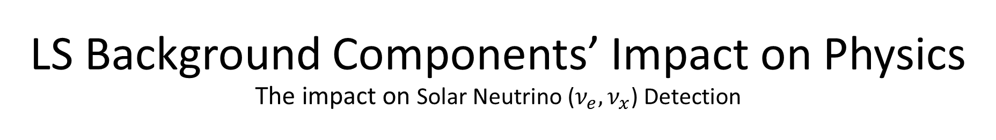
LS Background Components’ Impact on Physics The impact on Solar Neutrino ($ν_{e}, ν_{x}$) Detection
Solar $ν_{e}$, $ν_{x}$ can be detected by elastic scattering:
$$v_{e,x}+e^{−}→v_{e, x}+e^{−}$$
A rough estimation for the signal and background rates for low energy region
pp region will be overwhelmed by the ¹⁴C $→$ this talk will focus on the region with recoil energy > 0.4 MeV
rate (cpd/kton)
$pp$ ~1378
$7Be$ ~517
$pep$ ~28
$13N$ ~7.5
$15O$ ~5.4
$17F$ ~0.1
J.Phys.G 43 (2016) 3, 030401
Nucl.Sci.Tech. 34 (2023) 9, 137

Slide 10
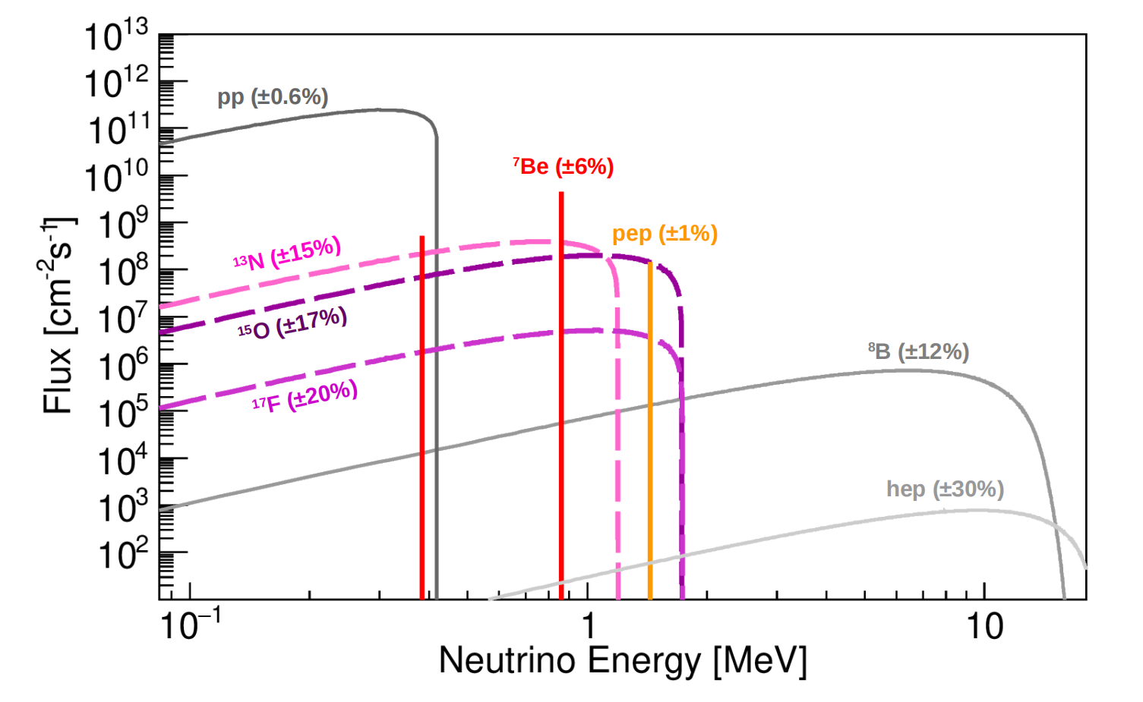
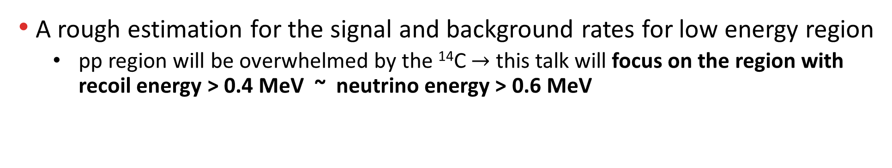
LS Background Components’ Impact on Physics The impact on Solar Neutrino ($ν_{e}, ν_{x}$) Detection
Solar $ν_{e}$, $ν_{x}$ can be detected by elastic scattering:
$$v_{e,x}+e^{−}→v_{e, x}+e^{−}$$
A rough estimation for the signal and background rates for low energy region
pp region will be overwhelmed by the ¹⁴C $→$ this talk will focus on the region with recoil energy > 0.4 MeV ~ neutrino energy > 0.6 MeV
JCAP 10 (2023) 022

Slide 11
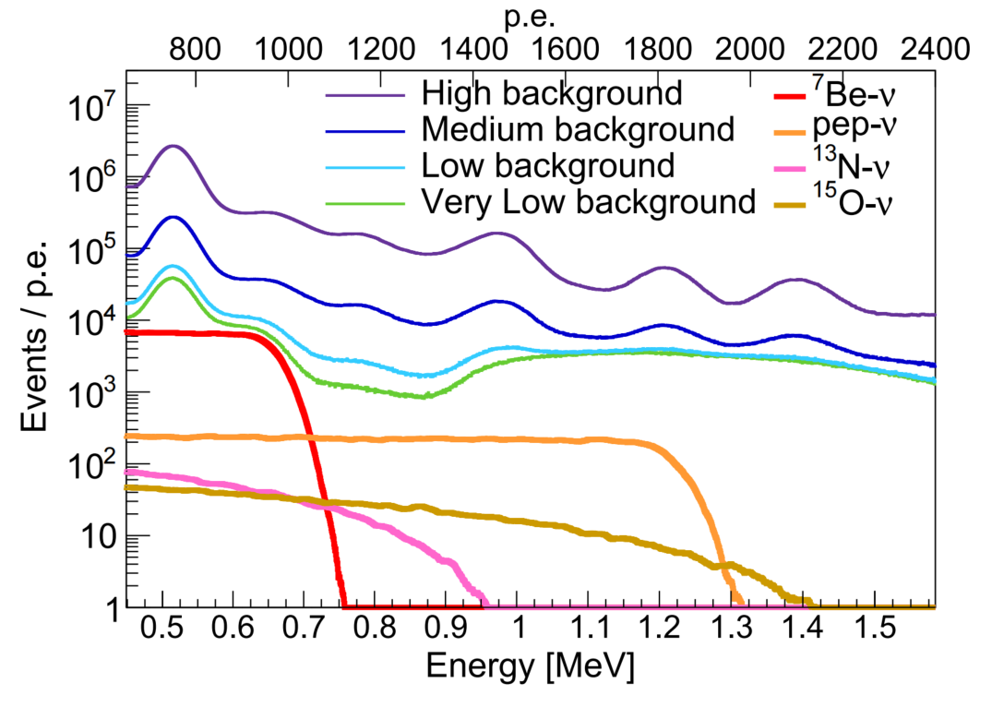

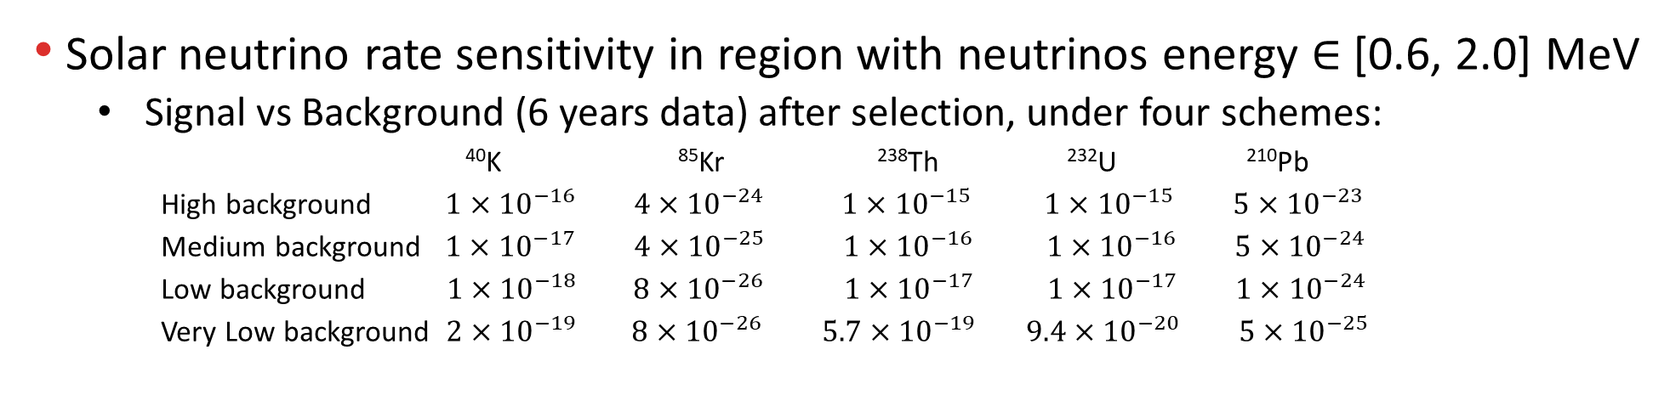
LS Background Components’ Impact on Physics The impact on Solar Neutrino ($ν_{e}, ν_{x}$) Detection
Solar neutrino rate sensitivity in region with neutrinos energy $∈$ [0.6, 2.0] MeV
Signal vs Background (6 years data) after selection, under four schemes:
⁴⁰K ⁸⁵Kr ²³⁸Th ²³²U ²¹⁰Pb
High background $1×{10}^{−16}$ $4×{10}^{−24}$ $1×{10}^{−15}$ $1×{10}^{−15}$ $5×{10}^{−23}$
Medium background $1×{10}^{−17}$ $4×{10}^{−25}$ $1×{10}^{−16}$ $1×{10}^{−16}$ $5×{10}^{−24}$
Low background $1×{10}^{−18}$ $8×{10}^{−26}$ $1×{10}^{−17}$ $1×{10}^{−17}$ $1×{10}^{−24}$
Very Low background $2×{10}^{−19}$ $8×{10}^{−26}$ $5.7×{10}^{−19}$ $9.4×{10}^{−20}$ $5×{10}^{−25}$
The unit is $g/g$
JCAP 10 (2023) 022
$$v_{e,x}+e^{−}→v_{e, x}+e^{−}$$

Slide 12
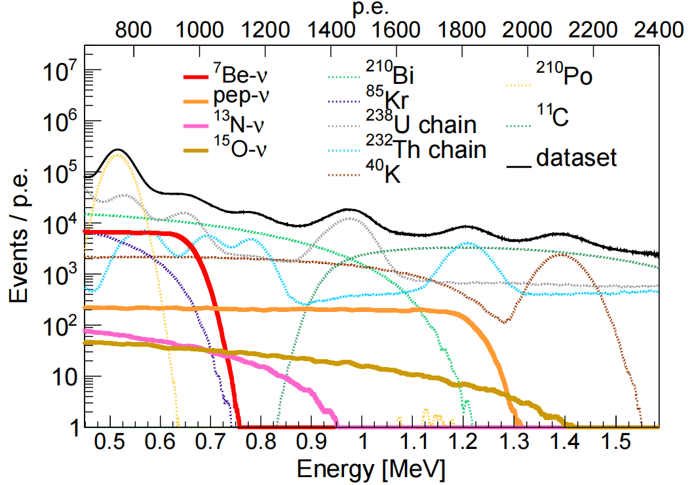

LS Background Components’ Impact on Physics The impact on Solar Neutrino ($ν_{e}, ν_{x}$) Detection
Solar neutrino rate sensitivity in region with neutrinos energy $∈$ [0.6, 2.0] MeV
Signal vs Background (6 years data) after selection, under four schemes:
⁴⁰K ⁸⁵Kr ²³⁸Th ²³²U ²¹⁰Pb
High background $1×{10}^{−16}$ $4×{10}^{−24}$ $1×{10}^{−15}$ $1×{10}^{−15}$ $5×{10}^{−23}$
Medium background $1×{10}^{−17}$ $4×{10}^{−25}$ $1×{10}^{−16}$ $1×{10}^{−16}$ $5×{10}^{−24}$
Low background $1×{10}^{−18}$ $8×{10}^{−26}$ $1×{10}^{−17}$ $1×{10}^{−17}$ $1×{10}^{−24}$
Very Low background $2×{10}^{−19}$ $8×{10}^{−26}$ $5.7×{10}^{−19}$ $9.4×{10}^{−20}$ $5×{10}^{−25}$
The unit is $g/g$
JCAP 10 (2023) 022
$$v_{e,x}+e^{−}→v_{e, x}+e^{−}$$

Slide 13
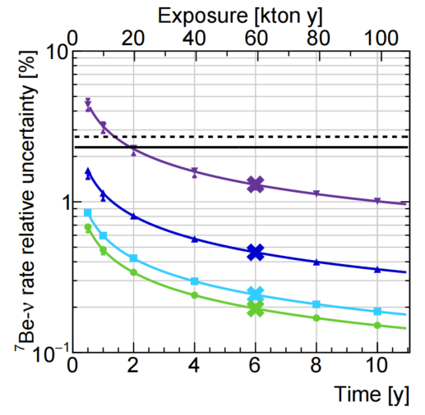
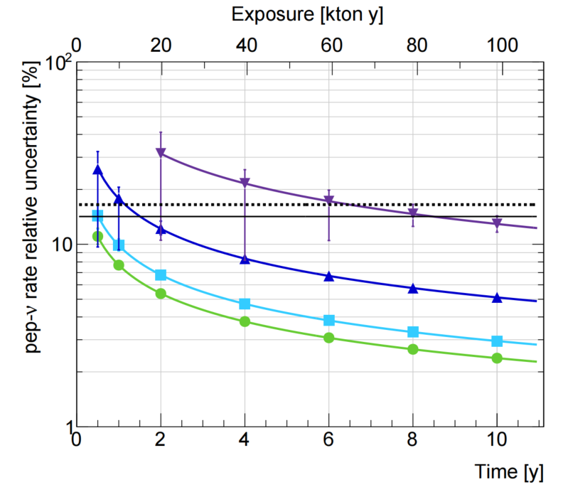
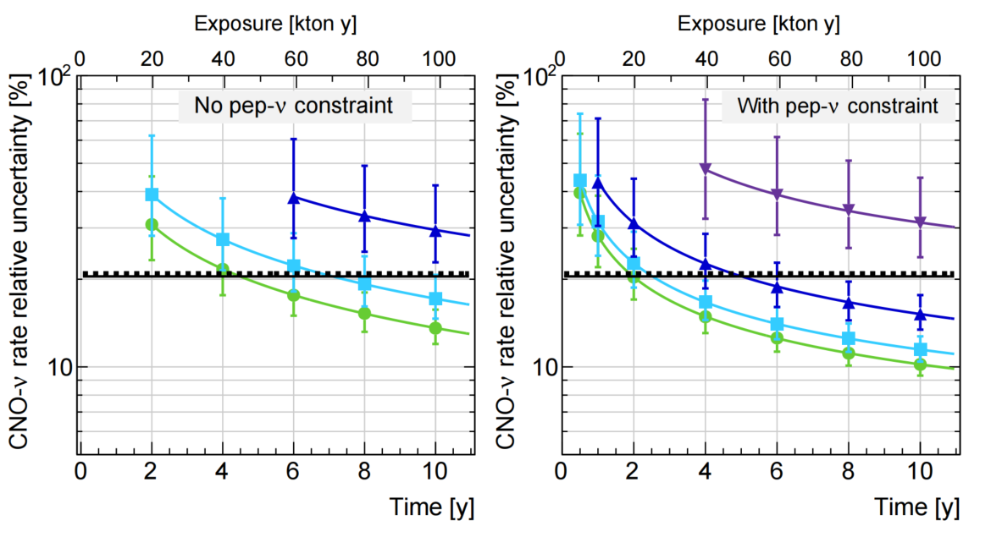
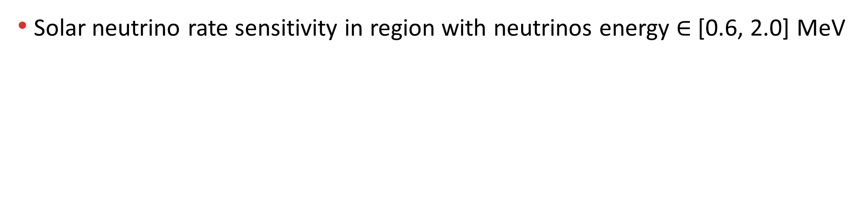
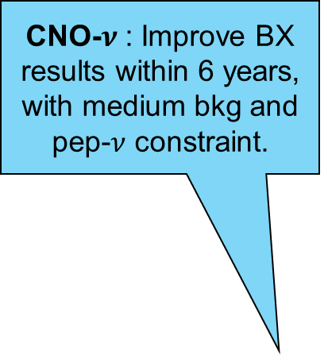
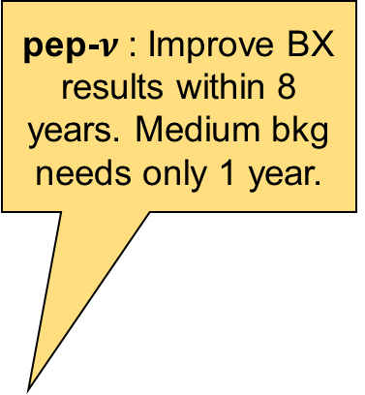
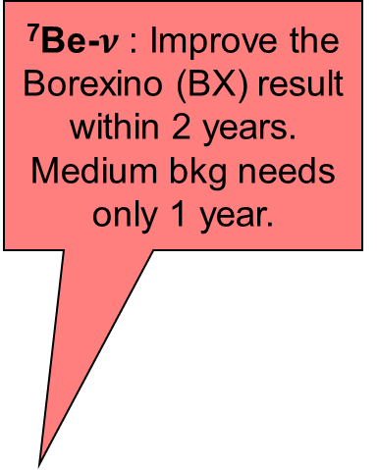
LS Background Components’ Impact on Physics The impact on Solar Neutrino ($ν_{e}, ν_{x}$) Detection
Solar neutrino rate sensitivity in region with neutrinos energy $∈$ [0.6, 2.0] MeV
⁷Be-$ν$ : Improve the Borexino (BX) result within 2 years. Medium bkg needs only 1 year.
pep-$ν$ : Improve BX results within 8 years. Medium bkg needs only 1 year.
CNO-$ν$ : Improve BX results within 6 years, with medium bkg and pep-$ν$ constraint.
JCAP 10 (2023) 022
$$v_{e,x}+e^{−}→v_{e, x}+e^{−}$$

Slide 14
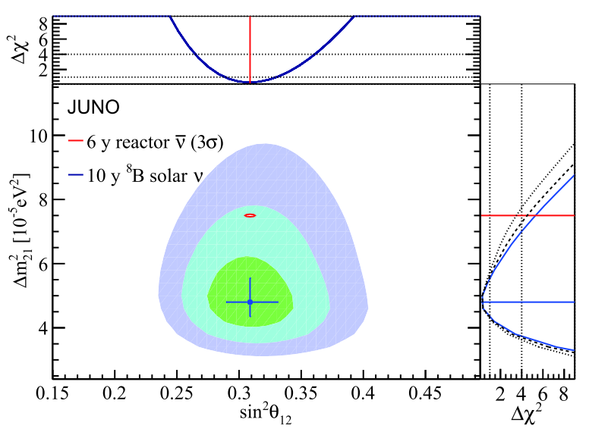
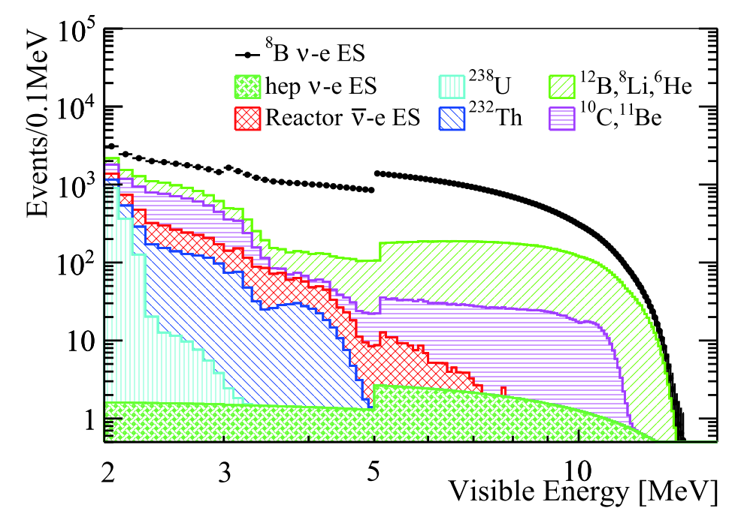
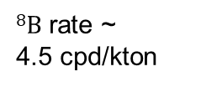
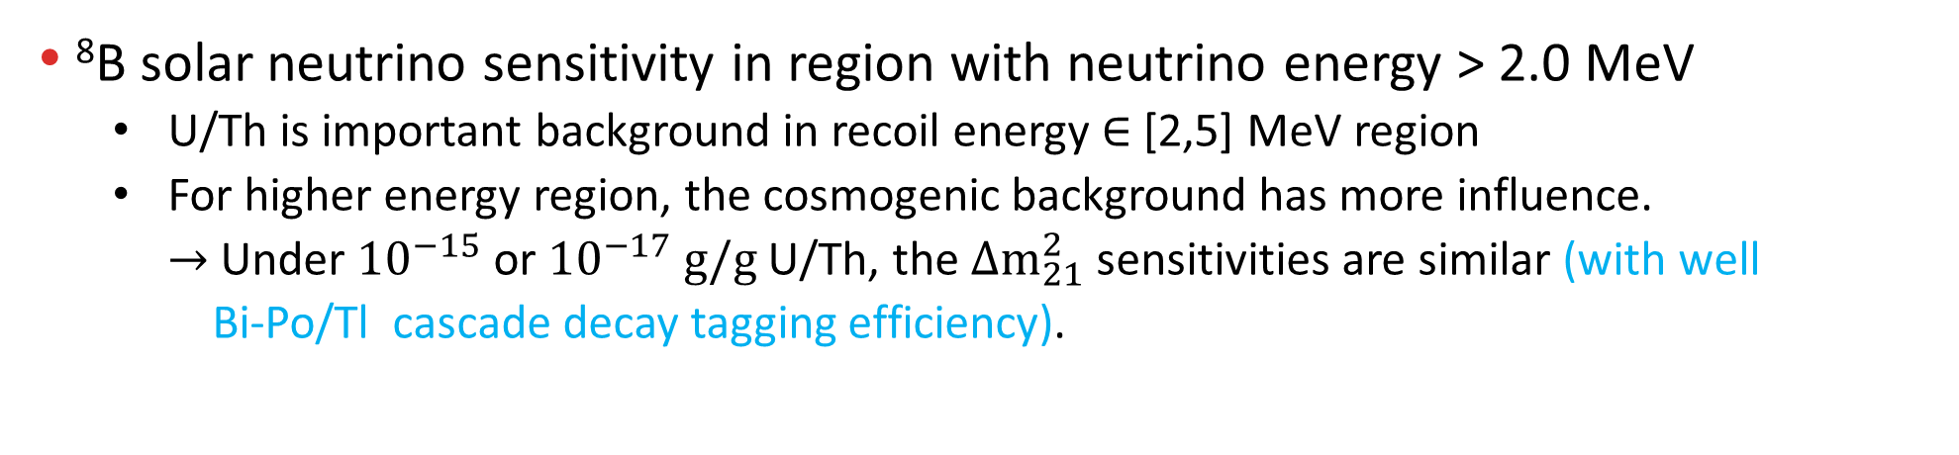

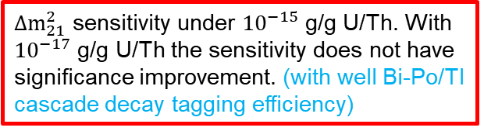
LS Background Components’ Impact on Physics The impact on Solar Neutrino ($ν_{e}, ν_{x}$) Detection
⁸B solar neutrino sensitivity in region with neutrino energy > 2.0 MeV
U/Th is important background in recoil energy $∈$ [2,5] MeV region
For higher energy region, the cosmogenic background has more influence.
$→$ Under ${10}^{−15}$ or ${10}^{−17}$ $g/g$ U/Th, the $Δm_{21}^{2}$ sensitivities are similar (with well
Bi-Po/Tl cascade decay tagging efficiency).
$8B$ rate ~
4.5 cpd/kton
Chin.Phys.C 45 (2021) 2, 023004
Chin.Phys.C 45 (2021) 2, 023004
${10}^{−17}$g/g U/Th, after 10 years of data taking, all selection applied
$Δm_{21}^{2}$ sensitivity under ${10}^{−15}$ g/g U/Th. With ${10}^{−17}$ g/g U/Th the sensitivity does not have significance improvement. (with well Bi-Po/Tl cascade decay tagging efficiency)
$$v_{e,x}+e^{−}→v_{e, x}+e^{−}$$

Slide 15






LS Background Components’ Impact on Physics The impact on Solar Neutrino ($ν_{e}, ν_{x}$) Detection
⁸B Solar $ν_{e}$, $ν_{x}$ can also be detected by CC and NC interactions:
CC : $ν_{e}+13C→e^{−}+13N({\frac{1}{2}}^{+};ground)$
prompt : $e^{−}$ delay : $13N$ $β^{+}$ decay, lifetime~863 s 3929 events (10 years)
NC : $ν_{x}+13C→ν_{x}+13C({\frac{3}{2}}^{−};3.685 MeV)$
single energy $γ$ : 3.685 MeV 3032 events (10 years)
U/Th ~ ${10}^{−17}$ g/g ⁴⁰K ~ ${10}^{−18}$ g/g
²¹⁰Pb ~ ${10}^{−24}$ g/g
$ν_{e}+13C→e^{−}+13N({\frac{1}{2}}^{+};ground)$
$$ν_{x}+13C→ν_{x}+13C({\frac{3}{2}}^{−};3.685 MeV)$$
Astrophys.J. 965 (2024) 2, 122
Astrophys.J. 965 (2024) 2, 122

Slide 16


LS Background Components’ Impact on Physics The impact on Solar Neutrino ($ν_{e}, ν_{x}$) Detection
⁸B Solar $ν_{e}$, $ν_{x}$ can also be detected by CC and NC interactions:
Sensitivities under:
U/Th ~ ${10}^{−17}$ g/g
⁴⁰K ~ ${10}^{−18}$ g/g
²¹⁰Pb ~ ${10}^{−24}$ g/g
Astrophys.J. 965 (2024) 2, 122

Slide 17




Background Control During Installation
Final checks of the acrylic tank inside and outside.
Moisture spray over two days reduced dust levels inside CD air from ~10,000 to ~100.
Two weeks high pressure water jet to remove the protection film and clean the inner acrylic surface by 3D rotating nozzle. Check water cleanness until satisfactory.

Slide 18








Liquid Scintillator Mixing and Purification
Four purification plants + LS Mixing + QA/QC + high purity N₂ and water production plant
to guarantee radio-purity and transparency
5000 m³ LAB tank
Al₂O₃ to remove particles
Distillation to remove radioactive impurities
Add 2.5 g/L PPO, 3 mg/L bis-MSB and 5×10⁻⁵ g/g BHT
SS pipes to underground
JUNO
OSIRIS for LS qualification
Gas stripping to remove Rn and O₂
Water extraction to remove radioactive impurities

Slide 19


Liquid Scintillator Filling
Simultaneous water extraction and LS filling
Comprehensive QC/QA program for LS production, measured for batches:
Radiopurity by ICP-MS every week: U/Th < 1×10⁻¹⁶ g/g
²²²Rn in fresh LS, monitored by CD: <1 mBq/m3
²²²Rn leak < 0.5 mBq/h
Frequent radiopurity monitoring for N₂ and water
Weighted average attenuation length > 20m
2024, Dec 18
Start of Water Filling
2025, Feb 1
End of Water Filling
Water Phase
2025, Feb 8
Start of LS Filling
Mixed Phase
20
2025, Aug 22
End of LS Filling
Attenuation length (m)
Attenuation length Weighted average: 20.6m
2025, Aug 23
Replace 100 t old LS
Full detector calibration
More LS optical properties information can be Fatima’s poster
2025, Aug 26
08:00
Start of Data Taking
10
Feb
Mar
Apr
May
Jun
Jul
Aug
Sampling time

Slide 20


Commissioning Results
VETO Water :
U/Th<0.4×10⁻¹⁵ g/g, ²²²Rn<10 mBq/m³, ²²⁶Ra<1 mBq/m³
Acrylic, water, PMTs, steel and LS are clean and water shielding works :
Single rate <7 Hz for R<17.2m & E>0.7MeV (design 7.2Hz)
Good enough for reactor neutrinos
Spatial distribution of the single events near the acrylic inner surface.
The spots corresponds to the anchors.
Anchor

Slide 21

Commissioning Results
VETO Water :
U/Th<0.4×10⁻¹⁵ g/g, ²²²Rn<10 mBq/m³, ²²⁶Ra<1 mBq/m³
Acrylic, water, PMTs, steel and LS are clean and water shielding works :
Single rate <7 Hz for R<17.2m & E>0.7MeV (design 7.2Hz)
Good enough for reactor neutrinos
LS cleanness is very close to other solar neutrino experiments
²³⁸U < 3×10⁻¹⁷ g/g (low radon area in a small fiducial volume)
< 1×10⁻¹⁶ g/g (fitted plateau from full detector radon decay)
²³²Th < 1×10⁻¹⁶ g/g (R<13m)
²¹⁰Po < 1×10⁵ [cpd/kt]
Recirculation probably impossible, unlike Borexino, KamLAND, SNO+,…
Radiopurity control of raw material:
Meticulous Monte Carlo Simulation for proper distribution of radioactivity budget
Careful material screening
Accurate detector production handling
Better than spec. by 15% !
Radiopurity control during installation :
Leak check of all joints (each < 10⁻⁸ mbar$∙$L/s) for ²²²Rn and ⁸⁵Kr √
Cleaning and washing of all pipes & vessels to remove dust (by check water/LAB cleanness) √
Clean room environment during installation √
Acrylic Surface treatment and protection(Rn daughters) √
LS filling scheme: water replacement and water washing √
JHEP 11 (2021) 102

Slide 22


Summary
JUNO is a large multiple-purpose neutrino observatory, with 20 kton high transparency and high radio-purity liquid scintillator.
Background status of the liquid scintillator $↔$ physic sensitivities
${10}^{−15}$ g/g U/Th, 80k cpd/kton ²¹⁰Po’s contribution to the B/S of the reactor neutrino measurement < 2%.
With ${10}^{−16}$ g/g U/Th, ${10}^{−17}$ g/g ⁴⁰K, $4×{10}^{−25}$ g/g ⁸⁵Kr, $5×{10}^{−24}$ g/g ²¹⁰Pb, JUNO can improve Borexino’s ⁷Be and pep solar neutrino rate results whitin one year of data taking.
With similar background level, JUNO will also has good sensitivities on the CNO and ⁸B solar neutrinos.
The background control is carefully planned and implemented.
Commissioning result :
Single rate <7 Hz for R<17.2m & E>0.7MeV (design 7.2Hz)
²³⁸U < 3×10⁻¹⁷ g/g (small fiducial volume), ²³⁸U < 1×10⁻¹⁶ g/g (full detector)
²³²Th < 1×10⁻¹⁶ g/g (R<13m)
²¹⁰Po < 1×10⁵ [cpd/kt]
Data taking started in the end of Aug, 2025. Physics results coming soon.

