Slide 1
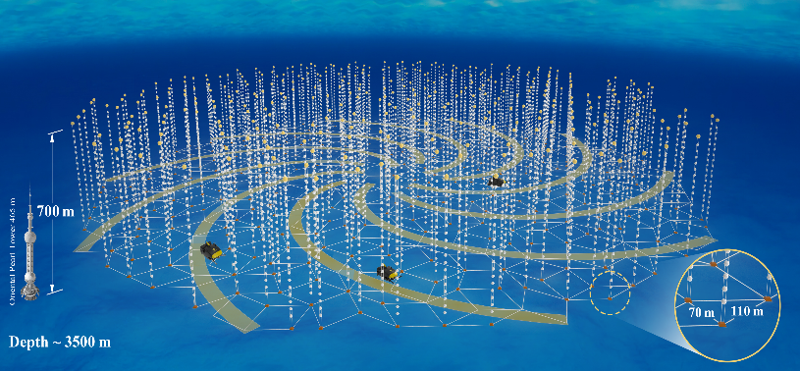
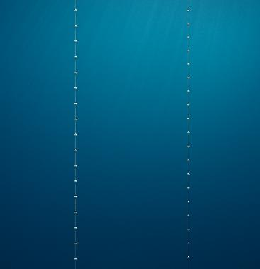
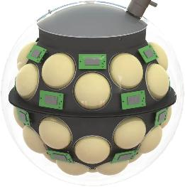


Physics-driven optimisation of the TRIDENT neutrino telescope
Iwan Morton-Blake
On behalf of the TRIDENT collaboration
Tsung-Dao Lee Institute / Shanghai Jiao Tong University
The Neutrino Telescopes Workshop 2025, Padova, Italy

Slide 2

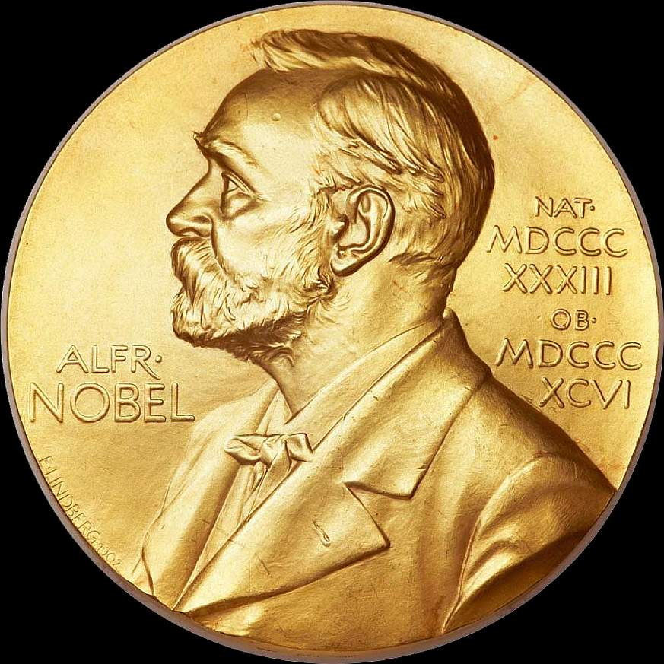
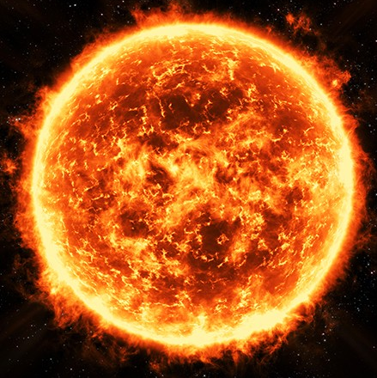
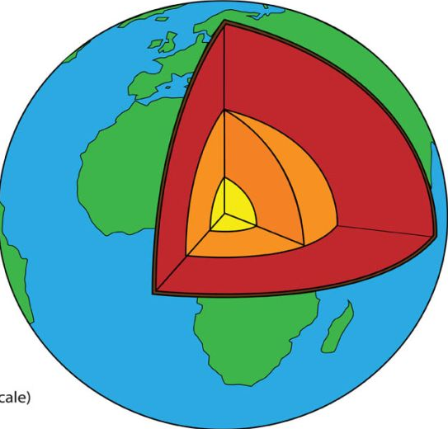
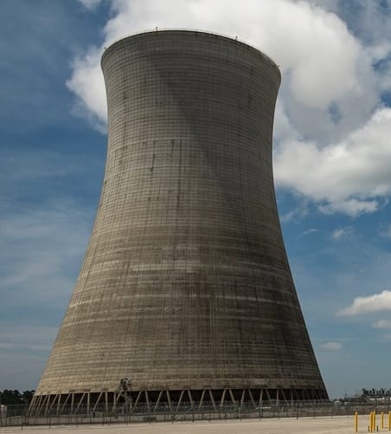
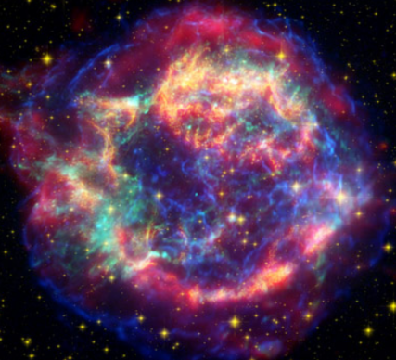
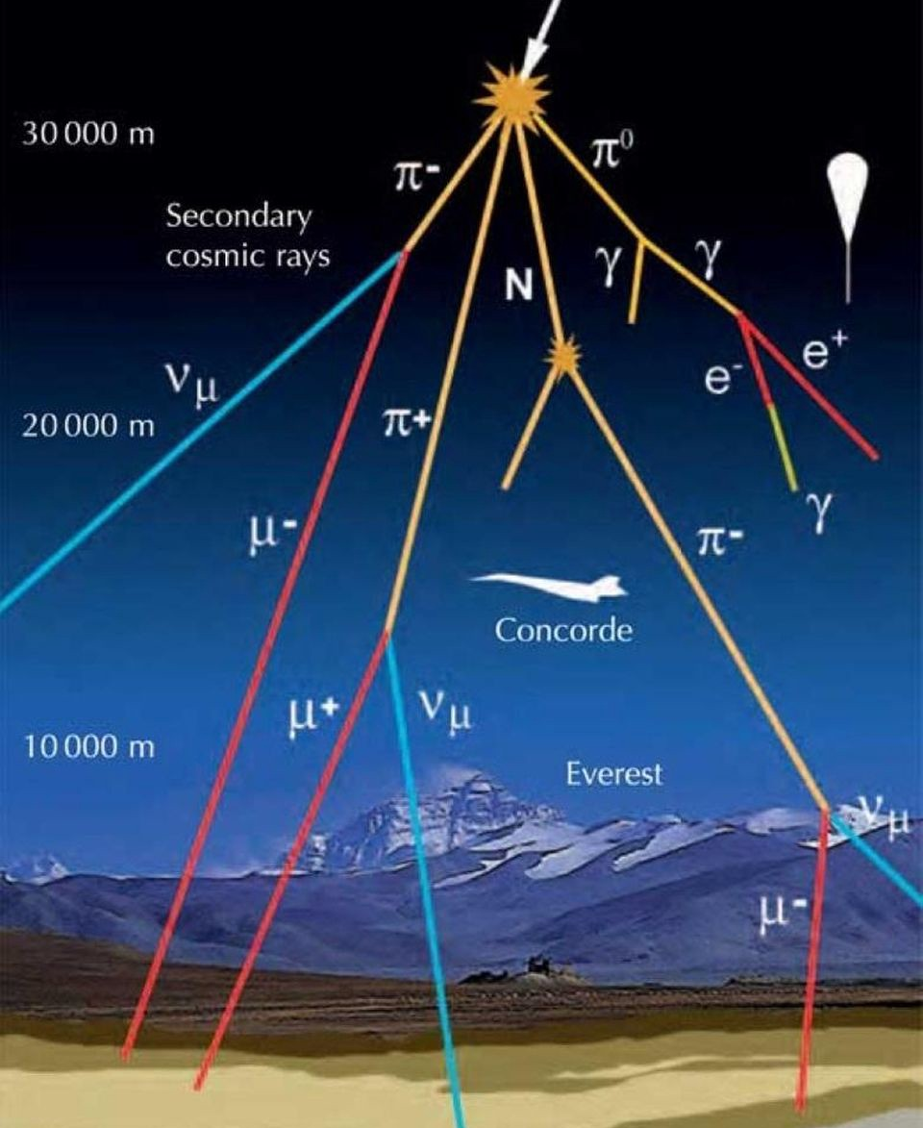
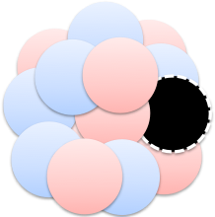
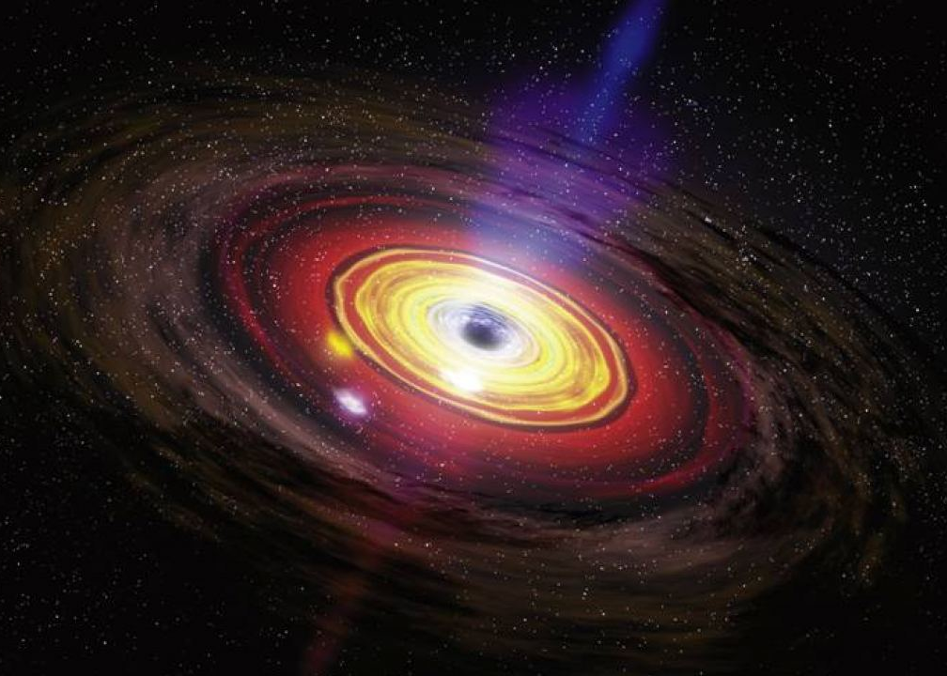
Neutrino Sources
~70 years experience in neutrino measurement!
Homestake (1970)
SNO (2002)
Solar
KamLAND (2005)
Borexino (2010)
Geoneutrinos
Reines & Cowan (1957)
Daya Bay (2012), KamLAND +…
10¹⁰
Reactor
1
Kamiokande (1987)
Flux [cm⁻² s⁻¹ sr⁻¹ MeV⁻¹]
Supernova
Super-Kamiokande
(1998)
10⁻¹⁰
Atmospheric
KamLAND-Zen (2011) (0vBB)
10⁻²⁰
Exotic Searches
Active galactic nucleus, cosmological sources
keV GeV PeV

Slide 3
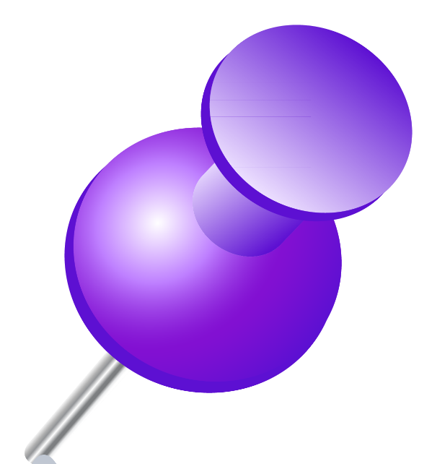
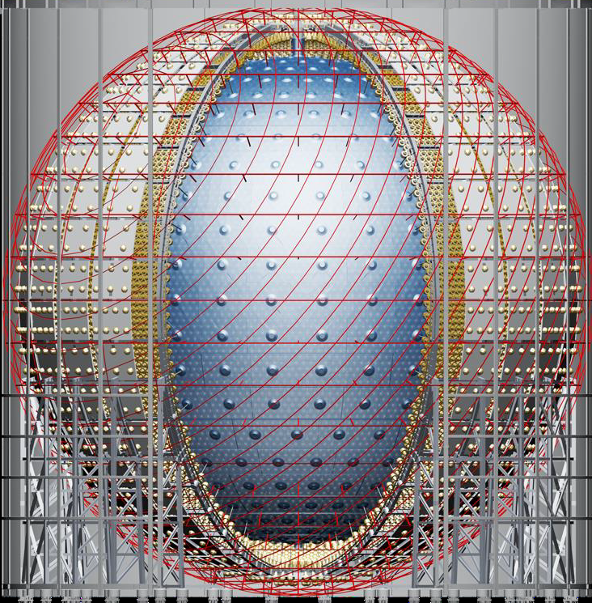

Entering Next-Gen: Liquid Scintillator Detectors
Solar
JUNO
~20,000 tons
Liquid scintillator
Geoneutrinos
10¹⁰
Reactor
1
Flux [cm⁻² s⁻¹ sr⁻¹ MeV⁻¹]
Supernova
10⁻¹⁰
Atmospheric
10⁻²⁰
Kiloton- LS
Detectors
Exotic Searches
Active galactic nucleus, cosmological sources
keV GeV PeV

Slide 4
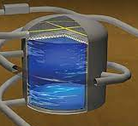
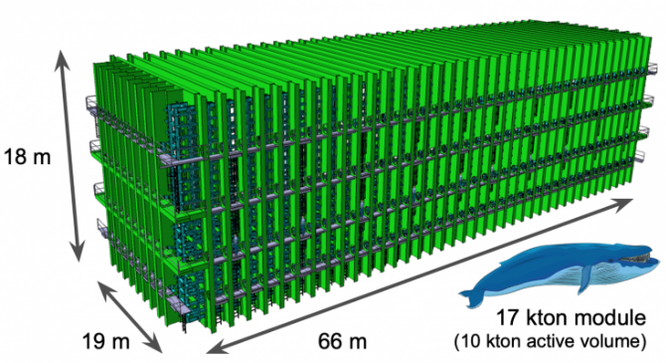
Entering Next-Gen: Water Cherenkov / LArTPCs
e.g.: Hyper-Kamiokande
~200,000t purified water
Solar
Geoneutrinos
10¹⁰
Reactor
1
DUNE
~70 kT Liquid Argon
Flux [cm⁻² s⁻¹ sr⁻¹ MeV⁻¹]
Supernova
10⁻¹⁰
Atmospheric
10⁻²⁰
Exotic Searches
Active galactic nucleus, cosmological sources
keV GeV PeV

Slide 5
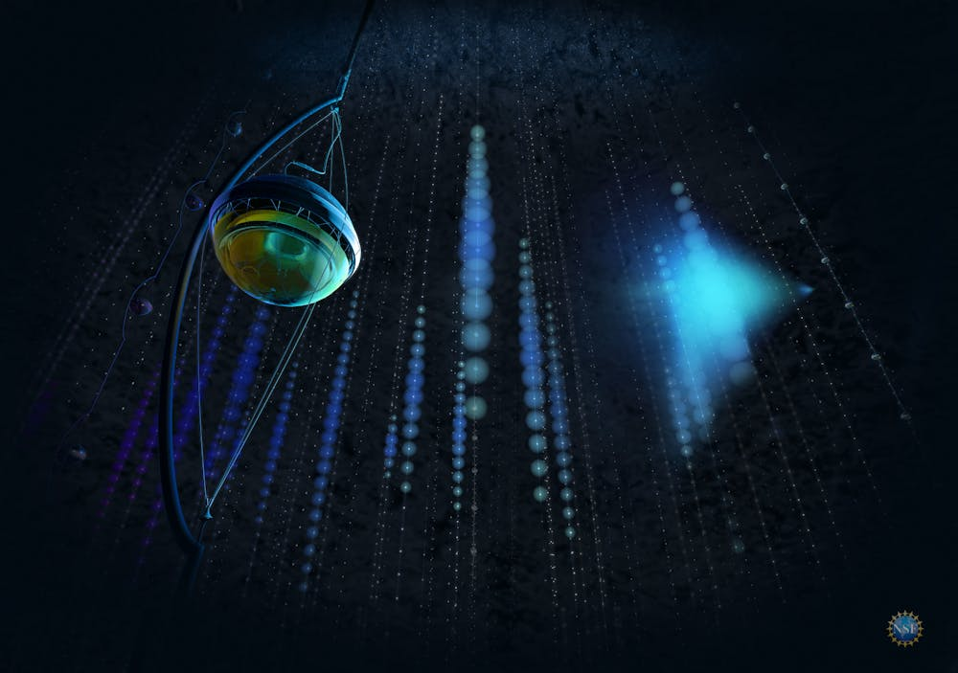
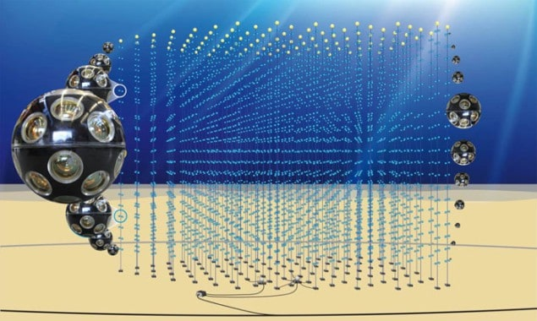
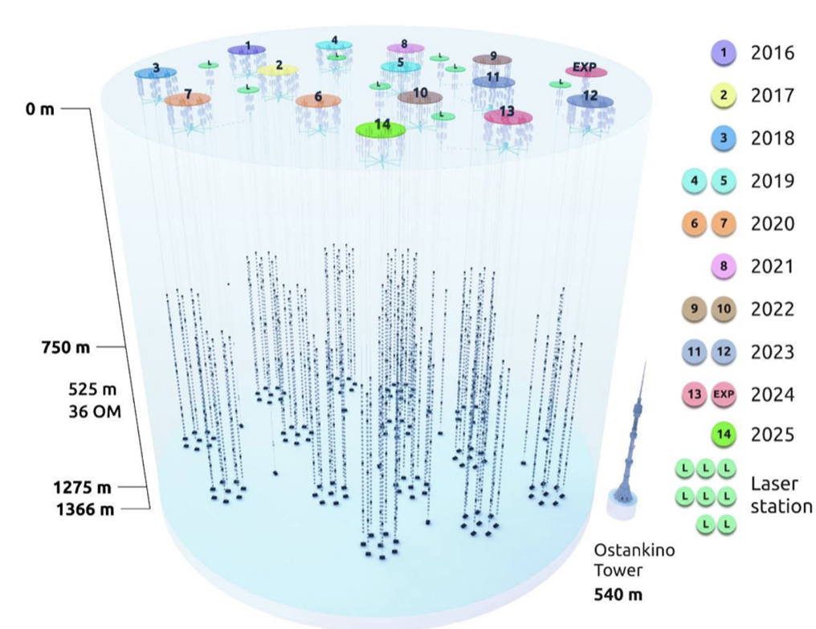
Neutrino Telescope Cherenkov Detectors
Solar
Geoneutrinos
10¹⁰
Reactor
1
Flux [cm⁻² s⁻¹ sr⁻¹ MeV⁻¹]
Supernova
10⁻¹⁰
Atmospheric
10⁻²⁰
Under-Ice/Water
Telescopes
Exotic Searches
Active galactic nucleus, cosmological sources
keV GeV PeV

Slide 6
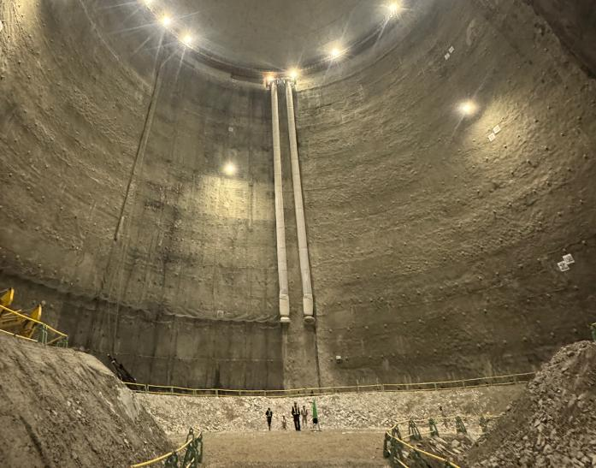
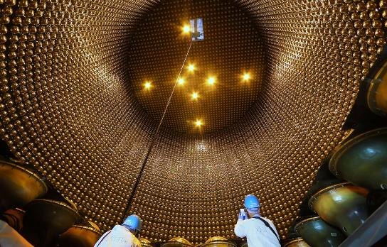
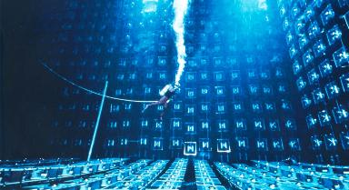
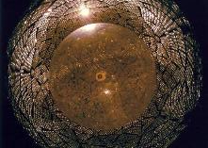

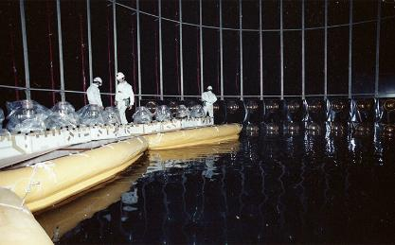
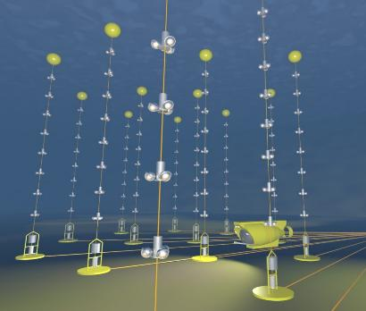
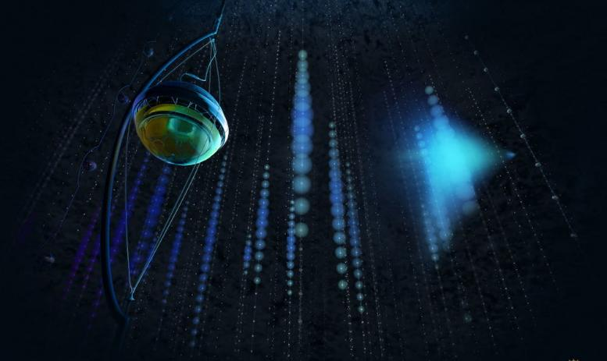
23 kilotons
190
kilotons
3 kilotons
…
200
kgs
1 kiloton
1 kiloton
They grow up so fast 🥲
0.1 km³
1 km³

Slide 7
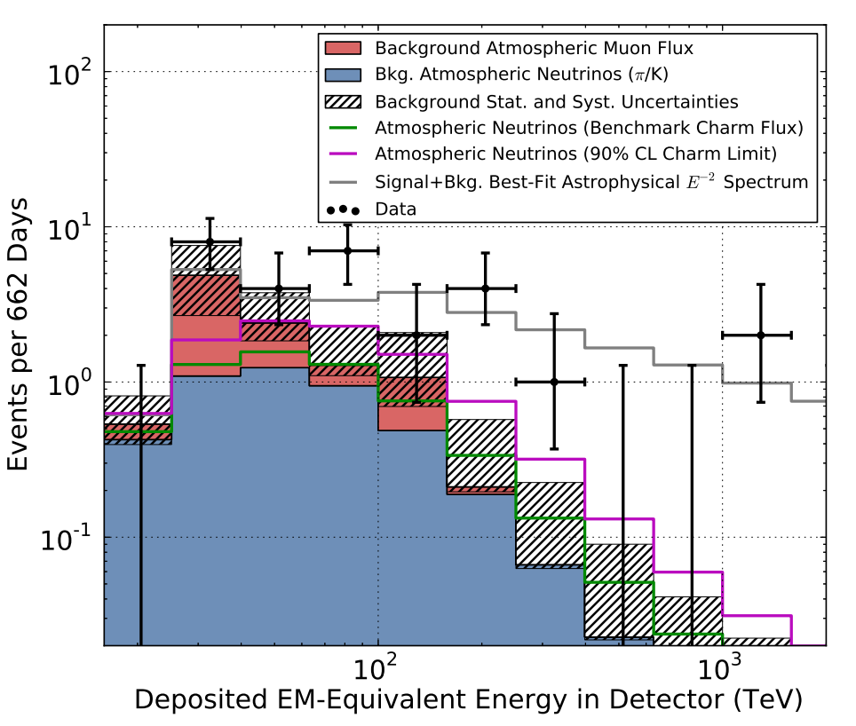
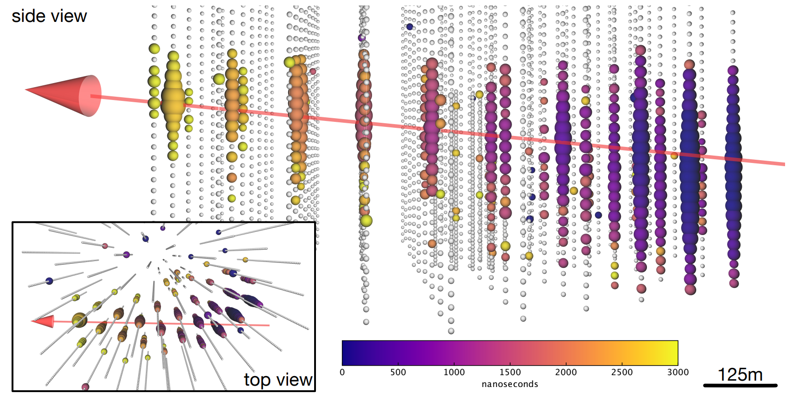
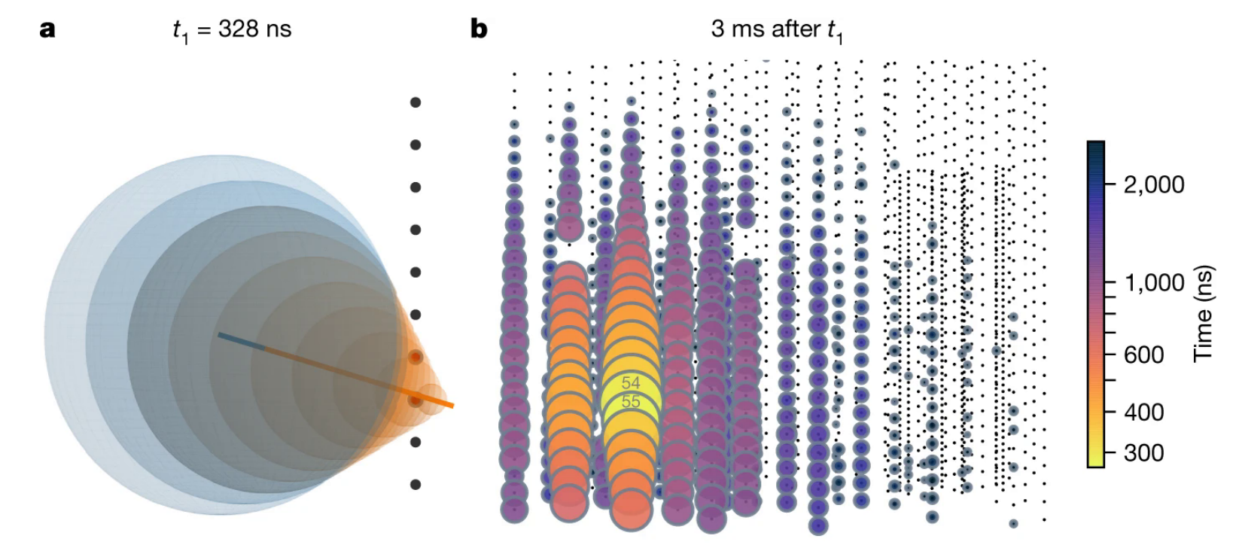
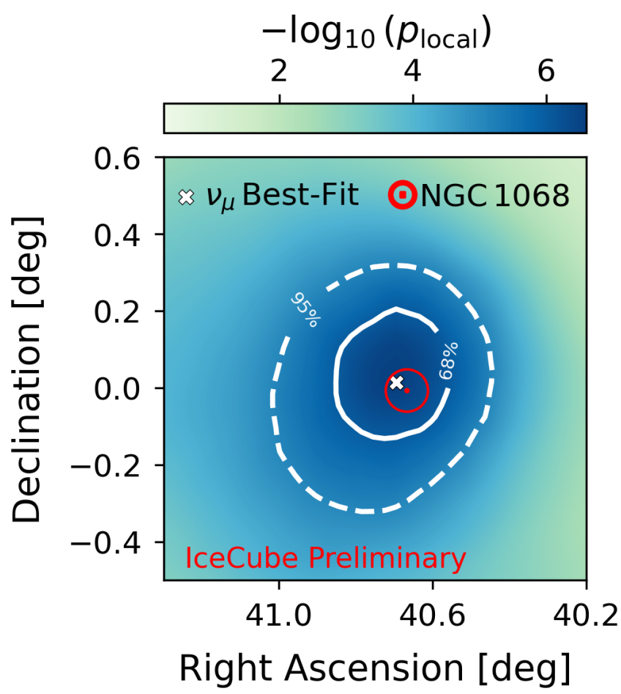
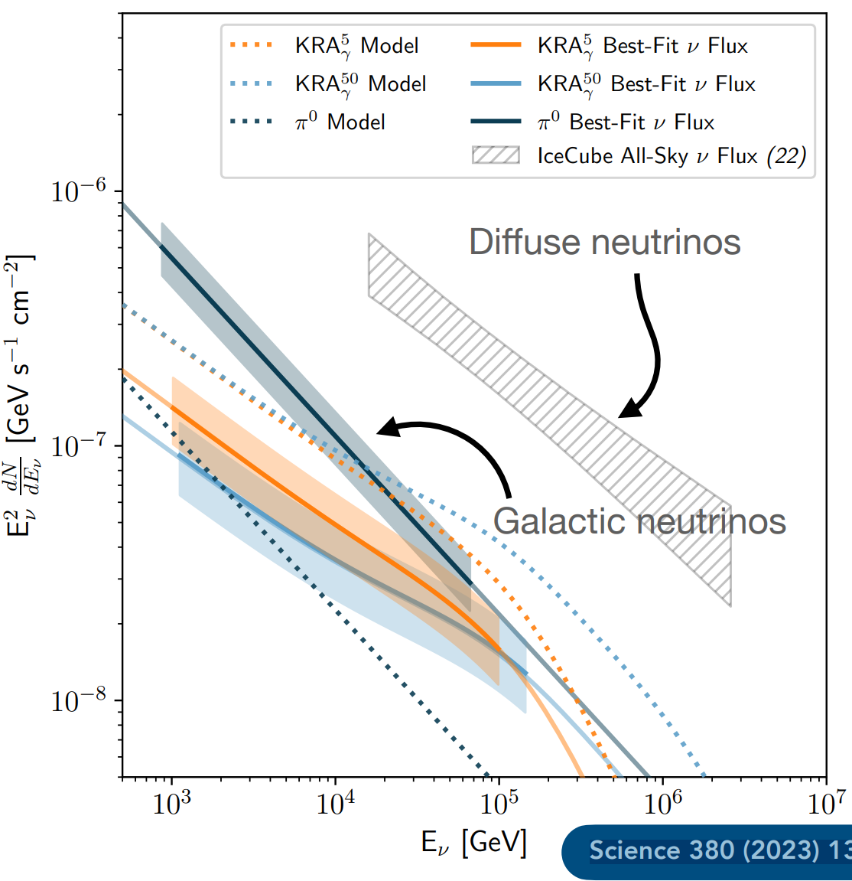
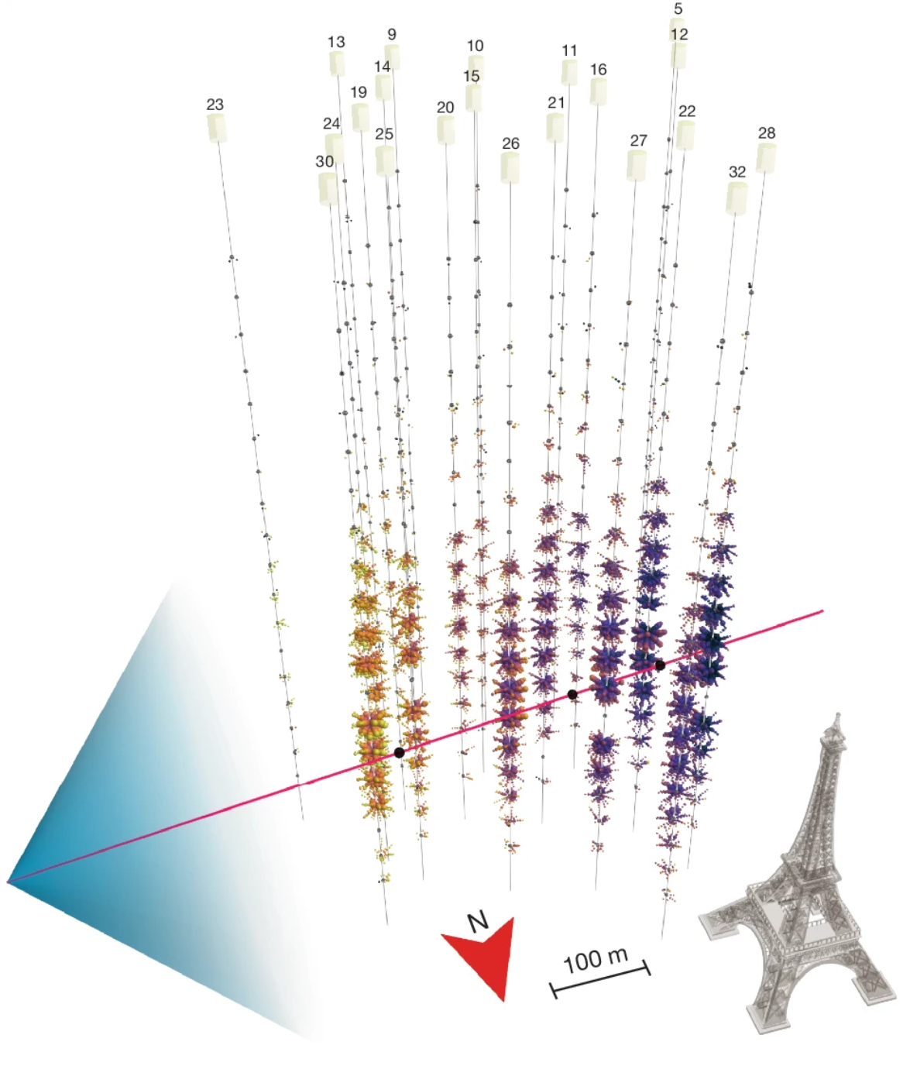
Neutrino Telescopes
(Some) highlights from the last 12 years
Detect extraterrestrial high-energy diffuse neutrino flux
Evidence for neutrino emission from a flaring blazar
Glashow resonance event at 2.3σ
Neutrino emission from active galaxy NGC 1068 reaches 4σ
Galactic plane >TeV neutrinos observed at a 4.5σ
Ultra-high-energy cosmic neutrino
Science. 342 6161 (2013)
Science. 361 6398 (2018)
Nature 591 220-224 (2021)
Science 378 538-543 (2022)
Science 380 1338 (2023)
More, better neutrino telescopes on the way!
Nature 638 376–382 (2025)

Slide 8
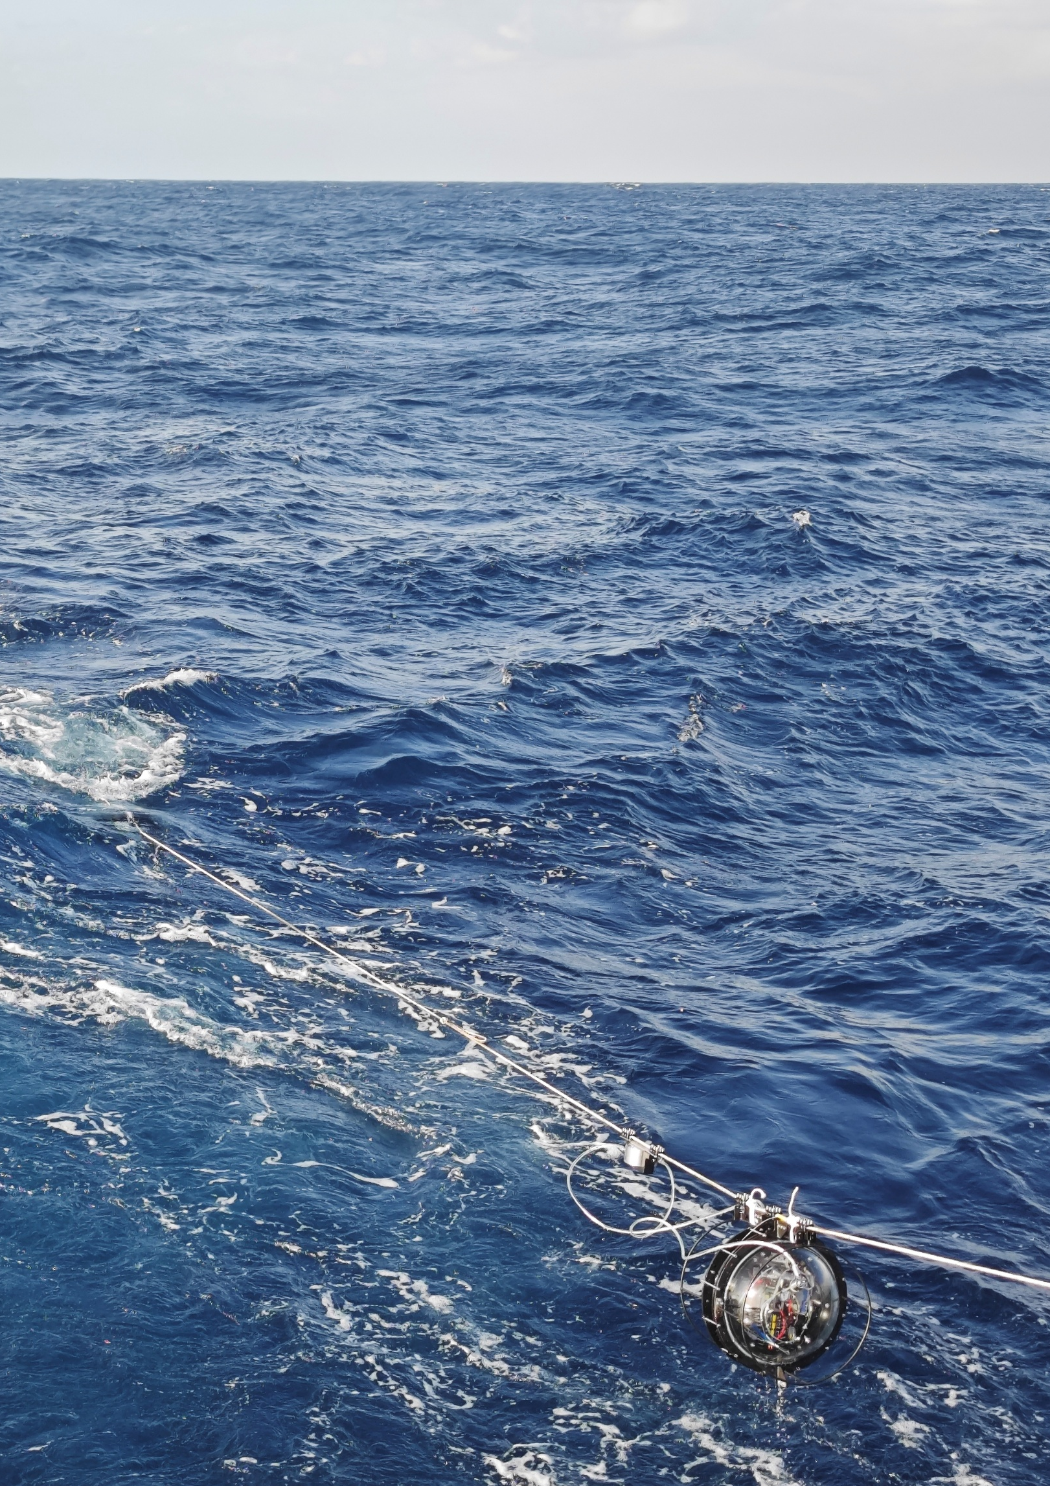


TRIDENT → ~10km³

Slide 9

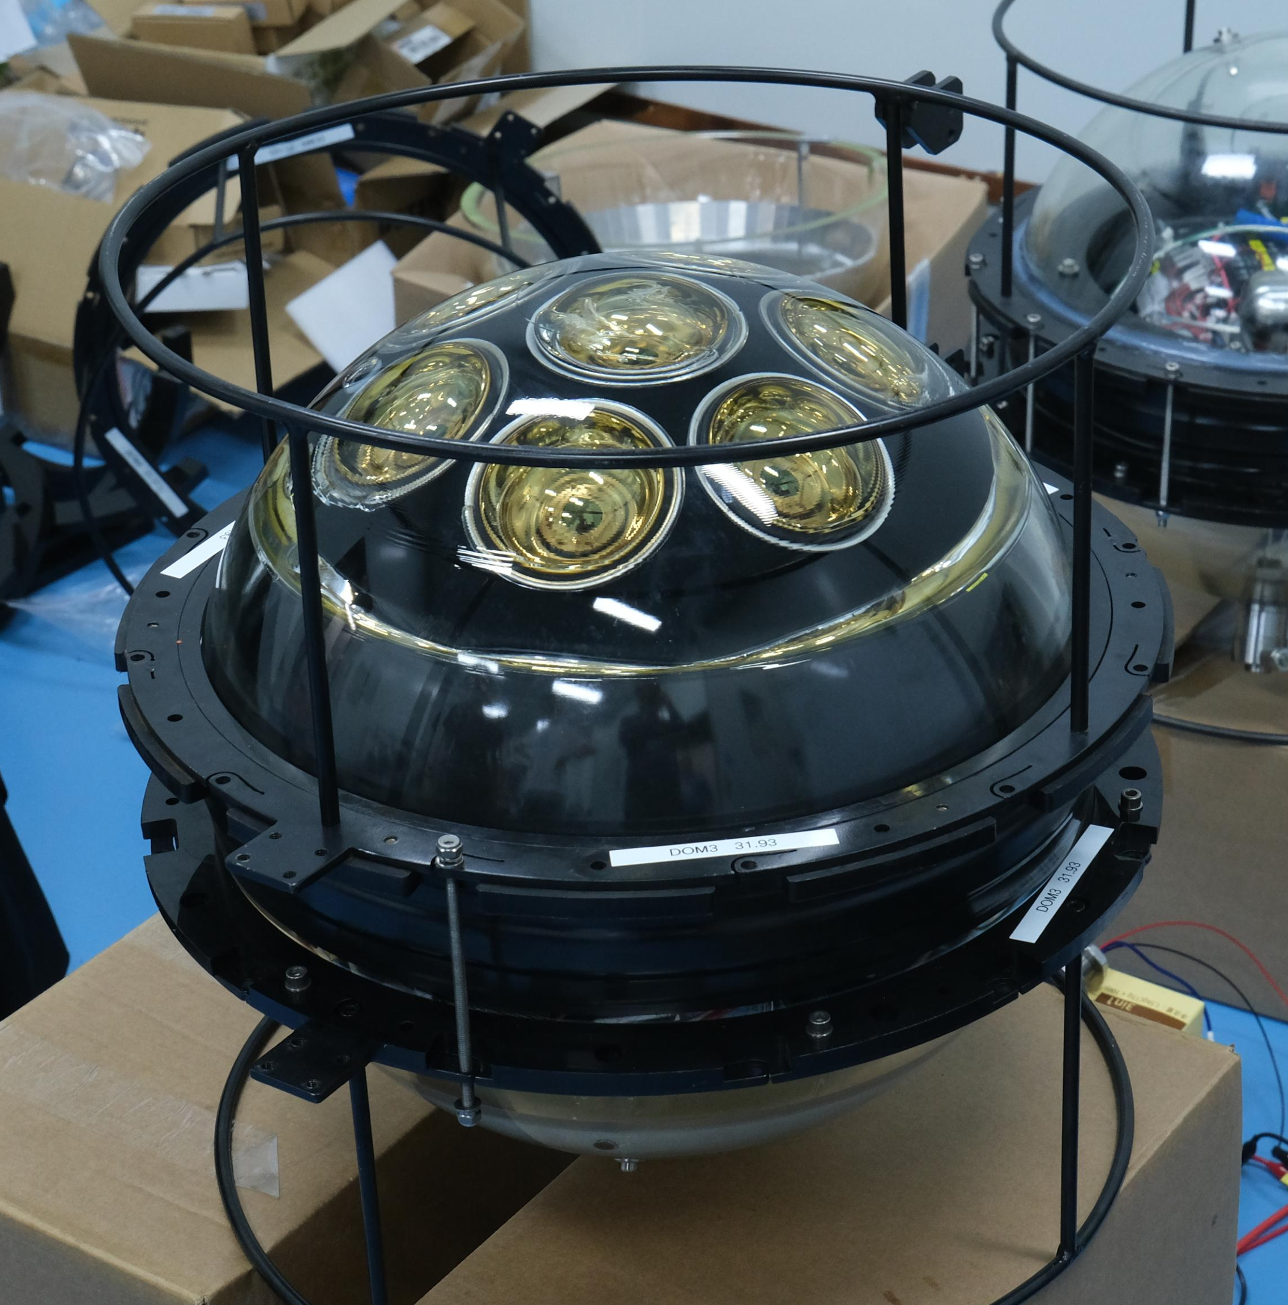
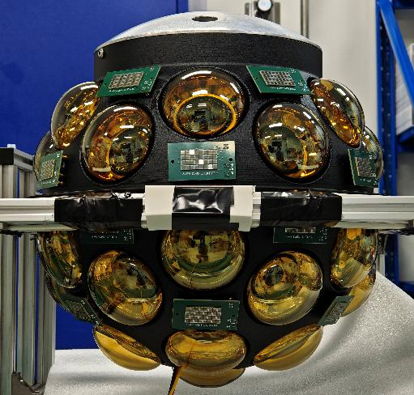
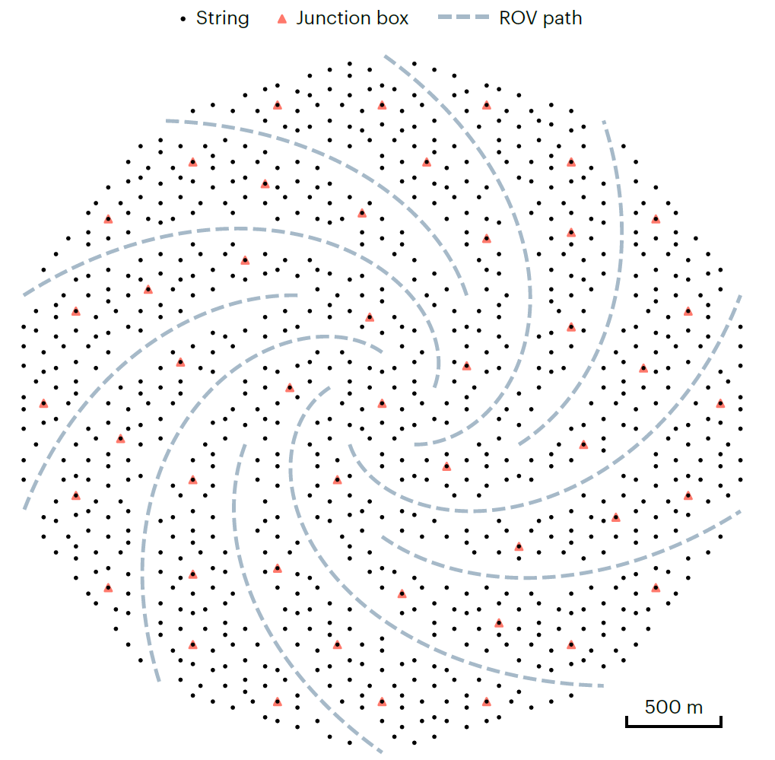
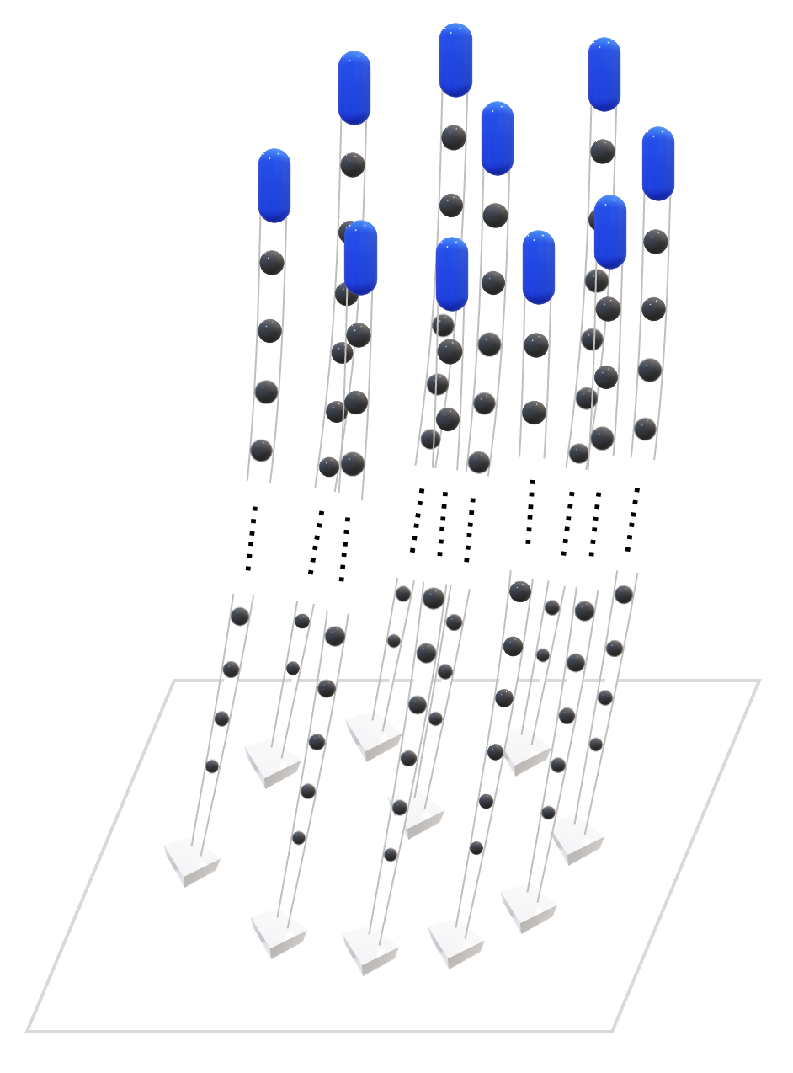
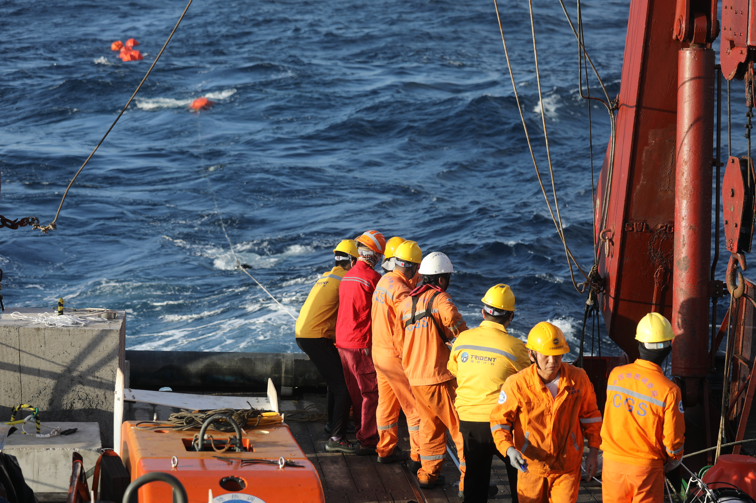
Timeline
Present day
First String Deployment: Phase -1
Expeditions to Sea
TRIDENT
R&D
for Technology + Deployment
Full TRIDENT Array
“Neutrino Telescopes in China”:
Donglian Xu 3rd October 09:00
This talk

Slide 10
TRIDENT → ~10km³
Experimental goals:
Rapidly discover neutrino sources
Sensitivity to all flavors

Slide 11
TRIDENT → ~10km³
Detector Design:
Experimental goals:
Rapidly discover neutrino sources
Sensitivity to all flavors
Bigger is better?
Want to optimize for both goals simultaneously

Slide 12
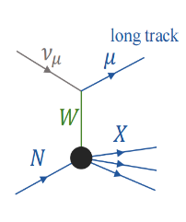
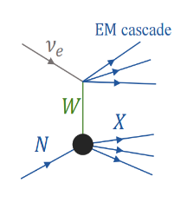
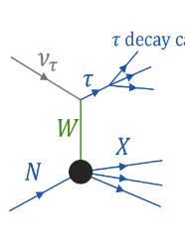
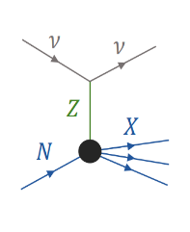
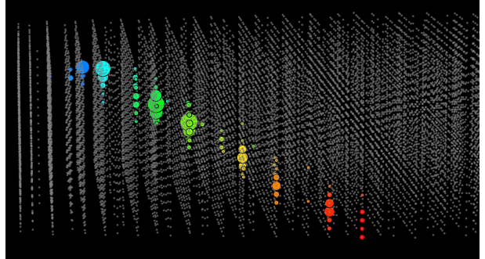
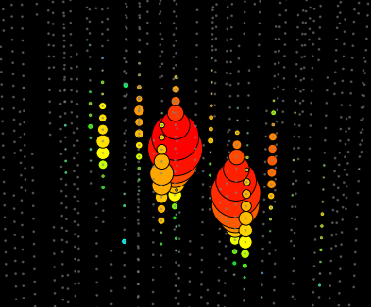
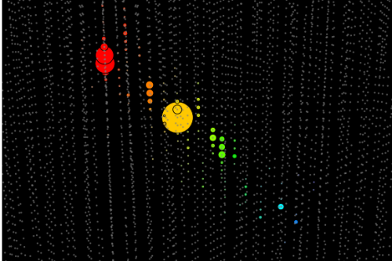
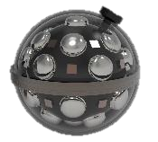




Event interaction types
Charged-Current
Neutral-Current
$τ$ decay
Muon tracks
Cascades
(τ decay can also produce muons)
$$ν_{μ}$$
$$ν_{e}$$
$$ν_{τ}$$
TRIDENT simulation

Slide 13
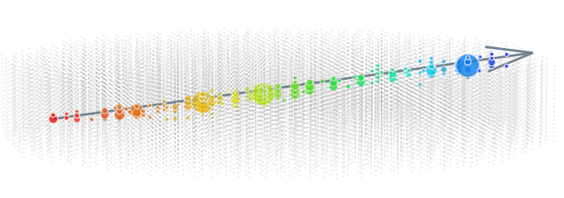
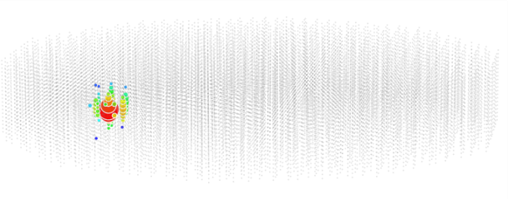
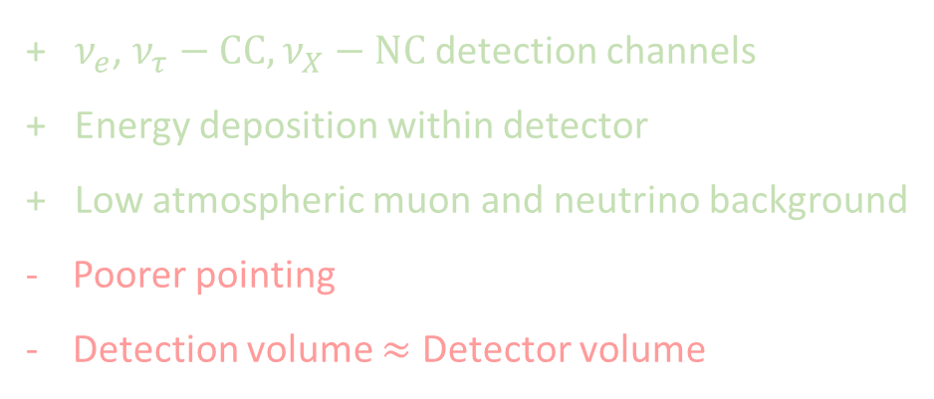
All-Flavour Detection
+ Excellent for pointing → point source discovery
+ Detection volume > Detector volume
Partial energy deposition within detector
Atmospheric muons : strong down-going background
+ $ν_{e}$, $ν_{τ}−CC,$ $ν_{X}−NC$detection channels
+ Energy deposition within detector
+ Low atmospheric muon and neutrino background
Poorer pointing
Detection volume $≈$ Detector volume
Difficult to optimize for all types events of all energies!

Slide 14
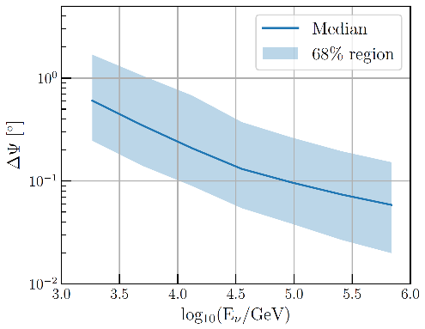
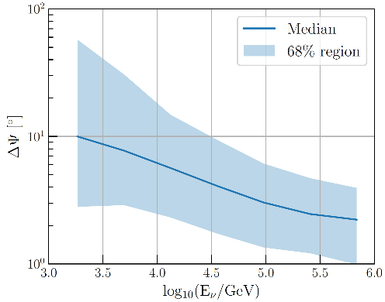



All-Flavour Detection
Track angular resolution
Simulated Track-like event in TRIDENT
~0.1°
$$ν_{μ}$$
$$μ$$
TRIDENT Simulation
Cascade angular resolution
Simulated Cascade-like event in TRIDENT
TRIDENT Simulation
$$ν_{e/τ}$$
~3°

Slide 15



Experimental goals:
Rapidly discover neutrino sources
Sensitivity to all flavors
Point source sensitivity/
Discovery potential vs declination with tracks
TRIDENT neutrino flavour ratio sensitivity with tracks, cascades and $ν_{τ}$ double-pulse identification
Nature Astronomy 7, 1497–1505 (2023)
“Real-time Optical Calibration Strategy and Astrophysical Tau Neutrino Identification in Water-based Next-generation Neutrino Telescopes” W. Tian, PhD Thesis
Combine both goals into a single figure of merit?

Slide 16








1) Source neutrino flux
Energy + Direction
TRIDENTSim
2) Forced Interaction near the detector
Event weighting → Earth propagation, cross sections, oscillation
3) Deep Inelastic Scattering (CORSIKA8[1,2])
Neutral and Charged Current interactions, Particle production
4) Lepton, hadron propagation (CORSIKA8/Geant4[3])
5) Cherenkov photon generation + propagation (Geant4/Optix[4])
Scattering, absorption, dispersion
6) Detector response
Photoelectron generation, ⁴⁰K + dark noise mixing
Signal photons +
noise + radioactivity
7) Electronics response, Triggering, data cleaning
time

Slide 17






Detector design
Sensitivity $\sim \sqrt{Mass}$
Resolution $\sim \sqrt{Phot e}$
$ ¥ €
Photocoverage
# PMTs

Slide 18
Neutrino Telescope Design

Slide 19

Neutrino Telescope Design
Cost + Engineering
Physics
Experiment design must be lead by physics,
limited by engineering and cost

Slide 20




Neutrino Telescope Design
Site Location
2) Optical Modules – hDOMs
3) String Layout / Volume

Slide 21



Detector Design – Location
TRIDENT sensitive viewing region
Hong Kong
Low seacurrents, bioactivity
540km
Low atmospheric muon rate
Sanya
480km
TRIDENT
180km
YongXing Island
South China Sea
Near the equator
3.5 km deep
Large, flat plane
“MuonSLab: A plastic scintillator based detector for muon measurement in the deep ocean”
1:25 scale string models in SJTU Ship-towing tank

Slide 22
Detector Design – hDOMs
Hybrid Digital Optical Module
Hybrid: PMTs + SiPMs
PMTs
Fine timing resolution (TTS FWHM ~1.8 ns)
High quantum efficiency >30% at 400nm
Balance design with:
Physics performance
Reduction of backgrounds
e.g. ⁴⁰K & PMT Dark noise
Cost & Power consumption
Additional low energy physics
SiPMs
→ Fine timing resolution
Fills spaces between the PMTs, extra sensitivity
SiPM arrays aids in calibration
JINST 19 (2024) 06, P06011
JINST 19 (2024) 05, P05040

Slide 23




Detector Design – hDOMs
“A Cost Effective Optimization of the hybrid-DOM Design for TRIDENT”
Check / compare performances for various designs:
e.g. neutrino detection efficiency + angular resolution
3-inch PMT hDOM design
31 3” PMTs
24 SiPMs
(4x8 array)
4-inch PMT hDOM design
19 4” PMTs
5 SiPMs
(8x8 array)

Slide 24




Detector Design – Geometry
Nature Astronomy 7, p1497–1505 (2023)
KM3NeT
Baikal GVD
P-ONE
Nature Astronomy 4 913–915 (2020)
Lake Louise Winter Institute 2025,
Agustín Sánchez Losa
5th International Symposium on Cosmic Rays and Astrophysics, Zhan-Arys Dzhilkibaev

Slide 25



Detector Geometry : String Spacing
Given N number of strings, how should they be arranged?
Quickly alters detector volume
Strongly impacts detection efficiency
Deployment difficulties, strings may tangle if too close!
(looking top-down on detector)
Increasing string spacing / volume

Slide 26



Detector Geometry : String Height
Given N number of strings, how should they be arranged?
Impacts horizontal event detection cross-section
Deployment/maintenance issues if too tall!
(looking side-on)
Increasing string height / volume

Slide 27



Detector Geometry : Clustering
Given N number of strings, how should they be arranged?
Deployment/maintenance benefits
Impacts energy range
Miss events in cluster-cluster gaps
More edge events
(looking top-down on detector)
Equal volumes,
More severe clustering

Slide 28









Comparing Geometries
Using full-chain detector simulation with site-measured optical conditions, atmospheric backgrounds and hDOM backgrounds:
Figure of Merit:
Neutrino source discovery potential
Designs compared vs “Reference” geometry:
Average string spacing ~ 100m
String height ~ 600m
“Reference” geometry

Slide 29





Track Performance vs Detector Size
Track-like events
Relative signal event rate
Rel. pointing resolution
Better
TRIDENT Simulation
TRIDENT Simulation
Dense 3km³ → Sparse 16km³
Big sparse detector : More (fewer) high- (low-) energy tracks Worse direction resolution

Slide 30



Cascade Performance vs Detector Size
Cascade-like events
Relative Signal Event Rate
Rel. Pointing Resolution
Better
TRIDENT Simulation
TRIDENT Simulation
Dense 3km³ → Sparse 16km³
Big sparse detector : More (fewer) high- (low-) energy cascades Worse direction resolution

Slide 31




Source Discovery Potential
Assuming the “standard” geometry takes 5 years to discover a given source
How much slower/faster can each geometry discover same source?
$$E^{−2}$$
“hard” source
$$φ\left(E_{ν}\right)∝$$
$$E^{−3}$$
“soft” source
Bigger detector is not necessarily better
Worse at low energies tracks and cascades:
Worse at high energies tracks and cascades:
Dense detector favours low energy events
TRIDENT Simulation

Slide 32

Source Discovery Potential – String Clustering
String clusters show poorer performance for all channels, except for low energy cascades.
However, physics must be weighed against deployment & maintenance cost, safety
TRIDENT Simulation

Slide 33


Source Discovery Potential – Optical properties
While geometry choice is significant,
water optical properties are essential!
→ Attenuation length can have larger impact than geometry choices
TRIDENT Simulation

Slide 34

Source Discovery Potential – Optical properties
Photon detection efficiency should therefore lead the design of a detector.
Ongoing/future measurements at site and in TRIDENT Phase-1 will influence the final design choice
TRIDENT Simulation

Slide 35

Conclusion
TRIDENT is an upcoming neutrino telescope aims to reach next-generation size and performance
TRIDENT’s design is optimised directly via its physics goals:
Rapid source discovery and all-flavour detection
Bigger does not necessarily mean better:
Event rate must be balanced with reconstruction quality.
Optical properties play a significant role and should lead design
Phase-1 deployment next year used is input
Aim to add flavour ratio sensitivity into design optimisation

Slide 36

TRIDENT Analysis and Simulation
When they’re not building the detector, they’re contributing to the work shown here.
TRIDENTSim development
Reconstruction and analysis methods for Phase-1
Developing TRIDENT’s diverse physics programme

