Slide 1
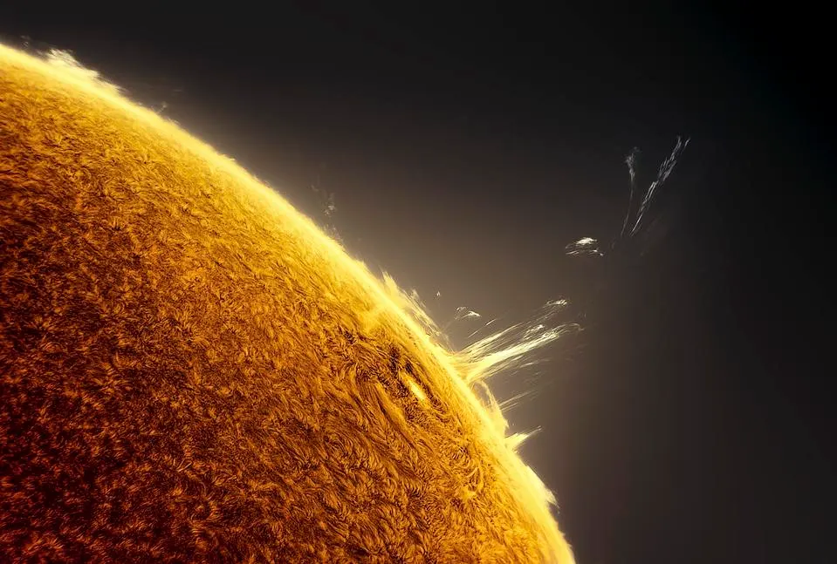



Searches for Solar Neutrinos in the XENONnT experiment
Giovanni Volta
XXI Wokshop on Neutrino Telescope
Sep 30, 2025, Padova
Solar Flare X1 from AR2994 in ‘Motion’ © Miguel Claro

Slide 2
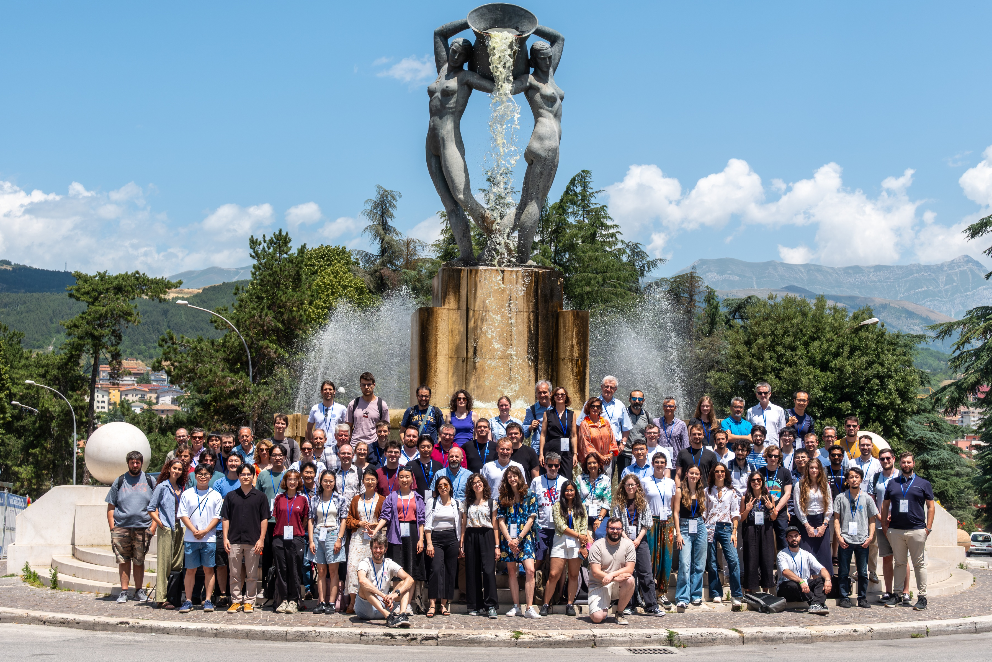
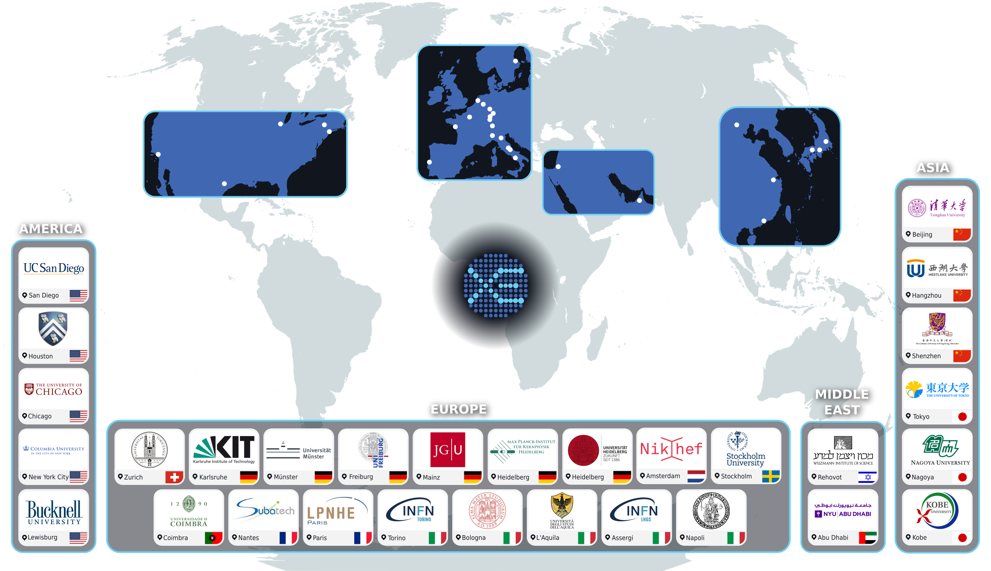
The XENON collaboration
XENON Collaboration Meeting © Maxime Pierre
180 scientists, 30 institutions, 12 countries
Laboratori Nazionali del Gran Sasso (LNGS)
Dual phase liquid-gas xenon time projection chamber
Primar goals to detect search for dark matter (e.g., Weakly Interactive Massive Particles)
01/11

Slide 3
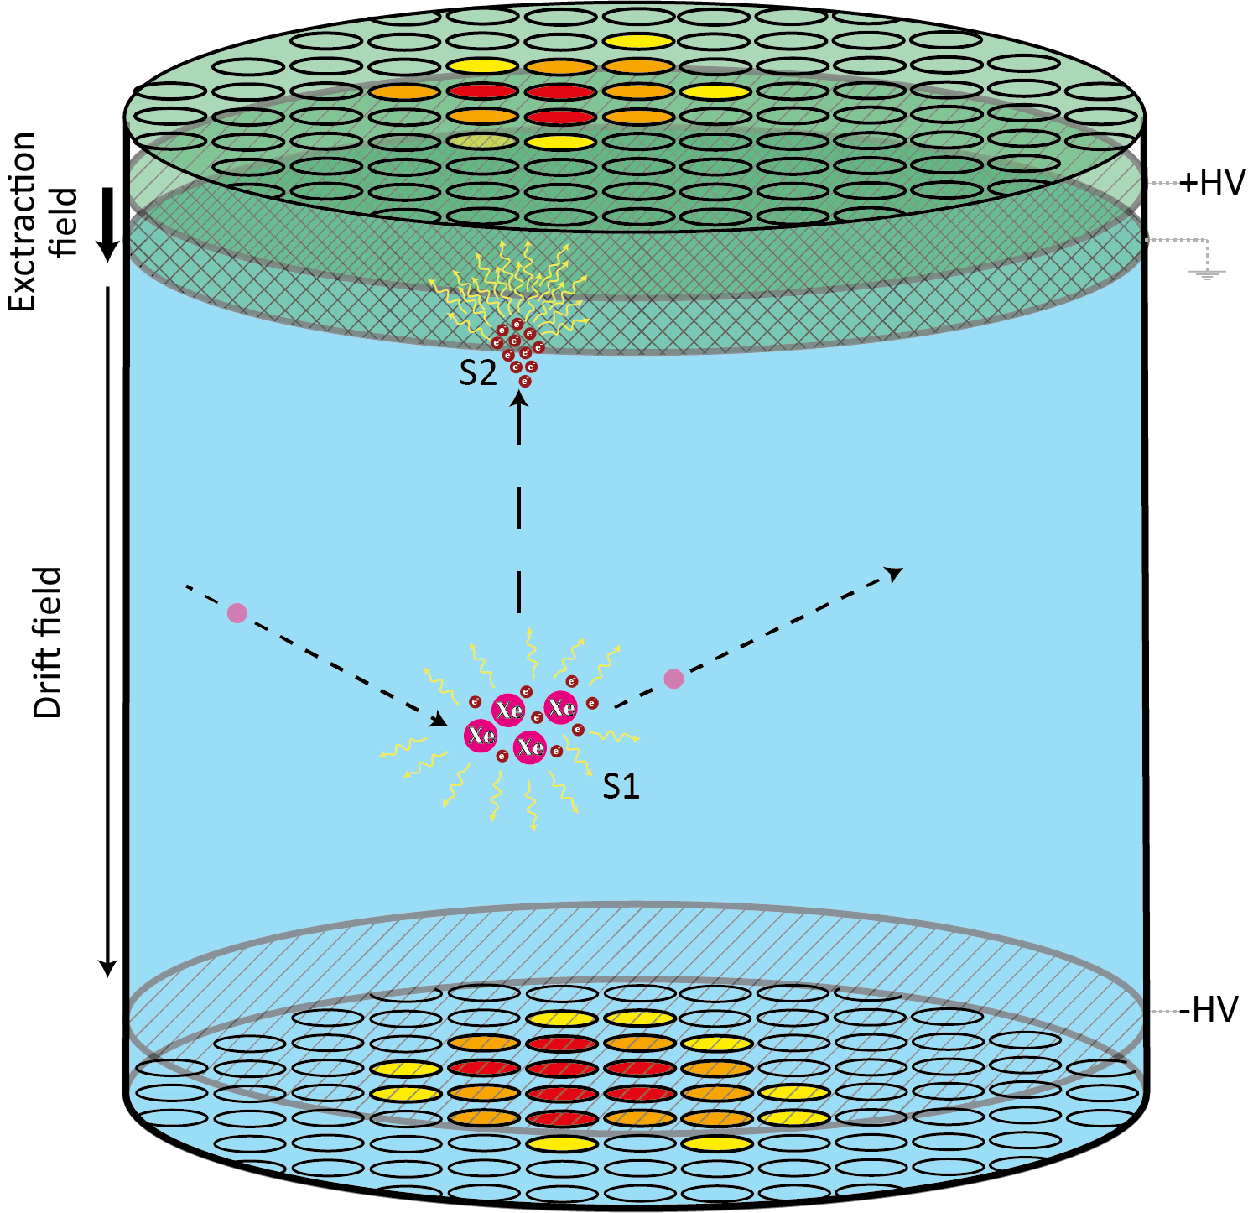


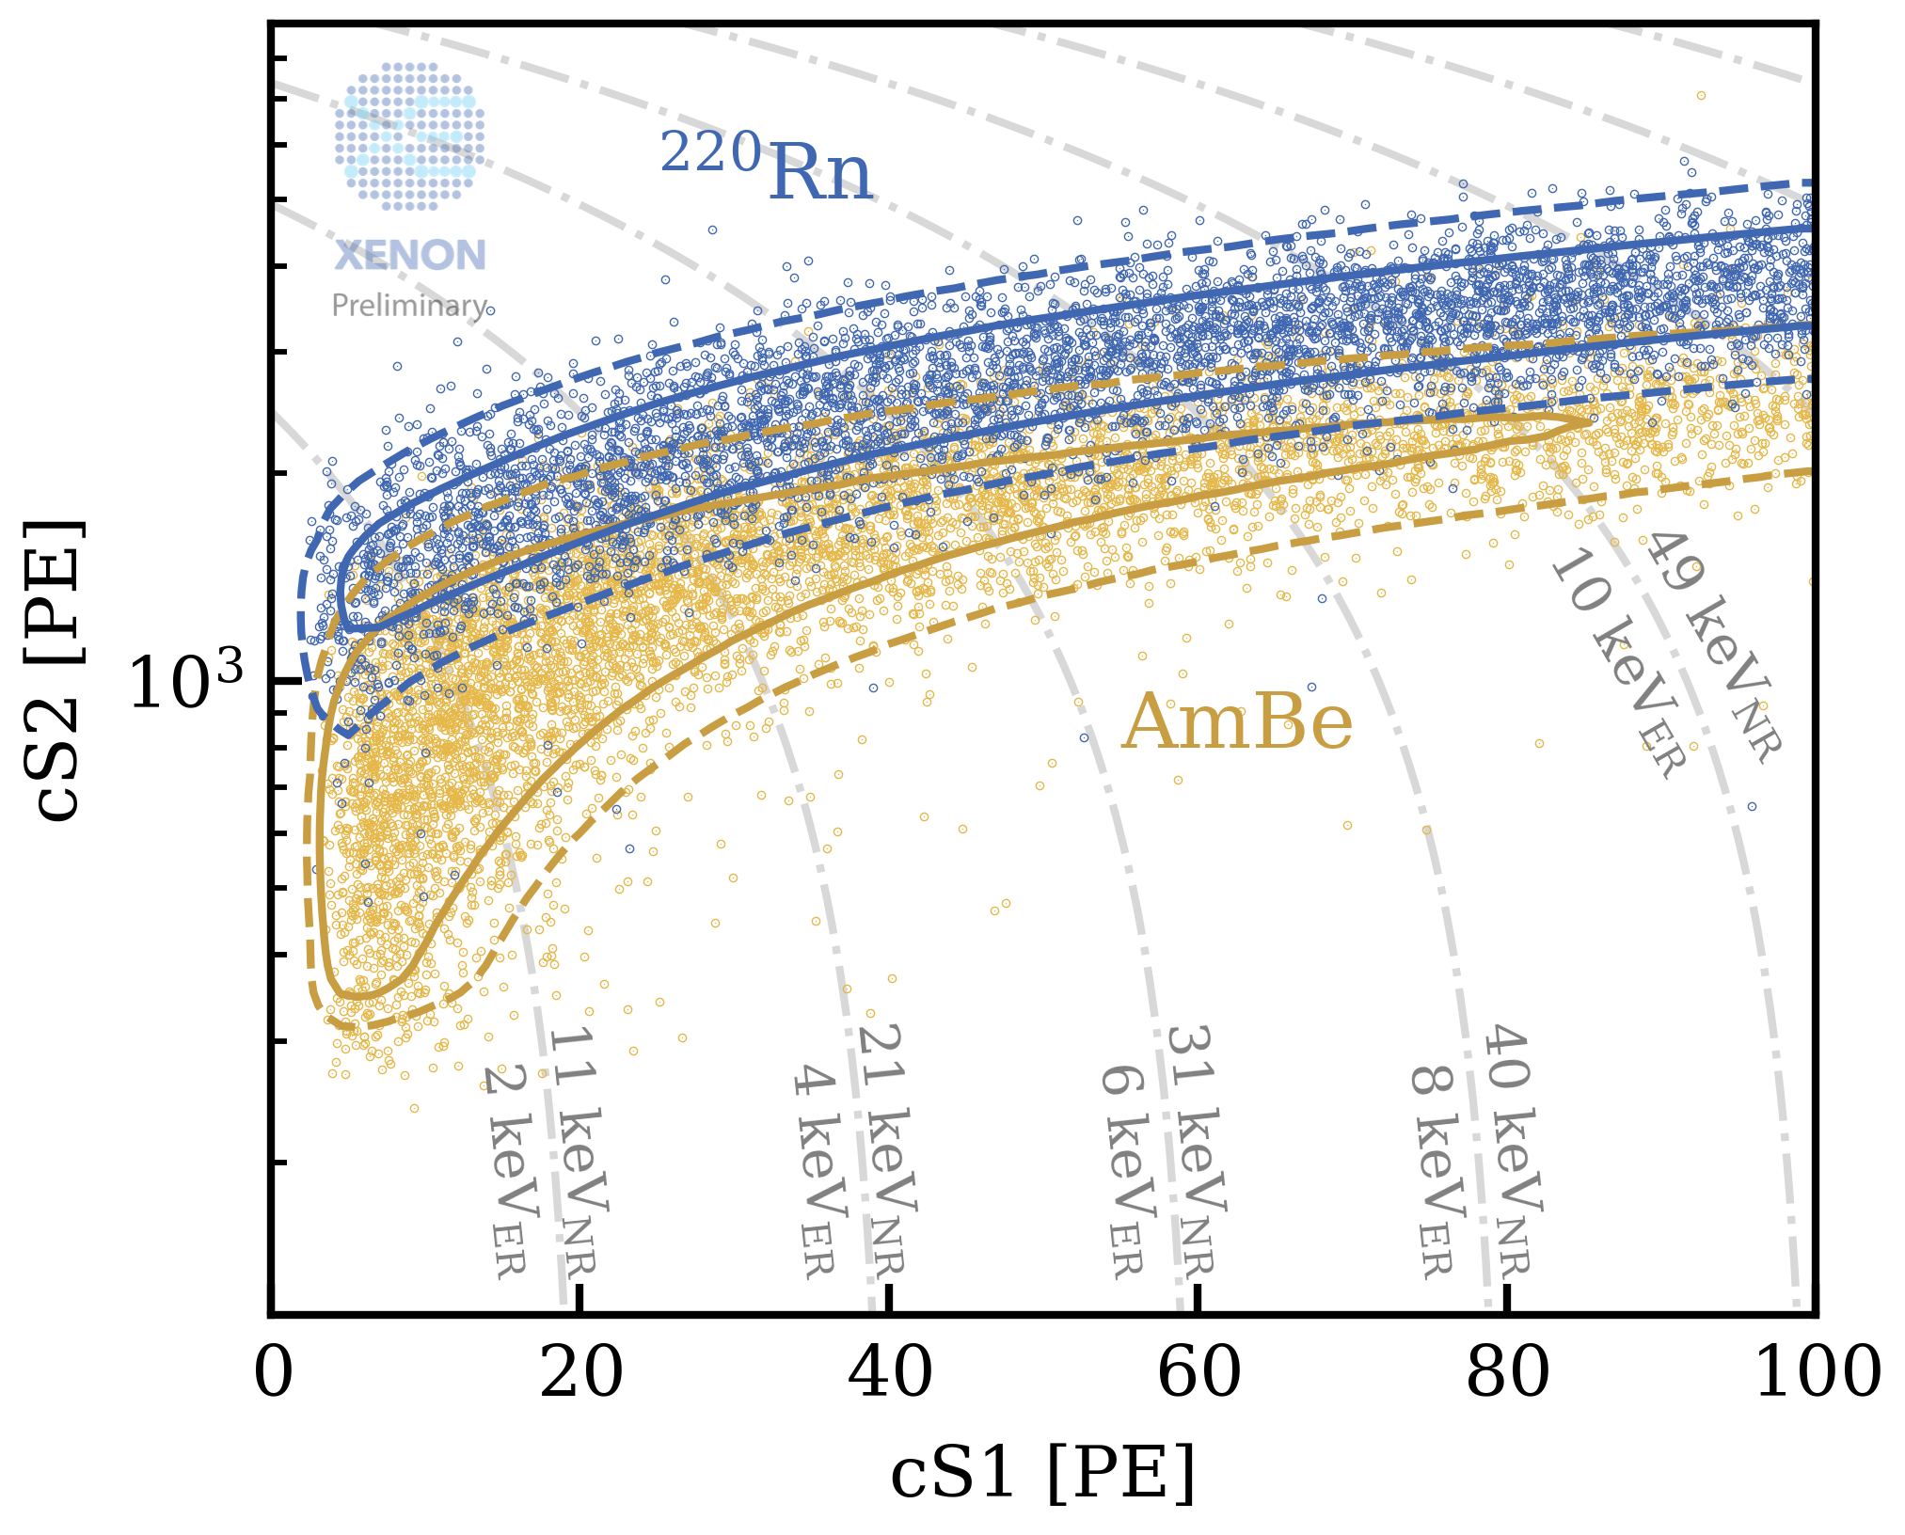
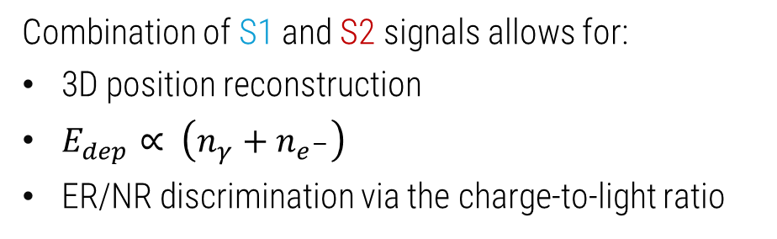

The Daily Business of XENONnT
Combination of S1 and S2 signals allows for:
3D position reconstruction
$E_{dep}∝ \left(n_{γ}+n_{e^{−}}\right)$
ER/NR discrimination via the charge-to-light ratio
β, γ, υ, …
S2
ER
S1
WIMP, n, υ, …
Scintillation photons (S1) and free electrons ($∝$ S2) are produced from an impinging particle.
NR
02/11

Slide 4
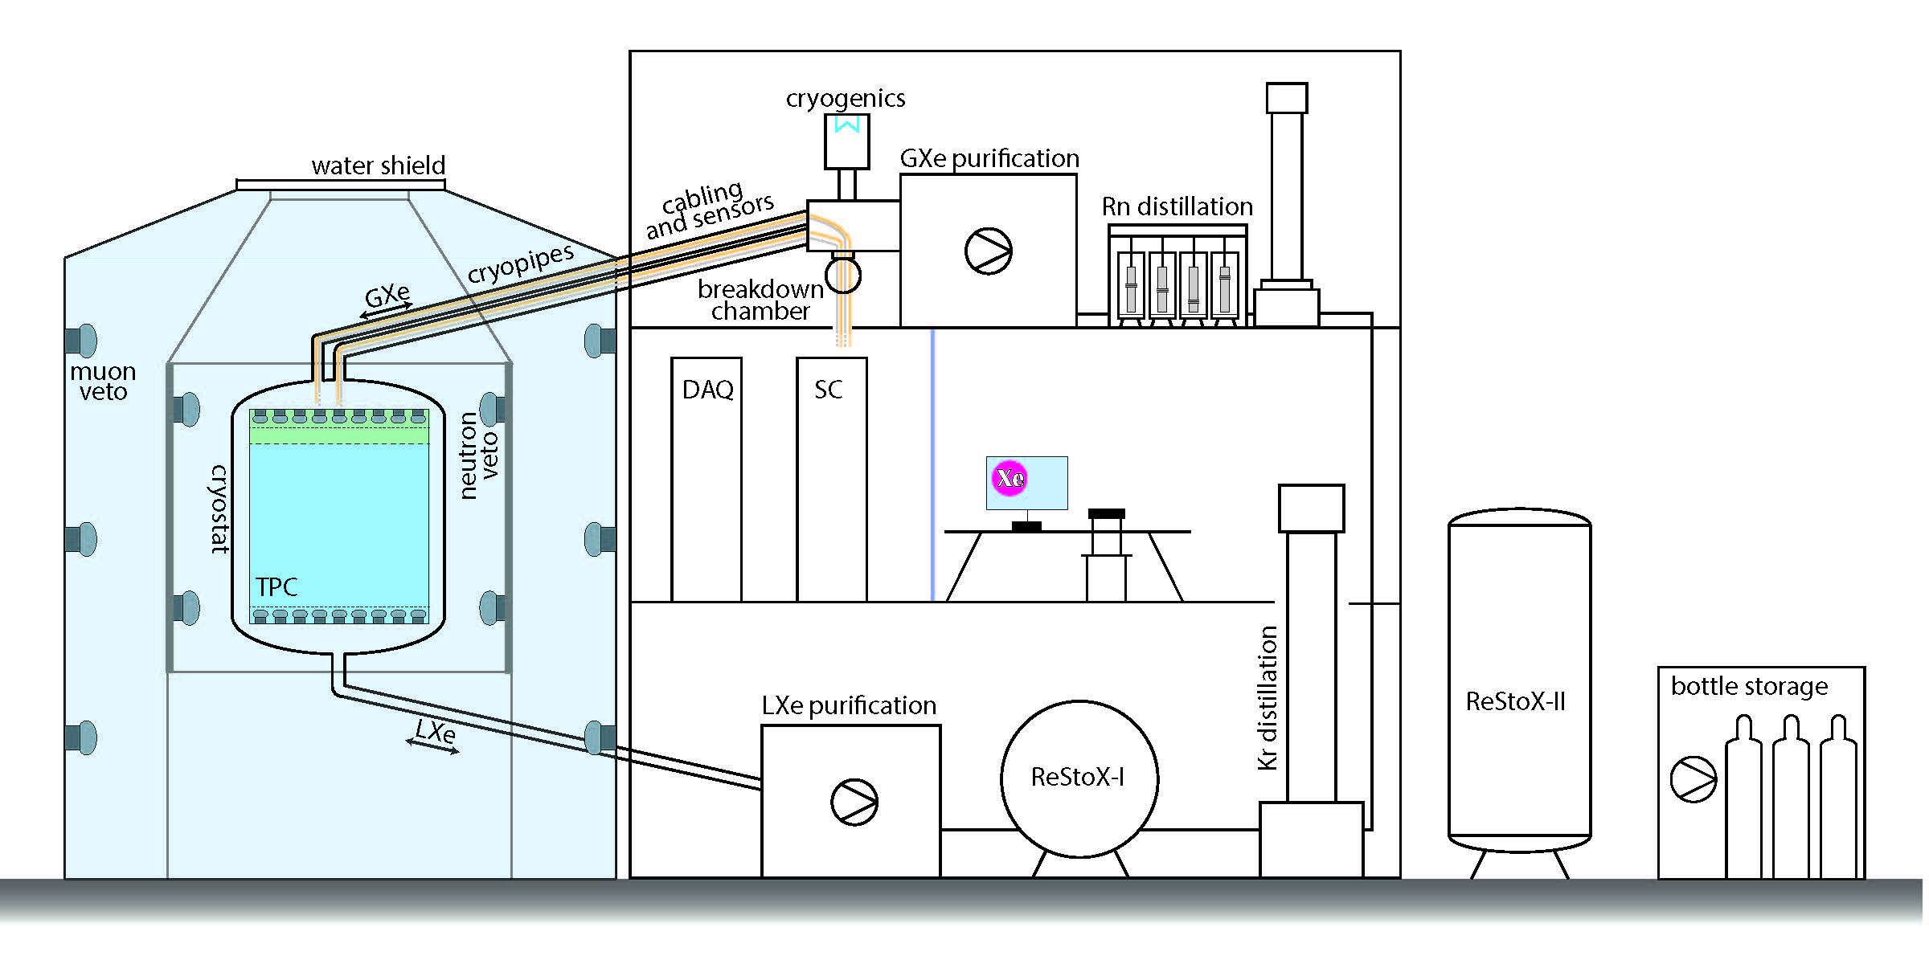
The XENONnT experiment
The XENONnT dark matter experiment
Depth: 1400 m (3800 m w.e.)
Three nested detectors (muon veto, neutron veto, TPC) in a ~10 m ×10 m water tank
Three-floor auxiliary building hosting experiment infrastructure
XENONnT TPC in short
5.9 tonnes of LXe target
Ultra-low background conditions
E_{threshold} ~1 keV
03/11

Slide 5
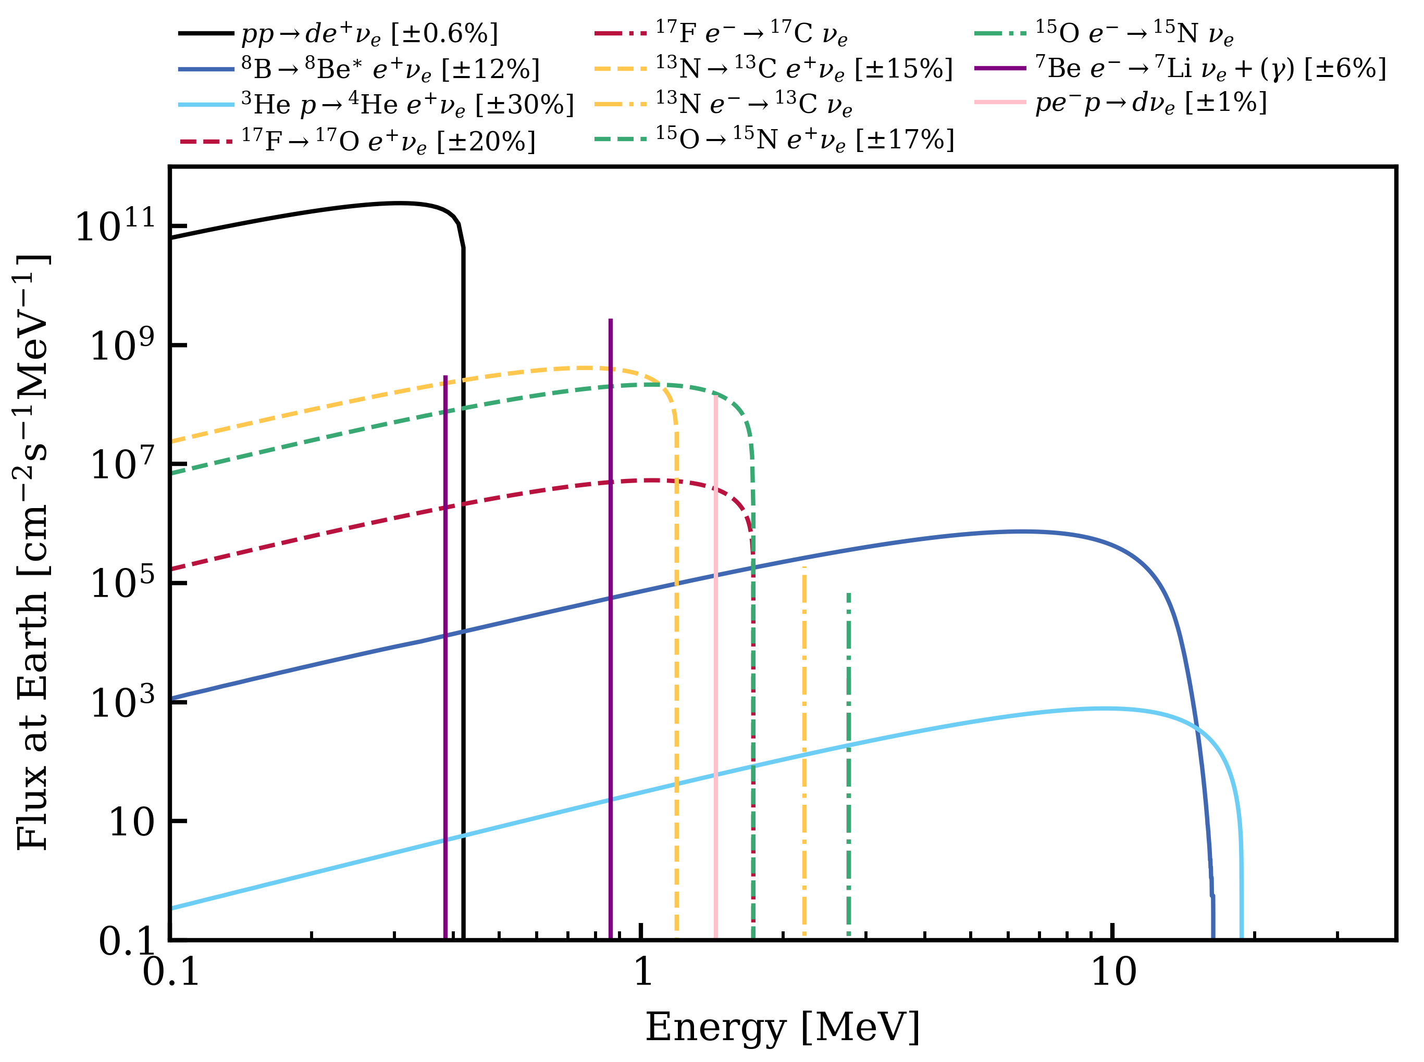
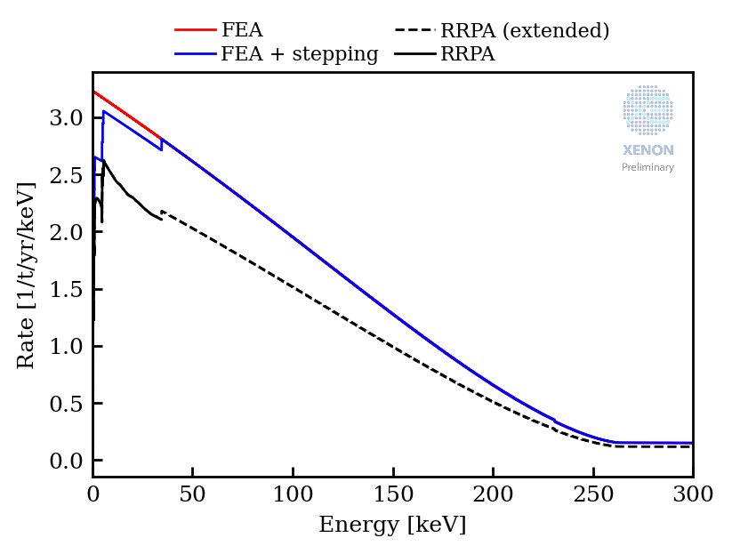
Solar neutrinos – Electron recoils from neutrinos
Grand unified neutrino spectrum at Earth: Sources and spectral components
Low-energy electronic recoil in xenon detectors by solar neutrinos
Search for solar-pp elastic electron neutrino scattering
Dominant in solar neutrino flux (91%)
Electron recoil signal below 250 keV
Free electron approximation (FEA) assume electrons are free
FEA + stepping approximation for accounting for electron binding energy
Relativistic random phase approximation (RRPA) for calculation of the atomic many-body wave functions
04/11

Slide 6
We are in the final stages of this analysis. Today I will discuss our methods and outlook, with final results to be unveiled soon!

Slide 7
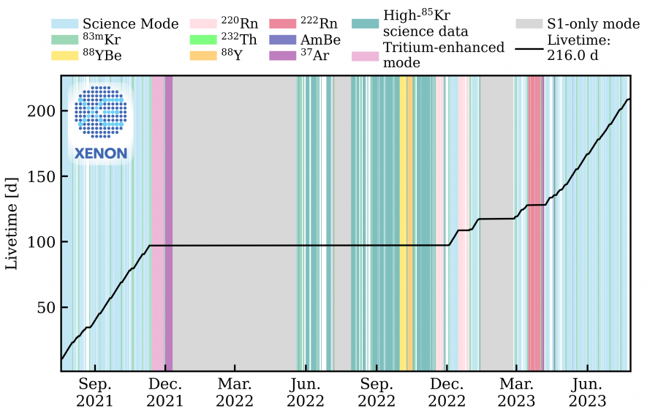
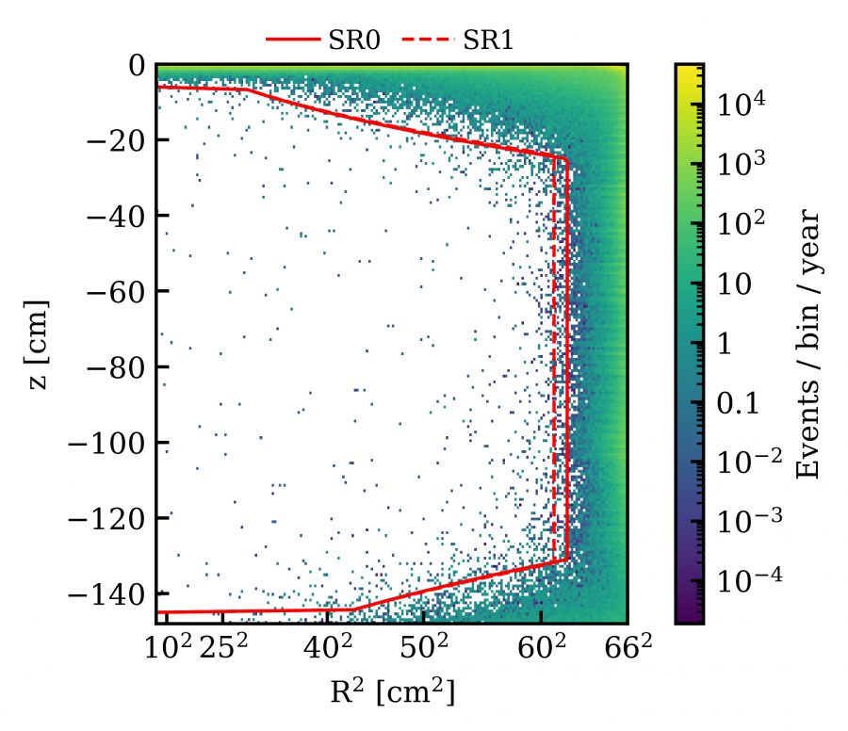
Science data collection
ROI: [1, 140] keV
Defining the analysis volume using material radioactivity
SR0 (SR1): ~ 4.13 (4.24) tons
SR0: ~ 97 days
SR1(b): ~ 119 days
05/11

Slide 8
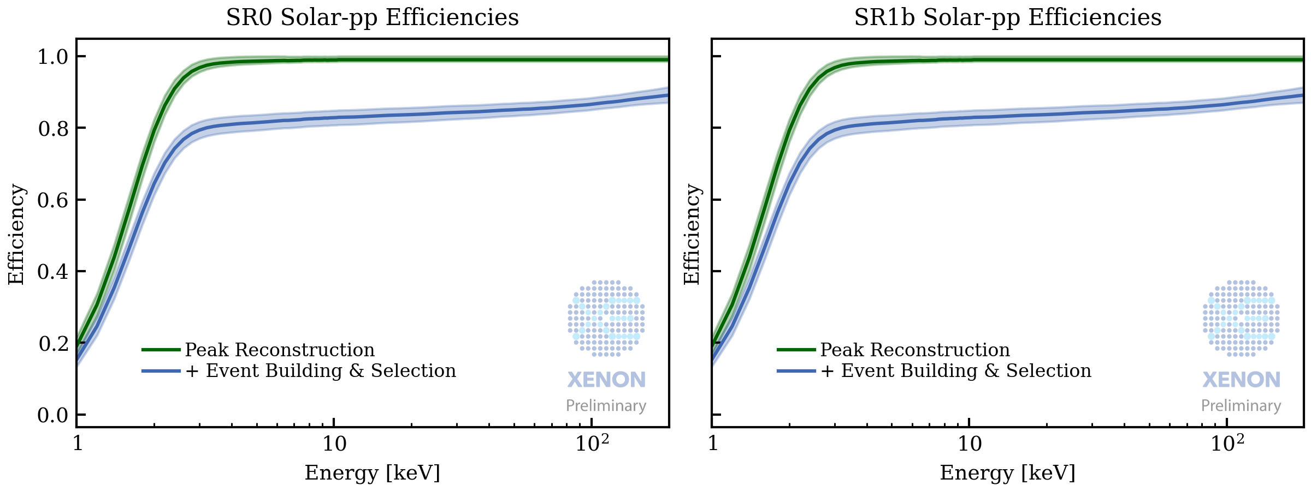
Efficiency & Threshold
Signal and Event Reconstruction
How well we reconstruct individual S1 and S2 signals.
How good we pair S1-S2 signals to construct physical events.
Achieved 1 keV low-energy threshold.
Selection criteria
How good we select physical data
Rejecting unphysical events and improperly reconstructed events
Fairly flat and ~90% in the ROI
06/11

Slide 9
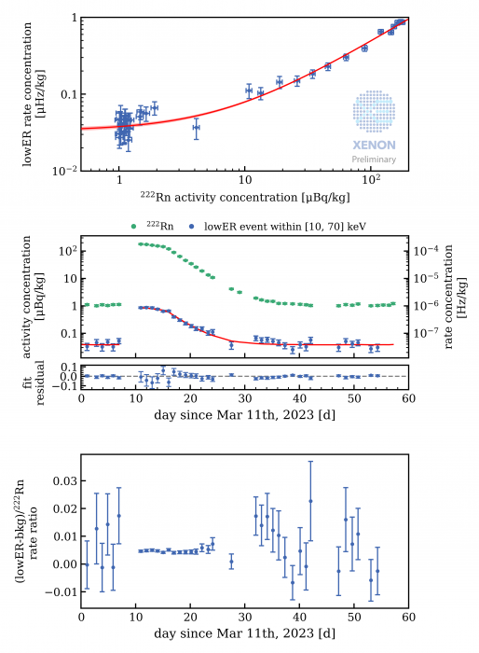
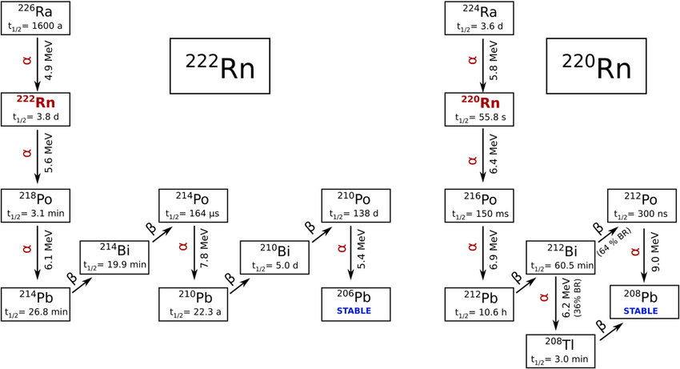
Background contribution: ²¹⁴Pb
Radon Removal in XENONnT down to the Solar Neutrino Level
²¹⁴Pb - daughter of ²²²Rn - contributed via the β decay in the ROI
Online cryogenic distillation to remove radon based on the difference volatility of Rn and Xe:
²²²Rn in SR0 ~1.9 μBq/kg
²²²Rn in SR1 ~0.9 μBq/kg
Comparable level to solar
neutrino background!
Dedicated ²²²Rn calibration in SR1 to estimate the ²¹⁴Pb/²²²Rn ratio to constraint ²¹⁴Pb in science data
Measure a constant ratio of 0.67 ± 0.03
07/11

Slide 10
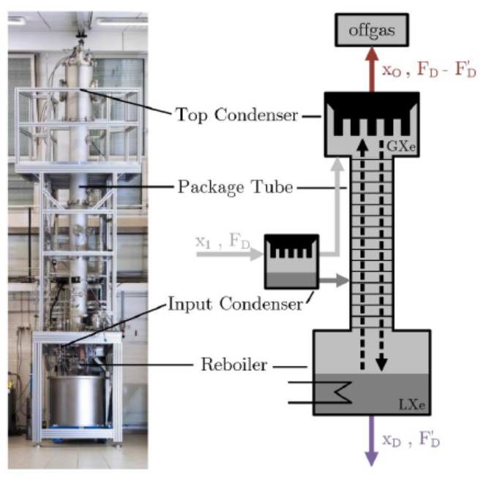
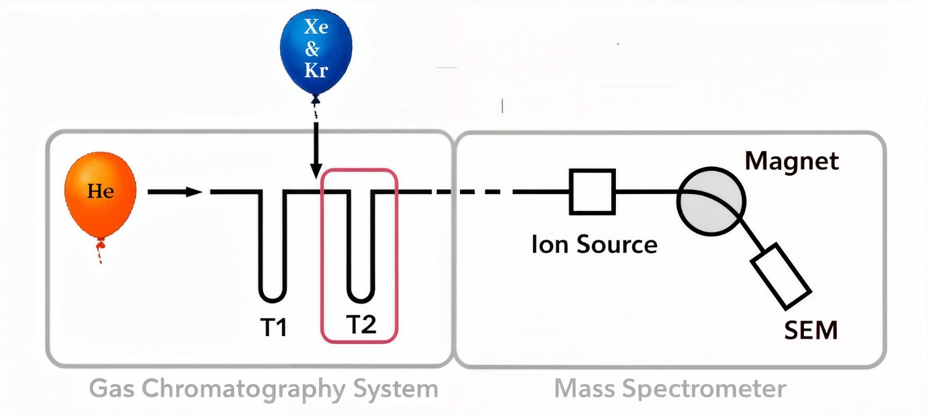
Background contribution: ⁸⁵Kr
A cryogenic distillation column for the XENON1T experiment
Krypton assay in xenon at the ppq level using a gas chromatographic system and mass spectrometer
⁸⁵Kr internal background in LXe, introduced as a contaminant during xenon's extraction from air:
β− decay – Q value ~ 687 keV – T_{1/2}~10.76 y – ⁸⁵Kr/^{nat}Kr ~ 2×10⁻¹¹ mol/mol
Multiple operations by cryogenic distillation column: 10 ppb (10⁻⁸) → 60 ppq (6×10⁻¹⁴) ^{nat}Kr/Xe
Xenon samples from the detector measured at Max-Planck-Institut für Kernphysik in Heidelberg
Rare Gas Mass Spectrometer (RGMS)
Credits: Guida, M.
Currently we are validating the RGMS measurements
Kr distillation column
08/11

Slide 11
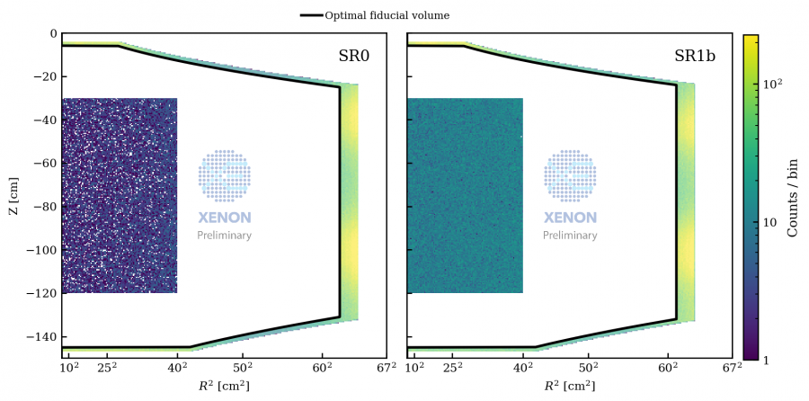
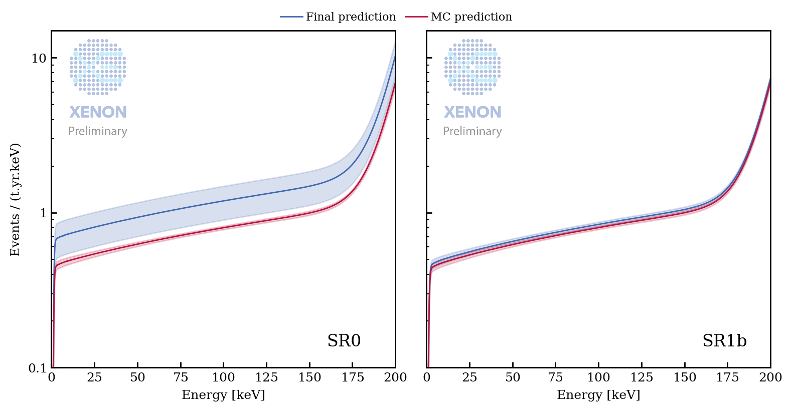
Background contribution: radiogenic gamma-ray from materials
Radiogenic contaminants contribute to the low-energy ER background via Compton scattering of high-energy gamma rays.
The self-shielding of LXe confines this background primarily to the outer region of the active volume.
Careful material selection and screening make this a subdominant background.
Constrained by comparing (subtracted) data and Monte Carlo simulations in an edge volume outside the fiducial volume.
09/11
Sss

Slide 12
That’s all folks!
Or maybe not…

Slide 13
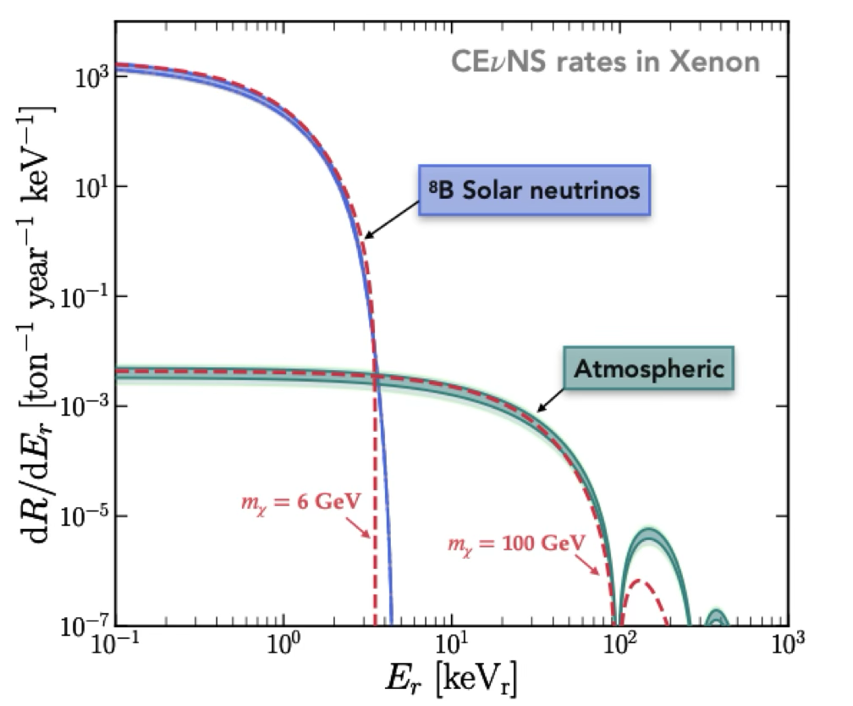
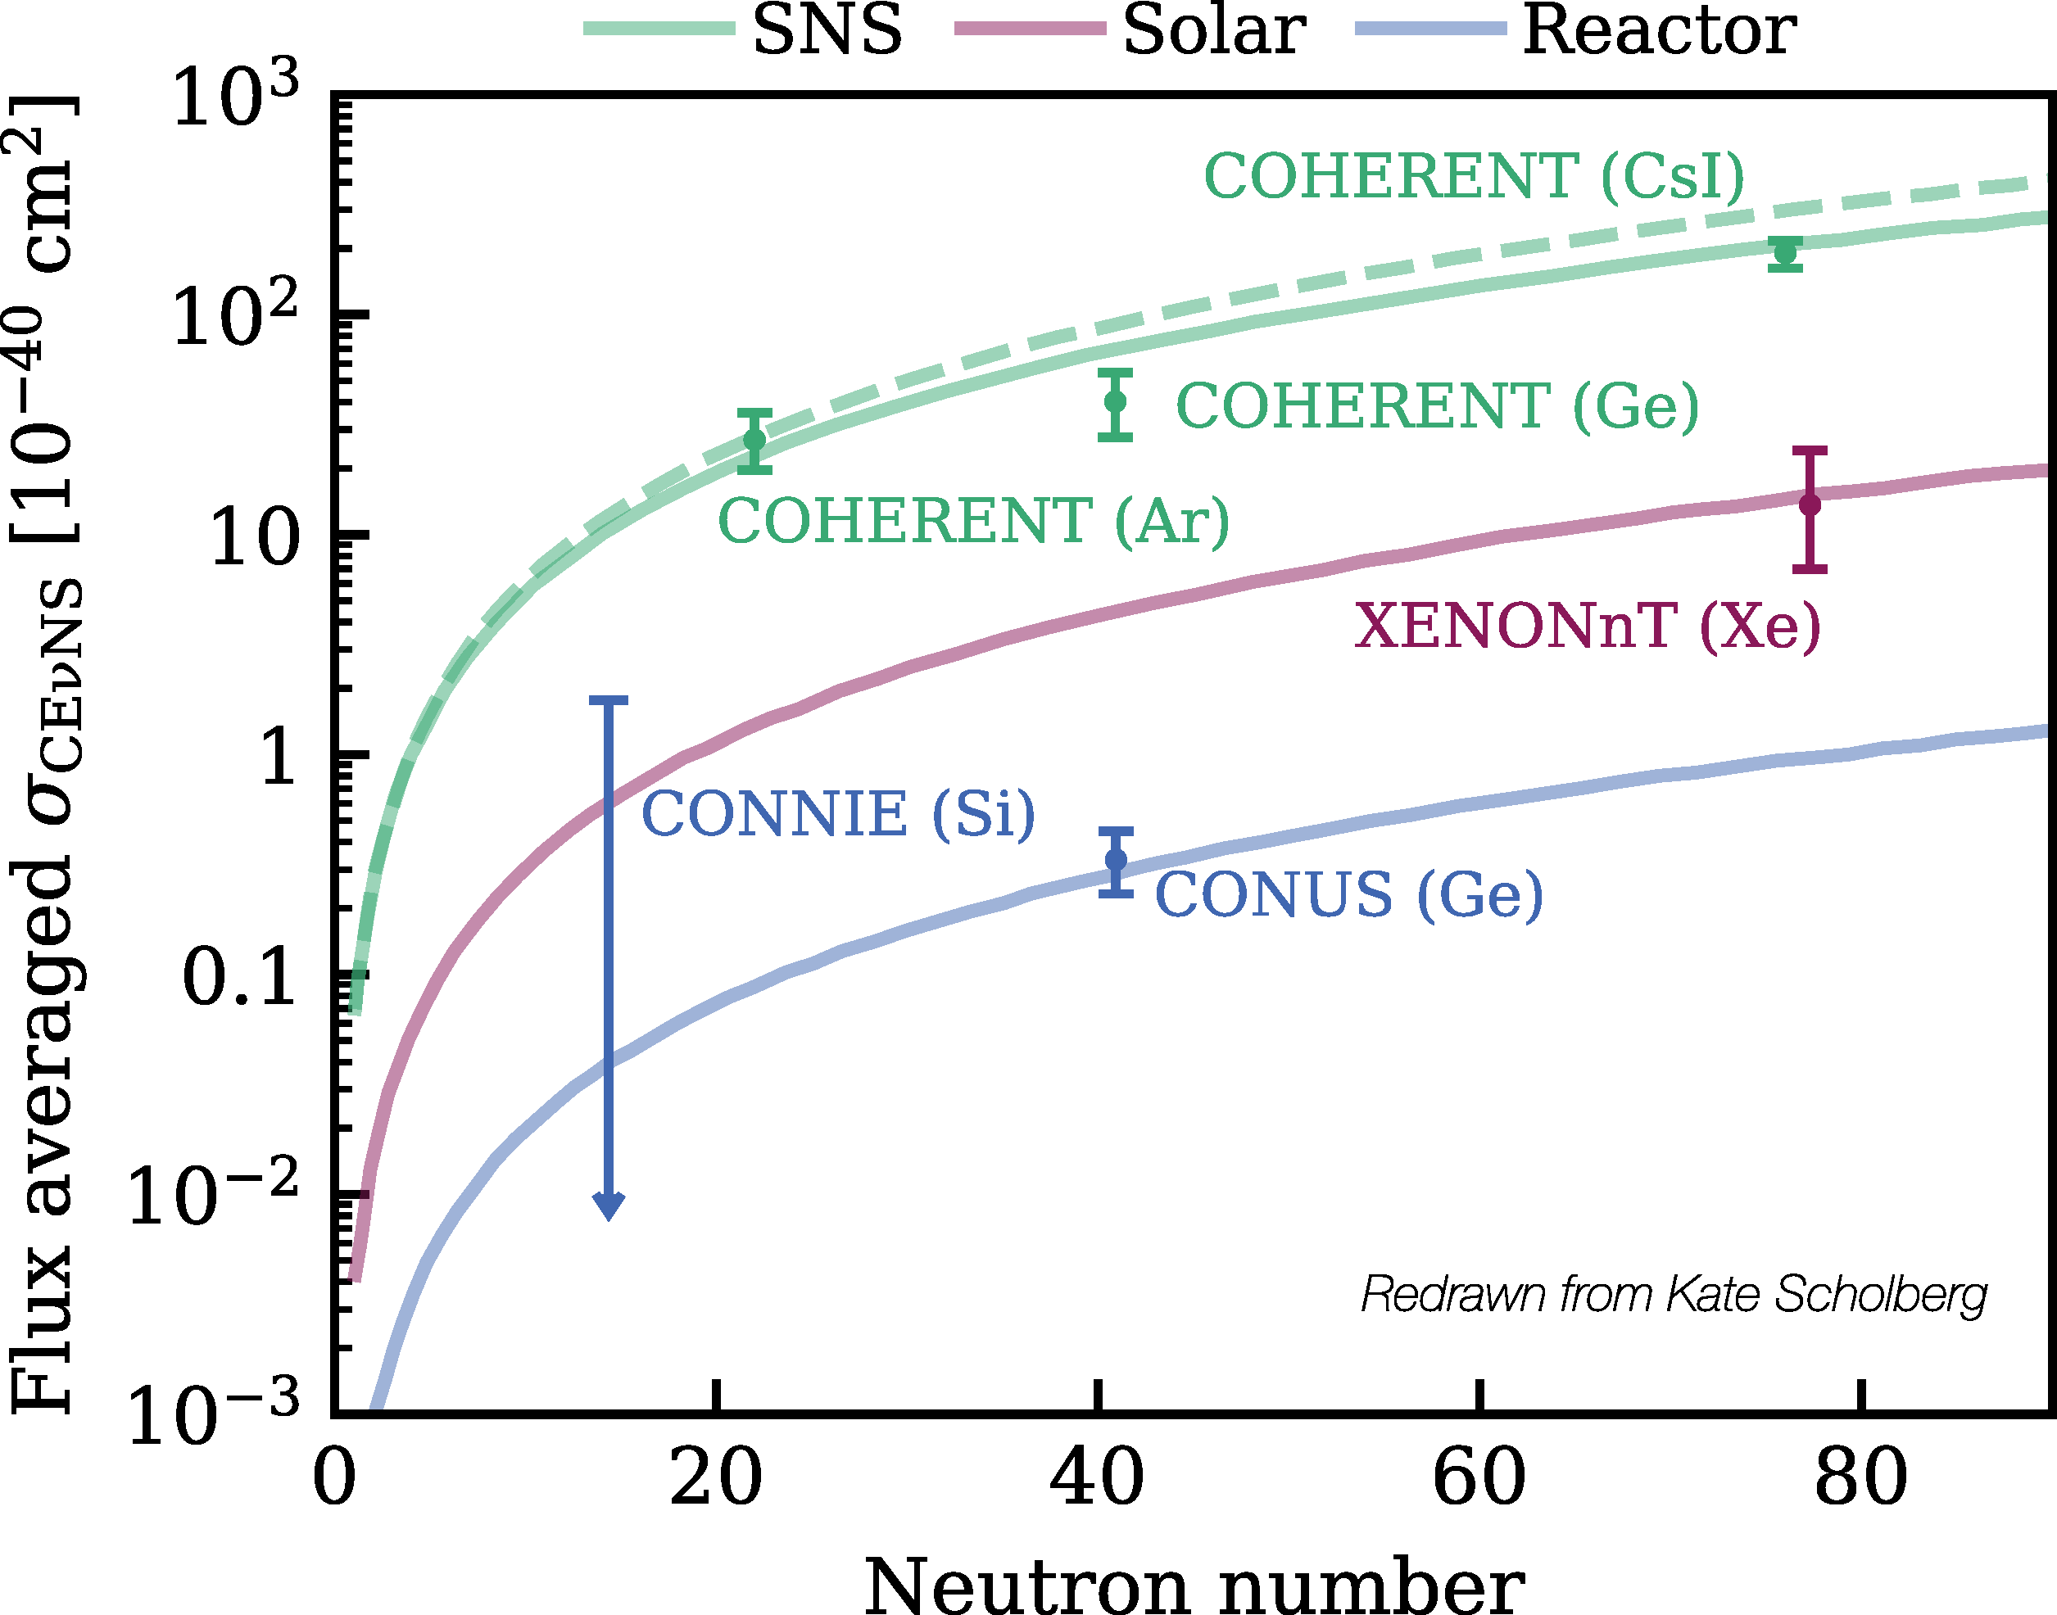
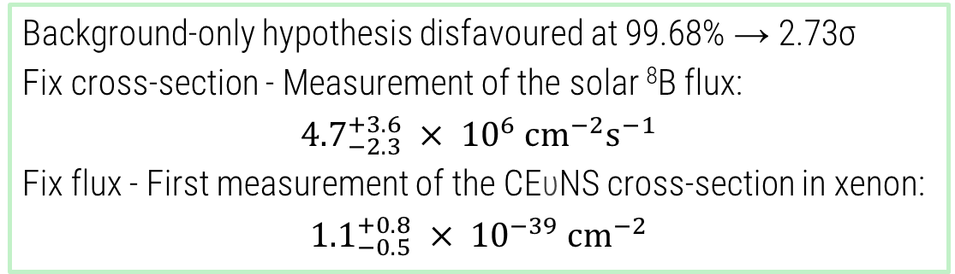
Solar neutrinos – Nuclear recoils from neutrinos
First Indication of Solar ⁸B
Neutrinos via Coherent Elastic Neutrino-Nucleus Scattering with XENONnT
CEυNS = Coherent Elastic Neutrino-Nucleus Scattering
Measured by COHERENT (2017) with spallation neutron source
σ ∝ N² and only at low momentum transfer → small recoil energies
In LXe TPC induce a signal indistinguishable from WIMPs
Developed a dedicate analysis pipeline to measure ⁸B solar neutrino via CEυNS
Snapshot of ⁸B analysis
Background-only hypothesis disfavoured at 99.68% → 2.73σ
Fix cross-section - Measurement of the solar ⁸B flux:
$${4.7}_{−2.3}^{+3.6} × {10}^{6} {\text{cm}}^{−2}{\text{s}}^{−1}$$
Fix flux - First measurement of the CEυNS cross-section in xenon:
$${1.1}_{−0.5}^{+0.8} × {10}^{−39} {\text{cm}}^{−2}$$
10/11

Slide 14
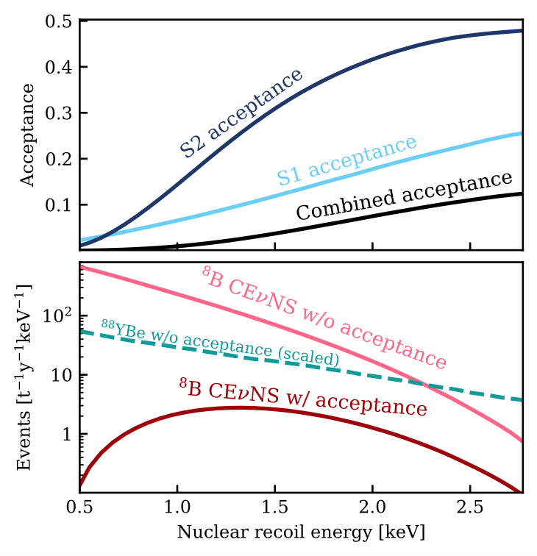
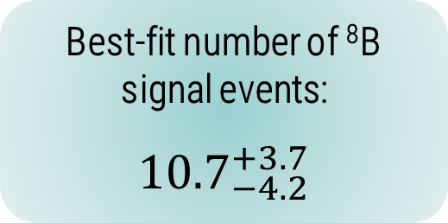
How did we get there?
First Indication of Solar ⁸B
Neutrinos via Coherent Elastic Neutrino-Nucleus Scattering with XENONnT
Low energy deposited: > 90% of detectable recoils below 2.1 keV
Decent exposure (~3.5 t × yr) by combining full SR0 and SR1
Lowering down PMT coincidence for event reconstruction from 3 to 2
Calibrating the low-energy NR response with 152 keV neutrons from an external ⁸⁸YBe source
Enhancing the sensitivity through refined background constraints and a dedicated inference parameter space
Expected Background:
26.4 ± 1.5
Expected Signal:
12 ± 3
Events Observed:
37
Best-fit number of ⁸B signal events:
$${10.7}_{−4.2}^{+3.7}$$
11/11

Slide 15
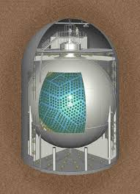
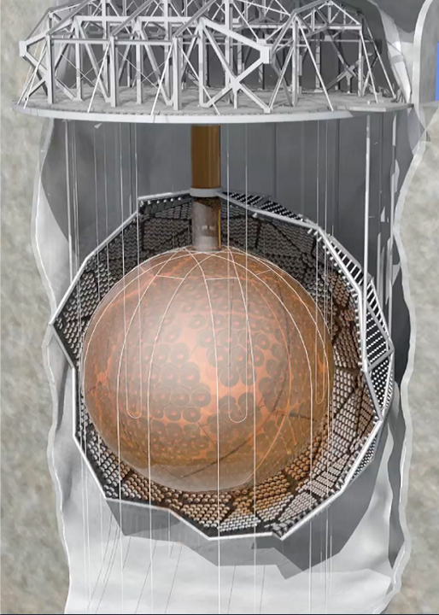
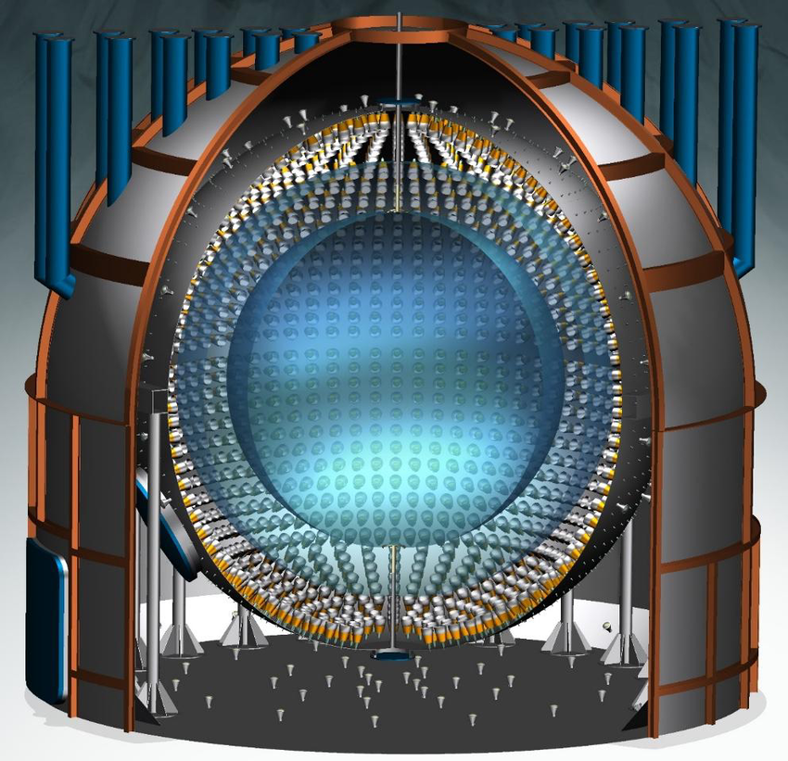

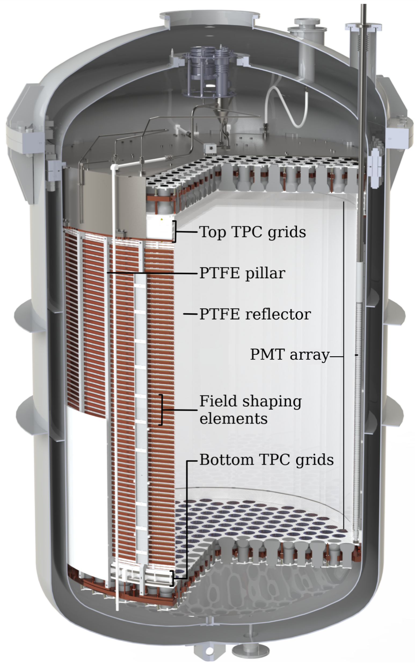
Super-Kamiokande
50 kt
Sitting on the shoulders alongside the giants: XENONnT is the smallest solar neutrino detector
KamLAND
1000 t
SNO
1000 t
Borexino
270 t
XENONnT
8.5 t
Credits: Hammann, R.

Slide 16
BACK-UP SLIDES

Slide 17
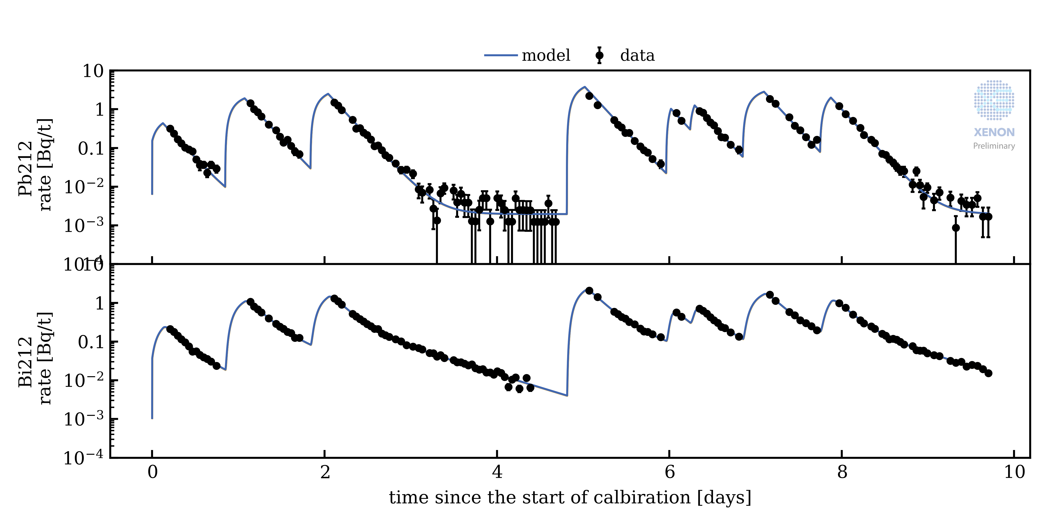
Background contribution: ²¹²Pb
²¹²Pb, daughter of ²²⁰Rn which is continuously emanated from detector materials contributed via the β decay of in the ROI
Concentration a factor ×10 smaller compared to ²²²Rn makes this less problematic
A plate out model is established using ²²⁰Rn calibration data, which allows for constraining the ²¹²Pb background rate using the ²¹²Bi-Po rate that is easy to measure.
SR1 calibration data

Slide 18
Other backgrounds contribution
Intrinsic background
Xe136: 2υββ decay – constrained from EXO half life and measured isotopic abundance.
Xe124: 2ECEC decay – possibility to leave it free of constrained using XENON1T measurement.
Bi214: from Rn222 – high energy gammas from an-instrumented liquid xenon, subdominant.
Possible contamination
Kr83m: IC – leftovers from by-weekly calibration campaigns, unharmful.
H3-like: from SR1 contamination.
Neutron activation
Xe125 – per-se unharmful however leads to I125. Negligible
Xe133m: β+γ(81 keV) – left free in the inference
Xe129m and Xe131m – outside ROI

Slide 19
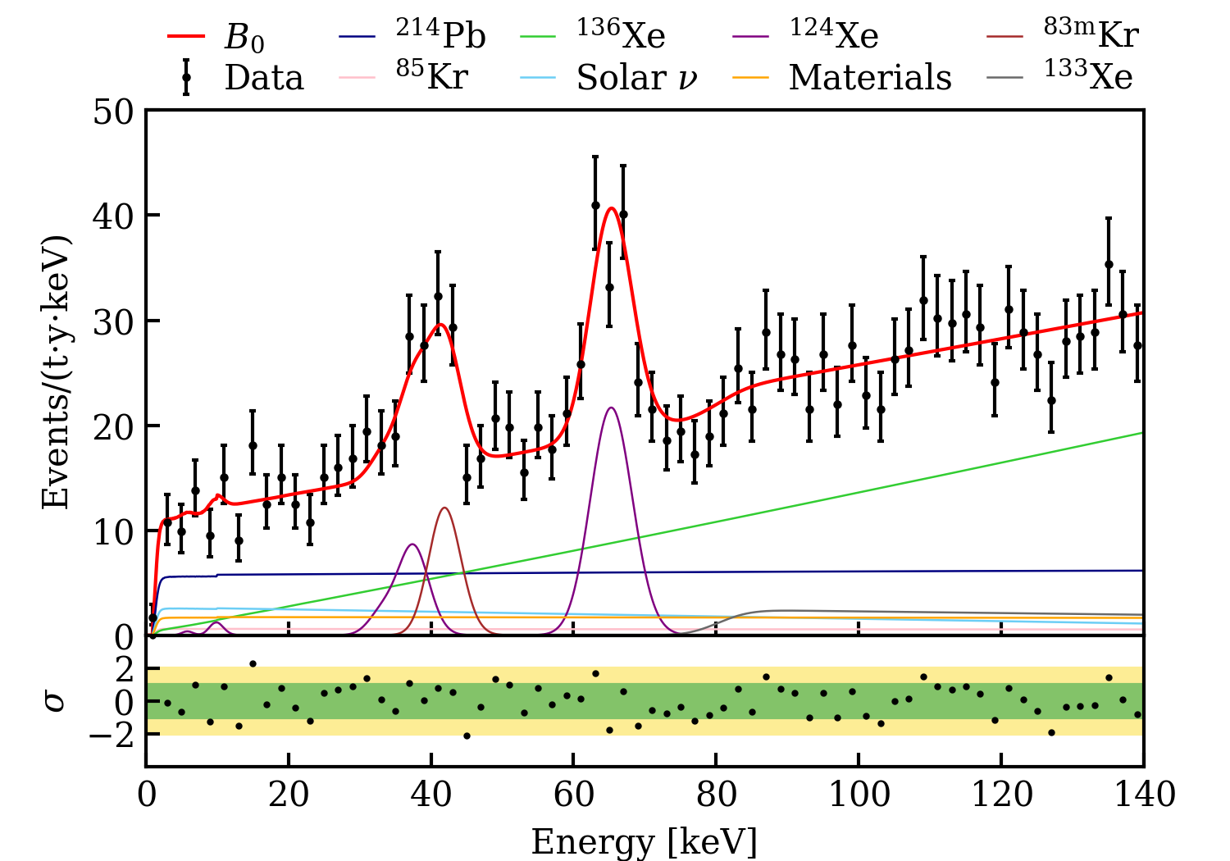
SR0 low-ER search
Search for New Physics in Electronic Recoil Data from XENONnT

Slide 20
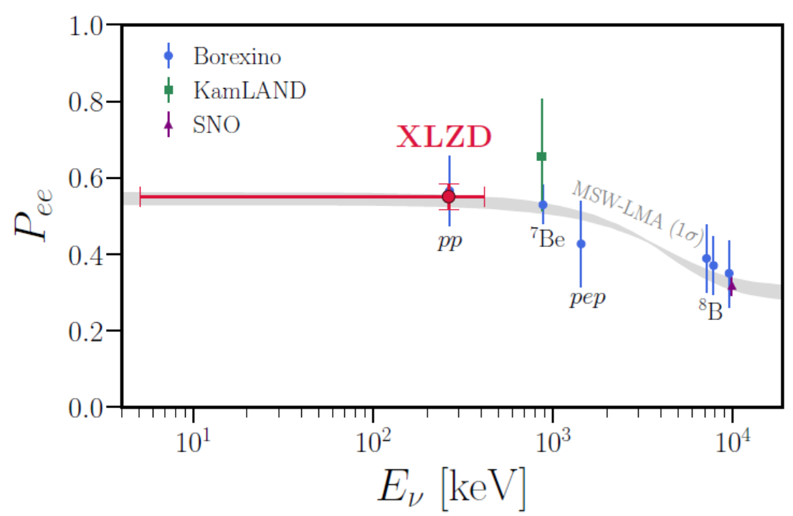
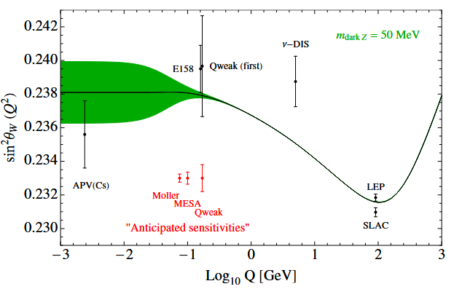
Measurement for the pp neutrino
Low-E neutrino physics
Measurement for νe survival probability (Pe-e)
Measurement for the Weinberg angle
Search for exotic neutrino interactions (ex. Magnetic moment)
Goal for XENONnT: Demonstration with 3σ
Measurement with few % precision expected in future experiment
A next-generation liquid xenon observatory for dark matter and neutrino physics
The XLZD Design Book: Towards the Next-Generation Liquid Xenon Observatory for Dark Matter and Neutrino Physics

