Slide 1
EIC MARCO Solenoid activity @ GE
Stefania Farinon Pasquale Fabbricatore
stefania.farinon@ge.infn.it pasquale.fabbricatore@ge.infn.it

Slide 2
Introduction
I coordinate the activities of the Applied Superconductivity Group at the INFN Genova Section
Our group has been involved in superconducting magnet development for over 30 years
We have a long-standing expertise in the design, modeling, and testing of superconducting systems for high-energy physics applications
We collaborate extensively with industry, in particular with ASG Superconductors, a world leader in the fabrication of superconducting magnets, contributing to major international projects such as LHC (accelerator dipoles, CMS ed ATLAS) and ITER (fusion)
We will be responsible for the development of the MARCO superconducting solenoid for the EPIC project

Slide 3
EPIC MARCO – Magnet Collaboration Overview
The EPIC MARCO project is supported by an international collaboration involving several key institutions:
🧲 Brookhaven National Laboratory (BNL)
Host site of the EPIC experiment
Responsible for the installation and integration of the detector systems
🧲 Jefferson Lab (JLab)
In charge of coordinating the magnet development on behalf of the US
Oversees technical requirements and project interfaces
🧲 CEA (France)
Commissioned by JLab to design the superconducting magnet system
Developed the conceptual and engineering design of the solenoid and cryogenic systems
🧲 INFN (Italy)
Will launch an international tender for the magnet fabrication
Will follow up the construction
Contributes the magnet as an in-kind contribution to the project

Slide 4
INFN Responsibilities in EPIC MARCO
As part of its in-kind contribution, INFN will be responsible for the construction of the superconducting solenoid, with the following key tasks:
✅ Finalize the Tender Package
Prepare the complete technical documentation and specifications required for the public procurement process of the magnet construction.
🏗️ Vendor Selection
Select the industrial partner for magnet fabrication with an international tender, in close consultation with CEA and Jefferson Lab, ensuring alignment with project requirements.
🛠️ Manufacturing Readiness
Develop comprehensive engineering documentation, including detailed work plans, manufacturing and assembly procedures, Quality Assurance and Quality Control (QA/QC) plans.
Participate in the Manufacturing Readiness Review alongside CEA and Jlab.
🧪 Magnet Production and Acceptance Testing
Oversee and manage the full manufacturing process, up to and including: Factory integration, Acceptance tests of the complete magnet system, Verification of performance against specifications.

Slide 5
Magnet Construction – Timeline and Key Milestones
📅 Kick-off
The kick-off meeting for INFN’s involvement took place on Jan. 31, 2025
🕒 Project Duration
The timeline for the superconducting magnet construction is 5 years from T0 (T0 = contract signature)
We are considering reducing it to 4 years if the cold test is performed at BNL
🔩 NbTi Conductor
The conductor will be supplied by BNL
It has already been ordered from LUVATA, an important milestone given that:
Procurement can take up to 2 years
Early procurement is essential to maintain the schedule
📝 Next Step
The full construction plan is currently under finalization
Approval by the EPIC Executive Board is expected in September 2025

Slide 6
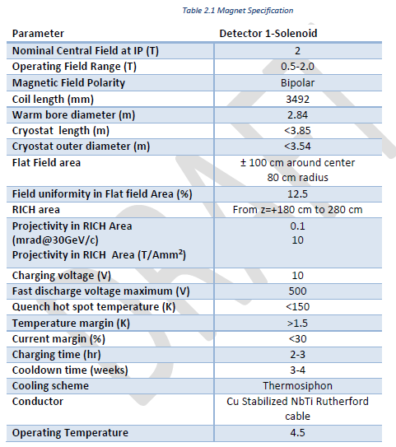
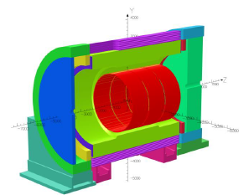
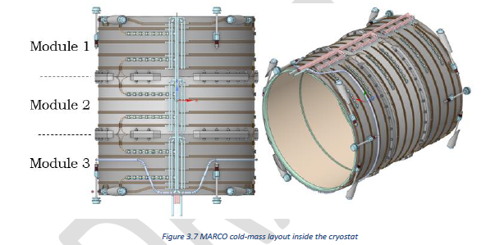
Marco solenoid characteristics
The MARCO solenoid is designed to generate a 2 T magnetic field with an operating current of 3924 A.
It consists of three modules, each housing an identical superconducting coil wound internally onto a brass mandrel.
The coils are indirectly cooled using a thermosiphon system.
The CEA design, as described in the TDR, while technically solid, presents two main weaknesses that will require further evaluation and potential mitigation.

Slide 7
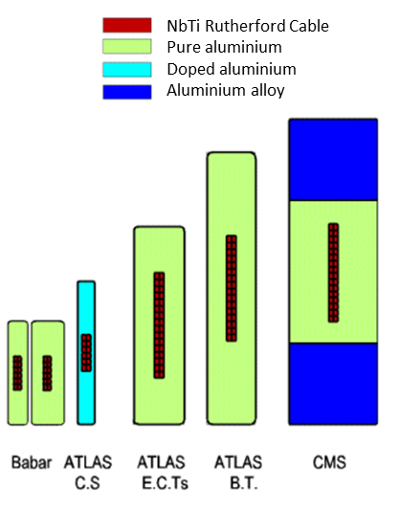
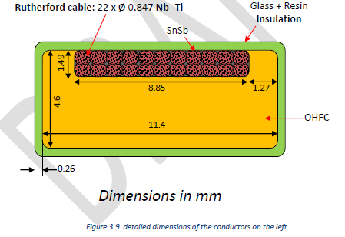
Superconducting cable
The typical conductor for this class of magnet is an aluminum-stabilized Rutherford cable.
However, there are no longer any suppliers of high-purity aluminum-stabilized cables:
The supply chain that produced the cables for CMS and ATLAS no longer exists.
Japanese manufacturers that supplied these cables in the past, even in recent years (such as Hitachi and Furukawa), no longer offer this product.
At present, potential alternatives in China remain unclear.
Given the tight EPIC project timeline, there is insufficient time to either develop a new extrusion line or restore an existing one—such as the Furukawa line in Brazil, previously used for manufacturing the Mu2e Al-stabilized conductor.
As a result, the decision was made to use a copper-stabilized conductor, which is readily available on the market.
This choice, while pragmatic, may affect the magnet’s thermal stability, and a detailed analysis is required to fully assess its implications.

Slide 8
Mechanical support (1/2)
The typical mechanical support structure for superconducting solenoids is an outer cylinder.
To ensure thermal contraction compatibility, brass was selected as the natural choice for this component—since its integrated thermal contraction from room temperature to 4 K (~3.8 mm/m) is close to that of copper (~3.3 mm/m).
However, this choice introduces several potential issues:
Fabrication challenges:
Brass is often available in cast form, which has poor mechanical properties.
Forged brass, which would provide the required strength, is extremely difficult to source in the necessary dimensions.
Cost concerns:
The estimated cost for a suitable forged brass outer cylinder could range between 1 to 2 M€.

Slide 9
Mechanical support (2/2)
We have worked in close collaboration with CEA and have demonstrated that the outer cylinder can be made of aluminum alloy instead of brass, despite the larger thermal contraction mismatch (aluminum: 4.3 mm/m vs. brass: 3.8 mm/m).
However, due to time constraints—as a full redesign of the TDR would otherwise be required—the technical specification and procurement documents will list brass as the baseline option.
Suppliers will be requested to also quote the aluminum alternative, which is expected to be the preferred solution.

Slide 10
Current Project Status
A review of the experiment layout is currently underway, which includes, among other changes, the removal of the barrel section.
While these modifications do not directly affect the magnet, they have a significant overall impact, prompting CEA to revise the magnet design accordingly.
On our side, the technical specifications for the procurement are essentially complete and have been shared with both JLab and CEA.
We are now waiting for the finalization of the experiment configuration in order to finalize and officially release the documentation.

Slide 11
INFN Genova EPIC team
Project Responsible: S.Farinon
RUP: S.Minutoli (Dir. Tecnologo)
RUP Office: P. Fabbricatore (former Dir. Tecnologo)
DEC: S. Farinon (Dir. Tecnologo)
Design: 1 Mechanical Engineer (to be selected)
Fabrication: A.Bersani (I Tecnologo)

Slide 12
Conclusions
The MARCO solenoid is a key component of the EPIC experiment, requiring high-performance superconducting technology and close international coordination.
INFN will contribute the fabrication of the magnet system as an in-kind contribution, leveraging decades of experience in magnet development.
The estimated cost is on the order of 15 M€, but we are currently carrying out an investigation with ASG to verify this assumption.
The collaboration between BNL, JLab, CEA, and INFN is well-structured and progressing, with technical specifications already shared and aligned.
Critical decisions have been made on key aspects such as the conductor and mechanical structure, balancing feasibility, cost, and performance.
The project is entering a crucial phase:
Final experimental layout under revision
Magnet design updates ongoing at CEA
Procurement documents nearly finalized and ready for release upon project confirmation
INFN is fully committed to delivering the magnet system on time and to specifications, ensuring the success of the EPIC MARCO project.

Slide 13
THANKS FOR THE ATTENTION

