Slide 1



SVT Toward the TDR design
Some pending issues
SVT-TDR meeting
Pisa - Jan. 27-2012
G. Rizzo

Slide 2
Goal of this meeting
Identify issues that need to be solved (soon) to finalize the TDR design by March.
  Keeping in mind that this SVT design is probably not the final one, but it needs to be credible and should be used to evaluate the costs.
Try to answer some of the pending questions (a few of them in the following slides)
Agree on which background numbers should be used for the design of the SVT system.
  background is still “evolving” :
    rates from pairs have increased (under investigation)
    Other sources are now available and are not negligible

Slide 3
SVT background from Dec 2011 production
Results presented by R. Cenci in Frascati in Dec. 2011
  independent check perfomed by C. Stella in TS confirmed these numbers
Pairs: rates increase w.r.t. May 2011 production
in L0-1-2 +40-20%
x2.5-x4 in L3-4-5!!!!
Rad. Bhabha: rates are not small w.r.t to pairs (use May ‘11 pairs as reference)
L0-1-2-3 rates are 5-10-20-50% of rates from pairs
L4-5 rates are high as for pairs!
Touschek: rates are not small w.r.t pairs (except in L0) from 1 to 3 times higher than pairs in L1-5 (use May 2011 pairs as reference)
Beamgas not yet included. Other missing sources?
New back rates presented in Dec. not acceptable for the whole SVT (not only L0)!

Slide 4
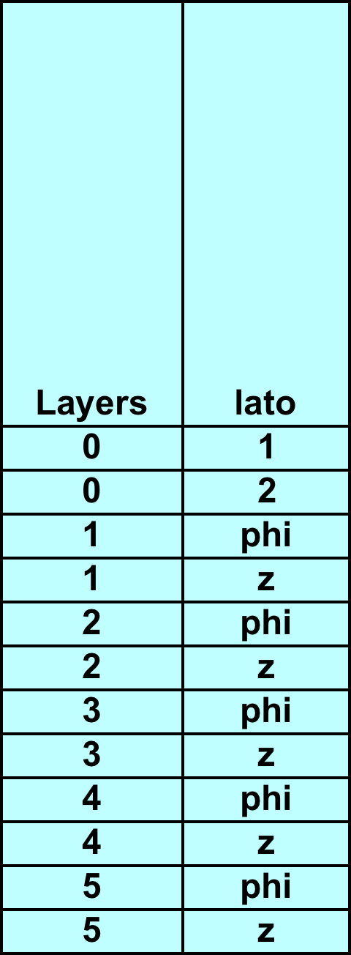
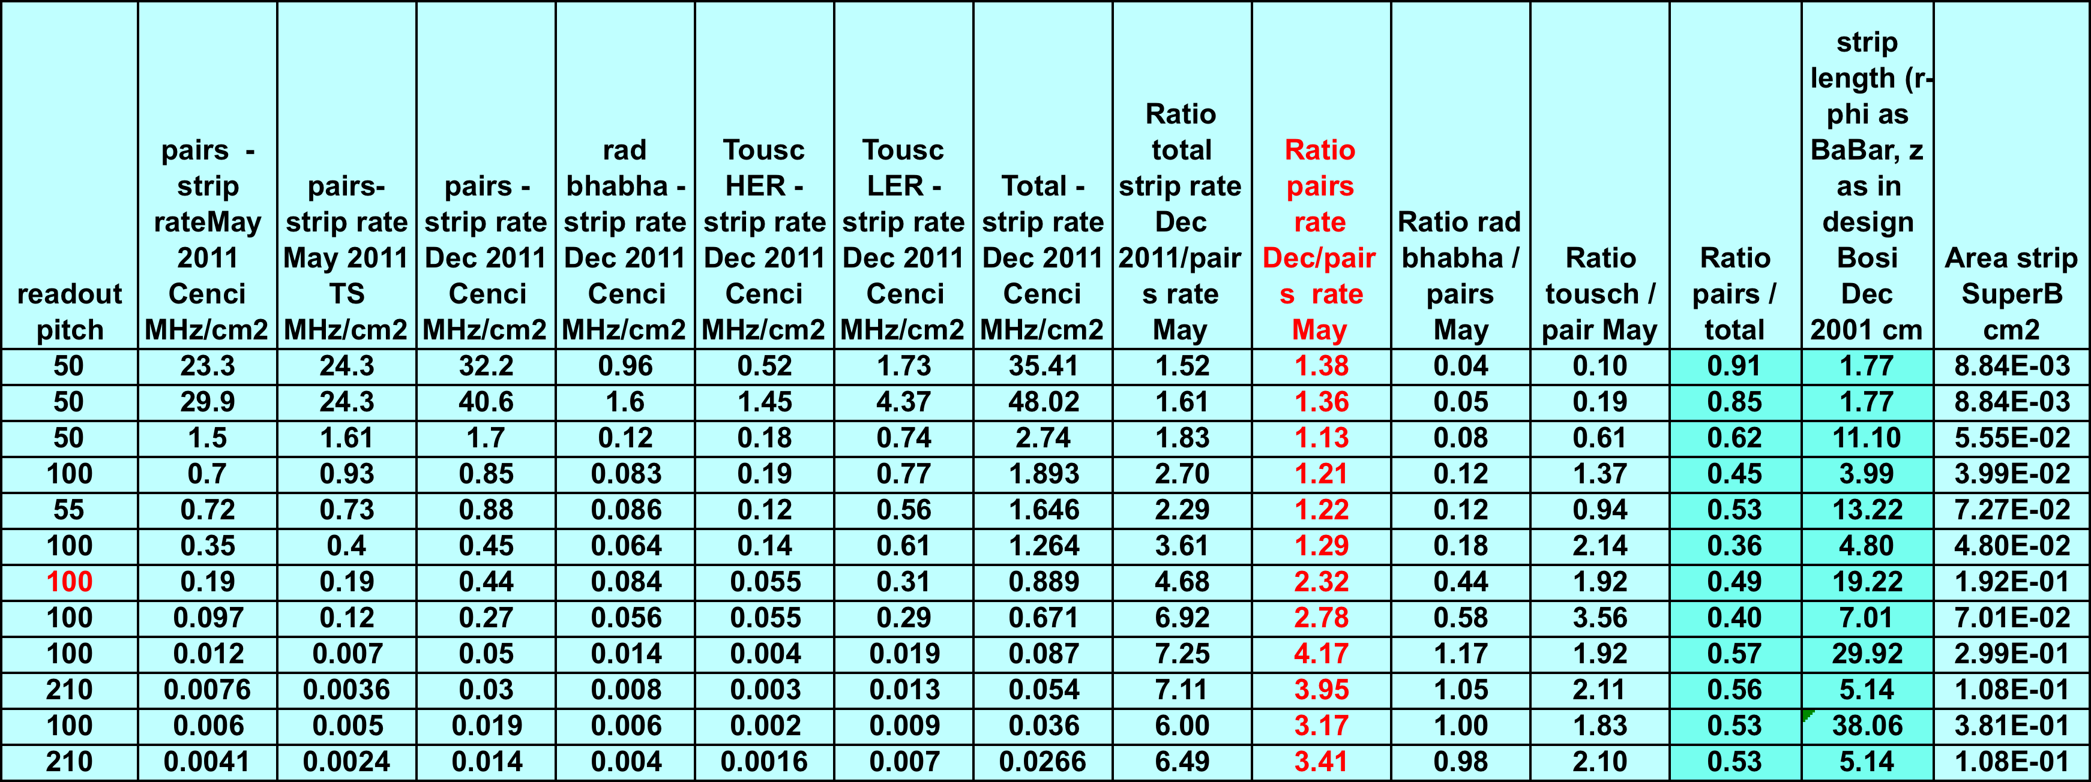
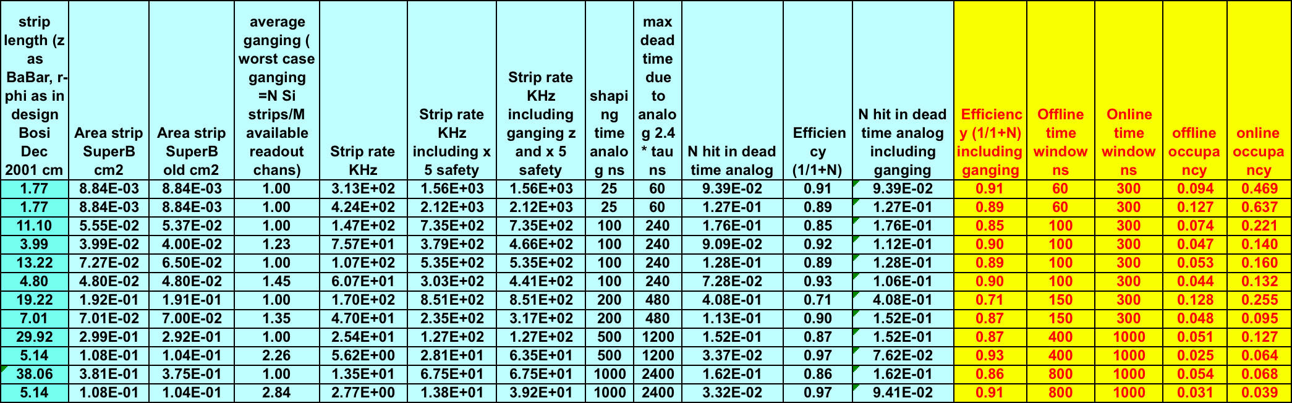
SVT Background – Dec 2011

Slide 5
SVT background from Dec 2011 production
New back rates from Dec production are not acceptable for the whole SVT (not only L0):
With new numbers offline occupancy (to be used in reconstruction) is too high for L1-5: 7-5-12-5-5% in r-phi and 5-5-5-2.5-2.5% in z.
  In BaBar the average offline occupancy in 2003 was ~0.7-0.6-0.4% in L1-2-3 ~ 0.1% L4-5
  Tests performed in 2003 for the high lumi running of BaBar, performed with BaBar x5 background occupancy (~3-4% in L1-2-3 and <1% in L4-5), indicate BaBar reco code start to have problems with this level of background.
  My guess is that in SuperB reco code cannot handle an offline occupancy 10 times higher (L1-2-3) and 25-50 times higher (L4-5) than what we had in BaBar.
  What should be a reasonable limit for offline occupancy is not easy to evaluate. Asked reco experts.
  Dave Brown answer: ~5% occu. is MAYBE still ok, 10% not acceptable!
    Still need to check if 5% is the right limit.
  Note: Online occupancy in BaBar is x5 w,r,t offline occu. In SuperB online occupancy is x1.5-x5 w.r.t offline (time window varies with layers)
Efficiency due to analog dead time <= 90% in all layers (r-phi)!

Slide 6
Differences in Bruno: Dec vs May production
B field (1.5 T) active only in +/-20cm in Dec production
  In May production B field was ON everywhere inside the beam line for pairs and OFF for Rad Bhabha production.
  New pairs production in Jan with B field extended in +/-40 cm. Strip rate back down by a factor 2 in Layers 3-4-5, but still a factor ~ 2 higher than in May.
  Layer 0-1-2 still +40%-20% w.r.t May.
  Checks by Cenci and Stella consistent
Shields shape different
  consistent with new IR design
Material of criostats now inserted
Plot of origin point for tracks
that hit SVT are now produced (Cenci, Stella)
to understand better the origin of
SVT background.
Shortcuts introduced to reduce CPU
time that can change the results:
  kinematic cuts at the generator level
  geant step increaased
New test production in a few days without shortcuts in 4)

Slide 7
New Control Plots
More plots shown at the SVt-Back meeting:
http://agenda.infn.it/conferenceDisplay.py?confId=4569
Layer0
Layer1

Slide 8
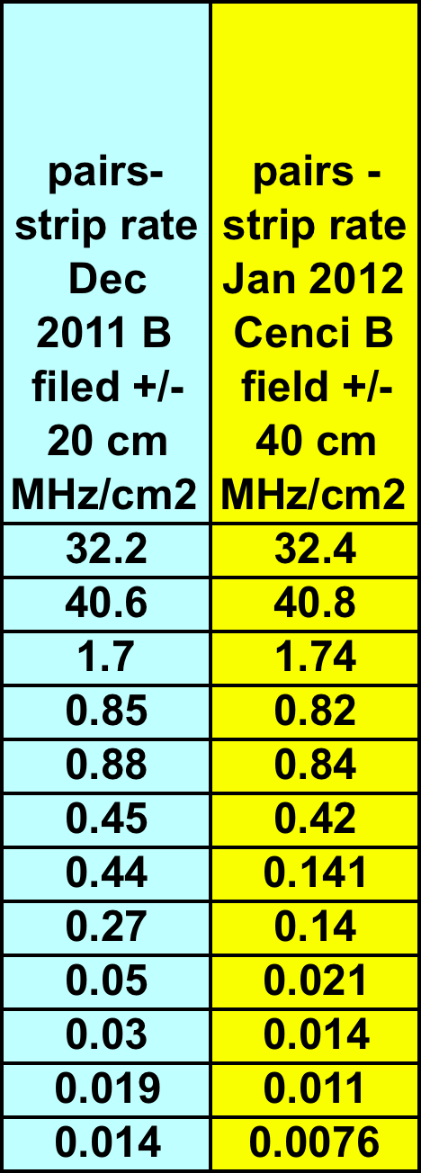
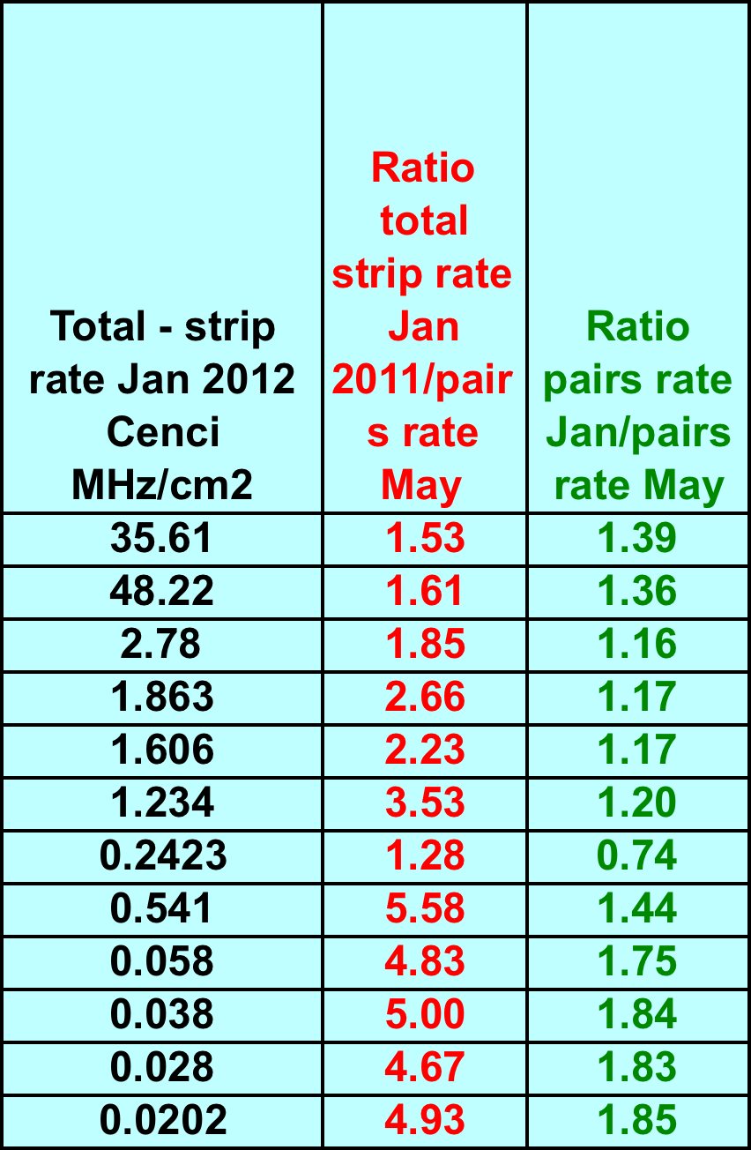
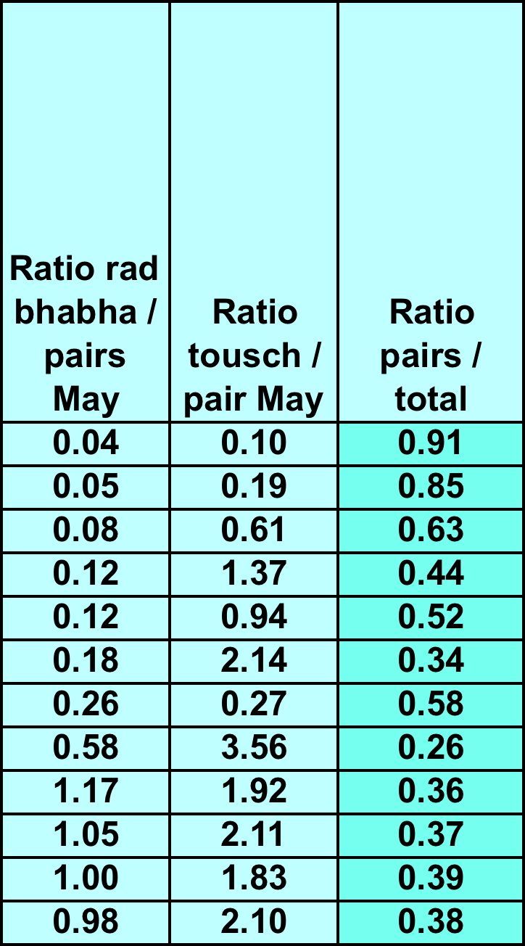
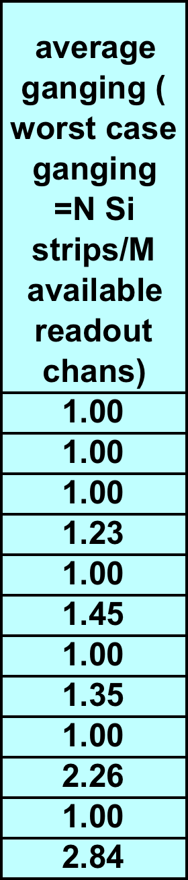
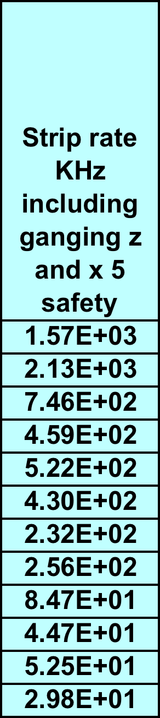
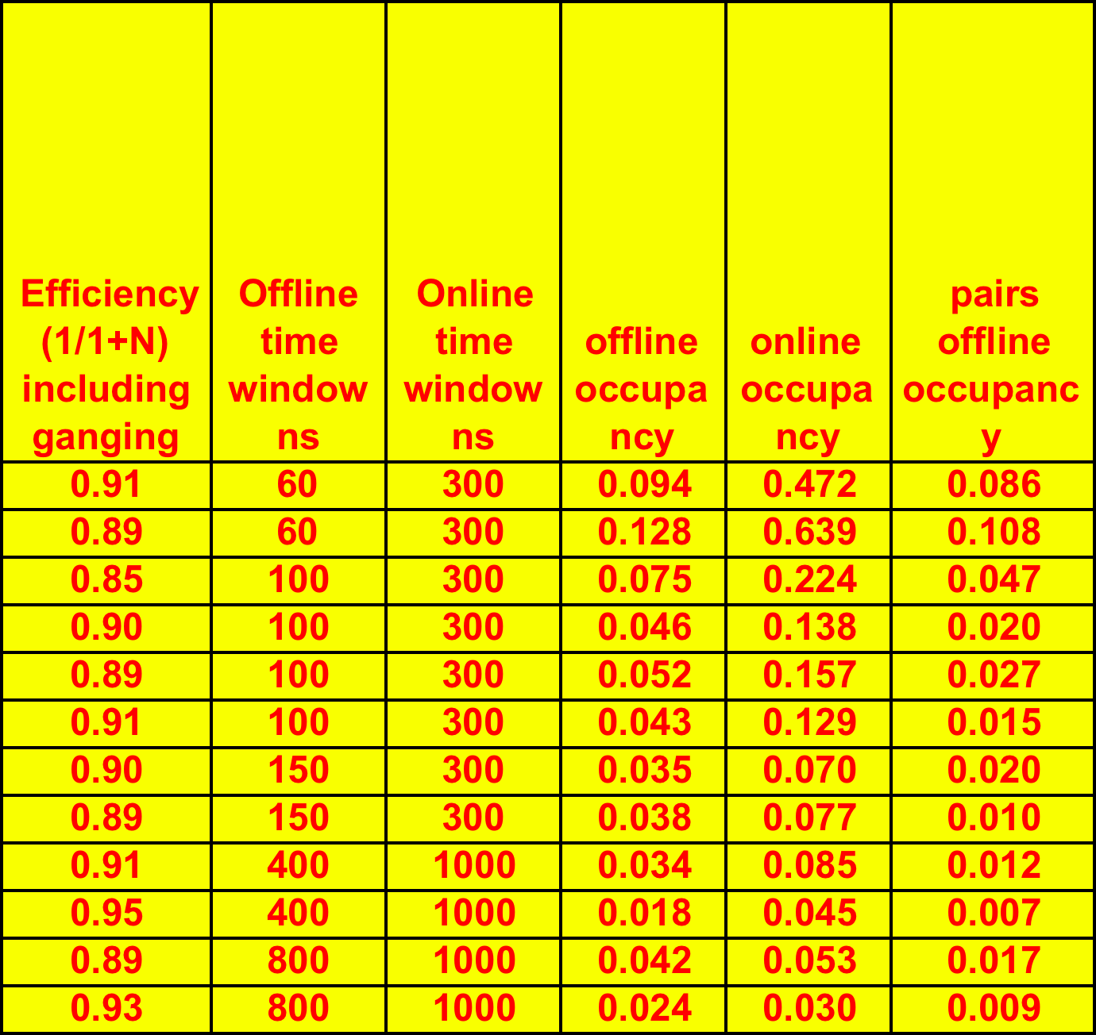
SVT Background – Jan 2011
Need to reduce rates to stay in the range 3-5% offline occupancy
  understand better what is the acceptable occupancy limit, probably between 3-5%
  Layer0 rates estimated with Bruno should be reduced by 30% (in Bruno there is a smaller radius w.r.t actual striplets design). Not yet done in these tables.
Next steps:
Pairs: try to understand if there are bugs in new production and, from origin points plots, if there are margins of reduction (shields shape? )
Touschek: M. Boscolo will try to change collimators settings to reduce the Touschek losses.
Touchek and Rad Bhabha production with extended field (no changes in L0-1-2 expected, could help in L3-4-5)
Expect this process will take >= 1 months, but we cannot wait final numbers to design the electronics for SVT in time for TDR.

Slide 9
Proposal on back. rates to be used for SVT – TDR design
While background number are being checked, we should design the SVT electronics chain assuming the max rate considered acceptable for reconstruction (Dave Brown inputs):
  In Layers 1-5 → 5% offline occupancy →
    strip rates: 500 kHz L1-2 (100 ns cut), L3 330 kHz (150 ns cut), L4-5 125-65 kHz (400-800 ns cut)
  In Layer0 striplets → 10% offline occupancy →
    Strip rate 1.67 MHz (60 ns cut).
My feeling is that these numbers are still ok for electronics:
  FE chips simulation seems ok and number of lines/chip needed is probably still reasonable (need to quantify this for each layer and see the corresponding HDI design).
  dose, fluence should be reviewed as they are available with latest background production.
  Other issues high back vs electronic design?
BUT these numbers could be problematic for performance/reconstruction and the effect should be evaluated to set a more quantitative limit on acceptable offline occupancy (not only based on Dave’s feeling…)
    Need to discuss this in a dedicated meeting.
  Today more focus on electronics/mechanics.

Slide 10
Some pending issues (1)
Performance studies in high occupancy/low efficiency (for all layers) with fastsim.
  How can we implement all sources for background in fastsim?
  Low Efficiency (due to analog dead time) can be plugged in fastsim
Reconstruction with 5% occupancy in all SVT layers is really possible?
  How can we test this without the reco code?
  Need to discuss this in a dedicated meeting.
  Need to get more people involved on these issues.
  Today more focus on electronics/mechanics.

Slide 11
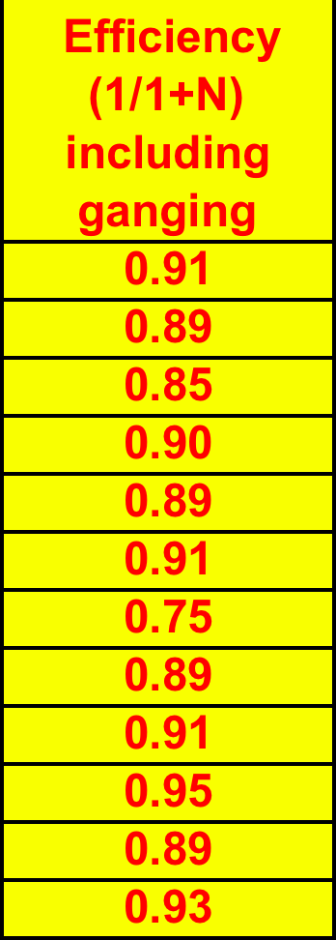

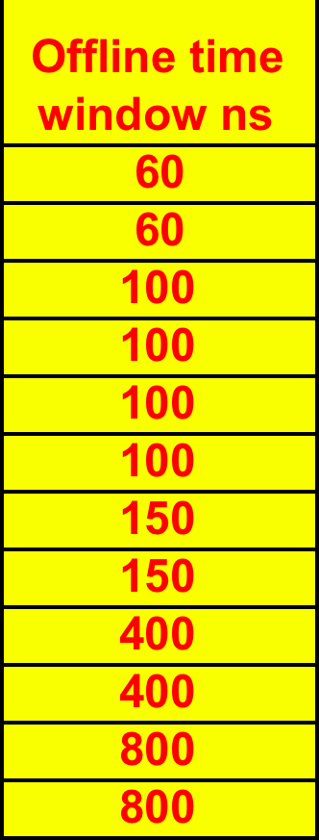
Some pending issues (2)
  Efficiency due to analog dead time:
  These number are a bit pessimistic: analog dead time=2.4 xshaping time, assuming 1 MIP released/strip.
  Need to be reevaluated considering energy released/strip from various sources.
  Pavia did it in the past for pairs; new plots from Cenci from other sources being produced.
  Timing cuts for offline occupancy evaluation:
    Study on hit time resolution under way (started?) in PV-MI to check if these assumptions are reasonable

Slide 12
Some pending issues (3)
Do we have a solution for the peripheral electronics? Citterio
HDI dimensions for each layer as proposed by Bosi (as in BaBar) are really ok?
  How many lines/chip are required in each layer?
  Encoder/serializer can fit in those HDI?
  Other issues?
Transition cards (“old BaBar matching cards”) dimensions positions as proposed by Bosi are realistic?
Do we need cooling on transition cards?
Power distribution?
Fanout for striplets?

Slide 13
Some pending issues (4)
DAQ (Villa)
Need to plug in new background numbers and check carefully assumption in the Electronics_load xls file produced by Mauro.

Slide 14
Some pending issues (5)
Mechanics (Bosi)
Layer0 mounted on beam pipe:
  It can move w.r.t SVT, but this is ok if its position can be monitored with a running global alignment as done in BaBar for each run.
  Vibration cannot be followed! their frequency and amplitude should be evaluated.
SVT quick demounting being developed with several assumptions that need to be verified with others (Fabbricatore, Sullivan, Raffaelli…)

