Slide 1



Requirements on pixels for Layer0
SVT- Meeting
Jan 30, 2012
Giuliana Rizzo
Universita’ & INFN Pisa

Slide 2
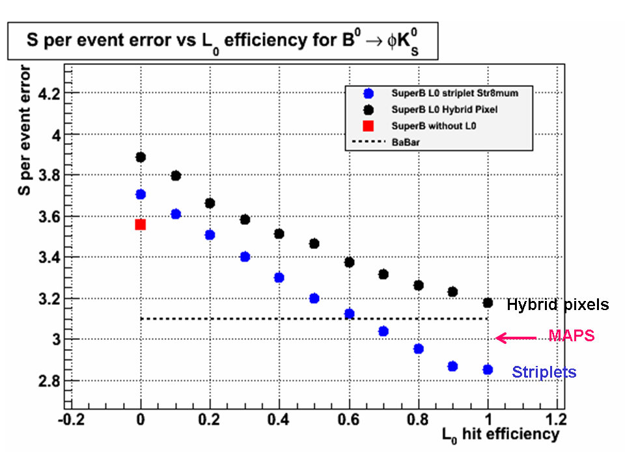
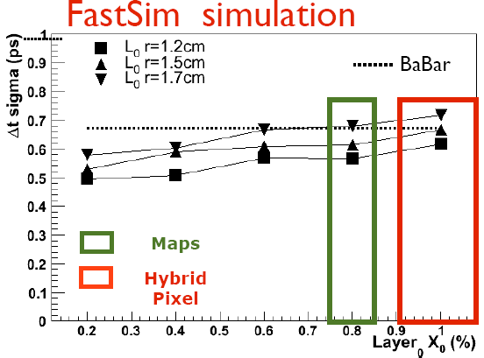
Requirements from Physics
B→π π, βγ=0.28, hit resolution =10 μm
Δt resolution (ps)
~10% better
~20% more Luminosity
Results from Fastsim:
Resolution of 10-15 um in both coordinates
Total material budget <= 1% X0 (~ 0.5% to be competitive with striplets)
Radius ~1.3-1.5 cm

Slide 3
Constraints from Background
Main source of back. in Layer0: e+e- e+e- pair production.
In the following a safety factor x5 is applied on results from simulation shown here
Hit Rate depends on:
  sensor thickness (low momentum track with large crossing angle) & Layer0 radius.
  MAPS (10 um thick) 75-100 MHz/cm² R=1.5-1.3 cm
  Hybrid Pixel (200 um thick): 200-325 MHz/cm² R=1.5-1.3 cm
Other sources being evaluated: ~ 10% of pairs rates.
DC beam (4ns bunch spacing)
TID: ~15 Mrad/yr
Eq. fluence ~ 2.5 x 10¹³ n/cm2/yr
  Standard CMOS MAPS are marginal!

Slide 4
Other requirements
Layer0 with 8 modules, Area_pix_mod=7.68 cm2
  6 chips, A_chip=1.28 cm2 (256x200 pixels, 50 um pitch)
Assumption:
  online timewindow=TS (with trigger jitter 100 ns)
  LV1 trigger rate 150 kHz (Delta_t=6.7 us)
  Triggered latency ~ 10 us
The pixel architecture should be triggered to reduce the amount of data to be transferred off module
Timestamp resolution:
Fine timestamp resolution <=1 us is necessary to reduce the required bandwidth/module to acceptable level (5-10 Gbit/s!).
Required bandwidth/module:
  Data push:
    Hit Rate x Area_pix_mod x 30bit/hit = 17-23-46-75 Gbit/s
    calculated with Hit rate 75-100-200-325 MHz/cm2)
  Triggered:
    Hit Rate x Area_pix_mod x 30bit/hit x TS x f_LV1_trigger=
    With TS=1 us → Triggered bandwidth/module=2.5-3.5-7-11 Gbit/s
    With TS=10 us (>1/f_trigger) → Data push bandwidth/mod.=17-24-46-75 Gbit/s

Slide 5
Timestamp resolution & occupancy
Smaller timestamp (<400 ns) helps to reduce occupancy to acceptable levels for reconstruction.
Impact parameter resolution with L1-L5 (BaBar)
Considering the extrapolation of tracks on Layer0, hits to be associated with tracks, reconstructed in L1-L5, can searched in a window as large as 3x3 mm2 → 60x60 pixels
  Window ~ +/- 5 x impact parameter resolution.
  Impact parameter resolution for low momentum track ~ 300 um.
Pixel occupancy < 0.1% probably ok (need quantitative study).
  50x50 um pixel pitch 2.5-5 kHz/pixel (for 100-200 MHz/cm2)
  With TS of 1us pixel occ.=0.25%-0.5% (for 100-200 MHz/cm2)
  Need 400 – 100 ns TS for back hit rates 100-200 MHz/cm2

Slide 6
From SuperBelle TDR

