Slide 1

ME0 Module Production
Piet Verwilligen
GEM Coordination – December 19th, 2024
INFN – sezione di Bari

Slide 2
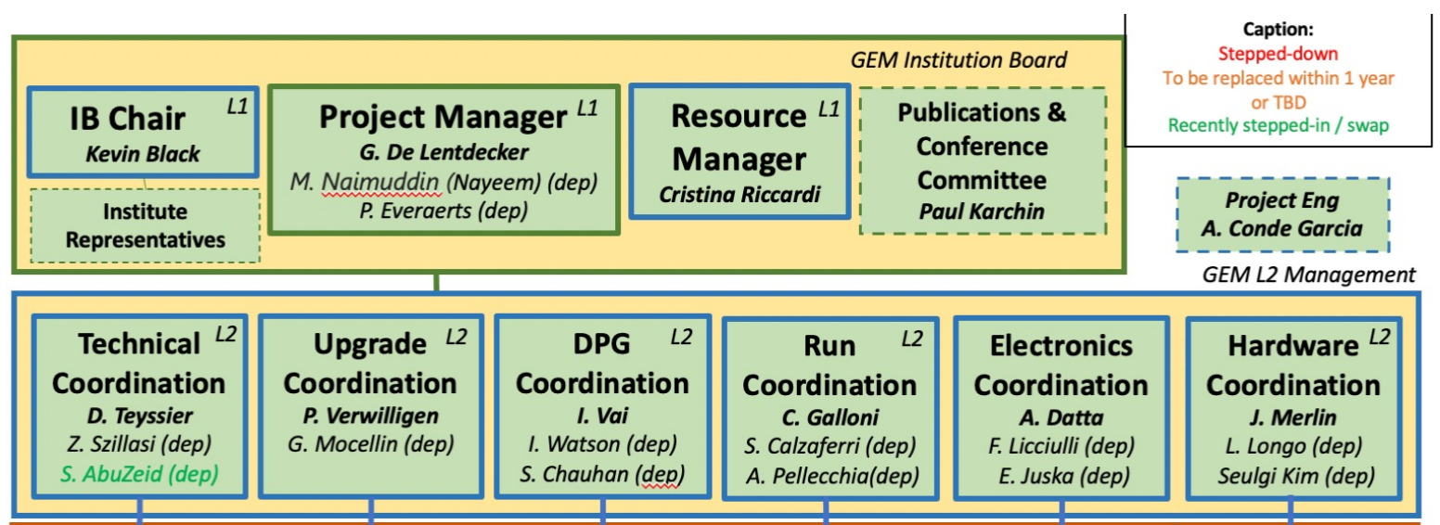
GEM Bari & Coordination GEM
Italian institutes in GEM: Ba, Bo, LNF, Na, Pv
  29 FTE M&Ob (28%) – 52 persons on authorlist (28%)
  Core contribution: 2.6M (20%)
INFN Bari between founding institutes of CMS GEM
  Design & Responsibility for Front-End (VFAT3)
  Responsibility for Chamber Production
  CMS Italia GEM coordination P.V.
  GEM Bari: 5 staff, 3 Post-doc, 6 PhD students
Currently 4 Level-2 coordinators in GEM organigram
  Upgrade, Run-Coordination, Production, Electronics

Slide 3
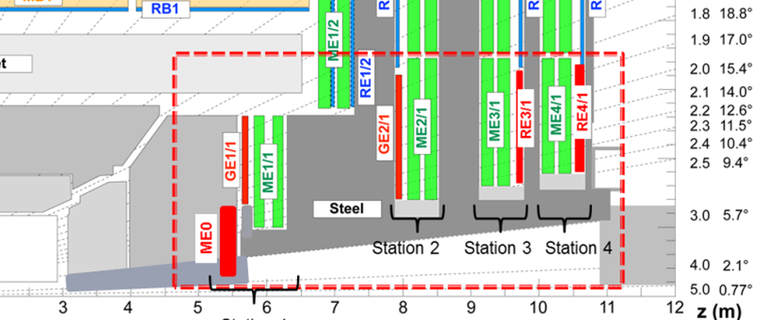
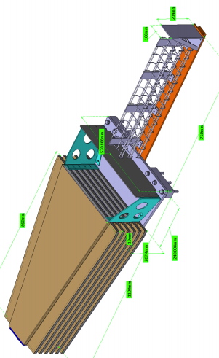
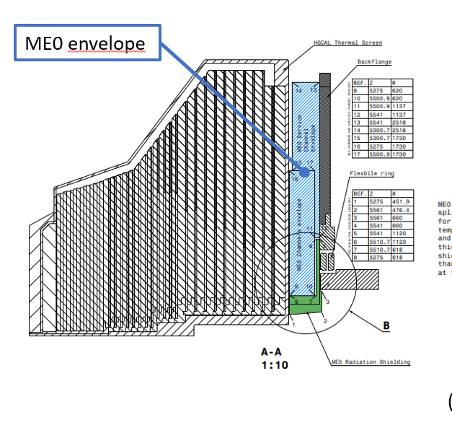
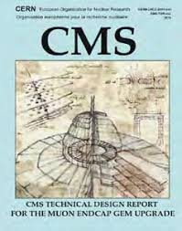

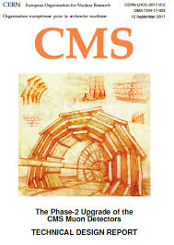

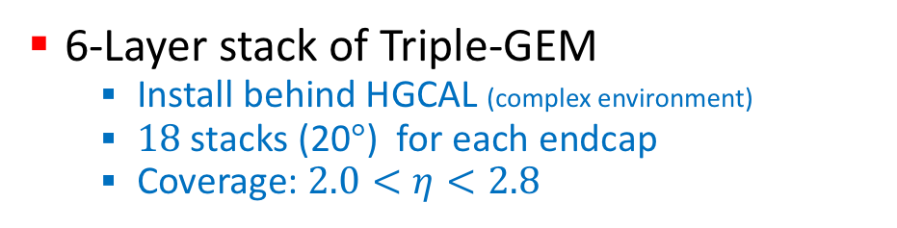
The ME0 project: challenges
Original Requirements*:
  97% module efficiency
  $<500μ$rad resolution
  8-10 ns time resolution
  $≤15\%$ gain uniformity
  Efficient operation at average hit rates up to 150kHz/cm^{2*}
  Accumulate charge up to 7.9C/cm^{2*}
  Discharge rate that does not impede performance or operation
  * updated w.r.t. TP & Muon TDR
ME0
6-Layer stack of Triple-GEM
  Install behind HGCAL (complex environment)
  $18$ stacks (20$°$) for each endcap
  Coverage: $2.0<η<2.8$

Slide 4
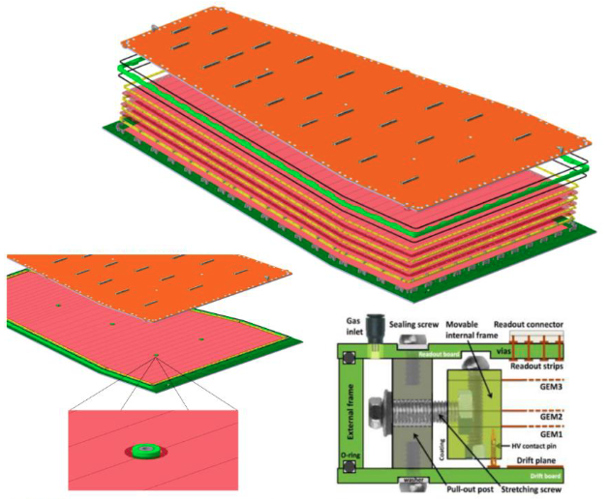
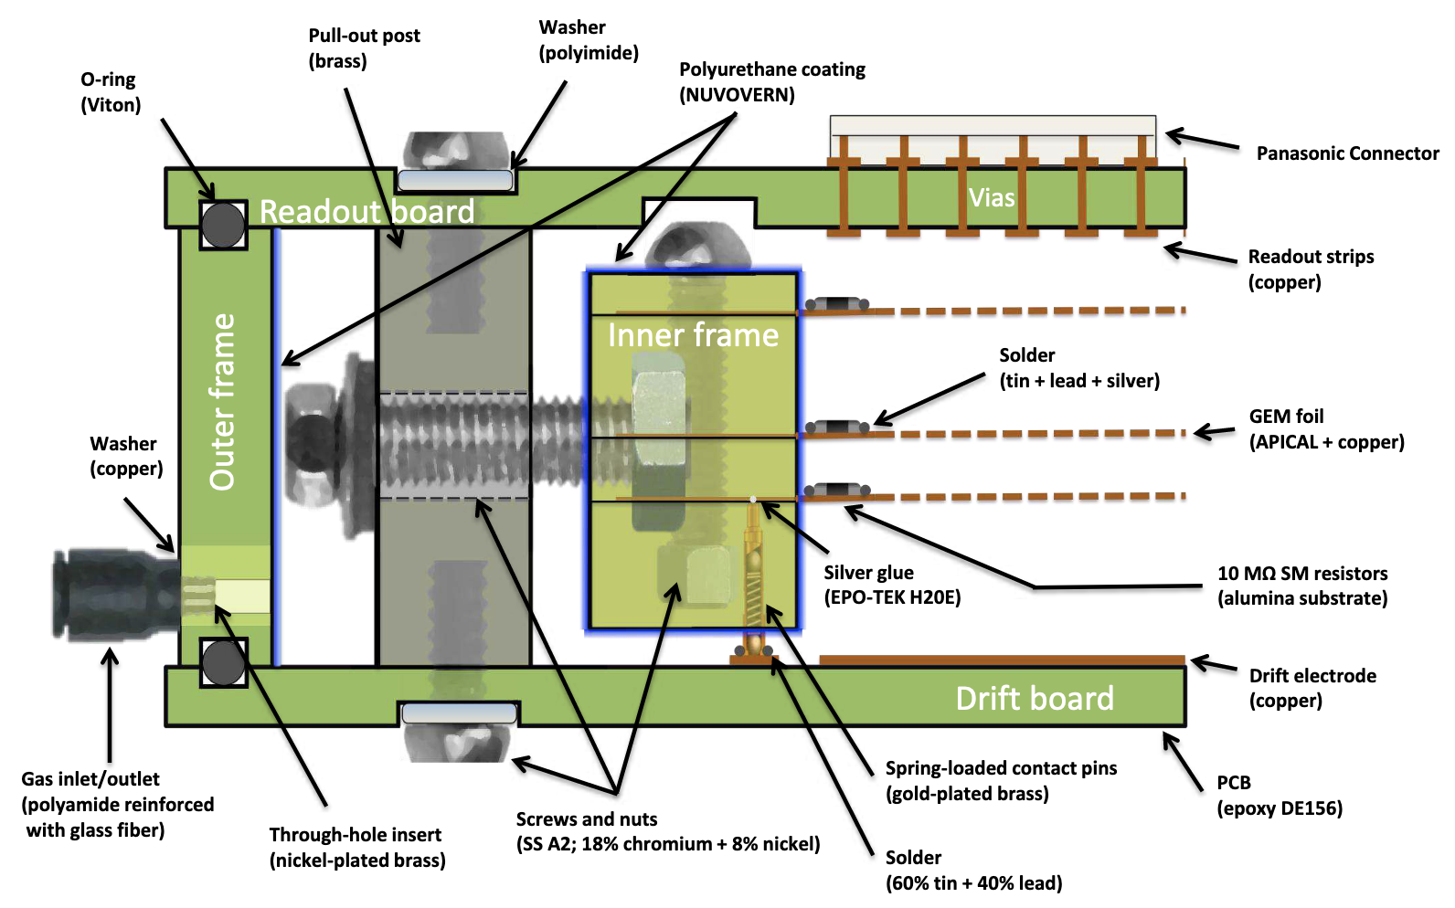
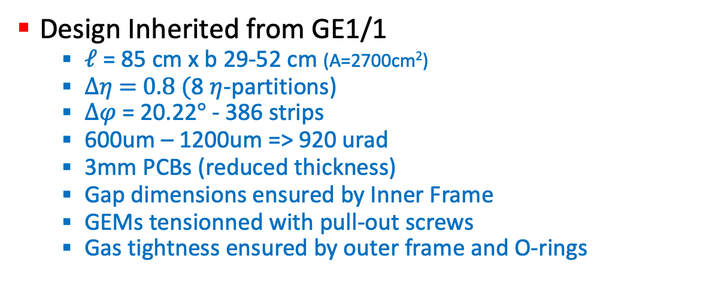
ME0 Design: Overview
Design Inherited from GE1/1
  $ℓ$ = 85 cm x b 29-52 cm (A=2700cm²)
  $∆η$ = 0.8 (8 $η$-partitions)
  $∆φ$ = 20.22$°$ - 386 strips
  600um – 1200um => 920 urad
  3mm PCBs (reduced thickness)
  Gap dimensions ensured by Inner Frame
  GEMs tensionned with pull-out screws
  Gas tightness ensured by outer frame and O-rings

Slide 5
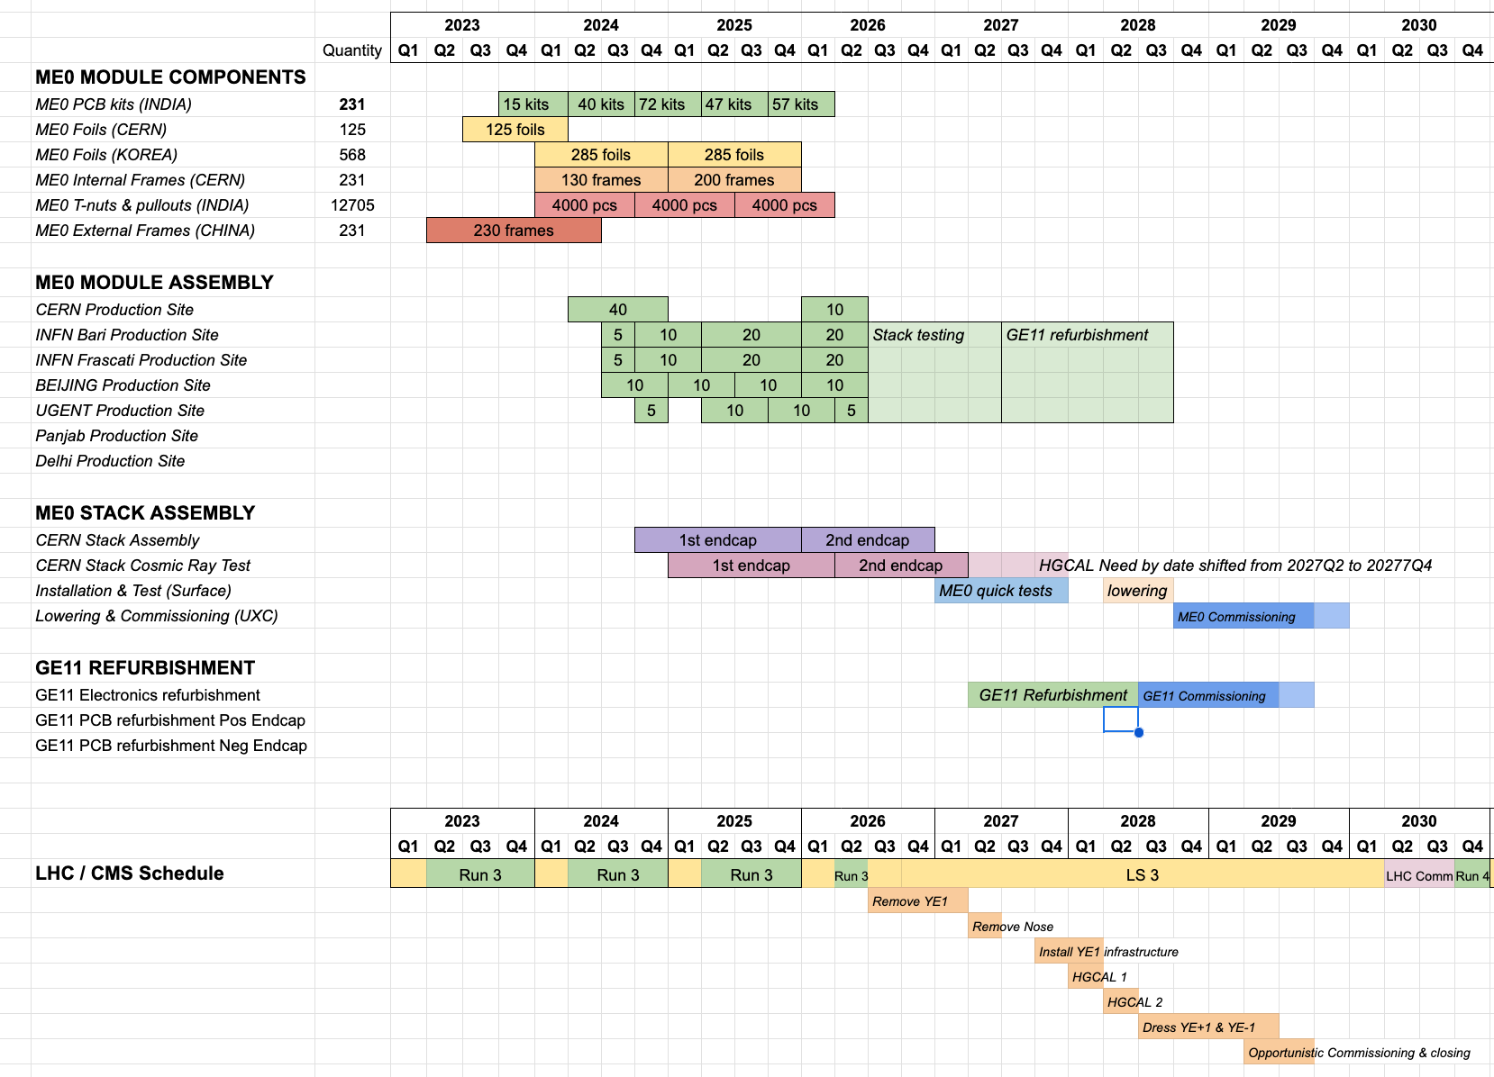
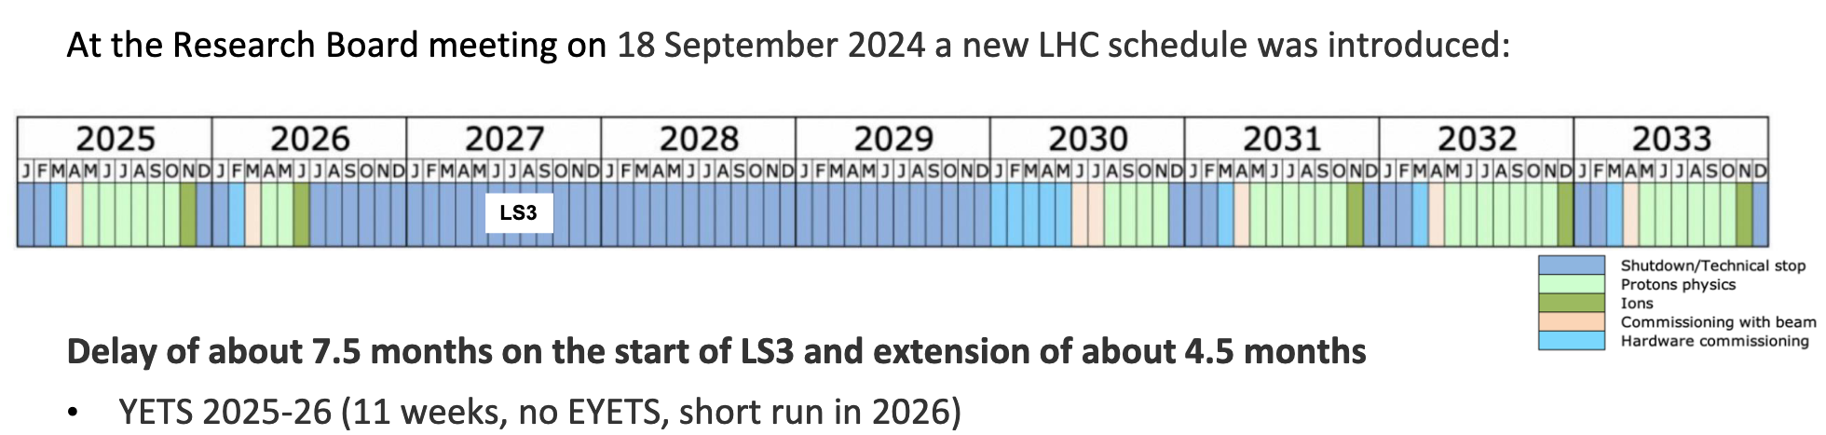
ME0 Simplified Schedule
today
Procurement & QA
Module Production
Q2 2024 – Q2 2026
Stack Production 2025 - 2026
24 months
Installation
Jan ‘27

Slide 6
ME0 Schedule for Bari
Recap of 2024
  Started production at CERN
  1st round of Production July – September ‘24
    Reduced from 10 to 5 chambers b/c August holidays
    5 high quality chambers produced and tested up to QC5
  2nd round of Production December – February ’25
    1st chamber constructed and brought through QC5
    2nd chamber needs repair in clean room
Forecast 2025
  Finish 2nd round (8 chambers) in Jan-Feb ‘25
  Expect 2 more rounds May-July & Oct-Dec ‘25
  Total expected: 28
2025 will mark the start of Stack Assembly @ CERN
  Construction sites need to send manpower (Bari: D.Troiano)
  CERN constructionsite will move from Modules -> Stacks
    Need performand Module Production sites (IT: Ba, LNF)
    Indian sites joining, but they never build & tested GE11 A-to-Z
    This might result in a higher load on Bari construction site
    as it was the most performant construction site outside CERN

Slide 7
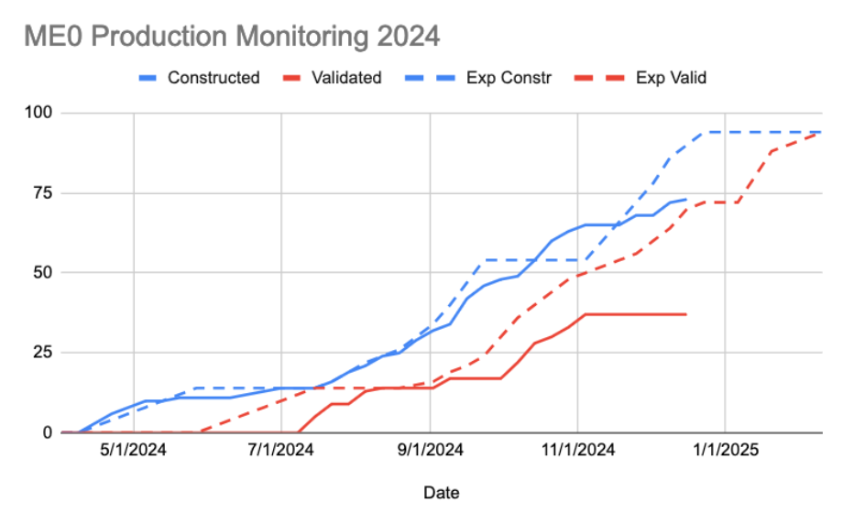
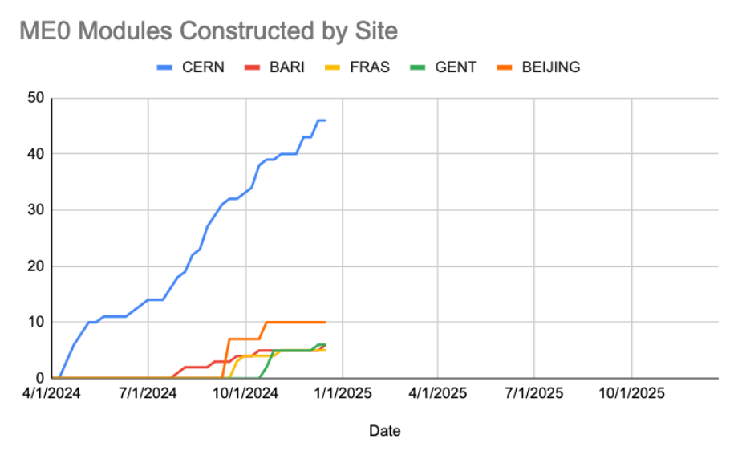
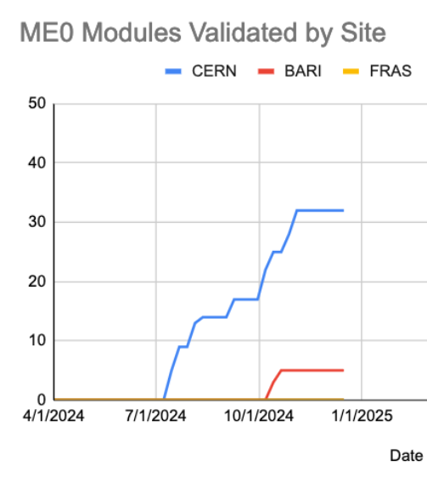
Achievements 2024
Module Production
  Total:
    75 constructed - Expected 80 by Dec 31st 94% done
    41 validated - Expected 50 by Dec 31st 82% done

Slide 8
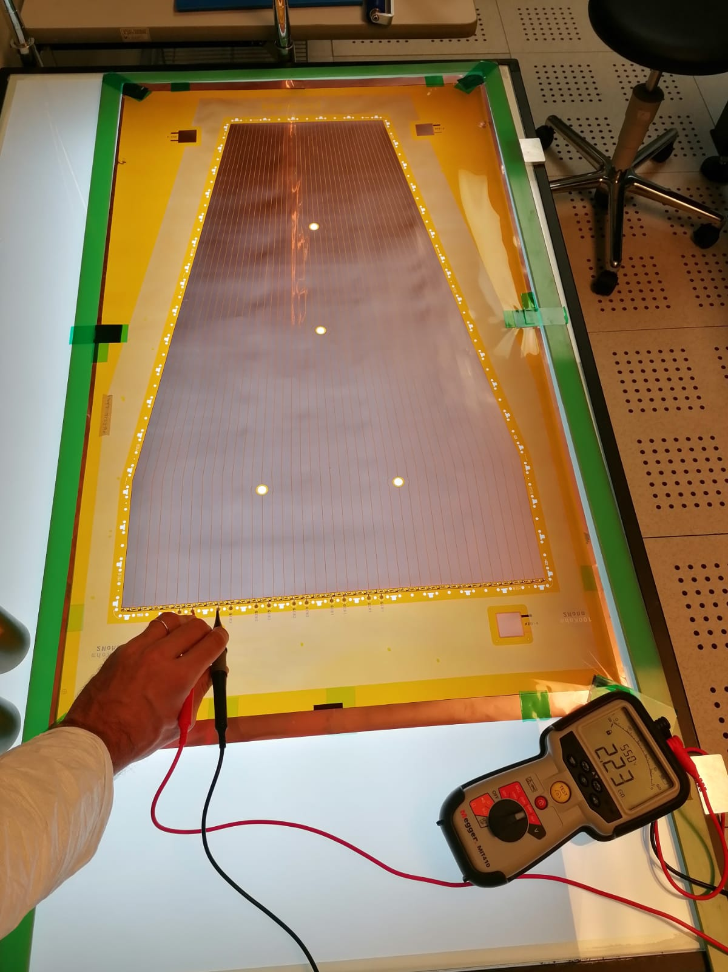
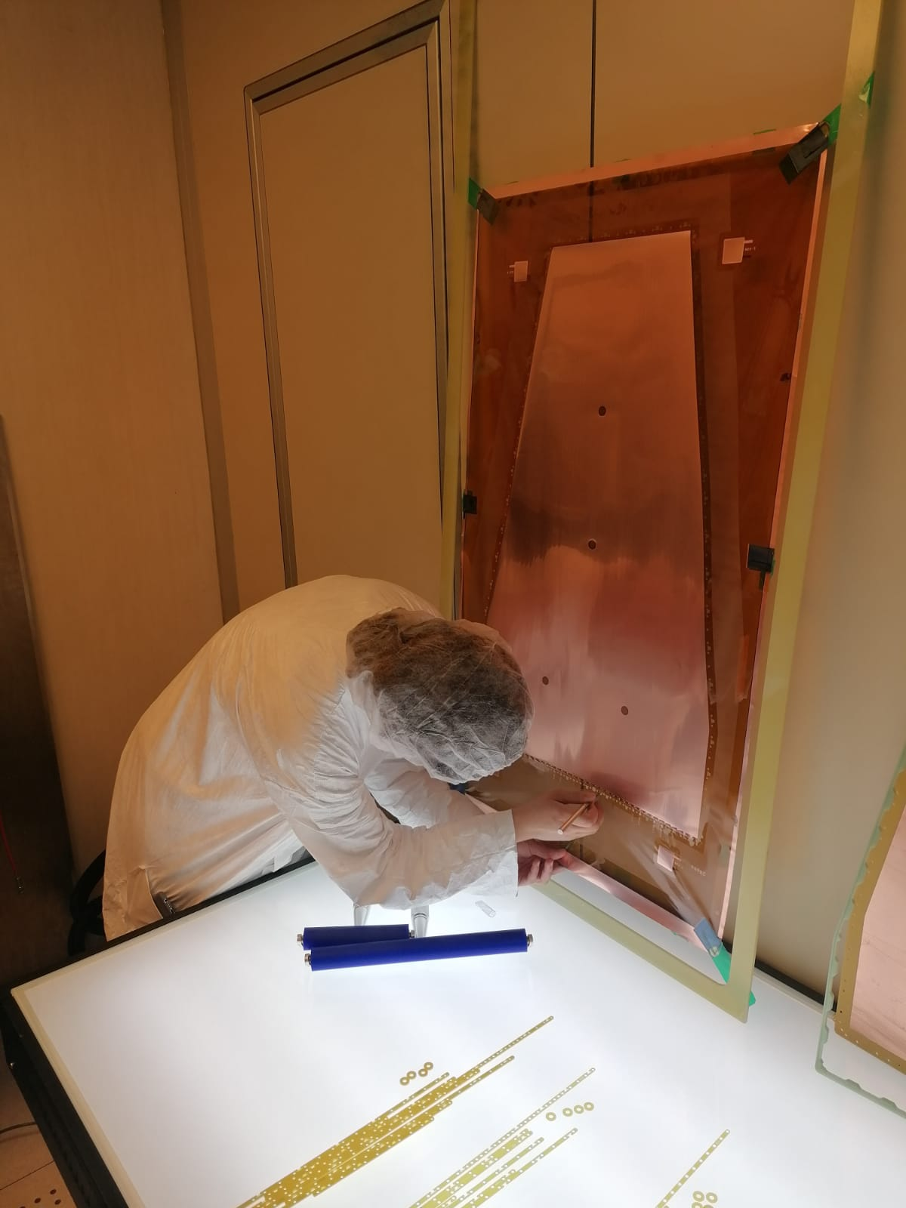
ME0 Construction in CP3

Slide 9
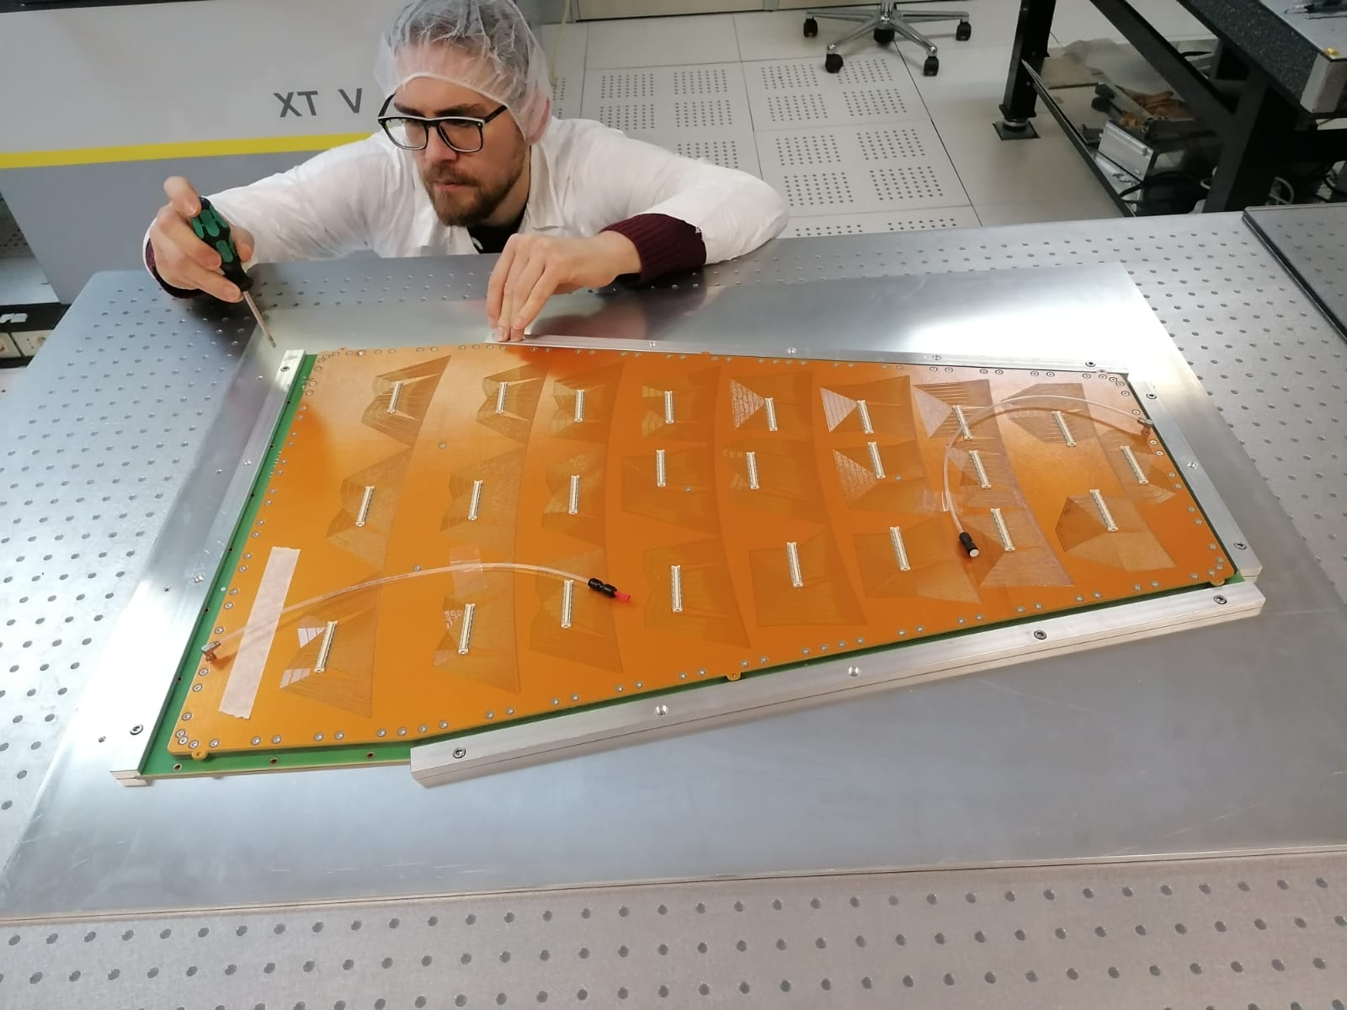
ME0 Construction in CP3

Slide 10
Organization
For each ME0 Module
  ½ day of Pre-Assembly in GEM Laboratory
  ½ day of Assembly in Clean Room
    Eventually other ½ day to go back to solve problems
  ½ day for QC3 (gas leak test) and QC4 (HV test)
  1 day of flushing with dry gas
  ½ day for QC5 (Gain calibration)
  ½ day for QC5 (Gain uniformity)
  1 day back-up in case tests need to be repeated
Total: 1 module / week (in regime)
We have pool of people (Staff / Post-doc / PhD)
  “shifts” for construction in Camera Pulita
  Organization of QC3 – QC4 – QC5-I – QC5-II tests

Slide 11
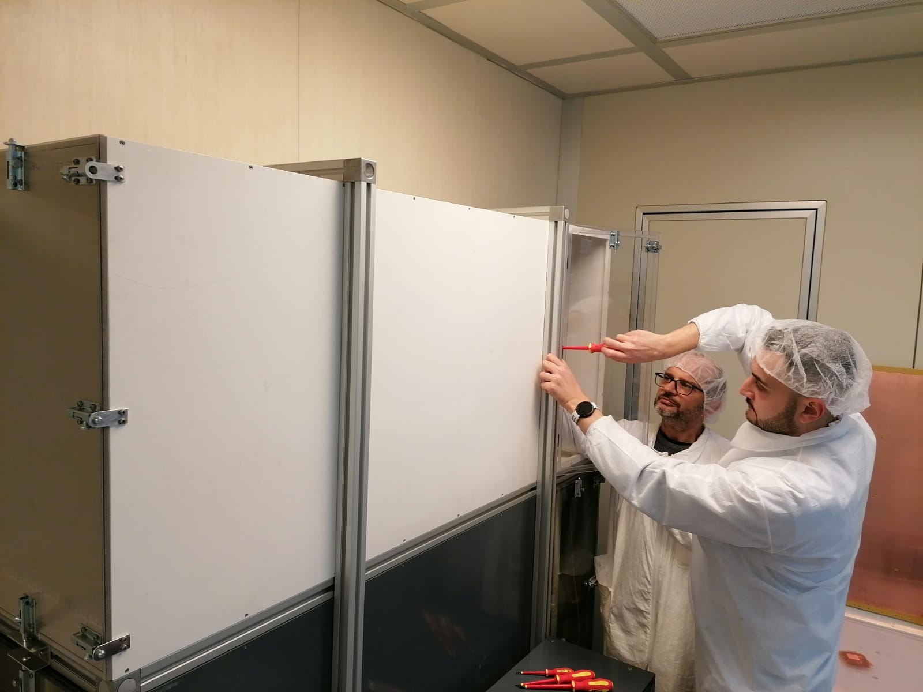
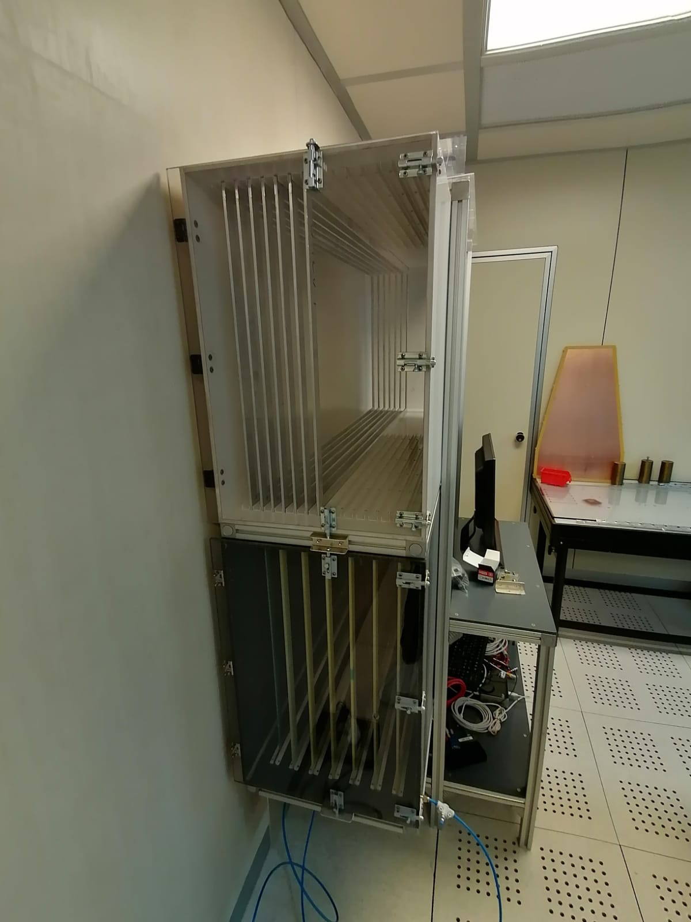
Sharing CP3 Clean Room
Since couple of years we share the CP3 clean room with ALICE (bended ALPIDE tracker)
To improve efficiency in clean room we have constructed a new foil box
  Foil capacity 7 foils -> 21 foils

Slide 12
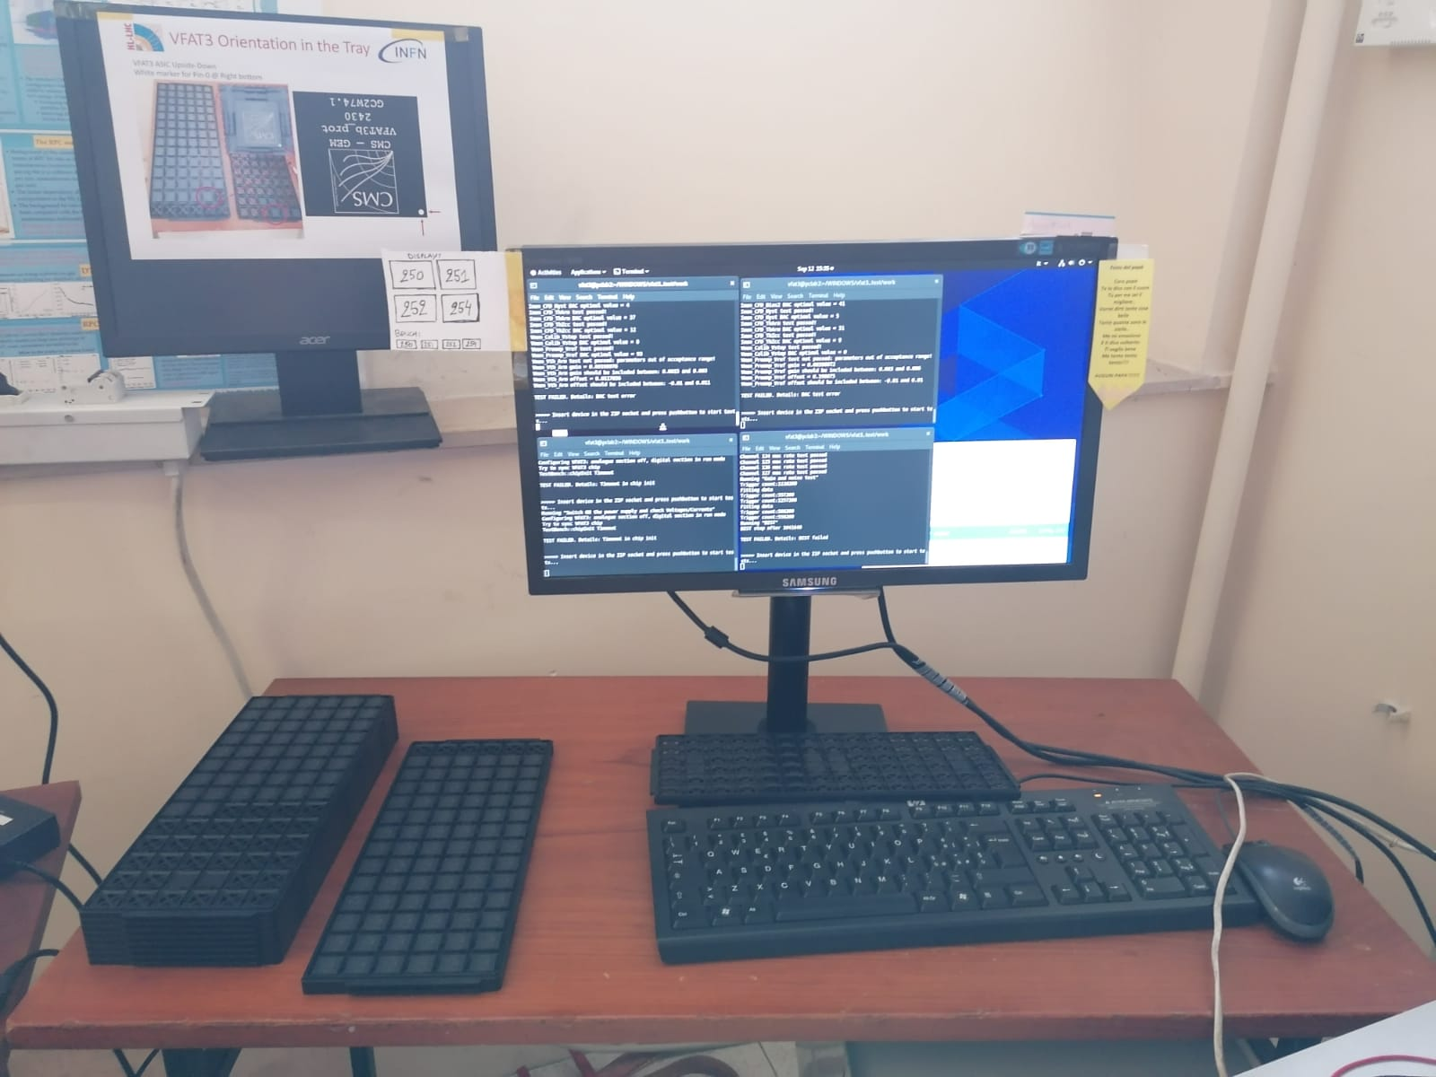
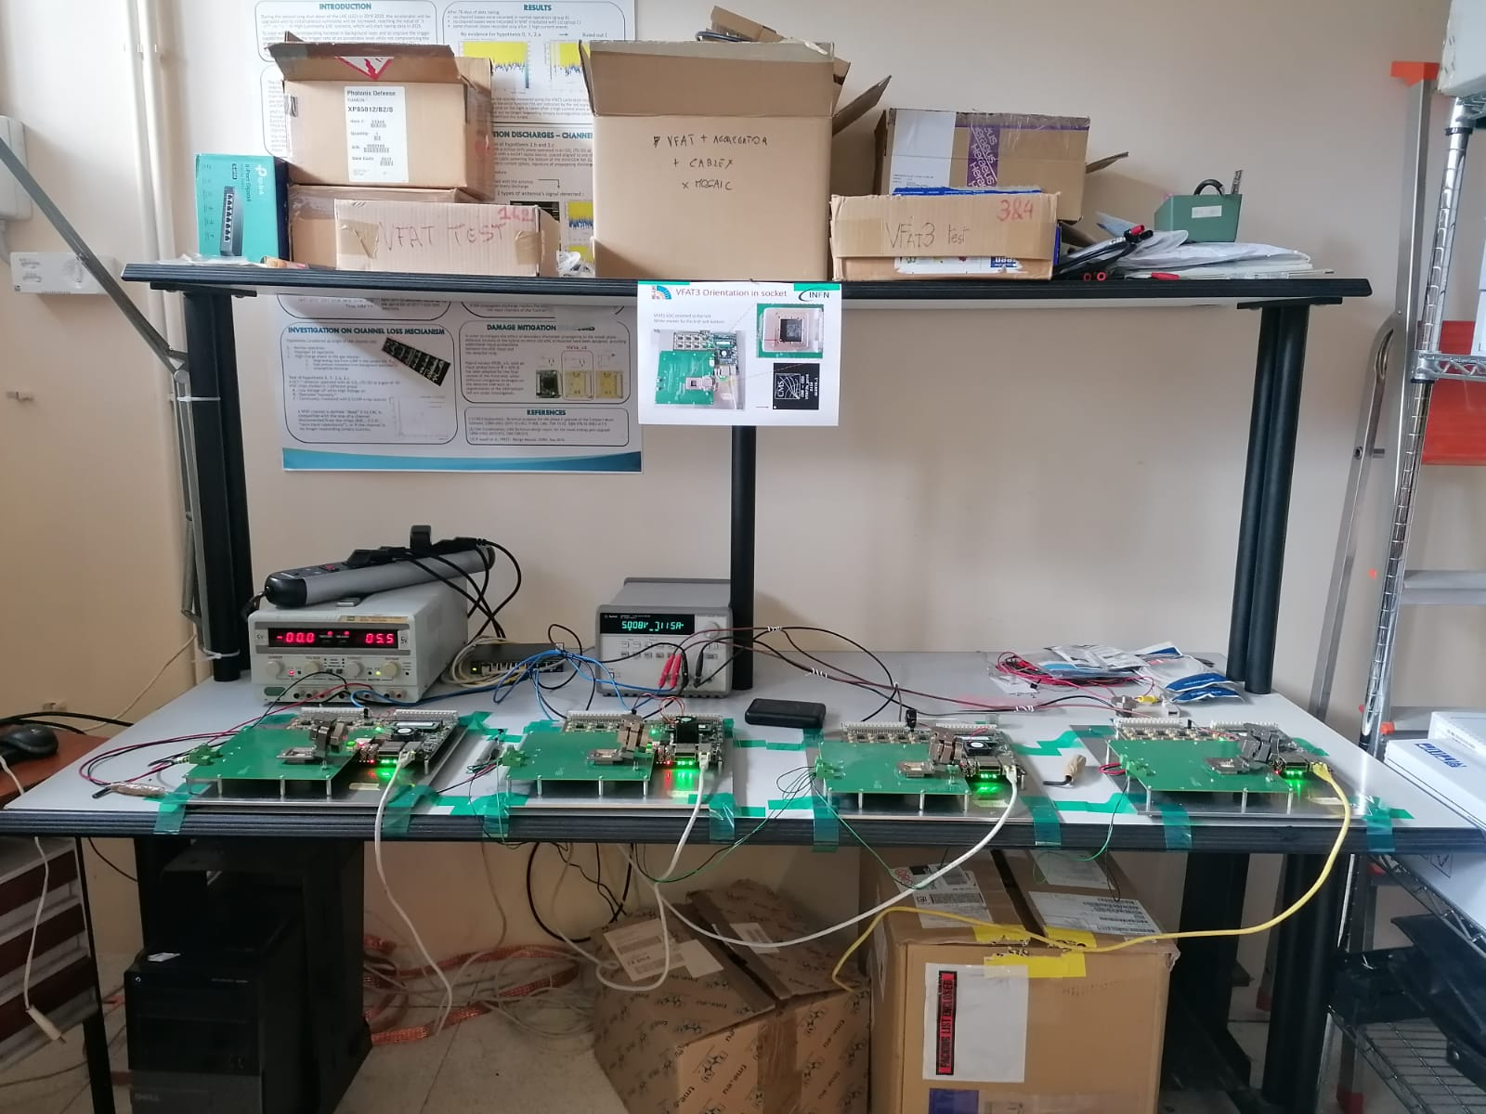
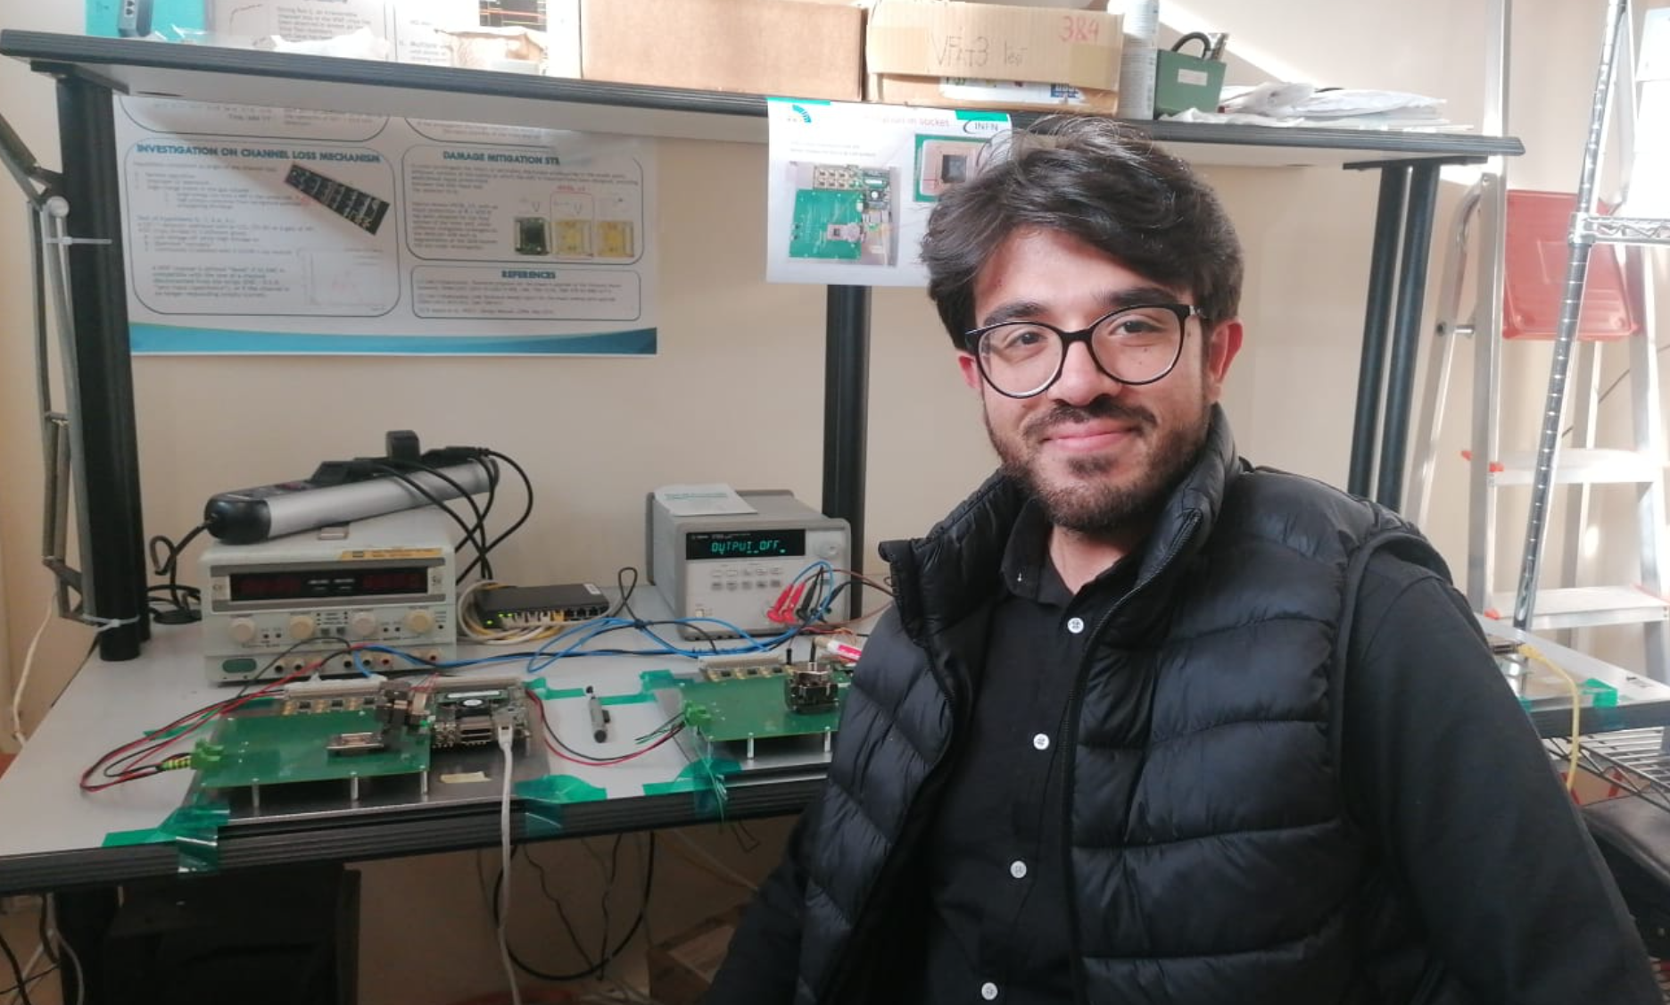
VFAT3 Testing @ Bari
Equally important for the construction of Stacks
  Test of Packaged VFAT3 in Bari
  10,000 chips packaged
    8000 for ME0 – 2000 for GE21
    Packaging yield: 96% (9868 good according to IMEC)
  Need to test these chips in house before mounting
    chip yield expected: 85% - need 7000 good ME0 plugin cards
    First batch of 1600 sent to plugin-card production company
    Efficiency of test-stands is decreasing – labor intensive
    New sockets needed. Expect testing January – March

