Slide 1

The Page-Wootters scheme of time emerging from quantum entanglement
M.Genovese
Project Qutenoise, SAN PAOLO FOUND.
Project Phoenicis- PNRR- NQSTI

Slide 2
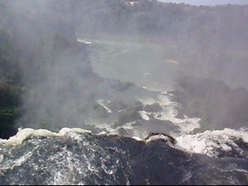
πάντα ῥεῖ ὡς ποταμός [Eraclitos]
“It is what passes (shi 逝) like that, indeed, not ceasing day or night.” [Confucius, The Analects, 2491]

Slide 3
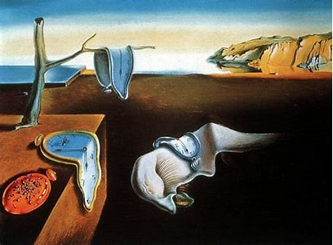
Quid est ergo tempus? si nemo ex me quaerat, scio; si quaerenti explicare velim, nescio.
Aurelius Augustinus Hipponensis, Confessiones, XI, 14

Slide 4
Tempus item per se non est, sed rebus ab ipsis consequitur sensus, transactum quid sit in aevo, tum quae res instet, quid porro deinde sequatur
Titus Lucretius Carus, De Rerum Natura
[Time also exists not by itself, but simply from the things which happen the sense apprehends what has been done in time past, as well as what is present and what is to follow after.]
Earlier ideas of Parmenides of Elea (Παρμενίδης ὁ Ἐλεάτης): the phenomena of movement and change are simply appearances of a static, eternal reality.

Slide 5
Time in modern philosophy
[Del Santo, Gisen arXiv 2404.06566
Le Bihan Qu’est ce que le temps?]
A Theory: monadic attribution. An event is present, past or future (flux of time)
Presentism only present objects exist, present becomes past, future becomes present
Dynamical Eternalism
Moving spotlight: events to be set on a fixed manifold, the present being singled out as it was lit by a light moving along the manifold
But if only present is real, what about propositions about past?
How to build «verificators» about these propositions?
Verificators about past can only exist in present for a presentist
What about trans-temporal relations?
Deflationist Presentism : propositions about past are false or undefined :
In what future differs from past? No knowledge of past?
Reductionist Presentism: past as a new methaphysic category
No clear intuition, Ockham’s rasor
…

Slide 6
Hybrid-Theories
Growing block: events come into existence at present, but persist in past
Future is not existing
Then a proposition not true with the present bloc (now + past) will become true.
At the end this requires two time : one, objective time, describing the evolution of the bloc past-present and an indexical time corresponding to perception of time inside the bloc: proliferation of entities (Ockham’s razor)
Problems with the inacessability of objective time and on the definition of «status» of past
In different reference frames different simultaneity hyperplanes: how do I define the «present»?

Slide 7
B-Theory: dyadic relation (time exists but doesn’t flow). Given two events E₁ E₂
E₁ before E₂ E₁ after E₂ or E₁ simultaneous to E₂
Eternalism Bloc universe. Only temporal relations exist. Past, Present and Future are all ontologicallly real
largely anti-intuitive: future contingency?

Slide 8
A-Theories
Presentist
Presentisme deflationist, presentism reductionist minimal, presentism reductionist inflationist, presentism ersatzist, ..
Eternalist
Moving light spot, dynamic tree universe, …
Hybrid Theories
Non-futurism, non futurism à la Forest, growing block…
B-Theories
Eternalist
Multiple futures, modal realism, counterparts theory, static tree universe (same ontological meaning of futures, «red line theory»), determinations cloud, …

Slide 9
A-Theories
Presentist
Presentisme deflationist (propositions about past are false o undertimed), presentism reductionist minimal (propositions about past are true but without past verificators), presentism reductionist inflationist (propositions about past are true but with past verificators but outside nature laws), presentism ersatzist (universe at certain time is an abstract object, a set of consistent propositions ), ..
Eternalist
Moving light spot, …
Hybrid Theories
Non-futurism (block theory, but with undetermined future), non-futurism à la Forest (only persons living now are conscious et live really), growing block (past and present are a growing block), dynamic tree universe (Branching of possible futures with a fixed past), …
B-Theories
Eternalist
Multiple futures, modal realism (every possibility of existence of the universe it exists a universe) , counterparts theory (different modalities are individuals retaining a relation of similarity), static tree universe («fixed» branching tree of events, past and future) (same ontological meaning of futures, «red line theory»), determinations cloud, modal conventionalism (future closed by «linguistic conventions», open by reality structure), …

Slide 10
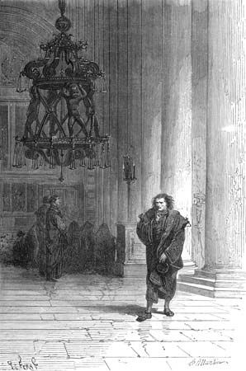
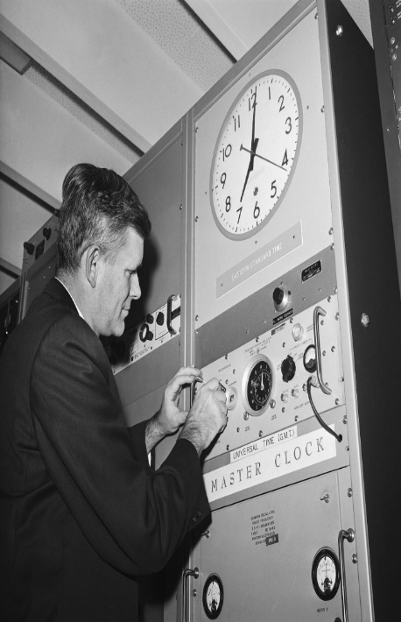
Time in Physics
Classical Mechanics Absolute Time (non relativistic QM): a fixed background parameter
SR Time: a proper time for each observer, time as 4th coordinate (set of privileged inertial frames)
GR Time: not at all an absolute time. Time is a general spacetime coordinate (time non-orientability, closed timelike curves…)

Slide 11
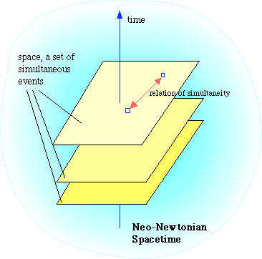
Classical (deterministic) mechanics Absolute Time a fixed background parameter
(B-theory)
Absolute, true, and mathematical time, from its own nature, passes equably without relation to anything external, and thus without reference to any change or way of measuring of time

Slide 12
Non relativistic quantum mechanics Absolute Time
again a fixed background parameter, but
Interpretation of time “interpretation dependent”
Properties emerge by quantum measurement
(e.g. Copenhagen interpretation
Multiple futures possible, the collapse of wave function determines one
A theory (with eternalism)
But not for multi-universe (B theory, static tree universe, …))
:

Slide 13
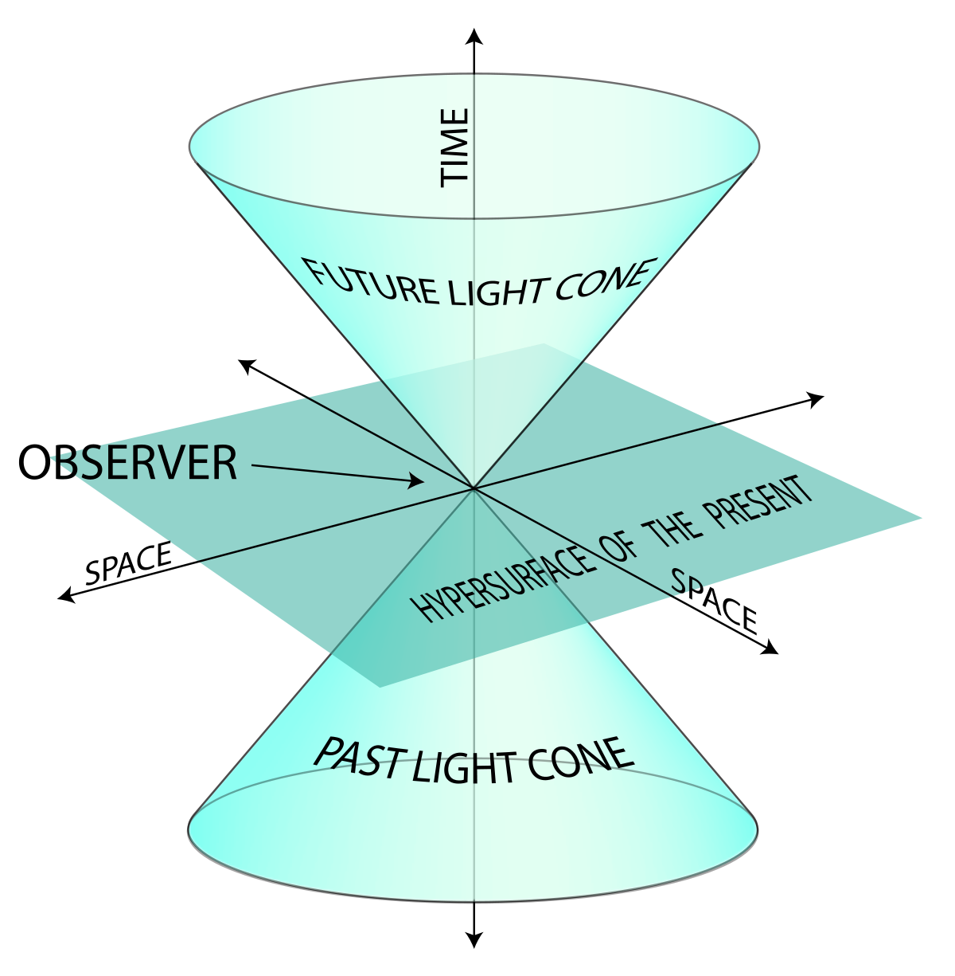
SR Time: a proper time for each observer, time as 4th coordinate (set of privileged inertial frames)
proper time : time that an observer sees on a clock at rest

Slide 14
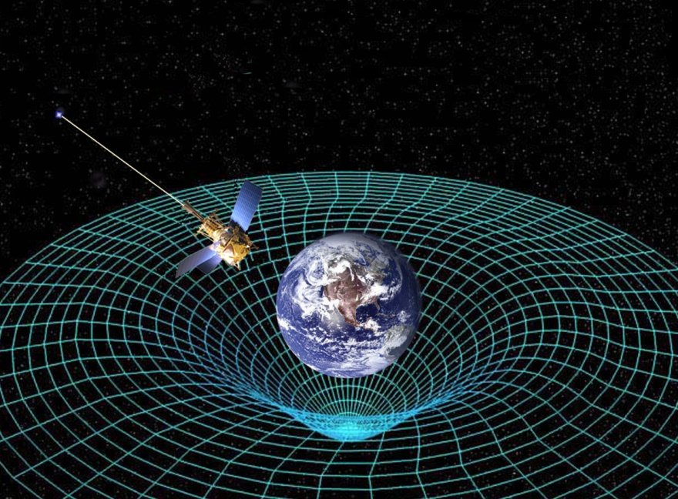
GR Time: not at all an absolute time. Time is a general spacetime coordinate
Problems in cosmology
If it exists a «cosmic time»: against B theories
in favour of a theory A eternalist such as «moving spotlight»
Time non-orientability: closed timelike curves…: no A theory…

Slide 15
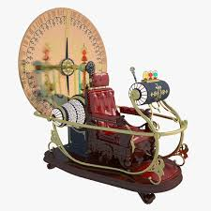
Closed timelike curves
Grand father paradox

Slide 16
α (β) = 0, 1 (presence, lack in the path)
Problem of consistency in classical case
Interaction
Consistency condition
Two paths, lower one going to CTC
α = 0 no consitent solution
α =1 possible consistency

Slide 17
Solution thanks to quantum superpositions
[Deutsch Phys. Rev. D 44, 10 (1991)]
Tracing out the degrees of freedom corresponding to the system not crossing CTC one must find ρ(CTC)
But: non-linearity due to CTC
perfect discrimination of non-orthogonal states
violation of the uncertainty principle
violation of no-cloning theorem
….
Problems even in an open time-like curve (OTC), when the qubit does not interact with its past copy, but it is initially entangled with another, chronology-respecting, qubit.
To avoid violating entanglement monogamy, one has to postulate a non-linear evolution
Alternative approach to OTCs, to preserve linearity and avoid all other drastic consequences → qubit state in the OTC described by pseudo-density operator
[C.Marletto, et al., Nature communications 10 (2019) 182

Slide 18
Problems even in an open time-like curve (OTC), when the qubit does not interact with its past copy, but it is initially entangled with another, chronology-respecting, qubit.
To avoid violating entanglement monogamy, one has to postulate a non-linear evolution.
We have proposed an alternative approach to OTCs, to preserve linearity and avoid all other drastic consequences →
qubit state in the OTC described by pseudo-density operator
[C.Marletto, V.Vedral , S.Virz\'i , E.Rebufello , A.Avella , F.Piacentini , M.Gramegna , I.Degiovanni, M.Genovese; Nature communications 10 (2019) 182]
Pseudo density operator [JF. Fitzsimons, JA. Jones & V.Vedral Sc. Rep. 5:18281 ]
Includes also temporal correlations

Slide 19
Problems with closed systems:
the whole universe
In canonical quantum gravity general relativistic evolution and constraints →
Wheeler – De Witt equation for “the universe wave function” ψ
H_{tot} ψ = 0
Stationary equation!!
[E.Anderson, Ann.Phys. 524 (2012) 757;R.Sorkin, Int J.Th.Phys 85 (1994) 523; W.Unruh and R.Wald,PRD 40 (1989) 2598;…]
B-theory- Bloc universe eternism

Slide 20
Sketch of derivation:
Hamiltonian and Lagrangian formalism should be equivalent, but there may be issues on the inversion of Legendre transform (e.g. singularity Hessian matrix ∂ L/ ∂(∂ ₀q_{i})∂(∂ ₀ q_{j})
→ constraints
ADM formalism for GR: foliate Lorentzian space-time in space like manifold (timelike) Σ
Einstein – Hilbert Action S= ∫ d⁴x 1/(16 π) √ g R is rewritten in terms of the metric h on Σ and the «extrinsic curvature» K where
N (shift vector)
Nn (lapse vector)

Slide 21
Due to the independence of K on derivatives of N (shift vector) and Nn (lapse vector) → constraints
Defined
The form of H_{ADM} leads to
Quantizing Poisson brackets

Slide 22
Constraints lead to
for a generic functional
And finally to Wheeler - De Witt equation

Slide 23
A POSSIBLE WAY OUT
[D.Page and W.Wootters,PRD 27 (1983) 2885; W.Wootters, IJTP 23 (1984) 701]
It may exist states of a system composed by entangled subsystems that are stationary, but subsystems can be interpreted as evolving
Stationary state ρ [H, ρ] = 0
Let decompose the system in “a clock” with Hamiltonian H
The rest, with Hamiltonian H’
Let choose a special state of the clock to mark 0 time | ψ _{c} (0) >, H=H_{c} ⊗ I_{r} +H’ ⊗ I_{c}
For each state
| ψ _{c} (t) > = exp(- i H_{c} t) | ψ _{c} (0) >
one associates time t

Slide 24
For any stationary observable A of the rest of the system the conditional expectation value E(A,t) when the clock reads t is
P_{t} = | ψ _{c} (t) > < ψ _{c} (t) | ⊗ I_{r}
E(A,t) = Tr (A P_{t} ρ ) / Tr ( P_{t} ρ ) = Tr (A exp[- i (H_{c} ⊗ I_{r} )t] P₀ exp[i (H_{c} ⊗ I_{r} )t] ρ ) / Tr ( P_{t} ρ ) =
Tr (exp[i ( I_{c} ⊗ H’)t] A exp[- i ( I_{c} ⊗ H’) t] P₀ ρ ) / Tr ( P_{t} ρ )
Where one used [H, ρ] = 0
Thus one recovers Heisenberg’s evolution
E(A,t) = Tr [ exp[i ( H’)t] A exp[- i ( H’) t] ρ _{r}]
ρ _{r} =Tr _{c}(P₀ ρ ) / Tr ( P_{t} ρ )

Slide 25
Gambini Pullin scheme [PRD 79 (2009) 041501]
Extension for multi-time measurements
The conditional probability of obtaining an outcome d for an observable at «time» t
is extended to multi-time measurements

Slide 26
Further developments
- Compatibility of canonical typicality (i.e. for all pure states in which Universe can be, after tracing over the environment a small subsytem is described by canonical distribution) [Favalli, Smerzi PRD 105 (2022) 023525]
Time emerging from interation with Environment [Gemsheim, Rost PRL 131 (2023) 140202]
Attempts toward extensions to emergent space-time [de la Hamette et al., arXiv:2110.13824; Ahmad et al, Phys. Rev. Lett. 128, 170401 (2022); Hoehn, et alJ. Math. Phys. 63, 112207 (2022).Favalli & Smerzi, AVS Quantum Sci. 4, 044403 (2022) ]
…

Slide 27
OTHER (EVENTUALLY
RELATED) PROPOSALS
Problem of Time in quantum Gravity [E.Anderson, Ann.Phys. 12 (2012) 757]
There is a fundamental time: apparent frozenness is a formalism dependent statement [Kuchar, …], Reference matter time [Anderson,…], cosmological constant as a reference fluid [Unruh Wald,…],…
Time emerging in quantum regime: semiclassical approaches [Haliwell & Hawking,..]
“Timeless approaches “ [Barbour, Rovelli], …
Quantum hystories [Gell-Mann & Hartle, …]

Slide 28
E.Anderson

Slide 29
AN EXPERIMENTAL APPROACH
E.Moreva,M.Gramegna,G.Brida,V.Giovannetti,L.Maccone,M.Genovese Phys. Rev. A 89(2014) 052122
We want to show that a static state can have subsystems that evolve and one subsytem can act as clock for the others
For this purpose we consider
( | H > | V > - | V > | H > )
|ψ⁻ > = ____________________
√(2)
The polarisation of one photon is the “clock”.

Slide 30

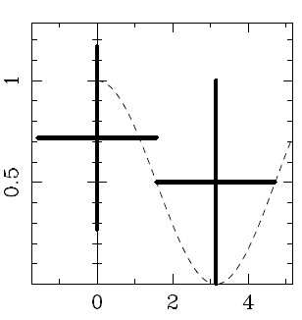

The clock is initialised in | + > and then evolves as
clock readout measurement in the basis
|+> t= 0
|-> t = π/(2 ω)
Once time has been measured from clock photon we use it to prove that the other photon’s polarisation evolves: making many measurements for several birefringent material thickness we have a set of couples (0,+), (π/(2 ω),-), (π/(2 ω),+), …

Slide 31
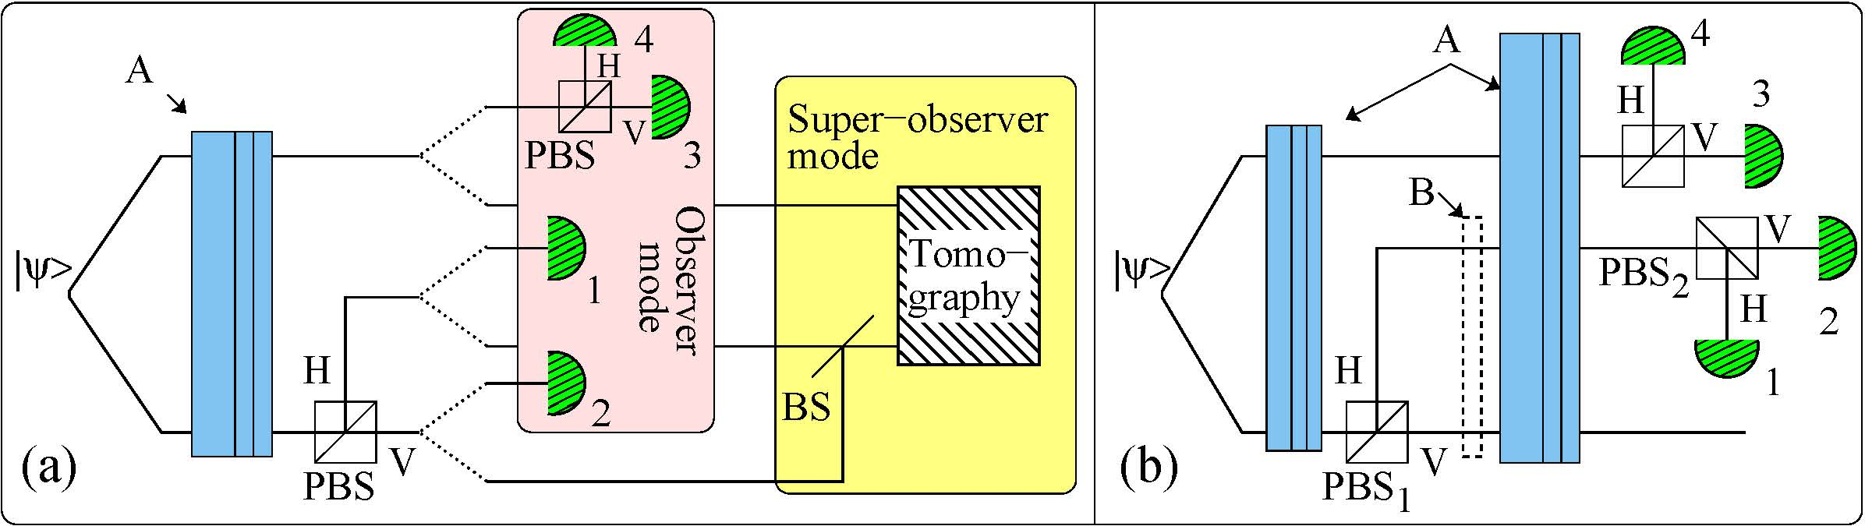
Page - Wootters scheme
In observer mode (a, pink box) the clock is the polarization of a photon.
It is an extremely simple clock: it has a dial with only two values, either |H> (detector 1 clicked) corresponding to time t = t1, or |V> (detector 2 clicked) time t=t2.
The experimenter also measures the polarization of the first photon with detectors 3
and 4.
This last measurement can be expressed as a function of time (t1,t2: he has access to time only through the clock photon) by considering the correlations between the results from the two photons

Slide 32
In super-observer mode (a, yellow box) the experimenter takes the place of a hypothetical observer external to the universe that has access to the abstract coordinate time and tests
the global state of the universe.
He must perform a quantum interference experiment that tests the coherence between the different histories (wavefunction branches) corresponding to the different measurement outcomes of the internal observers.
In our setup, this interference is implemented by the BS: a quantum erasure experiment

Slide 33
Gambini Pullin (GPPT) scheme [R. Gambini et.al., PRD79 041501(2009)] (b).
Two times measurements implemented by the two PBS.
PBS1: initial time measurement (non-demolition measurement obtained by coupling the photon
polarization to its propagation direction; initialization of the system state implemented through entanglement).
PBS2: final time measurement (together with detectors 1 and 2)
Between these two time measurements both the system and the clock evolve freely (birefringent plates A).
The abstract coordinate time (the thickness of the quartz plates A) is inaccessible
As before, the time dependent probability of finding the system photon vertically polarized is p(t1)=P{3|1} and p(t2)=P{3|2}.

Slide 34
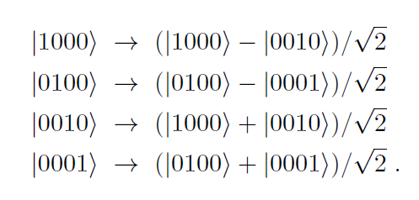
THE EXPERIMENTAL SET-UP
- The experimenter does not have access to external clocks (no knowledge of thickness)
- He considers correlation between detectors (coincidences P₁₄ (+,0) … for several thicknesses)
showing the evolution of the second photon for the “two times measured by the clock”
He demonstrates that the total state does not evolve by erasing “the clock photon” qubit with a second beam splitter
If | + > (upper arm) = |1000> (upper arm) |- > (upper arm) = |0100 >
| + > (lower arm) = |0010> (upper arm) |- > (lower arm) = |0001 >
The effect of a balanced BS

Slide 35
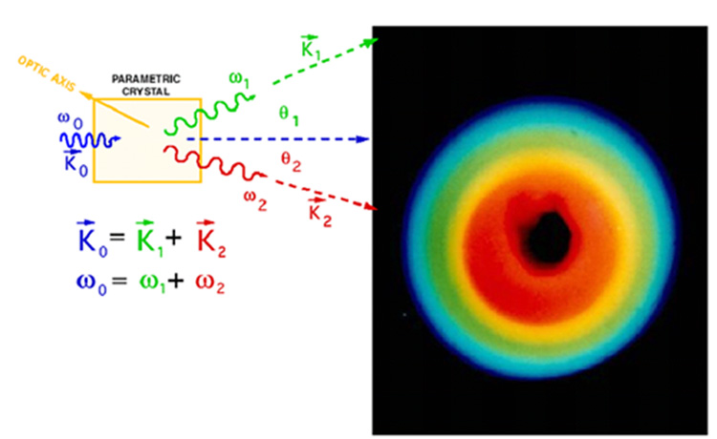
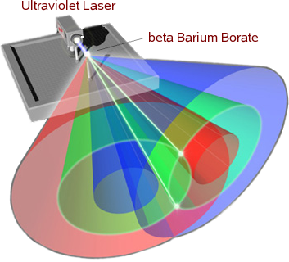
PDC: a brief summary
Type-I PDC
Type-II PDC

Slide 36
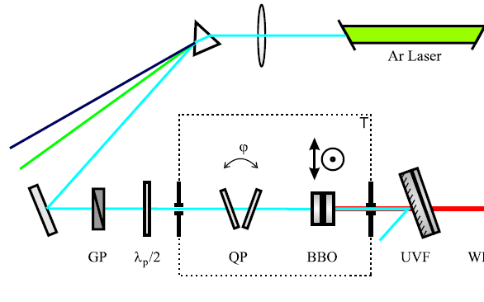
Our source
[( | H > | V > - | V > | H > ) ]
__________________________
√(2)
The produced state can be reconstructed by tomography and compared with ψ⁻ state: F = 99%
Measurements
One photon of the photons of ψ⁻ state is then addressed to interferometer (clock state)
The photons are measured by Si SPAD detectors
We evaluate several coincidences: R₊₊, R₊₋, R₋₊, R—
From which probabilities are calculated

Slide 37
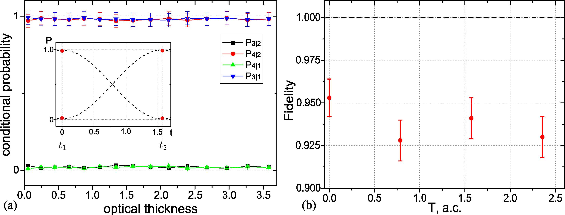
PaW RESULTS
Observer mode: plot of the clock-time dependent probabilities of measurement outcomes as a function of the of the plate thickness (abstract coordinate time T); circles and squares represent p(t1)=P{3|1} and p(t2)=P{3|2}. As expected from the PaW mechanism: independent of T.
The inset shows the graph that the observer himself would plot as a function of clock-time: circles representing the probabilities of finding the system photon V at the two times t1, t2, the triangles of finding it H.
Super-observer mode: plot of the conditional fidelity between the tomographic reconstructed state and the theoretical initial state |ψ⁻ >

Slide 38
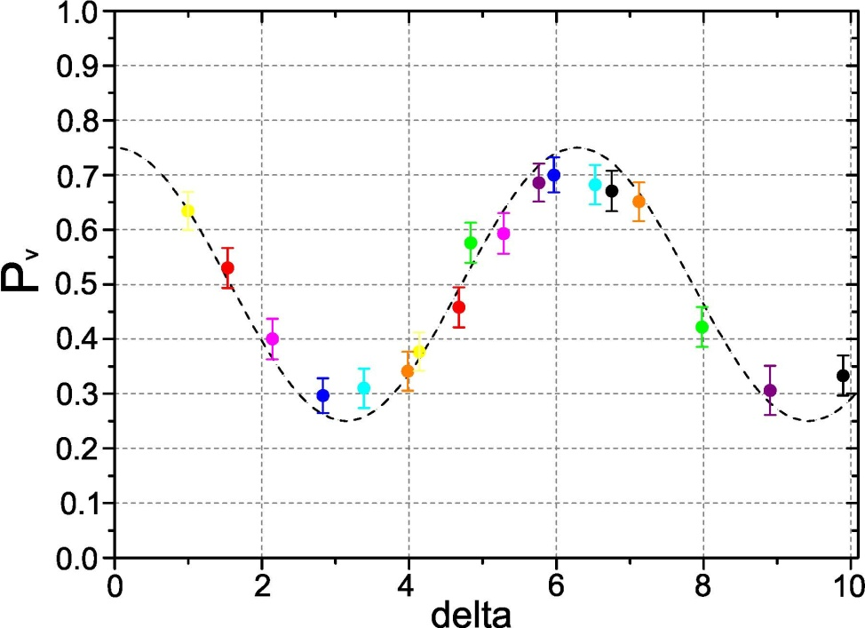
Gambini Pullin Results
GPPT experimental results compared with theoretical curve.
Probability p(t) that the upper photon is V as a function of the time t recovered from the lower photon.
The points with matching colours represent p(t1+δi) and p(t2+ δ i): additional birefringent elements (time delays in clock photon)

Slide 39
System with a memory [Giovannetti,Lloyd, Maccone PRD 92 (2015) 045033]
The initial memory state |r> evolves when interacting with the clock/system state
Single measurement
Two measurements

Slide 40
[E.Moreva,M.Gramegna,G.Brida,L.Maccone, M.Genovese, PRD 96 (2017) 102005]
Sigle photon
Position along x : the clock
Polarisation: the system
Position along z: memories
L_{coherence} > 100 m

Slide 41
Further experimental ideas: time of arrival
The definition of time of arrival in QM is «model dependent»
[Roncallo, Sacha, Maccone, Quantum 7 (2023) 968]
Kijowski proposal [Kijowski Rep Math Phys 6 (1974) 361]
Time of arrival probability
Quantum flux proposal [Delgado & Muda PRA 56 (1997) 3425]
Expectation value of the Schrödinger current

Slide 42
Semiclassical proposal [Vona & DÜrr]]
L distance source-detector, in terms of FT of ψ
Quantum Clock proposal
[Maccone & Sacha PRL 124 (2022) 11040 following Giovannetti et al PRD 92 (2015) 045033]
PVOM describing a joint measurement on particle and «clock»
Described by a POVM
( x can be the position, but also other observables, e.g. polarization, …)

Slide 43
That leads to the joint probability that the particle arrived and the time t
and then to the time of arrival probability

Slide 44
Time of arrival interference (n= 4 gaussian wave packets):
N=4

Slide 45
N=2 counterpropagating

Slide 46
How to realise it?
Neutrons?
Photons?
Photons acquire an effective mass in wave guides [Raudorf Am. J.Phys. 46 (1978) 35]
In a rectangular wave guide
One introduces an effective mass from
with

Slide 47
CONCLUSIONS
Page Wootters scheme can provide a solution of the problem of the definition of time
(Eternalist B theory)
We have realised two experiments addressed to show Wootters and Page idea at work:
a globally stationary state respect to evolution (polarisation rotations) is created
we show how the two subsystems evolve and that the evolution of one subsystem can be used as clock for the other
we demonstrate that the global wave function remains stationary while the two subsystems evolve
the GPPT scheme and memories are also “realised”
-New ideas under examination
[V.Giovannetti,S.Lloyd,L.Maccone PRD 2015; Roncallo, Sacha, Maccone, Quantum 7 (2023) 968]

