Slide 1
Front End Electronic Design
For outer Layers of SuperB (L.4 & L.5)
Team: Luca Bombelli, Bayan Nasri, Carlo Fiorini, Paolo Trigilio

Slide 2
Table of Contents
FE architecture and Noise evaluation
Analog Efficiency
Timing accuracy

Slide 3
Remind of chosen architecture
FE-Block Diagram

Slide 4
FE-Model (2)
Detector Model used in simulation
Parameters (from Luciano):
C_{AC} = 20× C_{AC}
C_{Fanout} = preliminary estimation
Strip | Layer | Type | C_{D}(pF) | R_{B}(MΩ) | R_{S}(Ω) | I leakage(nA) | C_{AC}(pF) | C_{Fanout}(pF)
Phi | 4 | p | 45.5 | 2.7 | 121.3 | 7.4 | 910 | 10
Phi | 5 | P | 57.1 | 2.5 | 152.1 | 8.4 | 1142 | 10
Z | 4 | n | 23.1 | 2.7 | 46.3 | 4.5 | 462 | 25
Z | 5 | n | 23.1 | 3.3 | 46.3 | 3.8 | 462 | 25

Slide 5
FE-circuit
Preamplifier
Shaper
Digital control:
4 selectable peaking time (1000, 750, 500, 357 ns)
2 polarity (n-strip, p-strip)
2 gain setting (nominal gain, +30%)

Slide 6
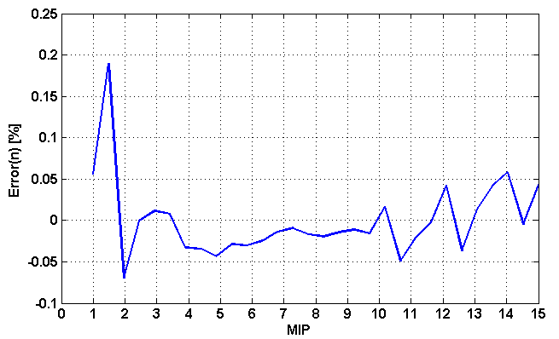
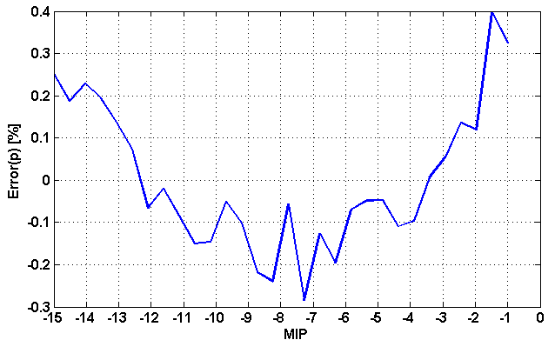
Non-linearity
Shaper output
n-strip linearity error
p-strip linearity error

Slide 7
ENC Estimation (1)
phi-Strip
Layer 4: p-strip, Cd=45.5p, Rs=121.3Ω
Layer 5: p-strip, Cd=57.1p, Rs=152.1Ω
Tp(ns) | 250 | 375 | 500
ENC_FET | 694 | 515 | 451
ENC_Rs | 461 | 335 | 290
ENC_RB | 168 | 229 | 265
ENC_Rf | 703 | 606 | 612
ENC_Leakage | 104 | 142 | 165
ENC_others | 418 | 305 | 279
ENC_Total | 1184 | 954 | 915
Rbias = 8Mohm per strip
Can be reduced to 167 with Rbias = 20 Mohm
Tp(ns) | 500 | 750 | 1000
ENC_FET | 529 | 444 | 393
ENC_Rs | 407 | 333 | 287
ENC_RB | 275 | 338 | 390
ENC_Rf | 611 | 623 | 627
ENC_Leakage | 175 | 216 | 248
ENC_others | 308 | 265 | 243
ENC_Total | 1010 | 963 | 950
Rbias = 10Mohm per strip
Can be reduced to 276 with Rbias = 20 Mohm

Slide 8
ENC Estimation (2)
Z-Strip
Layer 4: n-strip, Cd=23.1p, Rs=46.3Ω
Layer 5: n-strip, Cd=23.1p, Rs=46.3Ω
Tp(ns) | 250 | 375 | 500
ENC_FET | 664 | 482 | 421
ENC_Rs | 154 | 109 | 94
ENC_RB | 168 | 233 | 270
ENC_Rf | 507 | 412 | 414
ENC_Leakage | 82 | 113 | 131
ENC_others | 390 | 288 | 258
ENC_Total | 953 | 751 | 717
Tp(ns) | 500 | 750 | 1000
ENC_FET | 421 | 352 | 312
ENC_Rs | 94 | 77 | 66
ENC_RB | 244 | 301 | 349
ENC_Rf | 414 | 418 | 420
ENC_Leakage | 120 | 148 | 172
ENC_others | 259 | 225 | 206
ENC_Total | 706 | 684 | 687

Slide 9
Timing Resolution with TOT – Noise jitter
Montecarlo on real preamplifier
Peaking Time = 1us
Signal = 52.8mV (1 MIP)
Noise = 1.58mV (822 el)
Threshold = 0.25 MIP
Jitter TOT = 18ns rms

Slide 10
Timing Resolution with TOT – Time walk
Peaking Time = 1us
Threshold = 0.25 MIP
Dynamic Range =
0.25-15 MIP
Signal applied at time 0s
Time walk = 936ns

Slide 11
Timing Resolution with TOT – characteristic
Analog TOT
Peaking Time = 1us
“Analog” TS
TOT clock = 2 MHz
(3 bit TOT)
TS clock = 30 MHz

Slide 12
Timing Resolution with TOT - Outputs
Digital TOT
TS

Slide 13
Timing Resolution with TOT – Energy reconstruction
With only this information, reconstruct what was the time walk.

Slide 14
Timing Resolution with TOT – Time correction
Peaking Time = 1us
TS
Time walk correction
Reconstructed time

Slide 15
Timing Resolution with TOT – Time correction with phase error
Peaking Time = 1us
TOT = 3 bits
TOT clock = 2 MHz
Signal applied at time 0
Max error = 80ns
Some residual structure in the reconstructed time

Slide 16
Timing Resolution with TOT – Time correction with phase error
Peaking Time = 1us
TOT = 4 bits
TOT clock = 4.2 MHz
Signal applied at time 0
Max error = 50ns
Some residual structure in the reconstructed time

Slide 17
Timing Resolution with TOT – Time correction with phase error
Peaking Time = 1us
TOT = 5 bits
TOT clock = 8.8 MHz
Signal applied at time 0
Max error = 35ns

Slide 18
Timing Resolution with TOT – Time correction with phase error
Peaking Time = 1us
TOT = 6 bits
TOT clock = 18 MHz
Signal applied at time 0
Max error = 25ns
Constant and uniform time error!

Slide 19
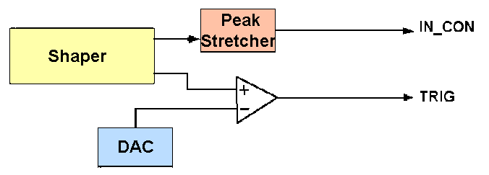
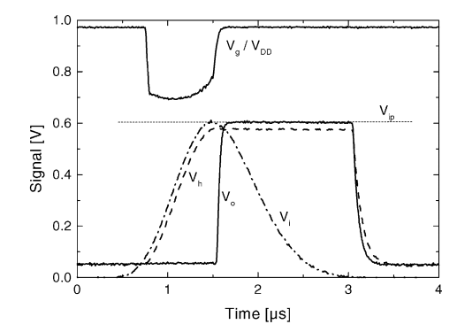
Improve the Timing Resolution
Peak-Stretcher

Slide 20
Improve the Timing Resolution (2)
Jitter PKS Vcomp = 36ns rms (noise 800el)
Time-walk PKS Vcomp = 28ns (1-15 MIP)
Unlike in TOT, it is difficult to correct for time-walk!

Slide 21
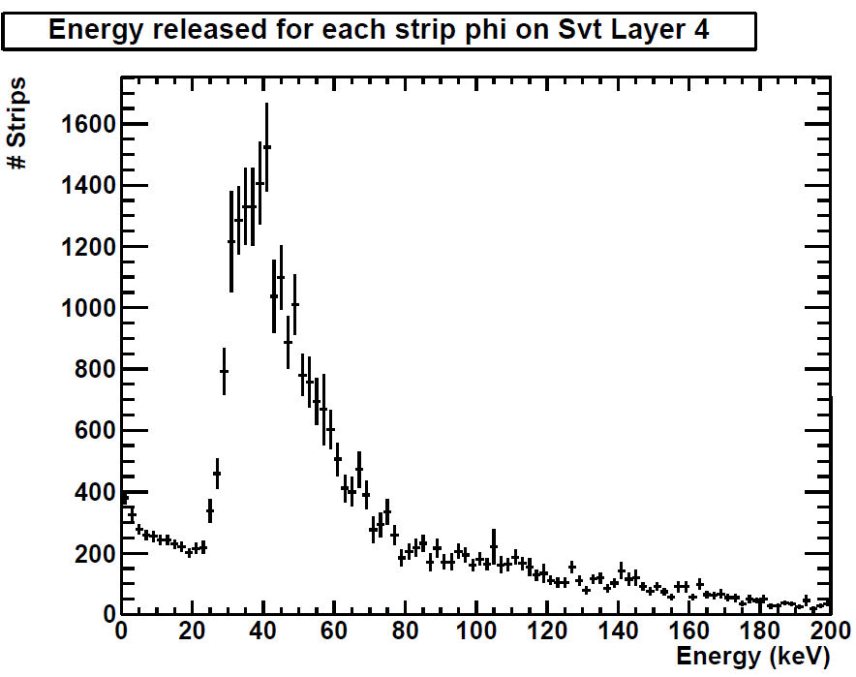
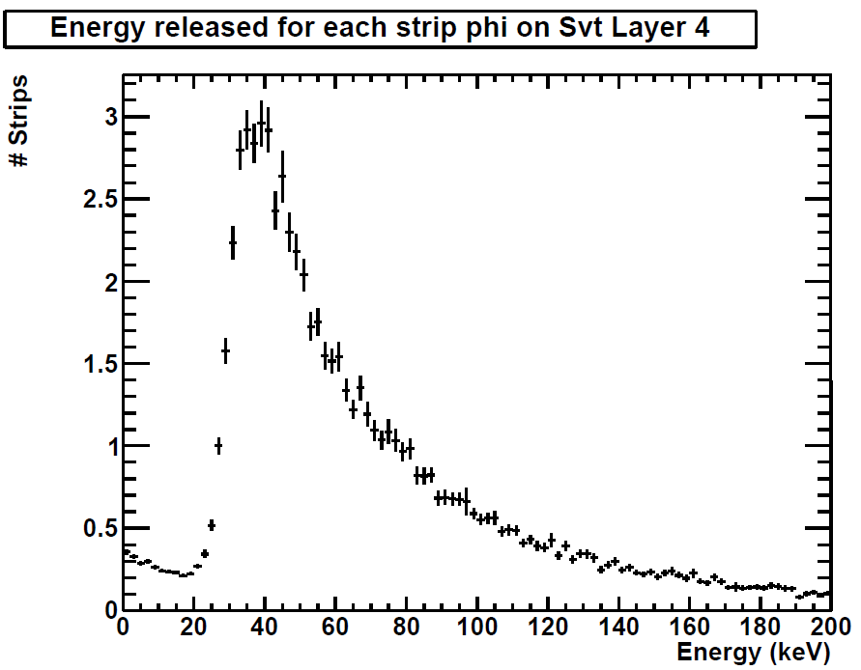
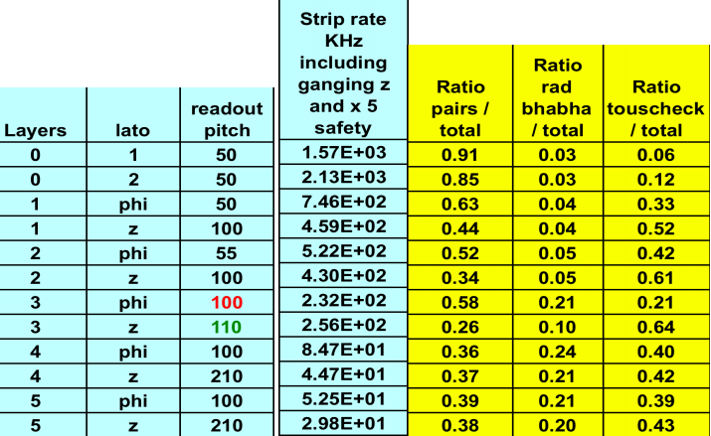
Efficiency simulation: Background data used (Only layer 4 is shown)
Pairs
Touscheck LER
Rad babha
$\text{Q}\text{gen}$=$\frac{E}{3.6 eV}$

Slide 22
Efficiency simulation: Pulse shape and calculation
Possibility to generate a random sequence of pulses
with a given energy distribution.
On the right we have an example, used as a first (coarse)
background estimate
3° order shaper

Slide 23
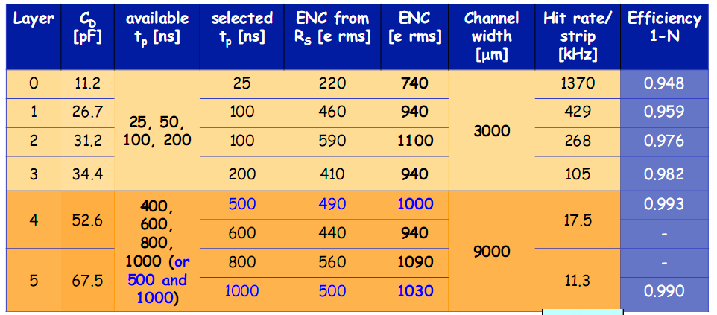
Efficiency simulation: check with Ludovico
Strip | Strip rate [KHz] | Peaking time [ns] | Efficiency (η)
L0 phi | 1370 | 25 (real poles) | 96.4 %
L1 Phi | 428 | 100 (real poles) | 95.0%
L2 Phi | 268 | 100 (real poles) | 96.9%
L3 phi | 105 | 200 (real poles) | 97.4%
L4 phi | 17.5 | 500 (real poles) | 98.3 %
L5 phi | 11.3 | 1000 (real poles) | 97.8 %

Slide 24
Efficiency simulation: results
Layer 4
Strip | Strip rate [KHz] | Peaking time [ns] | Efficiency (η)
phi | 84.5 | 250 | 96.1%
phi | 84.5 | 375 | 94.1%
phi | 84.5 | 500 | 92.2%
phi | 84.5 | 500 (real poles) | 91.3%
Layer 5
Strip | Strip rate [KHz] | Peaking time [ns] | Efficiency (η)
phi | 52.5 | 500 | 95.2%
phi | 52.5 | 750 | 92.9%
phi | 52.5 | 1000 | 90.5%
phi | 52.5 | 1000 (real poles) | 89.2%

