Slide 1
Diagnostic techniques for mapping the electron plasma density
Danilo Giulietti
Physics Department of the University and INFN, Pisa, Italy

Slide 2
Introduction
The diagnostics for mapping the plasma electron density and the degree of homogeneity are based on the refractive effects of the plasma crossed by a probe beam; the most used are Schlieren, Shadowgraphy and in particular Interferometry.
Mapping the density of a plasma is of primary importance in countless experimental contexts. Among these certainly those relating to studies on controlled thermonuclear fusion, in the two "Magnetic" and "Inertial" schemes, but also those of high intensity laser-matter interaction and the new acceleration techniques based on the enormous electric fields associated with the plasma waves.

Slide 3
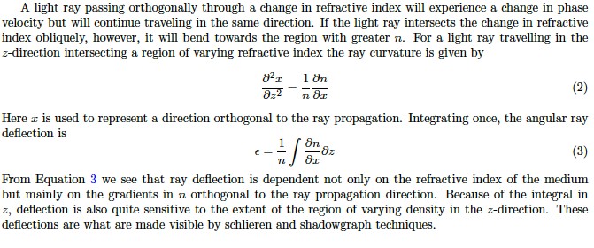
Light propagation in non homogeneous media

Slide 4
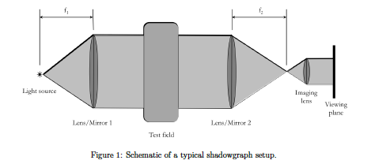
Shadowgraphy

Slide 5
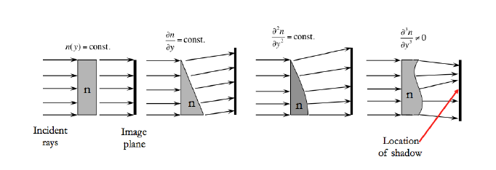
Shadow origin

Slide 6
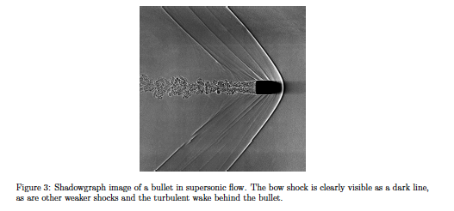
Shadowgraphy

Slide 7
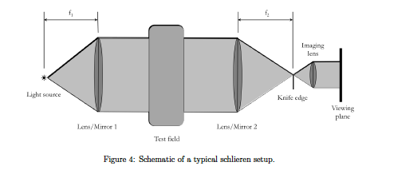
Schlieren

Slide 8
Schlieren sensitivity

Slide 9
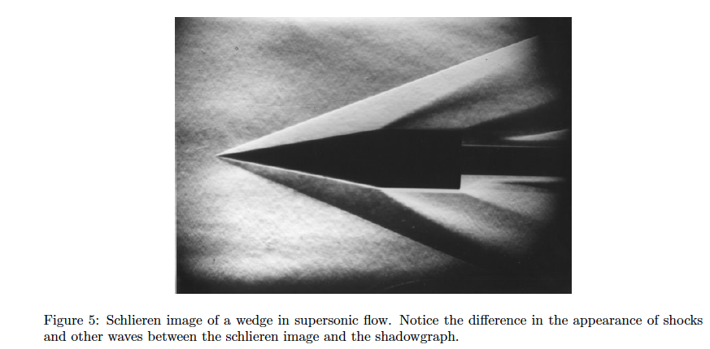
Schlieren

Slide 10
Interferometry
While with Shadowgraphy and Sclieren we have qualitative information on the spatial trend of the refractive index of a medium, with Interferometry we can obtain quantitative information.
By knowing the relationship that links the refractive index of the medium (solid, liquid, gaseous, plasma) to its density, interferometry allows us to trace the spatial mapping of the latter.

Slide 11
Interferometry requires
coherent radiation

Slide 12
Coherence
Coherence expresses the potential for two waves to interfere. Two monochromatic beams from a single source always interfere. Wave sources are not strictly monochromatic: they may be partly coherent. Beams from different sources are mutually incoherent.

Slide 13
Relationship between bandwidth, coherence time and length
The larger the bandwidth range of frequencies Δν a wave contains, the faster the wave decorrelates

Slide 14
Interference
To measure Spatial and Temporal Coherence

Slide 15
Radiation Coherence Degree
To measure Temporal Coherence
Michelson Interferometer

Slide 16
PLASMA INTERFEROMETRY

Slide 17
Plasma refractive index and critical density

Slide 18
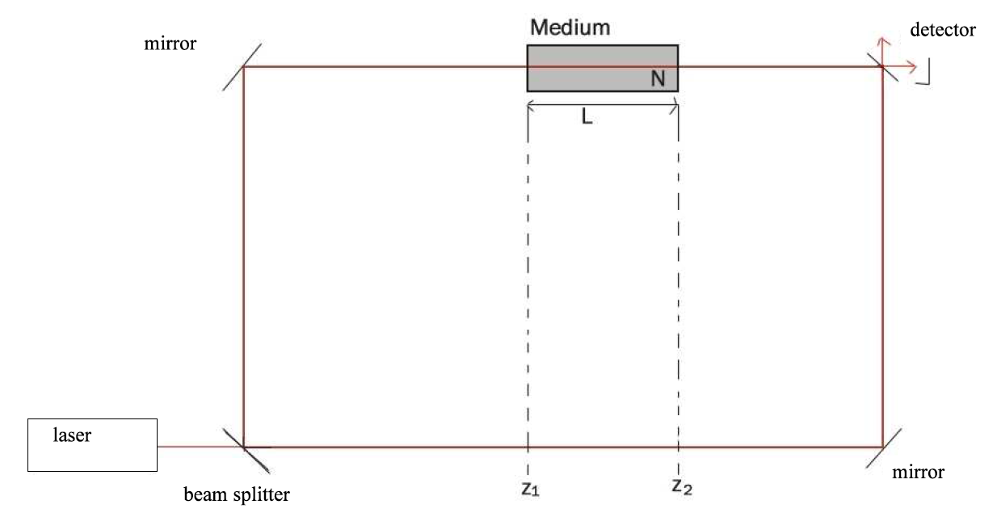
INTERFEROMETRY

Slide 19
Phase difference and number of fringes

Slide 20
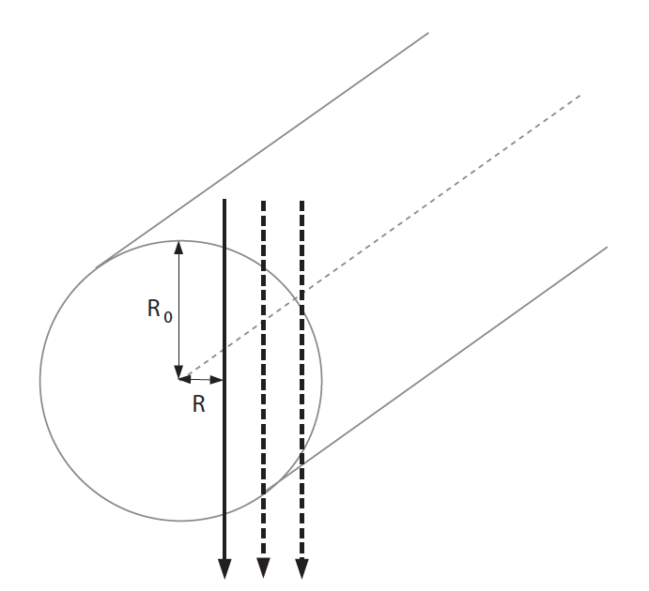
Deconvolution and Abel Inversion

Slide 21
Some examples in experiments of laser produced plasmas

Slide 22
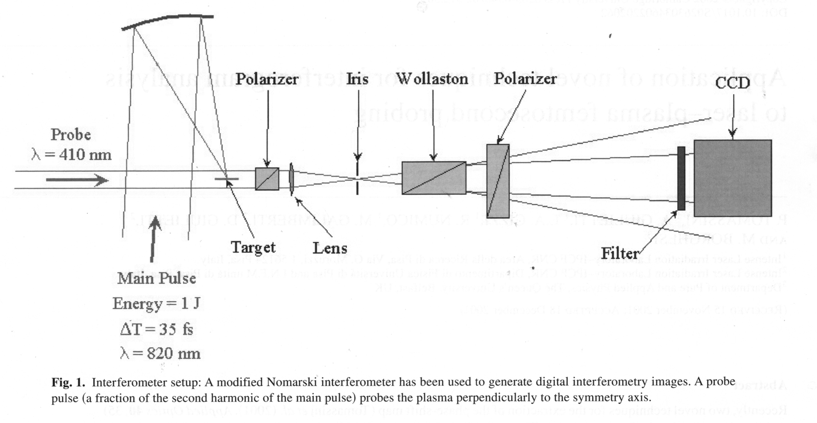
Nomarski Interferometer Setup

Slide 23
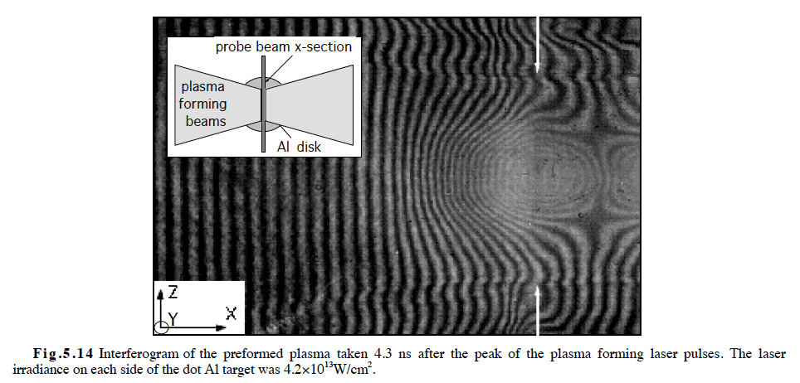
Interferogram

Slide 24
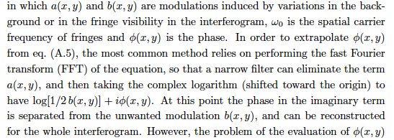
From the interferogram to the phase map

Slide 25
From the phase difference map to the electron density by Abel Inversion

Slide 26
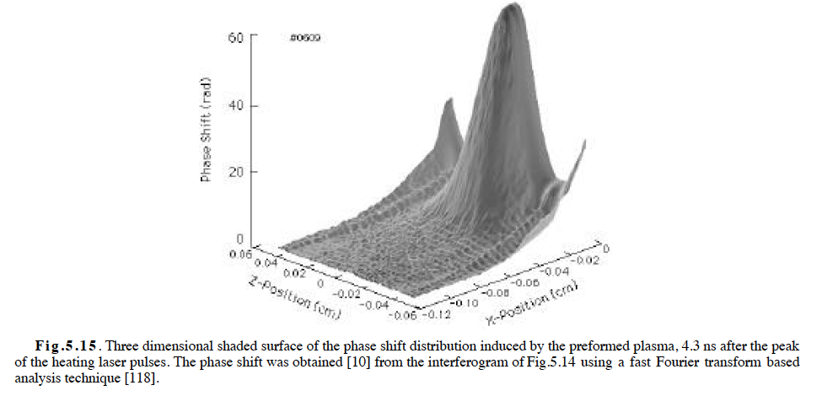
3D phase shift

Slide 27
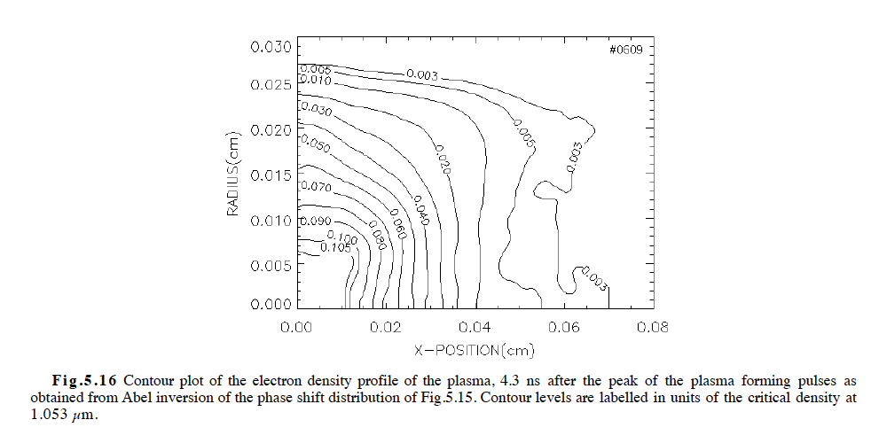
Electron density

Slide 28
Dipartimento di Fisica “E. Fermi”
Dottorato in Fisica Applicata
Experimental study of stable propagation and efficient electron acceleration in plasmas with ultra-short laser pulses
Candidate: Andrea Gamucci
Supervisor: Prof. Danilo Giulietti

Slide 29
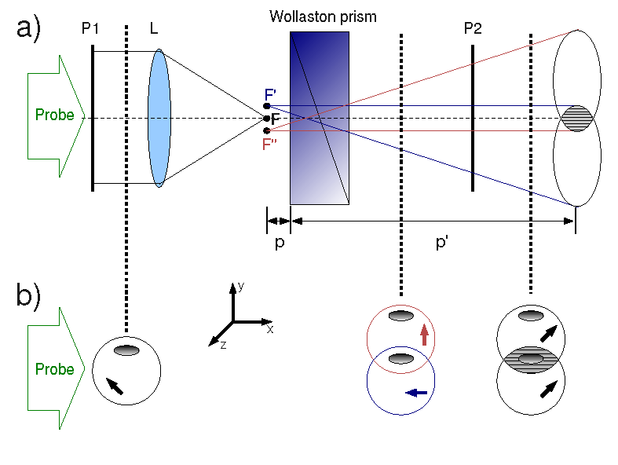
Nomarski interferometry

Slide 30
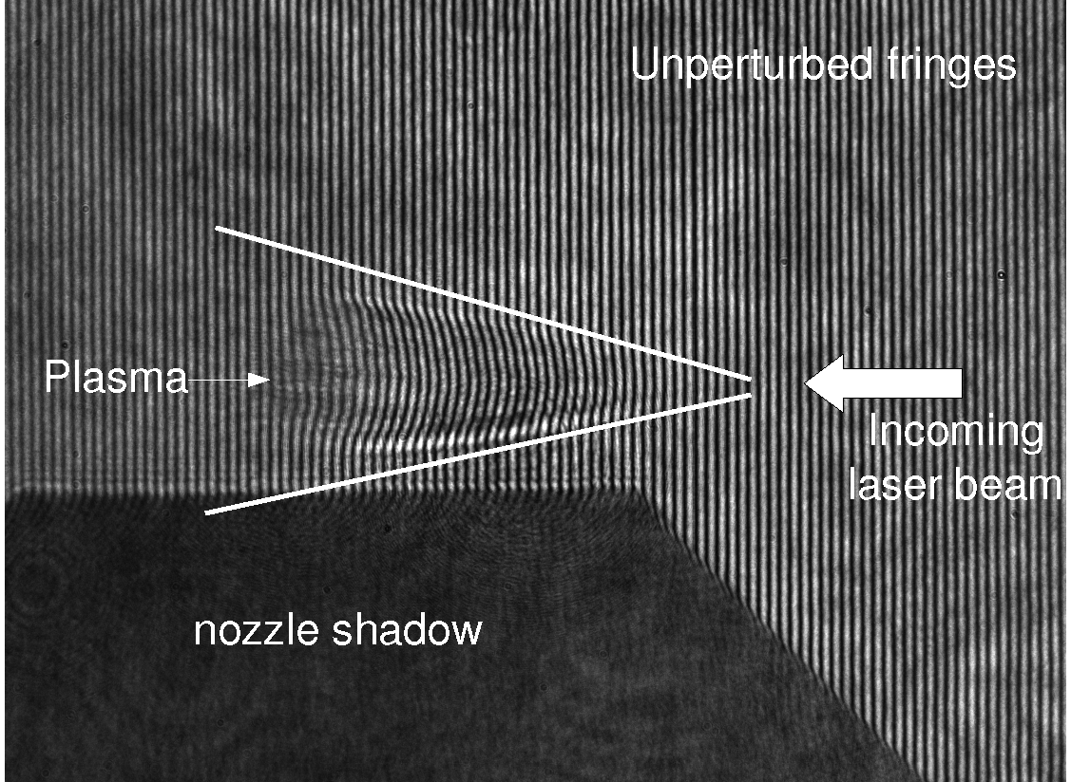
The interferogram analysis
η =η(n_{e}) & n_{e} << n_{c}

Slide 31
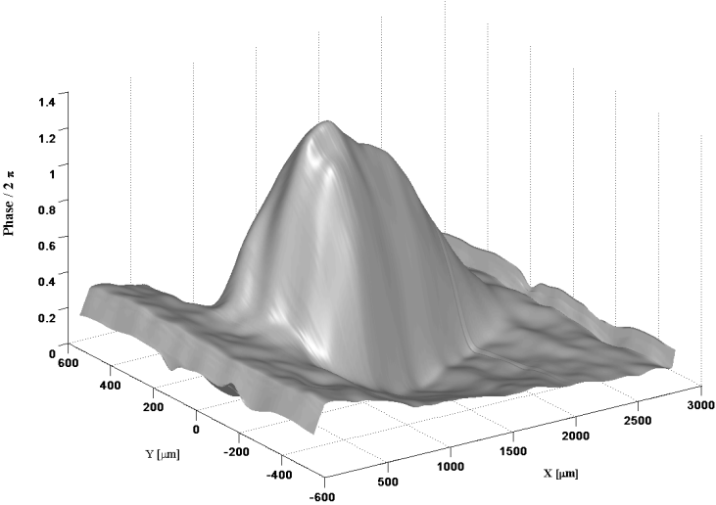
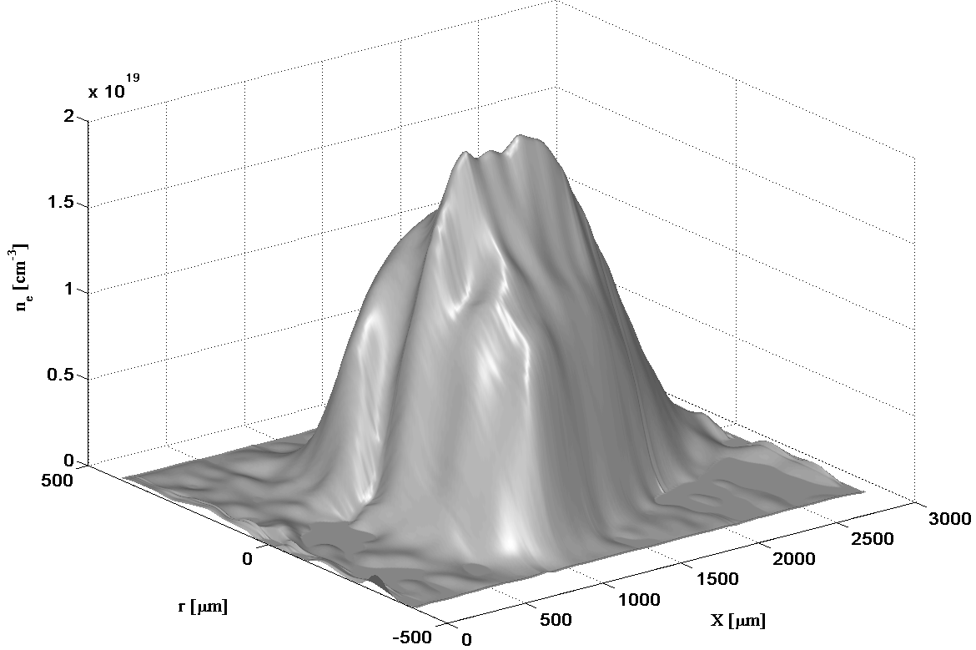
Propagation
tools for the analysis
The main experimental diagnostic used to address the problem of laser propagation for acceleration purposes has been ultrafast interferometry
fringe pattern
phase-shift map
electron density map
Original CWT-based algorithm
P. Tomassini et al.,
Appl. Optics 40, 6561 (2001)
Generalized Abel inversion to non-axisymmetric density distribution
P. Tomassini & A. Giulietti,
Opt. Commun. 199, 143 (2001)

Slide 32
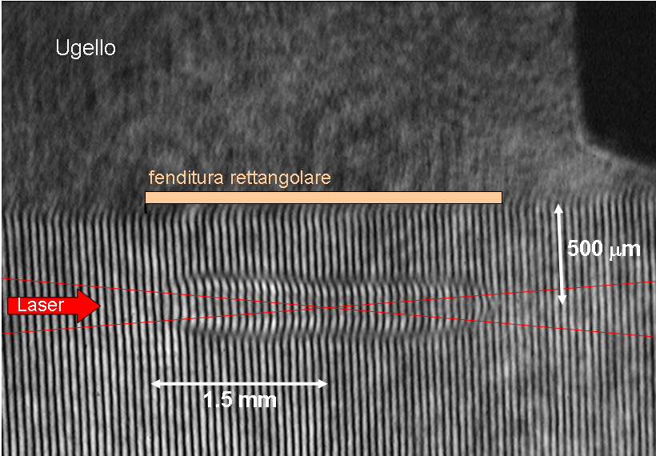
Propagation
A typical interferogram
Nozzle
Gas-jet slit

Slide 33
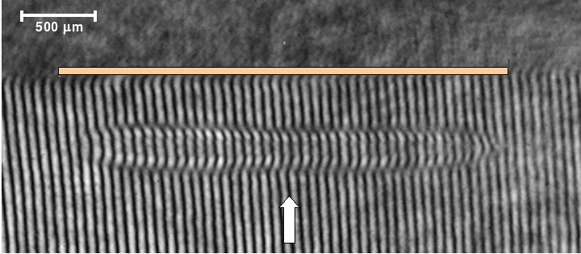
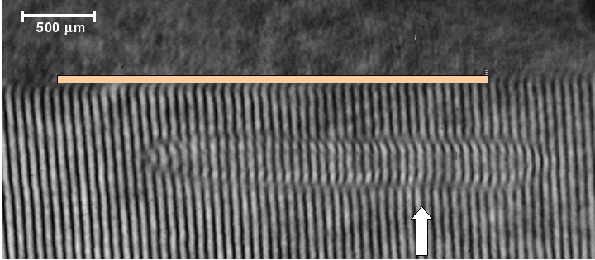
Propagation
channel production @ Pisa
Target: He @ 8 bar
E_{pump}: 460 mJ
x_{focus}: -1mm
pump
Target: He @ 8 bar
E_{pump}: 460 mJ
x_{focus}: 0mm
pump
Target: He @ 8 bar
E_{pump}: 490 mJ
x_{focus}: +1mm
pump

Slide 34
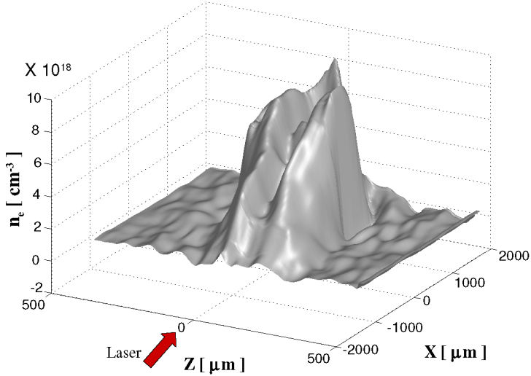
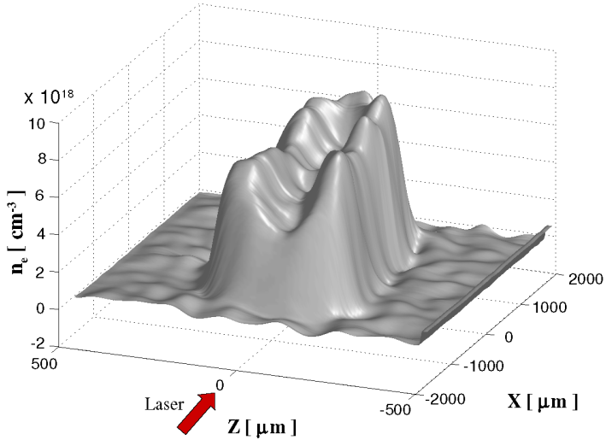
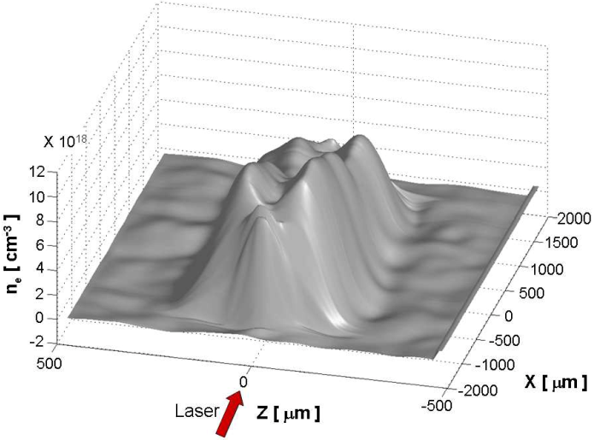
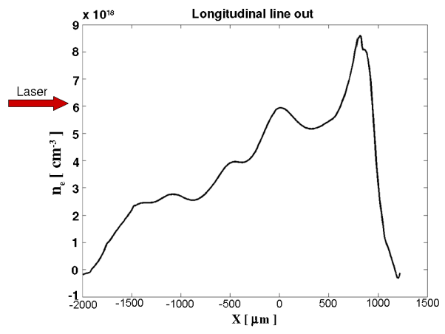
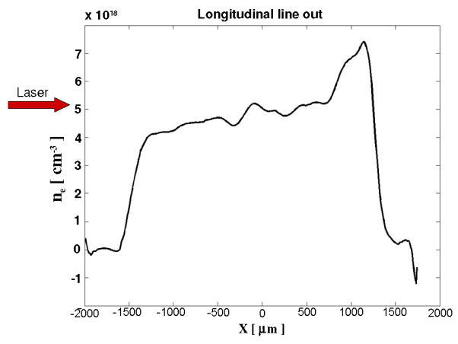
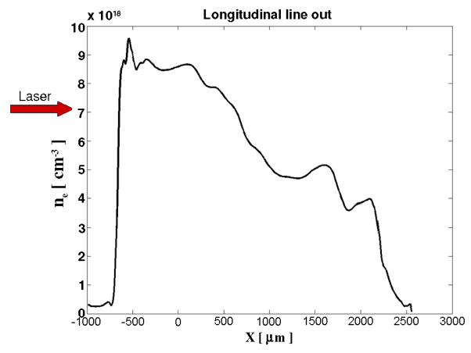
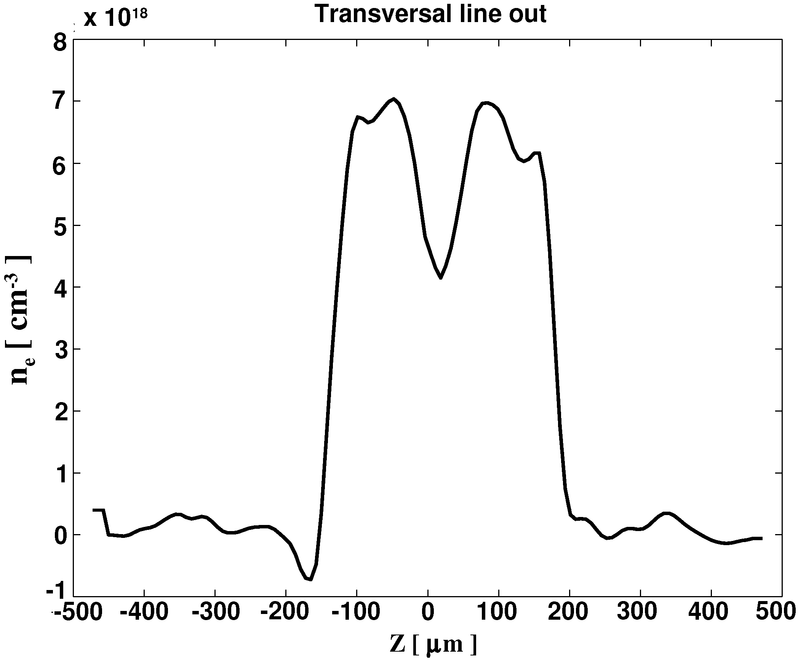
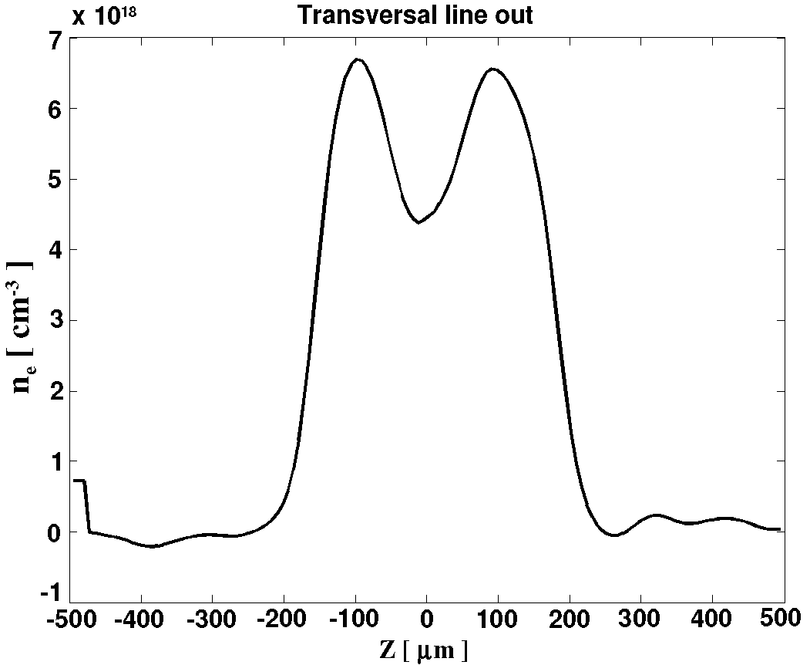
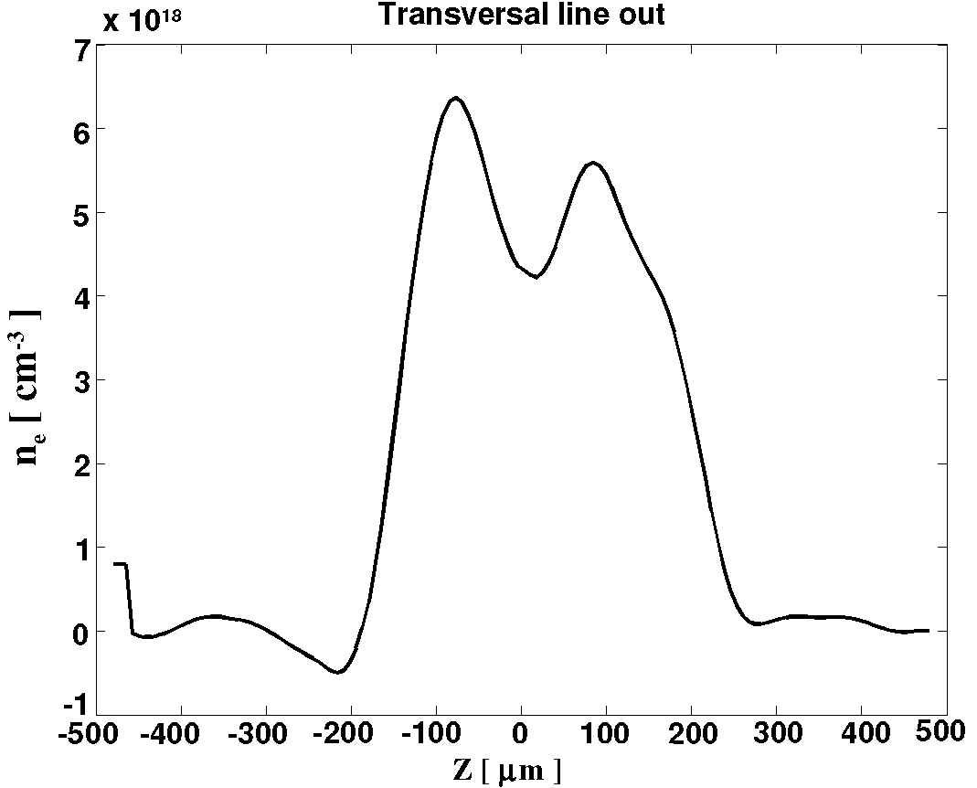
Propagation
channel production @ Pisa

Slide 35
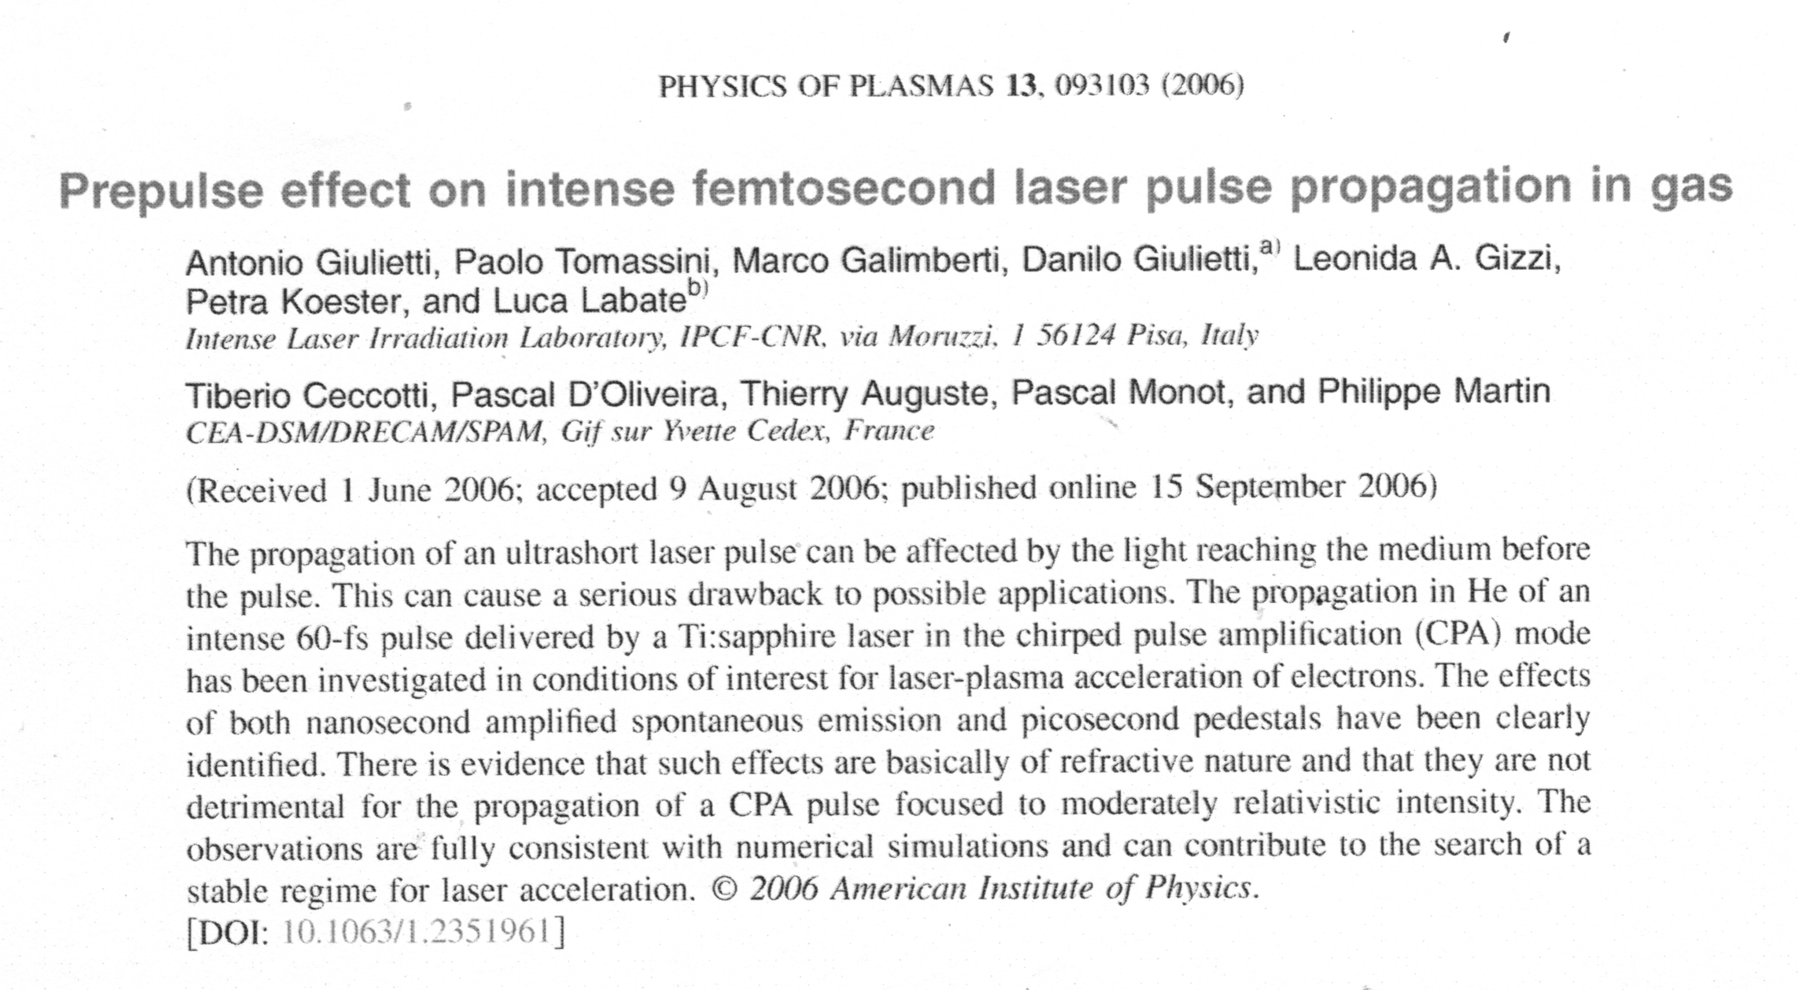

Slide 36
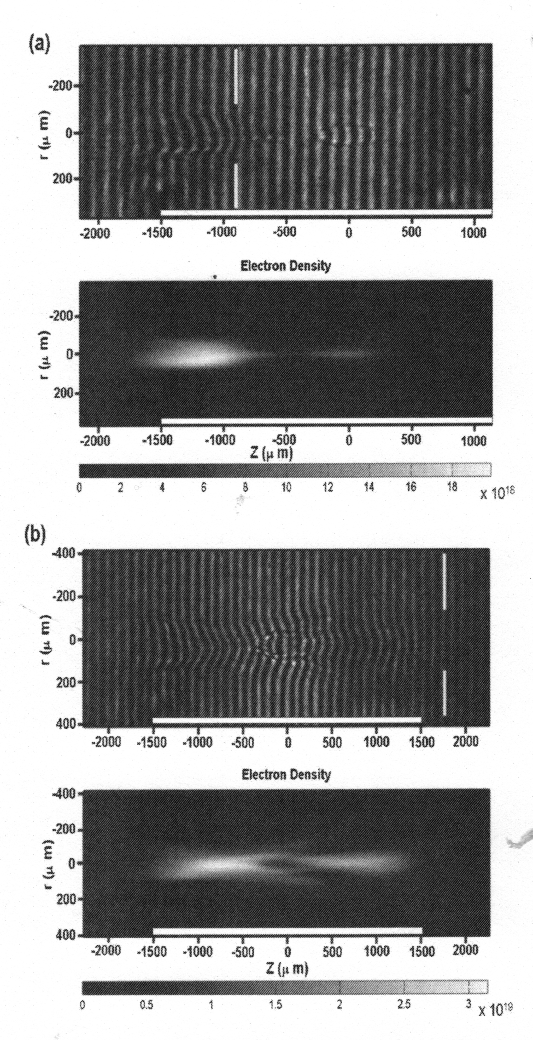

Slide 37
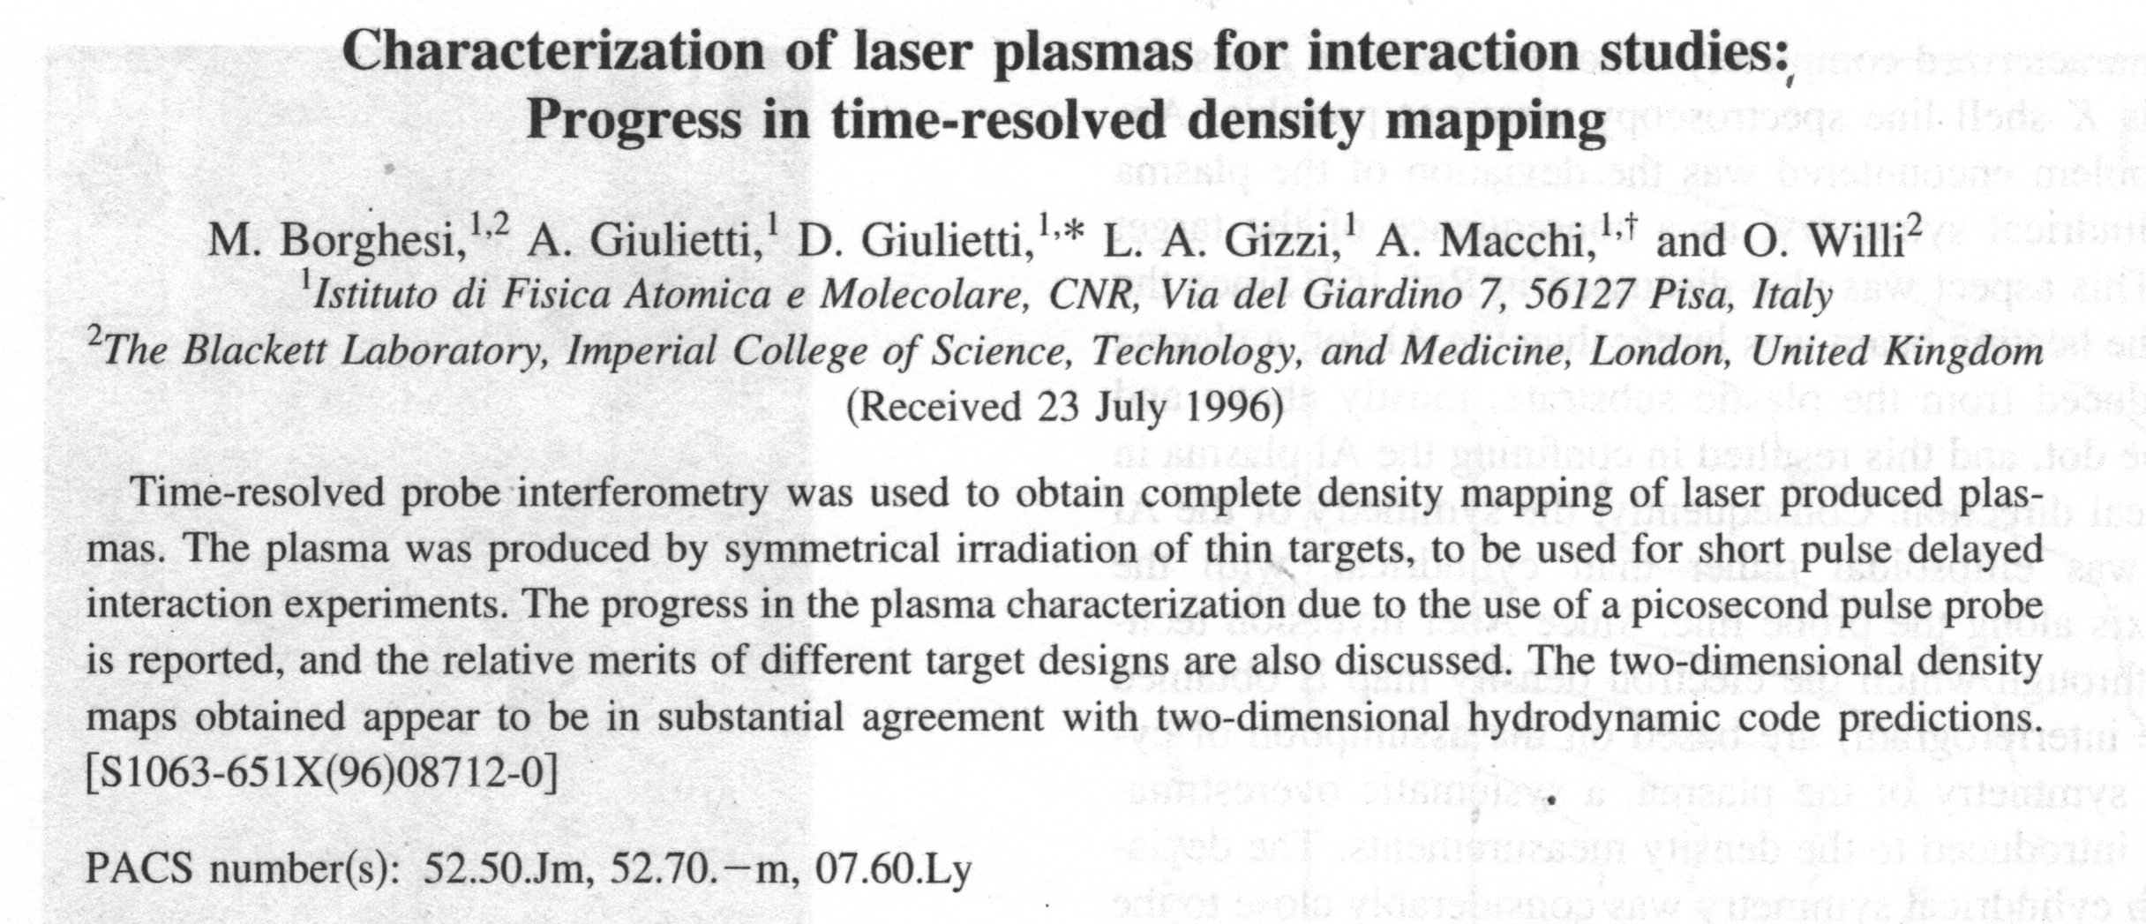
Nomarski Interferometer

Slide 38
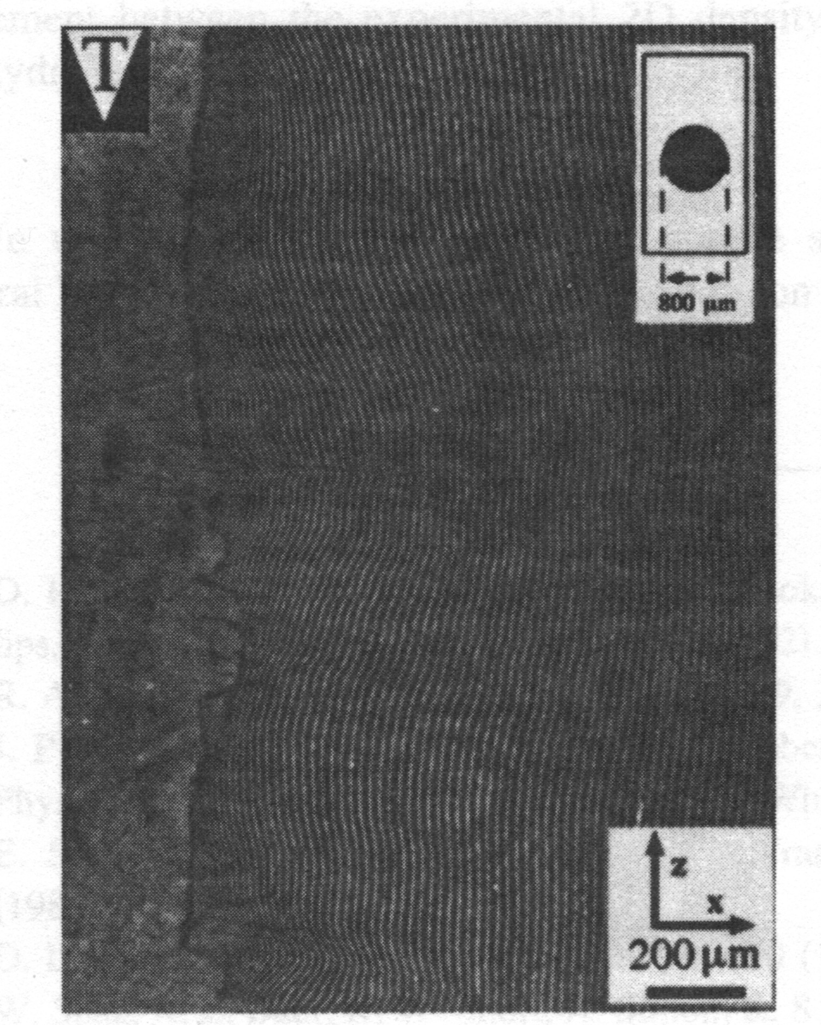
Interferogram

Slide 39
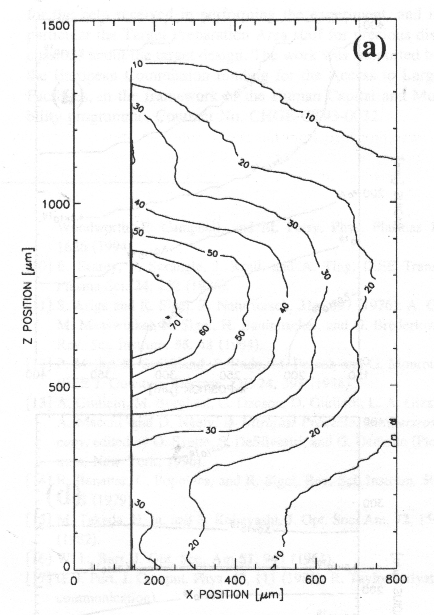
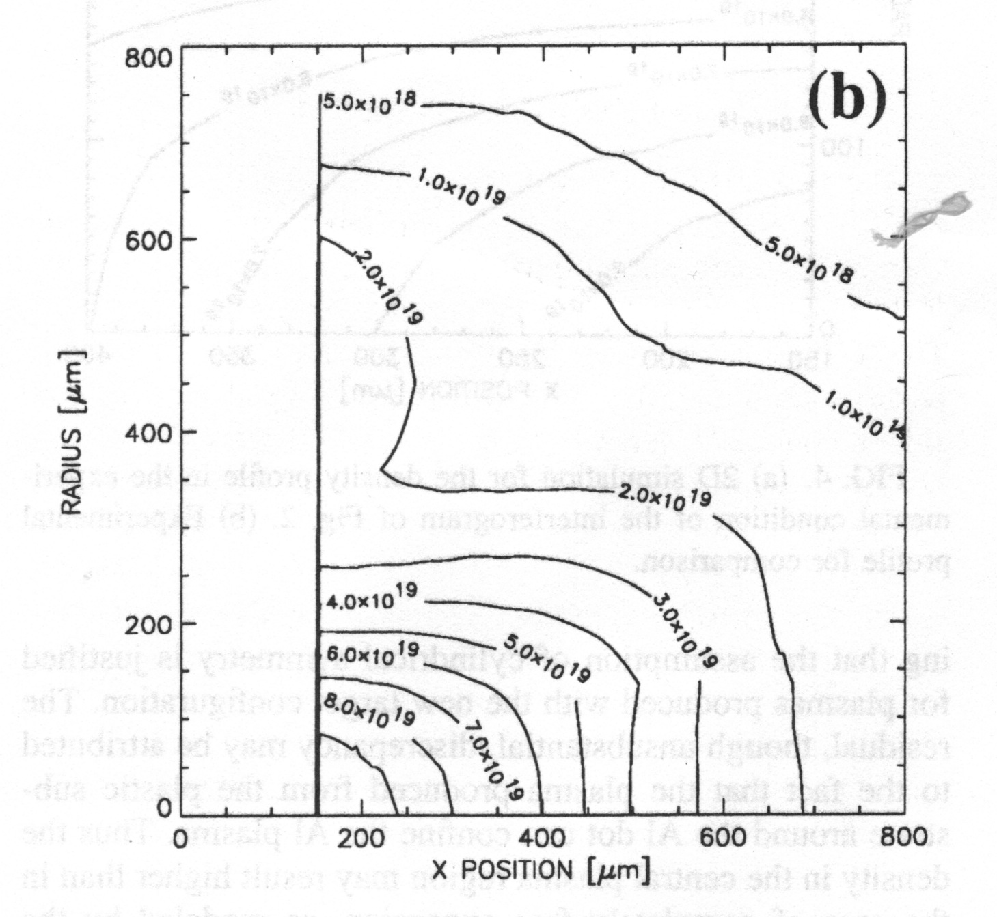
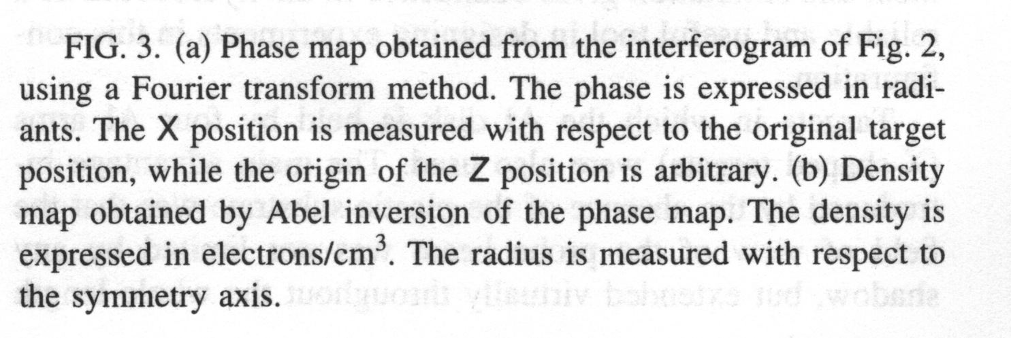
Phase and Density Maps

Slide 40
SPARC-PLASMONX INFRASTRUCTURE
@
LABORATORI NAZIONALI di FRASCATI

Slide 41
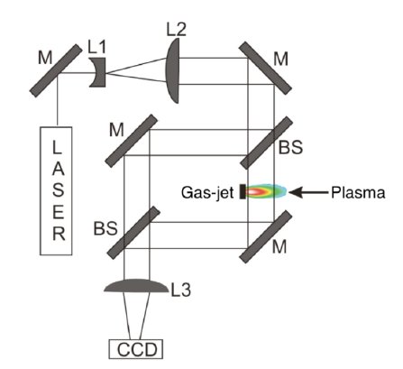
Mach-Zender interferometer schematics @FLAME
Curcio, A.,…, Giulietti, D. et al., 2017. Trace-space reconstruction of low-emittance electron beams through betatron radiation in laser-plasma accelerators. Physical Review Accelerators and Beams, 20(1), p.012801.
Curcio, A.,…, Giulietti, D. et al., 2017. Single-shot non-intercepting profile monitor of plasma-accelerated electron beams with nanometric resolution. Applied Physics Letters, 111(13).

Slide 42
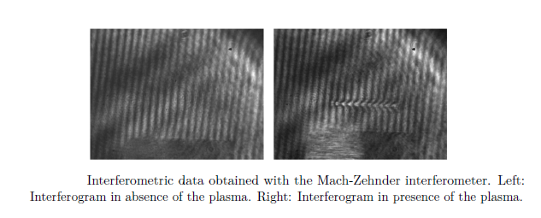
Typical interferograms @FLAME
Curcio, A.,…, Giulietti, D. et al., 2017. Trace-space reconstruction of low-emittance electron beams through betatron radiation in laser-plasma accelerators. Physical Review Accelerators and Beams, 20(1), p.012801.
Curcio, A.,…, Giulietti, D. et al., 2017. Single-shot non-intercepting profile monitor of plasma-accelerated electron beams with nanometric resolution. Applied Physics Letters, 111(13).

Slide 43
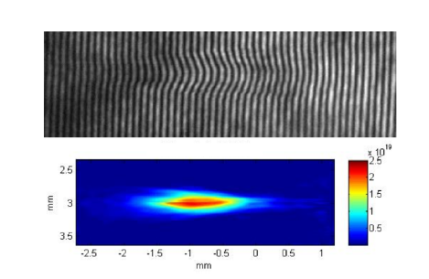
Electron plasma density retrieval @FLAME
Abel inversion assuming cylindrical symmetry…
Curcio, A.,…, Giulietti, D. et al., 2017. Trace-space reconstruction of low-emittance electron beams through betatron radiation in laser-plasma accelerators. Physical Review Accelerators and Beams, 20(1), p.012801.
Curcio, A.,…, Giulietti, D. et al., 2017. Single-shot non-intercepting profile monitor of plasma-accelerated electron beams with nanometric resolution. Applied Physics Letters, 111(13).

Slide 44
Calibration
The reliability of the electron density values ​​that interferometry diagnostic provides can be further increased thanks to a calibration that can come from the simultaneous detection of specific radiations emitted during the laser-plasma interaction; such as the second harmonic (2ω_{L}) of the laser radiation or the 3ω_{L}/2 produced in the coupling of the laser radiation with the plasmons of the two-plasmon decay.

Slide 45
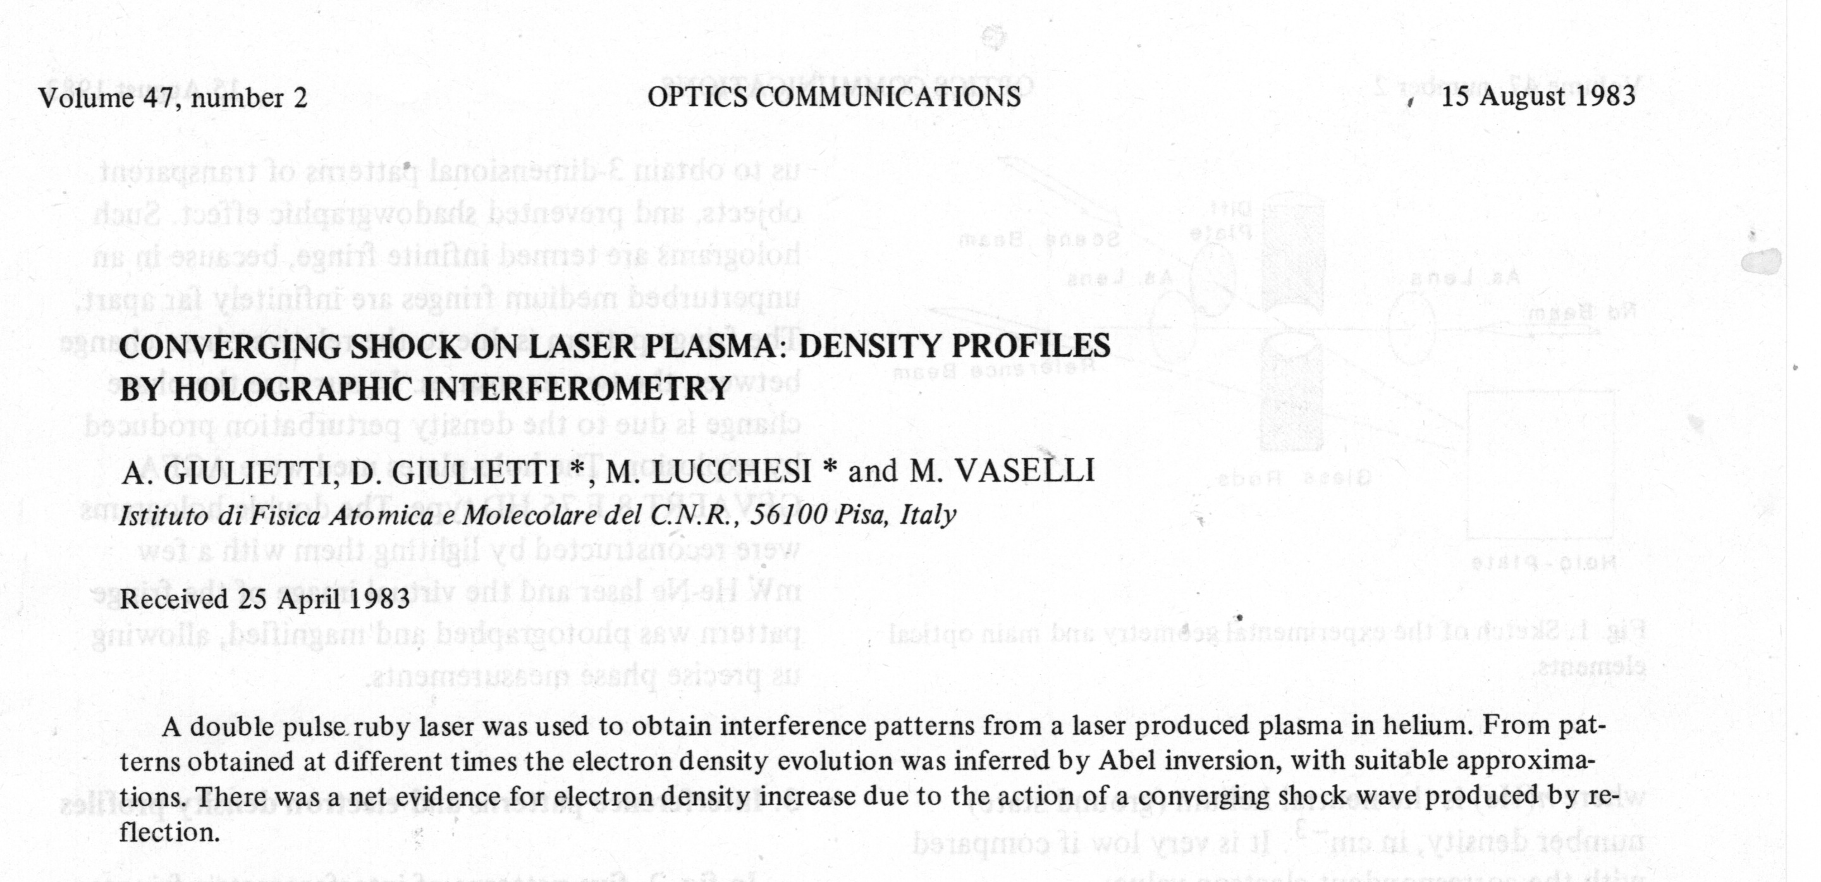
Holographic Interferometry

Slide 46
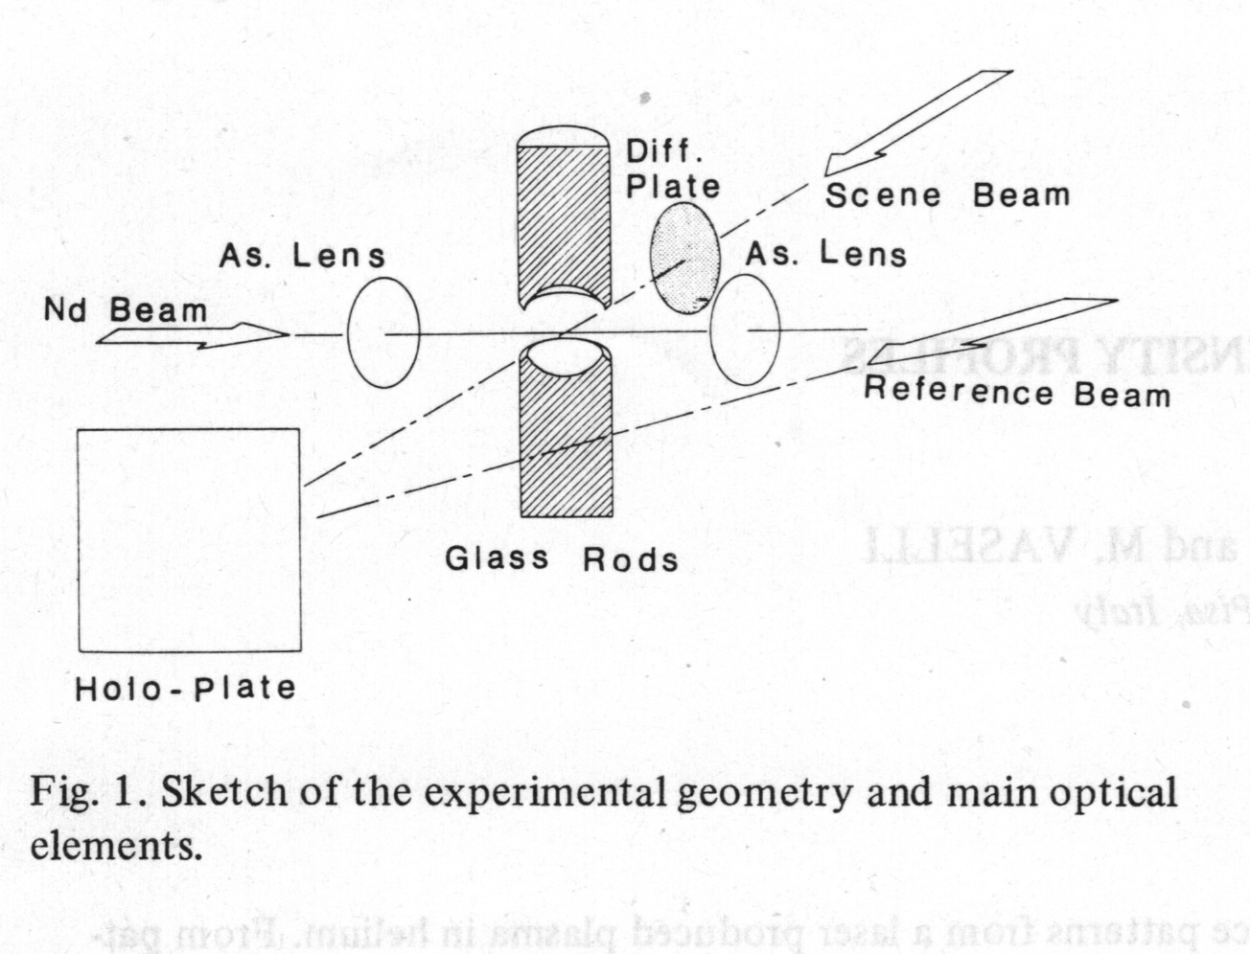
Setup

Slide 47
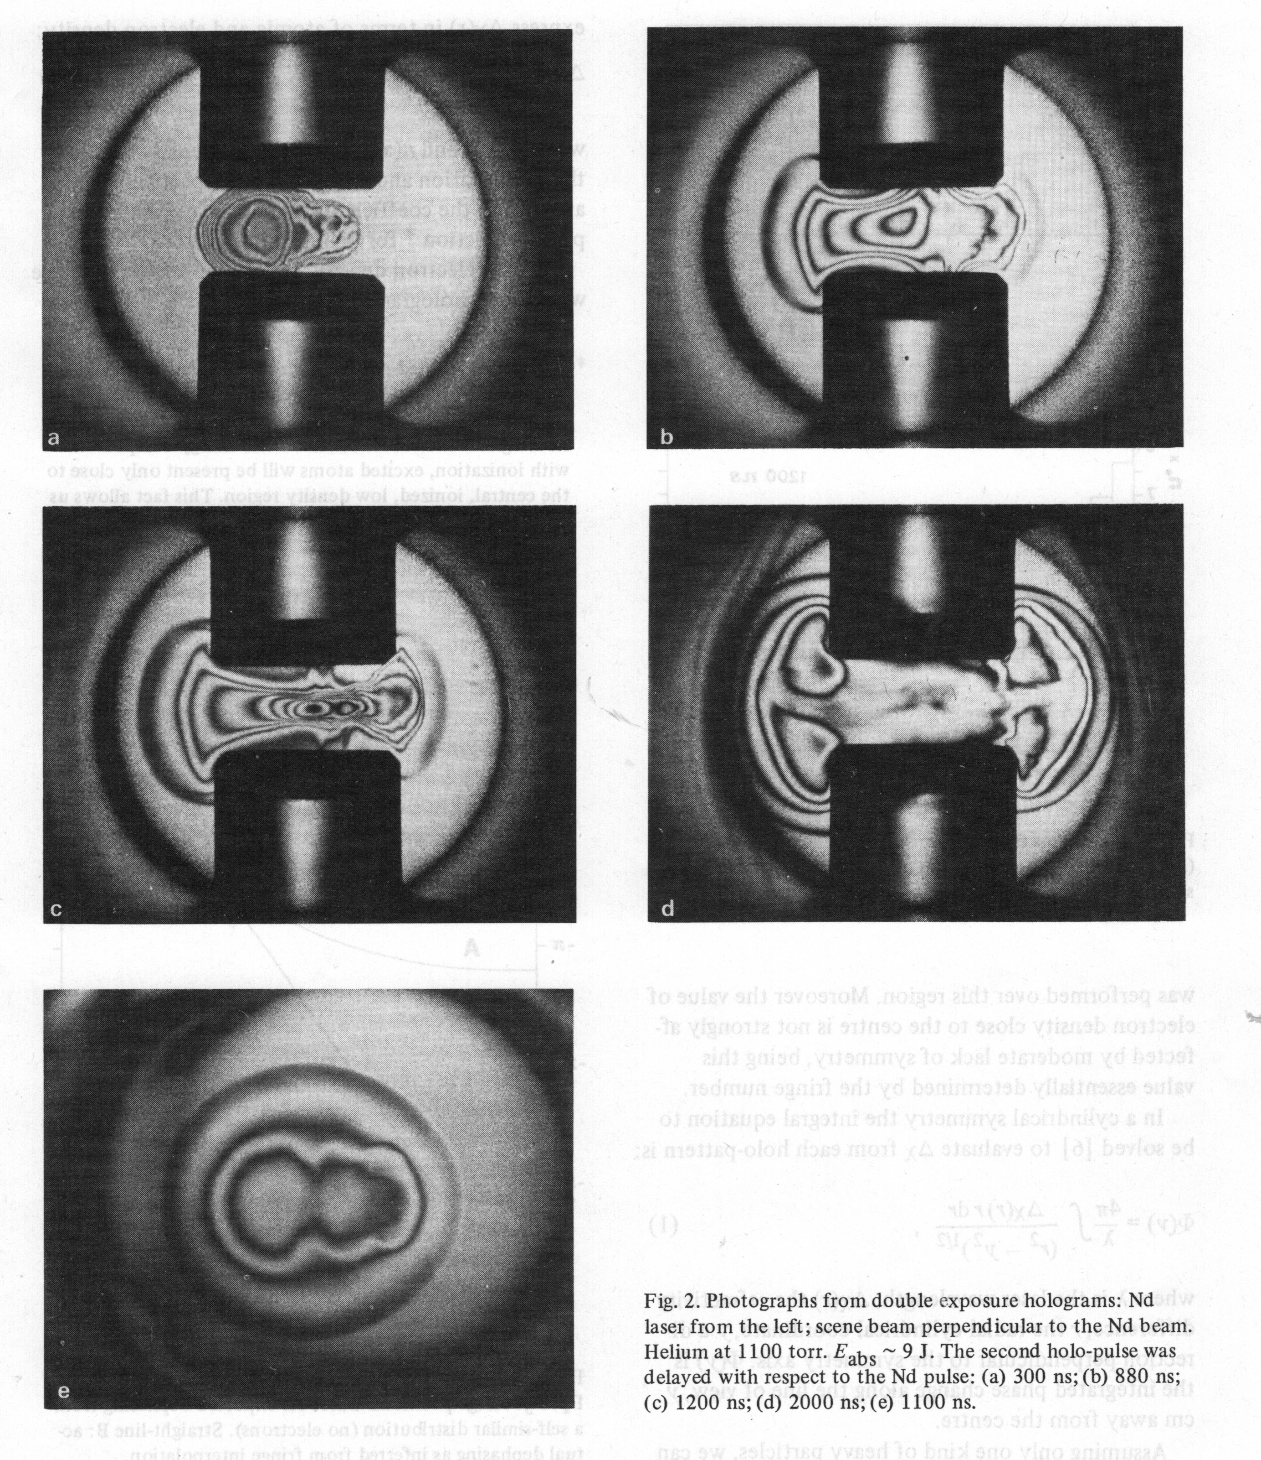
Photographs from double exposure holograms

Slide 48
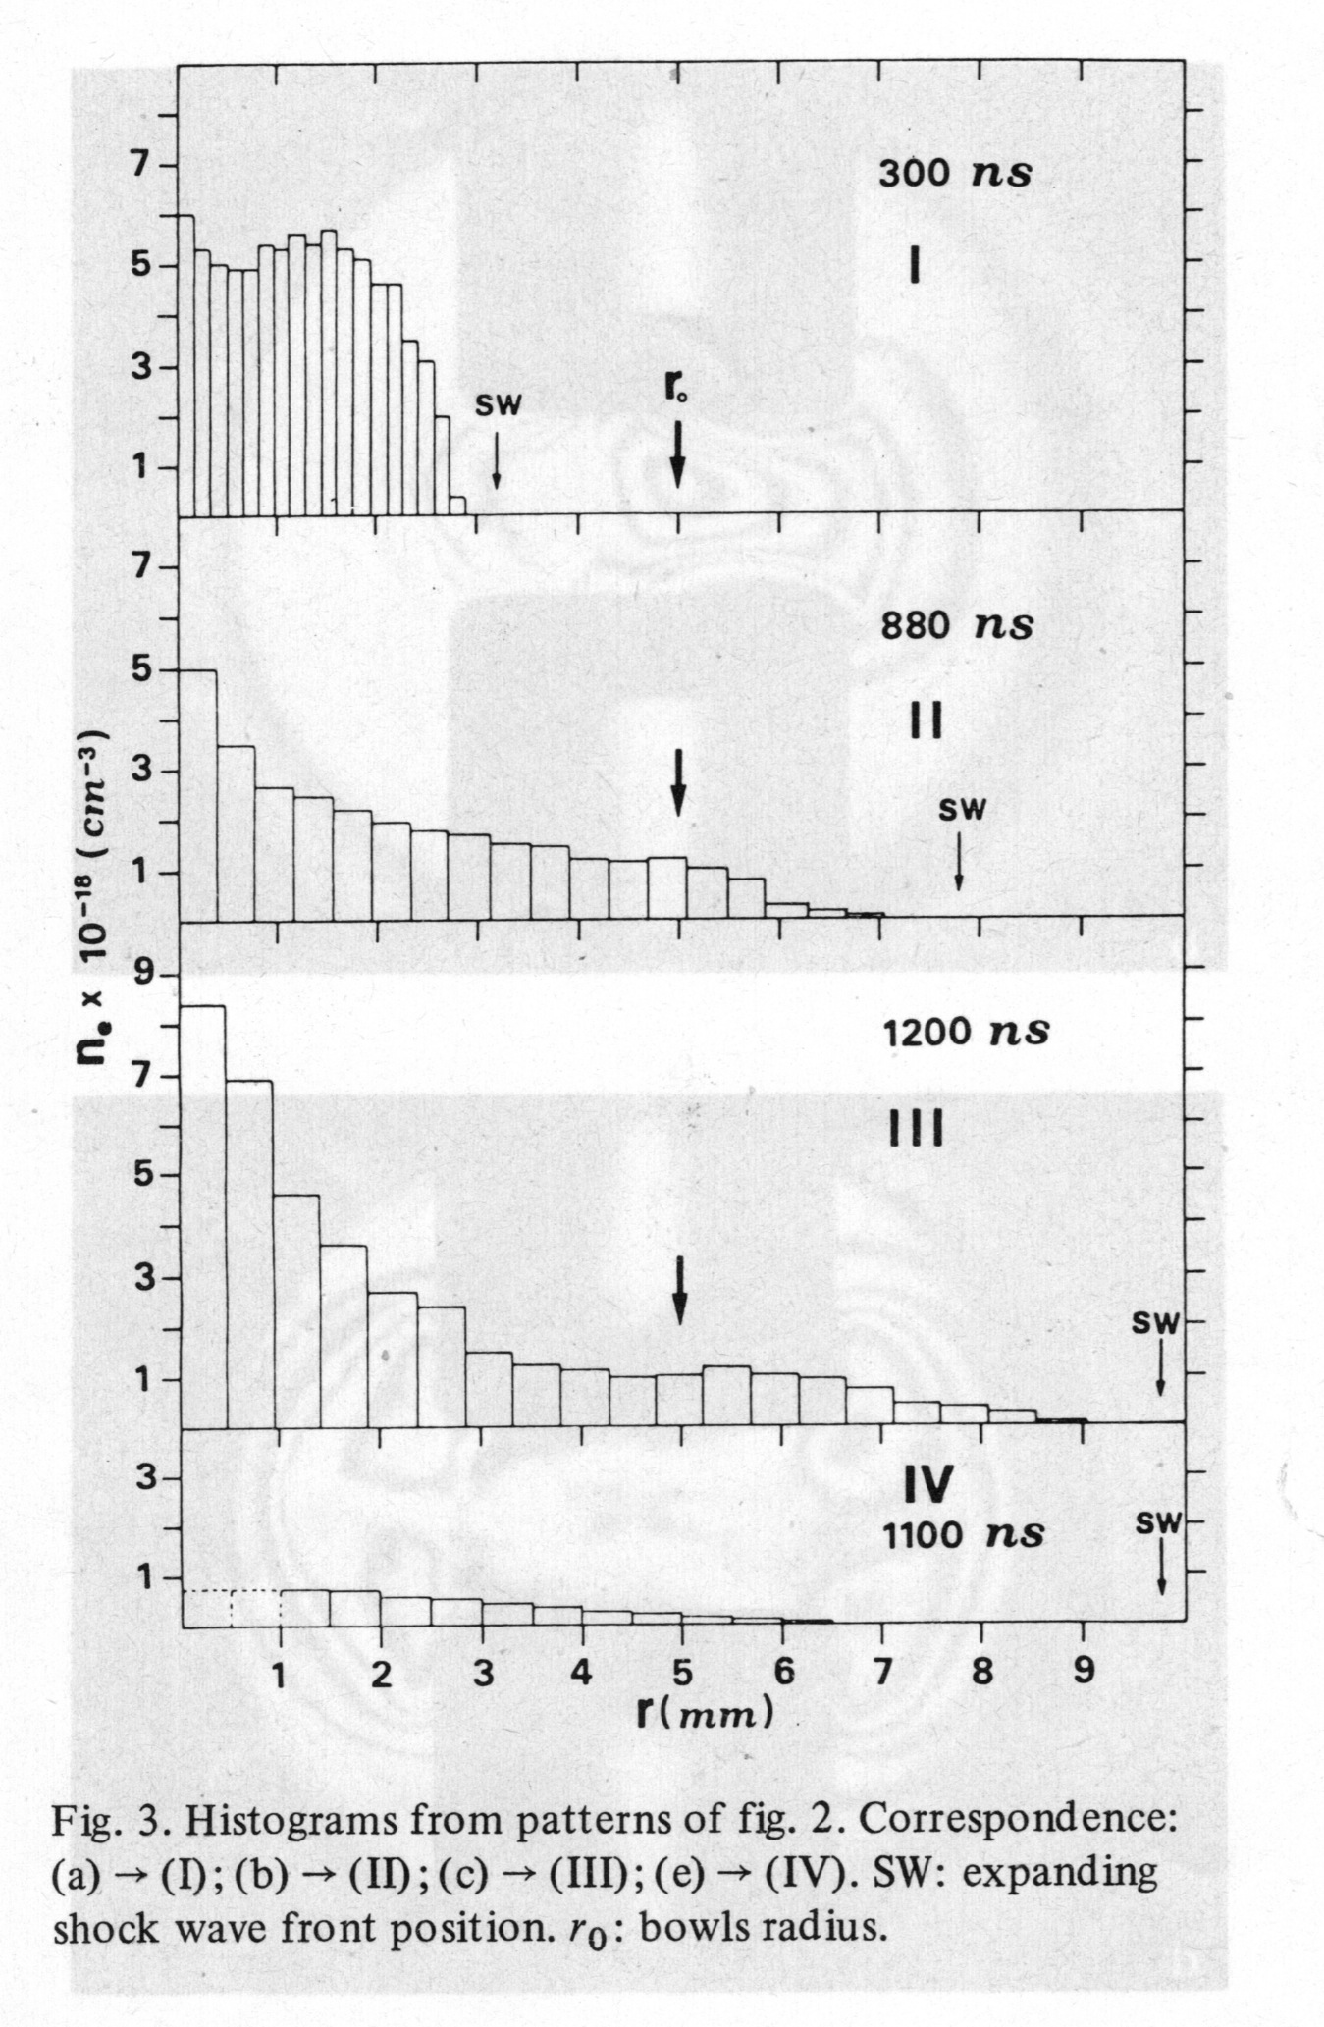
Histograms from patterns of fig.2

Slide 49
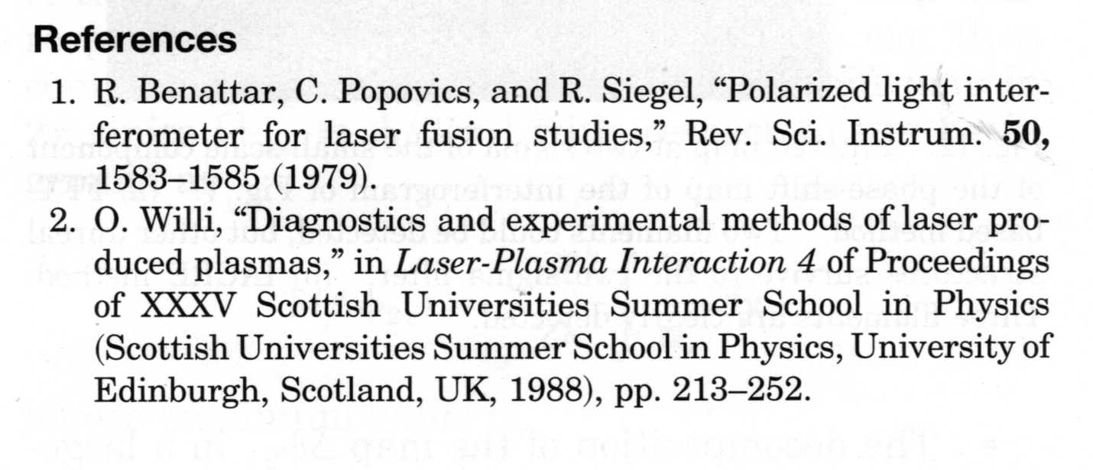
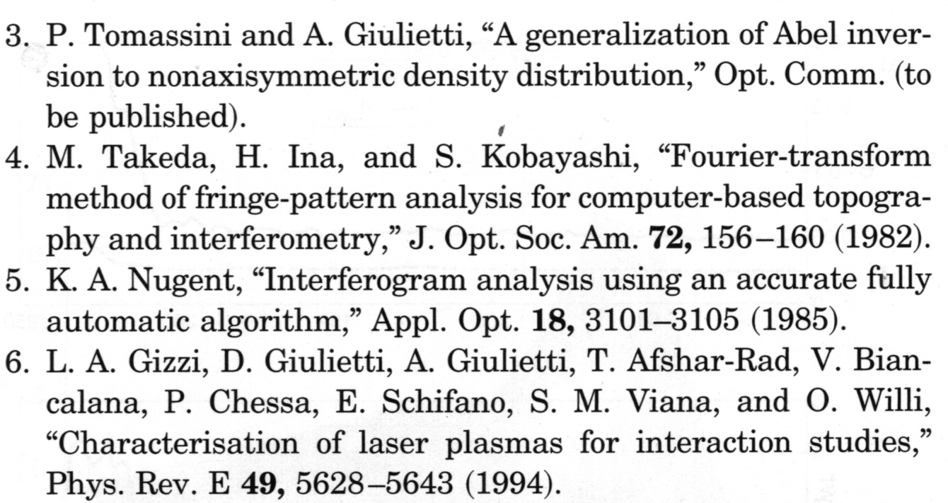

Slide 50
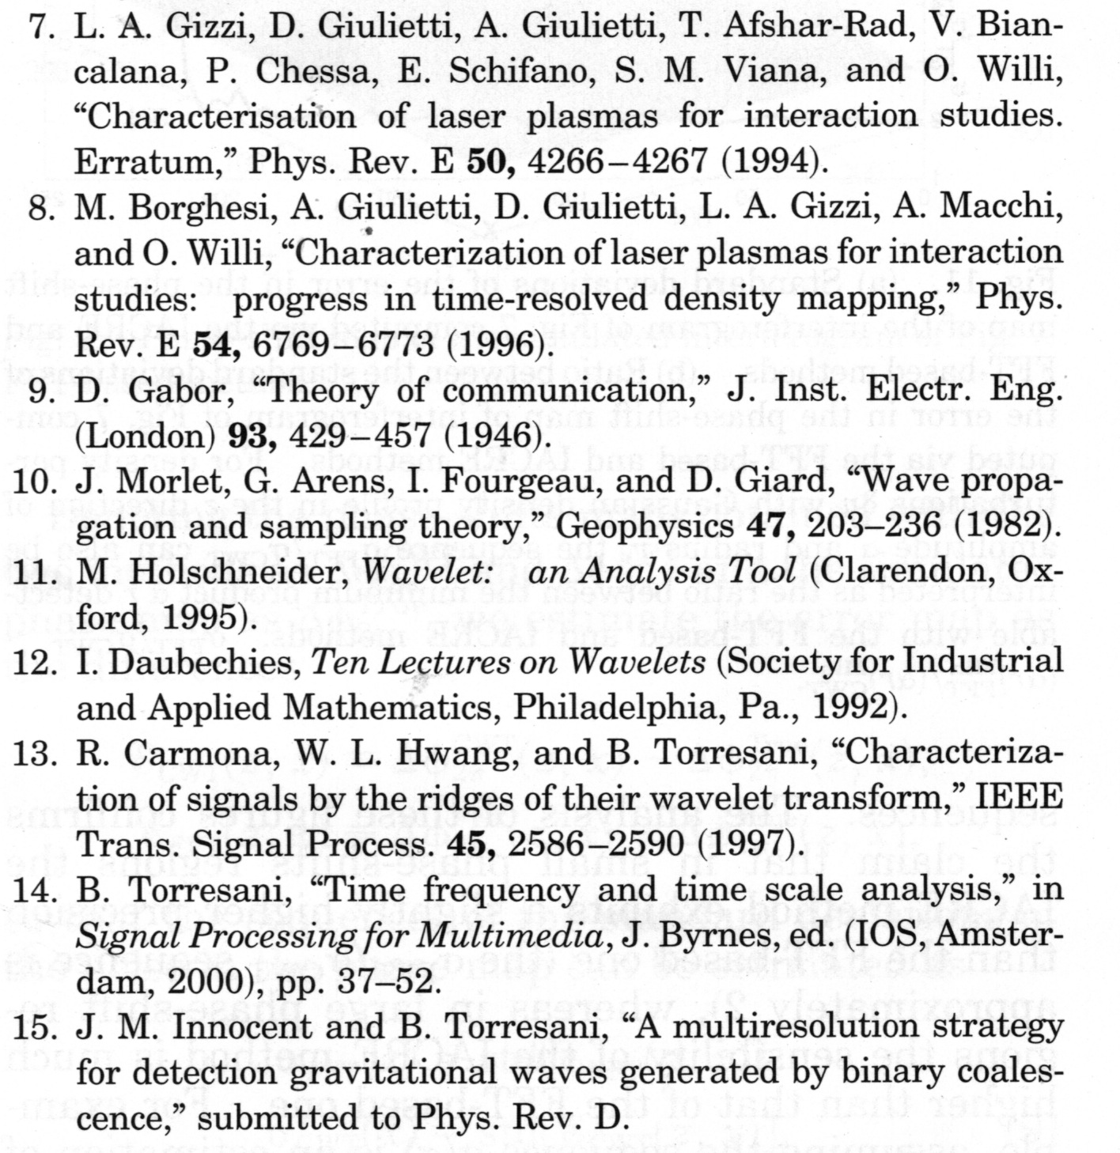

Slide 51
Conclusions
Plasma interferometry is a well-established and easy-to-implement diagnostic method for quantitative electron density mapping.
The reliability of the electron density values ​​that it provides can be further increased thanks to a calibration that can come from the simultaneous detection of specific radiations emitted during the laser-plasma interaction.

