Slide 1
Controlling piezoelectricity in organic polymers
PhD seminars
Season XI
Rome, 06/12/2024
Stefano Paolo Villani
stefano.villani@uniroma1.it

Slide 2
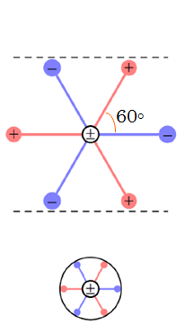
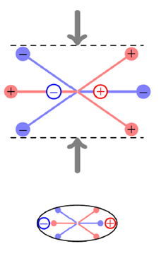
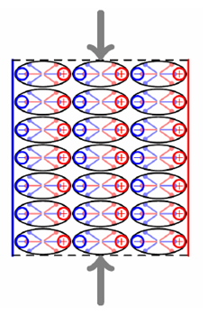
Piezoelectric effect
A deformation induces an electric dipole
A surface charge is induced and hence a tension
Collection of atoms with certain symmetries
$$−V$$
$$+V$$

Slide 3
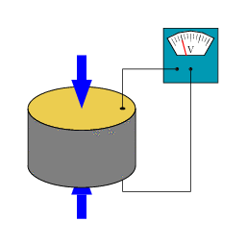
Piezoelectric effect
Mechanical energy
Electrical energy
A surface charge is induced and hence a tension
$$−V$$
$$+V$$

Slide 4
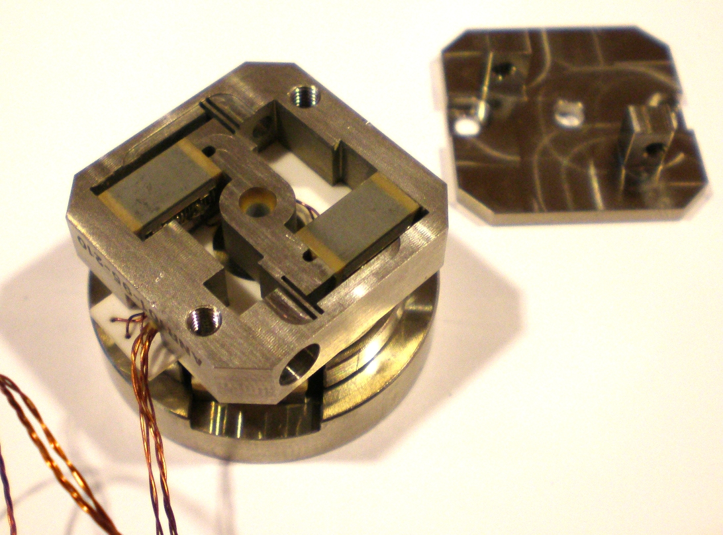
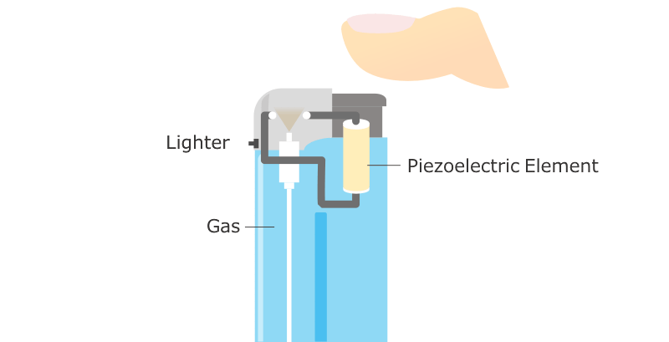
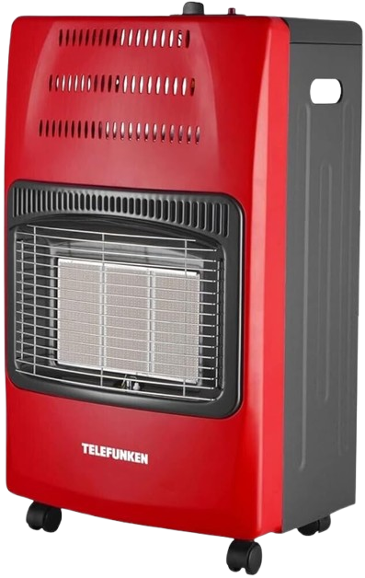
Piezoelectric effect
Piezo-motors
Like in Paolo’s home in Cortina D’Ampezzo
Piezo-sensors

Slide 5
Piezoelectric effect
Best piezoelectrics are inorganic crystals, but:
low mechanical flexibility
high fabrication costs
may be toxic (e.g. contain Lead)
Piezo-motors
A promising alternative are organic piezoelectrics
at date, worse performances
Conjugated polymers (CPs)
candidates to outperform the state-of-the-art
Piezo-sensors

Slide 6
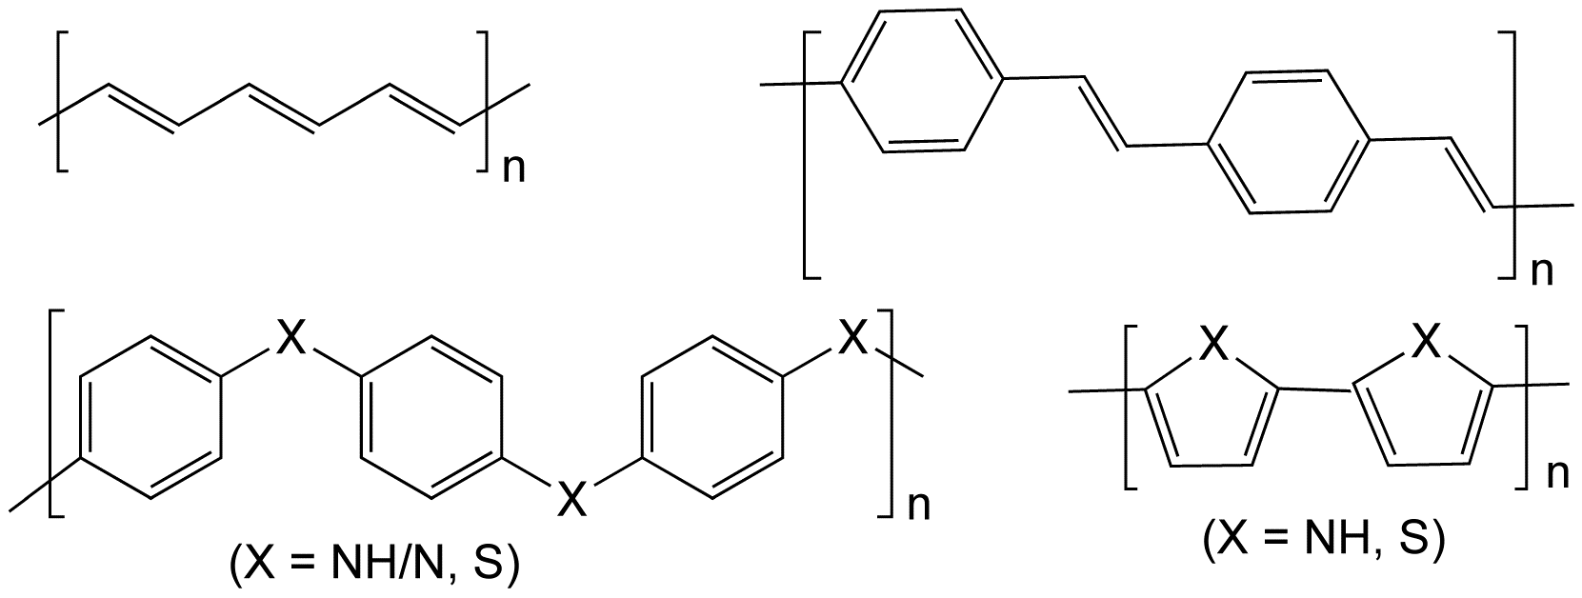
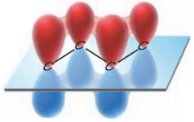
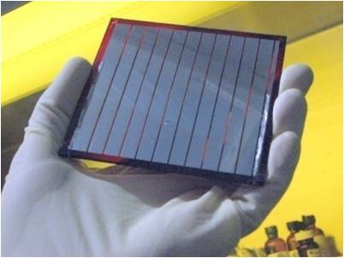
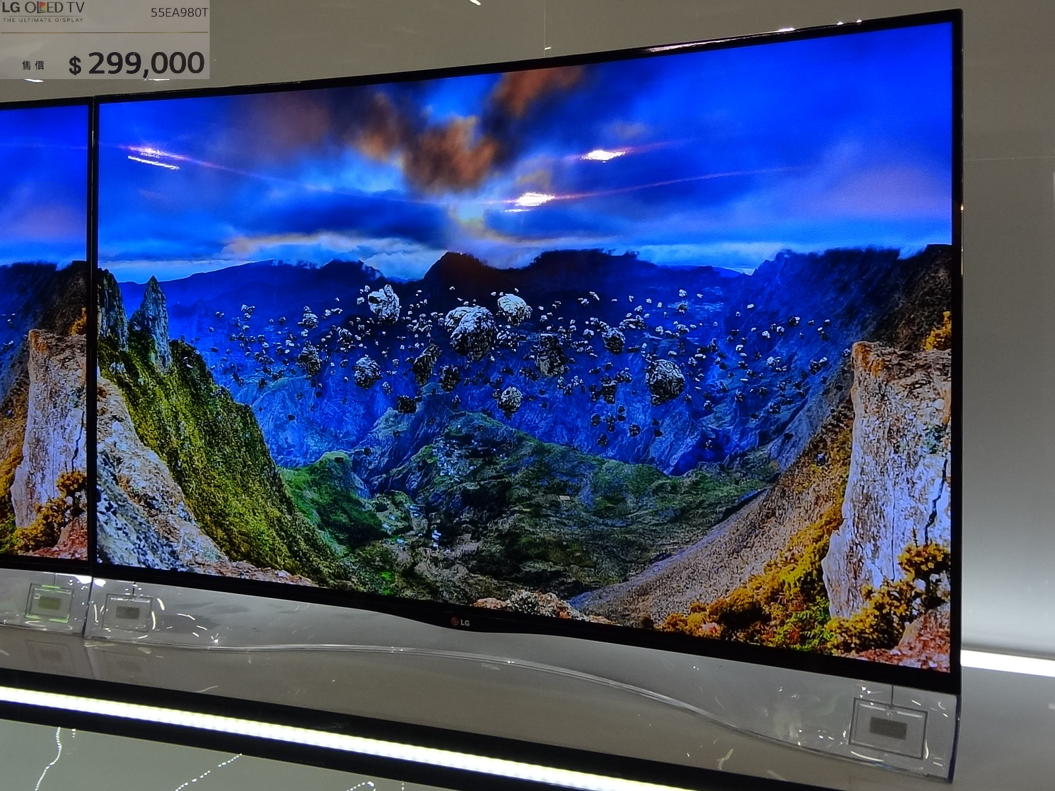
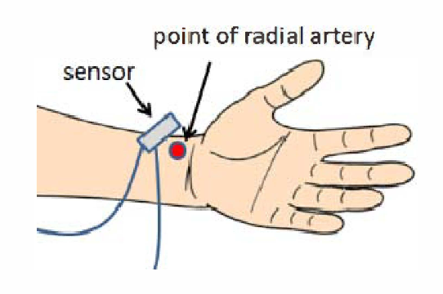
Conjugated polymers (CPs)
Organic (1D) materials with a backbone of atoms
Conjugation: overlap of p-orbitals Results in electrons delocalization
Organic solar panels
Electronics: AMOLED and OLED
Biomedical
6

Slide 7
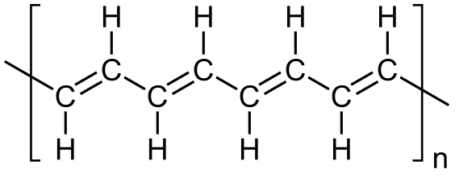
Conjugated polymers (CPs)
Organic (1D) materials with a backbone of atoms
Conjugation: overlap of p-orbitals Results in electrons delocalization
Carbyne
Polyacetylene (PA)
Substituted PA (SPA)
Infinitely-long straight chain of carbon atoms
7

Slide 8
A model for conjugated systems
$$+Δ$$
$$−Δ$$
$$l_{1}$$
$$l_{2}$$
Onsite energy difference $Δ$ (SPA)
Bond-length alternation BLA = $\left|l_{1}−l_{2}\right|$
Electronic polarization: net dipole moment per unit cell $P$
Non-equivalent atoms and no BLA
Non-equivalent atoms and BLA
Unit cell with inversion symmetry
Inversion symmetry is broken
Net dipole moment $P≠0$
(spontaneous polarization)
Null net dipole moment $P=0$

Slide 9
A model for conjugated systems
$$+Δ$$
$$−Δ$$
$$l_{1}$$
$$l_{2}$$
Onsite energy difference $Δ$ (SPA)
electron-phonon (el-ph) coupling term $β$
Bond-length alternation BLA = $\left|l_{1}−l_{2}\right|$
Equivalent atoms ($Δ=0$)
$E_{gap}∝βBLA$ (metal-insulator transition)
el-ph $β$ favors dimerization (Peierls instability)
Inequivalent atoms ($Δ≠0$)
$E_{gap}=2\sqrt{Δ^{2}+{\left(βBLA\right)}^{2}}$
Atom inequivalence ($Δ≠0$) contrast dimerization

Slide 10
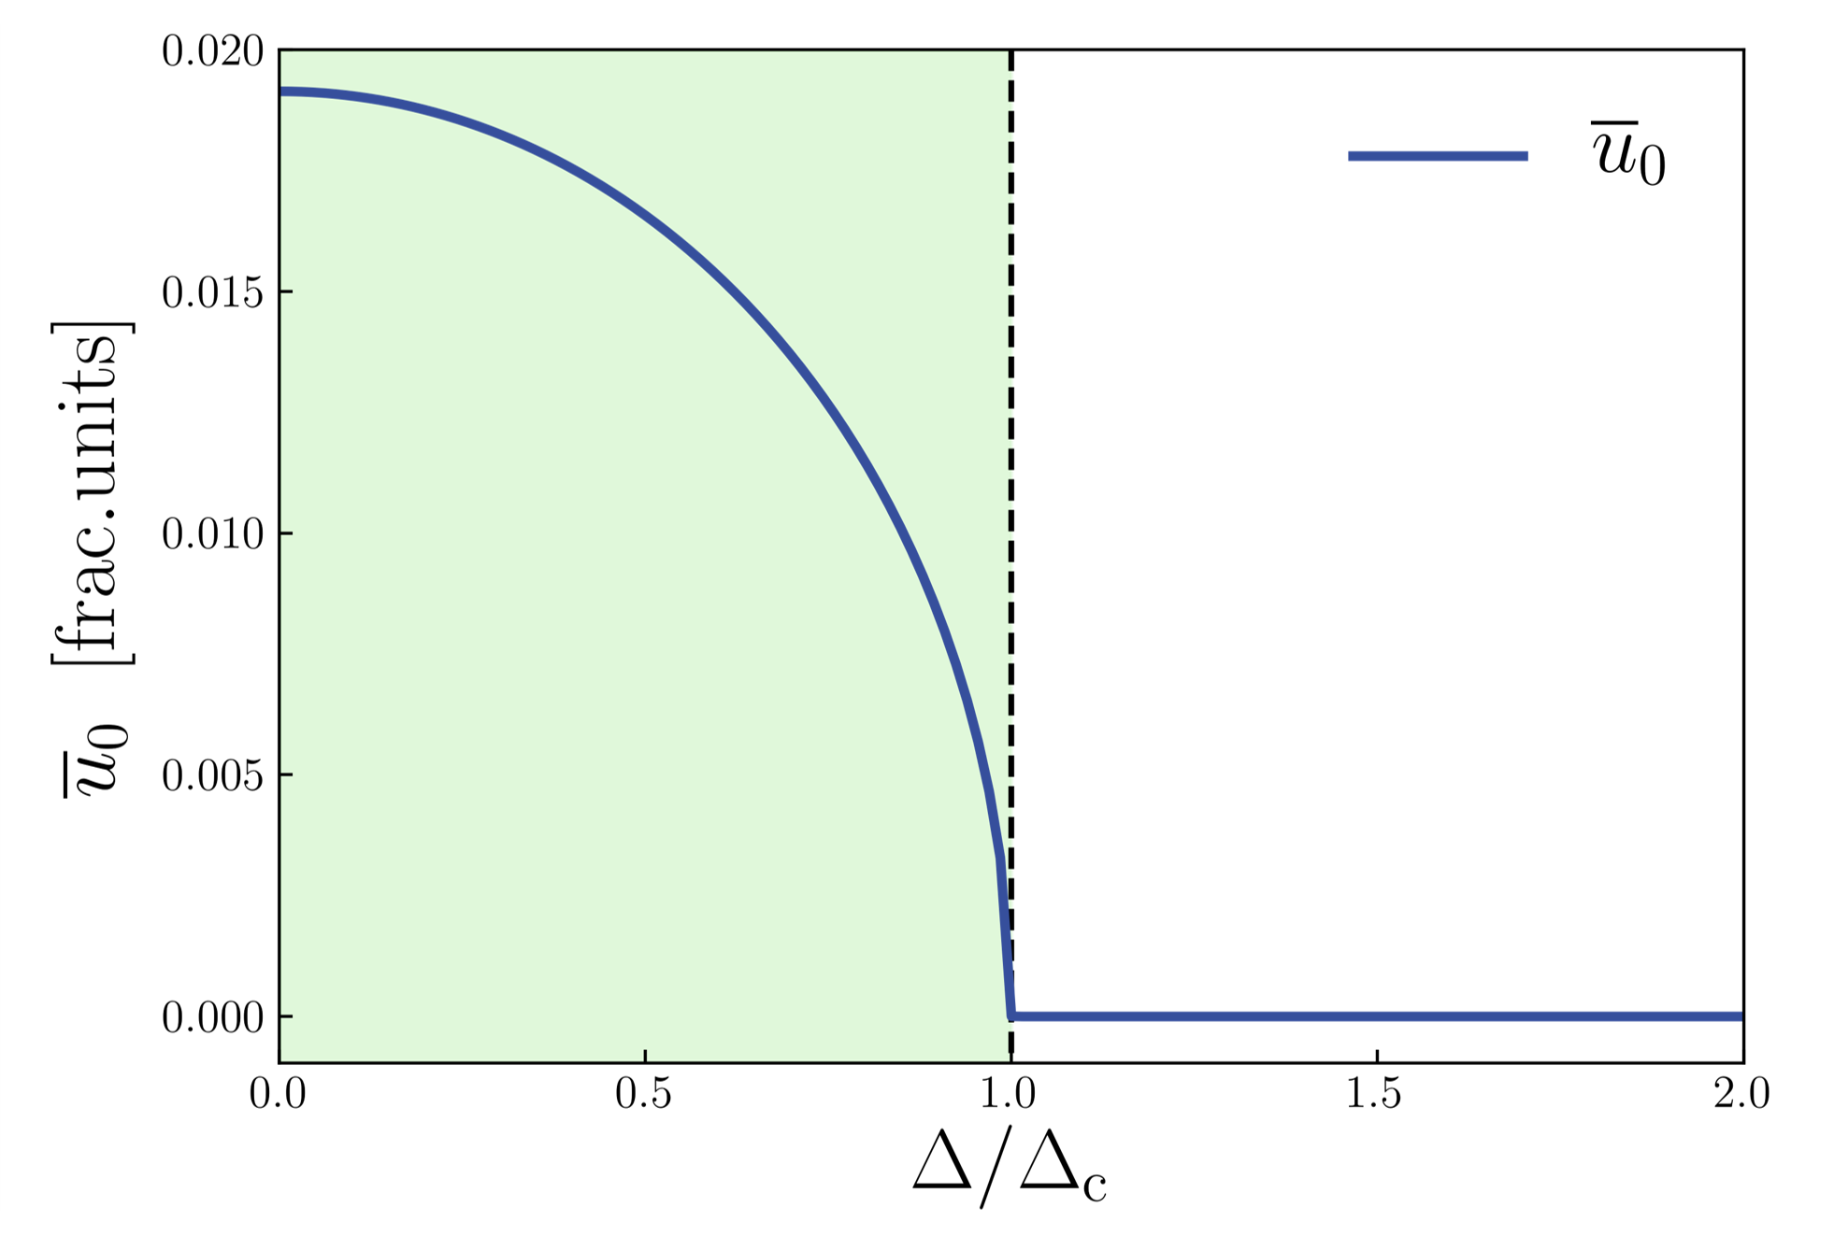
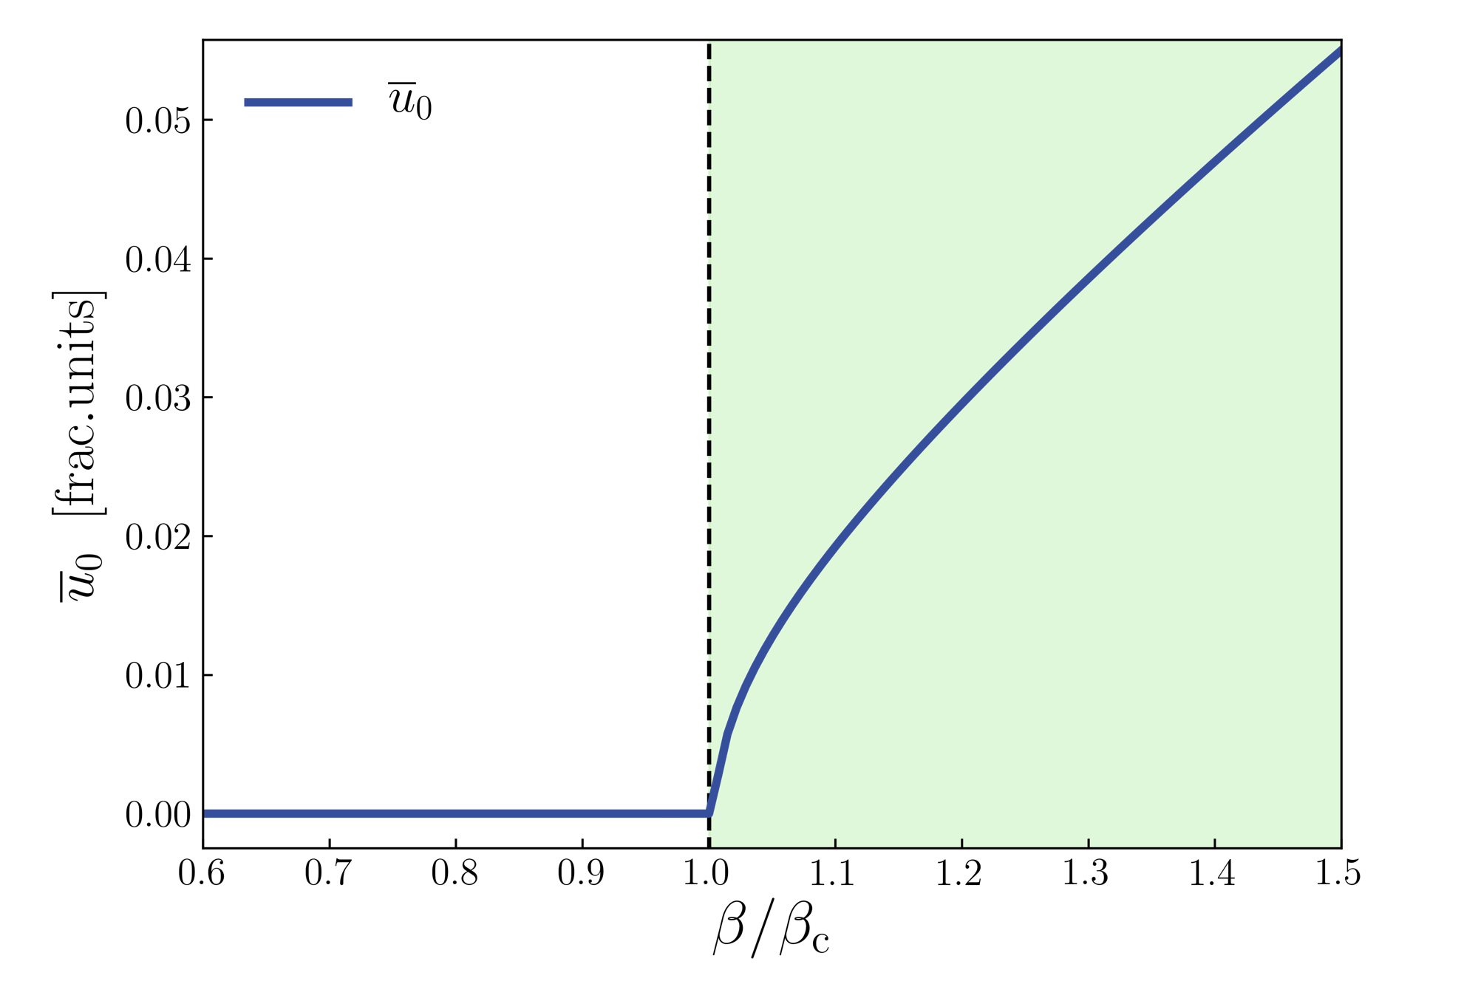
A model for conjugated systems: structural transition
Competing mechanisms result in a second order structural phase transition
BLA is the order parameter
$$BLA≠0$$
$$BLA=0$$
vs
Fixed el-ph $β$
Fixed on-site energy difference $Δ$
$BLA/$cell length
$BLA/$cell length
$${Δ<Δ}_{c}$$
$$BLA≠0$$
$${Δ>Δ}_{c}$$
$$BLA=0$$
$${β<β}_{c}$$
$$BLA=0$$
$${β>β}_{c}$$
$$BLA≠0$$
$${Δ/Δ}_{c}$$
$${β/β}_{c}$$

Slide 11
Piezoelectricity in the model
Piezoelectricity: response to a strain $ε$
Breaking of symmetry is necessary $(Δ≠0,BLA≠0→P≠0)$
Strain: $a\left(ε\right)=a_{0}\left(1+ε\right)$
Born effective charges
Enhancement of topological origin
Piezoelectric coefficient $c_{p}$
$$Z^{∗}$$
$$c_{p}=\frac{dP}{dε}∝ {\left.\frac{∂P}{∂r}\right|}_{r_{0}} \frac{∂r}{∂ε}$$

Slide 12
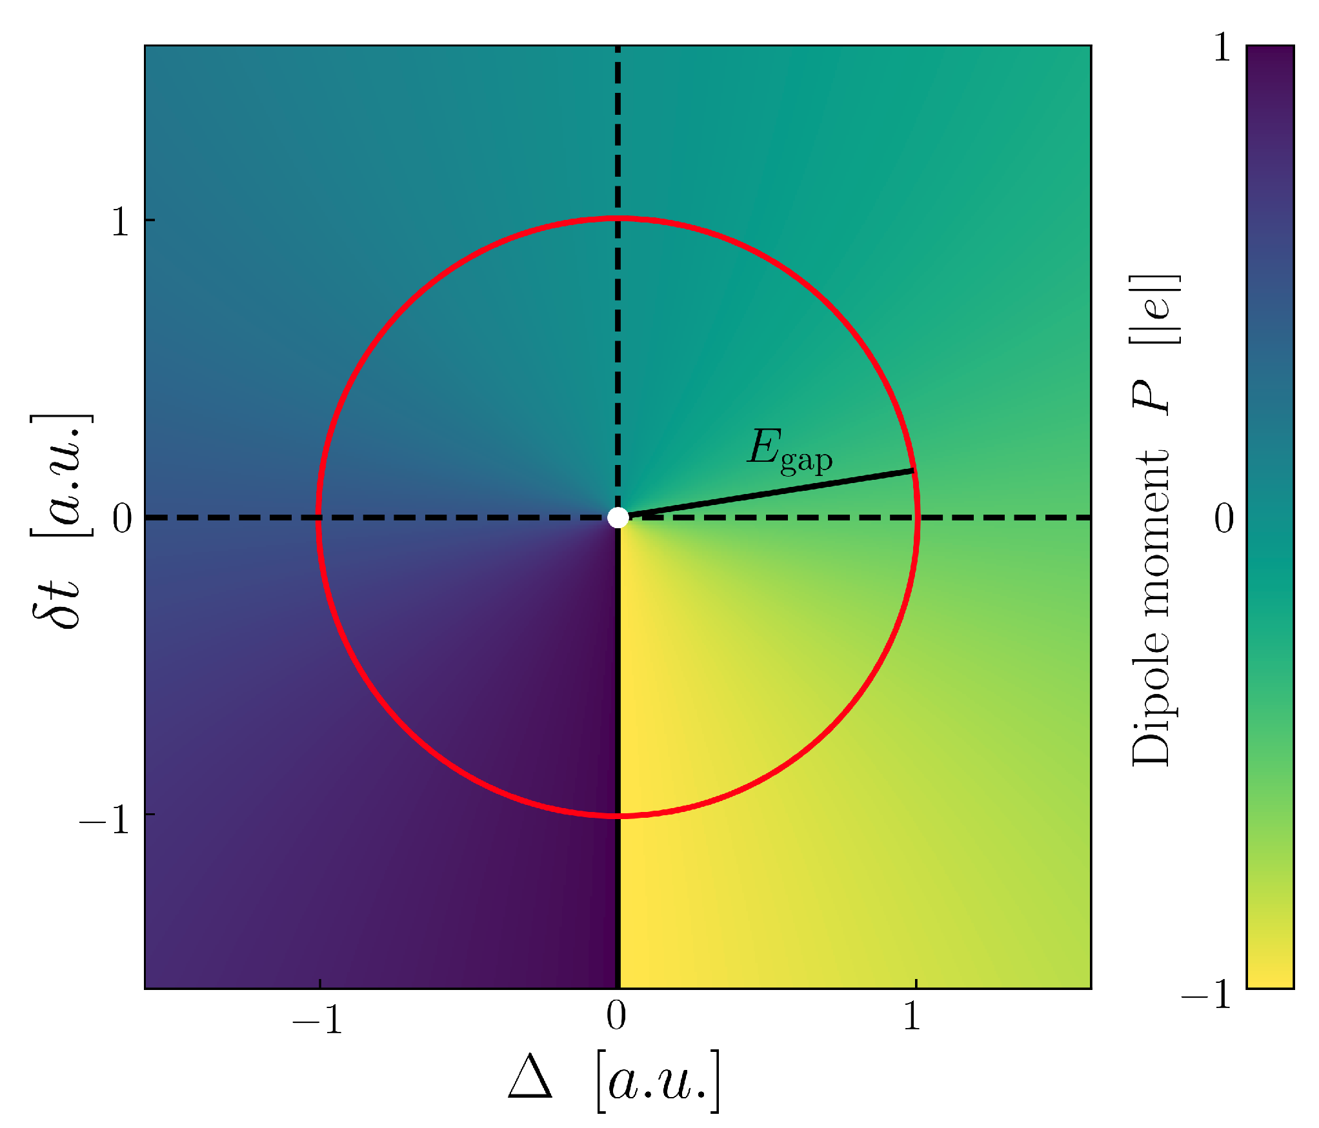
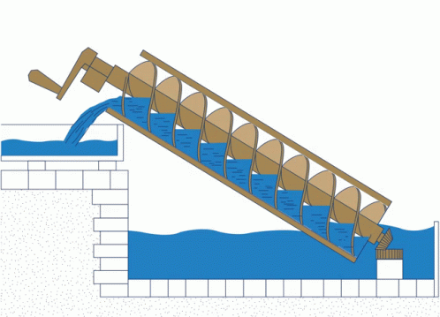
Topological character of polarization: Thouless pump
Polarization $P$ in a 2D $\left(Δ,δt\right)$-parameters space
hopping energy difference: $t_{1}−t_{2}=δt=β\text{BLA}$
$E_{gap}=2\sqrt{Δ^{2}+{\left(δt\right)}^{2}}$
$$t_{1}$$
$$t_{2}$$
Origin is a metallic point $\left(E_{gap}=0\right)$: non-trivial topology
Similar to Archimedes screw
Thouless pump (PRB, 1983) A loop enclosing the origin pumps out a quantum of charge from the unit cell
$$δt$$
$$Δ$$

Slide 13
Topological enhancement of polar responses
Born effective charges $Z^{∗}$
Response to ionic displacement
$$Z^{∗}=\frac{dP}{dr}$$
$$dr$$
$$δt$$
$dδt=βd\text{r}$ (vertical color gradients)
Enhanced response close to the origin
$$Z^{∗}∝β\frac{Δ}{E_{gap}^{2}}$$
$$Δ$$
Notes:
derivatives wrt u are vertical color gradients

Slide 14
Piezoelectricity in the model
Response to a strain $ε$
Breaking of symmetry is necessary $(Δ≠0,BLA≠0→P≠0)$
Strain: $a\left(ε\right)=a_{0}\left(1+ε\right)$
Born effective charges
Enhancement of topological origin
Piezoelectric coefficient $c_{p}$
$$Z^{∗}$$
$$c_{p}=\frac{dP}{dε}∝ {\left.\frac{∂P}{∂r}\right|}_{r_{0}} \frac{∂r}{∂ε}$$
$$\frac{∂r}{∂ε}∝{\left|Δ−Δ_{c}\right|}^{−1/2}$$
(Same wrt $β$)
Control of the enhancement: functional CPs for electro-mechanical energy conversion

Slide 15
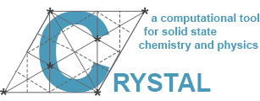
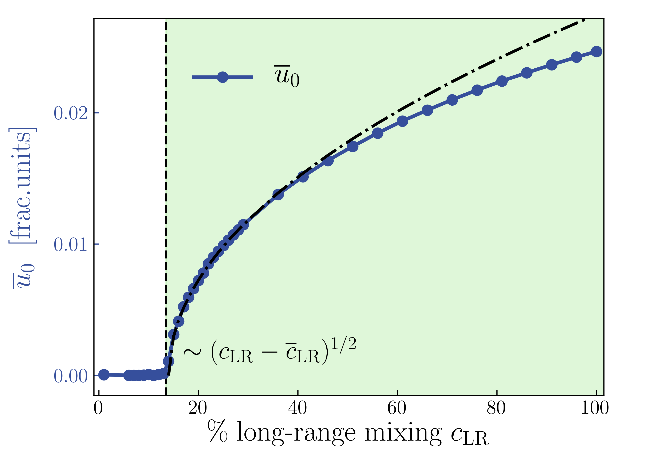
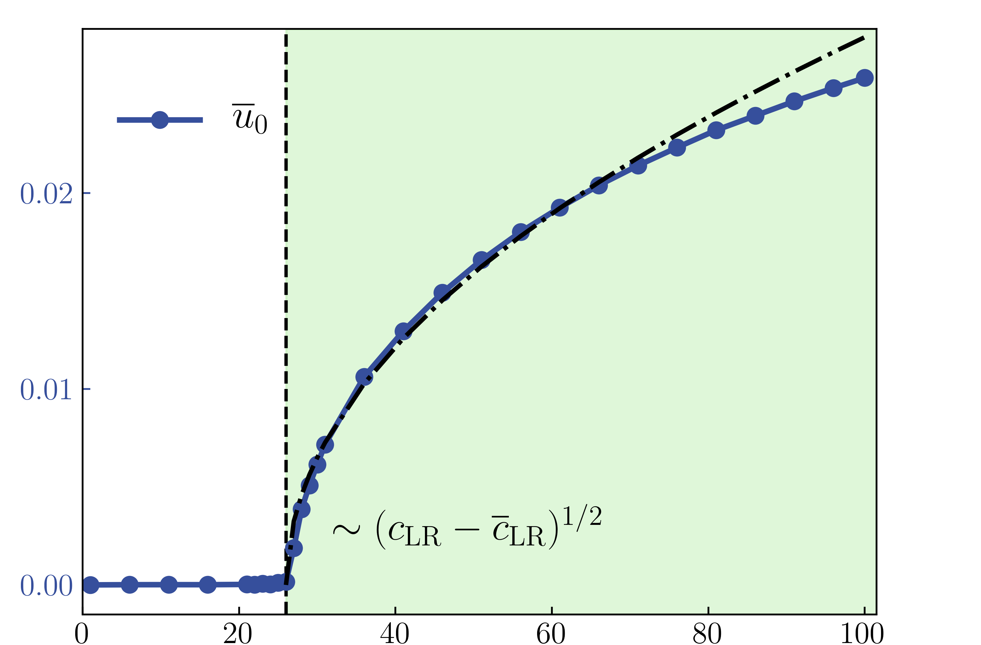
Piezoelectricity in real polymers
Model’s predictions confirmed using Density functional theory (DFT) calculations
Polymethineimine (PMI)
Mono-Fluorinated PA (MFPA)
Range-separated hybrid functional
$$E_{xc}^{LC−ωPBE}=E_{xc}^{PBE}+c_{LR}(E_{x}^{LR,HF }−E_{x}^{LR,PBE})$$
Related to the dielectric environment
$$β∝c_{LR}∝ε_{r}^{−1}$$
(MFPA)
(PMI)
DFT
DFT
model
model
$BLA/$cell length
$BLA/$cell length
$Δ≠0$
$Δ≠0$
$$BLA≠0$$
$$BLA≠0$$
$$β∝c_{LR}$$
$$β∝c_{LR}$$

Slide 16
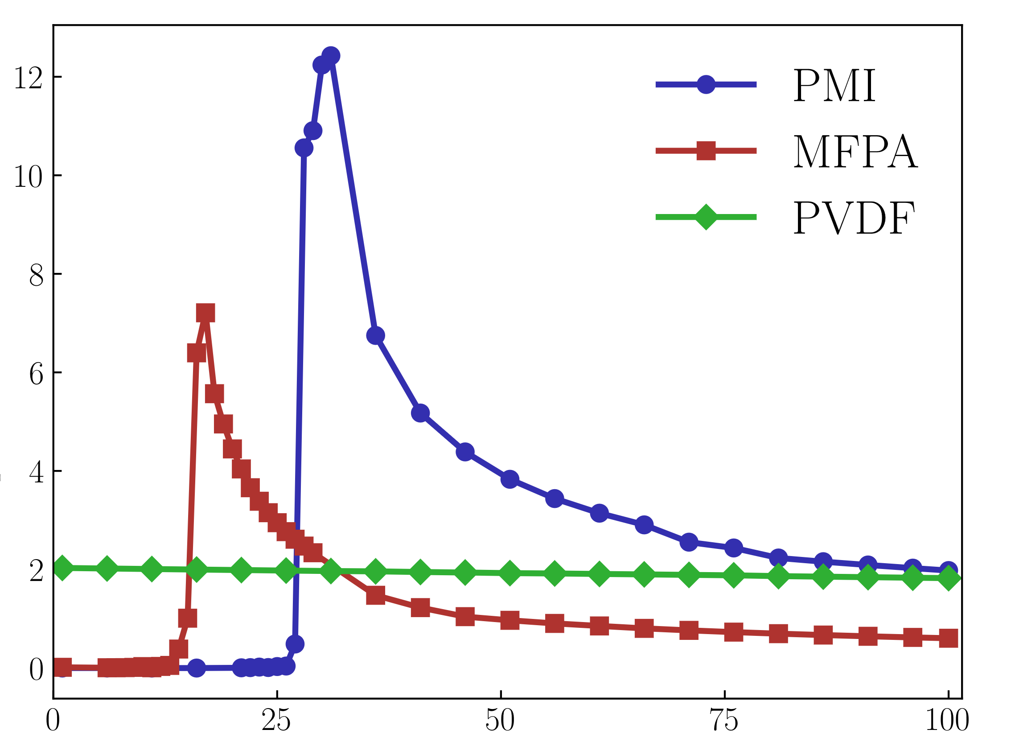
Piezoelectricity in real polymers
Comparison with state-of-the-art
Polyvinylidene fluoride (PVDF)
best and most used piezo-polymers
not conjugated
$c_{p}$ [pC/N]
Piezoelectric CPs outperform state-of-the-art
$$c_{LR}$$

Slide 17
Conclusions
Conjugated polymers as organic piezoelectric materials with enhanced functionalities
$c_{p}$ [pC/N]
related to structural properties
topological enhancement of $Z^{∗}$
Possibility to control piezoelectric response
$$c_{LR}$$
Outperform state-of-the-art materials

Slide 18
Additional materials

Slide 19
1D model for conjugated systems
$$+Δ$$
$$−Δ$$
$$t+δt$$
$$t−δt$$
$$l_{1}$$
$$l_{2}$$
Tight-binding toy-model (Rice-Mele)
$u=\frac{l_{1}−l_{2}}{l_{1}+l_{2}}$ : bond length difference
$u=0$ equidistant atoms
$u≠0$ different bond lengths
$Δ$: onsite energy
Atoms equivalence ($Δ=0$ in PA)
$t:$ bond energy between equidistant atoms (p-orbitals)
$β:$ electron-phonon coupling parameter
Bond energy variation $δt=−βu$
$K:$ elastic-constant term
Lattice distortion energy: $\frac{1}{2}Ku^{2}$

Slide 20
Charge density waves (CDWs)
CDWs: electronic charge density acquires a spatial modulation
Character determined by interplay between many ingredients
Let’s consider a 1D chain of atoms
equivalent monovalent atoms with no el-lattice interaction (no CDW)
Peierls electronic instability: el-lattice interaction causes dimerization bond-centered CDW

Slide 21
Charge density waves (CDWs)
CDWs: electronic charge density acquires a spatial modulation
Character determined by interplay between many ingredients
Let’s consider a 1D chain of atoms
equivalent monovalent atoms with no el-lattice interaction (no CDW)
non-equivalent atoms, site-centered CDW
Peierls electronic instability: el-lattice interaction causes dimerization bond-centered CDW
non-equivalent atoms and dimerization CDW with mixed character

Slide 22
Density functional theory (DFT) calculations
Model’s prediction tested on real SPA conjugated polymers (fixed $Δ≠0$ in the model)
Polymethineimine (PMI)
Mono-Fluorinated PA (MFPA)
Range-separated hybrid functional
$$E_{xc}^{LC−ωPBE}=E_{xc}^{PBE}+c_{LR}(E_{x}^{LR,HF }−E_{x}^{LR,PBE})$$
Long range (LR)
Essential for structure of conjugated polymer chains Ferretti et al., PRB, 2012; Romanin et al., 2021
$$β∝c_{LR}∝ε_{0}^{−1}$$
LR part accounts for screened Coulomb vertex corrections to el-ph dressing Li et al., PRL, 2019; Attaccalite et al., NanoLet., 2010
$c_{LR}$related to dielectric environment Kronik et al., Advanced Materials, 2018

Slide 23
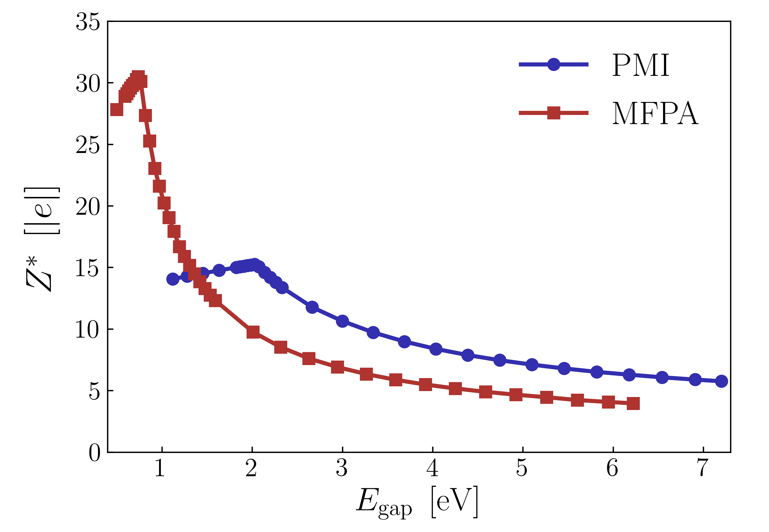
Piezoelectricity in real polymers
$$Z^{∗}∝β\frac{Δ}{E_{gap}^{2}}$$
Enhancement of polar responses
Mono-Fluorinated PA (MFPA)
Maximum at critical points
Polymethineimine (PMI)
$Z^{∗}$ up to $30\left|e\right|$ for $E_{gap}∼1eV$

Slide 24
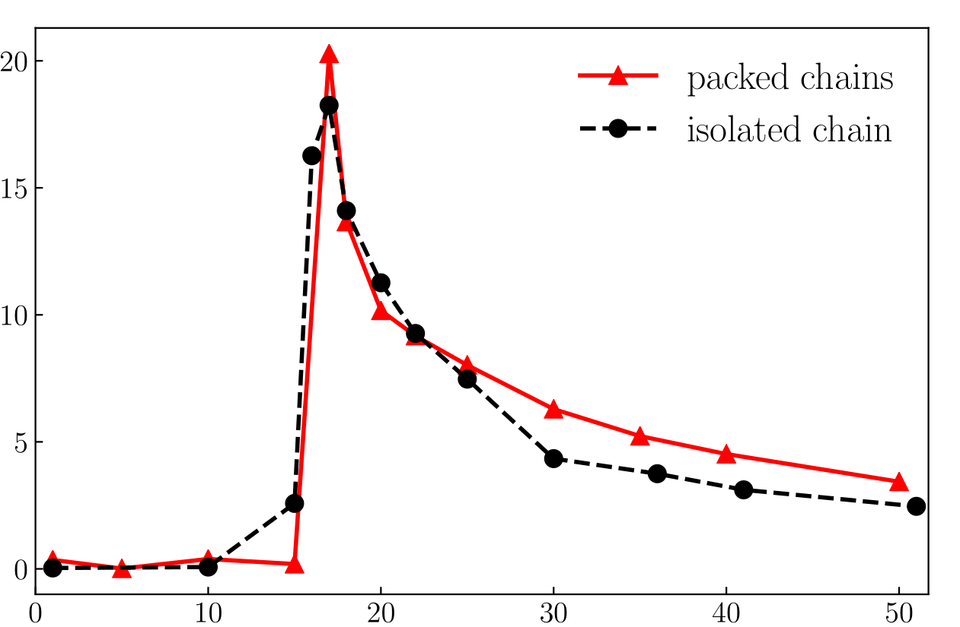
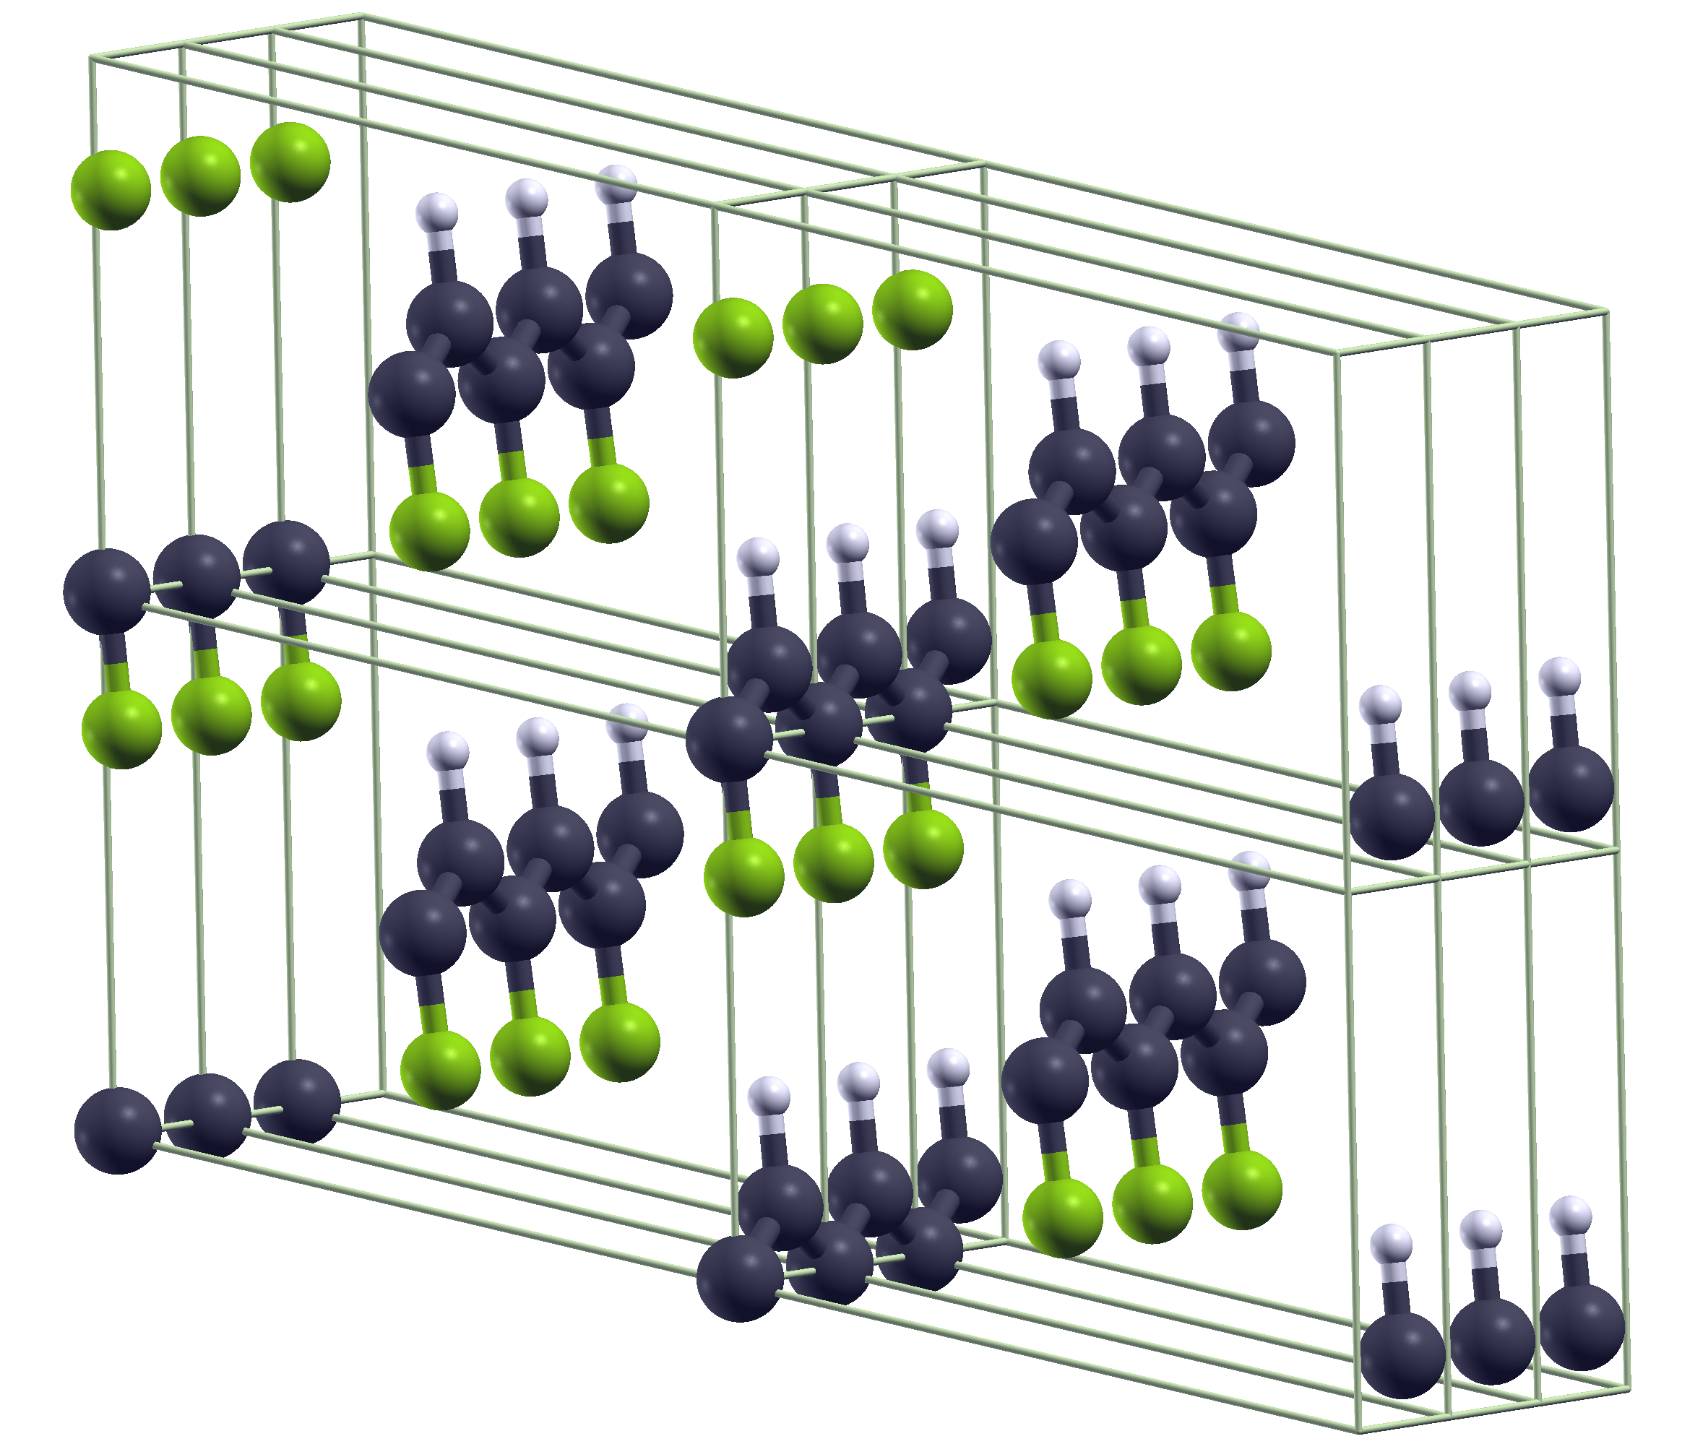
Robustness of polar responses
Topological nature guarantees robustness of polar response enhancement
Isolated vs packed polymers
Packed chains
$c_{p}$ [pC/N]
$$c_{LR}$$

