Slide 2
Contents
Introduction to QA/QC and EDMS
Large Projects and Contribution from Industry
From TESLA to Industrial Production for XFEL
Results and Conclusions

Slide 3
Contents
Introduction to QA/QC and EDMS
Large Projects and Contribution from Industry
From TESLA to Industrial Production for XFEL
Results and Conclusions

Slide 4
Production and exchange of any type of goods are naturally based on the application QA & QC at a certain level.
For complex object and apparatus specific rule and qualification patents have been developped do make possible both: the assurance of the expected quality and its indirect control through properly documeted production steps.
Whoever produces something for a certan function or use has every interest in producing items that are attractive in terms of quality and cost. The experience demostrated that the strict application of specific rules and controls, QC, during the production assures the quality, QA, of the final product.
Whoever buys something for a certan function or use is asking items that are attractive in terms of quality and cost. The certified application of all the codified rules and controls during the production and the use of materials and subcomponents also certified are the guarantee for the buyer.

Slide 5
Preamble
QA (Quality Assurance) is process oriented and focuses on defect prevention,
QC (Quality Control) is product oriented and focuses on defect identification
Prior to the extensive division of labor and mechanization resulting from the Industrial Revolution, it was possible for workers to control the quality of their own products.
The Industrial Revolution led to a system in which large groups of people performing a specialized type of work were grouped together under the supervision of a foreman who was appointed to control the quality of work manufactured.

Slide 6
Some Historical References - 1
From the time of the First World War, manufacturing processes typically became more complex, with larger numbers of workers being supervised. Following this experience a few new concets have been introduced:
Taylor, utilizing the concept of scientific management, helped separate production tasks into many simple steps (the assembly line) and limited quality control to a few specific individuals, limiting complexity.
Ford emphasized standardization of design and component standards to ensure a standard product was produced, while quality was the responsibility of machine inspectors,
Shewhart at Bell Laboratories developed in 1924 the control chart and the concept of of statistical control, equivalent to exchangeability. With comtributions from others sampling inspection was put on a rational statistical basis

Slide 7
Some Historical References - 2
After World War II, Deming and Juran promoted the collaborative concepts of quality and these concepts were used in the extremely fast re-development of the Japanese economy
In spite of these important developments, the US continued to apply the old Quality Control (QC) concepts of inspection and sampling to remove defective products from production lines, essentially unaware of or ignoring advances in QA for decades
The inroduction of some new concepts and procedures started worldwide
  Failure test and stress test in all the extreeme operational conditions
  Statistical control on parts or on the process that made the part, ideally eliminating the defect before more parts can be made like it
  Total quality management that includes the processes which are managed with QA.
  Models and standards like what specified in the ISO 17025 international standard that specifies the general requirements for the competence to carry out tests and or calibrations.

Slide 8
The Company Quality concept
During the 1980s, the concept of "company quality" with the focus on management and people came to the force also in the U.S. It was considered that, if all departments approached quality with an open mind, success was possible if management led the quality improvement process.
The company-wide quality approach places an emphasis on four aspects (enshrined in standards such as ISO 9001):
Elements such as controls, job management, adequate processes, performance and integrity criteria, and identification of records
Competence such as knowledge, skills, experiences, qualifications
Soft elements, such as personnel integrity, confidence, organizational culture, motivation, team spirit and quality relationships
Infrastructure (as it enhances or limits functionality)
The quality of the outputs is at risk if any of these aspects is deficient.

Slide 9
QA attitude and organization
The importance of actually measuring Quality Culture throughout the organization is illustrated by a survey that was done by Forbes Insights in partnership with the American Society for Quality. A survey of more than 60 multinational companies found that those companies whose employees rated as having a low quality culture had increased costs of $67 million/year for every 5000 employees compared to those rated as having a high quality culture.^{[30]}
Quality Assurance is not limited to manufacturing, and can be applied to any business or non-business activity, including: design, consulting, banking, insurance, computer software development, retailing, investment, transportation, education, scientific institution, national and international research laboratories, scientific infrastructures and enterprises.
The realization of large scientific projects, like the moon program or a SRF based accelerator strongly benefit from well establisced QA culture and organization.

Slide 10
Quality Management Practice
QA comprises a quality improvement process, which is generic in the sense that it can be applied to any activity and it establishes a quality culture, which supports the achievement of quality.
This in turn is supported by quality management practices which can include a number of business systems and which are usually specific to the activities of the business unit concerned.
In manufacturing and construction activities, these business practices can be equated to the models for quality assurance defined by the International Standards contained in the ISO 9000 series and the specified specifications for quality systems.
In the system of Company Quality, the work being carried out was shop floor inspection which did not reveal the major quality problems. This led to quality assurance or total quality control, which has come into being recently.

Slide 11
From Industrial Production to Science
QA/QC concepts and procedure were among the main drivers of the unprecedented economic development after the 2nd World War
Japan and West Germany were the first to widely adopt these procedures and benefit from them, followed by most of other Countries with different delays and speeds, according to their status and desire for redemption.
The benefits introduced by the application to the industrial productions of QA/QC rules and procedures became evident from the sixties and seventies, starting from electronics.
The impressive impact of the highly reliable custom electronics and its consequent impact on instrumentation and industrial automation pushed all the world economy toward reliable production and global commerce
Science has greatly benefited from the availability of high quality industrial manufacturing, integrated QA/QC concets in its behavior, invested in industrialization and contributed spin-offs and start-ups.

Slide 12
Contents
Introduction to QA/QC and EDMS
Large Projects and Contribution from Industry
Preparing series production: the cavity example
Series production better than prototypes

Slide 13
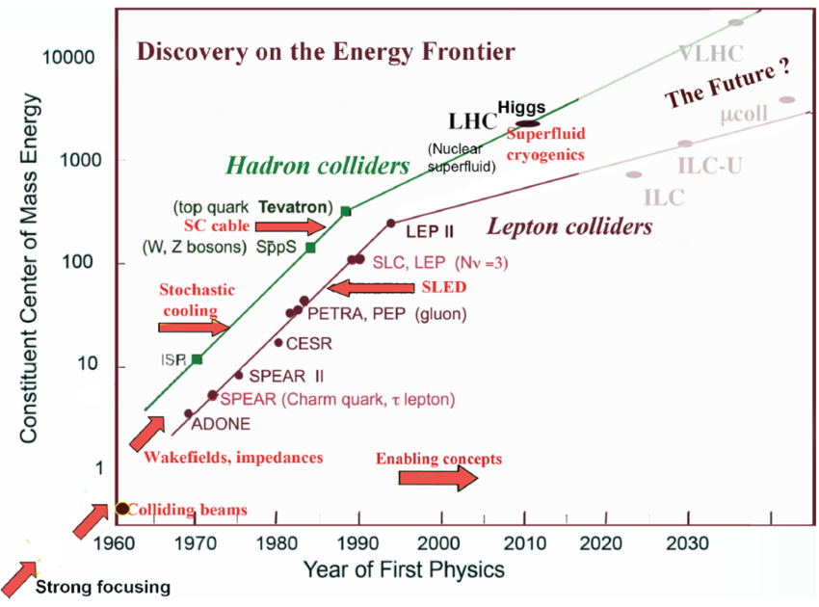
From 1979 HEP drives Accelerators R&D
CEPC-hh
CEPC
K. Yokoya, 2014

Slide 14
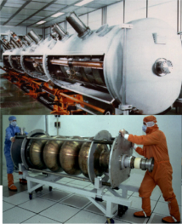
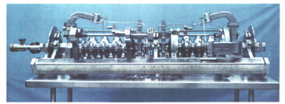
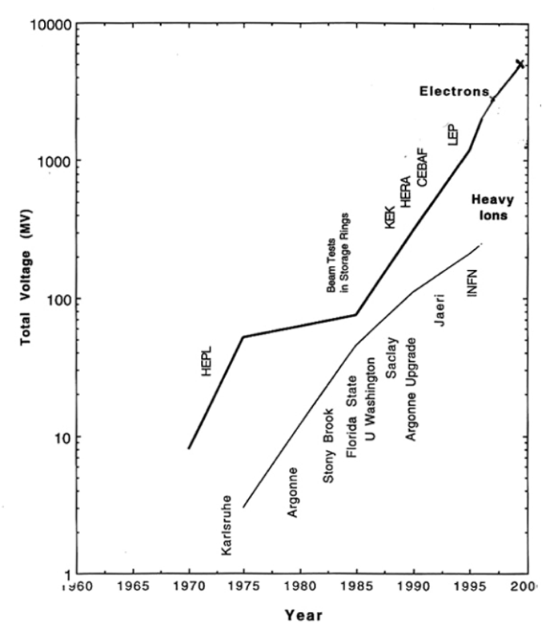
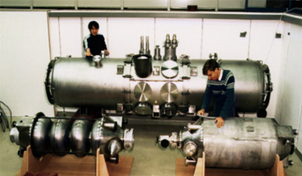
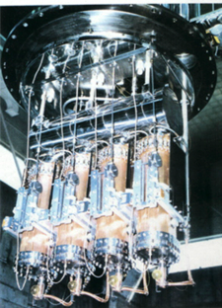
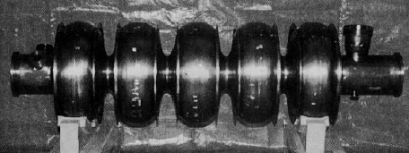
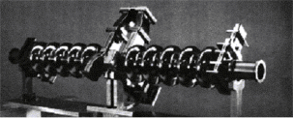
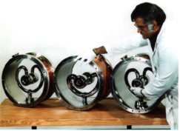
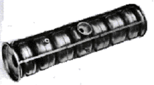
SCRF From HEPL to year 2000
“Livingston Plot” from Hasan Padamsee

Slide 15
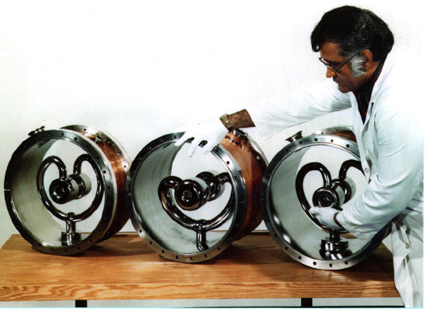
SRF at the pioneering age in the seventies
Argonne National Labs
ATLAS: Heavy-ion Linac
Originated at Caltech
Implementd and used in other labs
for β ~ 0.1
Stanford University
HEPL: Electron Linac for FEL
First multicell electron cavity: β = 1

Slide 16
Limiting Problems
Material properties
    Moderate Nb purity (Niobium from the Tantalum production)
    Low Residual Resistance Ratio, RRR Low thermal conductivity
    Normal Conducting inclusions Quench at moderate field
Cavity treatments and cleanness
    Cavity preparation procedure at the R&D stage
    High Pressure rinsing and clean room assembly not yet introduced
Microphonics
    Mechanical vibrations in low beta structures High RF power required
Multipactoring
    MP has been the major limit for HEPL, and electron linacs to 1984
    Pill-box like geometry: higher shunt impedance but higher MP problems
Quenches/Thermal breakdown low RRR and NC inclusions
Field Emission
    General limit at those time because of poor cleaning procedures and material

Slide 17
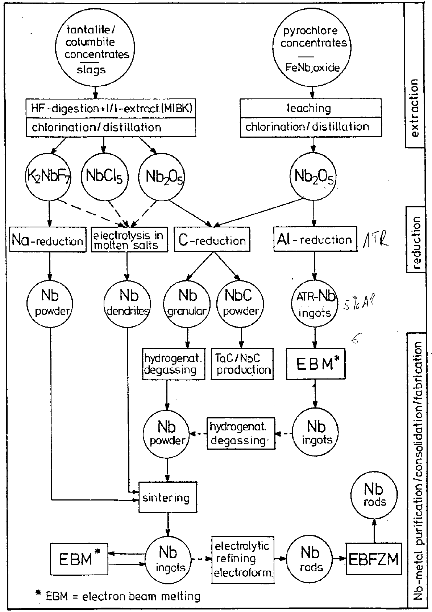
Main routes of Nb fabrication process
Classical routes for Nb, consist of the carbothermic reduction of Nb₂O₅ and the aluminothermic reduction of Nb₂O₅ followed by EBM.
An alternative route of niobium fabrication and alloying is powder metallurgy. For special applications it may be convenient to produce powder with high purity hydriding. The production of high-grade niobium with small Ta-concentration can be performed via the sodium reduction of purified K₂NbF₇.

Slide 18
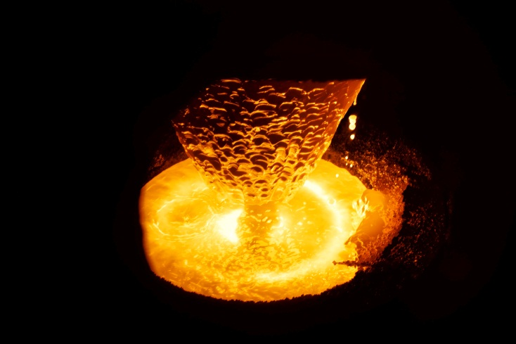
Electron Beam Melting of Niobium
Electrode (Rotating)
During of the ingot melts, molten metal globules fall into a pool on the ingot which is contained in a water cooled copper crucible. Impurities are evaporated and pumped away. Power impact is maintained to keep the pool molten out to within a few mm of the crucible wall. During melting the ingot formed is continuously withdrawn through the crucible.
Electron Beam Gun
Focus & Aiming Coils
Electron Beam
Vacuum
Molten Pool
Water Cooled Crucible
Ing.

Slide 19
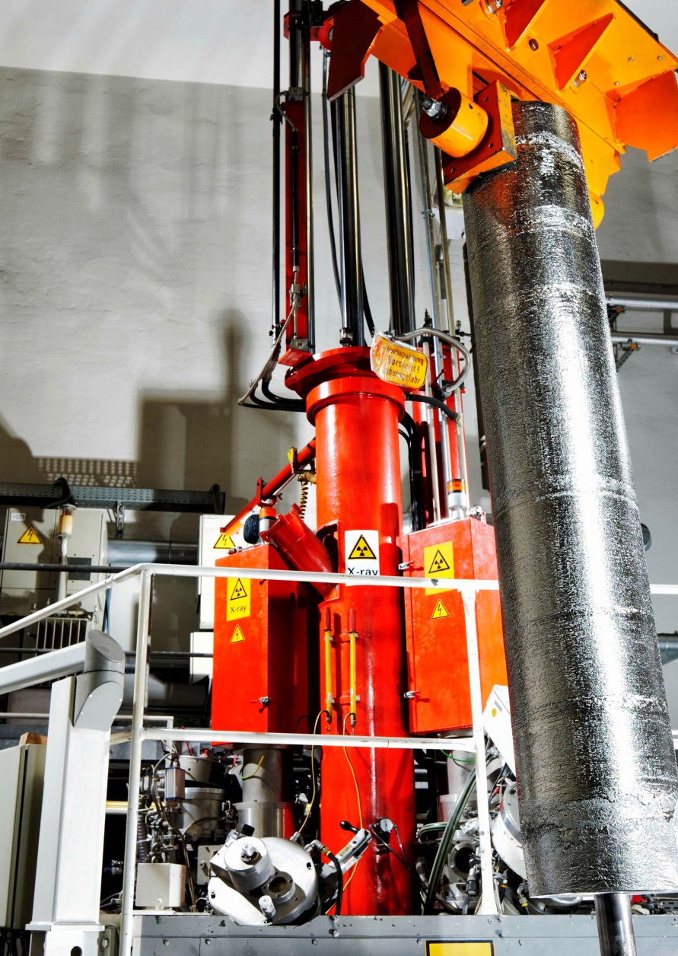
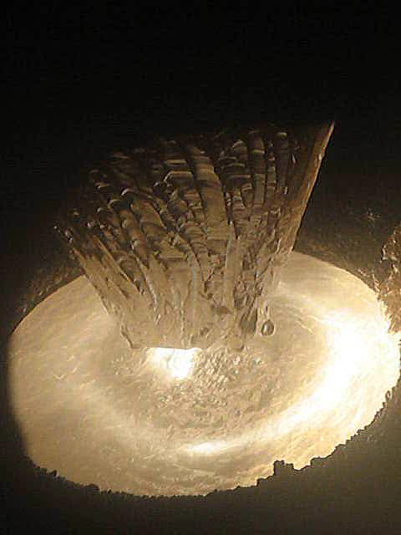
Electron Bem Melting
EB Melting of Nb Ingots at Fa. HERAEUS (Germany)
As a result of the increasing demand for refractory metals in the last few decades, the electron-beam furnace has been developed to a reliable, efficient apparatus for melting and purification.
One problem sometimes observed with e-beam melted ingots is the nonhomogeneous distribution of impurities. The skin of the ingot contains more impurities than the inside. Top to bottom inhomogeneity.

Slide 20
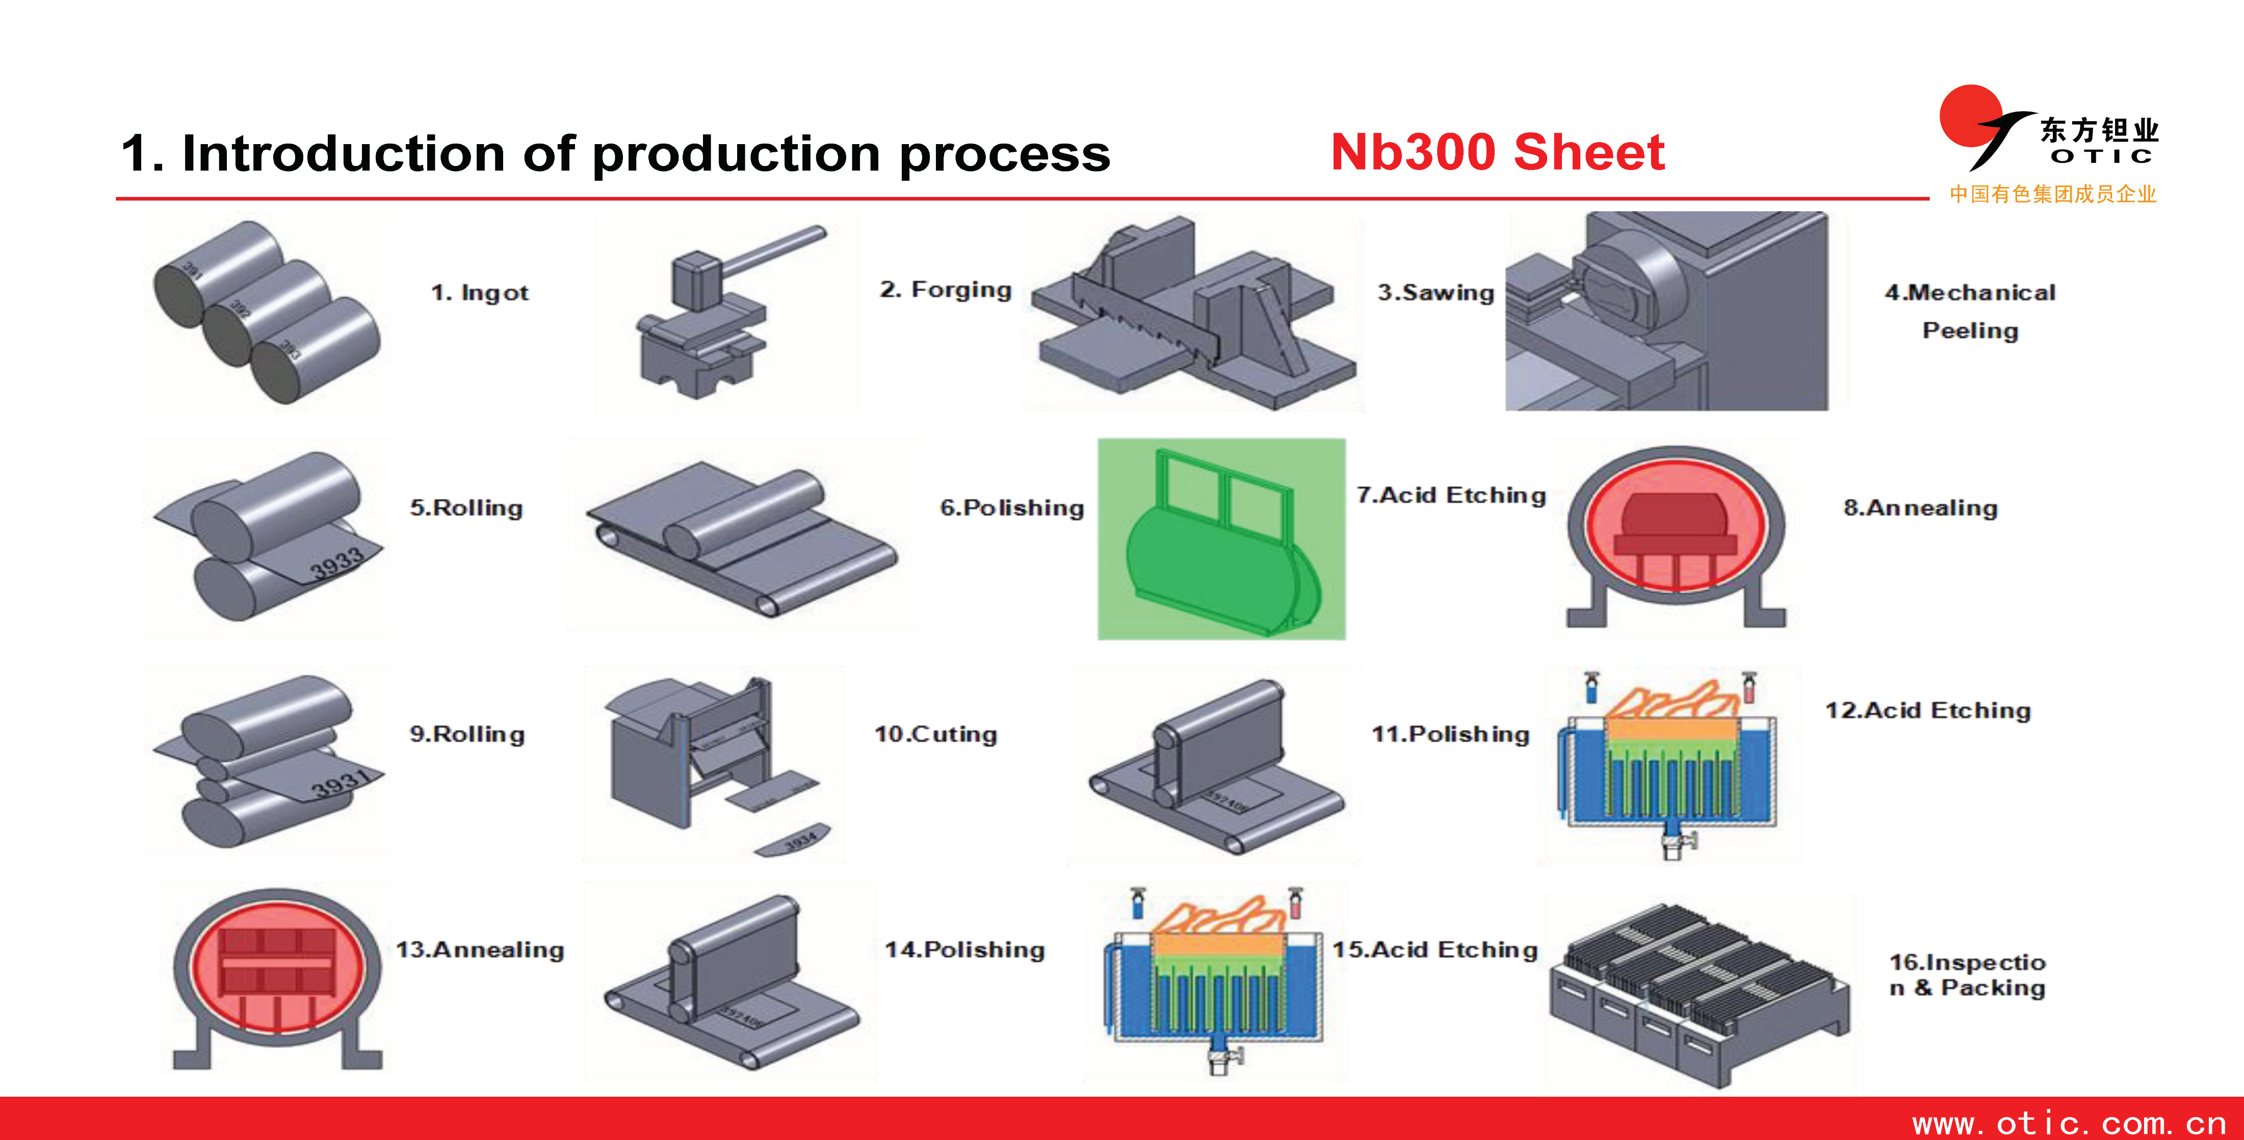
Nb Sheets Fabrication at OTIC

Slide 21
1884/85 The Cornell Brake-throug
First great success
A pair of 1.5 GHz cavities developed and tested at Cornell: 4.5 MV/m Chosen for CEBAF at TJNAF for a nominal E_{acc} = 5 MV/m
330 Cavities produced in industry but treated and tested at TJNAF

Slide 22
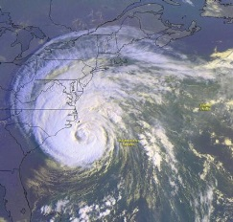
A great success for CEBAF
Lost Time Totals June'97-May'01
Excellent reliability of SRF technology
Moderate field > 5 MV/m
The only warm-up for the vvvIsabelle Hurricane
CEBAF
1.5 % in FY 01
0.0 % in FY 01

Slide 23
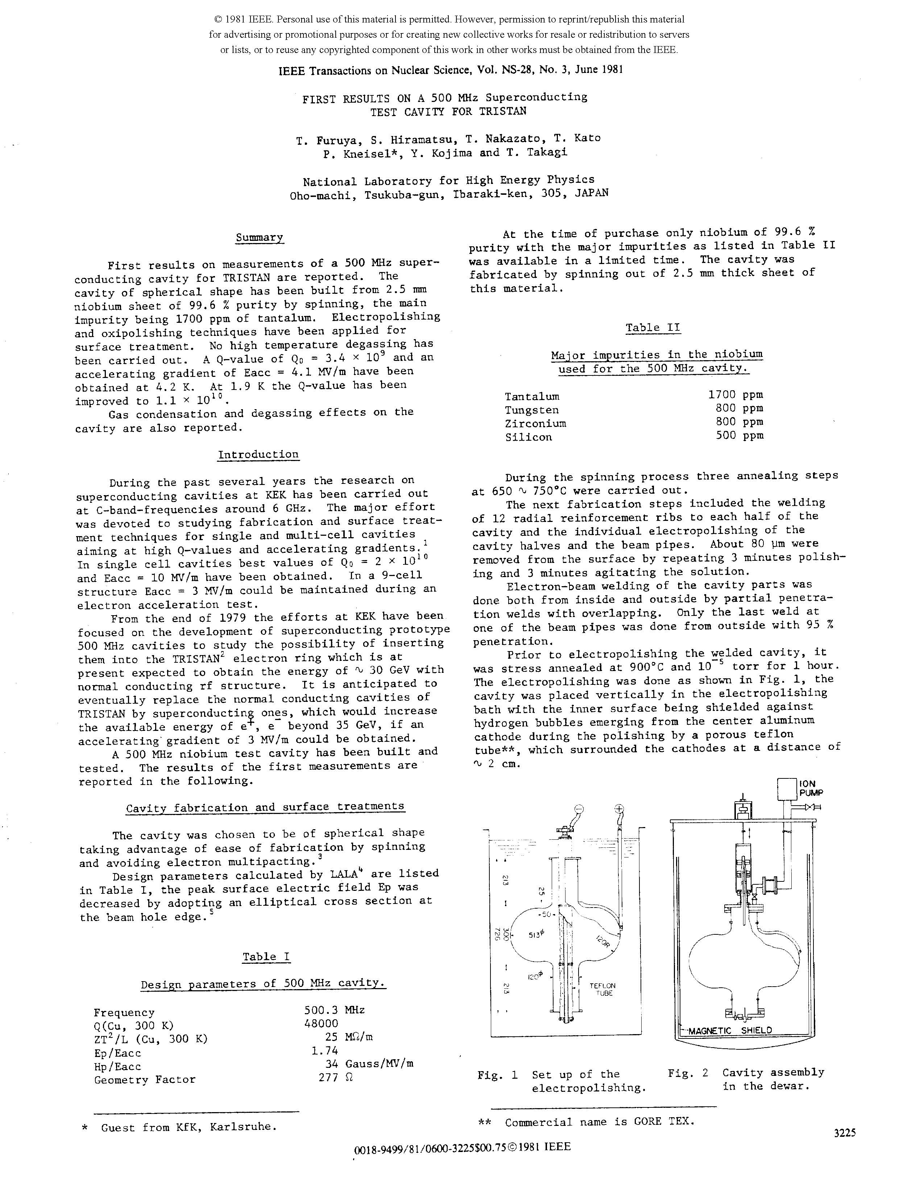
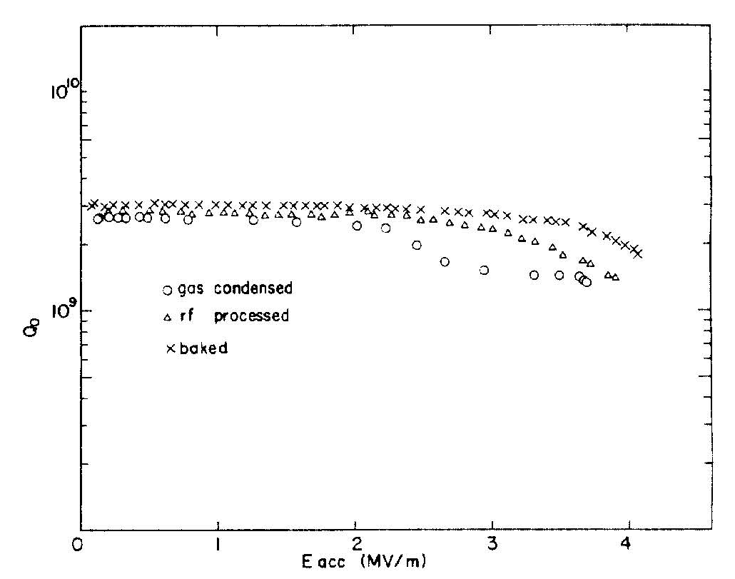
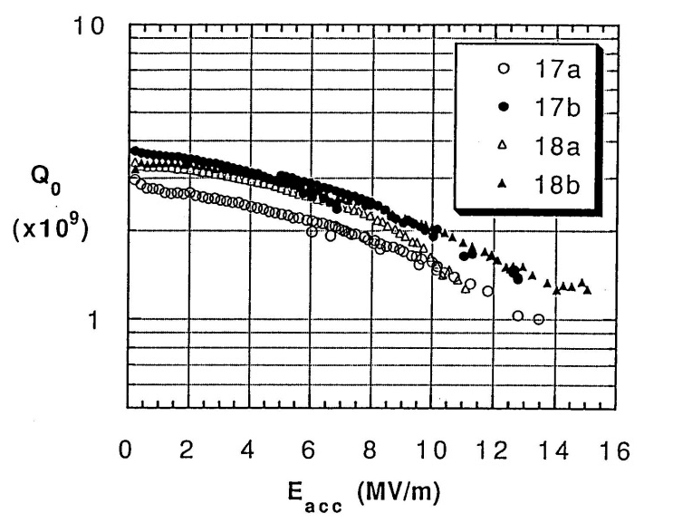
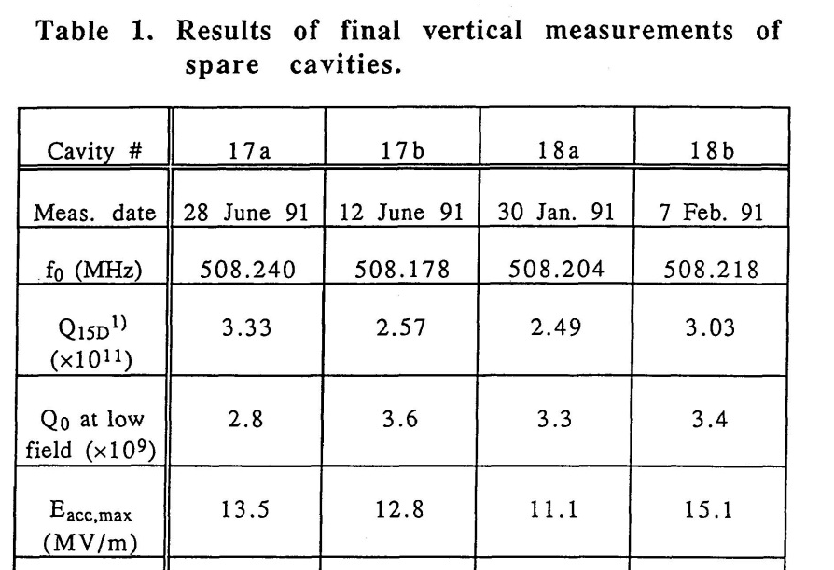

TRISTAN SRF from KEK to MHI
KEK 1981
1995

Slide 24
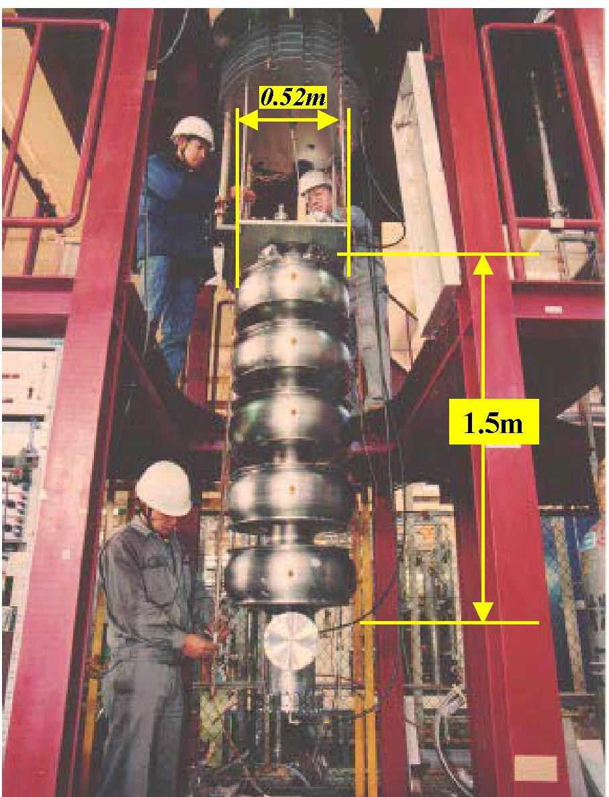
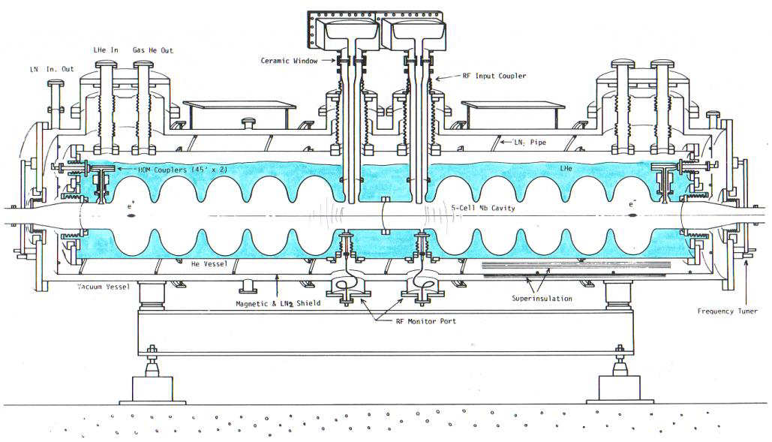
First Industrial Production in Japan (1988 – 1995)
The first mass-production of SRF Cavities in the world
SRF Cavity for TRISTAN at KEK
Bulk-Nb - 508MHz - 5-Cell Cavity
32 SRF cavities were fabricated by Mitsubishi and operated in TRISTAN

Slide 25
LEP-2 as the first QA/QC Industrialization
Complete inftrastructure set up at CERN collecting resources and competences:
  Compelete chemical plant
  Big (6-8 m³) Electron Beam Welding machine cryo-pomped
  Availability of the main CERN mechanical workshop with new machinary
  Special support from scientists of 3 member Countries (France, Germany and Italy) to prepare in parallel a QA/QC based industrialization
Moderate results with bulk Niobium but
Oustandig resuts with the new CERN tecnology of Nb coating of Cu by magnetron sputtering
All aquipments and receipts trasferred to 3 industryies for mass production. QA/QC procedures and EDMS included

Slide 26
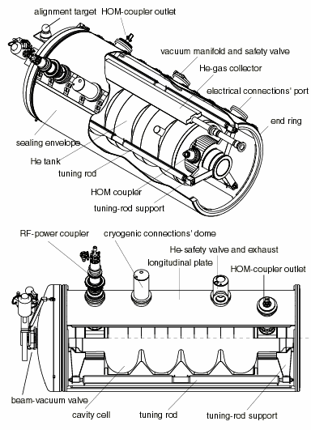
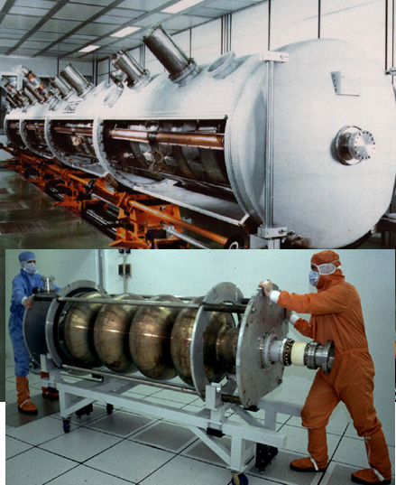
LEP 2 Cavities and Modules
4-cell, 352 MHz,
L_{act}=1.7 m
32 bulk niobium
  Limited to 5 MV/m
  Poor material and inclusions
256 Nb sputtered on Cu
  Magnetron-sputtering of Nb on Cu
  Completely done by industry
  Moderate Q-slope at 350 MHz
  Field emission above 8 MV/m
  Average E_{acc} = 7.8 MV/m – cryo-limited

Slide 27
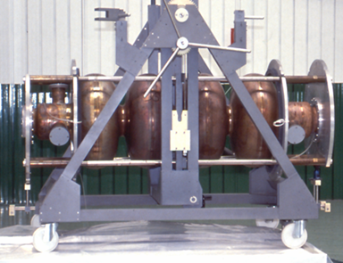
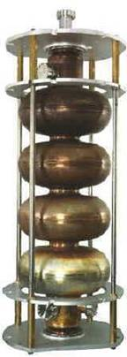
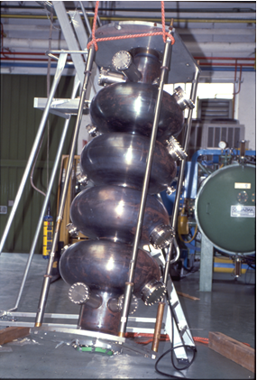
LEP-2 Cavities in Industry

Slide 28
A great success for LEP II
Accelerating Field Evolution with time
Final energy reach
limited by
allowable cryogenic power
from G. Geschonke’s Poster for the ITRP visit to DESY
100 GeV: 3500MV
Mean Nb/Cu
6.9 MV/m
96 GeV:
Mean Nb/Cu
6.1 MV/m
104 GeV: 3666MV
Mean Nb/Cu
7.5 MV/m
design

Slide 29
Contents
Introduction to QA/QC and EDMS
Large Projects and Contribution from Industry
From TESLA to Industrial Production for XFEL
Results and Conclusions

Slide 30
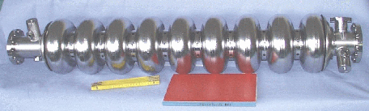
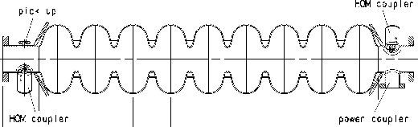
First Steps of the TESLA Game
Major contributions from: CERN, Cornell, DESY, CEA-Saclay, INFN-LASA
9-cell, 1.3 GHz
TESLA cavity parameters
R/Q | 1036 | W
E_{peak}/E_{acc} | 2.0
B_{peak}/E_{acc} | 4.26 | mT/(MV/m)
Δf/Δl | 315 | kHz/mm
K_{Lorentz} | ≈ -1 | Hz/(MV/m)²

Slide 31
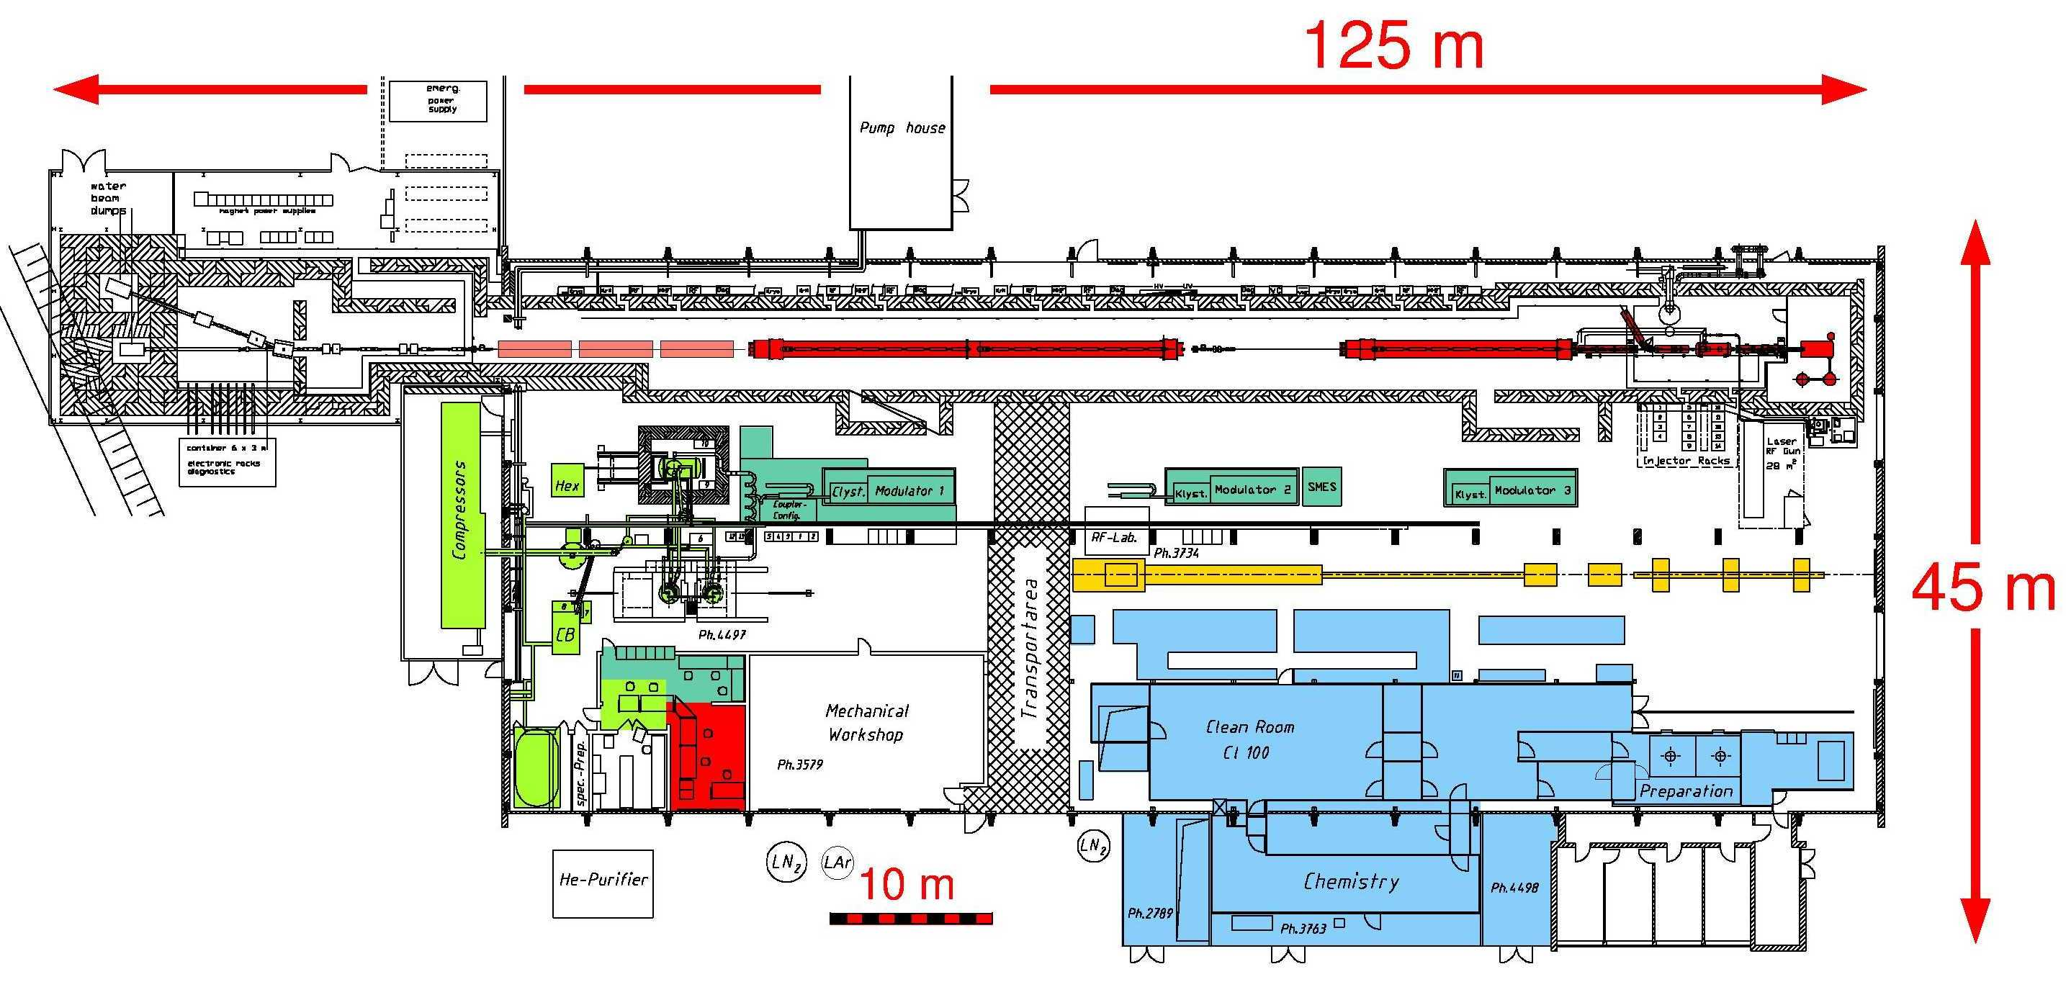
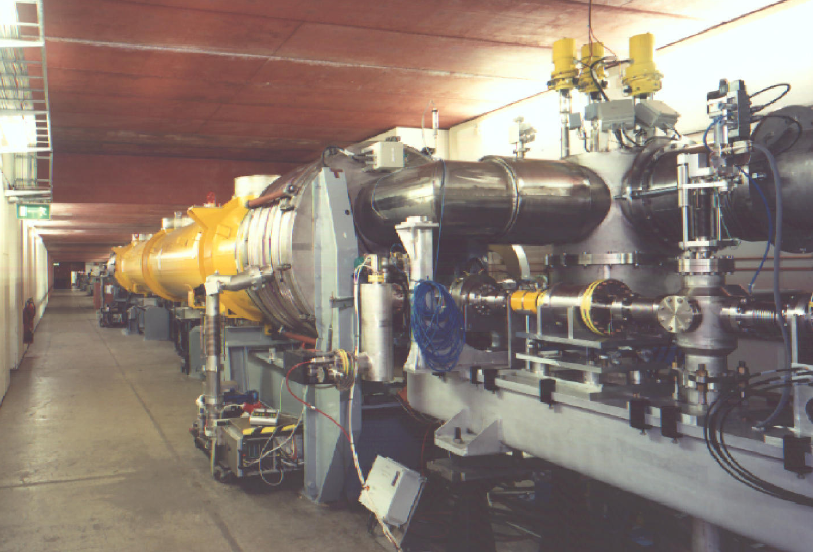
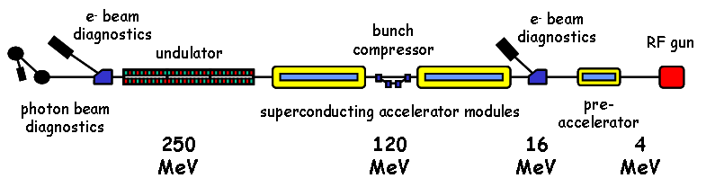
TTF: a new infrastructure at DESY
TTF as operated for SASE FEL

Slide 32
The way to improve SRF Performances
In parallel with the machine design, all major TESLA sub-components have been conceived, designed and protopyped for TTF.
Most of the process has been performed in strict collabotration with industry.
Concerning SRF cavities, all the technology already mastered by industry have been further improved with the help of Labs experience. All the mechanical fabrication done in industry.
The acquisition of an EB Welding machine at DESY had the strong opposition by the Director Biorn Wiik
The matured experience on the Niobium welding has been transferred directly from Labs to industry
Clean room operation and special surface treatments were developped at the DESY infrastructure and promptly tranferred to Industry

Slide 33
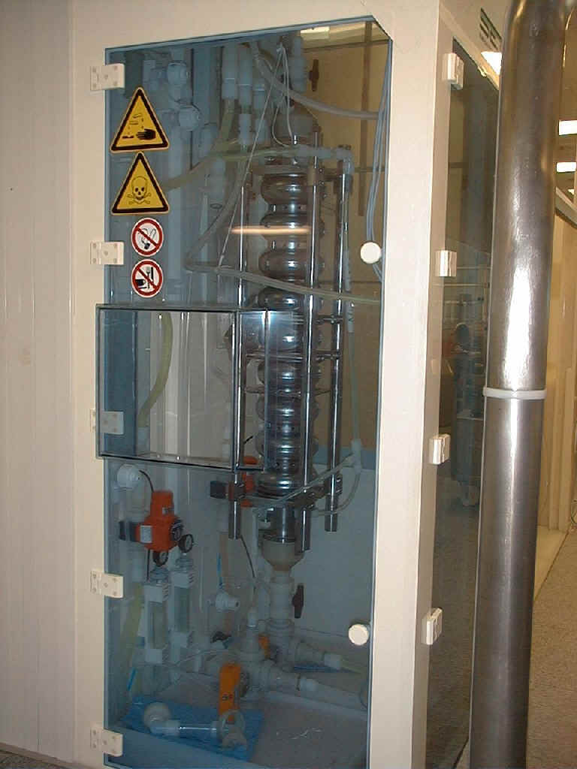
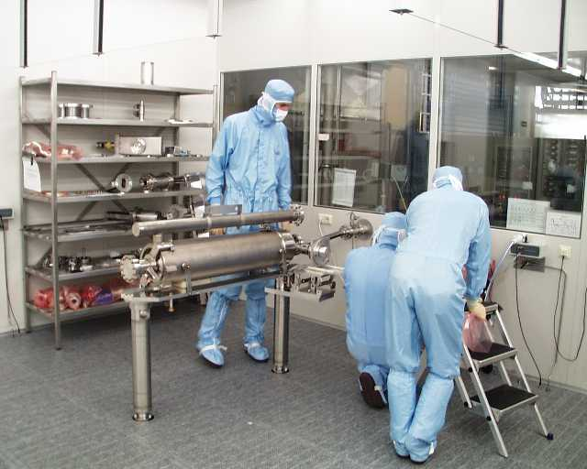
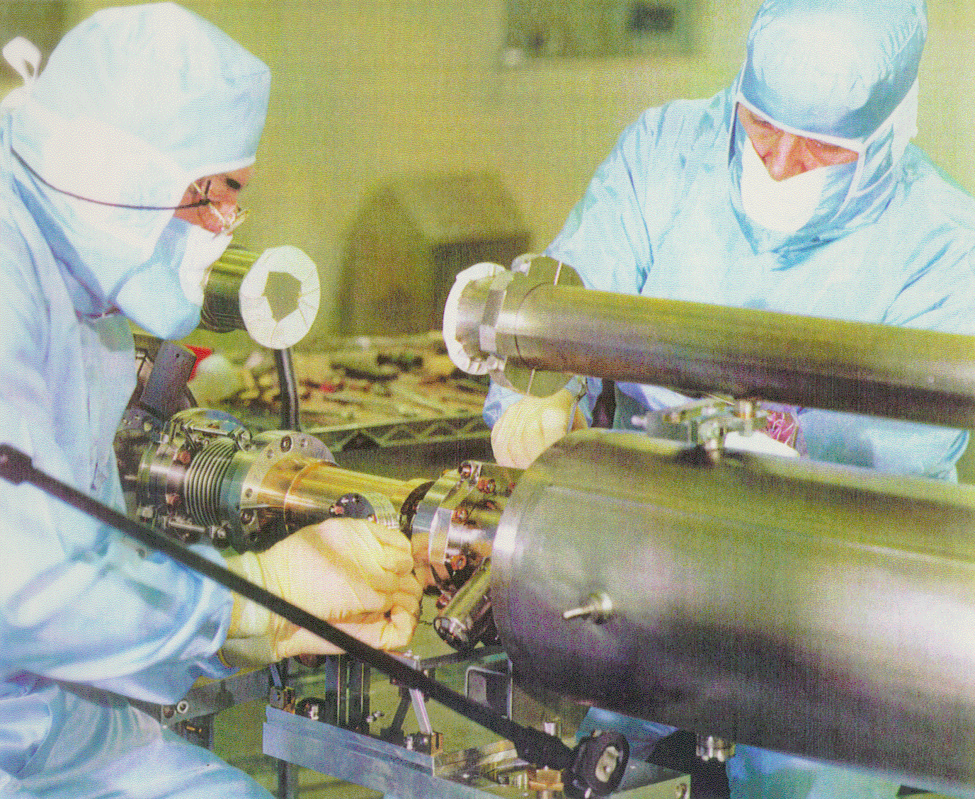
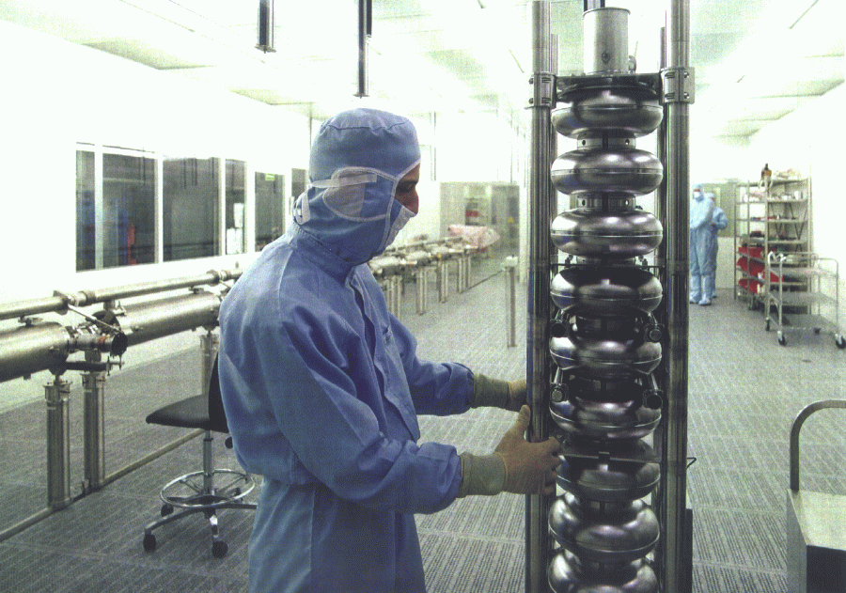
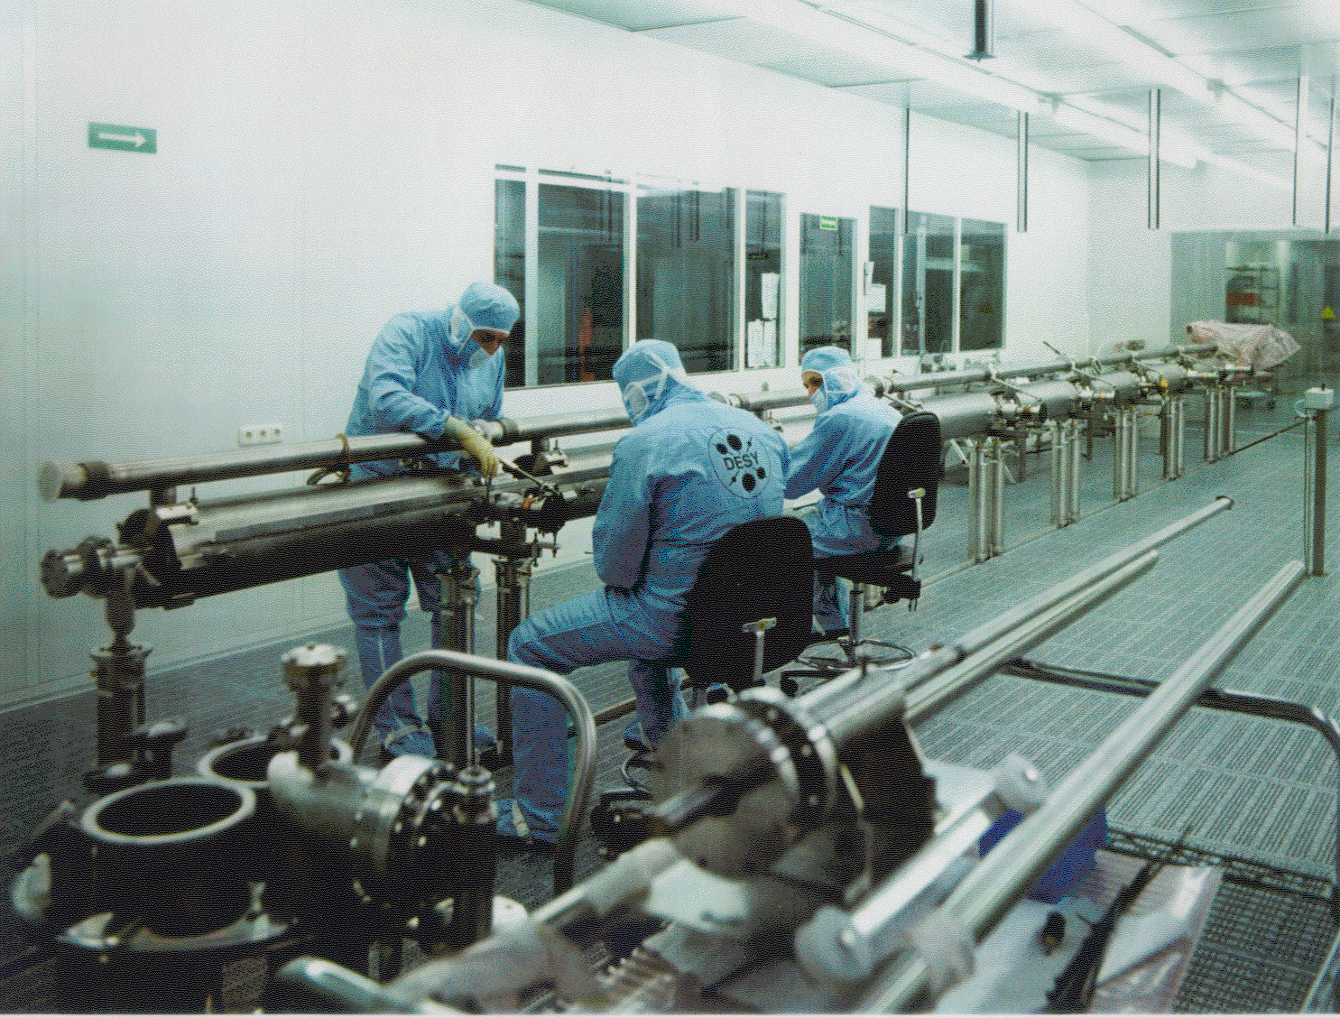
Preparation of TESLA Cavities

Slide 34
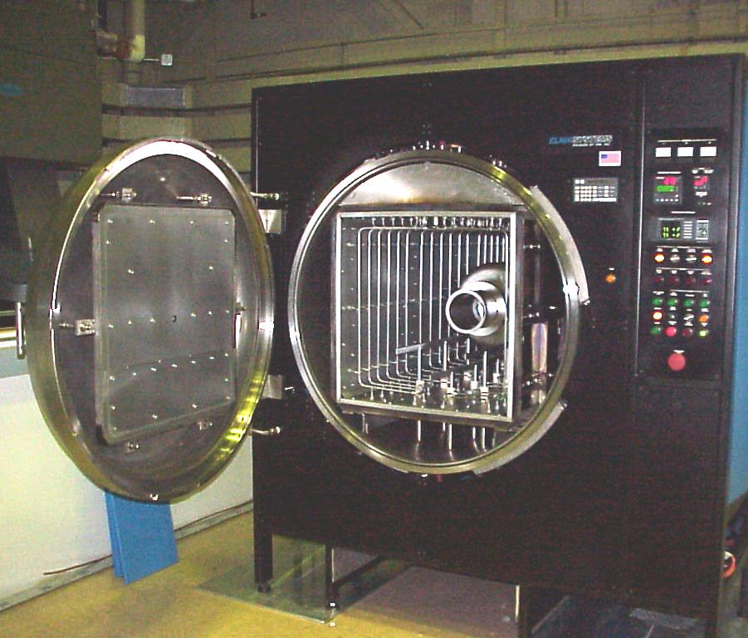
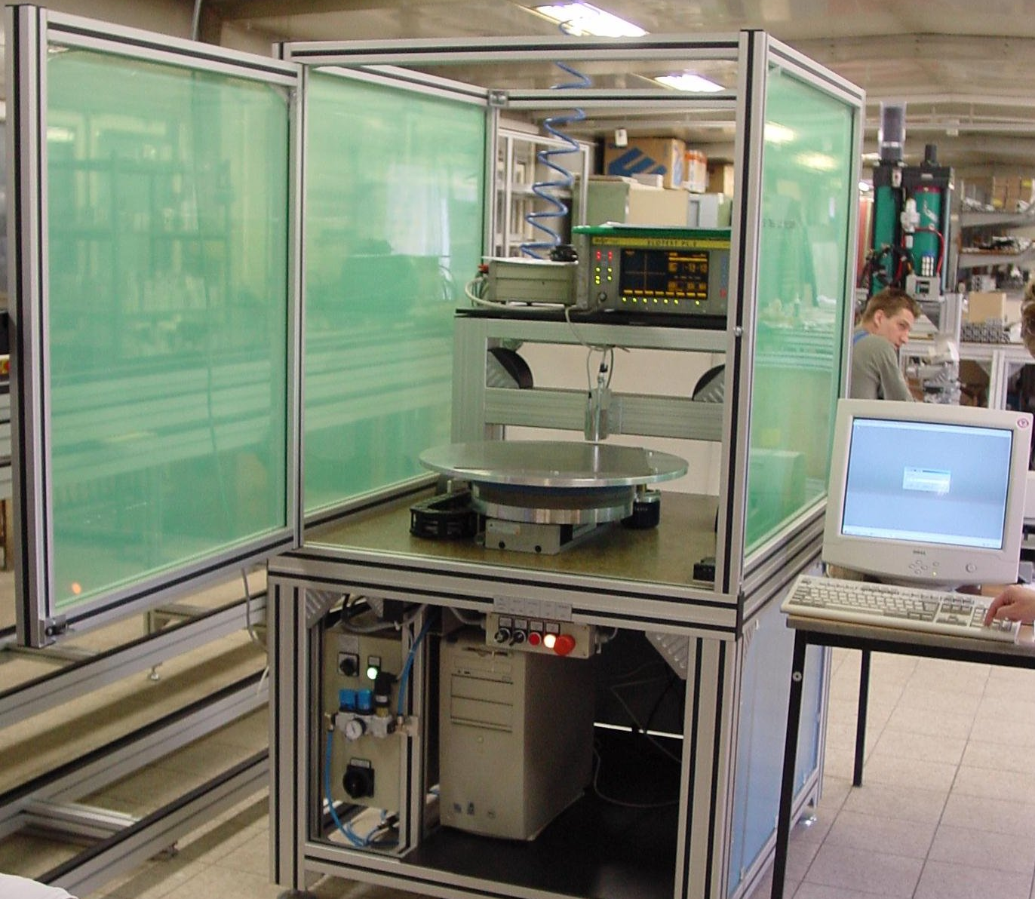
HT Furnace and Eddy Current Scanner
High Temp. Furnace to improve RRR reproduced at DESY from Jlab (1400C)
Eddy Current Scanner of Nb Sheets to detect foreign inclusions

Slide 35
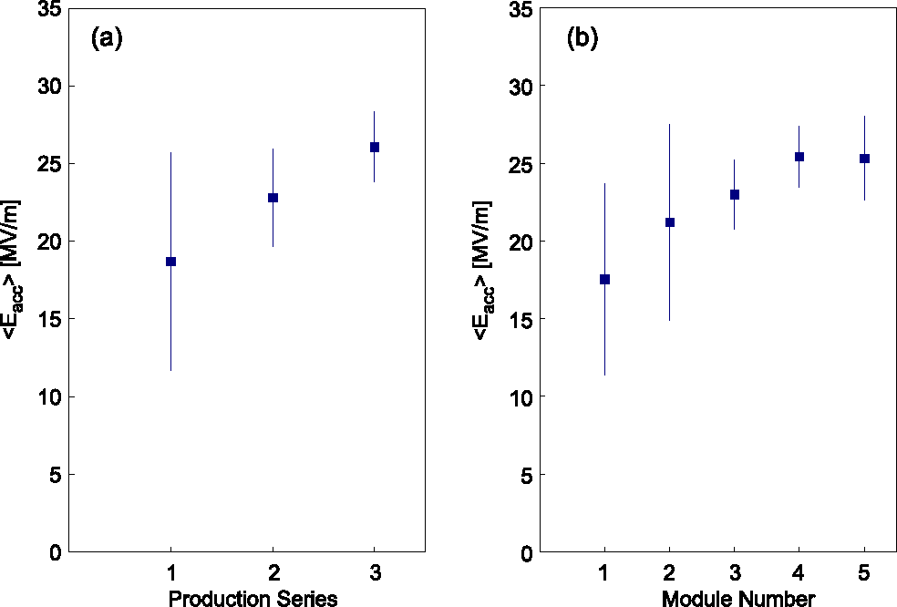
Learning Curve with BCP
BCP = Buffered Chemical Polishing
3 cavity productions from 4 European industries: Accel, Cerca, Dornier, Zanon
4th production of 30 cavities to define Quality Control for Industrialization
<E_{acc}> @ Q₀ ≥ 10¹⁰
<E_{acc}> @ Q₀ ≥ 10¹⁰
<2001>
<1999>
<1997>
Improved welding
Niobium quality control
Module performance in the TTF LINAC

Slide 36
Two major contributions to rise the limits
In-Situ Baking (120-140 °C) from CEA-Saclay (Bernard Visentin)
  Cures Q-drop at High Field
    Formation of a uniform Nb₂O₅, dielectric, layer on the surface
      Reduction of the normal conducting dissipation from NbO and NbO₂
    Diffusion of the high oxygen concentration in the superconducting layer
      Better BCS performances, i.e. lower surface resistance
Electro-polishing (EP) from KEK (Kenji Saito)
  Improves field emission and maximum field
    Much smoother surface, less local field enhancement
      Better cleaning with high pressure water rinsing
      Q-drop cure by in-situ baking more efffective
      High temperature (1400 °C) heat treatment avoidable

Slide 37
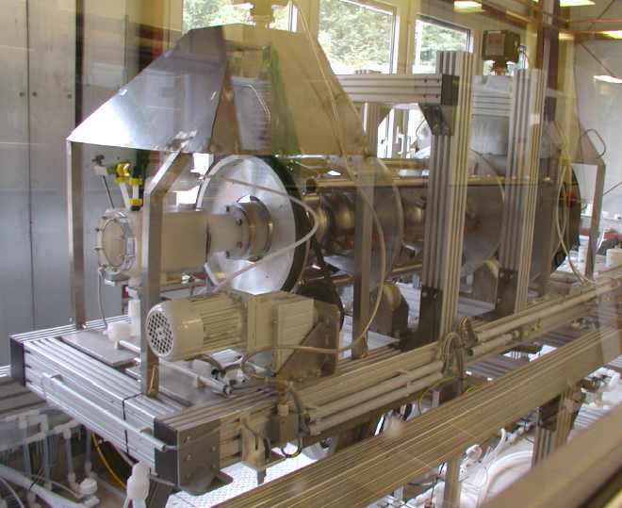
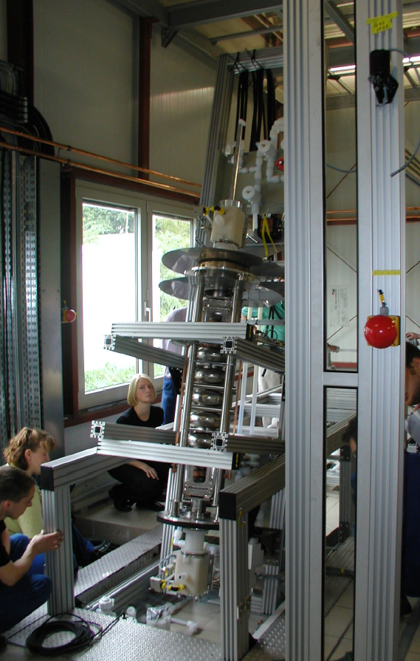
EP at DESY from the KEK Experience

Slide 38
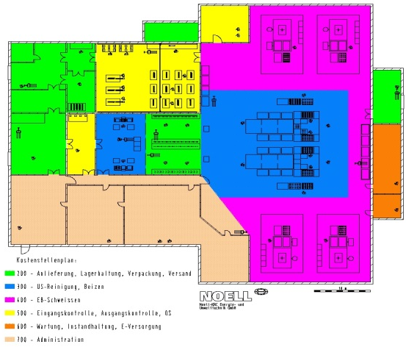
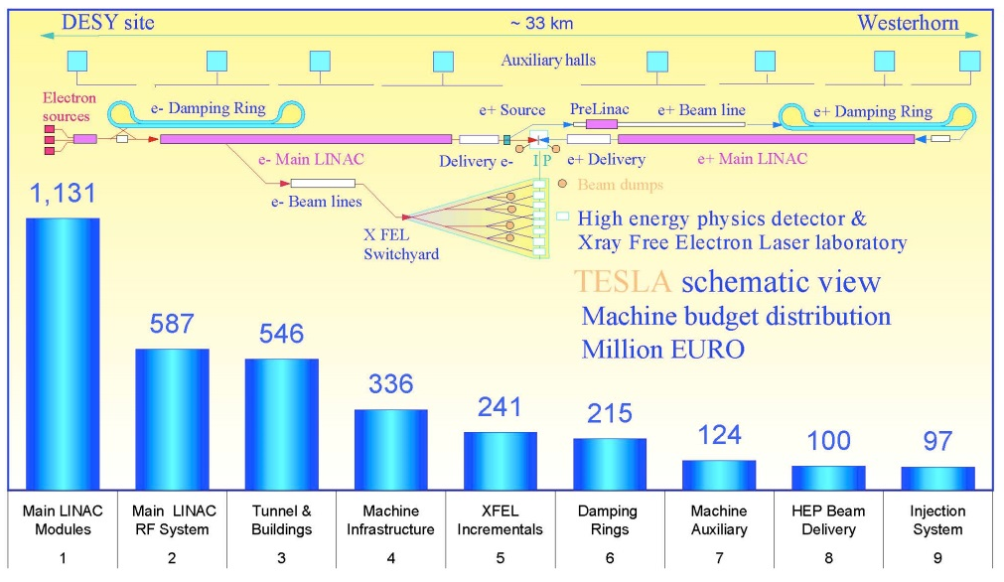
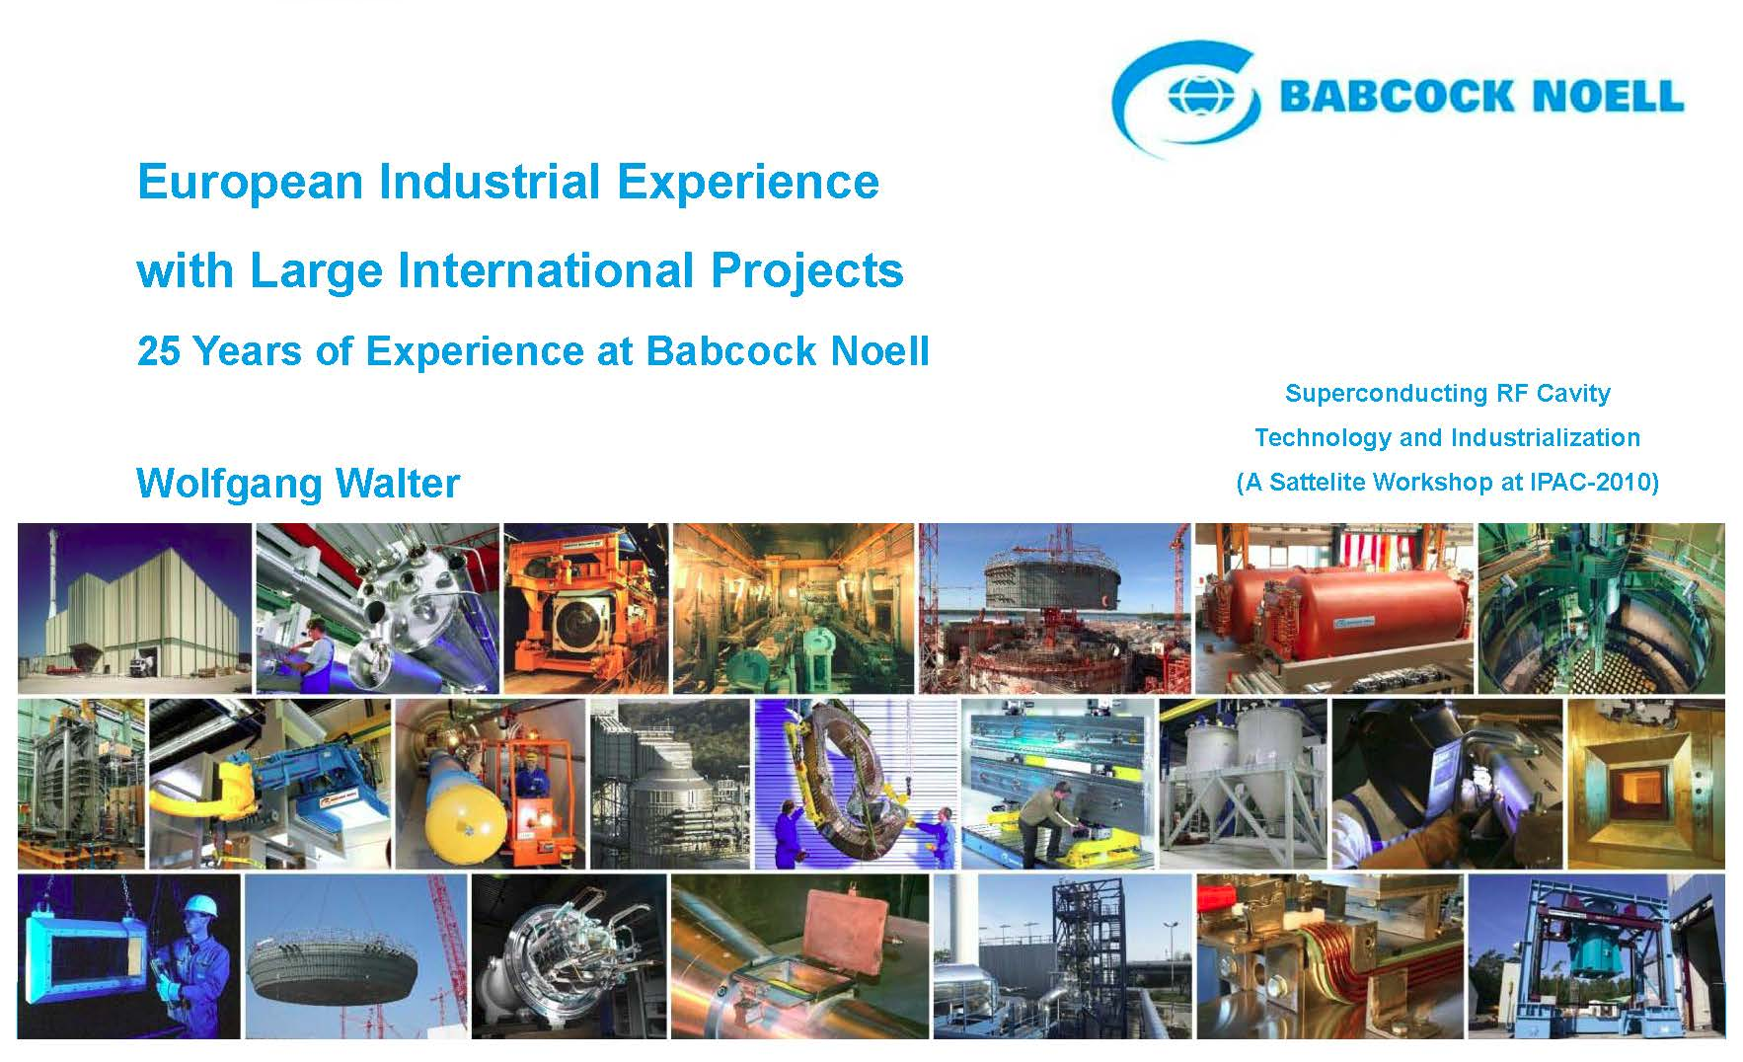
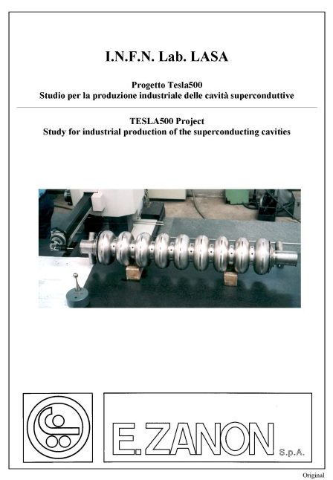
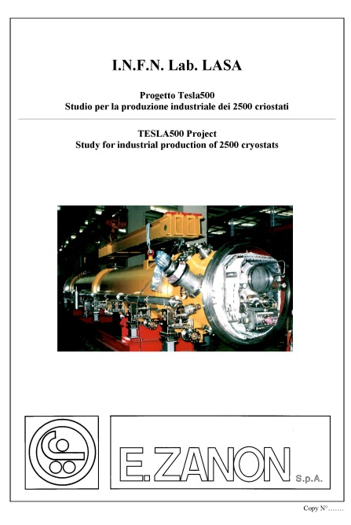
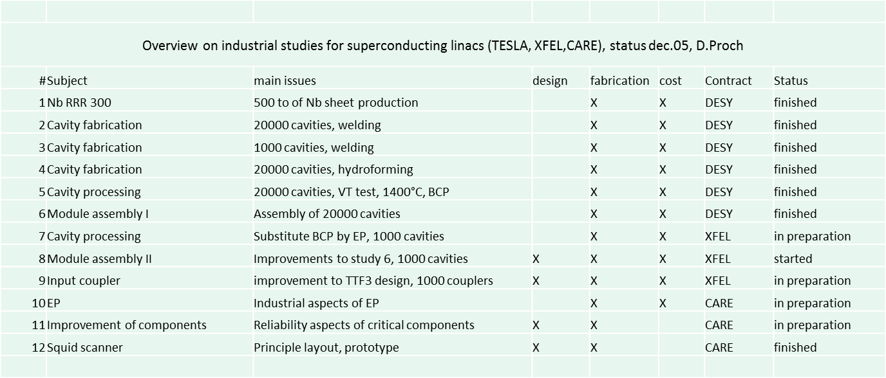
Industrial Studies for TESLA TDR & E-XFEL

Slide 39
European XFEL Cavity Production - 1
At the end of the long prequalification process (TTF, FLASH, ILC,…)
Ettore Zanon, EZ & Research Instruments, RI
were contracted at the end 2010 to produce each
8 Cavities for infrastructure rump/up and qualification
  4 Dummy CVs (DCV), 4 Reference CVs (RCV)
280 XFEL type series cavities (first 8 are PCV)
12 ILC HiGrade cavities
Additional 120 cavities allocated end 2012 to each companiy
Nb & NbTi supplied by DESY
Production precisely following detailed specifications which also include the exact definition of infrastructure to be used (build to print)
Final treatment after main EP: final EP for RI / flash BCP for EZ

Slide 40
European XFEL Cavity Production - 2
No performance guaranty by the vendors, i.e. the risk of unexpected low gradient or field emission is taken over by XFEL/DESY (responsibility for re-treatment).
Goal: average usable XFEL gradient 23.6 MV/m at Q₀=1x10¹⁰, X-Rays <1x10⁻²mGy/min)
First series cavities (PCV) to be delivered end 2012 – begin 2013
All cavities to be delivered till end 2014 – begin 2015
Delivery rate: about 8 CVs/week (4/each vendor)
Supervision of the CV production: DESY & INFN/LASA

Slide 41
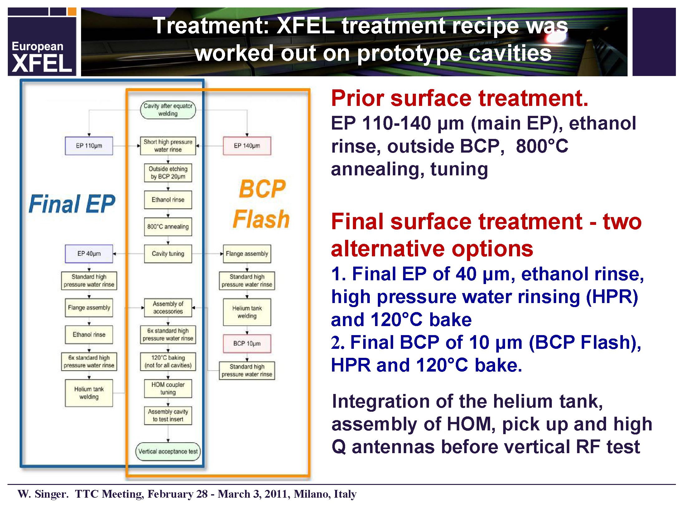
Treatments as from Experience on Prototype

Slide 42





Engineering Data Management System
Information generator
Information user
Local Files
(CAD User)
Change
generated
Looking for
Read
Leave a comment
Data
EDM-System
EDMS
Managed Files
Databank
(Oracle)
Application of EDMS for cavity fabrication. Aim: - paper less documentation, up to date information, tracking the trends.

Slide 43


Involvement of cavity producer
DESY
Producer
DESY
create the work description (in EDMS).
create the protocol template (in EDMS).
message to Producer.
log in EDMS.
open the Inbox.
read work description
produce accordingly cavity part
fill out the template of protocol.
submit the protocol to release -life-cycle.
check and release the protocol.
message to Producer (in EDMS).

Slide 44









Fabrication, EDMS & Cavity Data Bank
Fabrication
EDMS
Cavity-DB
Phys. Part
Files
Inspection sheet
Inspection sheets for quality management
Fabrication structure. Subassembly parts related. Procedure related
Statistical analysis
All XFEL SC cavity documents (specifications, protocols, PED data etc.)
recorded in EDMS. RI and E. Zanon have an access (to relevant data only)

Slide 45

QC of Niobium Shsets via EDMS
More than 15000 niobium sheets for cell fabrication ordered and delivered to DESY
A fully EDMS controlled process was developed by DESY, with a QC team, in order to fulfill all requirements for PED, QA and logistics
The process is connected to the EDMS at three work team stations:
• Team “Labelling” for incoming inspection, certificate examination and sheet labelling
• Team “Scanning” for visual examination and eddy current scanning
• Team “Stamping” for permanent marking of the sheets and preparation for its supply to the cavity producer.
From MOP035 @ SRF2023

Slide 46

Cavity Fabrication and EDMS
XFEL cavities are part of a pressure equipment according to PED regulations.
Main requirement is to ensure full traceability of the finished cavity through the whole fabrication history back to the raw material and its inspection certificates.
Because of the non conventional production, it was decided to perform an external QC procedure in addition to the QA at the manufacturer. Namely:
  • fast flow of QM documents to DESY.
  • structured and well organized repository of documents.
  • an acceptance procedure for checking the quality and releasing the cavity for treatment processes after fabrication.
From MOP035 @ SRF2023

Slide 47

Cavity Document Structure in the EDMS
The product breakdown structure (PBS) of the cavity for XFEL is the representation for each part of the cavity and the cavity itself
With the receipt of QM all the cavity documents are generated by the supplier and put in the EDMS:
• physical parts are created, and the complete structure of each cavity is built step by step following the fabrication progress
• QM documents are created and directly linked to the physical part.
From MOP035 @ SRF2023

Slide 48

Some details: Dumb-bell fabrication steps
1) Mechanical and Visual Checks,
2. Check of frequency,
3. Calculation of trimming,
4. “1.trimming“
5. Mechanical and Visual Checks,
6. Check of frequency,
7. Decision :
      “accepted to use for a cavity“ or
      “trimming necessary“ or
  ➔ If decision „Accepted to use for a cavity
7. Calculation of position in cavity and prognoses of cavity length and frequency after welding,
  ➔ If decison “trimming necessary”
8. Calculation of trimming
9. “trimming“
10. Mechanical and Visual Checks,
11. Check of frequency,
12. Decision :
      “accepted to use for a cavity“ or
      “trimming necessary“ or
  ➔ If decision “Accepted to use for a cavity”
  ➔ If decision “trimming necessary”
13. Calculation of trimming,
14. “trimming“
15. Mechanical and Visual Checks,
16. Check of frequency
17. Decision :
      “accepted to use for a cavity“
      “Bad quality, don’t use this dumb-bell for a cavity“
  ➔ If Decision „Accepted to use for a cavity

Slide 49

Acceptance Procedure before Treatments
Once the cavity fabrication is completed, a contractual hold point is reached, and the customer performs a release procedure for acceptance.
The procedure is completely supported and processed by using the EDMS.
Based on QM documentation the producer ask the final document
All documents for the QC are already collected in the EDMS
The inspection report Is delivered to the supplier via EDMS
From MOP035 @ SRF2023

Slide 50






PED Activities and TUEV Control
Test piece (TP) is composed by 2 cell with helium vessel, without end groups, representing all pressure bearing parts and welds. It is built using exactly the same manufacturing methods and welding parameters that will be later used for production. Two EBW machines/company. Then two test pieces had been built.

Slide 51

Test Piece for PED Destructive Test
❖ Test piece (TP) is composed by 2 cell with helium vessel, representing all pressure bearing parts and welding seams.
❖ It is built using the same welding parameters that will be used in the series production.
❖ Two EBW machines/company. Consequently two test pieces had been built per company and destructively tested by TUEV NORD.
❖ Previously DESY has done similar tests on real cavities and gave the feed back to companies
From MOP048 @ SRF2023

Slide 52
Major Infrastructures at EZ & RI
2 EBW (Electron Beam Welding) plants, equipped with cryo-pumps
ISO 7 and ISO 4 Clean Rooms with cleaning and rinsing facility
UPW (Ultra Pure Water - 18 MΩ·cm) production system (>3000 l/h)
HPR (High Pressure Rinsing – 100 bar) apparatus
800 °C and 120 °C ovens operating with High Vacuum.
Cavity Tuning Machine, CTM, provided by DESY
RF tests set up (for HalfCell, DumbBells and EndGroups), provided by DESY
US (Ultra Sonic) cleaning baths
Complete chemical processing plants (EP, BCP or both)
Cavity internal visual inspection systems

Slide 53

Equipment supplied by DESY to RI & EZ
Tuning Machine

Slide 54

Equipment supplied by DESY to RI & EZ
HAZEMEMA
Equipment for RF measurement of half cells, dumb bells and end groups called HAZEMEMA
All equipments Provided with CE certification according EU regulations

Slide 55



Cavity Infrastructure Layout at EZ
Building layout: clean rooms ISO10, ISO7, ISO4, US and BCP treatment, 120ºC baking, 800ºC oven, EBW, tuning machine etc.

Slide 56




Examples of EZ Infrastructure (courtesy of EZ)
New EBW machine
New oven for 800ºC treatment
Borescope for optical inspection

Slide 57

Deep Defect Analysis Capability @ Labs - 1
Topographical defects at the welding seams

Slide 58

Deep Defect Analysis Capability @ Labs - 2
Etching pits: EBSD with strain maps via grain reference orientation deviation (GROD)

Slide 59

Deep Defect Analysis Capability @ Labs - 3
Dangerous surface defects generated by bad HPR (Hihg Pressure Water rinsing)

Slide 60
Contents
Introduction to QA/QC and EDMS
Large Projects and Contribution from Industry
From TESLA to Industrial Production for XFEL
Results and Conclusions

Slide 61
Final performance: Eacc
Total after 313 retreatments performed on 237 of the 831 cavities
Before:
E max 31.4 ± 6.8 [MV/m]
(RI): E max 33.0 ± 6.5 [MV/m])
(EZ): E max 29.8 ± 6.6 [MV/m])
After:
E max 33.0 ± 4.8 [MV/m]
(RI): E max 34.7 ± 4.4 [MV/m])
(EZ): E max 31.5 ± 4.9 [MV/m])
Before:
E usable 27.7 ± 7.2 [MV/m]
(RI): E usable 29.0 ± 7.3 [MV/m])
(EZ): E usable 26.4 ± 6.6 [MV/m])
After:
E usable 29.8 ± 5.1 [MV/m]
(RI): E usable 31.2 ± 5.2 [MV/m])
(EZ): E usable 28.6 ± 4.8 [MV/m])

Slide 62
Final performance: Q0
Total after 313 retreatments performed on 237 of the 831 cavities
Before :
Q0 @ 4 MV/m 2.15 ± 0.32 [1.10¹⁰]
(RI): Q0 @ 4 MV/m 2.11 ± 0.32 [1.10¹⁰])
(EZ): Q0 @ 4 MV/m 2.18 ± 0.32 [1.10¹⁰])
After:
Q0 @ 4 MV/m 2.23 ± 0.34 [1.10¹⁰]
(RI): Q0 @ 4 MV/m 2.21 ± 0.34 [1.10¹⁰])
(EZ): Q0 @ 4 MV/m 2.26 ± 0.33 [1.10¹⁰])
Before:
Q0 @ 23.6 MV/m 1.31 ± 0.26 [1.10¹⁰]
(RI): Q0 @ 23.6 MV/m 1.29 ± 0.24 [1.10¹⁰])
(EZ): Q0 @ 23.6 MV/m 1.34 ± 0.28 [1.10¹⁰])
After:
Q0 @ 23.6 MV/m 1.37 ± 0.25 [1.10¹⁰]
(RI): Q0 @ 23.6 MV/m 1.34 ± 0.22 [1.10¹⁰])
(EZ): Q0 @ 23.6 MV/m 1.41 ± 0.26 [1.10¹⁰])

Slide 63

E-XFEL: Usable Installed Voltage

Slide 64
Lessons Learned from EuXFEL production
Industry, once trained, did as well as the labs behind.
Results obtained were very close to the best available 13 years before, at the time of the ITRP, but much more stable
Results depend on: the technology applied + QA/QC & EDMS
The complete cycle in industry improves the yield
A second treatment was crucial to improve the yield
HPR was usually sufficient, flash BCP required in few cases, EP excluded becaude of the He tank
The possibility of a second treatment improves the yield, both for high field and field emission onset

Slide 65
A Few General Concepts to be Followed
The success of a new large research infrastructure must have a number of obvious but crucial characteristics:
  Respect and deliver the design specifications
  Service and maintenece time limited and precisely scheduled
  Availability very close to 100%
An accelerator based user facility asks the accelerator to be designed and built fullfilling all the requirements specified above. Namely:
  All components must be sufficiently overdesigned to garantee a suffuciently long MTBF (Mean Time Between Failures)
  A perfect balance must be calculated between redundancy and MTBF + MTTR (Mean Time To Repair) to limit the number of unscheduled shutdown
  The production of each component must follow the best practice, being manufactured by industry stricly following the QA/QC practice
  An efficient and complete EDMS system must be on place since the beginning

Slide 66
Goog practices
Use as much as possible components that are standard and produced by industry. Always ask and verify all the available documentation. When designing balance redundany and MTBF.
Develop the new components in dedicated infrastructures designed and built, possibly with industry, to be adequate to the task. The number and expertise of people is crucial.
For special components start as soon as possible the selection of possible manufacturers and include them in the R&D process.
Select an EDMS system and use it extensively from the beginnig
Train personal to the QA/QC paractices and to the use of EDMS

Slide 67


Thank you for your attention

