Slide 1
KM3NeT detection units calibration
V. Kulikovskiy on behalf of KM3

Slide 2
Objectives
Demonstrate KM3NeT DAQ system.
Optical and copper cablings, SFP-based network,
Mini-rack build for DAQ (rack choice, power, installation advices).
Demonstrate KM3NeT (mini) detector operation.
Runs planning.
Data analysis.
Calibrate detection unit.
Time calibration – skew measurement with oscilloscope.
Time calibration with laser source – data analysis.
Automated mass PMT high-voltage tuning: runs planning and data analysis.
Instrumentation check:
Piezo and hydrophone background and signal measurement in non-audible range (30KHz).
Tilt & Compass check.

Slide 3
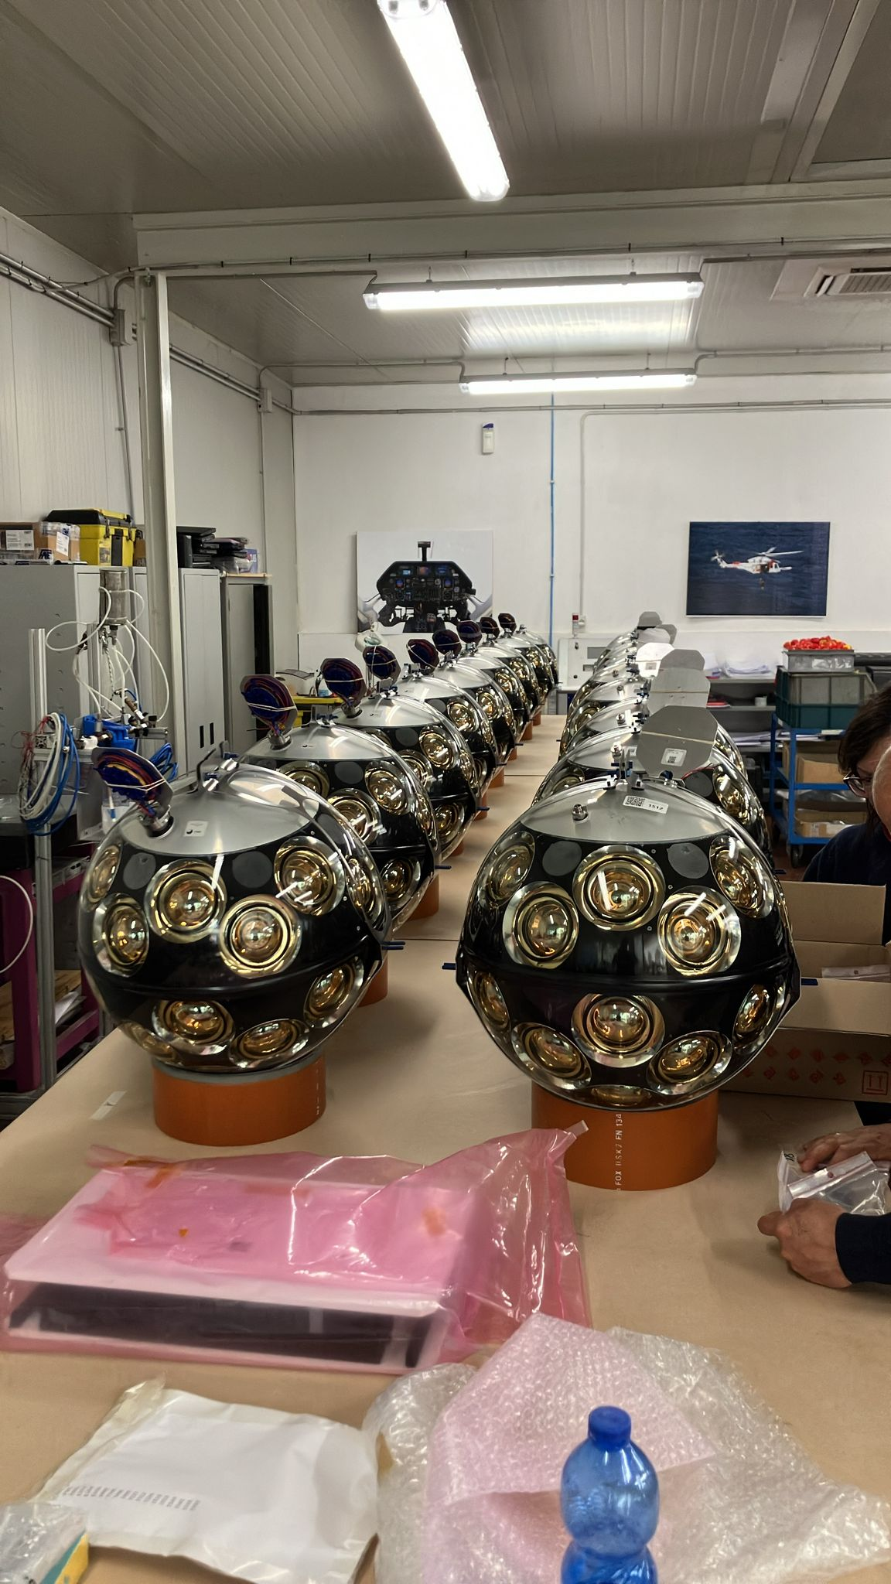
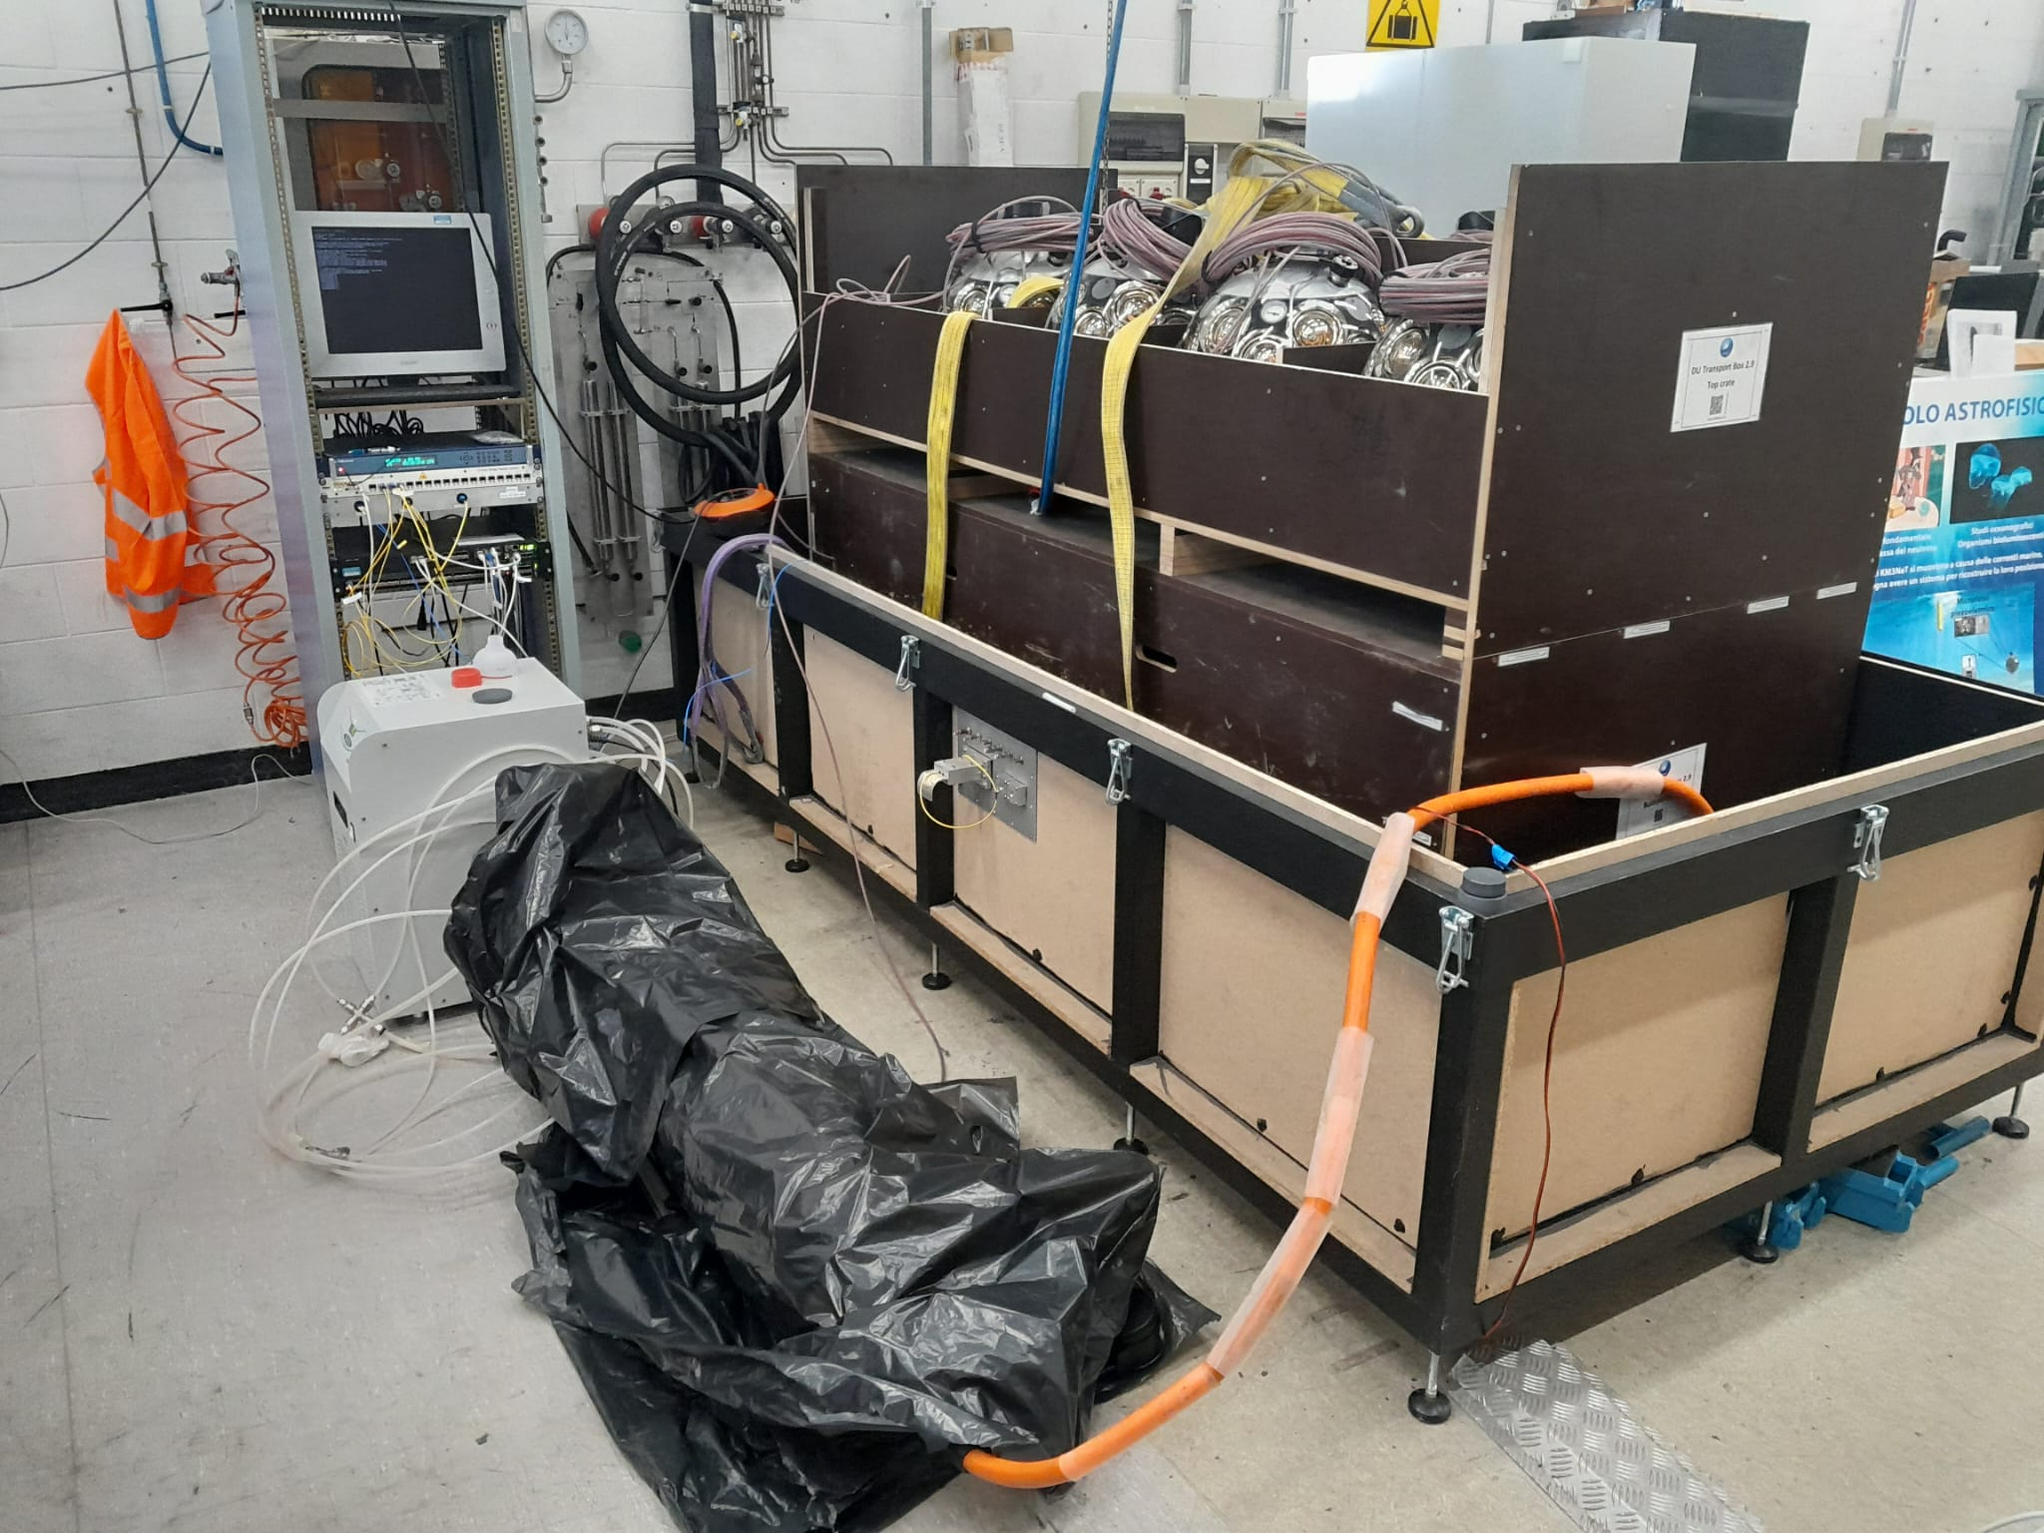
Setup
Detection Unit:
18 optical modules
31 PMTs
Piezo acoustic sensor
FPGA with White Rabbit core (time synchronisation <1ns)
Tilt & Compass
LED emitter
Hydrophone or Hydrophone + Acoustic emitter
Test station
Mini shore station fully operating DU in the exactly same way as a KM3NeT detector (runs planning, raw and triggered data acquisition, calibration devices control etc).
Picosecond laser source.
Acoustic emitter.

Slide 4
Risks
The proposed course is based on the setup that is used for the continuously going integration.
The DU at the course time and date may be not available (not yet finished or already sent for deployment).
Attention to the system setup.
Advantages
This is what we actually do.
Real setup for calibration and not the “demonstrator” or the lab toy setup.
System developed by international collaboration using best practices and high end technologies.
White rabbit synchronisation.
Optical fiber networks with DWDM.
Docker based DAQ system.

