Slide 1
Characterization of (High Speed) Transmission Lines
Proposta

Slide 2
Preamble
Experiments today use detectors with front-end electronics that have to bring out the signal to the back-end R/O sited far from where the signal is generated.
The signal generated in the front-end must pass through a hierarchy of interconnects from chip to board, to flex circuit, to cables, to connectors, before being passed to optical transmission or arriving at the destination DAQ R/O module.
The signal from the front-end could be high frequency digital and/or low noise, either analog or digital. You want to optimize the quality of the received signal: low error bit rate and low distortion of the analog shape.
Today, measurement techniques and CAD simulation allow to check the integrity of the signal. In particular, time domain reflectometry (TDR) is a powerful way to extract the parameters (Scattering matrix) of the interconnect.

Slide 3
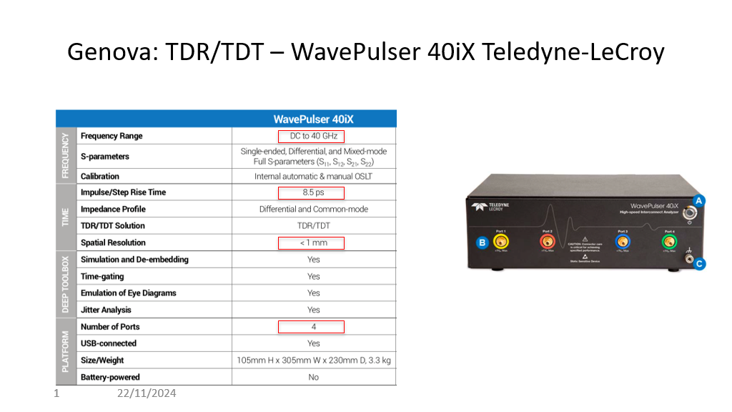
Teledyne LeCroy WavePulser 40iX

Slide 4
Signal Integrity – Examples form Experiment’s Cases
The first example of the use of TDR is to optimize the design of the 1.28 Gb/s line that brings the signal from the ATLAS-ITk pixel modules to the opto-boards. The differential electrical signal is transmitted through flex circuits, twinax cables, and several kinds of connectors before being converted to optical. Impedance matching and eye-opening optimization are the reason.
A second case is the characterization of a bundle of unscreened twisted pairs at cryogenic temperature to be used by DarkSide-20k for the readout of SiPM signals.

Slide 5
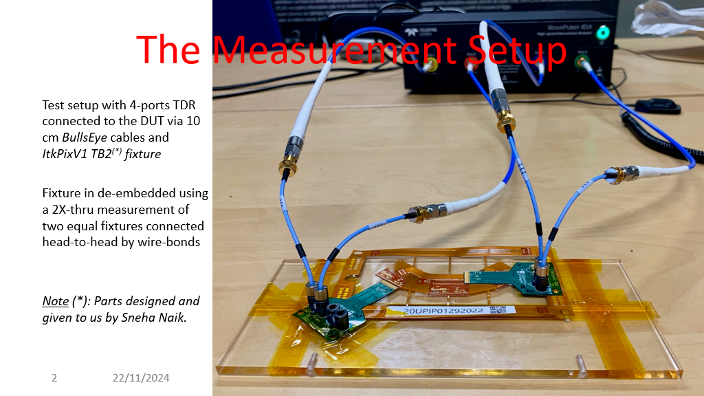
ATLAS - ITk

Slide 6
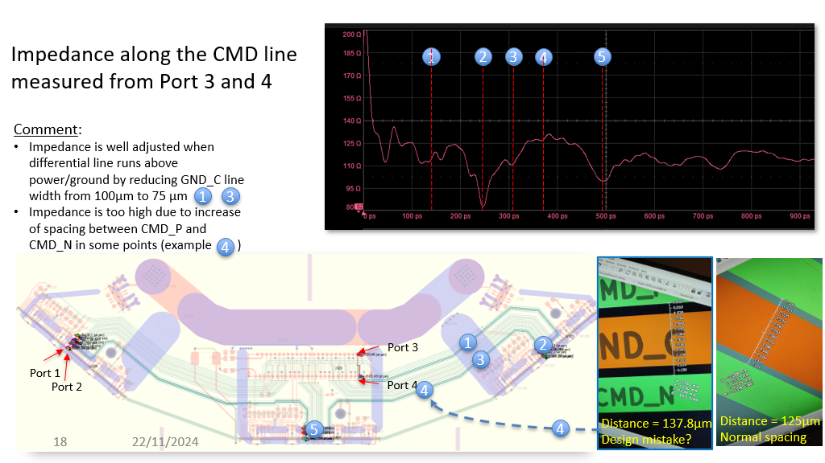
ATLAS - ITk
Audizione delle 8 proposte di laboratori hands-on: presentazioni da 10' + 5' per domande;
Template delle presentazioni:
- finalita' del laboratorio
- esercizi hands-on proposti
- personale che seguira' i partecipanti

Slide 7
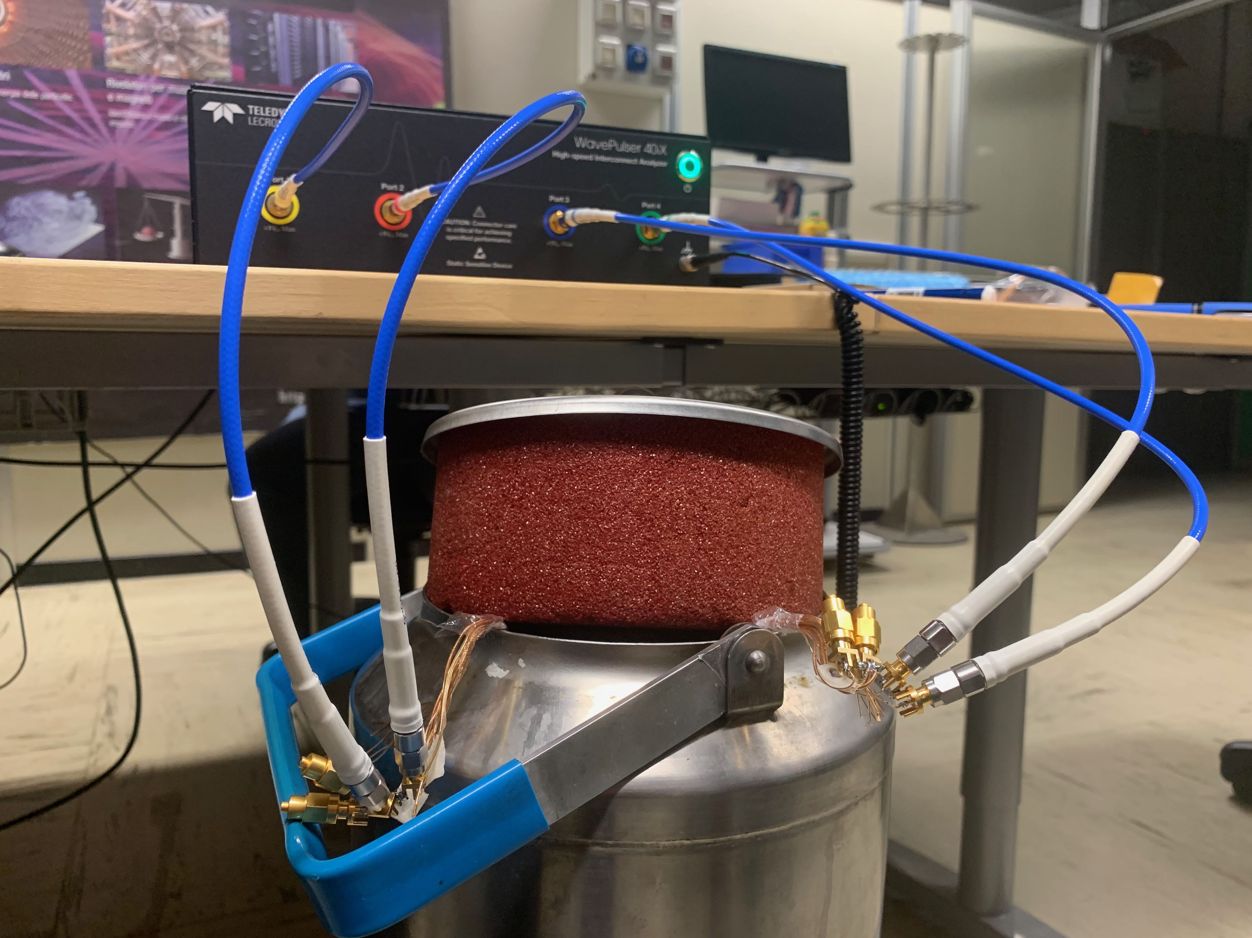
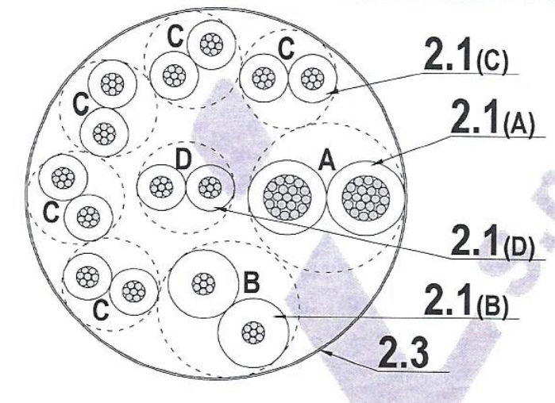
SAMI (prot.3) twisted pair cable
8 pairs: signal, LV & HV
TDR/TDT measurements of signal pairs (AWG30 with siltem jacket)
  T = 300K
  T=77K
DarkSide-20k
WavePulser 40iX
SAMI cable ver.2
13 m long

Slide 8
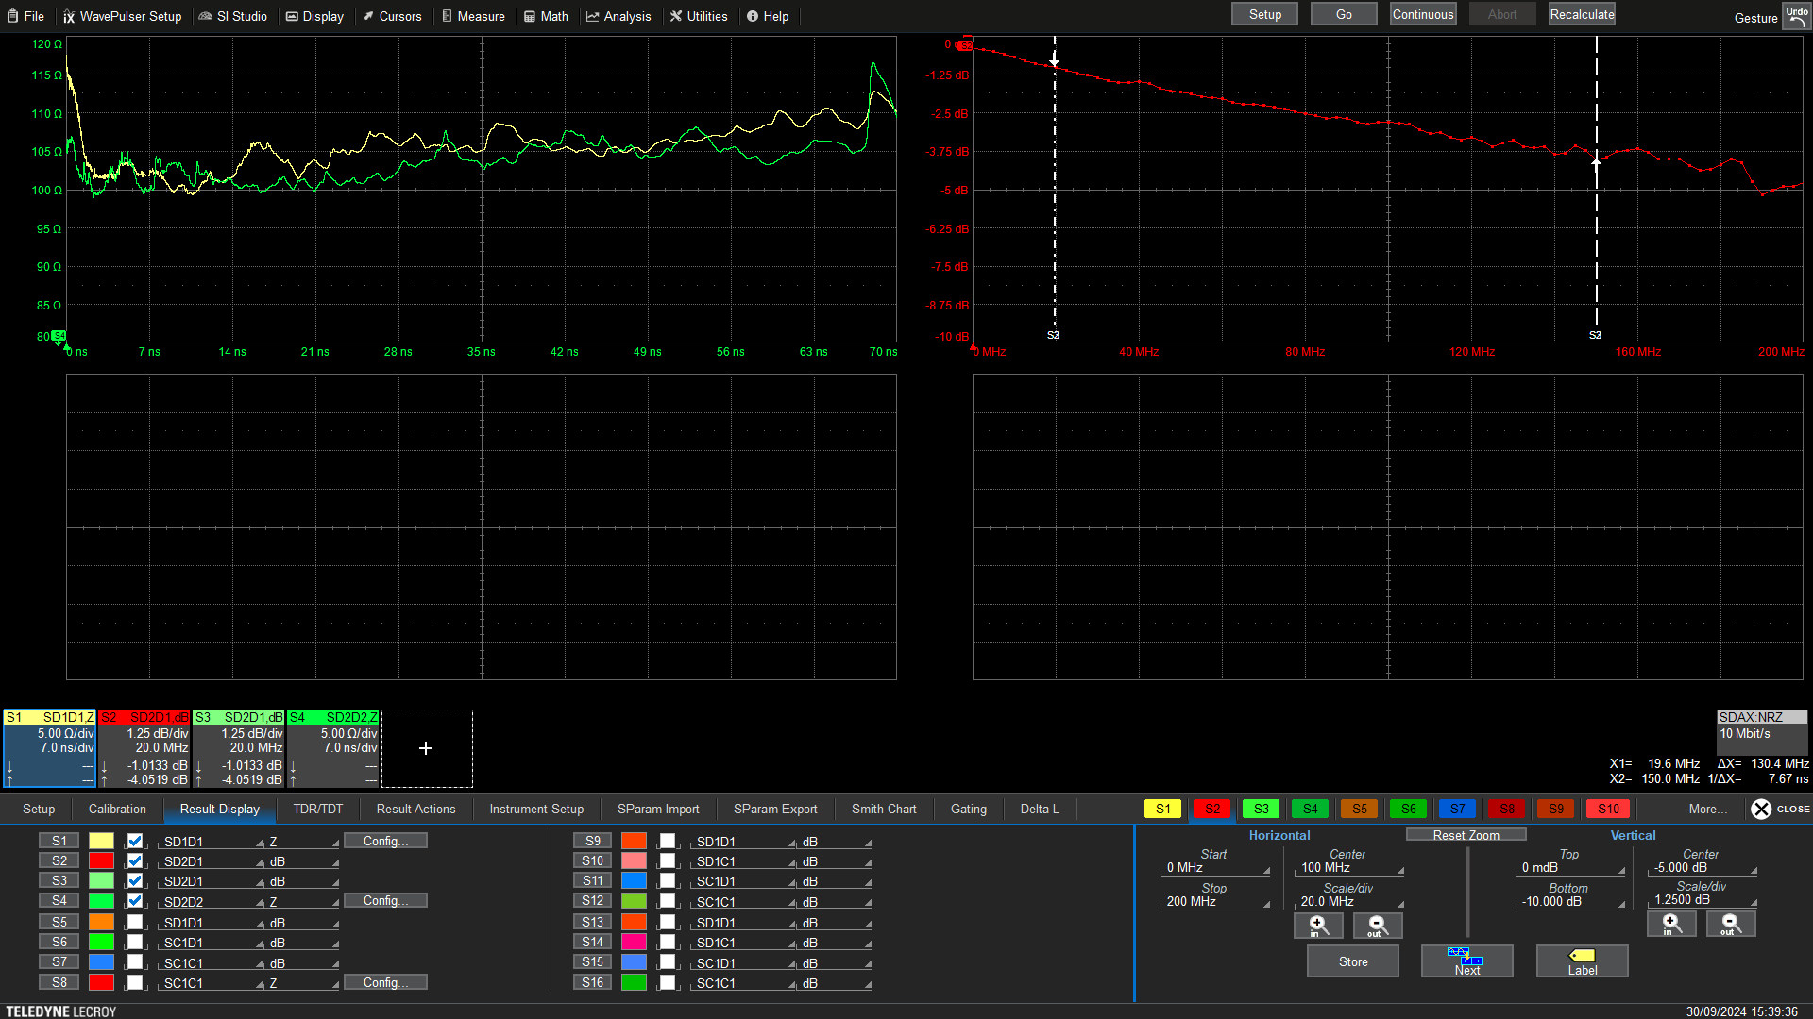
107±2 Ω
-1.01 dB @ 20MHz
102±2 Ω
c
Differential impedence – SD1D1.Z - SD2D2.Z
Insertion loss – SD2D1.dB
Measurements at T=77K
DarkSide-20k

Slide 9
Laboratory
The lab will provide hands-on exercises to characterize a transmission line with TDR
  S-parameters – insertion loss – return loss – impedance – crosstalk
  Simulate the effect of the line on a high-speed transmission (1.28 GHz) – eye diagram analysis
  Simulate the correction applied to the signal to improve the eye diagram: pre-emphasis, de-emphasis, equalization
  …

Slide 10
Proponents
Nanni Darbo – (ex)-Direttore di Ricerca
Claudia Gemme – Primo Ricercatore
Paolo Morettini – Direttore di Ricerca
Enrico Robutti - Primo Ricercatore
Ettore Ruscino – Cter Elettronico

