Slide 1

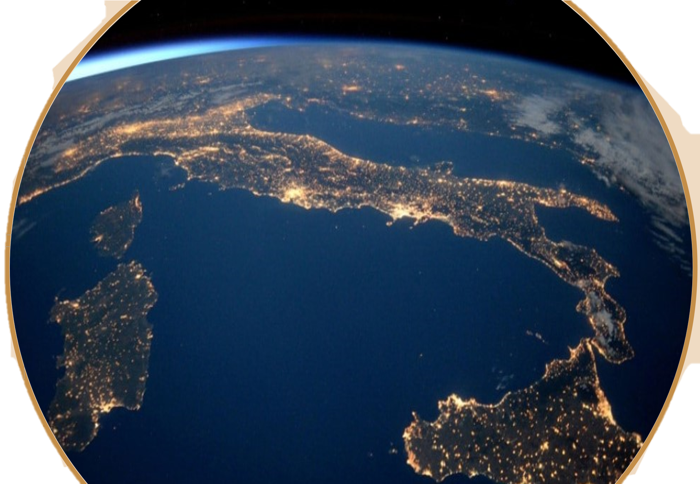
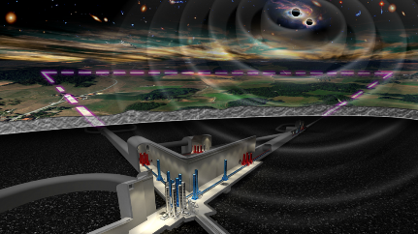
Hands-on Session: Calculation of the Loss Angle from Real Measurements of Free Oscillation Decay
Diana Lumaca
INFN – Sezione di Roma Tor Vergata

Slide 2
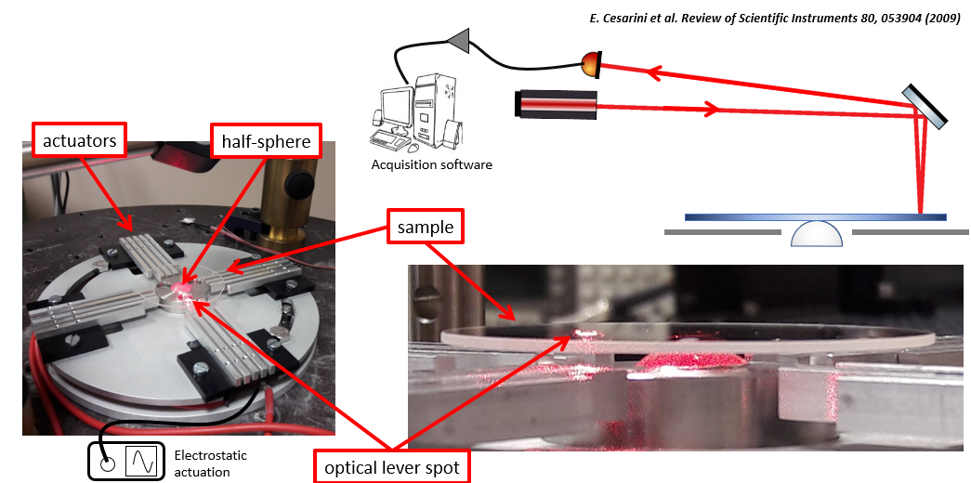
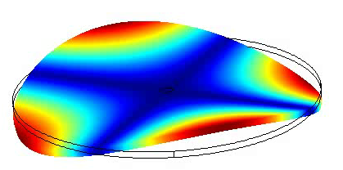
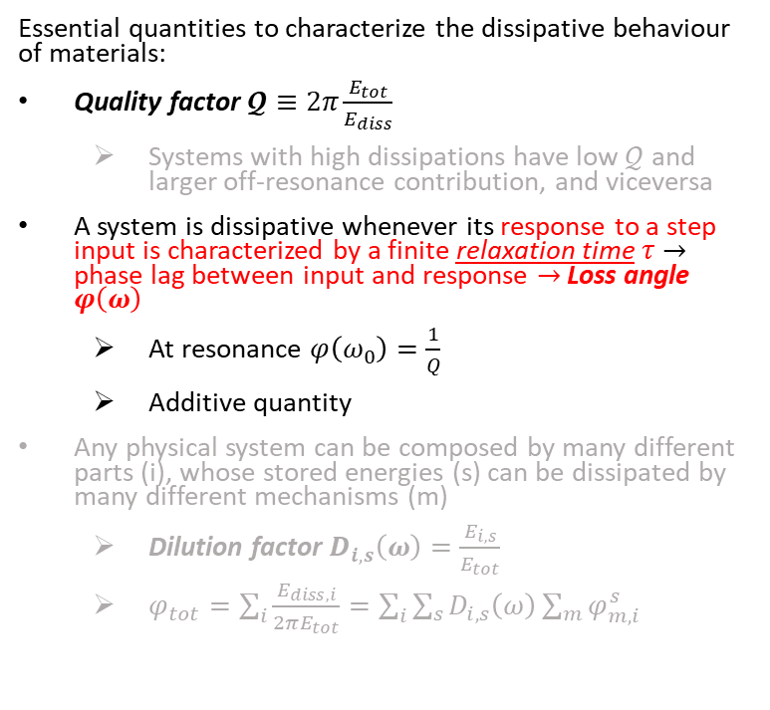
Loss Angle
GeNS – schematic view
Essential quantities to characterize the dissipative behaviour of materials:
  Quality factor $𝓠≡2π\frac{E_{tot}}{E_{diss}}$
    Systems with high dissipations have low $𝒬$ and larger off-resonance contribution, and viceversa
  A system is dissipative whenever its response to a step input is characterized by a finite relaxation time $τ$ $→$ phase lag between input and response $→$ Loss angle $φ\left(ω\right)$
    At resonance $φ\left(ω_{0}\right)=\frac{1}{Q}$
    Additive quantity
  Any physical system can be composed by many different parts (i), whose stored energies (s) can be dissipated by many different mechanisms (m)
    Dilution factor $D_{i,s}\left(ω\right)=\frac{E_{i,s}}{E_{tot}}$
    $φ_{tot}=\sum_{i}{\frac{E_{diss,i}}{2πE_{tot}}}=\sum_{i}{\sum_{s}{D_{i,s}\left(ω\right)}\sum_{m}{φ_{m,i}^{s}}}$
Notes:
Maybe you have already seen what is the loss angle first of all for a linear dissipative system it is the inverse of the quality factor at the resonance frequency. High dissipation low Q. Low dissipation high Q. The loss angle is an additive quantity, and any physical system can be composed by many different dissipative mechanisms considering the loss angle the ratio between the dissipated energy wrt the total energy in a cycle, every dissipation mechanism is weighted by a dilution factor that depends on the store energy with respect the total one

Slide 3
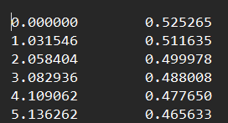
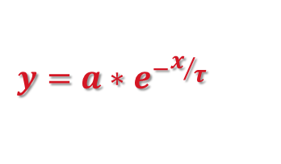
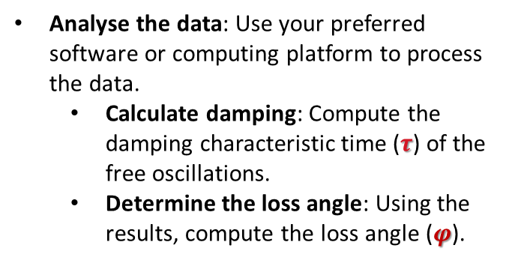
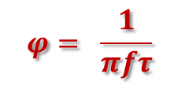
What to do?
% Parametri fisici del campione (SiO2)
diam. = 25.4e-3; % Diametro in metri
thick. = 0.5e-3; % Spessore in metri
E = 72e9; % Modulo di Young (Pa)
rho = 2200; % Densità (kg/m^3)
nu = 0.17; % Coeff. di Poisson
Access the measurements: Download the real measurements of the decay of free oscillations from google drive link
Form groups: Create up to 6 groups and assign each group one of the following files:
  5530, 12641, 21926, 33288, 33673, 46640
Understand the data format: The data files contain two columns: two columns (time, amplitude)
File name | f_{measured}
5530 | 5530,0078
12641 | 12641,375
21926 | 21926,609
33288 | 33288,125
33673 | 33673,4375
46640 | 46640,875
…
…
Analyse the data: Use your preferred software or computing platform to process the data.
  Calculate damping: Compute the damping characteristic time ($τ$) of the free oscillations.
  Determine the loss angle: Using the results, compute the loss angle ($φ$).
$$y=a∗e^{−x/τ}$$
modo | frequenza | a | tau | phi
(2,0) | 5530,01 | 0,5237 | 43,0225 | 1,34E-06
(3,0) | 12641,38 | 0,0032 | 12,2636 | 2,05E-06
(4,0) | 21926,61 | 0,0363 | 4,209 | 3,45E-06
Top secret
Top secret
Top secret
modo | frequenza | a | tau | phi
(5,0) | 33288,13 | 0,01481 | 2,222 | 4,31E-06
(2,1) | 33673,44 | 0,001916 | 11,72 | 8,07E-07
(6,0) | 46640,88 | 0,003551 | 1,3 | 5,25E-06
$$φ= \frac{1}{πfτ}$$

Slide 4
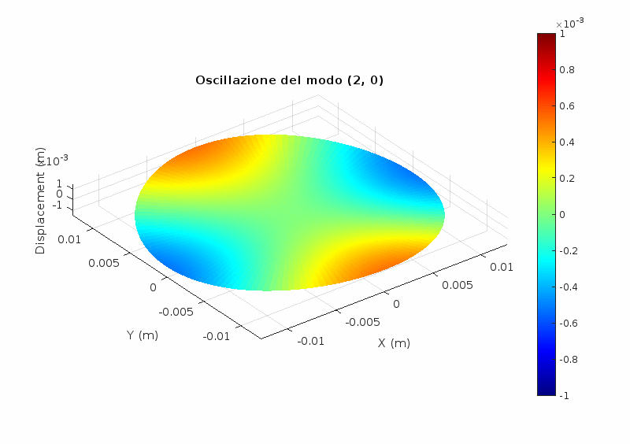
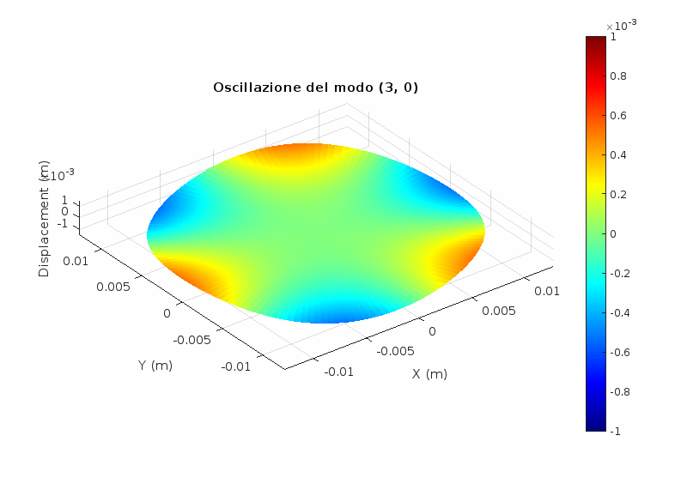
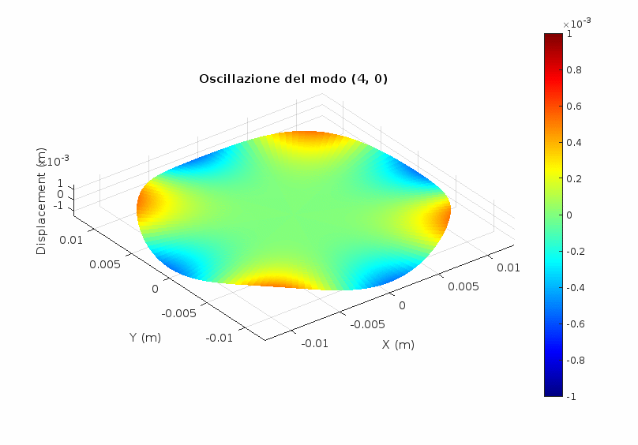
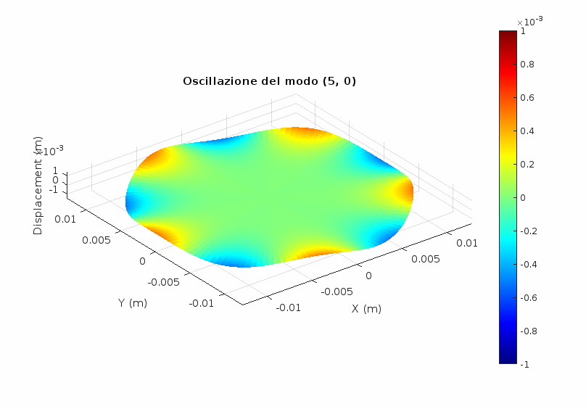
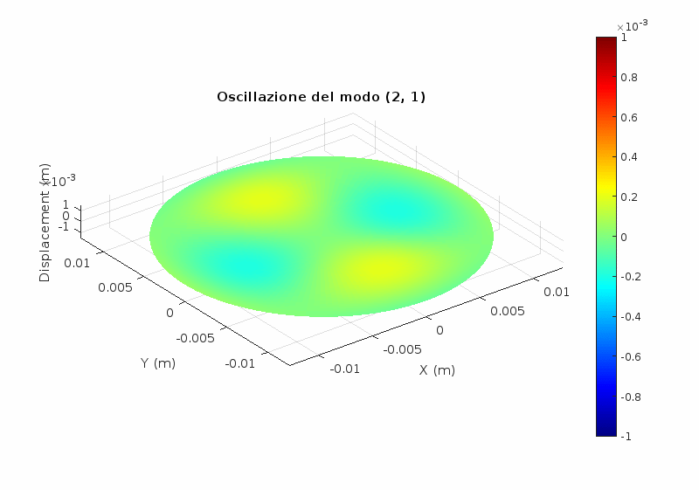
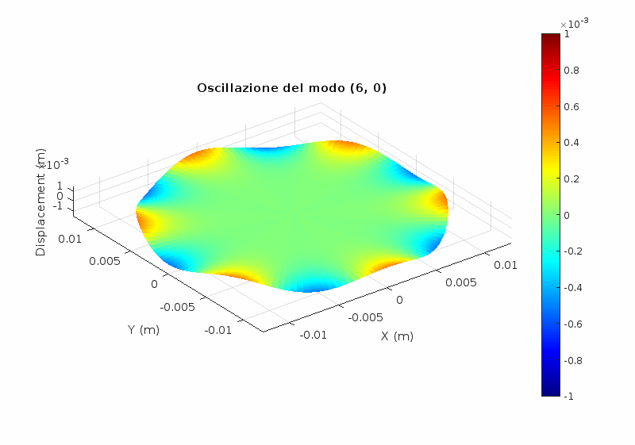
Resonant modes
Top secret
Top secret
mode |  | File name | f_{measured} | ϕ_{measured}
m | n
2 | 0 | 5530 | 5530,0078 | 1,37E-06
3 | 0 | 12641 | 12641,375 | 2,47E-06
4 | 0 | 21926 | 21926,609 | 3,60E-06
5 | 0 | 33288 | 33288,125 | 4,44E-06
2 | 1 | 33673 | 33673,4375 | 8,53E-07
6 | 0 | 46640 | 46640,875 | 5,44E-06
Top secret
Top secret
Top secret
Top secret
Use ResonantModes.m program to see the deformation shape of your mode!
Top secret
Top secret

Slide 5
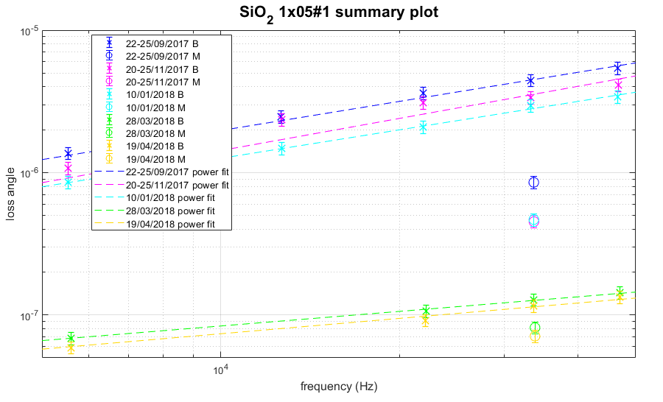
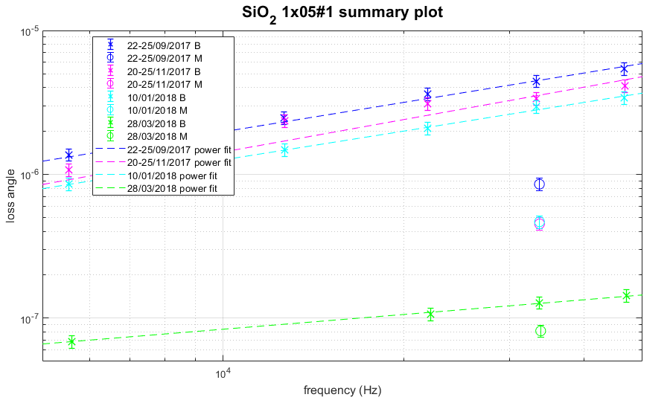
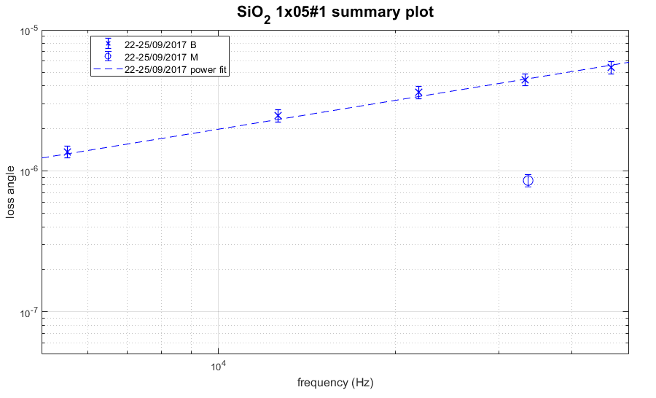
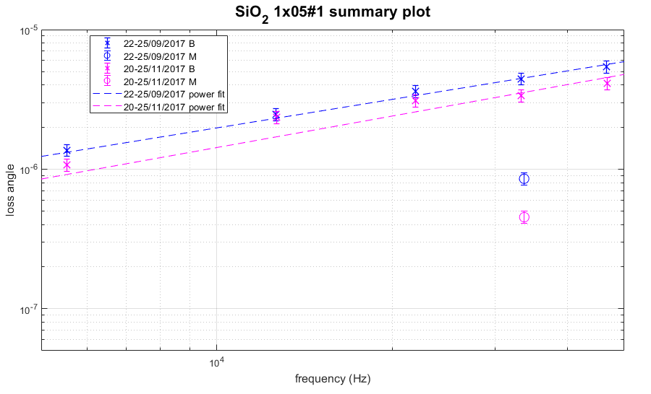
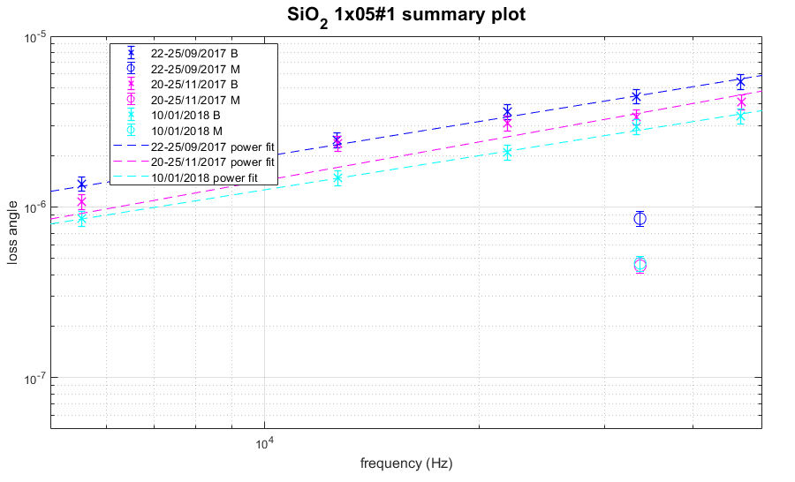
Start
Annealing 900°C
44 days in vacuum
CO₂ polishing of the edge
20 days ageing
Stability of the substrate’s losses and resonant frequencies is mandatory

