Slide 1
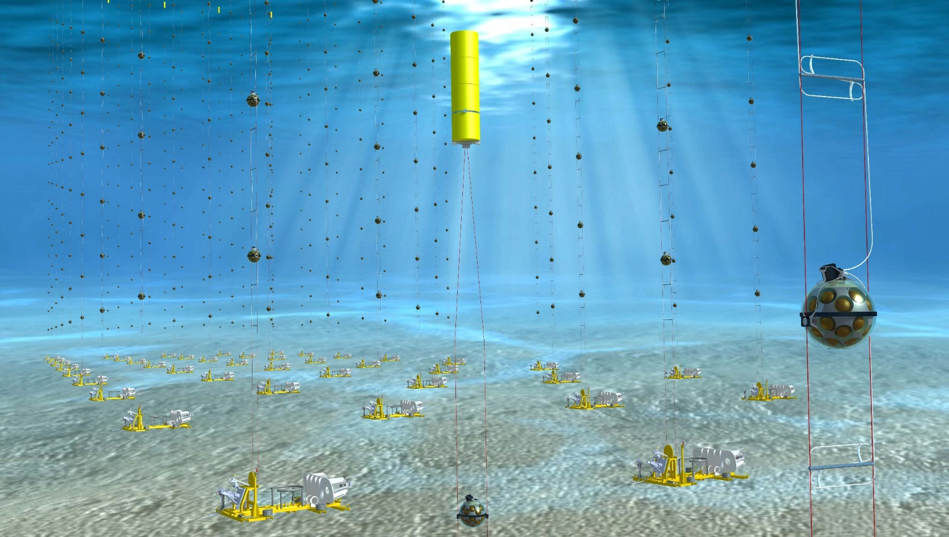


26 May -1 June 2024
Ischia Island (Naples, Italy)
Characterization of the cosmic neutrino flux with the KM3NeT experiment
Maurizio Spurio, maurizio.spurio@unibo.it
Università di Bologna and INFN
1

Slide 2


Multimessenger astrophysics: two communities
2
Three large experimental branches
Gravitational waves (GWs), observed using laser interferometers
GWs
CR
Electrons
Hadrons
Antimatter
Neutrinos
γ−rays
p⁻ e⁺
γ
Individual quanta: CRs, antimatter, γ -rays, and ν, with experimental methods born in high-energy physics laboratories
The electromagnetic radiation, from radio to X-rays, with techniques developed by astronomers

Slide 3

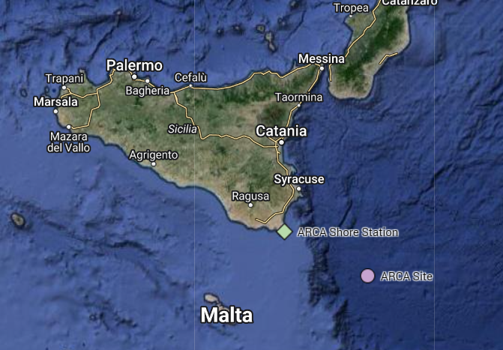
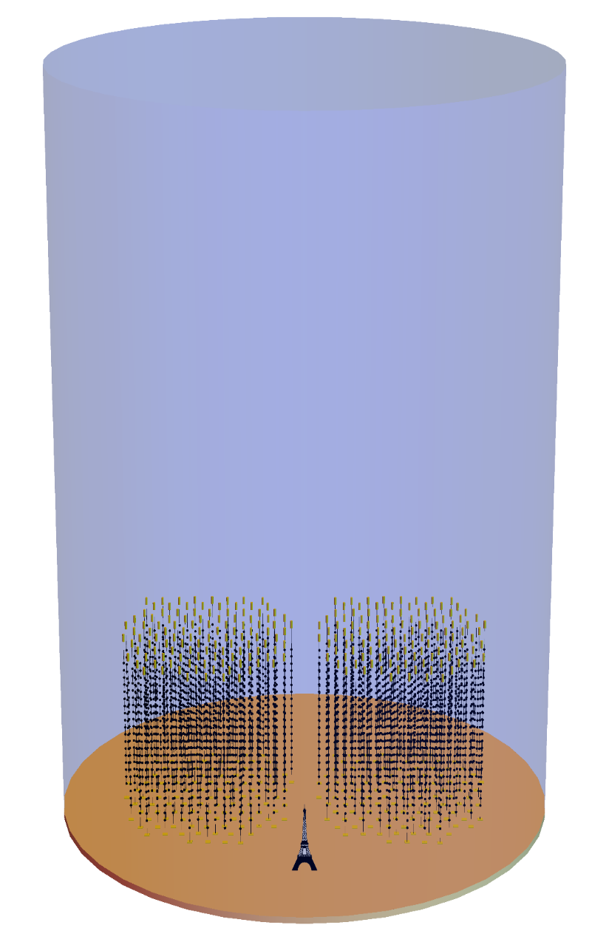
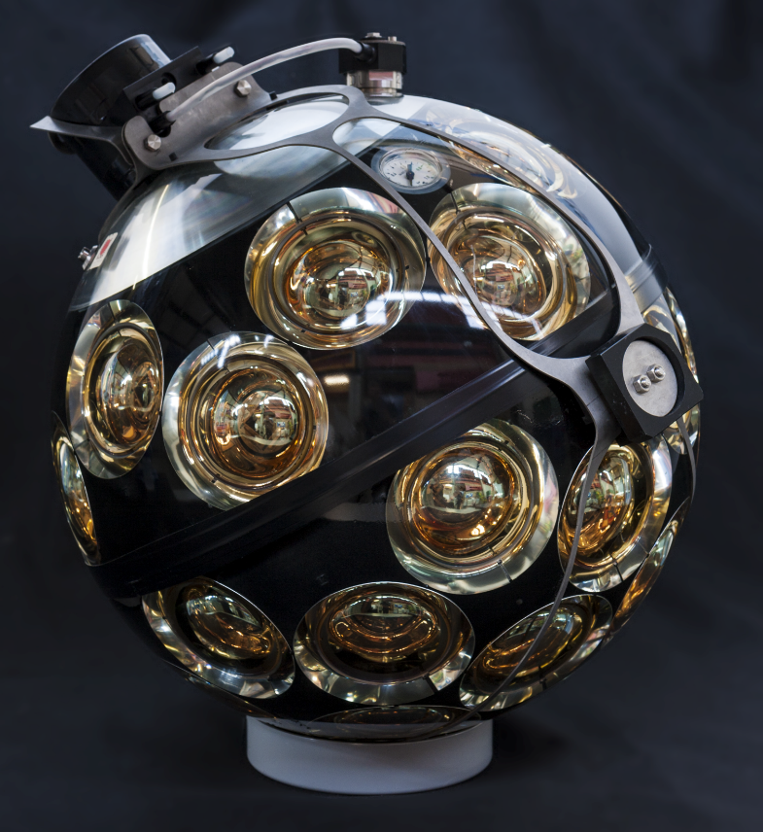
KM3NeT/ARCA for astroparticle physics
3
33 DUs Deployed
3500 m
31x 3’’ PMTs
9m/36m
1 Gton detector
230 Detection Units
18 DOMs / DU
800 m
43 cm

Slide 4
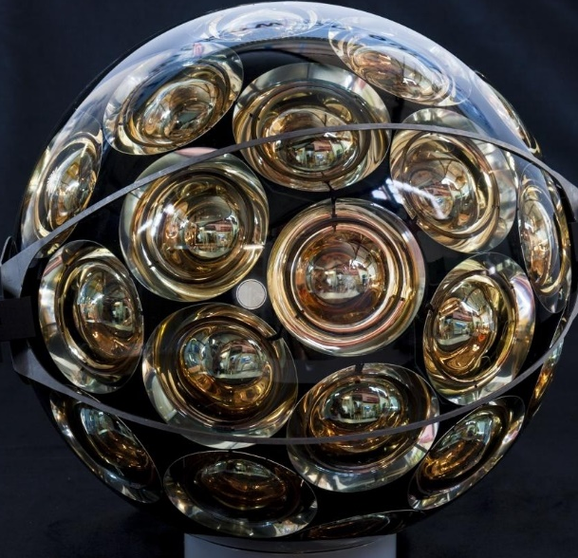
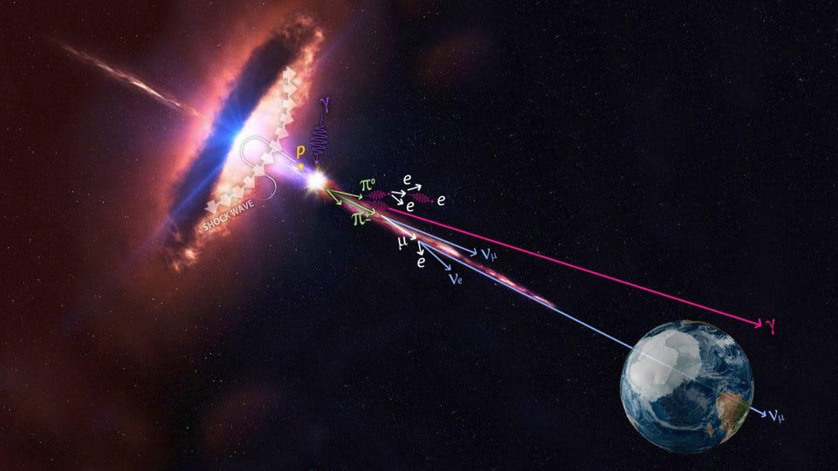
Searches for cosmic neutrinos
4
The experiment is in data taking while still in construction
Search for cosmic accelerators
Galactic
extragalactic
Multimessenger astrophysics
ν and gamma-rays
ν and GWs
ν and ...
Particle physics and exotic
ν from DM annihilation
Neutrino mass hierarchy

Slide 5
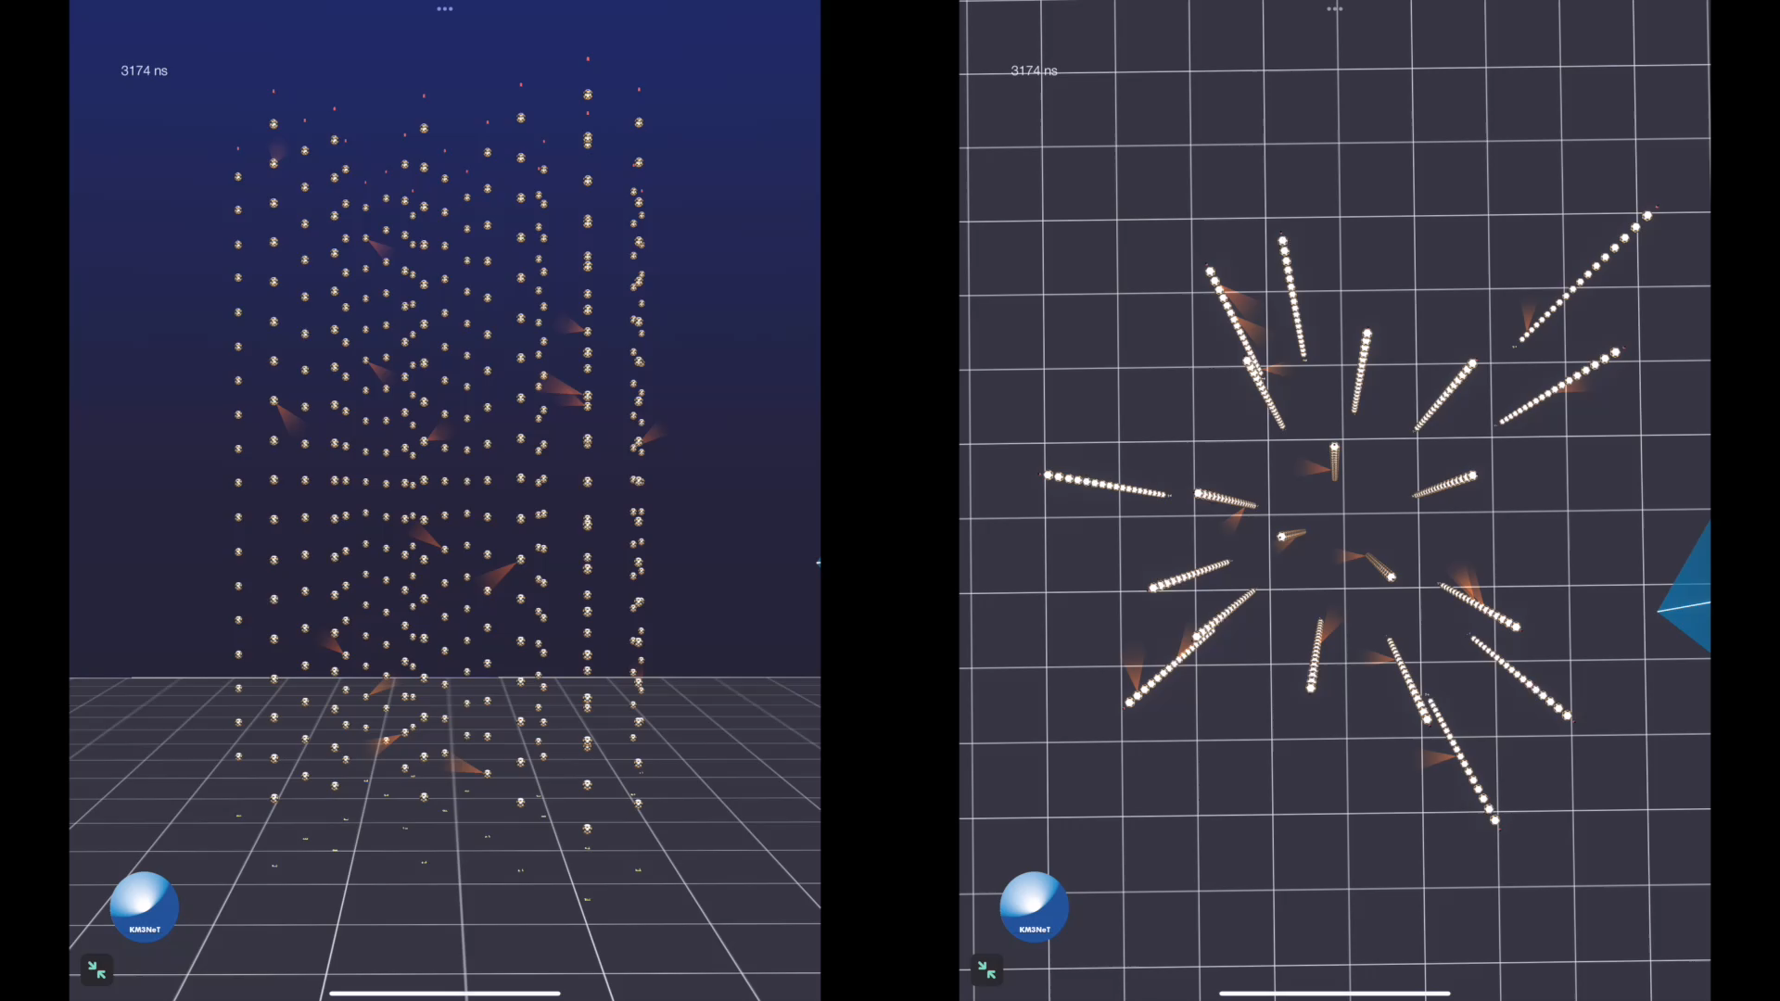
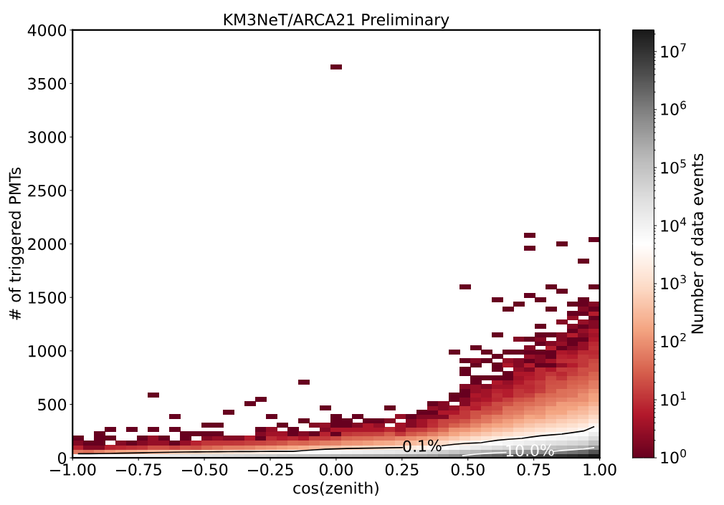
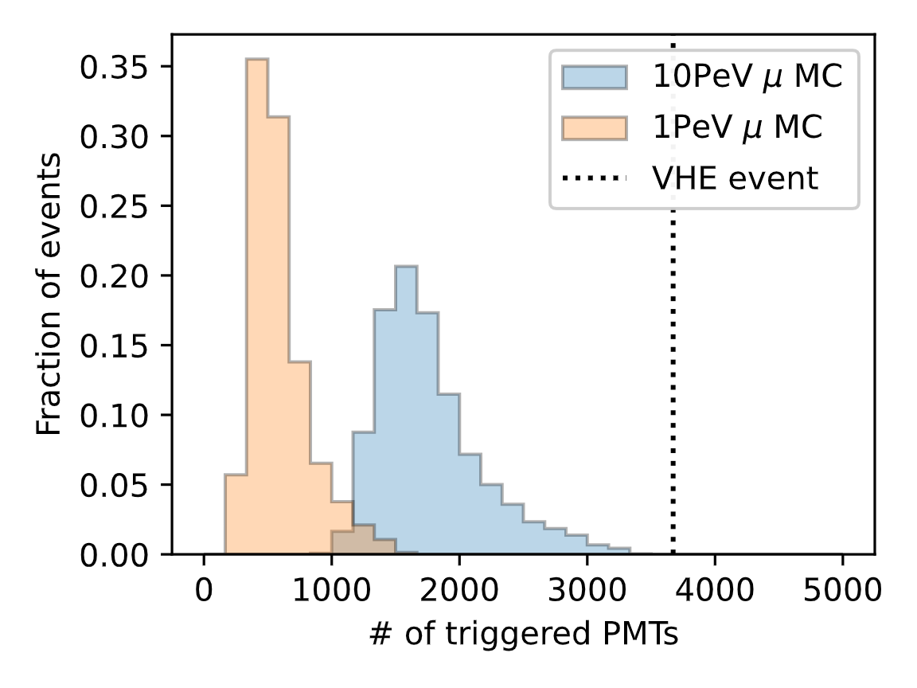
The highest energy neutrino ever observed so far
5

Slide 6
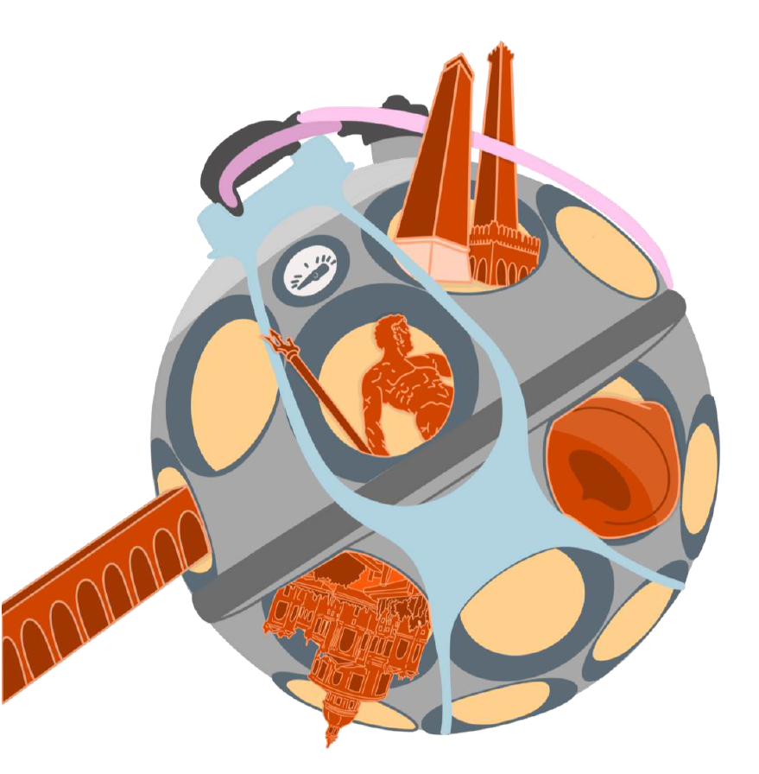
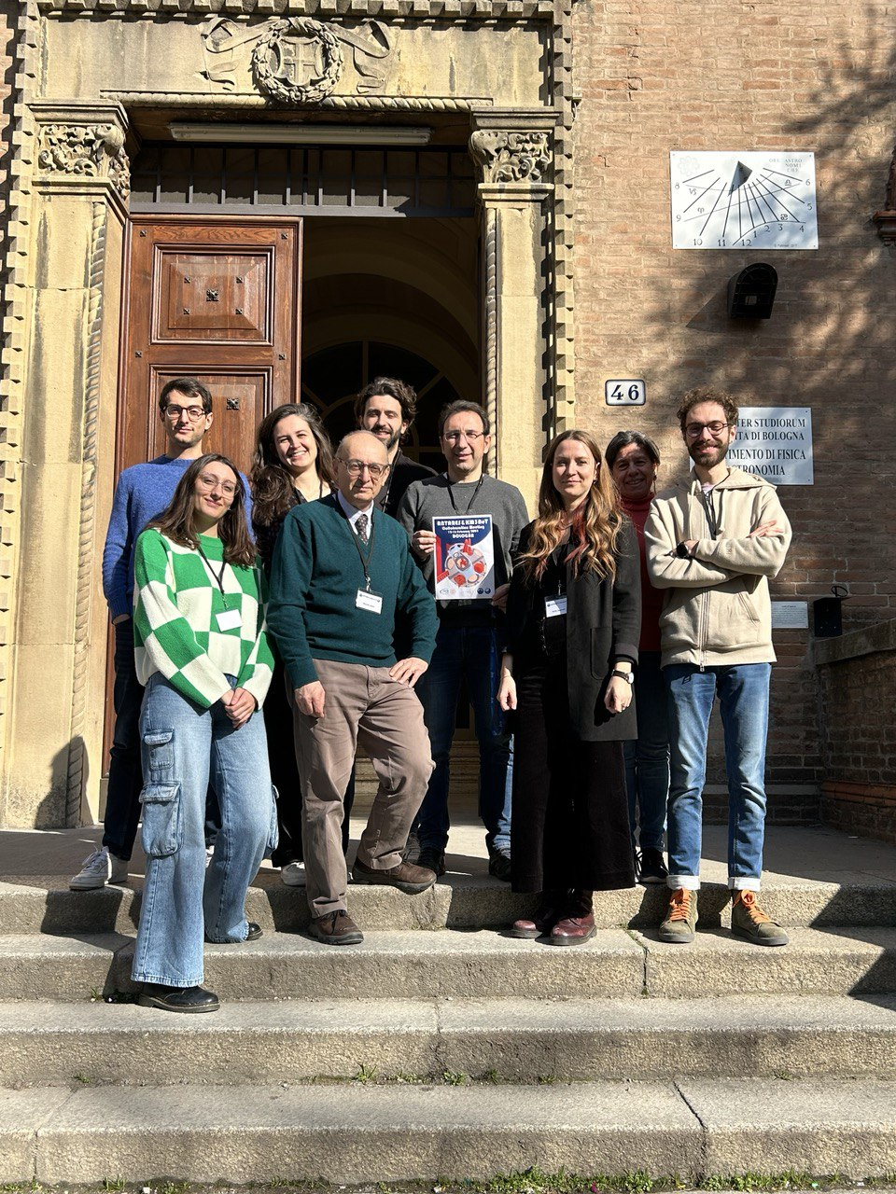
People in the Bologna group
6
T. Chiarusi (INFN) - DAQ Coordinator
G. Illuminati (INFN)- WG Astrophysics co-coordinator
A. Margiotta (UniBo)- Chair del Publication Comm. KM3NeT
M. Spurio (UniBo) - Deputy Spokesman ANTARES (i.e., precursor of KM3NeT)
G. Levi (UniBo)- software for the database
F. Benfenati (INFN) – technologist, data analysis
F. Filippini (INFN Post Doc) – Reliability, Availability, Maintainability and Safety (RAMS) officer
R. Muller (INFN Post Doc)- search for neutrino sources
F. Carenini, I. del Rosso (PhD) working on data analysis
(External) Prof. E. Cuoco (UniBo)- intercorrelation with gravitational waves

Slide 7
Activities and thesis in the Bologna group
7
Hardware
Data Acquisition (DAQ)/readout test of new KM3NeT lines
Integration and testing of base modules of the strings
Emulation Instrumentation Unit: testing of tools used for environmental studies
Software
Searches for neutrino from the Galactic plane
Searches for a cosmic diffuse neutrino flux
Developing a real-time alert system for the detector
Searches for point-like sources of neutrinos
Search for neutrinos in correlation with multi-messenger events (GWs, GRBs, ...)".

Slide 8
You and a possible thesis in KM3NeT-Bo
8
The experiment is in data taking while still in construction
Possible choice among one of the mentioned activity in software or hardware
The possible options depends on your skills and preference
For software, the requirement is a knowledge of C++ and Root
We have no constraint on the starting period of activities, but…
The possible thesis arguments depend on the starting periods (i.e.: we are actively involved in many analysis now. In few months, new analysis will start)
One supervisor and one co-supervisor (depending on the selected item)
Our preference is to have the student here in presence, with a fraction of the activities done remotely.
INFN association (of course), weekly meeting (person/remote) in the Bologna group, KM3NeT remote meeting (depending on the activity)
The interested people can contact me for a TEAMS or ZOOM colloquium and further information (spurio@bo.infn.it)

