Slide 1
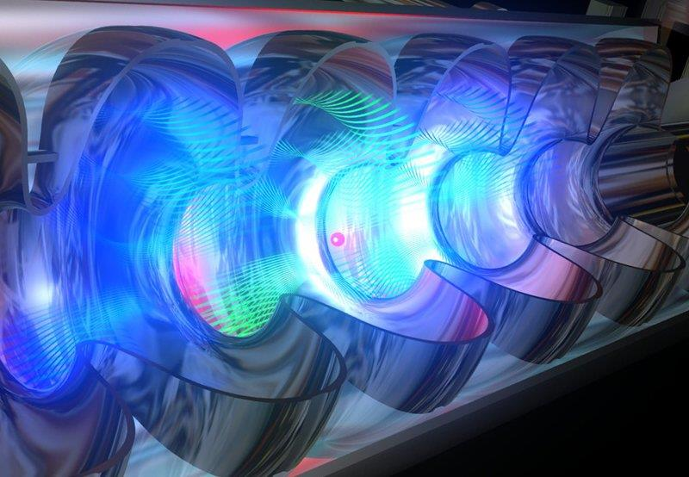

Particle Accelerators:
how they work, applications and frontiers
David Alesini
Accelerator Division, LNF-INFN, Frascati

Slide 2
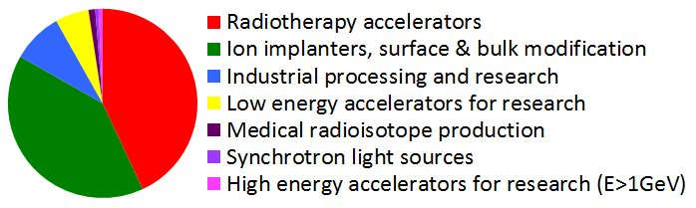
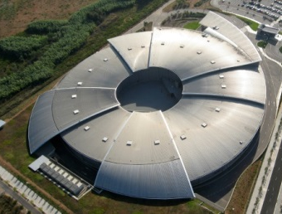
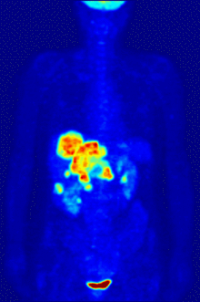
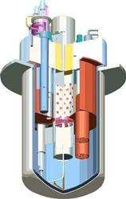
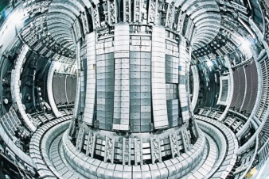
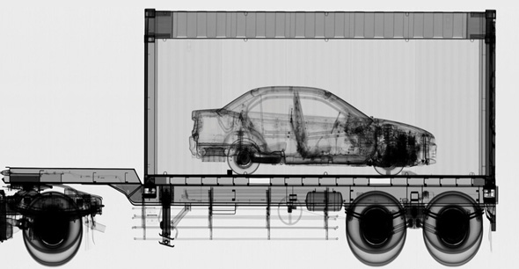

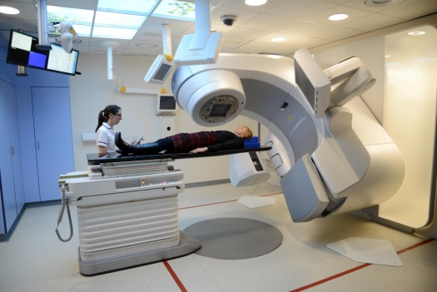
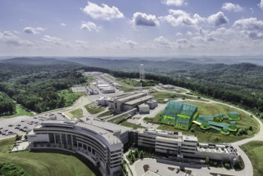
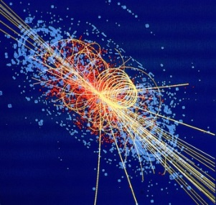
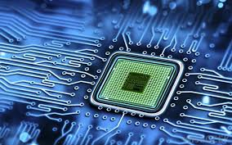
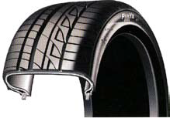
WHAT CAN PARTICLE ACCELERATORS DO?
>40000 accelerators in operation
Production of X and γ rays for physics of matter
Isotopes production
National security
Material studies for fusion
Controlled fission in nuclear reactors
sterilization
Neutron sources
Radiotherapy and adrotherapy
Ion implantation
Material treatment
High energy physics

Slide 3
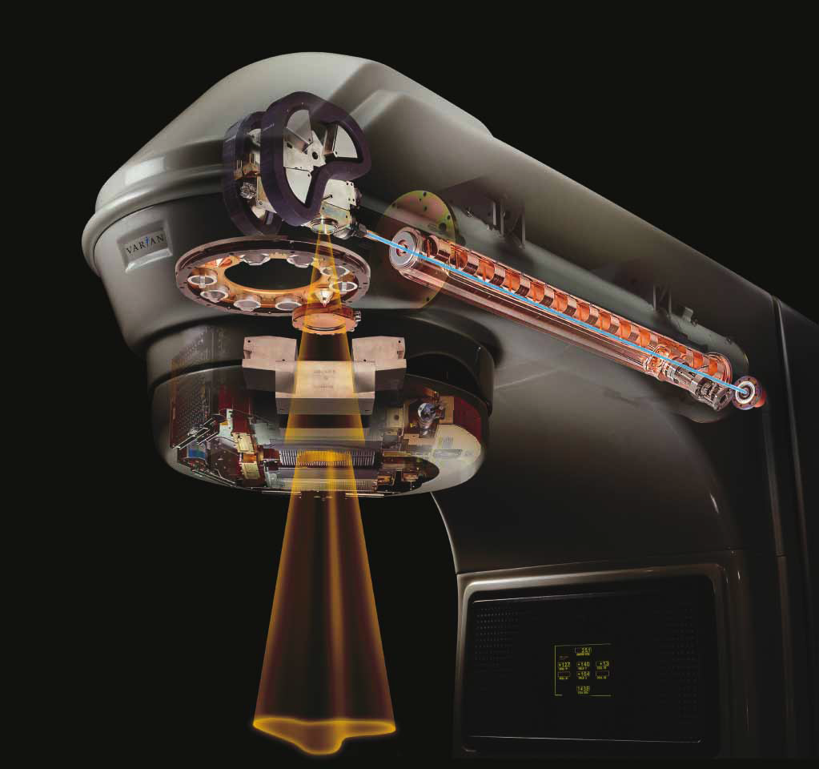
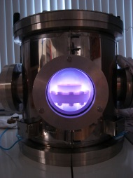
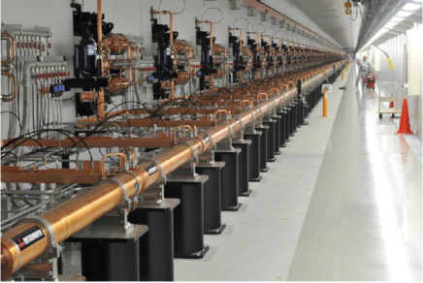

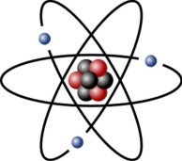
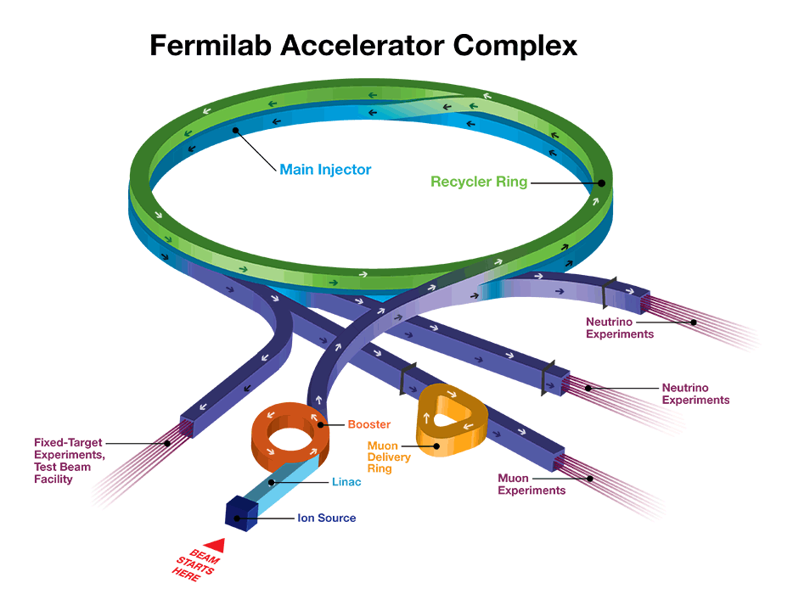
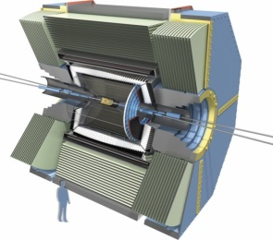
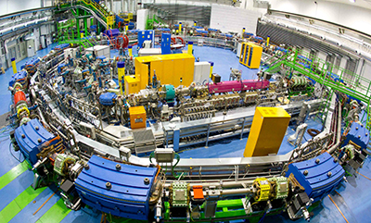
HOW DO PARTICLE ACCELERATORS WORK?
A particle accelerator can be considered as a device that transfers energy to charged particles (electrons, protons, ions, ...) through electro-magnetic fields.
SOURCE
ACCELERATOR
USERS
SOURCE
ACCELERATOR
USER

Slide 4
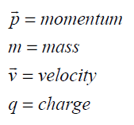

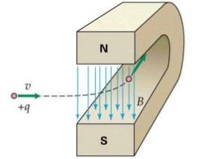
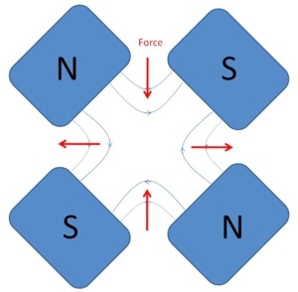
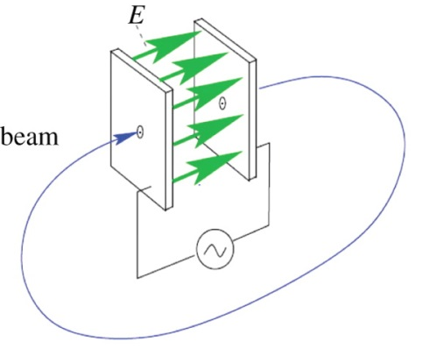
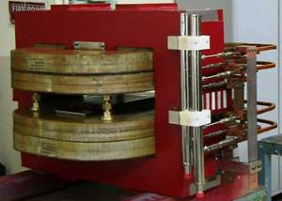
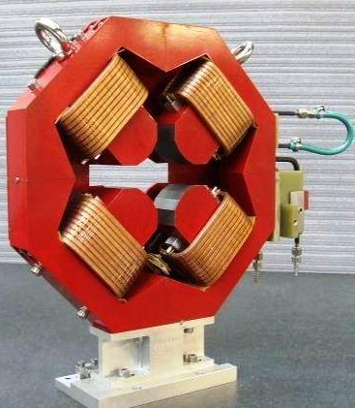
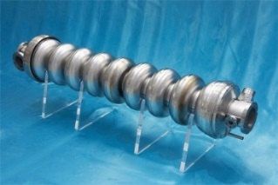
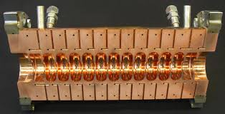
BASIC EQUATION FOR particle acceleratorS
Beams of charged particles are accelerated with the use of electric fields and are deflected, curved, and focused with the use of magnetic fields. The basic equation for the description of the acceleration and focusing processes is represented by the Lorentz Force.
BENDING AND FOCUSING
ACCELERATION
To accelerate, we need a force in the direction of motion
2nd term always perpendicular to motion => no energy gain
Longitudinal Dynamics
Transverse Dynamics

Slide 5
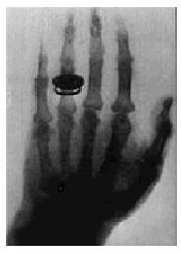

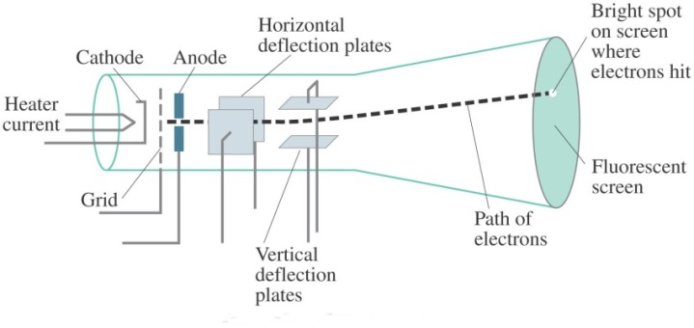
ACCELERATION: SIMPLE CASE
The first historical linear particle accelerator was built by the Nobel prize Wilhelm Conrad Röntgen (1900). It consisted in a vacuum tube containing a cathode connected to the negative pole of a DC voltage generator. Electrons emitted by the heated cathode were accelerated while flowing to another electrode connected to the positive generator pole (anode). Collisions between the energetic electrons and the anode produced X-rays.
Electric field
Anode
Cathode
+
Voltage ΔV
The energy gained by the electrons travelling from the cathode to the anode is equal to their charge multiplied the DC voltage between the two electrodes.
Particle energies are typically expressed in electron-volt [eV], equal to the energy gained by 1 electron accelerated through an electrostatic potential of 1 volt:
1 eV=1.6x10⁻¹⁹ J

Slide 6
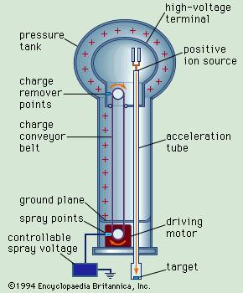
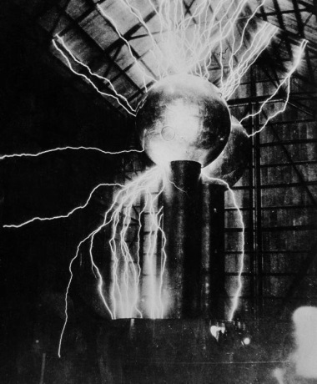
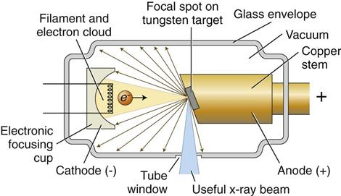
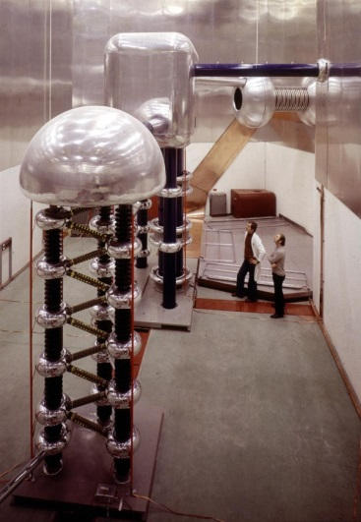
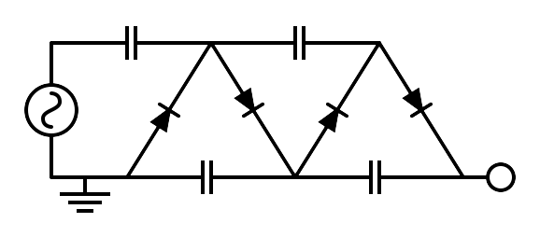
ELECTROSTATIC ACCELERATORS
To increase the achievable maximum energy, Van de Graaff invented an electrostatic generator based on a dielectric belt transporting positive charges to an isolated electrode hosting an ion source. The positive ions generated in a large positive potential were accelerated toward ground by the static electric field.
LIMITS OF ELECTROSTATIC ACCELERATORS
DC voltage as large as ∼10 MV can be obtained (E∼10 MeV). The main limit in the achievable voltage is the breakdown due to insulation problems.
APPLICATIONS OF DC ACCELERATORS
DC particle accelerators are in operation worldwide, typically at V<15MV (E_{max}=15 MeV), I<100mA.
They are used for:
⇒ material analysis
⇒ X-ray production,
⇒ ion implantation for semiconductors
⇒ first stage of acceleration (particle sources)
750 kV Cockcroft-Walton
Linac2 injector at CERN from 1978 to 1992

Slide 7
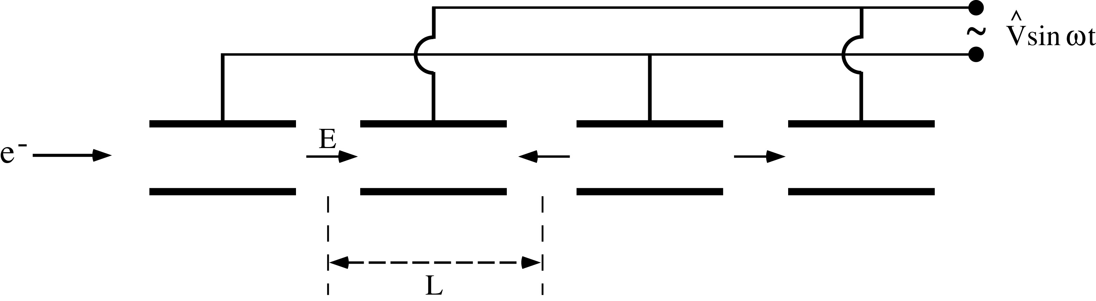
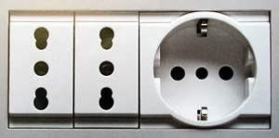
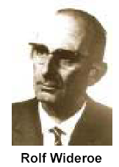
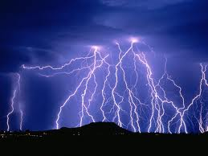
RF Accelerators : Wideröe “Drift Tube LINAC” (DTL)
Basic idea: the particles are accelerated by the electric field in the gap between electrodes connected alternatively to the poles of an AC generator. This original idea of Ising (1924) was implemented by Wideroe (1927) who applied a sine-wave voltage to a sequence of drift tubes. The particles do not experience any force while travelling inside the tubes (equipotential regions) and are accelerated across the gaps. This kind of structure is called Drift Tube LINAC (DTL).
10⁹-10¹⁰ V
With modern particle accelerators, we can now accelerate particles with energy up to thousands of GeVs.
Equivalent to the voltage of thousands of lightning strikes!

Slide 8
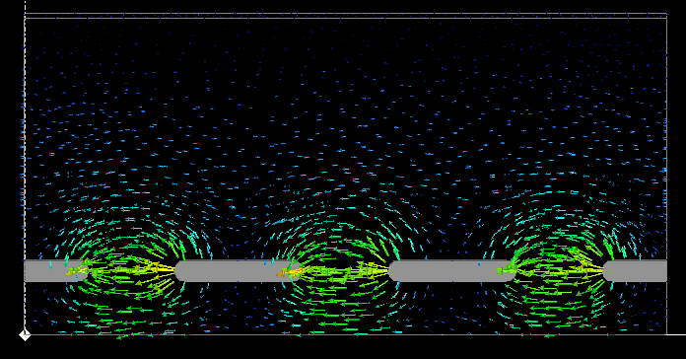

Slide 9
ELECTROSTATIC ACCELERATION: CONTINUOUS BEAM
We consider the acceleration between two electrodes in DC.
+
ΔV
-
E_{z}
source
z (direction of acceleration)
gap
ΔE
E_{z}
t
z
Energy-momentum relation
Lorentz force
W=E-E₀
rate of energy gain per unit length
energy gain per electrode pair

Slide 10
RF ACCELERATION: BUNCHED BEAM
We consider now the acceleration between two electrodes fed by an RF generator
E_{z}
source
z
Only these particles are accelerated
gap
ΔE
z
t_{inj}
These particles are not accelerated and basically are lost during the acceleration process
DC acceleration
RF acceleration
charge
charge
Bunched beam (in order to be synchronous with the external AC field, particles have to be gathered in non-uniform temporal structure)
t
RF period
t

Slide 11
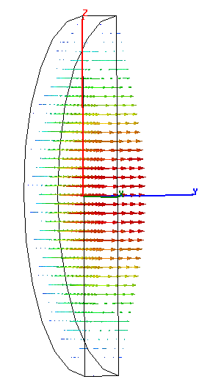
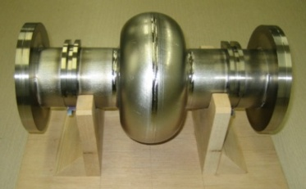
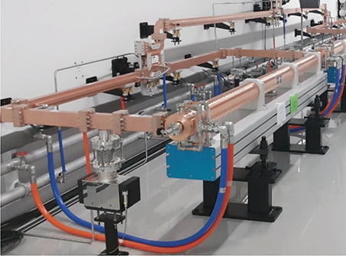
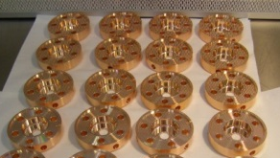
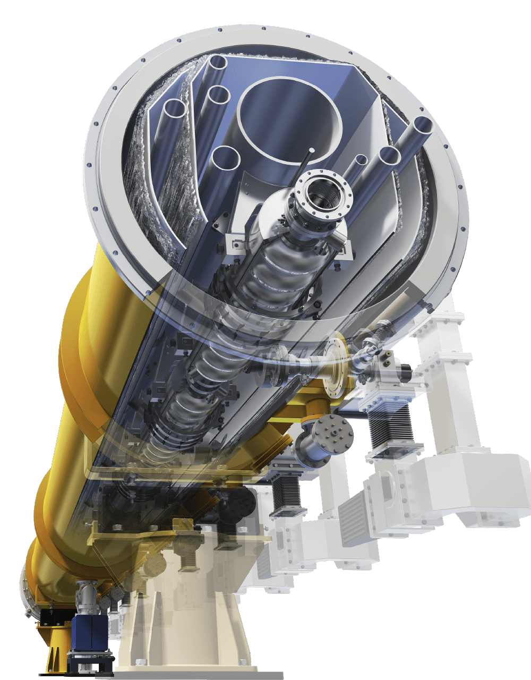

ACCELERATION WITH MULTI-CELL RF CAVITIES
Accelerating fields are confined in cavities that are metallic closed volumes were the e.m fields has a particular spatial configuration (resonant modes) whose components, including the accelerating field E_{z}, oscillate at some specific frequencies f_{RF} (resonant frequency) characteristic of the mode.
The modes are excited by RF generators that are coupled to the cavities through waveguides, coaxial cables, etc…The working frequencies can go from MHz to ten of GHz depending on the applications
The resonant cavities are usually grouped in multi-cell structures. This choice is motivated by reasons of efficiency and compactness.
There are both cavities that operate at normal conducting (NC, copper, surface resistance ∼mΩ) and superconducting (SC, niobium, surface resistance ∼nΩ) cavities that operate at few K.
SC (more complicated because of the necessity of cryostat) are used for operation in multi bunch/long train/high duty cycle machines
The average accelerating gradients that can typically be obtained are of the order of few 10 MV/m in SC and up to more than 100 MV/m in NC.

Slide 12
LORENTZ FORCE: ACCELERATION AND FOCUSING
Particles are accelerated through electric field and are bended and focalized through magnetic field.
The basic equation that describe the acceleration/bending /focusing processes is the Lorentz Force.
BENDING AND FOCUSING
ACCELERATION
To accelerate, we need a force in the direction of motion
2nd term always perpendicular to motion => no energy gain
Longitudinal Dynamics
Transverse Dynamics

Slide 13
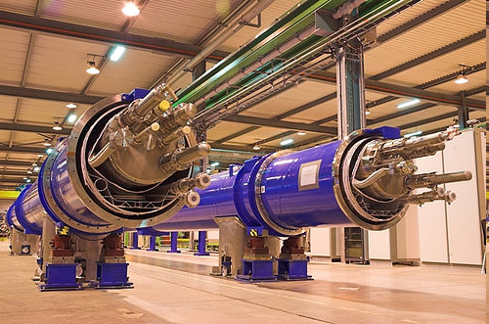
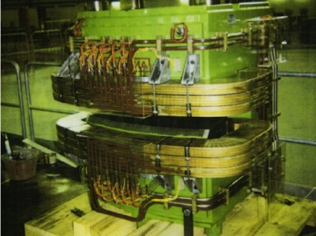
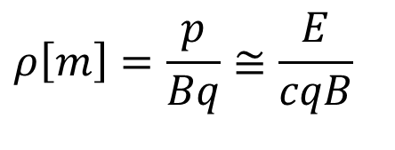
MAGNETIC FIELD: DEFLECTION
With magnetic fields it is possible to bend charged particles (moving at speed v) and it is possible to focus them keeping the particles confined inside in the vacuum chamber.
N
ρ
E. O. Lawrence (1930) had the idea to curve particles on a circular trajectory in order to pass many times in the same accelerating system gaining energy at each passage
B
S
$$ρ\left[m\right]=\frac{p}{Bq}≅\frac{E}{cqB}$$
Particles traveling in a linear accelerator pass through the accelerating structure only once, while in a circular accelerator they pass into the same cavity several times and at each turn, bunches gain energy thanks to the RF accelerating electric field.
magnet
Super Conducting magnets
(up to 15 T)
Normal Conducting magnets
(up to ∼1 T)
RF Cavity

Slide 14
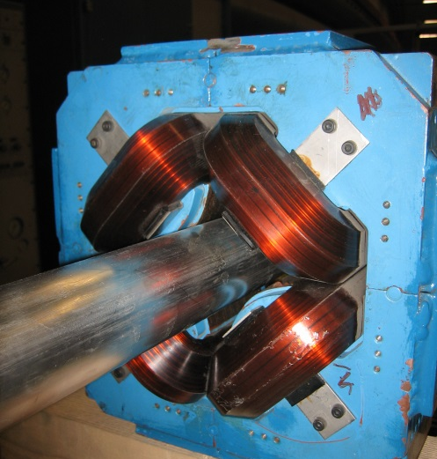
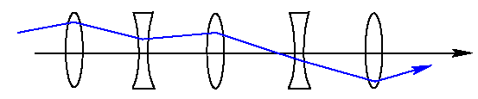
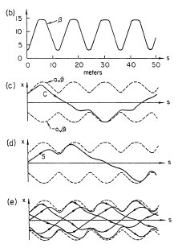



MAGNETIC FIELD: FOCUSING
Quadrupoles are used to focalize the beam in the transverse plane. It is a 4 poles magnet:
⇒B=0 in the center of the quadrupole
⇒The B intensity increases linearly with the off-axis displacement.
⇒If the quadrupole is focusing in one plane is defocusing in the other plane
Electromagnetic quadrupoles G <50-100 T/m
beam
y
x
N
S
x
S
N
z
y

Slide 15
TRANSVERSE FOCUSING: β-FUNCTION
A quadrupole focus in one plane and de-focus in the other plane.
To obtain the overall focus of a particle beam along a transport channel or in a circular accelerator it is necessary to use a sequence of quadrupoles with the alternating sign.
This configuration is able to guarantee stable trajectories.
s
The transverse trajectory described by each particle is a pseudo-sinusoid.
The envelope of all trajectories is called the β- function.
Longitudinal coordinate

Slide 16



LINAC AND SYNCHROTRON
A typical LINAC is, in conclusion, an alternating sequence of accelerating sections, quadrupoles, diagnostic elements (that allow the measurement of the beam position, profile, charge, etc…) and pumping systems. Vacuum in a particle accelerator is typically on the order of 10⁻⁸-10⁻¹⁰ mbar. If such pressures were not reached, the particles would be lost due to impacts with the gas molecules. They can be of few m up to km…
m
km
By dipoles the beam can also be circulated in a ring. A single accelerating cavity accelerate the particles at each passage. These machines are called synchrotrons.

Slide 17
APPLICATIONS

Slide 18






MEDICAL APPLICATIONS: RADIOISOTOPE PRODUCTION
Production of radioisotopes: protons of 7-100 MeV accelerated with cyclotrons or linacs (50 type of isotopes, used for diagnostics and treatment are produced with accelerators)
PET: Positron Emission Tomography

Slide 19



MEDICAL APPLICATIONS: RADIOTHERAPY
Metallic sheet for X ray production
One irradiate tumors woth X-rays or electrons
LINAC
Collimation system

Slide 20









MEDICAL APPLICATIONS: ADROTHERAPY
Anti-tumor therapy based on irradiation with protons and heavy ions (C).
It is more effective and more localized (Bragg resonance) than that based on electrons or X-rays
Specialized centers: CNAO in Pavia, PSI in Zurich, Loma Linda in California, Japan, ...
Courtesy M. Pullia

Slide 21




EXPLORING MATTER WITH ULTRA BRIGTH X-RAYS
A charged particle at a given energy which is bent by a dipole magnet emits electromagnetic radiation (synchrotron light).
photon
The radiated energy is related to the fourth power of the particle relativistic factor γ. It follows that only electron machines (light particles) basically emit photons (except LHC!).
X Rays:
0.01-10 nm (∼10⁻¹¹-10⁻⁸ m)
electron
∼10⁻¹⁰ m
ρ

Slide 22

Radiation FROM ULTRARELATIVISTIC PARTICLES
Electric Field
Charge at rest

Slide 23

Radiation FROM ULTRARELATIVISTIC PARTICLES
Moving charge
Charge at rest
v∼c
Relativistic contraction of the E field lines
Linear trajectory

Slide 24

Radiation FROM ULTRARELATIVISTIC PARTICLES

Slide 25

Radiation FROM ULTRARELATIVISTIC PARTICLES

Slide 26

Radiation FROM ULTRARELATIVISTIC PARTICLES

Slide 27
Radiation FROM ULTRARELATIVISTIC PARTICLES

Slide 28

Radiation FROM ULTRARELATIVISTIC PARTICLES

Slide 29

Radiation FROM ULTRARELATIVISTIC PARTICLES

Slide 30

Radiation FROM ULTRARELATIVISTIC PARTICLES

Slide 31

Radiation FROM ULTRARELATIVISTIC PARTICLES: DIPOLE
Trajectory from a dipole
Moving charge

Slide 32

Radiation FROM ULTRARELATIVISTIC PARTICLES: DIPOLE

Slide 33

Radiation FROM ULTRARELATIVISTIC PARTICLES: DIPOLE

Slide 34

Radiation FROM ULTRARELATIVISTIC PARTICLES: DIPOLE

Slide 35

Radiation FROM ULTRARELATIVISTIC PARTICLES: DIPOLE

Slide 36

Radiation FROM ULTRARELATIVISTIC PARTICLES: DIPOLE

Slide 37

Radiation FROM ULTRARELATIVISTIC PARTICLES: DIPOLE

Slide 38


Radiation FROM ULTRARELATIVISTIC PARTICLES: DIPOLE
Plane wave

Slide 39


Radiation FROM ULTRARELATIVISTIC PARTICLES: UNDULATOR
Moving charge
Trajectory in an undulator

Slide 40

Radiation FROM ULTRARELATIVISTIC PARTICLES: UNDULATOR

Slide 41

Radiation FROM ULTRARELATIVISTIC PARTICLES: UNDULATOR

Slide 42

Radiation FROM ULTRARELATIVISTIC PARTICLES: UNDULATOR

Slide 43

Radiation FROM ULTRARELATIVISTIC PARTICLES: UNDULATOR

Slide 44

Radiation FROM ULTRARELATIVISTIC PARTICLES: UNDULATOR

Slide 45

Radiation FROM ULTRARELATIVISTIC PARTICLES: UNDULATOR

Slide 46

Radiation FROM ULTRARELATIVISTIC PARTICLES: UNDULATOR

Slide 47

Radiation FROM ULTRARELATIVISTIC PARTICLES: UNDULATOR

Slide 48





Radiation FROM ULTRARELATIVISTIC PARTICLES: UNDULATOR

Slide 49

http://www.isa.au.dk/animations/animations.asp

Slide 50



BRIGHTNESS OF A PHOTON SOURCE
The most important parameter for a light source is not (only) the number of emitted photons per second but their “density” called brightness.
Source area
(A∼electron beam dimension)
Photon flux (PF)
Electron beam
trajectory
Angular divergence of the radiation (Ω)

Slide 51






EUROPEAN SYNCHROTRON SOURCES

Slide 52





FUNDAMENTAL PHYSICS: COLLIDERS
Collision between particles and targets

Slide 53


Birth of the Modern Colliders: TOUSCHEK
The brilliant idea of Bruno Touschek (1960) was to use colliding particles and antiparticles that, in their annihilation, would release all their energy to create new particles. Furthermore, the collision products would have been relatively "simple" compared to those produced by collisions against a complex target.
Collider ring
Detector

Slide 54





AdA (Anello di Accumulazione) FRASCATI 1960-1965
AdA is made of a weak focusing magnet able to circulate particles (e+/e-) with an energy of 250 MeV.
Trace of the first electrons accumulated in AdA. The average life was 21 sec, the average number 2.3.

Slide 55
luminosity
Number of particles per beam (∼10¹⁰)
Collision frequency (up to hundreds of MHz)
The luminosity in a collider is a measure of the collision rate. Is proportional to:
-the amount of colliding particles
-frequency of collision
-the beams dimensions at the interaction point
For gaussian beams
[cm ⁻² sec ⁻¹ ]
Transverse dimensions at the Interaction point (IP): up to few μ (or even less)
σ_{x}
σ_{y}
IP

Slide 56
LUMINOSITY: EXAMPLE
Particle Φ generation @ DAФNE
~2.10¹⁰
368.000.000 Hz (120 bunches)
1 mm
10 μm
Cross section Φ
σ_{Φ}~ 3 ·10⁻³⁰ cm²
frequency of event of Φ particle production
Lσ =300 events/s

Slide 57




LHC (Large Hadron Collider) CERN
LHC main parameters
  Colliding particles proton-proton but also ions (Pb-Pb)
  Max Energy per beam 7 TeV
  Number of bunches 2808
  Crossing angle 300 μrad
  Emittance 5x10⁻¹⁰ m
  IP transv. Dim. (σ_{x}=σ_{y}) 16 μm
  Machine length 27.8 Km
B_{MAX dipoles} ∼8 T with I= 11700 A @T = 1.9 K
L = 10³⁴ cm⁻²s⁻¹

Slide 58


ENERGY AND LUMINOSITY: COLLIDER DEVELOPMENT
The development of colliders followed two different directions:
-higher and higher energies (discovering machines, LHC,…)
-higher and higher luminosities (to increase the number of events and to perform precise measurements)
Increase the number of events per second for high precision measurements
Energy densities more and more “near” to the BIG BANG
Saturation energy of different technologies

Slide 59



MAIN R&D ACTIVITIES ON PARTICLES ACCELERATORS
There are several R&D lines on particle accelerator physics and technology that we can summarize as follows:
HIGH ACCELERATING FIELD
HIGH ENERGY MACHINES
HIGH BEAM QUALITY/INTENSITIES
SUSTAINABILITY: REDUCTION OF COST, POWER CONSUPTION
MI-LASA and LNL activities on supercoducting cavities
Compact machines for fundamental, applied physics and industrial or medical applications
High energy colliders for fundamental physics
New generation synchrotron radiation sources

Slide 60







LIMITS OF HIGH ENERGY CIRCULAR MACHINES
Larger radius and/or new magnets (HTS, High Temperature Superconductors?)
Hadron colliders (p,…)
ρ₂
ρ₁
The maximum magnetic fields reachable with superconducting Nb₃Sn magnets is 16-17 T (8 T LHC)
Larger radius or linear accelerator (limited luminosity and nm beam at IP)
The limit even more than the maximum radius of curvature is given by the power lost by synchrotron light emission
Lepton colliders

Slide 61




HIGH ACCELERATING FIELD⇒ NORMAL CONDUCTIONG HIGH FREQUENCY
The basic idea is to concentrate electromagnetic energy in smaller volumes to increase its density and, therefore, the value of the accelerating field.
High frequency metallic structures
Metallic structures working at 12 GHz can reach up to 100-150 MV/m accelerating field gradient with a small number of discharges: vacuum breakdown is a complex phenomena still under investigation.
Cell length ~ 5 cm
S-band
(3 GHz)
C-band
(6 GHz)
X-band
(12 GHz)
Ka Band
(36 GHz)
Cell length ~ 2.5 cm
Cell length ~ 1 cm
R&D on NC LINACS @INFN
EuPRAXIA@SPARC_LAB (LNF)
ASTERIX experiment. Funded by INFN CSN5.
MICRON experiment. Funded by INFN CSN5.
Cell length few mm

Slide 62




HIGH ACCELERATING FIELD⇒ DIELECTRIC STRUCTURES POWERED BY LASERS
Dielectric structures can be used
Lasers are intense pulsed sources of electromagnetic field and at the working frequencies of lasers (10¹³-10¹⁵Hz) metallic structures cannot be used (dissipation,…)
Gradient up to 5 GV/m have been measured
Main problems:
Low charge (university-scale/small lab/medical applications up to now)
Low energy: short devices (<1 mm), to achieve high energies thousands of devices have to be sincronized
Alignment and stabilization problems
Wakefield instabilities
MICRON experiment. Funded by INFN CSN5.

Slide 63


PLASMA ACCELERATORS
plasma
Laser or beam pulse (driver)
Accelerated beam (witness)
Plasma wave
Elettric field ∼100 MV/m
Field up to 100 GV/m
km
m
Accelerating bubble

Slide 64





PLASMA ACCELERATION MECHANISM
The laser or beam pulse creates a moving bubble (with velocity ∼c) in the plasma, which allows continuous acceleration of the electron beam
E_{acc}≅40 GV/m in a 20 cm channel with a 850 TW laser

Slide 65



EUPRAXIA@SPARC_LAB (LNF) PROJECT
Plasma acceleration R&D is focused in several directions:
beam quality improvement, stability
repetition rate
staging for maximum energy improvement
…
European project (ESFRI roadmap) with two pillars (Frascati and ELI-Praga) for implementation of infrastructures based on plasma wakefield acceleration producing high quality beams for different applications (2028-2030)
FEL
Users
Plasma module
X-band linac
Sparc-like photo injector

Slide 66



CERN FUTURE COLLIDERS OPTIONS
FCC: MAIN OPTION
CLIC- LINEAR COLLIDER
CIRCULAR COLLIDER ∼90 km
FCC-ee (phase I), ∼90 GeV/baam
FCC-hh (phase II), 85 TeV, 14 T dipole magnets
LINEAR COLLIDER e+/e-
∼50 km, 1.5 TeV, 100 MV/m accelerating cavities

Slide 67

CONCLUSIONS
⇒PARTICLE ACCELERATORS REMAIN ONE OF THE MOST POWERFUL INSTRUMENTS IN FUNDAMENTAL PHYSICS RESEARCH, PHYSICS OF MATTER AND PARTICLES WITH MANY APPLICATIONS IN MEDICAL AND INDUSTRIAL FIELDS.
⇒A JUMP IN TECHNOLOGY IS NECESSARY AND NEW IDEAS AND IMPORTANT RESULTS OPENED NEW AND PROMISING WAYS
⇒THE R&D IN THE PHYSICS AND TECHNOLOGY OF PARTICLE ACCELERATORS REMAINS ONE OF THE MOST EXCITING FIELDS OF RESEARCH IN APPLIED PHYSICS IN WHICH FANTASY AND CREATIVITY ARE THE FUNDAMENTAL INGREDIENTS… AND…
Acknowledgements
M. E. Biagini, A. Biagioni, M. Boscolo, F. Cardelli, A. Cianchi, L. Faillace, M. Ferrario, A. Gallo, S. Guiducci, C. Milardi, A. Mostacci, R. Pompili, R. Pompili, B. Sciascia
THANK YOU FOR YOUR ATTENTION!

Slide 68


I’m coordinating INFN-ACCELERATORI that is a committee, composed of various specialists with extensive experience in accelerators and accelerator-related technologies, which aims to:
Serve as a link between the community of accelerator experts within the INFN and the Institute’s top governing bodies (President, Executive Board, and Board of Directors).
Promote the establishment of thematically aligned networks among accelerator specialists on topics of significant interest
Foster the harmonization of expertise and technical infrastructure within the Institute in the field of accelerator science and technology.
Encourage and support participation in regional, national, and international funding calls.
Provide advisory input, upon request by INFN management, on matters related to particle accelerators, including the promotion and participation in projects, as well as strategic guidance in this domain.
https://acceleratori.infn.it/?lang=en

