Slide 1
Experimental study of laser-driven nuclear interactions
Alessandro Milani
PhD @ Université de Bordeaux & University of New South Wales
Supervisors: D. Batani, D. Raffenstin (Ubx), F. Ladouceur (UNSW)

Slide 2
Experimental study of laser-driven nuclear interactions
Alessandro Milani
PhD @ Université de Bordeaux & University of New South Wales

Slide 3
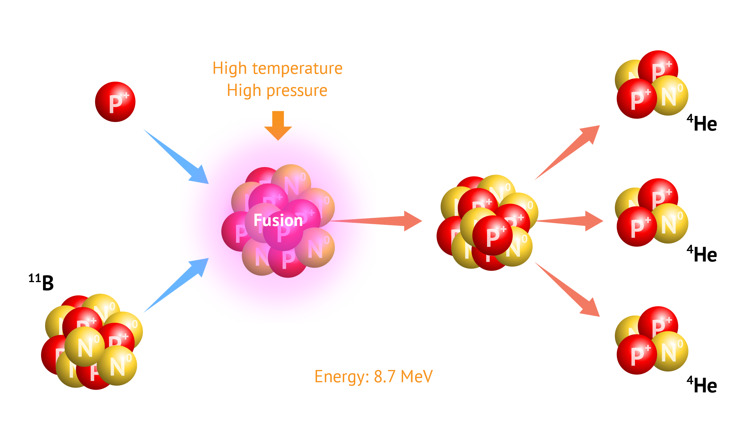
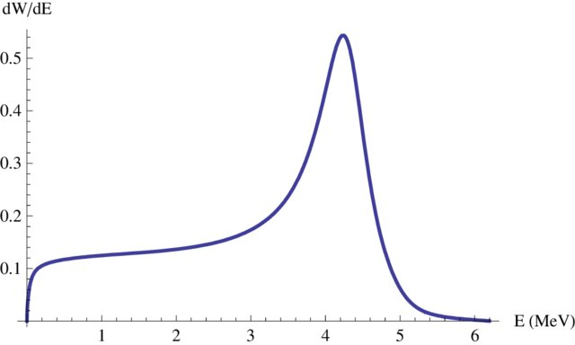
Hydrogen Boron Nuclear Fusion
The fusion reaction between Hydrogen and Boron nuclei
¹H + ¹¹B → ⁴He + ⁴He + ⁴He + 8.7 MeV
has recently attracted great research interest:
As clean, aneutronic energy source, with abudant and cheap fuel
As compact source of high energy alpha particles, for isotope production.
For hadrotherapy, via Proton Boron Capture Therapy (PBCT).

Slide 4
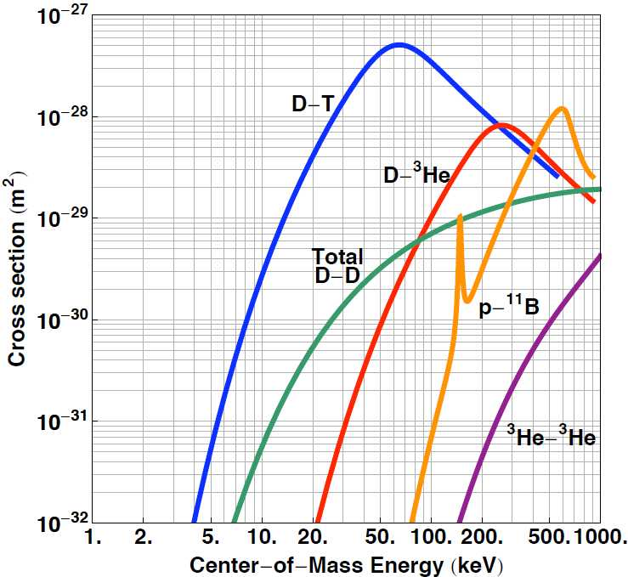
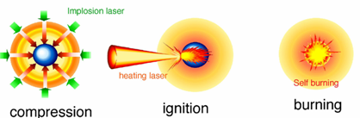
Hydrogen Boron Nuclear Fusion
But thermonuclear ignition is extremely difficult!
Fusion cross section is much lower than the DT reaction, requiring higher temperatures.
Bremsstrahlung losses are significant, due to Z = 5 of Boron.
Laser-driven fast ignition schemes are appealing, as protons can be accelerated to the right energy by the laser field, and triggering the reaction in a non-thermal way.
Promising results obtained in the last decade with ultra high power lasers.

Slide 5
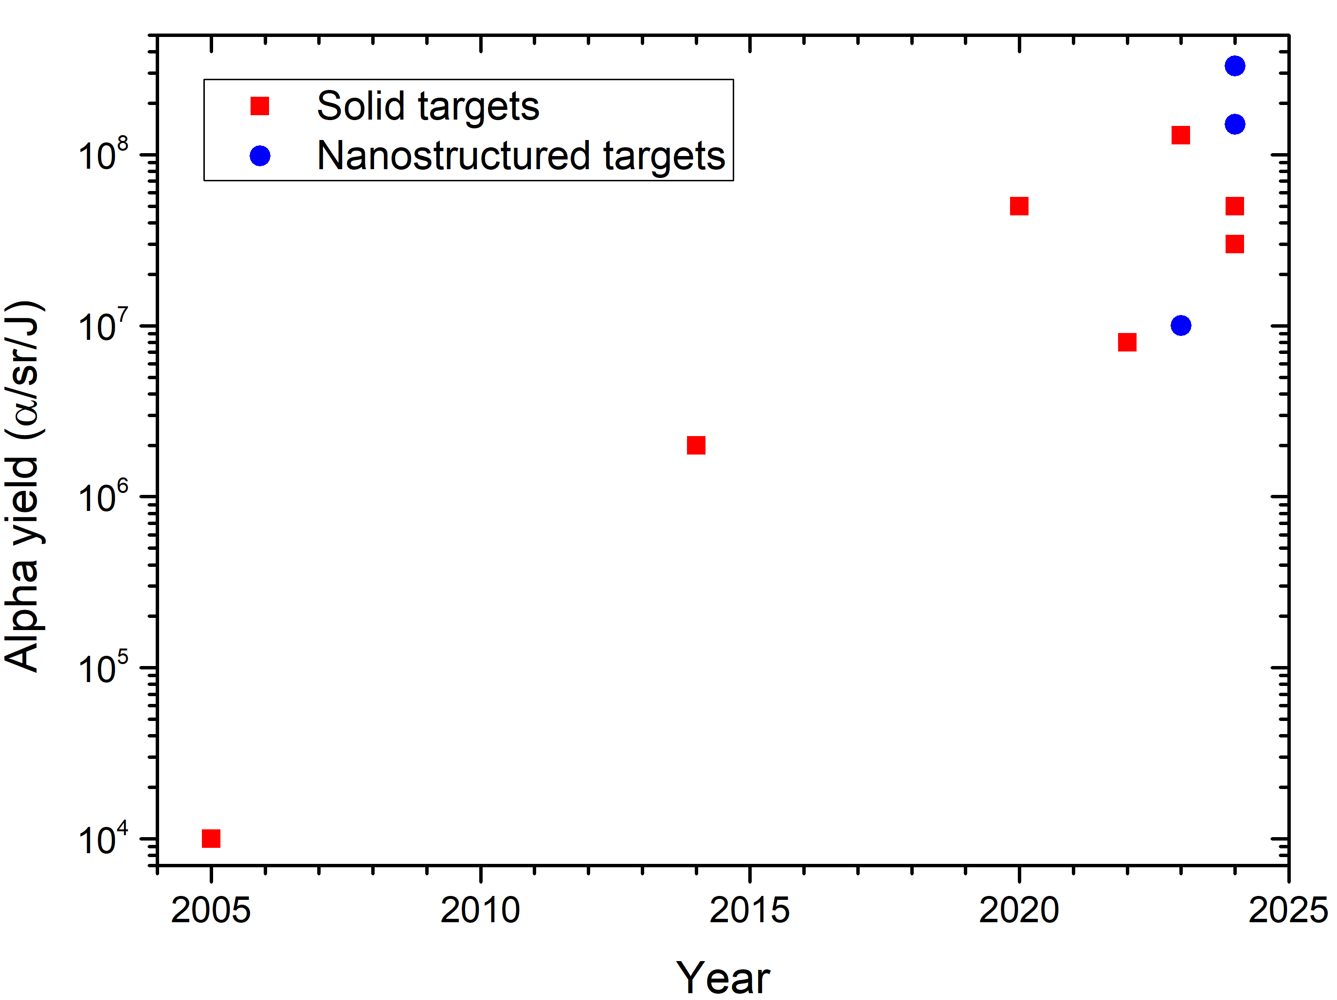
New Materials
Can we go even further by improving materials?
Usual targets are solid Borated materials, with Hydrogen only as contaminant below 1% content, or from a thin plastic coating.
Molloy
Schollmeier
Giuffrida
Margarone
Tosca
Only a small fraction of the laser energy is converted into proton energy.
Picciotto
Baccou
Labaune
There is still a net improvement margin from the target side!
Belyaev

Slide 6
Why Foams?
Laser-Plasma coupling is enhanced for plasmas near the critical density:
$n_{c}= \frac{ε_{0}m_{e}ω^{2}}{e^{2}} ≈$few mg/cm³ for laser wavelength of 1 μm
Underdense case: the laser propagates through the plasma, low conversion efficiency
Critical density case: strong coupling between laser and plasma modes, volumetric effect, high conversion efficieny
Overdense case: the laser is reflected at the boundary with the solid, surface effect, low conversion efficiency

Slide 7
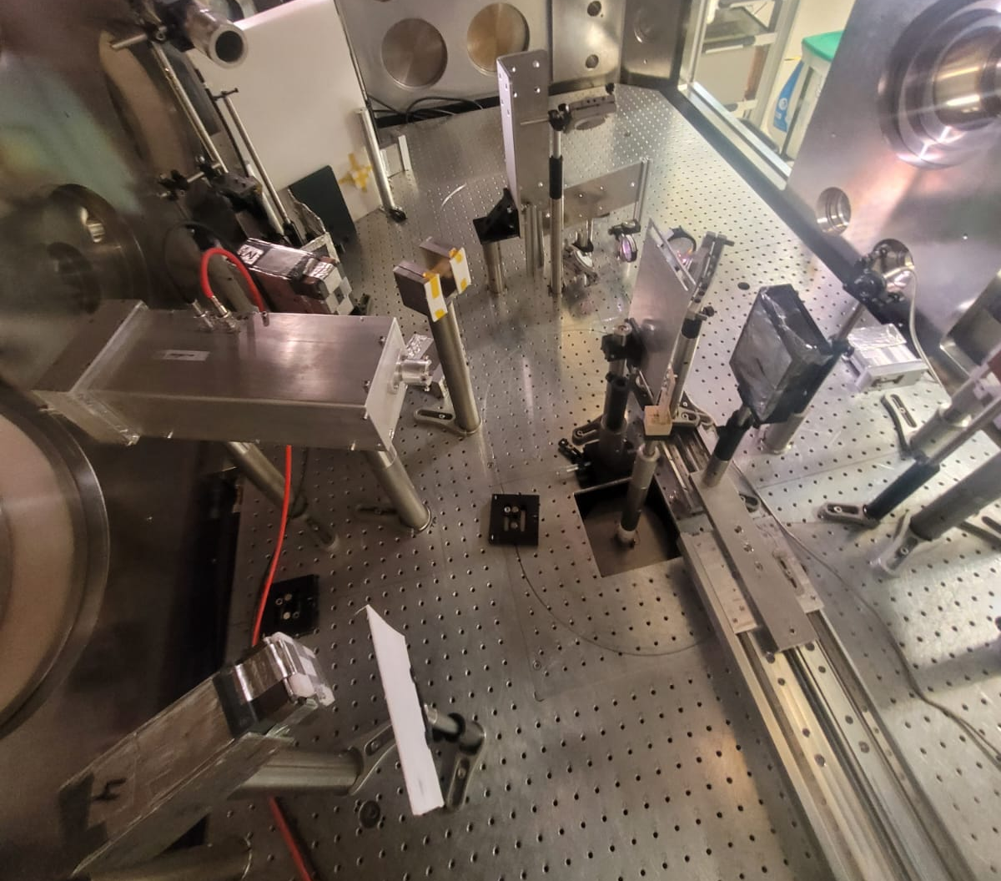
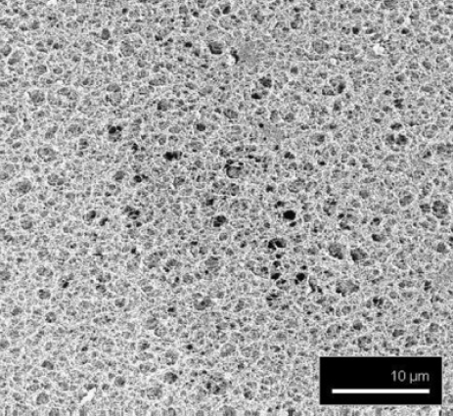
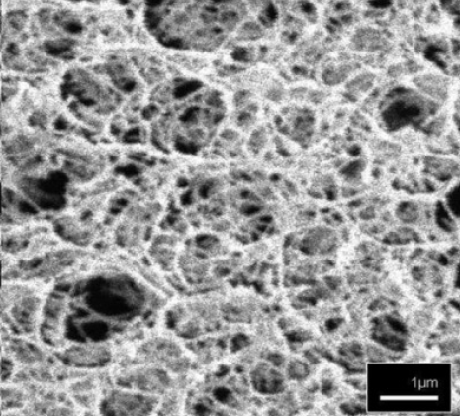
Exp. Campaign GSI, Darmstadt, Feb-2025
Investigation of the process of p⁺ acceleration in very long scale-length laser-generated plasmas using plastic foam targets
Use the “improved” proton source for the production of α-particles from the proton-boron fusion reaction
Thomson Parabola Spectrometer
Laser, 60 J – ps @ 1μm
Target
Electron Spectrometer
Boron catcher + Radiochromic films stack
+ TOF detectors, X-ray spectrometers, Nuclear track detectors, EMP detectors, gamma spectrometer…

Slide 8
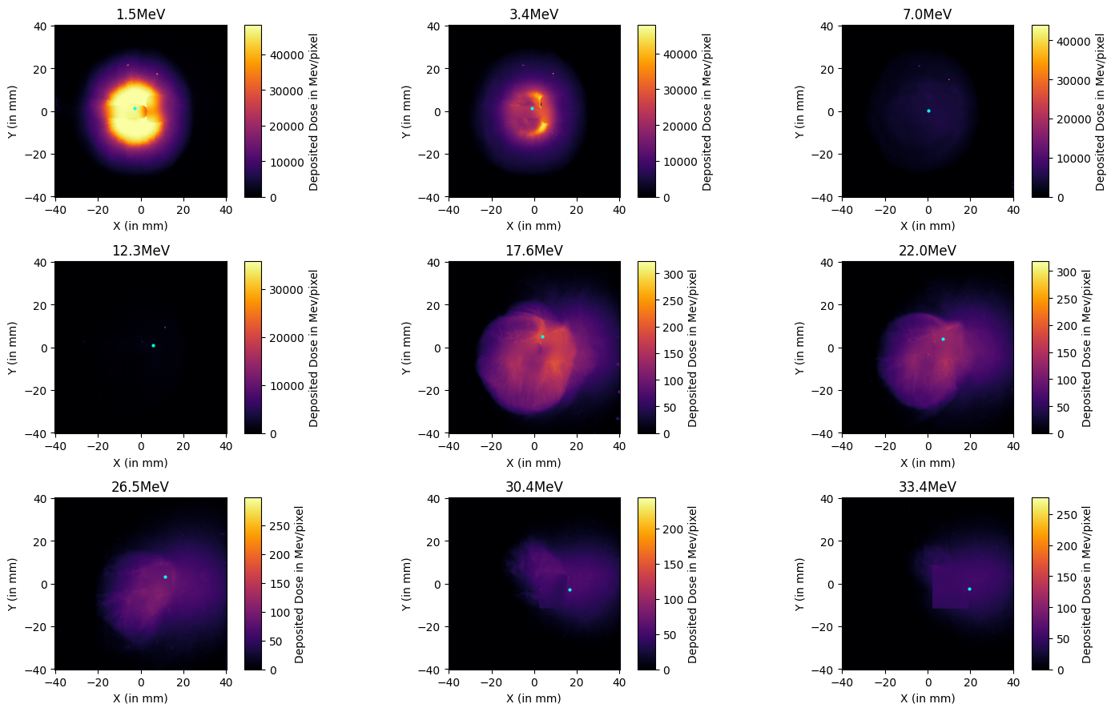
Exp. Campaign @ GSI, Darmstadt, Feb-2025
Analysis of data is still ongoing, but results are promising: High number of protons emitted from the foams, due to DLA or Coulomb explosion mechanisms, at energies where fusion cross section is high!
And maximum proton energy appears higher than a pure TNSA process.
Still, there is need to better understand the physics of the interaction of long pulse lasers with foams!

Slide 9
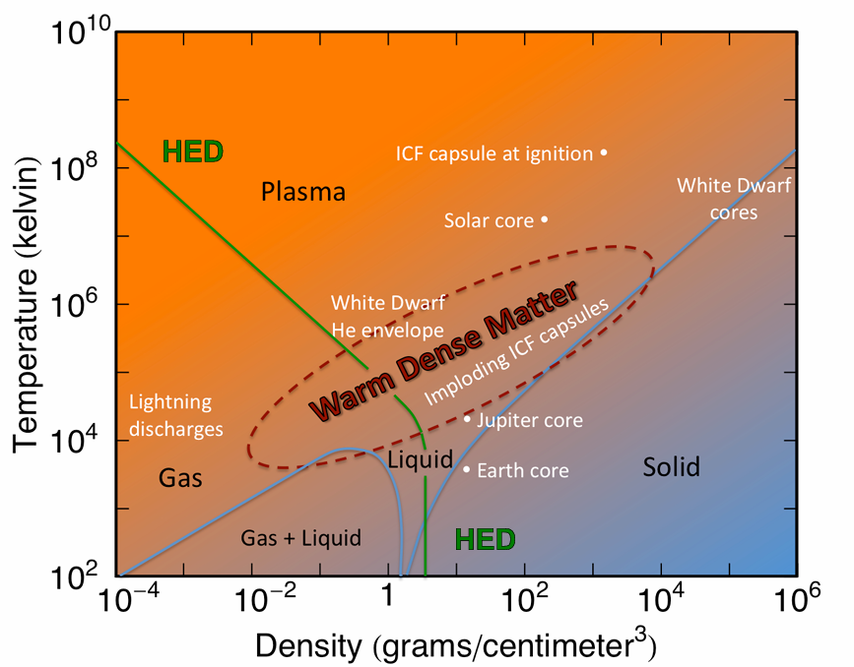
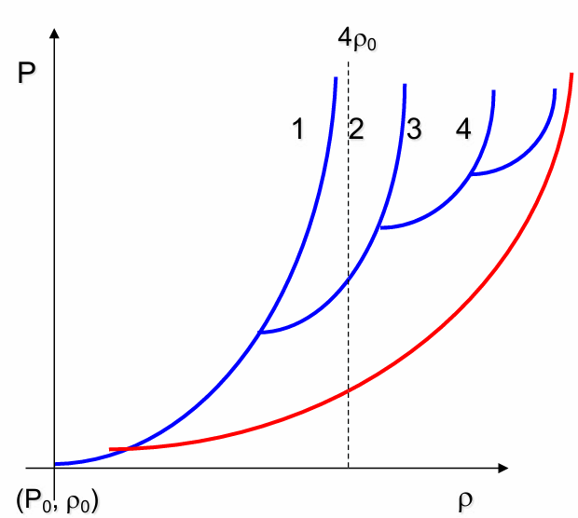
Laser Shock Compression
ICF ignition depends critically on compression: 1000x solid densities and ~100 Gbar are required, to be reached adiabatically.
A series of oppurtunely tuned shocks can approximate an isoentropic compression!
Shock compression
We need to know the behaviour of materials in extreme conditions and experimentally validate Equation of State calculations!
Isoentropic compression

Slide 10
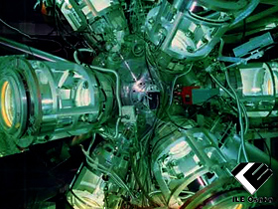
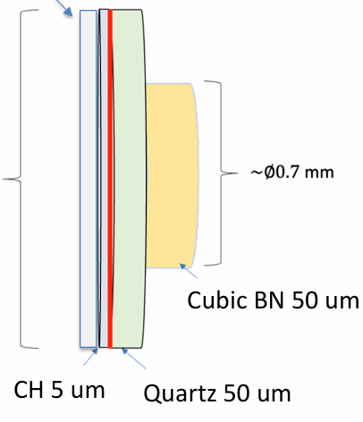
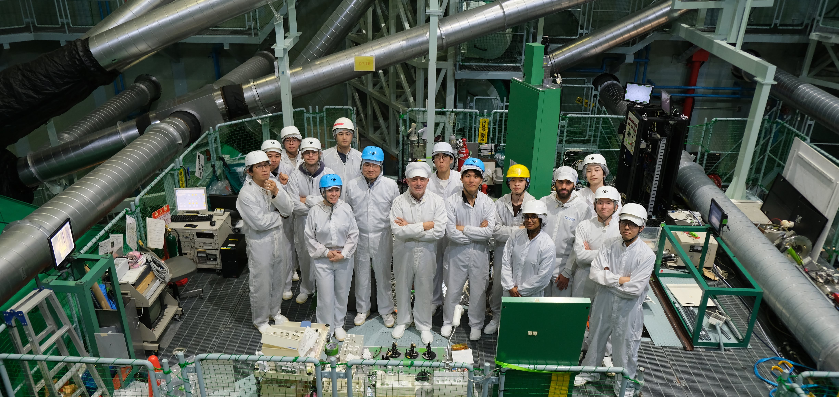
Exp. Campaign @ ILE, Osaka, Nov-2024
Cubic Boron Nitrate represents a promising alternative to diamond as ablator material for ICF capsules, due to its good mechanical properties (comparable with diamonds), and the possibility of having real time gamma diagnostics using Boron reactions.
VISARs, SOP, SSOP diagnostics
Laser, kJ – ns, 12 beams @ 351 nm
Goal of the experiment was to obtain data on BN EOS in the Mbar regime, and compare compression behaviour with high density Carbon.

Slide 11
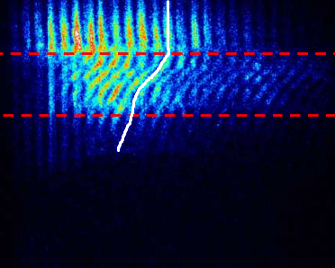
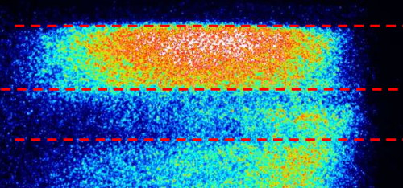
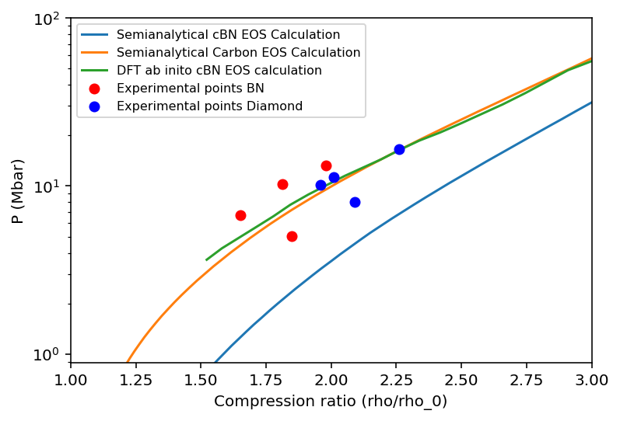
Exp. Campaign @ ILE, Osaka, Nov-2024
Shock velocity is obtained through interferometry (VISAR)
As passing of shocks heats the materials, temperature is measured with a streaked thermal camera
Cubic Boron Nitrate and Diamond show indeed similar compression behaviour
Semianalytical models for cubic Boron Nitrate seems to not be enough to reproduce accurately the experimental data (but they work for Carbon?), while Density functional theory models are better (although computationally very expensive)

Slide 12
Thank you for the attention!

Slide 13
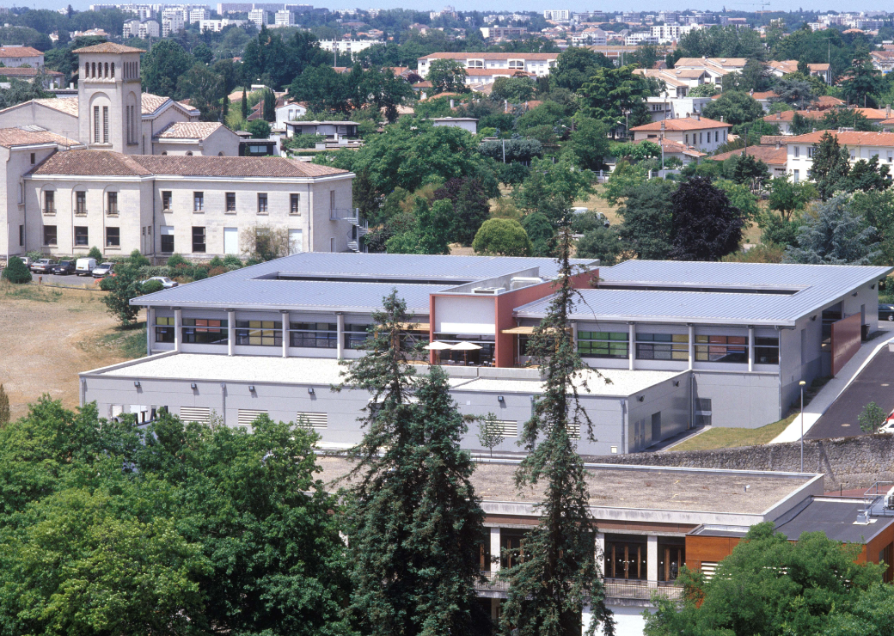
Our laboratory
CELIA stands for Centre Lasers Intenses et Applications and it is a joint research unit of Université de Bordeaux, Centre Nationale de Recherche Scientifique (CNRS) and Commissariat Energie Atomique (CEA), academic partner of the Laser MegaJoule facility.
The PETRUX team (Group for Particles and Transport, Ultra-short Radiation, and Matter under eXtreme conditions) conducts research, primarily experimental, on high-intensity laser-plasma interactions (using laser pulses ranging from nanoseconds to femtoseconds) and on the physics of high energy density (HED) matter.The HED regime is reached when the externally applied energy density to a material exceeds approximately 10¹¹ J/m³ (or around megabar pressure), resulting in significant changes in the material’s properties — from strongly coupled and degenerate condensed matter, through warm dense matter, to plasma.These extreme states of matter are of particular interest and occur naturally in planetary science and high-energy astrophysics, as well as in laboratory-scale experiments involving plasma acceleration, inertial confinement fusion (ICF), and scaled astrophysics.
The CELIA laboratory in Talence.
The LMJ interaction chamber.

