Slide 1
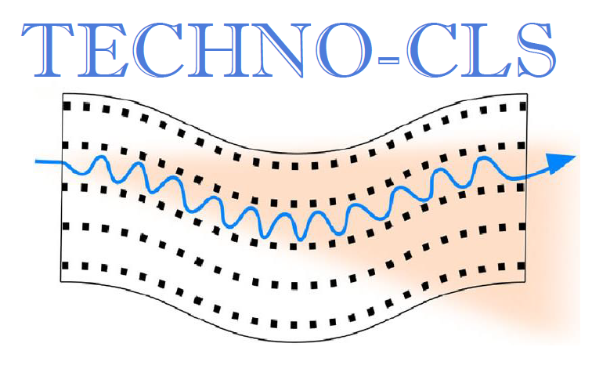
Light from Order: Radiation Generation through Oriented Crystal–Beam Interaction
Riccardo Negrello
Ph.D Student
University of Ferrara
INFN Ferrara Division
EIC-PATHFINDER-OPEN
TECHNO-CLS (GA 101046458)
H2020-MSCA-RISE
N-LIGHT (GA 872196)

Slide 2
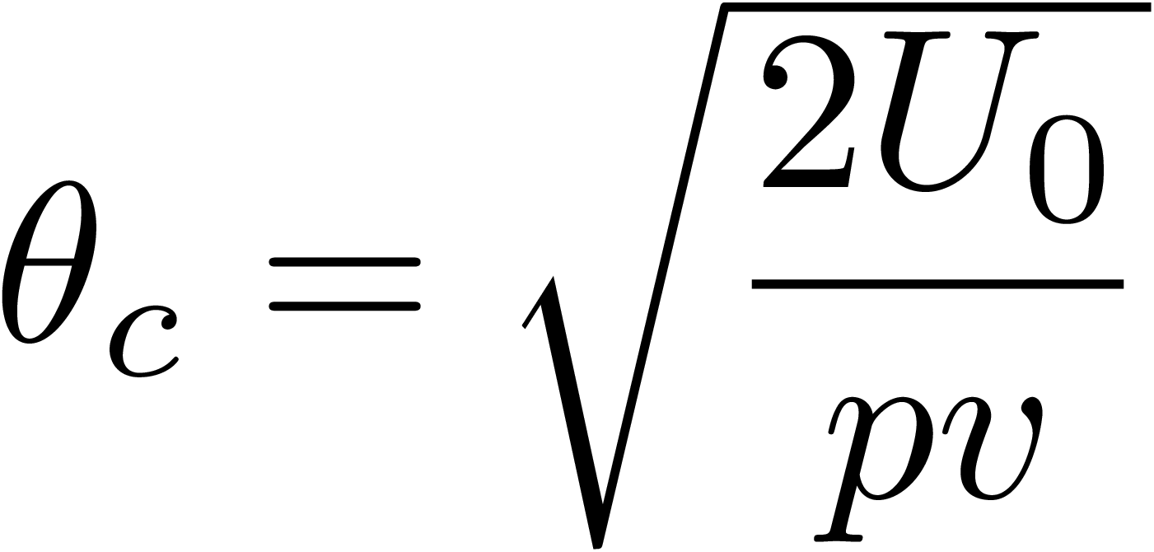
Channeling
Amorphous material
Oriented material
e+
particle
e-
If the incidence angle < critical angle
Multiple scattering
$$U_{0}≈21 eV$$
$E≈1 GeV →θ_{c}≈200 μrad$
$E≈100 GeV →θ_{c}≈20 μrad$
J. Lindhard, Kgl. Dan. Vid. Selsk. Mat.-Fys. Medd. 34 No 4, 2821–2836 (1965)
Particles feels the interaction with the atoms of the plane as a whole and start to oscillate in channeling
Multiple scattering causes particles to exit the channeling condition → dechanneling
2/9

Slide 3
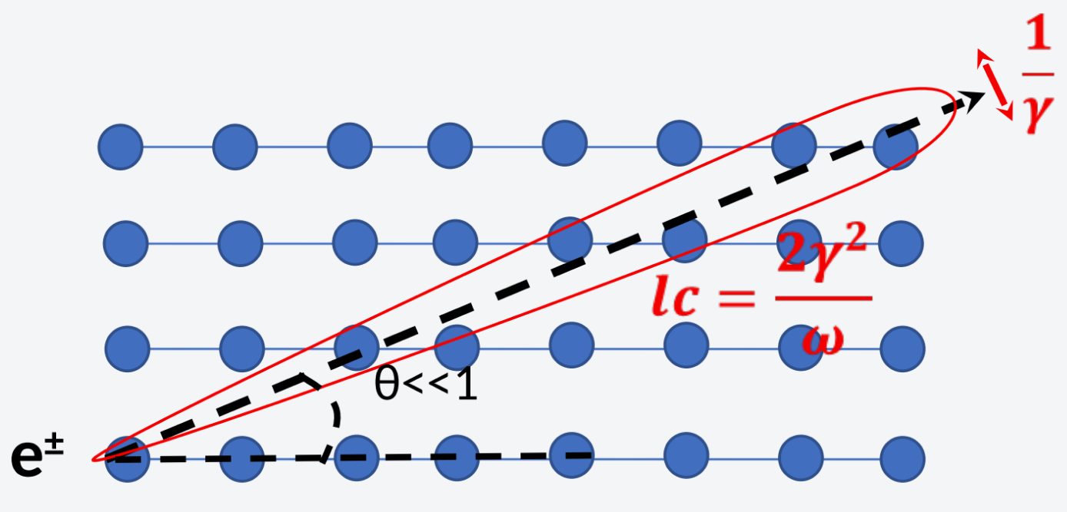
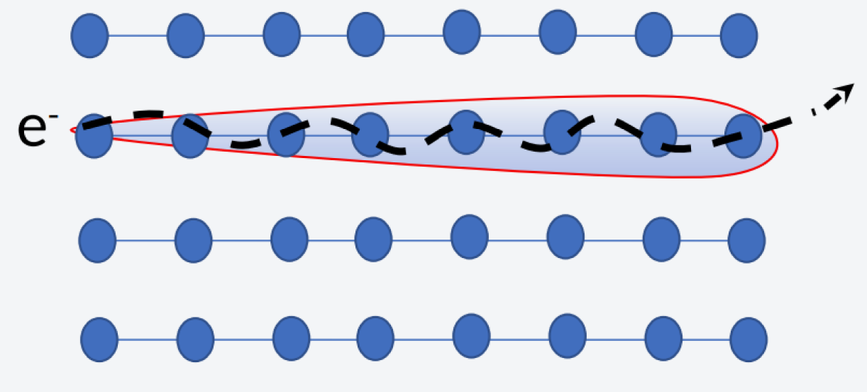
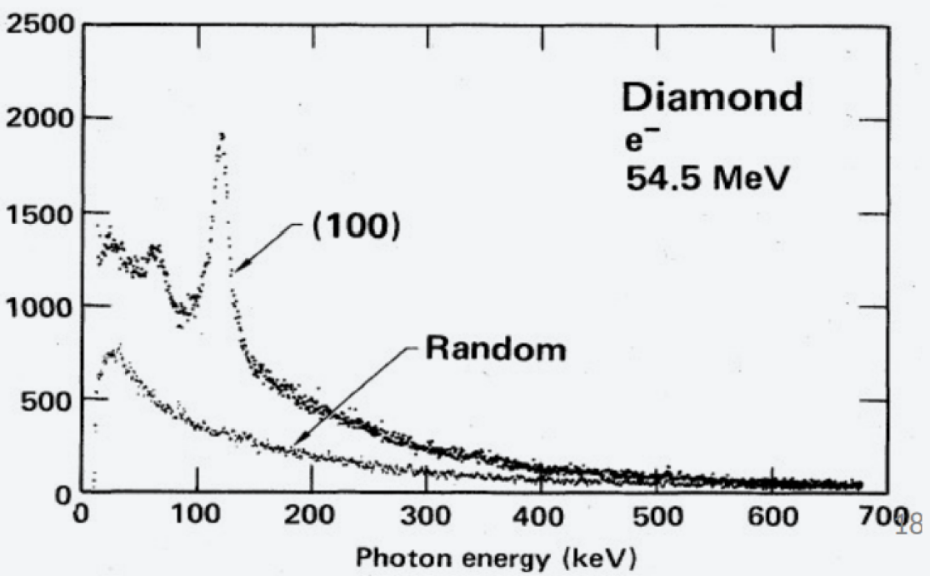
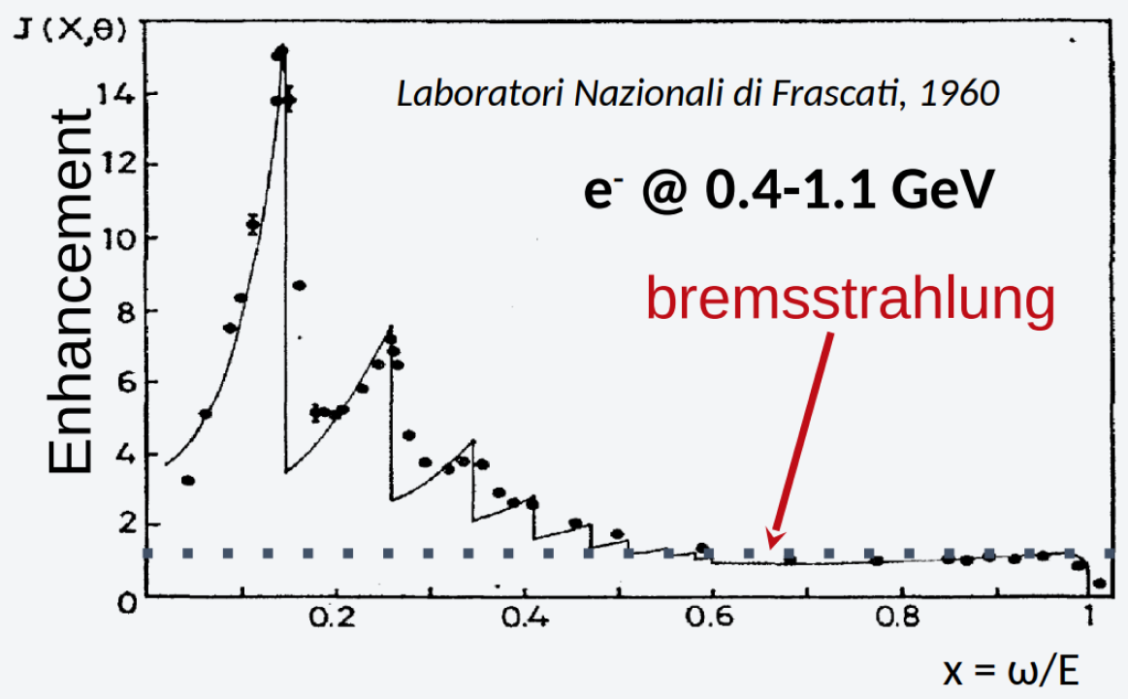
Enhancement of radiation in aligned crystals
Coherent Bremsstrahlung
Channeling Radiation
(1950s) Ter-Mikaelian, Ferretti, Dyson-Uberall
Channeling Radiation (1976, Kumakhov)
3/9

Slide 4
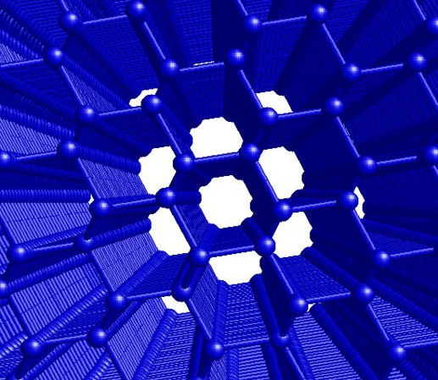
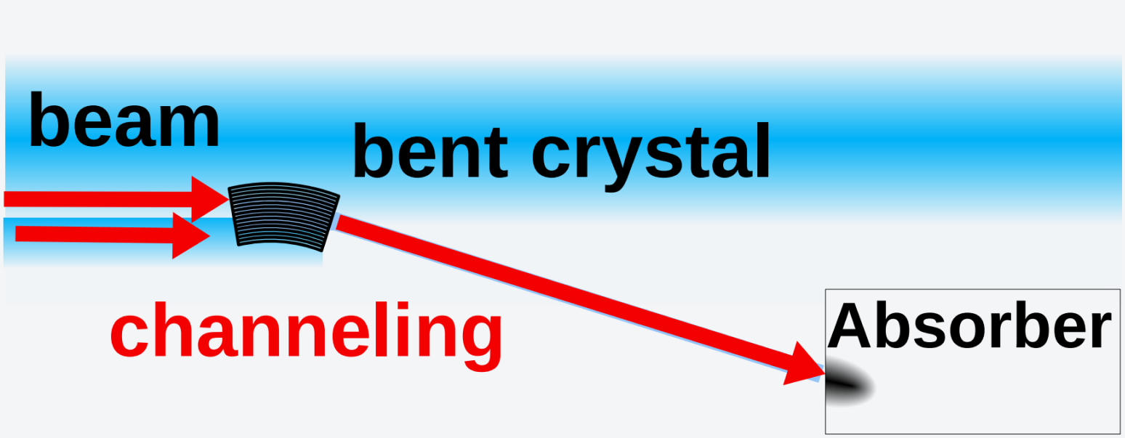
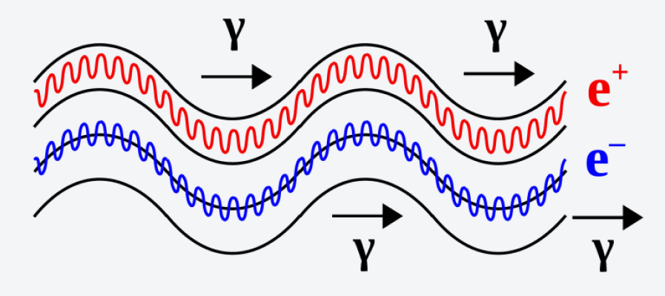
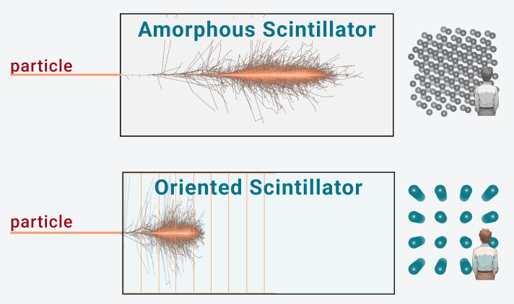
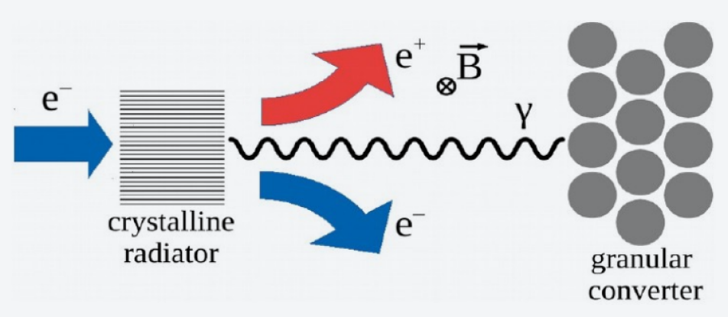
Experiments with crystals
Crystal-based collimation or beam extraction from an accelerator
Innovative X and gamma ray source (Crystalline Undulator)
Measurements of MDM & EDM of exhotic particles
Oriented Calorimeters
Improved positron source for future colliders
4/9

Slide 5
Experiments with crystals
Crystal-based collimation or beam extraction from an accelerator
Innovative X and gamma ray source (Crystalline Undulator)
Measurements of MDM & EDM of exhotic particles
Oriented Calorimeters
Improved positron source for future colliders
See P. Fedeli’s flash talk
5/9

Slide 6
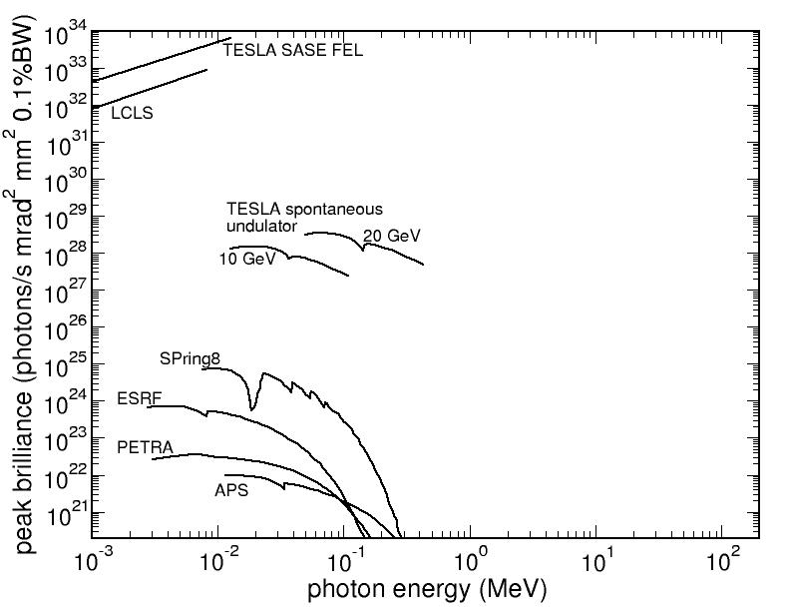
Radiation Sources: State of the Art
Which are the alternatives?
Inverse Compton Scattering & Gamma factory Requires an high intensity laser
Crystalline Undulator: - Crystals are passive elements
Cover this region
Korol, A.V., Solov’yov, A.V. Eur. Phys. J. D 74, 201 (2020).
6/9

Slide 7
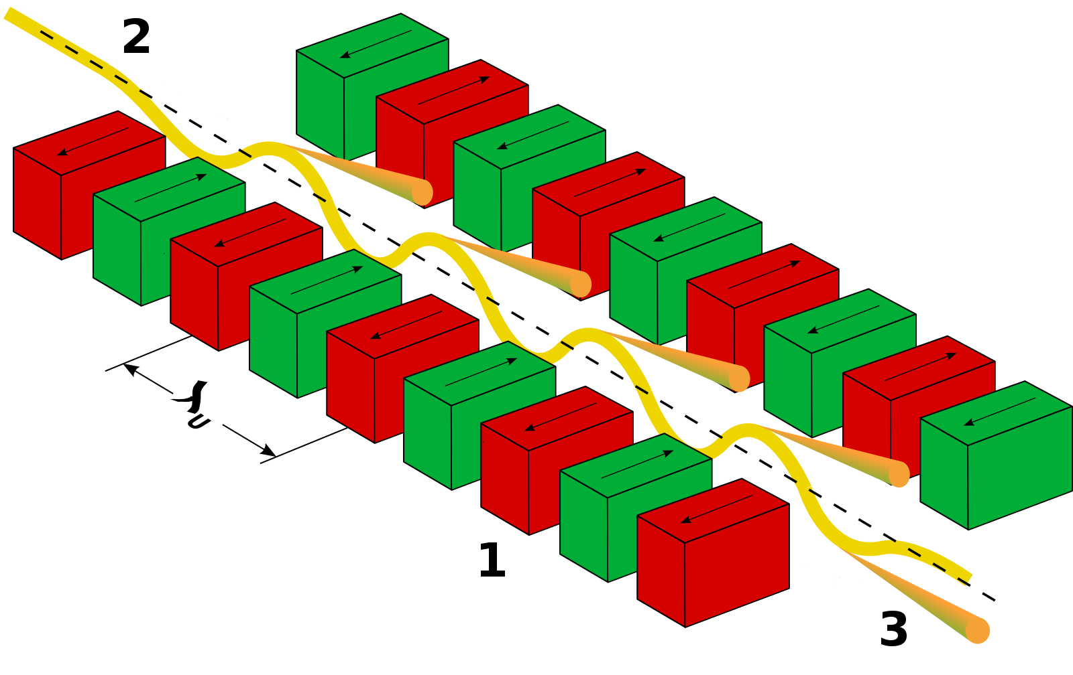
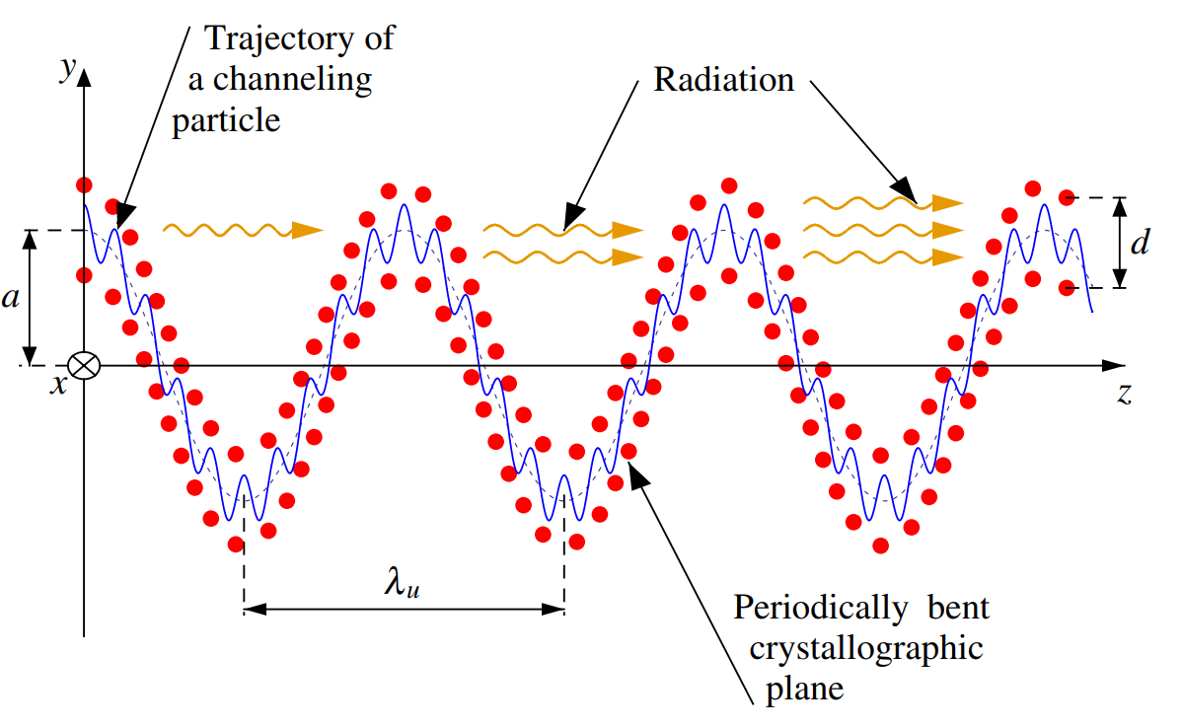
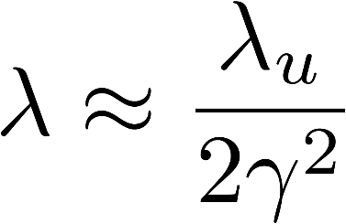
Crystalline Undulator
Magnetic undulator
Crystalline undulator
period ⁓ cm
X-ray production of ⁓10 keV
period < mm
Production of γ-rays of ⁓1 MeV
A. V. Korol and A. V. Solov’yov, Novel Lights Sources Beyond Free Electron Lasers, Springer Cham, 2022
7/9

Slide 8
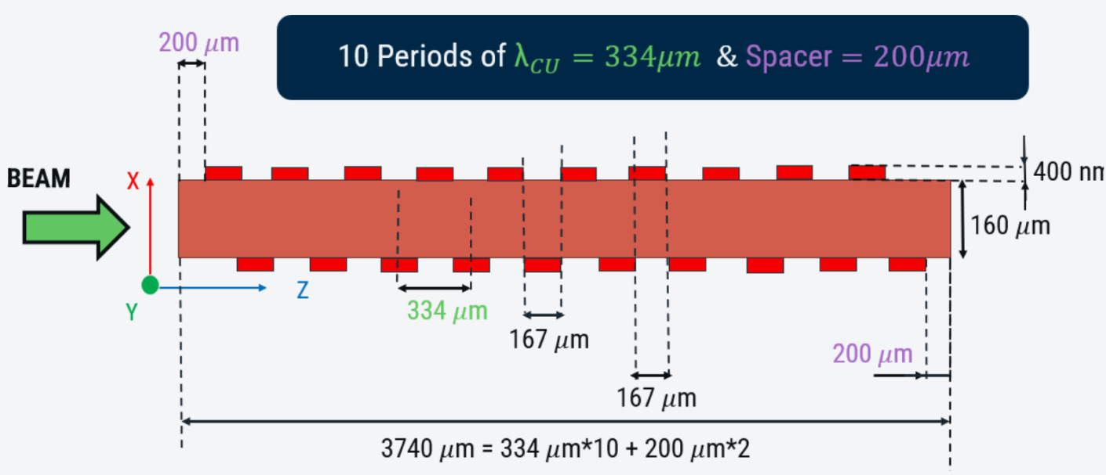
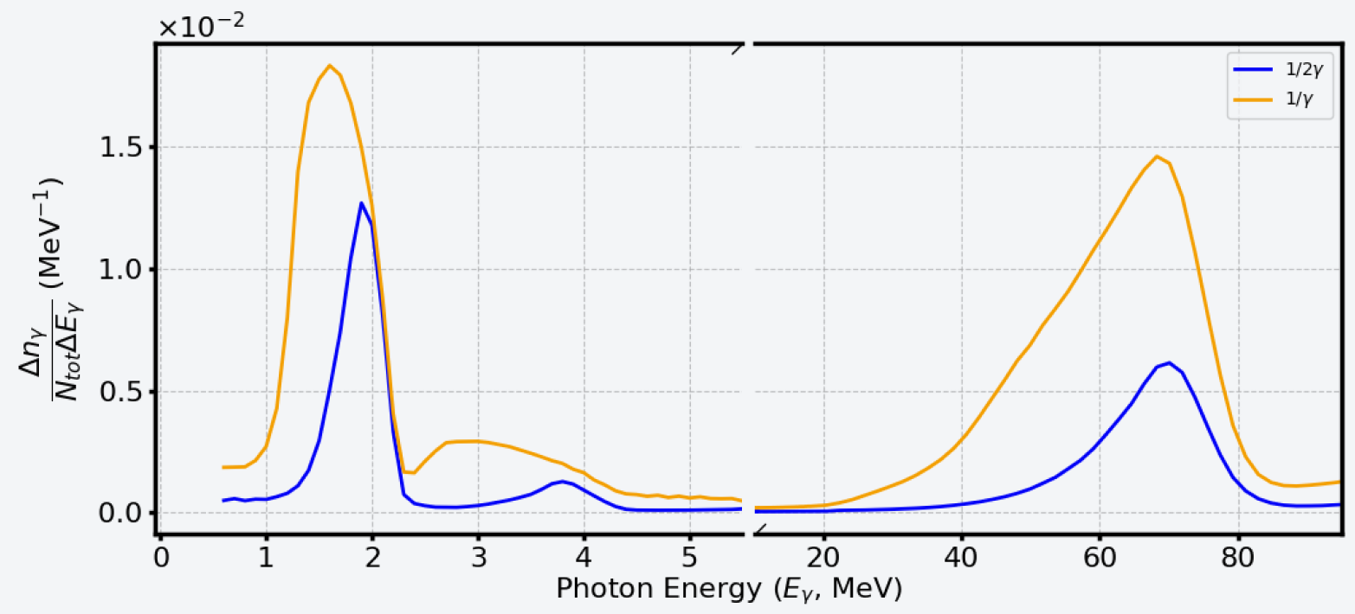
Simulations:
Crystalline undulator
Period 334 µm (10x)
Amplitude 1.85
Simulation: e+ 10 GeV
Long period oscillation
Crytalline Undulator peak
Short period oscillation
Channeling Radiation
TESTED @CERN SPS
e+ 35 GeV beam
8/9

Slide 9
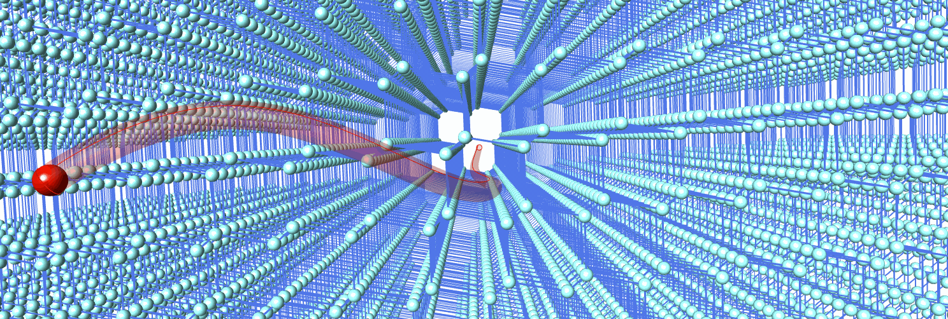
Applications
Conclusions
Medical physics
Nuclear interactions
Industry and technology
Accelerator physics
CU are tunable for specific applications.
Crystals function as passive elements.
Some prototypes have been produced and under test.
Thank you!
riccardo.negrello@unife.it
9/9

