Slide 1
SABRE North crystals meeting
Aldo Ianni
Lecce, Nov 27th, 2024

Slide 2
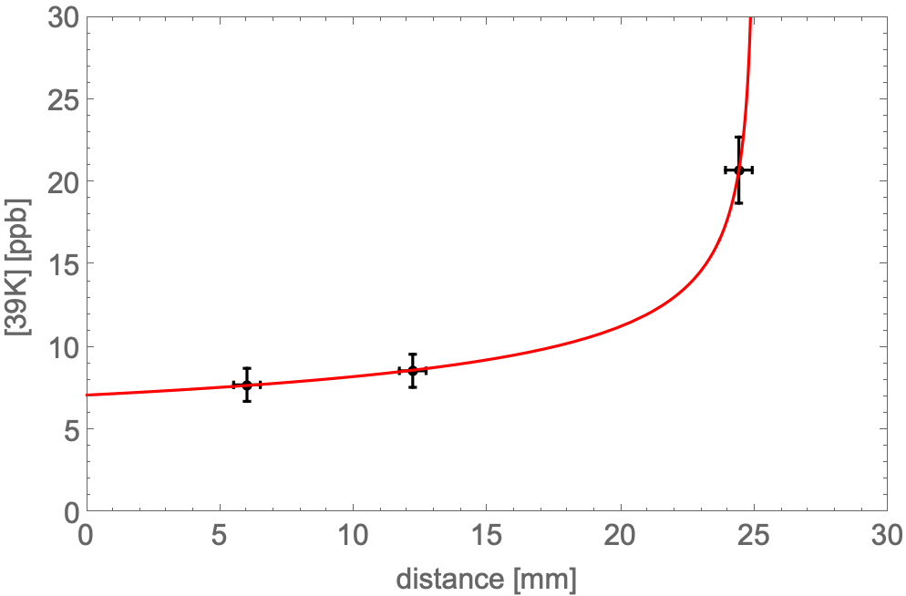
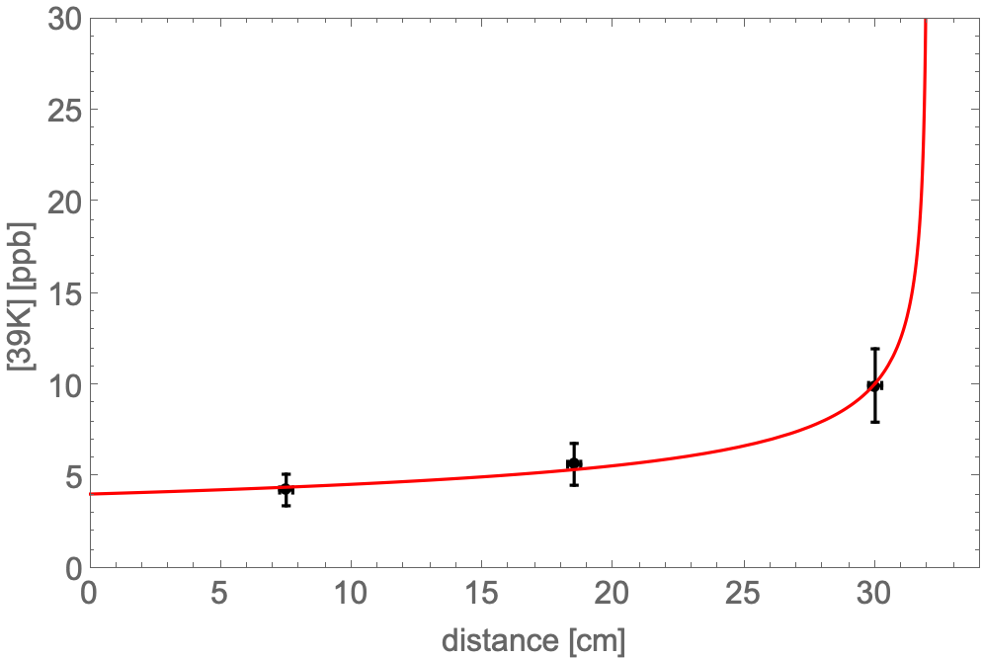
NaI-40
Grown without Thallium from 10 kg of Astro Grade.
Broken into chunks to make NaI-41
(test growth from chunks).
Opportunity to take samples from tip, tail and middle part for ICP-MS assay.
k_{eq} = 0.67±0.1 from the fit
<5.8±0.7> ppb

Slide 3
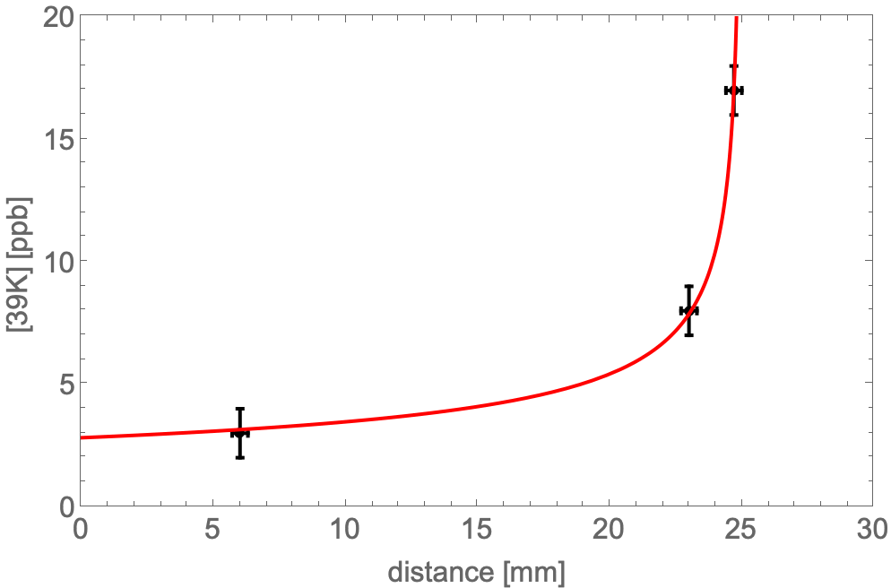
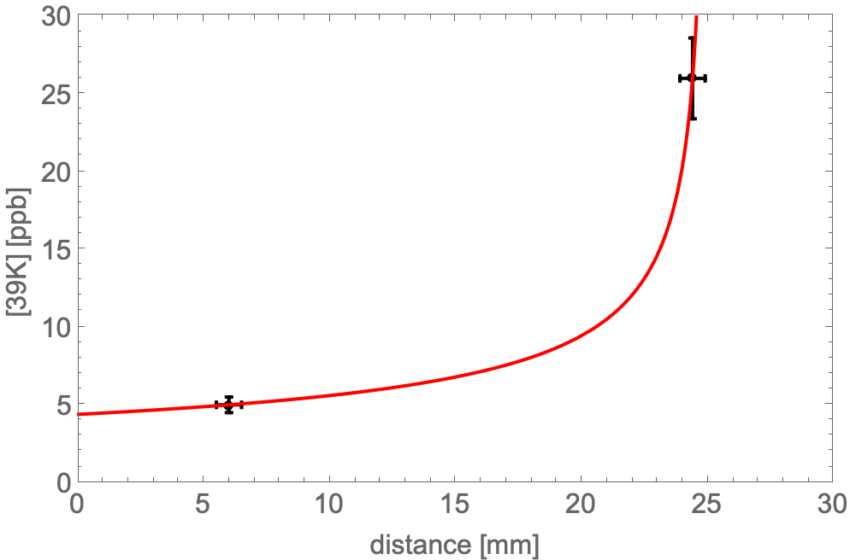
NaI-33 and NaI-35 tip/tail
k_{eq} = 0.59 ± 0.06
k_{eq} = 0.52 ± 0.04

Slide 4
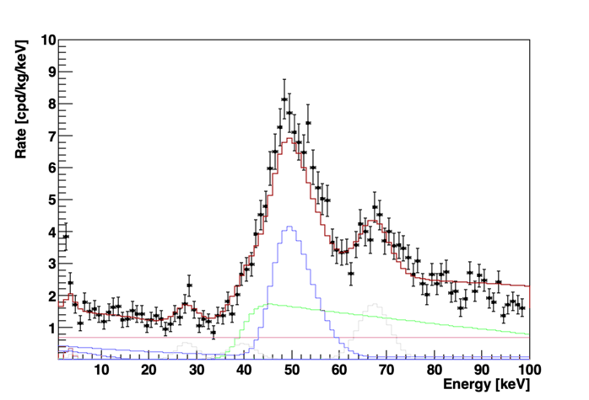
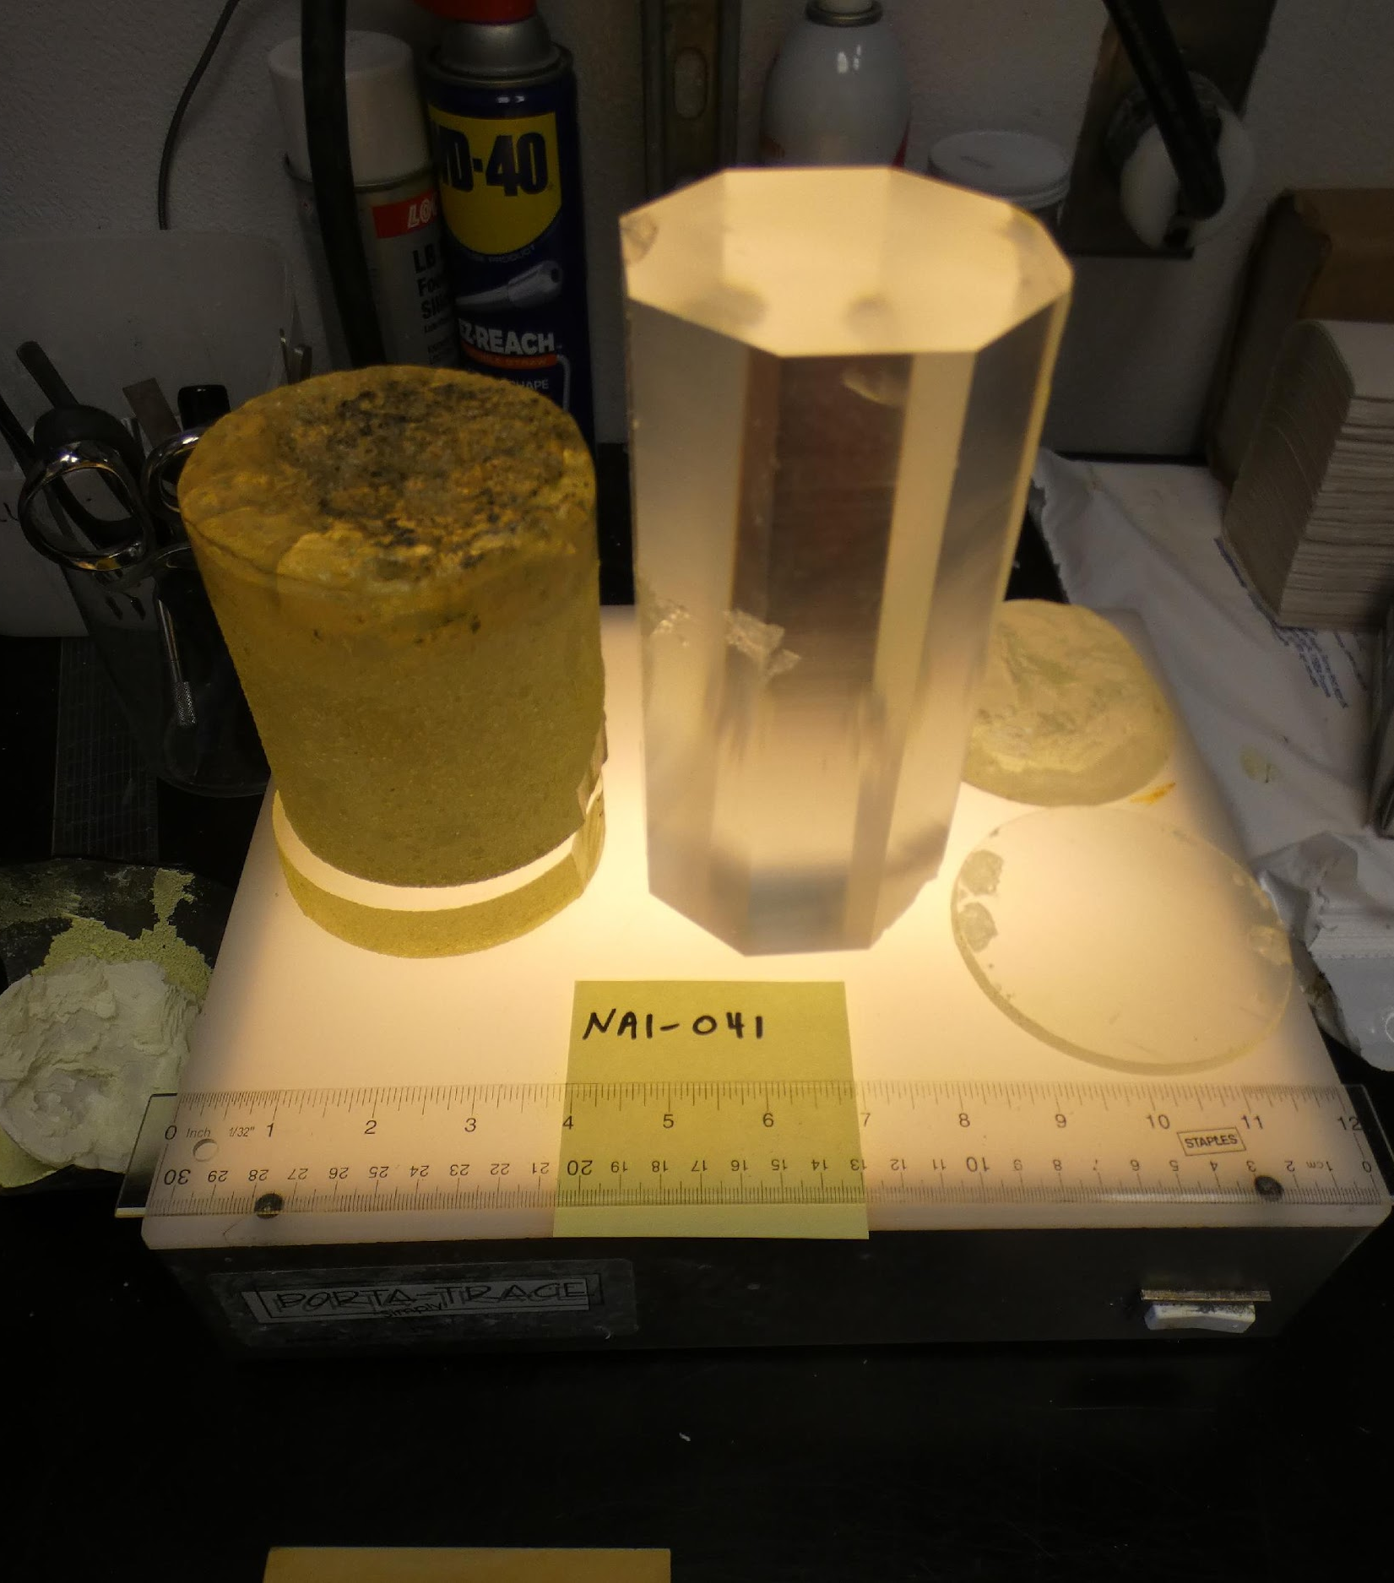
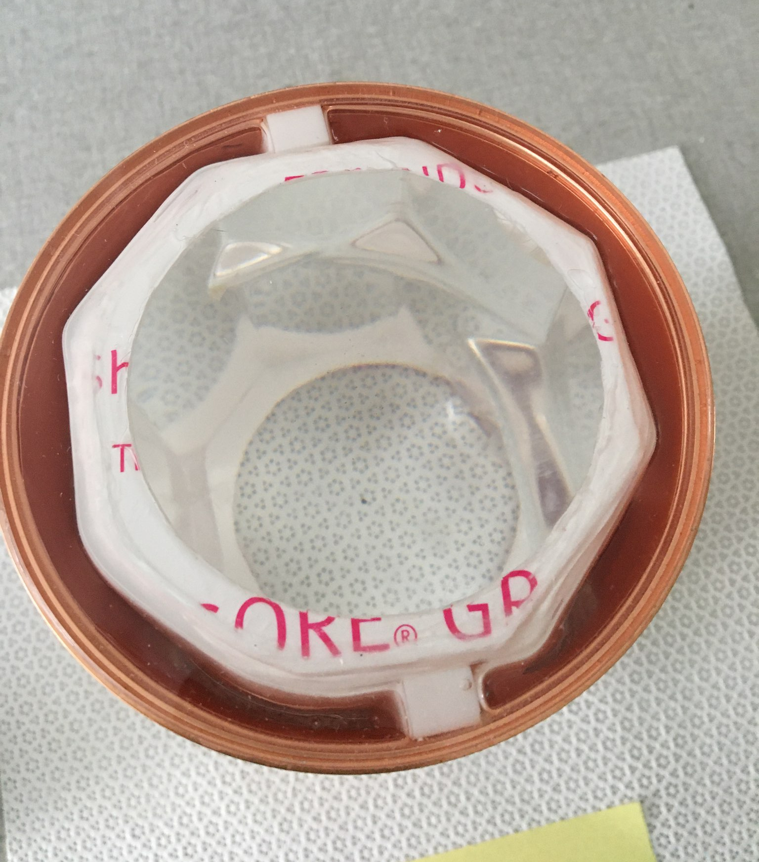
NaI-41
Results of ICP-MS measurements
underground since December 15th, 2023
LY = 10.02 +/- 0.03 phe/keV
FWHM energy resolution: 15.7% @59.6 keV
³⁹K: 5.7±0.9 ppb
k_{eq} = 0.63±0.1
Satisfactory results: important test toward
the production of NaI-42 from zone refined
powder
 | 39K [ppb] | 65Cu [ppb] | 85Rb [ppb] | 138Ba [ppb] | 133Cs [ppb] | 208Tl [ppm]
Tip | <4 | <5 | <0.8 | <0.2 | <0.3 | 520±4
Tail | 13.4±0.3 | <5 | <0.8 | 1.1±0.2 | 1.7±0.1 | 1343±10
Far Tail | 20.2±0.4 | 10.8±0.8 | <0.8 | 2.8±0.3 | 4.2±0.3 | 1607±12
²¹⁰Pb
²¹⁰Pb
preliminary
cosmogenics

Slide 5
Production of NaI-42
Zone refining of 12 kg of powder
Minimum 4 runs of ZR required
Production of crystal could start in Jan-Feb
Decision on encapsulation and transportation

Slide 6
Production of NaI-Korea
15 kg of purified powder from COSINE to RMD
RMD will grow a crystal with 8 kg
RMD send samples of powder to LNGS and LSC for screening
After growth RMD send sample of tip and tail to LSC
Crystal enclosure at RMD
Transportation by boat
Crystal ready early January
GOALS:
Test radiopurity from Korean powder with different growth method
Could ask COSINE collaboration to make use of distilled water for powder purification
An alternative to Merck

Slide 7
ZR for crystal production
It takes place at MELLEN
Procedure:
Dry powder for 1 week at RMD
Increase temperature at 400 C
Add SiCl₄ for 20 min
Remove gas from ampoule
Seal ampoule
Move ampoule to MELLEN
Leak test
Consolidation run
ZR run 25 passes at 2 inch/h
k_{eq} = C_{S} / C_{L} segragation coefficient, the lower k the greater impurities are moved away from crystal matrix

Slide 8
ZR accident
During first run for NaI-42 production: ampoule burst
Caused by leak in ampoule
Risk mitigation:
Consolidation run done at MELLEN
Leak test before starting ZR at MELLEN

Slide 9
H₂O + C –> H₂ + CO water consumes C coating at high temperature
NaI + H₂O --> NaOH + HI water produces NaOH which dissolve fused quartz
SiCl₄ + 2H₂O --> SiO₂ + 4HCl
NaOH + HCl --> NaCl + H₂O SiCl₄ consumes NaOH
Side effect of HCl
NaI + HCl --> NaCl + HI
2HI --> I₂ + H₂

Slide 10
ZR efficiency
k_{eq} can be measured from phase diagram, crystal growth (tip/tail), zone refining data
K ~ 0.45 – 0.67 expected significant reduction
Rb ~ 0.18 – 0.37 expected very significant reduction
Pb ~ 1.1 (PbI₂) no reduction expected, slight worsening
If Pb in the powder it can be removed by purging during ZR (PbI₂ volatile at 661 C) or, if coming from water, improve water quality in powder production

Slide 11
ZR Run4
Sample Run4 | ³⁹K [ppb] | ⁶⁵Cu [ppb] | ⁸⁵Rb [ppb] | ¹³³Cs [ppb] | ¹³⁸Ba [ppb] | ²⁰⁸Pb [ppb]
 | LSC/ Seast. | LSC/ Seast. | LSC/ Seast. | LSC/ Seast. | LSC/ Seast. | LSC/ Seast.
powder | 7 | 5 | <0.2 | 1 | 3.6 | 1.1
Zone 1 | <4 | <4 | <0.8(<0.6) | <0.3 | <0.3 | 2.0±0.3(2)
Zone 2 | <4 | <4 | <0.8(<0.6) | <0.3 | 1.2±0.3 | 2.0±0.2(1.3)
Zone 3 | 10±0.4 | <4 | <0.8(<0.6) | <0.3 | 2.7±0.2 | 1.6±0.3(1.2)
Zone 4 | 22±0.5 | <4 | <0.8(<0.6) | 1.1±0.1 | 8.1±0.5 | 1.9±0.3(1.2)
Zone 5 | 65±2 | 12±2 | <0.8(<0.6) | 9±0.2 | 17±0.9 | 1.4±0.3(1.1)
All beta-like contribution in ROI for NaI-33 spectral fit (~30% of rate) corresponds to ~0.4 ppb of ⁸⁵Rb

Slide 12
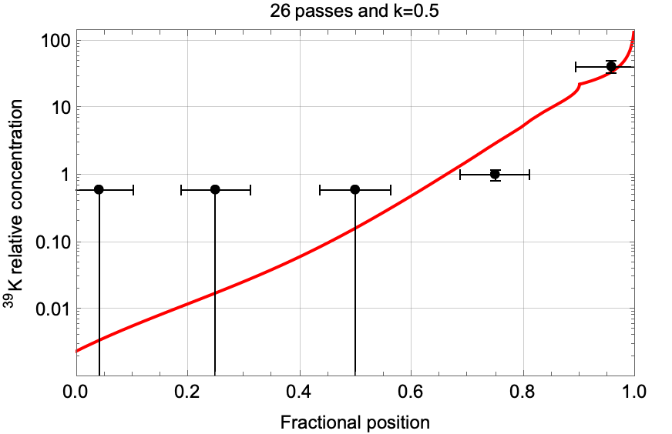
Qualitative comparison with the model: K
RUN1
RUN4
Within 80% length ~92% reduction
Within 75% length ~95% reduction

Slide 13
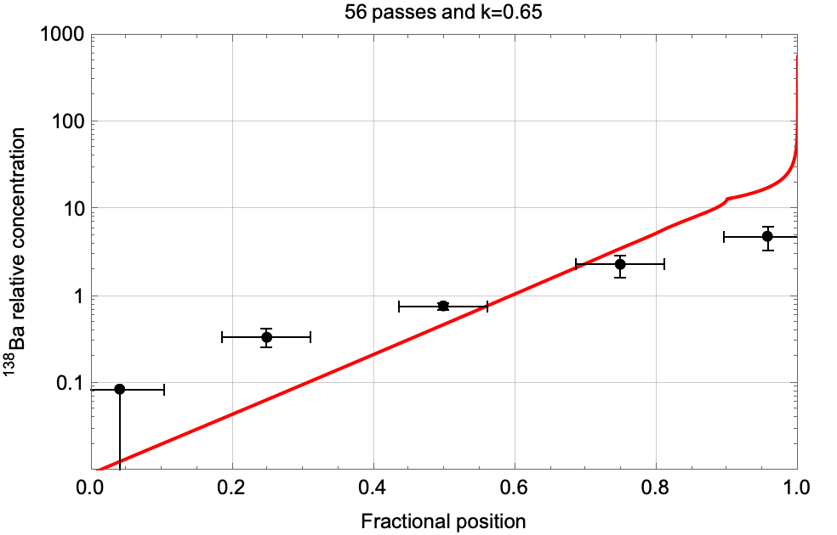
Qualitative comparison with the model: Ba
RUN4
RUN4
Ba is a proxy of Ra
Within 80% length ~77% reduction
Within 75% length ~84% reduction

Slide 14
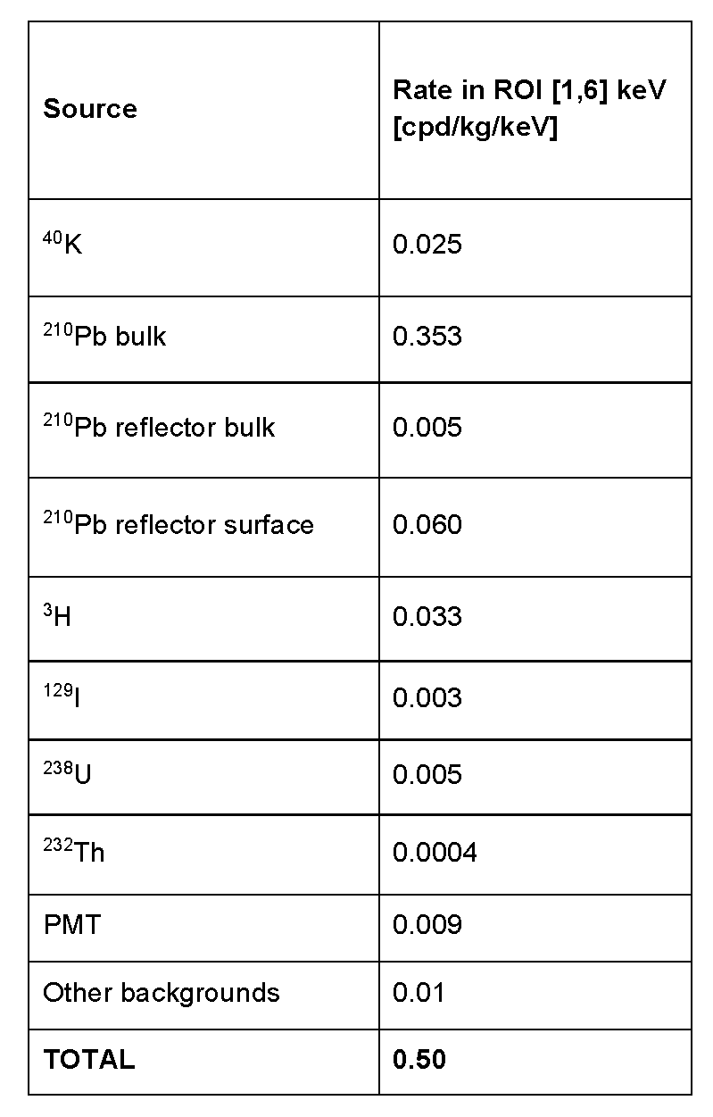
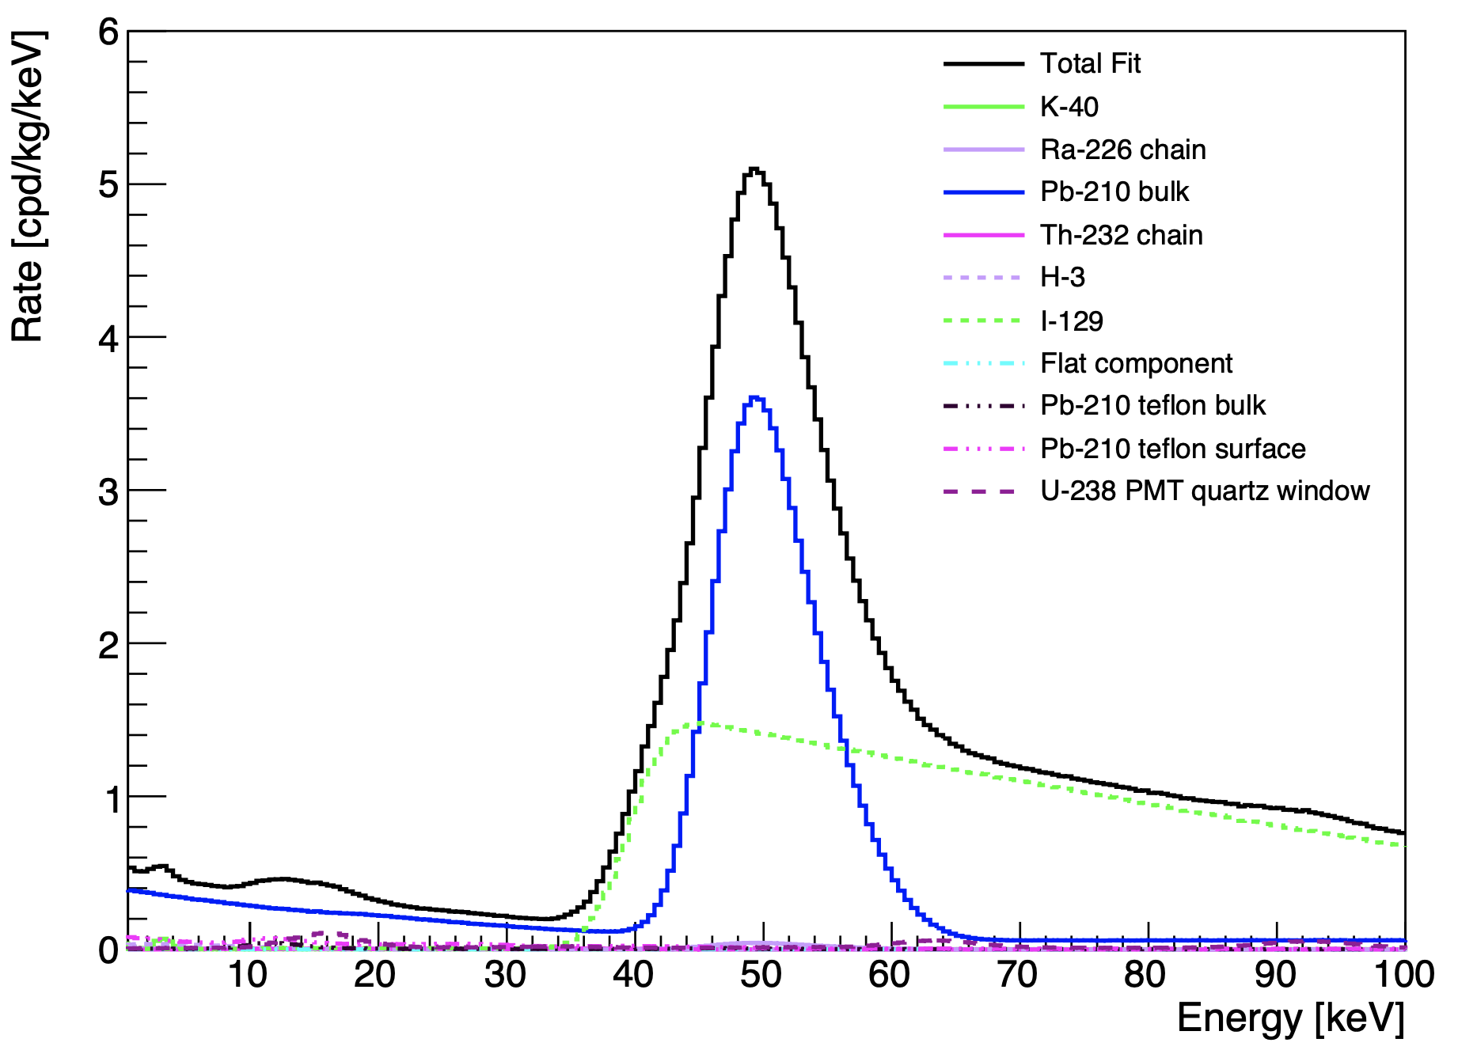
Expected background in SABRE crystals
Use spectral fit from NaI-33
Apply reduction as from zone refining purification
Produce spectrum with MC code

