Slide 1
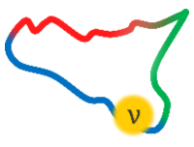
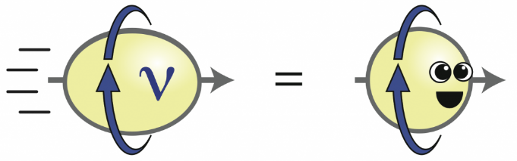
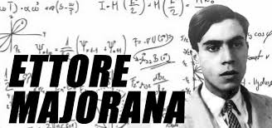
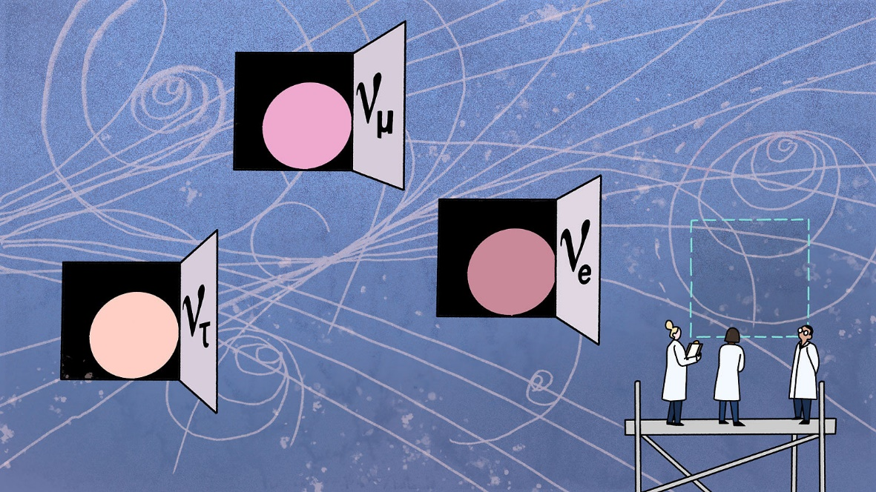


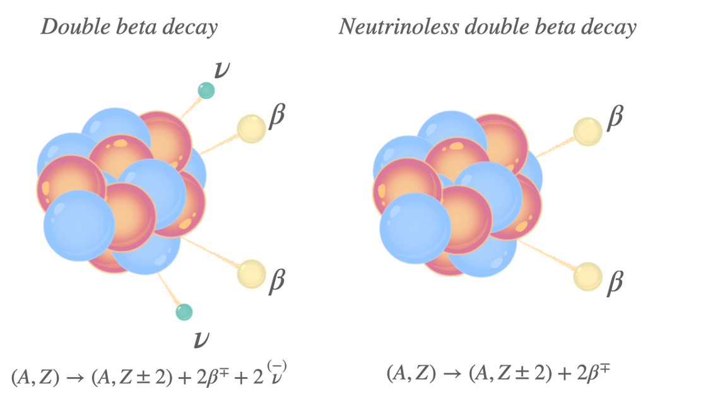


Multi-Aspect Young ORiented Advanced Neutrino Academy
MAYORANA Workshop
Modica (Sicily-Italy), June 16 to 18, 2025
Two-neutrino double-beta decay:
A key for the 0νββ NMEs problem
Fedor Šimkovic

Slide 2
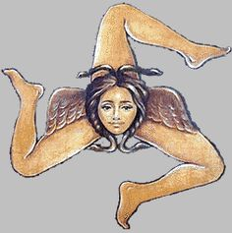

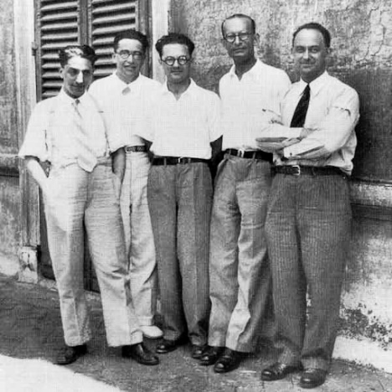
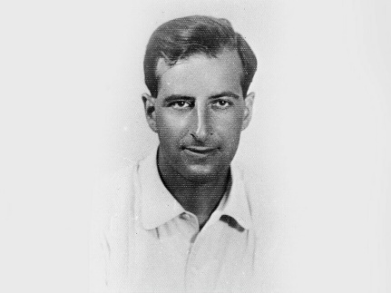
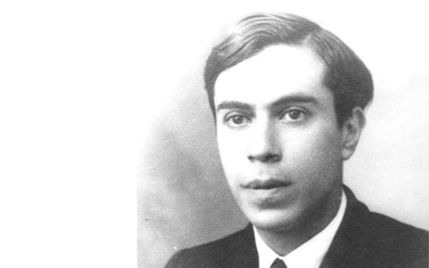
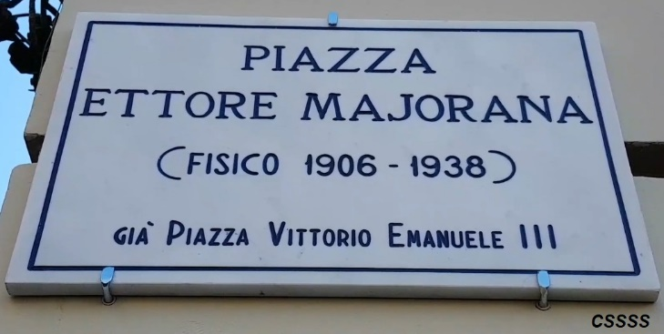
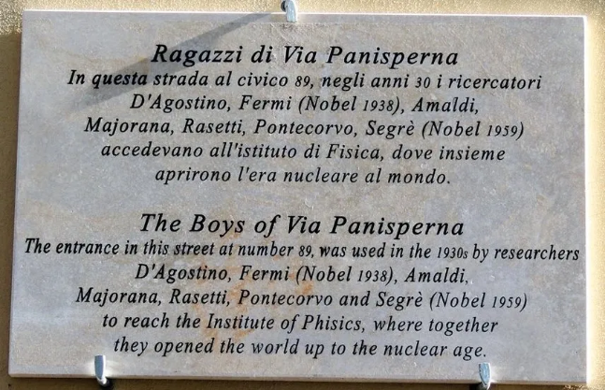
OUTLINE
Introduction (a connection of 0νββ and 2νββ NMEs)
II. A derivation of the 2νββ−decay half-life revisited
(the r ole of a summation of over contributions through the states
of intermediate nucleus)
III. A calculation of the 2νββ−decay NMEs within a schematic model
(role of the spin-isospin symmetry restoration)
IV. The semi-empirical formula for 2νββ-decay NMEs
Improved description of the 2νββ-decay
(the effect of lepton energies in energy denominators, widths of
intermediate nuclear states, effect of p_{1/2} wave states, …)
New physics beyond the SM
Outlook
ν_{e}
ν_{μ}
Acknowledgments: A. Faessler, P. Vogel, O. Nitescu, ...
Bruno Pontecorvo
Ettore Majorana

Slide 3
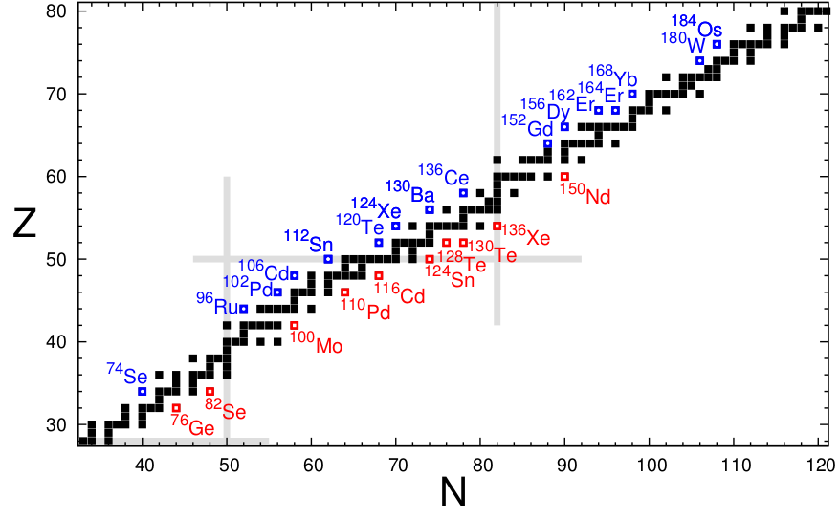
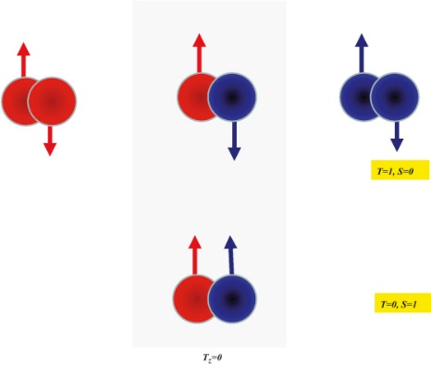
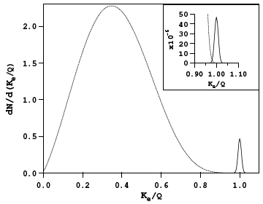
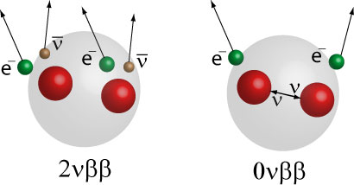
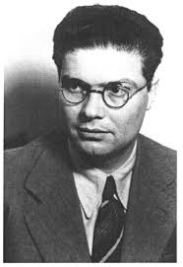
Nuclear
double-β
decay
(even-even nuclei,
pairing int.)
Phys. Rev. 48, 512 (1935)
Two-neutrino double-β decay – LN conserved
(A,Z) → (A,Z+2) + e⁻ + e⁻ + ν_{e} + ν_{e}
Goepert-Mayer – 1935. 1st observation in 1987
2νββ
Nuovo Cim. 14, 322 (1937)
Phys. Rev. 56, 1184 (1939)
0νββ
Neutrinoless double-β decay – LN violated
(A,Z) → (A,Z+2) + e⁻ + e⁻ (Furry 1937)
Not observed yet. Requires massive Majorana ν’s

Slide 4
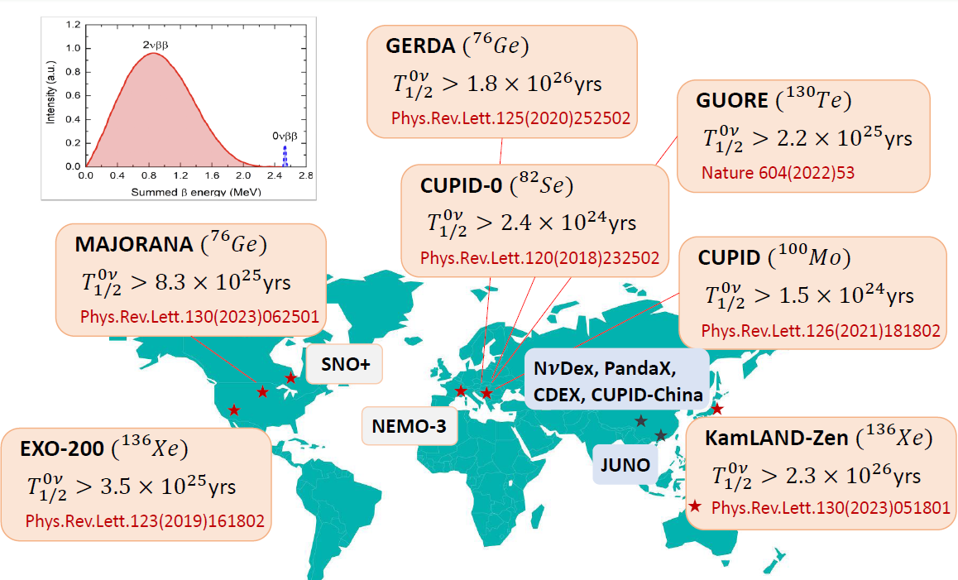
0νββ experiments – a worldwide competition of ideas and underground physics technologies

Slide 5

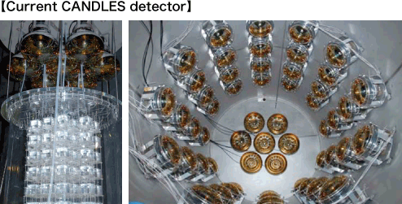
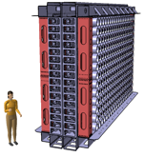
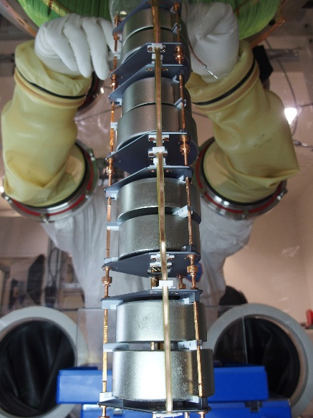
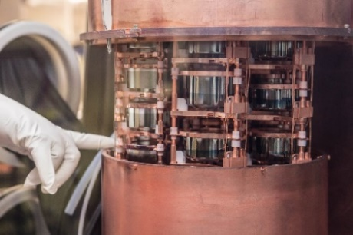
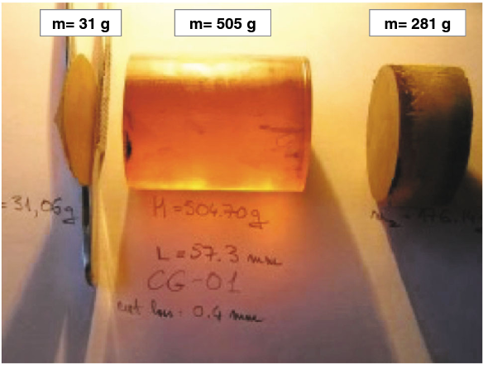
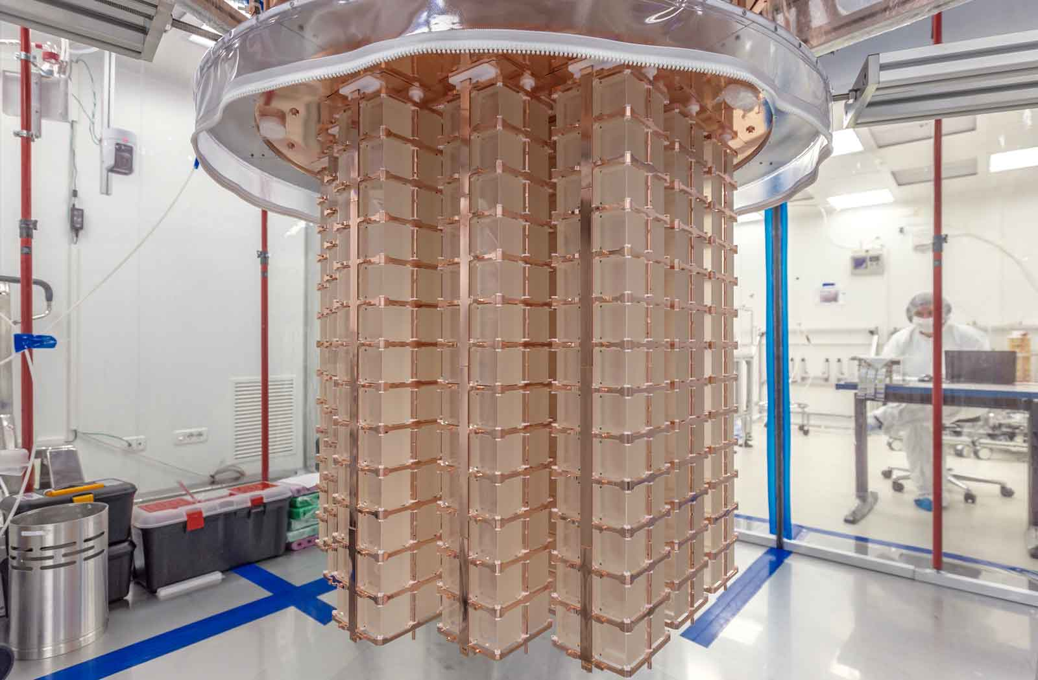
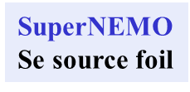
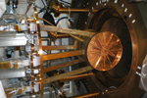
0ν ββ decay isotopes and experiments
CANDLE
CaF
scintillating
crystal
SuperNEMO
Se source foil
High-pressure TPC
chamber
GERDA, MAJORANA
Ge crystal
Candidates | Q_{ββ}(MeV) | N.A. (%)
⁴⁸Ca→⁴⁸Ti | 4.268 | 0.187
⁷⁶Ge→⁷⁶Se | 2.039 | 7.8
⁸²Se→⁸²Kr | 2.998 | 8.8
⁹⁶Zr→⁹⁶Mo | 3.356 | 2.8
¹⁰⁰Mo→¹⁰⁰Ru | 3.034 | 9.7
¹¹⁰Pd→¹¹⁰Cd | 2.017 | 11.7
¹¹⁶Cd→¹¹⁶Sn | 2.813 | 7.5
¹²⁴Sn →¹²⁴Te | 2.293 | 5.8
¹³⁰Te→¹³⁰Xe | 2.528 | 34.1
¹³⁶Xe→¹³⁶Ba | 2.458 | 8.9
¹⁵⁰Nd→¹⁵⁰Sm | 3.371 | 5.6
CUPID-0
ZnSe
scintillating
crystal
Aurora
CdWO₄ crystal
CUORE
TeO₂ crystal
Amore
CaMoO₄ crystal
EXO, KamLAND-Zen
Liquid Xe

Slide 6
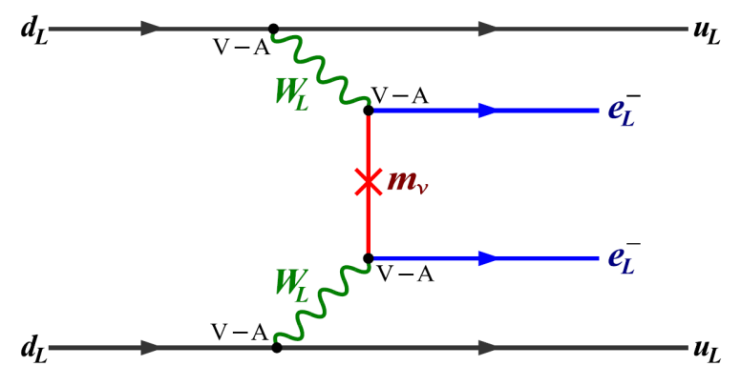

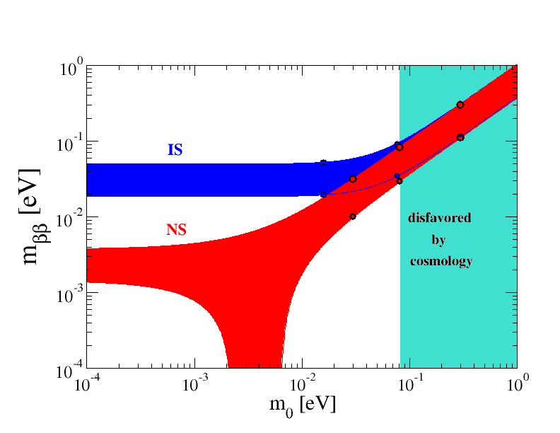

0νββ-decay
(LNV at ≈ GUT scale, exchange of three light ν)
(A,Z) → (A,Z+2) + e⁻ + e⁻
Phase space factor
well understood
?
NME must be evaluated
using tools of nuclear theory
Constraint from cosmology
= m₁ + m₂ + m₃
< 0.90 eV
< 0.26 eV (Planck coll.)
< 0.12 eV
Contrary, the constraint from
0νββ-decay (KLZ)
m_{ββ} < 0.036-0.156 eV
implies
< 0.12 eV

Slide 7
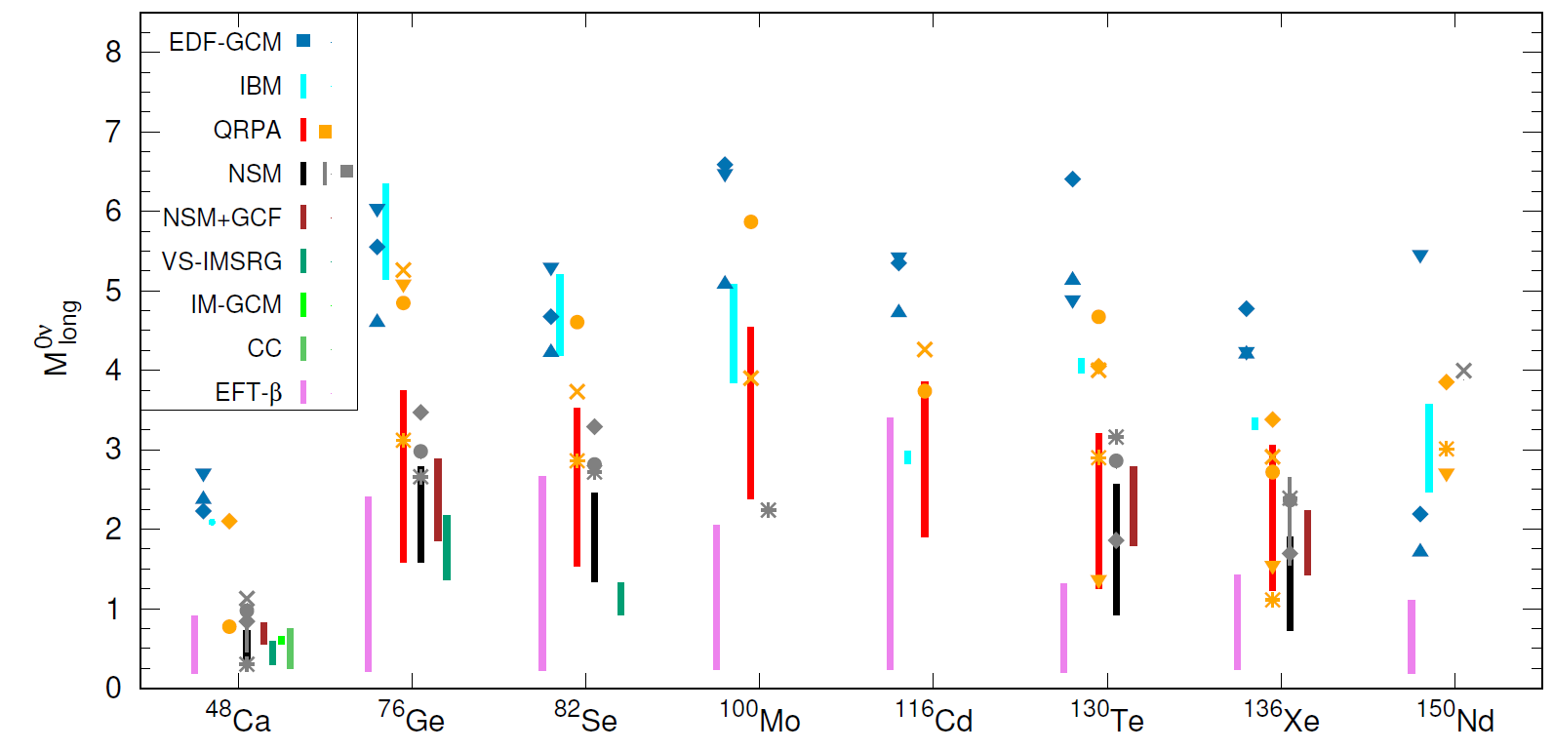
0νββ-decay NME
status 2023(25)
The nuclear w. f. of
(A,Z), (A,Z+1)*, (A,Z+2)
Many-body methods
of choice:
! Isospin, and spin-isospin symmetries
(M_{Fcl}≈0, M_{GTcl} strongly suppressed):
The 0νββ nuclear transition operators
(F, GT, and tensor type):
All
models
missing
essential
physics
Impossible
to assign
rigorous
uncertainties
Riv. Nuovo Cim. 46, 619 (2023)
Differencies:
Many-body appr.
Size of the m.s.
residual int.

Slide 8
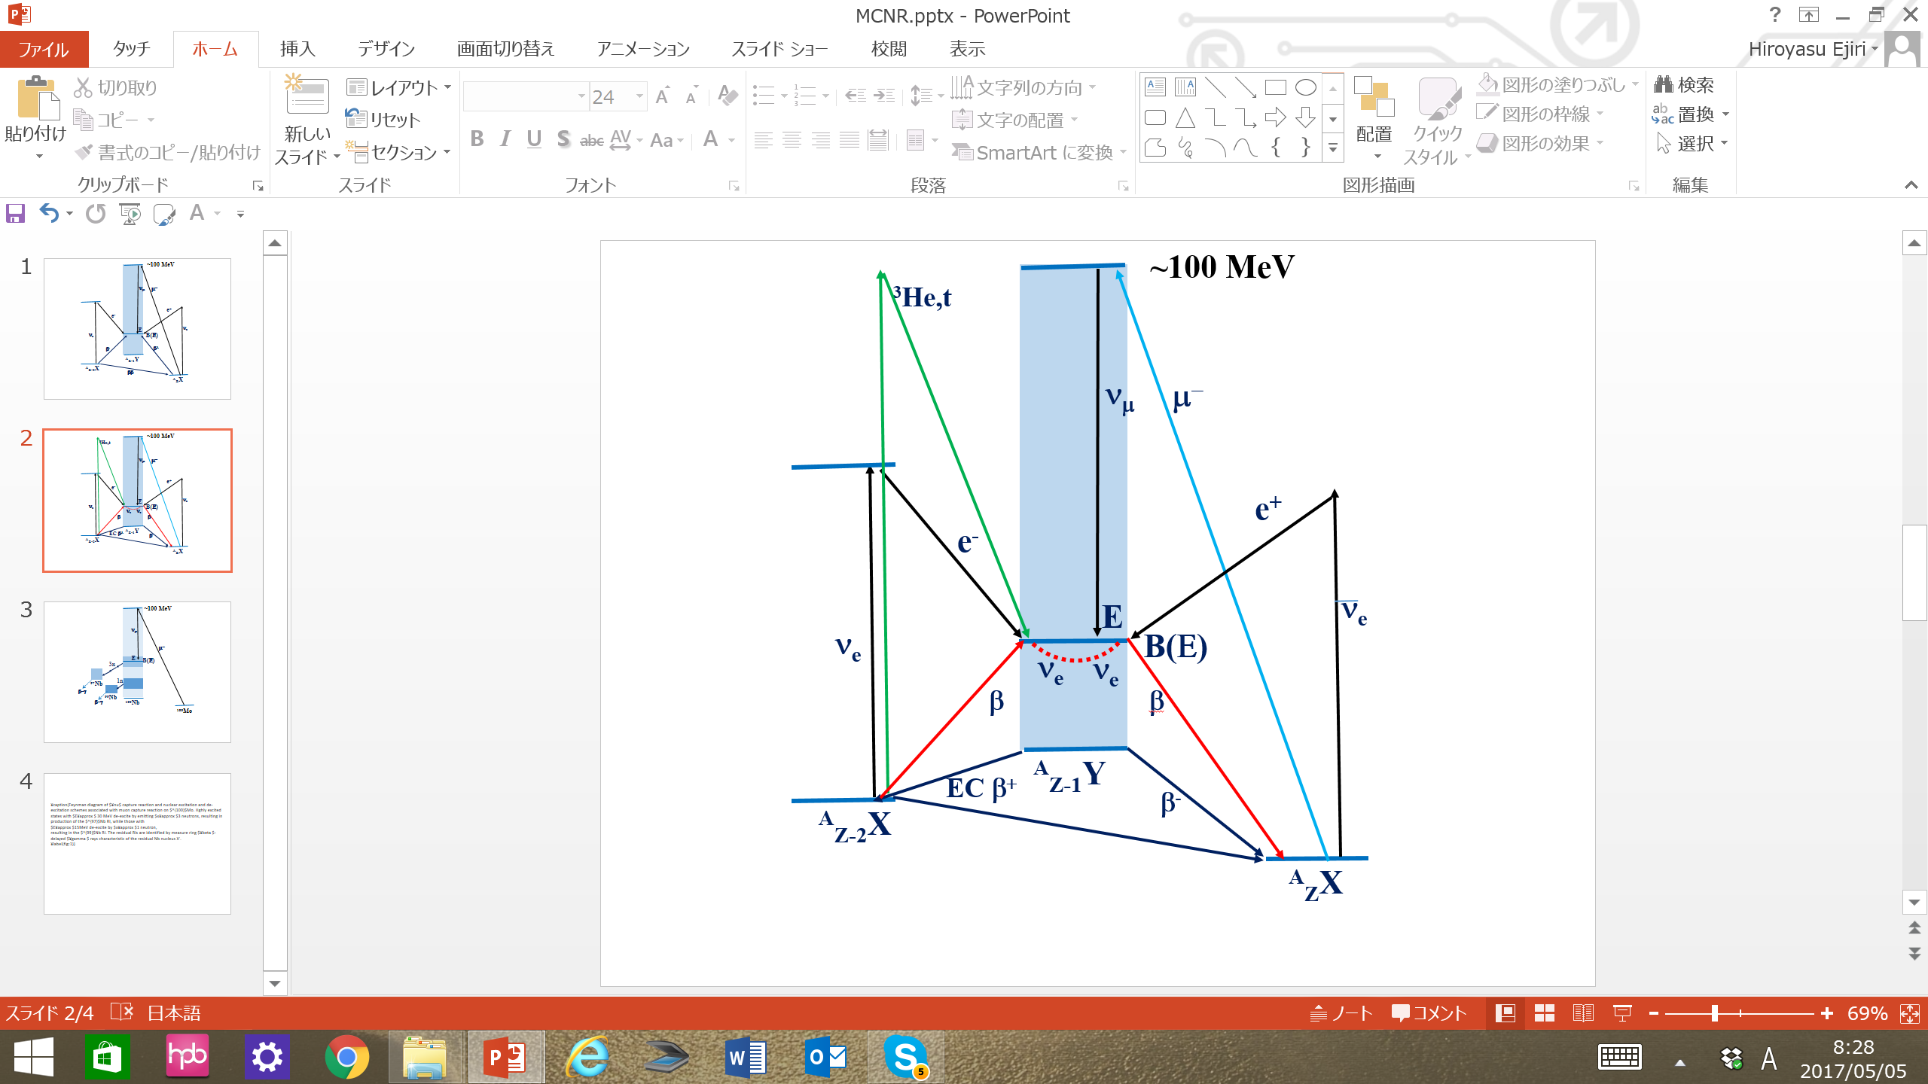
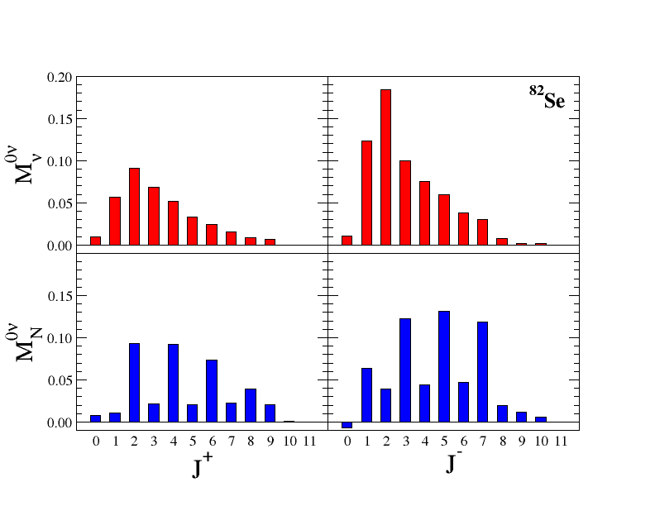
Supporting nuclear physics experiments
(Measurements still not conclusive for 0νββ NME)
β-decay, EC and 2νββ decay
μ-capture
(π⁺, π⁻)
(³He,t), (d,²He), transfer reactions
γ-ray spectroscopy, γγ-decay
A promising experimental tool:
Heavy-Ion Double Charge-Exchange
Multipole
decomposition
of light and heavy
0νββ-decay NMEs
normalized to unity
Higher multipoles
are populated mostly due to large ν-momentum transfer

Slide 9
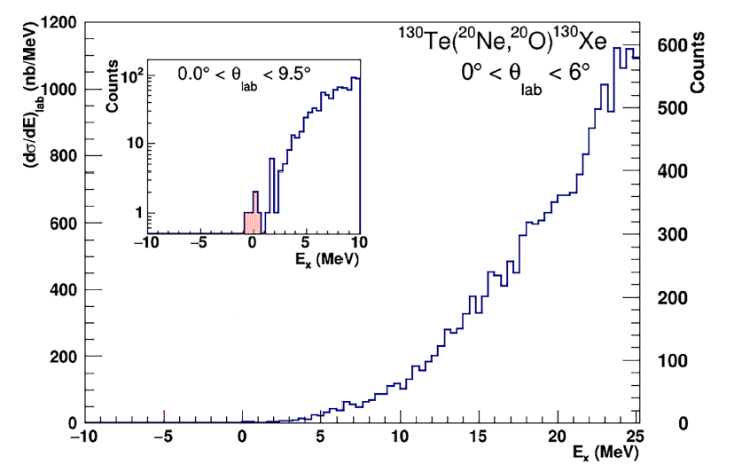

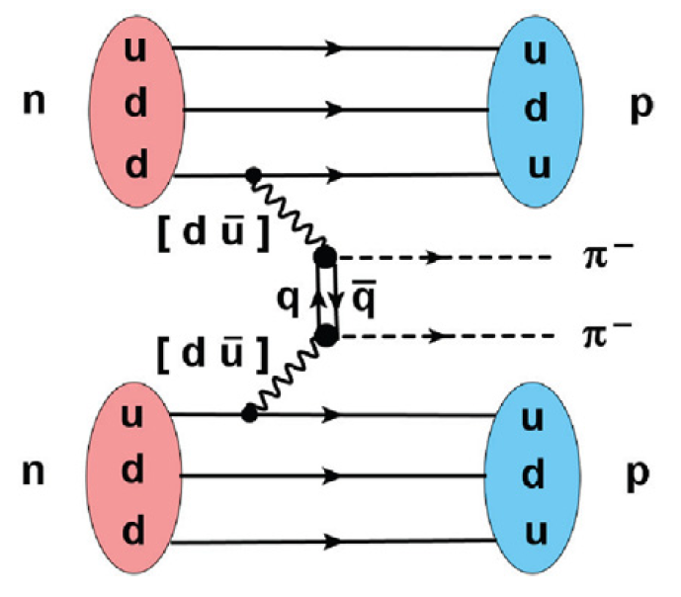
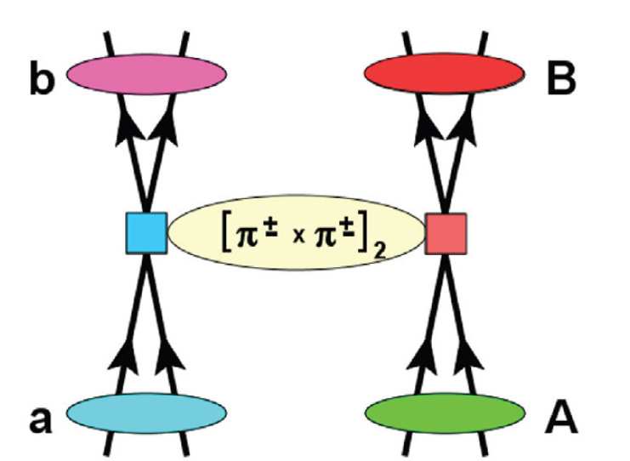
The ¹³⁰Te(²⁰Ne,²⁰O)¹³⁰Xe DCE reaction
¹³⁰Xe
¹³¹Xe
¹³²Xe
Z
¹³⁰I
V. Soukeras et al. Res. in Phys. 28 (2021) 104691
¹²⁹I
(²⁰Ne,²⁰O) and ββ-
¹³¹I
NURE
¹²⁸Te
¹²⁹Te
¹³⁰Te
Resolution
~ 500 keV FWHM
N
g.s. → g.s. transition can be isolated
Absolute cross section measured
State (MeV) | Counts | Absolute coss section (nb) | Cross section 95% limit (nb)
g.s. (0⁺) + 2⁺ (536 keV) | 5 | 13 | [3--18]
Analysis of cross-section sensitivity < 0.1 nb
in the Region Of Interest

Slide 10

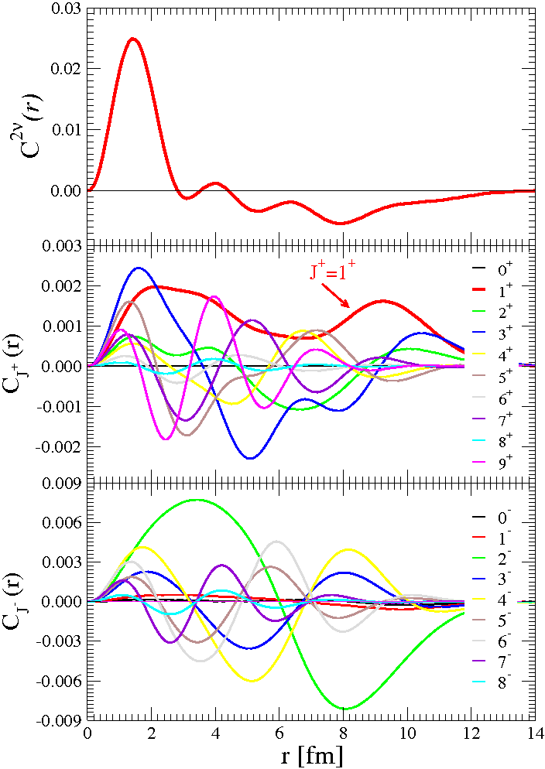


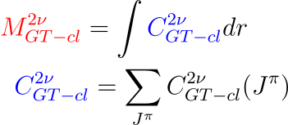
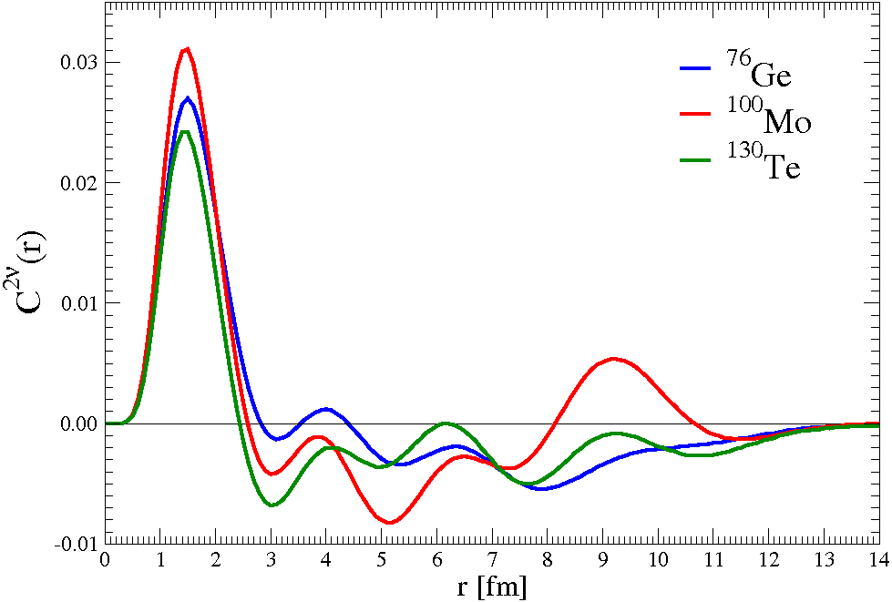

A connection between closure 2νββ and 0νββ GT NMEs
(and NMEs of DCE reactions)
0νββ
2n-potential
is well
determined
for J^{π}= 1⁺
C_{J}(r) dr = M_{GT}^{2ν}
for J^{π}≠ 1⁺
C_{J}(r) dr = 0
F.Š., R. Hodák, A. Faessler, P. Vogel, PRC 83, 015502 (2011)

Slide 11

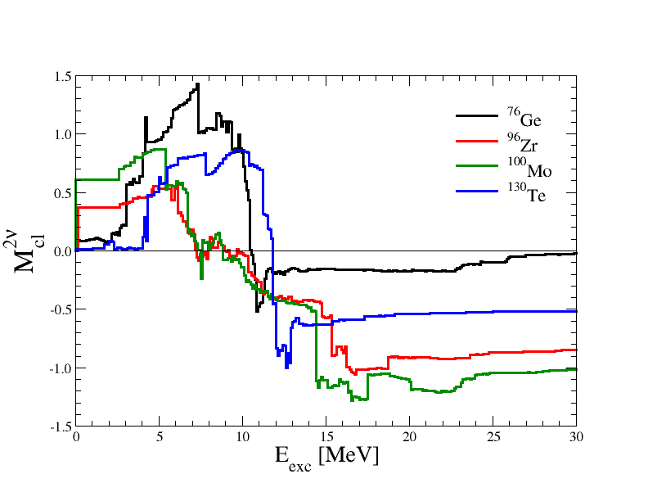
ISM, EDF : M^{0ν} M^{2ν}_{GT-cl}
M^{DGT} ≡ M_{GT-cl} – only 1⁺
M^{0ν} - contribution
from many J^{π} (!)
QRPA: There is no proportionality between
0νββ- and 2νββ-decay NMEs
(change of sign at GTR level)
Region of GT resonance
QRPA - close to
a restoration of
SU(4) symmetry
ISM: N. Shimizu, J. Menendez, K. Yako,
PRL 120, 142502 (2018)
QRPA: F.Š., R. Hodák, A. Faessler, P. Vogel,
PRC 83, 015502 (2011)

Slide 12


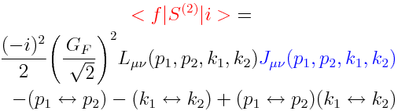
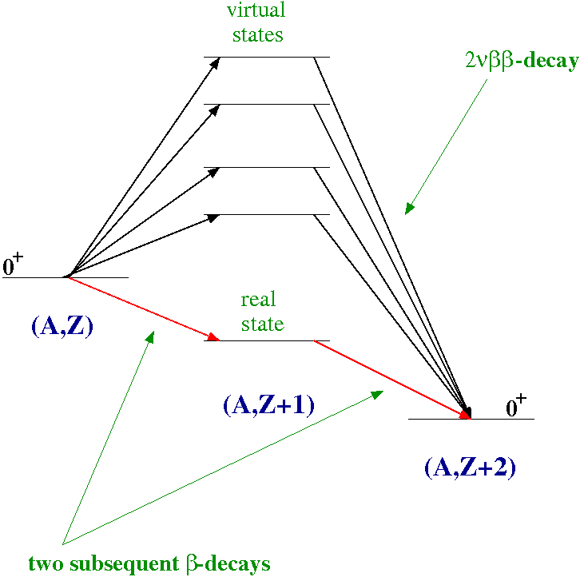

2νββ-decay NME
Weak interaction Hamiltonian
Phys. Atom. Nucl. 62 (1999) 585
Hadron part
of amplitude
2νββ-decay amplitude
F.Š., G. Pantis, Phys. Atom. Nucl. 62 (1999) 585
A sum over intermediate nuclear states represents
a sum over all meson and γ-exchange correlations
of two β-decaying nucleons inside nucleus

Slide 13
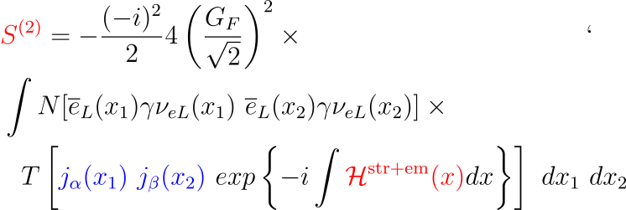
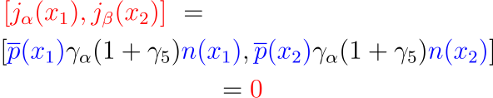
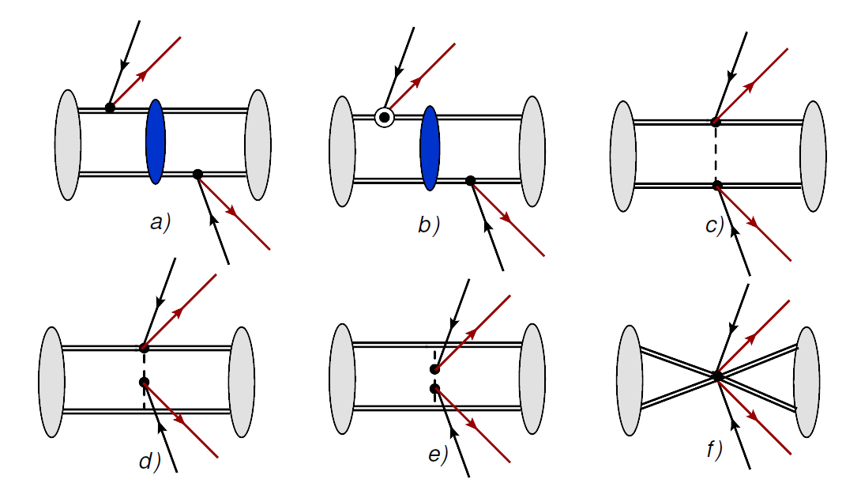


The two-nucleon β-decays in 2νββ-decay
are connected through strong and EM interactions
c, d, e pion-exchange contributions
(and maybe also f) are already included
ín a and b diagrams

Slide 14


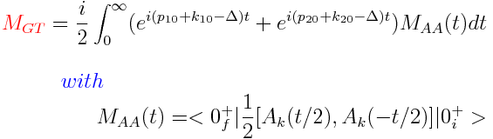
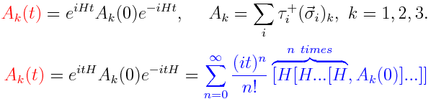



Due to 0⁺→ 0⁺ nuclear transition
Nuclear current
(impulse approx.)
2νββ-decay NME in time
integral representation
time dependent axial current
Completeness:
Σ_{n} |n><n|=1
Standard form of 2νββ-decay NME
integration over time variable
Δ=(E_{i}-E_{f})/2, stands for sum of lepton energies

Slide 15
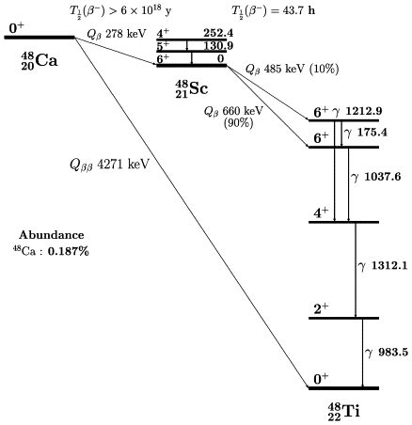
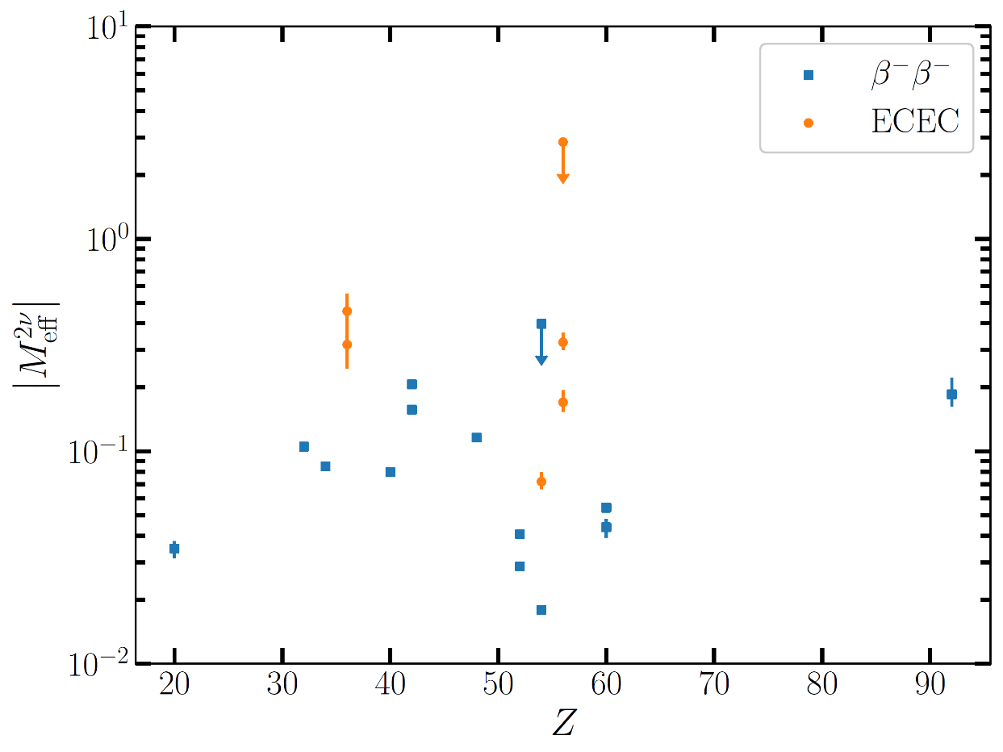
Understanding of the 2νββ-decay NMEs is of crucial
importance for correct evaluation of the 0νββ-decay NMEs
Both 2νββ and 0νββ operators connect the same states.
Both change two neutrons into two protons.
Explaining 2νββ-decay is necessary but not sufficient
T= T_{z} = 4
For g.s.
of even-even
nuclei
T=T_{z}
QRPA calculations at the forefront: i) importance of pairing
int.; ii) importance of isospin and spin-isospin symmetry
restoration (isoscalar and isovector residual int.); iii) importance
of relative deformation of the initial and final nuclei
T= T_{z} = 2

Slide 16
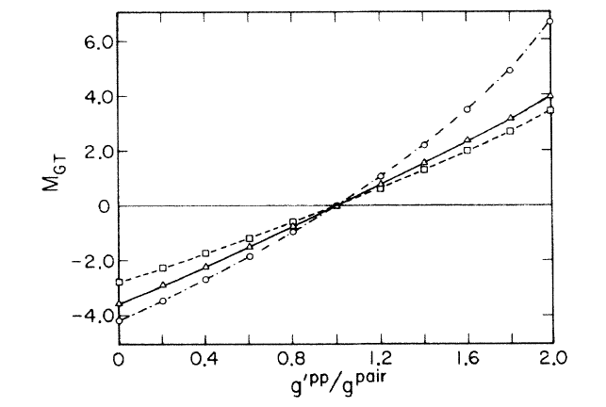
M^{2ν}_{F-cl} = 0
The DBD Nuclear Matrix Elements
and the SU(4) symmetry restoration)
M^{2ν}_{GT-cl} = 0
Suppression of the Two Neutrino Double Beta Decay by Nuclear Structure Effects
P. Vogel, M.R. Zirnbauer, PRL (1986) 3148
O. Civitarese, A. Faessler, T. Tomoda, PLB 194 (1987) 11
E. Bender, K. Muto, H.V. Klapdor, PLB 208 (1988) 53
…
38 years ago
The isospin is known to be a good approximation
in nuclei
In heavy nuclei the SU(4) symmetry is strongly
broken by the spin-orbit splitting.
What is beyond this behavior?
Is it an artifact of the QRPA?

Slide 17
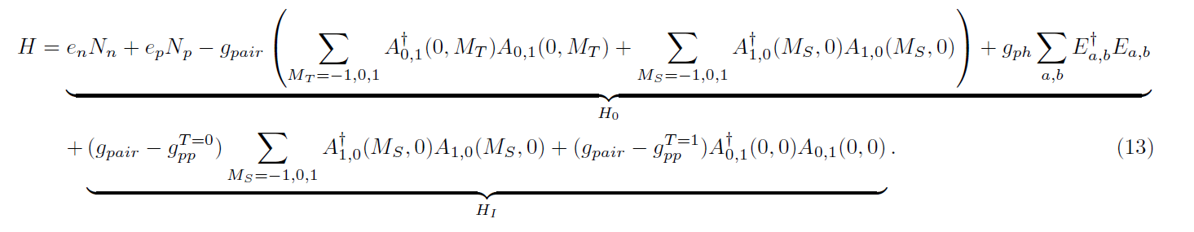
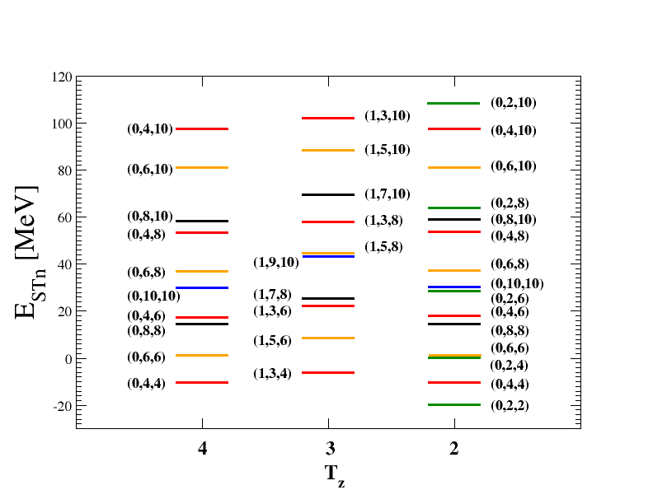
s.p. mean-field
Conserves SU(4) symmetry
Study of
2νββ NME
within the
schematic
model
H_{I} violates SU(4)
symmetry
g_{pair}- strength of isovector like nucleon pairing
(L=0, S=0, T=1, M_{T}=±1)
g_{pp}^{T=1}- strength of isovector spin-0 pairing
(L=0, S=0, T=1, M_{T}=0
g_{pp}^{T=0}- strength of isoscalar spin-1 pairing
(L=0, S=1, T=0)
g_{ph}- strength of particle-hole force
Energies of excited states
for the case of conserved SU(4) symmetry
M_{F}=0, M_{GT}=0 (see SU(4) multiplets)
D. Štefánik, F.Š., A. Faessler, PRC 91, 064311 (2015)

Slide 18
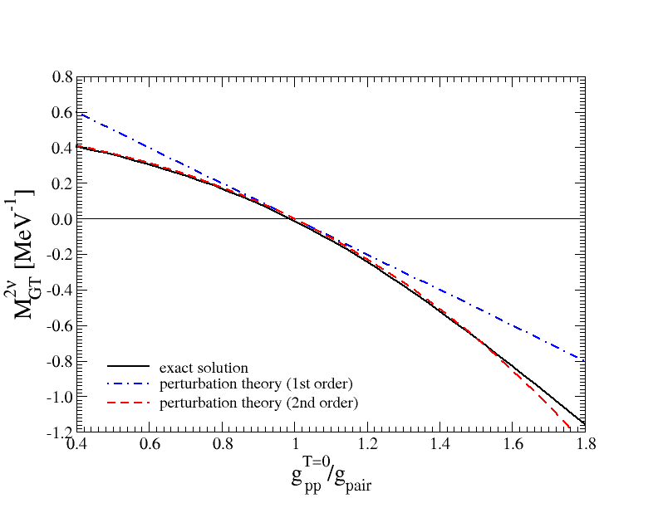


M_{GT} up to the second
order of perturbation theory due to
the violation of the SU(4) symmetry by
the particle-particle interaction of H
M_{F} and M_{GT} do not depend on the mean-field part of H
M_{F} and M_{GT} are
governed by a weak violation
of the SU(4) symmetry by the
article-particle interaction of H
Results confirm the dependence of M_{F} and M_{GT} on
g_{pp}^{T=0} and g_{pp}^{T=1} by the QRPA

Slide 19



Single State Dominance ( ¹⁰⁰Mo, ¹⁰⁶Cd,¹¹⁶Cd, ¹²⁸Te …)
Isotope f.s. T_{1/2}(SSD)[y] T_{1/2}(exp.)[y]
2νβ⁻β⁻
¹⁰⁰Mo 0_{g.s.} 7.3 10¹⁸ 7.07 10¹⁸
0₁ 4.2 10²⁰ 6.1 10²⁰
¹¹⁶Cd 0_{g.s.} 1.1 10¹⁹ 2.63 10¹⁹
¹²⁸Te 0_{g.s.} 1.1 10²⁵ 2.49 10²⁴
EC/EC
¹⁰⁶Cd 0_{g.s.} >4.4 10²¹ >4.7 10²⁰
¹³⁰Ba 0_{g.s.} 5.0 10²² 2.2 10²¹
E_{i}-E_{f}= -0.041 MeV
HSD, higher levels
contribute to the decay
1⁺
SSD, 1⁺ level
dominates in the decay
(Abad et al., 1984,
Ann. Fis. A 80, 9)
¹⁰⁰Tc
0⁺
¹⁰⁰Mo
E_{i}-E_{f}= -0.343 MeV
SSD
common approx.
Domin, Kovalenko, F.Š., Semenov, NPA 753, 337 (2005)

Slide 20


2νβ⁻β⁻−decay
2νEC/β⁺−decay
Study of
differential
characteristics
E₁-E_{i} ≈ 0 or neg. ⇒
sensitivity
to lepton energies
in energy
Denominators
SSD and HSD
offer different
differential
characteristics
¹⁰⁰Mo → ¹⁰⁰Ru
Do not
depend
on
M^{i}M^{f}
F.Š., Šmotlák, Semenov
J. Phys. G, 27, 2233, 2001

Slide 21




Semi-empirical
formula
for 2νββ-decay
(g.s. to g.s.)
PRC 111, 024307 (2025)

Slide 22


There is no reliable
calculation of the 2νββ-decay NMEs yet
PRC 111, 024307 (2025)

Slide 23







Improved description of
the 0νββ–decay rate
(a way to fix g_{A} ^{eff})
Both 2νββ and 0νββ operators connect the same states.
Both change two neutrons into two protons.
Explaining 2νββ-decay is necessary but not sufficient
PRC 97, 034315 (2018)
Taylor expansion
We get
The g_{A}^{eff} can be deterimed with measured half-life and ratio of NMEs and calculated NME
dominated by transitions through low lying states of the intermediate nucleus (ISM)

Slide 24




The running sum of the 2νββ–decay NMEs
(QRPA)
ξ₁₃ tell us about
importance of
higher lying states
of int. nucl.
HSD: ξ₁₃≈0
ξ₁₃≈1 (large)
Possible because of a large cancellation
of contributions through lower and
higher-lying states of (A,Z+1) nucleus
ξ₁₃ can be determined phenomenologically from the shape
of energy distributions of emitted electrons
F.Š., Šmotlák, Semenov, J. Phys. G, 27, 2233, 2001

Slide 25


KamLAND-Zen Exp. : ξ₁₃<0.26 (¹³⁶ Xe)
ξ₁₃ can be determined phenomenologically
from the shape of energy
distributions of emitted electrons
The g_{A}^{eff} can be deterimed with measured
half-life, ratio of NMEs ξ₃₁ and calculated NME,
dominated by transitions through
low lying states of the intermediate nucleus.
M_{GT-3} have to be calculated
by nuclear theory - ISM
KamLAND-Zen Coll. (+J. Menendez, F.Š.),
Phys.Rev.Lett. 122, 192501 (2019)

Slide 26


CUPID-Mo Exp. : ξ₁₃=0.45±0.03 (stat) ±0.05 (syst) (¹⁰⁰ Mo)
Phys.Rev.Lett. 131, 162501 (2023)
T_{1/2} = [7.07±0.02(stat)±0.11(syst)] x 10¹⁸ yr
ξ₅₁/ξ₃₁ = 0.364-0.368 (QRPA), 0.367 (SSD), 0.349 (ISM)
g_{A}^{eff} (pnQRPA) = 1.0 ±0.1(stat)±0.2(syst)
g_{A}^{eff} (ISM) = 1.11 ±0.03(stat)±0.05(syst)

Slide 27

CUORE Exp. (¹³⁰Te)
It does not make sense(!?)
We are confused …
arXive: 2503.24137 [nucl-ex]

Slide 28





The role of the width of the states of the intermediate nucleus
(E_{n} → E_{n} + i Γ_{n}/2 )
We found that ξ_{IR11} and ξ_{IR31} are negligibly small

Slide 29




Effect of the electron p_{1/2}-wave state in 2νββ-decay (preliminary)

Slide 30


2νββ probes
New Beyond SM Physics
All 100 kg- and ton-class 0νββ experiments can also study a diverse
range of exotic phenomena, e.g. through spectral distortion in $2νββ$.
Future searches will probe the $2νββ$ with high statistics about 10⁵-10⁶ events.
Common subjects:
Majoron(s) emission
(partly)bosonic neutrinos,
Lorentz invariance
violation
Recent subjects:
Lepton-number conserving
right-handed currents
(PRL 125 (2020) 17, 171801)
Neutrino self-interactions
(PRD 102 (2020) 5, 051701)
Sterile neutrino and light
fermion searches through
energy end point
(PRD 103 (2021) 5, 055019;
PLB 815 (2021) 136127)
Spectral index n

Slide 31
Exotic 2νββ
Sterile Neutrino
(or HNL)
Consider either mixing of sterile ν with active ν,
or right-handed currents
Phys.Rev.D 103 (2021) 055019

Slide 32
2νββ probe – sterile neutrino search
CUPID-Mo
m_{N}= 0.5 MeV and 1.5 MeV, sin²θ= 0.01
Eur. Phys. J. C 84, 925 (2024)
mixed with
active ν
Pure sterile ν
contr.

Slide 33






